Slide 1
Dual readout calorimeter for CepC
Franco Bedeschi.
CDR International Review,
Beijing, September 2018
OUTLINE
Basic requirements
Detector description
Detector performance
IDEA implementation
Future work

Slide 2

e+e- →HZ physics constraints
Calorimeters (see Gang Li talk):
  H→γγ ➔ ECAL resolution
    As good as possible – at least 20%/$\sqrt{E}$ + 1%
  H→qq, VV ➔ ECAL+HCAL resolution
    As good as possible – at least 3-4% on jets from W,Z decay

Slide 3
e+e- →Z/WW physics constraints
Additional EW physics drivers:
  High precision acceptance determination
  Good e/γ/π⁰ discrimination

Slide 4
Other drivers
Z→τ⁺τ⁻
τ⁺◊ρ⁺ν◊π⁺π⁰ν
minΔπ⁺γ @ 2 m
π⁰ important in tau and HF physics
    No π⁰: 35% τ ◊ l (e, μ) νν + 20% τ◊(1,3)π± lν
    1 π⁰: 28% τ◊(1,3)π±π⁰lν
    2 −3π⁰: 10% τ◊π± (2,3) π⁰lν
  High granularity/Pre-shower → π⁰ identification
  Overlap with π⁺ may require longitudinal segmentation
Δγ @ 2 m

Slide 5
Dual Readout calorimeter
Dual Readout Calorimeters main features
  Designed to optimize EM, hadronic and jet resolution
    Large sampling fraction for good EM resolution
    Event by event correction for EM fluctuations in showers and jets
  Intrinsic transverse granularity up to 1-2 mm
  Potential for longitudinal segmentation with timing or specific fiber geometries
  Particle ID capabilities
  Fast detector response
  All electronics in the back simplifies cooling and access

Slide 6
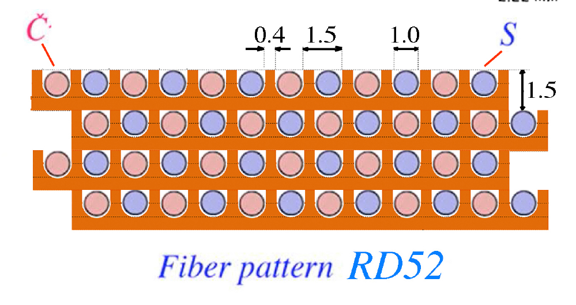
Basic configuration
Alternate clear and scintillating fibers in metal matrix
Scintillating fibers sensitive to all charged particles
Clear fibers sense only Cherenkov light
  Mostly electrons and positrons

Slide 7
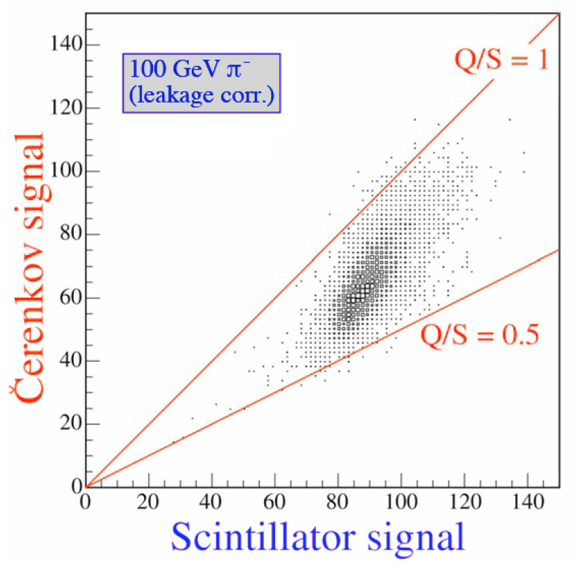
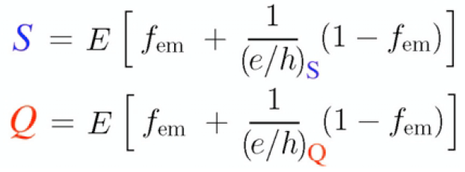
Working principle
Measure simultaneously:
  Scintillation signal (S)
  Cherenkov signal (Q)
Calibrate both signals with e-
Unfold event by event f_{em} to obtain corrected energy

Slide 8

Performance EM
Test beam data
1/$\sqrt{E}$

Slide 9
Radial shower profile
Test beam data

Slide 10
Radial shower profile
Test beam tuned simulation
50 GeV electrons
100 GeV π⁰

Slide 11
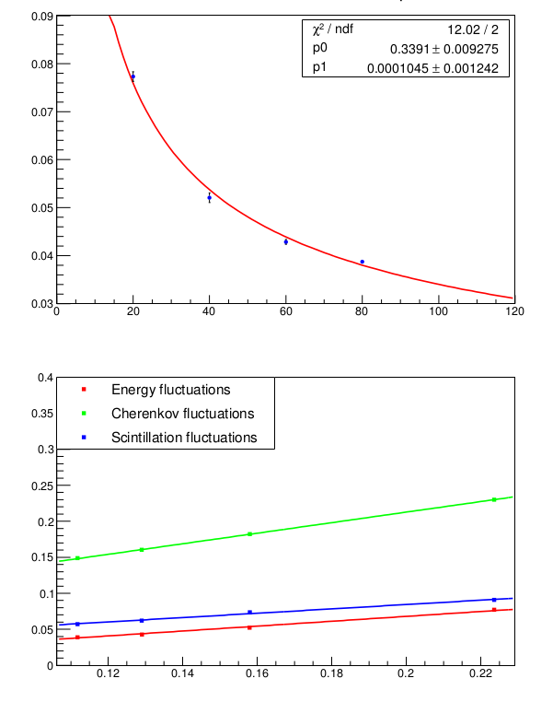
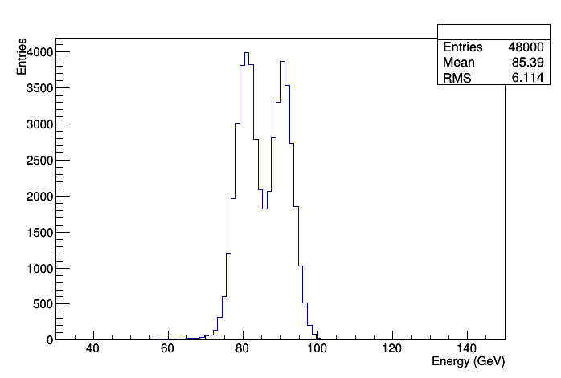
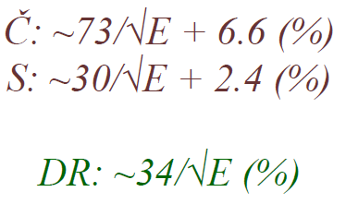
Performance HAD
Use test beam data to tune simulation
Use simulation to correct for lateral leakage
81 and 91 GeV jet separation

Slide 12
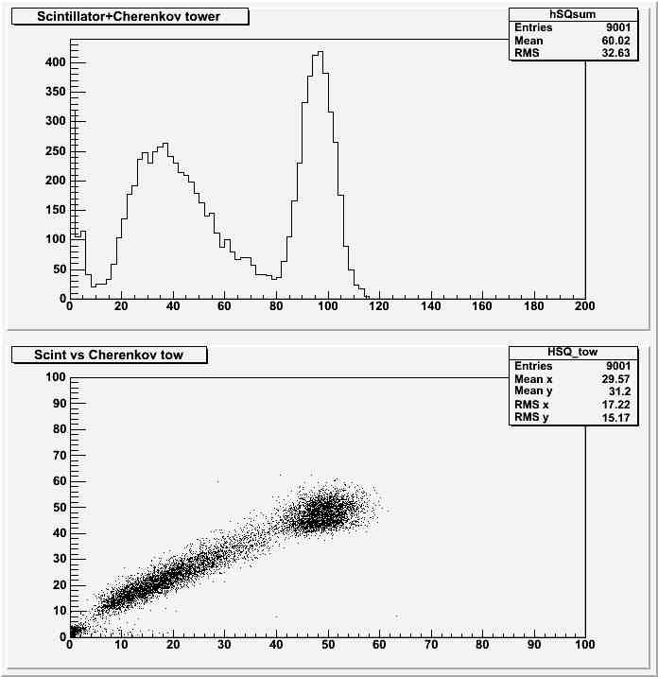
Particle ID
Test beam
80 GeV electron proton separation
  Rejection power 600 @ 98% efficiency
Hadrons
Mu
Electrons
S+Q
S
Q

Slide 13
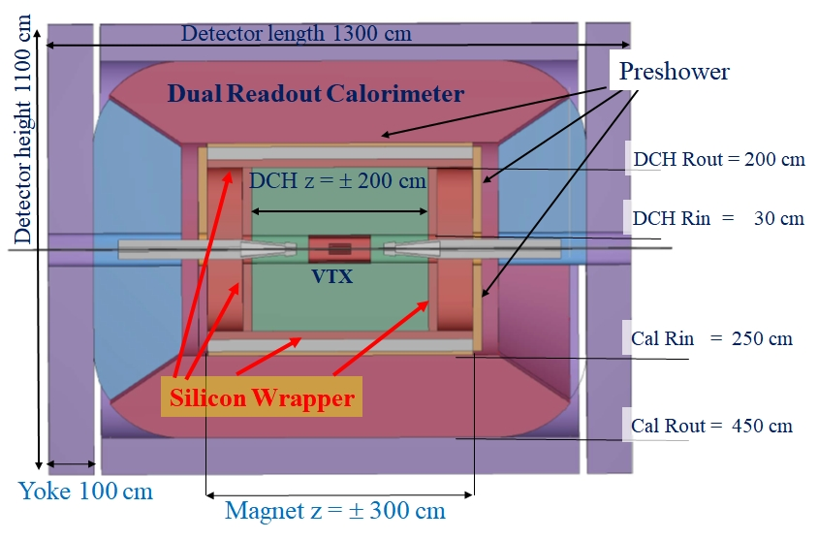
IDEA implementation
Calorimeter outside thin coil
Pre-shower in front
  Improve π⁰ ID
  Improve acceptance determination

Slide 14
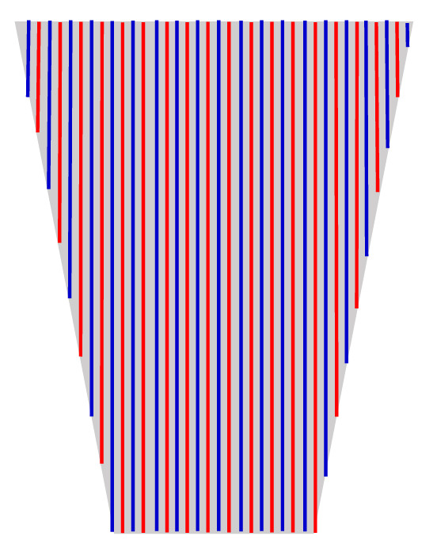
IDEA implementation
Projective geometry
Full coverage
Wedge geometry

Slide 15
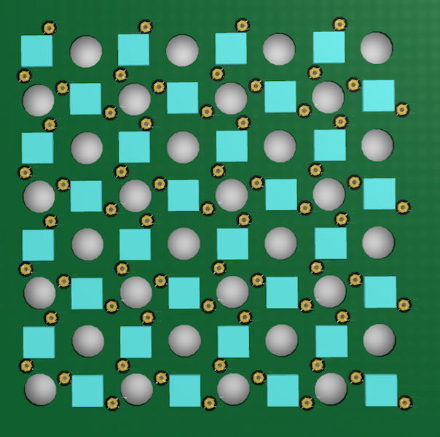
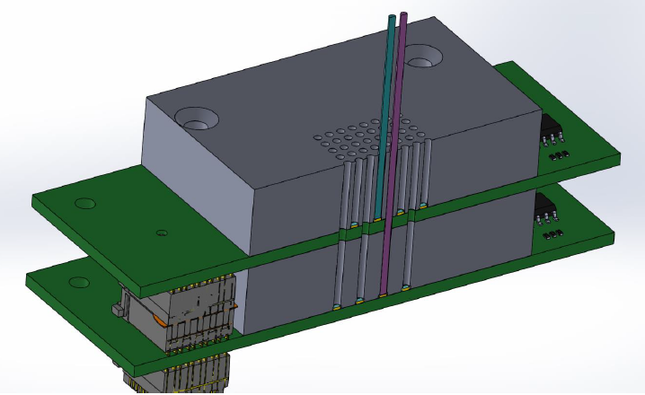
Readout
Dual layer SiPM readout
  Avoids optical cross-talk
Saturation studied with dedicated test beams
  25 μm pixels OK for Cherenkov – Need 10 μm for Scintillator
  3rd test beam in progress

Slide 16
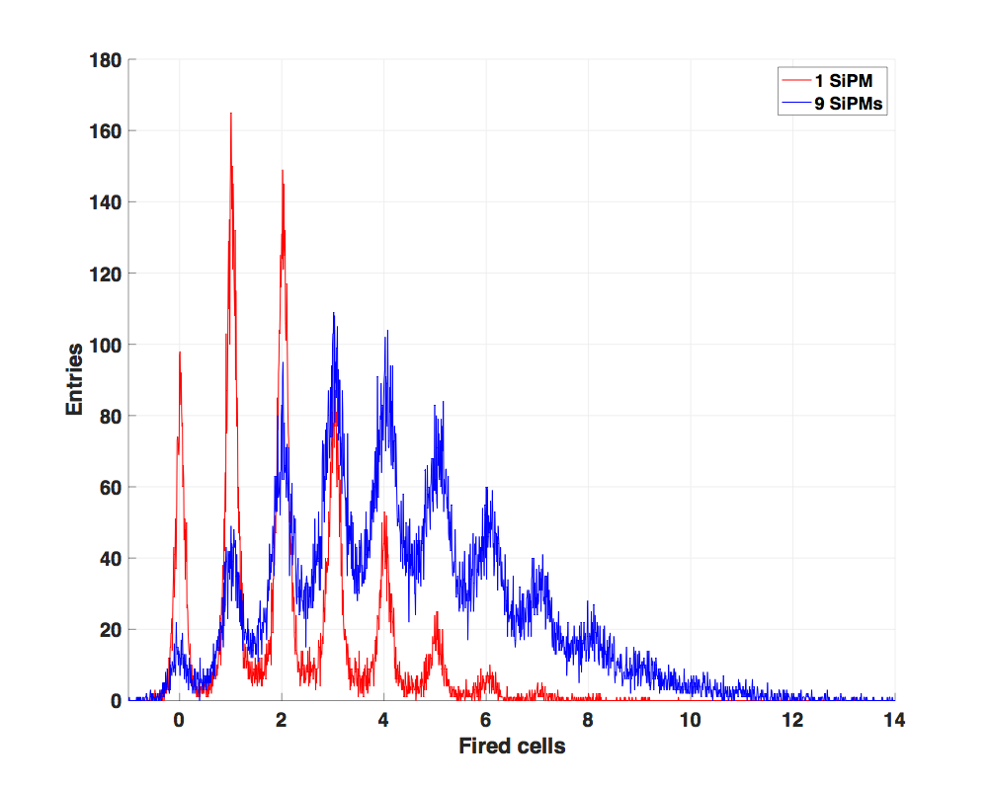
Readout
Group SiPM to reduce numbers of channels
  8 fibers/channel → 5.6 mm granularity
    200x10⁶ fibers → 25x10⁶ channels
  Parallel to serial readout ASIC under study (/256)
    25x10⁶ channels → 10⁵ serial lines
Multi-Photon spectrum preserved also with 9
grouped SiPM
ASIC
SiPM
Output
FPGA

Slide 17
Future work
Physics benchmarks with full simulation
Mechanics:
  Metal matrix technology
  Fast module assembly
  Calorimeter support
Electronics
  SiPM readout optimization (pixel size and x-talk)
  Define readout chain
    ASIC selection or development
    Signal processing on detector
    Readout and back-end design
  Explore timing for longitudinal information

Slide 18
Conclusions
Dual readout calorimetry is a well understood technology
Excellent EM and HAD resolution in a single package
Intrinsic high transverse granularity
Particle ID on isolated tracks

Slide 19
Backup
BACKUP

Slide 20
IDEA group summary
Total number of collaborators:
  69
Total number of institutions:
  18

Slide 21
IDEA group (1)
INFN - Sezione di Bari and University of Bari, Italy
  Marcello Abbrescia
  Nicola De Filippis
INFN - Sezione di Bologna and University of Bologna, Italy
  Lorenzo Bellagamba
  Lisa Borgonovi
  Davide Boscherini
  Sylvie Braibant
  Elisa Fontanesi
  Paolo Giacomelli
  Alessandro Polini
INFN - Sezione di Catania and University of Catania, Italy
  Sebastiano Albergo
  Antonella Sciuto
INFN - Sezione di Firenze and University of Firenze, Italy
  Stefania De Curtis
  Piergiulio Lenzi

Slide 22
IDEA group (2)
INFN - Sezione di Ferrara and University of Ferrara, Italy
  Gianluigi Cibinetto
  Riccardo Farinelli
  Isabella Garzia
  Vincenzo Guidi
  Mauro Moretti
INFN - Laboratori Nazionali di Frascati, Italy
  Giovanni Bencivenni
  Monica Bertani
  Erika de Lucia
  Danilo Domenici
  Giulietto Felici
  Catia Milardi
  Gianfranco Morello
  Marco Poli Lerner
INFN - Sezione di Lecce and University of Lecce, Italy
  Francesco Grancagnolo
  Marco Panareo
  Giovanni Tassielli

Slide 23
IDEA group (3)
INFN - Sezione di Milano and University of Milano, Italy
  Attilio Andreazza
  Alessandro Vicini
INFN - Sezione di Milano and University of Insubria, Italy
  Massimiliano Antonello
  Massimo Caccia
  Romualdo Santoro
INFN - Sezione di Milano Bicocca and University of Parma, Italy
  Luca Trentadue
INFN - Sezione di Pavia and University of Pavia, Italy
  Carlo Michel Carloni Calame
  Roberto Ferrari
  Gabriella Gaudio
  Guido Montagna
  Oreste Nicrosini
  Fulvio Piccinini
  Giacomo Polesello
  Lorenzo Pezzotti

Slide 24
IDEA group (4)
INFN - Sezione di Padova and University of Padova, Italy
  Patrizia Azzi
INFN - Sezione di Perugia and University of Perugia, Italy
  Gianmario Bilei
  Livio Fano'
INFN - Sezione di Pisa, Universita' di Pisa and Scuola Normale Superiore, Italy
  Paolo Azzurri
  Franco Bedeschi
  Vincenzo Cavasinni
  Maria Chiara Roda
  Luigi Rolandi
  Roberto Tenchini
  Guido Tonelli
INFN - Sezione di Roma1 and University of Roma "La Sapienza", Italy
  Barbara Mele
  Gianluigi Chiarello
  Simonetta Gentile
  Luca Silvestrini

Slide 25
IDEA group (5)
INFN - Sezione di Roma3 and University of Roma "Tor Vergata", Italy
  Michela Biglietti
  Paolo Branchini
  Marco Ciuchini
  Biagio Di Micco
  Addolarata Farilla
  Mario Greco
  Monica Verducci
INFN - Sezione di Torino and Universrity of Torino, Italy
  Lia Lavezzi
  Marco Maggiora
  Angelo Rivetti
INFN - Sezione di Trieste and University of Udine, Italy
  Marina Cobal
  Emidio Gabrielli

Slide 26
e+e- operation modes
Wide range of running conditions at CepC
  Z pole (90 GeV):
    ~ 10 ns between beam crossing
    High luminosity O(10³⁵)
  ZH (250 GeV):
    ~ 1 μs between beam crossing
    Moderate luminosity - O(10³⁴)

Slide 27

CepC, FCC, ILC, CLIC luminosity comparison
Z
WW
ZH
$$t\overline{t}$$
100xLEP
FCC SR power/beam < 50 MW
CepC SR power/beam < 30 MW

Slide 28
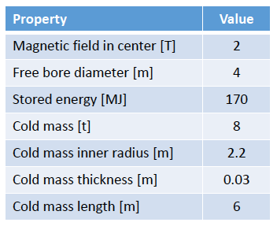
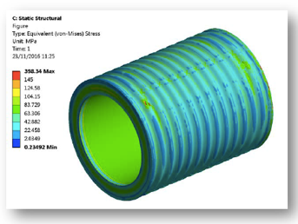
2T solenoid
Two options:
  Large bore (R=3.7 m) – calorimeter inside
  Smaller bore (R=2.2 m) – calorimeter outside
    Preferred: simpler/ Extreme EM resolution not needed
      Thick calorimeter
    Thin (30 cm): total = 0.74 X₀ (0.16 λ) at θ = 90º
Courtesy of H. ten Kate et al.

Slide 29
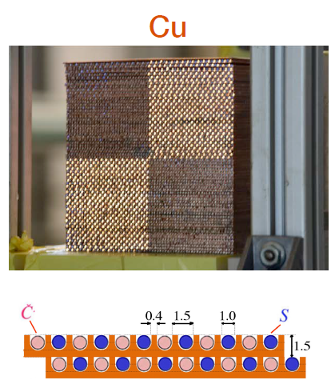
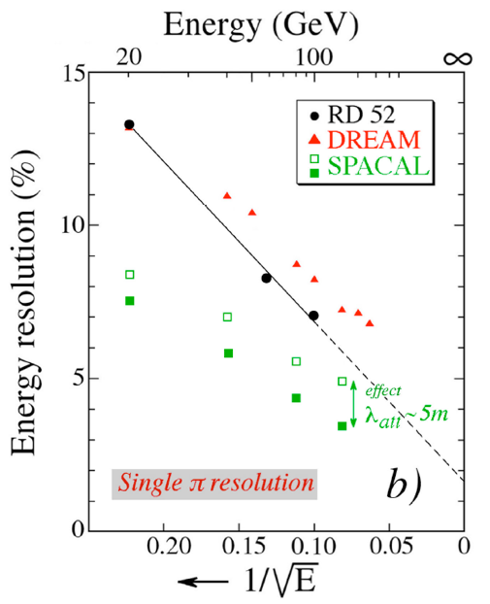

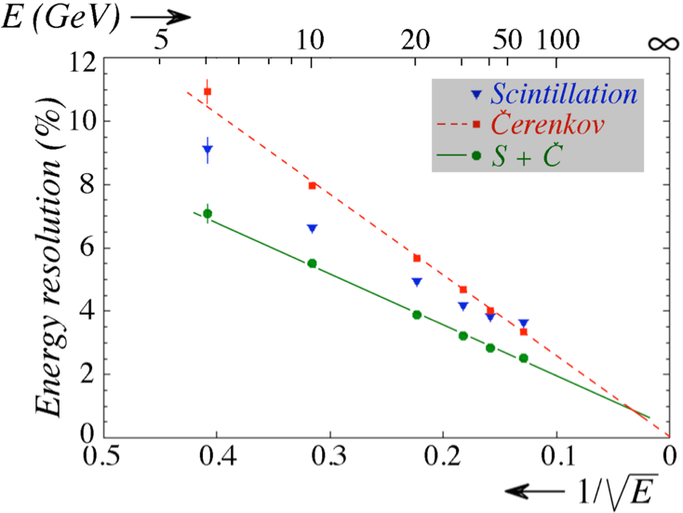

Calorimeter
Copper dual readout calorimeter
  Demonstrated EM resolution
  Observed Had resolution dominated by lateral leakage (~6%)
Courtesy of DREAM/RD52

