Slide 1
IDEA Drift Camber: the occupancy "saga" and other considerations
F. Grancagnolo
INFN – Lecce
CERN, June 26, 2018

Slide 2
OUTLINE
A few facts exploiting cluster counting/timing besides spatial resolution improvement and particle identification (not discussed here).
A short clarifying summary of the "occupancy saga".
An example (MEG2) of tracking in high occupancy environment.
A brief discussion on the drift chamber DAQ and Data Transfer.

Slide 3
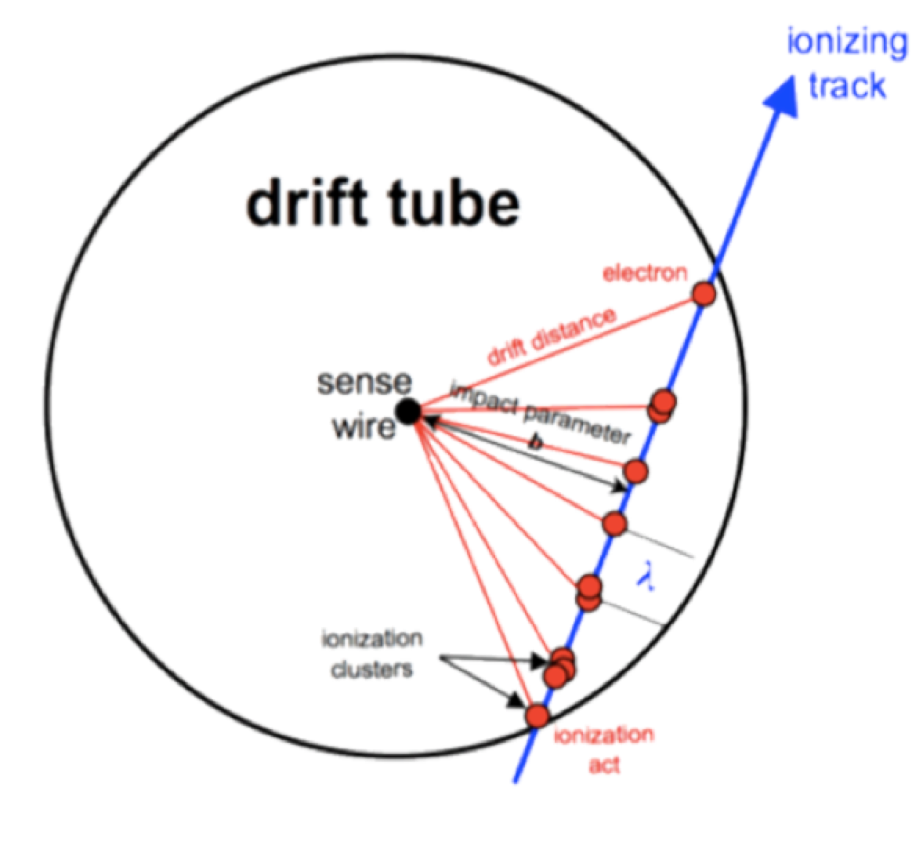
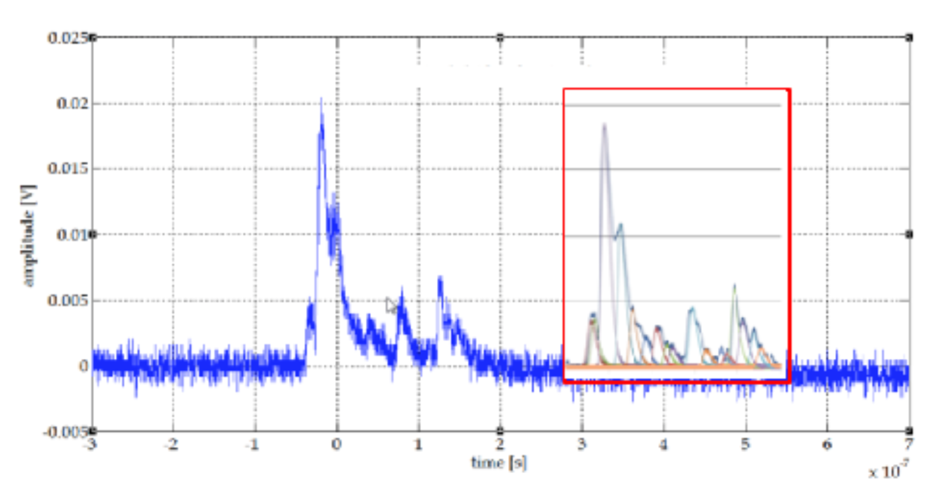
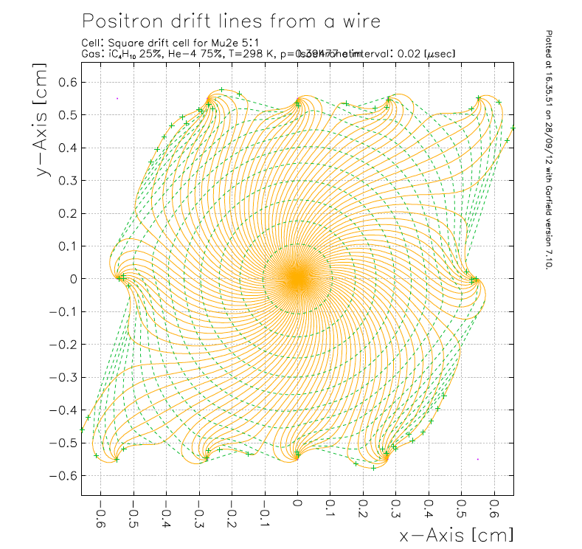
A few facts
Ideal case: drift tube
Digitized signal (1 GHz, 2 GSa/s)
Real case: drift cell
integration time
75%He/25%iC₄H₁₀ 20 ns
t₀
t_{first}
t_{last}
Δt
reconstructed
signal
r.m.s.
noise
11 mm cell
t_{max}
t_{i+1} – t_{i} ≈ a few ns at small t_{i}, t_{i+1} – t_{i} ≈ a few × 10 ns at large t_{i}
t_{max} constant in ideal case (slightly depends on track angle in drift cell case)
Δt ≤ t_{max}, length of digitized signal, depends on impact parameter b (t_{first})
N_{cl} depends only on Δt (or b, or t_{first}) in cylindrical drift tube case
N_{cl} doesn't depend on b in square drift cell case, but only on the track angle
t_{last} constant in the ideal case => defines the trigger time t₀ = t_{last} − t_{max}

Slide 4
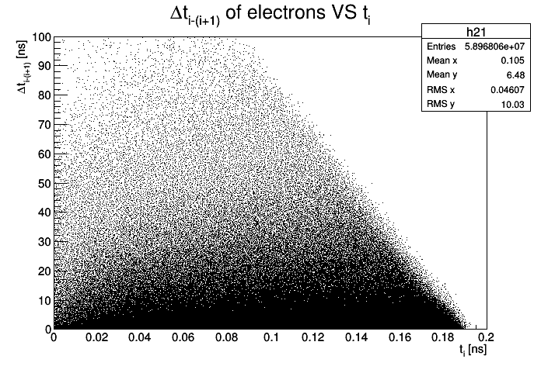
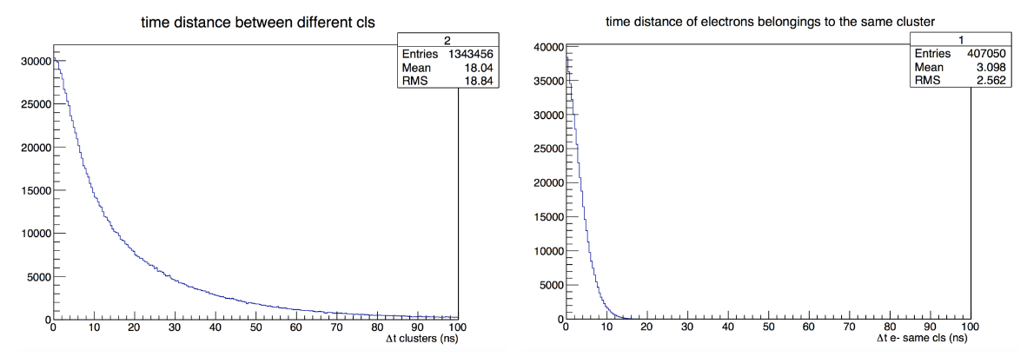
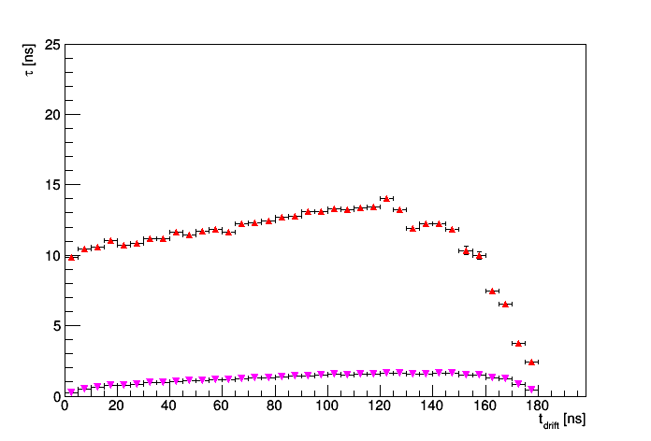
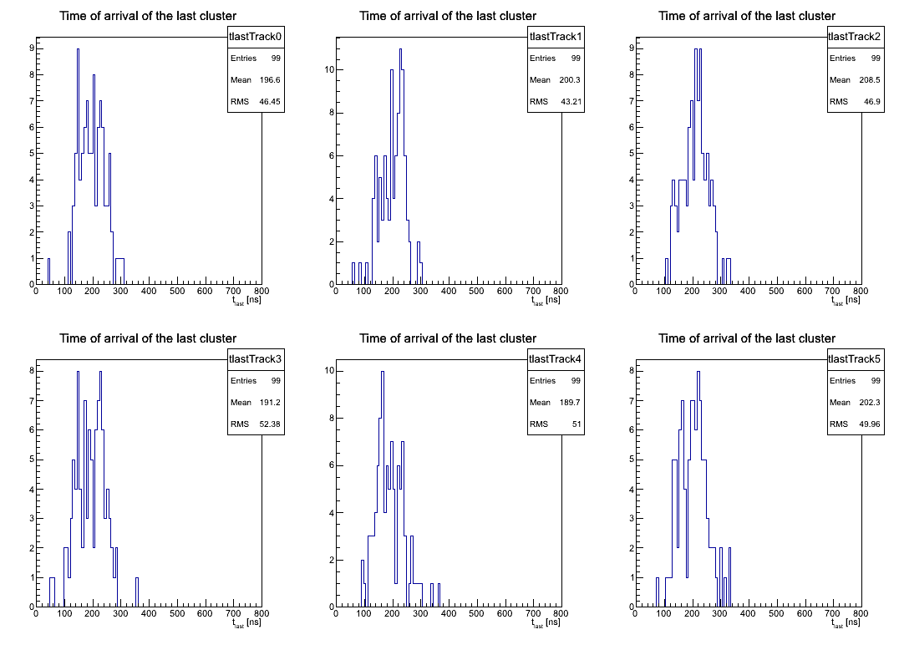
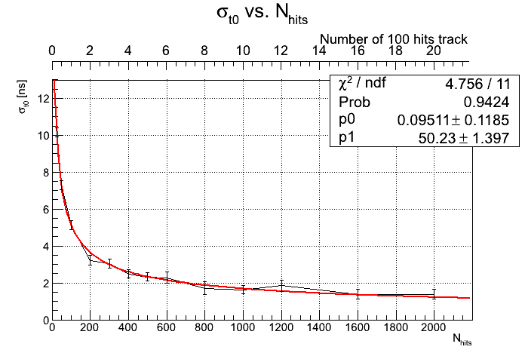
A few facts (7 mm cell, faster gas)
peaks separation
t_{i+1} – t_{i}
i = 1, N_{cl}
t_{i+1} – t_{i}
i = 1, N_{ele}
(same cluster)
cluster separation
electron separation
cell edge and
track angle effects
μs
N_{tracks}
t_{last} for a single track
(100 hits)
σ(t_{last}) ≈ 5 ns
(r.m.s./√100)
σ_{t0} as a function of N_{tracks}
(t₀ = t_{last} − t_{max})
N_{hits}

Slide 5
A few facts (7 mm cell, faster gas)
peaks separation
t_{i+1} – t_{i}
i = 1, N_{cl}
t_{i+1} – t_{i}
i = 1, N_{ele}
(same cluster)
cluster separation
electron separation
cell edge and
track angle effects
μs
N_{tracks}
Bunch Xing
identification!
Track filtering!
Trigger
capabilities?
t_{last} for a single track
(100 hits)
σ(t_{last}) ≈ 5 ns
(r.m.s./√100)
σ_{t0} as a function of N_{tracks}
(t₀ = t_{last} − t_{max})
N_{hits}

Slide 6
Consideration about occupancy
Average drift signal duration: <Δt> = t_{max}/2 (slightly larger given the time compression at small impact parameters) and <t_{first}> = t₀ + t_{max}/2.
A peak in the signal is identified as an electron if above threshold and with proper rise and fall times.
A physical hit must contain at least a few electron peaks spaced by no more than the cluster separation time, δt_{cl}.
An isolated electron peak is suppressed if its time differs from t_{first} of the track hit by > δt_{cl}. Otherwise, it slightly affects the impact parameter and negligibly the particle identification.
Two synchronous tracks overlapping in the same cell are indistinguishable, the promptest one defines the impact parameter.
Two tracks delayed in time (i.e., belonging to different BX) can be separated if t_{last} of the earlier one and t_{first} of the later one differ by > δt_{cl}.

Slide 7
Consideration about occupancy
In the case of 20 ns inter-bunch crossing time (at 91 GeV) and 400 ns maximum drift time, assuming that the hits are all from ionisation track segments and not from isolated Compton electrons from photons, it would be straightforward to integrate the occupancy over 20 BX.
However,
  hits associated to BX_{i} and BX_{j} are separated in time and will not contribute to the occupancy if (i-j)×20 ns ≥ δt_{cl}.
  assuming conservatively δt_{cl} ≈ 100 ns, the occupancy must be integrated over 4 BX at most.
91 GeV
4BX
365 GeV
1BX
from Nilou

Slide 8
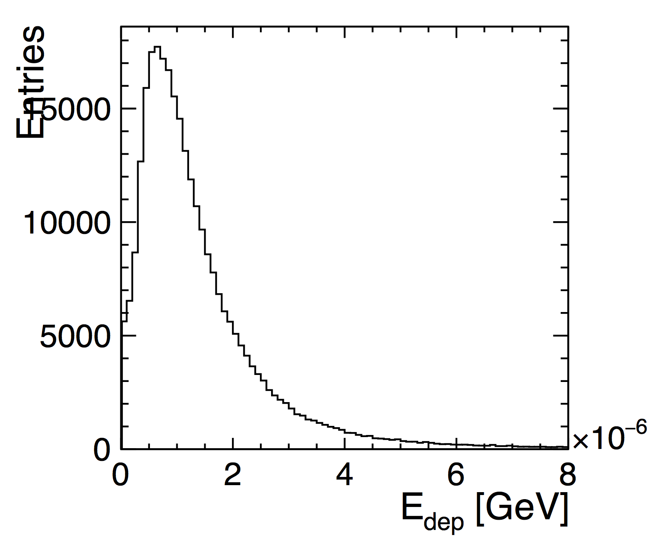
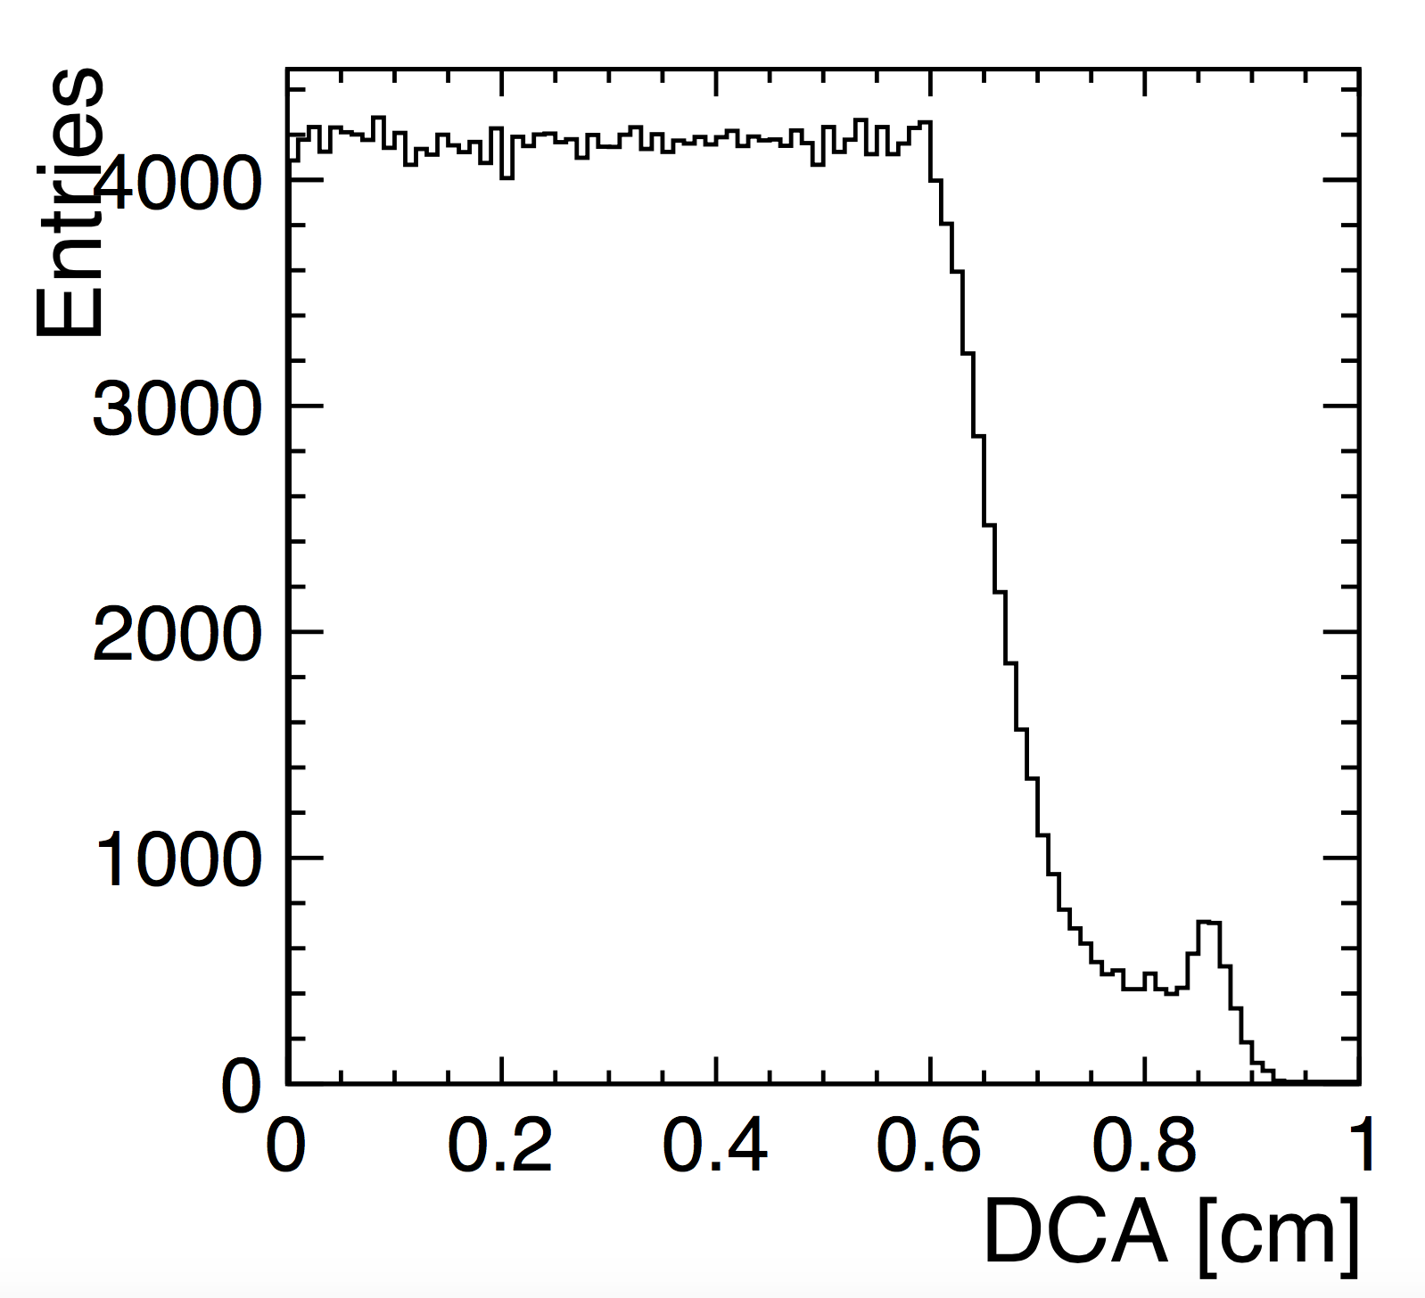
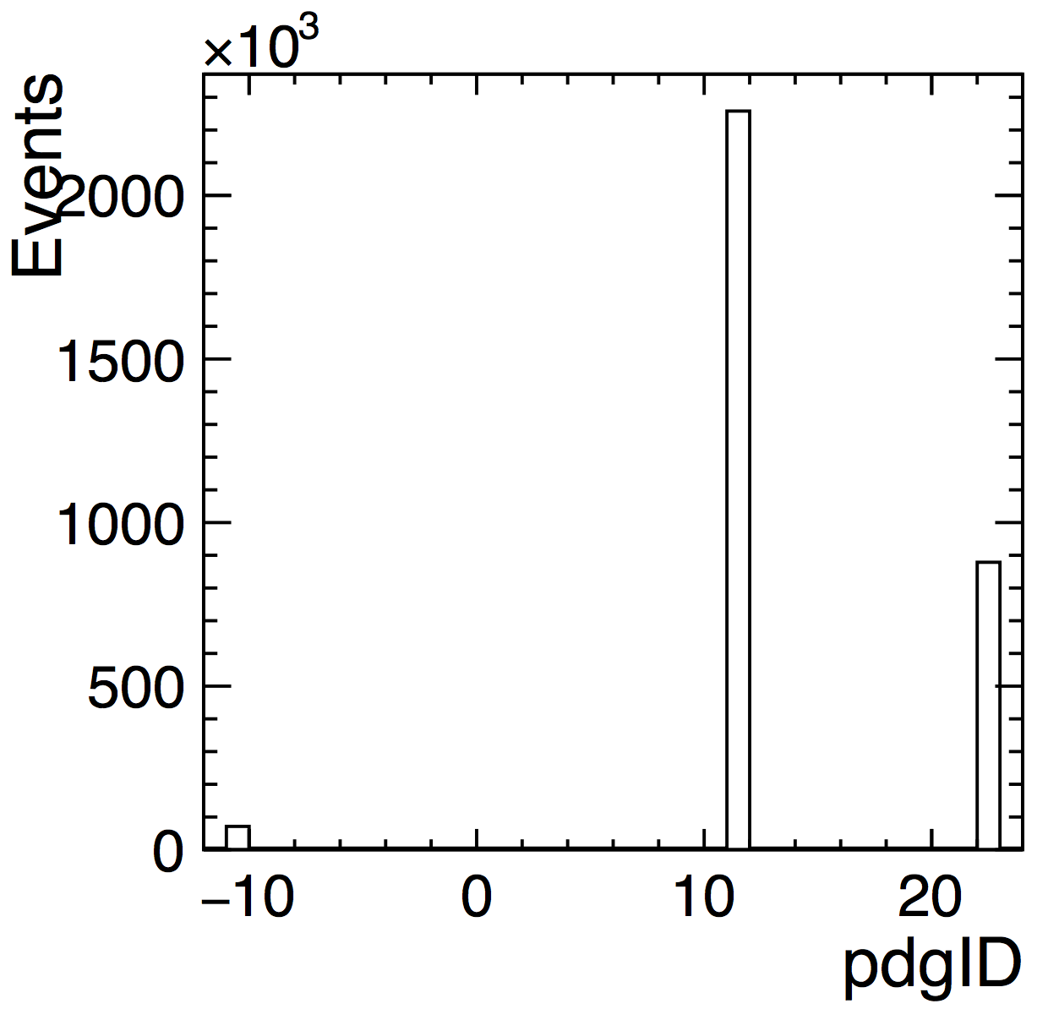
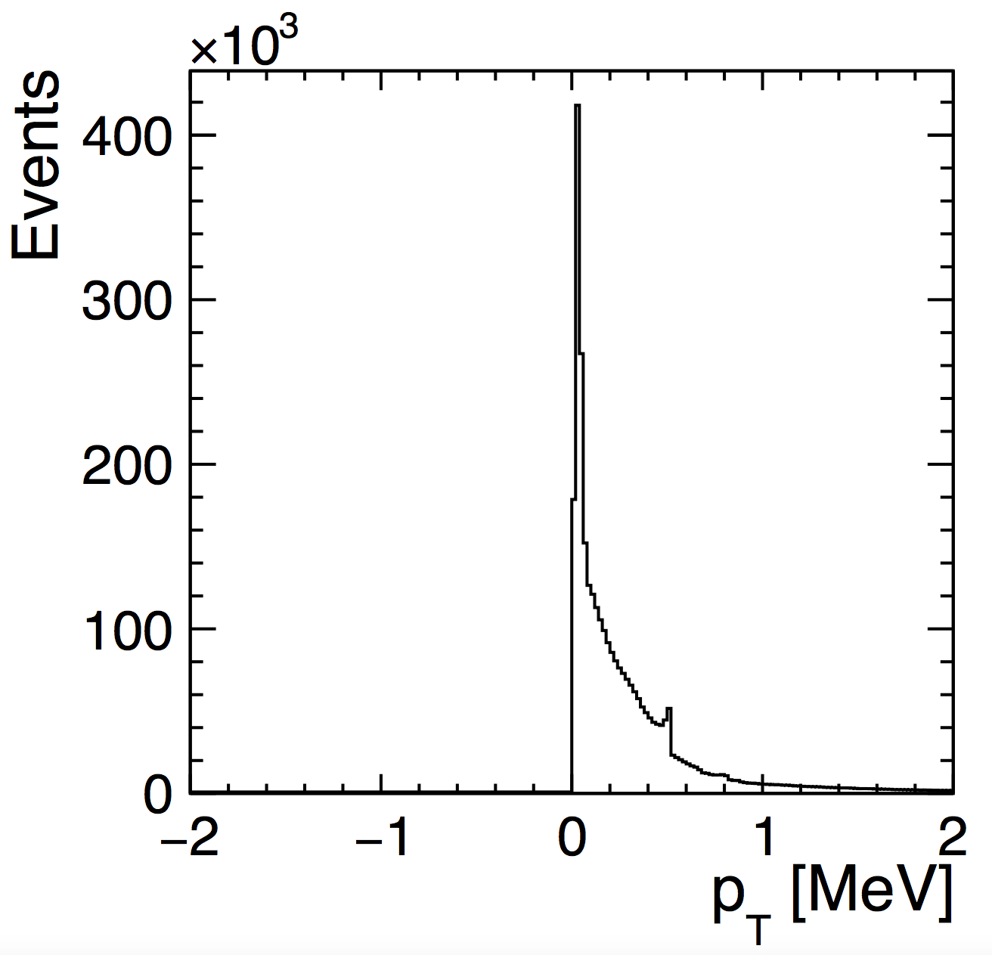
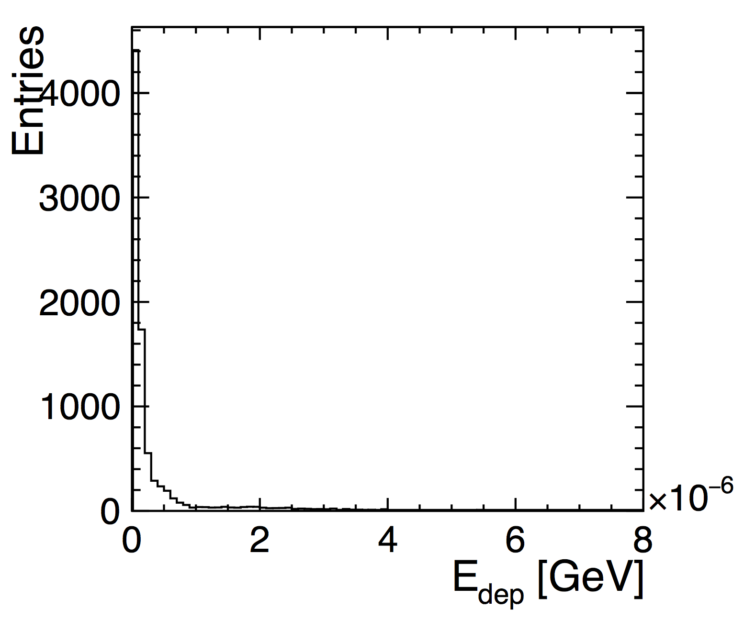
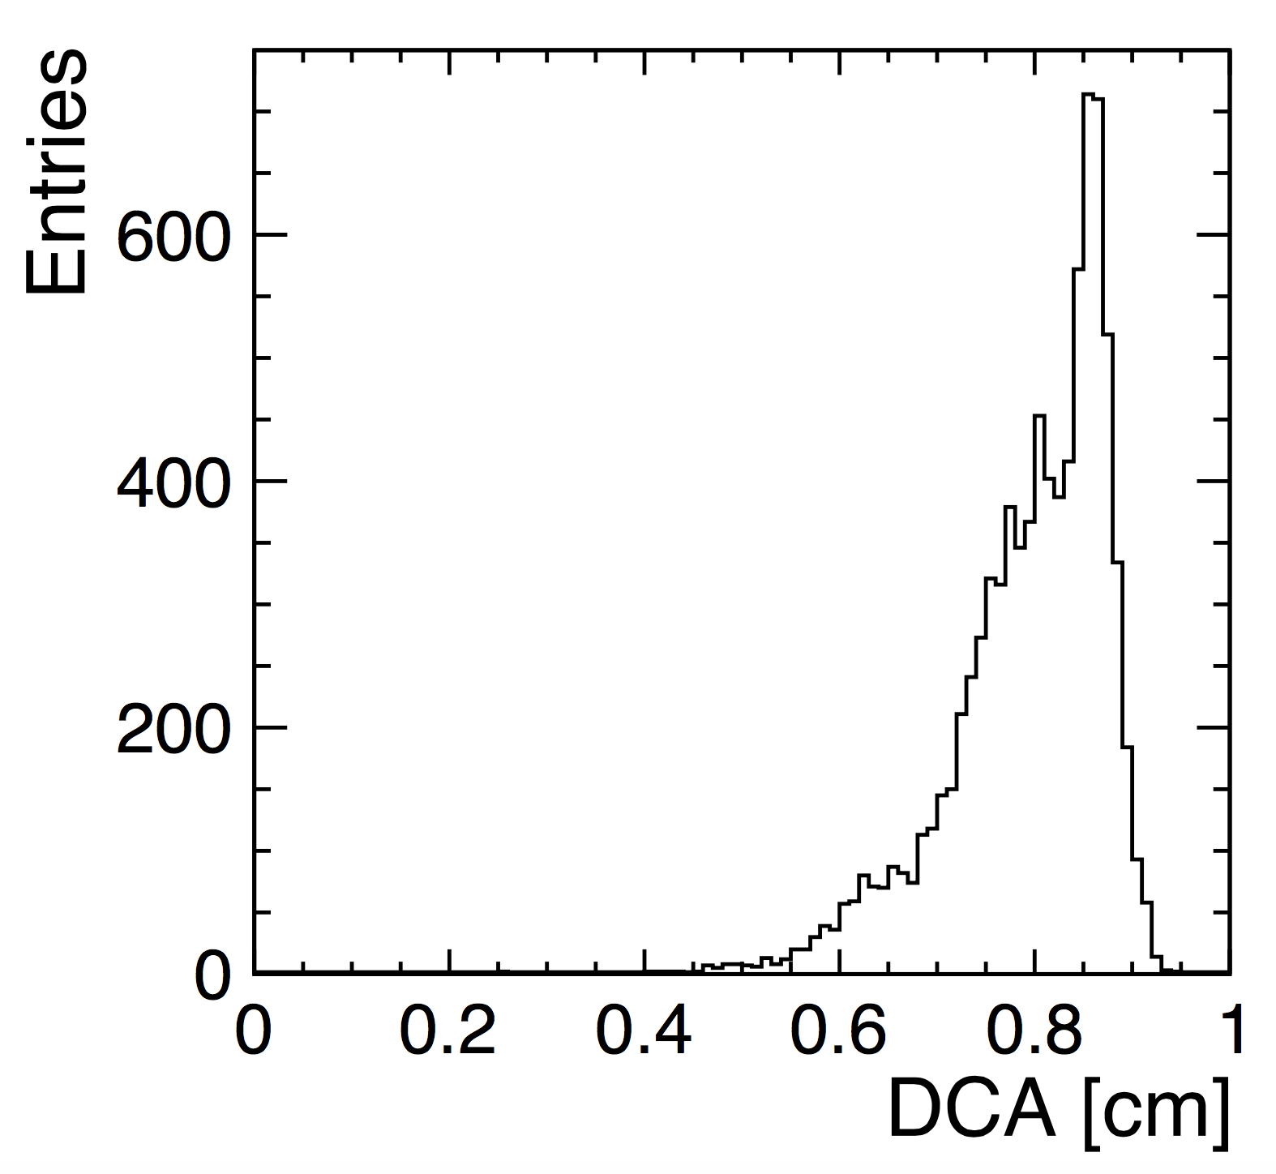
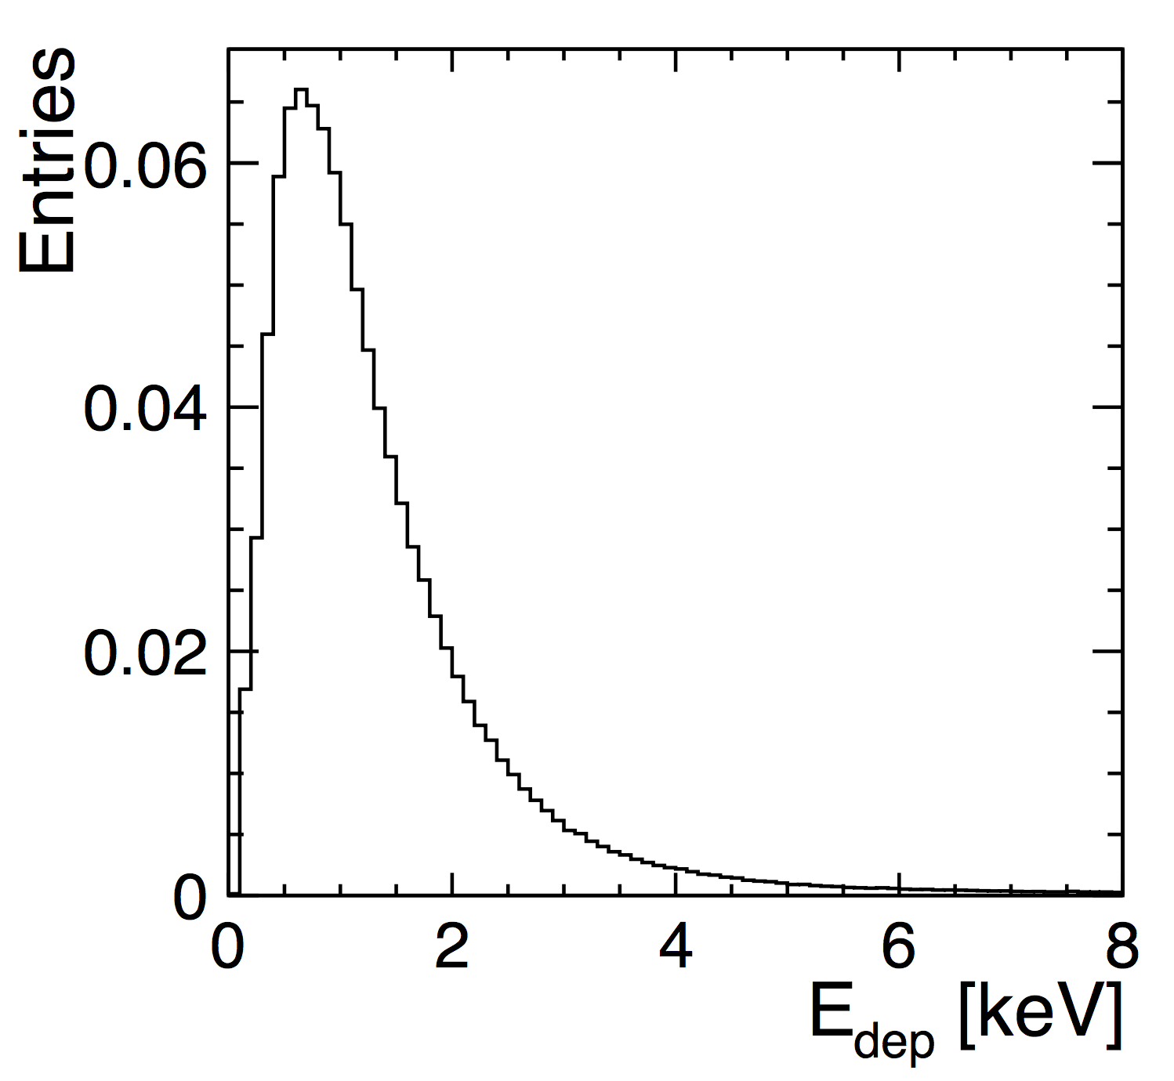
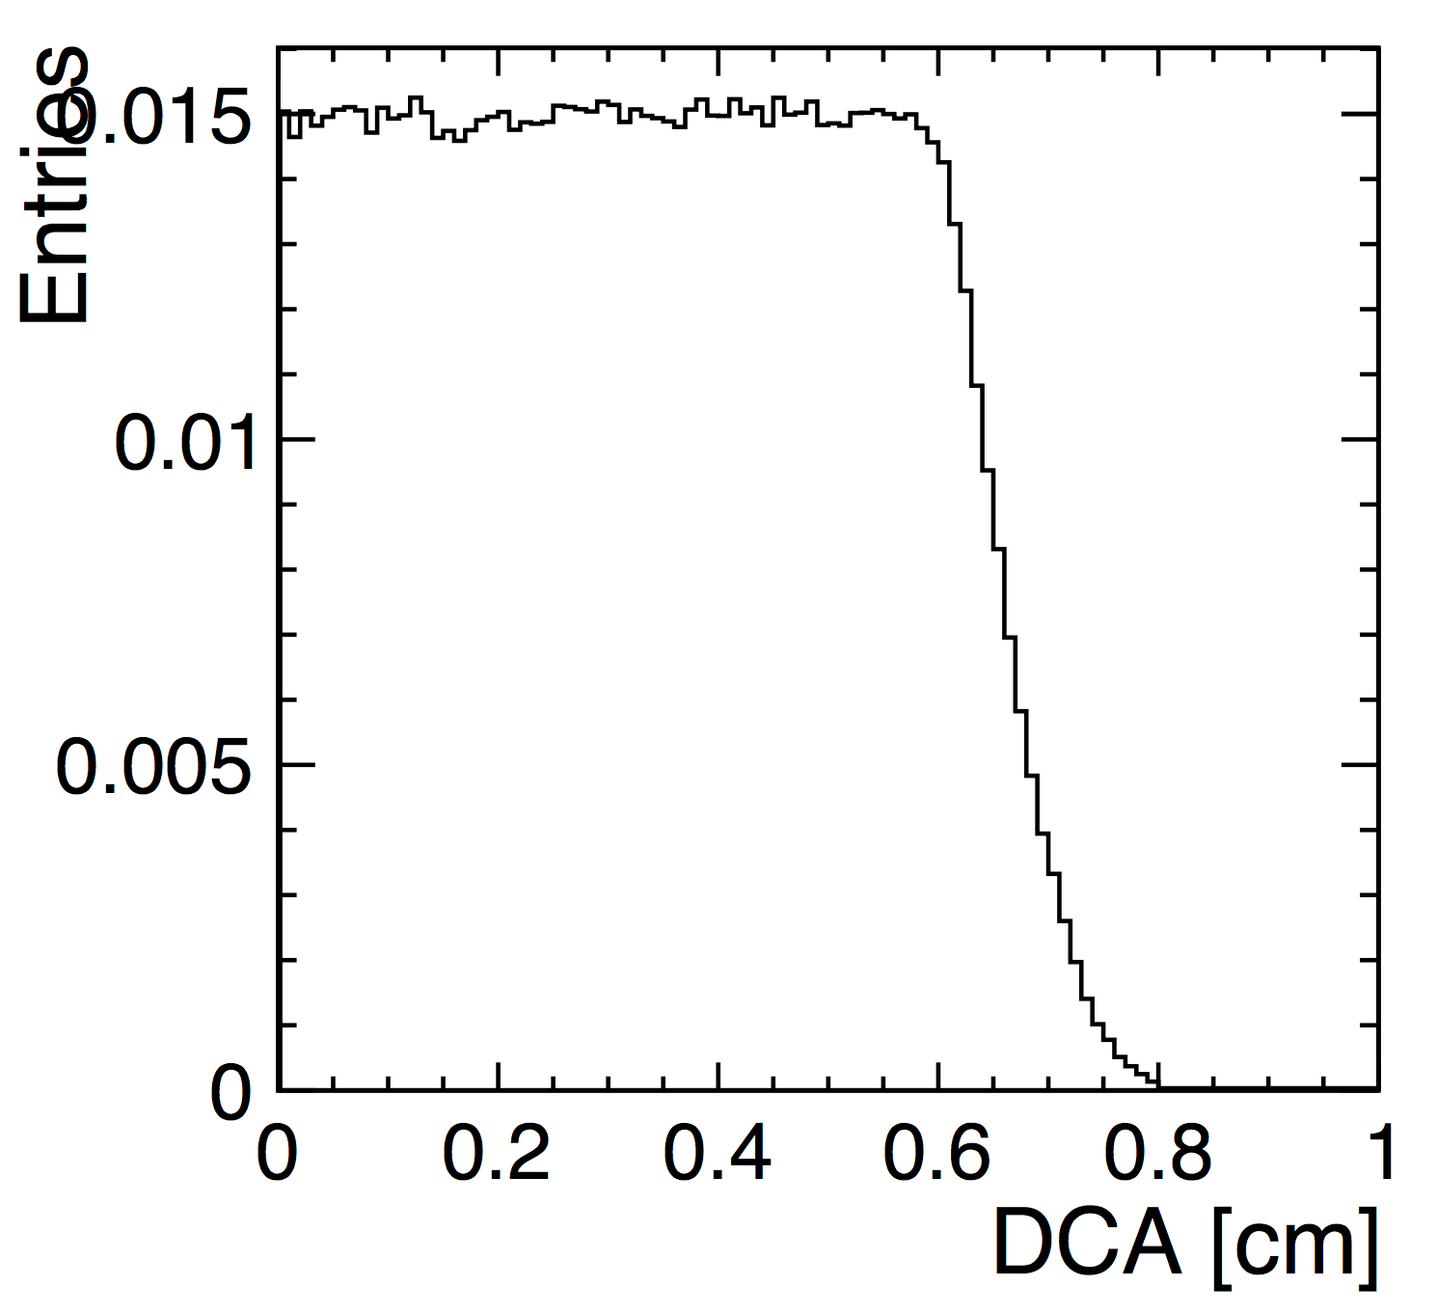
Consideration about occupancy
100 eV
cell
boundary
hit from single
GEANT4 step

Slide 9
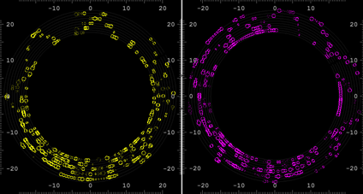
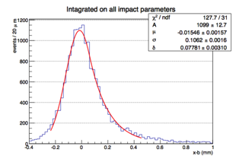
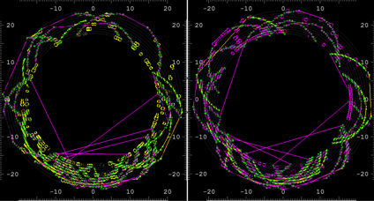
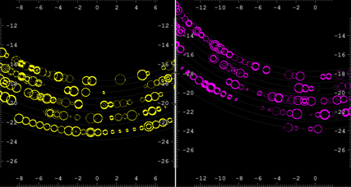
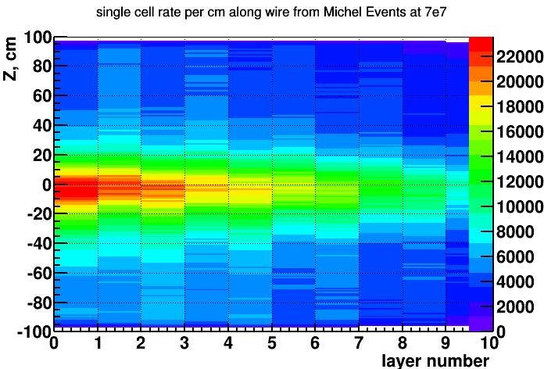
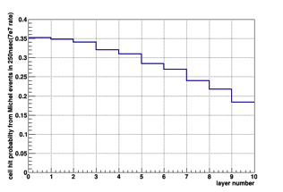
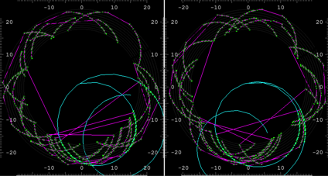
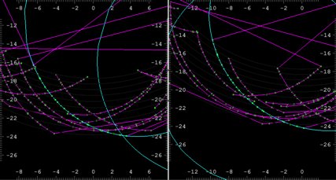
MEG2 DCH high occupancy
spatial resolution on 7 mm cell
hits in 250 ns window
both views
3D
track finding
and fit
σ = 106 μm
(He/iC₄H₁₀ = 85/15)
arXiv:1605.07970
segment fit + turn merging
discard short segments and isolated hits
full track fit
zoom
signal
track
michel
tracks

Slide 10
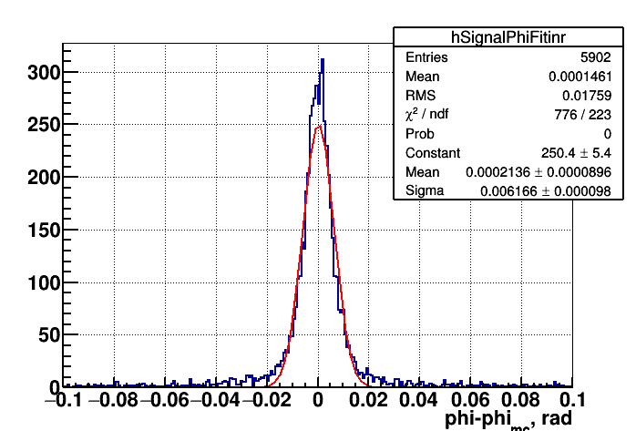
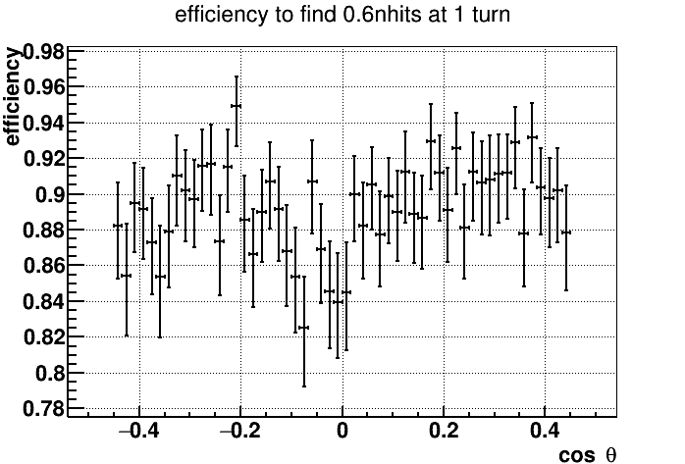
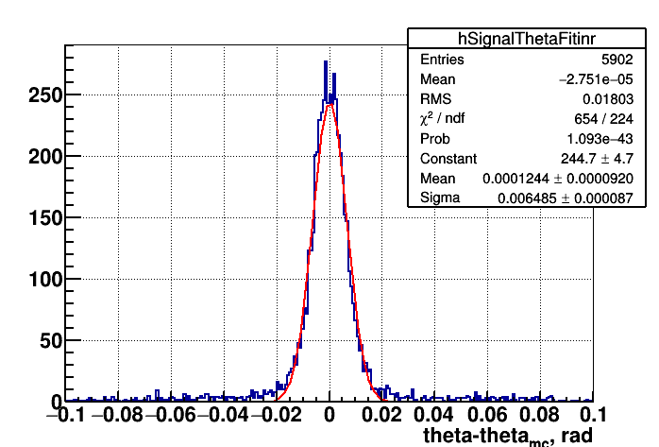
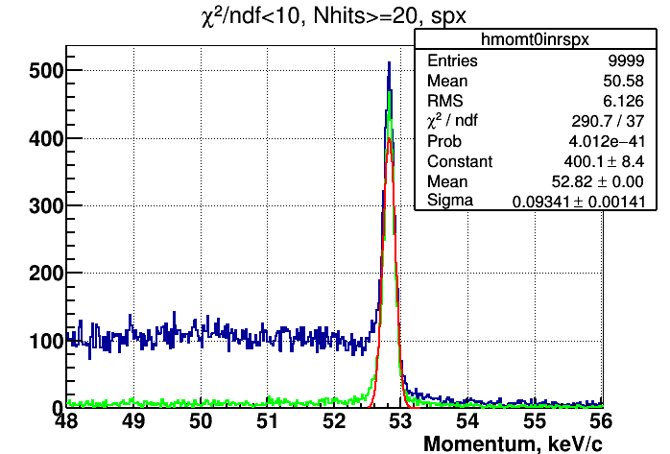
MEG2 DCH Performance
σ_{ϕ} = 6.2 mrad
Preliminary
track finding + fit
ε ≈ 90%
σ_{ϑ} = 6.5 mrad
σ_{p} = 93.4 KeV/c
Δp/p = 1.7×10⁻³

Slide 11
Data Transfer: Example
Running conditions
  91 GeV c.m. energy
  200 KHz trigger rate
    100 KHz Z decays
    30 KHz γγ → hadrons
    50 KHz Bhabha
    20 KHz beam backgrounds
D.C. operating conditions
  drift cells: 56,000 , layers: 112
  max drift time (≈1 cm): 400 ns
  cluster density: 20/cm
  gas gain: 6×10⁵
  single e⁻ p.h.: 6 mV
  r.m.s. electronics noise: 1 mV
  e⁻ threshold: 2 mV; rise time 1 ns
  signal digitization:
      12 bits at 2×10⁹ bytes/s

Slide 12
Example: traditional data transfer
Z decays:
10⁵ events/s × 20 tracks/event × 130 cells/track × 4×10⁻⁷ s × 2×10⁹ bytes/cell/s ≅ 200 Gb/s
γγ → hadrons:
3×10⁴ events/s × 10 tracks/event × 130 cells/track × 4×10⁻⁷ s × 2×10⁹ bytes/cell/s ≅ 30 Gb/s
Bhabha:
5×10⁴ events/s × 2 tracks/event × 0 cells/track × 4×10⁻⁷ s × 2×10⁹ bytes/cell/s ≅ 0 Gb/s
Beam noise (assume 2.5% occupancy):
2×10⁴ events/s × 1.5×10³ cells/event × 4×10⁻⁷ s × 2×10⁹ bytes/cell/s ≅ 25 Gb/s
Isolated peaks (assume 2.5% occupancy):
2×10⁵ events/s × 1.5×10³ cells/event × 4×10⁻⁷ s × 2×10⁹ bytes/cell/s ≅ 250 Gb/s
Transferring all digitized data (reading both ends of wires):
≥ 1 TB/s!

Slide 13
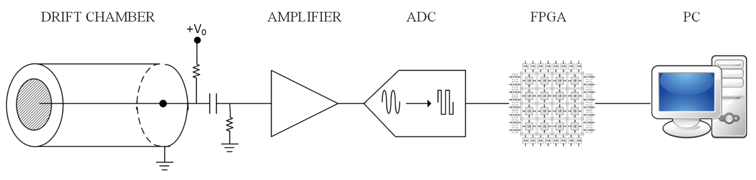
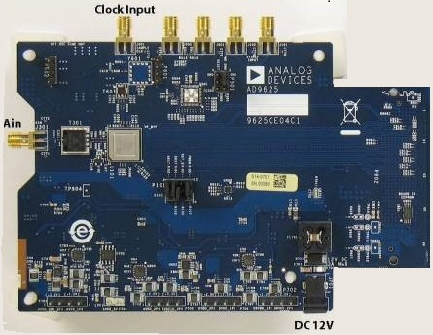
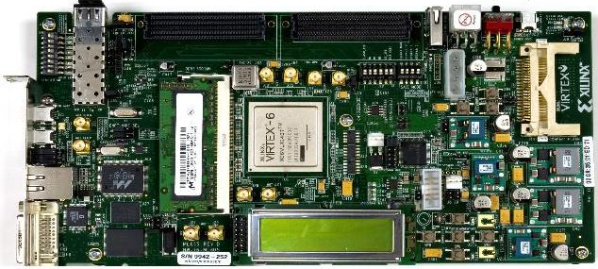
Example: the solution
The solution consists in transferring, for each hit drift cell, instead of the full spectrum of the signal, only the minimal information relevant to the application of the cluster timing/counting techniques, i.e. the amplitude and the arrival time of each peak associated with each individual ionisation electron.
This is accomplished by using a FPGA for the real time analysis of the data generated by the drift chamber and successively digitized by an ADC.
A fast readout algorithm (CluTim) for identifying, in the digitized drift chamber signals, the individual ionization peaks and recording their time and amplitude has been developed as VHDL/Verilog code implemented on a Virtex 6 FPGA, which allows for a maximum input/output clock switching frequency of 710 MHz. The hardware setup includes also a 12-bit monolithic pipeline sampling ADC at conversion rates of up to 2.0 GSPS.

Slide 14
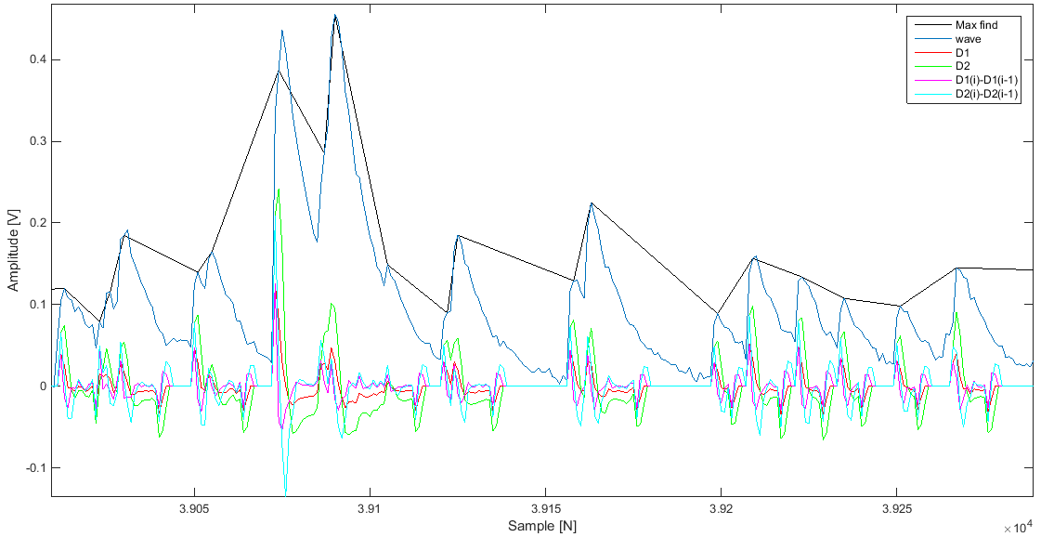
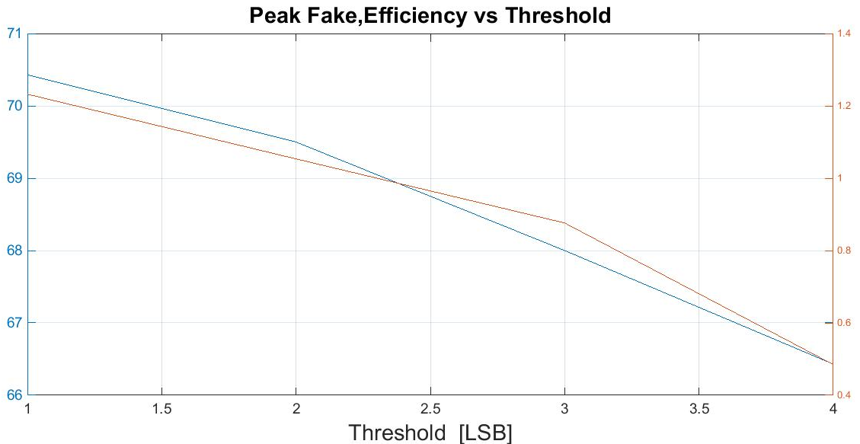
Example: CluTim algorithm
At the beginning of the signal processing procedure, a counter starts to count providing the timing information related to the signal under scrutiny.
The determination of a peak is done by relating the i-th sampled bin to a number n of preceding bins, where n is related to the rise times of the signal peak. Details of the algorithm can be found in next slide.
the input signal to the ADC, the peaks found, and the values of the auxiliary functions used and of their differences. Efficicency
The memories are continuously filled as new peaks are found. When a trigger signal occurs at time t₀, the reading procedure is enabled and only the data relative to the found peaks in the [t₀; t₀ + t_{max}] time interval are transferred to an external device
Sixteen samples S_{K,X} at 125MHz to the FPGA input.
STEP 1: Of the Sixteen samples S_{K,X} ,where K is the sample number among those available , and X is the time instant in which they are present, the functions D1_{K,X} e D2_{K,X} are calculated with use of the following equations :
D1_{K,X}=((2*S_{k,X}-S_{K-1,X}-S_{K-2,X})/16)*3
D2K,X =((2*S_{k,X}-S_{K-2,X}-S_{K-3,X})/16)*5
STEP 2: The values ​​of D1_{K,X} and D2_{K,X} and the differences between D1_{K,X} and D1_{K-1,X} and between D2_{K,X} and D2_{K-1,X} are compared with the thresholds proportional to the level of noise present in the input signal.
STEP 3: In order to transfer the data in memory , the last step before being sent to an external device is to check that there are no adjacent peaks
Sixteen samples S_{K,X} at 125MHz to the FPGA input.
STEP 1: Of the Sixteen samples S_{K,X} ,where K is the sample number among those available , and X is the time instant in which they are present, the functions D1_{K,X} e D2_{K,X} are calculated with use of the following equations :
D1_{K,X}=((2*S_{k,X}-S_{K-1,X}-S_{K-2,X})/16)*3
D2K,X =((2*S_{k,X}-S_{K-2,X}-S_{K-3,X})/16)*5
STEP 2: The values ​​of D1_{K,X} and D2_{K,X} and the differences between D1_{K,X} and D1_{K-1,X} and between D2_{K,X} and D2_{K-1,X} are compared with the thresholds proportional to the level of noise present in the input signal.
STEP 3: In order to transfer the data in memory , the last step before being sent to an external device is to check that there are no adjacent peaks

Slide 15
Example: CluTim data transfer
Z decays:
10⁵ events/s × 20 tracks/event × 130 cells/track × 20 peaks/cell × 2 bytes/peak ≅ 10 Gb/s
γγ → hadrons:
3×10⁴ events/s × 10 tracks/event × 130 cells/track × 20 peaks/cell × 2 bytes/peak ≅ 1.6 Gb/s
Bhabha:
5×10⁴ events/s × 2 tracks/event × 0 cells/track × 20 peaks/cell × 2 bytes/peak ≅ 0 Gb/s
Beam noise (assume 2.5% occupancy):
2×10⁴ events/s × 1.5×10³ cells/event × 0 peaks/cell × 2 bytes/peak ≅ 0 Gb/s
Isolated peaks (assume 2.5% occupancy):
2×10⁵ events/s × 1.5×10³ cells/event × 0 peaks/cell × 2 bytes/peak ≅ 0 Gb/s
Transferring only time and amplitude of each electron peak (reading both ends of wires):
≈ 25 GB/s!

Slide 16
Thin solenoid for the CTF detector placed in front of the identification system (option)
Alexey Bragin
Budker Institute of Nuclear Physics,
Novosibirsk, Russia
May 2018

Slide 17
Thickness in radiation lengths
Materials | Thickness X, mm | Radiation length X₀ мм X/X₀ |  | Material ratio, %
SC wire, NbTi/Cu = 1/1 | 0.56 | 17.7 | 0.032 | 31.0
Carbon fibre (1.5 g/cm³) | 1.5 | 251 | 0.006 | 5.8
Epoxy compound (NB as filler) | 1.5 | 150* | 0.010 | 9.7
Aluminum strips (2 x 0.5 mm) | 1.0 | 88.9 | 0.011 | 10.7
Radiation shields, Al | 2.0 | 88.9 | 0.022 | 21.4
Vacuum vessel, Al | 2.0 | 88.9 | 0.022 | 21.4
Total, X_{tot} |  |  | 0.103 | 100

Slide 18
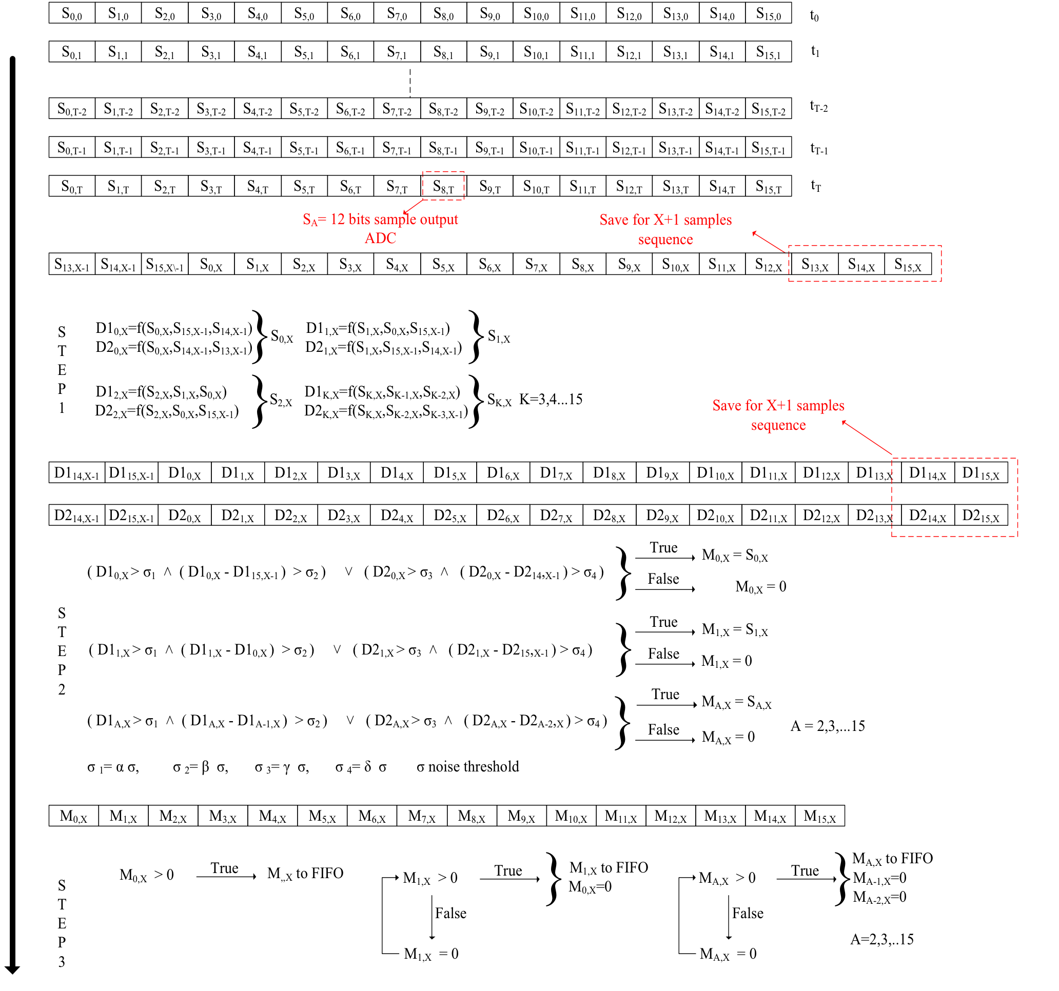
Example: CluTim algorithm
Sixteen samples S_{K,X} at 125 MHz to the FPGA input.
STEP 1: Of the Sixteen samples S_{K,X} ,where K is the sample number among those available, and X is the time instant at which they are present, the functions D1_{K,X} e D2_{K,X} are calculated with use of the following equations :
D1_{K,X}=((2*S_{k,X}-S_{K-1,X}-S_{K-2,X})/16)*3
D2_{K,X} =((2*S_{k,X}-S_{K-2,X}-S_{K-3,X})/16)*5
STEP 2: The values ​​of D1_{K,X} and D2_{K,X} and the differences between D1_{K,X} and D1_{K-1,X} and between D2_{K,X} and D2_{K-1,X} are compared with the thresholds proportional to the level of noise present in the input signal.
STEP 3: In order to transfer the data in memory, the last step before being sent to an external device is to check that there are no adjacent peaks
Input signal to the ADC, peaks found, results of the functions D1, D2 and their differences
G. Chiarello, C. Chiri, G. Cocciolo, A. Corvaglia, F. Grancagnolo, M. Panareo, A. Pepino and G. Tassielli. "The Use of FPGA in Drift Chambers for High Energy Physics Experiments", Chapter 7 in "Field - Programmable Gate Array", book edited by George Dekoulis, ISBN 978-953-51-3208-0, Print ISBN 978-953-51-3207-3, Publ.: May 31, 2017 doi:10.5772/66853, http://dx.doi.org/10.5772/66853
Sixteen samples S_{K,X} at 125MHz to the FPGA input.
STEP 1: Of the Sixteen samples S_{K,X} ,where K is the sample number among those available , and X is the time instant in which they are present, the functions D1_{K,X} e D2_{K,X} are calculated with use of the following equations :
D1_{K,X}=((2*S_{k,X}-S_{K-1,X}-S_{K-2,X})/16)*3
D2K,X =((2*S_{k,X}-S_{K-2,X}-S_{K-3,X})/16)*5
STEP 2: The values ​​of D1_{K,X} and D2_{K,X} and the differences between D1_{K,X} and D1_{K-1,X} and between D2_{K,X} and D2_{K-1,X} are compared with the thresholds proportional to the level of noise present in the input signal.
STEP 3: In order to transfer the data in memory , the last step before being sent to an external device is to check that there are no adjacent peaks
Sixteen samples S_{K,X} at 125MHz to the FPGA input.
STEP 1: Of the Sixteen samples S_{K,X} ,where K is the sample number among those available , and X is the time instant in which they are present, the functions D1_{K,X} e D2_{K,X} are calculated with use of the following equations :
D1_{K,X}=((2*S_{k,X}-S_{K-1,X}-S_{K-2,X})/16)*3
D2K,X =((2*S_{k,X}-S_{K-2,X}-S_{K-3,X})/16)*5
STEP 2: The values ​​of D1_{K,X} and D2_{K,X} and the differences between D1_{K,X} and D1_{K-1,X} and between D2_{K,X} and D2_{K-1,X} are compared with the thresholds proportional to the level of noise present in the input signal.
STEP 3: In order to transfer the data in memory , the last step before being sent to an external device is to check that there are no adjacent peaks

