Slide 1
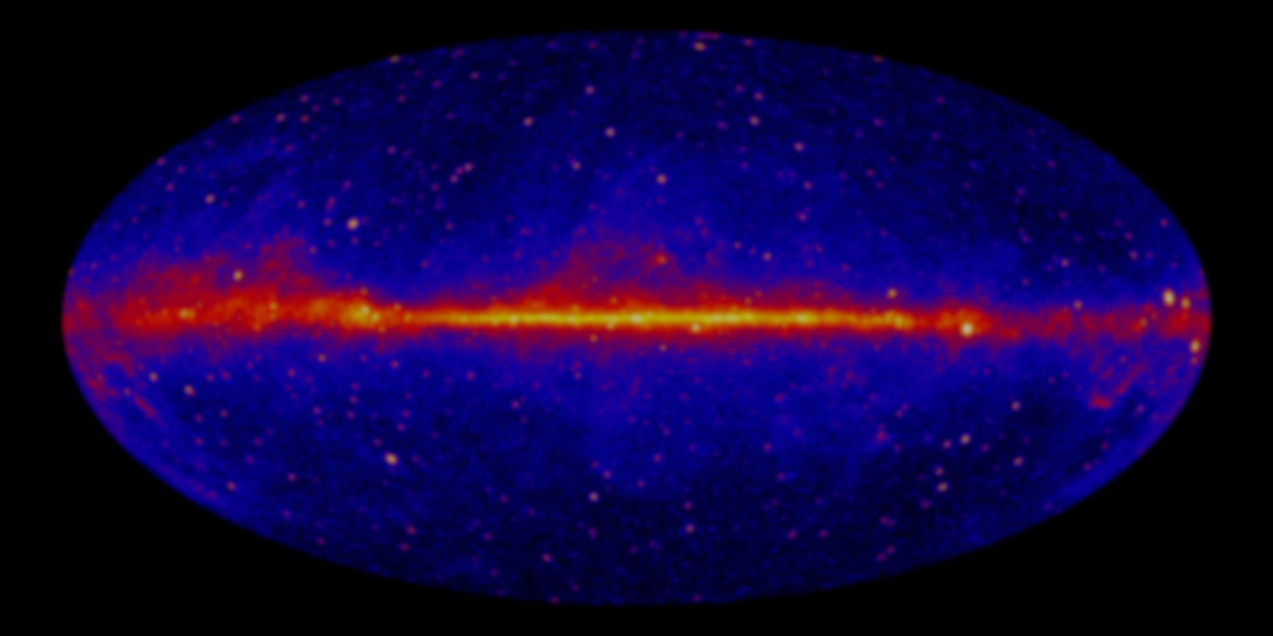
Gamma-ray variability analysis from Fermi to LHAASO
Jianeng Zhou(SHAO)
Collaborators:
Zhongxiang Wang(SHAO), Liang Chen(SHAO), Paul J. Wiita (TCNJ), Jithesh Vadakkumthani(IUCAA), Nidia Morrell(LCO), Jujia Zhang(YNAO)
Pengfei Zhang(YNU), Dahai Yan(YNAO)
2018/10/10 @ Linzhi

Slide 2
Gamma-ray variability analysis
Based on Fermi-LAT
To LHAASO
New Fermi gamma-ray sources
Gamma-ray
Expectation
QPOs
Local temporal analysis
QPO origination

Slide 3
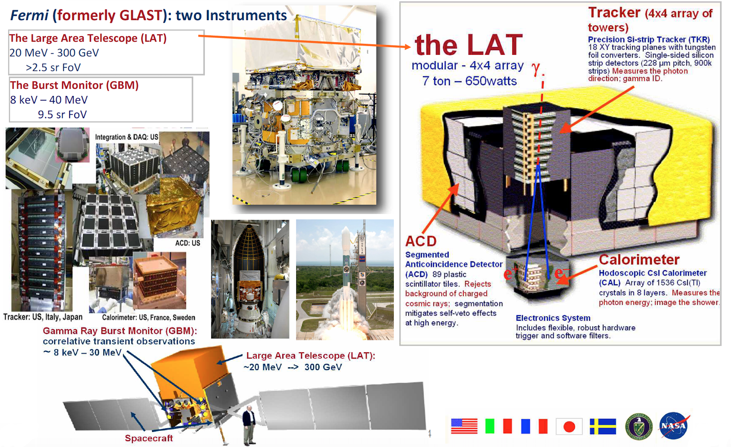
Fermi large area telescope
Stefano Ciprini

Slide 4
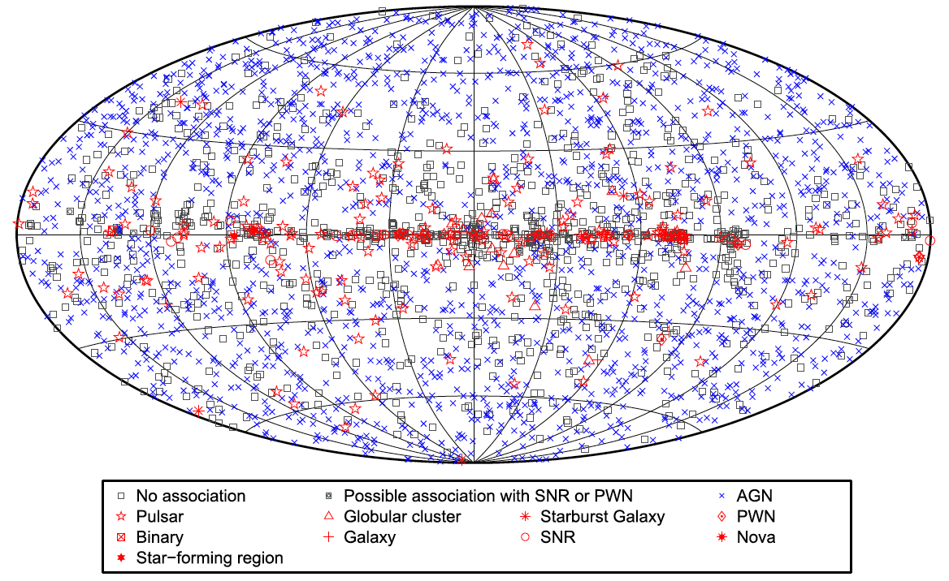
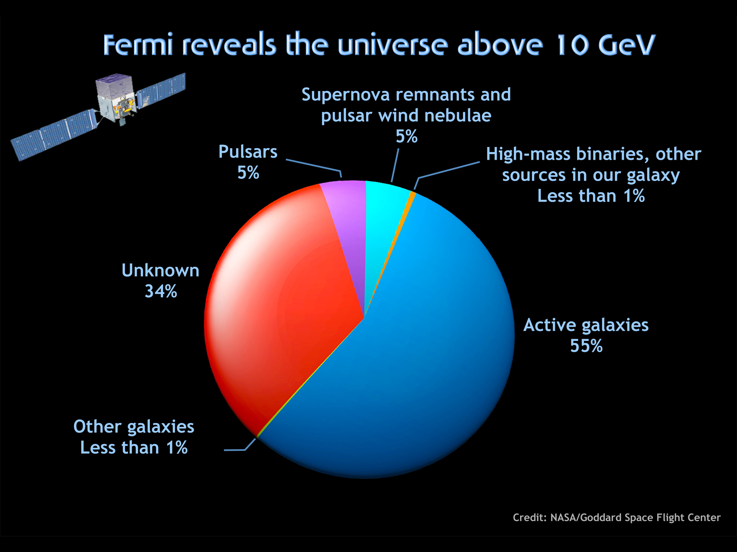
Fermi Large Area Telescope third catalog sources map
 | Identified | Associated
FSRQ | 38 | 446
BL Lac | 18 | 642
Unknown type | 5 | 568

Slide 5
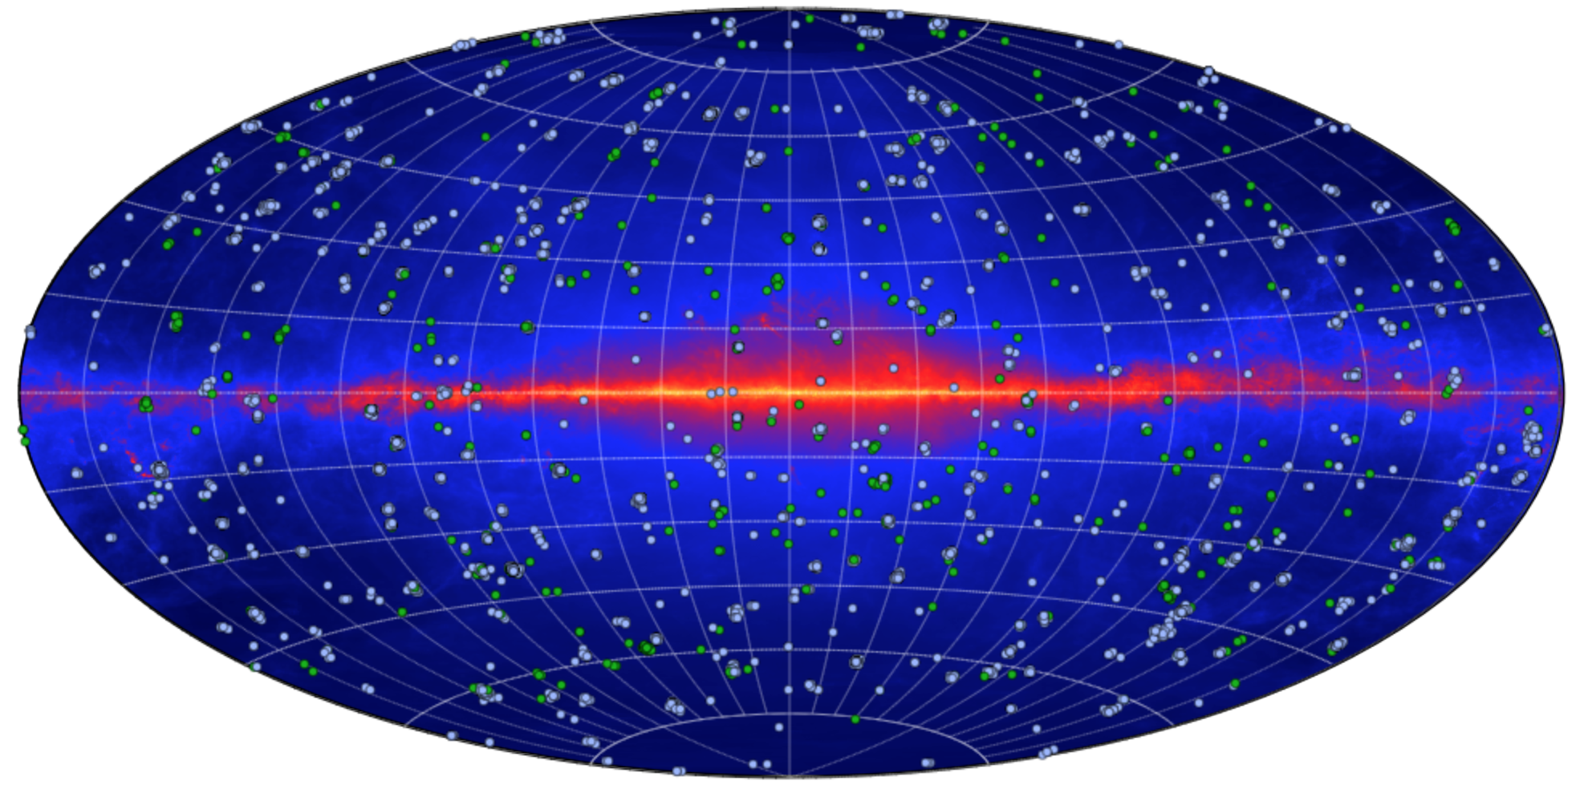
Fermi All-sky Variability Analysis
Up to now, with 479 weeks data, 4647 flares were detected.
518 sources are identified.
393 of which are blazars…
Abdollahi et al., 2017

Slide 6
“new”gamma-ray sources
3FGL
3FGL
FL8Y

Slide 7
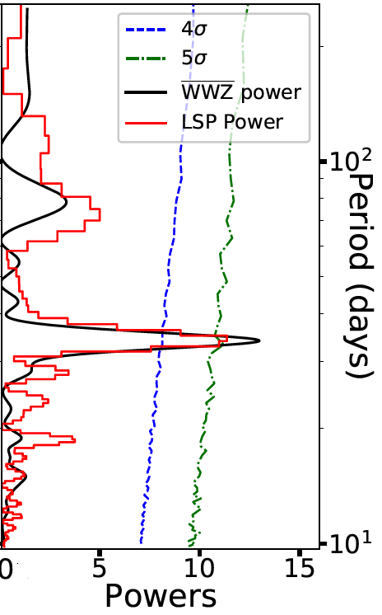
Timing analysis

Slide 8
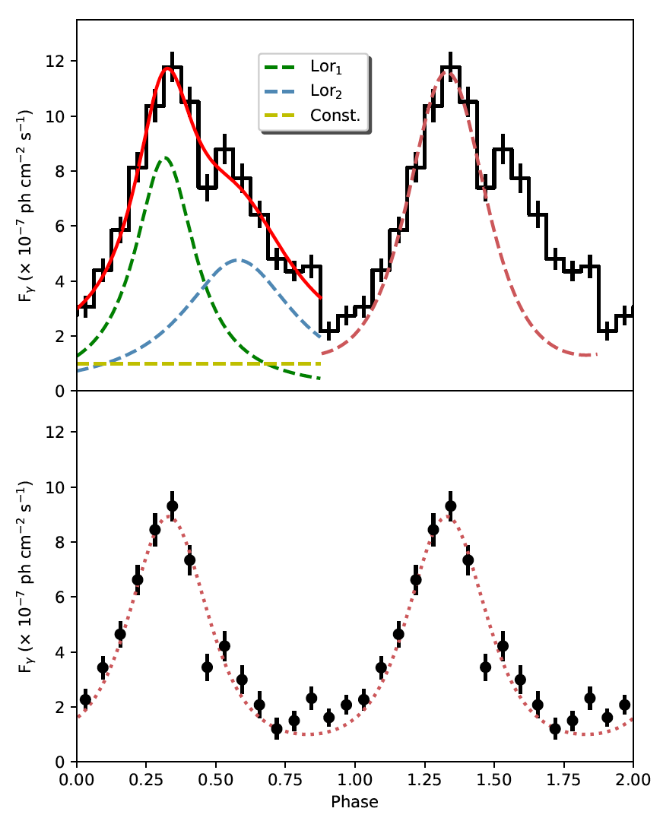
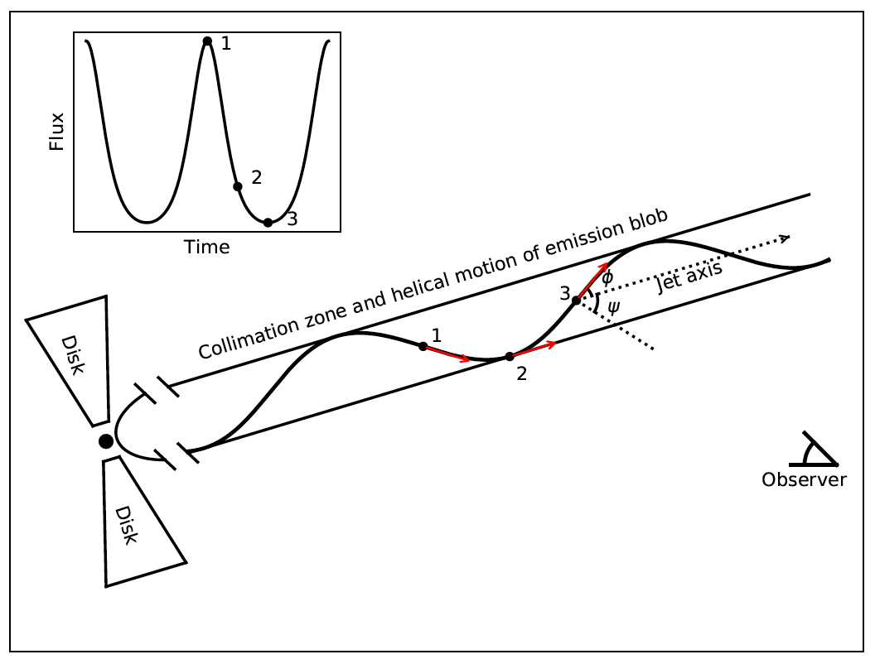
Timing analysis
Pitch angle = 2 deg
Inclin. angle = 5 deg, Lorentz factor = 8.5
Pitch ~ 2.2 pc
D_{proj_tot} ~ 2.2*6*sin5 ~1.1 pc
This is the only case in more than 1700 Fermi detected blazars !!

Slide 9
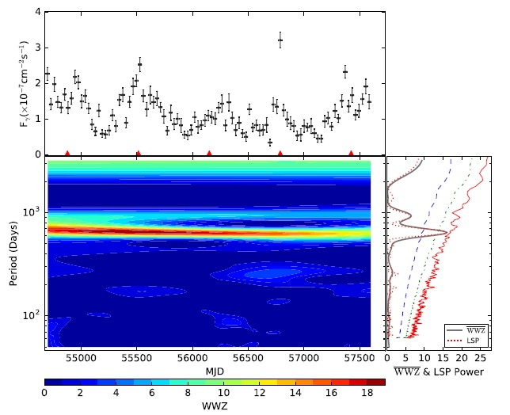
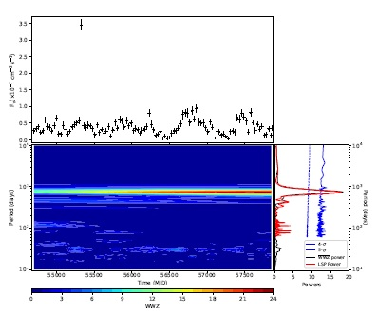
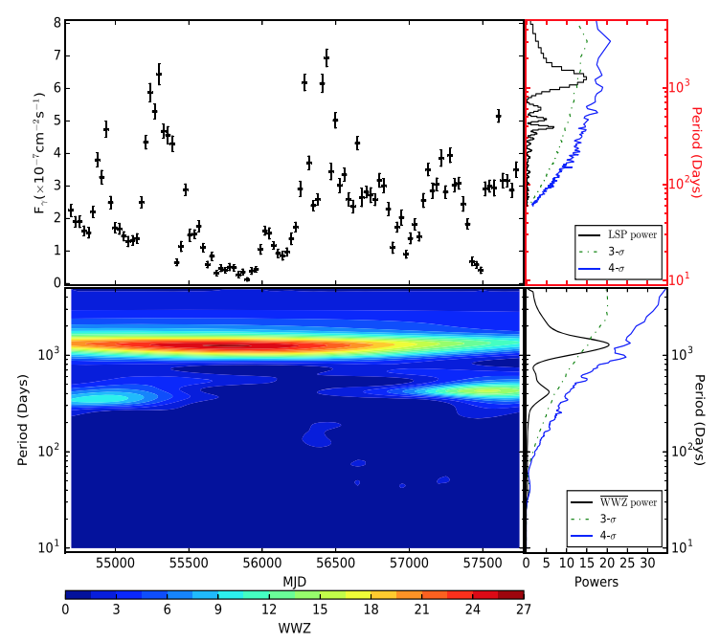
QPOs on year-long timescale
PKS 2155-304:
P = 1.74 yrs
4.9sigma significance (Zhang et al. 2017)
PKS 0301-243:
P = 2.1 yrs
~5sigma significance (Zhang et al. 2018)
PKS 0426-380:
P = 3.35 yrs
~3.6sigma significance (Zhang et al. 2017)

Slide 10
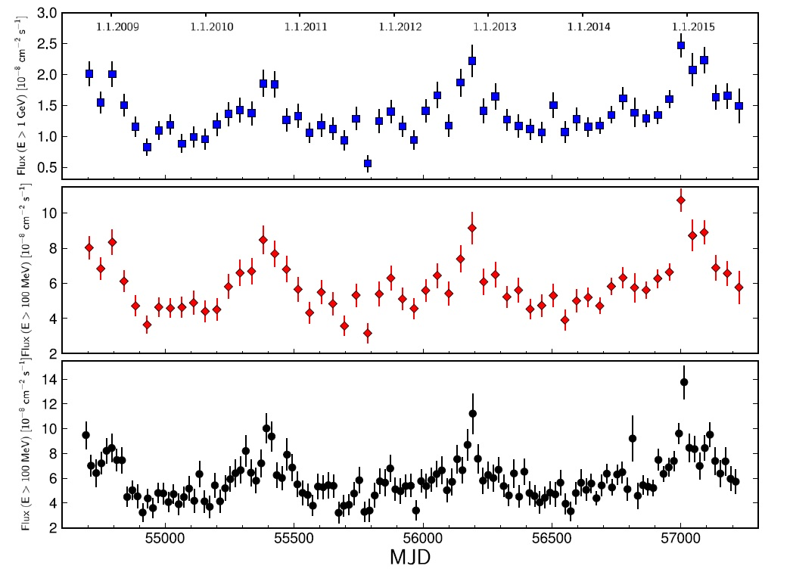
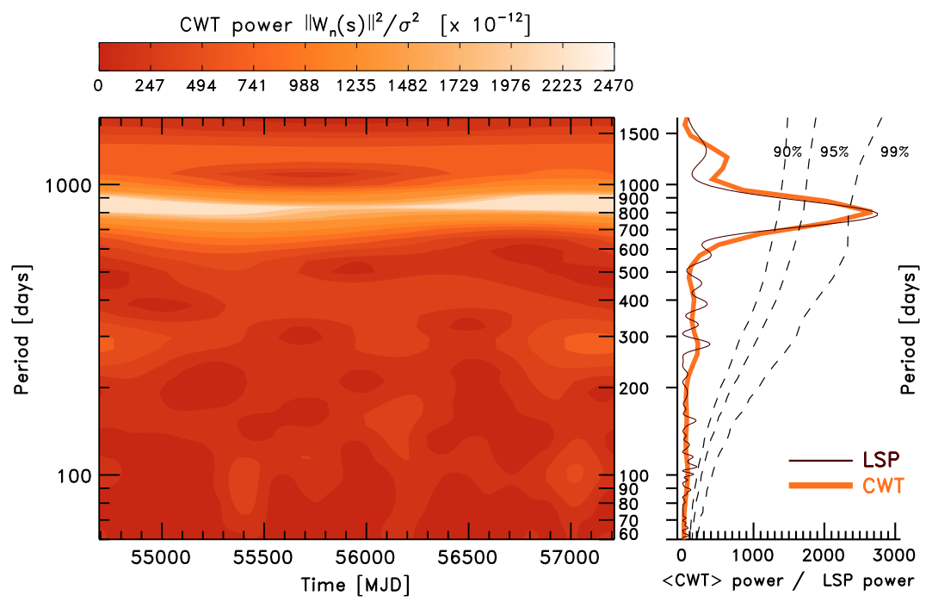
PG 1553+113 – a 2.18 years QPO
  Intrinsic origin:
  Pulsational accretion
  Apparent origin:
  periodically Doppler factor changing
Ackermann et al. 2015, ApJL

Slide 11
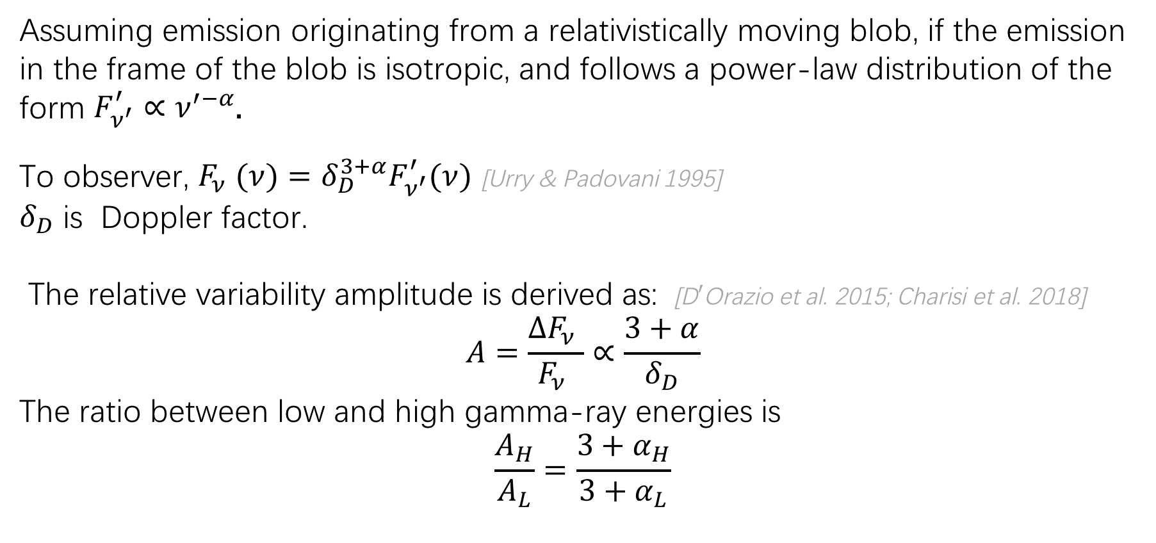
Cause of gamma-ray QPO in blazar - PG 1553+113
Assuming emission originating from a relativistically moving blob, if the emission
in the frame of the blob is isotropic, and follows a power-law distribution of the
form $F_{ν^{′}}^{′}∝ν^{′−α}$.
To observer, $F_{ν }(ν)=δ_{D}^{3+α}F_{ν^{′}}^{′}(ν)$ [Urry & Padovani 1995]
$δ_{D}$ is Doppler factor.
The relative variability amplitude is derived as: [D$′$Orazio et al. 2015; Charisi et al. 2018]
$$A=\frac{∆F_{ν }}{F_{ν }}∝\frac{3+α}{δ_{D}}$$
The ratio between low and high gamma-ray energies is
$$\frac{A_{H}}{A_{L}}=\frac{3+α_{H}}{3+α_{L}}$$
Yan et al., 2018, ApJ accepted

Slide 12
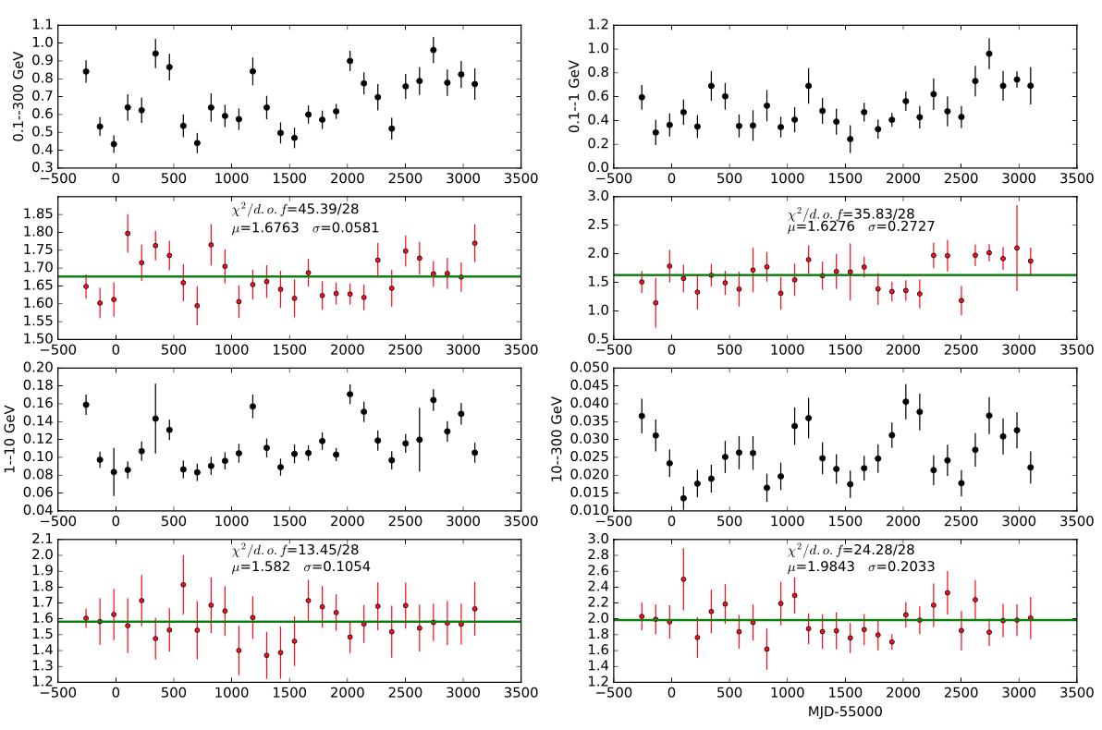
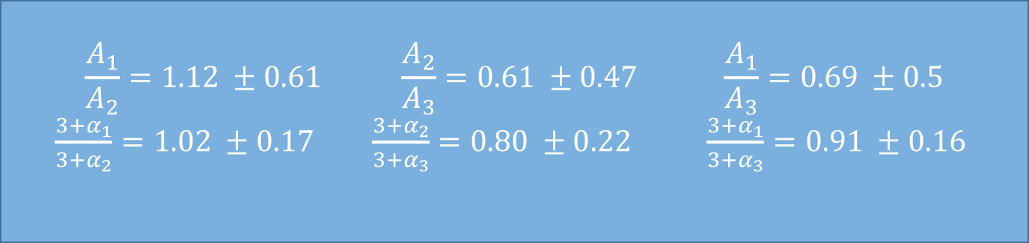
Cause of gamma-ray QPO in blazar - PG 1553+113
$$\frac{A_{1}}{A_{2}}=1.12 ±0.61 \frac{A_{2}}{A_{3}}=0.61 ±0.47 \frac{A_{1}}{A_{3}}=0.69 ±0.5$$
$\frac{3+α_{1}}{3+α_{2}}=1.02 ±0.17$ $\frac{3+α_{2}}{3+α_{3}}=0.80 ±0.22$ $\frac{3+α_{1}}{3+α_{3}}=0.91 ±0.16$
Yan et al., 2018, ApJ accepted

Slide 13
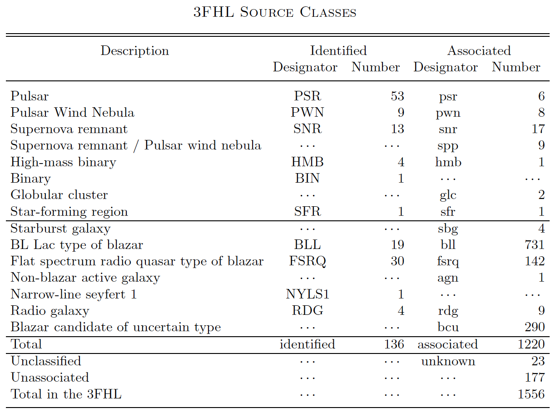
Expectation on detecting blazar flares by LHAASO
( 10 GeV – 2 TeV )
360 sources for 2FHL
Ajello et al. 2018, ApJS

Slide 14
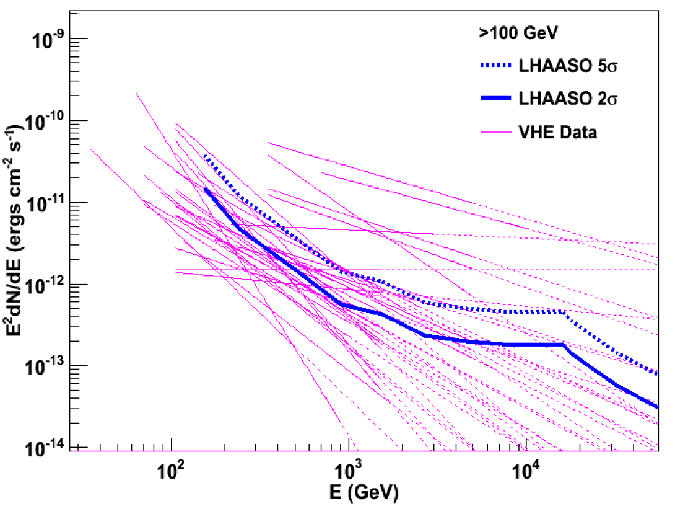
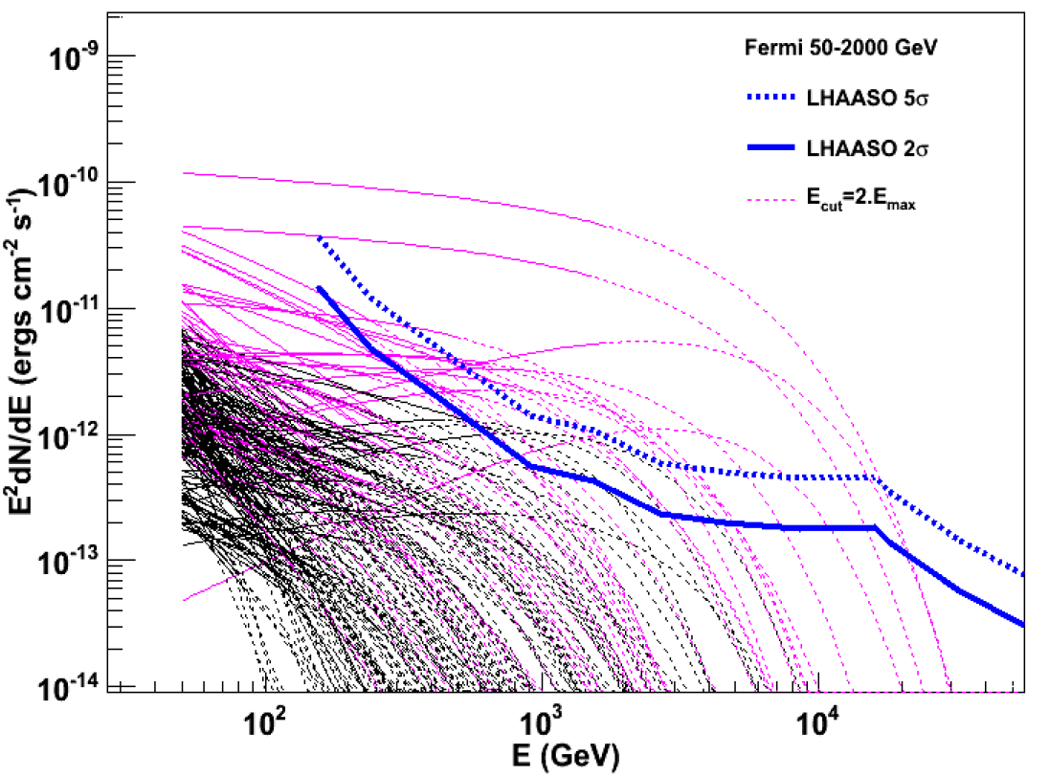
Expectation on detecting blazar flares by LHAASO
By Songzhan Chen

Slide 15
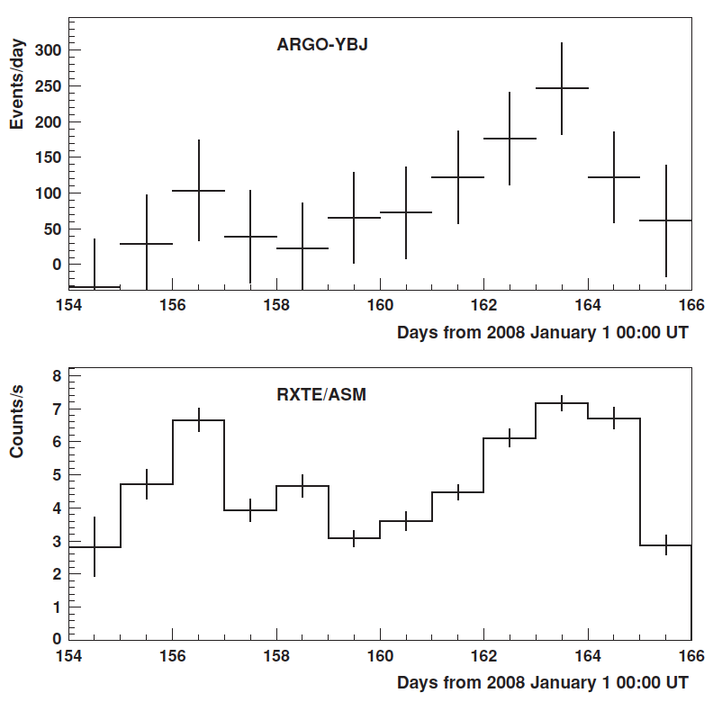
Expectation on detecting blazar flares by LHAASO
Rate of excess events with N_{pad}>=100 observed from
Mrk421 by ARGO-YBJ
Flares
High energy photons
All benefit from long-term monitoring by LHAASO
Aielli et al. 2010, ApJL

Slide 16
THANKS

