Slide 1
LHAASO-WFCTA 进展
张寿山
中国科学院高能物理研究所
LHAASO合作组会议，西藏林芝， 2018年10月 8-12日

Slide 2
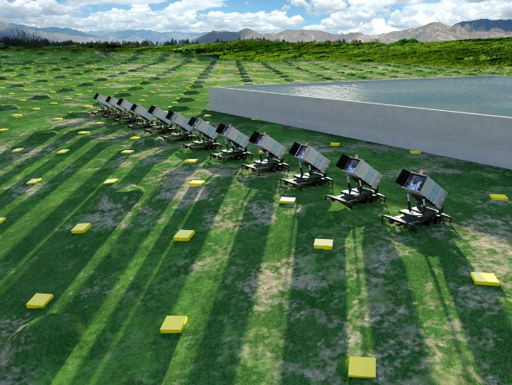
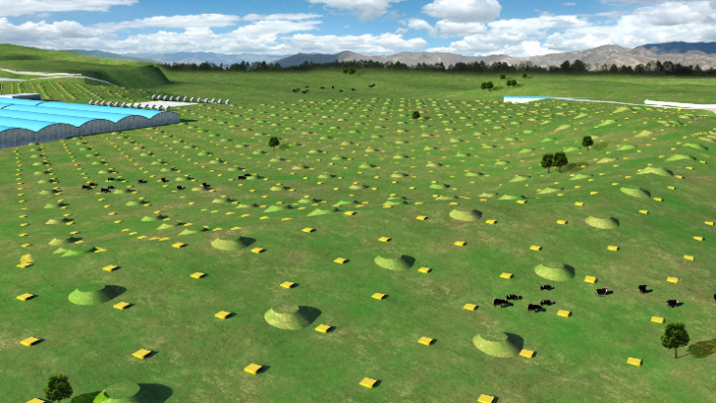
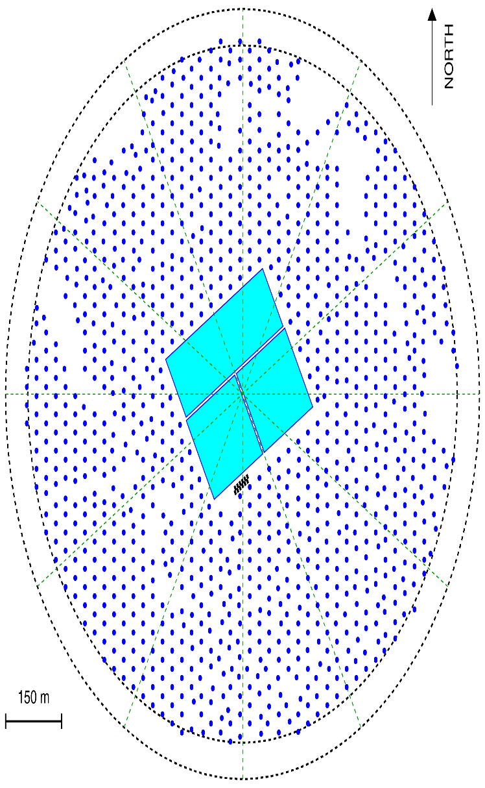
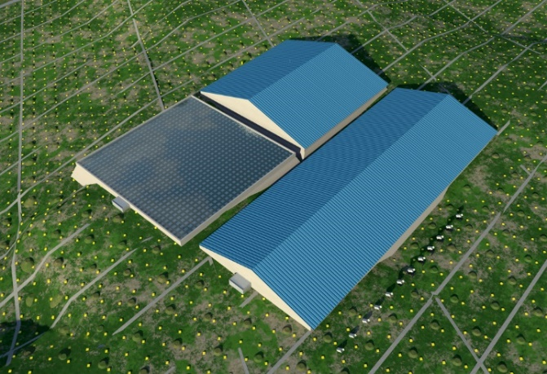
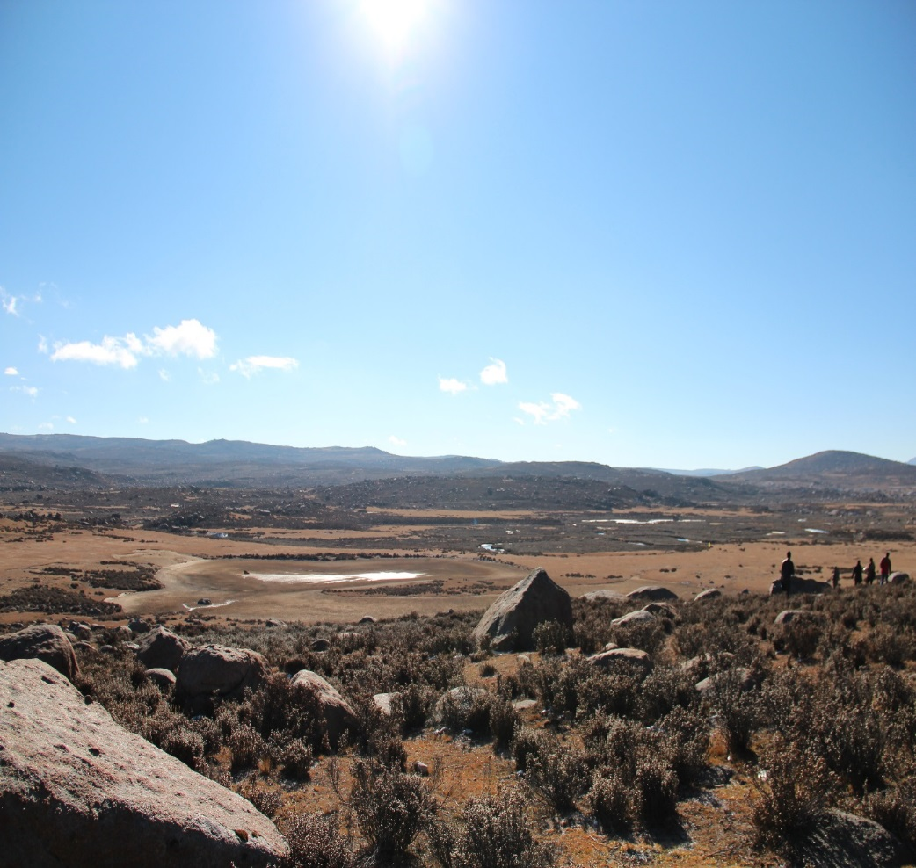
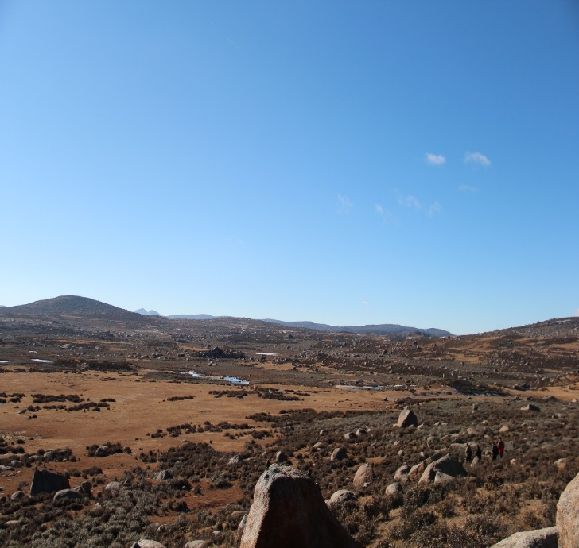
LHAASO
KM2A:
5195 EDs
1171 MDs
WFCTA:
18 Cherenkov telescopes (1024 pixels/telescope)
WCDA:78,000 m² 3000 cells (25m²/cell)
Daochen, Sichuan (29º21’ 31” N, 100º08’15” E, 4410 m a.s.l., 600 g/cm)

Slide 3

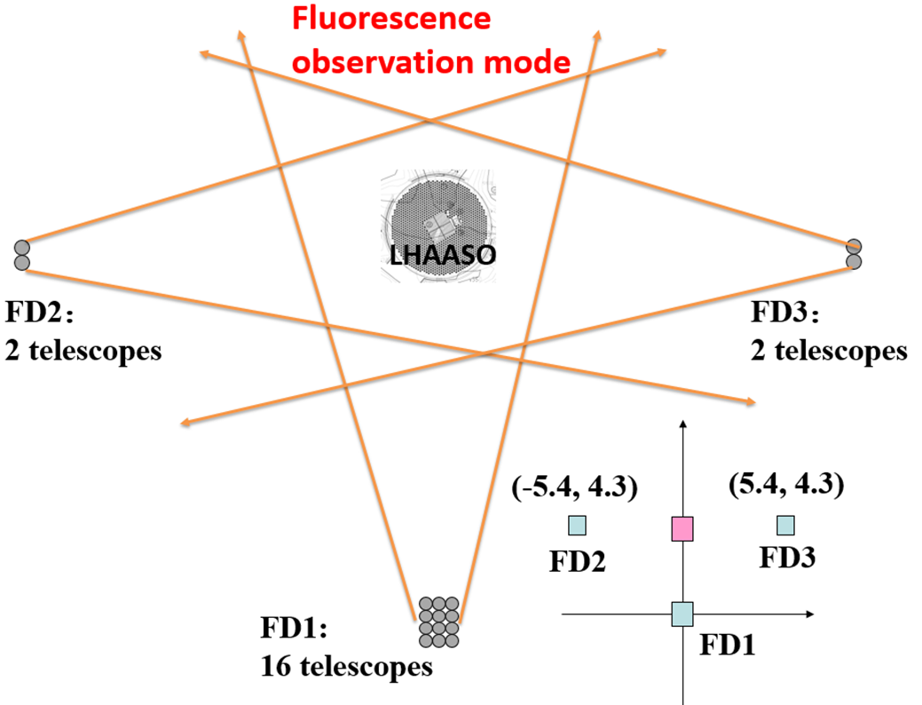
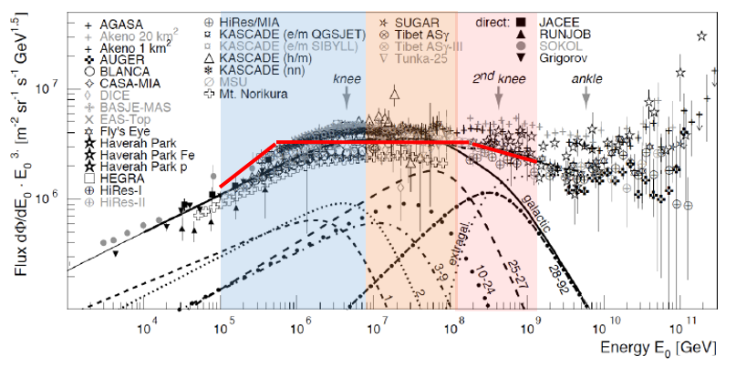
LHAASO science in cosmic ray measurement
  Measure individual cosmic ray spectra from 10TeV to EeV
  Multi-parameters, Multi-stages
0.1-10 PeV (Cherenkov mode)
  pure proton and light nuclei (P+He) spectra
  6 telescopes (30°in zenith) + ¼ WCDA
1- 100 PeV (Cherenkov mode)
  Pure iron or heavy nuclei spectra
  18 telescopes (45 °in zenith) + scintillator detectors + muon detectors array
>100 PeV (fluorescence mode)
  2nd knee
  20 telescopes + muon detectors array

Slide 4
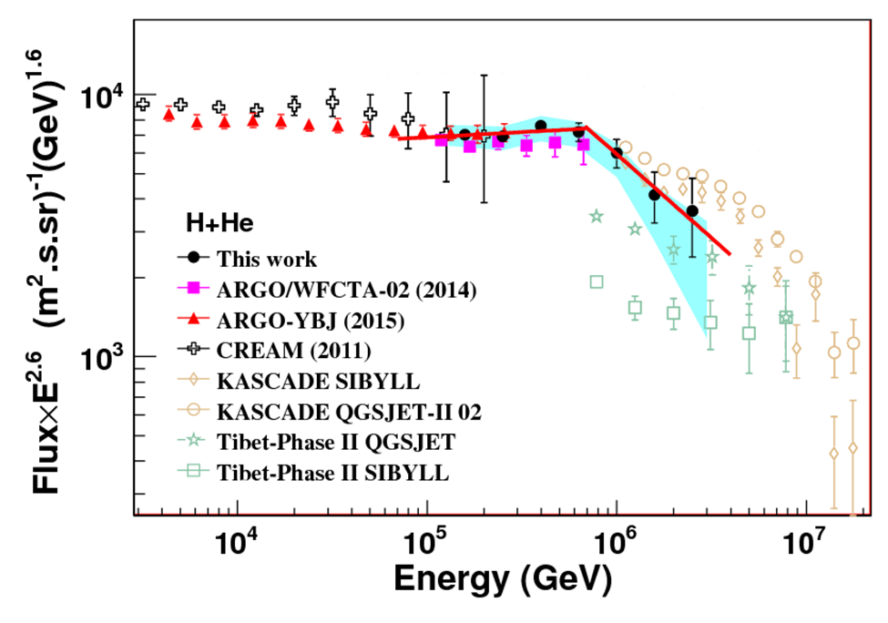
LHAASO science in cosmic ray measurement
  Measure individual cosmic ray spectra from 10TeV to EeV
  Multi-parameters, Multi-stages
0.1-10 PeV (Cherenkov mode)
  pure proton and light nuclei (P+He) spectra
  6 telescopes (30°in zenith) + ¼ WCDA
1- 100 PeV (Cherenkov mode)
  Pure iron or heavy nuclei spectra
  18 telescopes (45 °in zenith) + scintillator detectors + muon detectors array
>100 PeV (fluorescence mode)
  2nd knee
  20 telescopes + muon detectors array

Slide 5
LHAASO science in cosmic ray measurement
  Measure individual cosmic ray spectra from 10TeV to EeV
  Multi-parameters, Multi-stages
0.1-10 PeV (Cherenkov mode)
  pure proton and light nuclei (P+He) spectra
  6 telescopes (30°in zenith) + ¼ WCDA
1- 100 PeV (Cherenkov mode)
  Pure iron or heavy nuclei spectra
  18 telescopes (45 °in zenith) + scintillator detectors + muon detectors array
>100 PeV (fluorescence mode)
  2nd knee
  20 telescopes + muon detectors array

Slide 6
LHAASO science in cosmic ray measurement
  Measure individual cosmic ray spectra from 10TeV to EeV
  Multi-parameters, Multi-stages
0.1-10 PeV (Cherenkov mode)
  pure proton and light nuclei (P+He) spectra
  6 telescopes (30°in zenith) + ¼ WCDA
1- 100 PeV (Cherenkov mode)
  Pure iron or heavy nuclei spectra
  18 telescopes (45 °in zenith) + scintillator detectors + muon detectors array
>100 PeV (fluorescence mode)
  2nd knee
  20 telescopes + muon detectors array

Slide 7
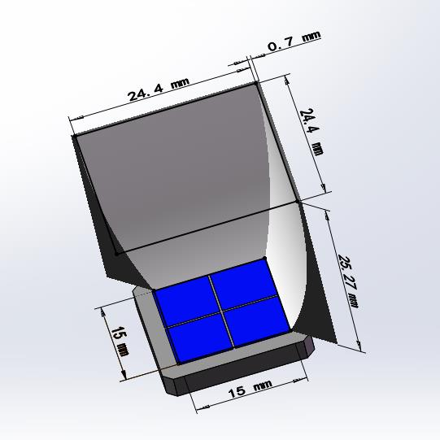
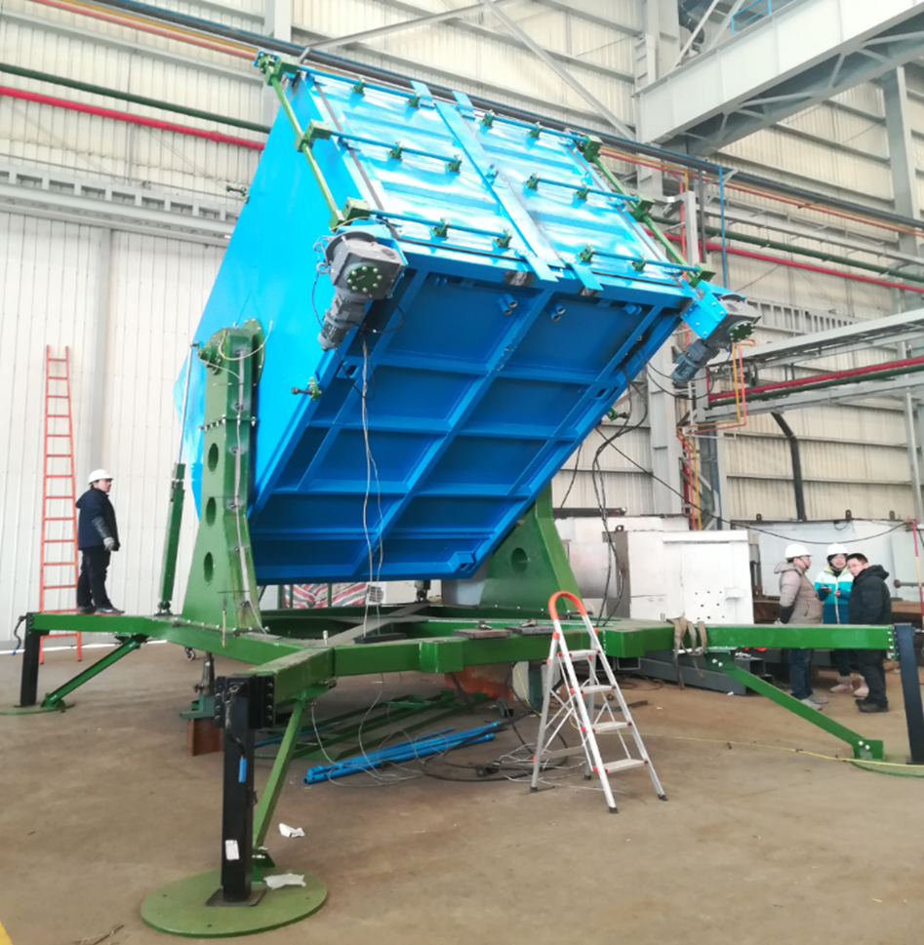
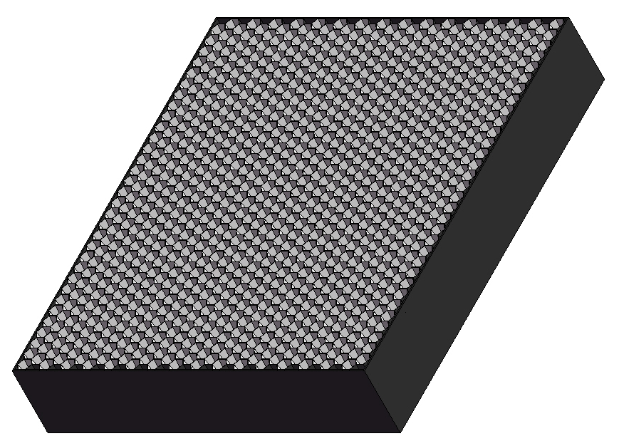
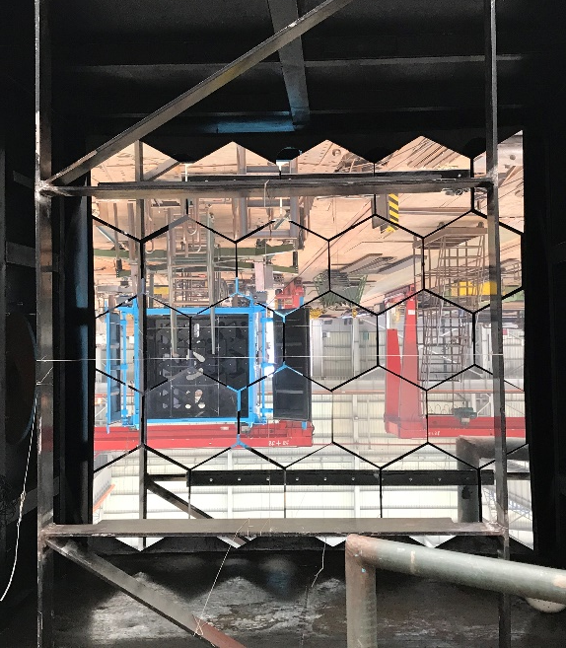
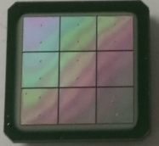
Wide Field of View Cherenkov Telescope (WFCTA)
5m² spherical mirror
32×32 SiPMs array
Pixel size 0.5°
FOV: 16°× 16°
Portable design: easy to switch the array configurations
Duty cycle：>30%.
WFCTA:
18 Cherenkov telescopes (1024 pixels/telescope)
SiPM camera
A prototype of WFCTA

Slide 8
合作任务与单位
合作任务
合作单位
可移动可调节镜筒
高能所
慢控制和监测系统
空间中心
SiPM成像探头
云南大学
  日内瓦大学
高能所
反射式球面光学
高能所
望远镜标定及大气监测
西南交大，高能所
读出电子学系统
四川大学

Slide 9
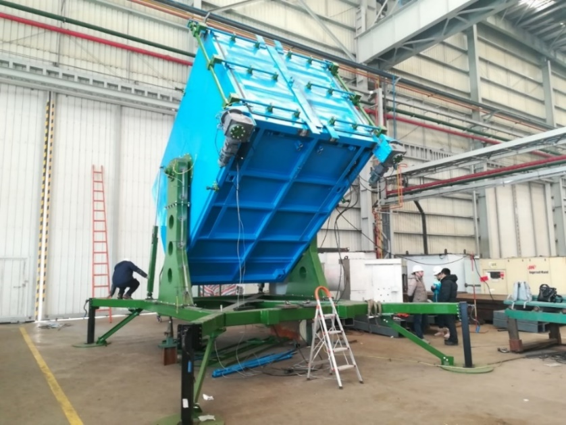
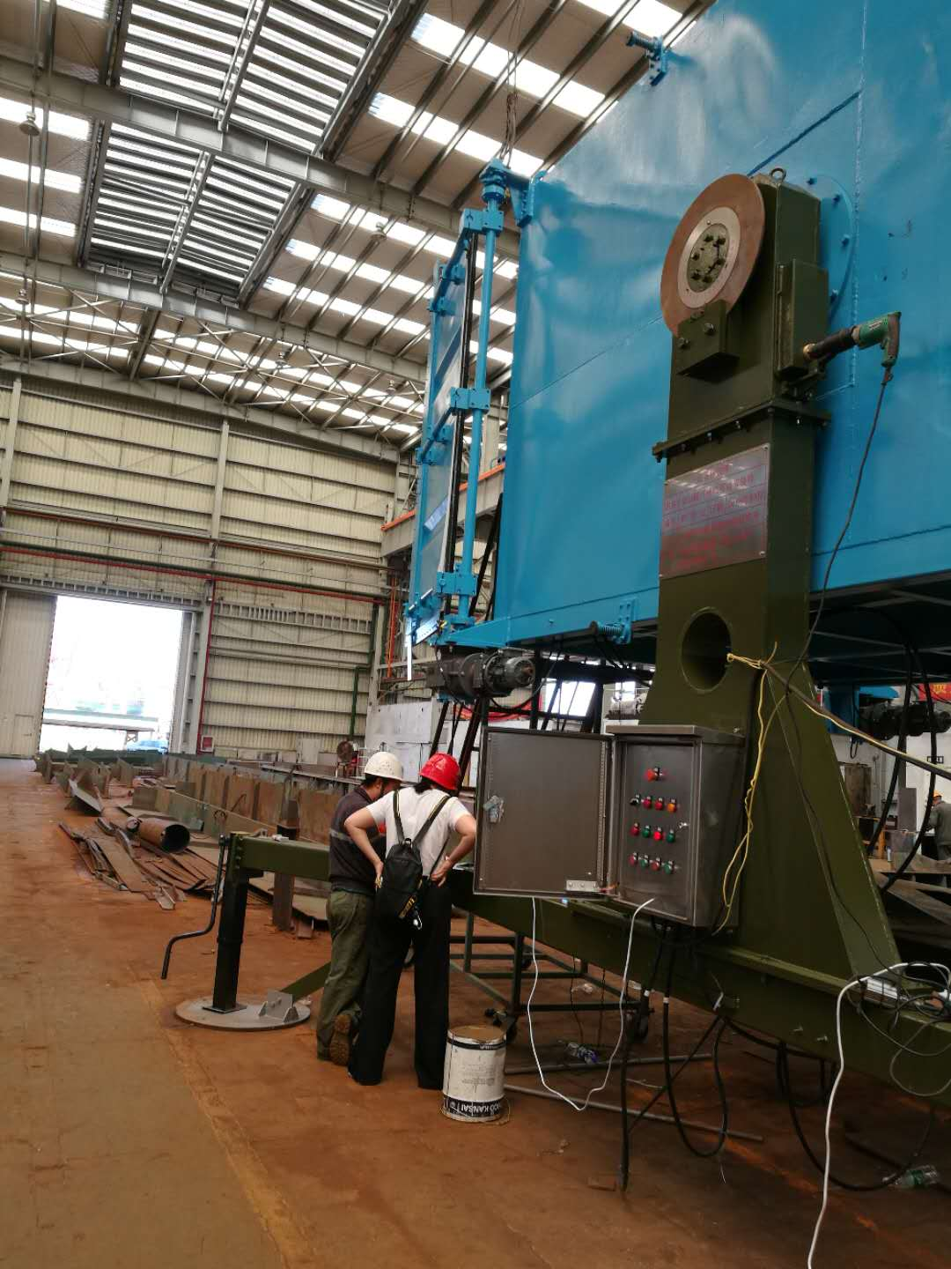
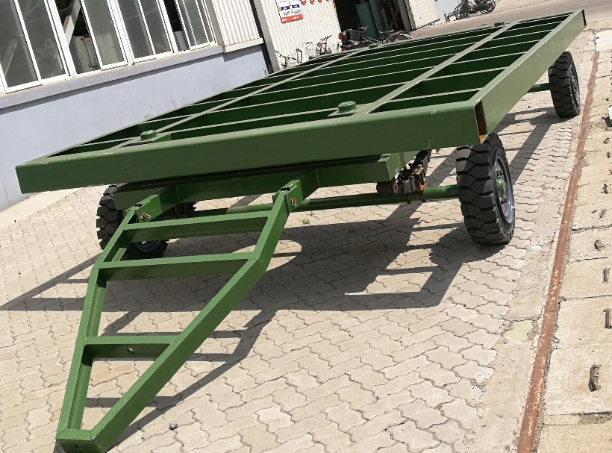
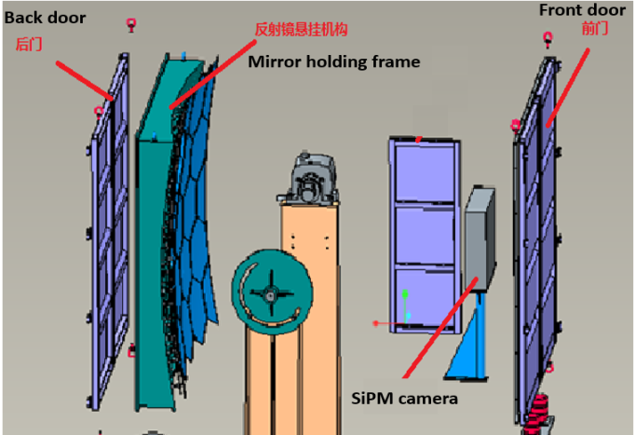
可移动可调节镜筒进展
  由望远镜镜筒、可移动底盘、俯仰轴系和球面反射镜悬挂桁架组成；
  采用可移动设计，仰角0°- 90°可调，实现望远镜阵列重新布局，实现不同能区观测需求。
  已完成6台生产和测试，这个月底上稻城组装
主要指标
可移动可调节镜筒样机
镜筒内部结构示意图

Slide 10
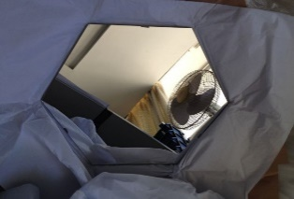
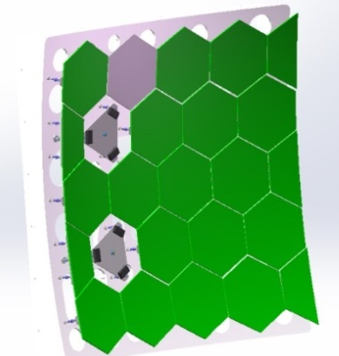
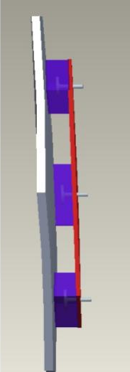
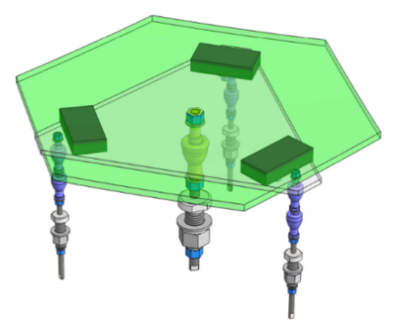
反射式球面光学系统进展
主要参数
  面积：~5m²/台；
  每台由20面六边形球面镜和5面半镜组成；
  曲率半镜：5800±10mm
  反射率：>85%@400nm
已完成6台镜子生产和测试，这个月底上稻城组装
单面反射镜
拼接完整的反射镜
反射镜安装固定示意图
反射镜安装拼接图

Slide 11
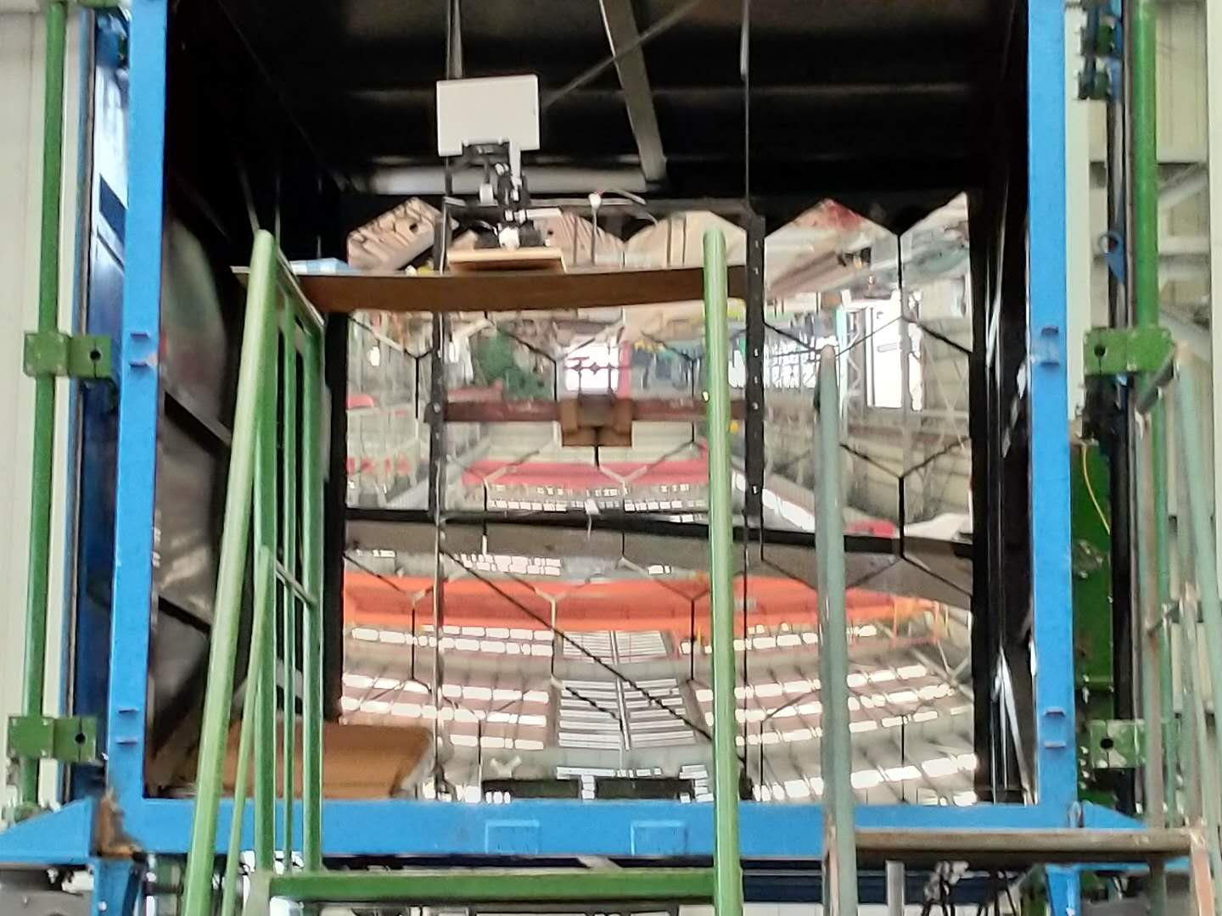
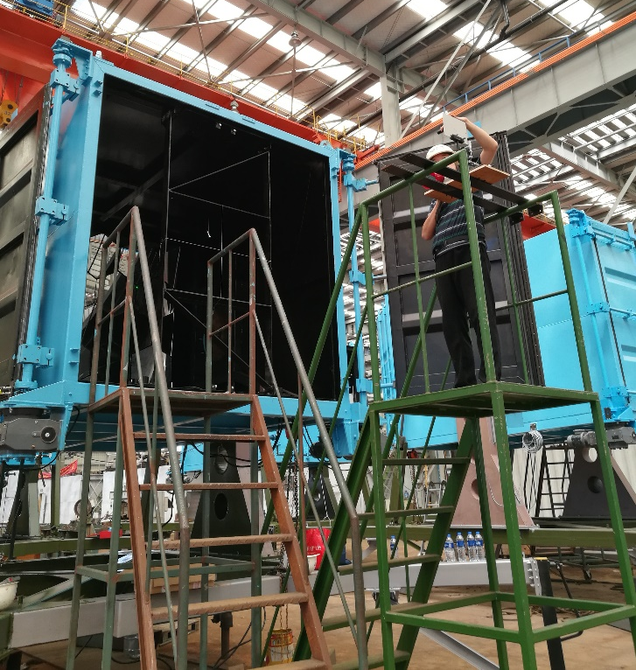
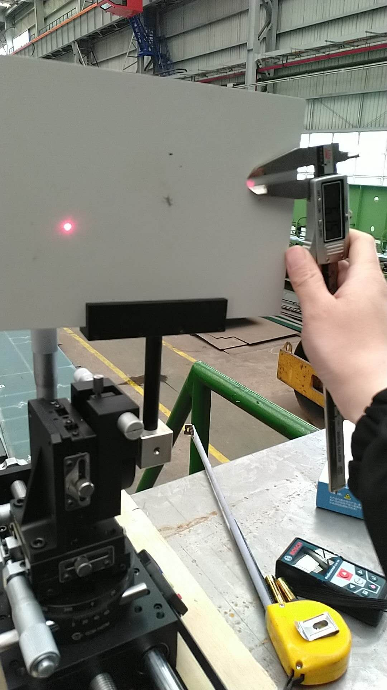
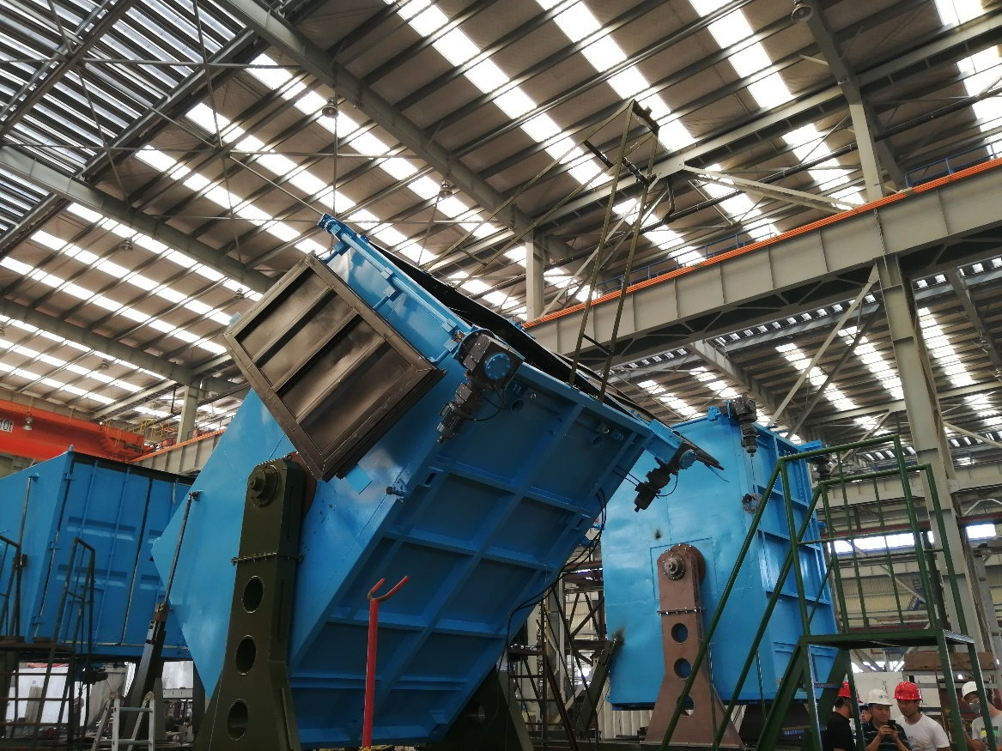

Slide 12
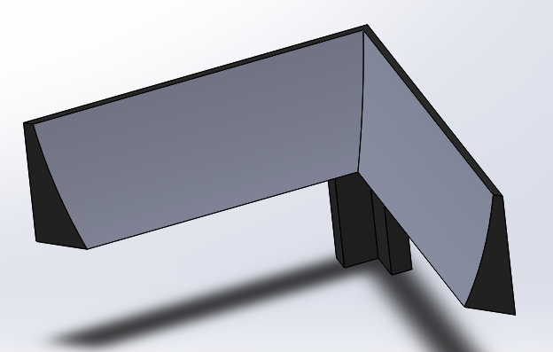
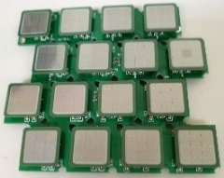
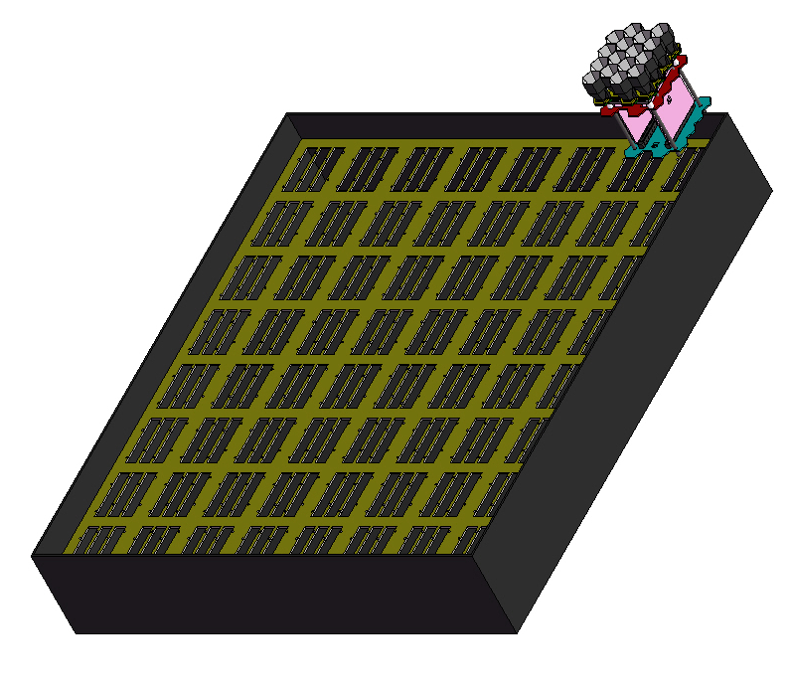
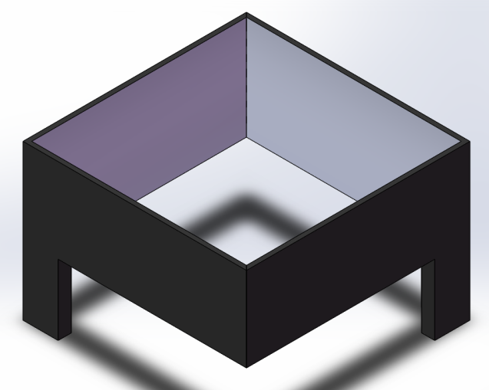
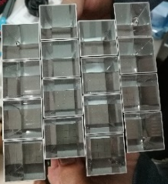
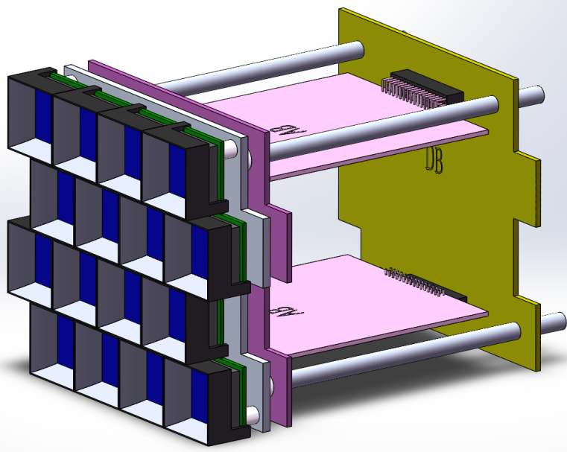
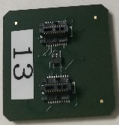
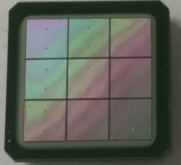
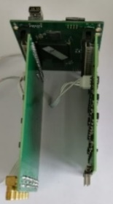
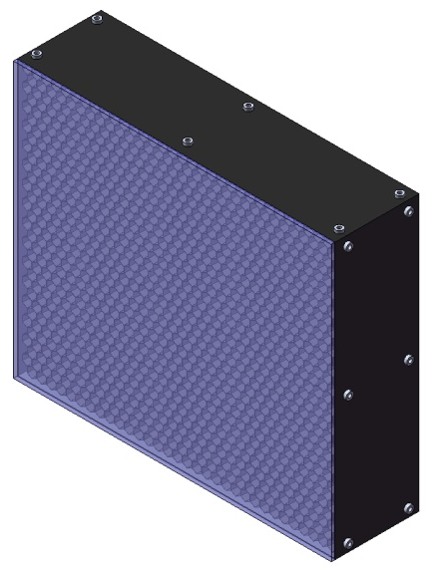
Schematic diagram of SiPM camera assembly
64 ×
AB2
A module has 4×4 SiPMs.
SiPM camera box
AB1
Cluster
DB
SiPM camera：32×32 SiPMs
Optical filter
在云大超净室组装（葛茂茂报告）

Slide 13
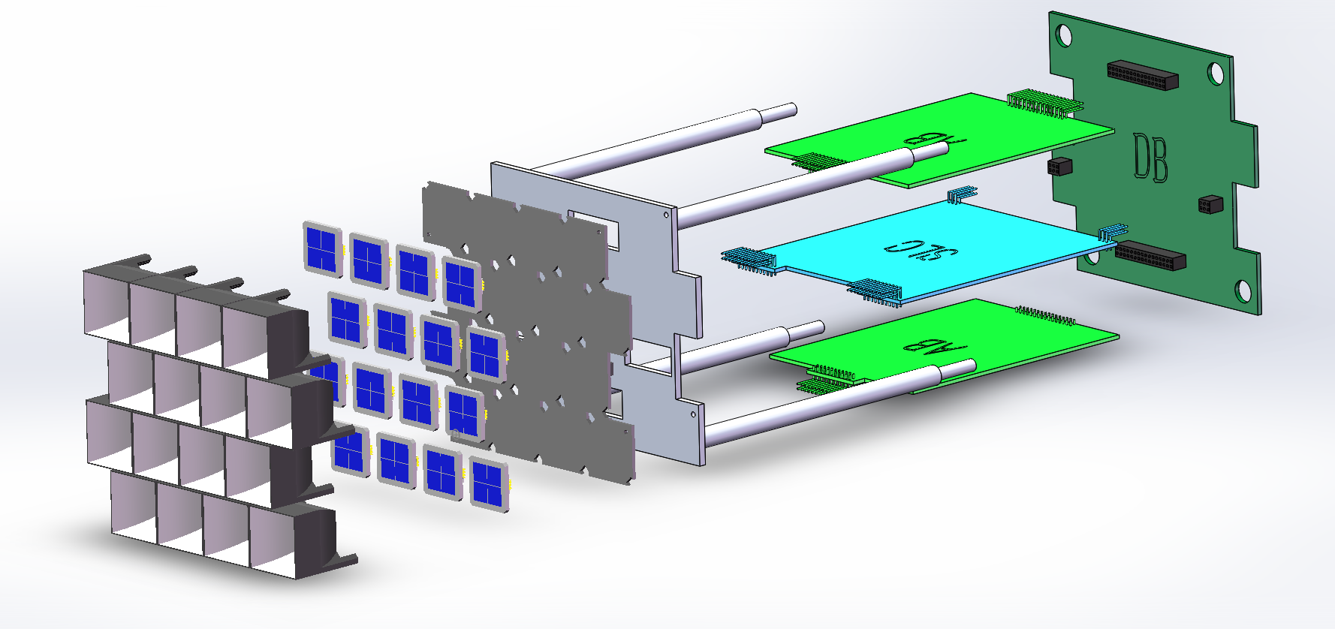
  Square SiPM：15 mm×15 mm
Digital Board
Metal frame
Analog Board
SiPM board
Winston cone
Slow control
board
Light concentrator (Winston cone): is to increase the effective area of the SiPM
SiPM board: 16 SiPMs, 16 temperature sensors (embedded in the SiPM chip ), and 16 pre-amplifiers
Slow control board:
  16 temperature and high voltage compensation loops;
  16 channels of high voltage power supply.
Analogue board: 16 channels of amplifier and shaping circuit
Digital board: 50 MHz FADC and FPGA

Slide 14
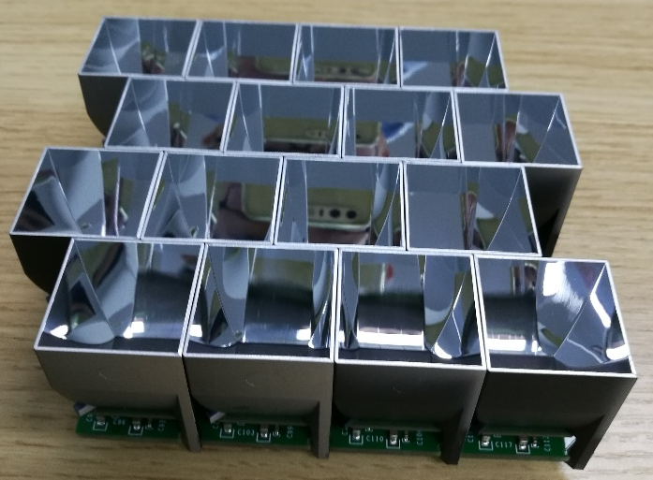
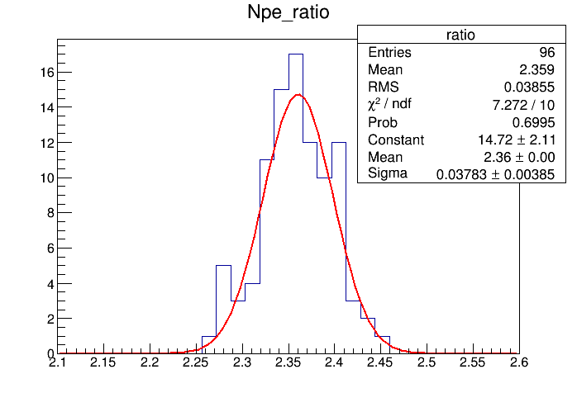

  Square SiPM：15 mm×15mm
Pixel size: 25.4 mm × 25.4 mm
SiPM size: 15 mm × 15 mm
Light concentrator (cone)：
Outlet: 15 mm×15 mm
Inlet: 25.4mm×25.4mm
Height: 25.3mm
light concentrators (cone)
The number of photons increased by ~2.3 times
With cone/without cone

Slide 15
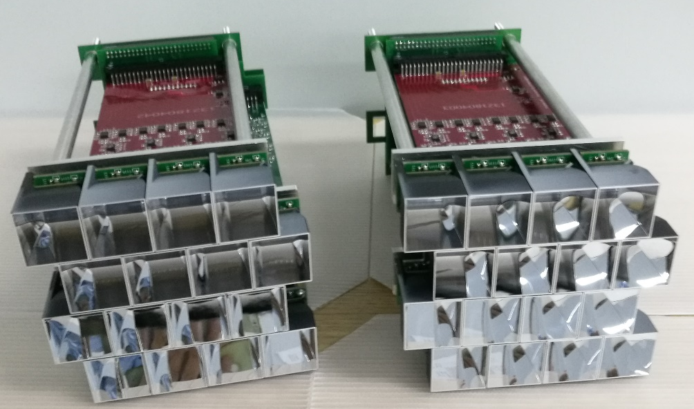
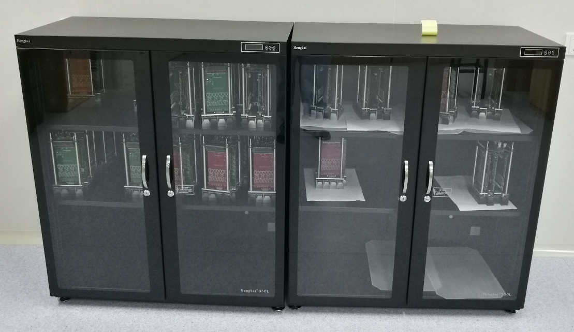
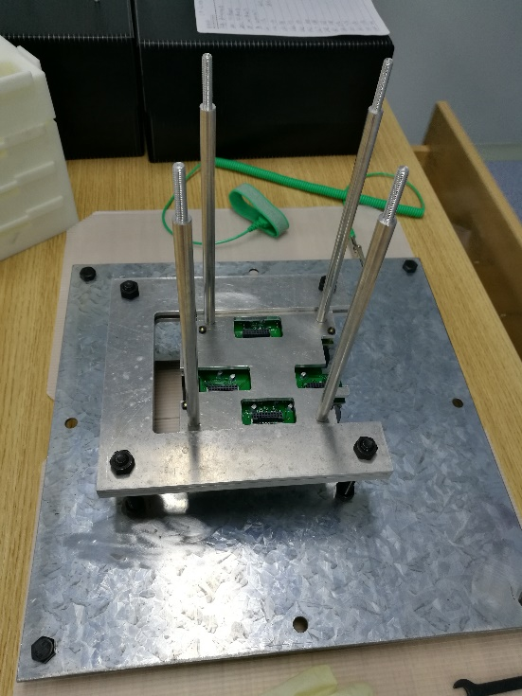
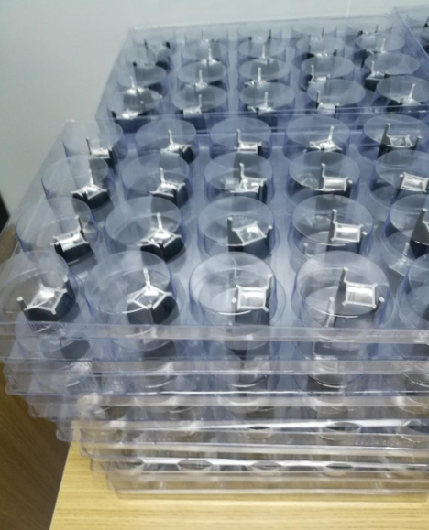
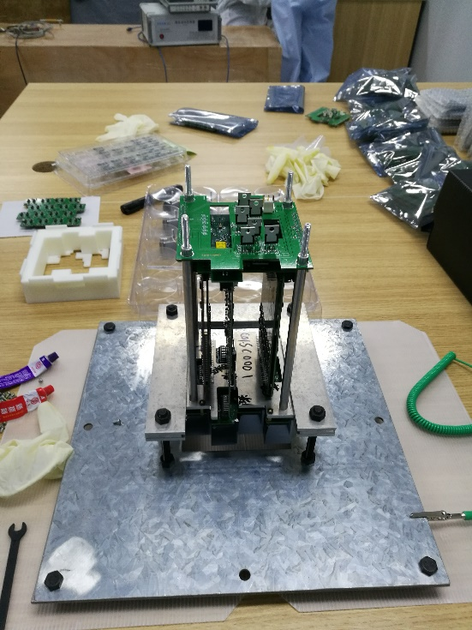
64 sub-clusters have been assembled in the clean room

Slide 16
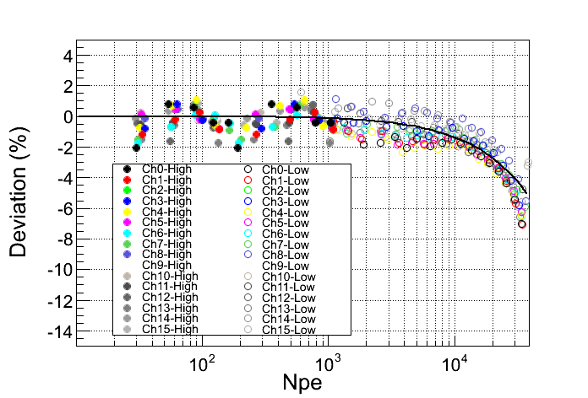
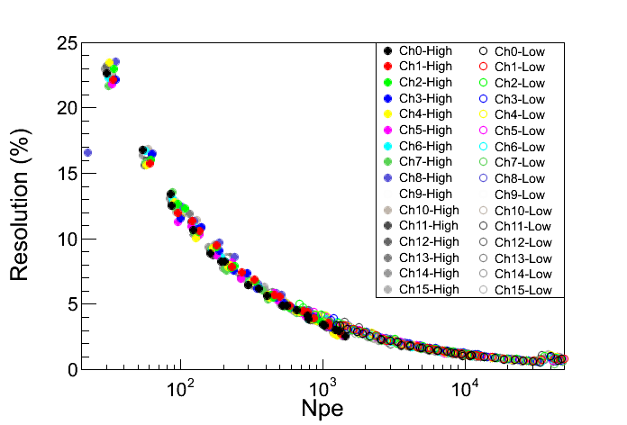
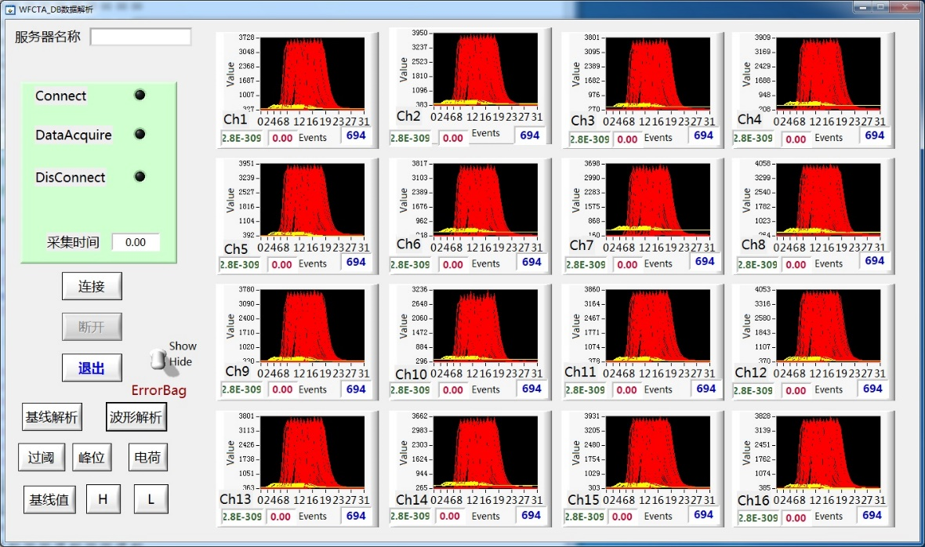
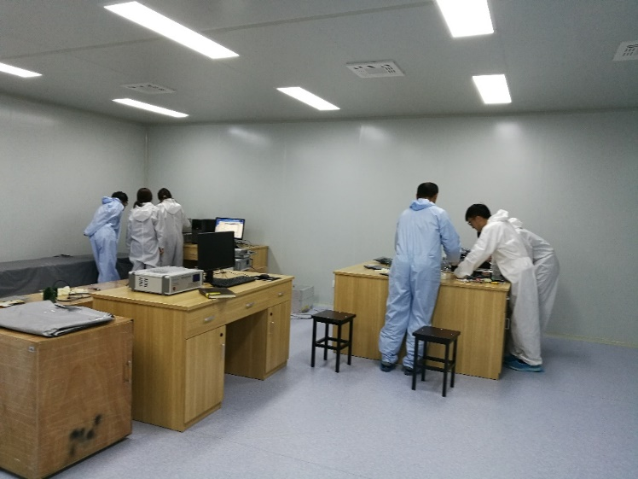
Dynamic range
resolution
64 sub-clusters have passed the test.

Slide 17
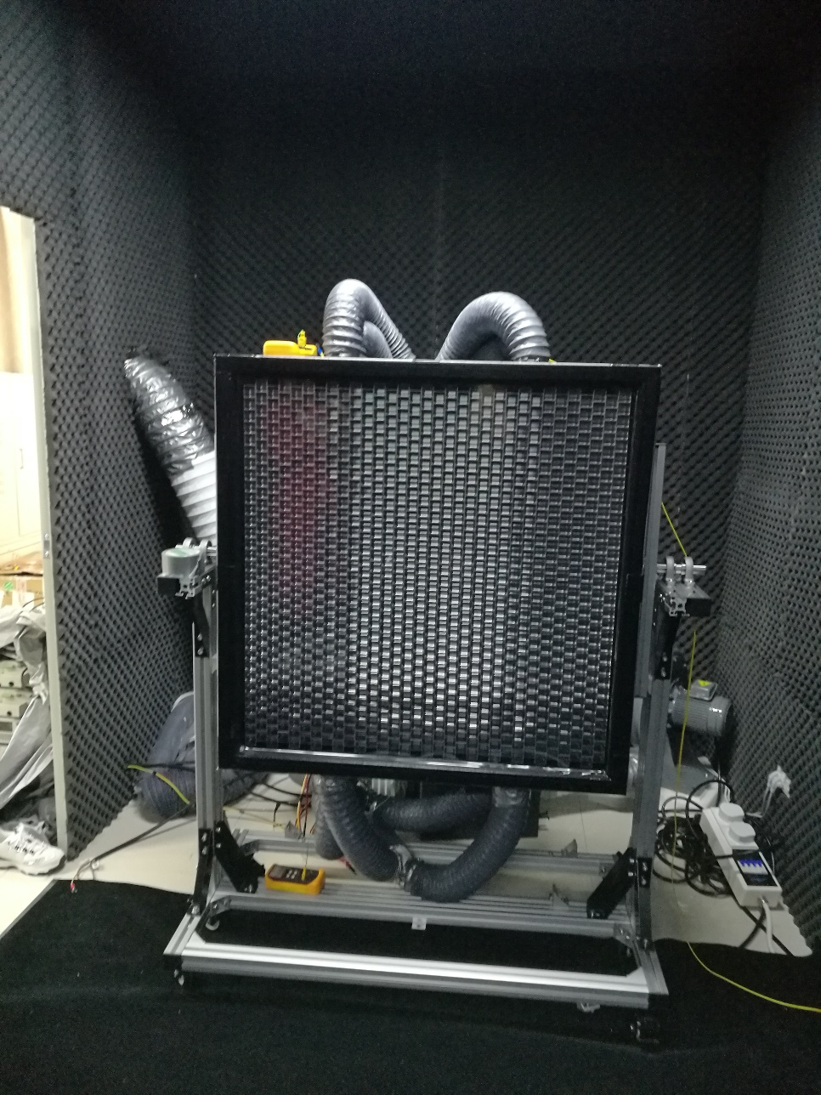
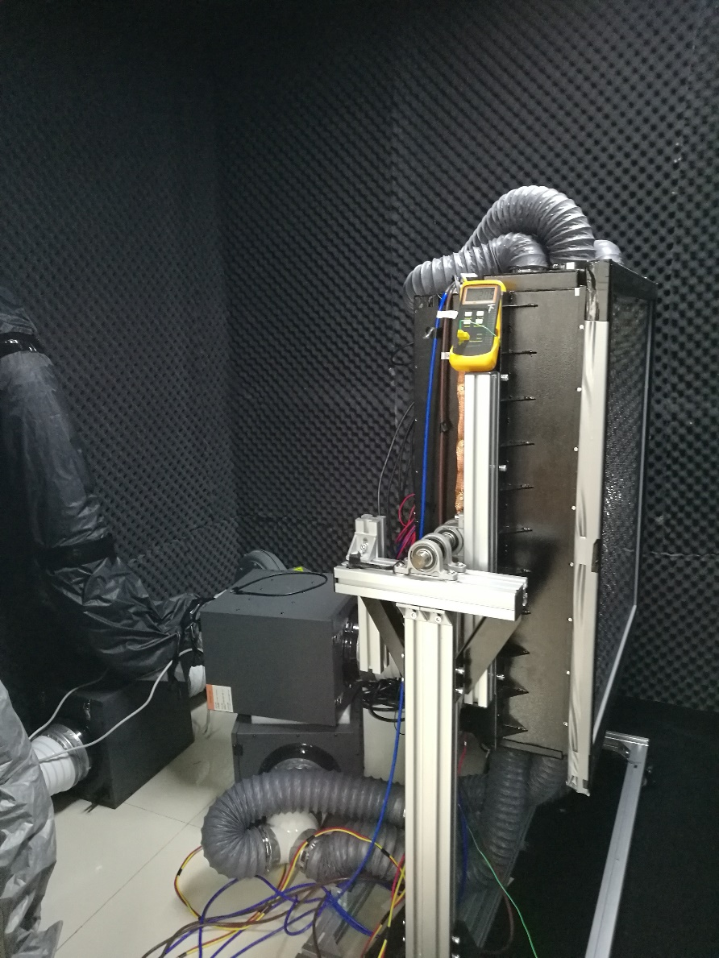

Slide 18


<40℃

Slide 19


Slide 20


Slide 21


Slide 22


Slide 23


Filter window：AR + cutoff
To improve signal to noise ratio
Filter
Moon less night
550 nm
Sky background light spectrum
in the moon less night
Moon night
NSB(without filter)/NSB（with filter）
λ （nm）

Slide 24




NSB/NSB₀
Full moon night
Threshold of the telescope：
~15 TeV @ moonless night，
~100 TeV @ full moon night
Proton
Helium
CNO
MgSiAl
Iron

Slide 25


激光定标和大气监测系统 （谢宁报告）
工艺性能
主要指标
工艺性能
  主要由N2激光器/YAG固体激光器、激光控制器、能量探头、功率计、水冷却系统、升降台，三维转台等部分构成；绝对刻度望远镜能量和监测站点大气质量。
项目 | 技术指标
N2激光器 | 波长337nm，能量≥170μJ
YAG激光器 | 波长355nm，能量≥2mJ
三维旋转台 | 方位角范围：0-360° 仰角范围：0-90°角位台范围：±45° 最小转动角度：＜0.02°重复精度：<0.05°
工程进度
已完成第一台激光升降台制作；2019年7月完成激光定标和大气监测系统安装和调试。
N2/YAG激光器及激光转台
激光升降台

Slide 26
总结
已完成6台可移动可调节镜筒和球面反射镜的生产和测试
  测试结果：性能满足要求
  镜筒正在做防腐喷漆，拆装运输
  预计月底运输到稻城组装
已完成第一台SiPM成像探头制作
  已在实验运行3天，硬件工作正常
  FPGA程序有一些bug，正在调试
  预计10月20号左右运输至稻城测试
6台望远镜制作和运行计划
  预计11月份第一台望远镜开始在稻城运行
  2019年6月份共6台望远镜在稻城运行

Slide 27
Thank you for your attention!

Slide 29

SiPM成像探头增益监测
UV-LEDs 安装在镜子中心，监测SiPM成像探头的效应
  SiPM成像探头增益的温度效应
  背景光对SiPM增益的影响
  监测电子学高低增益的比值
UV-LEDs 基本信息
  6个LED灯珠，每个光强~3000 photons/SiPM （~1000pe/SiPM）
  脉冲宽度<20 ns， 频率 1 Hz
  监测统计误差: ~0.6% /分钟 @ 无月,
  ~0.8%/分钟@100倍背景光
LED
安装
位置
v_{cc}
R0
C1
Mirror
R3
恒温系统：
±3℃
SiPM
R2
-
+
UV light 400 nm
R1
UV LED
OPA 846
SiPM camera
The supply voltage of the SiPM is equal to Vcc-V_{R0} .
LED温度效应：0.2%/℃

Slide 30
Trigger algorithm
One of Cherenkov event
First level trigger：single channel trigger
Signal to noise ratio: S/N>n
Threshold varies with the intensity of the sky background light.
Second level trigger： pattern recognition
Fluorescence event
Site3
Site2
Round-shaped
pattern
Line-shaped pattern
Energy threshold of the telescope: ~30 TeV @ moonless night, ~300 TeV @ half moon night.
Site1

Slide 31

North
Moon trajectory
East
West
South
Cherenkov telescope array: 16 telescopes are aimed from north-east to north-west.

Slide 32
16 ×
Data
DB
Trigger & Data Buffer & Communication Board
4 × 4 SiPMs & Preamplifiers
Low
gain
50M 14 bit FADC
FPGA
Single trigger
Synchronizing
High
gain
50M 14 bit FADC
Event trigger
Temperature
High
voltage
AB
Slow Control Board
BDB
64 ×
The architecture
of SiPM camera
readout electronics
TCP/IP
Low voltage power supply
Switch
TCP/IP
The SiPM gain (break down voltage) is sensitive to the temperature.
Slow Control Board: temperature & high voltage compensation loop.
Service

