Slide 1
Geminga周围宇宙线慢扩散和伽马射线辐射
毕效军 （高能所）
2018/10/9
西藏-林芝
2018年第二次LHAASO合作组会议

Slide 2
TeV gamma-ray halo of Geminga
A.U. Abeysekara et al. HAWC collaboration, Science 2017
The diffusion coefficient is hundreds times slower than that at the ISM derived by B/C !
The pulsar contribution of e+ to AMS-02 data is negligible?

Slide 3
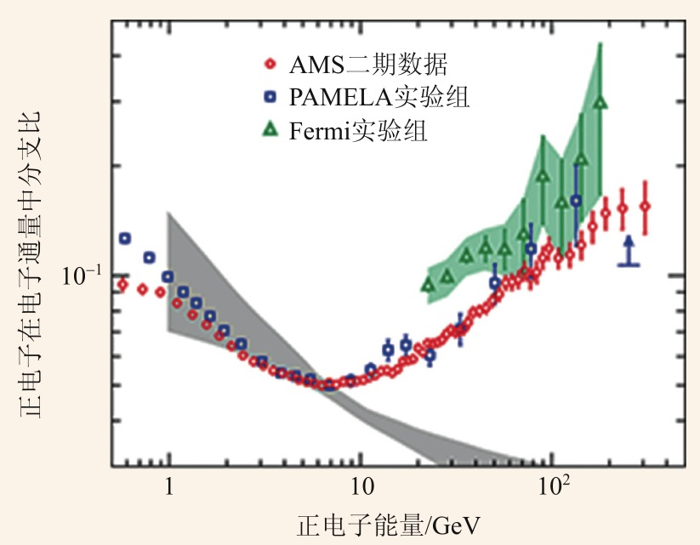
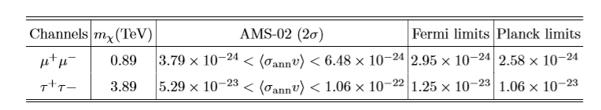
Positron excess and extra e+ sources
Positron excess is confirmed by different experiments.
Extra positron sources:
Astrophysical sources - pulsars
Dark matter
Excluded!?
Q. Xiang, X. Bi, S. Lin, P. Yin 2017
DM needs very large annihilation cross, but severely constrained by Fermi and Planck observations.

Slide 4
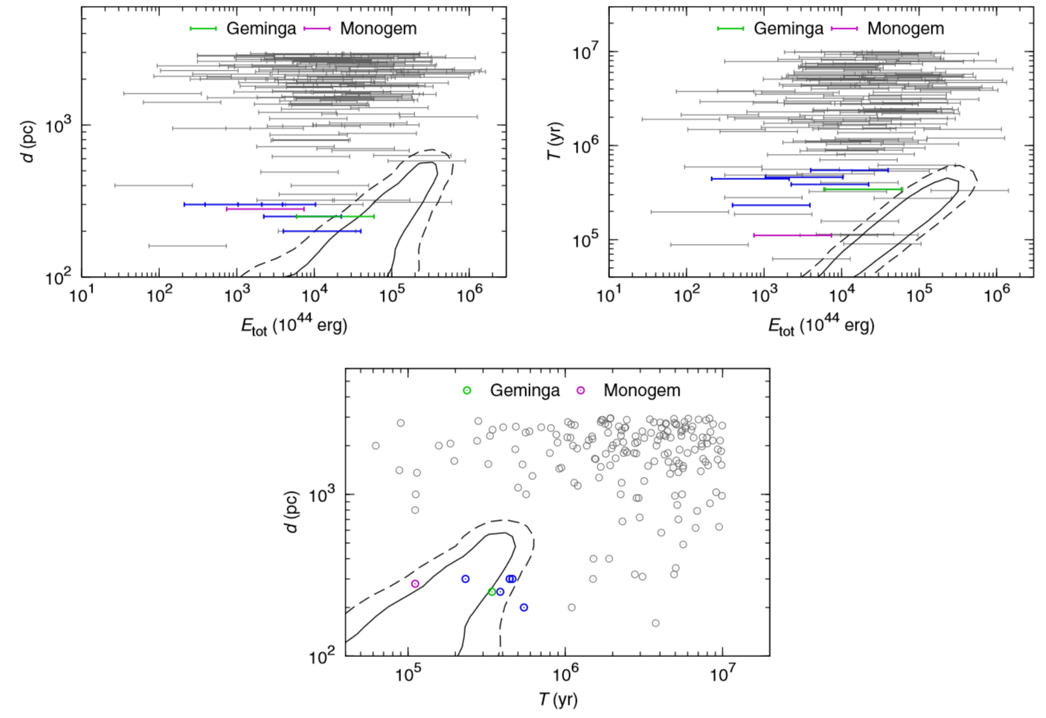
Can positrons come from nearby pulsars?
Yin, Yu, Yuan, Bi, PRD2013

Slide 5
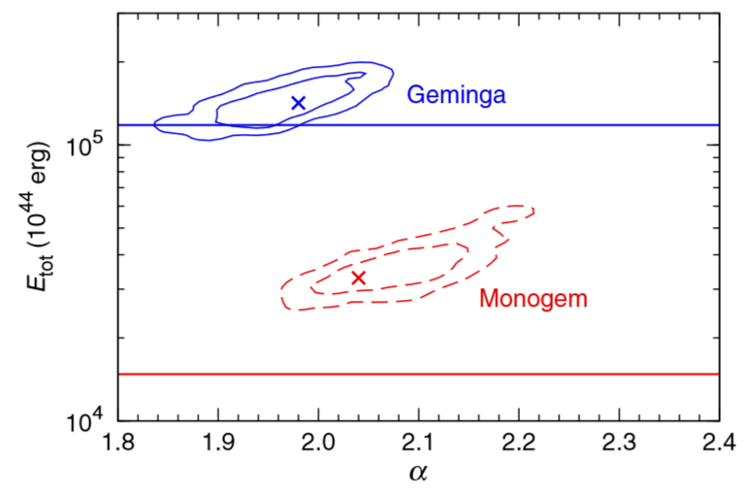
Geminga and Monogem are most possible candidates
Considering all possible uncertainties, pulsars can explain the positron excess marginally assuming 100% spin-down energy converted to e+-.
But, the HAWC result seems to indicate the pulsar scenario is excluded either, so that no proper extra positron sources available to account for positron excess!

Slide 6
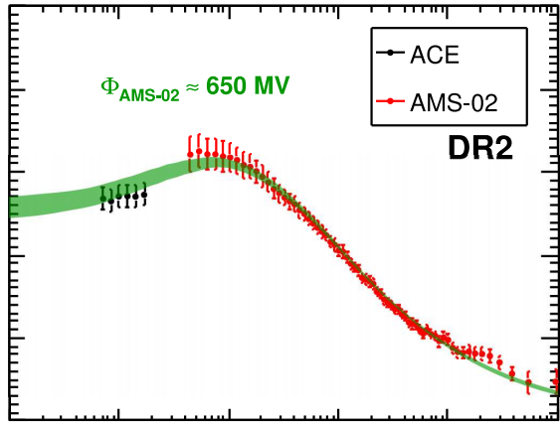
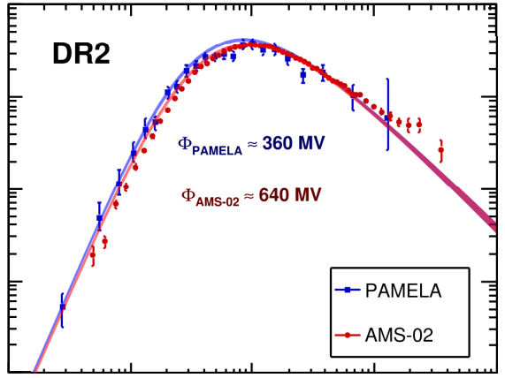
Diffusion in ISM must be large!
Contradiction#1
B/C anti-proton diffuse gamma-ray
Trotta et al. 2011
Contradiction#2
Yuan et al. 2017
H.E.S.S has observed 20 TeV e-/e+ -> no source exist within few pc
The H.E.S.S Collaboration 2017

Slide 7
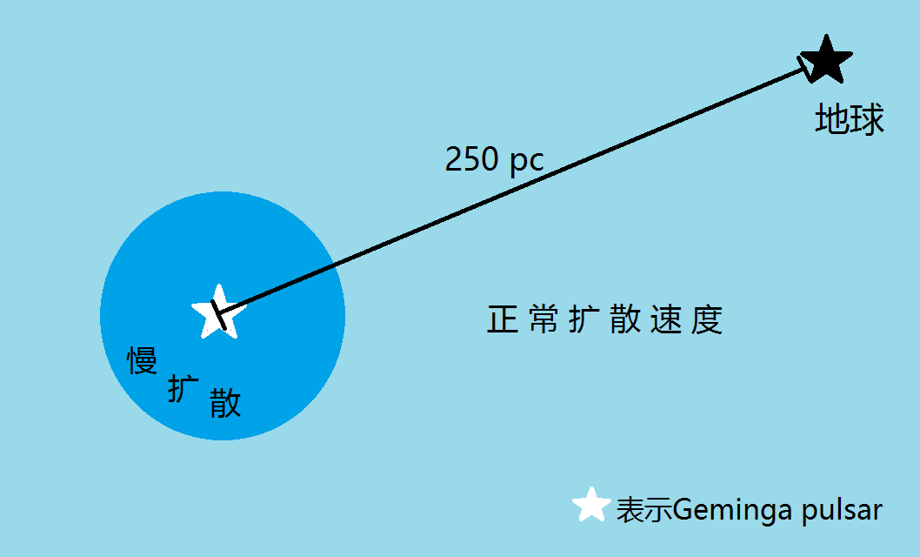
Two-zone diffusion for Geminga
r*
The slow diffusion region is near the source; while the diffusion is still fast in most interstellar space.

Slide 8
Two-zone diffusion for Geminga
Propagation equation:
Diffusion coefficient:
D1 is derived by HAWC, D2 is the normal value
Numerical solution is required!
Operator splitting:
The finite volume method is adopted for the diffusion operator
GALPROP and DRAGON only apply to cases of smooth varying of D
We may expect the scenario be between the normal case and HAWC case

Slide 9
Unexpected result of positron flux!
Spatial distribution of e-/e+
Spectrum at the earth
Earth
K. Fang, X. Bi, P. Yin, Q. Yuan 2018
Black line: fast diffusion with normal speed
Red line: slow diffusion given by HAWC
Other lines: two-zone diffusion with r*=40 pc, 70 pc, 100 pc

Slide 10
Geminga (considering the HAWC new observaton) solves the positron excess
Compare with AMS-02 e+
K. Fang, X. Bi, P. Yin, Q. Yuan 2018
The best-fit r_star is 50 pc
The conversion efficiency of Geminga is ~50-70%

Slide 11
What is mechanism to produce a slow diffusion?
MHD waves can be amplifed by CRs streaming instabiltiy due to the large cosmic ray density gradient – a widely discussed mechanism necessary for DSA ( see Ptuskin et al 2003)
Evoli et al. 2018 has given a careful calculation of D based on the mechanism

Slide 12
Self-generated turbulence
Evoli et al adopt a one-dimensional diffusion assuming the electrons transport within a 1pc tube flux
We have done a 3D calculation for the self-generated turbulence and the D
left：100 TeV diffusion coefficient at 100TeV near Geminga
right：growth and dissipation rate at different time

Slide 13
Self-generated waves
left：100 TeV diffusion coefficient at 100TeV near Geminga
right：growth and dissapiation rate at different time
So this mechanism does not work to generate such a small diffusion coefficient! (Similar to not work to accelerate CR up to the knee.) Actually the reason is simple as the high energy electron (~100TeV) energy density is too small to amplify the MHD waves. (reason to ISM)
We suspect if this is an environment effect?

Slide 14
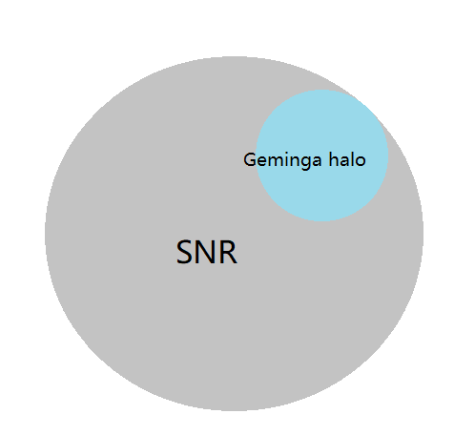
A possible mechanism
Just a guess: The slow diffusion may be an effect left by its prior SNR
The fast motion of the pulsar has been ignored.
Geminga has travelled ~70pc away from its origin positron.
According to a SNR evolution model SNR can expand to 90pc or large after 340 kyr evolution if ISM density is low, in such case the pulsar is still within the SNR as shown;
The medium in the downstream of the shock may have strong turbulence and have a very small diffusion coefficient

Slide 15
A possible mechanism
A very strong turbulence is generated after passing the shock wave; then we calculate its decay with time by dissipation
Different assumption of the initial condition:
Left：the turbulence is independent on the strength of shock waves
Right：f0 is proportional to the shock wave velocity;

Slide 16
讨论：
是否具有普遍性：Geminga，
  Monogem，within the Monogem ring
  Vela X, within the SNR and more extended than x-ray filament
  PSR B1957+20, x-ray ->tens of TeV e+-, gamma ray is expected if spin down energy is large, but no gamma ray detected as in ISM
地面大视场高能伽马探测器在更多扩散造成的扩展源，在不同能段测量伽马射线晕及其分布对了解慢扩散机制至关重要；是LHAASO独特的优势
源附近普遍存在慢扩散和银河系宇宙线的传播过程紧密相关；比如对各向异性、伽马射线能谱变化、宇宙线谱指数的变化等等都密切相关。

Slide 17
Summary
HAWC observation of the TeV gamma ray halos indicate a very slow diffusion around Geminga. Two zone diffusion model explains well the positron excess on the Earth.
Self-generated waves by CR e-+ is not enough to amplify the MHD waves to such slow diffusion.
We guess such slow diffusion is possibly related with the prior SNR, considering the fast motion of the pulsar and the TeV halo is generated quite late.

