Slide 1
LHAASO对宇宙线分成份能谱的测量预期
马玲玲 尹丽巧 张寿山等
高能所
第四次LHAASO合作组会议 • 西藏林芝

Slide 2
主要内容
测量宇宙线能谱的现状及所面临的困难
LHAASO分阶段、多参数测量宇宙线能谱
各阶段LHAASO测量宇宙线能谱的能力
总结和展望

Slide 3
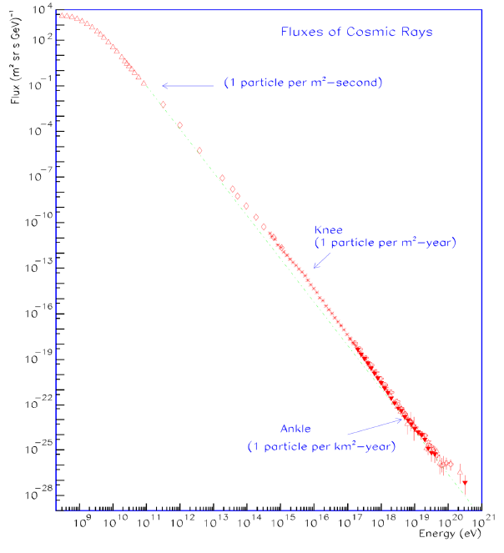
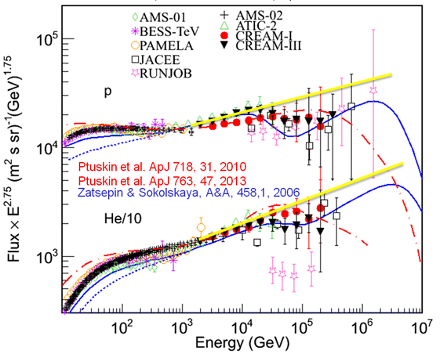
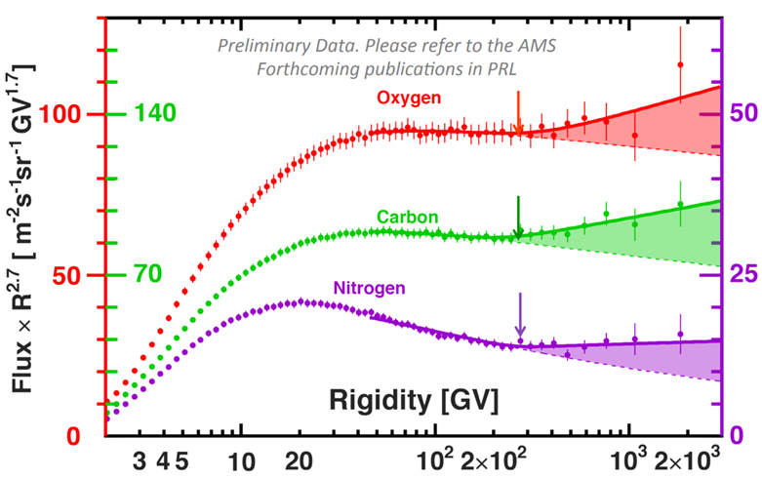
测量宇宙线能谱的现状及困难
空间直接测量
地面间接测量
1：在200GV处测到了各成份能谱变硬
2：在10TeV处测到了小的拐折
3：将能谱测量至100TeV

Slide 4
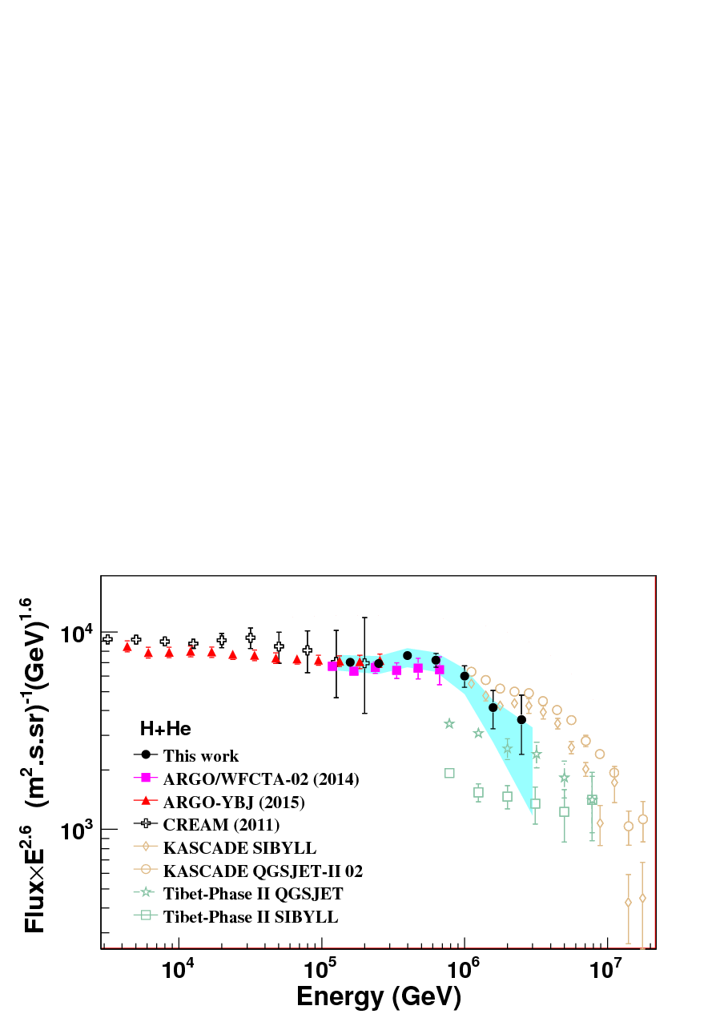
通过大气簇射间接测量
  EAS 阵列
  契伦科夫望远镜/阵列
  荧光望远镜
H+He能谱的测量
  ARGO-YBJ：
    3TeV-300TeV
  ARGO-YBJ+C-telescopes
    100TeV-3PeV
能量标定不确定
成份测量困难
模型依赖
LHAASO能做什么？

Slide 5
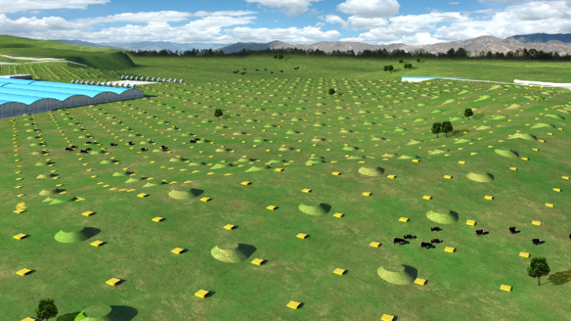
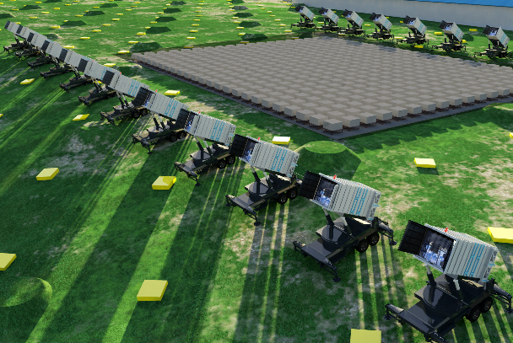
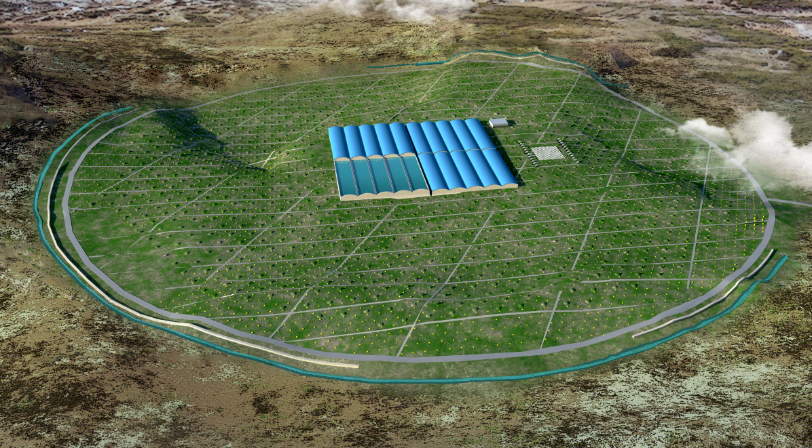
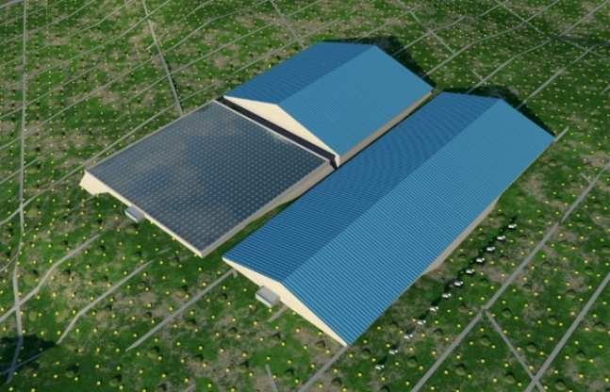
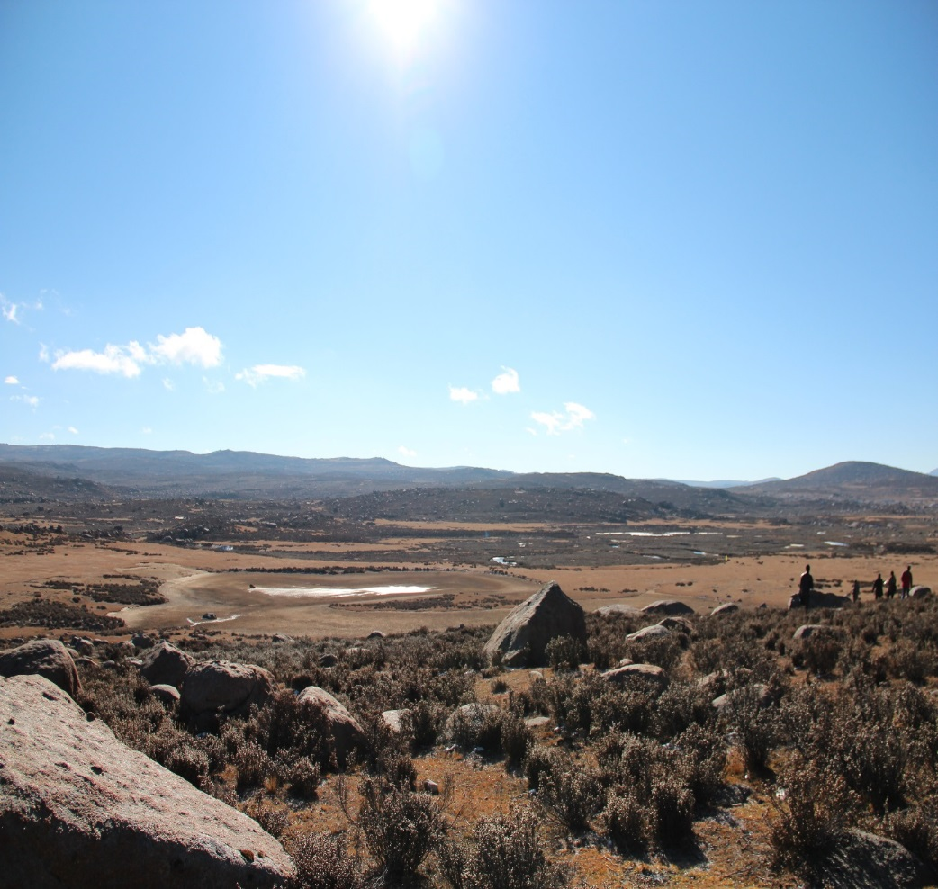
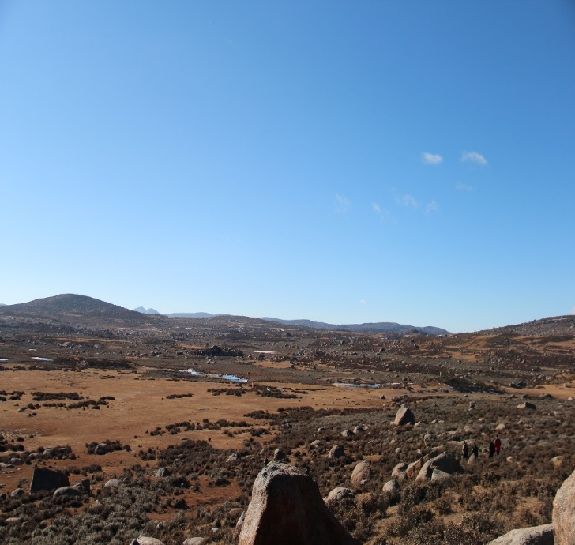
Large High Altitude Air Shower Observatory
KM2A:
5195 EDs: 1 m² each, 15m spacing
1171 MDs: 1146 MDs, 36 m² each, 30m spacing
WFCTA:
18 Cherenkov telescopes (1024 pixels/telescope)
WCDA:
3200 cells (25m²/cell)
四川稻城
(29º21’ 31” N, 100º08’15” E, 4410 m a.s.l., 600 g/cm)
WCDA++
1.

Slide 6
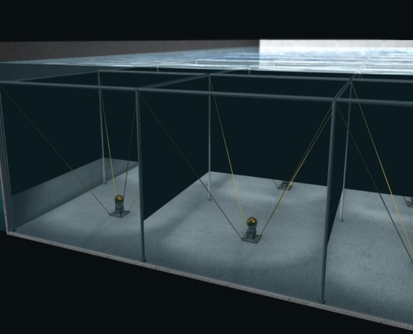
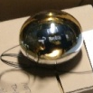
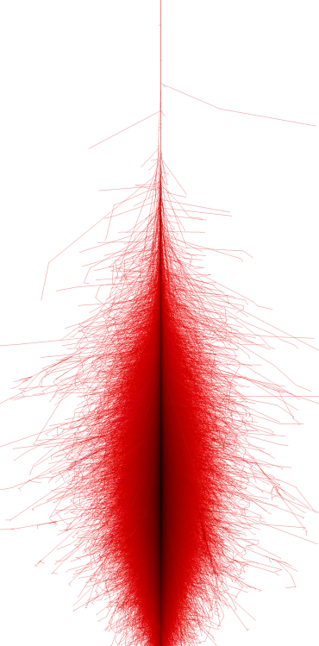
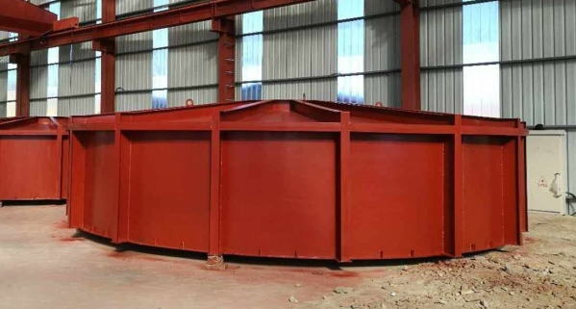
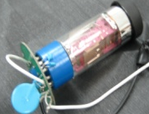
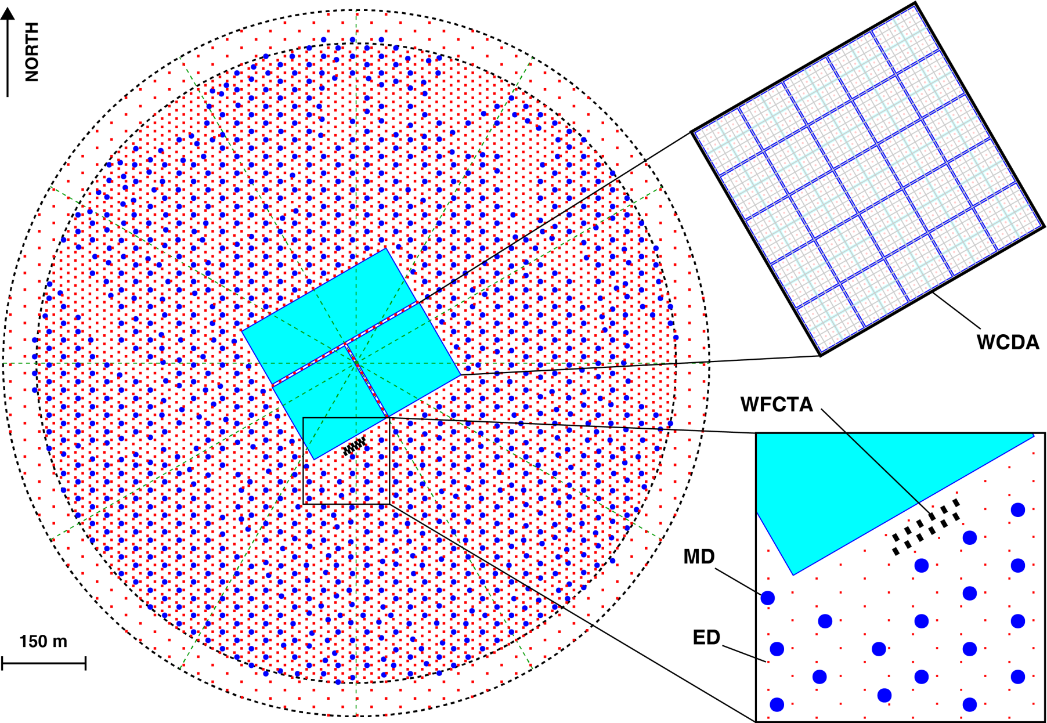
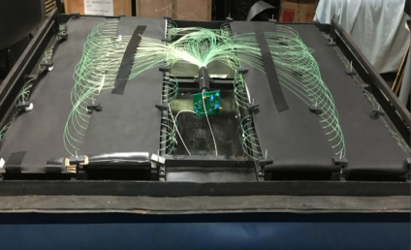
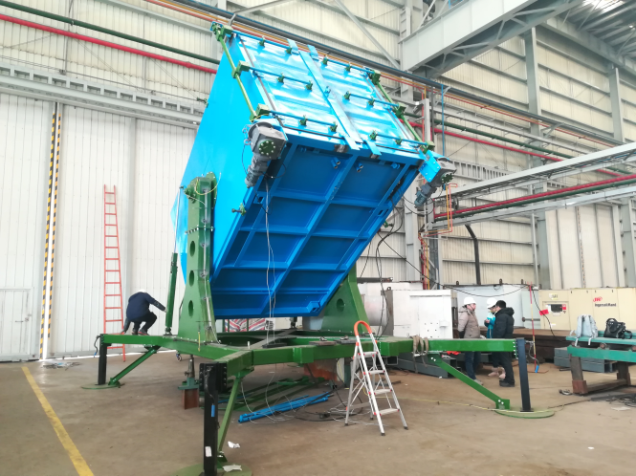
多探测器联合观测
8 in
1 in
>10TeV
5m
7m
1m

Slide 7

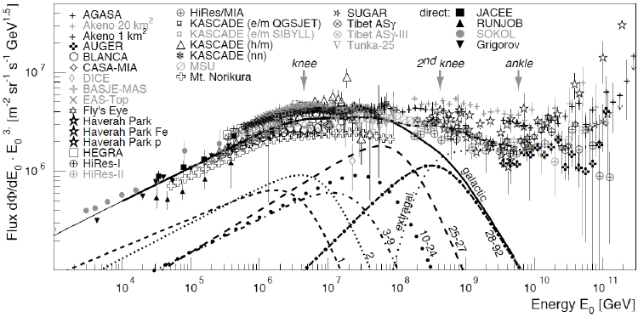

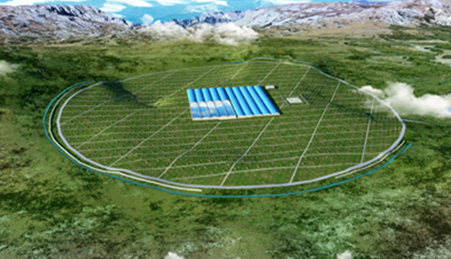
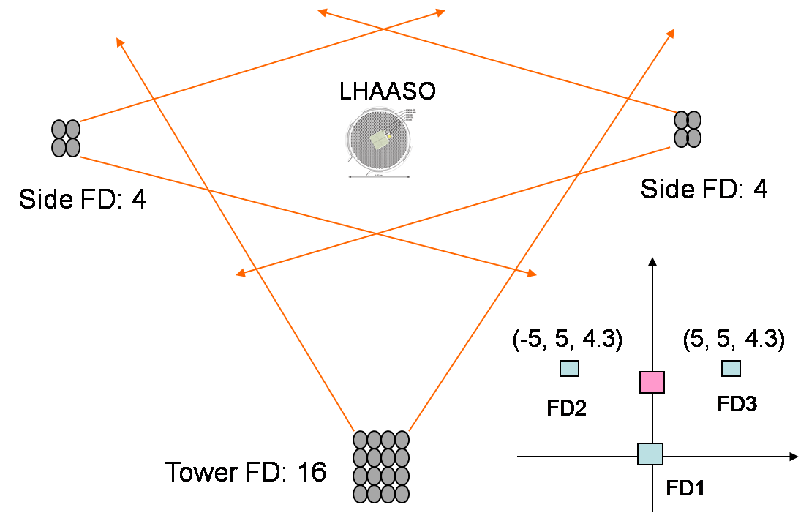
LHAASO的宇宙线能谱测量
测量10TeV to至EeV的分成分能谱
  多阶段，多参数
10TeV-100TeV：获取能标；
100TeV-10PeV： H，He knees
  3. 10PeV-100PeV: knee for iron
4. >100PeV: second knee

Slide 8
Prospects of proton, proton and helium from 100TeV to 10PeV

Slide 9
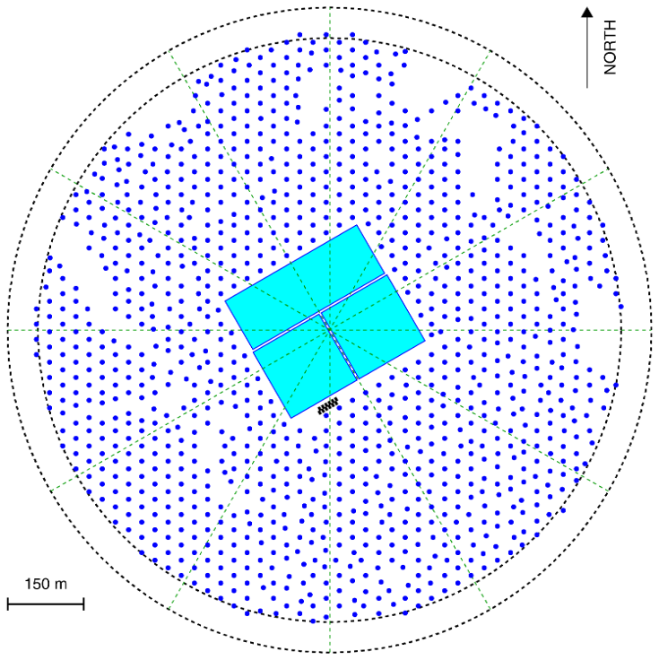
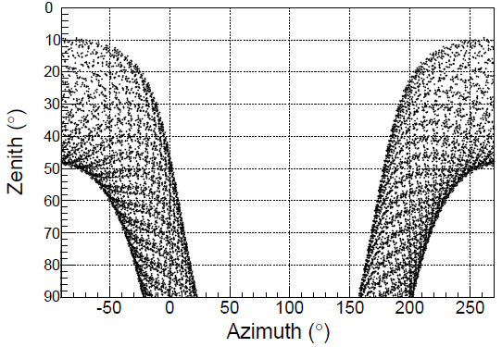
  LHAASO四分之一阵列
  6 WFCT telescopes
  WCDA++, namely the pound with higher dynamic range.
  300 muon detectors
6 Tel. FoV
¼ LHAASO
Elevation of 60 toward North
with full-moon duty cycle >30% above 100 TeV

Slide 10
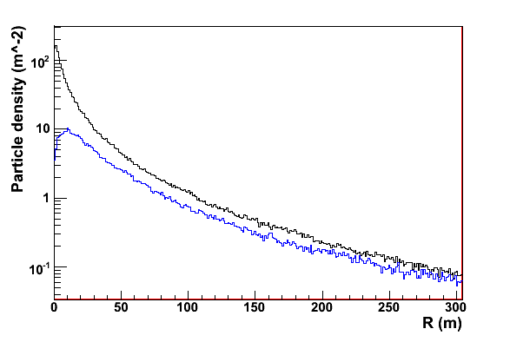
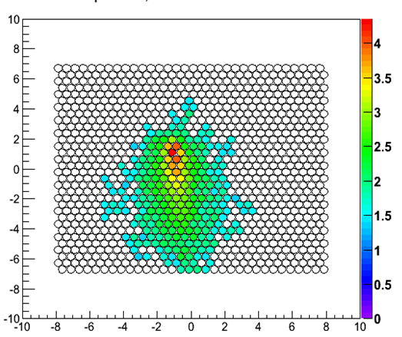
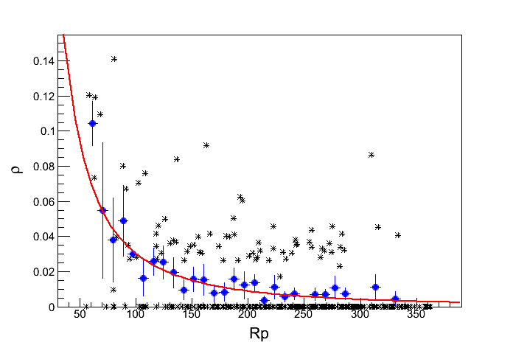
  Measurement and Reconstruction
  WCDA
  Core reconstruction: 3m
  Arrival direction reconstruction: 0.3°
  Energy flux near the core
  WFCTA
  SIZE (total PE in image)
  Width, Length
  Angular offset between arrival directions to the image center
  KM2A - MD
  Lateral distribution of Muon
proton
iron
* Measured Muon lateral distribution
● Average Muon lateral distribution
― Fiting

Slide 11
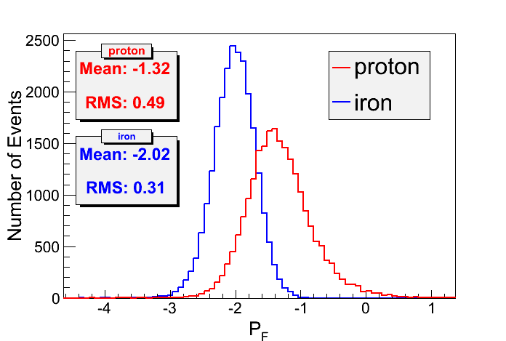
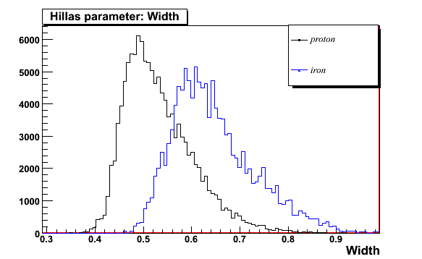
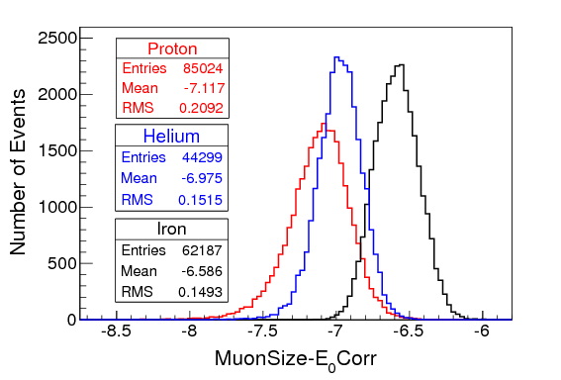
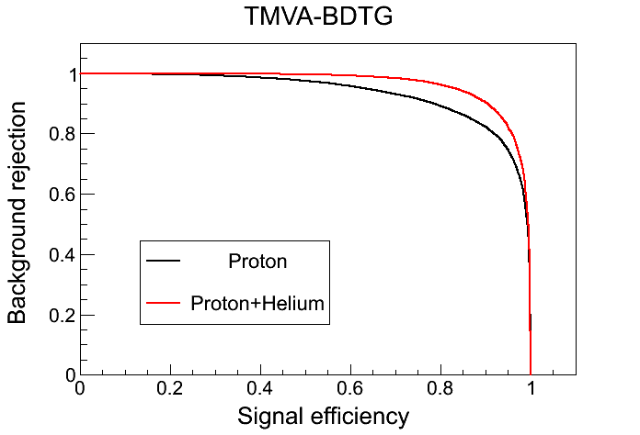
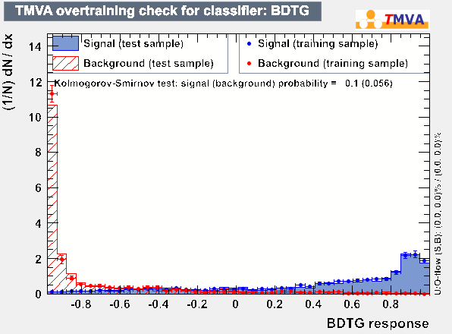
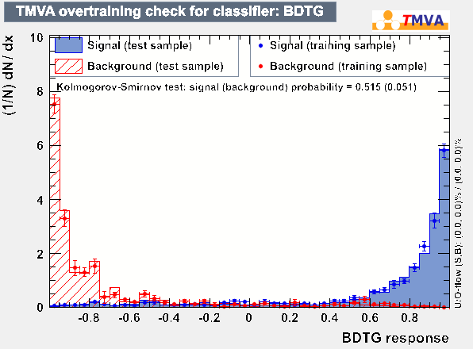
Particle Identification
WCDA
WFCTA
KM2A MD
pμ1
Proton + Helium
Proton

Slide 12
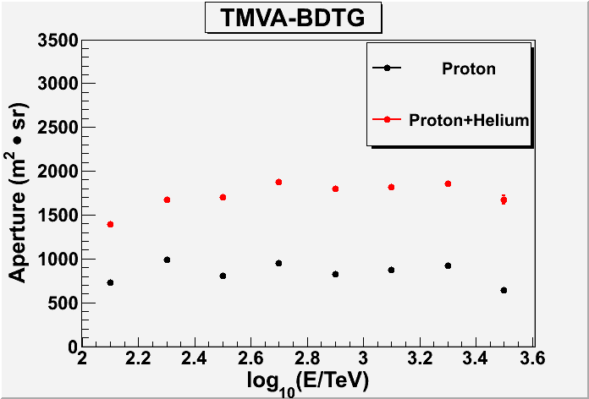
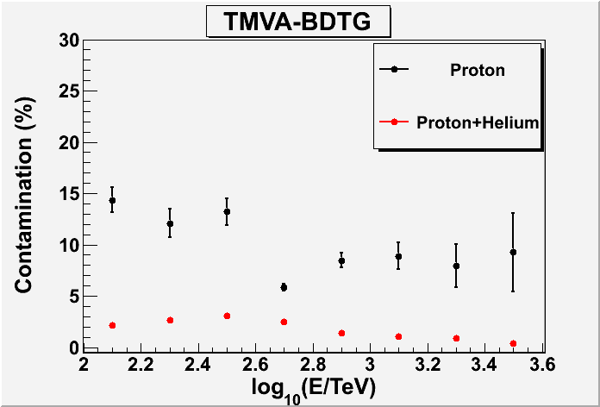
Particle identification Results
¼ LHAASO
 | Proton | Proton+Helium
Aperture | ~900 | ~1800
Contamination | ~10% | <4%

Slide 13
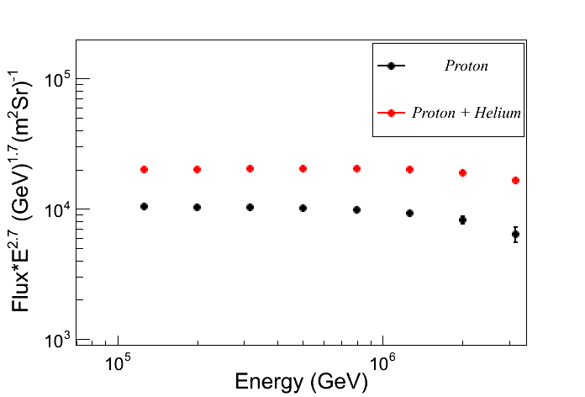
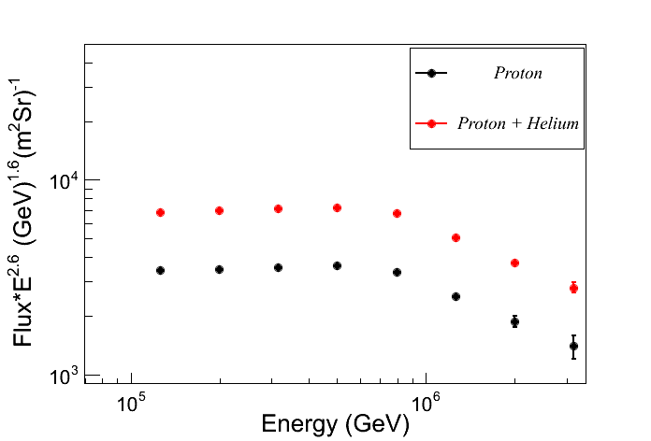
Prospects for cosmic ray spectra
  One year statistics, 10% duty cycle
  6 Cherenkov Telescopes
5121
6461
1130
1476
Horandel model
ARGO-YBJ & WFCT Model
Notes:
6461

Slide 14
Prospects of iron knee from 10PeV to 100PeV

Slide 15
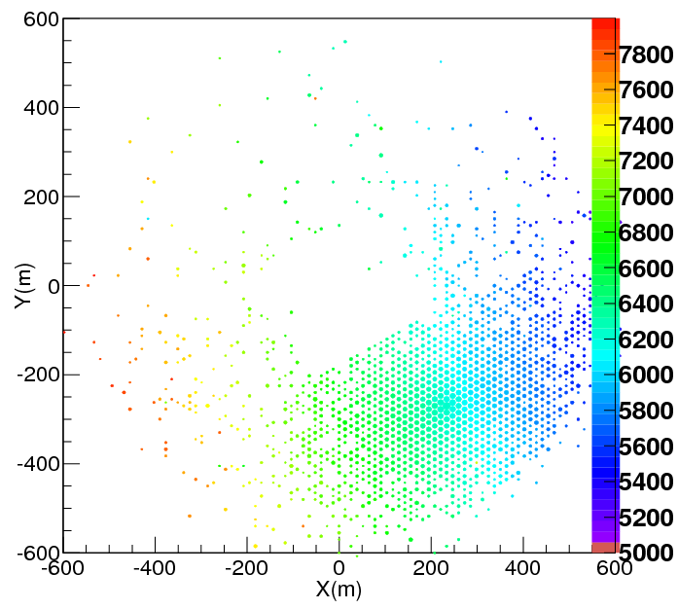
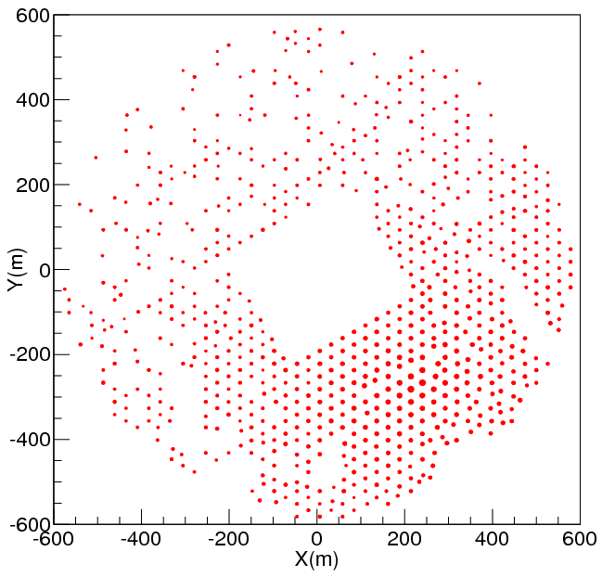
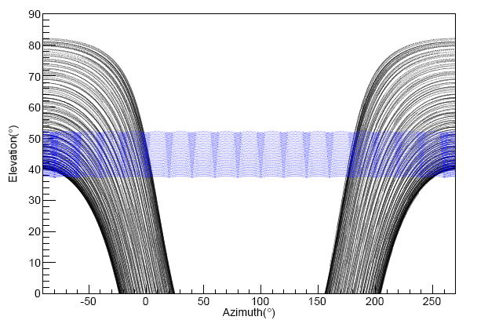
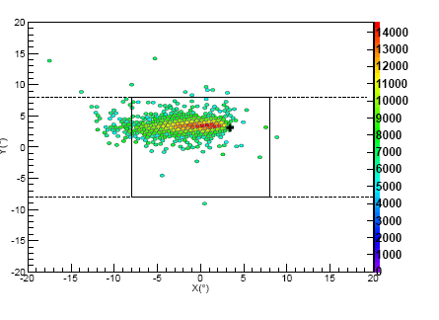
KM2A:
  Geometry reconstruction
    3m， 0.3°
  No. of Muons
  No. of electromagnetic particles
WFCTA:
  Px: angular offset between shower arrival direction and the image center Xmax
  Npe: Number of pe. in the Cherenkov image
Selection criteria:
1: The cores should be in the array of KM2A
2: The arrival diections should be in the FOV of WFCTA (|X|<8°|Y|<7°)
3: N_{trigger}>100
4: Rp<400m
Elevation of 45° toward North with full-moon duty cycle >30

Slide 16
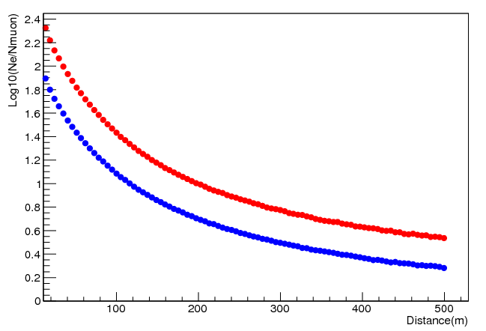
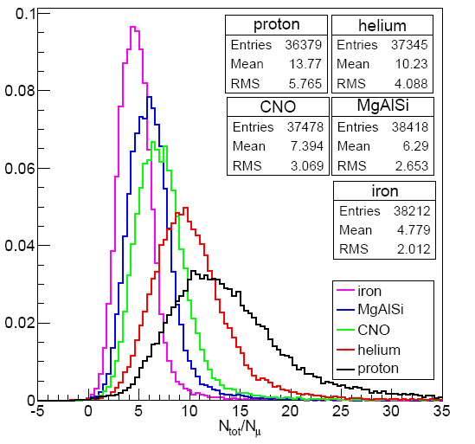
Particle Identification N_{tot}/N_{μ}
Red: Proton
Blue: Iron
Lateral distributions of Log10(N_{ch}/N_{μ})
Normalized to 1

Slide 17
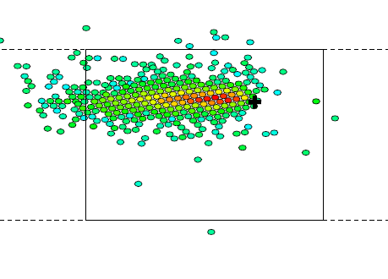
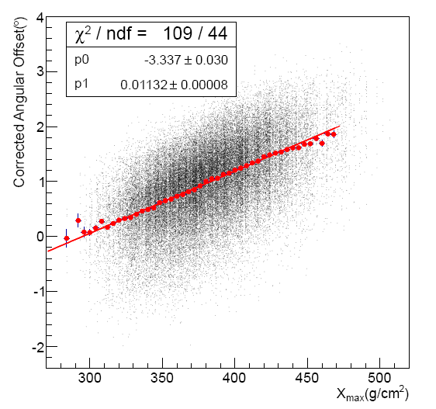
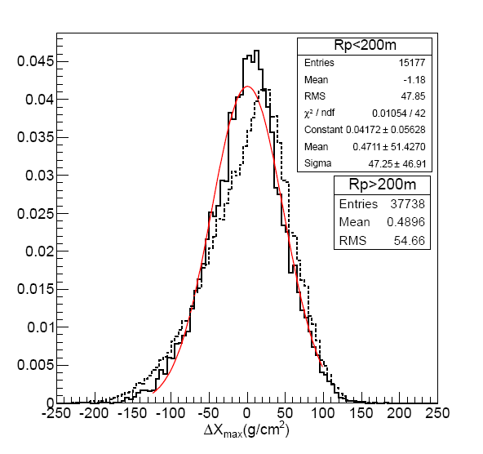
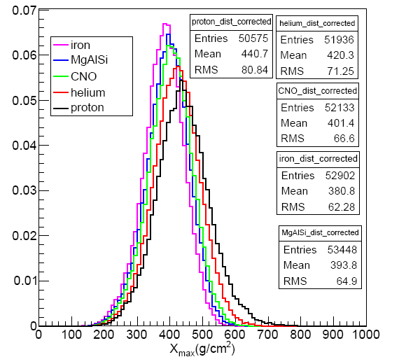
Particle Identification X_{max}
Angular offset

Slide 18
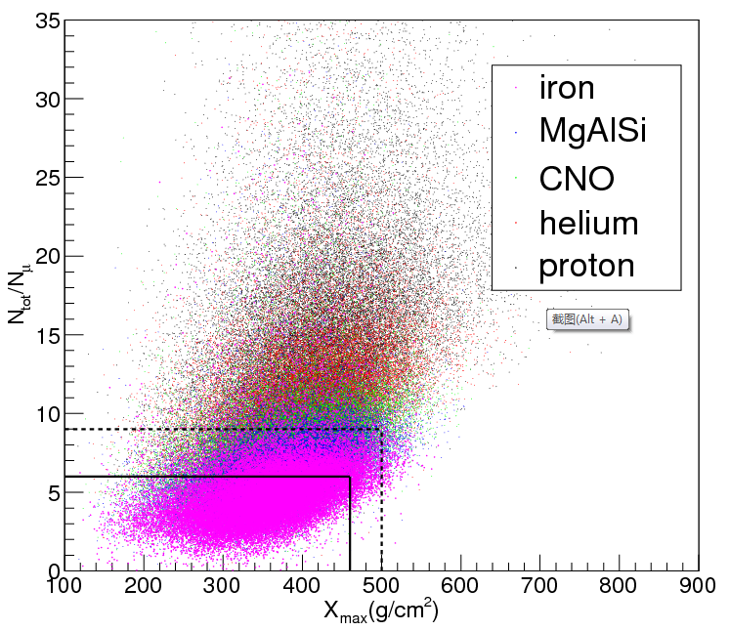
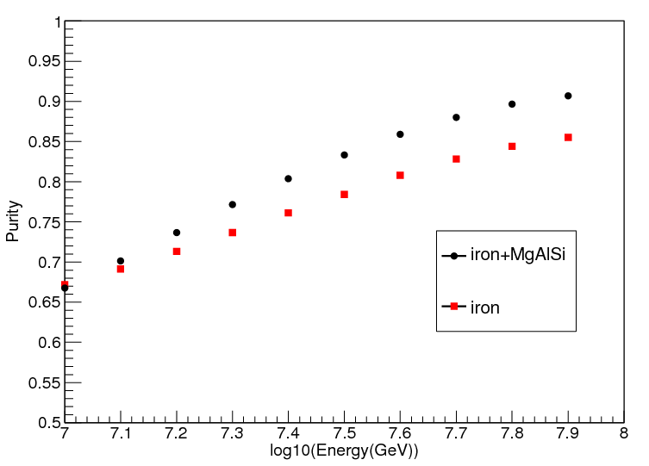
Particle Identification and purity
Iron
Iron+MgAlSi
The correlation is less then 0.9

Slide 19
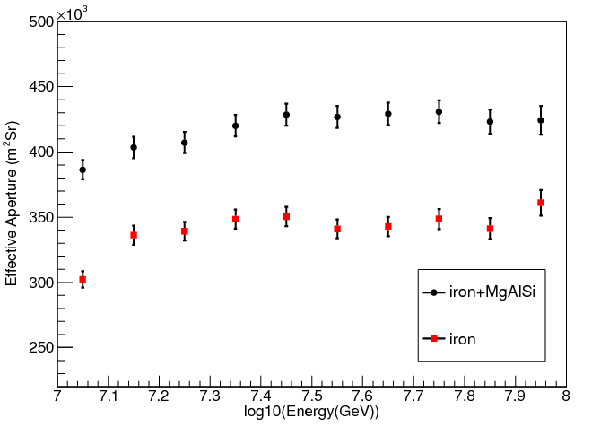
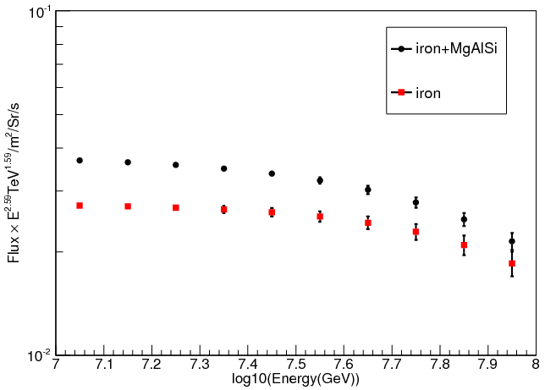
Aperture and flux
200
145
Aperture for iron : 3.5X10⁵m²Sr

Slide 20

Energy Resolution

Slide 21
总结和展望
在100TeV至10PeV能量段，利用6台广角契伦科夫望远镜，1个WCDA（++）水池，及MD探测器，能够得到高纯度，高统计量的质子，质子及氦核的能谱
在10PeV至100PeV能量段，利用18台契伦科夫望远镜，MD探测器，ED探测器，能够得到铁核，铁核及MgAlSi的能谱
能量分别率优于20%

Slide 22
谢谢大家

