Slide 1
$Λ_{c}^{+}$ physics at BESIII
Pei-Rong Li (李培荣）
On behalf of the BESIII Collaboration
LanZhou University
2018.11.10 @ WuHan

Slide 2
Outline
Introduction to the lightest charm baryon ${ Λ}_{c}^{+}$
BESIII results on its production and decays
$Λ_{c}^{+}$ hadronic decays
BF($Λ_{c}^{+}$→pK⁻π⁺) +11hadronic modes :PRL 116, 052001 (2016)
BF($Λ_{c}^{+}$→pK⁺K⁻, pπ⁺π⁻) :PRL 117, 232002 (2016)
BF($Λ_{c}^{+}$→nK_{s}π⁺) :PRL 118, 12001 (2017)
BF($Λ_{c}^{+}$→pη, pπ⁰) :PRD 95, 111102(R) (2017)
BF($Λ_{c}^{+}$→ $Σ^{−}$π⁺π⁺π⁰) :PLB 772, 388 (2017)
BF($Λ_{c}^{+}→Ξ^{ (∗)0}K^{+}$) : PLB 783,200 (2018)
$Λ_{c}^{+}$ semi-leptonic decay
BF($Λ_{c}^{+}$→$Λ$e⁺$ν_{e}$) :PRL 115, 221805(2015)
BF($Λ_{c}^{+}$→$Λ$μ⁺$ν_{μ}$) : PLB 767, 42 (2017)
$Λ_{c}^{+}$ inclusive decay ${ Λ}_{c}^{+}$→$Λ$+X
BF($Λ_{c}^{+}$→$Λ$X) : PRL 121, 062003(2018)
BF($Λ_{c}^{+}$→$e$X) : arXiv: 1805.09060
$Λ_{c}^{+}Λ_{c}^{−}$ pair cross section : PRL 120,132001(2018).
Summary & prospect

Slide 3
Renaissance on the charmed heavy baryon
Before 2014, the charmed baryons have been produced and studied at many experiments, notably fixed-target experiments (such as FOCUS and SELEX) and e⁺e⁻ B-factories (ARGUS, CLEO, BABAR, and BELLE).
Large uncertainties in experiment=>Retarder development in theory.
Afterwards, more extensive measurements on charmed baryons are performed at BESIII, BELLE and LHCb.
The absolute BF measurements at BESIII and BELLE.
The observation of the DCS mode $Λ_{c}^{+}$→pK⁺π⁻ at BELLE.
The observation of the doubly charmed baryon ${ Ξ}_{cc}^{++}$ at LHCb.
These experimental progresses have revoked the activities in the theoretical efforts.

Slide 4
The charmed baryon family
Singly charmed baryons
Established ground states:
$Λ_{c}^{+}$, $Σ_{c}$, ${ Ξ}_{c}^{(′)},Ω_{c}$
Excited states are being explored
Doubly charmed baryons(${ Ξ}_{cc}^{++}$) observed recently.
No observations of triply charmed baryons.
$Λ_{c}^{+}$ decay only weakly, many recent experimental progress since 2014.
$Σ_{c}$: B($Σ_{c}→$ $Λ_{c}^{+}$π)~100%, B($Σ_{c}→$ $Λ_{c}^{+}γ$)?
${ Ξ}_{c}^{}$: decay only weakly; no absolute BF measured, most relative to ${ Ξ}_{}^{−}$ π⁺(π⁺).
$Ω_{c}$:decay only weakly; no absolute BF measured.

Slide 5
$Λ_{c}^{+}$: The lightest charmed baryon spectroscopy
Most of the charmed baryons will eventually decay to $Λ_{c}^{+}$.
The $Λ_{c}^{+}$ is one of important tagging hadrons in c-quark counting in the productions at high energy experiment.
Also important input to $Λ_{b}^{}$(including ${ Ξ}_{cc}^{++}$) physics as $Λ_{b}^{}$ decay preferentially to $Λ_{c}^{}$.
==>Important input to B physics and V_{ub} calculations.
$Λ_{c}^{+}$may provide more powerful test on internal dynamics than D/Ds does !
Naïve quark model picture: a heavy quark (c) with an unexcited spin-zero diquark (u-d). Diquark correlation is enhanced by weak Color Magnetic Interaction with a heavy quark(HQET).
Strange baryons (Λ[uds])
m_{u}, m_{d} ≈ m_{s} → (qqq) uniform
u d
Charmed baryon (Λ_{c}[udc])
m_{u}, m_{d} << m_{c} →
diquark + quark
(qq) (Q)
$$\overline{d}$$
Charmed meson (D⁺[c$\overline{d}$])
m_{d} << m_{c} →
quark + heavy quark
(q) (Q)
u
d
c
s
c

Slide 6
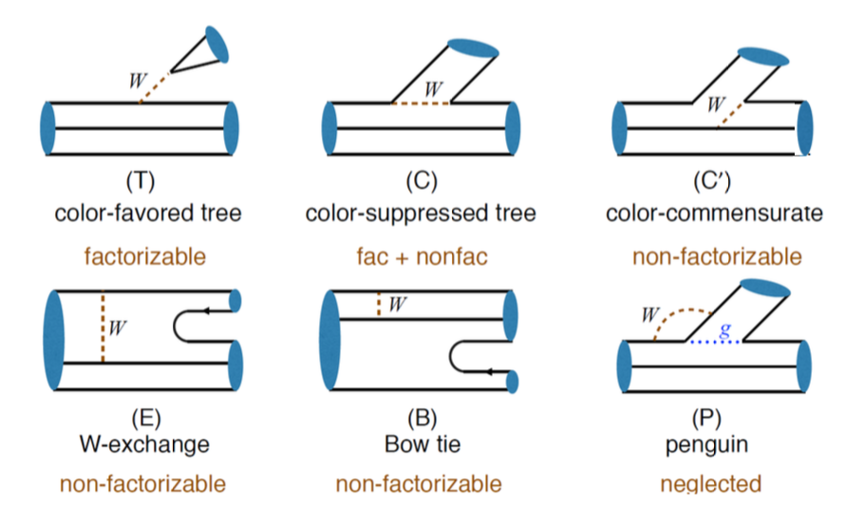
$Λ_{c}^{+}$ weak decays
Contrary to charmed meson, W-exchange contribution is important.(No color suppress and helicity suppress)
Phenomenology aim at explain data and predict important observables.
Calculate what they can(HQET, factorization)+parametrize what they cannot+ some non-perturbations extracted from data=> explain and predict.

Slide 7
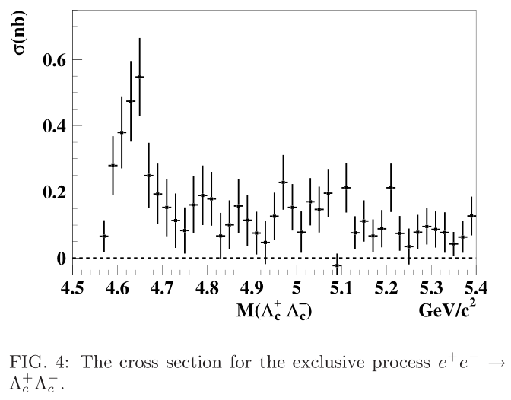
BESIII data taking @ $Λ_{c}^{+}Λ_{c}^{−}$ threshold
In 2014, BESIII took data above Λ_{c} pair threshold and run machine at 4.6GeV with excellent performance!
Measurement using the threshold pair-productions via e⁺e⁻ annihilations is unique: the most simple and straightforward.
~106$×$10³ $Λ_{c}^{+}Λ_{c}^{−}$ pairs make sensitivity to 10⁻³.
First time to systematically study $Λ_{c}^{+}$ at threshold.
Collect more $Λ_{c}^{+}$ data are in the schedule.
PRL101 (2008) 172001
BELLE
Energy(GeV) | lum.(pb⁻¹)
4.575 | 47.67
4.580 | 8.54
4.590 | 8.16
4.600 | 567.93

Slide 8
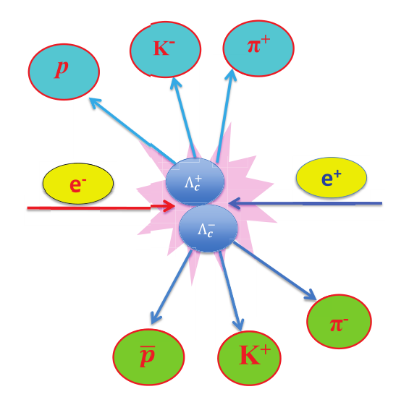
Production near threshold and tag technique
E_{cms}-2M$Λ$_{c}=26MeV only!
$Λ_{c}^{+}Λ_{c}^{−}$ produced in pairs with no additional accompany hadrons.
e⁺e⁻→γ*→ $Λ_{c}^{+}Λ_{c}^{−}$
Clean backgrounds and well constrained kinematics.
Typically, two ways to study $Λ_{c}^{+}$ decays:
Single Tag(ST): detect only one of the $Λ_{c}^{+}Λ_{c}^{−}$.
=>Relative higher backgrounds
=>Higher efficiencies
=>Full reconstruction
Double Tag(DT): detec both of $Λ_{c}^{+}Λ_{c}^{−}$
=>Smaller backgrounds. =>Missing technique.
=>Lower efficiencies.
=>Systematic in tag side are mostly cancelled.

Slide 9
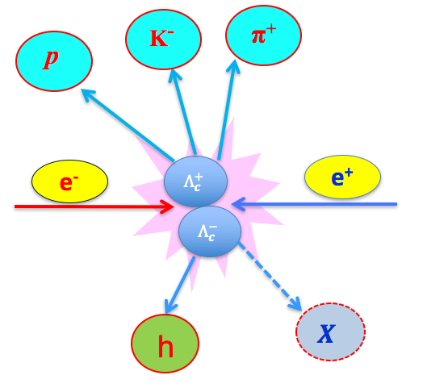
Several popular variables
∆E=E_{Λc}-E_{beam}
Beam-Constrained-Mass; M_{BC}=$\sqrt{E_{beam}^{2}−|\vec{p}Λc|2}$
E_{miss}=E_{beam}-E_{h}
$\vec{p}miss$= $\vec{p}Λc$- $\vec{p}h$
$\vec{p}Λc$= - $\vec{p}tag$・$\sqrt{E_{beam}^{2}−m_{Λc}^{2}}$
U_{miss}=E_{miss}-| $\vec{p}miss$|
M_{miss}=$\sqrt{E_{miss}^{2}−|\vec{p}miss|2}$
$\hat{p}$_{tag} is the direction of the momentum of the singly tagged $Λ_{c}^{}$.
E_{h}(p_{h}) are the energy(momentum) of h which are measured in e⁺e⁻ system.
m$Λ_{c}^{+}$ is the mass of the $Λ_{c}^{+}$ quoted from the PDG.

Slide 10
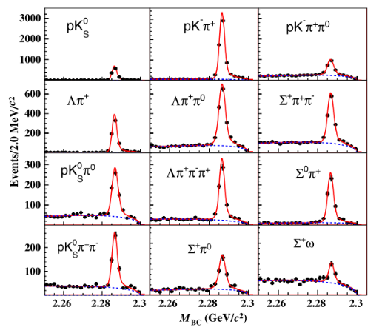
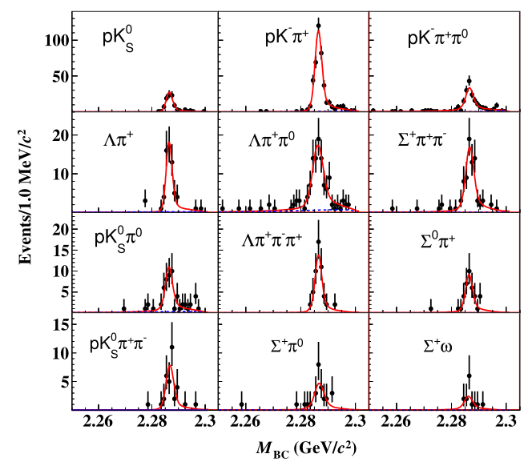
$Λ_{c}^{+}$ reconstruction at BESIII
The BFs are extracted via the double-tag technique.
BF is determined independent of N$Λ_{c}^{+}Λ_{c}^{−}$ and the systematic due to the reconstruction of ST side to be canceled.
~15400 ST yields and ~1000 DT yields

Slide 11
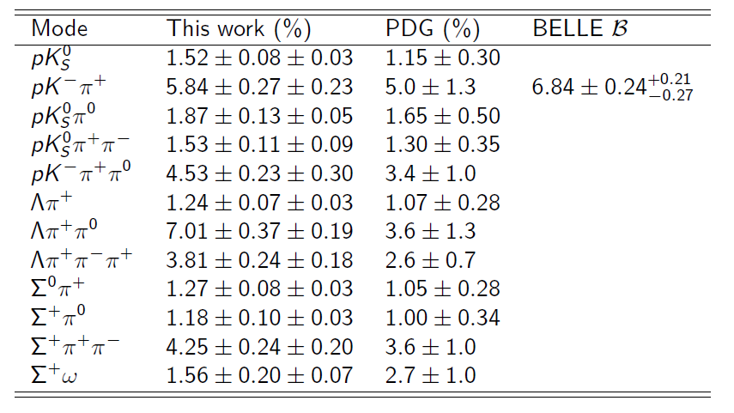
Results of 12 $Λ_{c}^{+}$ hadronic decay BFs
PRL 116, 052001 (2016)
567pb⁻¹ @ 4.6 GeV
No absolute measurement (Model independently) on $Λ_{c}^{+}$ BFs at threshold after $Λ_{c}^{+}$ discovered(30 years ago).
A least square global fit taking into account correlations over different modes are performed to improve the precision.
The precision of B(pK⁻π⁺) are comparable with Belle’s
The precisions of Λ_{c} decay rates is reaching to the level of charmed mesons!
N$Λ_{c}^{+}Λ_{c}^{−}$ as a byproduct determined to be (105.9±4.8±0.5)×10³

Slide 12
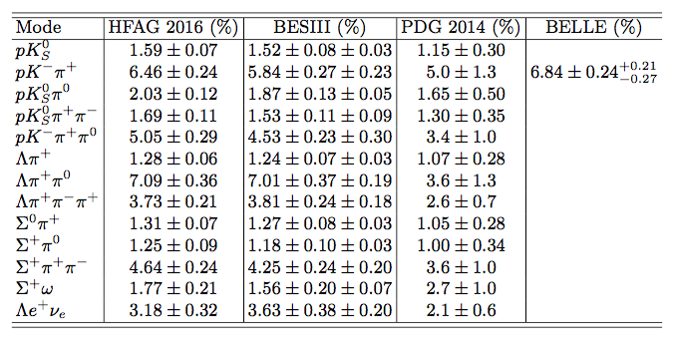
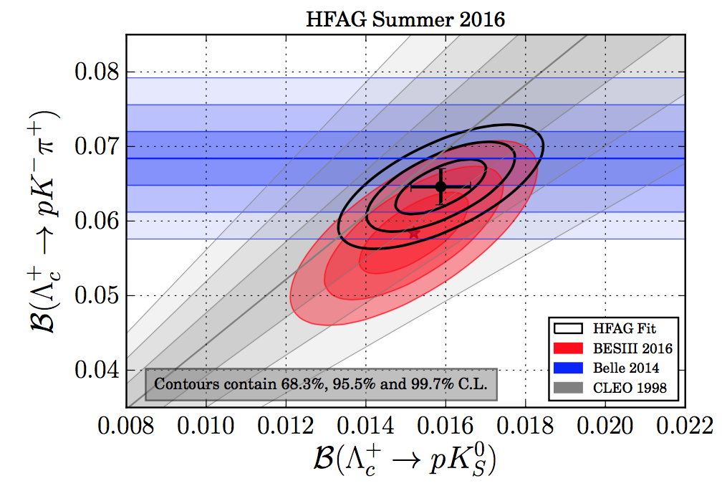
HFLAV Fit to world BF data
A fitter to constrain the 12 hadronic BFs and 1 SL BF, based on all the existing experimental data
Correlated systematics are fully taken into account
Eur. Phys. J. C77, 895 (2017)
The least overall 𝝌²/ndf=30.0/23=1.3
Precise $B\left(pK^{−}π^{+}\right)$ is useful for constrain V_{ub} determined via baryonic mode

Slide 13
Experimental precision reaches of the charmed hadrons
 | Golden hadronic mode | δB/B | Golden SL mode | δB/B
D⁰ | B(Kπ)=(3.88±0.05)% | 1.3% | B(Kev)=(3.55±0.05)% | 1.4%
D⁺ | B(Kππ)=(9.13±0.19)% | 2.1% | B(K⁰ev)=(8.83±0.22)% | 2.5%
D_{s} | B(KKpi)=(5.39±0.21)% | 3.9% | B(ɸev)=(2.49±0.14)% | 5.6%
Λc | B(pKπ)=(5.0±1.3)%(PDG2014) =(6.8±0.36)% (BELLE) =(5.84±0.35)% (BESIII) =(6.46±0.24)% (HFAG) | 26% 5.3% 6.0% 3.7% | B(Λev)=(2.1±0.6)%(PDG2014) =(3.63±0.43)% (BESIII) =(3.18±0.32)% (HFAG) | 29% 12% 10%
The precisions of Λc decay rates is reaching to the level of charmed mesons!
More data input will further constrain the HFLAV fit.
However, search for more unknown modes are important

Slide 14
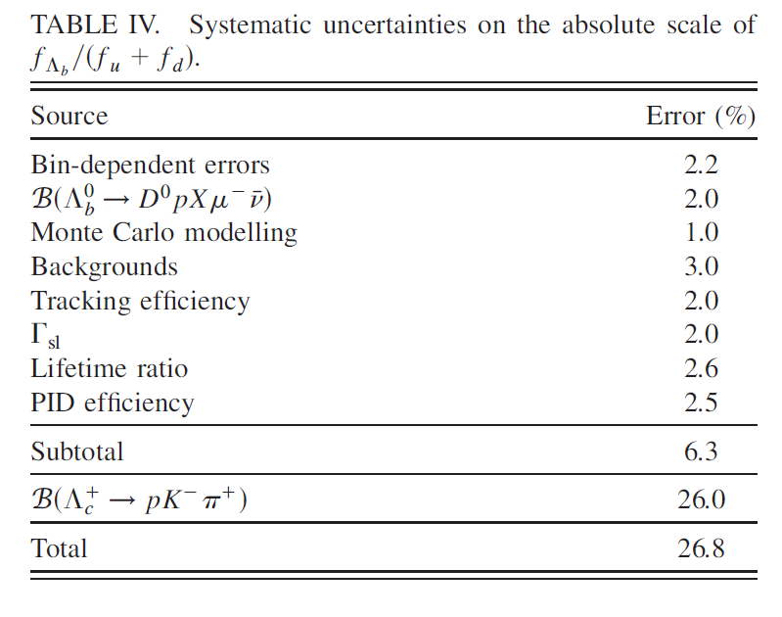
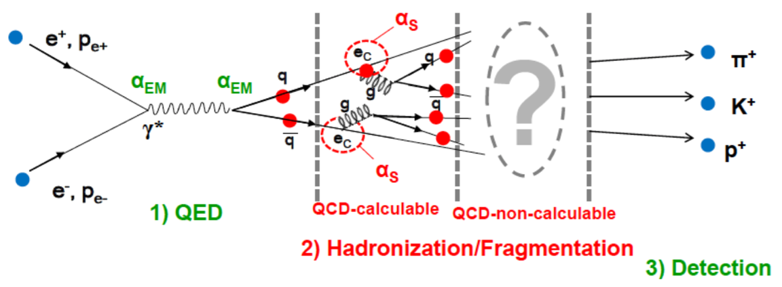
Important Input for b physics
stringent Fragmentation Function of b/c quark to baryon
[Eur. Phys. J. C12, 225 (2000); Eur. Phys. J. C 16, 597 (2000); Phys. Rev. D 85, 032008 (2012), Phys. Rev.D 66, 091101 (2002).]
Fragmentation Function (FF) is an important probe in experiment to test and calibrate QCD theory.
PhysRevD.85.032008
Now B($pK^{−}π^{+}$) are still dominated

Slide 15
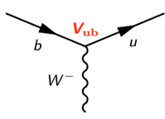
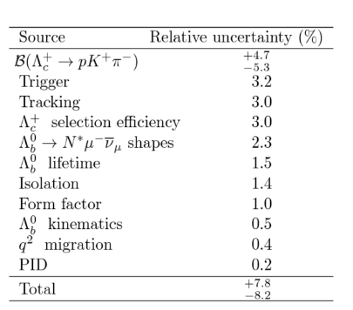
CKM matrix element V_{ub}
Nature Physics 11 (2015) 743
B($pK^{−}π^{+}$) are dominated systematic uncertainty

Slide 16
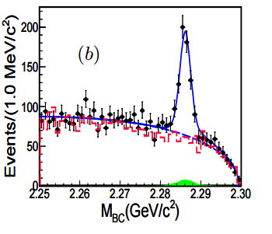
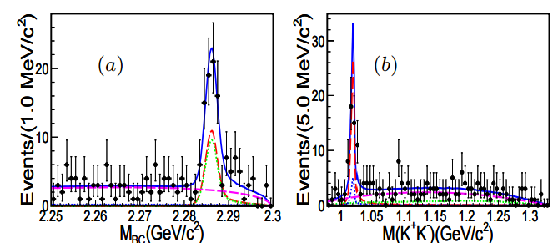
Singly Cabibbo-Suppressed Decays of
$Λ_{c}^{+}$→pπ⁺π⁻ and $Λ_{c}^{+}$→pK⁺K⁻
PRL117,232002(2016)
ST method: $Λ_{c}^{+}$→pΚ⁻π⁺ as ref. mode
First observation of SCS decay of $Λ_{c}^{+}$→pπ⁺π⁻
Improved measurement on the SCS decays $Λ_{c}^{+}$→pΚ⁺Κ⁻
$Λ_{c}^{+}$→pϕ are sensitive to non-factorable contributions from C diagrams

Slide 17
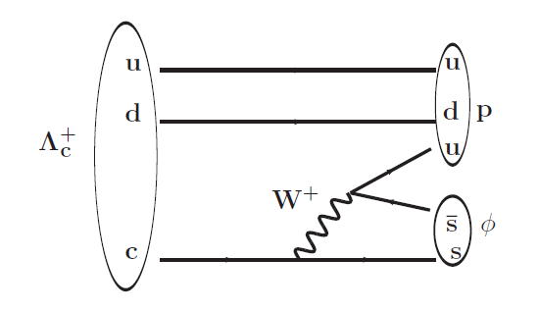
$Λ_{c}^{+}$→ pφ: test large-N_{c} expansion
Charmed meson decays
a₁ =c₁(μ) +c₂(μ) (1/N_{c} +χ₁(μ)),
a₂= c₂(μ) +c₁(μ) (1/N_{c} +χ₂(μ)),
If χ₁ = χ₂ = 0, naïve factorization
If χ₁ = χ₂ ≈ -1/N_{c}, large-N_{c} factorization
$Λ_{c}^{+}$→ pφ proceeds only through internal W-emission C diagram.
Input BF ⇒ |a₂|=0.45±0.03, Nc ≈7, close to a₂(m_{c})≈ -0.44(from theory)
1/N_{c} is also applicable to charmed baryon sector.
BESIII measurement are consistent with previous measurement.
arXiv:1801.08625

Slide 18
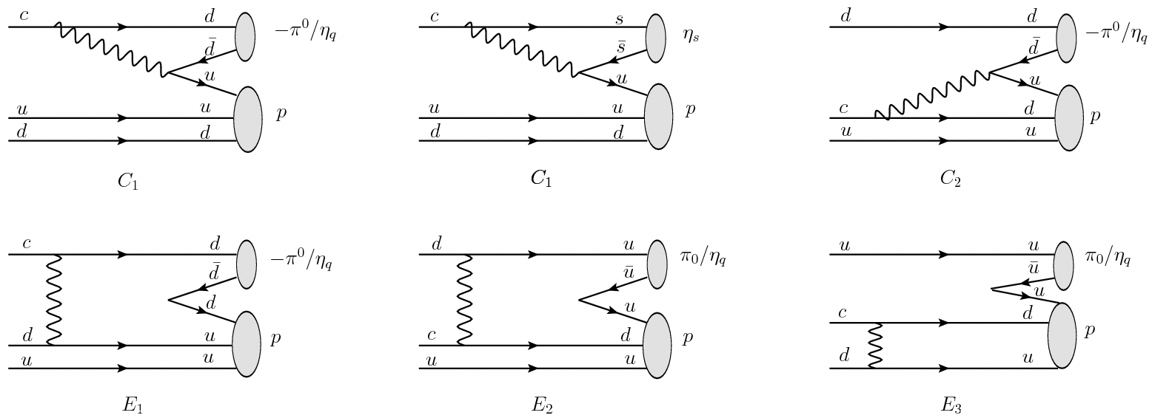
Singly Cabibbo-Suppressed Decays of $Λ_{c}^{+}$→pπ⁰ and $Λ_{c}^{+}$→pη
These modes have not been measured before.
Predicted BFs vary under different theoretical models(SU(3) symmetry and FSI)
B($Λ_{c}^{+}$→ pη)>>B($Λ_{c}^{+}$→ pπ⁰) in the SU(3) flavor symmetry generated by u,d and s
Nonfactorizable terms contribute constructively to pη and destructively to pπ⁰
Their relative size is essential to understand the interference of different non factorizable diagrams.

Slide 19
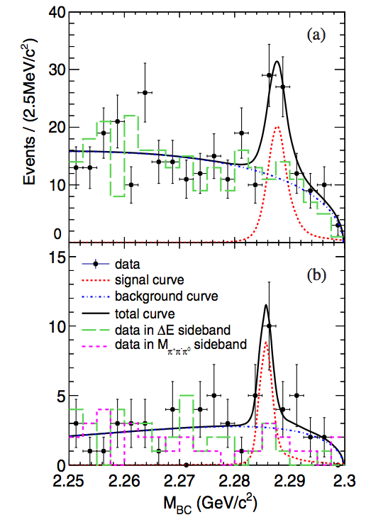
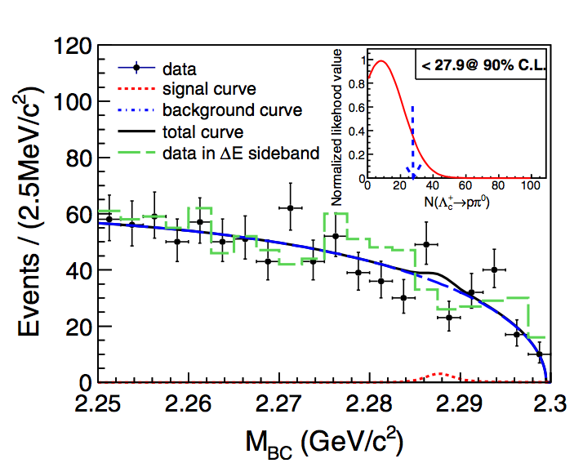
SCS Decays of $Λ_{c}^{+}$→pπ⁰ and $Λ_{c}^{+}$→pη
$Λ_{c}^{+}$→ pη(η→γγ)
PRD,111102(R) (2017)
ST method
$Λ_{c}^{+}$→ pπ⁰
$Λ_{c}^{+}$→ pη(η→π⁺π⁻π⁰)
First evidence for $Λ_{c}^{+}$→ pη with 4.2σ
B($Λ_{c}^{+}$→ pη)=(1.24±0.28±0.10)×10⁻³
No signal seen in $Λ_{c}^{+}$→ pπ⁰, B($Λ_{c}^{+}$→ pπ⁰)<2.7×10⁻⁴
^{d}
arXiv:1801.08625

Slide 20
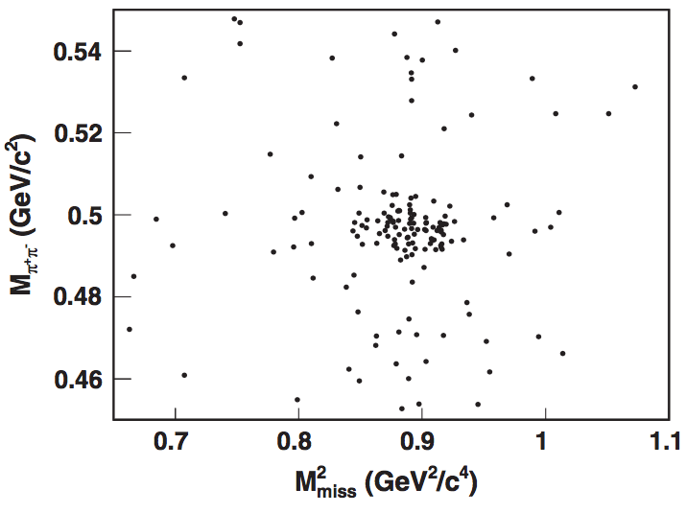
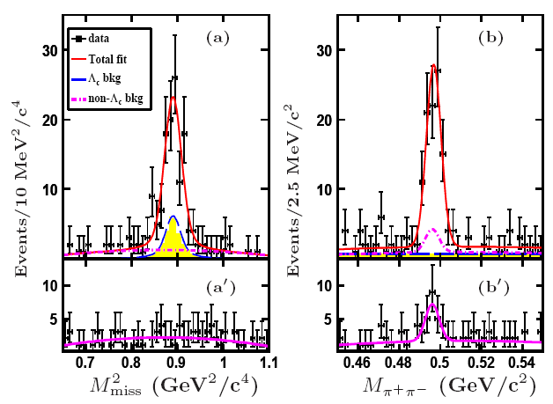
Observation of $Λ_{c}^{+}$→n$K_{s}^{0}$π⁺
First direct measurement of $Λ_{c}^{+}$decay involving the neutron in the final state.
PRL,118,112001(2017)
Peaking background from $Λ_{c}^{+}$→Σ⁺ (→nπ⁺) π⁺π⁻
2-D fitting extract 83±11 net signals => B[$Λ_{c}^{+}$→n$K_{s}^{0}$π⁺]=(1.82±0.23±0.11)%
B[$Λ_{c}^{+}$→n$K^{0}$π⁺]/B[$Λ_{c}^{+}$→pK⁻π⁺]=0.62±0.09; B[$Λ_{c}^{+}$→n$K^{0}$π⁺]/B[$Λ_{c}^{+}$→pK⁰π⁰]=0.97±0.16
A test of final state interactions and isospin symmetry in the charmed baryon sector. [PRD93, 056008 (2016)]

Slide 21
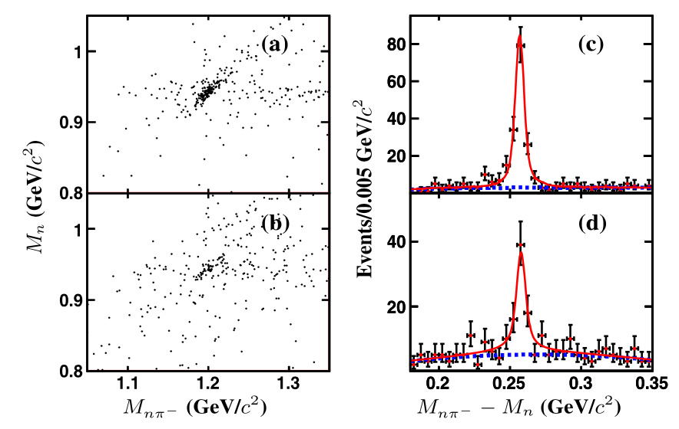
Study of $Λ_{c}^{+}$→ $Σ^{−}$π⁺π⁺(π⁰)
First observation of a large-rate forgotten channel $Λ_{c}^{+}$→Σ⁻π⁺π⁺π⁰ (CF decay)
PLB 772, 388 (2017)
$Λ_{c}^{+}$→ $Σ^{−}$π⁺π⁺
161±15
$Λ_{c}^{+}$decay involving the neutron in the final state(missing technique). Less known in experiment.
B($Λ_{c}^{+}$→Σ⁻π⁺π⁺π⁰)= (2.11±0.33 ±0.14)%
B($Λ_{c}^{+}$→Σ⁻π⁺π⁺)= (1.81±0.17 ±0.09)%
more precise than old result (2.3±0.4)%
B[$Λ_{c}^{+}$→Σ⁻π⁺π⁺]/B[$Λ_{c}^{+}$→Σ⁺π⁺π⁻] =0.42±0.05±0.02 better precision than rhe previous ratio 0.53±0.15±0.07
$Λ_{c}^{+}$→ $Σ^{−}$π⁺π⁺π⁰
88±14
Constrained variables:

Slide 22
W-exchange-only process $Λ_{c}^{+}→Ξ^{ (∗)0}K^{+}$
$Λ_{c}^{+}→Ξ^{0(∗)}K^{+}$ decay only through W-exchange.
W-exchange are non-factorable in theoretic calculation.
Large cancellation both in S-wave and P-wave.
This measurement helps in calibration of the W-exchange process in the charmed baryon sector.
The previous measurements have poor precision.
CLEO
CLEO
ARGUS

Slide 23
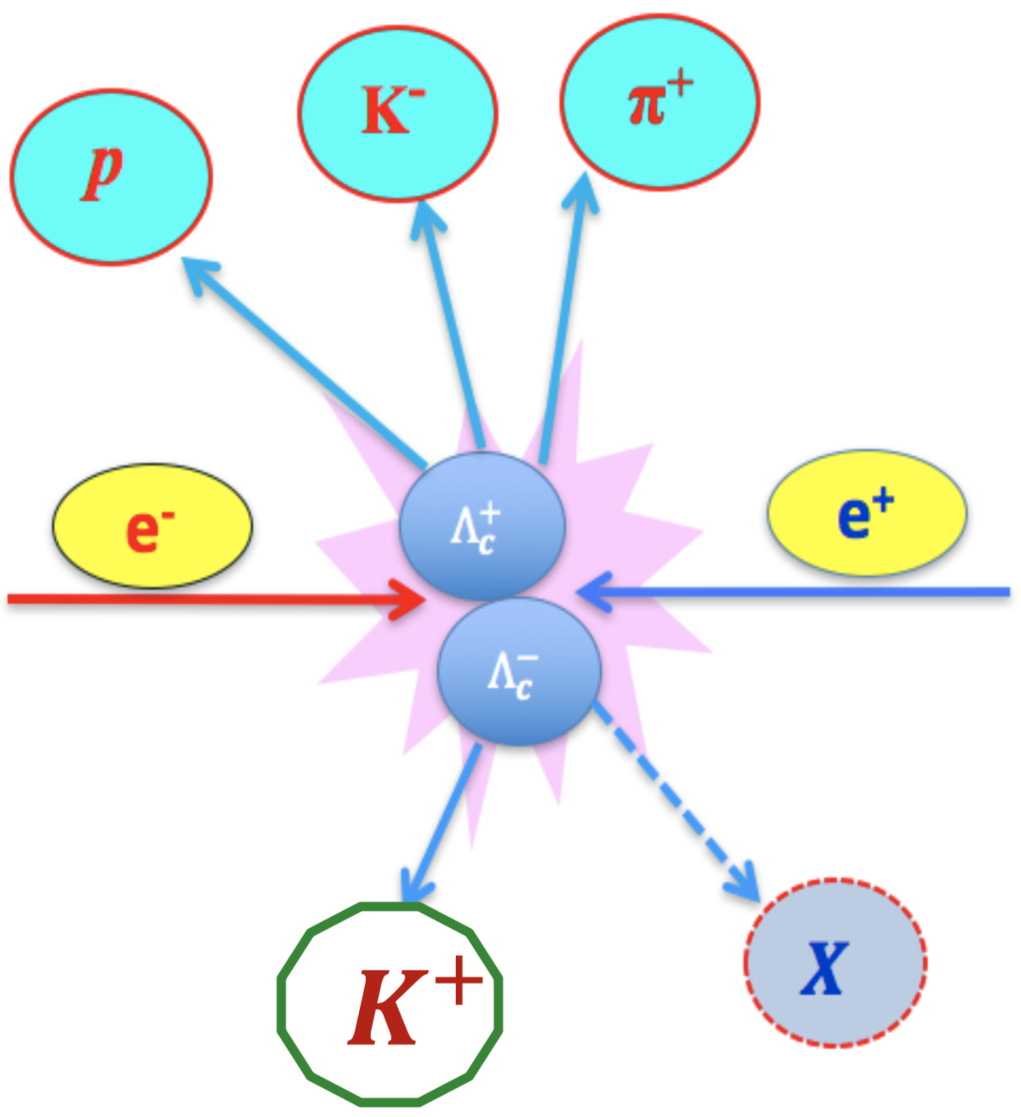
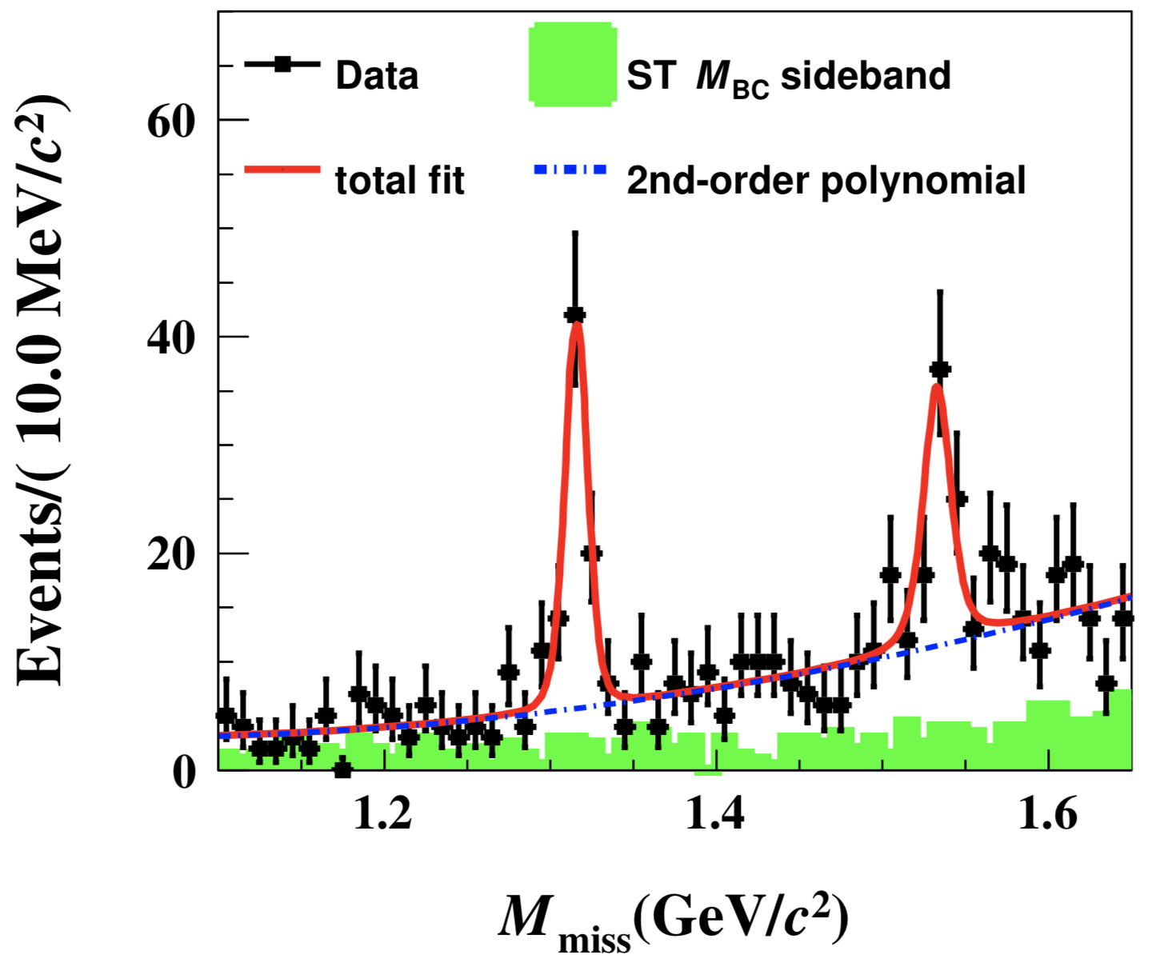
W-exchange-only process $Λ_{c}^{+}→Ξ^{ (∗)0}K^{+}$
Double tag and missing $Ξ^{0(∗)}$ to increase the detection efficiency.
Low backgrounds because the anti-strangeness of K⁺
First absolute measurement, using world largest on-threshold data at $\sqrt{s}$=4.6GeV
Improved precision
No model can accommodate the both rates
PLB 783,200 (2018)
10.3σ
6.4σ

Slide 24
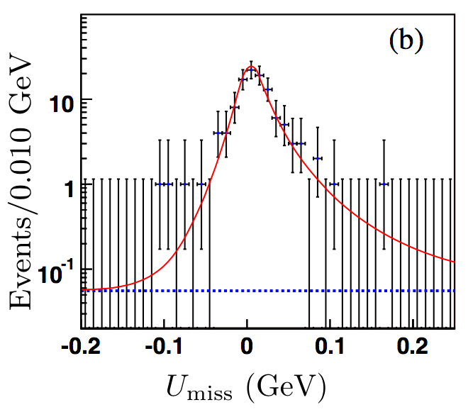
Absolute BF for $Λ_{c}^{+}$→$Λ$l⁺$ν_{l}$
PRL 115, 221805(2015)
Benchmark channel via the CF transition c→sl⁺$ν_{l}$
BESIII measured the electronic mode $Λ_{c}^{+}$→$Λ$e⁺$ν_{e}$ by missing the neutrino.
Provides stringent test for nonperturbative aspects of the theory of strong interaction.
Important input for implementing and calibrating the LQCD calculations.
$Λ_{c}^{+}$→$Λ$e⁺$ν_{e}$
104±11 signal
B[$Λ_{c}^{+}$→$Λ$e⁺$ν_{e}$]=(3.36±0.38±0.20)%

Slide 25
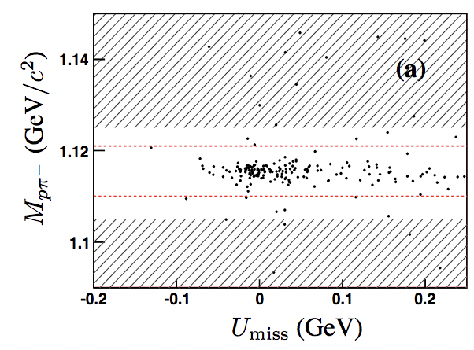
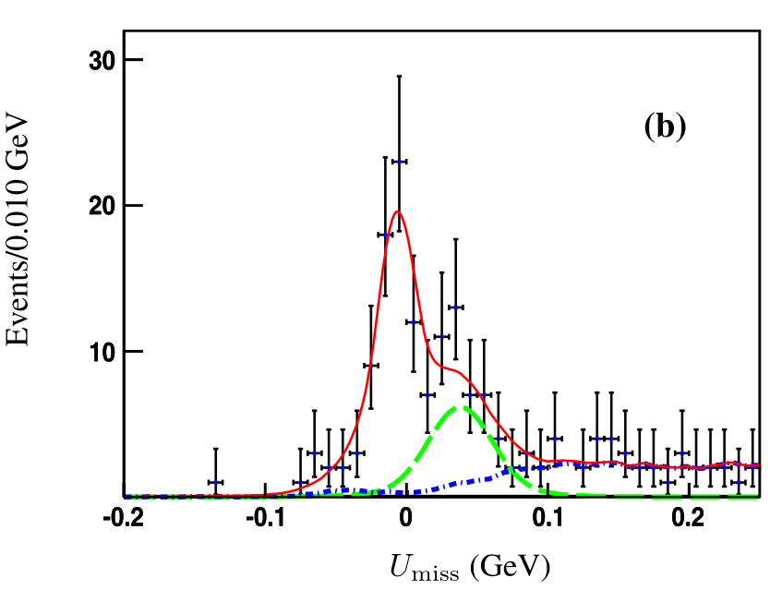
Study on $Λ_{c}^{+}$→$Λ$μ⁺$ν_{μ}$
$Λ_{c}^{+}$→$Λ$μ⁺$ν_{μ}$
79±11 signal
$Λ_{c}^{+}$→$Λ$π⁺π⁰
Double tag and missing neutrino.
Peaking backgrounds from muon-pion mis-ID
B[$Λ_{c}^{+}$→$Λ$μ⁺$ν_{μ}$]=(3.49±0.46±0.27)%
=>improved precision,
=>first absolute measurements.
Γ[$Λ_{c}^{+}$→$Λ$μ⁺$ν_{μ}$]/Γ[$Λ_{c}^{+}$→$Λ$e⁺$ν_{e}$]= 0.96±0.16±0.04
=>compatible with unity
PLB 767, 42 (2017)

Slide 26
$Λ_{c}^{+}$→$Λ$l⁺$ν_{l}$ BF is the largest error source.

Slide 27
The inclusive channel $Λ_{c}^{+}$→$Λ$+X
The inclusive process mediated by the c-s transition.
Essential input in the calculation of the $Λ_{c}^{+}$ life time.
Useful in understanding the heavier charmed baryons, esp. the less known double- or triple-charm baryons.
Current PDG: BF($Λ_{c}^{+}$→$Λ$+X)=(35±11)% with large uncertainty.
The sum of know exclusive modes only accounts for (24.5±2.1)% => need better understanding of the gap between exclusive and inclusive rates.
Comparison with K+X will shed light on the $Λ_{c}^{+}$ internal dynamics.
Search for the CPV by measuring the asymmetry.

Slide 28
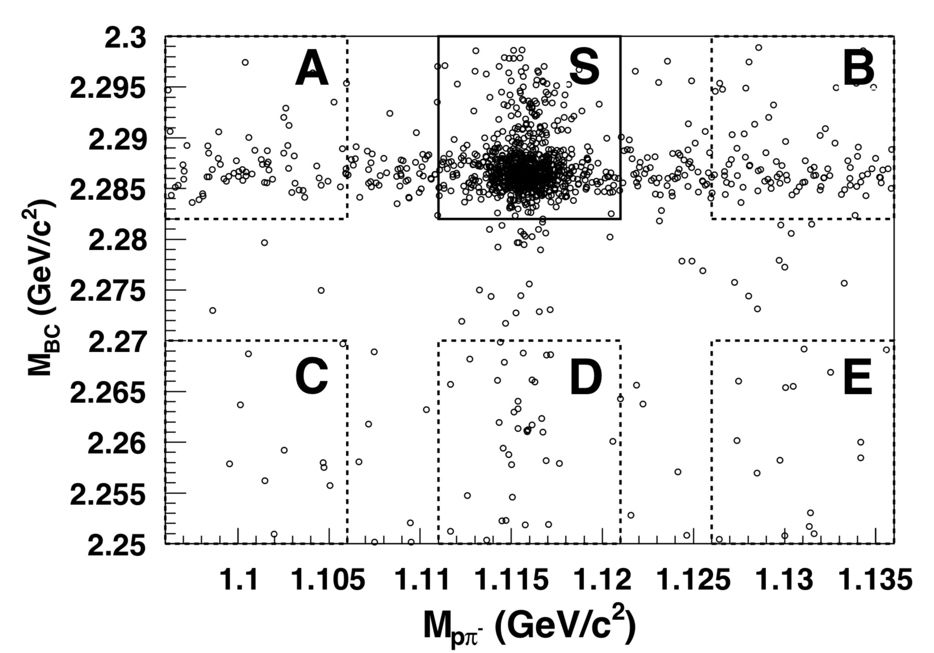
The inclusive channel $Λ_{c}^{+}$→$Λ$+X
PRL 121, 062003(2018)
In the ST modes of $Λ_{c}^{+}$→pK⁻p⁺ and p$K_{s}^{0}$, to measure the probability of find a $Λ$ in the final states.
Extract yields from 2D distributions in bins of 𝑝−|𝑐𝑜𝑠𝜃|
Data-driven 2D efficiency correction using several $Λ$ control samples.
$ℬ\left(Λ_{C}^{+}→Λ+X\right)={（38.2}_{−2.2}^{+2.8}±0.8)\%$
(excl. rate $(24.5±2.1)\%$ observed, indicates ~1/3 BFs are unknown)
$Acp{=(2.1}_{−6.6}^{+7.0}\text{±1.4}\text{)\%}$
(No CPV is observed.)
data
Comparison with K+X will shed light on the internal dynamics

Slide 29
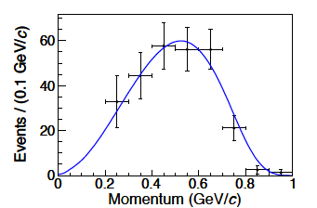
$Λ_{c}^{+}$→$e^{+}ν_{e}$+X
Current PDG: BF($Λ_{c}^{+}$→$e$+X)=(4.5±1.7)%.
Large rate, but also with large uncertainty
Tagged with $Λ_{c}^{+}$→pΚ⁻π⁺ and p$K_{s}^{0}$
=>
=>
The $Λ$l⁺$ν_{l}$ dominate the l⁺+X =>$𝓑$(pKl⁺$ν_{l}$)~10⁻³.
arXiv:1805.09060

Slide 30
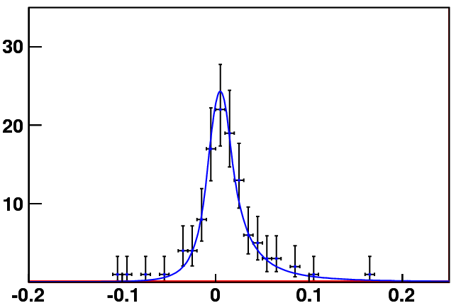
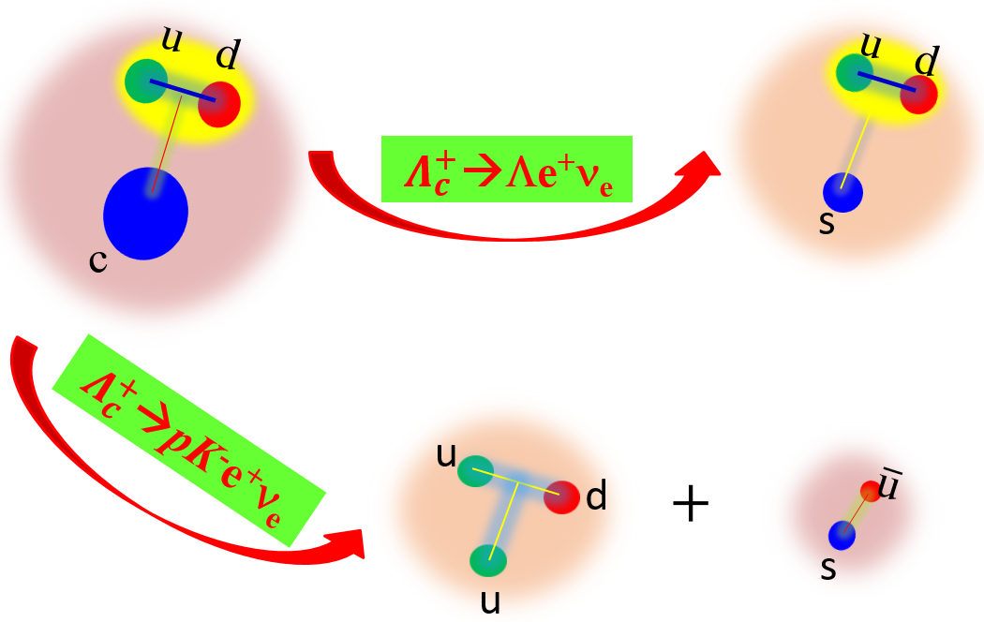
Why $Λ_{c}^{+}$→Λe⁺ν_{e} are dominated?
PRL 115, 221805 (2015)
arXiv:1805.09060
Events /0.010 (GeV)
U_{miss} (GeV)
B[Λ_{c}⁺→Λe⁺v]=(3.63±0.38±0.20)%
B[Λ_{c}⁺→e⁺+X]=(4.31±0.4)%

Slide 31
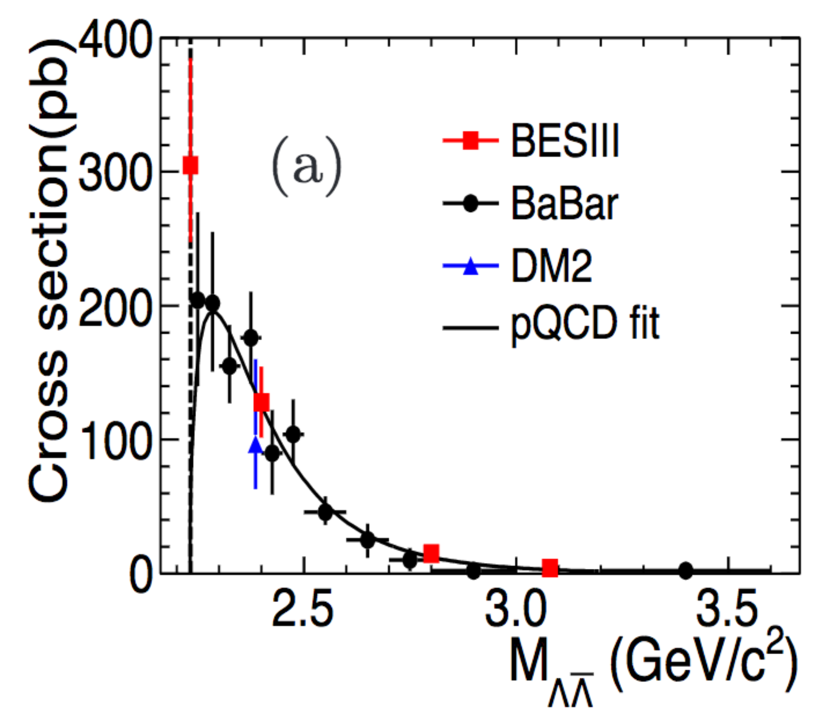
The cross-section of baryon pair
PRD97,032013(2018)

Slide 32
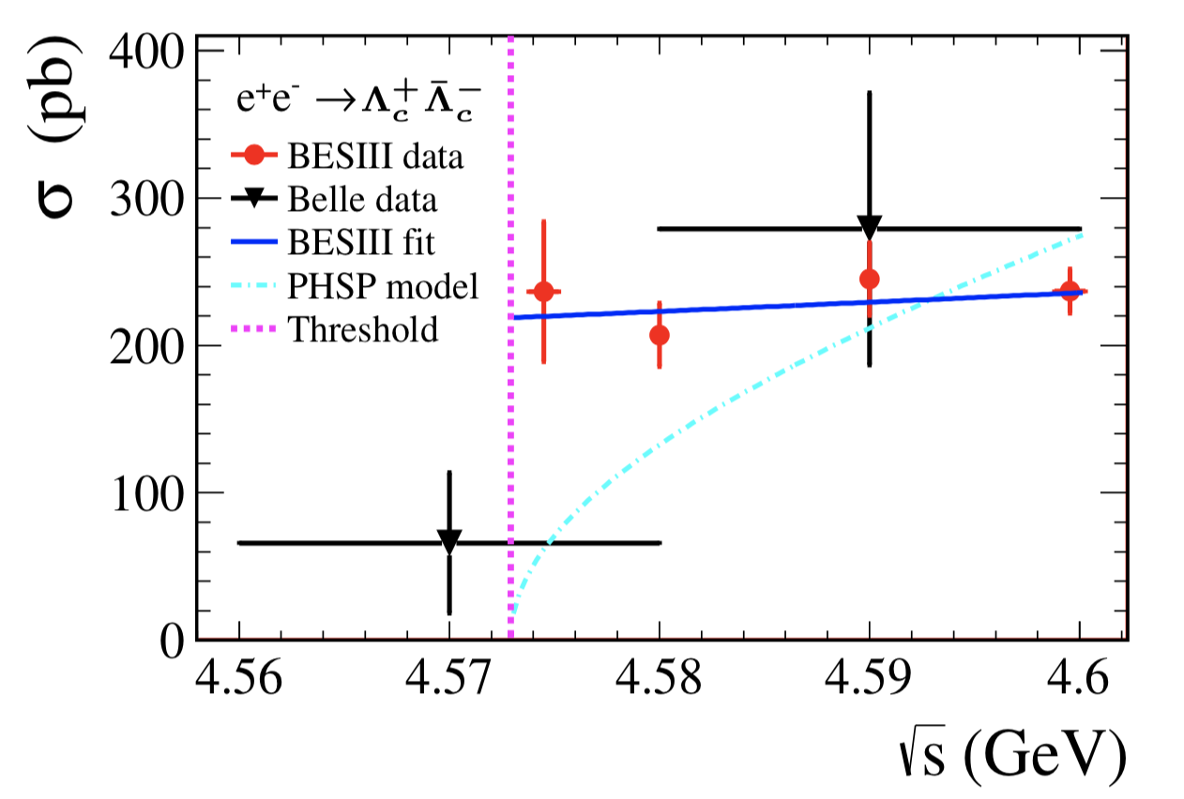
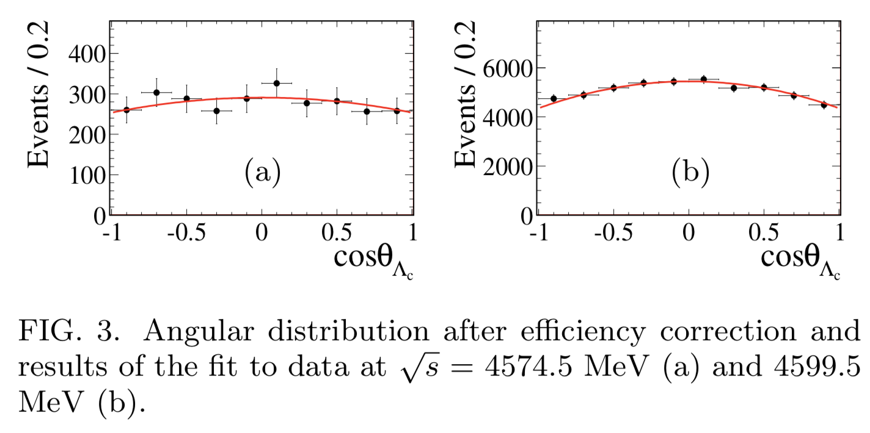
Cross-section and EMFF of e⁺e⁻→ $Λ_{c}^{+}Λ_{c}^{−}$ near threshold
Phys. Rev. Lett. 120, 132001 (2018).
One of the most basic observables that intimately related to the internal structure of the nucleon.
One of the most challenging questions in contemporary physics is why and how quarks are confined into hadrons.
The electromagnetic form factors (EMFFs) have been a powerful tool in understanding the structure of nucleons.

Slide 33
Summary
Threshold data at BESIII opens a new door to direct measurements of the decays ➔precise study of Λ_{c} decays
kinematics does not allow additional particle produced along with the $Λ_{c}^{+}Λ_{c}^{−}$ pair
fully reconstruct the pairs and take their yield ratios to measure the BFs:
low backgrounds and high detection efficiency
Era of precision study of the Λ_{c} decays:
provide more data for theorists to develop more reliable models
precise measurement of the W-exchange and W-internal-emission only process: to test the quark-diquark configuration important to understand the non-factorizable contribution
explore as-yet-unmeasured channels and understand full picture of intermediate structures
We are proposing to take a larger data set; a golden opportunity to thoroughly improve our knowledge on Λc decays

Slide 34
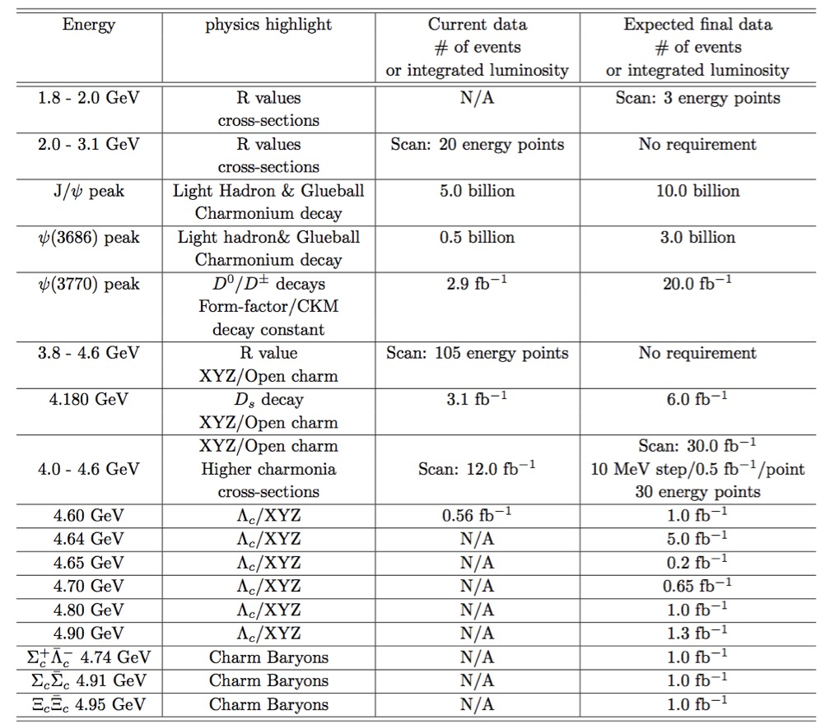
Prospect Charm Baryons data sample at BESIII

Slide 35
Precision Prospects（1）
Push the precisions to the level of those of D/Ds mesons.
Hadronic decays
PWA analysis of hadronic decays: hadron spectroscopy
studies of the modes involving n/$Σ/Ξ$ particles
more Cabbibo-suppressed modes, esp. W-exchange only process
SL decays :
so far, only Λe⁺ν_{e} mode is measured; How about pK⁻ e⁺ν_{e}?
many more SL modes can be established
 | golden mode | δB/B | SL | δB/B
D0 | B(Kpi)=(3.88±0.05)% | 1.3% | B(K e v)=(3.55±0.05)% | 1.4%
D+ | B(Kpipi)=(9.13±0.19)% | 2.1% | B(K0 e v)=(8.83±0.22)% | 2.5%
Ds | B(Kkpi)=(5.39±0.21)% | 3.9% | B(phi e v)=(2.49±0.14)% | 5.6%
Λc | B(pKpi)=(5.0±1.3)% (PDG2014) =(6.8±0.36)% (BELLE) =(5.84±0.35)% (BESIII) =(5.84±0.18)% (new BESIII) | 26% 5.3% 6.0% 3.0% | B(Λev)=(2.1±0.6)%(PDG2014) =(3.63±0.43)% (BESIII) =(3.63±0.20)% ( new BESIII) | 29% 12% 5.4%

Slide 36
Precision Prospects（2）
Prospects with the proposed new $Λ_{c}^{+}$ data set
precise measurement of the W-exchange and W-internal-emission only process: to test the quark-diquark configuration important to understand the non-factorizable contribution
establishment of more SL and neutron modes: $nlυ$, $pKlυ$, …
search for more decay modes unexplored yet in experiment
A good chance for BESIII to systematically enhance our knowledge on${ Λ}_{c}^{+}$ decays ( to the level of D/D_{s} mesons )
Better understanding of baryonic structure
many new observations
refresh the precisions in old data

Slide 37
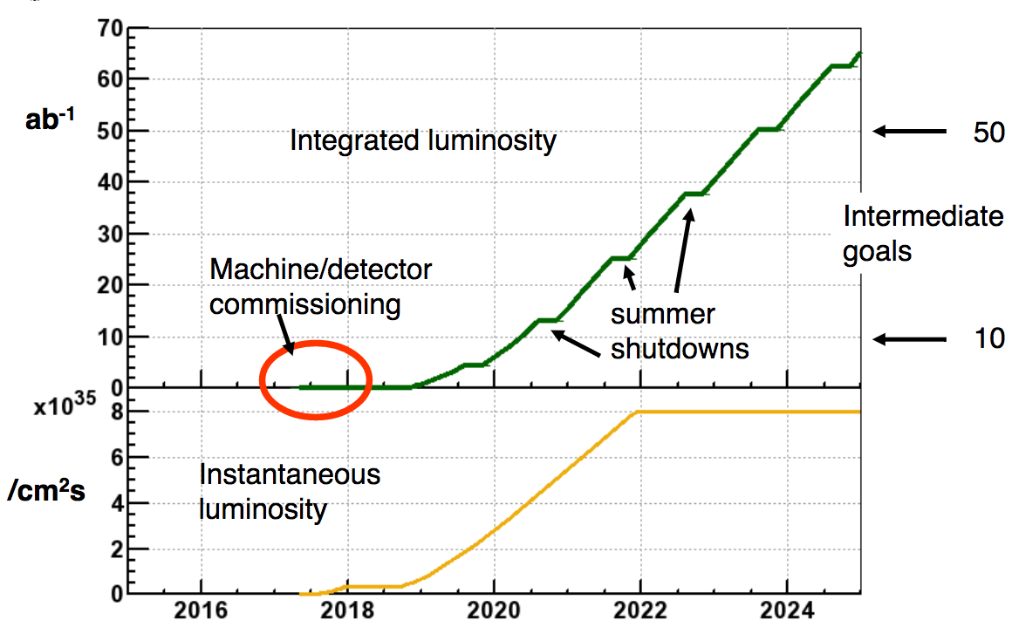
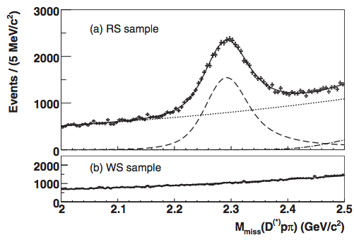
Competition from Belle & BelleII
Belle, PRL113, 042002 (2014)
Signal tags: 36447±432 @ 978/fb
Belle tags ~36K ${ Λ}_{c}^{+}$, while BESIII now tags 15K${ Λ}_{c}^{+}$ (567/pb@4.6GeV)
By middle of 2019, Belle-II will have 5/ab data, 5x of BELLE data; ➔ 180K ${ Λ}_{c}^{+}$ tagging; 12x BESIII data
We shall have 10x more ${ Λ}_{c}^{+}$ pairs ASAP
Many precise measurements at BESIII will reach to the level of systematic dominated ➔ BESIII has advantages on backgrounds and systematics

Slide 38
Energies go up to 5GeV

Slide 39
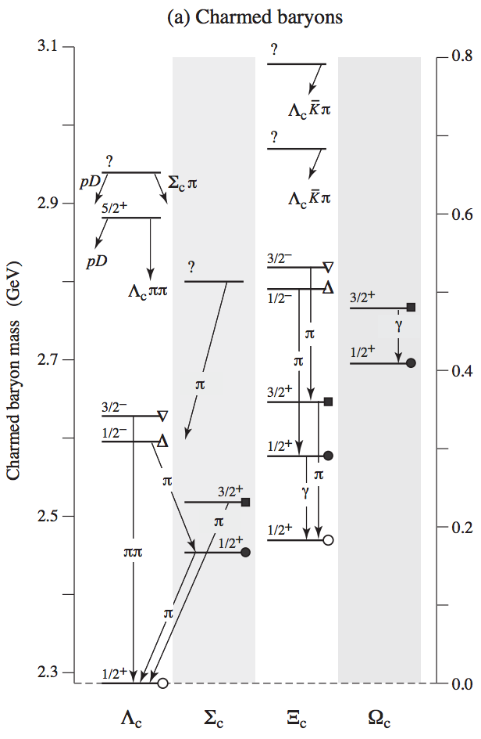
The charmed baryon spectroscopies
u d
u u
u d
c
c
c
$$Λ_{c}^{+}$$
$${Σ }_{c}^{++}$$
$${Σ }_{c}^{+}$$
u s
s d
d d
c
c
c
$$Ξ_{c}^{+}$$
$$Ξ_{c}^{0}$$
$${Σ }_{c}^{0}$$
If BEPCII can access energies up to 5GeV, we can study the $Λ_{c}$, $Σ_{c}$ and $Ξ_{c}$ at threshold.
Study on the isospin triplet $Σ_{c}$
First absolute measurements of $Ξ_{c}$ decays

Slide 40
Partiale Width of decay of $Σ_{c}^{+}$
(MeV)
Precise determination of $Γ\left(Σ_{c}^{+}→Λ_{c}^{+}π^{0}\right)$ can be used for for testing heavy quark symmetry and chiral symmetry
measurements of $Σ_{c}^{+}$ & Σ_{c}(2520) widths by Belle [PRD89, 091102 (2014)]: $Γ\left(Σ_{c}^{+}→Λ_{c}^{+}π^{0}\right)$ is not easy for Belle; BESIII has potential to improve it.
Wise; Yan et al.; Burdman, Donoghue (’92)
BESIII will search for the EM decay
(keV)

Slide 41
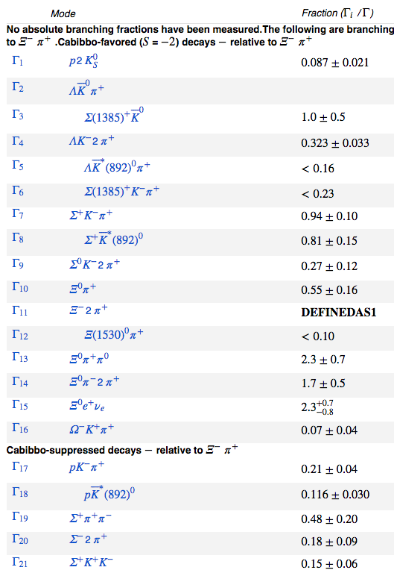
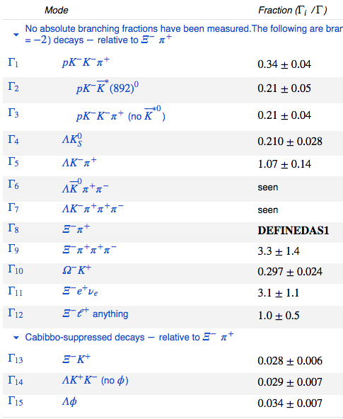
$Ξ_{c}^{}$ (usc)： 3-star particle in PDG
No absolute branching fractions have been measured/calculated
$Ξ_{c}^{+}$: relative to the decay of $Ξ^{−}2π^{+}$
$Ξ_{c}^{0}$: relative to the decay of $Ξ^{−}π^{+}$
Very limited knowledge on their decays
We have opportunity to firstly fill up the decay tables

Slide 42
Most of the $Ξ_{c}^{}$ weak decays to BP are missing in experiment.
BFs of Cabibbo-allowed decays
RQM Pole Pole RQM Pole Pole
(in units of %)

Slide 43
Most of the $Ξ_{c}^{}$ weak decay asymmetries are missing in experiment.
Decay asymmetry α for Cabibbo-allowed decays
Longitudinal pol. of daughter baryon from unpol. parent baryon
⇒ information on the relative sign between s- and p-waves

Slide 44
Charm-flavor-conserving weak decays
Light quarks undergo weak transitions, while c quark behaves as a “spectator” e.g. Ξ_{c}→ Λ_{c}π. Can be studied using HHChPT.
$$\text{s}→W^{−}u$$
Br(Ξ_{c}⁰→Λ_{c}⁺π⁻) = 2.9×10⁻⁴
Br(Ξ_{c}⁺→Λ_{c}⁺π⁰) = 6.7×10⁻⁴
can be firstly explored at BESIII
Cheng, Cheung, Lin, Lin, Yan, Yu (’92)
Semileptonic decays
|→ NRQM ←|
RQM
LFQM
QSR QSR
in units of 10¹⁰ s⁻¹

Slide 45
Thanks

