Slide 1


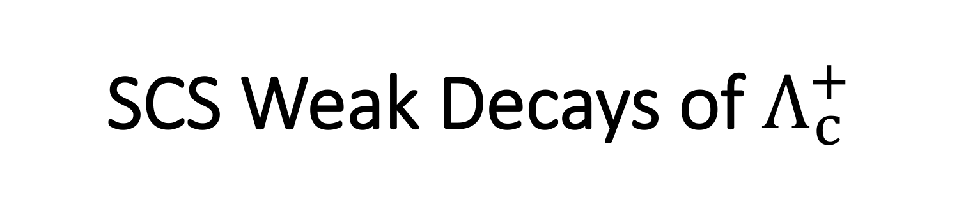
SCS Weak Decays of $Λ_{c}^{+}$
徐繁荣
暨南大学
BESIII 粲强子物理研讨会
武汉大学，2018 年 11月10日

Slide 2
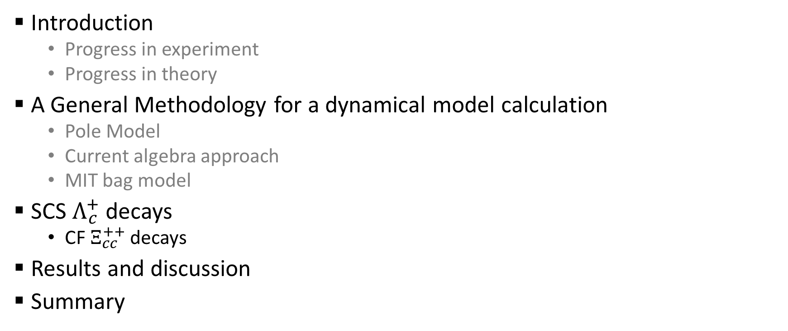
Outline
Introduction
  Progress in experiment
  Progress in theory
A General Methodology for a dynamical model calculation
  Pole Model
  Current algebra approach
  MIT bag model
SCS $Λ_{c}^{+}$ decays
  CF $Ξ_{cc}^{++}$ decays
Results and discussion
Summary
Hai-Yang Cheng, Xian-Wei Kang, FRX, PRD 97, 074028 (2018);
Hai-Yang Cheng, FRX work in progress

Slide 3
Introduction

Slide 4
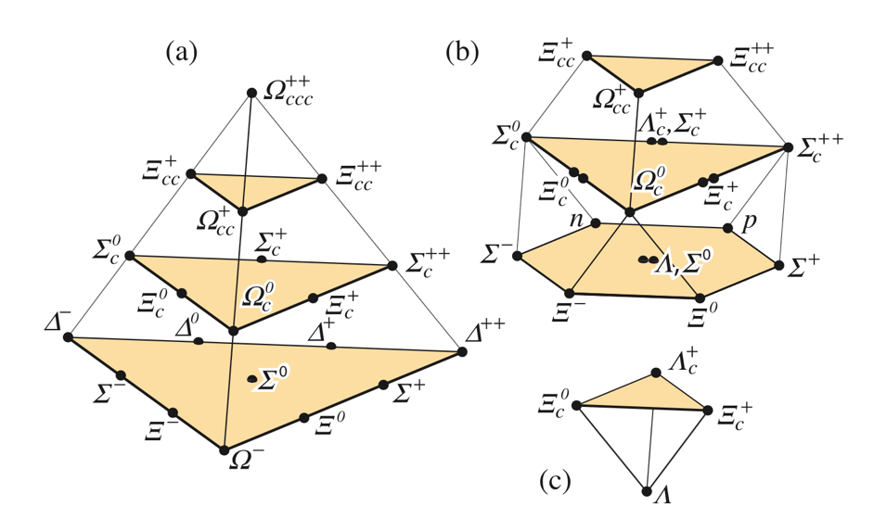
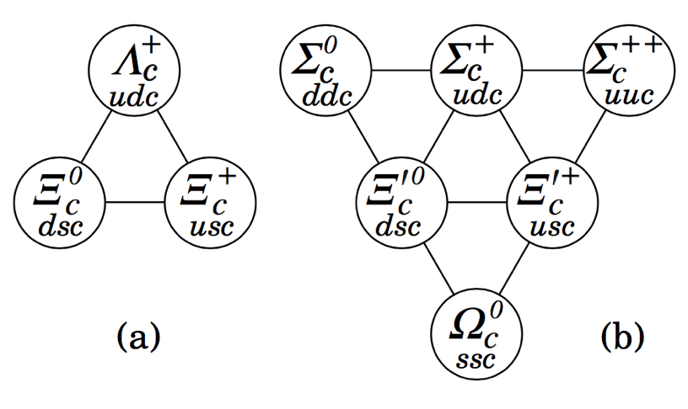
Introduction
Baryons in quark model
Singly charmed baryons
SU(4)
SU(3)

Slide 5
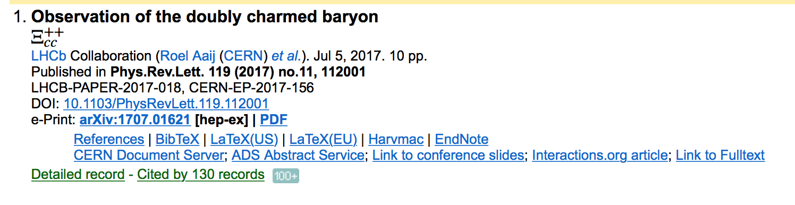
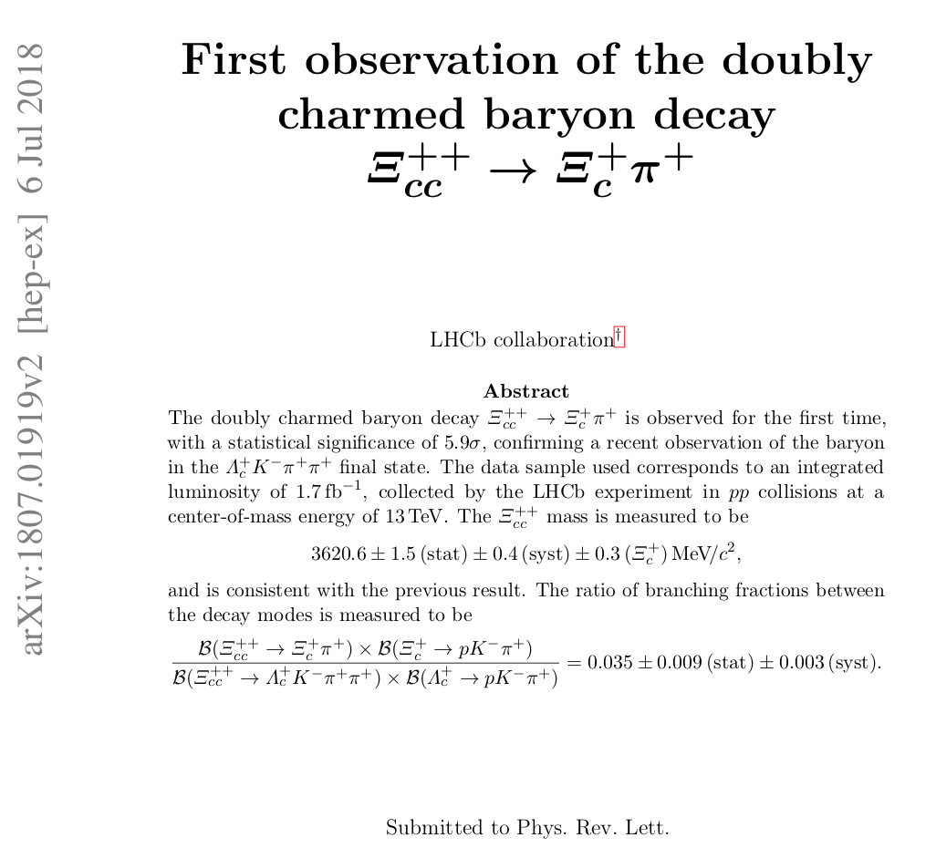
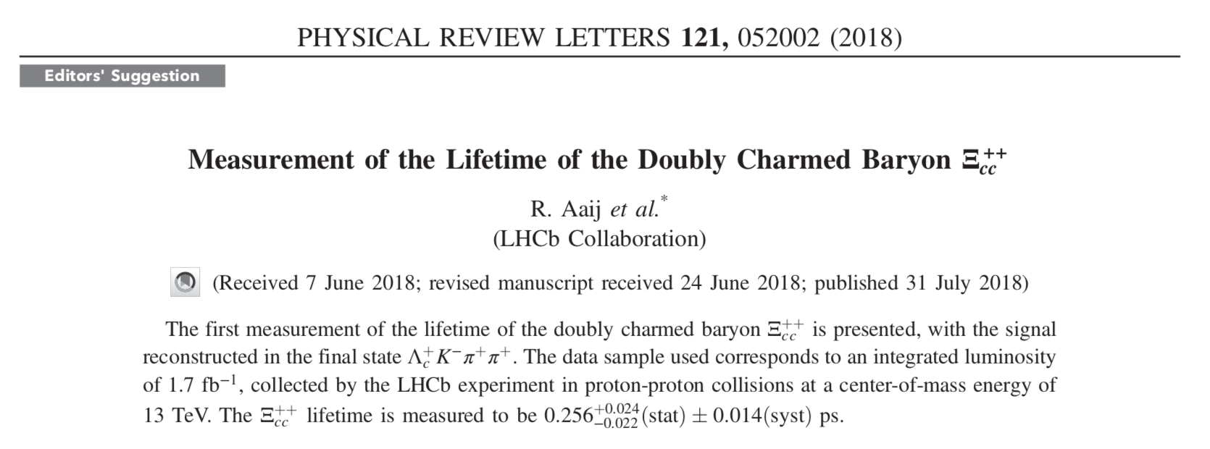
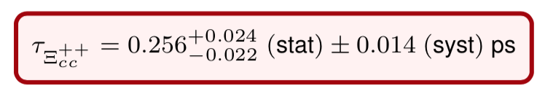
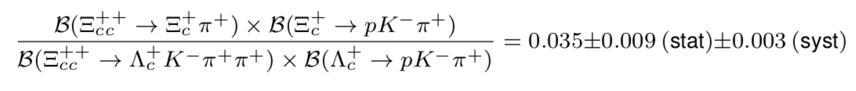

Introduction
Progress in doubly charmed baryons
  2017: $Ξ_{cc}^{++}$ discovered
  2018: $Ξ_{cc}^{++}$ lifetime measured, $Ξ_{cc}^{++}→Ξ_{c}^{+}π^{+}$measured

Slide 6
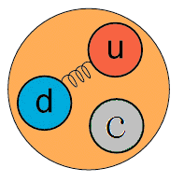
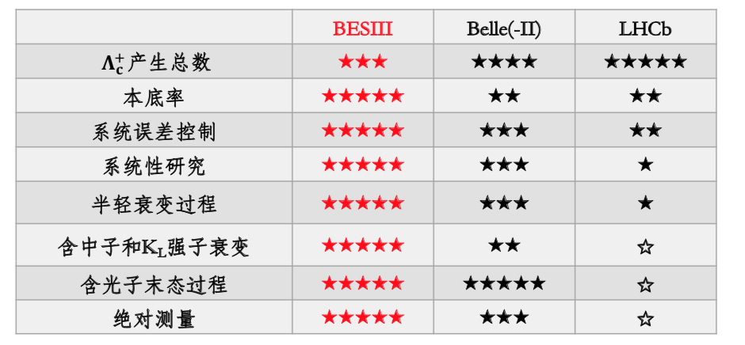
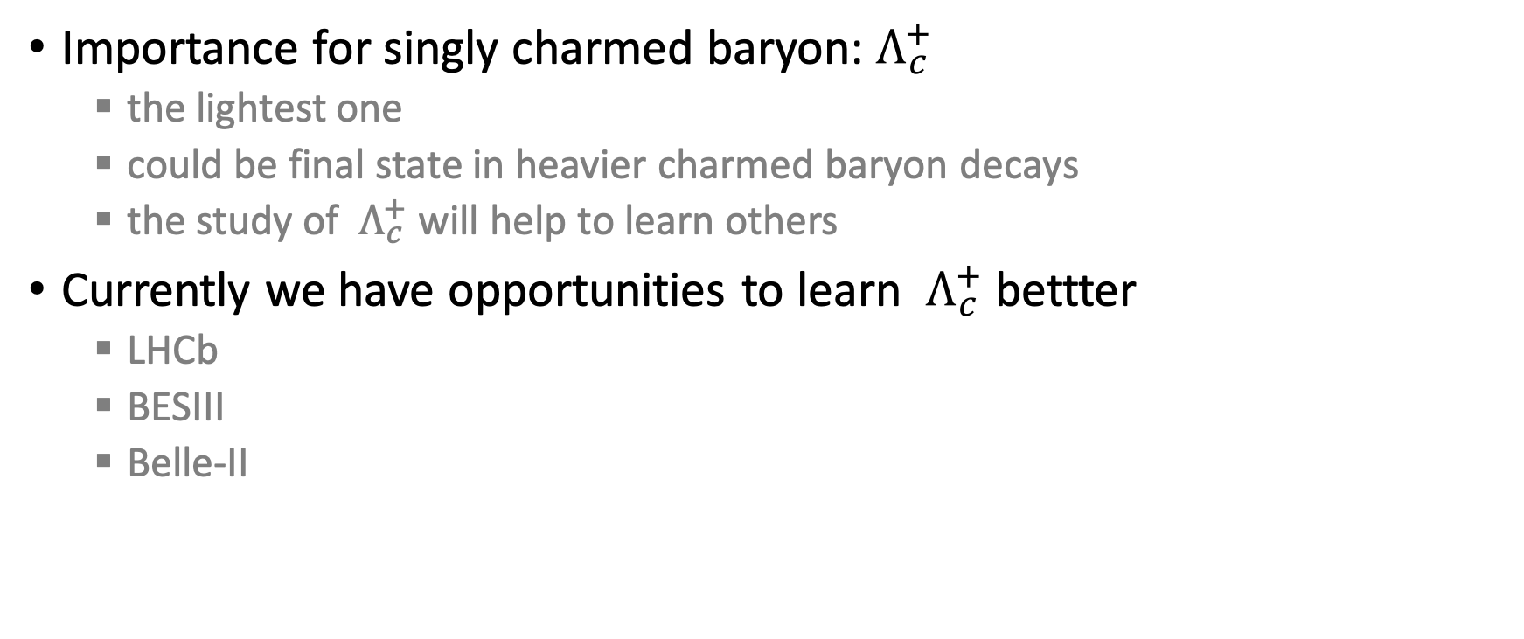
Importance for singly charmed baryon:${ Λ}_{c}^{+}$
  the lightest one
  could be final state in heavier charmed baryon decays
  the study of ${ Λ}_{c}^{+}$ will help to learn others
Currently we have opportunities to learn ${ Λ}_{c}^{+}$ bettter
  LHCb
  BESIII
  Belle-II
-C.P. Shen’s talk in HFCPV 2018

Slide 7
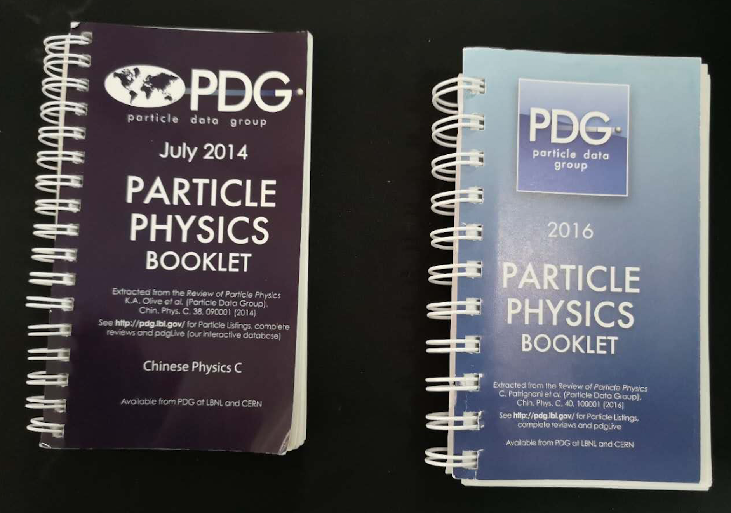
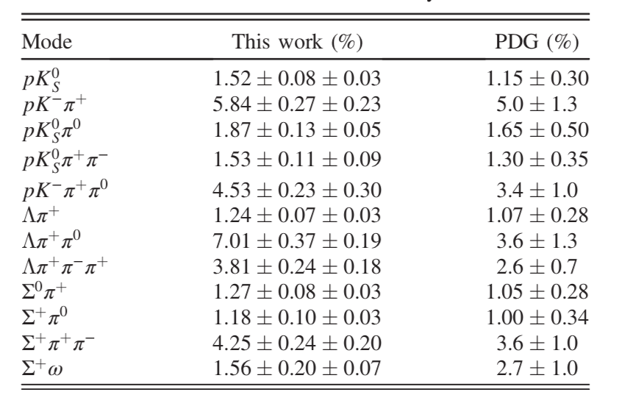
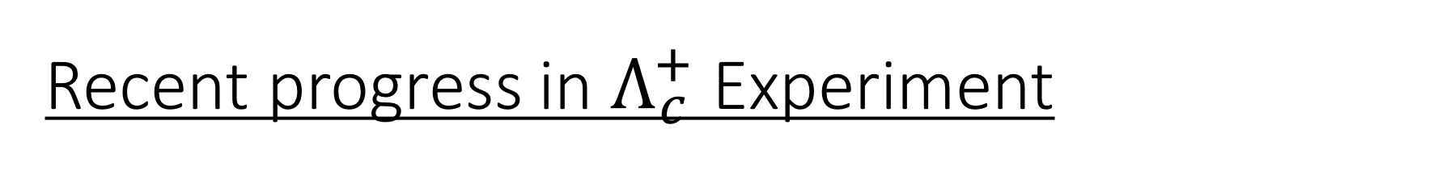

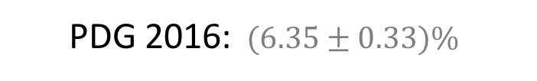
Recent progress in $Λ_{c}^{+}$ Experiment
$ℬ(Λ_{c}^{+}→pK^{−}π^{+}$)
  ARGUS + CLEO :$(5.0±1.3)\%$
  Belle: $(6.84±{0.24}_{−0.27}^{+0.21})\%$
  BESIII: $(5.84±0.27±0.23)\%$
12 modes measured by BESIII
PDG 2014
Belle, PRL 113 （2014), 042002
BESIII, PRL 116（2016）, 052001
  PDG 2016: $(6.35±0.33)\%$
PDG values for $Λ_{c}^{+}$ decay BFs before 2016 version become obsolete
Notes:
model dependence
model independence

Slide 8

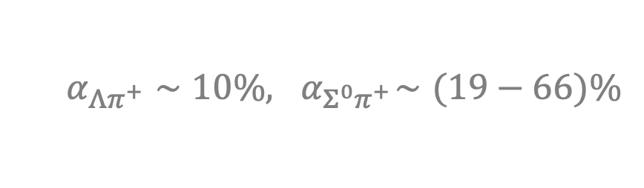
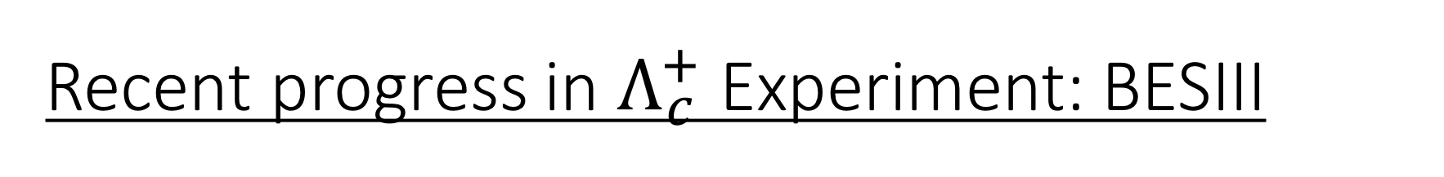
Recent progress in $Λ_{c}^{+}$ Experiment: BESIII
Singly-Cabibbo-suppressed decay has been measured
Neutral mode can be measured
The sensitivity of decay asymmetry will be improved
More precise measurement of Cabibbo-favored process
BESIII, PRD 95（2017), 111102
BESIII, PRL 118（2016), 112001
  $$α_{Λπ^{+}}∼10\%,{ α}_{Σ^{0}π^{+}}∼(19−66)\%$$
D. Wang, R.-G. Ping, L. Li, X.-R. Lyu, Y.-H. Zheng , Chin. Phys. C 41 (2017) 023106
BESIII, PLB 783（2018), 200-206

Slide 9

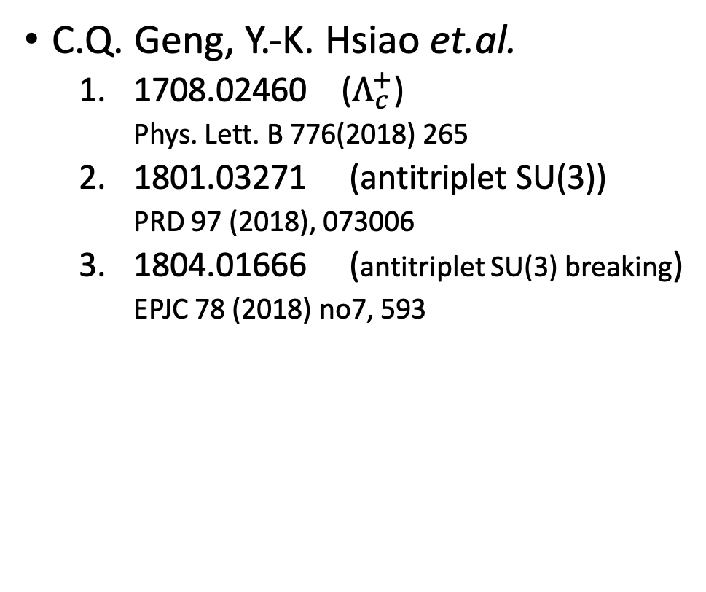
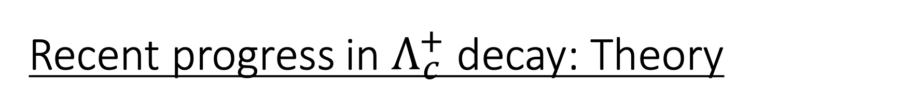
Recent progress in $Λ_{c}^{+}$ decay: Theory
C.D. Lu, W. Wang, F.-S. Yu et. al.
  1601.04241 ($Λ_{c}^{+}$ SU(3))
    PRD93(2016), 056008
C.Q. Geng, Y.-K. Hsiao et.al.
  1708.02460 ($Λ_{c}^{+}$)
    Phys. Lett. B 776(2018) 265
  1801.03271 (antitriplet SU(3))
    PRD 97 (2018), 073006
  1804.01666 (antitriplet SU(3) breaking)
    EPJC 78 (2018) no7, 593

Slide 10
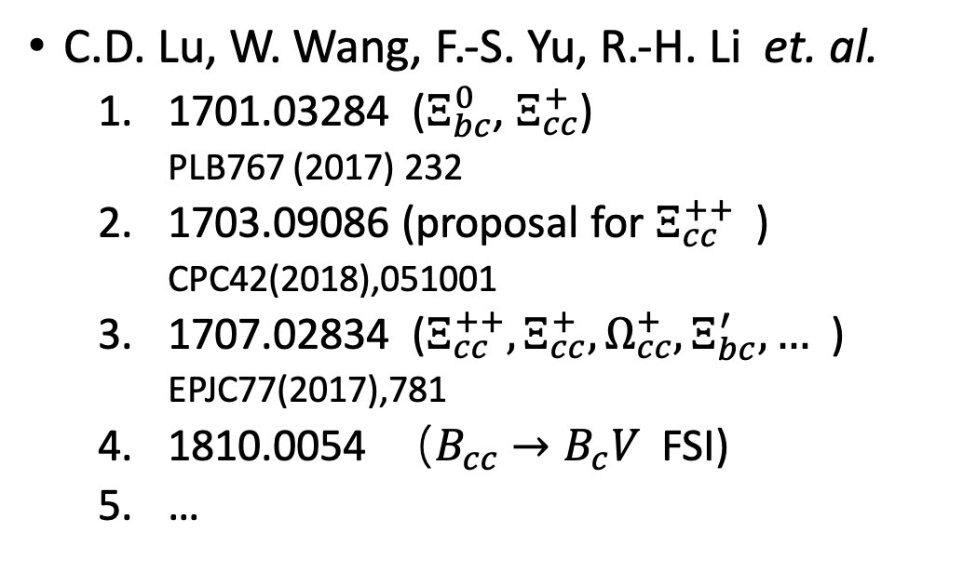
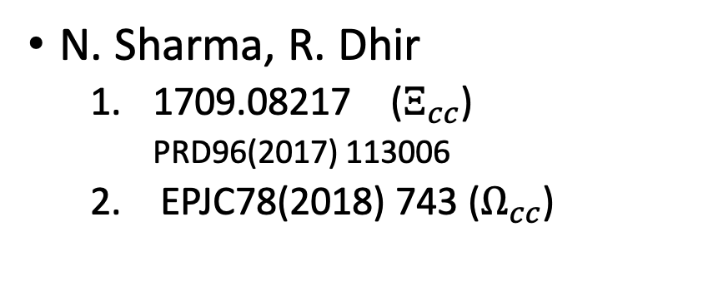
Other charmed baryon & other decays : Theory
C.D. Lu, W. Wang, F.-S. Yu, R.-H. Li et. al.
  1701.03284 ($Ξ_{bc}^{0}$, $Ξ_{cc}^{+}$)
    PLB767 (2017) 232
  1703.09086 (proposal for $Ξ_{cc}^{++}$ )
    CPC42(2018),051001
  1707.02834 ($Ξ_{cc}^{++},Ξ_{cc}^{+},Ω_{cc}^{+},Ξ_{bc}^{′},…$ )
    EPJC77(2017),781
  1810.0054 （$B_{cc}→B_{c}V$ FSI)
  …
C.Q. Geng, Y.-K. Hsiao
  1709.00808 (charmed baryon)
    JHEP 1711(2017) 147
  1810.01079 (3-body decay)
N. Sharma, R. Dhir
  1709.08217 ($Ξ_{cc}$)
    PRD96(2017) 113006
  EPJC78(2018) 743 ($Ω_{cc}$)
fac. + part of nf.

Slide 11
Hadronic weak decay theory
Diagrammatic scheme (Chau, Cheng, Tseng; Kohara)
Factorizable contribution
Two distinct internal W emission diagrams, three different W exchange diagrams
Need information of decay asymmetry to extract s-wave and p-wave amplitudes separately
Non-Factorizable contribution

Slide 12
Fac. vs. NF. contribtuon
Some processes only have fac. contribution
Some only have nf. contribution
Some have both fac. & nf. contribution

Slide 13
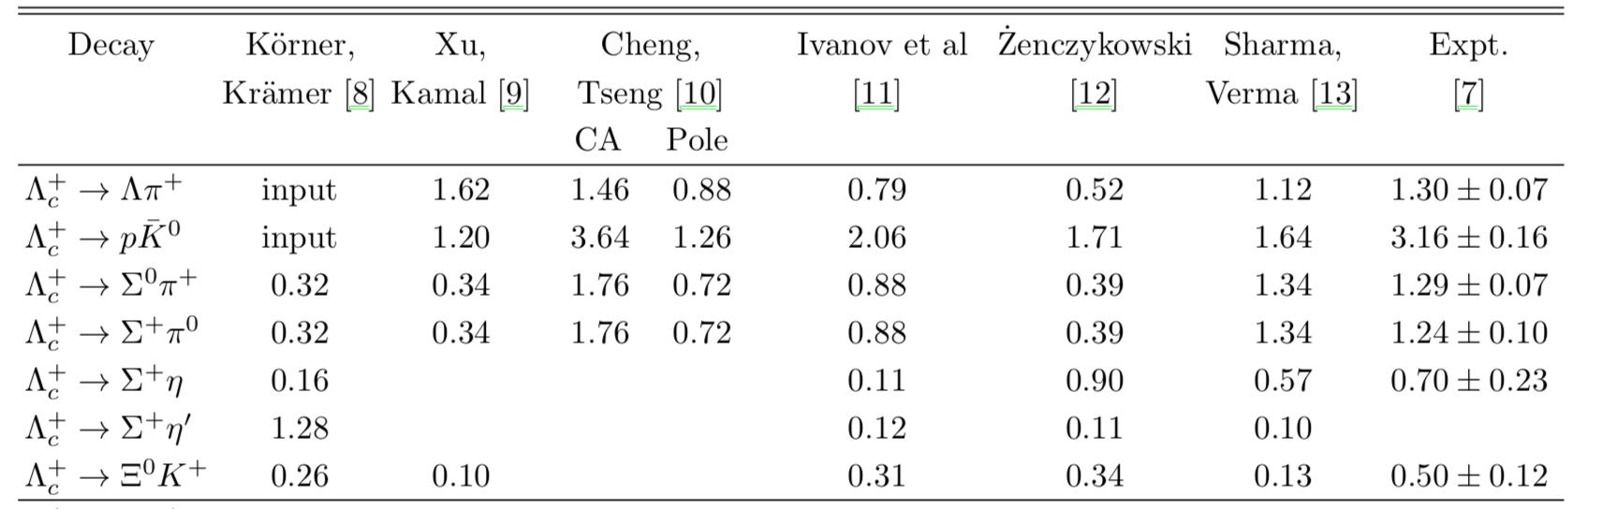
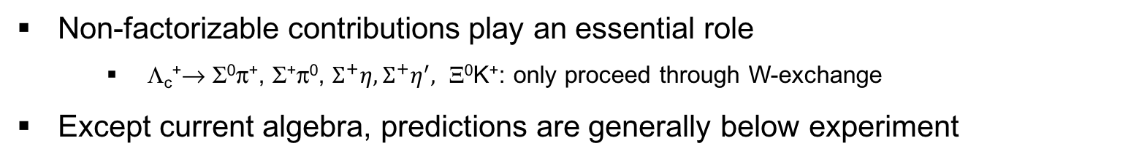
BF of Cabbibo-favored decays in 1990s
RQM Pole Pole RQM Pole C.A.
Non-factorizable contributions play an essential role
  Λ_{c}⁺→ Σ⁰π⁺, Σ⁺π⁰, $Σ^{+}η, Σ^{+}η^{′},$ Ξ⁰K⁺: only proceed through W-exchange
Except current algebra, predictions are generally below experiment

Slide 14
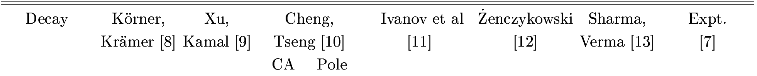

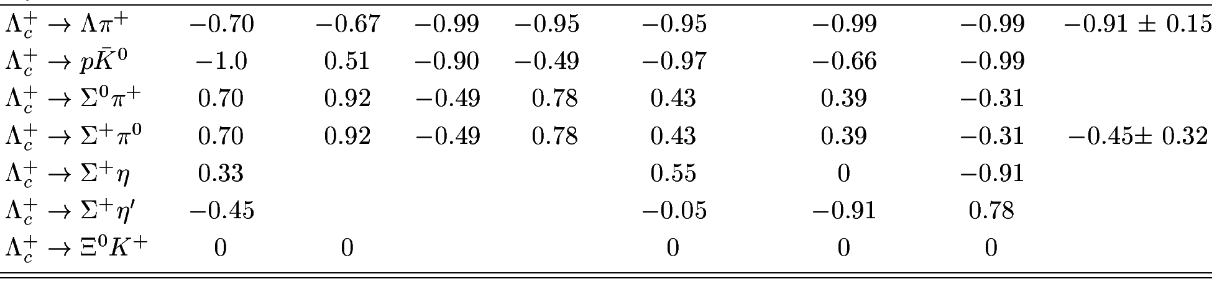
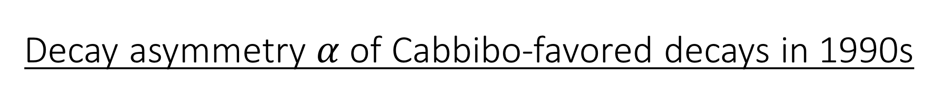
Decay asymmetry $α$ of Cabbibo-favored decays in 1990s
RQM Pole Pole RQM Pole C.A.
Λ_{c}⁺→ Σ⁺π⁰:
  CLEO (’95) measured α = -0.45±0.31±0.06
  Pole model & RQM predict positive α
  Current algebra leads to negative α
    -0.49 by H.-Y. Cheng et al.,
    -0.76 by Zenczykowski (hep-ph/9309265),
    -0.47 by Datta (hep-ph/9504428),
    -0.31 by Sharma et al.
Λ_{c}⁺→ Ξ⁰ K⁺
  theory: small s-wave ⇒ α = 0
  experiment ?
BESIII, PLB 783（2018), 200-206
The remaining challenge for us!

Slide 15
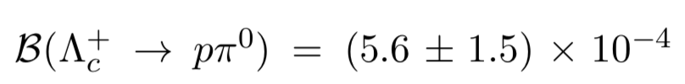
Theoretical progress in singly charmed baryons
SU(3) approach gives useful guidance
  C.D. Lu, W. Wang, F.-S. Yu, PRD 93 (2016), 056008
  Geng, Hsiao, Liu, Tsai, JHEP 1711, 147 (2017)
Some aspects need to be more careful
The decay asymmetry still requires a dynamical calculation!
SU(3)
BESIII:
now is solved in SU(3) approach
-- C.Q. Geng’s talk

Slide 16
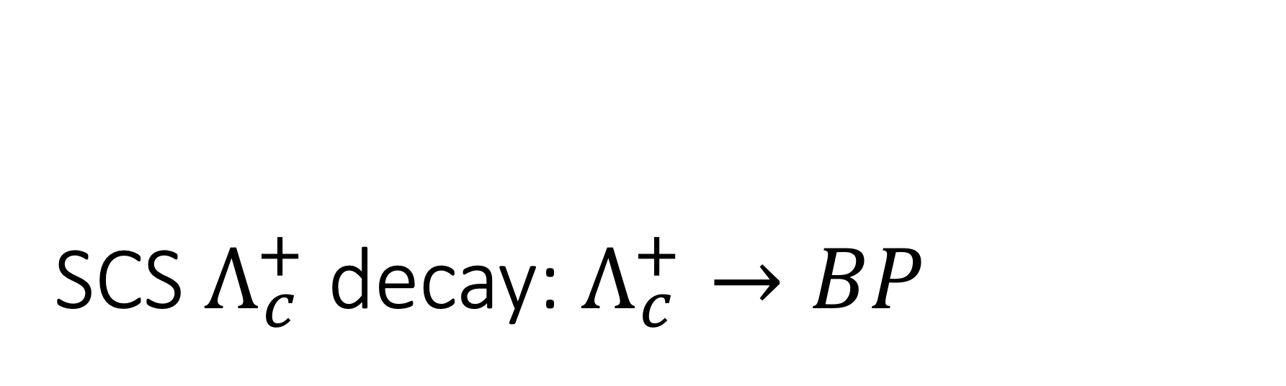
SCS $Λ_{c}^{+}$ decay: $Λ_{c}^{+}→BP$
A dynamical model calculation

Slide 17
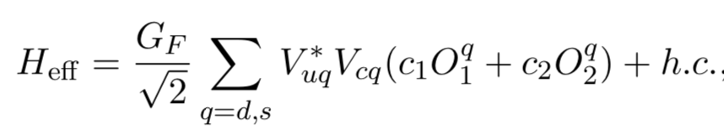
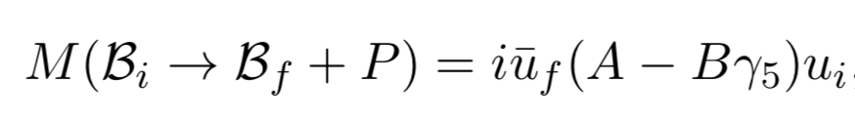
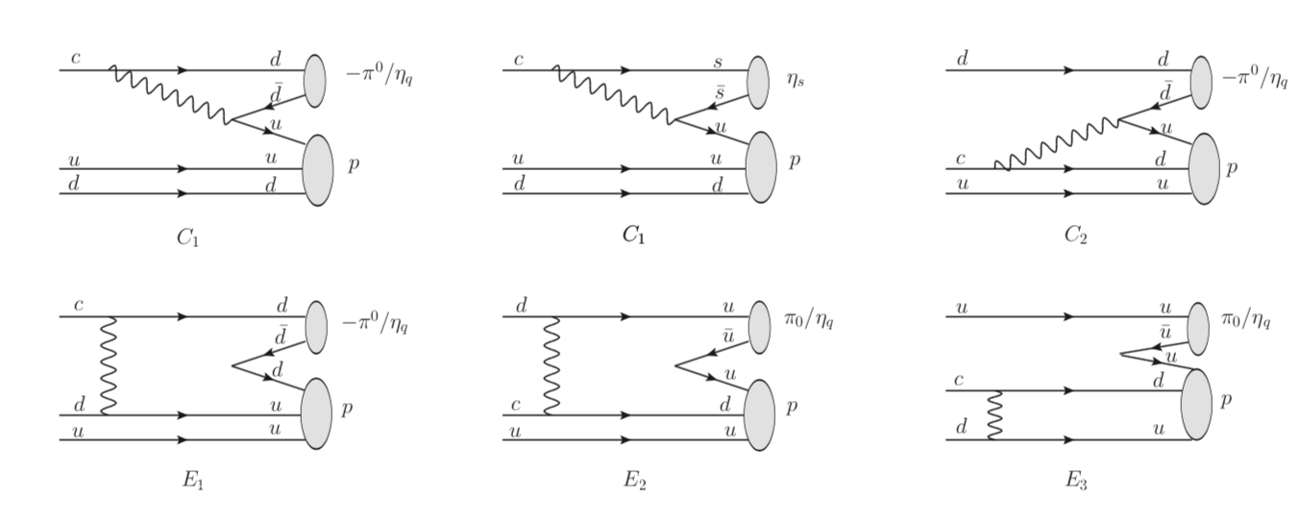
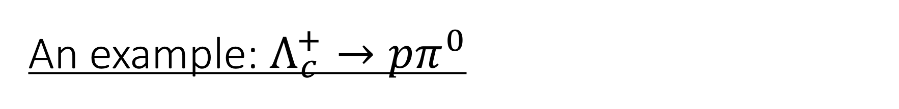
An example: $Λ_{c}^{+}→pπ^{0}$
internal W emission 1
internal W emission 2
W-exchange

Slide 18
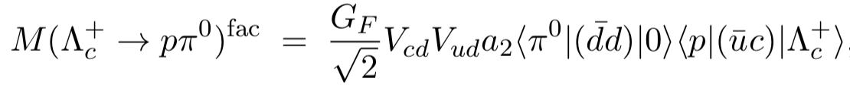
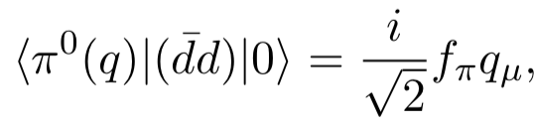
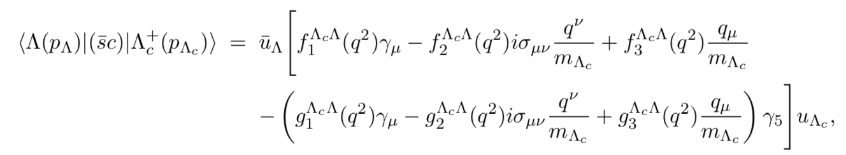

Factorizable contribution
$$a_{2}=c_{2}+c_{1}/N^{eff}$$
  The form factors rely on model calculation
  The Wilson coefficients rely on effective N

Slide 19


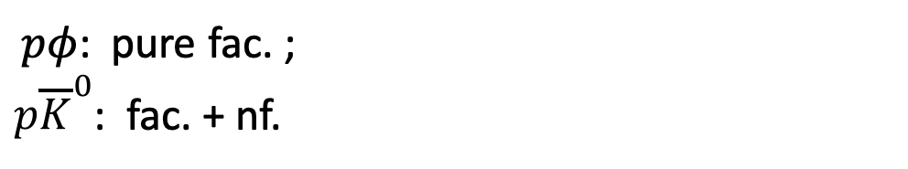
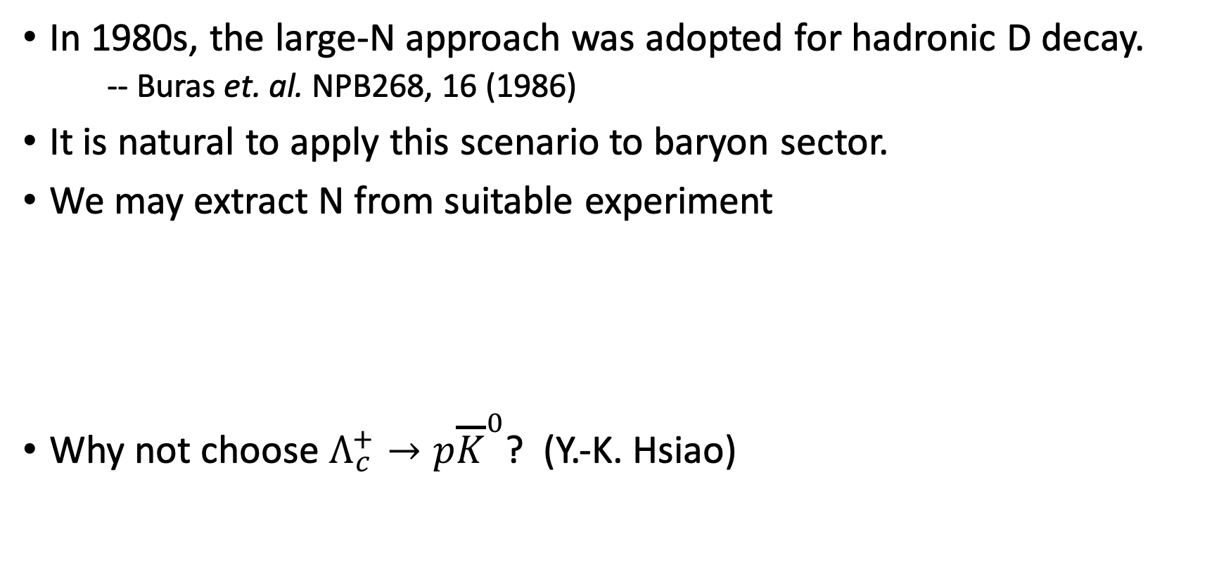
The issue about effective N
In 1980s, the large-N approach was adopted for hadronic D decay.
  -- Buras et. al. NPB268, 16 (1986)
It is natural to apply this scenario to baryon sector.
We may extract N from suitable experiment
Why not choose $Λ_{c}^{+}→p{\overline{K}}^{0}$? (Y.-K. Hsiao)
BESIII, Phys. Rev. Lett. 117, 232002 (2016).
  $$c_{1}=1.346, c_{2}=−0.636$$
$${|a}_{2}|=0.45±0.03, N^{eff}=7$$
$pφ$: pure fac. ;
${p\overline{K}}^{0}$: fac. + nf.

Slide 20

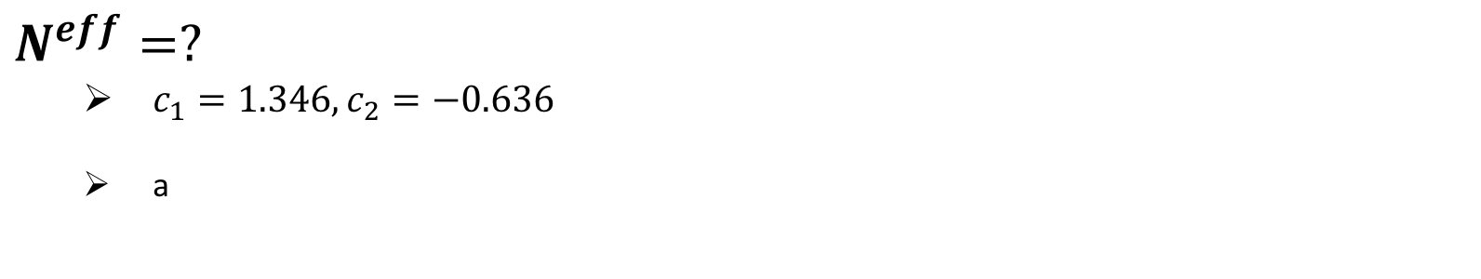

Factorizable contribution
$$a_{2}=c_{2}+c_{1}/N^{eff}$$
$$N^{eff}=?$$
  $c_{1}=1.346, c_{2}=−0.636$
  a
$${|a}_{2}|=0.45±0.03, N^{eff}=7$$
internal W-emission governed
BESIII, Phys. Rev. Lett. 117, 232002 (2016).

Slide 21
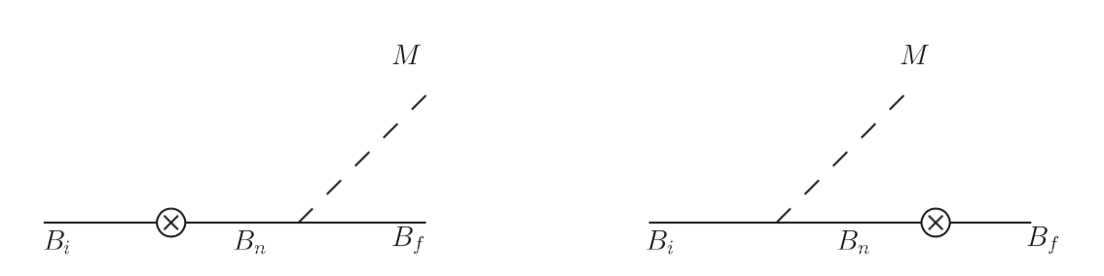
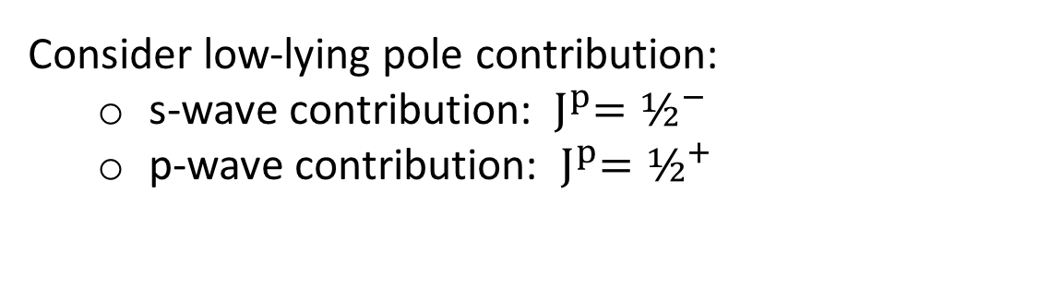
Non-factorizable contribution: Pole model
s-wave
p-wave
Dynamic model calculation
  Pole model
  Relativistic QM: Korner, Kramer, Ivanov…
Consider low-lying pole contribution:
  s-wave contribution: ${ J}^{p}=½^{−}$
  p-wave contribution: ${{ J}^{p}=½}^{+}$

Slide 22
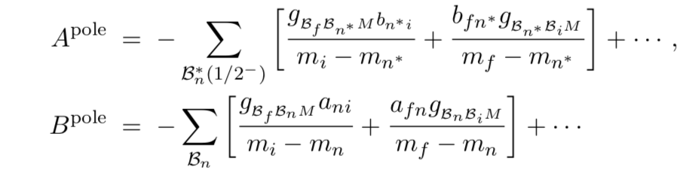
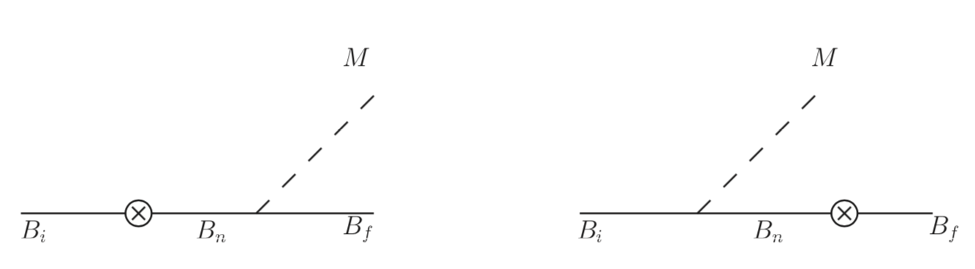
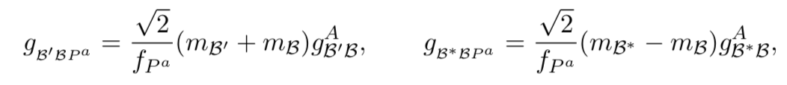
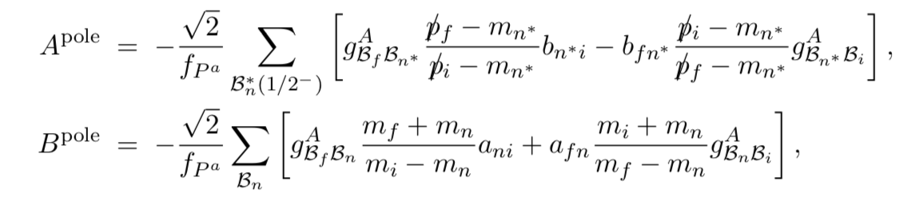
Non-factorizable contribution: Pole model
GT relation

Slide 23
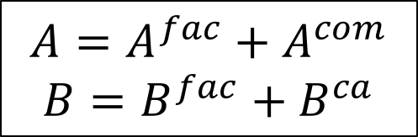
Current Algebra Approach
soft pseudoscalar-meson limit
s-wave, p-wave amplitudes
$$A={A^{fac}+A}^{com}$$
$$B=B^{fac}+B^{ca}$$

Slide 24
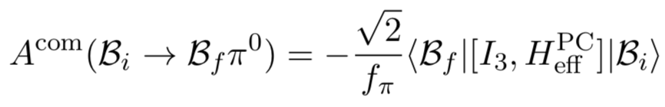


s-wave, p-wave contribution
Calculation of commutator

Slide 25







Baryon Matrix element:
MIT bag model calculation

Slide 26


Strong coupling:
MIT bag model calculation
axial-vector form factor
GT relation

Slide 27
Results and Discussion

Slide 28




Numerical results
The measured mode $pη$ , BF is in great agreement with experiment.
Several unmeasured mode, including $pπ^{0}$ and ${nπ}^{+}$, are predicted for both BF and $α$.
All decay asymmetries are predicted negative.

Slide 29


Numerical results
preliminary
Two different FF scenario are adopt, seems scalar diquark spectator are more reasonable.
NF contribution are sizebale for $Ξ_{cc}^{++}→Ξ_{c}^{+}π^{+}$, but the results need to be further comfirmed.

Slide 30


Comparison of BF with different groups
(10⁻³ )
SU(3) QM Fac. SU(3) SU(3) C.A.

Slide 31

Comparison of BF with different groups
preliminary
no s-wave Fac.

Slide 32




$$Λ_{c}^{+}→pπ^{0}, nπ^{+}$$
SU(3) approach: assumption of sextet 6 ($O_{−}$) dominance over 15 ($O_{+}$)
$pπ^{0}$ exceeded experiment limit,
then improved by including 15bar
⇒ $Γ\left(Λ_{c}^{+}→nπ^{+}\right)=2Γ(Λ_{c}^{+}→pπ^{0})$
Such relation is not hold for factorizable amplitude (consider both $O_{−}$ and $O_{+}$ contribution)

Slide 33


$$Λ_{c}^{+}→pπ^{0}, pη$$
The reason for $B\left(pη\right)>B(pπ^{0})$
Nonfactorizable terms contribute
constructively to $pη$
destructively to $pπ^{0}$

Slide 34

Summary
$Λ_{c}^{+}$ SCS decays have been calculated in a dynamic model.
$pη$ finds in great agreement with experiment.
$pπ^{0} , nπ^{+}$ and some other modes have been predicted;
$pπ^{0}$ satisfies current BESIII experiment limit.
All decay asymmetries are calculated to be negative, testable by BESIII.
Especially, BESIII has the capability to confirm the prediction of $pπ^{0} , nπ^{+}$ soon.
Preliminary doubly charmed baryon results are obtained.

Slide 35

To do list
$Λ_{c}^{+}→B P$
  a full pole model calculation: NR quark model calculation
$Λ_{c}^{+}→B V$
  ${\frac{1}{2}}^{−}$ state contribution to s-wave is not avoidable
$Ξ_{c}^{+,0}$decay ( BESIII, Belle(-II) )
doubly charmed baryon decay (LHCb)
doubly bottom baryon decay
…
Need your kind encouragement !

