Slide 1
News
Zhijun Liang
Institute of High Energy Physics ,
Chinese Academy of Science

Slide 2
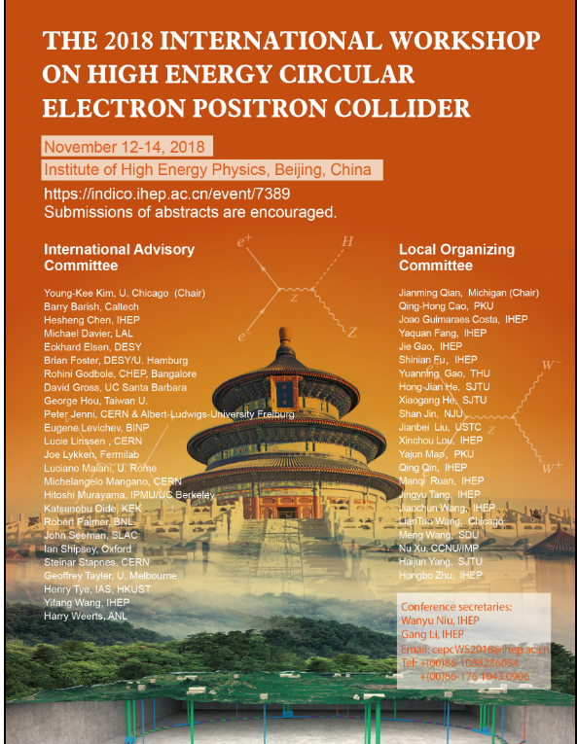
CEPC workshop
CEPC workshop (Nov 12-14, 2018)
https://indico.ihep.ac.cn/event/7389/
Electroweak section conveners:
Ayres Freitas
Maarten Boonekamp
Zhijun Liang

Slide 3
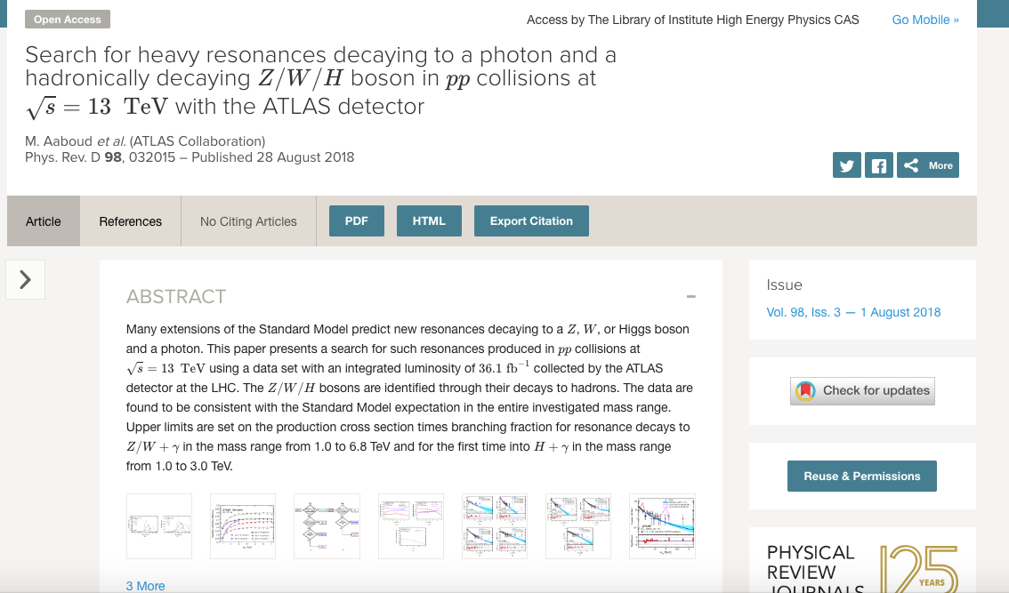
V/H+gamma high mass search
Published in PRD.
https://journals.aps.org/prd/abstract/10.1103/PhysRevD.98.032015

Slide 4
Contribution to Hcomb paper

Slide 5
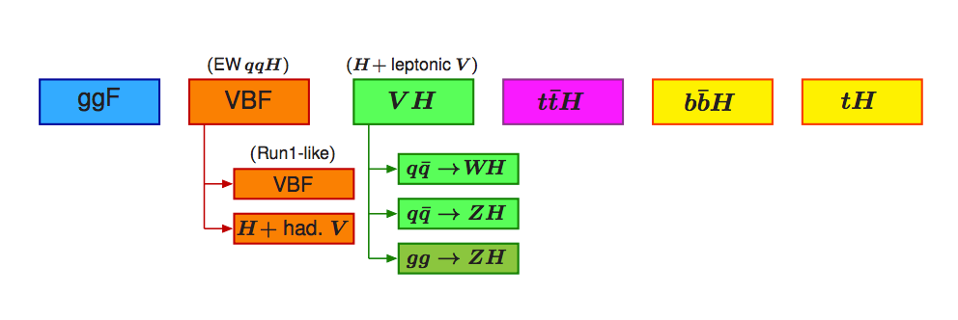
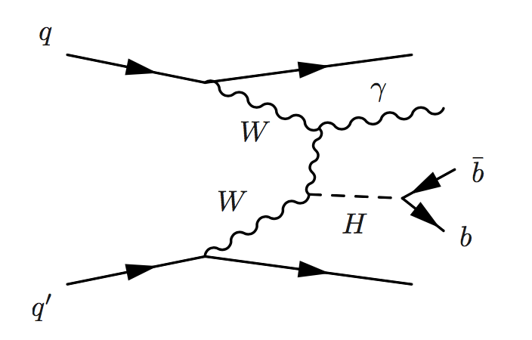
Question about stage 0
How does VBF H(bb)+gamma fit into this ?
Added one category (VBF+𝛾) under VBF ?
H+𝛾
VBf+𝛾

Slide 6
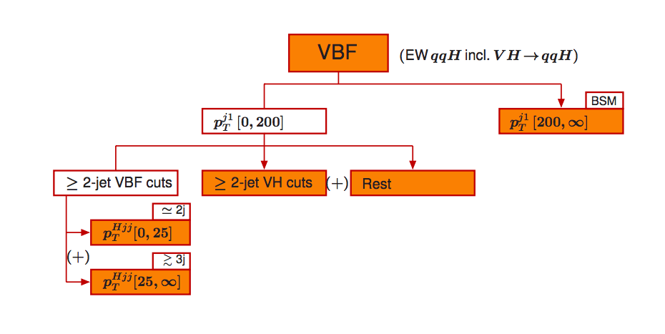
Question about stage 1:
VBF+gamma only has about 10 events .
Shall we just use one bin ?

