Slide 1

CEPC Detector Magnet
Conceptual Design Report
Wei Zhao, IHEP
For the Magnet group
CEPC international review, Beijing, SEP. 2018

Slide 2
Outline
Introduction
Magnetic field design
Superconducting coil
Cryogenic system
Iron yoke
Alternative designs and R&D
Summary

Slide 3
Introduction
Tunnel layout in the IR

Slide 4
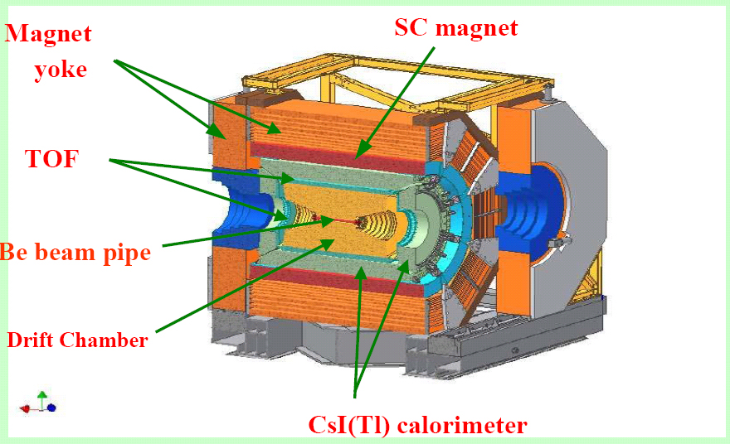
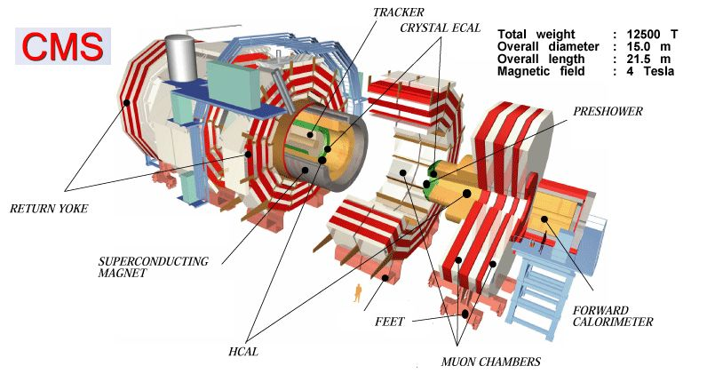
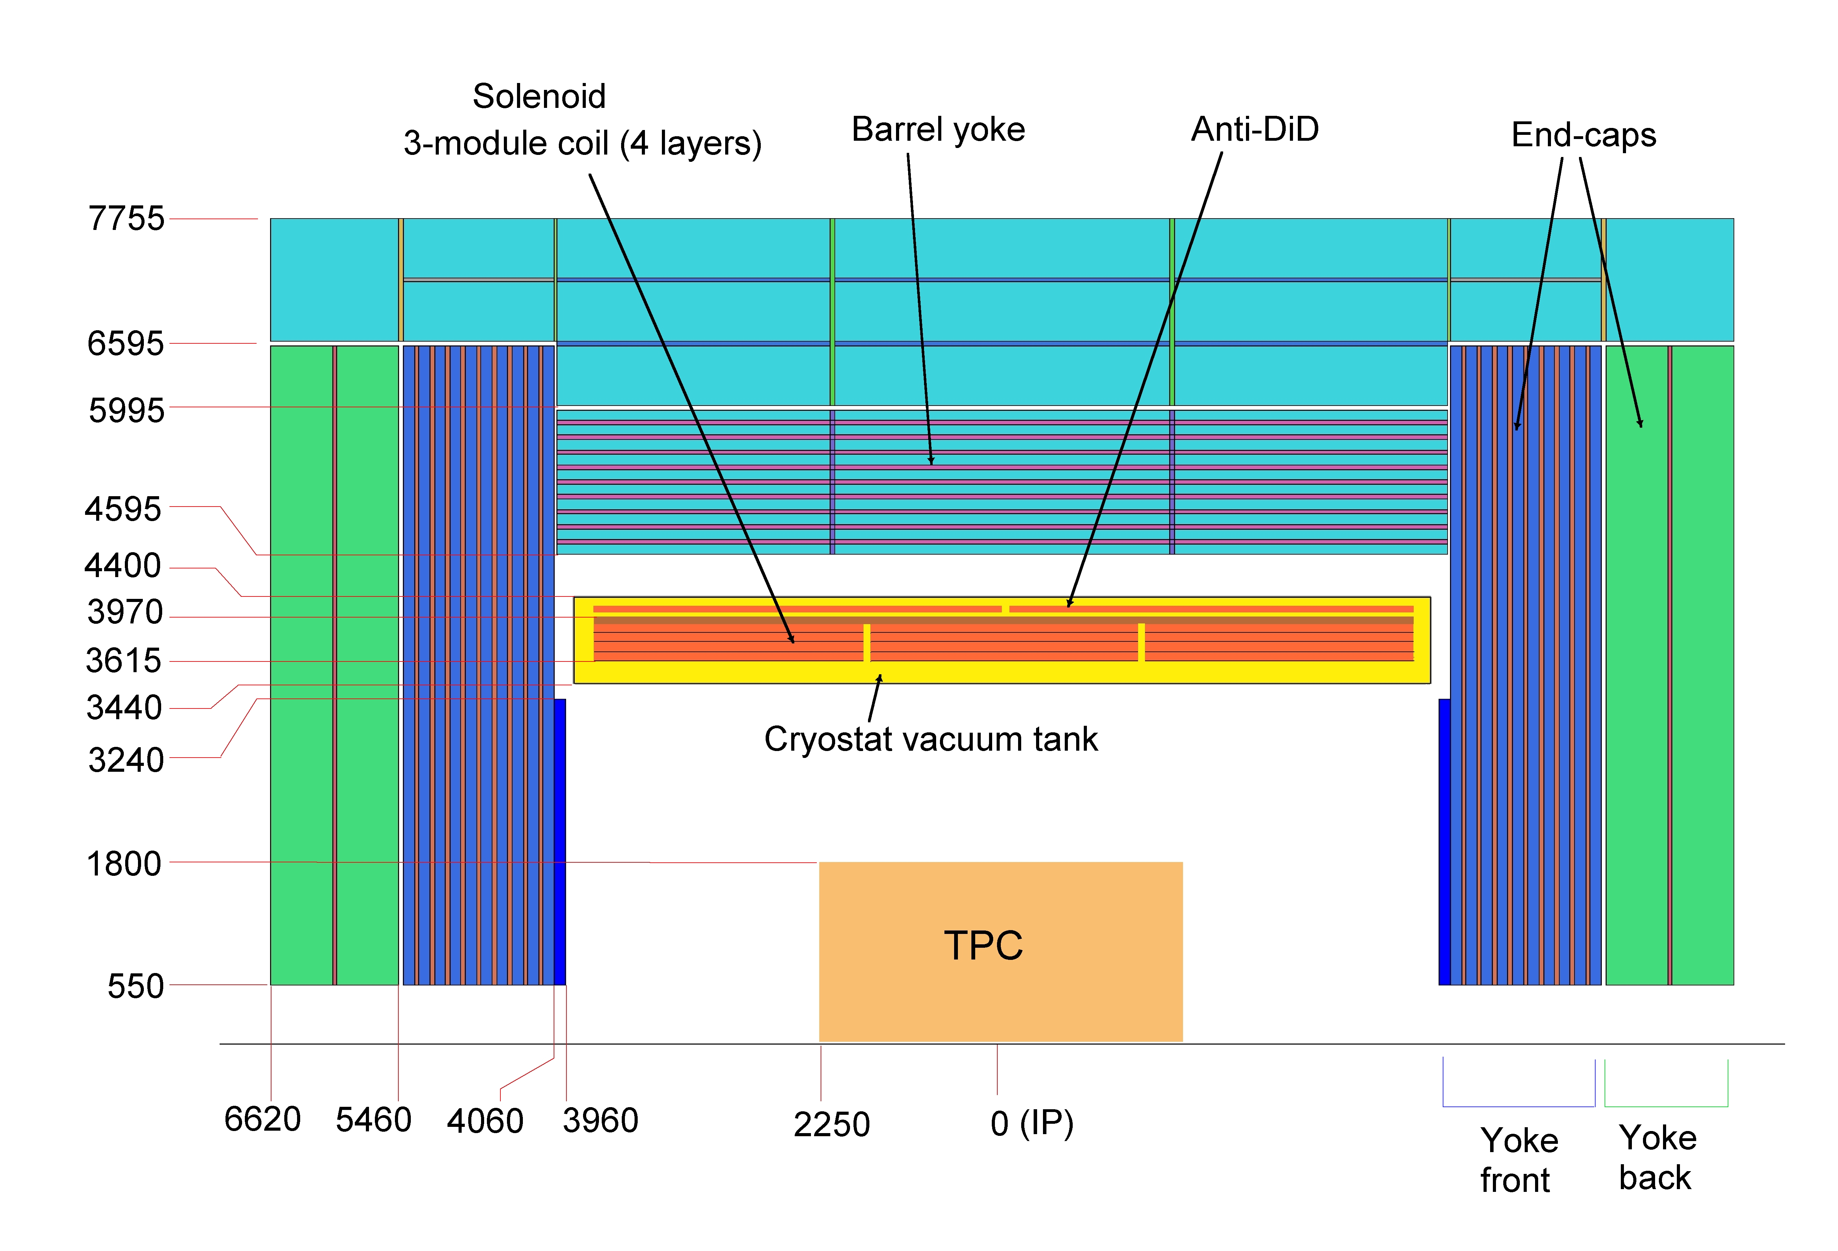
Introduction
Design Philosophy
The CEPC detector magnet follows the same design concepts of the BESIII magnet, as well as CMS and ILD.
Beijing Spectrometer (BESIII) magnet
ILD magnet cross section
Notes:
The superconducting solenoid is an expensive and technically challenging component. Its design is
based on the successful 4 T CERN CMS superconducting solenoid
Consequently, many technical solutions successfully used for CMS [349]
are proposed for ILD. The magnet consists of three main parts:
• the superconducting solenoid coil, made of three modules, mechanically and electrically
connected. With its thermal shields, it makes up the cold mass, supported inside the vacuum
tank by several sets of tie-rods;
• the anti-DID, located on the outer radius of the main solenoid, the dipolar magnetic field of
which enables to reduce the beam background in the vertex and tracking volume;
• the iron yoke, consisting of the barrel yoke and the two end-cap yokes, of dodecagonal shape.
The yokes are laminated to house muon detectors.
A detailed description of the conceptual design of the ILD
The aluminium superconductor stabilisation with indirect LHe cooling will be adopted. The self-supporting winding turn with aluminium alloy reinforcement is suitable for the CEPC magnet. The conductor with reinforcement wrapped around the pure aluminium as a box configuration is chosen for the magnet design and is manufactured in the R\&D project.

Slide 5
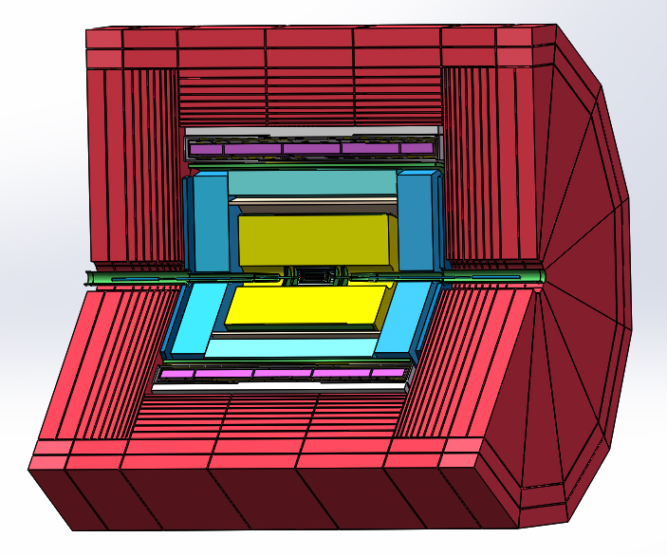
Introduction
Baseline design of CEPC detector magnet
Design Philosophy
Magnetic field: 3 Tesla at the interaction point
Bore size: 6.8 m in diameter, 8.3 m in length
Booster: located in a tunnel 25 m away, magnetic field 2 Gauss
larger size, higher field
(compare to BESIII)
Notes:
The CEPC detector magnet is an iron-yoke-based solenoid to provide an axial magnetic field of 3 Tesla at the interaction point. A room temperature bore is required with 6.8 m in diameter and 8.3 m in length.
The magnetic field in the tunnel should be controled to 2 Gauss, which might require extra shielding.

Slide 6
Magnetic field design
Feipeng Ning
Main parameters of the solenoid coil
The solenoid central field (T) | 3 | Working current (A) | 15779
Maximum field on conductor (T) | 3.5 | Total ampere-turns of the solenoid (MAt) | 20.3
Coil inner radius (mm) | 3600 | Inductance (H) | 10.5
Coil outer radius (mm) | 3828 | Stored energy (GJ) | 1.3
Coil length (mm) | 7445 | Cable length (km) | 30.1
Notes:
The superconducting coil is designed with 5 modules wound with 4 layers. The three middle coil modules and the two end coil modules are wound with 78 and 44 turns, respectively.
Based on state-of-the-art NbTi wire, we chose a current of 16 kA at an operating temperature of 4.5 K.
a 3.5 T peak magnetic field is in the innermost layer of the conductor.
The stored energy is 1.3 GJ.
We needed to do decimals to round up and round down numbers.

Slide 7
Detector magnets with iron yoke
 | CMS | SiD | ILD | CLIC_SiD | CLIC_ILD | CEPC
Central field(T) | 4 | 5.0 | 4.0 | 5.0 | 4.0 | 3
Max. field(T) | 4.6 | 5.75 | 4.77 | 5.8 |  | 3.5
Coil inner diameter (mm) | 6360 | 5462 | 7220 | 5488 | 7202 | 7200
Coil outer diameter (mm) | 6980 | 6224 | 7940 | 7008 | 7888 | 7656
Coil length (mm) | 12400 | 5586 | 7350 | 6230 | 7890 | 7445
Superconductor length(Km) | 45.4 | 26.8 |  | 40 |  | 30.1
Dimension of Superconductor(mm) | 22×64 | 21.6×64 |  | 97.4× 15.6 |  | 22×56
Layers | 4 | 6 | 4 | 5 |  | 4
Total turns | 2168 | 1459 | 1260 |  |  | 1288
Stored energy(GJ) | 2.69 | 1.59 | 2.27 | 2.3 |  | 1.3
Inductance(H) | 14.2 | 9.9 | 9.26 | 14 |  | 10.5
Nominal current(A) | 19200 | 17724 | 22500 | 18000 |  | 15779
Cold mass weight(t) | 220 | 130 | 168 | 170 | 210 | 120
Yoke weight | 12000 | 3360 | 13400 | 10800 | 8900 | 10000
Cooling Method | Thermosiphon | Forced flow | Thermosiphon |  |  | Thermosiphon
Notes:
Here We list the parameters of CMS ILC and CLIC detector magnets. Comparing these paremeters, we believe the CEPC magnet design is reasonable.

Slide 8
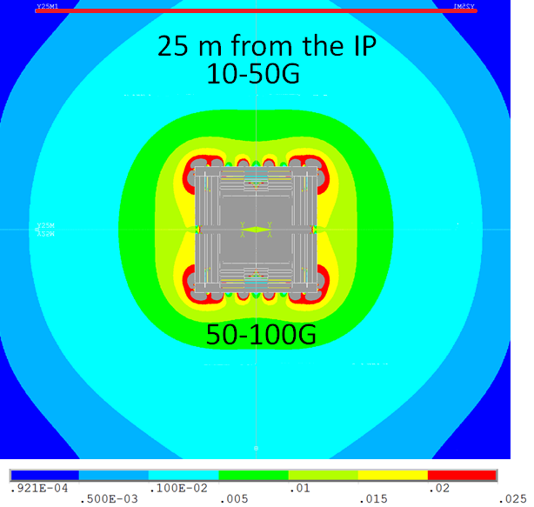
Magnetic Field Design
The Booster tunnel located 25 m away is indicated by the red line on the map. The field is about 12 Gauss in the center of the booster tunnel. The Booster tunnel might require extra shielding.
Stray field
50 Gs | R direction | 13.6 m
 | Z direction | 15.8 m
10 Gs | R direction | 29.4 m
 | Z direction | 26.0 m
Stray field distribution outside the magnet (the field is given in T)
Notes:
We don’t have a critical requirement for the stray field.

Slide 9
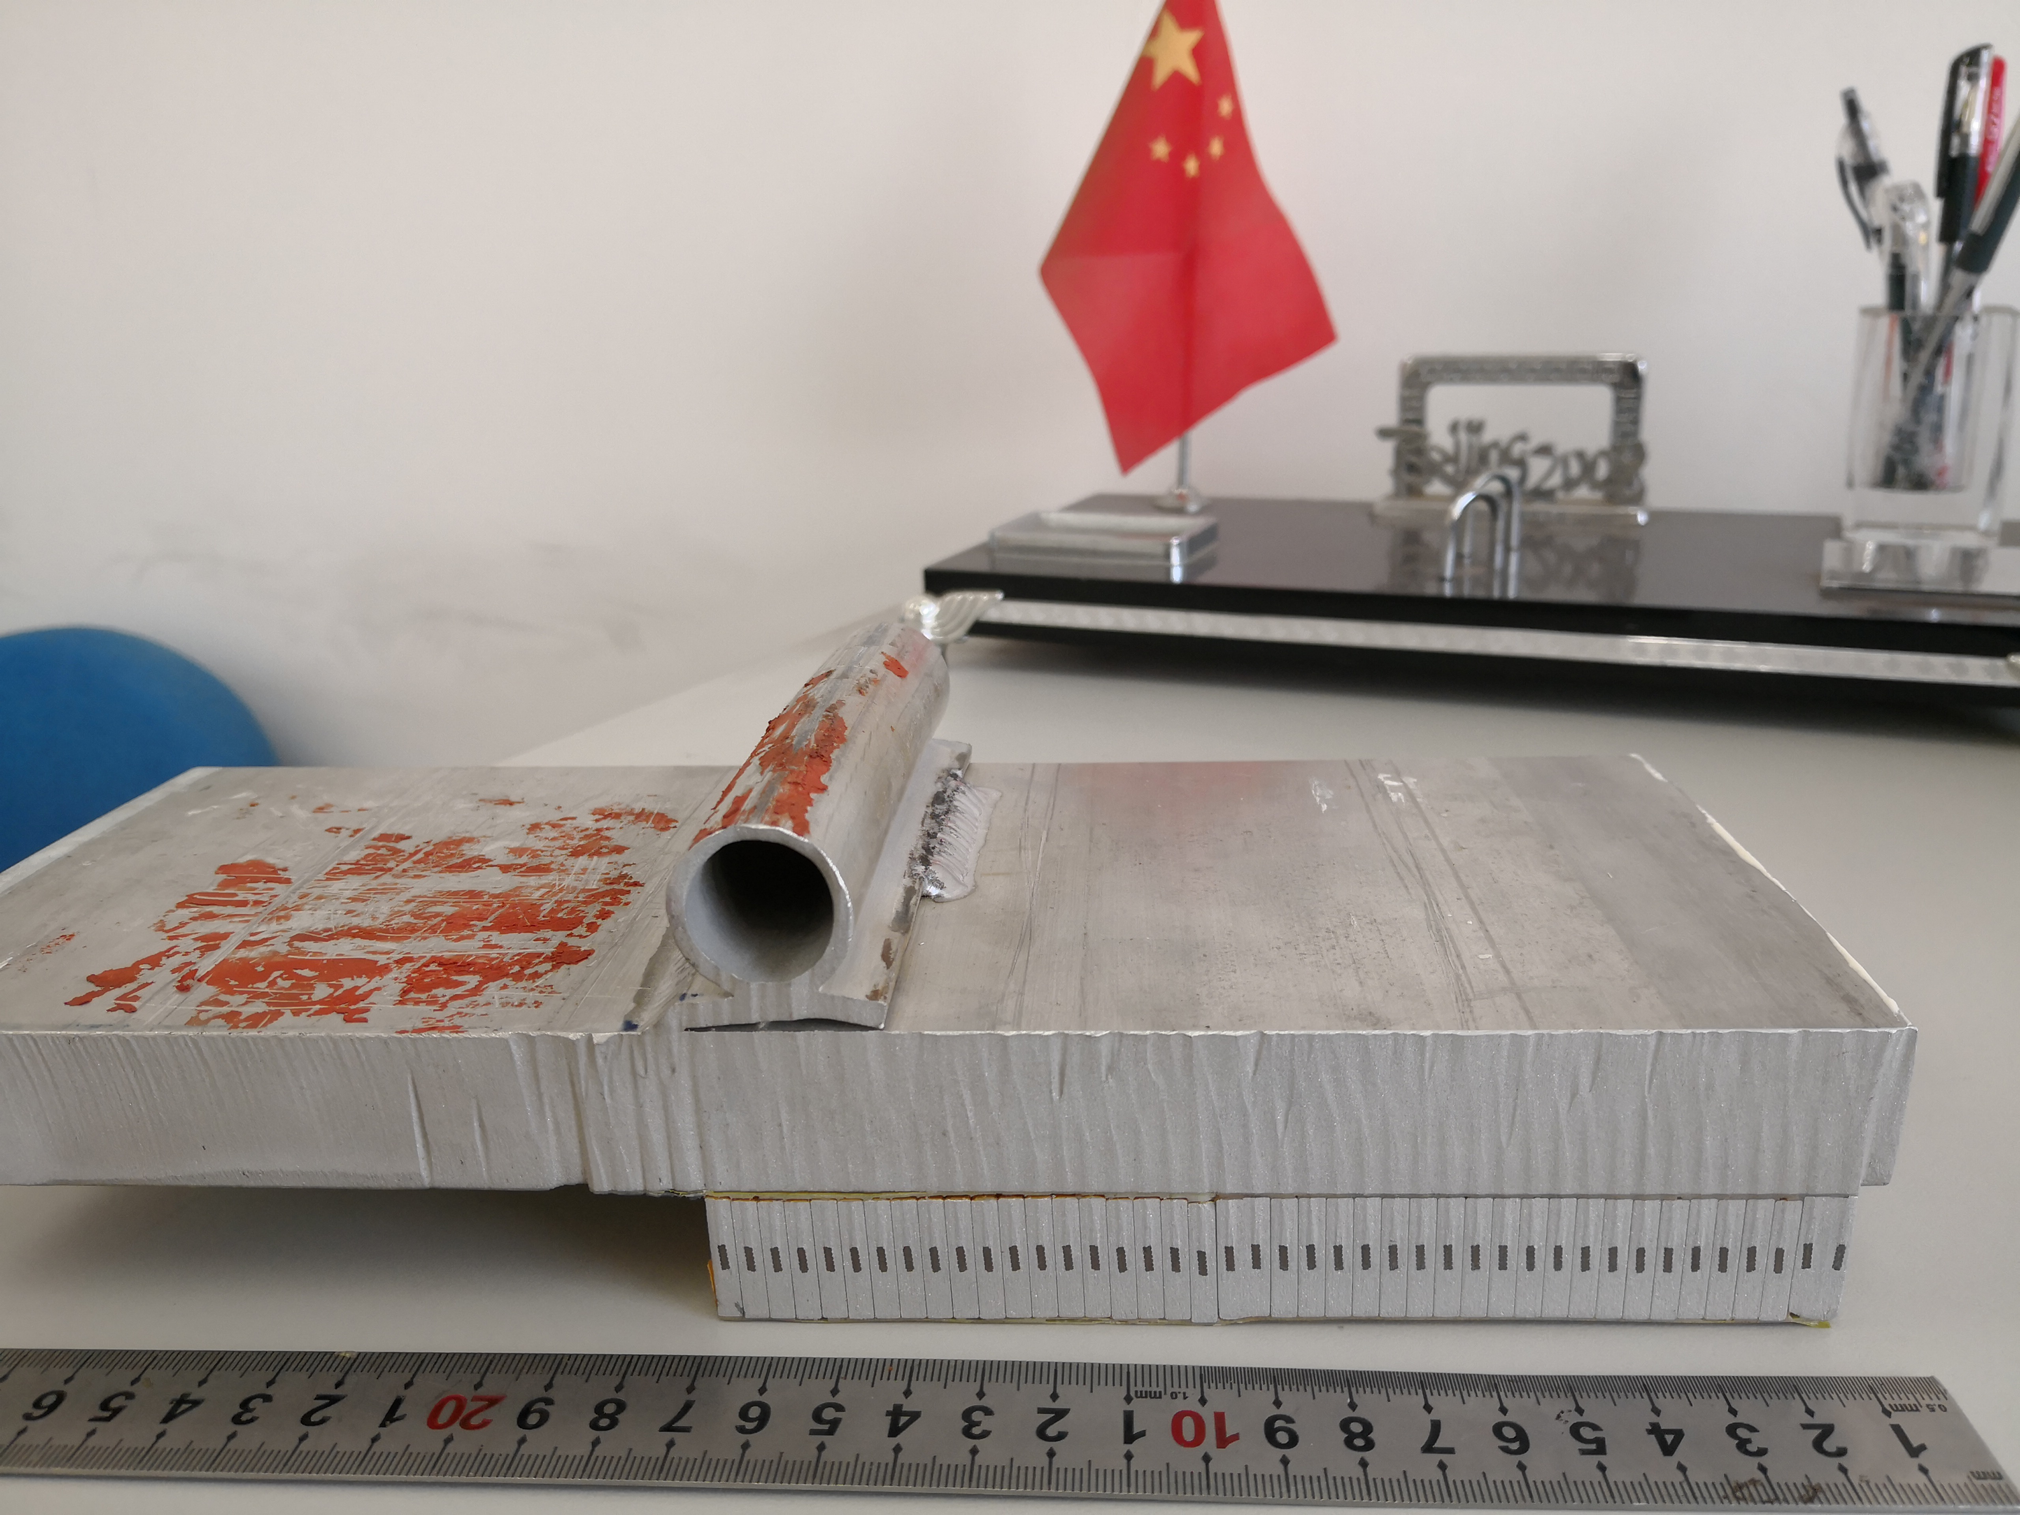
Superconducting coil
Starting point: BESIII Magnet
Aluminum alloy reinforcement
Fabrication: coextrusion technology
1 T, length 4 m
Bore diameter 2.7 m
CMS
Pure Al+Alloy
CEPC
Pure Al+Alloy
Pipe for
Liquid He at 4.2 K
22 mm ×72 mm
Aluminum
Mechanic support
22 mm × 56 mm
Nb-Ti Superconductor
(Rutherford Cable)
Embedded in pure Aluminu Structure
3.7mm*20mm
Pure aluminum stabilizer
Aluminum alloy reinforcement
Notes:
The coil design is from the experience of BESIII magnet.
The coil is wound by inner winding technique on the support aluminum-alloy cylinder. The support cylinder also takes away the heat energy induced by quench. The superconducting coil in the cryostat requires cooling at liquid helium temperature. The cold mass will be indirectly cooled by liquid helium (LHe) tubes. These tubes are welded to the support cylinder.
The self-supporting winding turn with aluminium alloy reinforcement is based on the CMS conductor. The CMS conductor is fabricated by ebeam welding aluminium alloy to the coextruded high purity Al/superconducting cable insert.
However, The feedback from the manufacturer is that using the coextrusion technology to produce the box configuration conductor is worth to try. The box configuration is potentially the most feasible one for reinforcement. So right now this box configuration is our baseline design.
The Rutherford cable contains 32 NbTi strands. All magnet finite element analysis has been done with this conductor with overall dimensions of 22 mm × 56 mm.
The manufacturer is trying to use coextrusion technology for both purity aluminium and aluminium alloy reinforcement.
The box configuration is potentially the best one for reinforcement.

Slide 10
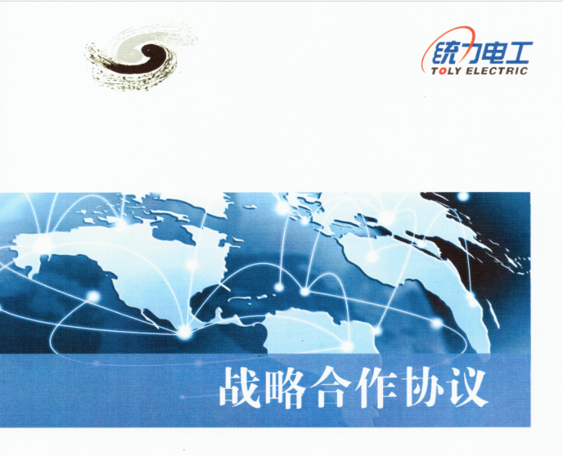
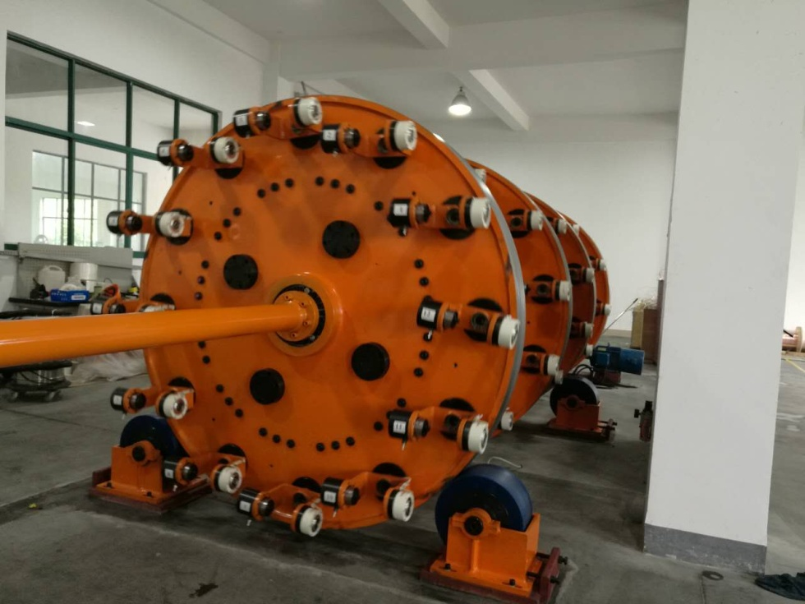
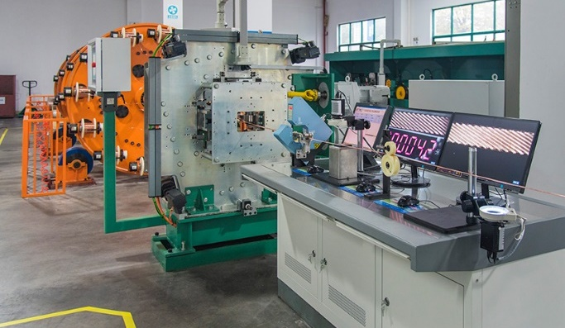
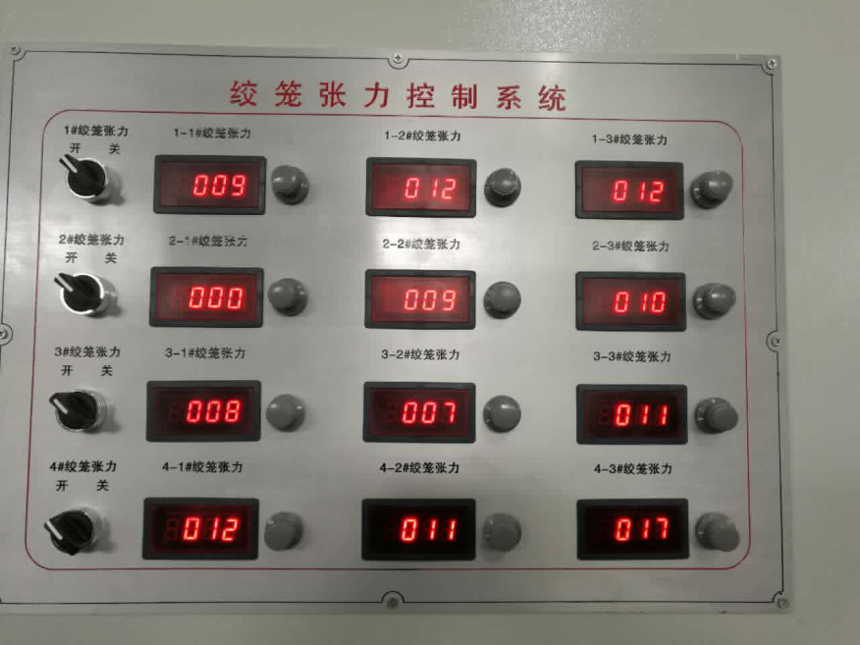
Superconducting coil – cable manufacture
Ling Zhao
Cooperation with Toly Electric Ltd. since 2015
Development of Rutherford cable
New cabling machine and tension control system of strands setting up in 2016 to improve quality
Notes:
since 2015, we have established the cooperation with Toly Electic. The first step is the development of Rutherford cable.

Slide 11
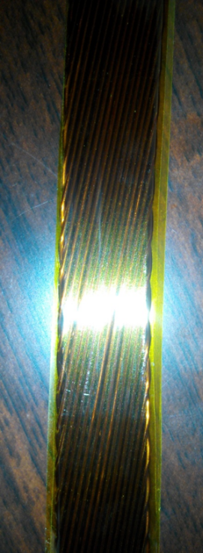
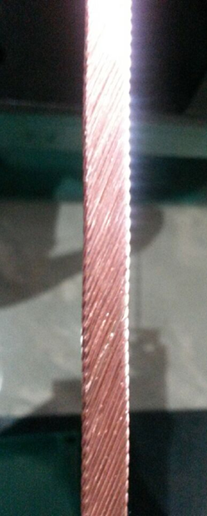
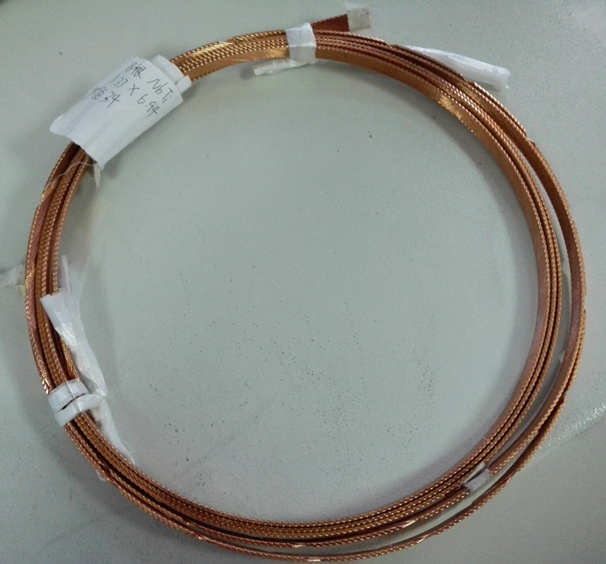
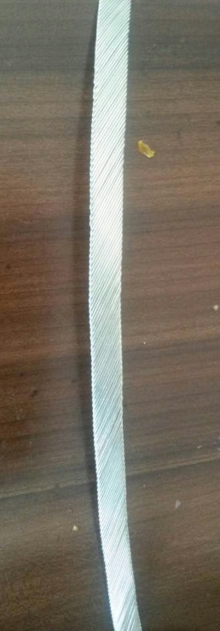
Superconducting coil – cable manufacture
Ling Zhao
Number of strands：20
Strand diameter：1.0mm
Materiel: Copper
Complete time: 2015.5
Number of strands ：17
Strand diameter ：0.727mm
Materiel: Nb/Ti
Complete time: 2015.7
Number of strands ：24
Strand diameter ：0.727mm
Materiel: Nb/Ti
Complete time: 2015.8
Number of strands ：18
Strand diameter ：1.2mm
Materiel: Nb/Ti
Complete time: 2016.2
Number of strands ：32
Strand diameter ：1.2mm
Materiel: Nb/Ti
Tangle：17.32
Length：》100m
RRR： 》100
Complete time: 2016.5
Notes:
1523A at 4.2K, 4T, Ic Degradation during manufacturing<10%

Slide 12
Ling Zhao
Superconducting coil – cable manufacture
Strand of Rutherford cable test results by WTS
1. RRR value declined by about 1/3 after the stranding process
2.Less affected by larger twist pitch of strands.
The decrease of the critical current is less than 7% after the stranding process.

Slide 13
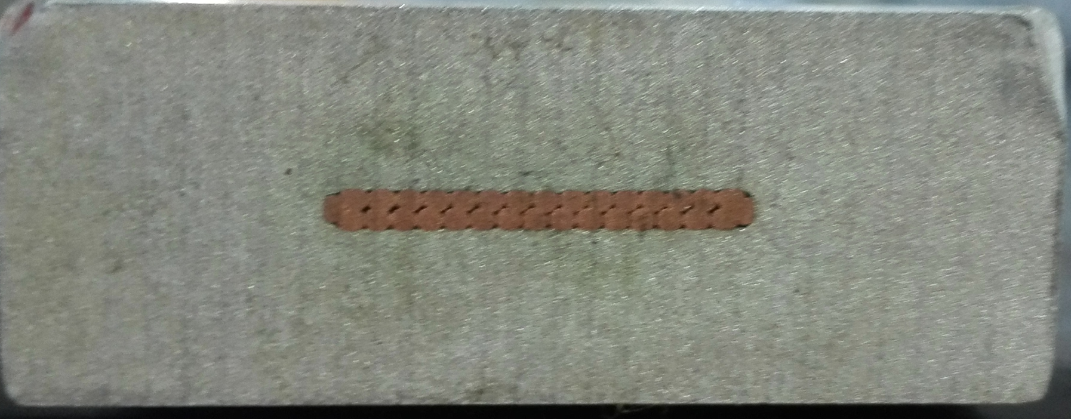
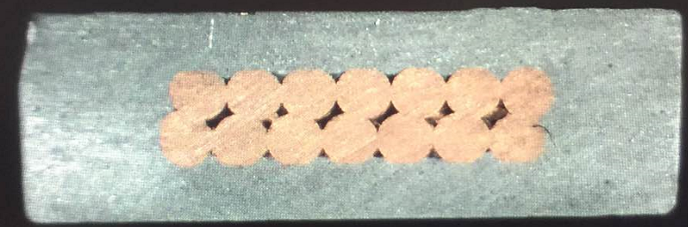
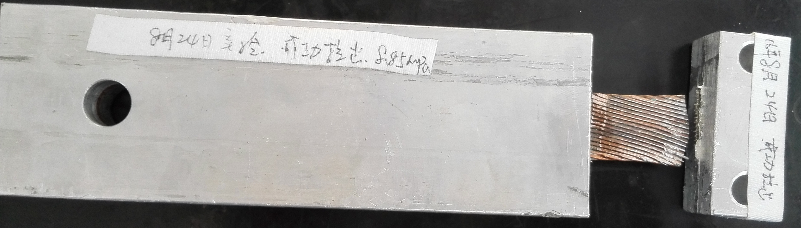
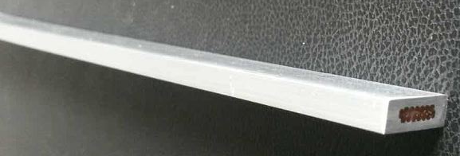
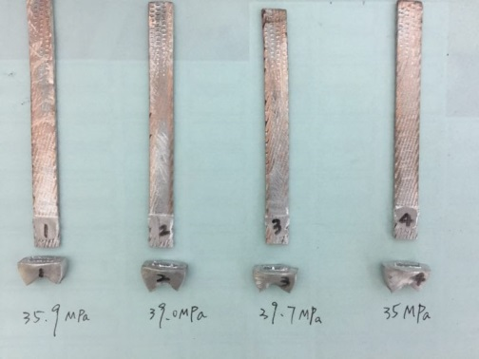
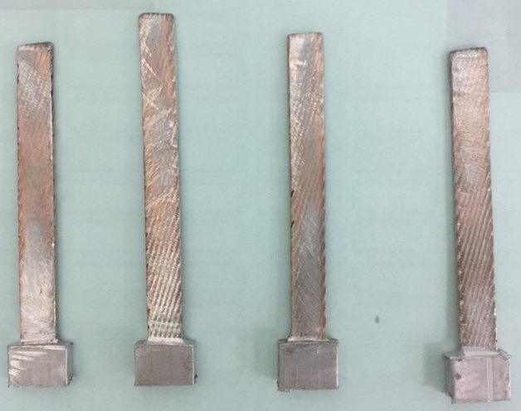
Ling Zhao
R&D progress
Different aluminum alloy and copper cable shear strength test
  The shear strength is larger than the required (20MPa) in the latest test. We used 99.99% aluminum material to improve the shear strength.
Dimensions: 15*4.7mm²
Number of strands ：14
Materiel : COPPER+Al
Complete time: 2017.4
Shear strength（COPPER &Al）：10 MPa
Number of strands ：32
Strand diameter ：1.2mm
Materiel :COPPER+Al
Length：1m
Complete time: 2016.8
Shear strength（copper &Al）：8.85 MPa
Dimensions: 15*4.7mm²
Number of strands ：14
Materiel : NbTi+Al
Complete time: 2017.8
Shear strength（COPPER &Al）：>35MPa

Slide 14
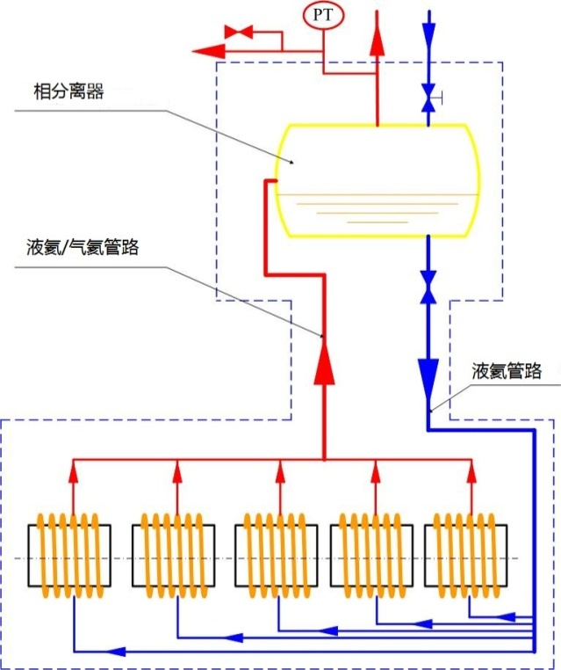
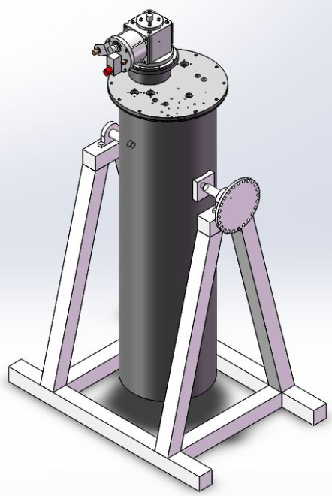
Superconducting coil – coil cooling
Meifen Wang
A small thermosiphon experiment device
The cold mass of 120 t.
The magnetic stored energy of 1.3 GJ
The coil indirect cooling mode using a thermosiphon process.
Motivation：
BESIII magnet used the forced flow method.
If there is a breakdown of the BESIII cryogenics system, the magnet will quench immediately.
Phase separator
Liquid/Gas helium
Liquid helium
Notes:
The thermosiphon method may keep cooling the coil when cryogenics system broken down

Slide 15
Quenches of
BESIII detector magnet @BEPCII collider in the past 10 years
NO. | Time | cause of quench | Quench current
1 | 2008.7.29 | SCQ’s quench | 3034A(0.9T)
2 | 2008.8.18 | SCQ’s quench | 3369A(1.0T)
3 | 2008.9.23 | Current ramping down too fast | 3190A
4 | 2008.12.18 | SCQ’s quench | 3369A
5 | 2009.2.26 | Unknown | 3369A
6 | 2009.3.7 | Unknown | 3369A
7 | 2009.3.27 | Power grid fault | 3369A
8 | 2009.4.25 | Unknown | 3369A
9 | 2009.5.7 | Cryogenic system failure | 3369A
10 | 2009.5.31 | Cryogenic system failure | 3369A
11 | 2009.12.25 | Cryogenic system failure | 3369A
12 | 2010.1.13 | Vacuum system failure | 3369A
13 | 2010.11.16 | SCQ’s quench | 3369A
14 | 2011.1.13 | Cryogenic system failure | 3369A
15 | 2011.1.17 | Cryogenic system failure | 3369A
16 | 2011.5.10 | Cryogenic system failure | 3369A
17 | 2011.5.26 | Cryogenic system failure | 3369A
18 | 2011.6.1 | Cryogenic system failure | 3369A
19 | 2012.1.29 | Cryogenic system failure | 3369A
20 | 2012.2.3 | Cryogenic system failure | 3369A
21 | 2012.2.14 | SCQ’s quench | 3369A
22 | 2012.3.23 | Power grid fault | 3369A
23 | 2012.11.15 | Power grid fault | 3369A
24 | 2013.2.10 | Cryogenic system failure | 3369A
25 | 2014.03.12 | Cryogenic system failure | 3369A
26 | 2014.05.26 | Quench detector misoperation | 3369A
27 | 2015.02.20 | Cryogenic system failure | 3369A
28 | 2015.05.18 | Power network problem | 3369A
29 | 2015.12.30 | Quench detector misoperation | 3200A
30 | 2016.01.17 | Cryogenic system failure | 3369A
31 | 2016.02.9 | Cryogenic system failure | 3369A
32 | 2017.04.13 | Power Fluctuation | 3369A
33 | 2017.05.07 | Cryogenic system failure | 3369A
34 | 2017.11.28 | Cryogenic system failure | 3369A
35 | 2018.03.05 | Cryogenic system failure | 3369A
36 | 2018.05.26 | SCQ’s quench | 3369A
37 | 2018.05.28 | Cryogenic system failure | 3369A
Two phase helium force flow cooling
Total 37 quenches
19 cryogenic system failure
5 electricity power failure
6 caused by SCQ magnet quench
2 quench detector failure
1 vacuum failure
1 operation error
3 unknown(during ramping up/down)
Detector magnet @CEPC: Liquid helium thermal siphon cooling to avoid quench caused by cryogenics failure

Slide 16
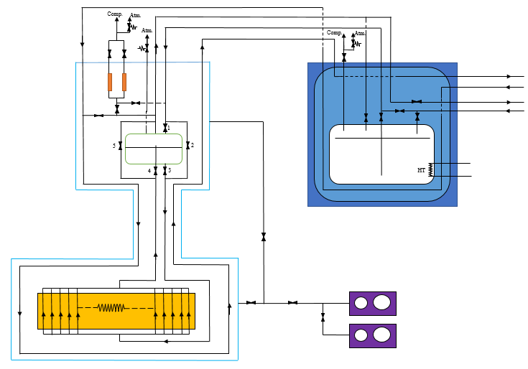
Ancillaries: Cryogenics
Baotang Zhang, Meifen Wang
The CEPC detector magnet cryogenic system:
  the external system-- outside the coil vacuum vessel
  the inner system -- inside the coil vacuum vessel
The cryogenic system provides the liquefaction and refrigeration at 4.5 K in the cryogenic sequences.
Cryogenic sequences: cooling, normal operation, energy dump, warming up.
A cryoplant 750W@4.5 K
Current Lead
Phase Separator
Intermediated Cryogenic Dewar
Thermal Shield
Main
Magnet
Vacuum Unit
Backup
Notes:
The CEPC detector magnet cryogenic system is composed of two sub-system: the external system and the inner system, which are located outside and inside the coil vacuum vessel. The external system includes cold box, intermediate Dewar , the inner system includes coil circuit.
The cryogenic sequences include cooling down, normal operation, energy dump and warming up. The first status is the cooling down process by forced flow helium from 300K to 100K to 4.2K. The second status is the normal operation process in thermosiphon flow condition, which is the main working model for the magnet. The third one is the energy dump process. It is divided into fast discharge, slow discharge and post quench re-cooling. The last status is the warming up.
A cryoplant with a capacity of 750W@4.5 K is under design for the operation of the superconducting facility.

Slide 17
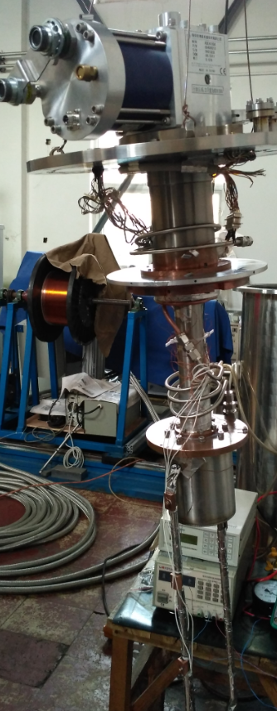
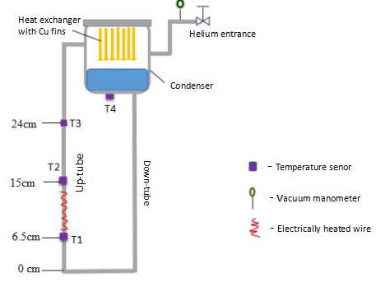
Ancillaries: Cryogenics
Baotang Zhang, Meifen Wang
A mini apparatus for thermosiphon theory study based on liquid helium
Building a two-phase natural circuit loop
Investigating the heat and mass transfer characteristics
Numerical modelling of the mass flow rate
Schematic of the circuit loop
Experimental apparatus
Thermosyphon loop

Slide 18
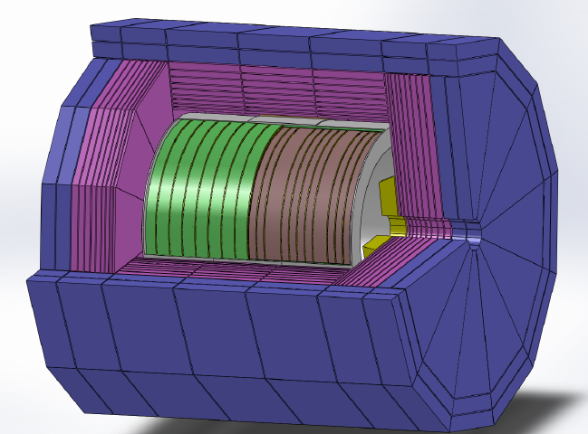
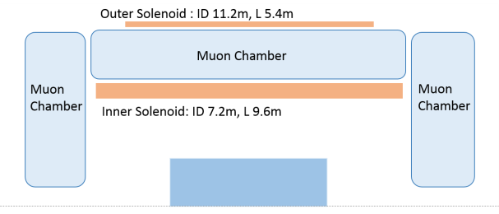
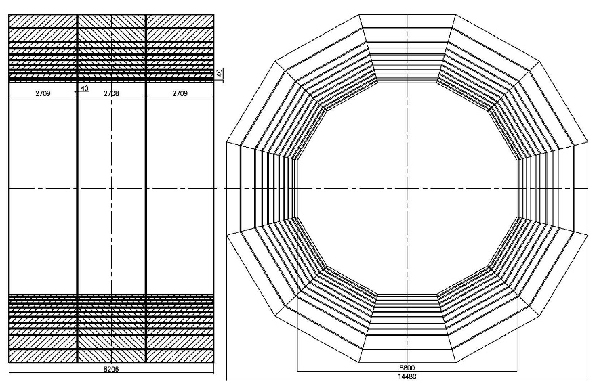
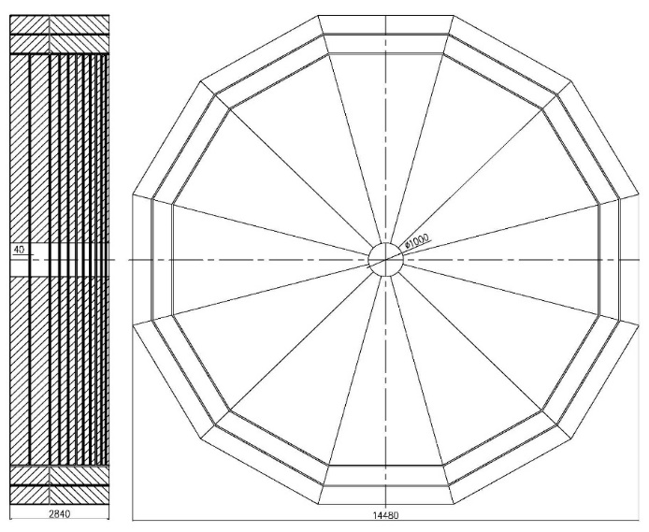
Iron yoke
The iron yoke serves as the magnetic flux return and the main mechanical structure of the sub-detectors.
R&D
The yoke weight reducing
The dual solenoid design (active shielding)
Barrel yoke
end-cap yokes
Notes:
The barrel yoke is subdivided along the beam axis into 3 rings, with 11 layers in each ring. Each ring of the barrel yoke is composed of 12 segments. 40 mm gap is designed between the rings and the layers for placing the muon detector and the electronics cables and services. From the inner to the outer, the layer thicknesses are 80 mm, 80 mm, 120 mm, 120 mm, 160 mm, 160 mm, 200 mm, 200 mm, 240 mm, 540 mm, 540 mm, respectively.
We are studying the possibility of reducing the yoke weight due to cost concerns.
We also want to study the dual solenoid design of cepc detector magnet.

Slide 19
Alternative designs and R&D
LTS solenoid for IDEA detector
HTS solenoid for IDEA detector
Dual solenoid design
Superconducting conductor
Thermosyphon circuit

Slide 20
LTS solenoid for IDEA detector
A alternative design for CEPC detector (Ultra-light 2T/4m bore Detector Solenoid for FCCee)
Obvious savings when coil is positioned inside:
  Factor ≈ 4.2 in stored energy
  Factor ≈ 2.1 in cost!
The solenoid design:
  Self-supporting single layer coil
Radiation thickness:
  Cold mass: X0= 0.46, λ= 0.09
  Cryostat (25 mm Al): X0= 0.28, λ= 0.07
  a total X0= 0.74 < 1(at η= 0)
Herman ten Kate, FCC Annual meeting Amsterdam, April 9-14, 2018
Notes:
Ultra-light: ultra-thin & transparent around the tracker

Slide 21
LTS solenoid for IDEA detector – LTS cable
Requirements:
2T in thin solenoid with radiation length X₀<1 in radial direction
Radial envelope <300 mm
Magnetized iron for muon detection
R&D
Self-supporting single layer coil
Up to 20% additional reduction in the overall thickness may be achieved with more R&D and engineering
M. Caccia, An International Detector for Electron-Positron Accelerator (IDEA), Workshop on Circular Electron-Positron Colliders, Roma, May 24-26th, 2018.

Slide 22
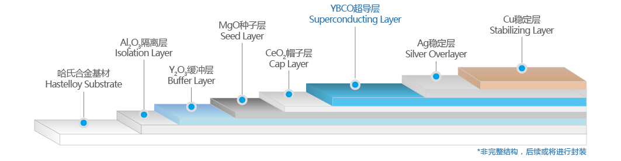
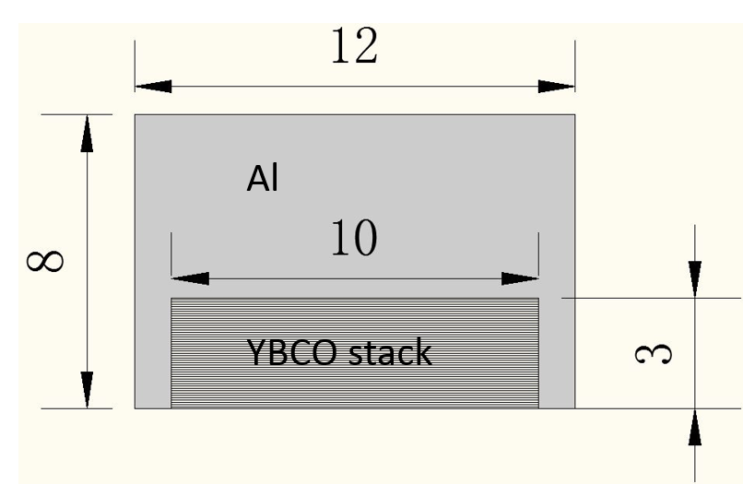
HTS solenoid for IDEA detector
YBCO stacked-tape cable
Material | Thickness | Radiation thickness |  | Material
 | X, mm | X₀, mm | X/X₀ | Ratio
Cu | 0.01 | 14.36 | 0.0007 | 17.97%
Fe | 0.05 | 17.57 | 0.0028 | 73.41%
Ag | 0.002 | 8.543 | 0.0002 | 6.04%
YBa2Cu3O7 | 0.002 | 20 | 0.0001 | 2.58%
MgO | 0.00000001 | 78.28 | 0.0000 | 0.00%
Al2O3 | 0.00000008 | 70.38 | 0.0000 | 0.00%
CeO2 | 0.0000003 | 16.54 | 0.0000 | 0.00%
Total, X_{tot} |  |  | 0.0039 | 100%
35 YBCO tapes stacked together
embedded in 5 mm pure aluminium
Material | Thickness | Radiation thickness |  | Material
 | X, mm | X₀, mm | X/X₀ | Ratio
Cu | 0.35 | 14.36 | 0.0244 | 12.26%
Fe | 1.75 | 17.57 | 0.0996 | 50.09%
Ag | 0.07 | 8.543 | 0.0082 | 4.12%
YBa2Cu3O7 | 0.07 | 20 | 0.0035 | 1.76%
MgO | 0.00000035 | 78.28 | 0.0000 | 0.00%
Al2O3 | 0.0000028 | 70.38 | 0.0000 | 0.00%
CeO2 | 0.0000105 | 16.54 | 0.0000 | 0.00%
Support cylinder, Al | 5 | 88.97 | 0.0562 | 28.26%
Glass/polyimide/epoxy | 2 | 286 | 0.0070 | 3.52%
Total, X_{tot} |  |  | 0.1989 | 100%
  Radiation thickness
  Cold mass: CEPC X0= 0.2 FCCee X0= 0.46
HTS coil cooling @20K
Notes:
45% reduction in the overall thickness

Slide 23
R&D
Superconducting conductor
  Simulation with an elasto-plastic 2D FE model
  Experimental material properties of all conductor components
  10 m long NbTi embedded inside stabilizer, Ic 5 kA at 4 T
  Further development: longer Ic Al-based NbTi conductor ( >100m >10kA @4T)
  Coextrusion technology
Thermosyphon circuit
  1:10 scale thermosiphon circuit for simulation and experiment

Slide 24
Summary
Keep iron yoke structure as the baseline design
Iron yoke reducing and the dual solenoid as candidate options
Further discussion on the 2 T IDEA magnet
Further development of longer and higher Ic Al-based NbTi conductor (>100m,>10kA@4T)
Study of thermal siphon cooling system for LTS coil
Study of candidate option(HTS, no iron yoke, HTS coil cooling method @20K)

