Slide 1
Dual readout calorimeter for CepC
Franco Bedeschi
CDR International Review,
Beijing, September 2018
OUTLINE
Basic requirements
Detector description
Detector performance
IDEA implementation
Future work

Slide 2
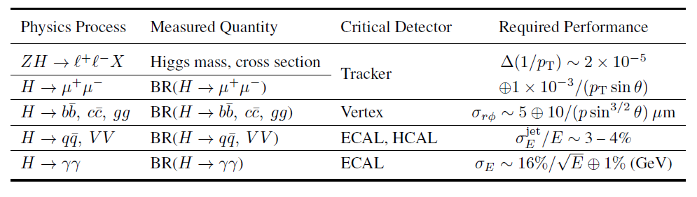

e+e- →HZ physics constraints
Calorimeters:
  H→γγ ➔ ECAL resolution
    As good as possible – at least 16%/$\sqrt{E}$ + 1%
  H→qq, VV ➔ ECAL+HCAL resolution
    As good as possible – at least 3-4% on jets from W,Z decay
(*) LHC may observe these channels with similar ot better precision before CepC

Slide 3
e+e- →Z/WW physics constraints
Additional EW physics drivers:
  High precision acceptance determination
  Good e/γ/π⁰ discrimination

Slide 4
Other drivers
Z→τ⁺τ⁻
τ⁺◊ρ⁺ν◊π⁺π⁰ν
minΔπ⁺γ @ 2 m
π⁰ important in tau and HF physics
    No π⁰: 35% τ ◊ l (e, μ) νν + 20% τ◊(1,3)π± lν
    1 π⁰: 28% τ◊(1,3)π±π⁰lν
    2 −3π⁰: 10% τ◊π± (2,3) π⁰lν
  High granularity/Pre-shower → π⁰ identification
  Overlap with π⁺ may require longitudinal segmentation
Δγ @ 2 m

Slide 5
Dual Readout calorimeter
Dual Readout Calorimeters main features
  Designed to optimize EM, hadronic and jet resolution
    Large sampling fraction for good EM resolution
    Event by event correction for EM fluctuations in showers and jets
  Intrinsic transverse granularity up to 1-2 mm
  Potential for longitudinal segmentation with timing or specific fiber geometries
  Particle ID capabilities
  Fast detector response
  All electronics in the back simplifies cooling and access

Slide 6
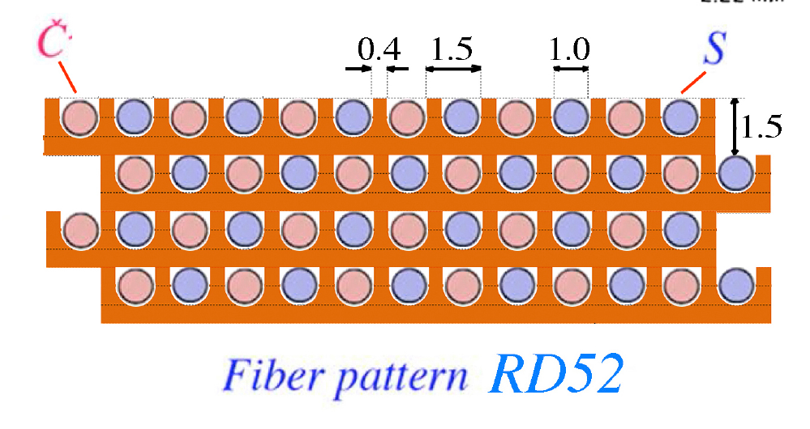
Basic configuration
Alternate clear and scintillating fibers in metal matrix
Scintillating fibers sensitive to all charged particles
Clear fibers sense only Cherenkov light
  Mostly electrons and positrons

Slide 7
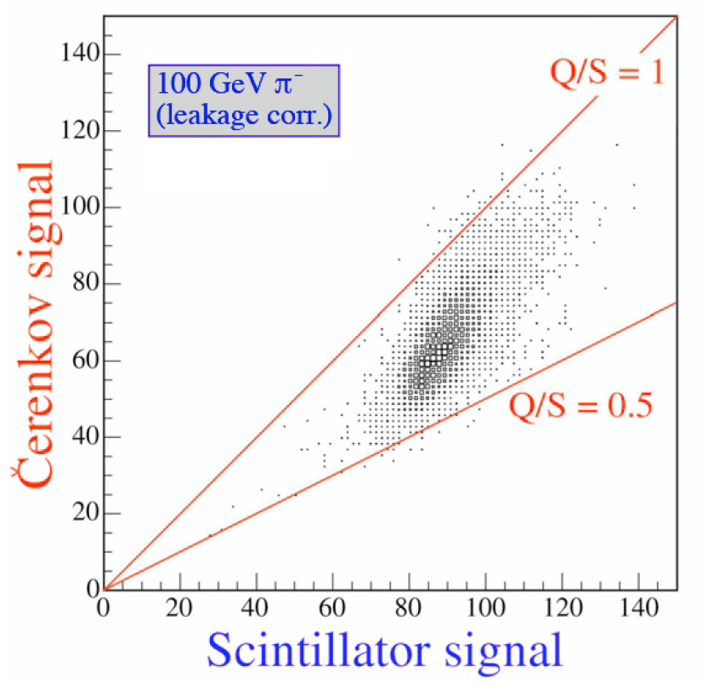
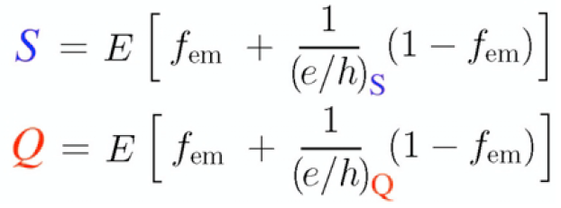
Working principle
Measure simultaneously:
  Scintillation signal (S)
  Cherenkov signal (Q)
Calibrate both signals with e-
Unfold event by event f_{em} to obtain corrected energy

Slide 8
Performance EM
Use test beam data to tune simulation
Use simulation to correct for lateral leakage

Slide 9
Radial shower profile
Test beam data

Slide 10
Radial shower profile
Test beam tuned simulation
50 GeV electrons
100 GeV π⁰

Slide 11
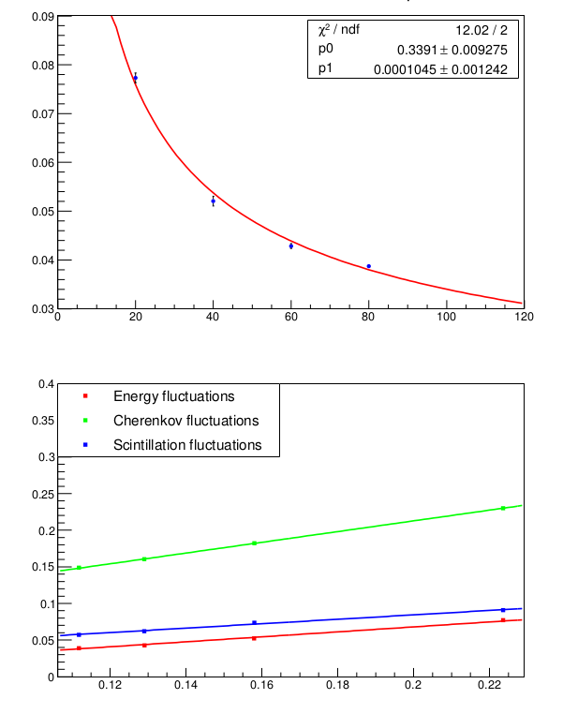
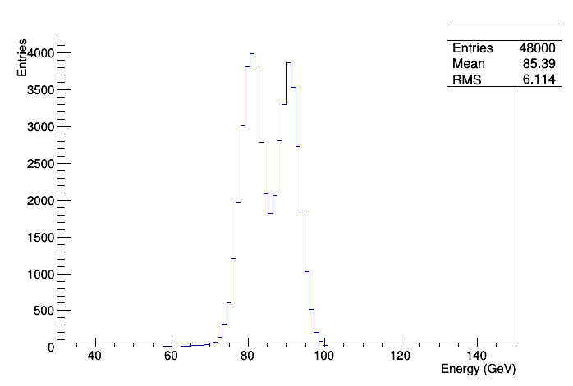
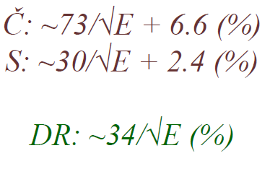
Performance HAD
Use test beam data to tune simulation
Use simulation to correct for lateral leakage
81 and 91 GeV jet separation

Slide 12
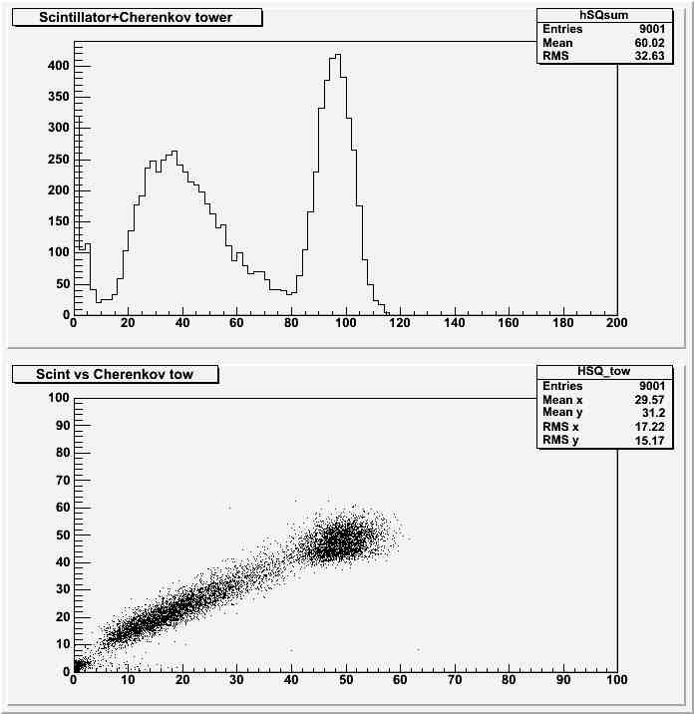
Particle ID
Test beam
Test beam tuned simulation
80 GeV electron proton separation
  Rejection power 600 @ 98% efficiency
Hadrons
Mu
Electrons
S+Q
S
Q

Slide 13
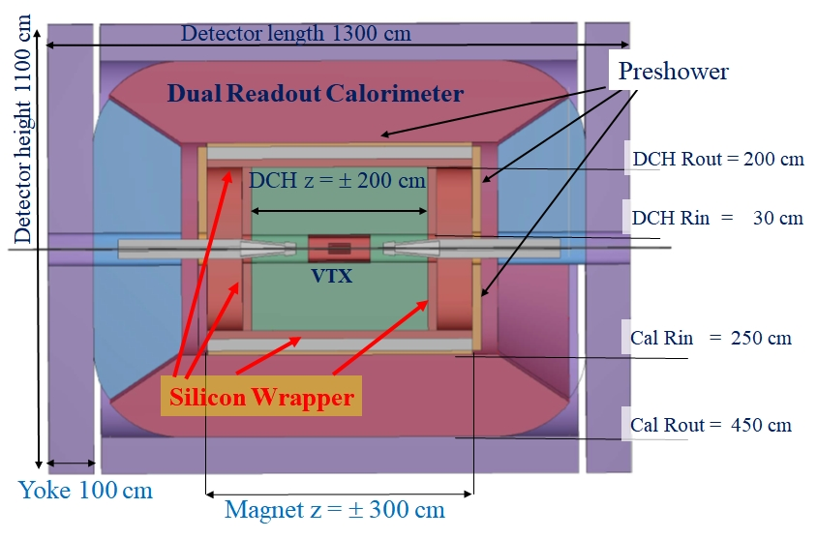
IDEA implementation
Calorimeter outside thin coil
Pre-shower in front
  Improve p0 ID
  Improve acceptance determination

Slide 14
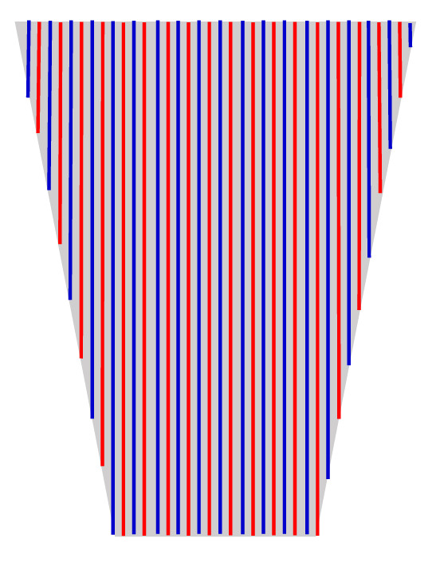
IDEA implementation
Projective geometry
Full coverage
Wedge geometry

Slide 15
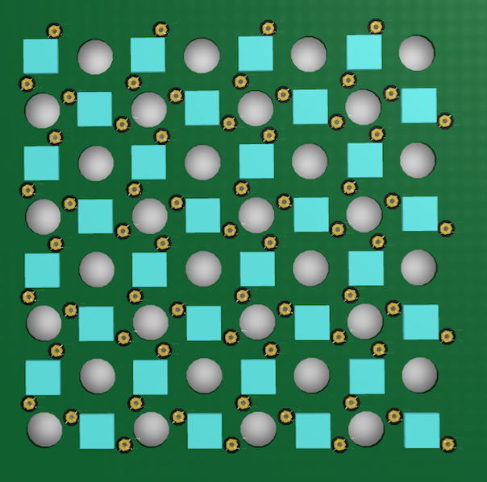
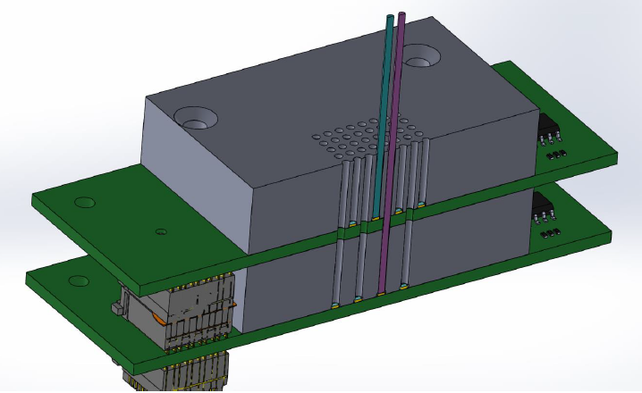
Readout
Dual layer SiPM readout
  Avoids optical cross-talk
  3rd test beam in progress

Slide 16
Readout
Group SiPM to reduce numbers of channels
  8 fibers/channel → 5.6 mm granularity
  Parallel to serial readout ASIC under study
ASIC
SiPM
Output
FPGA

Slide 17
Future work
Physics benchmarks with full simulation
Mechanics:
  Metal matrix technology
  Fast module assembly
  Calorimeter support
Electronics
  SiPM readout optimization (pixel size and x-talk)
  Define readout chain
    ASIC selection or development
    Signal processing on detector
    Readout and back-end design
  Explore timing for longitudinal information

Slide 18
Backup
BACKUP

Slide 19
e+e- operation modes
Wide range of running conditions at CepC
  Z pole (90 GeV):
    ~ 10 ns between beam crossing
    High luminosity O(10³⁵)
  ZH (250 GeV):
    ~ 1 μs between beam crossing
    Moderate luminosity - O(10³⁴)

Slide 20

CepC, FCC, ILC, CLIC luminosity comparison
Z
WW
ZH
$$t\overline{t}$$
100xLEP
FCC SR power/beam < 50 MW
CepC SR power/beam < 30 MW

Slide 21
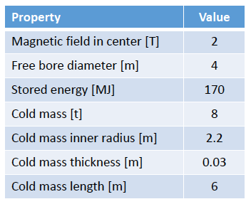
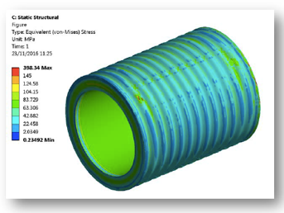
2T solenoid
Two options:
  Large bore (R=3.7 m) – calorimeter inside
  Smaller bore (R=2.2 m) – calorimeter outside
    Preferred: simpler/ Extreme EM resolution not needed
      Thick calorimeter
    Thin (30 cm): total = 0.74 X₀ (0.16 λ) at θ = 90º
Courtesy of H. ten Kate et al.

Slide 22
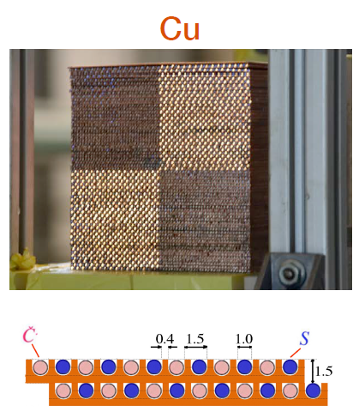
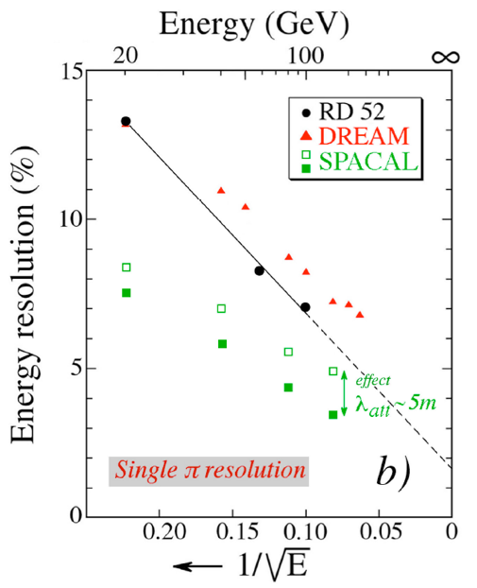

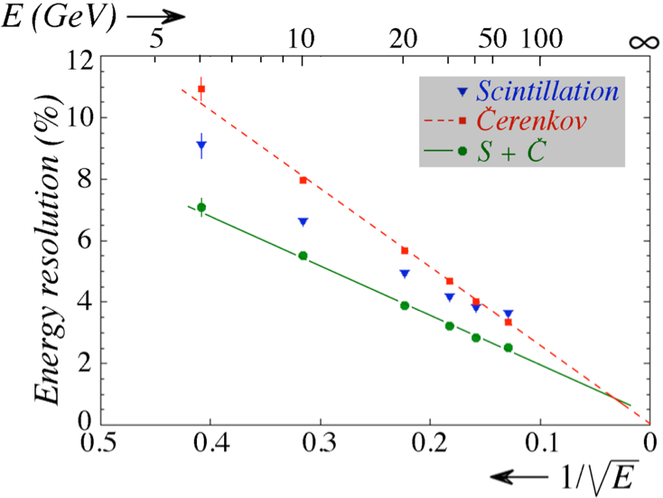

Calorimeter
Copper dual readout calorimeter
  Demonstrated EM resolution
  Observed Had resolution dominated by lateral leakage (~6%)
Courtesy of DREAM/RD52

