Slide 1


7th IHEP-KEK SCRF Collaboration Meeting
Beijing, 22-23 September 2018
650MHz Cavity Cryomodule for CEPC Accelerator
Ruixiong HAN
hanrx@ihep.ac.cn)
IHEP Cryogenics group
September 22th, 2018

Slide 2
  Outline
CEPC Cryogenic system
CEPC Cryomodule
CEPC Test Cryomodule and distribution valve box
Heat load of CEPC Cryomodule
Schedule

Slide 3
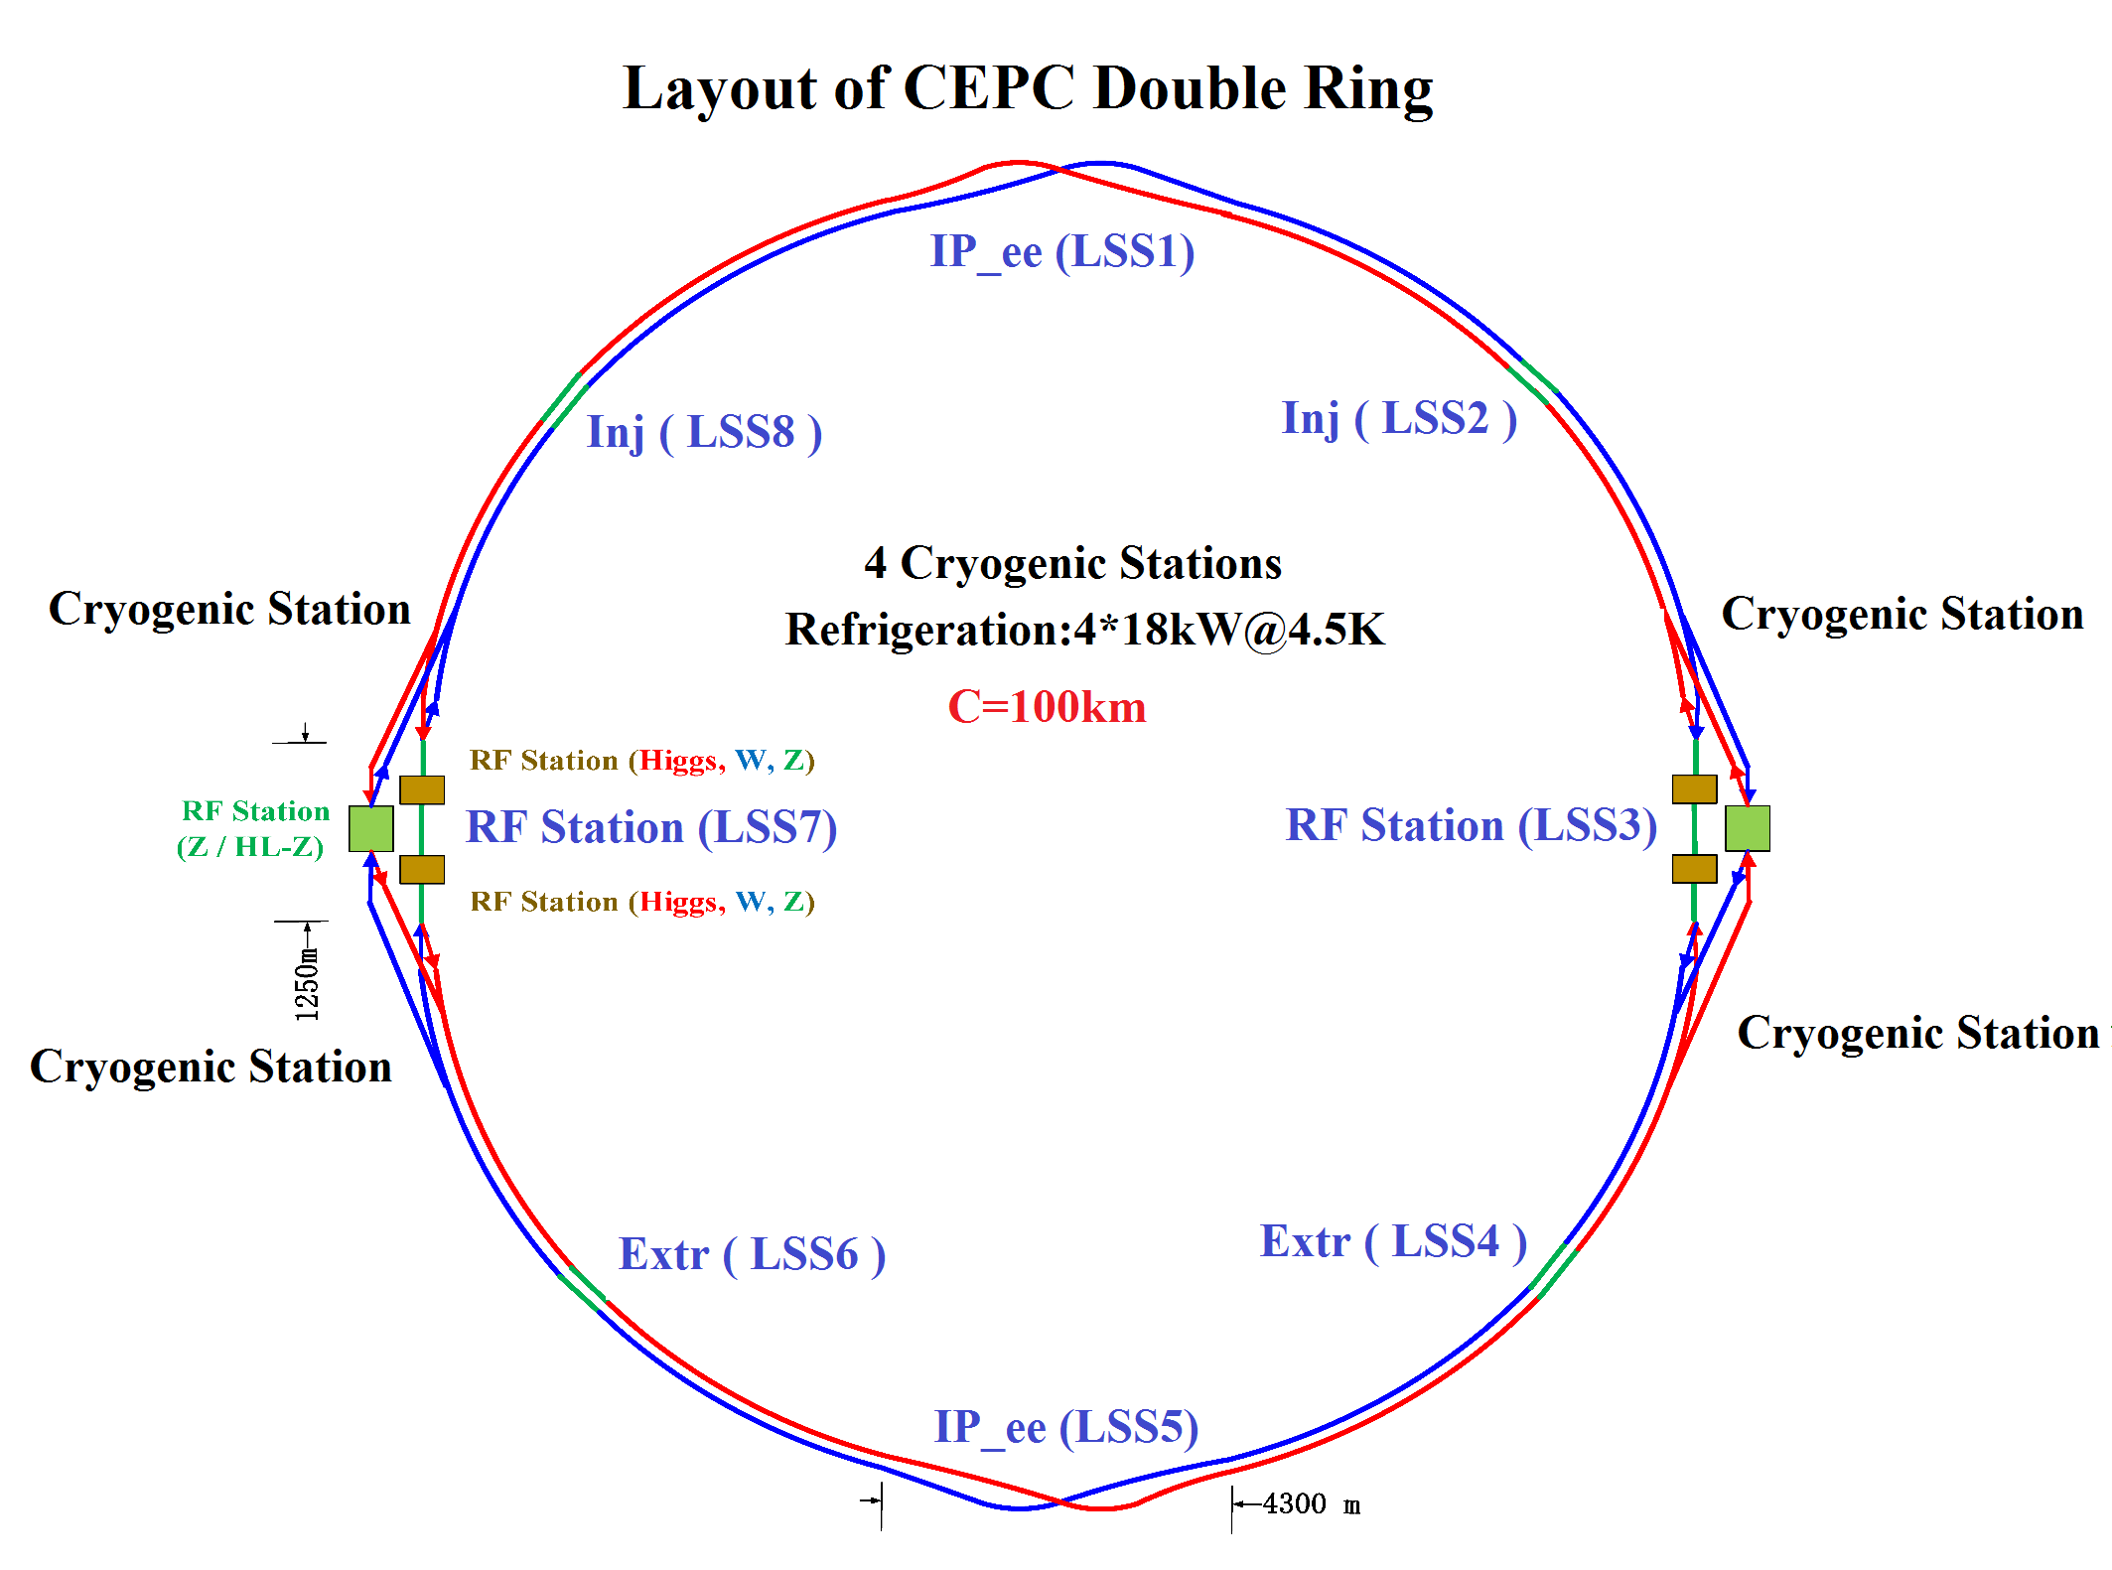
CEPC Cryogenic System
336 650 MHz RF cavities for the Collider;
96 1.3 GHz RF cavities for the Booster;
There are 4 cryogenic station in the CEPC cryogenic system;
Each cryogenic station lies besides the RF station, which provides helium for the collider ring and the booster ring;

Slide 4
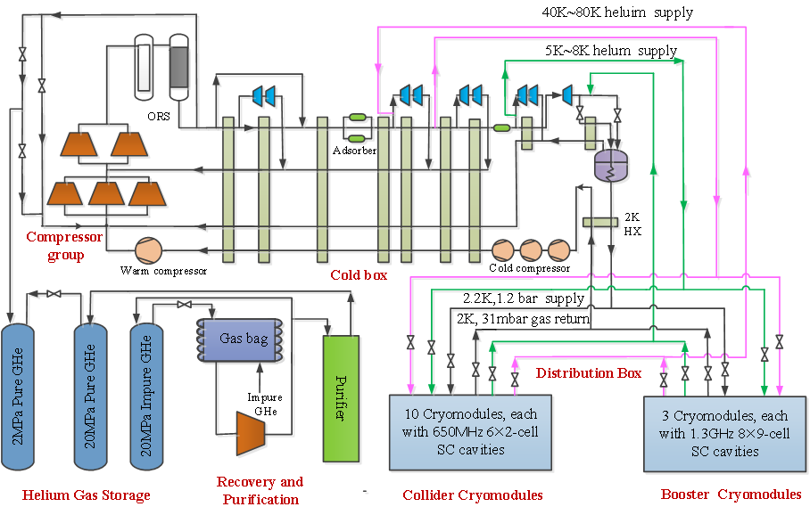
CEPC Cryogenic System
The Cryogenic system mainly includes the refrigerators, cycle compressors, helium storage tanks, helium purification equipments, cold compressors, distribution boxes and cryomodules;
The cryomodules have two shields, a 40K~80K shield and a 5K~8K shield. A 2.2K, 1.2bar helium is supplied for the cryomodules and the 2K, 31mbar helium gas return to the cold box by the cold compressors;

Slide 5
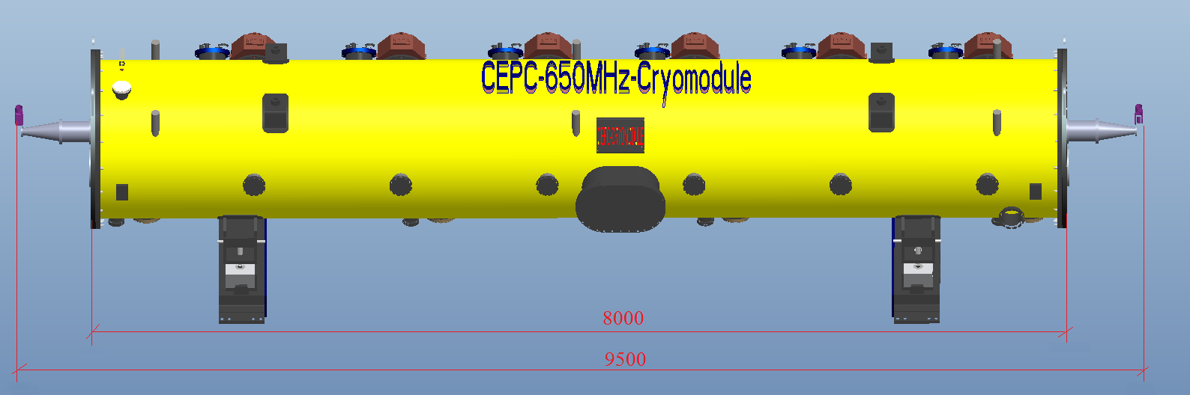
CEPC 650MHz-Cavity Cryomodule
Six 2-cell Cavities Cryomodule
Overall length(flange to flange, m) | 8.0
Diameter of Vacuum vessel ,m | 1.4
Beamline height from floor, m | 1.5
Cryo-system working temperature, K | 2
Number of cavities | 6
Number of coupler | 6
HOM absorber | 2
Number of 200-POST | 6
Cryomodule performance |  | Specification
RF gradient [MV/m] |  | 13.8(H), 9.4(W), 9.6(Z)
Dynamic heat loads at 2K (Q_{o}=1E10) |  | 19.0(H), 8.7(W), 9.2(Z)
Static heat loads at 2K (Max. Operation) |  | 5W
Number of leakage | He →insulation | 0
 | He →beam pipe | 0
 | Insulation →coupler | 0
 | Insulation →beam pipe | 0
 | Coupler →beam pipe | 0
Alignment x/y inside (Cavities) |  | ±0.5mm
Alignment z inside |  | within 2 mm
Coupler antenna design z |  | within 2 mm

Slide 6
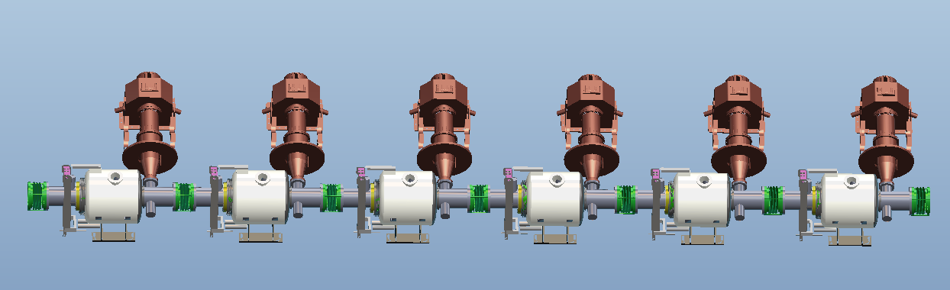
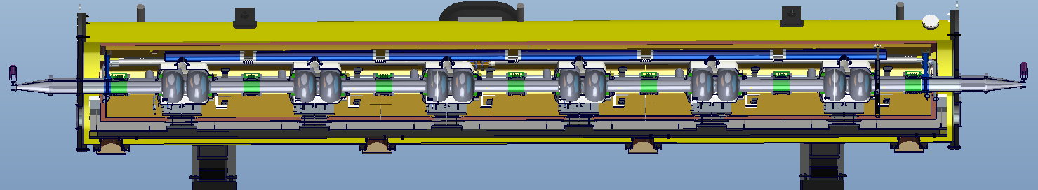
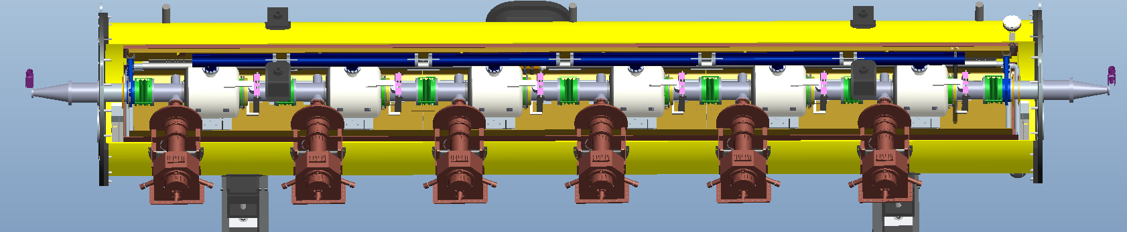
CEPC 650MHz-Cavity Cryomodule

Slide 7
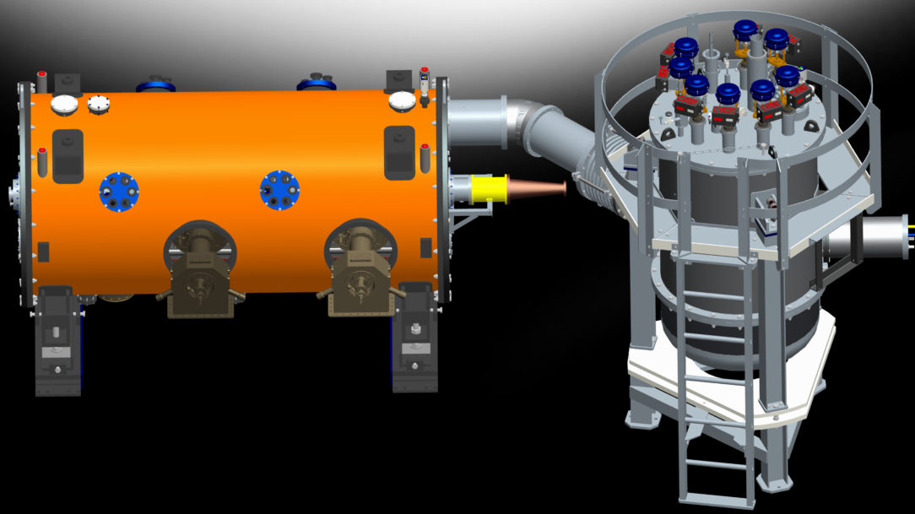
CEPC Test Cryomodule & Valve Box

Slide 8
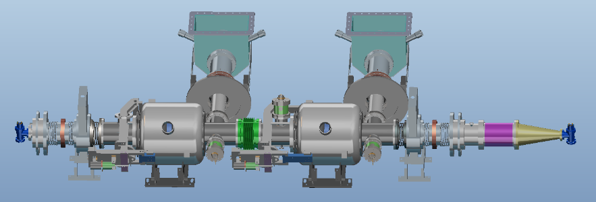
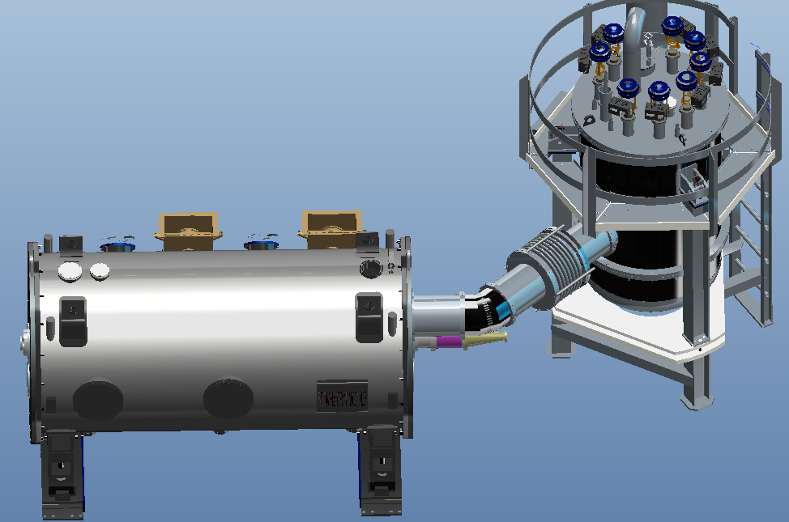
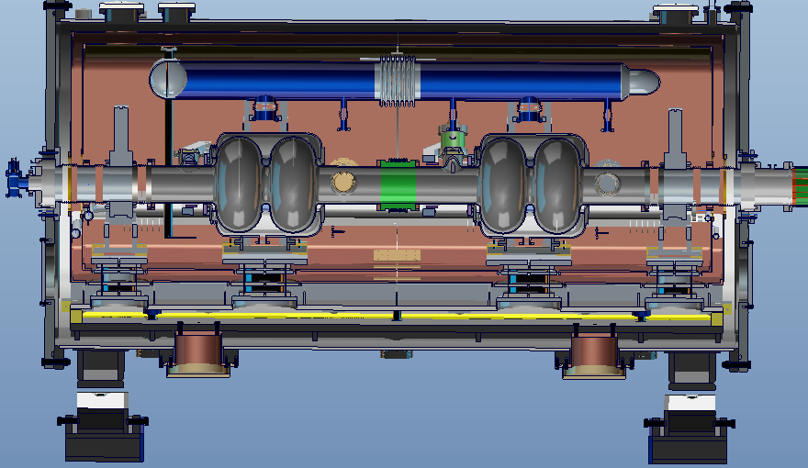
CEPC Test Cryomodule
Two 2-cell 650 MHz superconducting cavities;
Two high power couplers
Two mechanical tuners
Two HOM absorbers
High Q₀
Fast cool-down is introduced
•Vacuum vessel
– Material:316L stainless steel
–Outer diameter = 1424mm
– Length=3000mm
•Support post
–Supporting the all cold mass in the vacuum vessel
–Supporting Cavities：Diameter is 180mm
–Supporting RF-Gate Valve：Diameter is 150mm
–Number:2+2=4
–Material：FRP(G-10)
•Thermal radiation shield
–Aluminum plate ＋Muti-layer insulation of aluminum-evaporated film(Super Insulation)
–40K-70K Nitrogen gas, 5K-10K helium gas
•Strongback
–Stainless steel
–Room temperature

Slide 9
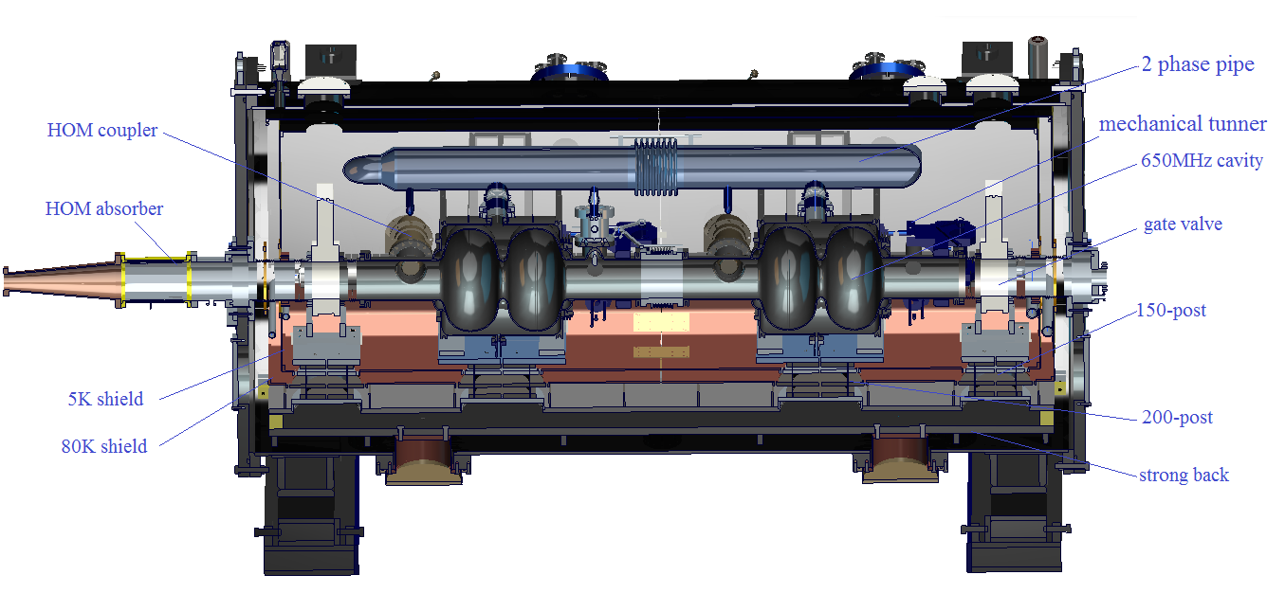
CEPC Test Cryomodule-X-Z Section

Slide 10
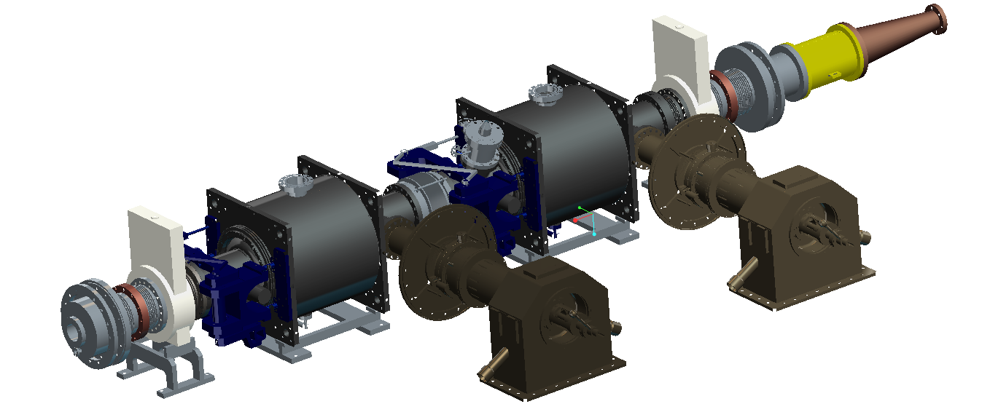
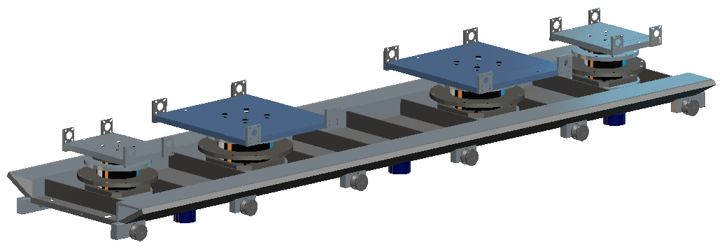
CEPC Test Cryomodule-Cavity-string

Slide 11
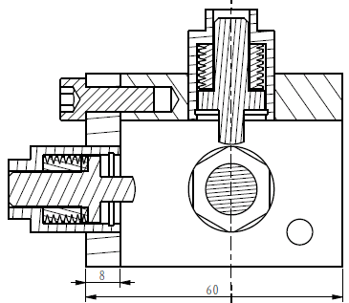
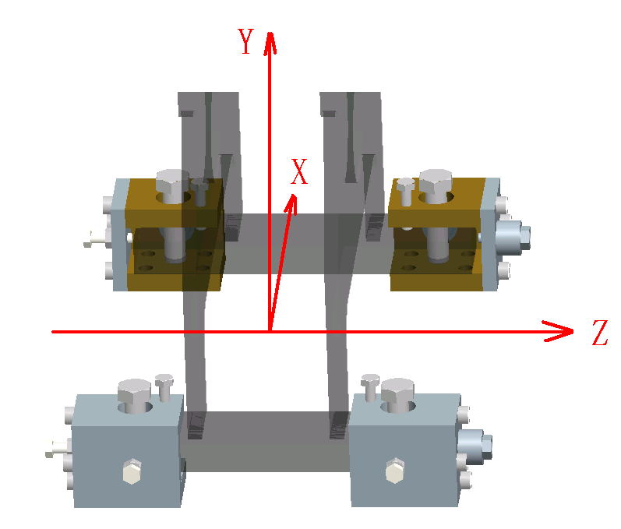
CEPC Test Cryomodule-Adjustments
X,Y,Z：± 4mm
Active
Follow

Slide 12
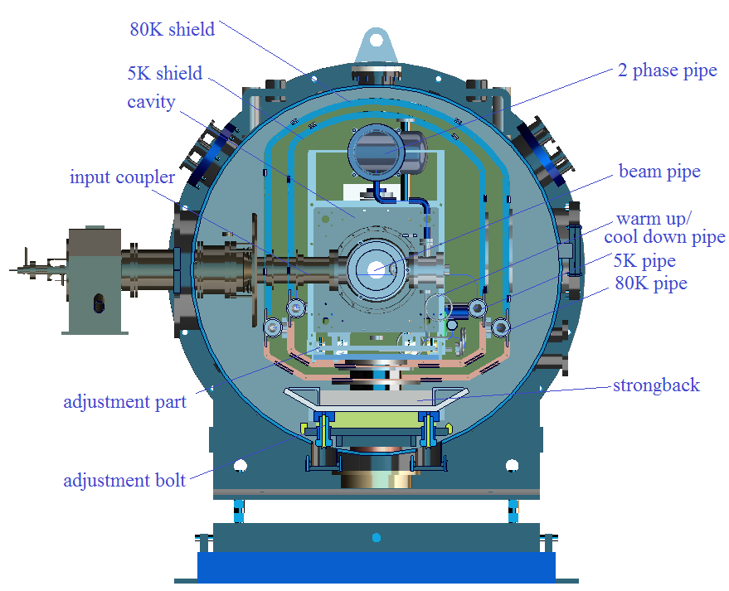
CEPC Test Cryomodule-X-Y Section

Slide 13
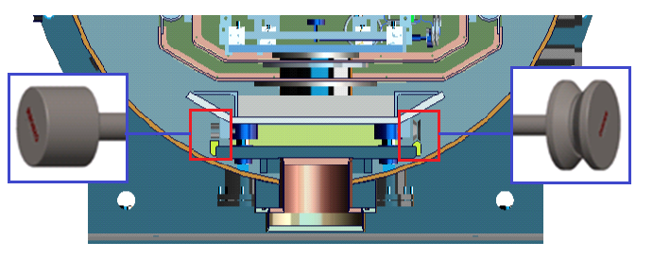
CEPC Test Cryomodule

Slide 14
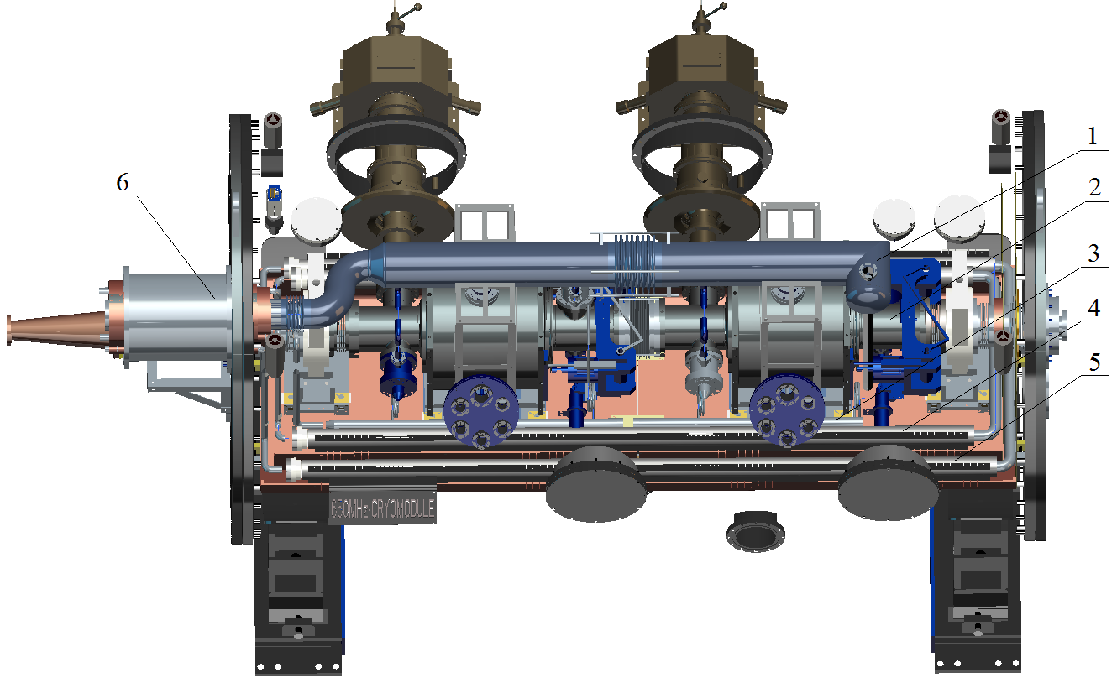
CEPC Test Cryomodule-cryoenic pipes
1-2K Pipe；2- Beam Pipe ；3-cool down /warm up pipe； 4-5Kshield Ω pipe；
5- 80Kshield Ω pipe ；6-2Ktansfer line；

Slide 15
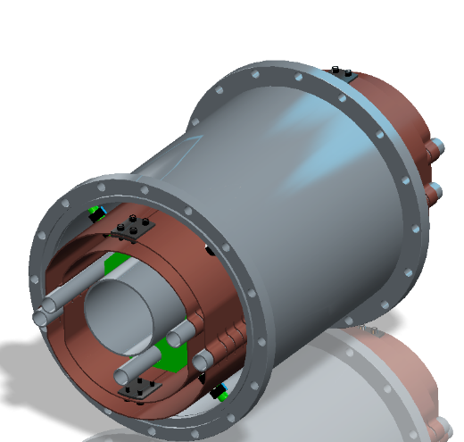
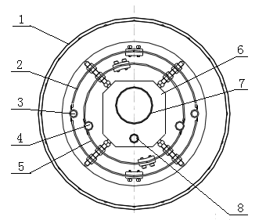
CEPC Test Cryomodule-2K transfer line
1-Outer pipe，2-80K shield，3-80K pipe，4-5K pipe，5-5Kshield，6-G10 support，7-2K pipe，8-cool down pipe

Slide 16
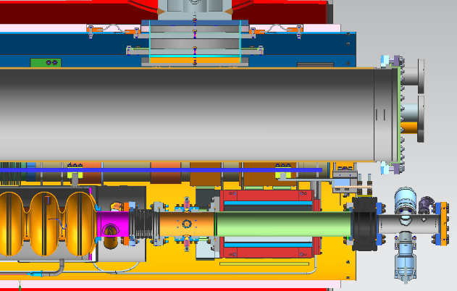
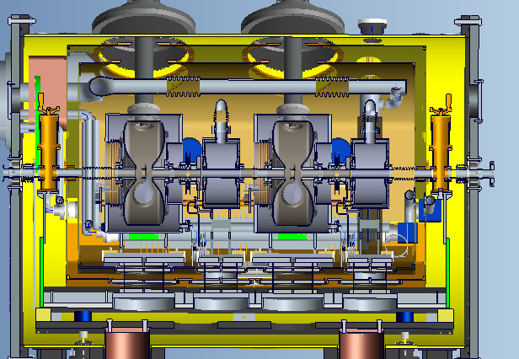
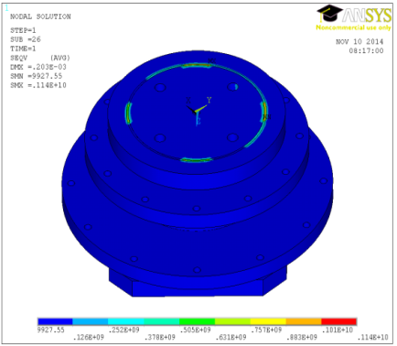
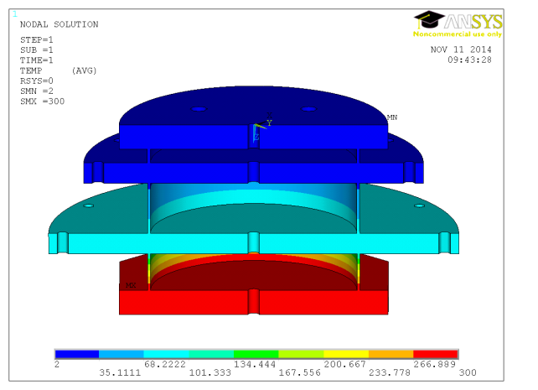
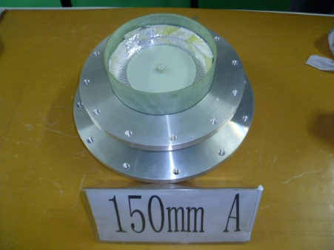
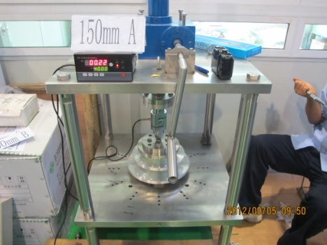
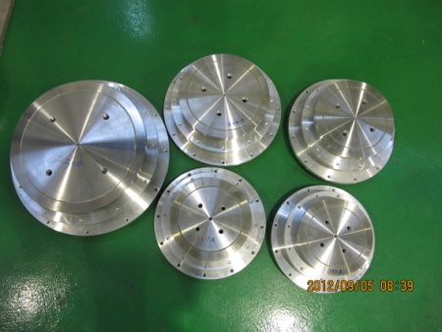
CEPC Test Cryomodule-POSTS
POST
POST
200
180
TEST
300
Tension Test
150
160

Slide 17
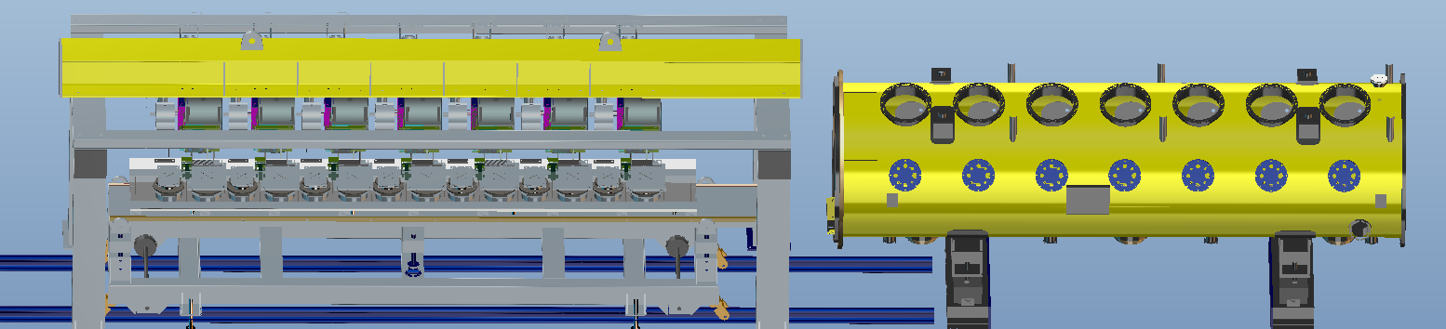
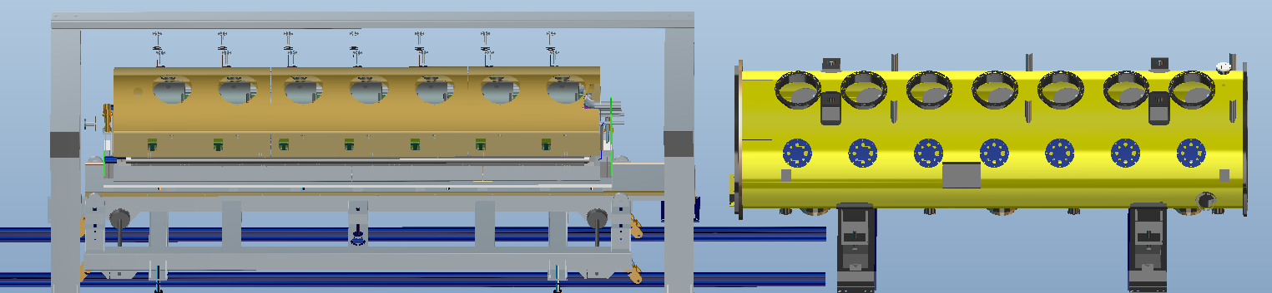
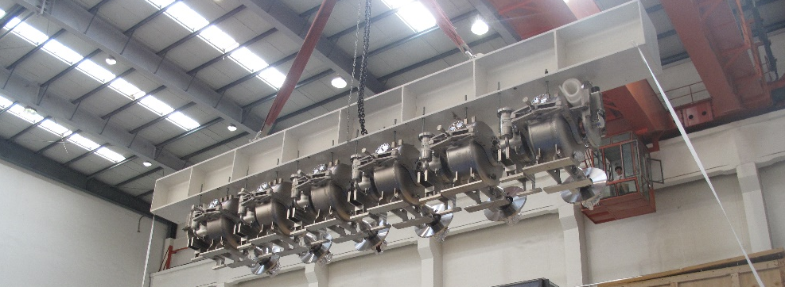
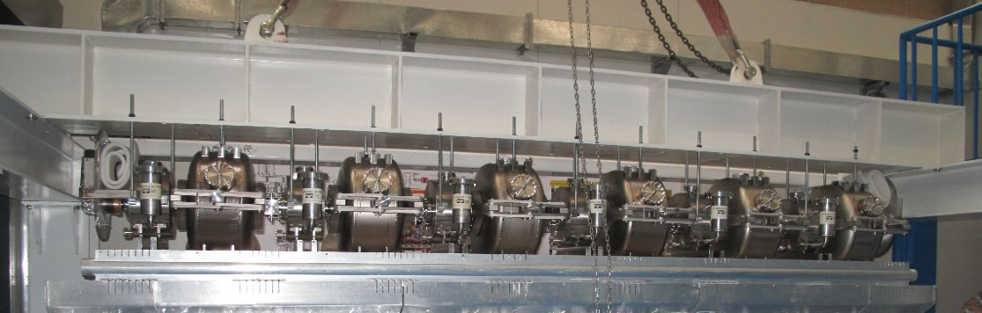
CEPC cryomodule Assembly equipment

Slide 18
Heat Load of CEPC cryomodule
Heat load summary of the CEPC cryomodule
Heat source | N | Static/W |  |  | Dynamic/W
 |  | 80K | 5K | 2K | 80K | 5K | 2K
Cavities | 6 | / | / | / | / | / | 120
Input Couplers | 6 | 36.00 | 18.00 | 2.10 | 60.00 | 36.00 | 6.00
HOM couplers | 12 | / | / | / | / | / | 6.00
200-POSTs | 6 | 44.37 | 6.81 | 2.10 | / | / | /
Instrumentation Cables | / | / | / | 0.54 | / | / | /
Radiation | / | 32.50 | 1.28 | / | / | / | /
Other | / | 1.00 | 0.30 | 0.20
Summary |  | 113.87 | 26.49 | 4.94 | 60 | 36 | 132

Slide 19
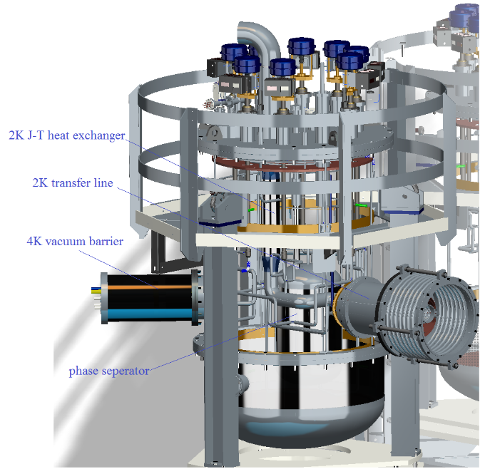
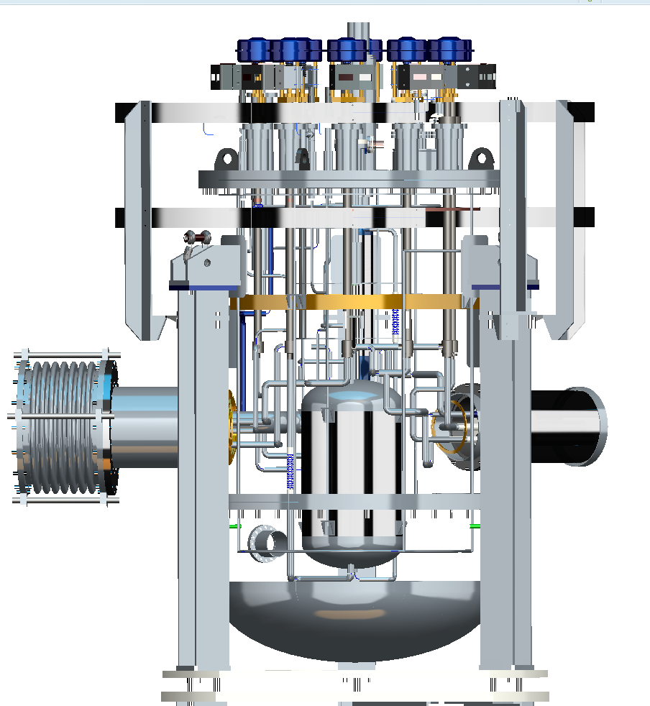
Distribution Valve Box

Slide 20
Conclusion and Schedule
The conceptual design of CEPC cryomodule and the mechanical design of test cryomodule have been completed.
The structure and specification of the CEPC cryomodule were introduced, and the detail design of test cryomodule was shown.
The 650MHz cavities, distribution valve box and test cryomodule will be fabricated.
2017. 12 Conceptual design of CEPC Cryomodule will have been completed.
2018. 08 Mechanical design of CEPC test Cryomodule will have been completed.
2019. 04 Fabrication of CEPC test Cryomodule will have been completed.
2019. 10 Assembly of CEPC test Cryomodule will have been completed.
2020. 06 Commissioning of beam source system will have been completed.

Slide 21
Thanks for your attention

