Slide 1
L-band Resonant Ring for testing of RF Windows for ILC
Baiting DU
High Energy Accelerator Research Organization (KEK)

Slide 2
Outline
Motivation
Theory of resonant ring
Low power test of 500W
Preparation for high power test

Slide 3
Motivation- Local power distribution system (LPDS) for ILC
10MW Multi beam klystron
3.3MW
1.1MW at RF window
For testing RF window:
Considering maximal standing wave, testing power should be 4 times higher than 1.1MW.
Required power is 4.4 MW.

Slide 4
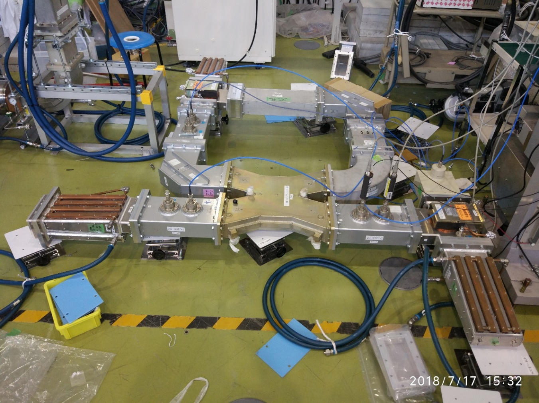
Photo of resonant ring (only for low power test)
Resonant ring is closed loop of waveguide system which can amplify power.
Circulator
Input
H-corner
Circulator
Dummy load
Dummy load
Fixed hybrid
Frequency is variable around 1.3 GHz.

Slide 5
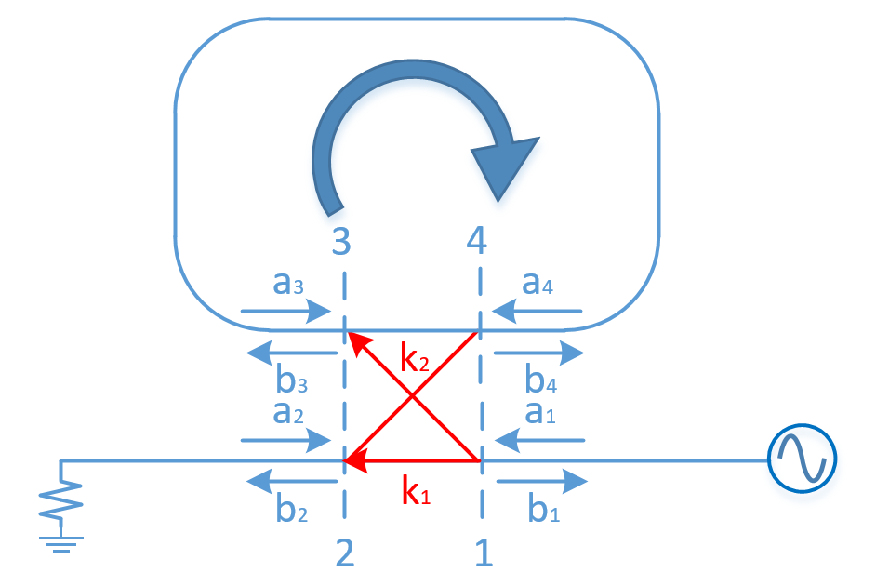
Theory of resonant ring
$a_{i} \& b_{i}$ are voltage.
$k_{1} \& k_{2}$ are voltage coefficient.
Assume: no reflection.
$→b_{1}=a_{2}=a_{3}=b_{4}=0$

Slide 6
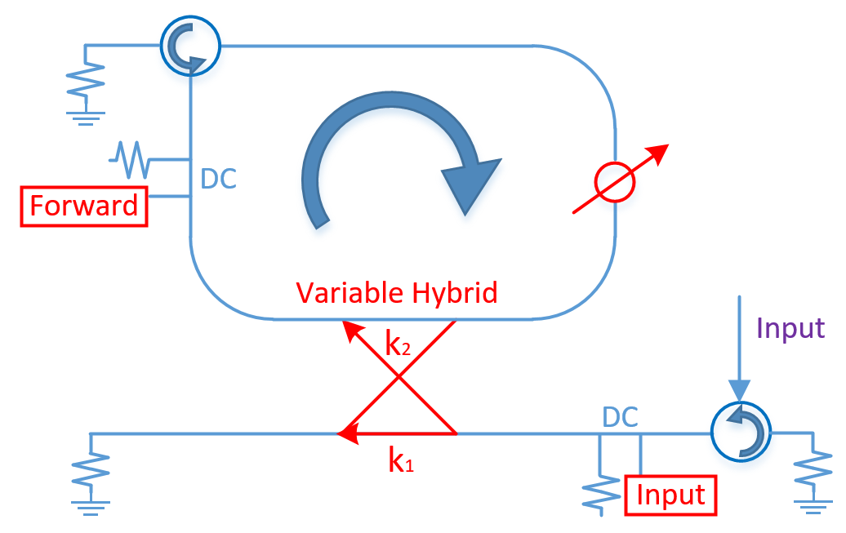
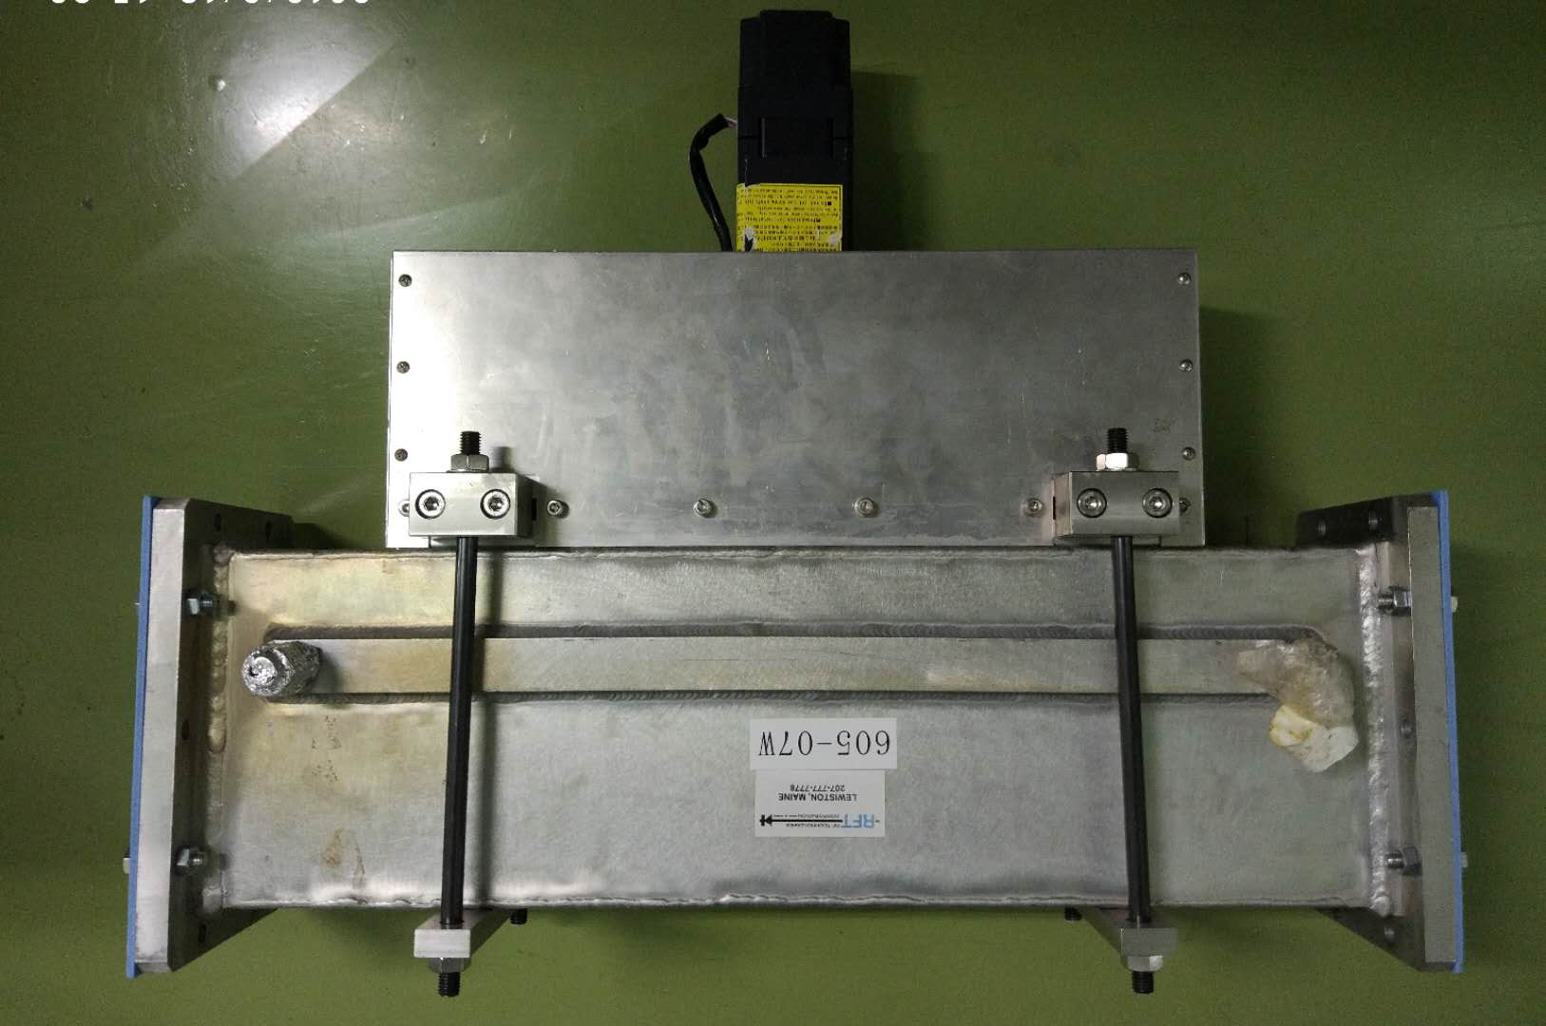
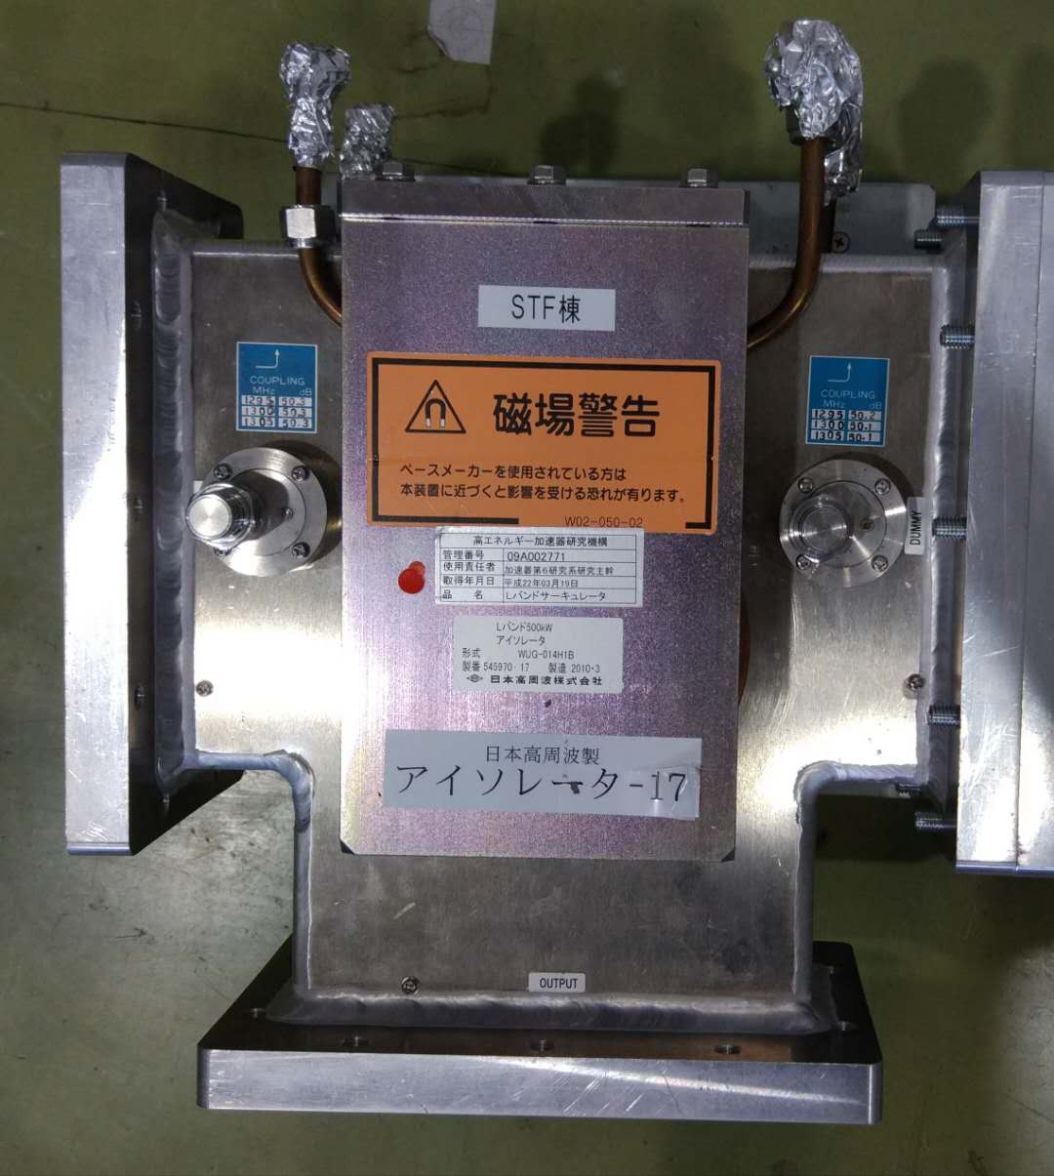
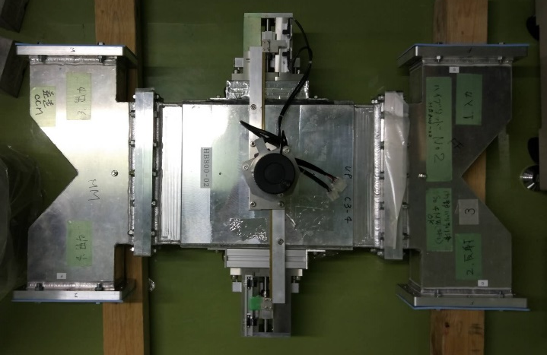
Low power test of 500W
Phase shifter, variable hybrid and 500kW circulator are developed in STF.
One turn loss is -0.21 dB.
Var. hybrid
Phase shifter
500 kW circulator

Slide 7
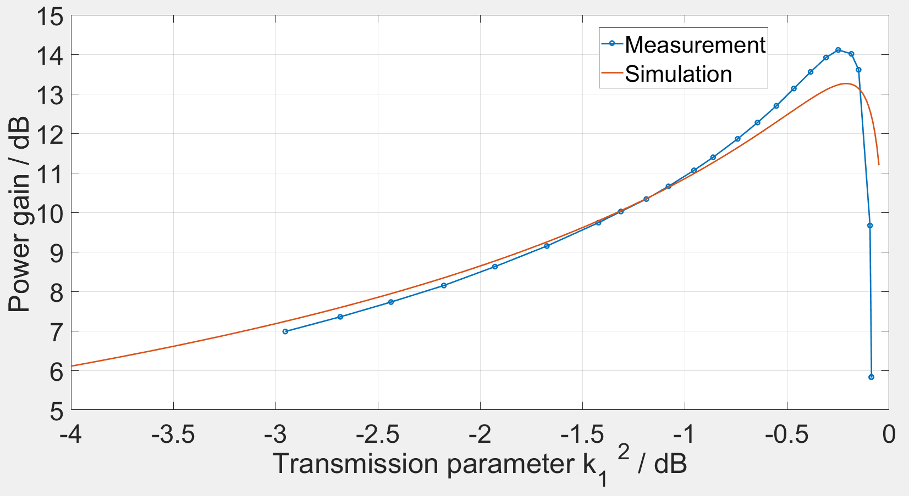
Power gain – $k_{1}$
$G_{max}$ when $k_{1}^{2}=loss$.
G decrease fast when $k_{1}^{2}>loss$.

Slide 8
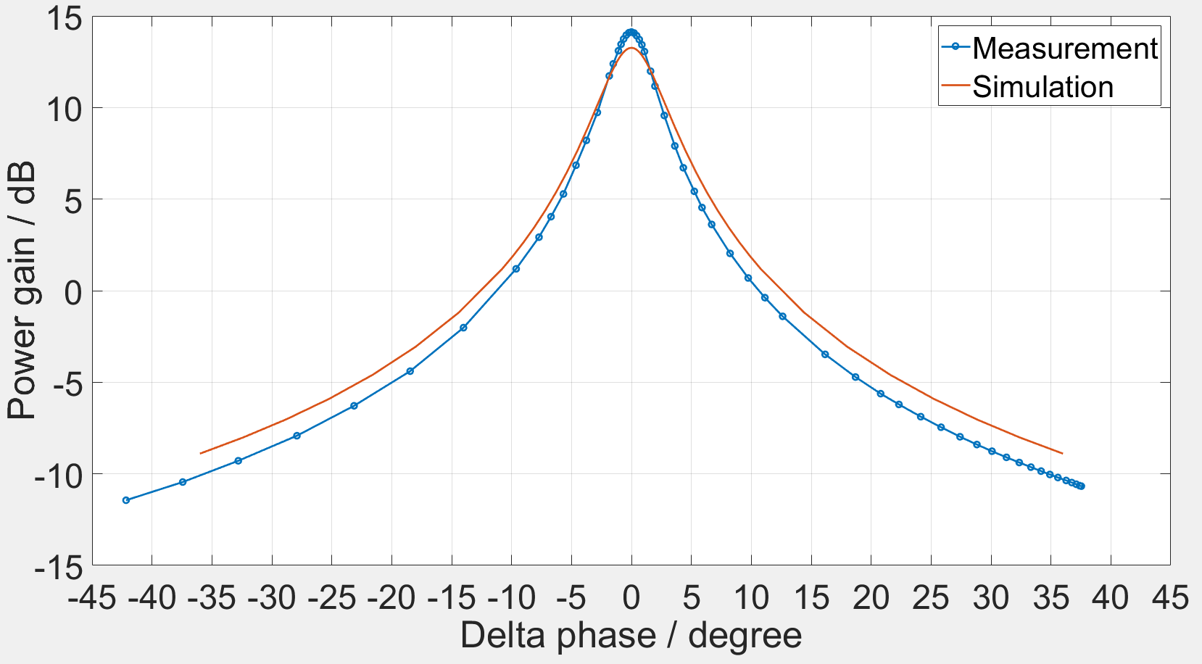
Power gain – phase difference
Phase shifter is used to change one turn phase
$k_{1}^{2}=loss=−0.21 dB$
Measurement
$G_{max}=14.12 dB$
3 dB width: $4.0°$
3.58 mm for 1.3 GHz
Simulation:
$G_{max}=13.26 dB$
3 dB width: $5.4°$
4.84 mm for 1.3 GHz

Slide 9
Preparation for high power test
Resonant ring should be pressurized for high power.
Var. hybrid and phase shifter can’t be pressurized.
Frequency is changed to change one turn phase.
500 kW circulator can’t be used for 5 MW and replaced by 3-stub tuner.
Small reflection will be accumulated to be high reflected power in ring.

Slide 10
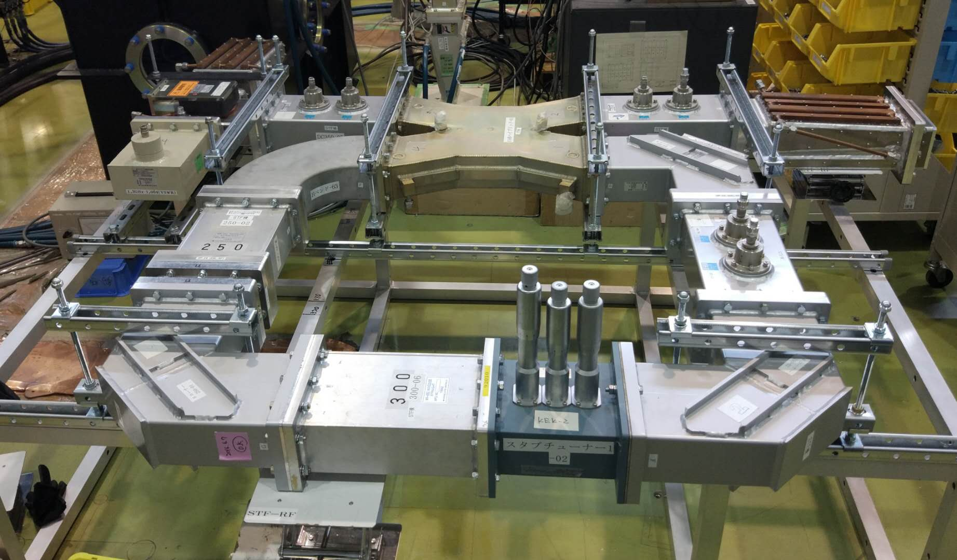
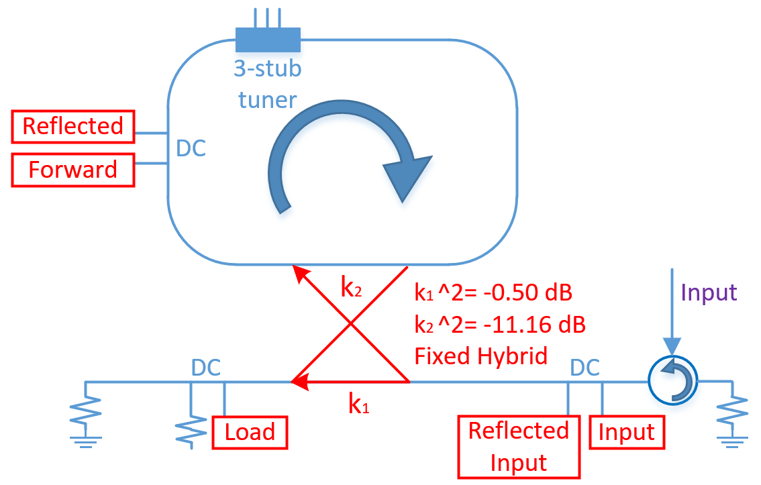
Figure of resonant ring for high power operation

Slide 11
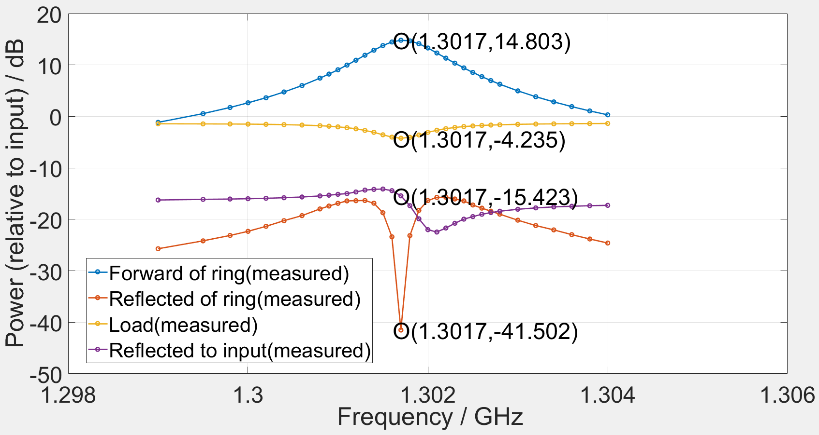
Measurement of tuned resonant ring with input of 500 W
Difference between forward and reflected power in ring is 56.31 dB.
$G_{max}=14.803 dB$
Unloaded Q: $Q=\frac{πf}{αv_{g}}\frac{G\left(1−Loss\right)}{1−\frac{\left(P_{L}+P_{r−in}\right)}{P_{in}}}== =6505$
$Loss=−0.04 dB$; $k_{1}^{2}=−0.50 dB$; $k_{2}^{2}=−11.16 dB$.

Slide 12
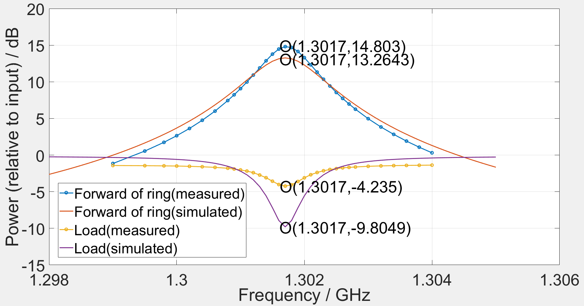
Measurement & simulation of tuned resonant ring with input of 500 W
$Loss=−0.04 dB.$
$k_{1}^{2}=−0.50 dB$.
$k_{2}^{2}=−11.16 dB$.
Measured $G_{max}$ is larger than simulated $G_{max}$

Slide 13
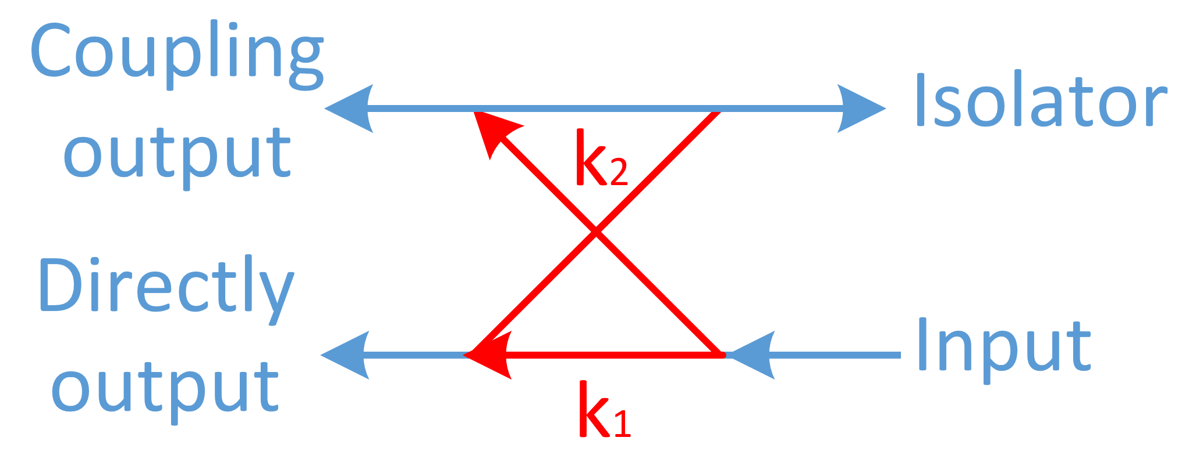
Measurement & simulation of tuned resonant ring with input of 500 W
Measured $G_{max}$ (14.80 dB) is larger than simulated $G_{max}$ (13.26 dB)
$k_{1}^{2}\left(−0.50 dB, 89.1\%\right)+k_{2}^{2}\left(−11.16 dB,7.7\%\right)<1$ for simulation
Some power is delivered to isolated port of hybrid.
This power can also be accumulated to be forward power by 3-stub tuner.
If $k_{2}^{2}=1−k_{1}^{2}\left(−0.50 dB\right)=−9.64 dB$, simulated $G_{max}$ will be 14.76dB.
3-stub tuner is necessary and effective for resonant ring.
Measured error

Slide 14
Summary and future plan
Principle of resonant ring is verified with input power of 500W.
Resonant ring is tuned well with input power of 500W.
Power gain is more than 14 dB.
High power operation of the resonant ring will be started after preparation being finished.
New RF window for the LPDS of ILC is designed in STF at the same time.

Slide 15
Thank you very much!

Slide 16
Backup
Phase shifter & Variable hybrid.
Reflection without 3-stub tuner.

Slide 17
Phase shifter
S. Kazakov et al., “L-band Waveguide Elements for SRF Application”, in Proc. Particle Accelerator Society Meeting, Tokai, Japan, 2009, pp. 980-982.
Moving fin inside the waveguide we can change value of longitudinal wave vector and thus we can change the phase of wave coming through the waveguide.

Slide 18
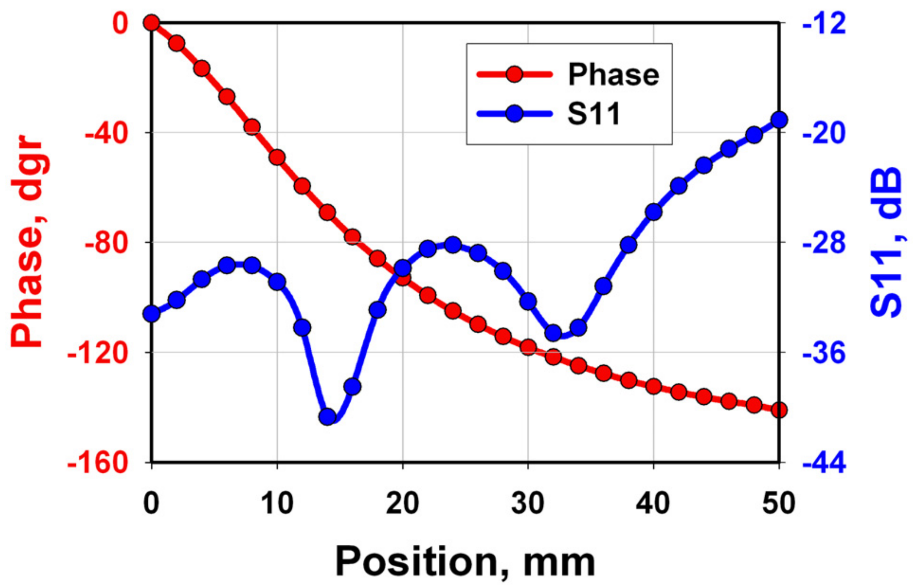
Phase shifter

Slide 19
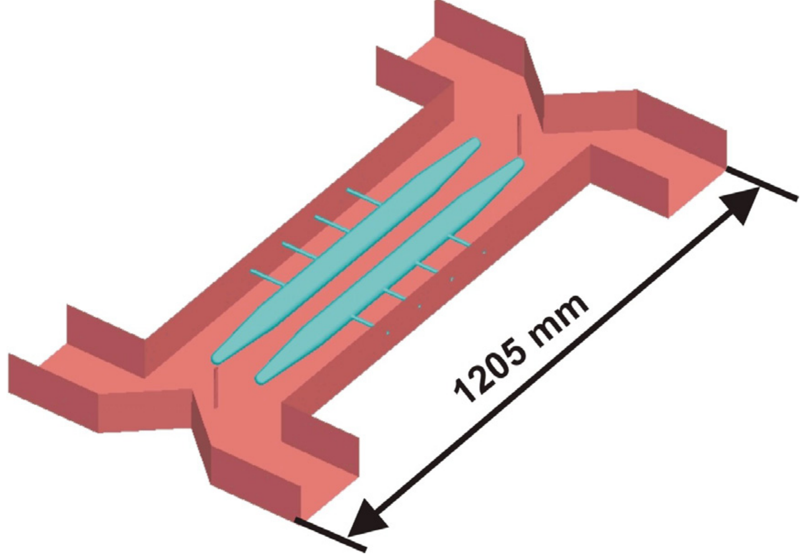
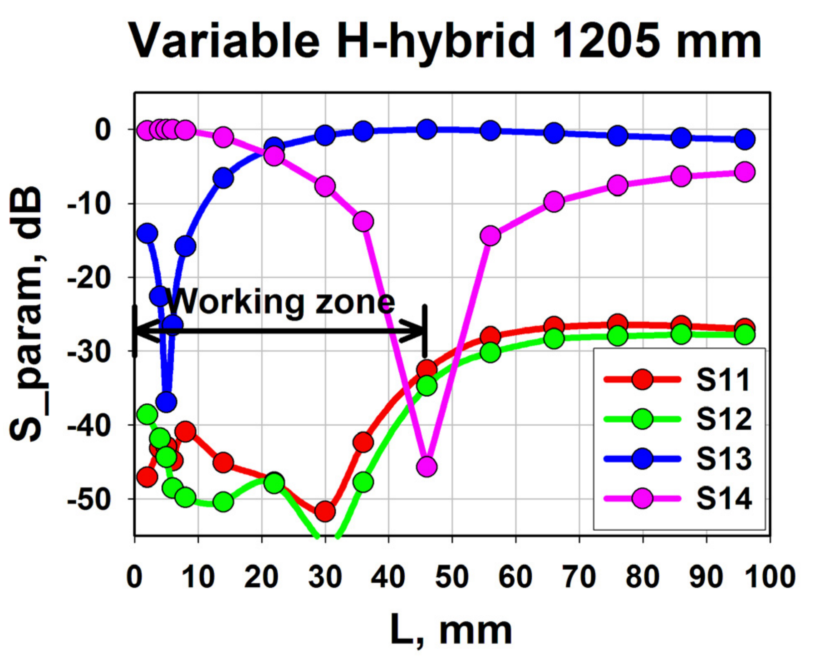
Variable hybrid
Port-2
Port-1
Port-3
Port-4

Slide 20
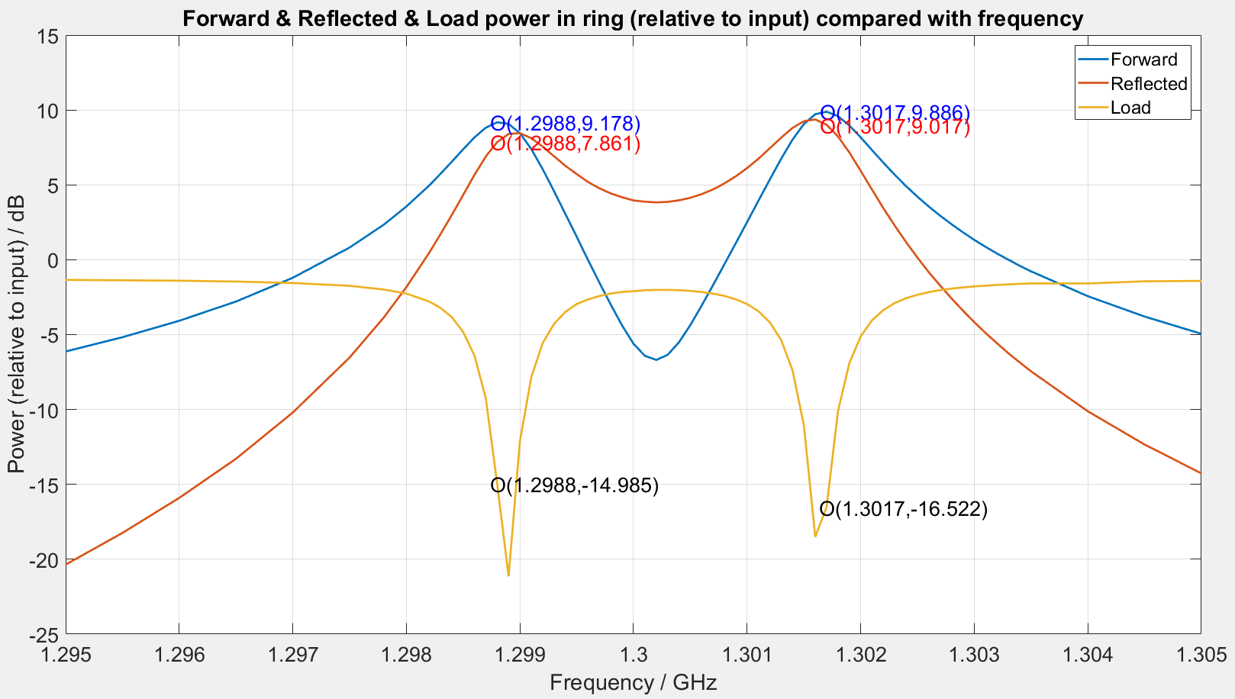
Reflection without 3-stub tuner (measurement)
Even small reflection (~=20dB) will be accumulated to high reflected power in the resonant ring.

