Slide 1

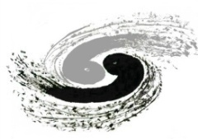

CEPC HOM Coupler and Absorber
Hongjuan Zheng, Fanbo Meng, Jiyuan Zhai
2018-09-22
  Institute of High Energy Physics
  Beijing, CAS
7th IHEP-KEK SCRF Collaboration Meeting. Sep. 22, 2018, IHEP, Beijing, China.

Slide 2
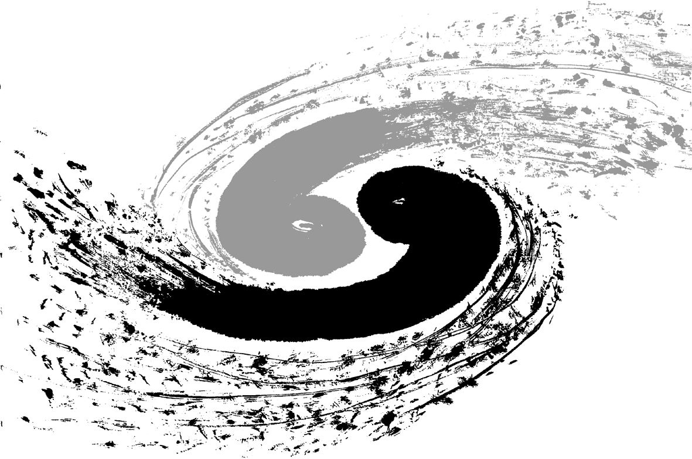
Outline
Introduction
Brief overview of HOM couplers
CEPC HOM coupler R&D status
CEPC HOM absorber
Summary

Slide 3
HOM Coupler for CEPC

Slide 4
Introduction
Higher-order-modes excited by the intense beam bunches must be damped to avoid additional cryogenic loss and beam instabilities. This is accomplished by extracting the stored energy via HOM couplers mounted on beam pipe and HOM absorbers outside the cryomodule.
There are three major varieties of HOM couplers mainly used
Waveguide
PEPII, CEBAF, Jlab high current cryomodule
Coaxial
LEPII, LHC, SOLEIL, HERA, XFEL, ILC, SNS……
Beam pipe
KEK-B, CESR-III, BEPC-II
For CEPC, coaxial type with double notch design is adopted.
Challenges for coaxial type: notch filter BW and tuning, cooling, feedthrough antenna heating, RF connection heating, cable heating …

Slide 5
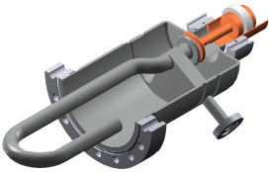
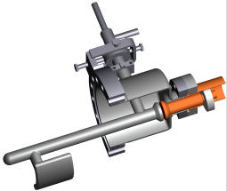
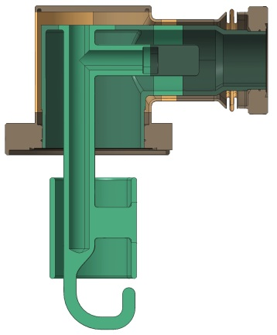
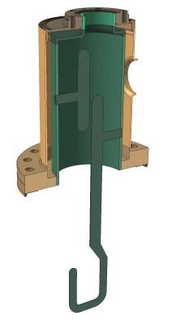
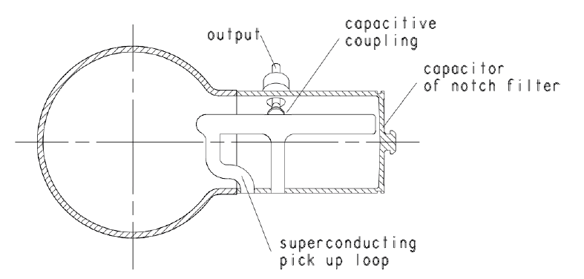
Coaxial HOM Couplers
When the cavity and cryomodule configuration, HOM power and high frequency modes behavior are determined (which means how much power is to be extracted at the cavity beam pipe), we could choose the damper.
LEPII HOM coupler:
max power ~ 850W
352 MHz
2 couplers needed
LHC (narrowband):
max power ~ 600W
400 MHz
2 couplers needed
LHC (broadband):
max power ~ 600W
400 MHz
2 couplers needed
SOLEIL:
Design value~ 5kW
325 MHz
4 couplers needed
HL-LHC DQW cavity:
Design value ~ 1kW
400 MHz
2 couplers needed
LHe cooling
Single notch
2K
LHC (narrowband):
Design value ~ 1kW
400 MHz
2 couplers needed
LHe cooling
Single notch
2K
Coupler for ILC, XFEL etc. ~ several watts

Slide 6
HOM Challenges for CEPC
Extract large HOM power (~ 1 kW per cavity ) with wide spectrum
  Coaxial HOM coupler & absorber mounted out crymodule
HOM issues of bunch train operation
  HOM power spectrum for bunch train scheme
  high pulsed peak power (4~7 kW, RF breakdown, not thermal effect)
  special instabilities
HOM heat load in multi-cavity cryomodule
  high Q₀ and large machine scale require small HOM heat load
  HOM power propagation through cavities
  heat load on the normal-conducting bellows and connections
  cable heat load
HOM damping
  The longitudinal coupled-bunch instabilities (CBI) driven by the HOM impedance of the RF cavities determine to large extent the highest beam current and luminosity

Slide 7
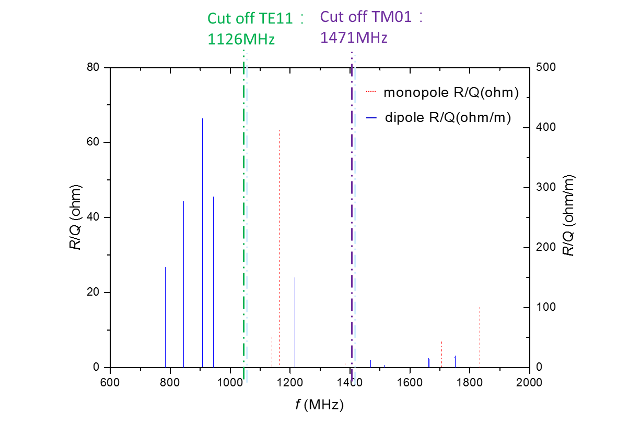
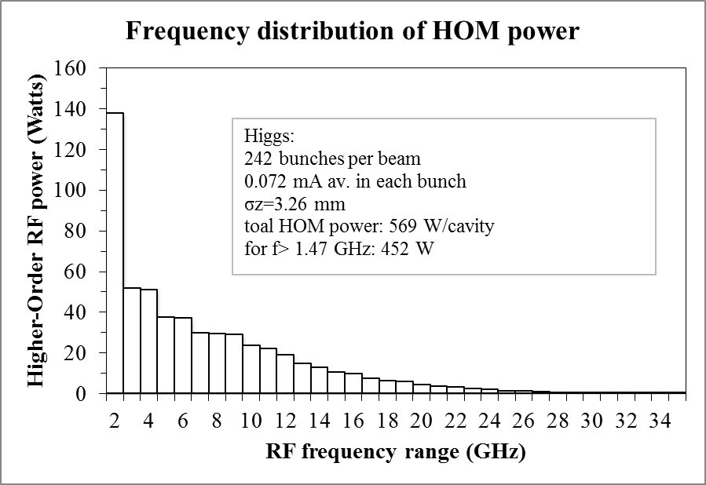
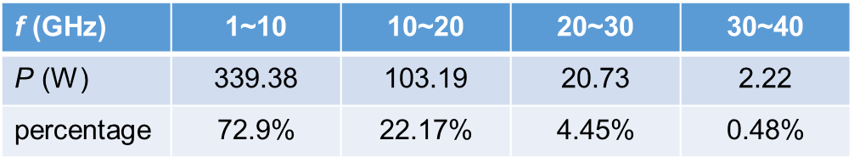
Cavity Spectrum and Power
Average power (single pass assumption)
79.4% above the cut off frequency
Dangerous monopole: aroud 1200 MHz
Dangerous dipole: 800 MHz ~ 900 MHz, 1200 MHz
HOM coupler: 800~1400 MHz
HOM absorber operating frequency: 1.4 ~ 20 GHz

Slide 8
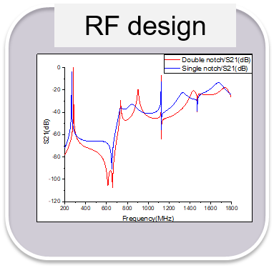
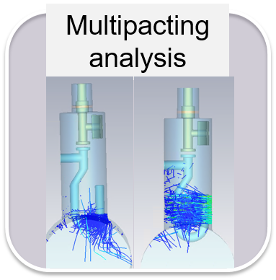
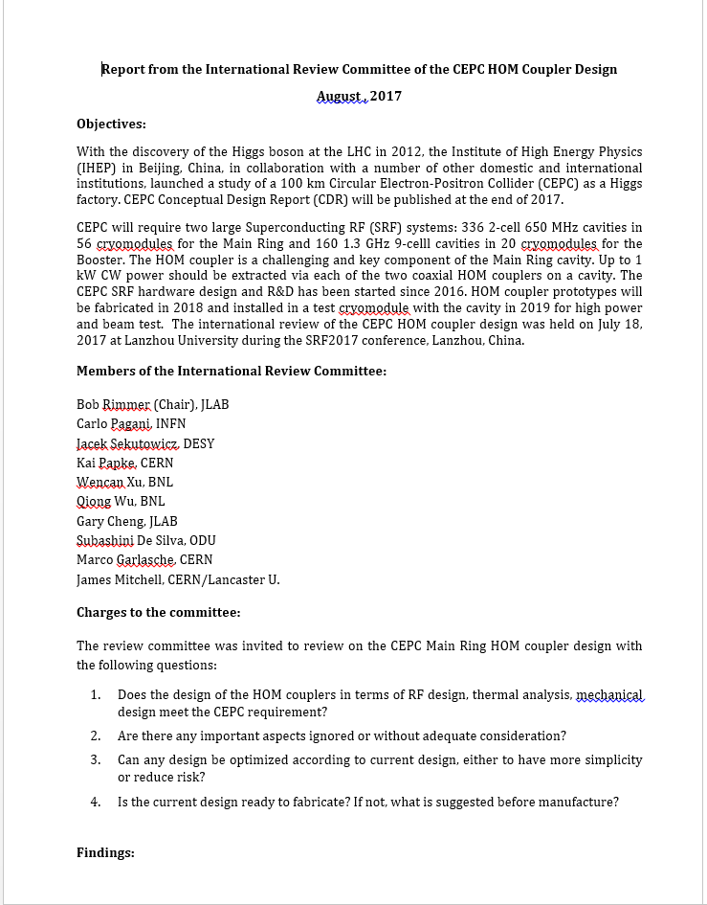
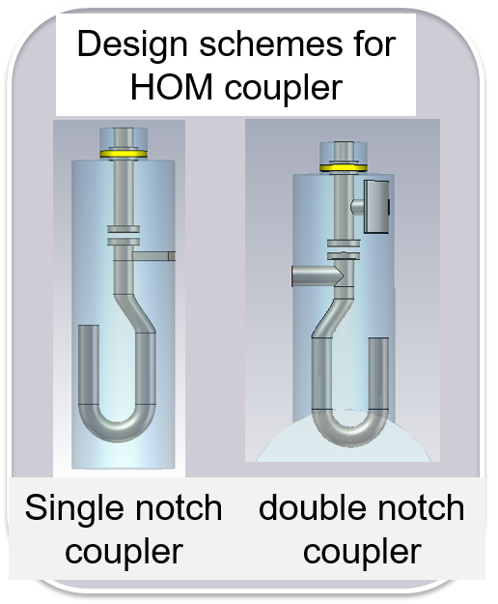
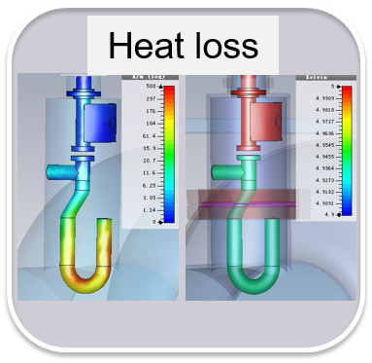
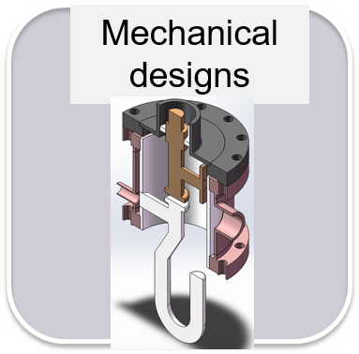
Design Contents
Design contents mainly includes RF design, power dissipation, multipacting analysis, heat loss, mechanical designs. The whole design has been finished.
~ 1 kW power
Five-pages report from the International Review Committee of the CEPC HOM Coupler Design chaired by Bob Rimmer (JLAB), July 18, 2017.
2 kW power per cavity, each direction 1 kW, assume 50 % coupled by the HOM coupler (0.5 kW). 1 kW power capacity will have enough margin.

Slide 9
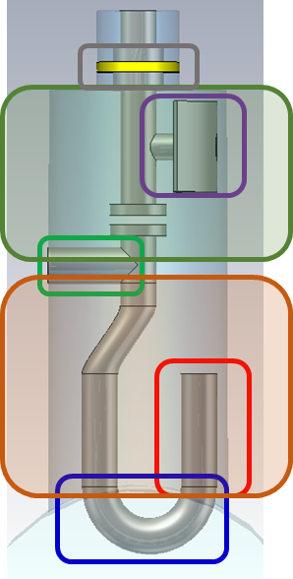
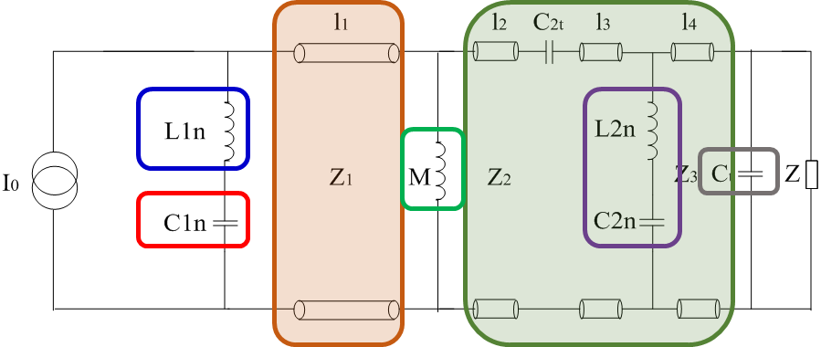
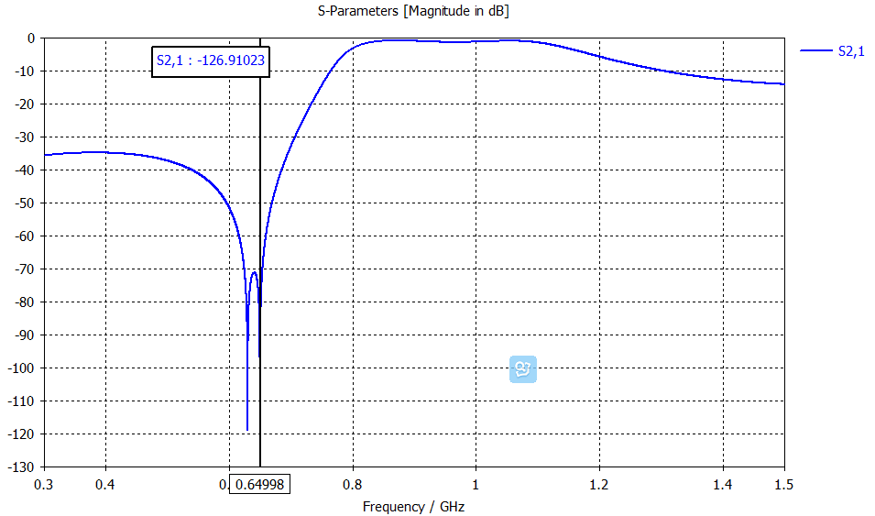
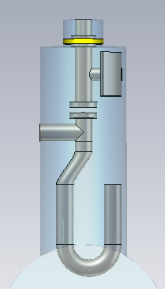
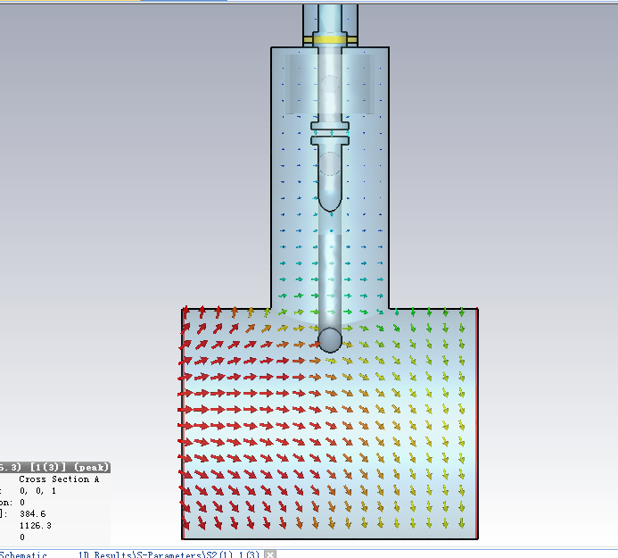
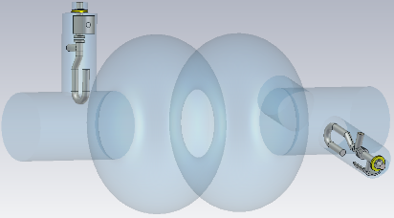
HOM Coupler Design
equivalent circuit (transmission line model) → optimize each part according to S21 curve
→ change to 3D model → electromagnetic optimization
Port2
Port1
Port3
Modes | f (GHz) | R/Q (monopole Ω, dipole Ω/m) | Q_{e} simulation
TM011 | 1165.574 | 65.2 | 2.46E+05
TM020 | 1383.898 | 1.3 | 1.55E+05
TE111 | 844.738 | 279.8 | 1.50E+04
TM110 | 907.592 | 420.1 | 4.58E+02

Slide 10
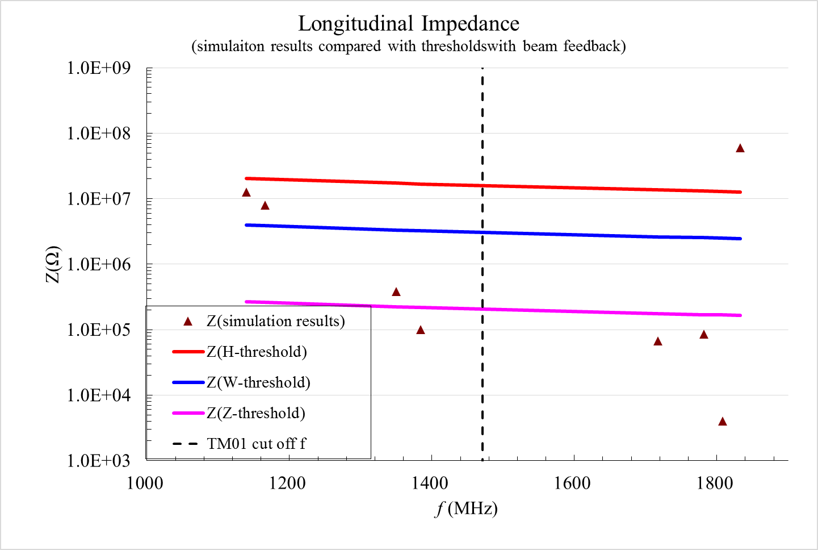
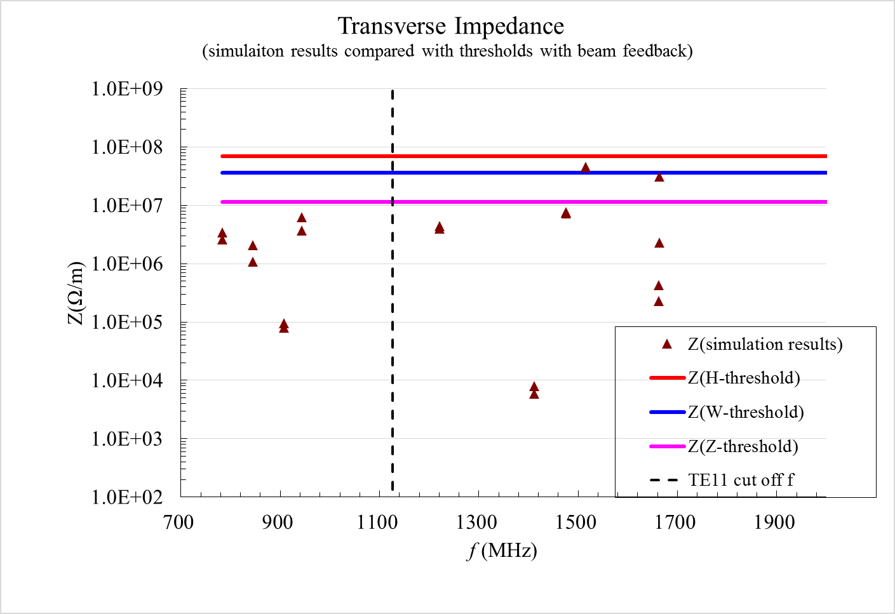
HOM Damping Results
TM011
Monopole modes impedance per cavity (cavity impedance thresholds with feedback and parking cavities in beamline)
Without frequency spread
Optimize the geometry of the HOM coupler, increase TM011 field in one side and reduce Q_{e} by asymmetric end cells, push idle cavities off-line. New cavity design has been done.
Dipole modes impedance per cavity (cavity impedance thresholds with feedback and parking cavities in beamline)
Without frequency spread

Slide 11
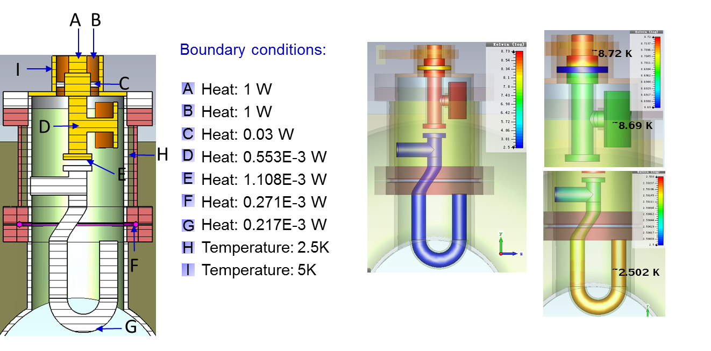
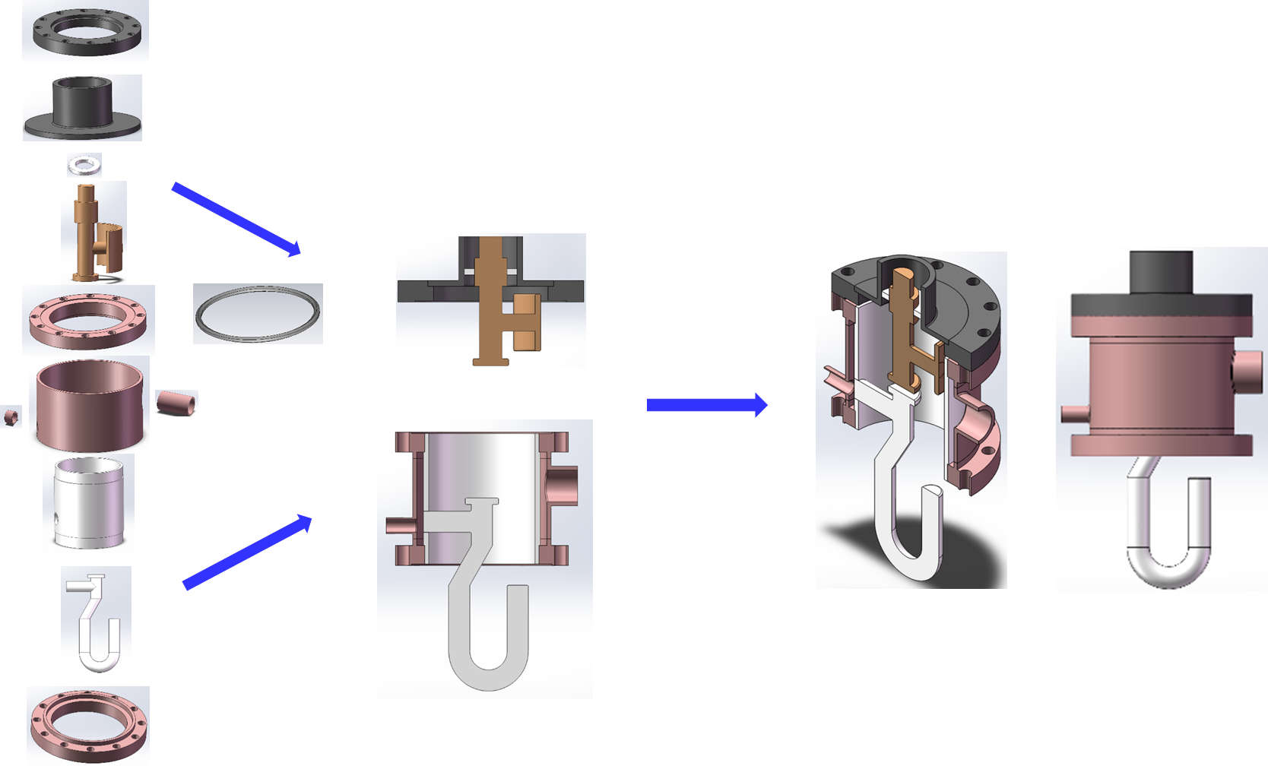
Thermal Analysis and Mechanical Structure
Power dissipation caused by the fundamental mode and 1 kW HOM is in the mW range.
A helium tank outside the HOM coupler is needed.
No active cooling by liquid helium inside the loop.

Slide 12
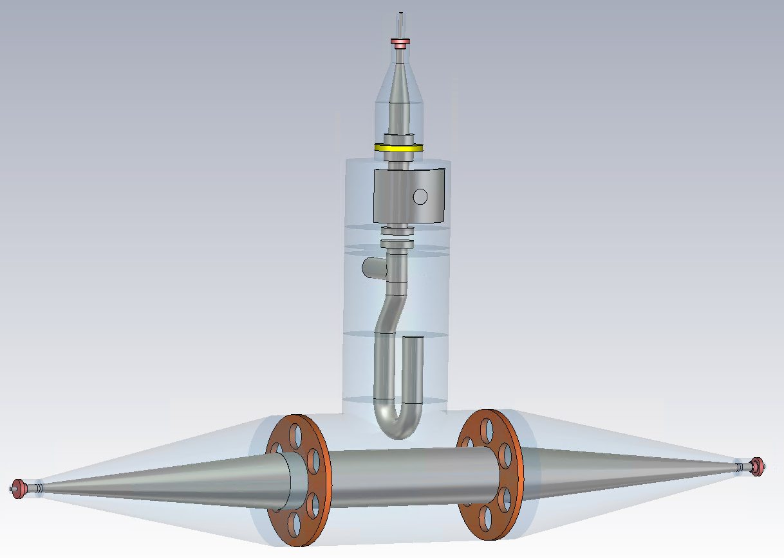
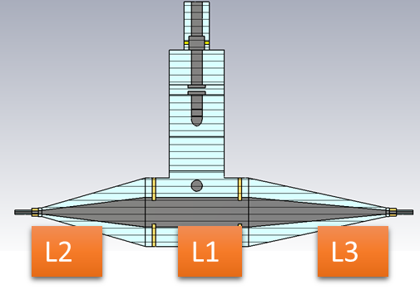
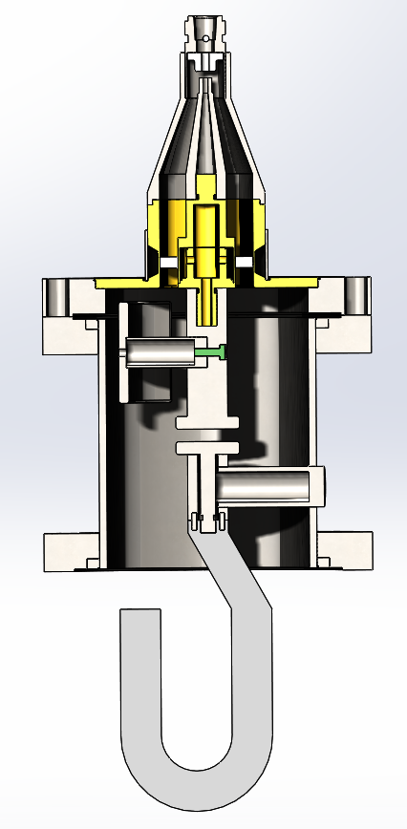
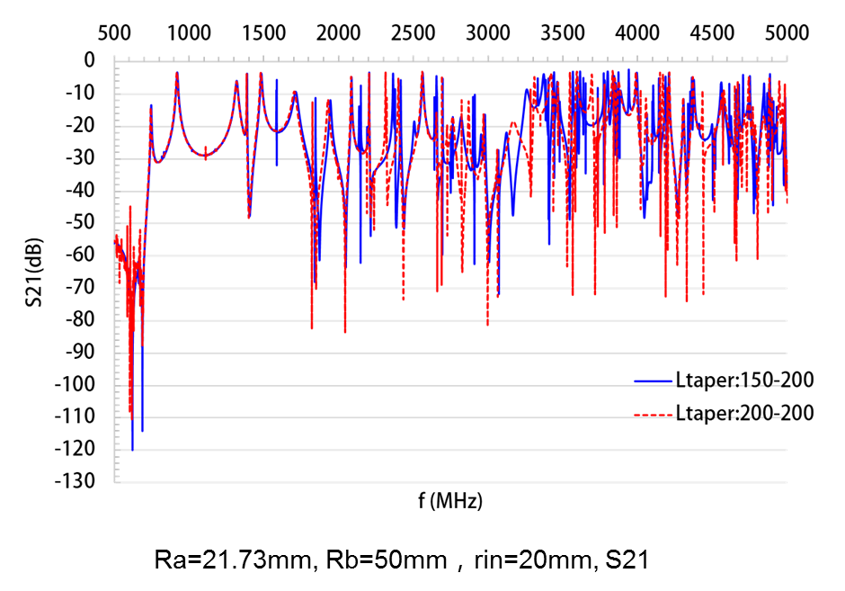
Test Bench and HOM Coupler Fabrication
Aim: Characterize the transmission and reflection of each coupler and check the influence of the fabrication errors.
Coaxial transmission line with HOM coupler model used to measure the transmission properties of the coupler
symmetry cone & asymmetry cone (200-150-200)
Stainless steel model
Dismountable HOM coupler design
Different inner conductor length

Slide 13
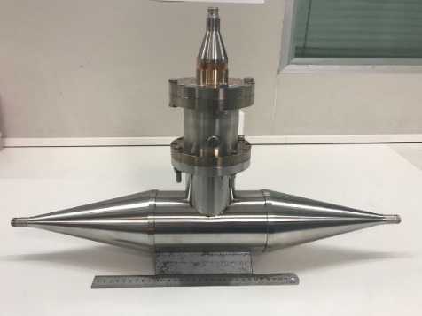
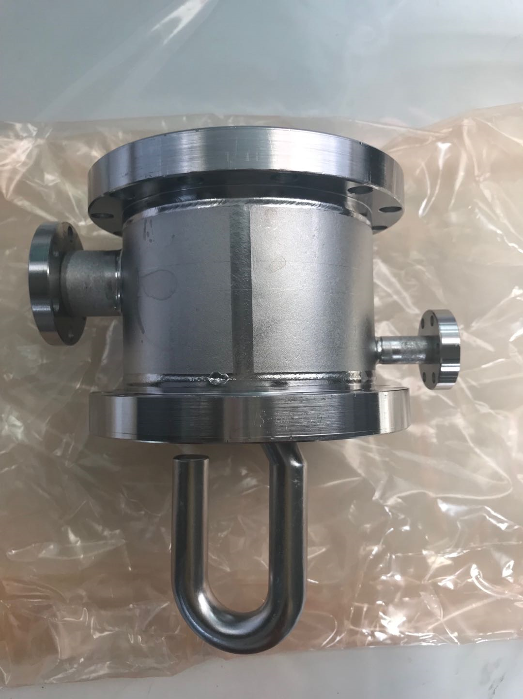
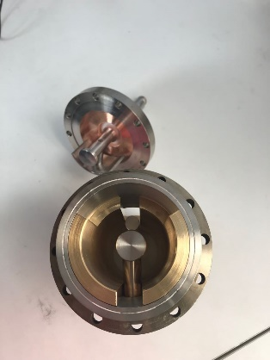
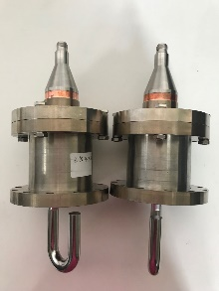
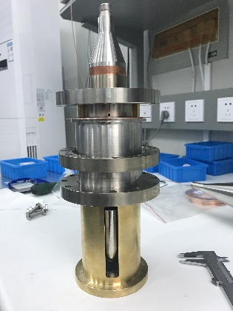
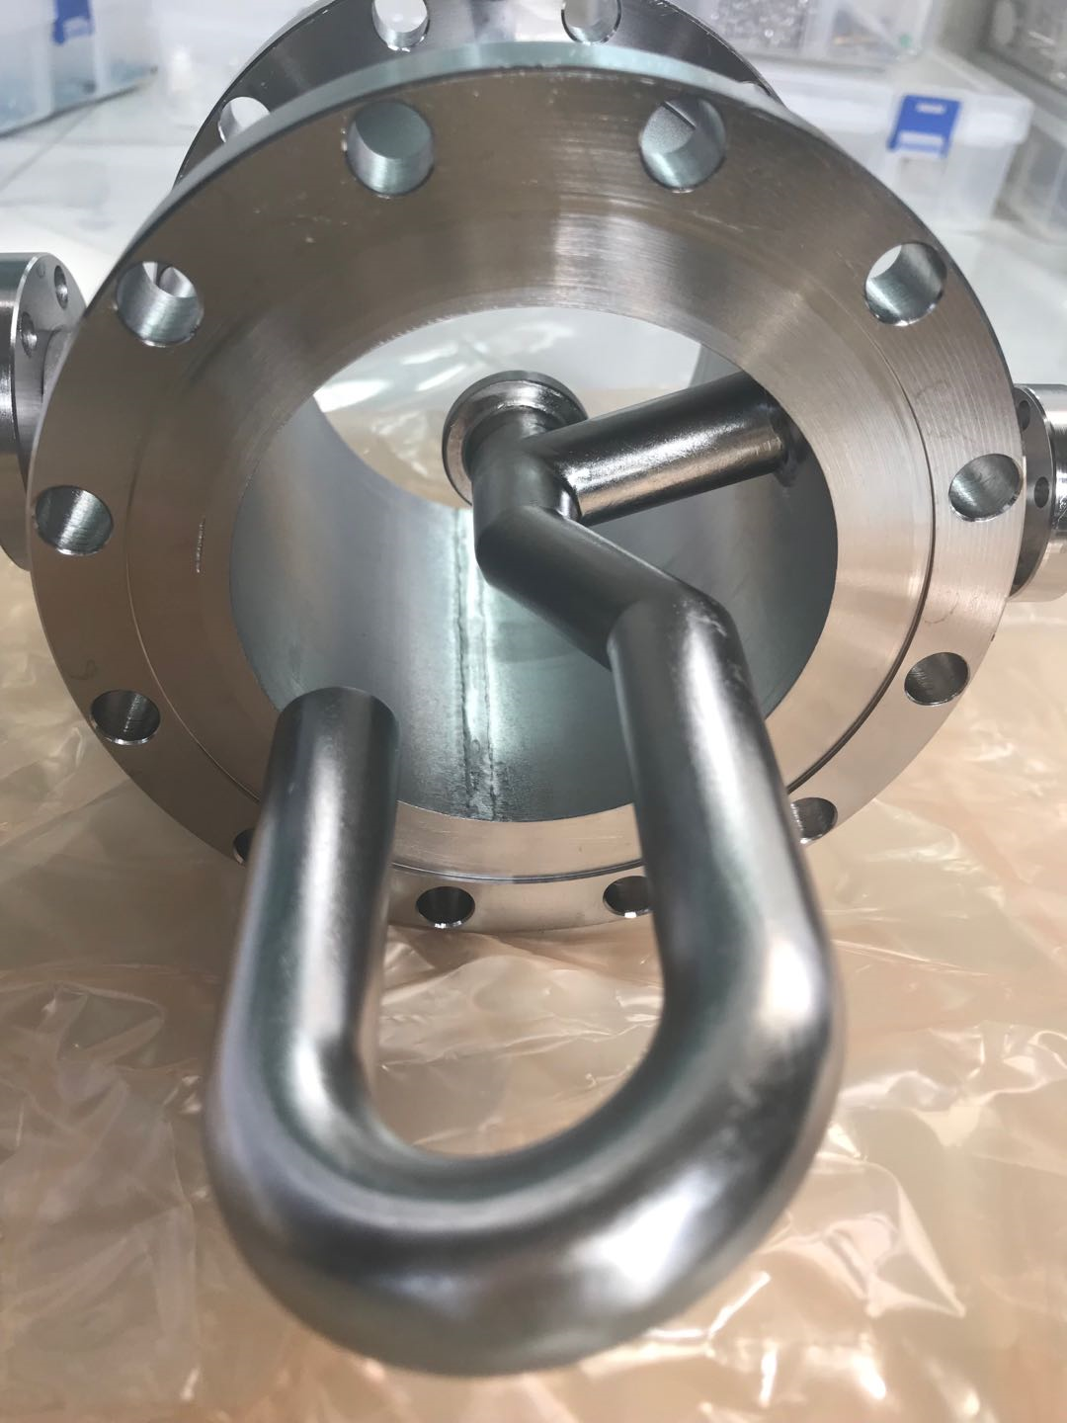
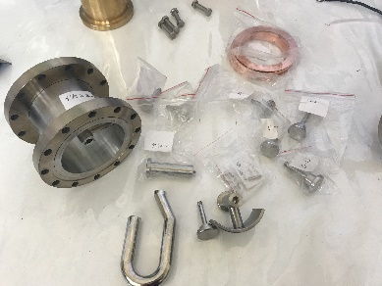
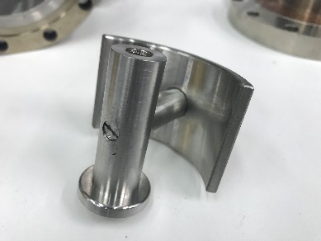
Test Bench and HOM Coupler Fabrication
Stainless steel model
Dismountable HOM coupler
Nb model

Slide 14
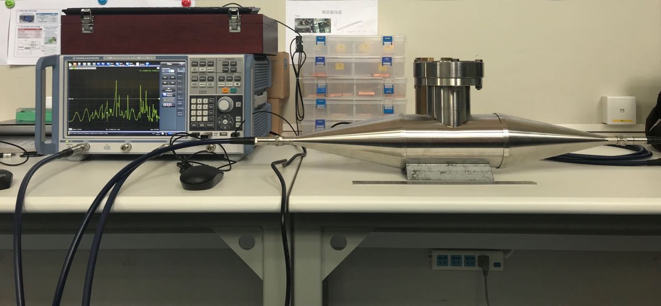
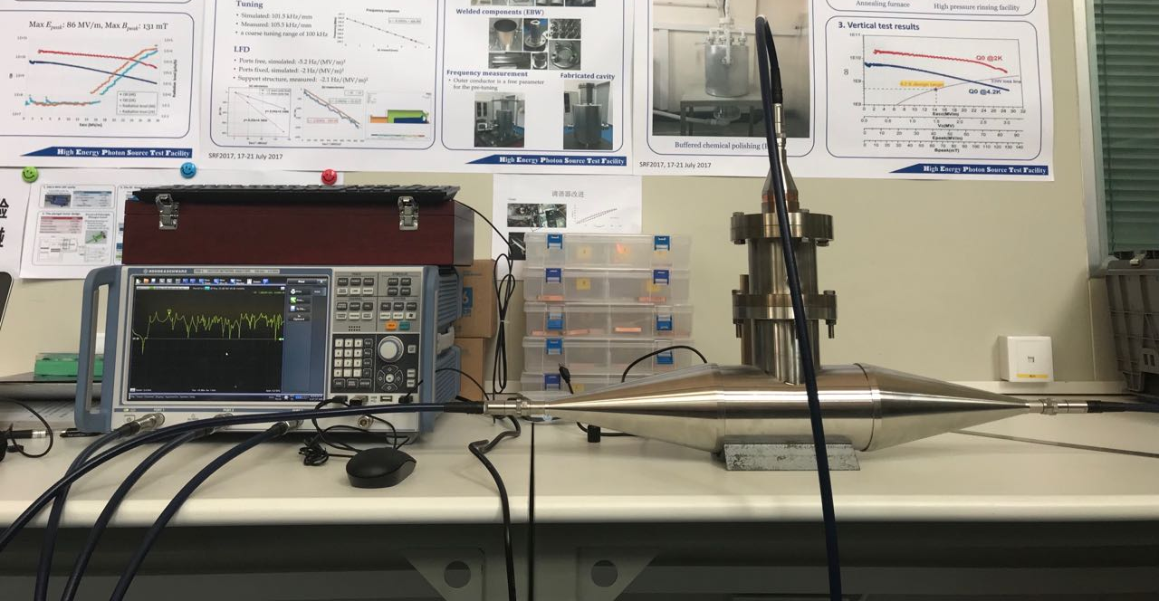
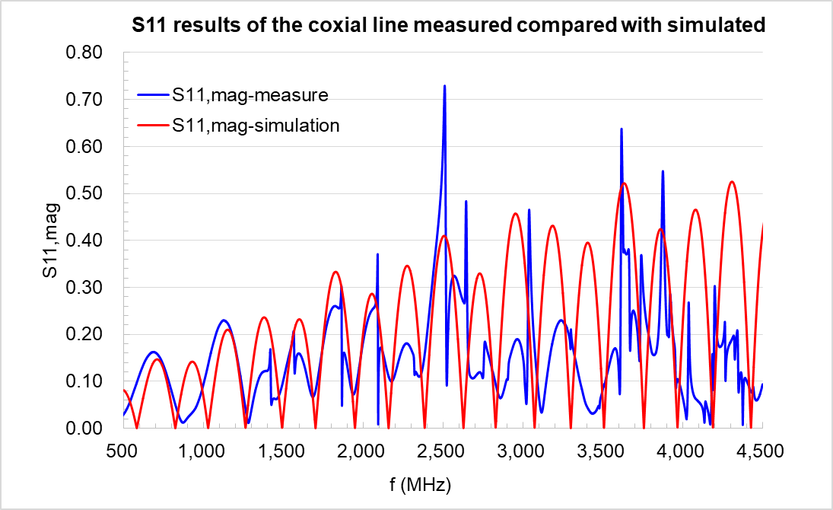
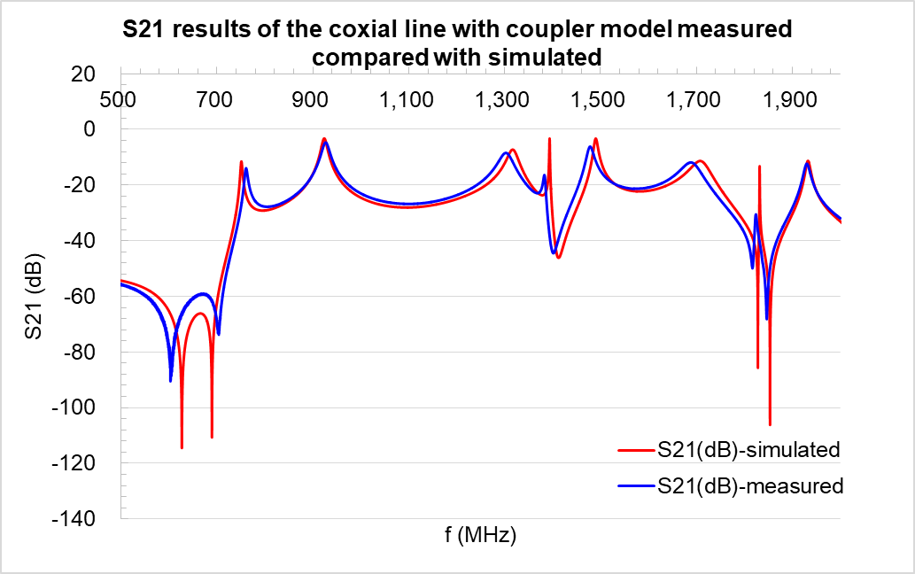
HOM Coupler Low Power Test
The measured results agree well with the simulated results.

Slide 15
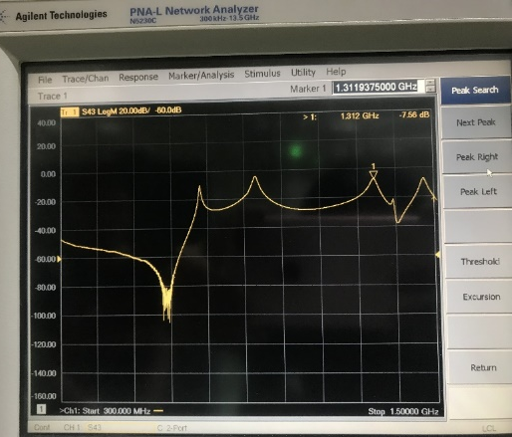
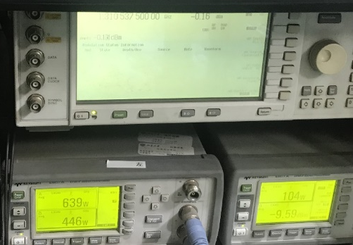
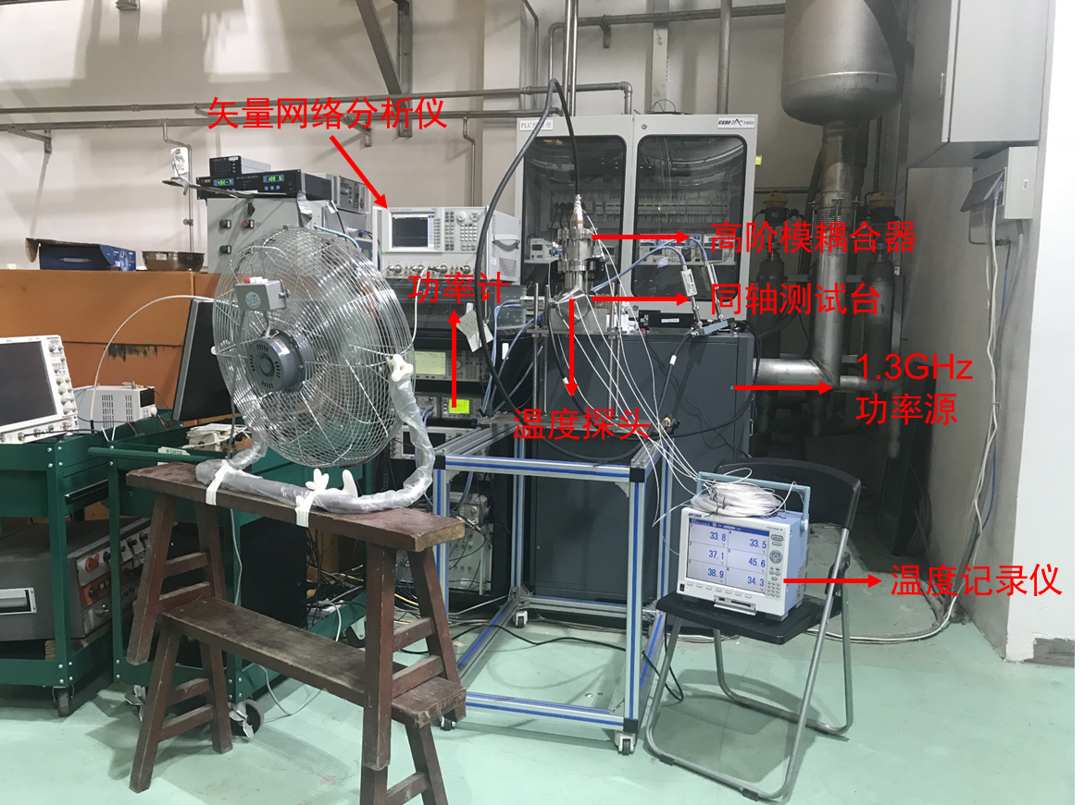
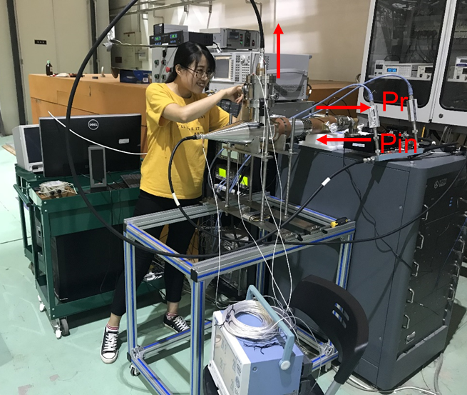
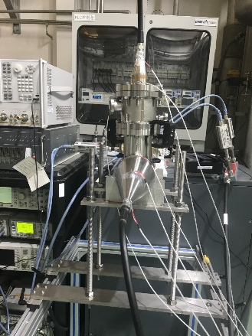
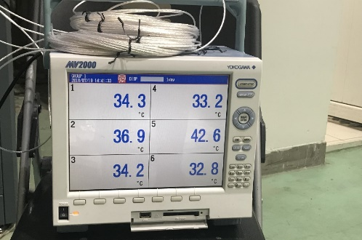
HOM Coupler High Power Test
Condition: room temperature
Power source: 1.3 GHz 3 kW
Frequency used: 1.3105375 GHz
Test results: input power 639 W, pick up power from HOM coupler port 104 W, temperature near pick up port is 34.3°C.

Slide 16
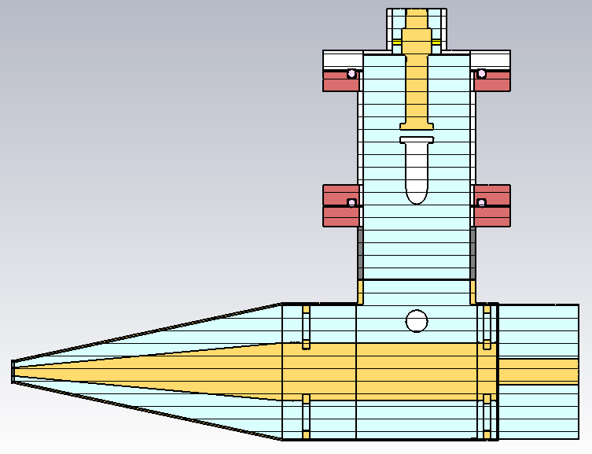
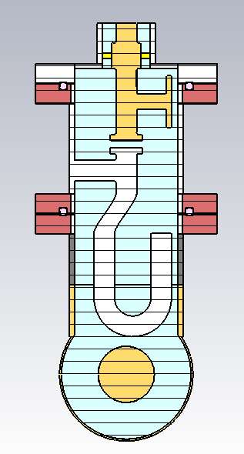
HOM Coupler 1 kW Power Test Plan
Aim: The main focus is to ensure the components have the correct frequency response, and to condition the interior surfaces prior to operation. The maximum power designed for the HOM coupler is 1 kW. It is necessary to test the coupler at high power first before installed on the cavity under 2 K.
Test box (under design):
Test condition: low temperature and room temperature tests are planed (next year).
Connect with coaxial cable
Thermal calculations both for low temperature and room temperature
Coaxial cable optimal design
Short plane

Slide 17
HOM Absorber for CEPC

Slide 18







HOM Absorber
Fanbo Meng
Due to short bunch length thus wide HOM frequency range, SiC+AlN composite is chosen for cavity HOM absorbing material.
Beam-pipe HOM absorber at room temperature outside the cryomodule
Mechanical and cooling structure
SiC+AlN composite bricks brazed on Molybdenum and then on copper plate
Microwave absorbing material test system
1 kW high power test finished. 5 kW test for the final goal.

Slide 19



Low Power Test for HOM Absorber
Fanbo Meng
The S parameter of HOM absorber
Coaxial test fixture
S11 (dB)
The S parameter of HOM absorber has been tested with VNA from 1GHz to 10GHz.
S21 (dB)

Slide 20

Low Power Test for HOM Absorber
Fanbo Meng
Absorbing efficiency = $1−{S11}^{2}−{S21}^{2}$
The absorbing efficiency of most frequency is larger than 50%.
Notes:
Including the reflection of the connector

Slide 21


High Power Test for HOM Absorber
Fanbo Meng
The high power test of HOM absorber is used 1.3 GHz Solid Amplifier in standing wave mode.
When the input power is 2 kW, the reflect power is 0.94 kW, and the absorber absorbing power is 1 kW.
During the test, the absorber is cooling by water.
HOM absorber
1.3 GHz Solid Amplifier
Short circuit piston

Slide 22
High Power Test for HOM Absorber
Fanbo Meng
The power increasing curve is shown in the diagram. The absorbing efficiency keeps on 50% during the test.

Slide 23
Summary
RF design for CEPC HOM coupler has been finished.
The prototypes fabrication of coupler and absorber have been finished.
The low power test show that the characterize of the transmission and reflection properties measured is not much different from the simulation results.
The high power tests have been successfully carried out for both coupler and absorber. 1 kW test for coupler has been planned with new test bench design. 5 kW test for absorber also planned to execute next year.
The coupler and absorber will be installed on the PAPS 650 MHz cryomodule next year.

Slide 24
Thank you for your attention!

Slide 25
Back slides

Slide 26






Cavity HOM Power of Z (48 trains)
cavity wideband impedance
Beam spectrum and cavity impedance
(bunch repetition rate 40 MHz dominated)
Power spectrum
Cut-off frequency: 1.47 GHz
HOM Power (W) | Average calculation | Spectrum calculation
< 1.85 GHz | 970 | 50
1.85 ~ 14 GHz | 966 | 976
Total | 1936 | 1026
~ kHz bandwidth
Total HOM power lower than single pass assumption: Safe pattern for the ideal cavity.
With HOM frequency spread and fill pattern change, HOM power could be very large in some cavities. Slightly detune the cavity will reduce the HOM power drastically while not affecting the accelerating mode.
Note that the CBI related frequency is revolution frequency 3 kHz, much smaller than HOM power related bunch frequency (~ MHz).

Slide 27



Cavity HOM Power of Higgs (quasi-half-ring fill)
Due to common RF of the two rings, cavities in different location will feel different fill pattern thus different beam spectrum.
HOM Power (W) | Average calculation | Spectrum calculation
< 1.85 GHz | 131 | 19
1.85 ~ 14 GHz | 440 | 440
Total | 571 | 459
Beam spectrum spacing 2.69 MHz (Z-pole 40 MHz)
Nearest distance between beam line and cavity impedance is 1 MHz.
Total HOM power lower than single pass assumption: Safe pattern for the ideal cavity.
Same as Z-pole, detune the cavity will reduce the HOM power.
Beam spectrum and cavity impedance
(bunch repetition rate dominated)
Power spectrum

Slide 28
HOM Damping Requirement for Z
Monopole mode | f (MHz) | R/Q (Ω) | Q_{e} (with feedback) | Q_{e} (without feedback)
TM011 | 1165.574 | 65.2 | 9.2×10³ | 2.6×10²
TM020 | 1383.898 | 1.29 | 3.9×10⁵ | 1.1×10⁴
TM021 | 1717.475 | 19.88 | 2.0×10⁴ | 5.8×10²
TM012 | 1832.801 | 17.26 | 2.2×10⁴ | 6.2×10²
Dipole mode | f (MHz) | R/Q (Ω/m) | Q_{e} (with feedback) | Q_{e} (without feedback)
TE111 | 844.738 | 279.82 | 4.0×10⁴ | 1.6×10²
TM110 | 907.592 | 420.05 | 2.6×10⁴ | 1.0×10²
TE121 | 1475.553 | 125.79 | 8.8×10⁴ | 3.5×10²
TM120 | 1662.599 | 18.80 | 5.9×10⁵ | 2.3×10³
Z: 120 2-cell cavity/beam
Average beta_x,y in RF cavity ~ 30 m
No frequency spread included
Shortest longitudinal feedback time: 11.9 ms (synchrotron oscillation period)
Feedback time for transverse mode: 3.3 ms (10 turns), could be shorter.
Cut off frequency: 1471MHz
Cut off frequency:1126 MHz

Slide 29
Collider HOM CBI Q_{ext} Threshold
3 kHz beam spectrum lines, impossible to detune the HOMs (or just no damping? Q₀__{TM0mp} = Q_{0_TM010}* f_{rf} / f_{HOM})
Mode | f (MHz) | R/Q* (monopole Ω, dipole Ω/m) | Q_{e} (H) | Q_{e} (W) idle cavities on-line | Q_{e} (W) idle cavities off-line | Q_{e} (Z) idle cavities on-line | Q_{e} (Z) idle cavities off-line
TM011 | 1165.574 | 65.2 | 1.9×10⁵ | 1.8×10⁴ | 2.0×10⁴ | 2.6×10² | 5.2×10²
TM020 | 1383.898 | 1.3 | 8.2×10⁶ | 7.6×10⁵ | 8.5×10⁵ | 1.1×10⁴ | 2.2×10⁴
TM021 | 1717.475 | 19.9 | 4.3×10⁵ | 4.0×10⁴ | 4.4×10⁴ | 5.8×10² | 1.2×10³
TM012 | 1832.801 | 17.26 | 4.6×10⁵ | 4.3×10⁴ | 4.8×10⁴ | 6.2×10² | 1.3×10³
TE111 | 844.738 | 279.8 | 4.9×10⁴ | 7.7×10³ | 8.6×10³ | 1.6×10² | 3.1×10²
TM110 | 907.592 | 420.1 | 3.3×10⁴ | 5.1×10³ | 5.7×10³ | 1.0×10² | 2.1×10²
TE121 | 1475.553 | 125.8 | 1.1×10⁵ | 1.7×10⁴ | 1.9×10⁴ | 3.5×10² | 6.9×10²
TM120 | 1662.599 | 18.8 | 7.4×10⁵ | 1.2×10⁵ | 1.3×10⁵ | 2.3×10³ | 4.6×10³
Average beta_x,y in RF cavity ~ 30 m, without feedback

Slide 30




New Cavity Design with Asymmetry End Cell
To untrap TE121 and TM012 mode, as well as TM011
Larger wall angle for mechanical stability and cleaning
TE121 (10 mm off-axis)
TM012 (on-axis)

Slide 31



Measured Results for Different L1 Length
L1
The measured results for different L1 lengths agree well with the simulated results.
L1 design value: 50.66 mm

Slide 32

Measured Results for Different L1 Length
L1
L1 design value: 50.66 mm
The measured results for different L1 lengths show that this segment have little effect on the frequency of the fundamental mode, it only effects the damping strength. For high frequency, it mainly affects the frequency of the second peak.

Slide 33


Measured Results for Different L2 Length
L2
The measured results for different L2 lengths agree well with the simulated results.
The errors are mainly from the installation error.
Increasing the points for measurement maybe better.
L2 design value: 5 mm

Slide 34

Measured Results for Different L2 Length
L2
L2 design value: 5 mm
The measured results for different L1 lengths show that
The longer for L2, the smaller bandwidth for the fundamental mode.
The longer for L2, the wave crest frequency moves in a smaller direction.

Slide 35


Measured Results for Different L3 Length
L3
The measured results for different L3 lengths agree well with the simulated results.
The measured results for different L3 lengths show that
Different L3 length has little effect on the fundamental mode.
The longer for L3, the wave crest frequency moves in a smaller direction.
L3 design value: 10 mm

Slide 36




HOM Absorber
Water cooling pipe
Brick structure to reduce the fabrication cost
SiC+AlN composite for broadband microwave absorbing
Microwave absorbing material test system

Slide 37
ε and μ Test Result for Ferrite

Slide 38

HOM Damping for TM111
Integral simulation of “cavity + HOM absorber + taper”:
absorber
Simulate the real HOM absorbing situation
For example: TM111 mode, frequency=1.456GHz, system QL=56.7
Cavity + HOM absorber + taper model

Slide 39


Broadband Absorbing Efficiency
$$P_{loss}=\frac{1}{2}ωε_{0}ε^{′′}\iiint{{\left|\overset{⃑}{E}\right|}^{2}dV}$$
The broadband absorbing efficiency is larger than 50%.
50%
39

