Slide 1
First trial of the In-situ Nitrogen Infusion at KEK
7th IHEP-KEK SCRF Collaboration Meeting
Beijing, 22-23 September 2018
September 22, Room A415 of Main Building, IHEP
Taro Konomi (KEK)

Slide 2
Contents
Motivation
In-situ Nitrogen Infusion system
Cavity and process
Results of vertical test
Summary and future plan

Slide 3
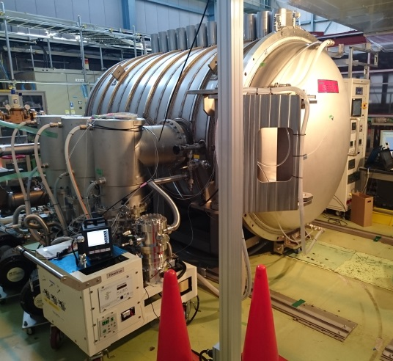
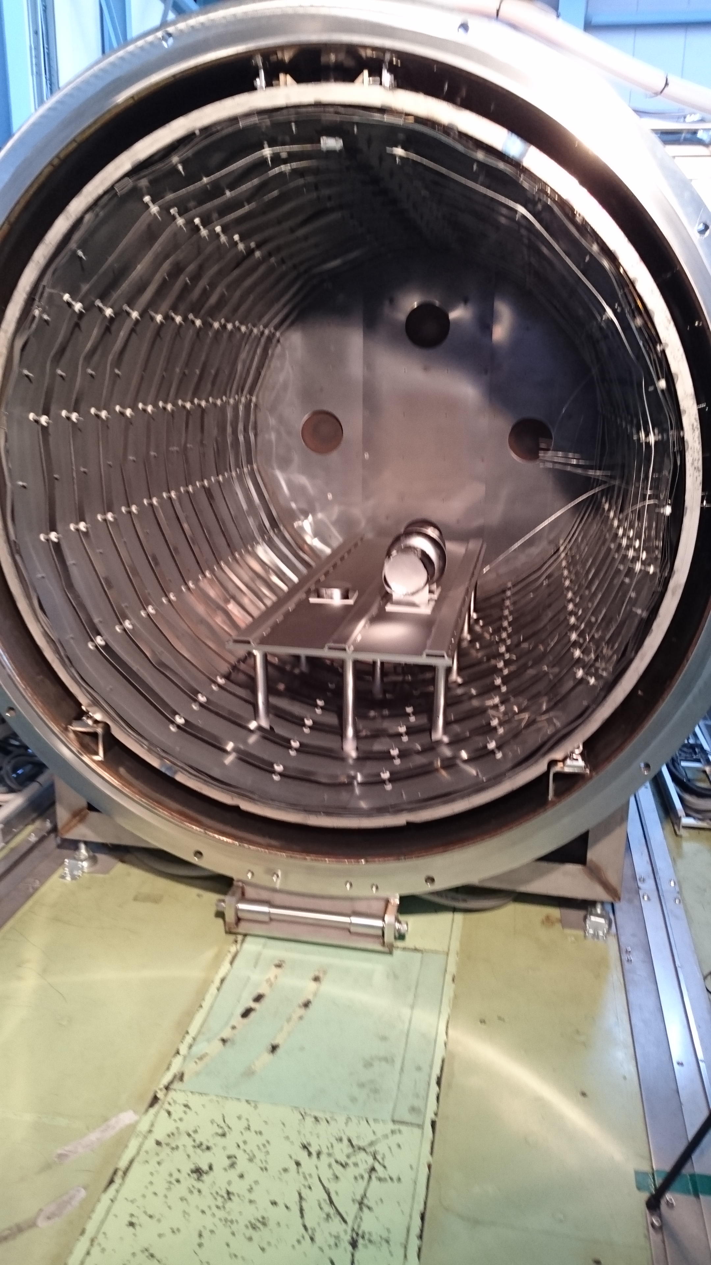
Motivation
Effect of 800ºC annealing:
  It is important to be carried out continuously both the 800 ºC annealing in vacuum and 120 ºC nitrogen infusion without exposure to the atmosphere. The annealing serves activation process by removing the oxide layer.
Risk of dust particles entrance in to the cavity
  When the cavity is put in the vacuum furnace. The in-situ nitrogen infusion system was prepared to prevent the dust entrance.
As received
~100 μm EP
WSR+HPR
Furnace
  800 Cx3h w/o N2
  120 Cx 48 h w/ N2
HPR
Assembly
VT

Slide 4
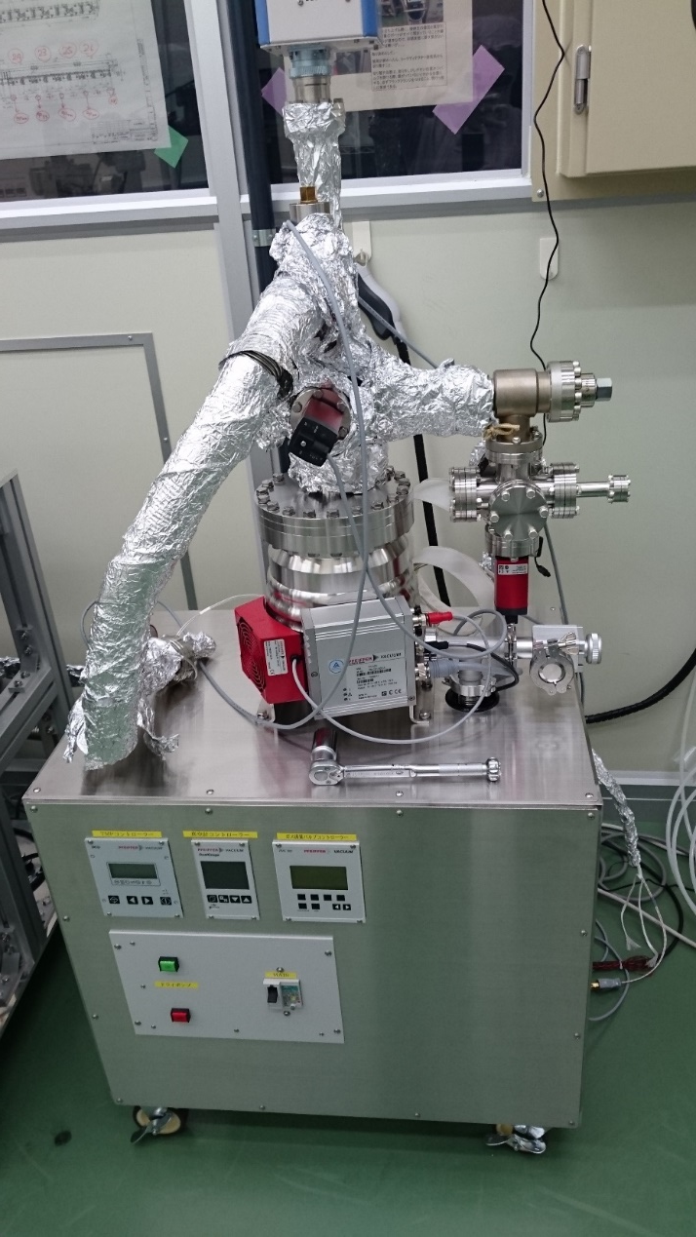
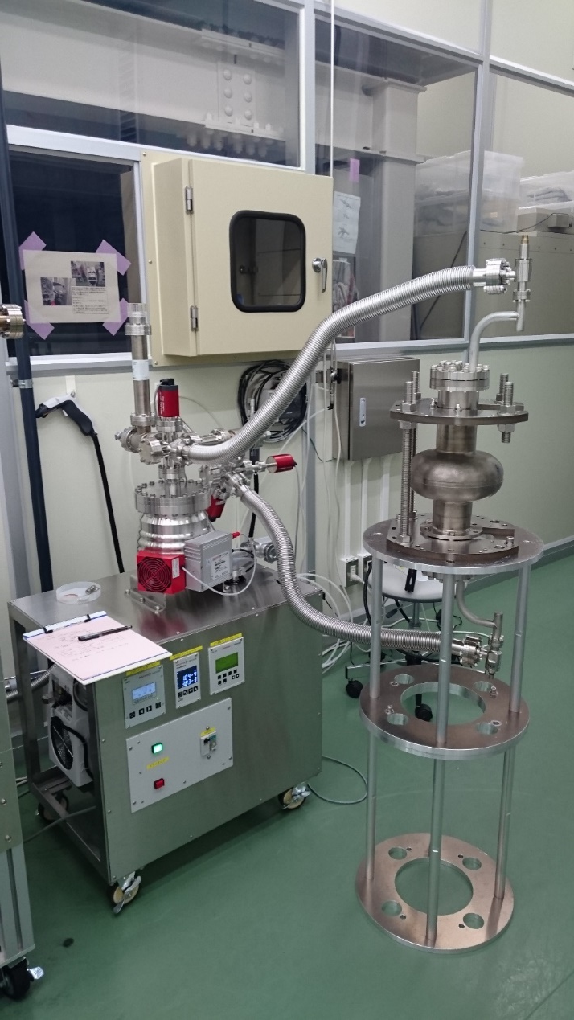
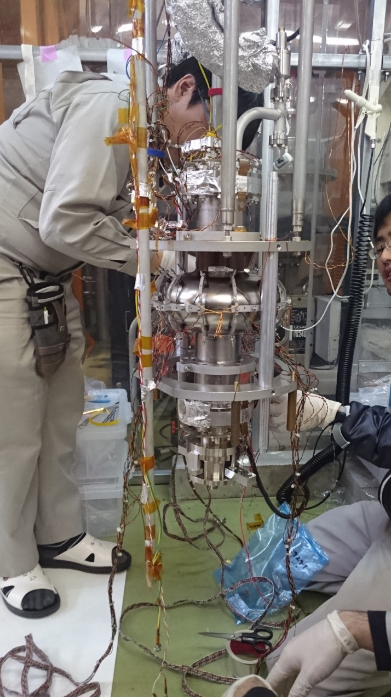
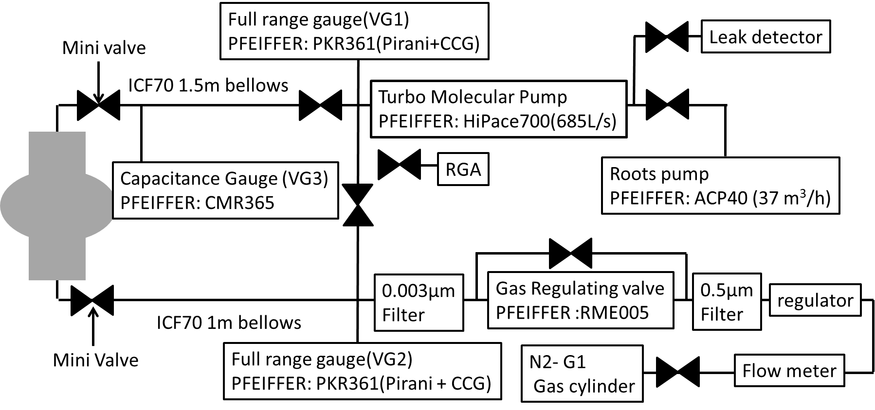
System of In-situ N-infusion
The pressure is controlled by monitoring the capacitance gauge mounted at pumping side of the cavity.
The purity of the nitrogen cylinder is more than 99.99995 vol.%.
The cavity can be transported to the vertical test stand without exposing the inner surface of the cavity to the atmosphere.

Slide 5
System of In-situ N-infusion
All temperature monitors were put on the cavity cell.
The temperature of each place in the cavity was controlled within ±15 ºC.
The main residual gas was hydrogen.

Slide 6
History of In-situ N-infusion
All tests were carried out by using 1.3 GHz single cell cavity (R-9).
  Nb sheet was fine grain produced by Tokyo Denkai and cavity was fabricated by MiraPro.
# | Surface treatment | Detail
1st | 800 ºC Annealing at KEK small furnace using oil diffusion pump Final EP (EP2) was omitted to check the furnace cleanness | As received +EP 100 μm +Anneal 800 ºC x 3hr +USR 15 min + HPR 3 hr + Baking 120 ºC x48 hr, w/o N2
2nd | Standard recipe without baking | + EP 20 μm + USR 15 min + HPR 3 hr
3rd | 120 ºC Baking with Nitrogen | +(without opening to the air ) +Baking 120 ºC x 48 hr, w/ N2 3Pa
4th | 160 ºC Baking with Nitrogen | +(without opening to the air) +Baking 160 ºC x 48 hr, w/ N2 3Pa
5th | Standard recipe (120 ºC baking without Nitrogen) | + EP 20 μm +USR 15 min +HPR 3 hr + Baking 120 ºC x 48 hr, w/o N2
6th | Nitrogen infusion (120 ºC x 48h ) | + N-infusion (800 ºC x 3 hr + 120 ºC x 48 h, w/N2 3Pa) +USR 15 min + HPR 3 hr
7th | 160 ºC Baking without Nitrogen | + EP 20 μm + USR 15 min + HPR 3 hr + Baking 160 ºC x 48 hr, w/o N2

Slide 7
Vertical test results
vertical test results of the in-situ nitrogen infusion and the standard recipe.
2K data of 5th and 7th vertical test was measured after quench. The residual resistance is higher than 3rd and 4th.
# | Surface treatment
1st | 800 ºC Annealing at KEK small furnace using oil diffusion pump Final EP (EP2) was omitted to check the furnace cleanness
2nd | Standard recipe without baking
3rd | 120 ºC Baking with Nitrogen
4th | 160 ºC Baking with Nitrogen
5th | Standard recipe (120 ºC baking without Nitrogen)
6th | Nitrogen infusion (120 ºC x 48h )
7th | 160 ºC Baking without Nitrogen

Slide 8
System of In-situ N-infusion
In the 5th vertical test, the multipacting was occurred at 15 and 18 MV/m during 1.5 K data taking and the flux was trapped.
In the 7th vertical test, the cavity was quenched at 26 MV/m in 1.5 K data taking and the flux was trapped. After quenched the cavity, we take the 1.5 K data again.
It is interesting that there is not field emission in 4th vertical test. The cavity was just applied in-situ nitrogen infusion at 160 C without opening the cavity to the air. High pressure rinsing or other surface treatment were not applied after 3rd vertical test. The nitrogen gas injected to the cavity was as low as 3 Pa, it didn’t have force to blow off the field emission source. It is considered that baking suppressed the field emission by changing the surface condition.

Slide 9
BCS Resistance
The BCS resistance show that the baking temperature is much more influence for the Q value than in-situ nitrogen infusion.
These results suggested that high temperature annealing for removing oxidation layer was important for infusing nitrogen into niobium.

Slide 10
Summary
KEK prepared in-situ infusion system that can introduce nitrogen to the cavity during baking and transport to vertical test without exposing to the air.
The effect of the in-situ nitrogen infusion was much smaller than baking temperature.
It was suggested that the nitrogen was not infused by oxidation layer or nitrogen effect was covered by the other effect.
In order to improve the in-situ infusion system, it is necessary to add a system for removing oxidation layer.

