Slide 1
CEPC Superconducting RF System
Jiyuan Zhai (IHEP) for the CEPC SRF Study Team
7th IHEP-KEK SCRF Collaboration Meeting
IHEP, Beijing, September 22, 2018

Slide 2
Outline
SRF system overview and parameters
Beam cavity interactions
Key technology design and R&D
Summary

Slide 3
CEPC SRF Design Requirements
Higgs long run first for the current operation plan:
one-time full installation of all the same cavities for H, W, Z. Use part of the Higgs cavities for W and Z. Park the idle cavities (or push off beamline?).
Cavity and cryogenics cost reduction of the first phase:
common H cavities, separate W/Z cavities.
Upgradable to 50 MW SR per beam:
longer RF tunnel, add cavities, variable coupler, RF configuration and cavity suitable for higher power.

Slide 4
CEPC SRF Design Challenges
 | H | W | Z
Collider Ring | 650 MHz 2-cell cavity
Lumi. / IP (10³⁴ cm⁻²s⁻¹) | 2.93 | 10.1 | 16.6 / 32.1
RF voltage (GV) | 2.17 | 0.47 | 0.1
Beam current (mA) | 17.4 x 2 | 87.7 | 460
Cavity number | 240 | 108 x 2 | 60 x 2
SR power (MW) | 30 | 30 | 16.5
2 K cavity wall loss (kW) | 6.1 | 1.3 | 0.1
Booster Ring (extraction) | 1.3 GHz 9-cell cavity
RF voltage (GV) | 1.97 | 0.585 | 0.287
Beam current (mA) | 0.52 | 2.63 | 6.91
Cavity number | 96 | 64 | 32
RF input power (MW) avg. | 0.07 | 0.02 | 0.02
2 K wall loss (kW) avg. | 0.17 | 0.01 | 0.02
High energy, low current: high gradient, high Q, more cells, narrow bandwidth
Low energy, high current: HOM power (less cells), parasitic loss, HOM CBI, FM CBI (low voltage, large detuning)
Large ring: gap transient, dense beam spectrum
Special issues with CEPC: parking cavities for W and Z, gap transient for Higgs half-fill, transient beam loading of bunch swapping for on-axis injection
Booster cavity voltage ramp: narrow bandwidth

Slide 5
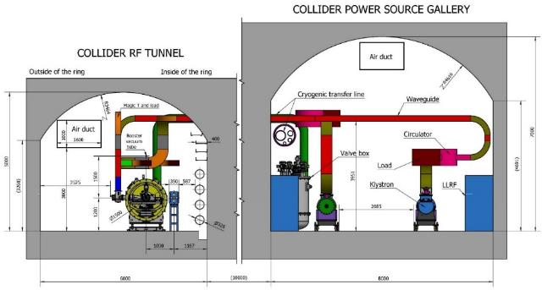
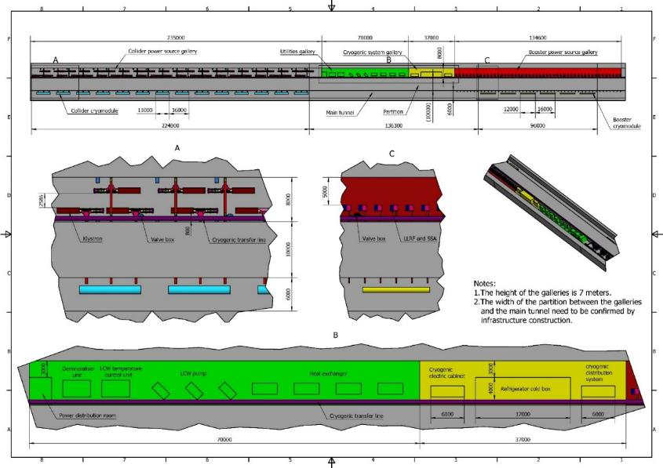
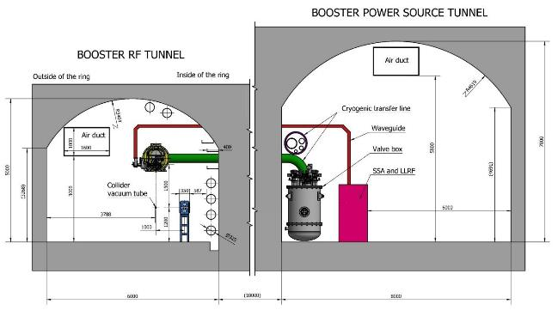
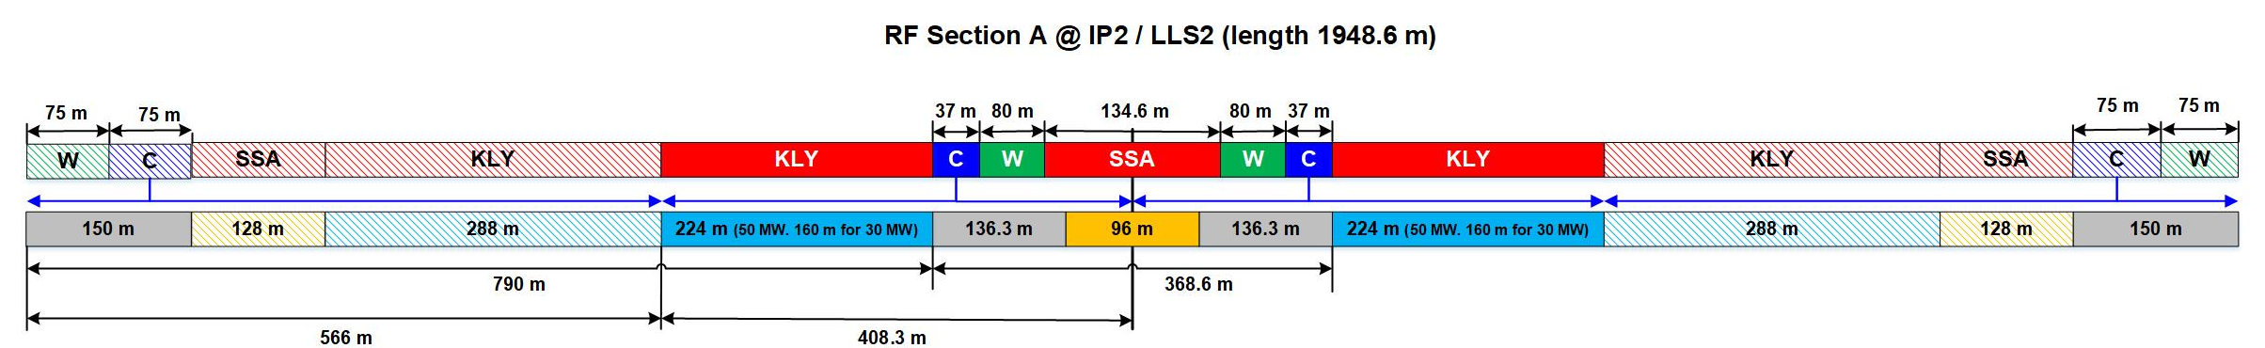
CEPC RF Layout
For 30 MW Higgs:
Collider: 240 650 MHz 2-cell cavities in 40 cryomodules (6 cav./ module).
Booster: 96 1.3 GHz 9-cell cavities in 12 cryomodules (8 cav. / module).
For 50 MW Higgs: add 16 Collider modules.

Slide 6
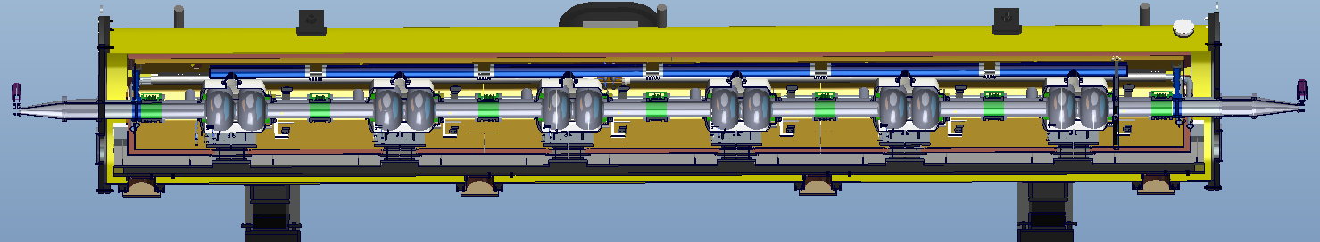
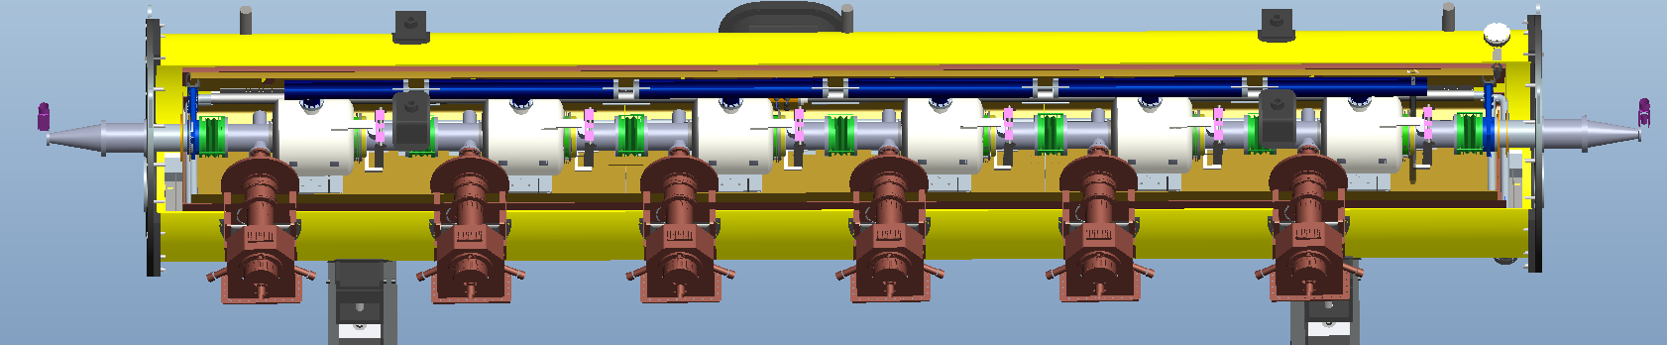
CEPC 650 MHz Cavity Cryomodule
Structure based on ADS cryomodule. High Q requirement drives new design features (fast cool down and magnetic hygiene).
Fast cool down rate is supposed to be 10 K/min during 45 K to 4.5 K.
Ambient magnetic field at cavity surface should be less than 5 mG. Magnetic shielding and demagnetization of parts and the whole module should be implemented for the magnetic hygiene control.
Overall length (flange to flange, m) | 8.0
Diameter of vacuum vessel (m) | 1.3
Beamline height from floor (m) | 1.2
Cryo-system working temperature (K) | 2
Number of cavities and tuners | 6
Number of couplers | 6
Number of RT HOM absorbers | 2
Number of 200-POSTs | 6
Static heat loads at 2 K (W) | 5
Alignment x/y (cavities) (mm) | 0.5
Alignment z (mm) | 2

Slide 7
CEPC Collider Ring SRF Parameters
Collider parameters: 20180330 | H | W | Z
SR power / beam [MW] | 30 | 30 | 16.5
RF voltage [GV] | 2.17 | 0.47 | 0.1
Beam current / beam [mA] | 17.4 | 87.7 | 460
Bunch charge [nC] | 24 | 19.2 | 12.8
Bunch number / beam | 242 | 1524 | 12000
Bunch length [mm] | 3.26 | 5.9 | 8.5
Cavity number (650 MHz 2-cell) | 240 | 2 x 108 | 2 x 60
Idle cavities on line / ring | 0 | 12 | 60
Cavity gradient [MV/m] | 19.7 | 9.5 | 3.6
Q₀ for long term operation | 1.5E10 | 1.5E10 | 1.5E10
Input power / cavity [kW] | 250 | 278 | 275
Klystron power [kW] (2 cavities / klystron) | 800 | 800 | 800
HOM power / cavity [kW] | 0.57 | 0.75 | 1.94
Optimal Q_{L} | 1.5E6 | 3.2E5 | 4.7E4
Optimal detuning [kHz] | 0.2 | 1.0 | 17.8
Optimized for the Higgs mode of 30 MW SR power per beam, with enough operating margin and flexibility.
Cavity number determined by coupler power capacity, less is better for W and Z to reduce the detuning. 2-cell is a balance of gradient, beam loading and HOM power and damping.
FM and HOM impedance and power, heat load
Gradient (stored energy) as high as possible
Input coupler power limit 300 kW (high risk)
Keep power level and RF distribution
HOM power per cavity limit 2 kW
Input coupler variable
Revolution frequency: 3 kHz (FM CBI)

Slide 8
Collider RF Issues for Z
CEPC CDR Z is challenging for RF hardware and beam operation with Higgs cavity, but feasible:
HOM CBI is OK with deeper TM011 mode damping (and large cavity frequency spread and fast bunch-by-bunch feedback), but critical. Better to have idle cavities off-line.
HOM power (1 kW per coupler) is within the current coaxial HOM coupler technology reach.
FM CBI is manageable by direct RF feedback.
Phase shift is moderate for small gaps (what is the beam dynamics limit?)
Parking cavities FM CBI can be mitigated by symmetry detuning.
Push RF limitation beyond Z baseline for higher current and luminosity:
Novel HOM coupler design with larger power capacity.
Very high power input coupler ( > 500 kW) and wide variable range (or two couplers per cavity).
KEKB/BEPCII type cryomodules (but cost …).

Slide 9
CEPC Booster SRF Parameters
10 GeV injection | H | H (HC) | W | Z | Z | Z (HC) | Z (HC)
Extraction beam energy [GeV] | 120 |  | 80 | 45.5
Bunch number | 242 |  | 1524 | 6000
Bunch charge [nC] | 0.72 |  | 0.576 | 0.384
Beam current [mA] | 0.52 | 1 | 2.63 | 6.91 | 6.91 | 20 | 40
Extraction RF voltage [GV] | 1.97 |  | 0.585 | 0.287
Extraction bunch length [mm] | 2.7 |  | 2.4 | 1.3
Cavity number in use (1.3 GHz TESLA 9-cell) | 96 | 96 | 64 | 32 | 16 | 32 | 64
Gradient [MV/m] | 19.8 | 19.8 | 8.8 | 8.6 | 17.3 | 8.6 | 4.3
Q_{L} (4E6-2E7) | 1E7 |  | 6.5E6 | 1E7 | 1E7 | 4E6 | 1E6
Cavity bandwidth [Hz] | 130 |  | 200 | 130
Beam peak power / cavity [kW] | 8.3 | 16 | 12.3 | 6.9 | 13.8 | 20 | 20
Input peak power / cavity [kW] (w/ detuning) | 15 | 22 | 12.4 | 7.1 | 19.1 | 20.1 | 20
Input average power per cavity [kW] (w/ detuning) | 0.7 |  | 0.3 | 0.5
SSA peak power [kW] (one cavity per SSA) | 25 | 25 | 25 | 25 | 25 | 25 | 25
HOM average power / cavity [W] | 0.2 | 0.2 | 0.7 | 4.1 | 4.1 | 12 | 24
Q₀ @ 2 K at operating gradient (long term) | 1E10 |  | 1E10 | 1E10
Total average cavity wall loss @ 2 K eq. [kW] | 0.2 |  | 0.01 | 0.02
15 Hz microphonics and remained Lorentz detuning for Higgs
Variable range limit
For HC Z, optimal detuning near or larger than revolution frequency, FM CBI
Z HOM DF: 34%

Slide 10
Booster HOM CBI and Feedback
Modes | f (GHz) | R/Q (monopole Ω, dipole Ω/m) | Q_{e} measured | CBI Growth Time (ms)
 |  |  |  | H-extraction | W-extraction | Z-extraction
TM011 | 2.45 | 156 | 5.9E4 | 2307 | 236.7 | 51.3
TM012 | 3.845 | 44 | 2.4E5 | 1281.3 | 131.5 | 28.5
TE111 | 1.739 | 4283 | 3.4E3 | 7308.6 | 967.1 | 209.6
TM110 | 1.874 | 2293 | 5.0E4 | 928.3 | 122.8 | 26.6
TM111 | 2.577 | 4336 | 5.0E4 | 490.9 | 65 | 14.1
TE121 | 3.087 | 196 | 4.4E4 | 12341 | 1633 | 353.9
 |  |  |  | H-injection | W-injection | Z-injection
TM011 | 2.45 | 156 | 5.9E4 | 149 | 29.6 | 11.3
TM012 | 3.845 | 44 | 2.4E5 | 82.7 | 16.4 | 6.3
TE111 | 1.739 | 4283 | 3.4E3 | 609 | 120.9 | 46.1
TM110 | 1.874 | 2293 | 5.0E4 | 77.4 | 15.4 | 5.9
TM111 | 2.577 | 4336 | 5.0E4 | 40.9 | 8.1 | 3.1
TE121 | 3.087 | 196 | 4.4E4 | 1028.4 | 204.1 | 77.8
All larger than the beam transverse feedback time limit of 1.6 ms (5 turns) and longitudinal feedback time limit of 2.5 ms (synchrotron oscillation period)
If the parked booster cavities are moved off beamline, the growth time will be increased to 1.5 and 3 times for the W and Z respectively.
Cavity HOM frequency spread (> 1 MHz) will have more margin
Average beta_x,y in RF cavity ~ 30 m
Monopole Cut off frequency:
2934 MHz
Dipole Cut off frequency: 2253 MHz

Slide 11
Statistics of Cavity HOM Frequency Spread
Empirical model of the cavity HOM frequency spread used for many projects:
σ_{HOM} = 0.1 ~ 0.5 % f_{HOM}
Statistics for the 50 TESLA cavities fabricated for the TTF linac and measured at 2 K:
TE111: 5 MHz, almost the same for all 18 modes.
TM110: varies from 1 MHz to 6 MHz and modes with lower frequency are more sensitive to the machining errors.
TM011: 9 MHz for all modes
Euro-XFEL data
J. Sekutowicz. “Multicell superconducting structures for high energy e+e- colliders and free electron laser linacs,” EuCARD Editorial Series on Accelerator Science and Technology, Vol.01 (2007).

Slide 12
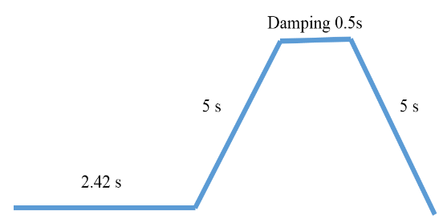
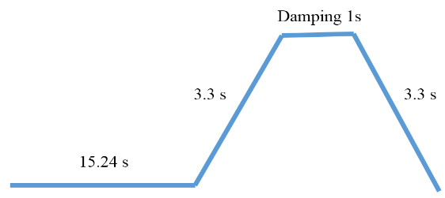
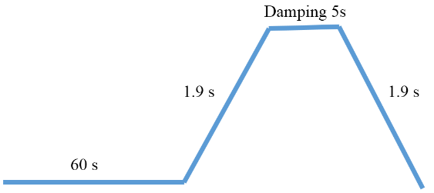
Booster Time Structure (off-axis injection)
 | H | W | Z
Injection from linac [s] | 2.42 | 15.24 | 60.00
Ramp-up or down [s] | 5.00 | 3.30 | 1.90
Damping [s] | 0.5 | 1.00 | 5.00
Extraction [ms] | 0.3 | 0.3 | 0.3
One injection duration for top-up (e+ and e-) [s] | 25.8 | 45.7 | 137.6
Number of injection times | 1 | 1 | 2
Total injection duration [s] | 25.8 | 45.7 | 275.2
Injection interval for top-up [s] | 73 | 153 | 438
Booster duty factor | 35% | 30% | 63%
SR duty factor | 4.4% | 2.3% | 5.1%
RF power duty factor | 3.8% | 2.4% | 7.4%
Cryogenic dynamic duty factor | 4.3% | 2.9% | 7.9%
HOM power duty factor | 18.4% | 15.6% | 33.7%
Higgs
W
Z
twice

Slide 13
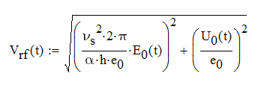
Booster Voltage Ramp
Beam energy increase linearly with time.
RF voltage ramp with constant synchrotron tune to avoid synchrotron-betatron oscillation.
Equilibrium bunch length and quantum lifetime not too short.
Multipacting during voltage ramp?
Counter-phasing can be used to ramp the effective RF voltage ?
Gradient E_{acc} / MV/m
Energy acceptance η / 0.2 %
Synchrotron tune ν_{s} / 0.01
Beam energy E₀ / 10 GeV
Very narrow bandwidth SRF cavity operation with microphonics and Lorentz detuning in a fast ramp synchrotron. Challenging but doable.

Slide 14
Booster Voltage Ramp
I₀ / 0.53 mA
E₀ / 120 GeV
E₀ / 120 GeV
Δf_{OD} / - 339 Hz
φ_{s} / 90 deg
V_{rf} / 1.83 GV
E_{acc} / 18.4 MV/m
P_{g} / 14 kW
Δf_{LFD} / - 452 Hz
V_{rf} / 1.83 GV
E_{acc} / 18.4 MV/m
I₀ / 0.53 mA
φ_{s} / 90 deg
P_{g} / 14 kW
Δf_{LFD} / - 452 Hz
Δf_{OD} / - 339 Hz
Assume 10 % Lorentz force detuning (LFD) remains not compensated by piezo actuators, 10 Hz peak-to-peak microphonics (need careful cryomodule design and quiet operation condition). LFD factor for TESLA 9-cell cavity with helium vessel and tuner: 1 Hz / (MV/m)²
Ensure the detuning not to cause Robison instability during injection and ramping.
With detuning, forward power 14 kW / cavity for + 20 Hz microphonics, 20 kW for - 20 Hz microphonics.

Slide 15
Outline
SRF system overview and parameters
Beam cavity interactions
  FM CBI
  Parking cavities
  Gap RF transient
  HOM power
Key technology design and R&D
Summary

Slide 16
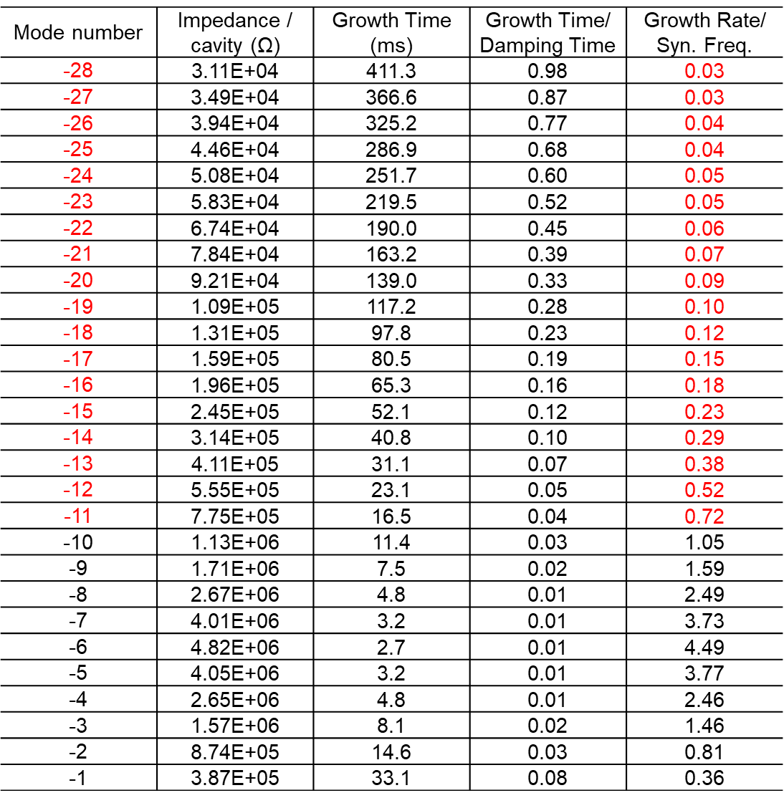
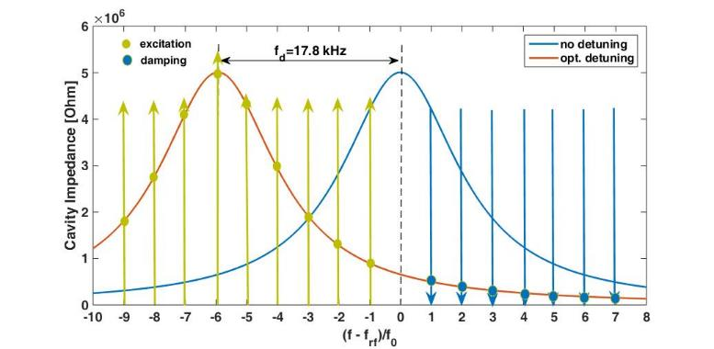
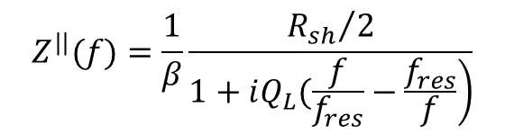
Fundamental Mode CBI of Z
Longitudinal coupling-impedance
$$Z^{||}(f)=\frac{1}{β}\frac{{R_{sh}}/2}{\left.1+iQ_{L}(\frac{f}{f_{res}}−\frac{f_{res}}{f}\right)}$$
Cavity resonance frequency

Slide 17
Simulation of Growth Rate and Direct RF Feedback
D. Teytelman.
3 ms growth time (1/4 synchrotron period)
Optimal direct loop gain of 14 the growth rates are reduced to a very reasonable 7.2 1/s (139 ms growth time, 11.6 synchrotron periods). That residual growth rate should be easy to control with standard bunch-by-bunch feedback.

Slide 18
FM CBI and Power of Parked Cavities
Large detuning and narrow BW to reduce FM power excited by the beam (limit?), but fast-growing CBI modes. Alternating detuning (positive and negative detuned cavities cancel each other) will mitigate the instabilities.
Small input power is required to have the signal to detune the cavity (?). Circulators and loads should keep working for the excited FM power. Cavities should be kept at 2 K to extract HOM power.
Power increases with square of the beam current. Different fill pattern will change the exited power.
Better to move the large number of idle W and Z cavities off the beamline (in the empty place of the future SPPC magnets) or with multi-by-pass (but needs lattice change and longer straight section), rather than parking (detune) them. Similar for the Booster. This will also reduce the HOM impedance significantly.
Radiation damping time
Sync. oscillation period
Beam excited FM power
-1 -2 -3 -4 -5 -6 -7 -8 -9 - 10 -11 -12
CBI mode No.
CEPC baseline Z mode FM CBI and beam excited power per cavity of the 156 parked cavities (reduce FM coupling to Q_{e} = 2E6)

Slide 19
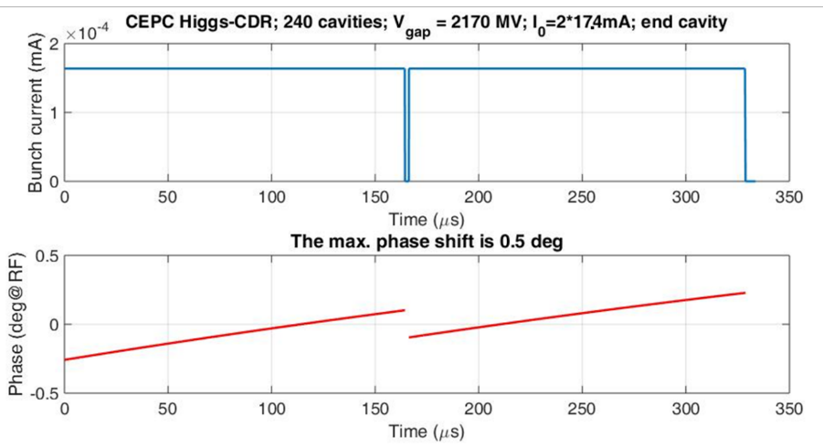
Beam Gap Phase Shift
Gaps for beam abort and mitigate ion-trapping and fast beam ion instability (FBII), and avoid collision in RF section (Higgs), as well as the bunch trains of the PDR and APDR scheme proposed by Jie Gao.
~ 10 % total gap needed for Z. But one gap will have too large phase shift and beam loss. Use many bunch trains with short gaps.
 | H | W | Z
Beam gap in number of buckets | 3091 | 550 | 24832
Beam gap length [us] | 4.76 | 0.85 | 38.20
Max relative voltage drop | 0.5% | 0.7% | 460%
Max bunch train phase shift [deg] | 0.5 | 0.6 | /
Phase shift for Higgs end cavity
Simulation based on D. Teytelman’s code with transfer functions.

Slide 20
Phase Shift of Z with Bunch Trains
48 trains of 250 bunches located symmetrically in the ring. Bunch spacing is 24.6 ns (16 RF buckets), gaps are 820 ns (533 buckets).
D. Teytelman.

Slide 21
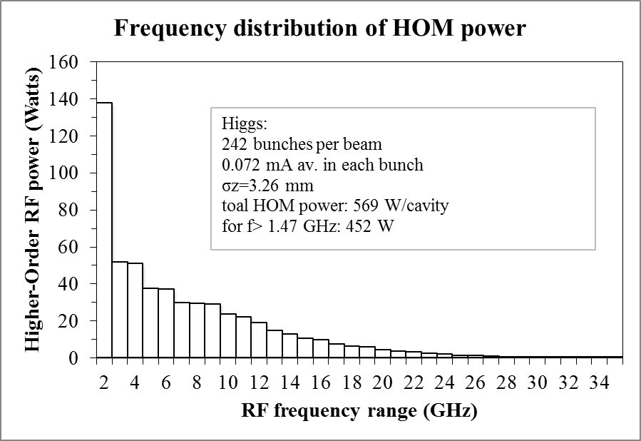
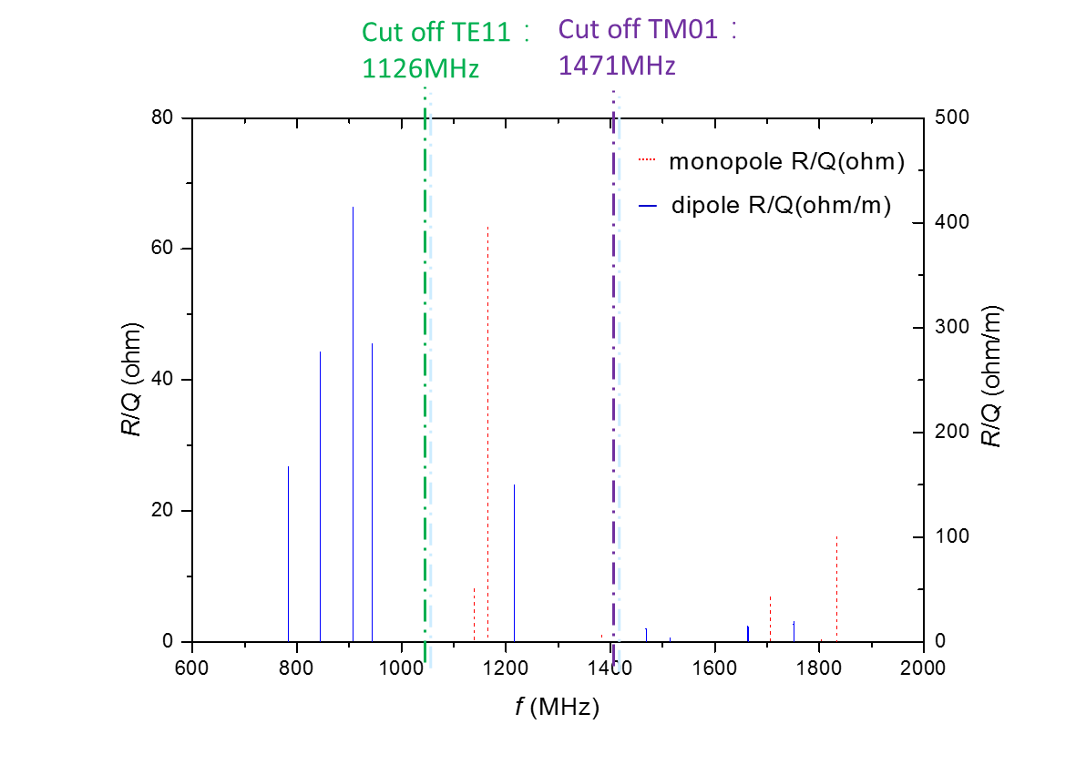
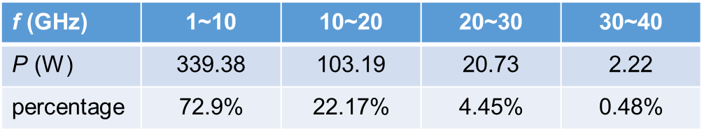
Collider Cavity HOM Spectrum and Power
Average power (single pass assumption)
Dangerous monopole: aroud 1200MHz
Dangerous dipole: 800 MHz ~ 900 MHz, 1200 MHz
HOM coupler: 800~1400 MHz
HOM absorber: operating frequency＞1.4 ~ 20 GHz

Slide 22
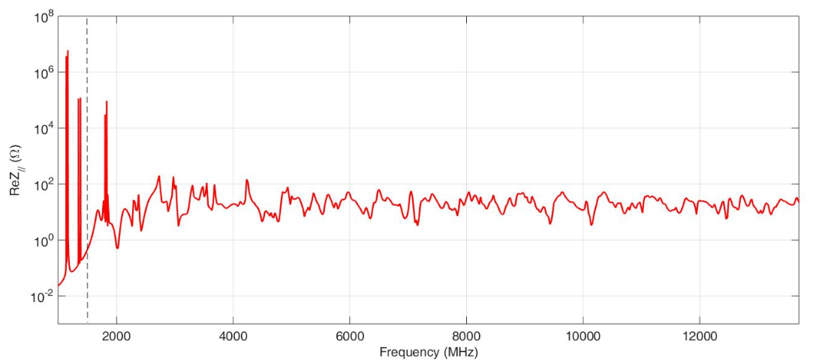
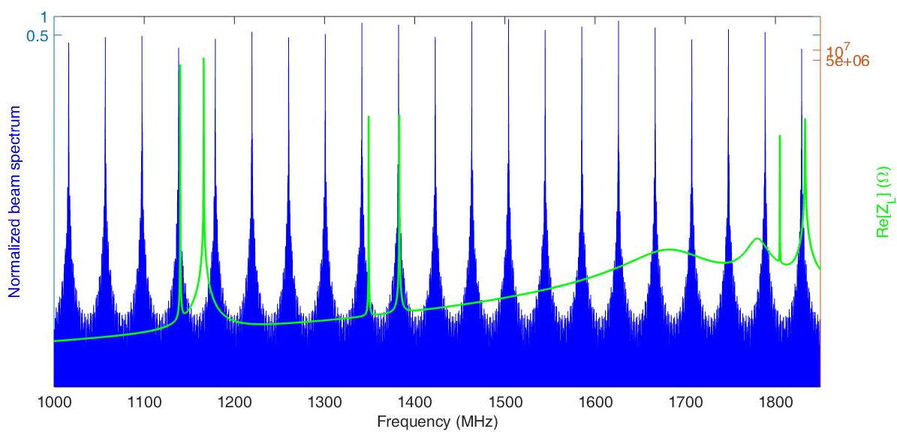
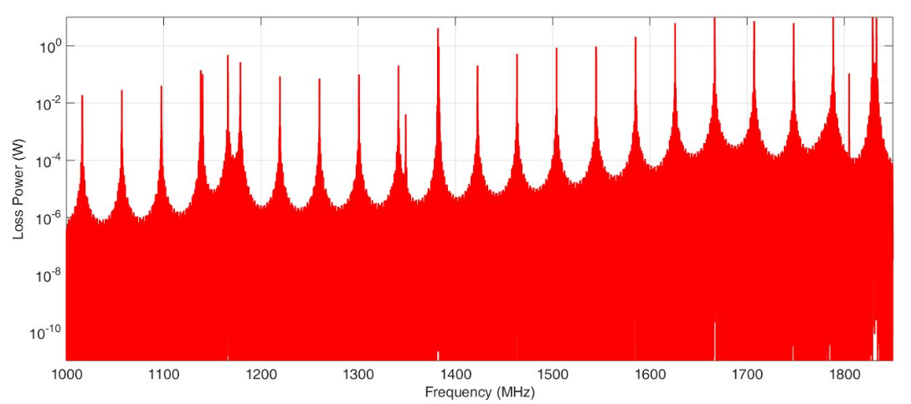
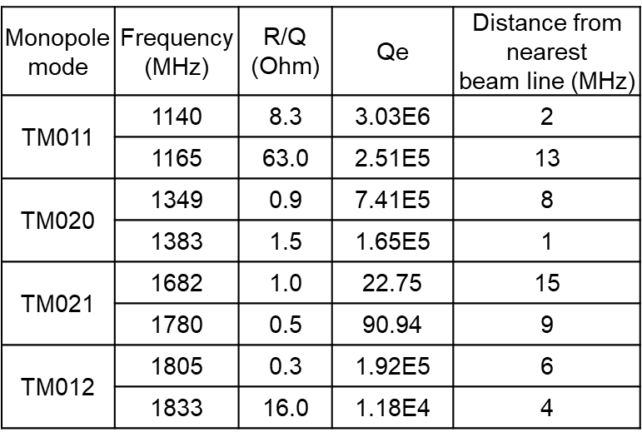
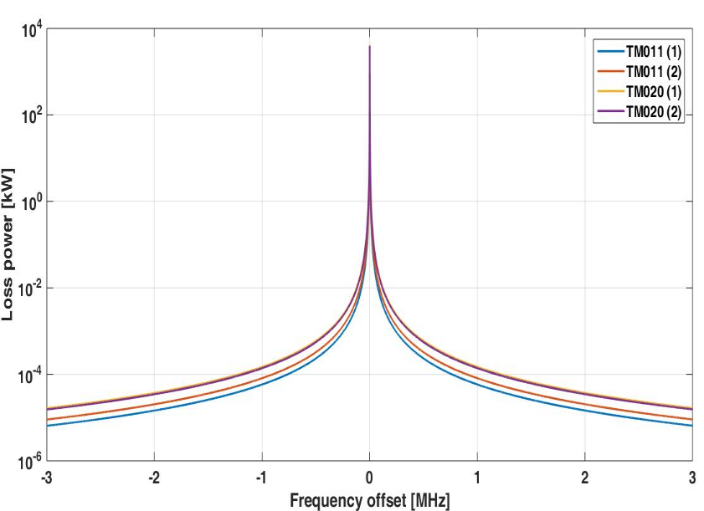
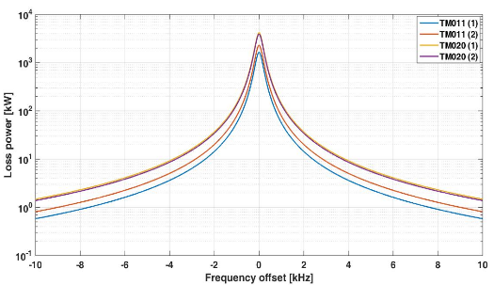
Cavity HOM Power of Z (48 trains)
cavity wideband impedance
Beam spectrum and cavity impedance
(bunch repetition rate 40 MHz dominated)
Power spectrum
Cut-off frequency: 1.47 GHz
HOM Power (W) | Average calculation | Spectrum calculation
< 1.85 GHz | 970 | 50
1.85 ~ 14 GHz | 966 | 976
Total | 1936 | 1026
~ kHz bandwidth
Total HOM power lower than single pass assumption: Safe pattern for the ideal cavity.
With HOM frequency spread and fill pattern change, HOM power could be very large in some cavities. Slightly detune the cavity will reduce the HOM power drastically while not affecting the accelerating mode.
Note that the CBI related frequency is revolution frequency 3 kHz, much smaller than HOM power related bunch frequency (~ MHz).

Slide 23
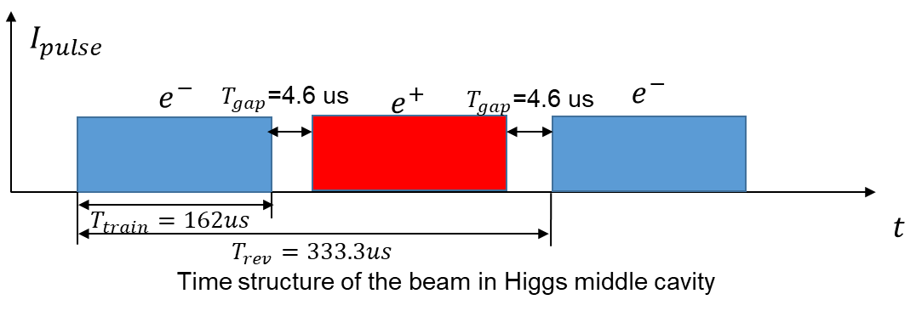
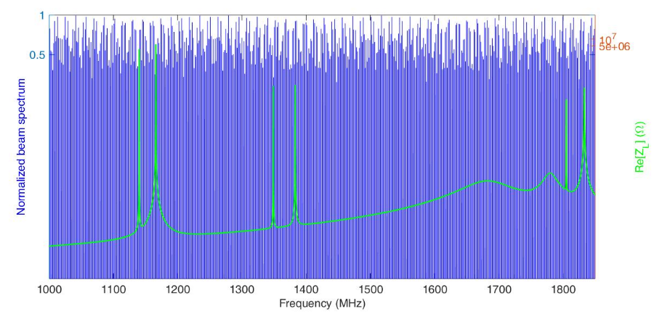
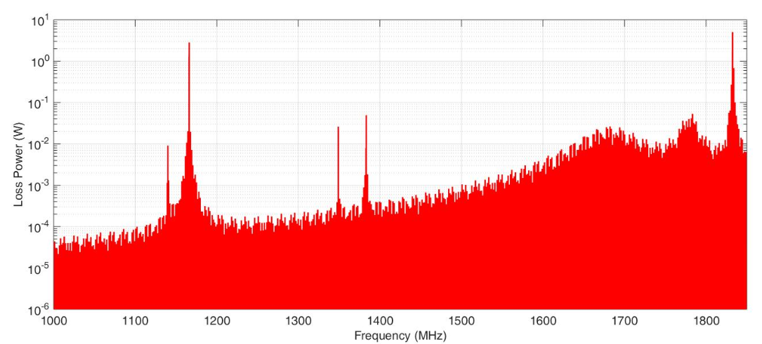
Cavity HOM Power of Higgs (quasi-half-ring fill)
Due to common RF of the two rings, cavities in different location will feel different fill pattern thus different beam spectrum.
HOM Power (W) | Average calculation | Spectrum calculation
< 1.85 GHz | 131 | 19
1.85 ~ 14 GHz | 440 | 440
Total | 571 | 459
Beam spectrum spacing 2.69 MHz (Z-pole 40 MHz)
Nearest distance between beam line and cavity impedance is 1 MHz.
Total HOM power lower than single pass assumption: Safe pattern for the ideal cavity.
Same as Z-pole, detune the cavity will reduce the HOM power.
Beam spectrum and cavity impedance
(bunch repetition rate dominated)
Power spectrum

Slide 24
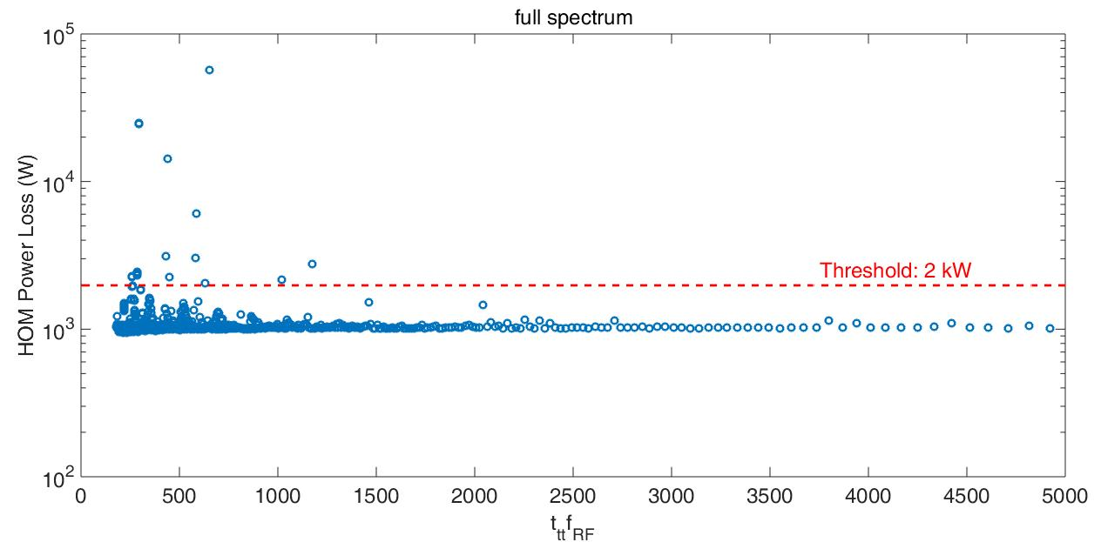
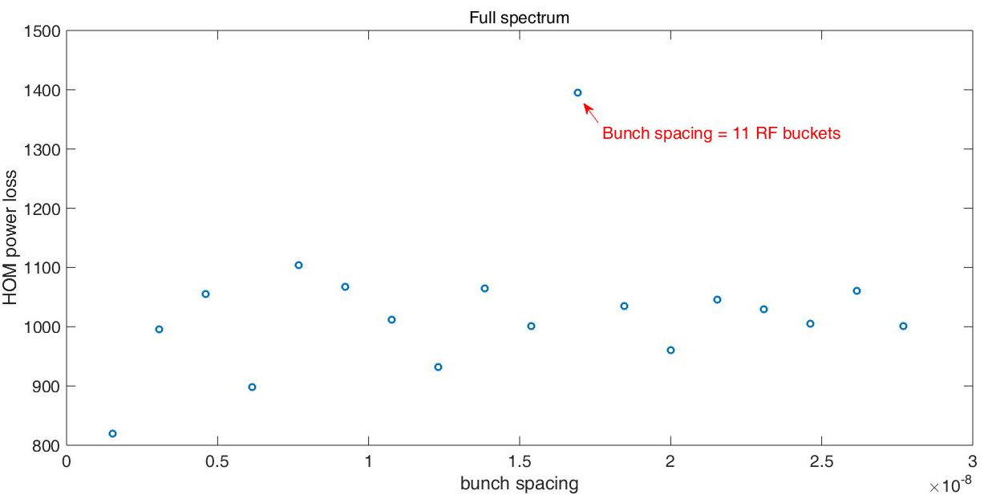
HOM Power of Different Bunch Pattern for Z-pole
Keep the bunch spacing constant ($t_{bb}=24.6 ns$)
Keep the train spacing constant ($N_{train}=48$)
Cut-off
(s)
HOM power of 29 filling patterns is above 2 kW.
The numbers of bunch trains are:
184 212 331 343 368 373 481 482 490 491 499 500 733 734 735 736 737 753 754 755 756 757 758 828 829 830 831 832 833
2 kW power per cavity, each direction 1 kW, assume 50 % coupled by the HOM coupler (0.5 kW). 1 kW power capacity will have enough margin.

Slide 25
Outline
SRF system overview and parameters
Beam cavity interactions
Key technology design and R&D
  Summary

Slide 26
CEPC SRF Technology R&D Plan
SRF Key Technology R&D (2016-2020)
    High Q & high gradient cavity with N-doped Nb & Fe-based superconductor
    Very high power (300 kW) variable input coupler with low heat load
    High power coaxial HOM coupler (1 kW) and wideband HOM absorber (5 kW)
Cryomodule Prototyping (2019-2022)
    Collider cryomodules: 650 MHz 2 x 2-cell and full scale 6 x 2-cell (11 m)
    Booster cryomodules: 1.3 GHz 2 x 9-cell and full scale 8 x 9-cell (12 m)
    High Q operation (clean assembly, magnetic hygiene and flux expulsion)
    Beam test with DC-photocathode gun
Prepare for Mass-Production (2021-2023)
    Supported by PAPS large SRF infrastructure (start operation in early 2020)
    In the frame of CEPC Industrial Promotion Consortium (CIPC)
    In synergy with other SRF accelerator projects (LCLS-II, SHINE, ILC, etc.)

Slide 27
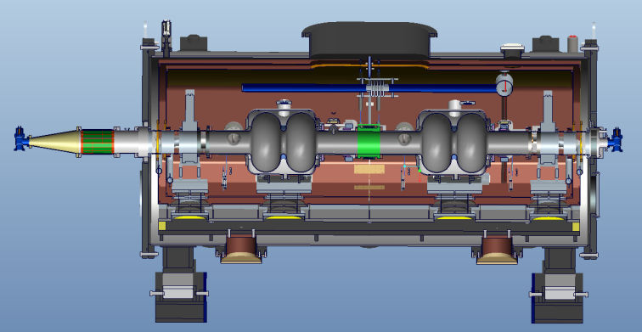
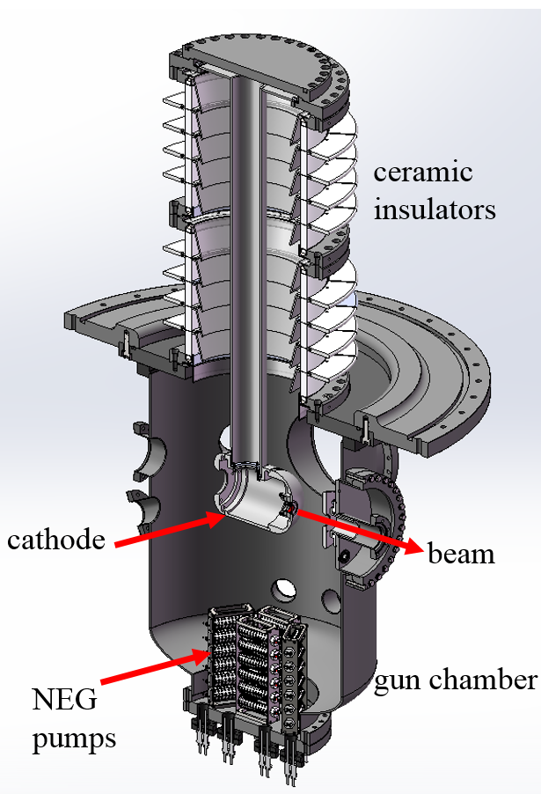
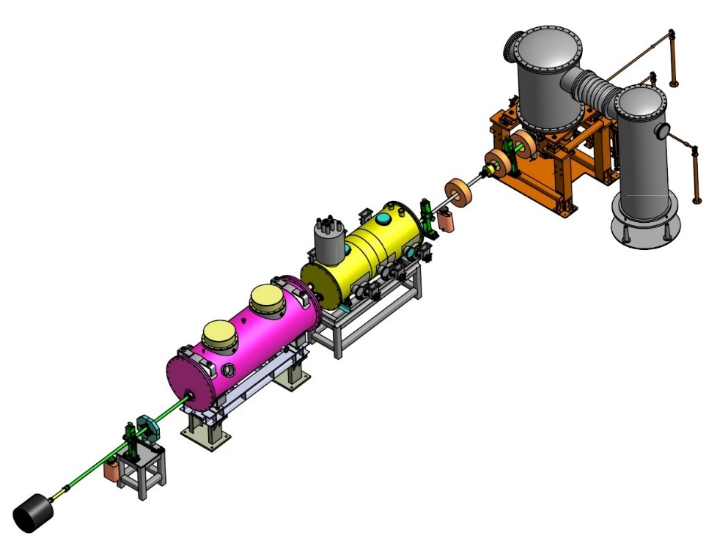
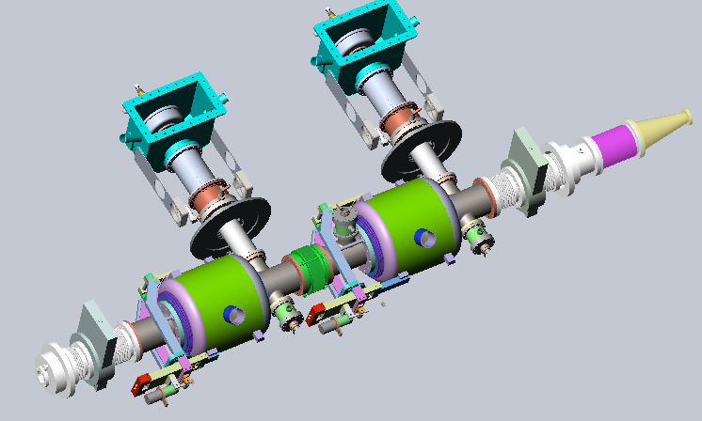
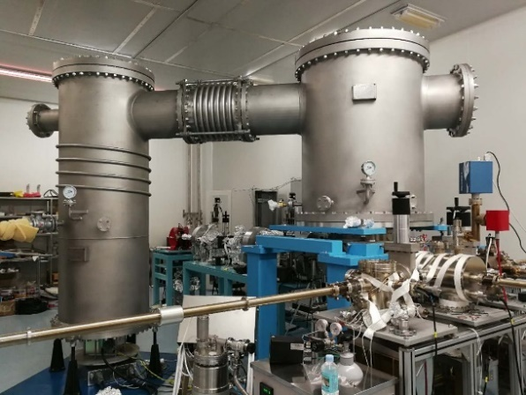
CEPC Collider Test Cryomodule
CW 10 mA, 50 MeV
350 keV beam commissioned with GaAs
New K₂CsSb cathode
DC photo cathode gun
650 MHz test module
1.3 GHz test module

Slide 28
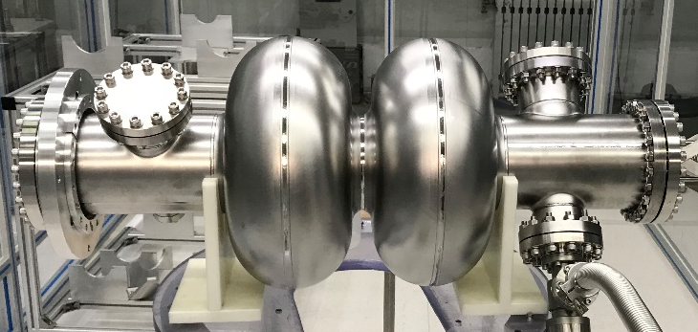
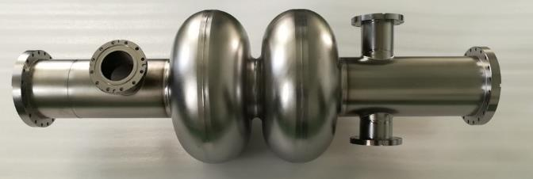
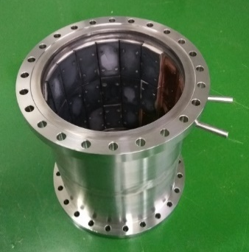
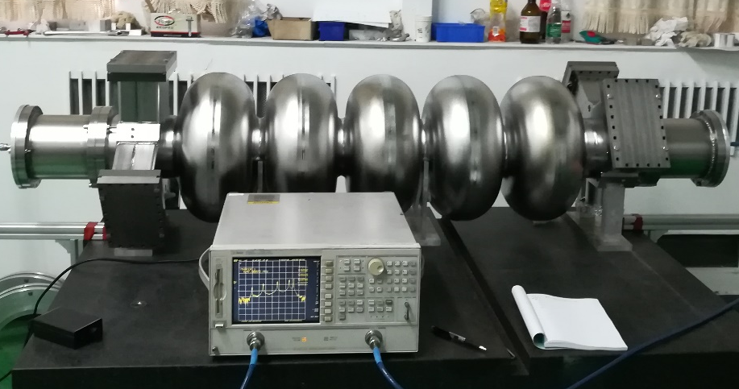
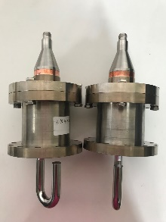
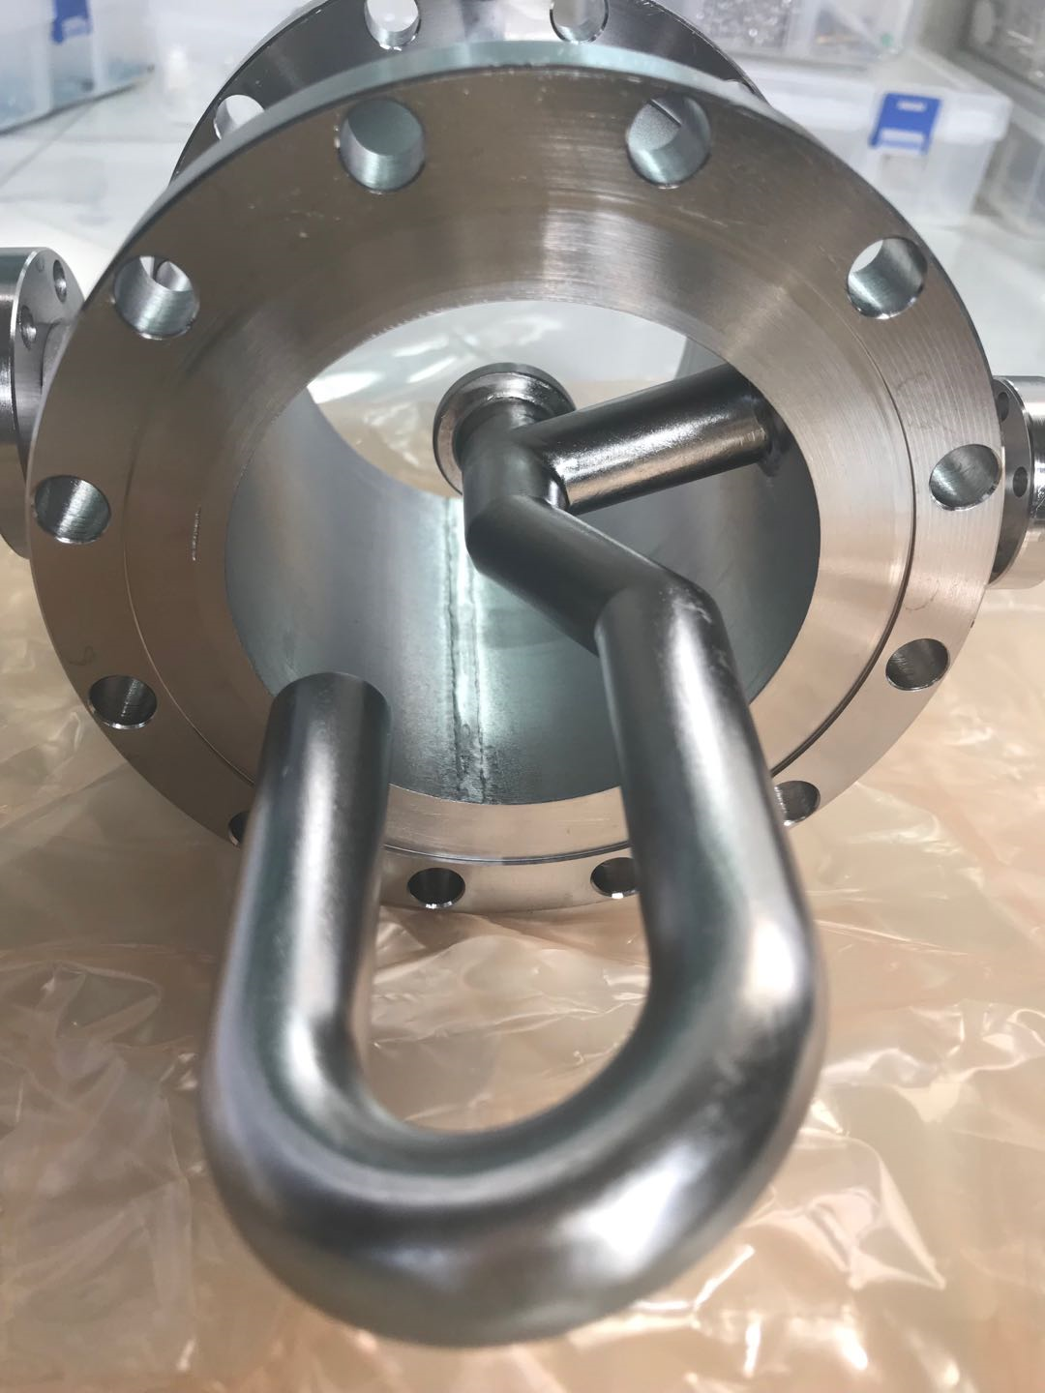
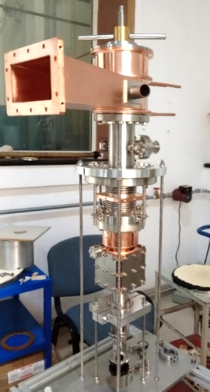
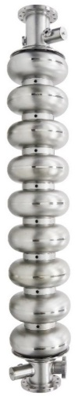
CEPC SRF Technology R&D Status
CEPC 650 MHz 2-cell cavity by OTIC
CEPC 650 MHz 2-cell cavity by HERT
CEPC cavity HOM absorber
CEPC 650 MHz 5-cell cavity with
waveguide HOM coupler by HERT
CEPC Collider HOM coupler by OTIC &
CEPC Booster
1.3 GHz 9-cell cavity and variable double window coupler by HERT

Slide 29
Summary
CEPC CDR SRF parameters and layout have been established in view of high Higgs priority, low construction cost and upgradability.
Beam cavity interaction issues (FM and HOM CBI, parking cavities, RF transients of bunch gap and swapping, HOM power) are challenging but manageable, especially for Z-pole.
SRF key components design and R&D launched, with support of PAPS SRF facility. SRF industrialization will be synergy with SHINE, CSNS-II and ADANES etc. in China (~ 1000 cavities in next five years).

Slide 30
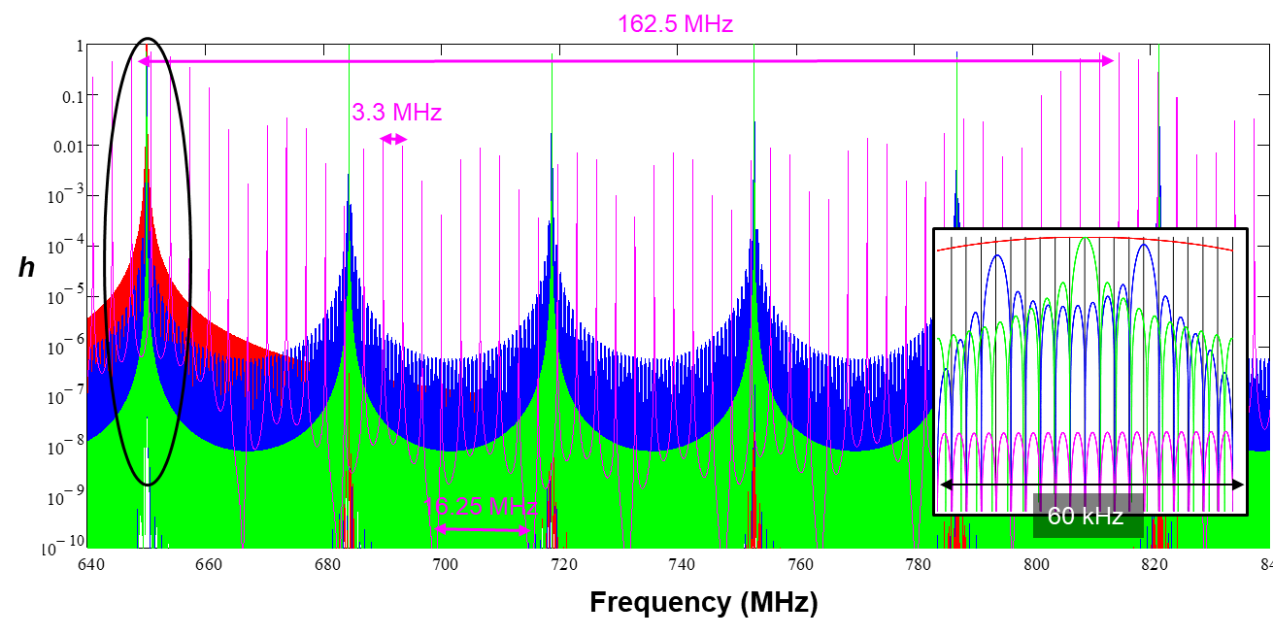
Fill Pattern and Beam Power Spectrum
Normalized beam power spectrum in terms of the fill pattern parameters:
h (f [frequency], n_{t} [number of bunch trains], n_{b} [bucket number between bunches], M_{b} [number of bunches in one train])
Train repetition: n_{t} f₀
Fine structure repetition: f₀
Bunch repetition: f_{rf} / n_{b}
Fine structure repetition: f_{rf} / n_{b} / M_{b}
Amplitude ~ 1 / (M_{b} n_{t})²
Bunch structure dominates when M_{b} >> n_{t}
Train structure dominates when n_{t} >> M_{b}
Red: h (1, 1, 10900)
Blue: h (10, 19, 1090)
Green: h (1, 19, 10900)
Pink: h (1090, 4, 10)
Detuned cavities are not always safe. Different fill pattern will move the beam spectrum peaks to generate large power. Slightly change the detune of each cavity to avoid resonance. Same attention should be paid to HOMs.

Slide 31
Higgs On-axis Injection and Bunch Swapping
Reduce the requirement of the Collider dynamic aperture of the Higgs mode. Acceptance (40 min beam lifetime): 13σ_{x} * 12σ_{y} (off-axis injection) , 8σ_{x} * 12σ_{y} (on-axis injection).
CEPC Collider Ring Lattice Design and injection scheme. Oral tomorrow afternoon.

Slide 32
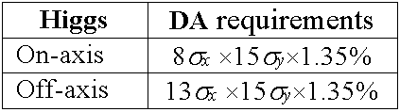
The on-axis injection
Circumference is same
Trajectory difference is 0.011m
0.037ns in time
17 degree RF phase shift in the booster
Several circulating bunches of collider ring are extracted to the booster ring. The circulating bunches of booster will be merged with the injected bunches. Then the merged bunches in the booster ring are injected into collider ring by vertical on-axis injection scheme. The procedure will be repeated several times so that all the circulating bunches of booster can be accumulated in the collider ring. The beamloading effect of booster RF system is weak. The maximum cavity voltage drop is 0.48% and the maximum phase shift is 0.63 degree. The peak HOM power per RF cavity is 62W.

Slide 33
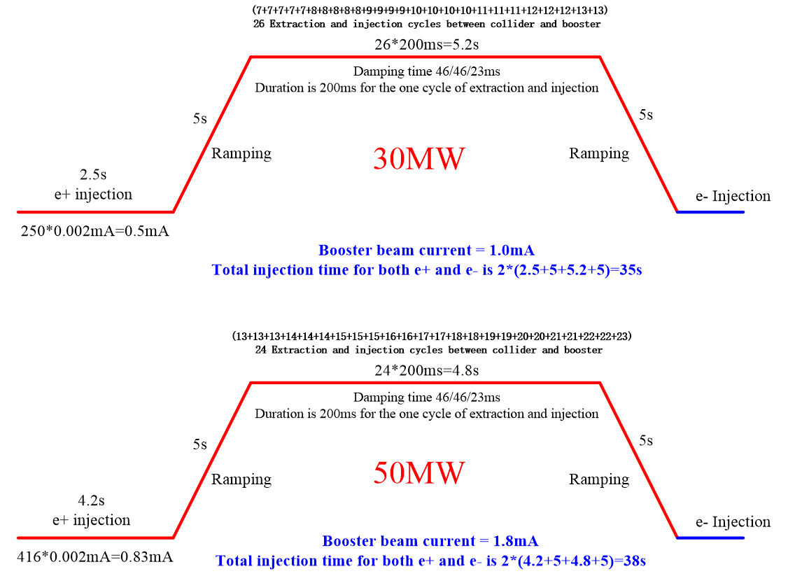
Transient Beam Loading of On-axis Injection
Transient beam loading in both Collider and Booster:
Bunch gap in the Collider Ring
Large bunch charge (x 33 up to 13 bunches) and larger total beam current (x 2) in the Booster
Max HOM power x 33 (peak) in the Booster 1.3 GHz 9-cell cavity. Peak HOM power and DF of off-axis injection is 1 W and 18 %. Peak HOM power and DF of off-axis injection is 34 W and ~ 7 % (2.4 W average, manageable by HOM coupler of the TESLA cavity).

Slide 34
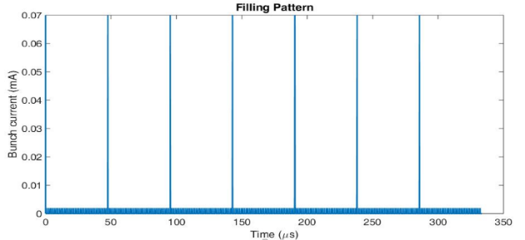
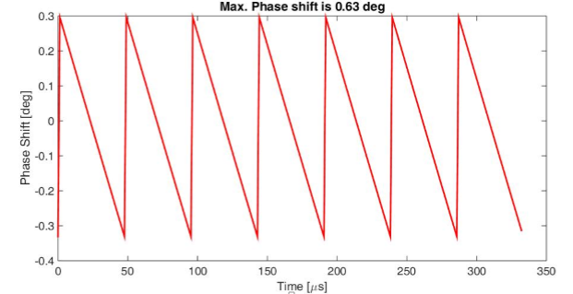
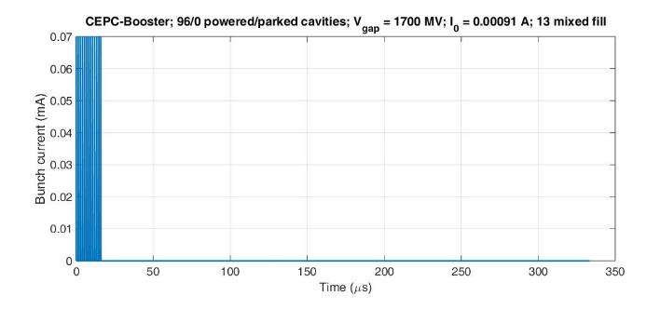
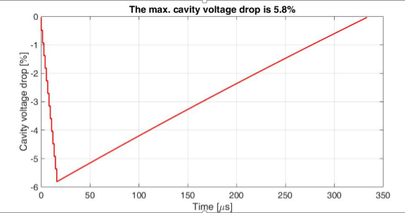
Booster Phase Shift of On-axis Injection
Best case: In first injection，7 large bunches (0.07mA) evenly distributed among the other small bunches. Max cavity voltage drop is 0.48 %. Max phase shift is 0.63 deg
Worst case: After last injection, only 13 large bunches. Assume they are in a very short bunch train. Max cavity voltage drop is 5.8 % . The maximum phase shift is 7.7 deg.

Slide 35
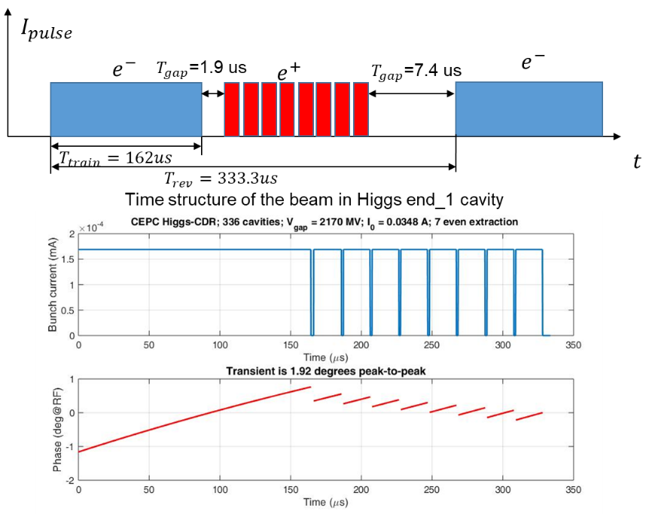
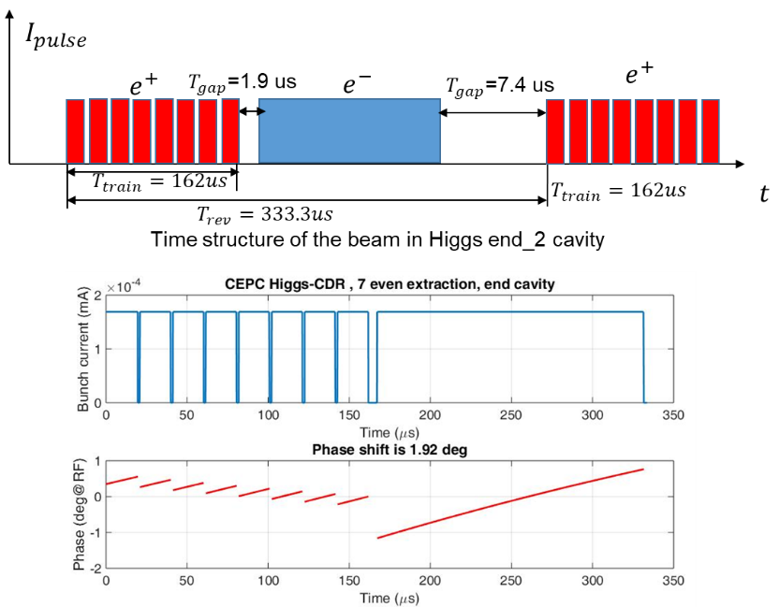
Collider Ring Phase Shift of On-axis Injection
Total phase shift of e- beam is not equal to e+ (?)
First end cavity of one RF section
Last end cavity of one RF section

Slide 36


Parasitic Loss
N. Wang, IHEP
natural bunch length
CEPC Z (460 mA, 12.8 nC)
SR loss: 33 MW
Cavity HOM loss: 0.5 MW (8.5 mm), 1.3 MW (2.4 mm)
Resistive wall loss: 1 MW (8.5 mm), 6.8 MW (2.4 mm)
And other loss: …
RF system must compensate the energy and power loss by increasing RF voltage and power.
Bootstrapping and bunch lengthening is necessary for stable RF operation.
bunch lengthening by BS, RW and other impedance
Resistive wall power loss of CEPC Z

Slide 37
Cavity HOM Frequency Spread
Cavity fabrication and tuning will make small HOM frequency spread, this will result in an “effective” quality factor Q.
Red: σ_{fR}=0
Blue: σ_{fR}=1 MHz
f_{R} = 1.16554 GHz, Q = 1.10×10⁵, 336 RF cavities

Slide 38
Future Plan for CEPC SRF System Design
Further optimization on system layout and parameters
HOM power for different fill patterns, avoid dangerous pattern
HOM propagation through cavities (collaboration with Rostock University)
LLRF direct feedback of the fundamental mode coupled-bunch instability (collaboration with KEK)
Booster voltage ramp and counter-phase ramp
RF issues for Higgs on-axis injection (collider and booster) and APDR

Slide 39
Cavity with more cells (4 or 5-cell)
A must for higher energy operation, and low HOM power (due to low current)
Possible for H with shared cavity if the input coupler power capacity could be increased to 500 ~ 800 kW or use two couplers per cavity for same gradient. If same coupler power, the gradient will be too low and cost more, beam loading effect ... But 1.5 times more HOM power, HOM damping and trapping, cavity pretuning, handling and infrastructure...
Not suitable for high current W and Z

Slide 40
HOM Damping Requirement for Z
Monopole mode | f (MHz) | R/Q (Ω) | Q_{e} (with feedback) | Q_{e} (without feedback)
TM011 | 1165.574 | 65.2 | 9.2×10³ | 2.6×10²
TM020 | 1383.898 | 1.29 | 3.9×10⁵ | 1.1×10⁴
TM021 | 1717.475 | 19.88 | 2.0×10⁴ | 5.8×10²
TM012 | 1832.801 | 17.26 | 2.2×10⁴ | 6.2×10²
Dipole mode | f (MHz) | R/Q (Ω/m) | Q_{e} (with feedback) | Q_{e} (without feedback)
TE111 | 844.738 | 279.82 | 4.0×10⁴ | 1.6×10²
TM110 | 907.592 | 420.05 | 2.6×10⁴ | 1.0×10²
TE121 | 1475.553 | 125.79 | 8.8×10⁴ | 3.5×10²
TM120 | 1662.599 | 18.80 | 5.9×10⁵ | 2.3×10³
Z: 120 2-cell cavity/beam
Average beta_x,y in RF cavity ~ 30 m
No frequency spread included
Shortest longitudinal feedback time: 11.9 ms (synchrotron oscillation period)
Feedback time for transverse mode: 3.2 ms (10 turns), could be shorter.
Cut off frequency: 1471MHz
Cut off frequency:1126 MHz

Slide 41
Collider HOM CBI Q_{ext} Threshold
3 kHz beam spectrum lines, impossible to detune the HOMs (or just no damping? Q₀__{TM0mp} = Q_{0_TM010}* f_{rf} / f_{HOM})
Mode | f (MHz) | R/Q* (monopole Ω, dipole Ω/m) | Q_{e} (H) | Q_{e} (W) idle cavities on-line | Q_{e} (W) idle cavities off-line | Q_{e} (Z) idle cavities on-line | Q_{e} (Z) idle cavities off-line
TM011 | 1165.574 | 65.2 | 1.9×10⁵ | 1.8×10⁴ | 2.0×10⁴ | 2.6×10² | 5.2×10²
TM020 | 1383.898 | 1.3 | 8.2×10⁶ | 7.6×10⁵ | 8.5×10⁵ | 1.1×10⁴ | 2.2×10⁴
TM021 | 1717.475 | 19.9 | 4.3×10⁵ | 4.0×10⁴ | 4.4×10⁴ | 5.8×10² | 1.2×10³
TM012 | 1832.801 | 17.26 | 4.6×10⁵ | 4.3×10⁴ | 4.8×10⁴ | 6.2×10² | 1.3×10³
TE111 | 844.738 | 279.8 | 4.9×10⁴ | 7.7×10³ | 8.6×10³ | 1.6×10² | 3.1×10²
TM110 | 907.592 | 420.1 | 3.3×10⁴ | 5.1×10³ | 5.7×10³ | 1.0×10² | 2.1×10²
TE121 | 1475.553 | 125.8 | 1.1×10⁵ | 1.7×10⁴ | 1.9×10⁴ | 3.5×10² | 6.9×10²
TM120 | 1662.599 | 18.8 | 7.4×10⁵ | 1.2×10⁵ | 1.3×10⁵ | 2.3×10³ | 4.6×10³
Average beta_x,y in RF cavity ~ 30 m, without feedback

Slide 42




TE121
f (MHz) | R/Q (Ω/m) | Qe (4 ports) | Qe (6 ports)
1476.923 | 126 | 5441 | 19
1514.663 | 13 | 3.75e+6 | 2E+4
1
3
EB
4
EB
2
3
1
5
4
6
2
f=1476.923MHz
For TE121-2 mode, only a small amount of HOM power come out from HOM coupler.
A large amount of stored energy concentrate in the middle cell. The field values in the beam pipe is low. Even so it can meet the CBI requirement.
f=1514.663MHz

Slide 43



TM012
f (MHz) | R/Q (Ω) | Qe (4 ports) | Qe (6 ports)
1814.447 | 0.07 | 3.07e+4 | 1095
1832.825 | 17 | 2.14e+7 | 2.8E+4
f=1814.447 MHz
f=1832.825 MHz
For TM012-2 mode, a large amount of stored energy concentrate in the middle cells.
Both end cells are distorted by the presence of the beam pipe on either end of the cavity.
Tuning the end cells for the "trapped modes" is one way to improve the field profile.
Compared with the symmetric end cell design, an asymmetric end cell design is better.
Modify the curve from equator to iris, the iris ellipsis to untrap the TE121 and TM012 mode, but still have the TM010 flat.
Even so it can meet the CBI requirement.

Slide 44
Choice of Cavity Freq, Temperature & Material
Frequency
  Booster (low current with low duty factor): 1.3 GHz (matured technology and widely used in Euro-XFEL, ERLs, LCLS-II, SHINE, PIP-III, ILC …)
  Collider: CW high current: 650 MHz (second harmonic, fulfill beam dynamics requirement, used in ADANES, PIP-II, eRHIC …)
Temperature and Cavity Material
  1.3 GHz Nitrogen-doped fine grain bulk Nb at 2 K
      1.8 K saves ~ 15 % of overall cryo-efficiency, large grain cavity has higher Q, but Nitrogen-doped cavity is much more efficient (2 times)
  650 MHz Nitrogen-doped fine grain bulk Nb at 2 K
      2~4 times cryo-efficient than at 4.5 K

Slide 45

Choice of Cavity Q₀
    Nitrogen-doping allows higher Q and large margin from cavity acceptance test to long-term operation (Q degradation in dirty environment) for both Collider and Booster.
    Nitrogen-doping is effective at high frequency (1.3 GHz, adopted by LCLS-II and SHINE) and low frequency (650 MHz), but anti-Q-slope is not yet shown in low frequency.
N-doping
CEPC VT spec
PIP-II-HB/CEPC (Bpeak/Eacc) = 1
CEPC/PIP-II-HB (G) = 1.1
PIP-II CDR, FNAL
PIP-II 650 MHz single cell cavity
M. Martinello , TTC 2018, RIKEN

Slide 46
PIP-II 650 MHz Multi-cell Cavity Performance
CEPC spec
CEPC spec
A. Rowe, TTC 2018, Milan

