Slide 1
Full Silicon Tracker
Weiming YAO (LBNL), Sergei Chekanov (ANL) and Chengdong FU (IHEP)
(on behalf of full silicon tracker group)
CepC CDR internatial reviewer
Beijing, 2018

Slide 2
Contents
Introduction
Concept design
Track performance
Future plan
Conclusion

Slide 3
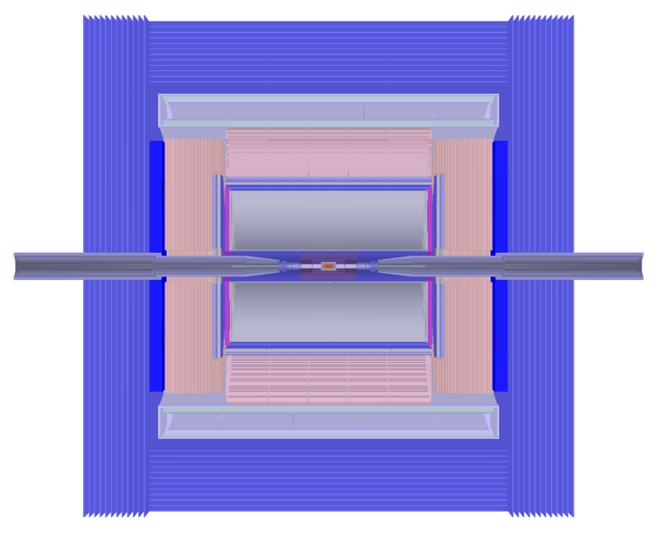
Introduction
Partial silicon tracker + TPC is designed as the tracker in the baseline detector for CepC. But other one or more tracker is still needed as the design for the potential second IP or as a backup tracker for the preferred tracker.
ILD and FCC-ee have their full silicon tracker designs and have done study well.
CepC silicon study group have also studied silicon detector as partial tracker, such as vertex detector (VXD), forward detector (FTD), etc.
Baseline detector @CepC
TPC
partial silicon tracker
(VXD, FTD, SIT/SET)
The study on full silicon tracker: technology, layout design and performance.
The technology can benefit from the partial silicon tracker study.
The full silicon tracker designs in other colliders can be referenced.

Slide 4
Technology
Planary layers cover solid angle as much as possible.
support layer + silicon layer:
double side
single side
other support
electronics
Silicon sensor technology (CMOS) is same as the VXD, FTD, SIT/SET in the baseline detector.
VXD:
Toward 16 μm pitch (2.8 μm single-point resolution)
SIT/SET and FTD_STRIP:
50μm pitch
<200μm thickness
FTD_PIXEL:
50μm
Electronics
Same as the baseline, not yet considered in simulation

Slide 5
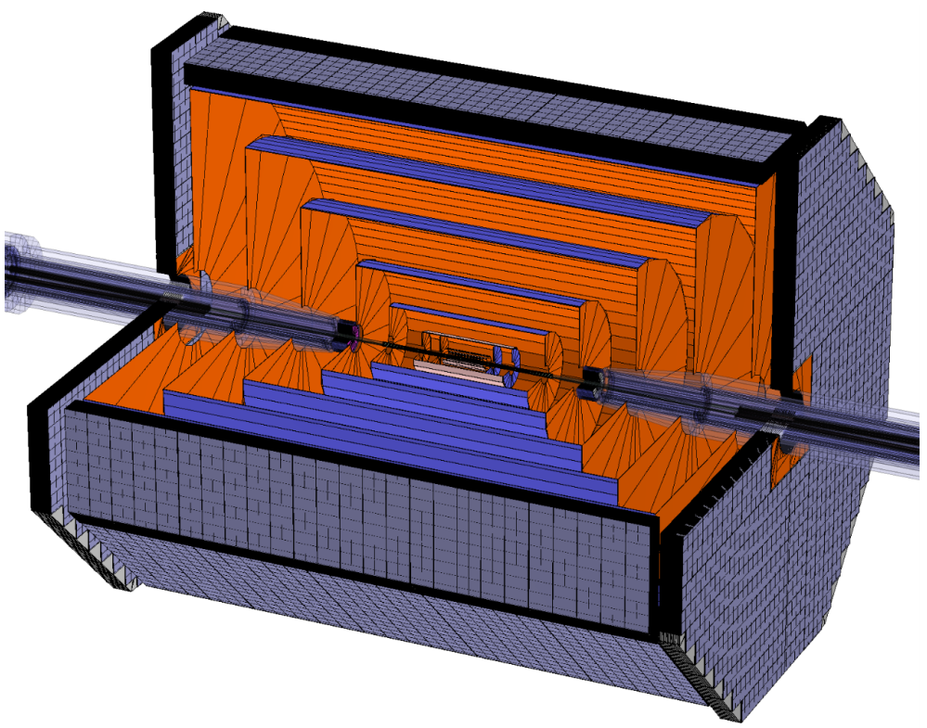
Full Silicon Tracker (FST) Concept designs
Replace TPC with silicon tracker and re-design silicon parts in the baseline, same beam pipe and calorimeters
3.0 Tesla
14.5 mm outer radius for Be beam pipe
Maximum 1.83 m outer radius and 4.6 m length at Z direction
Two options
FST: expand extra SIT layers and FTD disks to fill the tracker space, and rename the parts
FST2: expanding the SID design to full tracking volume
Double strip layer for FST and single strip layer for FST2
FST: more expensive and high performance
FST
FST2

Slide 6
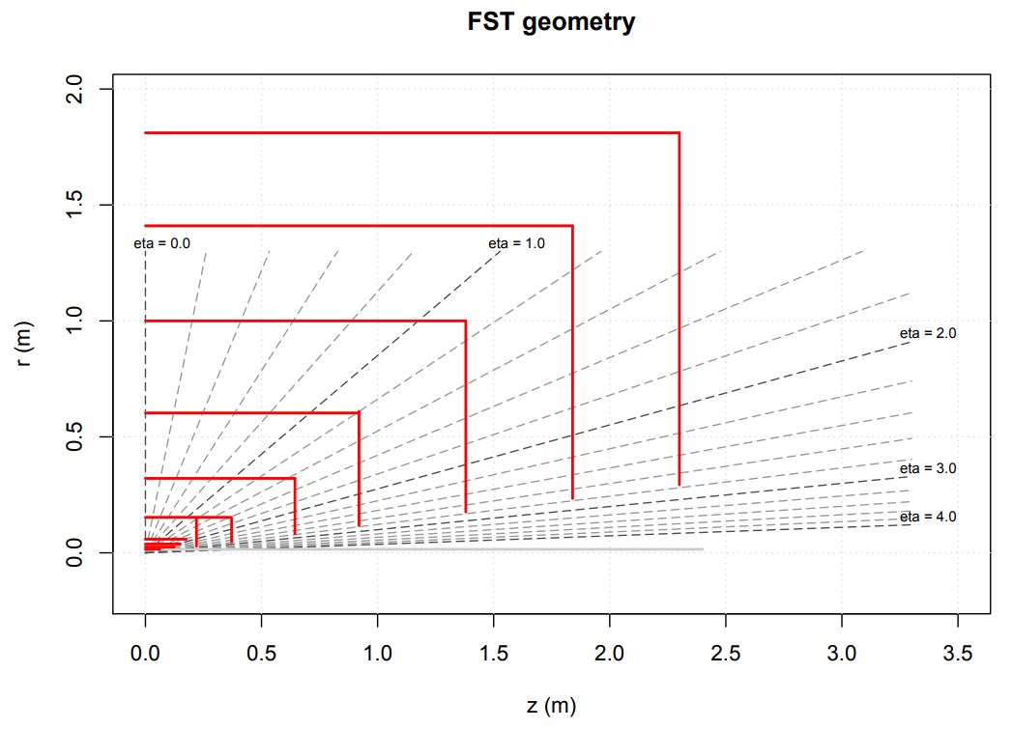
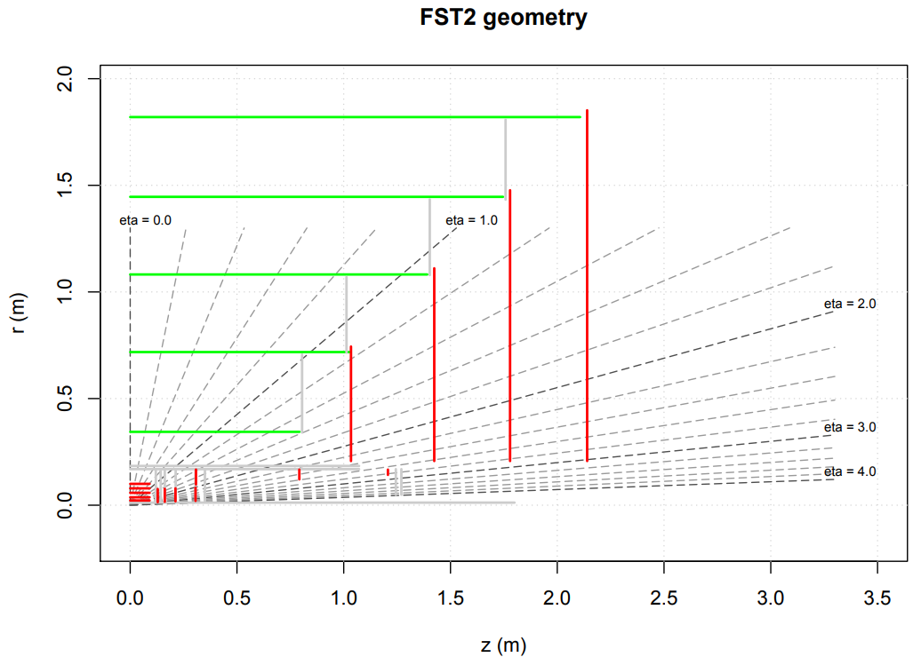
Layouts
SOT
EOT
VXD
EIT
Zoomed
VXD
EIT

Slide 7
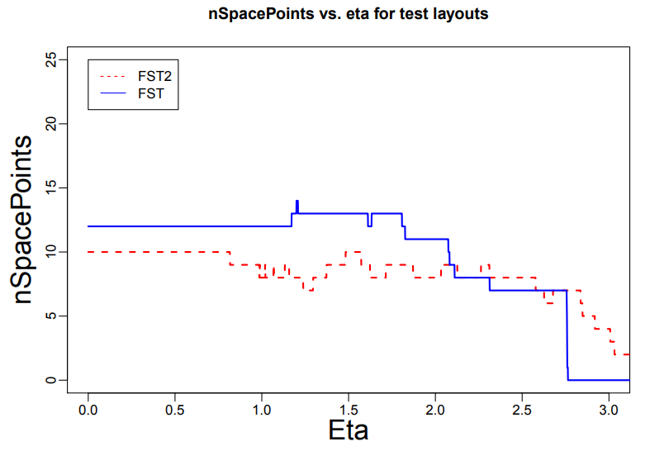
Space point
θ=20°
θ=85°

Slide 8
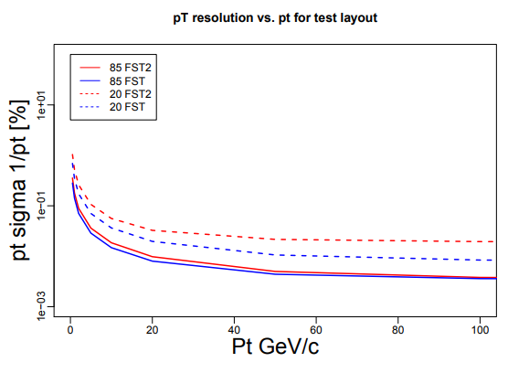
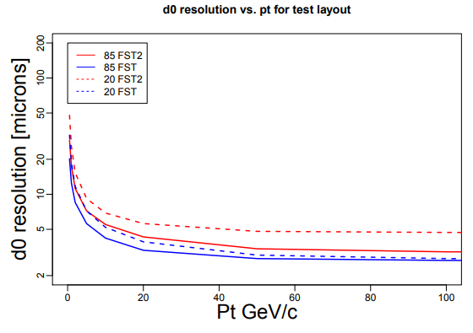
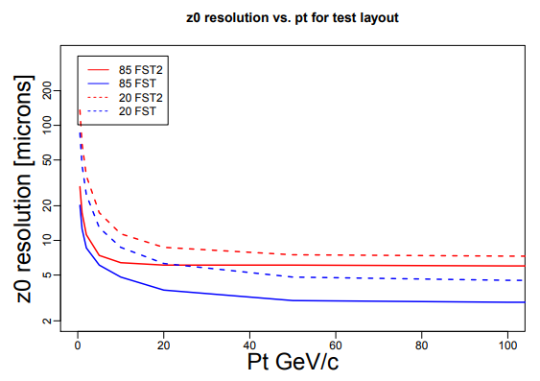
Fast simulation
Resolutions for tracks with θ=85° and 20°, represent for endcap and barrel
FST has better resolutions, benefit from more space points
Detail FST2 study http://atlaswww.hep.anl.gov/hepsim/detectorinfo.php?id=sidcc3

Slide 9
Layer Materials of FST
Mechanical properties have not been studied in detail
VXD (pixel) | silicon | kapton | aluminium | foam | Total support
Thickness(mm) | 0.05 | 0.05 | 0.01 | 0.94 | 1
SOT (strip) | silicon | peek | Carbon fiber | Rohacell 50D | epoxy | Carbon fiber | Total support
Thickness(mm) | 0.15+0.0024 | 0.1 | 0.08 | 0.9 | 0.08 | 0.08 | 1.2424
SiD-like, half of support layers, considering for two single-side layers combined as one double-side layer.
EIT (pixel) | silicon | Carbon fiber | Rohacell50D | peek | Total support
Thickness(mm) | 0.2+0.0048 | 0.16 | 1.8 | 0.2 | 2.1648
EOT (strip) | silicon | peek | Carbon fiber | Rohacell 50D | epoxy | Carbon fiber | silicon | Total support
Thickness(mm) | 0.15 | 0.2 | 0.16 | 1.8 | 0.175 | 0.16 | 0.15+0.0048 | 2.4998

Slide 10
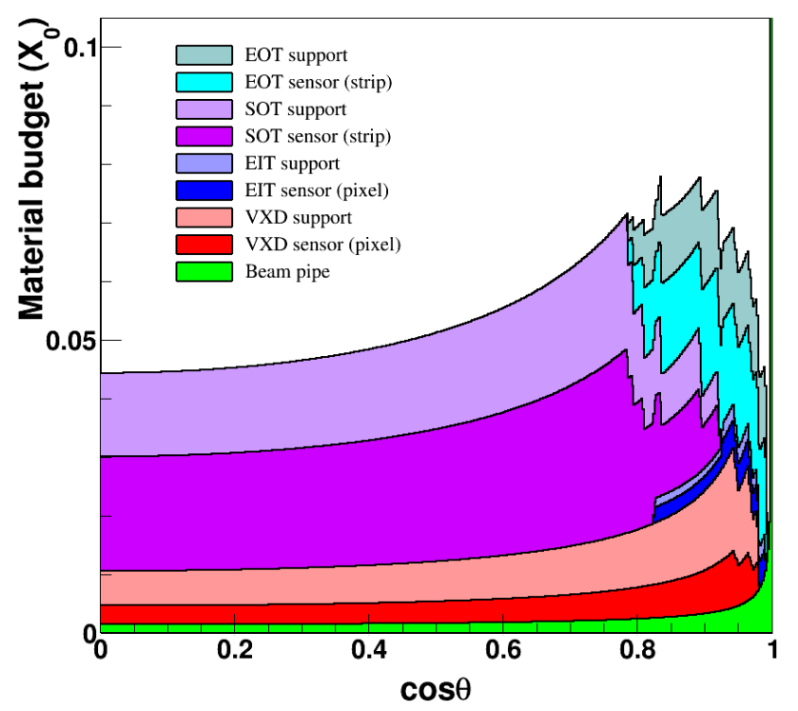
Material Budget of FST
From ~4.5% of X0 to ~8.1% (cosθ<0.99)

Slide 11
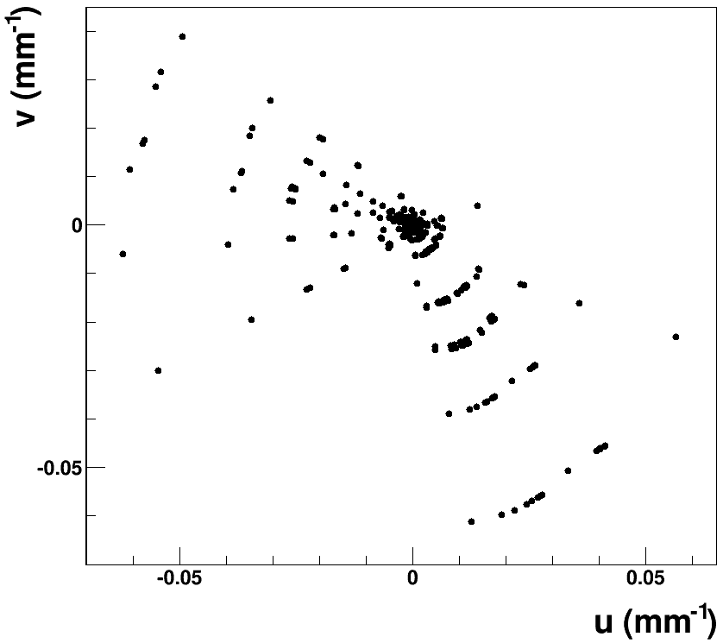
Simulation and Reconstruction Tools
MokkaC⎯a developed Mokka version @CepC
http://cepcgit.ihep.ac.cn/cepcsoft/MokkaC
Tracking and fit
ConformalTracking
used as the main track pattern recognition algorithm at CLIC, and FCC-ee are also performing
Implemented into CepC software, and ongoing
a ZH→ννGG event
Conformal space:
$$u=\frac{x}{x^{2}+y^{2}}, v=\frac{y}{x^{2}+y^{2}}$$
In conformal space, a track in magnetic field is a straight line
Track finding becomes straight line searching by pattern recognition (cellular automaton)
…
SOT
VXD
…

Slide 12
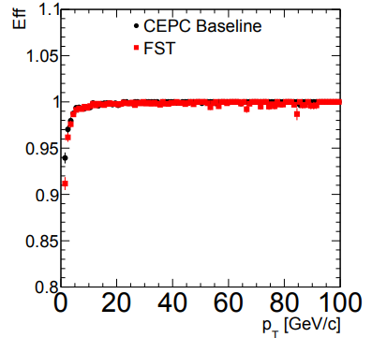
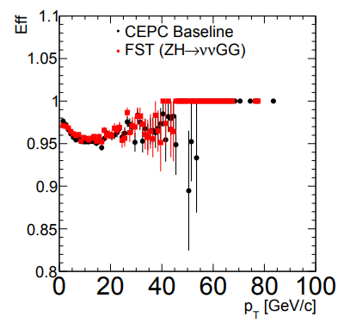
Tracking Efficiency of FST
ε= tracks matched with MC truth (>50%) / stable tracks
relative to stable tracks and matching algorithm, tracks in jets are influenced more
single muon
tracks in jets

Slide 13
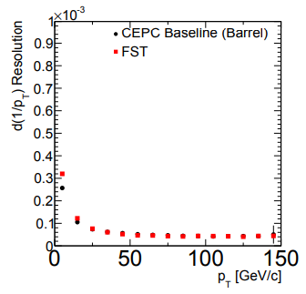
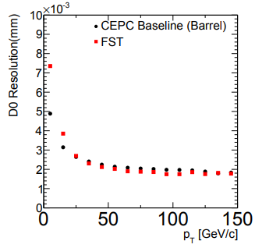
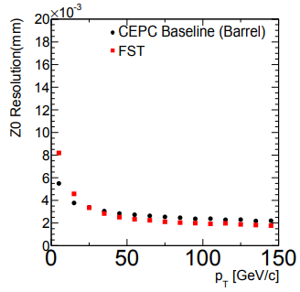
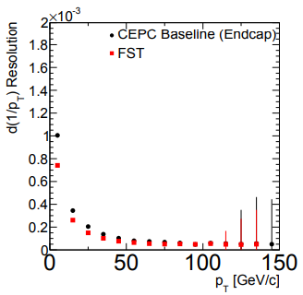
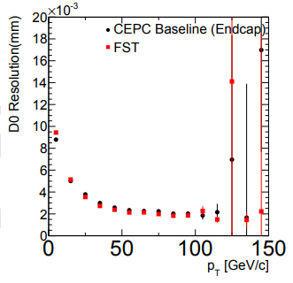
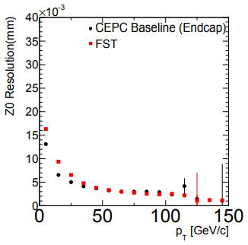
Resolution of FST (Single Muon)
Gang’s talk

Slide 14
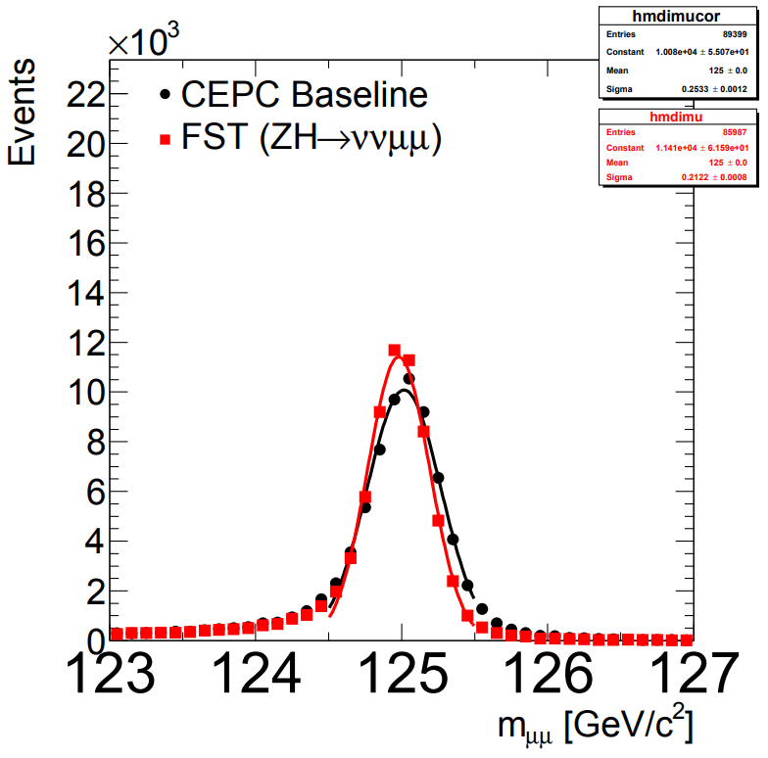
Mass Resolution (H→μμ)
Comparing to the baseline detector without PFA
0.21 GeV by FST

Slide 15
Future plan
Area/m² | pixel | strip | total
baseline | 0.37 + 0.13 | 111.76 + 1.69 | 113.95
FST | 0.46 + 0.13 | 225.62 + 41.96 | 268.17
FST/baseline | 1.18 | 2.36 | 2.35
With same dimension (pitch), electronics channels ∝ area
Optimize layouts
silicon thickness
support structure
Electronics in simulation
If necessary, balance cost and performance
Study on physical performance, implement into PFA

Slide 16
Conclusion
The concepts of full silicon tracker have been implemented and seem working.
Two options have been considered, one for expensive and higher performance, close to the baseline detector, another for cheap
Performance for more options can be estimated as between them.
Based on comparison with the baseline detector, it is expectable that the full silicon tracker can provide close performance for those particles with long life.
More optimization and study are in plan.

Slide 17
Thank you for your attention!

