Slide 1
IDEA: a detector concept for CepC
F. Bedeschi, INFN-Pisa
On behalf of the INFN group^{(*)}
CepC CDR International Review,
Beijing, September 2018
Outline
Main physics/technical drivers
Detector layout
Conclusions
(*) Collaborators listed in backup slides

Slide 2
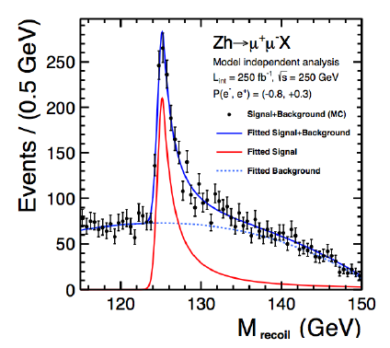
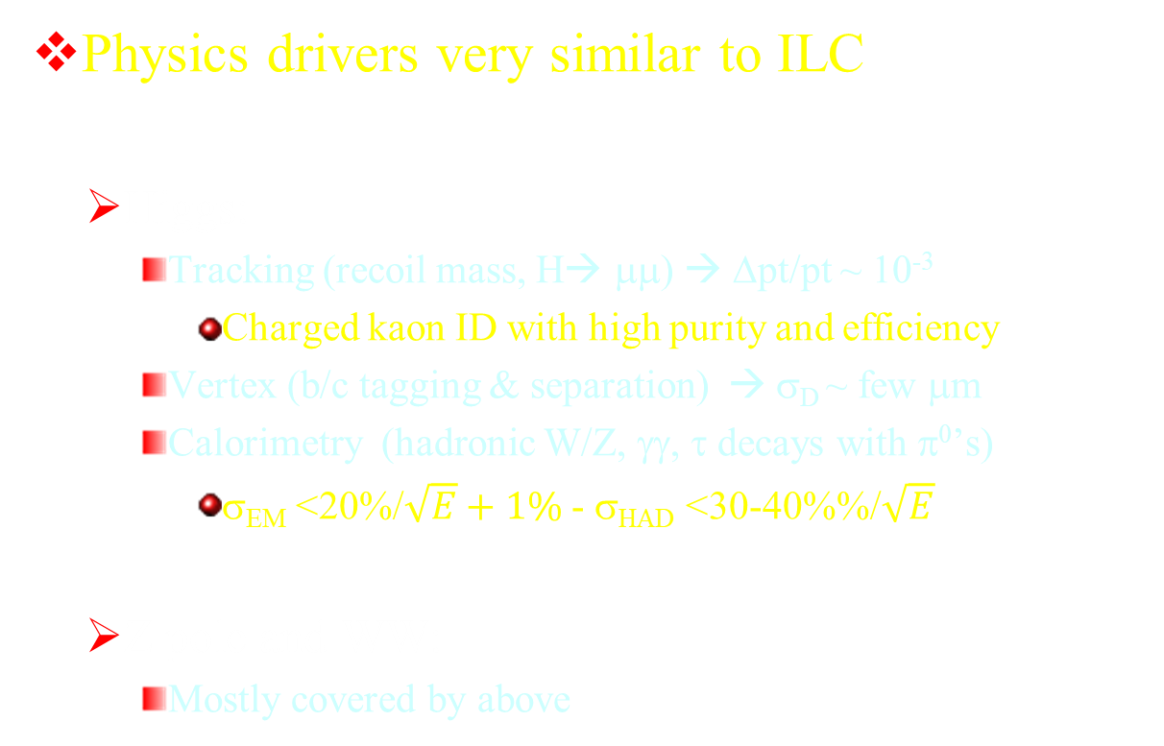
Physics drivers recap
Physics drivers very similar to ILC
  Higgs:
    Tracking (recoil mass, H→ μμ) → Δpt/pt ~ 10⁻³
      Charged kaon ID with high purity and efficiency
    Vertex (b/c tagging & separation) → σ_{D} ~ few μm
    Calorimetry (hadronic W/Z, γγ, τ decays with π⁰’s)
      σ_{EM} <20%/$\sqrt{E}+1\%$ - σ_{HAD} <30-40%%/$\sqrt{E}$
  Z pole and WW:
    Mostly covered by above

Slide 3
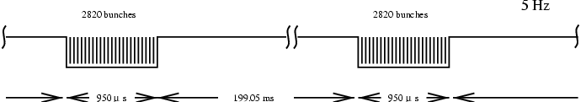

Differences with ILC
Luminosity is much higher!
  Non-negligible machine backgrounds
    Fast detector integrates less background in each readout
On Z pole detector solenoid field constrained by beam emittance preservation at IR
  Low field ~ 2 T optimizes luminosity
    Compensate with large number of measurements and large tracking volume
Beam time structure:
  Short bunch spacing (~ 20 ns Z, ~ 1 μs H)
  No large time gap
    Cooling harder for PF calorimeters and vertex detectors
    Ion backflow in TPC’s
Z
WW
ZH
$$t\overline{t}$$
100xLEP
FCC SR power/beam < 50 MW
CepC SR power/beam < 30 MW

Slide 4
Other drivers
Extreme statistical resolution on Z pole
  Acceptance systematics control is critical
    Silicon layer after main tracker for acceptance and charged resolution
    Pre-shower with high stability allows μm level acceptance definition for γ
High granularity calorimeter to resolve π⁰ from τ decays
  ~ 5 mm cell size looks sufficient
10 - 40 GeV e⁻
Z→τ⁺τ⁻
τ⁺◊ρ⁺ν◊π⁺π⁰ν
Δγ @ 2 m

Slide 5
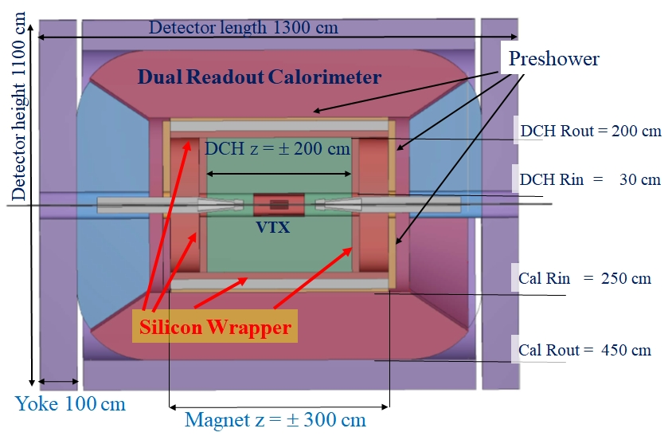
Detector layout
Beam pipe (R~1.5 cm)
VTX: 4-7 MAPS layers
DCH: 4 m long, R 35-200 cm
Outer Silicon Layer
SC Coil : 2 T, R~2.1 m
Preshower: ~ 1 X₀
DR calorimeter: 2 m/7 λ_{int}
Yoke + muon chamber

Slide 6
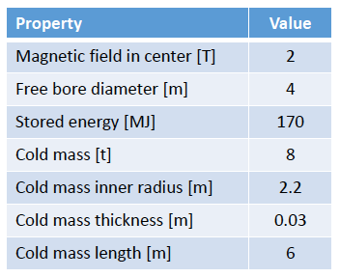
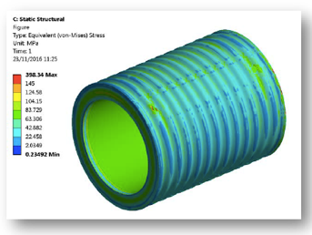
Detector solenoid
2T field solenoid – Rin ~ 2 m
  Can be made very thin ~30 cm total = 0.74 X₀ (0.16 λ) at θ = 90º
    Calorimeter can be located outside coil
  Small yoke thickness 50-100 cm Fe
    Scales with B R² → cost reduction over large coil

Slide 7
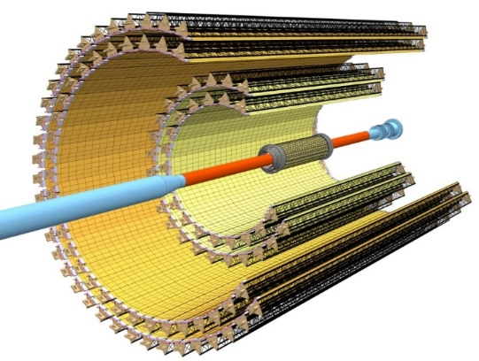
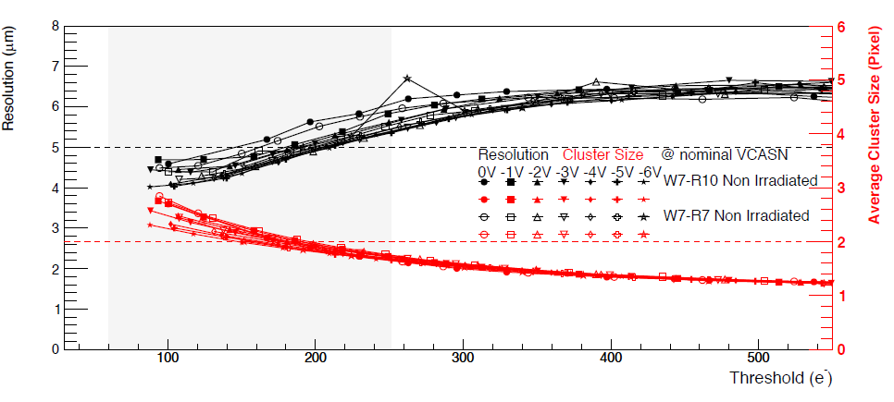
Vertex detector
Build on ALICE ITS technology
  30x30 μm MAPS
    5 μm spatial resolution
      Also after irradiation
    Smaller pixels possible
  %X0
    0.3-1.0% (in-out)
  Power:
    41-27 mW/cm2 (in-out)
  Radiation hard
  >100 kHz readout
    Faster possible
New 1 Meuro INFN research grant likely on this technology

Slide 8
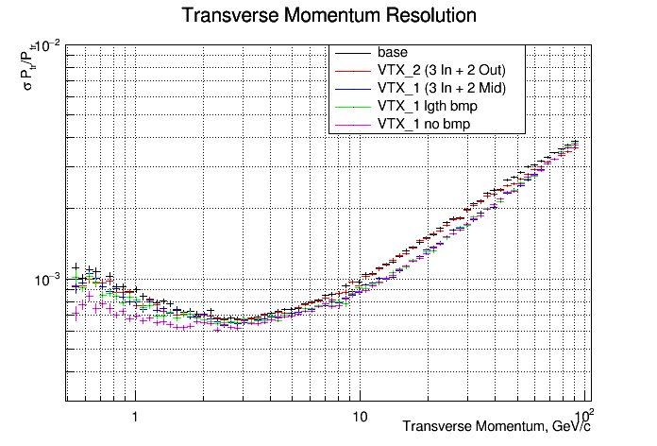
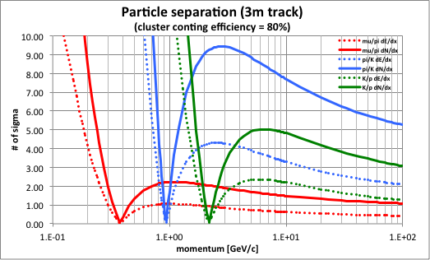
Tracker
Drift Chamber: fast, good resolution/dE/dx w/ cluster count
  Ultralight chamber (<1% X₀) – gas: He 90% - iC₄H₁₀ 10%
  4 m long, drift length ~1 cm, drift time ~400ns, σ_{xy} < 100 μm
θ = 65⁰
DCH+VTX+Silicon
Δpt/pt ~ 0.4 % @ 100 GeV

Slide 9
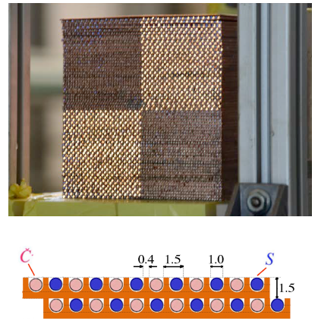
DR Calorimeter
Dual readout calorimeter
  Build on DREAM/RD52 experience
    Transverse granularity ~ 2 mm
    Event-by-event f_{em} fluctuations correction
  Demonstrated EM resolution
  Had. resolution extr. with GEANT4

Slide 10
Muons
Momentum measurement
  Vertex+DCH+Si: ~ 0.4% @ 100 GeV
  ID ok if isolated
Better muon ID in jets:
  More filter behind calorimeter
    Iron yoke (>50 cm Fe)
  with additional chambers
    μ-RWELL low-cost technology already proven for low rate applications (CMS/SHiP)
top copper layer
kapton
HV
ρ
kapton
ε_{r}
t

Slide 11
Pending issues
Forward tracking in vertex and large radius regions
  So far not designed at all
Potential calorimeter longitudinal segmentation
  (Monolithic) segmented calorimeter outside magnet
  EM lead calorimeter is 20 cm deep (22 X₀)
    Could go inside magnet with small change in magnet size
Pre-shower optimization
  Thickness, resolution & coverage (test beam just finished)

Slide 12
Conclusions
IDEA is a detector concept optimized for CepC
  Current detector described in the CepC CDR
Basic detector components based on proven techniques
More work in progress to optimize design
  Detector R&D/test beam
  Benchmark with simulation
  Mechanical engineering
Complements well the baseline detector, while it works well at the Higgs, it is optimized for best performance at the Z pole

Slide 13
Backup slides

Slide 14
INFN group summary
Total number of collaborators:
  69
Total number of institutions:
  18

Slide 15
INFN group (1)
INFN - Sezione di Bari and University of Bari, Italy
  Marcello Abbrescia
  Nicola De Filippis
INFN - Sezione di Bologna and University of Bologna, Italy
  Lorenzo Bellagamba
  Lisa Borgonovi
  Davide Boscherini
  Sylvie Braibant
  Elisa Fontanesi
  Paolo Giacomelli
  Alessandro Polini
INFN - Sezione di Catania and University of Catania, Italy
  Sebastiano Albergo
  Antonella Sciuto
INFN - Sezione di Firenze and University of Firenze, Italy
  Stefania De Curtis
  Piergiulio Lenzi

Slide 16
INFN group (2)
INFN - Sezione di Ferrara and University of Ferrara, Italy
  Gianluigi Cibinetto
  Riccardo Farinelli
  Isabella Garzia
  Vincenzo Guidi
  Mauro Moretti
INFN - Laboratori Nazionali di Frascati, Italy
  Giovanni Bencivenni
  Monica Bertani
  Erika de Lucia
  Danilo Domenici
  Giulietto Felici
  Catia Milardi
  Gianfranco Morello
  Marco Poli Lerner
INFN - Sezione di Lecce and University of Lecce, Italy
  Francesco Grancagnolo
  Marco Panareo
  Giovanni Tassielli

Slide 17
INFN group (3)
INFN - Sezione di Milano and University of Milano, Italy
  Attilio Andreazza
  Alessandro Vicini
INFN - Sezione di Milano and University of Insubria, Italy
  Massimiliano Antonello
  Massimo Caccia
  Romualdo Santoro
INFN - Sezione di Milano Bicocca and University of Parma, Italy
  Luca Trentadue
INFN - Sezione di Pavia and University of Pavia, Italy
  Carlo Michel Carloni Calame
  Roberto Ferrari
  Gabriella Gaudio
  Guido Montagna
  Oreste Nicrosini
  Fulvio Piccinini
  Giacomo Polesello
  Lorenzo Pezzotti

Slide 18
INFN group (4)
INFN - Sezione di Padova and University of Padova, Italy
  Patrizia Azzi
INFN - Sezione di Perugia and University of Perugia, Italy
  Gianmario Bilei
  Livio Fano'
INFN - Sezione di Pisa, Universita' di Pisa and Scuola Normale Superiore, Italy
  Paolo Azzurri
  Franco Bedeschi
  Vincenzo Cavasinni
  Maria Chiara Roda
  Luigi Rolandi
  Roberto Tenchini
  Guido Tonelli
INFN - Sezione di Roma1 and University of Roma "La Sapienza", Italy
  Barbara Mele
  Gianluigi Chiarello
  Simonetta Gentile
  Luca Silvestrini

Slide 19
INFN group (5)
INFN - Sezione di Roma3 and University of Roma "Tor Vergata", Italy
  Michela Biglietti
  Paolo Branchini
  Marco Ciuchini
  Biagio Di Micco
  Addolarata Farilla
  Mario Greco
  Monica Verducci
INFN - Sezione di Torino and Universrity of Torino, Italy
  Lia Lavezzi
  Marco Maggiora
  Angelo Rivetti
INFN - Sezione di Trieste and University of Udine, Italy
  Marina Cobal
  Emidio Gabrielli

