Slide 1



CEPC Accelerator Overview(CDR)
  J. Gao and Y. Zhang
  Onbehalf of CEPC Accelerator Group
  Institute of High Energy Physics
  CAS, Beijing
  CEPC Physics/Detector International Review
  Sept. 13-15 2018,IHEP, Beijing, China

Slide 2
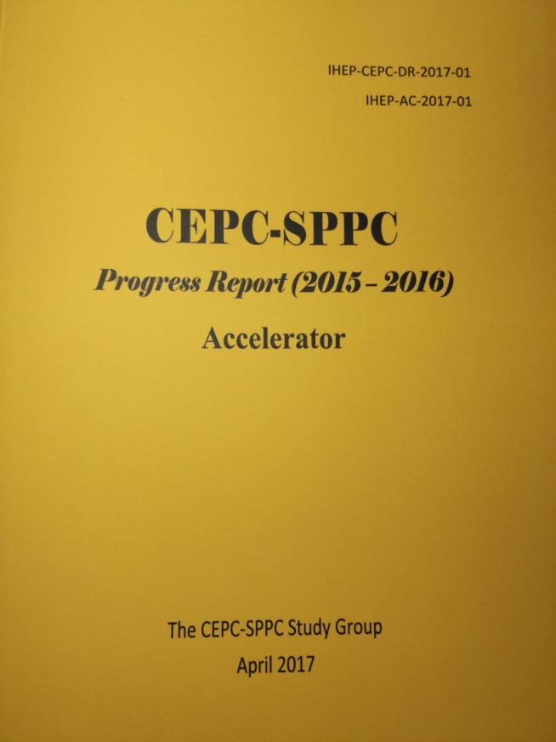
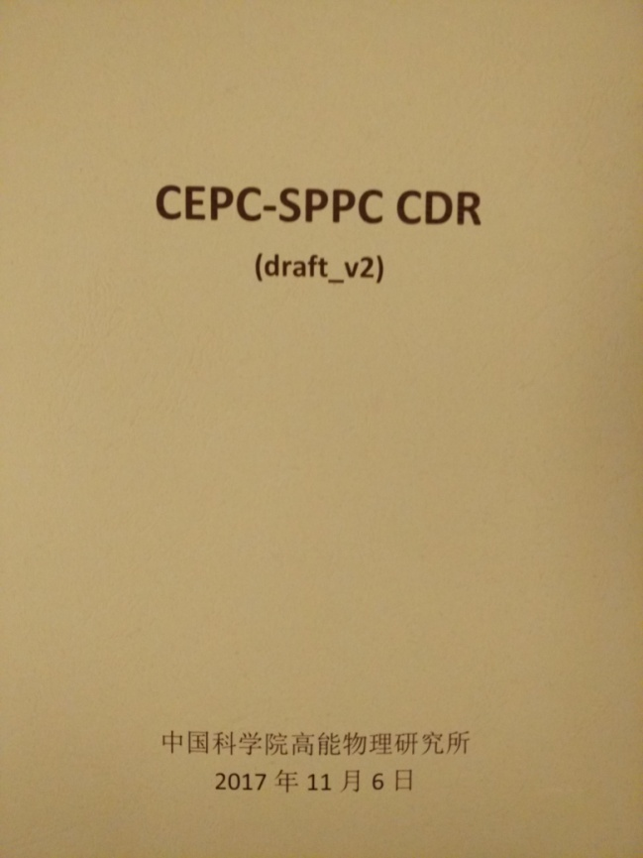
Accelerator from Pre-CDR to CDR
CEPC accelerator CDR completed in June 2018 (released on Spet. 2 2018)
  Executive Summary
  Introduction
  Machine Layout and Performance
  Operation Scenarios
  CEPC Collider
  CEPC Booster
  CEPC Linac
  Systems Common to the CEPC Linac, Booster
  and Collider
  8. Super Proton Proton Collider
  9. Conventional Facilities
  10. Environment, Health and Safety
  11. R&D Program
  12. Project Plan, Cost and Schedule
  Appendix 1: CEPC Parameter List
  Appendix 2: CEPC Technical Component List
  Appendix 3: CEPC Electric Power Requirement
  Appendix 4: Advanced Partial Double Ring
  Appendix 5: CEPC Injector Based on Plasma Wakefield Accelerator
  Appendix 6: Operation as a High Intensity γ-ray Source
  Appendix 7: Operation for e-p, e-A and Heavy Ion Collision
  Appendix 8: Opportunities for Polarization in the CEPC
  Appendix 9: International Review Report
Draft CDR for
Mini International
Review in Nov. 2017
March 2015
April 2017
arXiv:1809.00285
CDR International Review June 28-30, 2018, final CDR (accelerator) released on Sept. 2, 2018

Slide 3
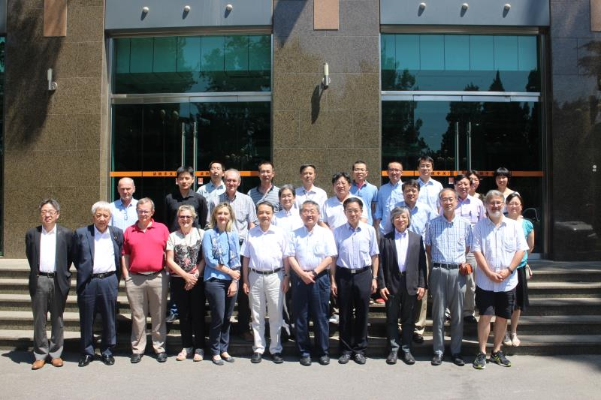
International Review of CEPC CDR
(June 28-30, 2018, IHEP)
Review Committee Members:
Brian Foster Oxford U./DESY
Eugene Levichev BINP
Katsunobu Oide (chair) CERN/KEK
Kazuro Furukawa KEK
Manuela Boscolo INFN
Marica Biagini INFN
Masakazu Yoshioka KEK/Tohoko University
Norihito Ohuchi KEK
Paolo Pierini ESS
Steinar Stapnes CERN
Yoshihiro Funakoshi KEK
Zhengtang Zhao (absent) SINAP

Slide 4
International Review Report of CEPC CDR (June 28-30, 2018, IHEP)
The Review Committee unanimously congratulates the CEPC team on the completion of the CDR, with remarkable successes in various aspects of the design. The progress since the pre-CDR has been a major step in the project...
The Committee believes that the CDR has already reached a sufficient level of maturity to allow approval to proceed to a Technical Design Report.

Slide 5

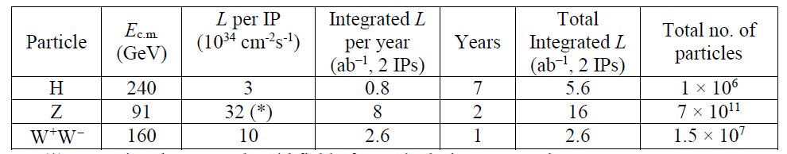
CDR Baseline Design
Higgs factory as first priority
Compatible with future pp collider
Maximum SR beam power 30 MW

Slide 6
Main Parameters
 | Higgs | W | Z（3T） | Z（2T）
Number of IPs | 2
Beam energy (GeV) | 120 | 80 | 45.5
Circumference (km) | 100
Synchrotron radiation loss/turn (GeV) | 1.73 | 0.34 | 0.036
Crossing angle at IP (mrad) | 16.5×2
Piwinski angle | 3.48 | 7.0 | 23.8
Number of particles/bunch N_{e} (10¹⁰) | 15.0 | 12.0 | 8.0
Bunch number (bunch spacing) | 242 (0.68μs) | 1524 (0.21μs) | 12000 (25ns+10%gap)
Beam current (mA) | 17.4 | 87.9 | 461.0
Synchrotron radiation power /beam (MW) | 30 | 30 | 16.5
Bending radius (km) | 10.7
Momentum compact (10⁻⁵) | 1.11
β function at IP β_{x}* / β_{y}* (m) | 0.36/0.0015 | 0.36/0.0015 | 0.2/0.0015 | 0.2/0.001
Emittance ε_{x}/ε_{y} (nm) | 1.21/0.0024 | 0.54/0.0016 | 0.18/0.004 | 0.18/0.0016
Beam size at IP σ_{x} /σ_{y} (μm) | 20.9/0.06 | 13.9/0.049 | 6.0/0.078 | 6.0/0.04
Beam-beam parameters ξ_{x}/ξ_{y} | 0.018/0.109 | 0.013/0.123 | 0.004/0.06 | 0.004/0.079
RF voltage V_{RF} (GV) | 2.17 | 0.47 | 0.10
RF frequency f _{RF} (MHz) (harmonic) | 650 (216816)
Natural bunch length σ_{z} (mm) | 2.72 | 2.98 | 2.42
Bunch length σ_{z} (mm) | 4.4 | 5.9 | 8.5
HOM power/cavity (2 cell) (kw) | 0.46 | 0.75 | 1.94
Energy spread (%) | 0.134 | 0.098 | 0.080
Energy acceptance requirement (%) | 1.35 | 0.90 | 0.49
Energy acceptance by RF (%) | 2.06 | 1.47 | 1.7
Photon number due to beamstrahlung | 0.082 | 0.050 | 0.023
Beamstruhlung lifetime /quantum lifetime* (min) | 80/80 | >400
Lifetime (hour) | 0.43 | 1.4 | 4.6 | 2.5
F (hour glass) | 0.89 | 0.94 | 0.99
Luminosity/IP L (10³⁴cm⁻²s⁻¹) | 2.93 | 10.1 | 16.6 | 32.1
*include beam-beam simulation and real lattice

Slide 7
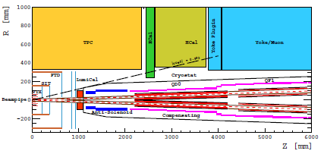
Accelerator Chain and Systems
Energy Ramp
10 ->45/120GeV
10 GeV
Electron
1) Injector
2) Booster
L=1.2km
Positron
C=100km
Three rings in the sane channel：
  CEPC & booster
  SppC
Booster Cycle (0.1 Hz)
The key systems of
CEPC:
1) Linac Injector
2) Booster
3) Collider ring
4) MDI
5) Civil Eng.
3) Main Ring
5) Civil Eng.
C=100km
45/120 GeV
4) Machine Detector Interface (MDI)

Slide 8
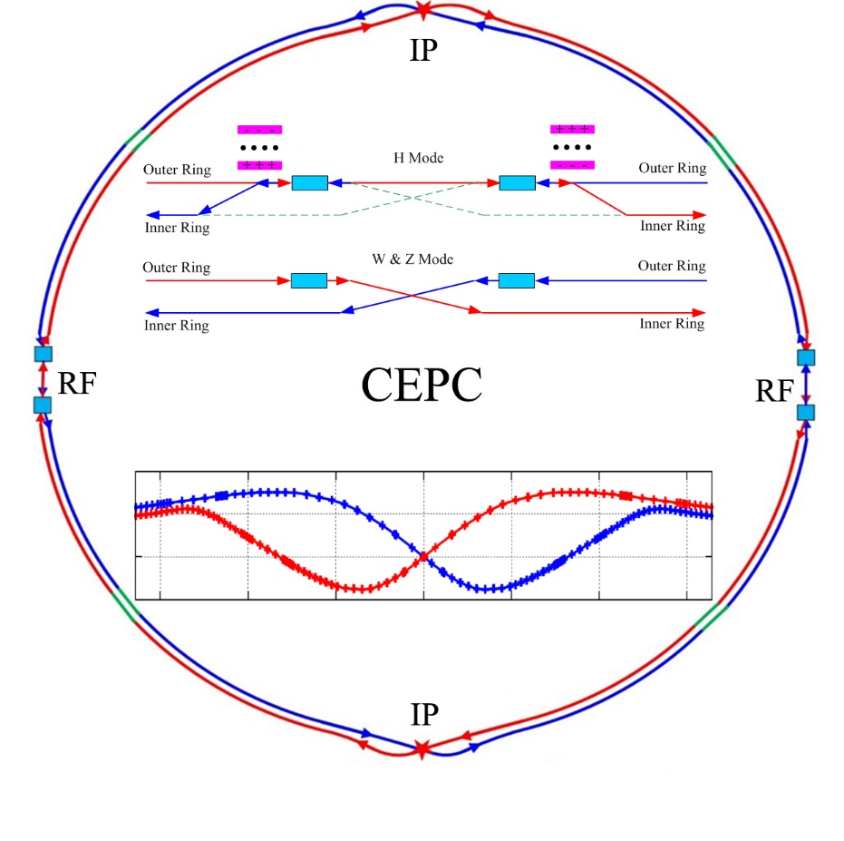
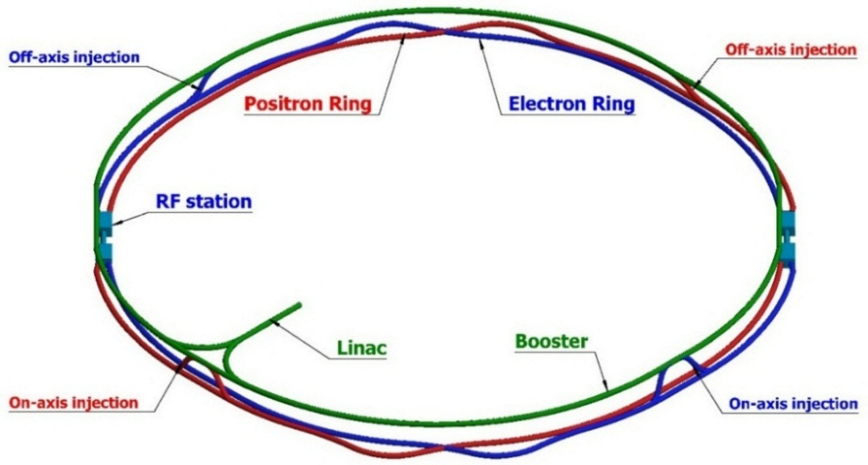
Layout
CEPC Linac injector (1.2km, 10GeV)

Slide 9
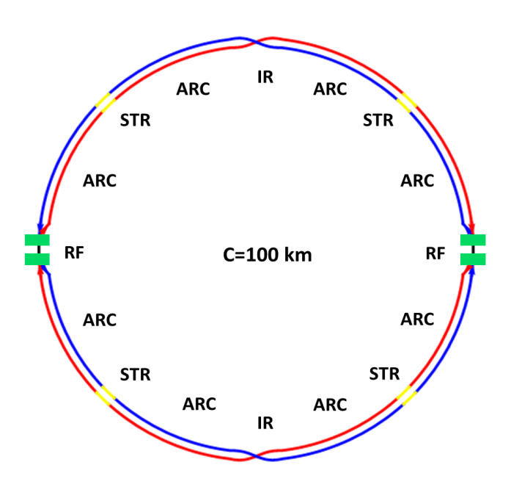
Collider Ring
The circumference of CEPC collider ring is 100 km.
In the RF region, the RF cavities are shared by two ring for H mode.
Twin-aperture of dipoles and quadrupoles is adopt in the arc region to reduce the their power. The distance between two beams is 0.35m.
Compatible optics for H, W and Z modes
  For the W and Z mode, the optics except RF region is got by scaling down the magnet strength with energy.
  For H mode, all the cavities will be used and bunches will be filled in half ring.
  For W & Z modes, half number of cavities will be used and bunches can be filled in full ring.
Notes:
2 fold symmetry

Slide 10
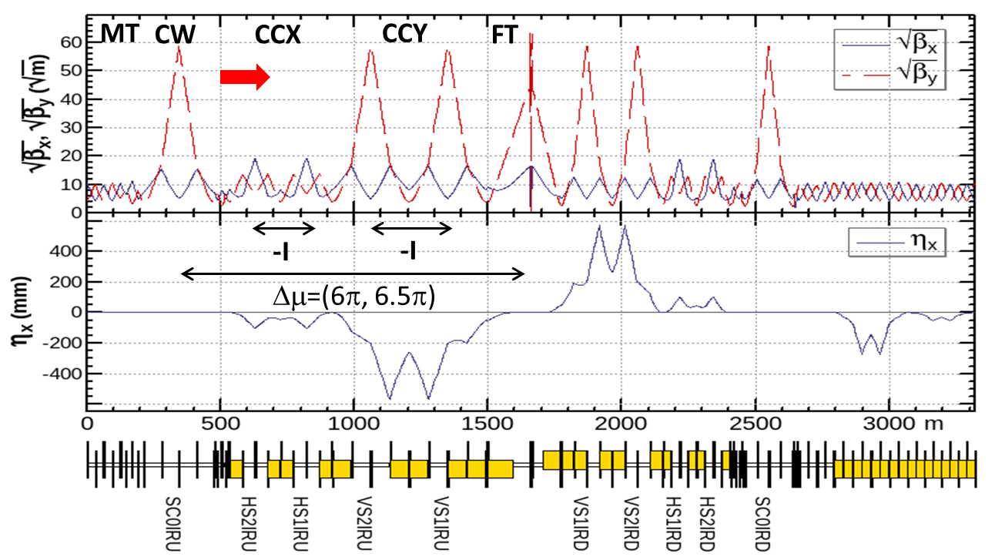
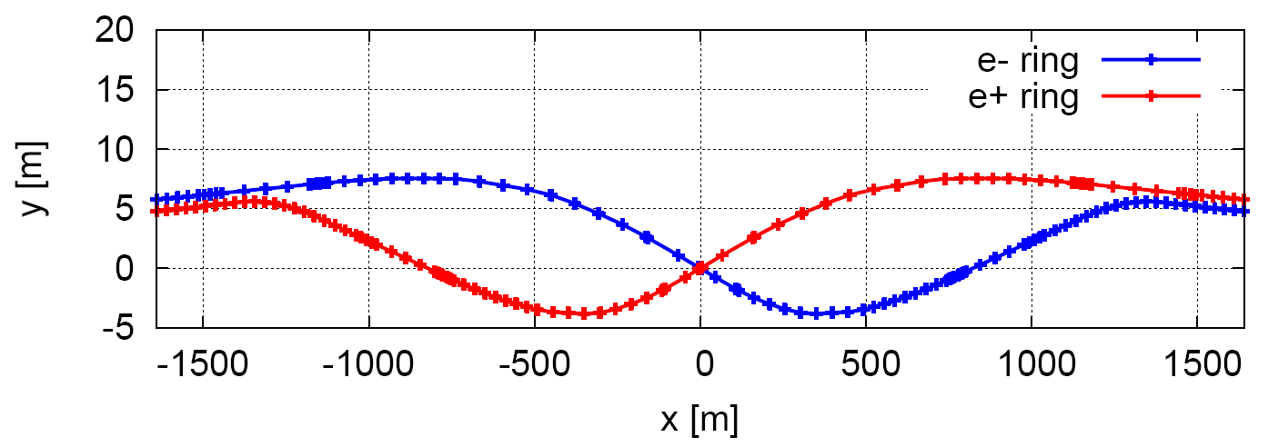
Optics of Interaction region
local chromaticity correction of both plane, asymmetric layout , crab-waist collision
L*=2.2m, θ_{C} =33mrad, G_{QD0} =136T/m, G_{QF1} =111T/m, L_{QD0} =2.0m, L_{QF1} =1.48m
IP upstream of IR: Ec < 120 keV within 400m, last bend Ec = 45 keV
IP downstream of IR: Ec < 300 keV within 250m, last bend Ec = 97 keV
Nonlinearity of Interaction region is well corrected locally
max deviation between two beamlines 9.7m
Notes:
to update line 3,4,5 and geometry figure
Modify 0 at IP
Lqd0=2m, MDI constraint

Slide 11
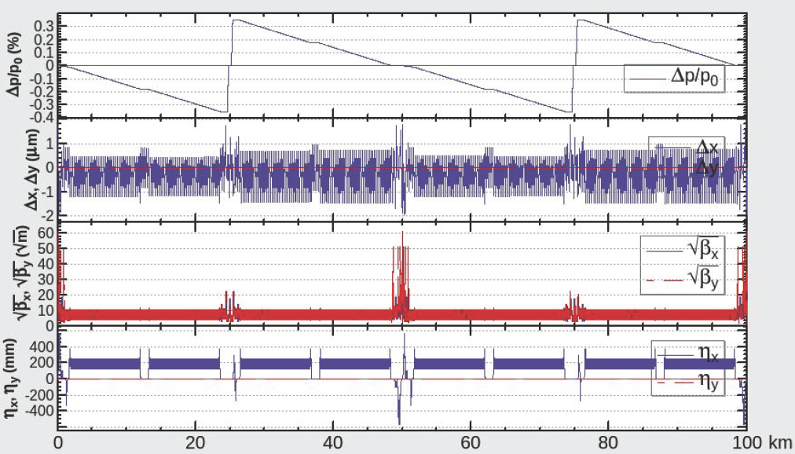
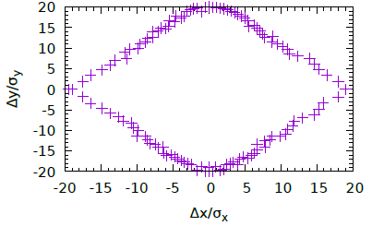
Lattice Design of Collider Ring
  An optics fulfill requirements of the parameters list, geometry, photon background and key hardware
    FODO cell, 90°/90°, non-interleaved sextupole scheme, period =5cells in arc
    Get a smallest average beta function to reduce the multi-bunch instability caused by RF cavities especially for the Z mode in RF region
    The function of the straight section is phase advance tuning and injection.
Energy sawtooth is around ±0.35 %. Closed orbit distortion in CEPC collider ring is around 1 mm and becomes 1um after tapering the magnet strength with beam energy
Optimized Dynamic Aperture fulfill the requirements of injection and beam lifetime
Notes:
Update figures

Slide 12
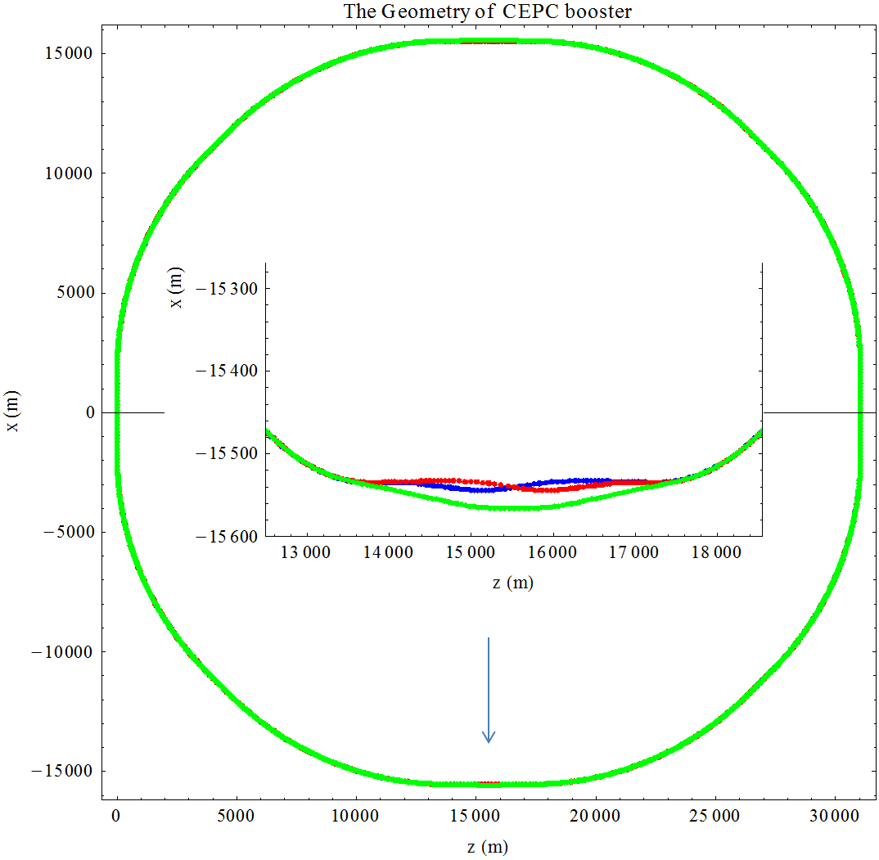
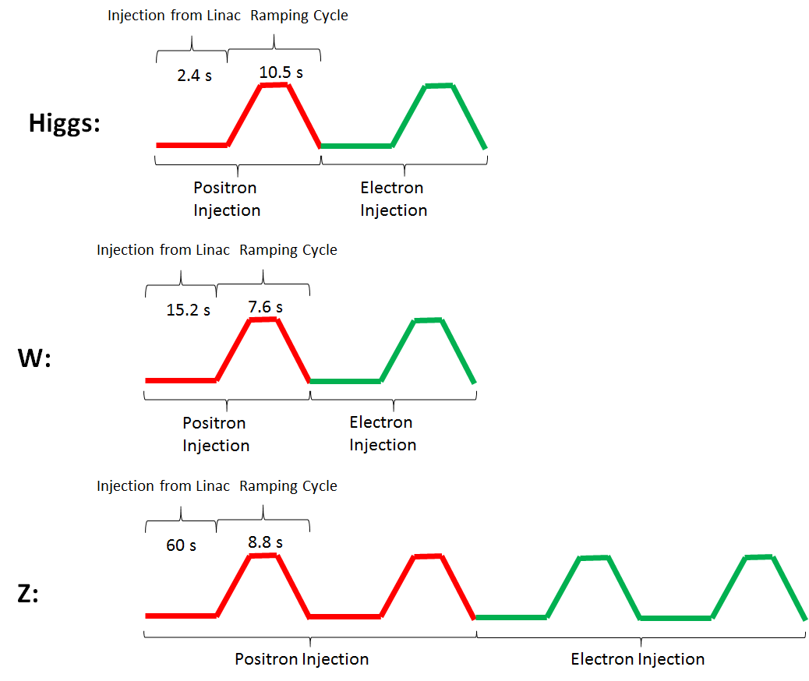
Booster & Injection Time Structure
25m separation @ IP
Mode | Higgs | W | Z
Bunch number | 242 | 1220 | 6000
Current threshold | 1 mA | 4 mA | 10 mA
Number of Cycles | 1 | 1 | 2
Injection period (sec) | 73.1 | 131 | 438
Full Injection time | 10 min | 15 min | 2.2 Hour (collide from 230mA

Slide 13
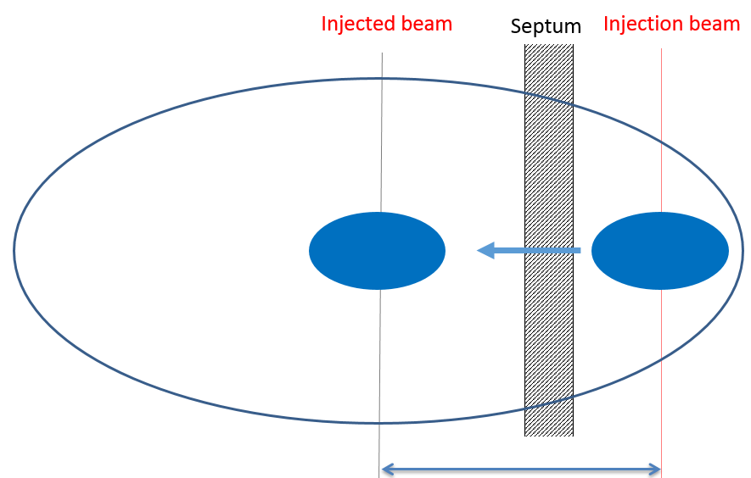
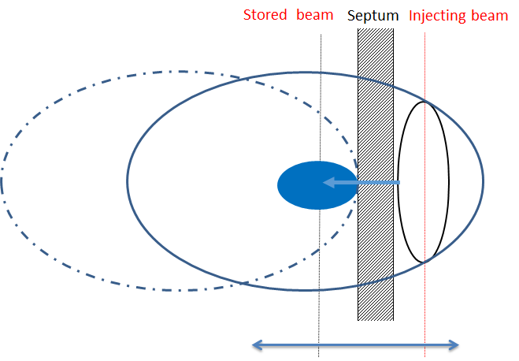
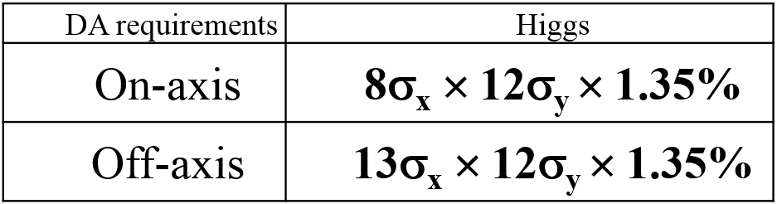
Beam Dynamics Status
The studies on key beam dynamic issues have been finished.
Design of interaction region
Compensation of detector solenoid
Control of detector background
Lattice design
On-axis injection scheme（only for Higgs）
Optimization of dynamic aperture
Beam acceleration in the Linac and booster ring
Impedance and instabilities
Beambeam effect

Slide 14
SRF Design Challenges
 | H | W | Z
Collider Ring | 650 MHz 2-cell cavity
Lumi. / IP (10³⁴ cm⁻²s⁻¹) | 2.93 | 10.1 | 16.6 / 32.1
RF voltage (GV) | 2.17 | 0.47 | 0.1
Beam current (mA) | 17.4 x 2 | 87.7 | 460
Cavity number | 240 | 108 x 2 | 60 x 2
SR power (MW) | 30 | 30 | 16.5
2 K cavity wall loss (kW) | 6.1 | 1.3 | 0.1
Booster Ring (extraction) | 1.3 GHz 9-cell cavity
RF voltage (GV) | 1.97 | 0.585 | 0.287
Beam current (mA) | 0.52 | 2.63 | 6.91
Cavity number | 96 | 64 | 32
RF input power (MW) avg. | 0.07 | 0.02 | 0.02
2 K wall loss (kW) avg. | 0.17 | 0.01 | 0.02
High energy, low current: high gradient, high Q, more cells, narrow bandwidth
Low energy, high current: HOM power (less cells), parasitic loss, HOM CBI, FM CBI (low voltage, large detuning)
Large ring: gap transient, dense beam spectrum
Special issues with CEPC: parking cavities for W and Z, gap transient for Higgs half-fill, transient beam loading of bunch swapping for on-axis injection
Booster cavity voltage ramp: narrow bandwidth

Slide 15
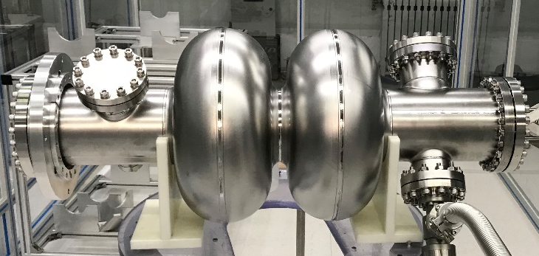
SRF Status
CEPC CDR SRF parameters and layout have been established in view of high Higgs priority, low construction cost and upgradability.
Beam cavity interaction issues (FM and HOM CBI, parking cavities, RF transients of bunch gap and swapping, HOM power) are challenging but manageable, especially for Z-pole.
SRF key components design and R&D launched, with support of PAPS SRF facility. SRF industrialization will be synergy with SHINE and ADANES etc. in China (~ 1000 cavities in next five years).
CEPC 650 MHz 2-cell cavity by OTIC

Slide 16
SRF Technology R&D Plan
SRF Key Technology R&D (2016-2020)
    High Q & high gradient cavity with N-doped Nb & Fe-based superconductor
    Very high power (300 kW) variable input coupler with low heat load
    High power coaxial HOM coupler (1 kW) and wideband HOM absorber (5 kW)
Cryomodule Prototyping (2019-2022)
    Collider cryomodules: 650 MHz 2 x 2-cell and full scale 6 x 2-cell (11 m)
    Booster cryomodules: 1.3 GHz 2 x 9-cell and full scale 8 x 9-cell (12 m)
    High Q operation (clean assembly, magnetic hygiene and flux expulsion)
    Beam test with DC-photocathode gun
Prepare for Mass-Production (2021-2023)
    Supported by PAPS large SRF infrastructure (start operation in early 2020)
    In the frame of CEPC Industrial Promotion Consortium (CIPC)
    In synergy with other SRF accelerator projects (LCLS-II, SHINE, ILC, etc.)

Slide 17
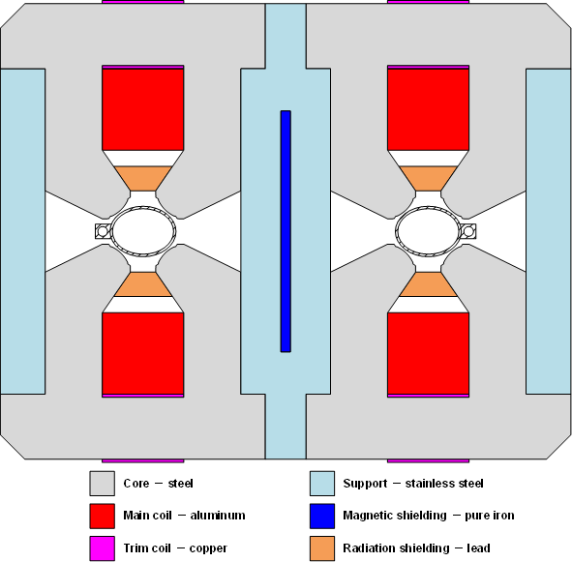
Collider Magnet
Over 80% of collider ring is covered by conventional magnet.
The most important issues are Cost & Power Consumption.
  Make the magnets compact and simple.
  Use aluminum for the coils.
  Dual aperture magnets save nearly 50% power.
  Consider the combined function magnets.
  Increase the coil cross section and decrease the operating current.

Slide 18
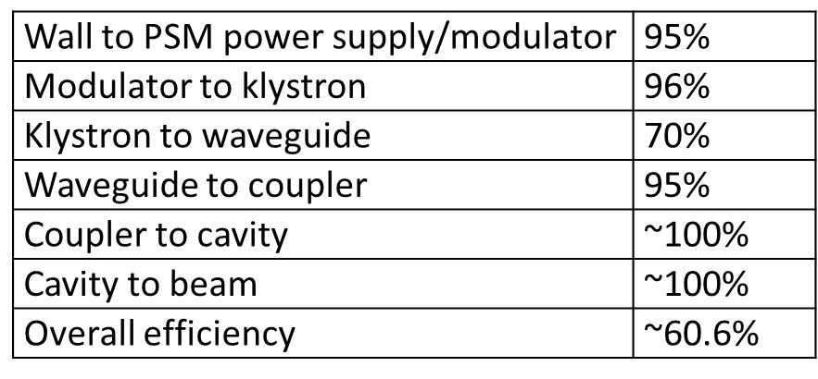
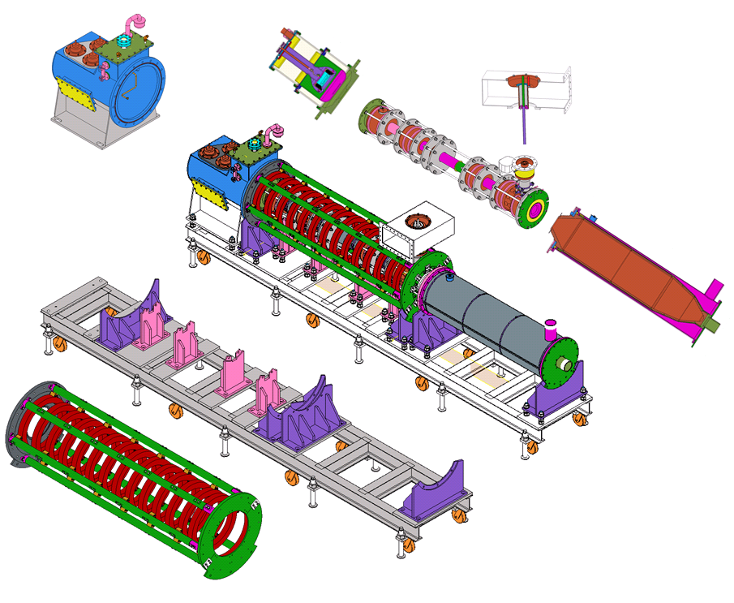
High efficiency klystron
CEPC Collider SRF Wall Plug Efficiency
The increase in efficiency of RF power sources is considered a high priority issue;
Development of high efficiency klystron is on going in China and other country;
The manufacture of the 1st tube will be completed this year in China and 3 schemes for the high efficiency design are ongoing based on 3 different gun design.

Slide 19
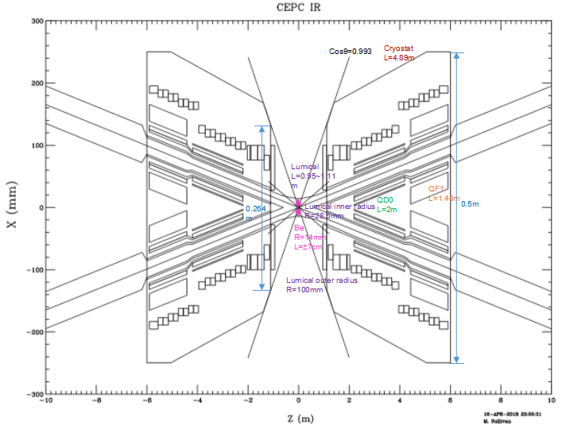
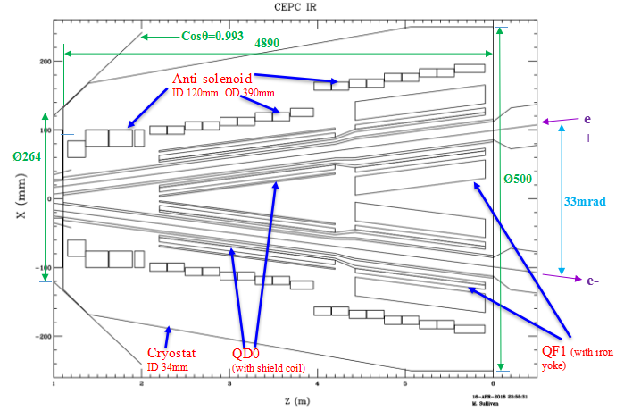
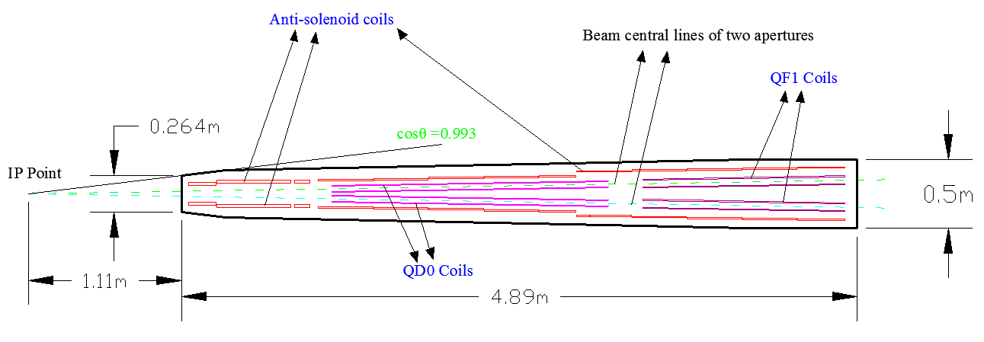
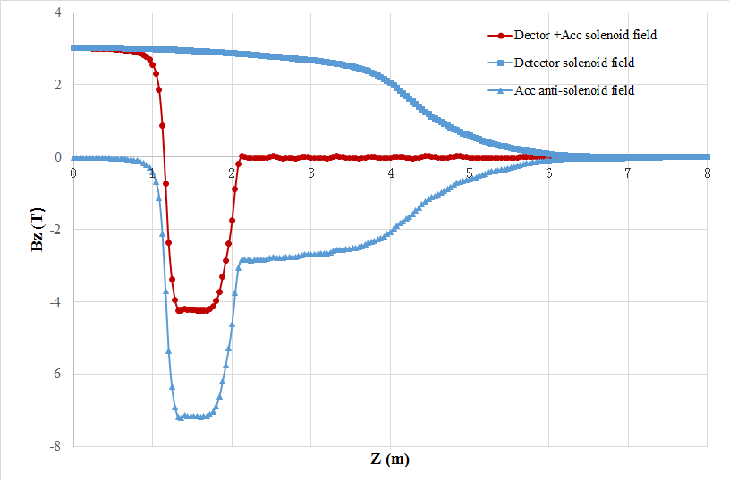
Final Focus Magnets & Cryostat
Anti coil

Slide 20
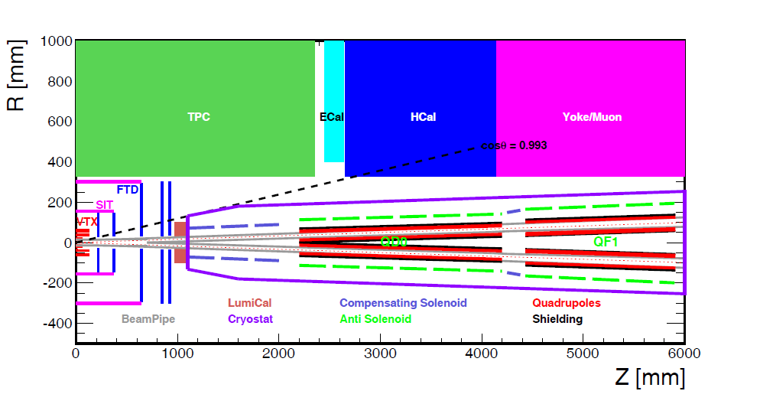
MDI Layout and Parameters
With Detector solenoid
Without Detector solenoid
~cryostat in detail
The accelerator components inside the detector without shielding are within a conical space with an opening angle of cosθ=0.993.
The e+e- beams collide at the IP with a horizontal angle of 33mrad and the final focusing length is 2.2m
Lumical will be installed in longitudinal 0.95~1.11m, with inner radius 28.5mm and outer radius 100mm.
The Machine Detector Interface (MDI) of CEPC double ring scheme is about ±7m long from the IP
The CEPC detector superconducting solenoid with 3T magnetic field and the length of 7.6m.

Slide 21
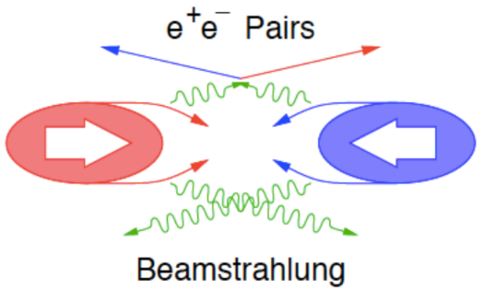
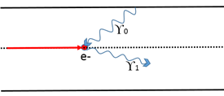
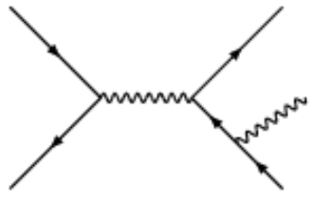
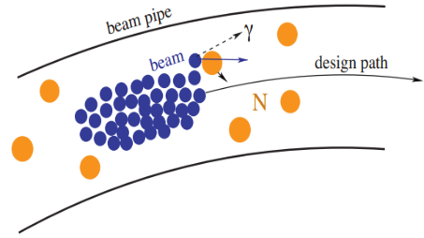
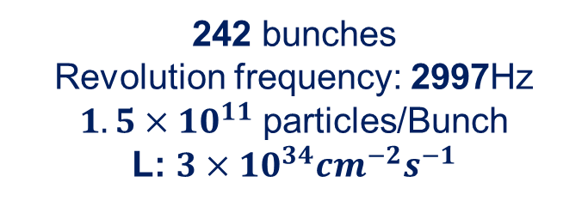
Beam Loss Backgrounds at IP
242 bunches
Revolution frequency: 2997Hz
$1.5×{10}^{11}$ particles/Bunch
L: $3×{10}^{34}{cm}^{−2}s^{−1}$
IP1
Beam-Thermal photon
scattering
Beamstrahlung
Beam Lost Particles
Energy Loss > 1.5%
(energy acceptance)
IP3
Radiative Bhabha
scattering
Beam-Gas
Scattering

Slide 22
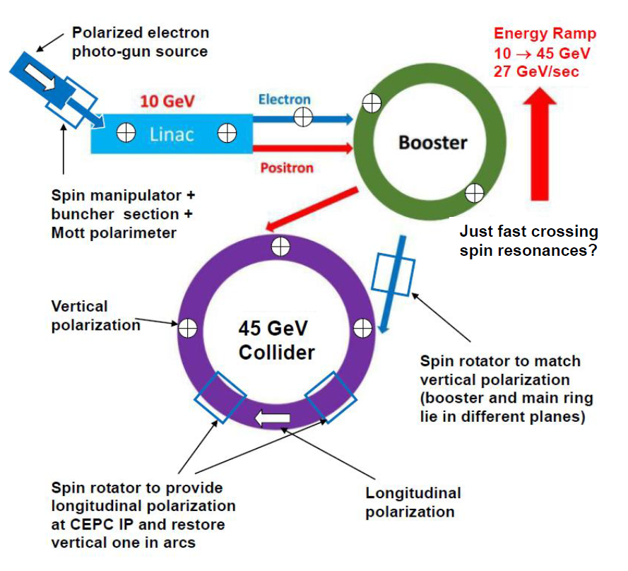
Preliminary Study for CEPC Z-pole Polarization
Longitudinal polarization of electrons
S. Nikitin

Slide 23
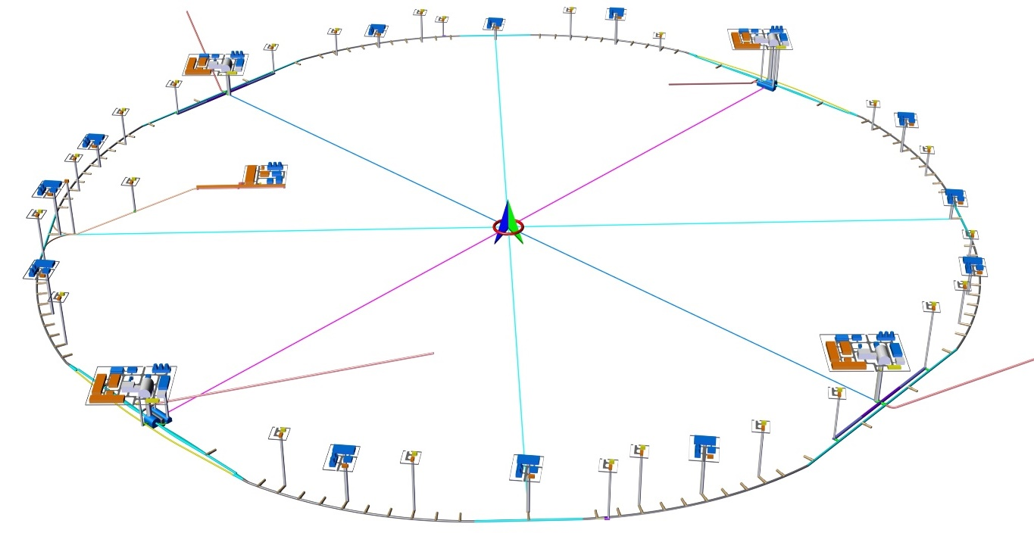
Civil Engineering Design
01. General Layout
3.24km
3.32km
LSS4
IP4
1.20km
IP1
LINAC
1.20km
BTL
LSS1
LSS3
1.20km
IP3
IP2
3.24km
3.32km
10.2km
L=99.67km
LSS2
1.20km

Slide 24

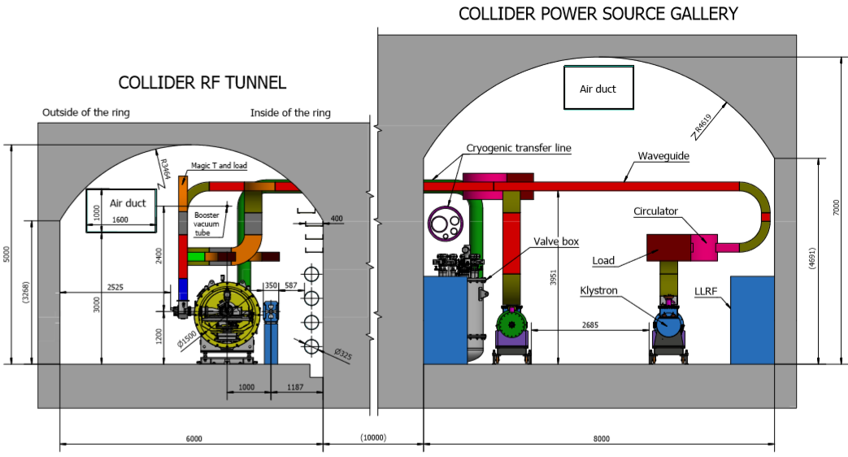
CEPC Tunnel Cross Sections, Arc and SCRF Regions
IP2 / IP4--SCRF region
Notes:
IR is arranged at IP1/IP3, with the length of 3320.00m for each one. The sections from the intersections of tunnels in the IR and tunnels at the curve sections to the zones within 1532.00m of both sides of halls are linear sections with the width ranging from 6.00m~10.74m and the height of 5.00m. At these linear sections, the routing direction of tunnel will be adjusted according to booster line and transfer lines. The zones within 1532.00m of both sides of halls are divided into two tunnels respectively for arranging positive / negative electron beam and booster beam . The tunnel for arranging positive / negative electron beam is 6.00m~11.40m wide, 4.50m high and 1509.30m long (single side). The tunnel for arranging booster line is 3.50m wide, 3.50m high, and 3018.60m long. The dimension of tunnel section is determined with consideration given to local control, electrical, beam measurement, vacuum and cooling equipment as well as requirements of passage of personnel and maintenance .

Slide 25
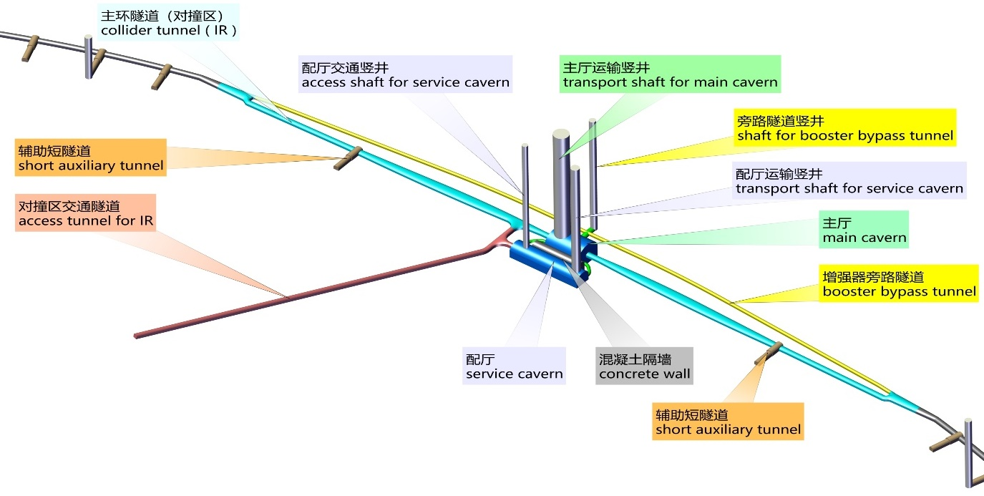
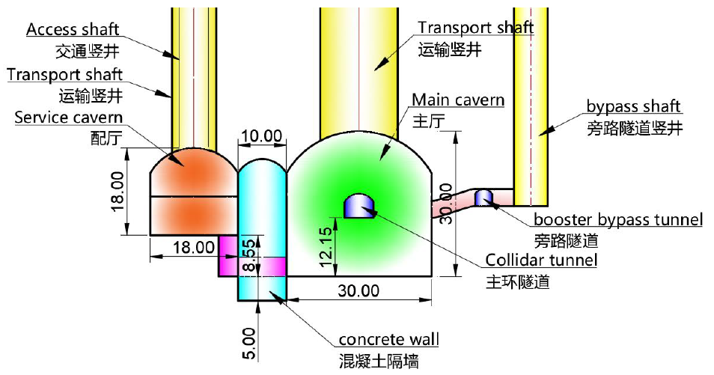
CEPC Tunnel in Detector Region
IP1 / IP3
3.32km
6.0~11.4x4.5
3.02km
3.5x3.5

Slide 26
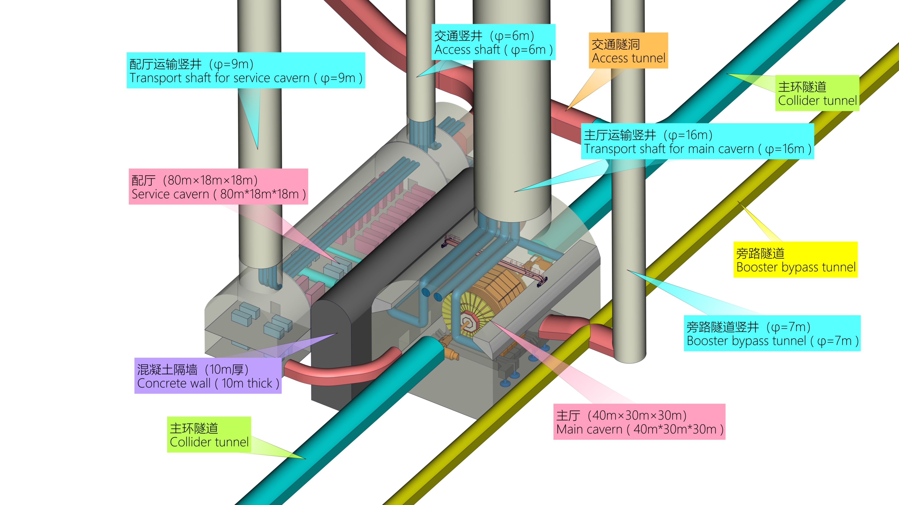
CEPC Detector Hall Area

Slide 27
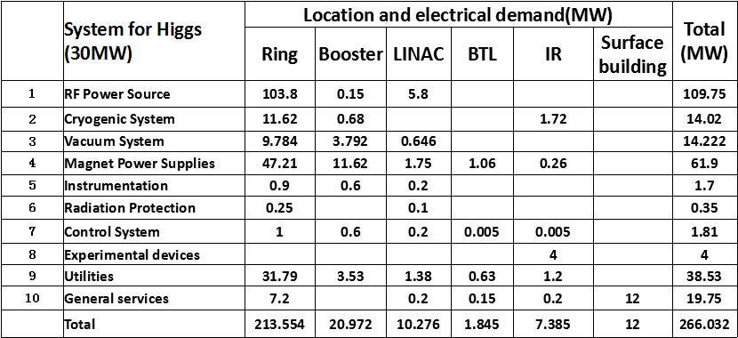
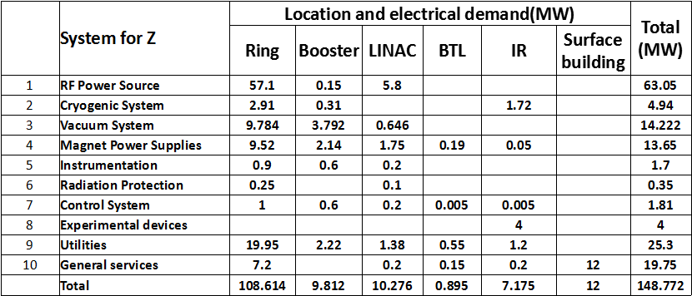
Power for Higgs and Z
Fermilab
with Tevatron
58MW
CERN-2012
LHC@3.5TeV
183MW
266MW
149MW

Slide 28
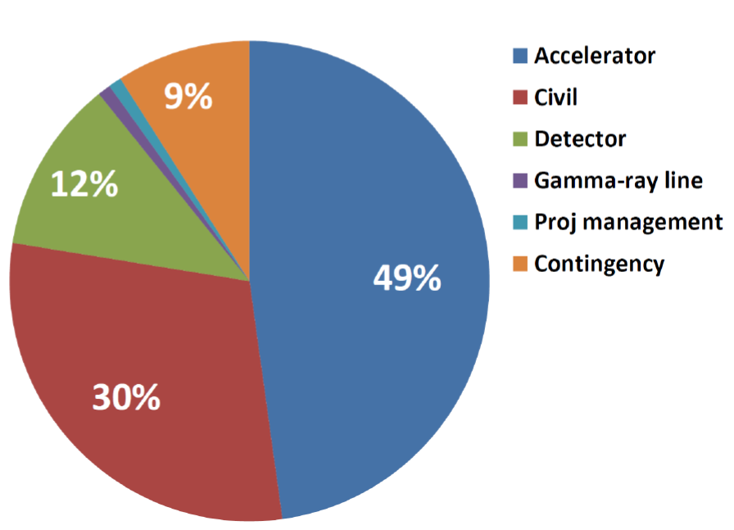
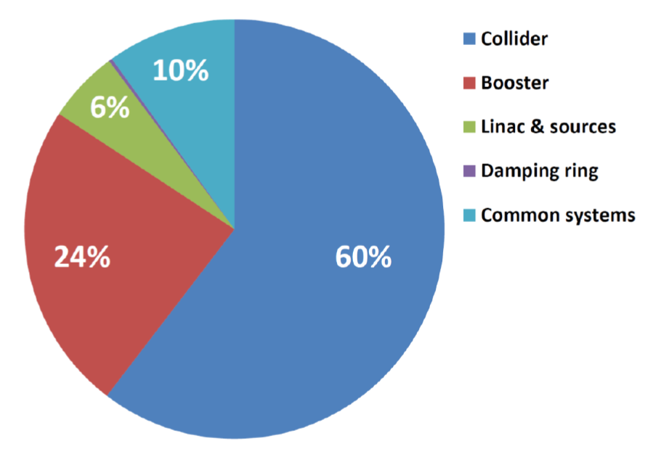
Cost Breakdown

Slide 29
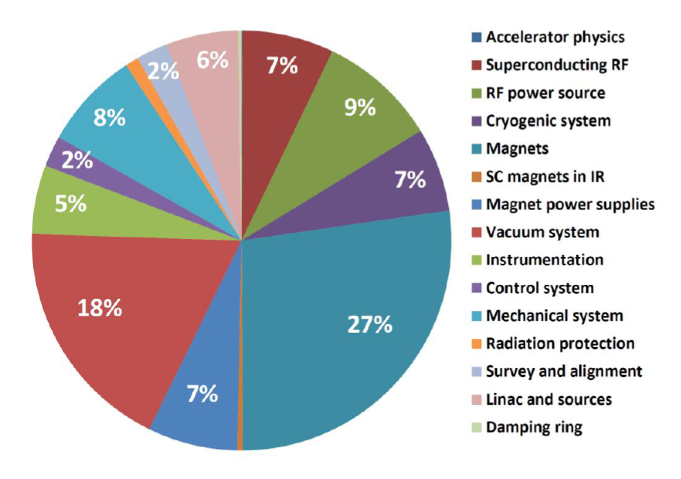
Cost Breakdown (cont)
LINAC
SRF
RF Power Source
Mechanical
Instrumentation
Cryogenic
Vacuum
Magnets
Magnet Power Supply

Slide 30
Conclusions
CEPC Accelerator CDR has been completed (formally released on Sept 2, 2018, after international review in June 2018) with all systems reaching the CDR design goals
CEPC MDI Design has been done in CDR with more detaied designs underway
CEPC civil engineering design has been done in CDR with detector
hall and tunnels
CEPC Z-pole polarization option has been preliminarily studied and in next years after CDR, a baseline of CEPC Accelerator Design with
Z-pole polarization will be given with the fund from MOST (II)

Slide 31
Further reading references:
CEPC-SppC CDR http://cepc.ihep.ac.cn/preCDR/volume.html.
CEPC-SppC Progress Report http://cepc.ihep.ac.cn/Progress%20Report.pdf.
J Gao, 2016 IHEP-AC-LC 2016-002.
J Gao, 2017 2017 Int. J. Mod. Phys. A 32 1746003.
D Wang, 2017 Int. J. Mod. Phys. A 32 1746006.
Y W Wang, 2017 Int. J. Mod. Phys. A 32 1746004.
T J Bian, 2017 Int. J. Mod. Phys. A 32 1746009.
F Su, 2017 Int. J. Mod. Phys. A 32 1746005.
Y F Wang, FCC Week talk, Amsterdam, April, 2018.
J Gao, A milestone year for Higgs factories in Aisa. ILC Newsline, 2018, March 1 (http://newsline.linearcollider.org/2018/03/01/2018milestoneyearasia/)
J Gao, China’s bid for a circular electron-positron collider. CERN Courier, 2018, June 1, (http://cerncourier.com/cws/article/cern/71537)

Slide 32
Thanks go to
CEPC accelerator team and international collaborators
Thank you for your attention

Slide 33
Backup Slides

Slide 34
CEPC Booster SRF Parameters
10 GeV injection | H | W | Z
Extraction beam energy [GeV] | 120 | 80 | 45.5
Bunch number | 242 | 1524 | 6000
Bunch charge [nC] | 0.72 | 0.576 | 0.384
Beam current [mA] | 0.52 | 2.63 | 6.91
Extraction RF voltage [GV] | 1.97 | 0.585 | 0.287
Extraction bunch length [mm] | 2.7 | 2.4 | 1.3
Cavity number in use (1.3 GHz TESLA 9-cell) | 96 | 64 | 32
Gradient [MV/m] | 19.8 | 8.8 | 8.6
Q_{L} | 1E7 | 6.5E6 | 1E7
Cavity bandwidth [Hz] | 130 | 200 | 130
Beam peak power / cavity [kW] | 8.3 | 12.3 | 6.9
Input peak power per cavity [kW] (with detuning) | 18.2 | 12.4 | 7.1
Input average power per cavity [kW] (with detuning) | 0.7 | 0.3 | 0.5
SSA peak power [kW] (one cavity per SSA) | 25 | 25 | 25
HOM average power per cavity [W] | 0.2 | 0.7 | 4.1
Q₀ @ 2 K at operating gradient (long term) | 1E10 | 1E10 | 1E10
Total average cavity wall loss @ 2 K eq. [kW] | 0.2 | 0.01 | 0.02

Slide 35
Main Parameters of Injector Linac
Parameter | Symbol | Unit | Designed
e⁻ /e⁺ beam energy | E_{e-}/E_{e+} | GeV | 10
Repetition rate | f_{rep} | Hz | 100
e⁻ /e⁺ bunch population | N_{e-}/N_{e+} |  | > 9.4×10⁹ / >9.4×10⁹
 |  | nC | > 1.5
Energy spread (e⁻ /e⁺ ) | σ_{e} |  | < 2×10⁻³ / < 2×10⁻³
Emittance (e⁻ /e⁺ ) | ε_{r} | nm⋅ rad | < 120
Bunch length (e⁻ /e⁺ ) | σ_{l} | mm | 1 / 1
e⁻ beam energy on Target |  | GeV | 4
e⁻ bunch charge on Target |  | nC | 10
The total beam transfer efficiency from transfer line to the injection point of collider ring is higher than 90%.
The transfer efficiency can be much higher with the application of damping ring which the beam energy is 1.1GeV.

Slide 36
CEPC Booster parameters @ injection (10GeV)
 |  | H | W | Z
Beam energy | GeV | 10
Bunch number |  | 242 | 1524 | 6000
Threshold of single bunch current | μA | 25.7
Threshold of beam current (limited by coupled bunch instability) | mA | 127.5
Bunch charge | nC | 0.78 | 0.63 | 0.45
Single bunch current | μA | 2.3 | 1.8 | 1.3
Beam current | mA | 0.57 | 2.86 | 7.51
Energy spread | % | 0.0078
Synchrotron radiation loss/turn | keV | 73.5
Momentum compaction factor | 10⁻⁵ | 2.44
Emittance | nm | 0.025
Natural chromaticity | H/V | -336/-333
RF voltage | MV | 62.7
Betatron tune ν_{x}/ν_{y}/ν_{s} |  | 263.2/261.2/0.1
RF energy acceptance | % | 1.9
Damping time | s | 90.7
Bunch length of linac beam | mm | 1.0
Energy spread of linac beam | % | 0.16
Emittance of linac beam | nm | 40~120

Slide 37
CEPC Booster Parameters @ extraction
 |  | H |  |  | W | Z
 |  | Off axis injection | On axis injection |  | Off axis injection | Off axis injection
Beam energy | GeV | 120 |  |  | 80 | 45.5
Bunch number |  | 242 |  | 235+7 | 1524 | 6000
Maximum bunch charge | nC | 0.72 |  | 24.0 | 0.58 | 0.41
Maximum single bunch current | μA | 2.1 |  | 70 | 1.7 | 1.2
Threshold of single bunch current | μA | 300
Threshold of beam current (limited by RF power) | mA | 1.0 |  |  | 4.0 | 10.0
Beam current | mA | 0.52 |  | 1.0 | 2.63 | 6.91
Injection duration for top-up (Both beams) | s | 25.8 |  | 35.4 | 45.8 | 275.2
Injection interval for top-up | s | 73.1 |  |  | 153.0 | 438.0
Current decay during injection interval |  | 3%
Energy spread | % | 0.094 |  |  | 0.062 | 0.036
Synchrotron radiation loss/turn | GeV | 1.52 |  |  | 0.3 | 0.032
Momentum compaction factor | 10⁻⁵ | 2.44
Emittance | nm | 3.57 |  |  | 1.59 | 0.51
Natural chromaticity | H/V | -336/-333
Betatron tune ν_{x}/ν_{y} |  | 263.2/261.2
RF voltage | GV | 1.97 |  |  | 0.585 | 0.287
Longitudinal tune |  | 0.13 |  |  | 0.10 | 0.10
RF energy acceptance | % | 1.0 |  |  | 1.2 | 1.8
Damping time | ms | 52 |  |  | 177 | 963
Natural bunch length | mm | 2.8 |  |  | 2.4 | 1.3
Injection duration from empty ring | h | 0.17 |  |  | 0.25 | 2.2

Slide 38
CEPC MDI Parameters
 | range | Peak filed in coil | Central filed gradient | Bending angle | length | Beam stay clear region | Minimal distance between two aperture | Inner diameter | Outer diameter | Critical energy (Horizontal) | Critical energy (Vertical) | SR power (Horizontal) | SR power (Vertical)
L* | 0~2.2m |  |  |  | 2.2m
Crossing angle | 33mrad
MDI length | ±7m
Detector requirement of opening angle | 13.6˚
QD0 |  | 3.2T | 136T/m |  | 2m | 19.51mm | 72.61mm | 40mm | 53mm | 1.3MeV | 527keV | 639W | 292W
QF1 |  | 3.8T | 110T/m |  | 1.48m | 26.85mm | 146.2mm | 56mm | 69mm | 1.6MeV | 299keV | 1568W | 74W
Lumical | 0.95~1.11m |  |  |  | 0.16m |  |  | 57mm | 200mm
Anti-solenoid before QD0 |  | 7.26T |  |  | 1.1m |  |  | 120mm | 390mm
Anti-solenoid QD0 |  | 2.8T |  |  | 2m |  |  | 120mm | 390mm
Anti-solenoid QF1 |  | 1.8T |  |  | 1.48m |  |  | 120mm | 390mm
Beryllium pipe |  |  |  |  | ±7cm |  |  | 28mm
Last B upstream | 67.66~161.04m |  |  | 1.1mrad | 93.38m |  |  |  |  | 45keV
First B downstream | 46.06~107.04m |  |  | 1.54mrad | 60.98m |  |  |  |  | 97keV
Beampipe within QD0 |  |  |  |  | 2m |  |  |  |  |  |  | 2.9W
Beampipe within QF1 |  |  |  |  | 1.48m |  |  |  |  |  |  | 3.1W
Beampipe between QD0/QF1 |  |  |  |  | 0.23m |  |  |  |  |  |  | 36.2W
The superconducting magnet parameters are same in tt and higgs.

Slide 39
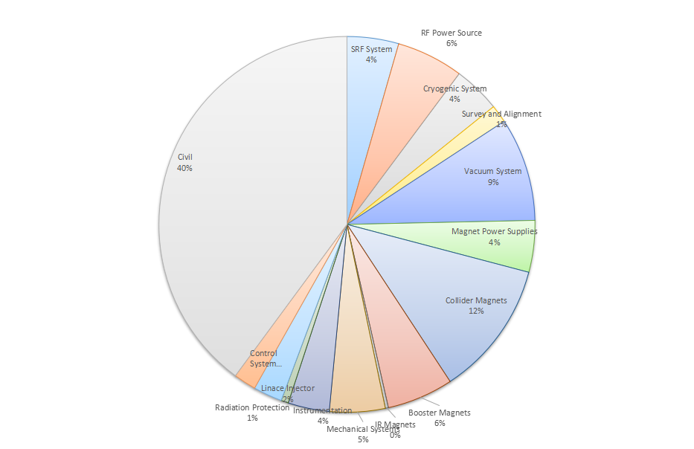
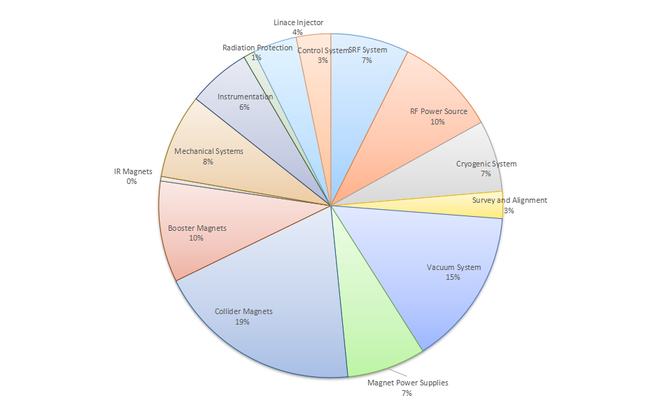
CEPC Cost Breakdown (no detectors)
Including civil cost
Without including civil cost

Slide 40
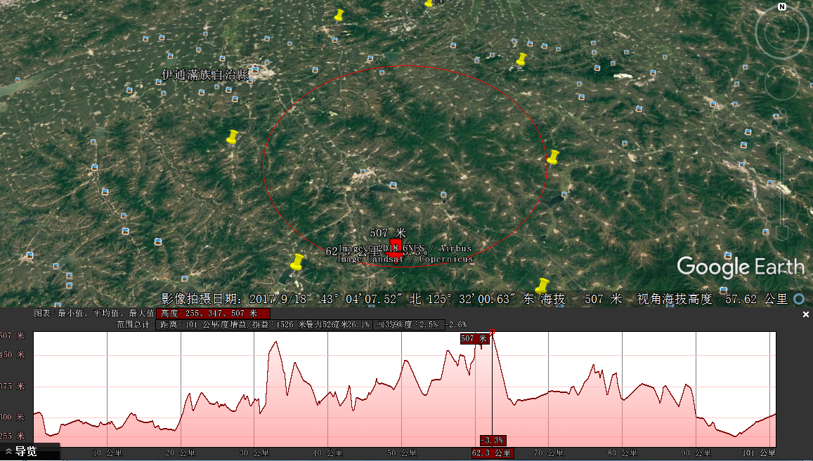
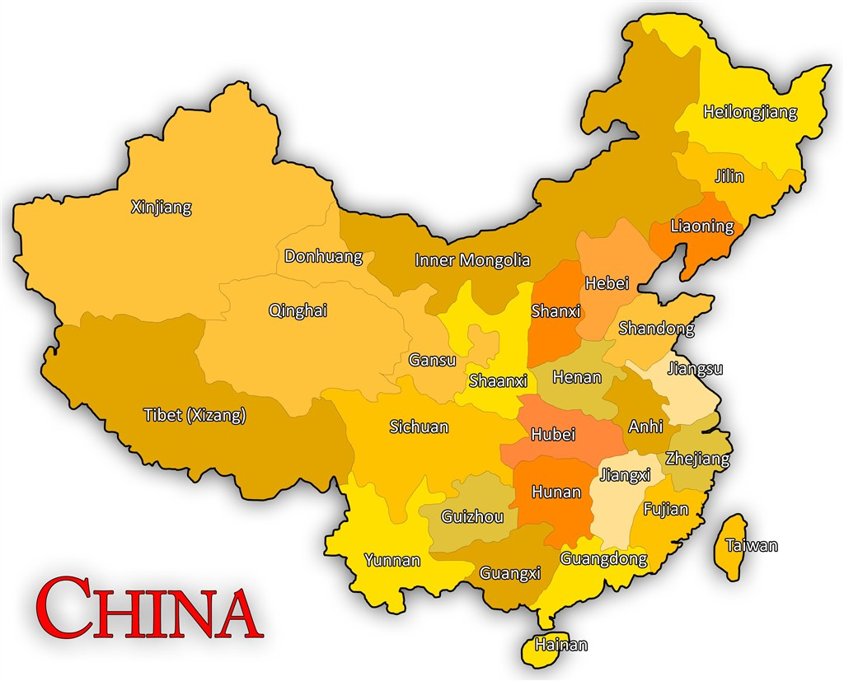
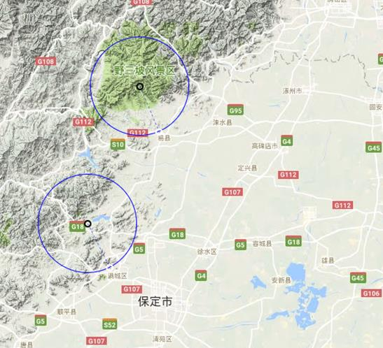
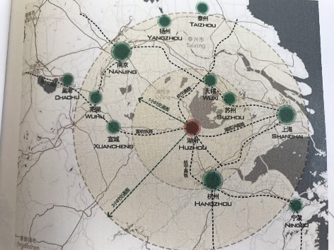

CEPC Site Selections
6
1
1)
4
4
2
2)
5
1) Qinhuangdao, Hebei Province（Completed in 2014）
2) Huangling, Shanxi Province（Completed in 2017)
3) Shenshan, Guangdong Province(Completed in 2016)
4) Baoding (Xiong an), Hebei Province (Started in August 2017)
5) Huzhou, Zhejiang Province (Started in March 2018)
6) Chuangchun, Jilin Province (Started in May 2018)
3)
3

Slide 41
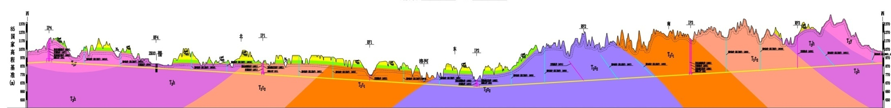
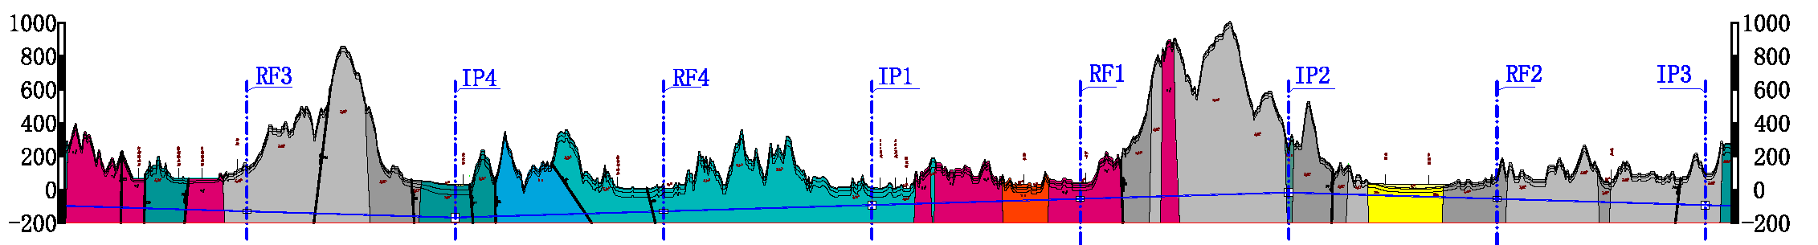
Item | Huangling | Shen-Shan | Funing
Project layout
Construction difficulty | Moderate | Relatively difficult | Relatively easy
Huangling（100km）
Shen-Shan（100km）
Funing（100km）
Notes:
Huangling: The site is mainly on the loess plateau. The buried depth of the tunnel and the depth of the shafts are quite different. The construction access layout is relatively simple.
Shen-Shan: The site is mainly the low mountain area. The buried depth of the tunnel and the depth of the shafts are large, and the construction access layout is relatively complicated.
Funing: The site is generally the low hilly areas; underground burial depth is not big; the construction site conditions are better; the construction access layout is relatively simple.

Slide 42




3 Project Layout and Preliminary Scheme
CEPC CDR Civil Enginnering Design (Funing 100km, example)

Slide 43

CEPC Detector Hall Area-2

Slide 44

CEPC Detector Hall Area-3

Slide 45






IR Mechanics Assembly
RVC whole layout
RVC head
RVC tail

Slide 46
Plan & Progress
3 design schemes for high efficiency design
  Scheme 1：optimize cavity chain by using the same gun as 1st tube;
  Scheme 2 ：with high voltage gun (110kV/9.1A), low perveance;
  Scheme 3：MBK, 54kV/20A electron gun
Parameter | Scheme1 | Scheme2 | Scheme3
Freq (MHz) | 650 | 650 | 650
Voltage (kV) | 81.5 | 110 | 54
Current (A) | 15.1 | 9.1 | 20(2.5×8)
Beam No. | 1 | 1 | 8
Perveance (µP) | 0.65 | 0.25 | 1.6(0.2×8)
Efficency (%) | >70 | >80 | >80
Power(kW) | 800 | 800 | 800(100×8)

Slide 47
1 group 1 day can alignment 2 difficult components / 4 common components.
If 1 group 1 day alignment 3 components, it will take 1 group 17057 days to finish 51170 components alignment
The total length of tunnel control network is about 101610m.
1 group 1 day can measure 4 stations+4 stations repeat measurement, the length of 4 stations is about 24m.
It will take 1 group 4234 days to finish tunnel control network survey.
How many time spend for alignment depends on how many groups we can have.

Slide 48


Key techniques and researches
Develop automatic observation system to improve tunnel survey efficiency
Integrates an automatic mobile platform and an vision instrument.
The automatic mobile platform mainly includes an omnidirectional mobile module, an elevating module, a self-balancing module, a power supply module and some control modules. It can be guided by a reflective stripe on the tunnel ground and provides a suitable position for vision instrument measurement.
Automatic observation system
Trace

Slide 49



（1）Critical technical problems
Comprehensive exploration technology for long distance complicated underground engineering.
Prevention and treatment technology study for underground water.
The design and construction of long distance tunnel under complicated geographical conditions and large-span underground caverns.
The construction management of complicated underground engineering.
Integration of long distance tunnel ventilation, ventilation and air conditioning system and smoke control system.
The development, manufacturing and application of TBM.

Slide 50



The waterproofing grade of underground caverns of the Project is Grade I.
Waterproof materials include waterproof membrane, waterproof coating, rigid waterproof material, and concrete admixture etc.
The study in the next stage will focus on new types of waterproof materials, which meet the waterproofing engineering requirements and are at lower costs.
Waterproof Study

