Slide 1
中微子散射信号模拟
刘金昌 魏玉婷

Slide 2
baseline
Neutrino flux → neutrino scatting spectrum with Ar → ee spectrum
→put it into detector →dual phase e- spectrum
Detector: 200kg Active LAr( D=56cm, H= 56cm)
探测器几何以及一些参数检验魏玉婷上周已经做过报告
Based on DS programme

Slide 3
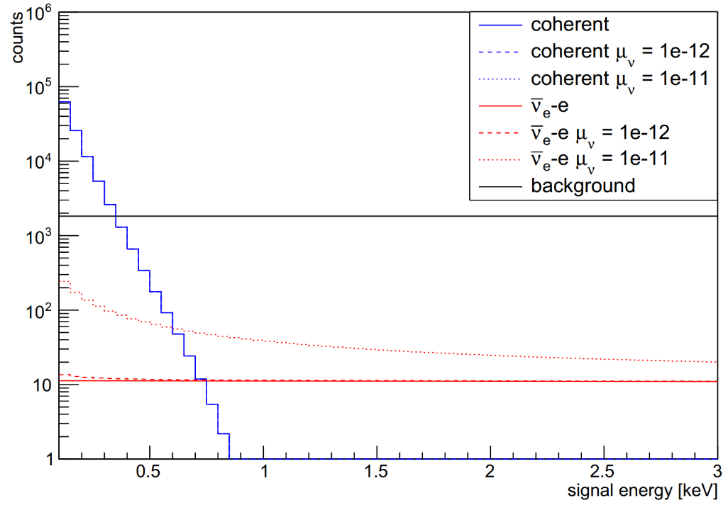
能谱与截面
Es: 1.76652 /day
Coherent: 302.929 /day
BG: 290 /day

Slide 4
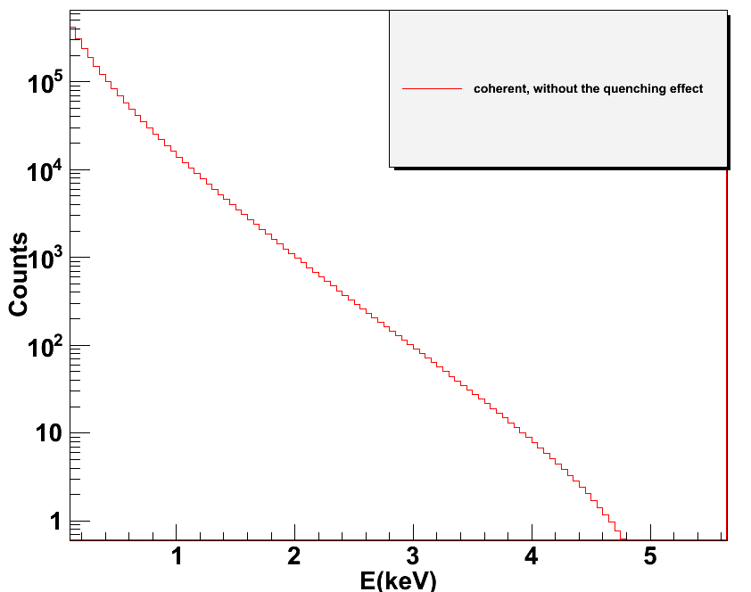
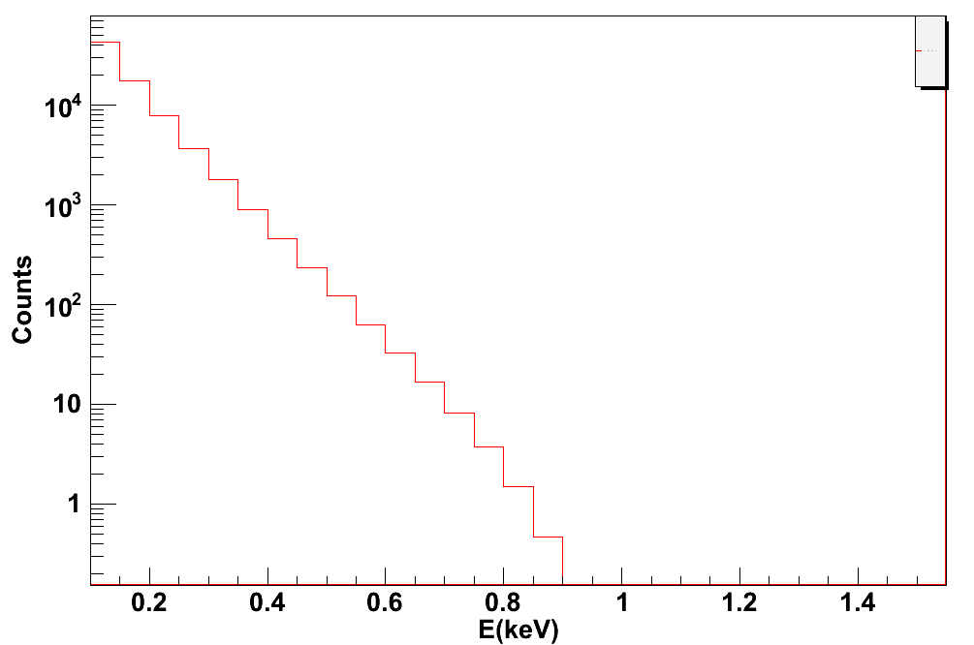
Neutrino scatting spectrum
Nr
ee
Qf=1/5.6

Slide 5
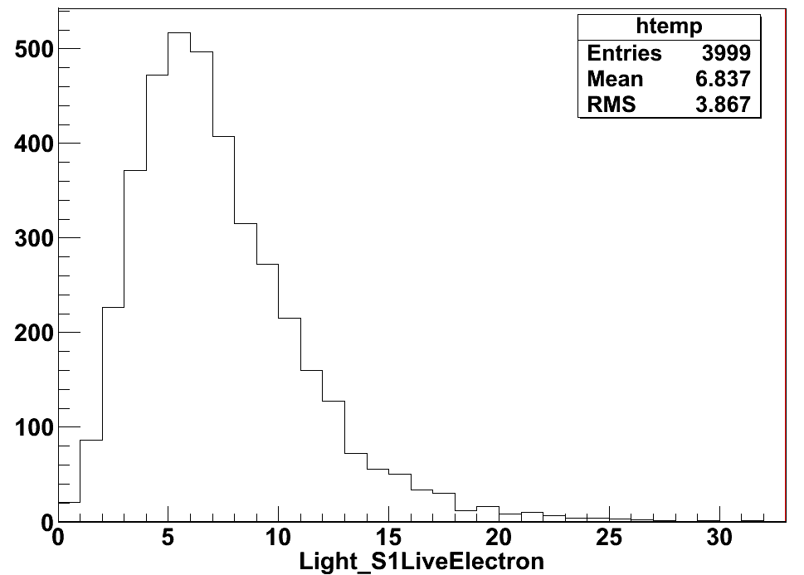
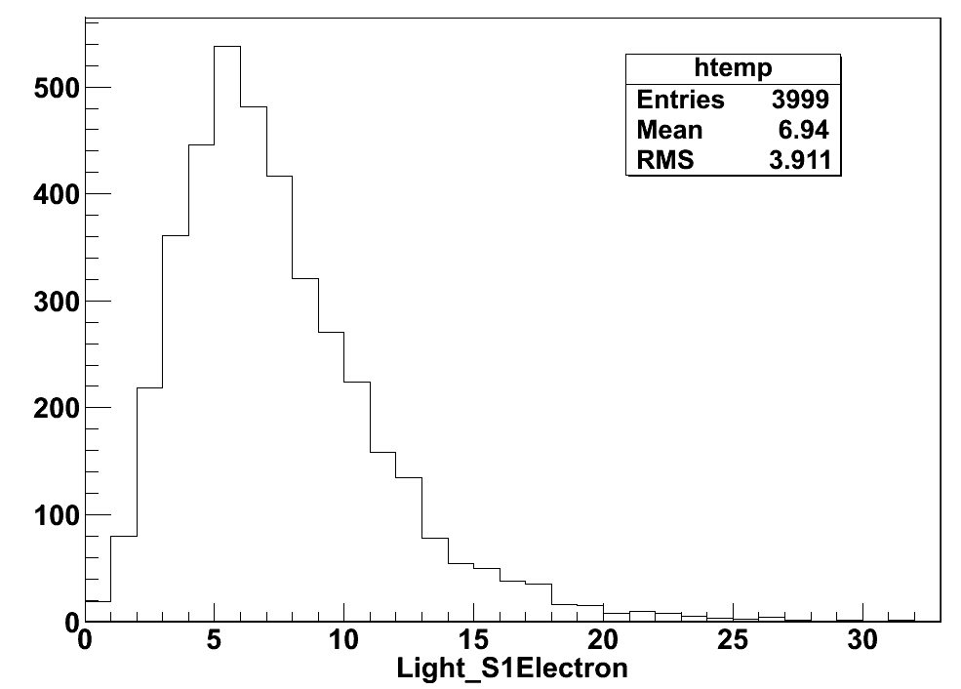
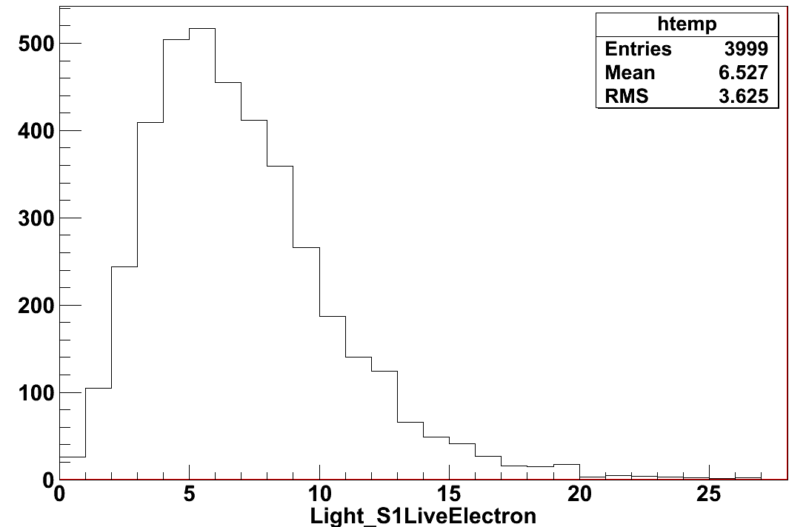
electrons
V=1500V
P(0,0,0)
15.8ms
After drift
5ms
Before drift

Slide 6
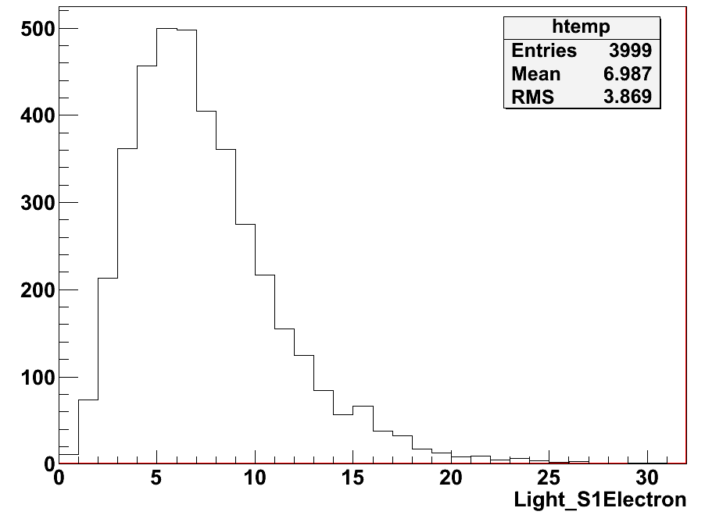
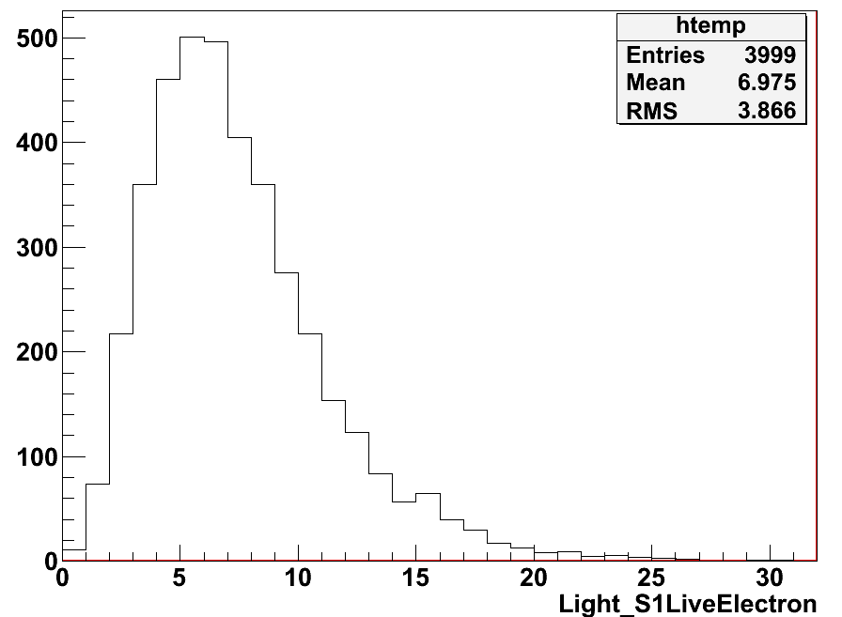
Position (1cm to top)
Before drift

Slide 7
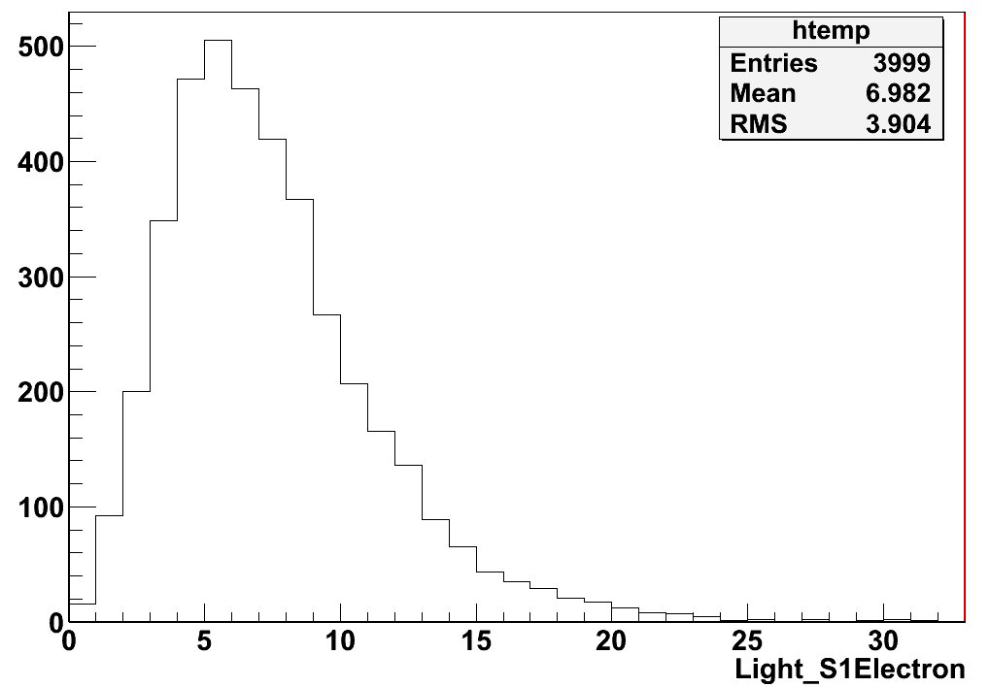
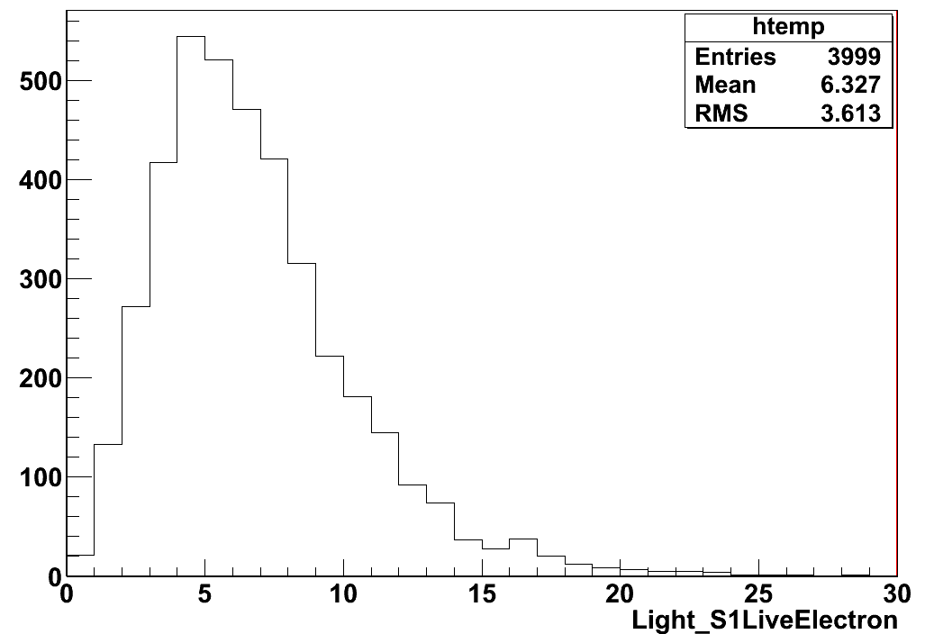
Position (55cm to top)
Before drift

Slide 8
Parameters:
Electrons number -- drift time( e- life , drift distance, drift V )
Drift V (temperature, E)

Slide 9
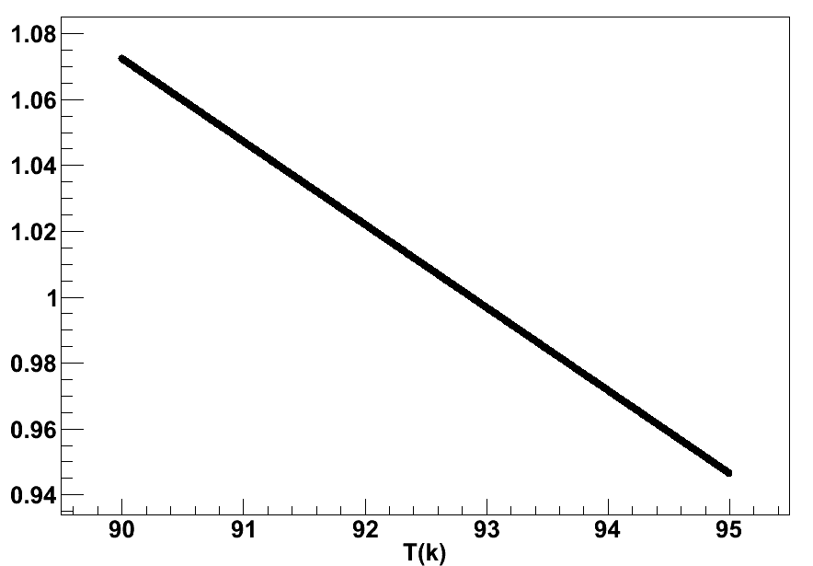
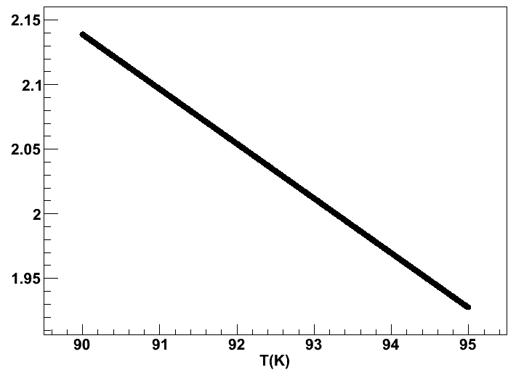
Temperature factor for drift V
V=1200V/cm
V=200V/cm

Slide 10
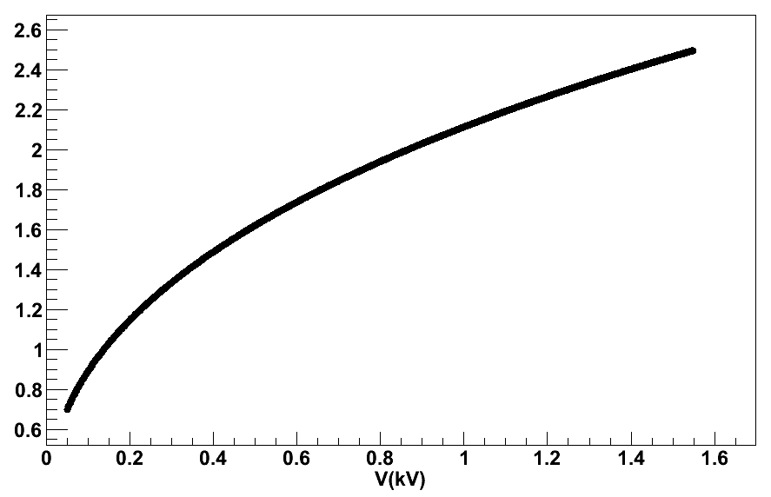
E factor for Drift V

Slide 11
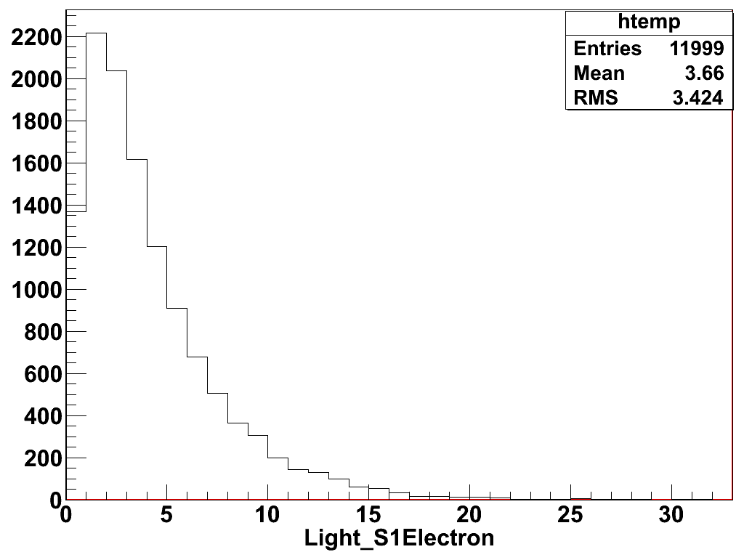
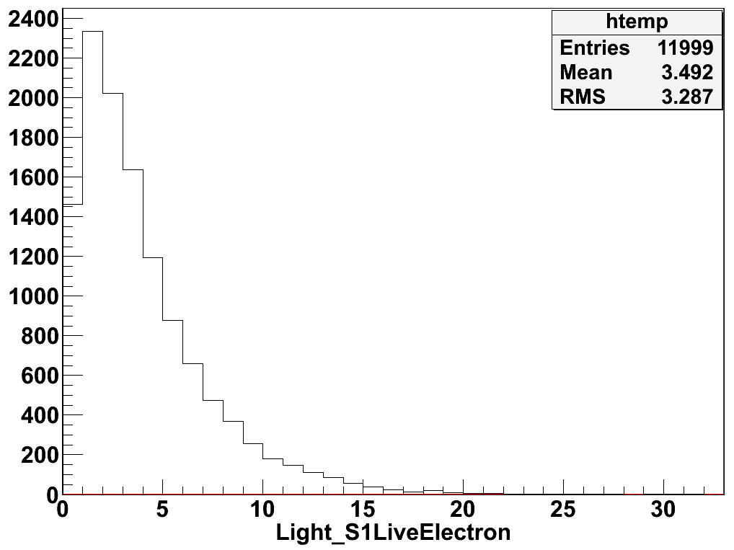
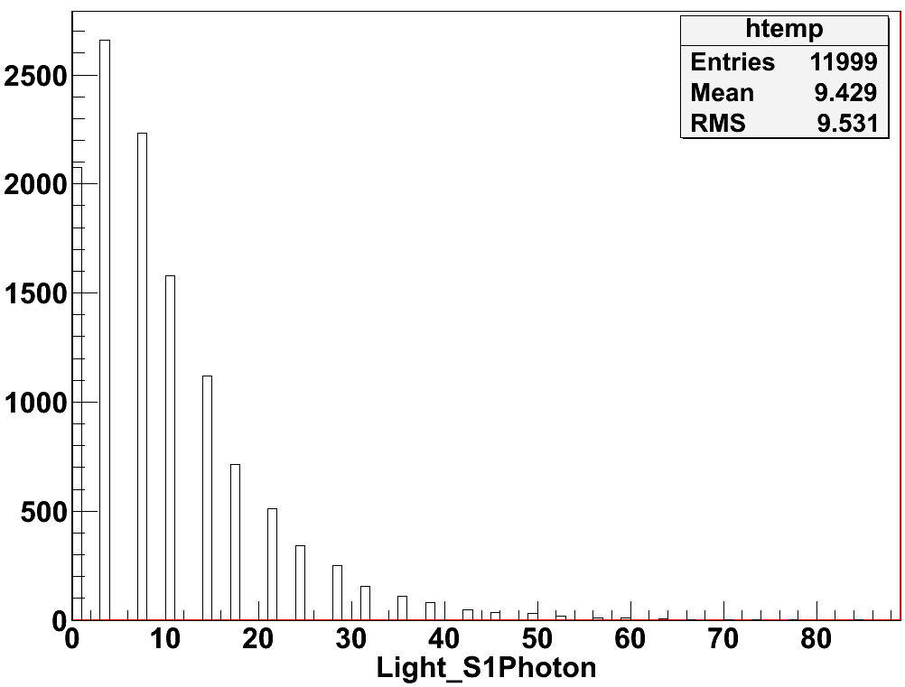
Energy lower limit to 0.02keV
After drift
P(0,0,0)
Electron life :5ms

Slide 12
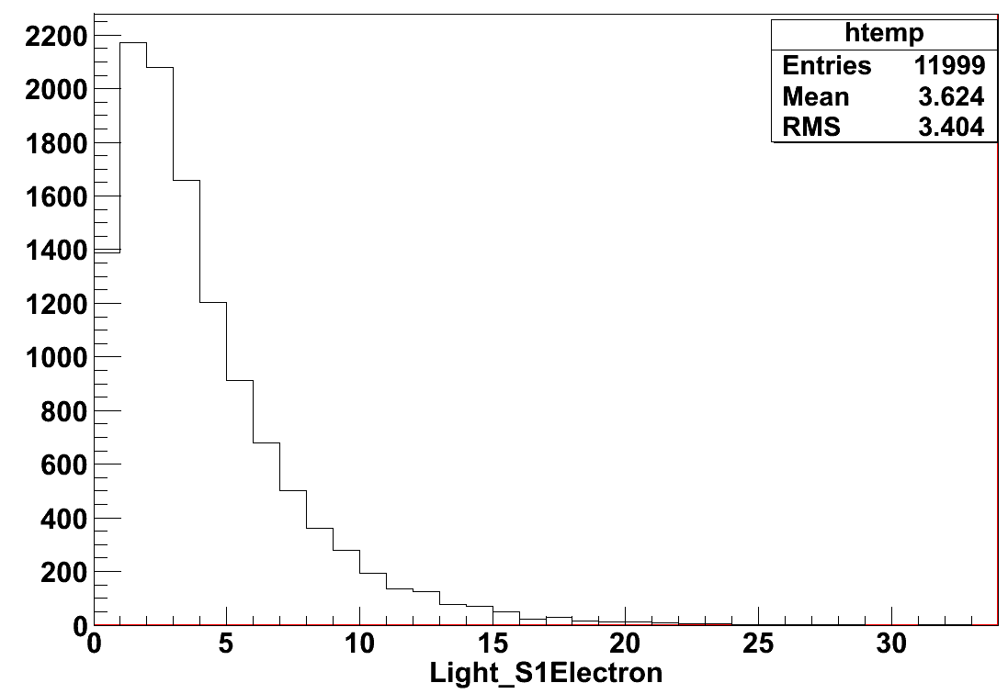
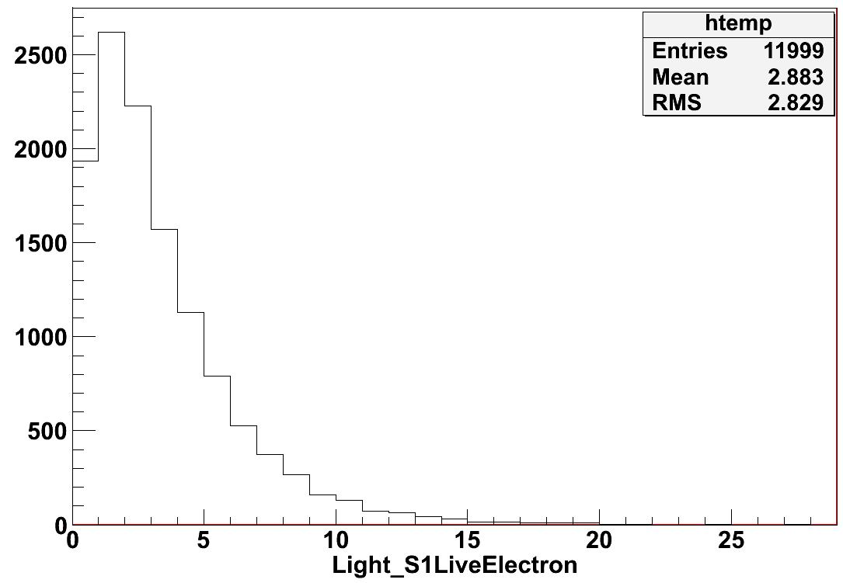
Worse conditions:
Electron life: 1ms
Before drift

Slide 13
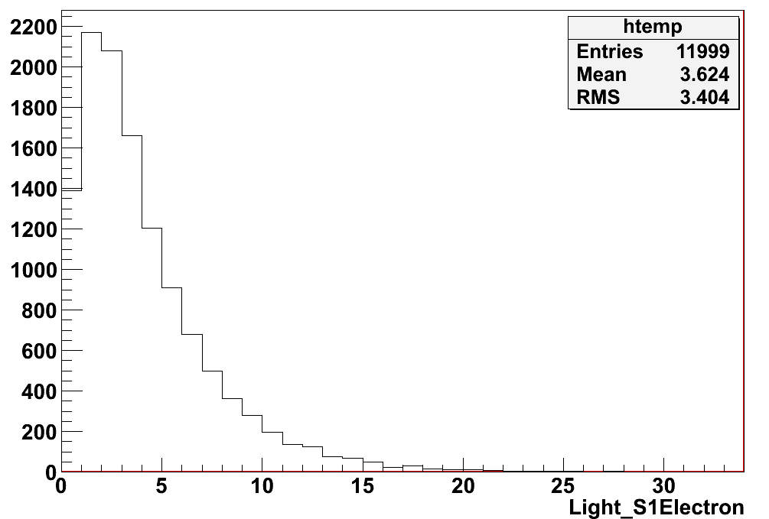
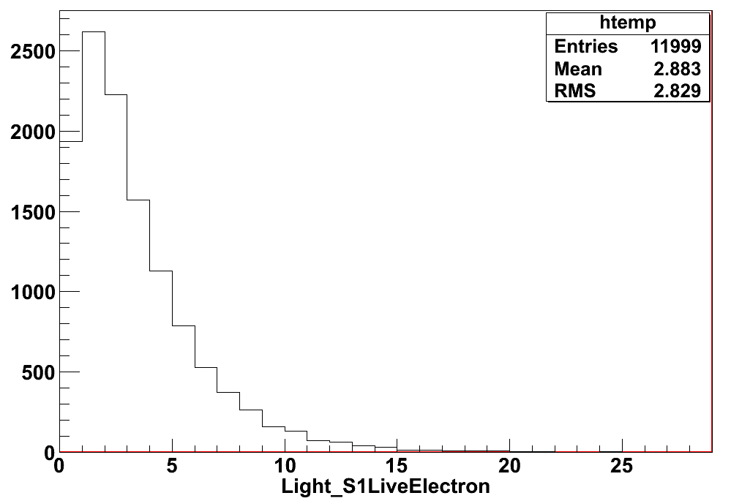
Drift V_min =Drift V(E=1500)/5
Before drift

Slide 14
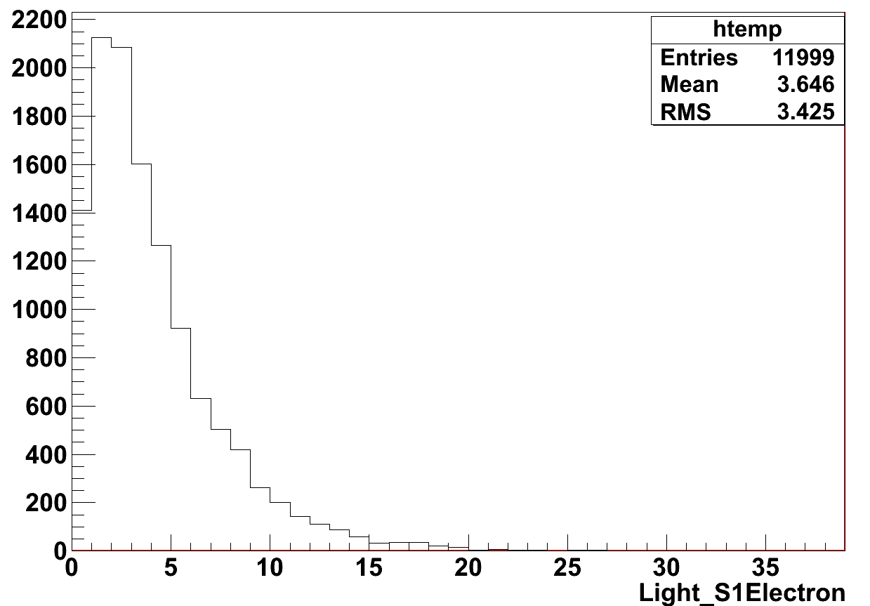
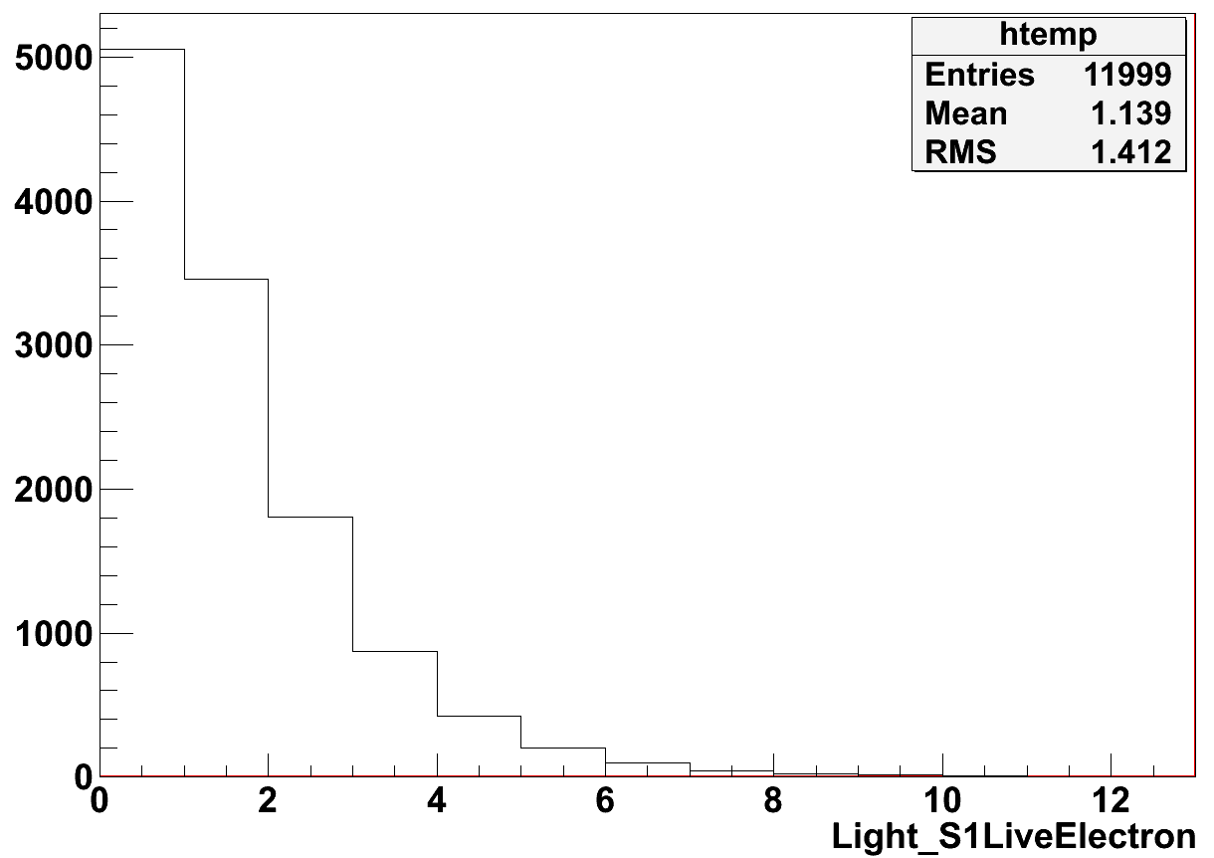
Drift V_min + electron life : 1ms
Before drift
After drift

Slide 15
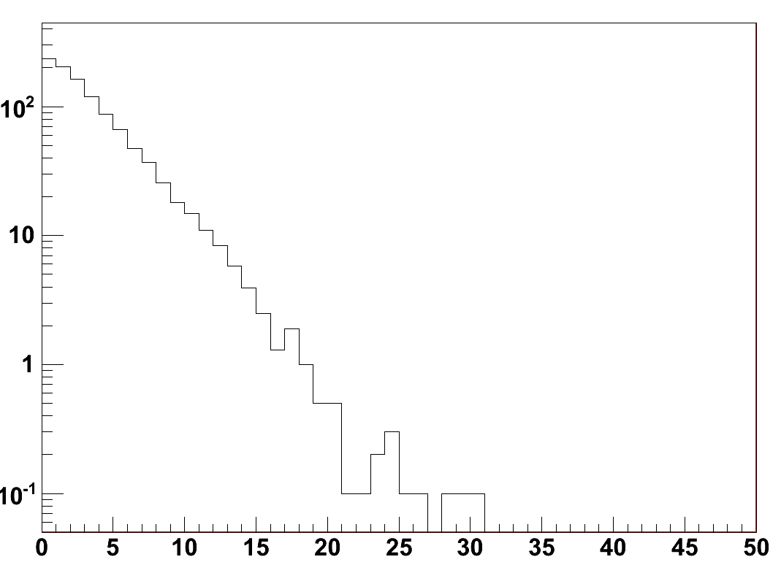
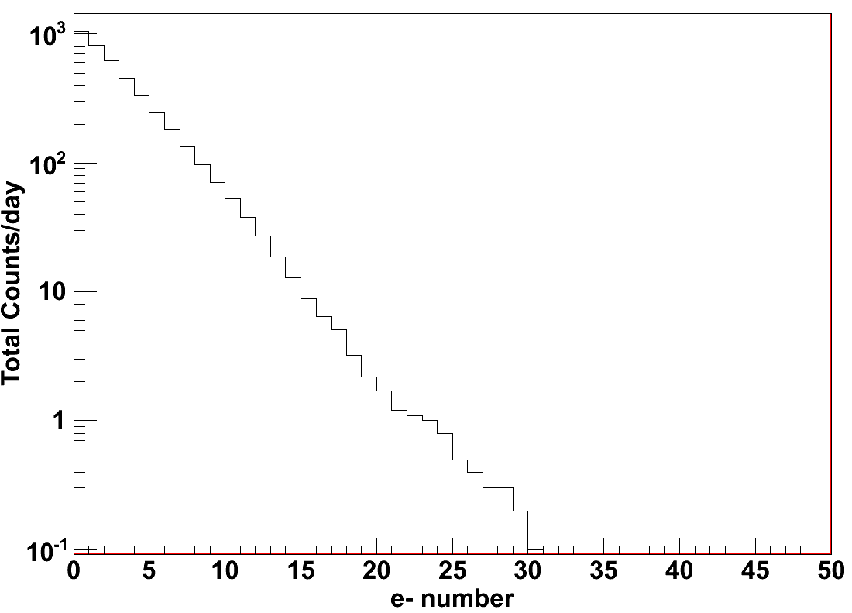
P(0,0,0) default parameters
cut
e- number

Slide 16
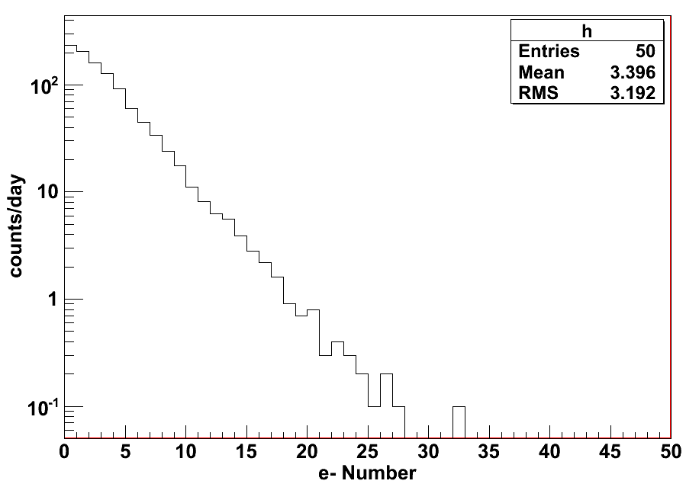
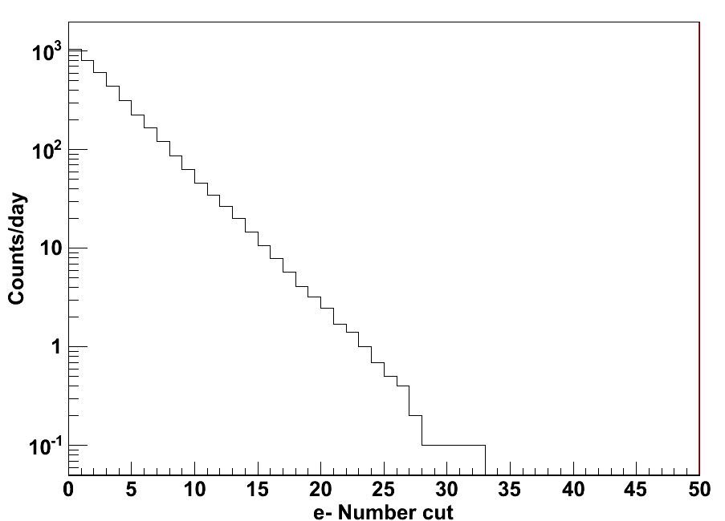
Uniform position

