Slide 1
Distinguish signal and background using simple features
Long Peixun
2018.9.20

Slide 2
Outline
Data used for machine learning
Data for training
Data for test
Data distribution analyze
Distribution display
Features will be used in machine learning
Some abnormal events
Machine learning model
Result
Test result
Curves
Background removal display
Summary

Slide 3
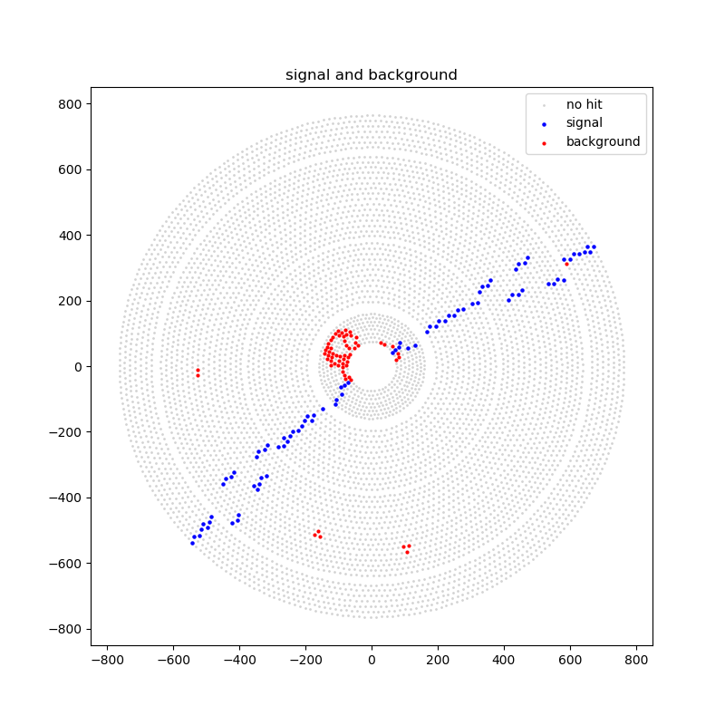
Data used for training
37169 events, $\sim 4.9×{10}^{6}$ hits.
Signal
round11, BBhabha
171208, 171209, 171210, 171211
Background
Random trigger
Runno = 52944
Mix signal and background

Slide 4
Data used for test
9276 events, $\sim 4.2×{10}^{5}$ hits.
Signal
round11, BBhabha
171212
Background
Random trigger
Runno = 52944
Mix signal and background

Slide 5
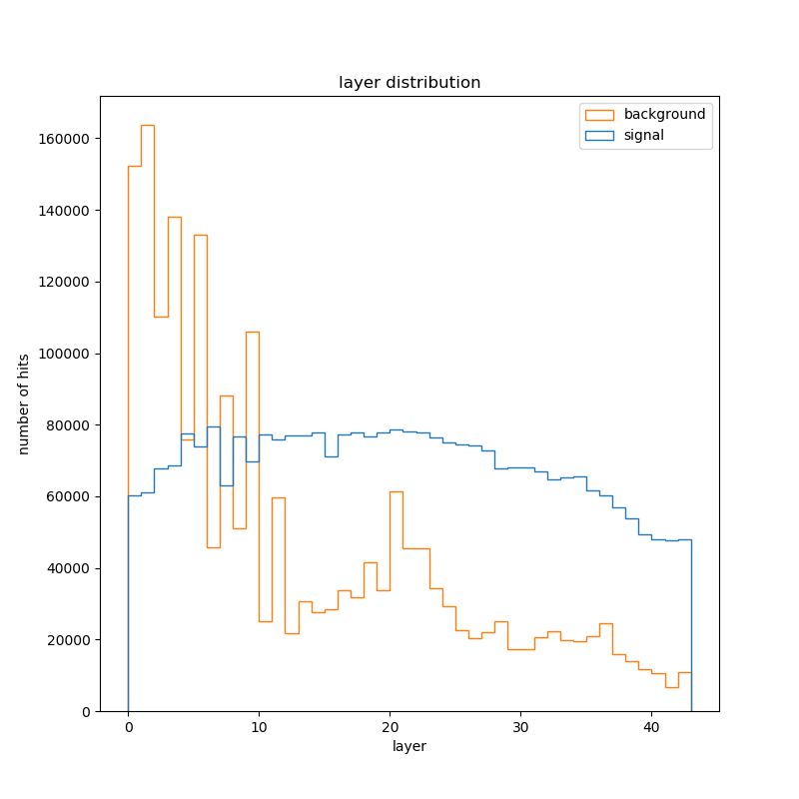
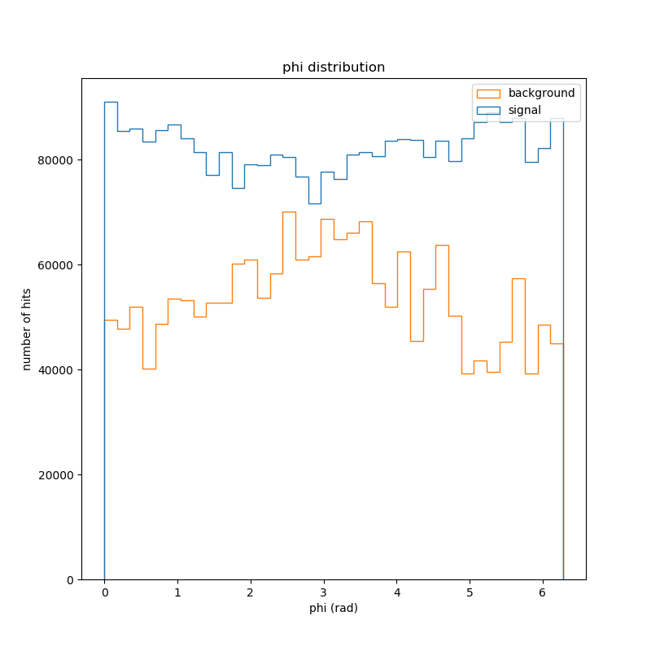
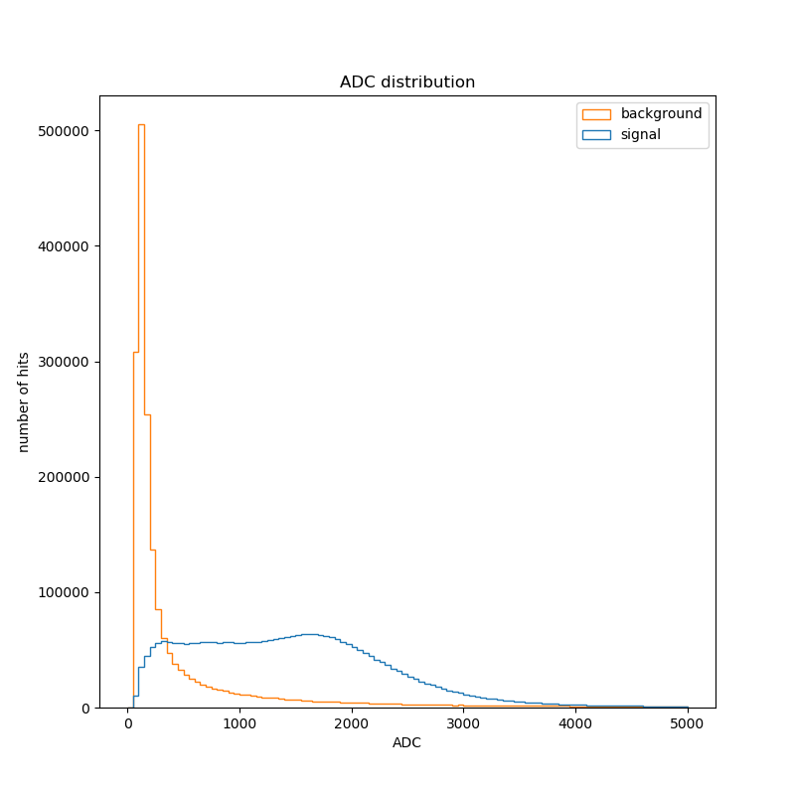
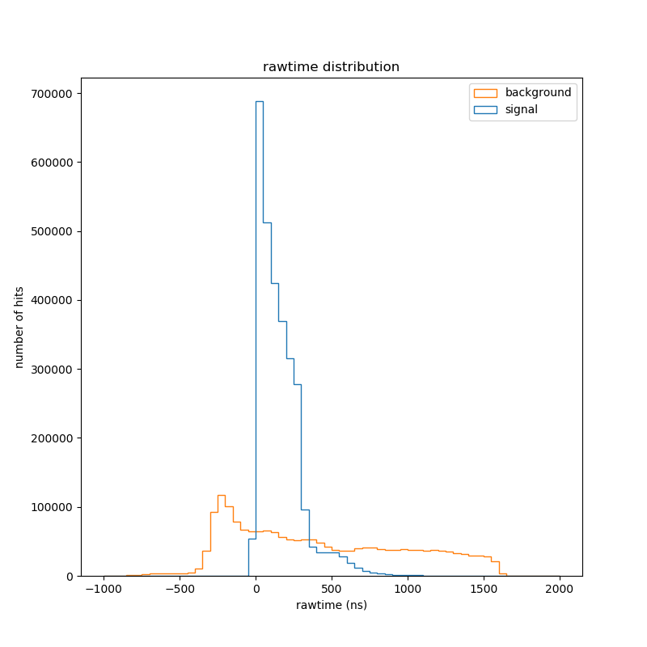
Overall distribution

Slide 6
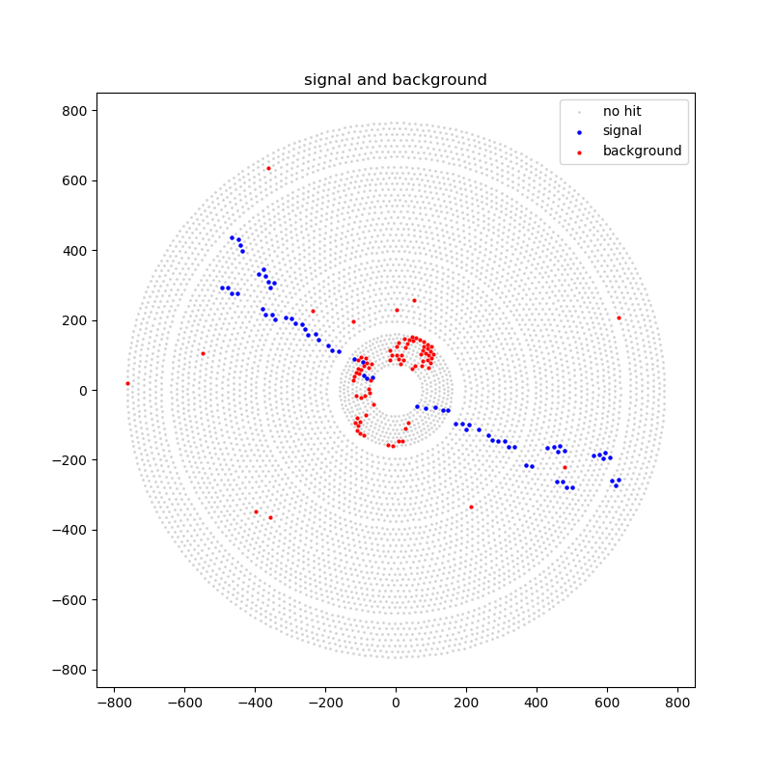
Rawtime and ADC in an event
Event ID = 38238

Slide 7
Simple features
Features will be used in machine learning
Layer
Rawtime
ADC
Only 3 features?
Use simple features as a reference for further research.

Slide 8
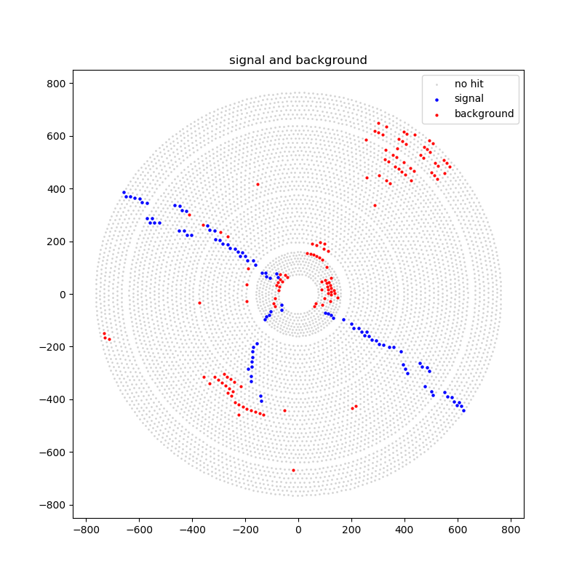
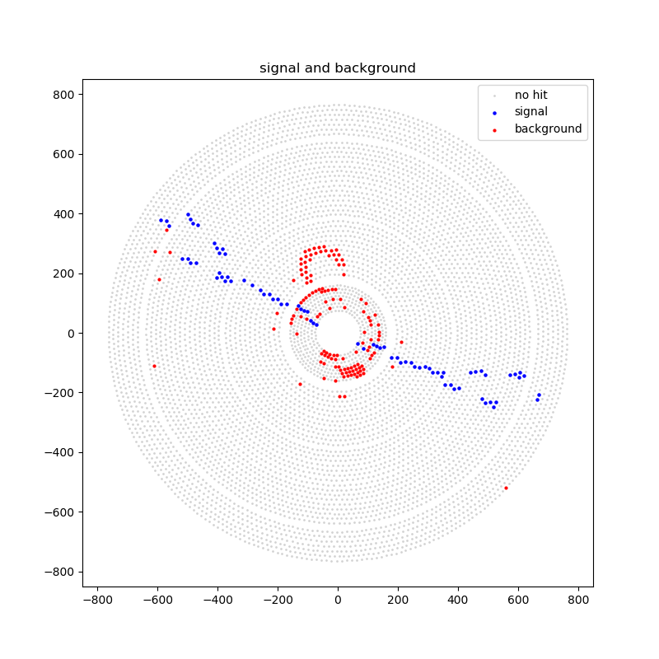
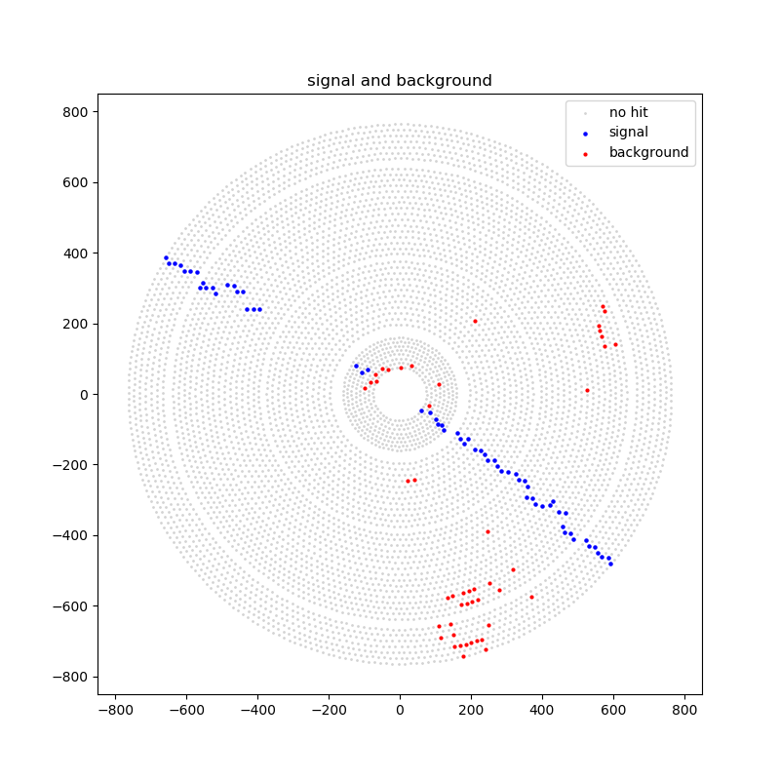
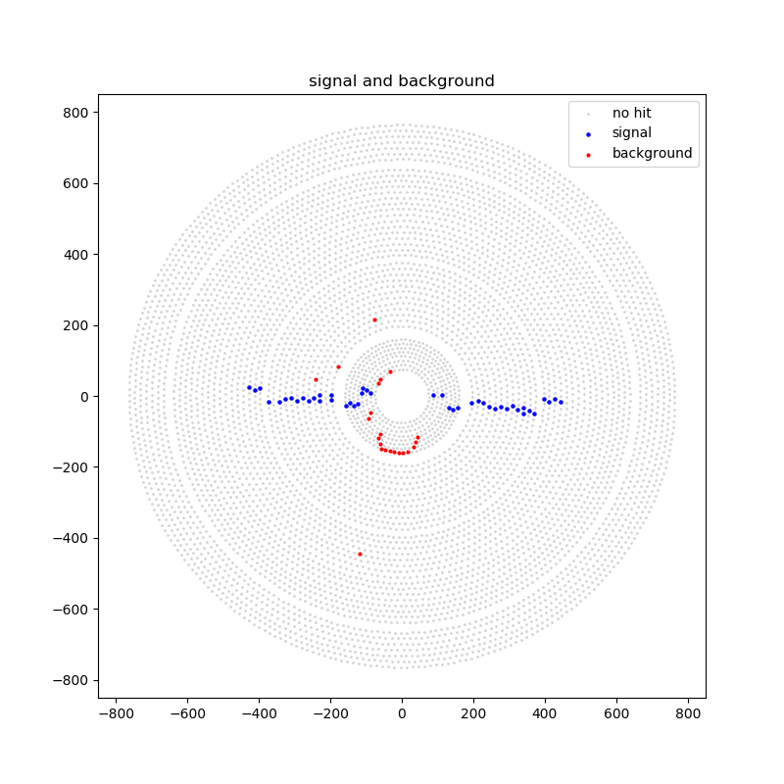
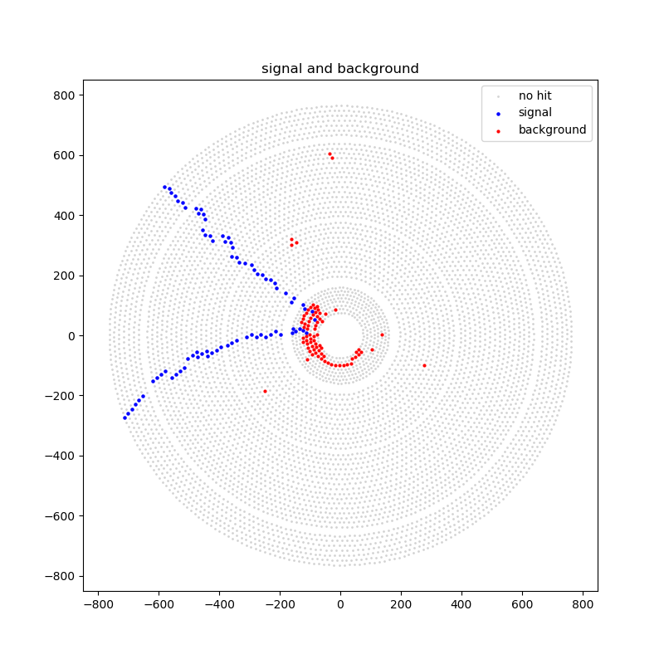
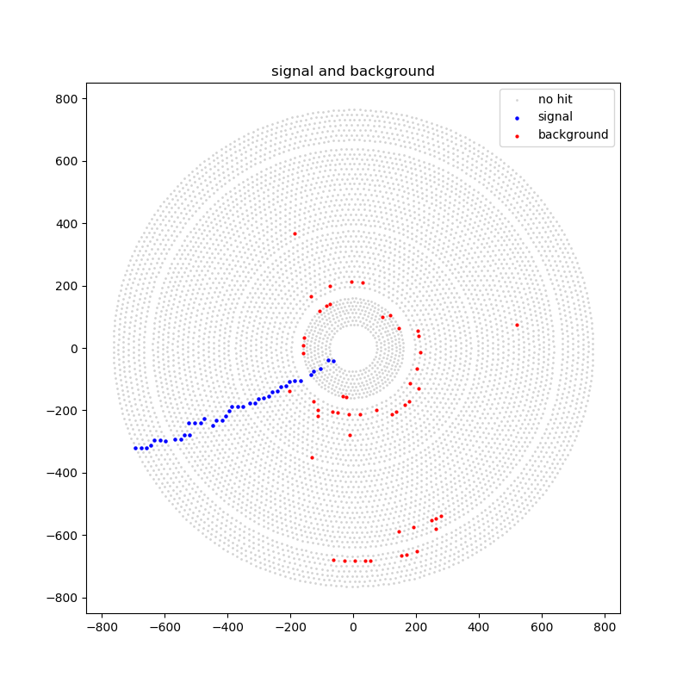
Some abnormal events

Slide 9
Machine learning model
Neural network
2 inner layers, 32 nodes per layer.
Input: 3 features (layer, rawtime, ADC)
Output: [0, 1]
Epoch = 1, batchsize = 128

Slide 10
Test Result
Require signal reserve rate (Recall) > 99%
Threshold = 0.25
Test result:
Test 1127273 samples, 822229 correct, 72.93965170814877 %
label signal: 704403 true signal: 698026
Signal reserve: 99.09469437239761 %
label background: 422870 true background: 124203
Background removal: 29.371438030600423 %
TP: 698026 FN: 6377
FP: 298667 TN: 124203

Slide 11
P-R curve and ROC curve
P-R curve
ROC curve

Slide 12
Background Removal – Signal Reserve

Slide 13
Background removal display
Evend ID = 31213

Slide 14
Background removal display
Evend ID = 40525

Slide 15
Background removal display
Evend ID = 218346

Slide 16
Summary
Just using simple features, the background removal effect is not good (~30%).
Next plan
Use “clearer” training data.
Consider more features, for example, neighbors’ features.
Use “clustering” to get overall structure of each event.
Cross validation.

