Slide 1
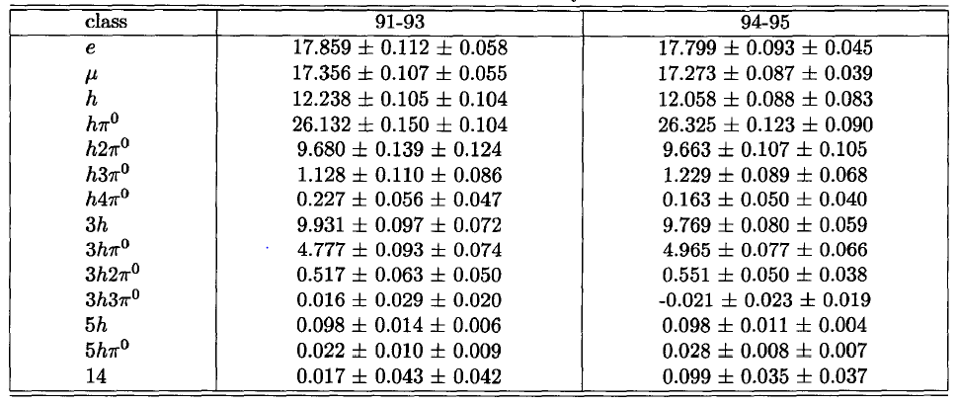
LEP上tau decay branching ratio的结果

Slide 2
利用Arbor的PID进行简单的tau decay branching测量
利用重建出的光子个数计算pi0的数目
0 photon->0 pi0
1-2photon->1 pi0
3-4photon->2 pi0
Sample 进行了初步的预选，所有存在非来自pi0的光子的事例均被剔除
角度限制在桶部
mis-id NUM | e(MC) | mu | h | hpi | h2pi | h3pi | h4pi | 3h | 3hpi | 3h2pi | 3h3pi | 5h | 5hpi | others
e(RECO) | 15357 | 9 | 198 | 559 | 162 | 20 | 0 | 6 | 2 | 0 | 0 | 0 | 0 | 0
mu | 1 | 15920 | 175 | 450 | 164 | 9 | 1 | 1 | 0 | 0 | 0 | 0 | 0 | 0
h | 293 | 874 | 11283 | 1159 | 43 | 0 | 0 | 28 | 0 | 0 | 0 | 0 | 0 | 0
hpi | 64 | 26 | 245 | 15242 | 1352 | 24 | 0 | 4 | 6 | 0 | 0 | 0 | 0 | 0
h2pi | 4 | 1 | 6 | 5677 | 3972 | 240 | 6 | 0 | 0 | 0 | 0 | 0 | 0 | 0
h3pi | 0 | 0 | 2 | 227 | 1532 | 321 | 11 | 0 | 0 | 0 | 0 | 0 | 0 | 0
h4pi | 0 | 0 | 0 | 1 | 115 | 50 | 1 | 0 | 0 | 0 | 0 | 0 | 0 | 0
3h | 8 | 1 | 1 | 169 | 9 | 1 | 0 | 8828 | 234 | 2 | 0 | 2 | 0 | 0
3hpi | 1 | 0 | 5 | 731 | 177 | 5 | 0 | 211 | 2614 | 96 | 1 | 0 | 0 | 0
3h2pi | 0 | 0 | 4 | 35 | 236 | 21 | 0 | 2 | 736 | 238 | 14 | 0 | 0 | 0
3h3pi | 0 | 0 | 1 | 1 | 30 | 4 | 1 | 0 | 14 | 53 | 11 | 0 | 0 | 0
5h | 0 | 0 | 0 | 8 | 1 | 0 | 0 | 3 | 13 | 1 | 0 | 61 | 0 | 0
5hpi | 0 | 0 | 0 | 2 | 3 | 0 | 0 | 1 | 34 | 3 | 0 | 1 | 3 | 0
others | 51 | 4 | 33 | 801 | 518 | 60 | 2 | 328 | 268 | 31 | 3 | 5 | 3 | 0
e:97%, mu:95%, h:94%, hpi0:61%, h2pi0:0.48, 3h:94%

Slide 3
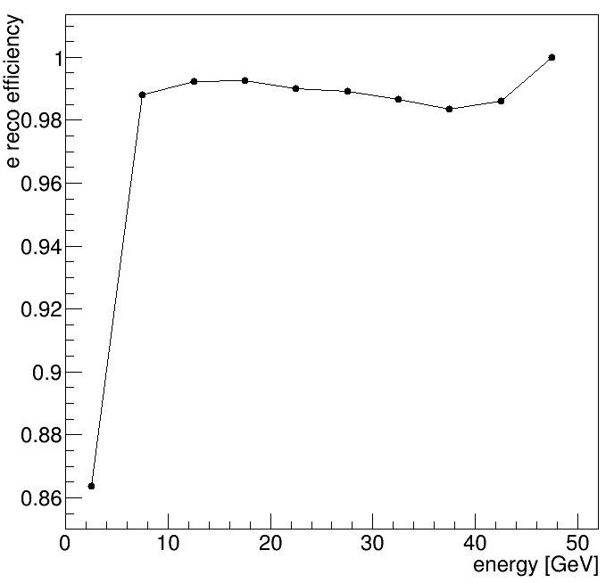
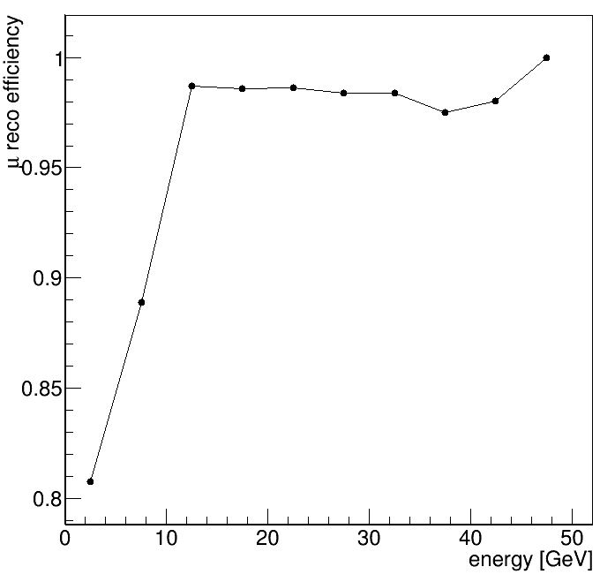
带电粒子径迹重建的效率基本符合预期
e, mu损失效率的主要原因是低能粒子被错误的重建为pi
3h损失效率的主要原因为低能粒子没有被正确的重建

Slide 4
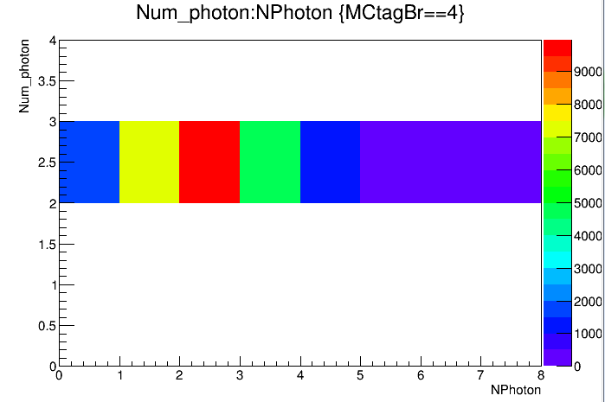
光子的重建效率不高，导致pi0的计数效率低

Slide 5
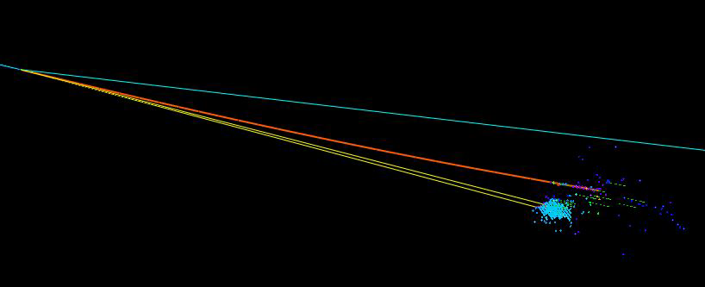

Slide 6
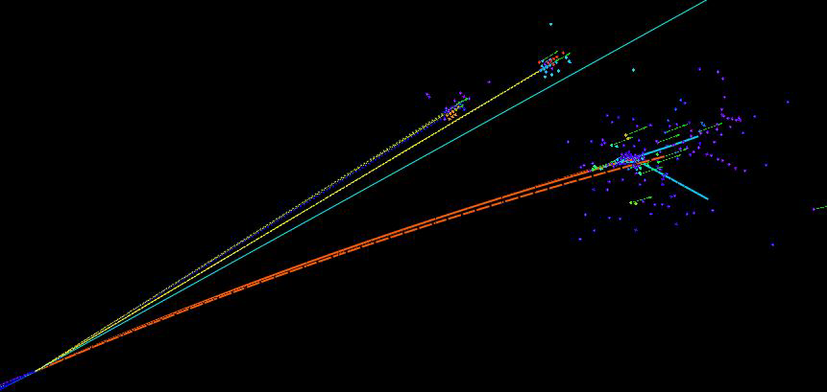

Slide 7
