Slide 1
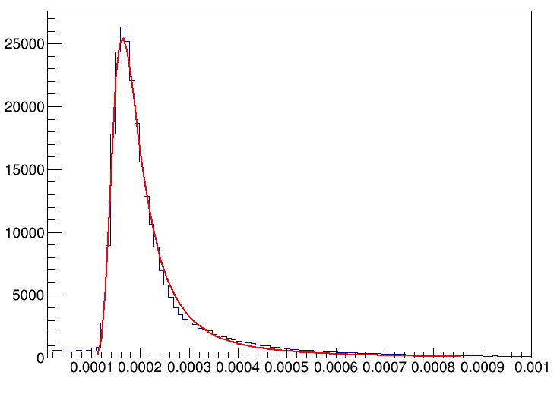
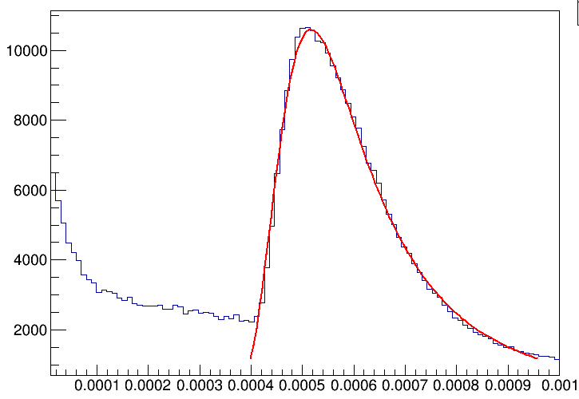
CEPC_v4 Calorimeter
Response of 10GeV muon
1MIP=0.1676MeV
1MIP=0.5294MeV
One Layer:29.3
Steel:25 PCB:0.7 cassette:0.5 cu:0.1 scintillator:3
One layer:5.95
Tungsten:2.8 Si:0.5 Slab:2.65

Slide 2
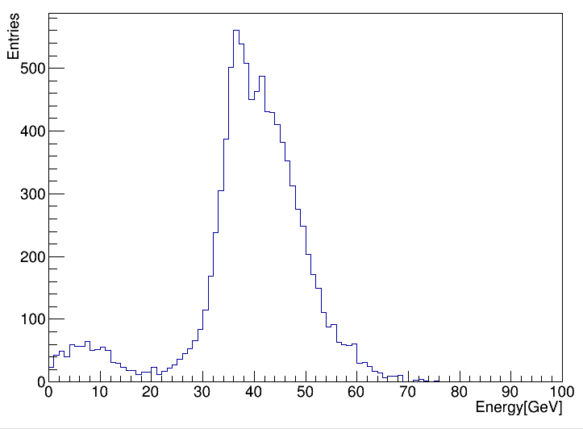
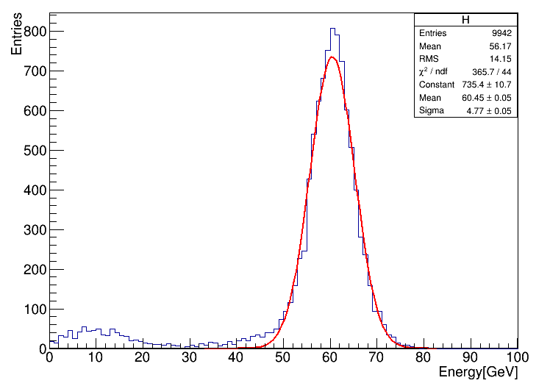
Cut condition:>0.5MIP and Event>0
Calibrate Ecal1=40.91
Calibrate Ecal2=81.81
Calibrate Hcal=40.91
Calibrate Ecal=58
Calibrate Hcal=69
e/h=1.19（Ref. CALICE）
ECAL: 20GeV photon
Hcal:60GeV pi-（Shower start in HCAL）
Combine Ecal and Hcal where pi- shower in both .

Slide 3
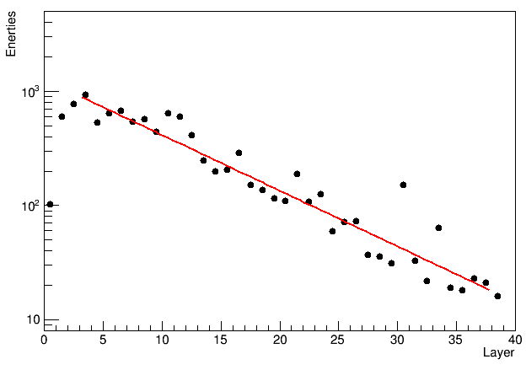
shower starts in the first AHCAL layer
Minimize energy leakage from the AHCAL
The rejection of muon events and leakage by electrons showering in the ECAL
Reject multi-particle events
5.5MIP 7 and $E_{thr}=$20MIP
${\text{λ}}_{I}$=22.28cm
evaluate=20cm
the true point of first hadronic interaction?

