Slide 1
V4 AHCAL reconstruction constant
蒋杰臣 赵航

Slide 2
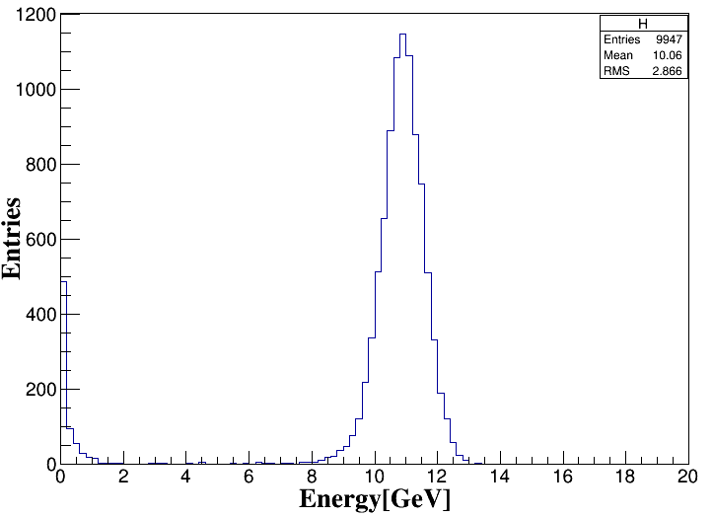
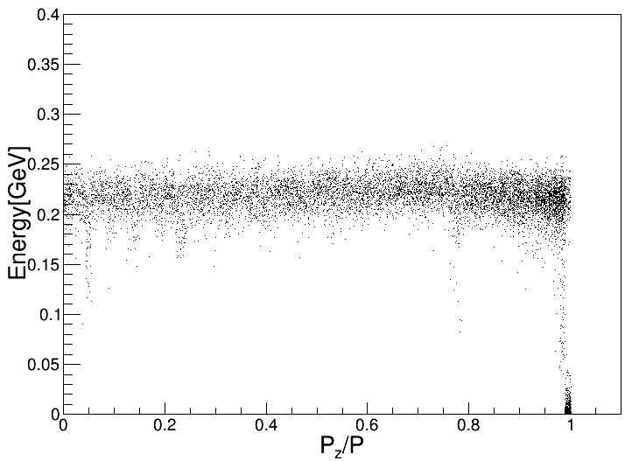
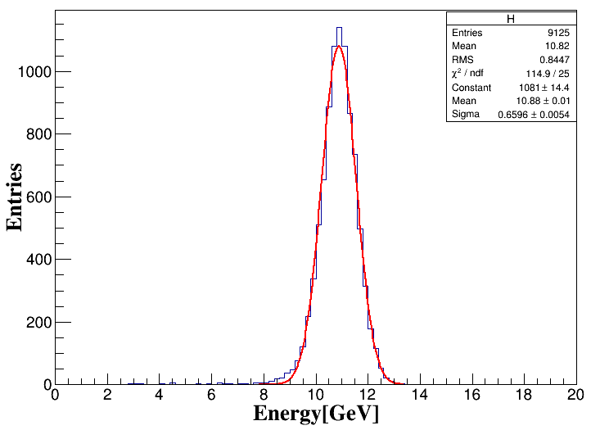
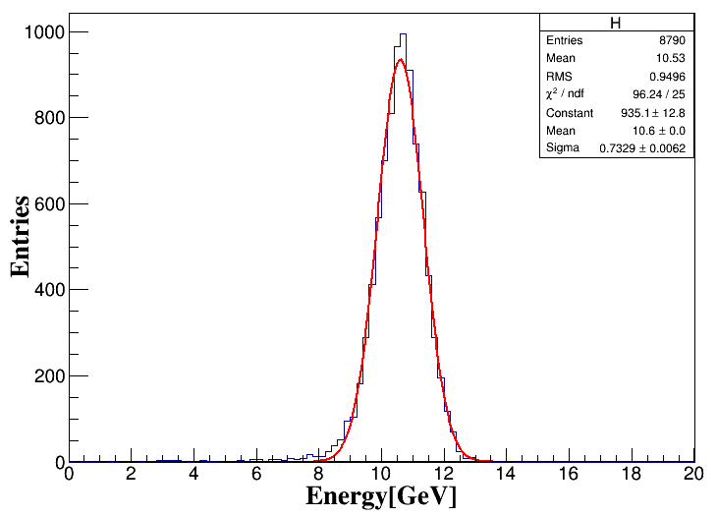
10GeV γ 4π
Cut ${p_{z}}/P$<0.99
absorberThickness
2.8mm Cal :61.77
absorberThickness
20 :2.1mm Cal:48.16
10 :4.2mm Cal:96.32
6.1%
6.9%

Slide 3
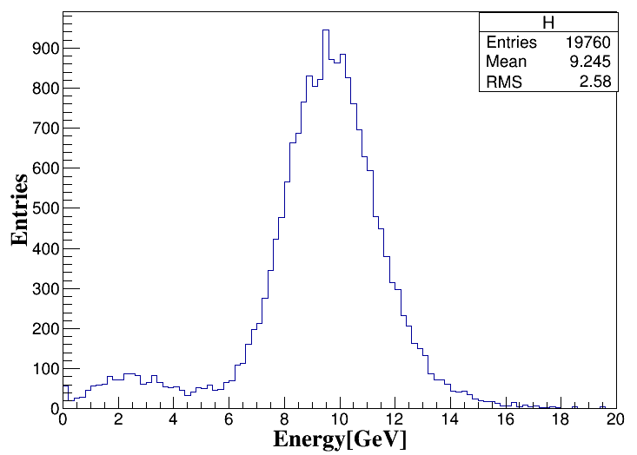
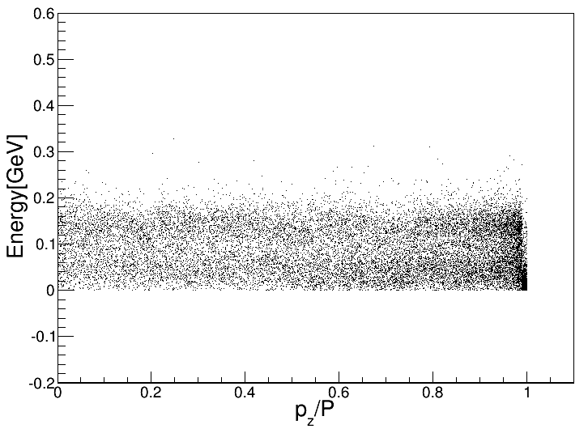
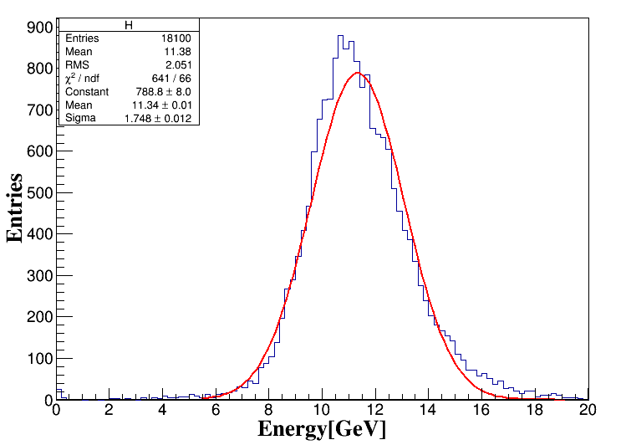
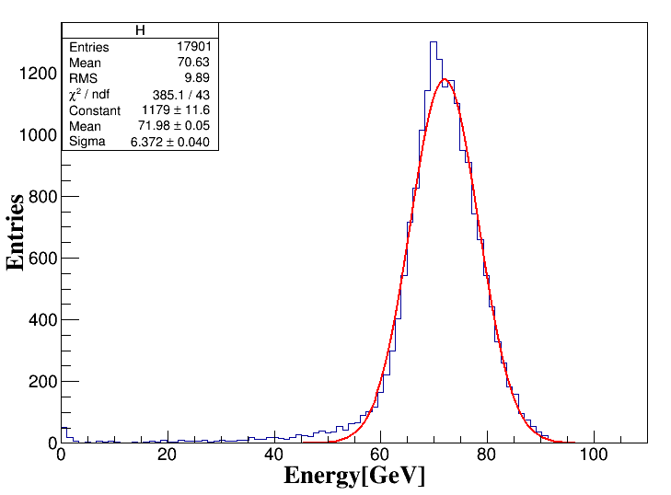
$$k_{L}$$
4π
Cut ${p_{z}}/P$<0.99
Cal: 79.5
重建能量随粒子入射能量的增加偏差增大
10GeV
60GeV

Slide 4
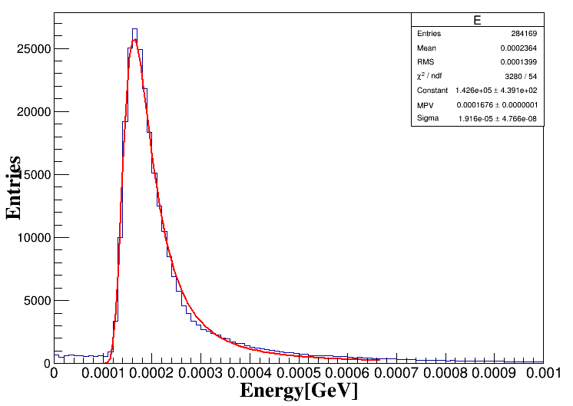
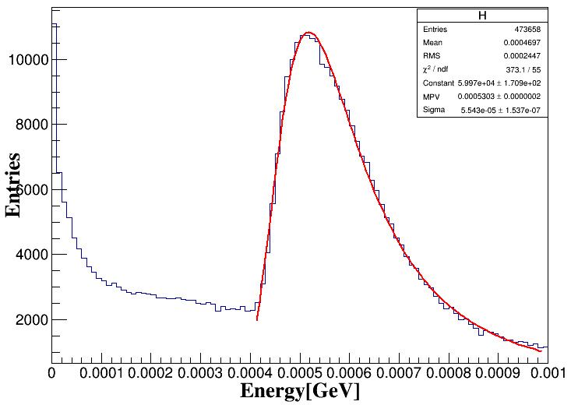
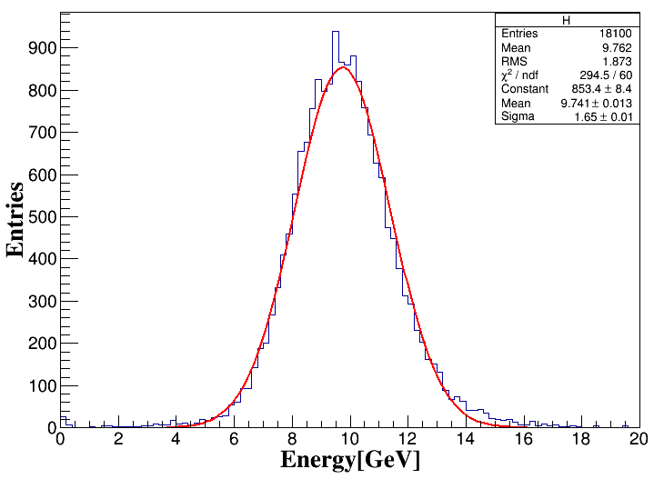
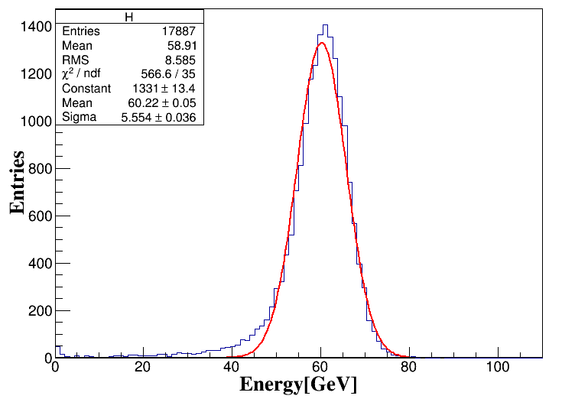
$$k_{L}$$
4π
Cut :$E_{hit}$>0.5MIP
初始Cal: 65
10GeV
60GeV

Slide 5
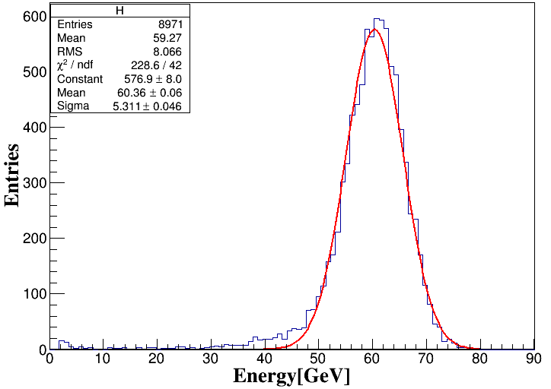
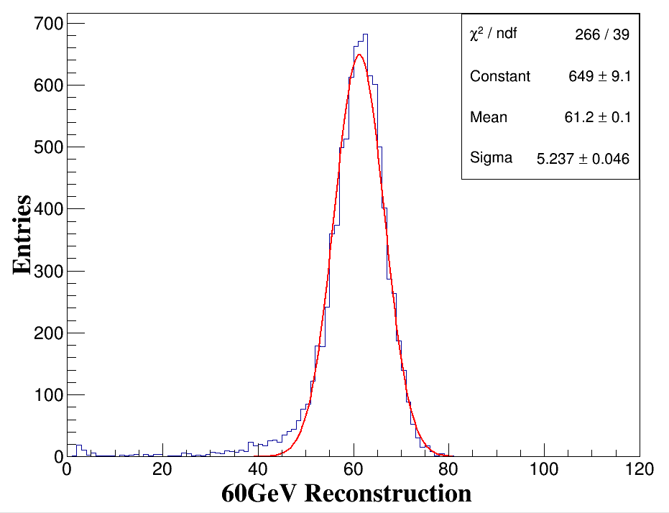
Cal: 65
Cal: 66.26
最小化得到最优的重建常数Cal= 66.26

Slide 6
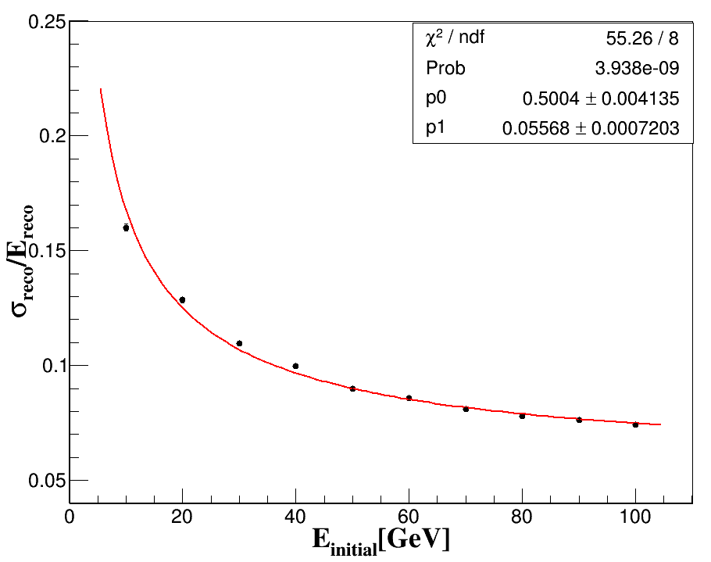
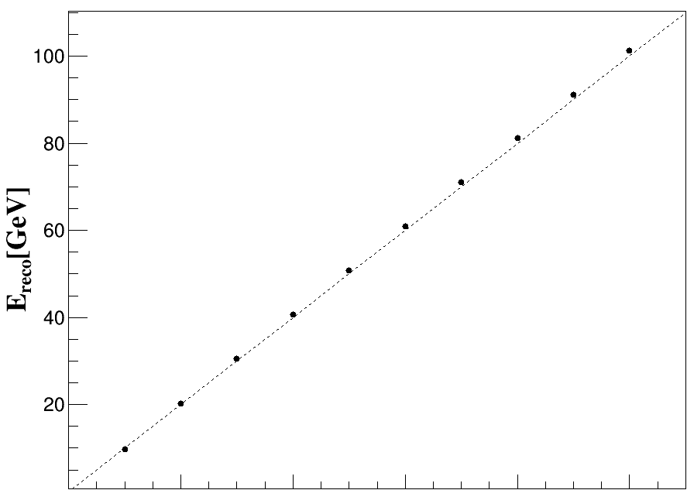
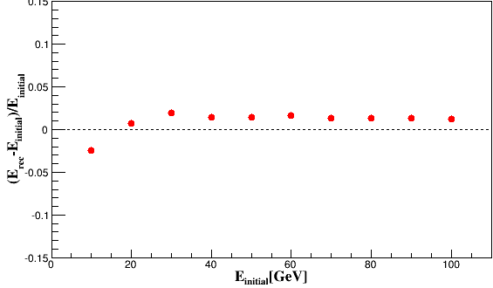
能量分辨
能量线性
Fit: $\frac{a}{\sqrt{E}}⊕b$
a=5$0±0.4\%$ b=5.6$±$0.07%

