Slide 1
Introduction, orientation of the School
Hai-Bo Li
IHEP
lihb@ihep.ac.cn

Slide 2
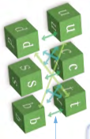
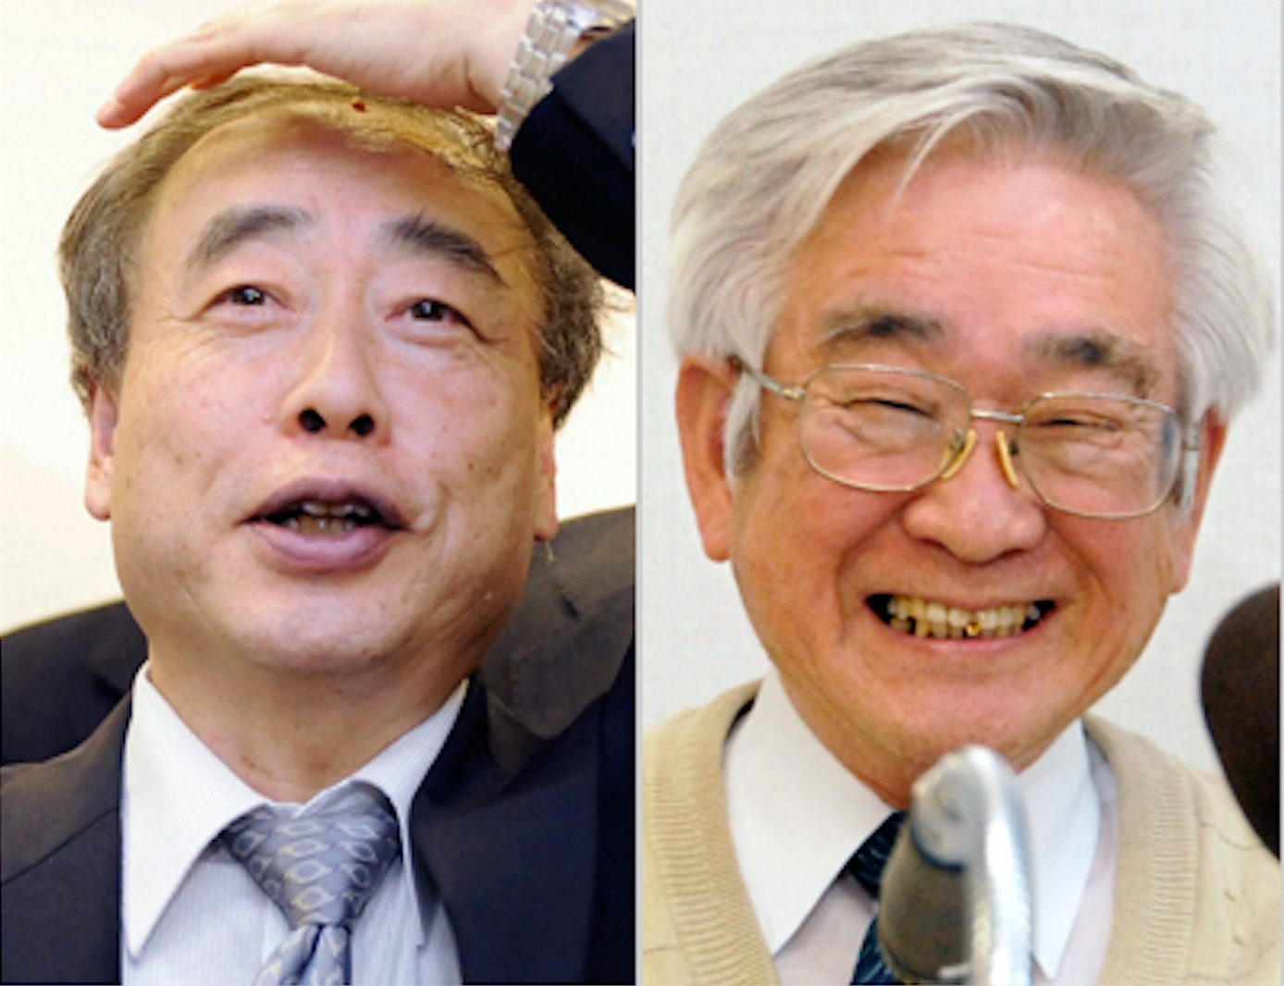
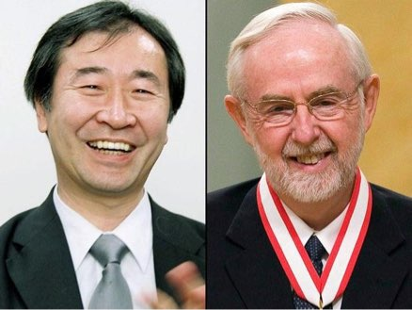
Flavor physics
Quarks
CKM
Flavor changing in neutrinos
Leptons
Kajita and McDonald
Are there FCNC in charged leptons?
aaaaaaaaa

Slide 3
Orientation of the school
Neutrino oscillation had been established experimentally →
the lepton flavor changing neutral currents;
Next step: charged Lepton Flavor violation → New Physics in flavor sector
No any indication of new physics from LHC experiments
Many high intensity experiments (running and proposals)
Muon physics: MEG&MEGII, Mu3e .. and COMET at J-PARC Mu2e at Fermilab …
g-2_muon ...
B/D/tau : Super-B factory/Belle-II, LHCb and its upgrade , BESIII and its upgrades
Gega-Z at FCC-ee and CEPC
Kaon physics: High intensity Kaon beams ... , high intensity hyperon beams ...
…

Slide 4
The School on the charged leptons
Students: graduate, undergraduate students; postdocs/young researchers (mainly from China).
Teachers: Lorenzo Calibbi (Nankai University, China)
Sébastien Descotes-Genon (CNRS & Univ. Paris-Sud, France)
Kiyoshi Hayasaka (Niigata University, Japan)
David Hitlin (Caltech, USA)
Tsutomu Mibe (KEK, Japan)
Gerco Onderwater (Groningen University, Netherland )
Angela Papa (Pisa and PSI )
TA group: Yohei Nakatsugawa, Dorian Pieters, Chen Wu
LOC: Hai-Bo Li (lihb@ihep.ac.cn 13522591667 ) ,
Miss Shan-Jun Ren (rensj@ihep.ac.cn 17301373566)
Miss Ye-Liu Mo (moyl@ihep.ac.cn)
Yao Zhang (zhangyao@ihep.ac.cn )

Slide 5
Sessions for questions and discussions
The discussion sessions will be chaired by TA group, and teachers should be present there to answer questions and join the discussions.
We also encourage teachers to leave questions and homework after your lectures, so that students can discuss what they learn.
We encourage students to raise any questions directly to teachers, or
you should send your questions to TAs.

Slide 6
Certificate of the school
Students should be present and sign off everyday, so that you will get your certificates.
We just encourage you to finish the school, and don’t miss this opportunity, please.

Slide 7
Reception and Banquet
We will have a reception on Monday at 18:30: cafeteria of the Guest House
On Wednesday, we will have a banquet at Quanjude Roast Duck

Slide 8
Lunch
We provide lunch everyday from June 3rd to 7th.
Teachers and TAs: Round table lunch in the cafeteria of Guest House
Students: Lunch coupons for the IHEP cafeteria for faculty
(高能所职工食堂）

Slide 9
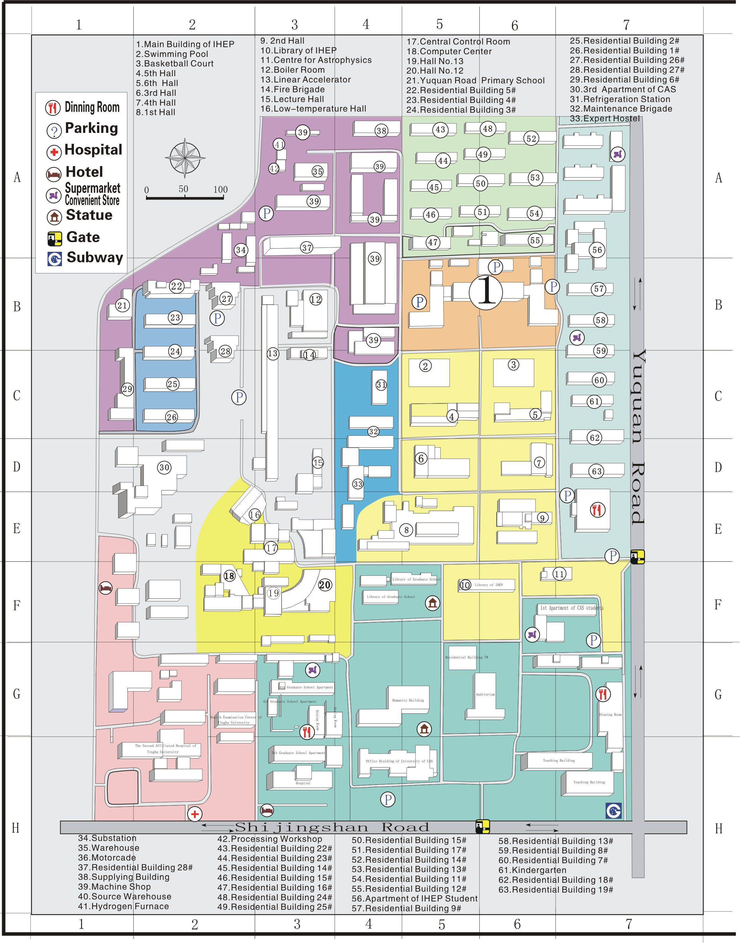
Conference room
IHEP Cafeteria

Slide 10
BESIII/BEPCII tours
If you want to take part in the BESIII/BEPCII tour,
please assemble at 16:50 in front of the New Building.

Slide 11
I wish all of you have a nice week. Enjoy your lectures! Let’s take a group photo outside of the New Building before the coffee break.

