Slide 1
Background estimation for COMET Phase-I
Chen WU

Slide 2
Outline
Introduction to COMET Phase-I
MC simulation preparation
Background estimations
Intrinsic physics background
Beam related background
Other background
Summary

Slide 3
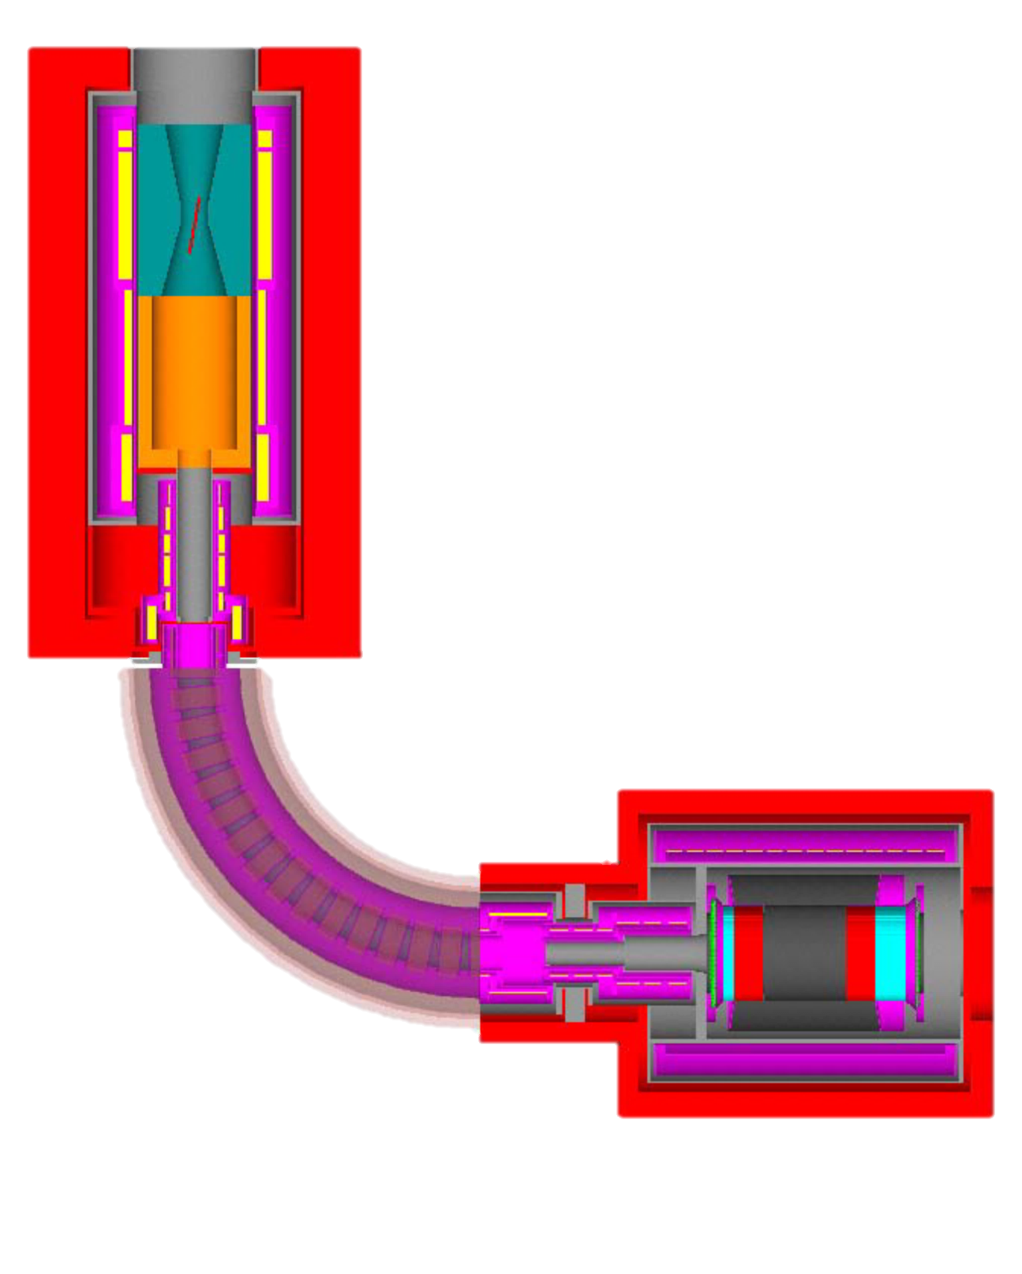
COMET Phase-I
COMET Phase-I:
Search μ→e with SES of $3.1×{10}^{−15}$
Measure beam and backgrounds
Consists of:
Proton Target
Capture solenoid
Muon transportation beam line
Stopping Target
Cylindrical Detector (CDC+CTH)

Slide 4
Beam Structure
time
Time Window
Proton Beam
From Stopped Muons
Leaked Protons
Beam Flash
0
Time [ns]
1170
Pulsed structure matters!

Slide 5
Beam Simulation – Ordinary Run
1. Generate ${2.6×10}^{9}$protons at production target with Geant4.10.1.p02
Started mass production in late 2015 on IN2P3 and IHEPCC
Motivation: cross check with ICEDUST and perform standalone optimization studies
With 5x2 times of re-seeding, final data size is equivalent to ~3000 bunches.
Still (60 cm , 2 cm) target in this simulation.
Gaussian beam: ($σ_{y}=2.9mm,σ_{x}=5.8mm$)
2. Take the beam profile at the beginning of 90 degree bending, repeat by 5 times: equivalent to ${1.3×10}^{10}$protons
CyDet are set as black hole for consecutive CyDet studies
3. Take the beam profile at the end of 90 degree bending, repeat by 2 times: equivalent to ${2.6×10}^{10}$protons. At last record particles on the surface of CyDet Box
Collimator: Vertical option

Slide 6
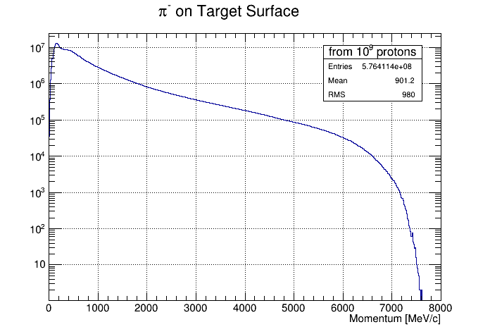
Beam Simulation – Stable Pion Run
1. Generate ${10}^{9}$protons at production target, take the sample on the surface and repeat by 10 times: equivalent to ${10}^{10}$protons
Still (60 cm , 2 cm) target in this simulation.
To generate enough late arrival pions, decay mode of pion is closed and weight is assigned by calculating the decay probability.
Gaussian beam: ($σ_{y}=2.9mm,σ_{x}=5.8mm$)
2. Take the beam profile at the end of 90 degree bending, repeat by 10 times: equivalent to ${10}^{11}$protons. Pion stopping position is recorded for RPC study.
Collimator: Vertical option

Slide 7
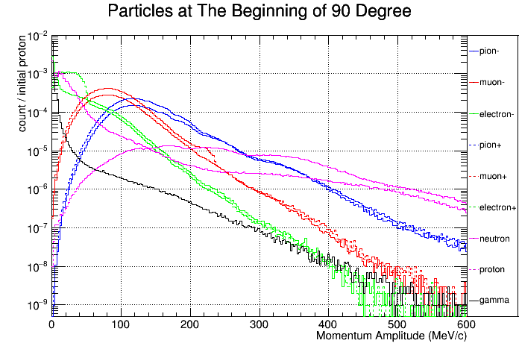
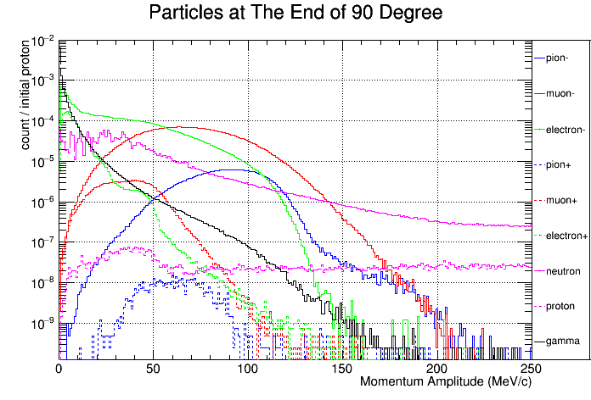
Beam Profile
Collimator: Vertical option

Slide 8
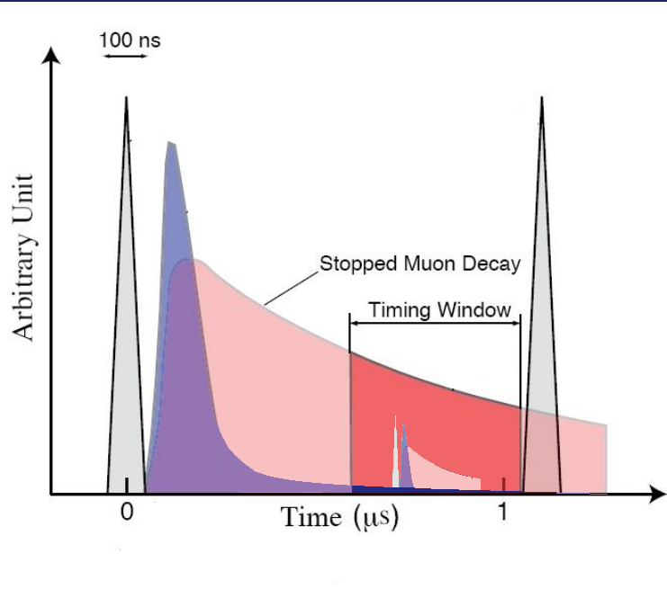
Backgrounds Estimation
Potential background sources for the search for the $μ^{−} N→e^{−} N$ conversion are grouped into four categories: intrinsic physics backgrounds, beam-related prompt backgrounds, beam-related delayed backgrounds, and other backgrounds according to the time structure.
Intrinsic Physics Backgrounds
Beam Related Backgrounds
Delayed
Prompt
Other Backgrounds (accidental)
Proton Pulse
Residual
Proton

Slide 9
Intrinsic Physics Backgrounds
From stopped muons:
39% (in Al): decay in orbit (DIO). End point energy of electron is the same as signal energy.
The rest: Capture by nuclear.
Secondary particles are mostly protons, neutrons, low energy electrons and soft gamma rays
Seldom case: radiative muon capture (RMC) will emit a hard gamma ray, with end point energy close to the signal energy.
Intrinsic physics backgrounds
Muon decay in orbit (DIO) | Bound muons decay in a muonic atom
Radiative muon capture (RMC) (external) | $μ^{−}+ A→ν_{μ}+ A^{′}+γ$ Followed by $γ→e^{−}(+e^{+})$
Radiative muon capture (RMC) (internal) | $$μ^{−}+ A→ν_{μ}+ A^{′}+e^{−}+e^{+}$$

Slide 10
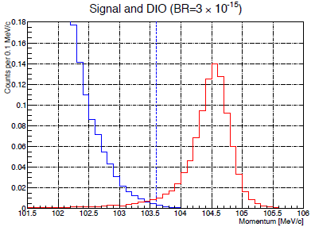
DIO Background
With Hideyuki
Muon decay in orbit (DIO) is a Michel decay $μ^{−}→e+ν_{μ}+ \overline{ν_{e}}$of the muons that are bounded in a muonic atom.
The spectrum (considering nuclear boosting) is calculated in “Phys. Rev. D 84, 013006”.
Simulation for DIO events was done with the muon stopping information recorded by the full simulation. (direction is isotropic, momentum is scanned bin by bin). Tracking is then performed.
Nomalized to the DIO spectrum, the contamination is controlled to 0.01 events by setting momentum cut at 103.6 MeV/c
Calculated Spectrum of DIO electrons

Slide 11
RMC Background
Muon nuclear capture is analogous to electron capture. Radiative muon capture (RMC) given by $μ^{−}+ A→ν_{μ}+ A^{′}+γ$ (external) combined with Compton scattering/pair production or $μ^{−}+ A→ν_{μ}+ A^{′}+e^{−}+e^{+}$ (internal).
Internal contribution is found to be orders smaller since the production of positron and electron takes extra energy, making the endpoint energy lower than external + Compton scattering by about 1 MeV, far away from the momentum window.
The endpoint energy is calculated as $k_{max}^{}= m_{μ}−B_{μ}−Δ_{Z−1}−E_{recoil}=101.85 MeV$.

Slide 12
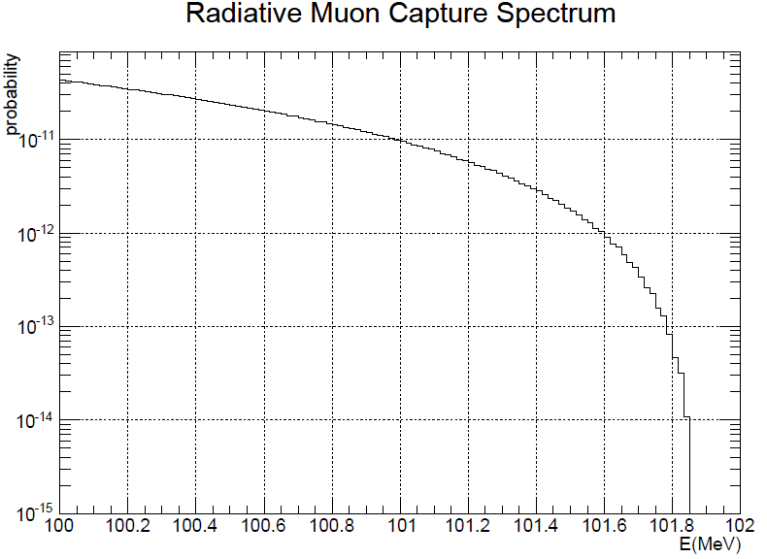
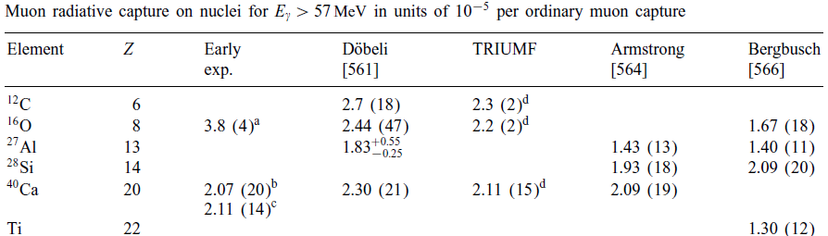
RMC Background
The spectrum (considering nuclear boosting) is calculated in “Phy Rev C, Volume 32, Number5, Nov 1985” A simplified version of this formula is from “Phy Rev C, Volume 32, Number5, Nov 1985”.
$$R\left(x\right)=C\left(1−2x+2x^{2}\right)x{(1−x)}^{2}$$
Where $x=k/k_{max}$
We choose this branching ratio for Al (Z=13) as ${Br}_{RMC−o57}=1.83×{10}^{−5}$based on “Physics Reports 354 (2001) 243–409”
The branching ratio of RMC (over $93 MeV$) to OMC for Al is ${Br}_{RMC−o93}=2.97×{10}^{−7}$.

Slide 13
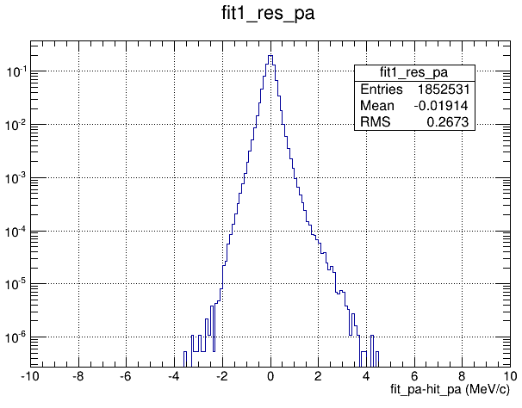
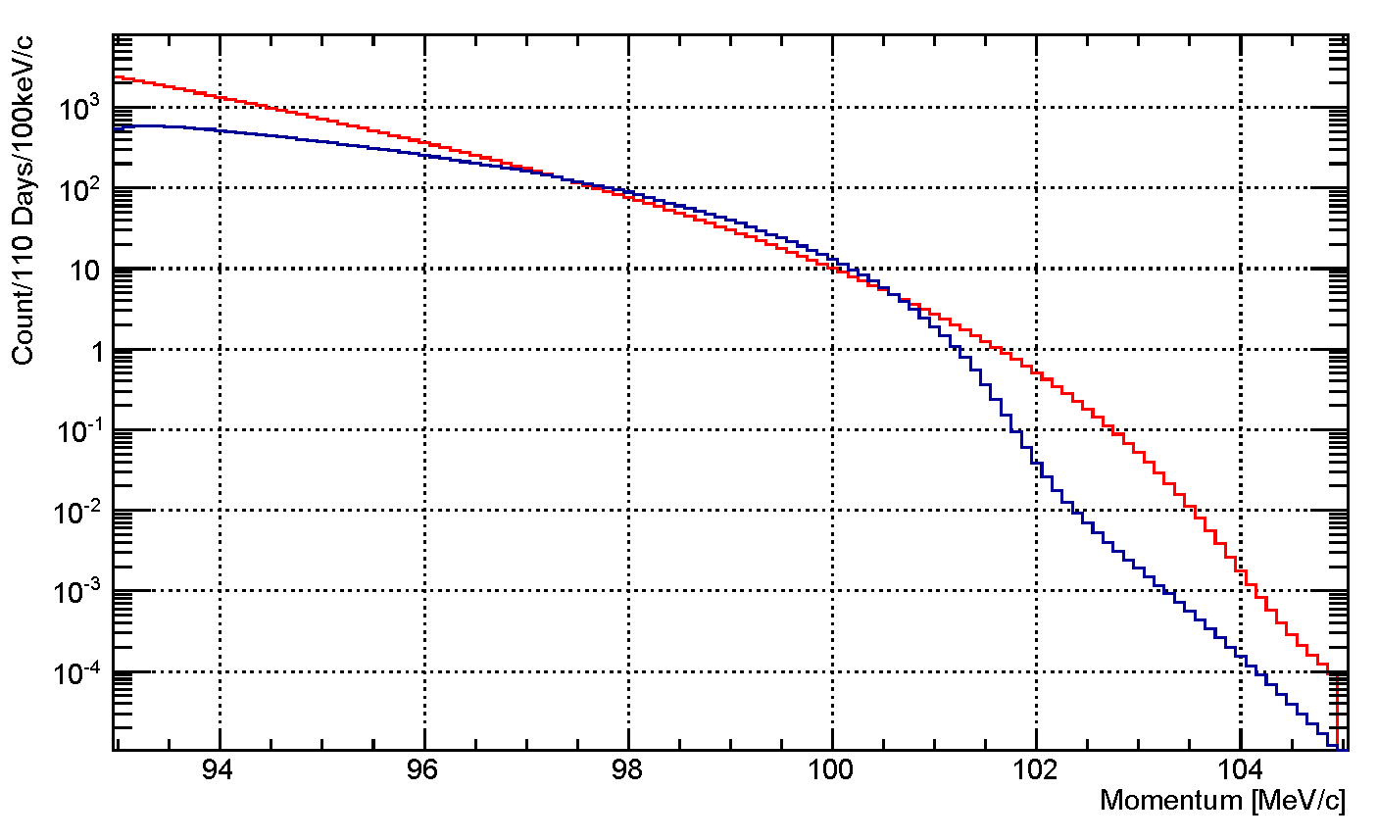
RMC Background
${4.3×10}^{9}$ photons are generated with muon stopping information recorded by the full simulation. (direction is isotropic, energy is scanned from 93 MeV to 103 MeV). Electrons in CDC are recorded.
After smearing the momentum these electrons with the resolution function, we got ${P_{γ−e}∙A_{geo}∙A}_{mom}={3.2×10}^{−12}$
$N_{bkg}=N_{p}∙N_{μ^{−}stop/p}∙f_{cap}∙f_{gnd}∙{Br}_{RMC−o93}∙P_{γ−e}∙A_{geo}∙A_{mom}∙A_{time}∙Eff$ Where $A_{time}∙Eff$ is expected to be the same with signal tracks, then $N_{bkg}=\frac{{Br}_{RMC−o93}}{SES}∙\frac{P_{γ−e}∙A_{geo}^{}∙A_{mom}^{}}{A_{geo}^{}∙A_{mom}^{}(=0.18)}=1.9×{10}^{−3}$
Electron momentum in CDC (resolution considered)
CDC intrinsic Resolution
In MeV/c
Red: e- from DIO (1%)
Blue: e- from RMC (0.19%)

Slide 14
Beam Related Backgrounds
Among all the beam related prompt/delayed backgrounds, RPC backgrounds are the most important one, for that pion survival rate in Phase-I is slightly higher and they can generate electrons through RPC with a spectrum covering the signal region.
$\overline{p}$ induced background has a large uncertainty. However such background can be effectively suppressed by $\overline{p}$ absorber.
Other particles can introduce backgrounds by decay or scatter
Beam Related prompt/delayed Backgrounds
Radiative pion capture (RPC)(external) | $$π^{−}+ A→e^{−}+e^{+}+A^{′}$$
Radiative pion capture (RPC) (internal) | $π^{−}+ A→γ+A^{′}$, $γ→e^{−}(+e^{+})$
$\overline{p}$ induced backgrounds | $$\overline{p} hits material to produce e^{−}$$
Beam electrons | $$e^{−} \text{scattering} \text{off} \text{a} \text{muon} \text{stopping} \text{target}$$
Muon decay in flight | $μ^{−}$ decays in flight to produce $e^{−}$
Pion decay in flight | $π^{−}$ decays in flight to produce $e^{−}$
Neutron induced backgrounds | neutrons hit material to produce $e^{−}$

Slide 15
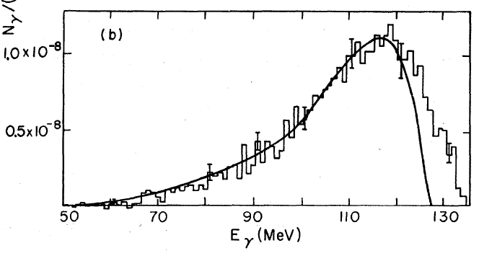
RPC Background
The radiative pion capture (RPC) is given by $π^{−}+ A→γ+ A^{′}$ (external) or $π^{−}+ A→A^{′}+e^{−}+e^{+}$ (internal). We assume two process contribute equally to backgrounds.
In “Phy Rev C, volume 5 number 6, 1972.6”, the branching ratio of external RPC to OPC in Al is estimated as $2\%$. Also RPC spectrum in Mg is provided. We suppose the spectrum of RPC gamma from Al is similar to Mg.

Slide 16
Pion Yield and Stopping Time
According to MC3 beam simulation, the number of pions got stopped in stopping target per proton is $N_{π−stop/p}=3.4×{10}^{−6}$.
From the independent simulation, pion stopping time distribution is as left. 700 ns window as default (500 ns is optional)
Delayed: $A_{time}=\text{\sim }{10}^{−16}$ ($9×{10}^{−13}$)
Prompt: $A_{time}=38.4\%$ ($57.3\%$) with $E_{ext}=3×{10}^{−11}$, $A_{time}×E_{ext}=1.1×{10}^{−11}$(1.7$×{10}^{−11}$)
Pion stopped per proton with different time window (left edge floating)
500
700

Slide 17
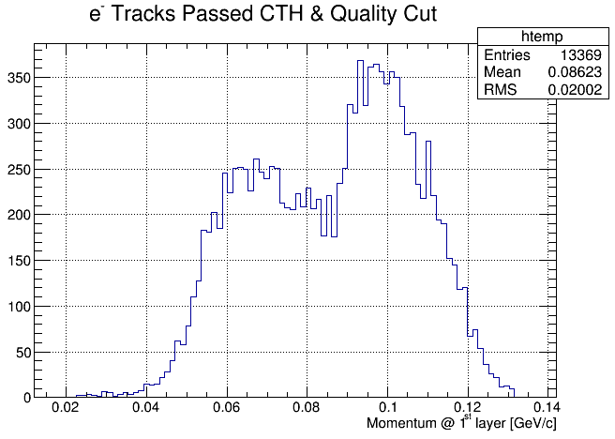
RPC Background
${2×10}^{7}$RPC photons are generated, 13369 of them left effective tack in CyDet . 538 of them falls in momentum window. $P_{γ−e}∙A_{geo}∙A_{mom}=2.7×{10}^{−5}$
Delayed: $N_{bkg}=N_{p}∙N_{π^{−}stop/p}∙{Br}_{RPC}∙P_{γ−e}∙A_{geo}∙A_{mom}∙A_{time}∙Eff×2(with internal)$ $≈0$ ($2.5 ×{10}^{−3}$)
Prompt: $N_{bkg}=N_{p}∙N_{π^{−}stop/p}∙{Br}_{RPC}∙P_{γ−e}∙A_{geo}∙A_{mom}∙A_{time}∙R_{ext}∙Eff×2$ $=2.8×{10}^{−3}$ ($3.1 ×{10}^{−3}$)
700 ns window as default (500 ns window as optional)

Slide 18
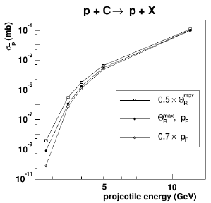
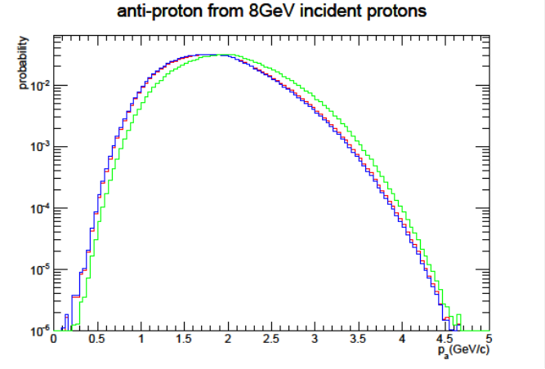
Anti-proton Background
Cross section of anti-proton is taken from http://dx.doi.org/10.1088/0954-3899/30/7/008, leading to $6.4×{10}^{−5}$ anti-proton per proton (70 cm long graphite target)
A series of theory models were considered and the most conservative one (1983 J. Phys. G: Nucl. Phys) is chosen. Tail component is estimated as $3.2×{10}^{−4}$ of all anti-protons.
$1.82×{10}^{9}$ low energy anti-protons were generated in simulation.
Resampling with different random seeds was done at the end of 90 degree bending by a factor of 100.

Slide 19
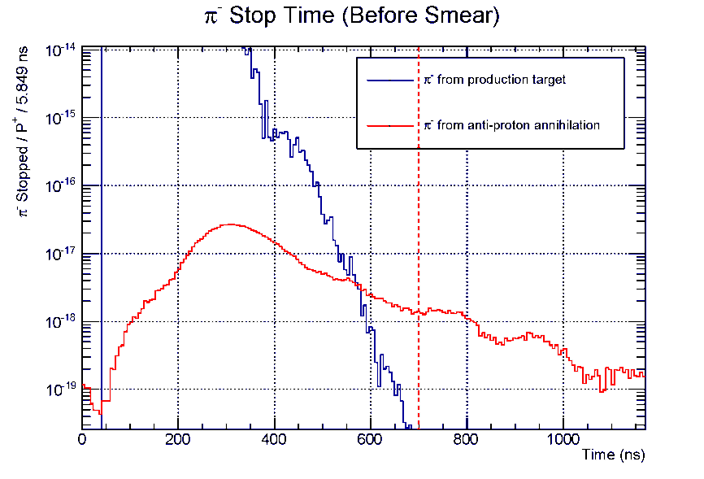
Anti-proton Background
The anti-protons can introduce background contribution by two different ways:
Generate late arrival high energy particles and introduce signal like tracks in CyDet by scattering/decay.
Generate late arrival pions stopped in stopping target and introduce signal like tracks in CyDet by RPC.
To study the first part, high energy tracks are repeated by 10 times in CyDet region with different random numbers.
Time acceptance is found to be $2×{10}^{−3}$
Upper limit of CyDet acceptance is $9×{10}^{−7}$
Final contribution is considered as $<3×{10}^{−4}$
To study the second part, pions are repeated by 10 times in CyDet region
Number of stopped pions in the time window is $4.9×{10}^{−17}$ ($1.5×{10}^{−16}$) per initial proton.
Given RPC study result, the final contribution is $1.2×{10}^{−3}$ ($2.2×{10}^{−3}$)
*700 ns window as default (500 ns window as optional)

Slide 20
Other Beam Related Backgrounds
Other beam related backgrounds are mainly caused by high energy electrons, muons and pions either decaying in flight or scattered by beam line material.
By repeating high energy beam particle samples by 10 times with different random seeds, it is found that for all beam particles, the probability of producing an energetic electron from one initial proton and accepted by CyDet with geometrical cut and momentum cut is:
Beam Particle | $$P_{p→e−o100}∙A_{geo}{∙A}_{mom}$$
Electron | $$<2×{10}^{−11}$$
Muon
Pion
Others
*From the sample of $5.1×{10}^{10}$ POT, 934 electrons over 100 MeV/c were found on the CyDet box, 4 passed geometry & quality cut, none in signal region.

Slide 21
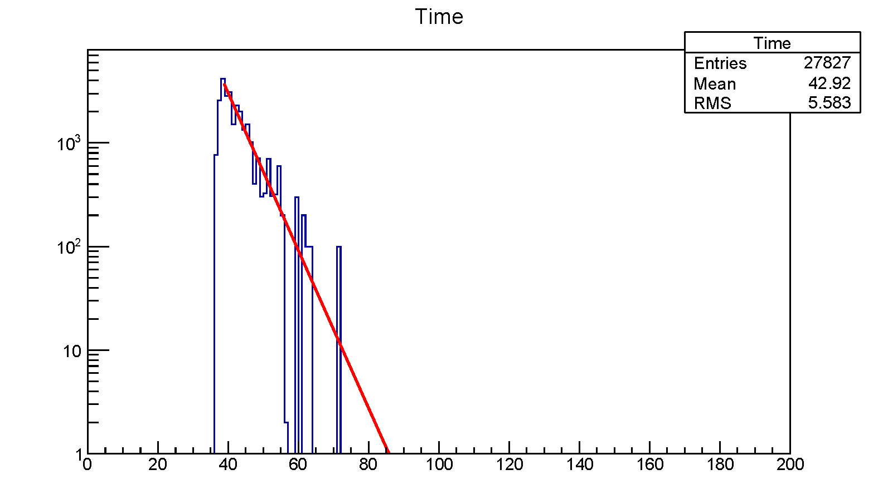
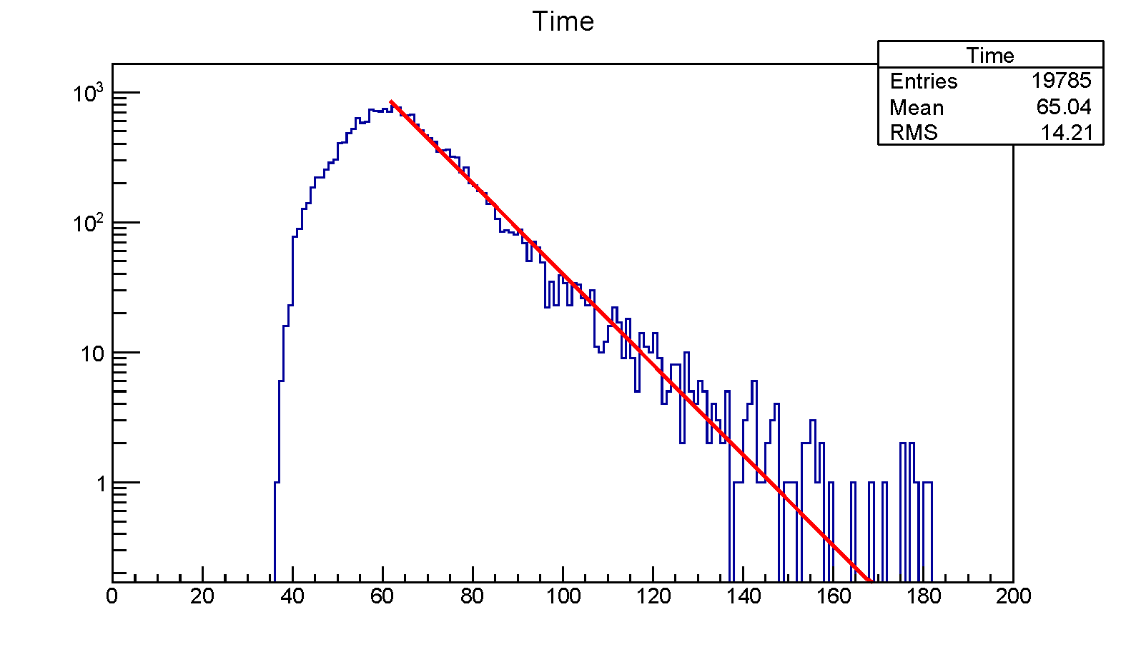
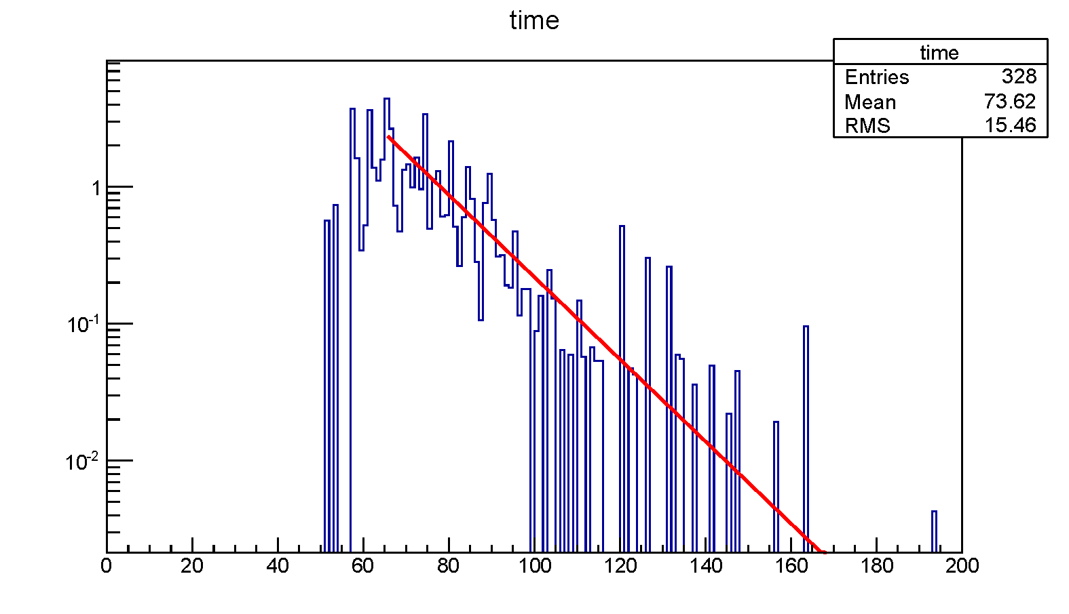
Other Beam Related Backgrounds
For delayed backgrounds, it’s found that the time distribution of energetic particles follow exponential curve.
By extrapolating the time distribution, the delayed background is found to be negligible.
Beam Particle | Delayed Backgrounds
Electron | $$2.0×{10}^{−33}$$
Muon (in flight) | $$<2.3×{10}^{−11}$$
Pion (in flight) | $$<1×{10}^{−7}$$
Others | $$∗$$
*This part is also considered to be negligible though still needs further investigation.
Beam Electron
Muon
Pion

Slide 22
Other Beam Related Backgrounds
For prompt backgrounds, assuming residual protons are uniformly distributed among bunch interval, then $A_{time}=38.4\% (57.3\%)$
The total contamination during COMET Phase-I running period can be calculated as:
$$N_{bkg}=N_{p}∙P_{p→e−o100}∙A_{geo}{∙A}_{mom}∙A_{time}∙Eff∙R_{ext}$$
Beam Particle | Prompt Backgrounds
Electron | $<5.9×{10}^{−3}$ ($<6.9×{10}^{−3}$)
Muon (in flight)
Pion (in flight)
Others
* 700 ns window as default (500 ns window as optional)

Slide 23
Other Backgrounds
Cosmic ray induced backgrounds can be caused by cosmic-ray muons that produce an electron which enters the detector, or cosmic-ray muons enter the detector and are misidentified as an electron. This contribution would be suppressed by Cosmic Ray veto system (CRV), which works as a veto with high efficiency of ${10}^{−4}$.
False tracking backgrounds are expected to be at a negligible level yet the estimation demands for a realistic tracking method, which we are still improving.
Other Backgrounds
Cosmic-ray induced backgrounds | $μ^{−}etc$ entering beam line and/or detector
False tracking | Hit points falsely considered as a $e^{−}$track.

Slide 24
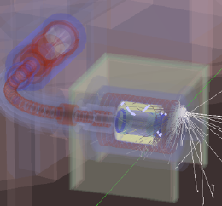
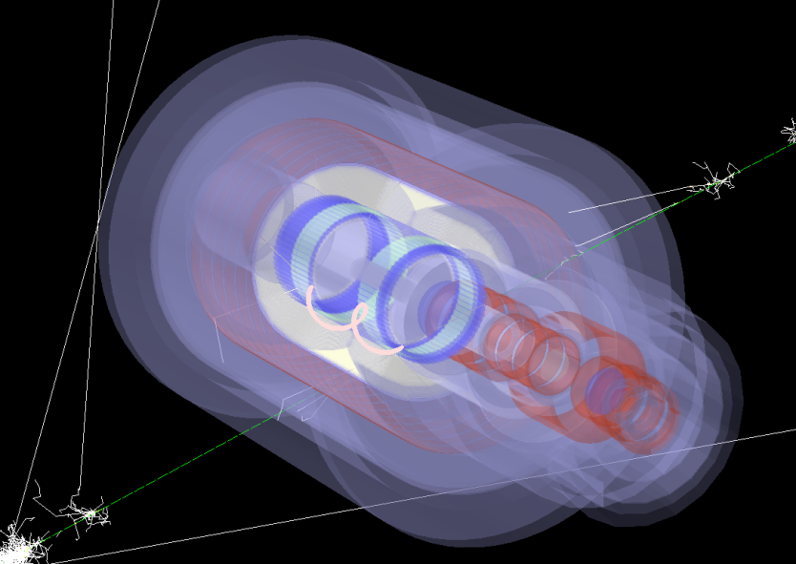
Cosmic Ray Background
By Nam
Two dedicated simulations are done for cosmic ray background study:
General one: covering the whole experimental hall. 23 million $μ^{∓}$(~1 minute).
Focused one: only dangerous area and directions based on general run’s result. 100 million $μ^{∓}$ (~1/2 day) are generated.
From the focused run, 35 electrons in CDC with 85~110 MeV/c momenta were found, but none met the CyDet requirements.
With the assumption that an additional CRV at dangerous area also has a veto inefficiency of ${10}^{−4}$, Cosmic ray background is expected to be smaller than 0.01.

Slide 25
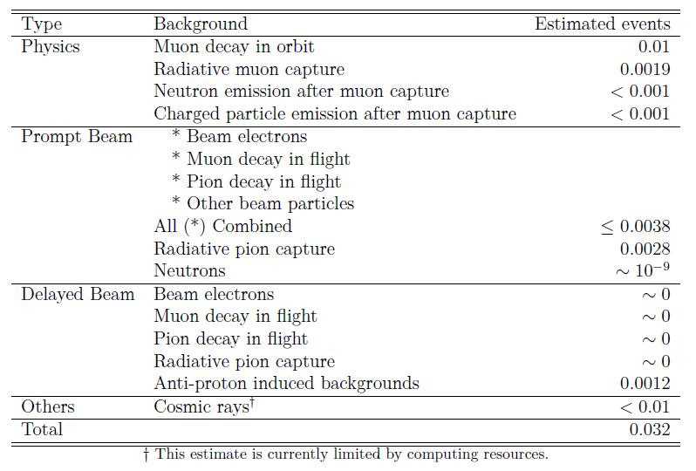
Summary of Backgrounds (in TDR)

Slide 26
Backup

Slide 27
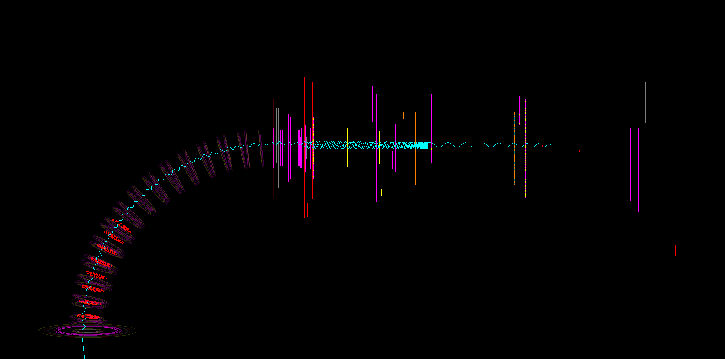
Pion stop time distribution & time window
By checking the time distribution of different pions (according to where they stopped) at the end of 90 degree bending, we can find out that the shoulder after 200ns is formed after Bridge Solenoid (BS).
Below is the histogram stack of different groups of pions.
Pions decay or pass through

