Slide 1
cLFV summer school
student talk:
Track finding using persistence homology
Dorian Pieters

Slide 2
Outlook
COMET Phase –I + Study motivation
Persistent homology
Result with toy model
Toy model vs real geometry
Resume and outline

Slide 3
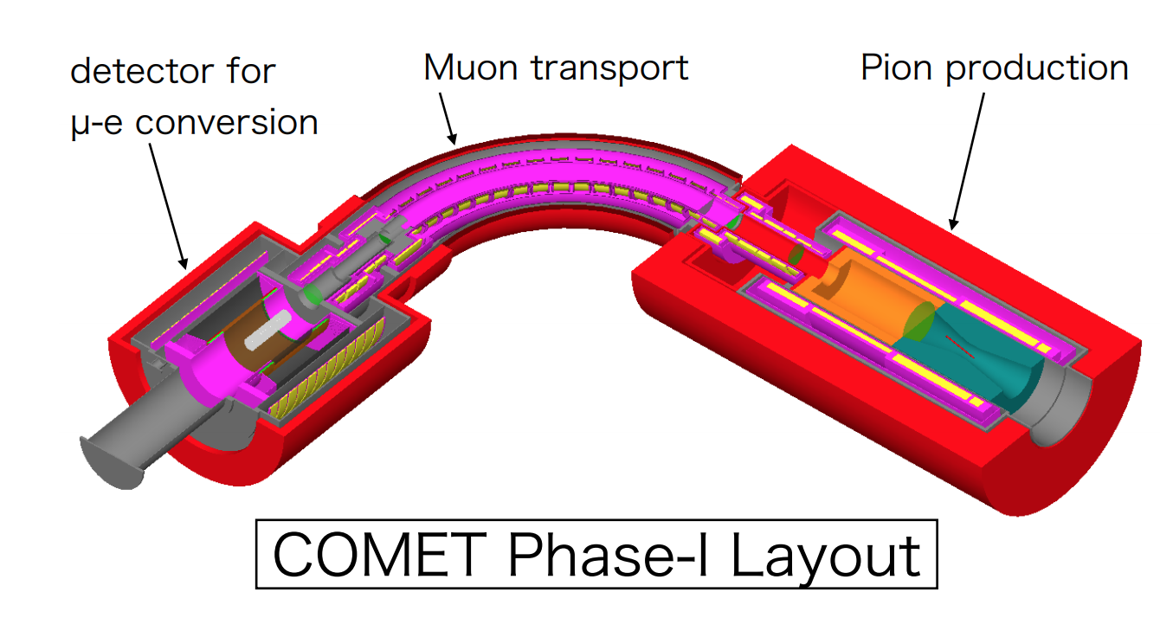
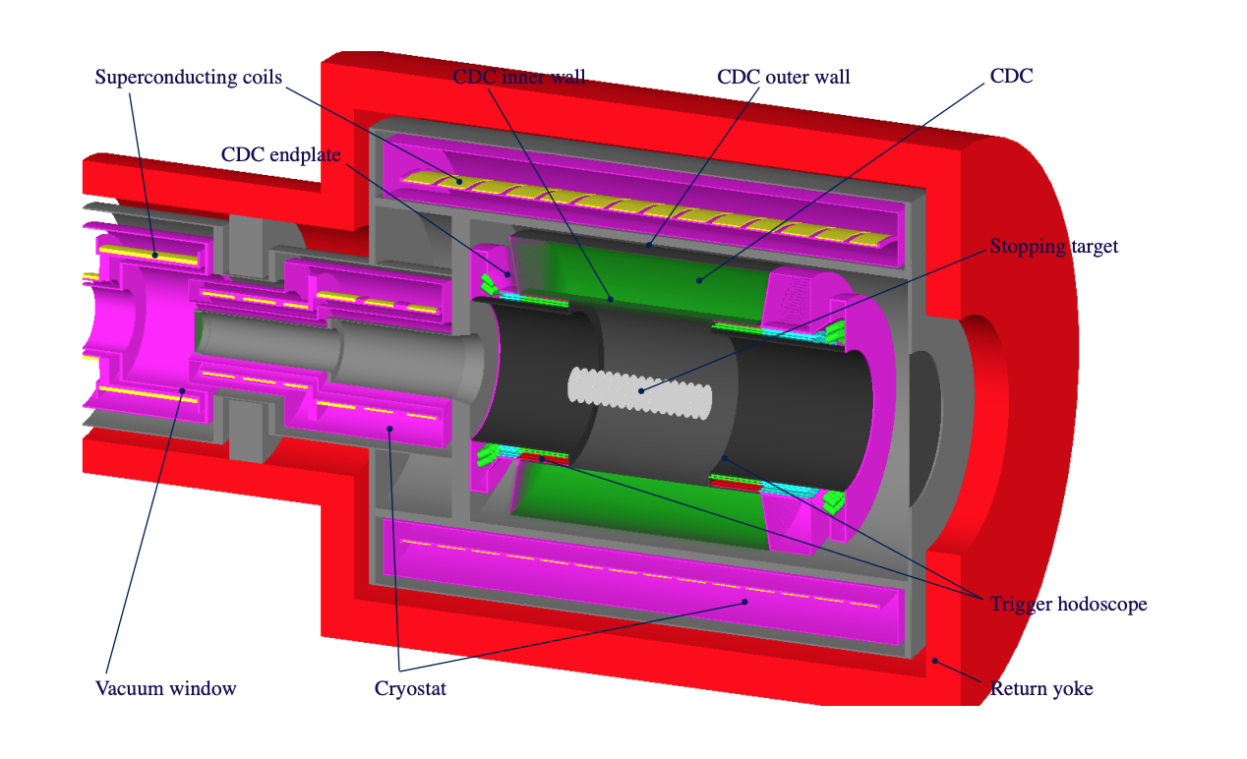
COMET Phase-I & Motivation
Searching for coherent $μ+N →e+N′$
→ Monochromatic signal $E_{e} \sim 105MeV$
Stereo cylindrical drift chamber :
20 Sense layers (including 2 guard layers)
4986 sense wires
14,562 field wires
Stereo angle of $64 \sim 75 mrad$
Rare process ( < ${7.10}^{−13}$ from SINDRUM II)
$→$ high luminosity needed ( proton beam 3.2 kW )
$→$ Need a robust way to separate background from the signal (Track finding)

Slide 4
Outlook
COMET Phase –I + Study motivation
Persistent homology
Result with toy model
Toy model vs real geometry
Resume and outline

Slide 5
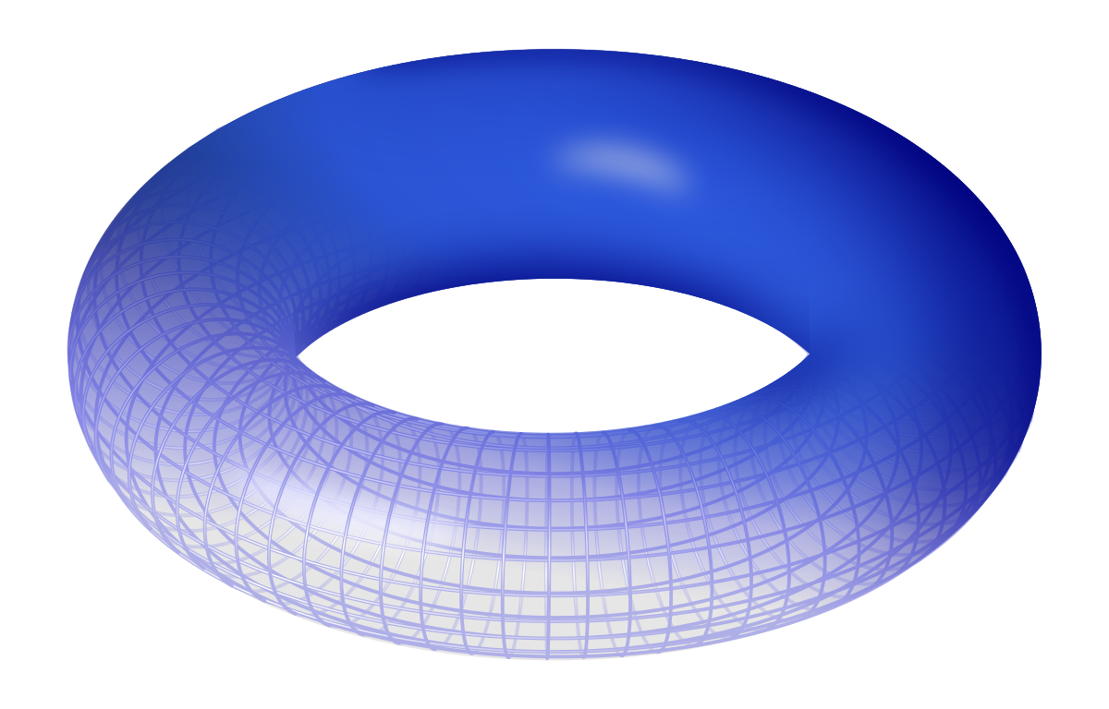
Topology
Topology is a mathematical field to study the properties of space that are preserved under continuous deformations.
The space in question are characterized by the Betti numbers :
$b_{0}=number of connected components$
$b_{1}=number of holes (1 dimensional hole)$
$b_{2}=number of voids (2 dimensionals hole)$
Taking a torus as example, we got :
$b_{0}=1$
$b_{1}=2$
$b_{2}=1$
But for us what’s interesting is the trajectory of the electron inside the CDC (adding the inner wall), projected on one endplate. So for each turn can be characterized with:
$b_{0}=1$
$b_{1}=1$
$b_{2}=0$
$$e^{−}$$
$$inner layer$$

Slide 6
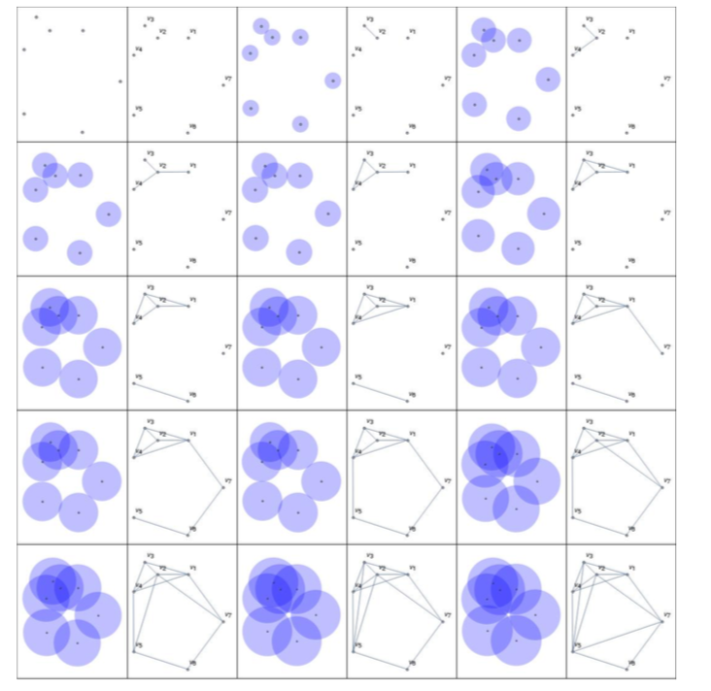
Persistent Homology: a simple example
Small example where we would like to observe a loop/hole
Replace all data points by vertices
Draw ball around those vertices with radius of r
Link two vertices if their sphere connect
Increase the radius of the balls
And repeat
We created a lot of holes/loops at the end of the process, but cannot distinguish the “main” hole from the others. We only have the birth radius/birth “time” of each loop
Wilfrid da Silva, Workshop 11-13/07/2018

Slide 7
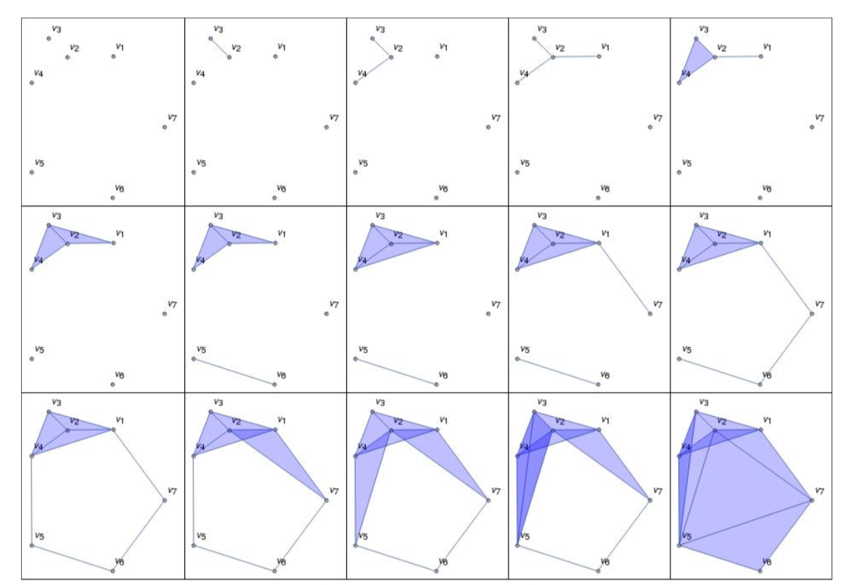
Persistent Homology: a simple example
To have more information on the loop created, we need to fill them and thus induce a death radius/”time” for each loop. We can for example use Vietoris-Rips rules, where we only fill the triangle
Wilfrid da Silva, Workshop 11-13/07/2018
→ We can see that “main” hole persist longer than the other one, and pick it up

Slide 8
Outlook
COMET Phase –I + Study motivation
Persistent homology
Result with toy model
Toy model vs real geometry
Resume and outline

Slide 9
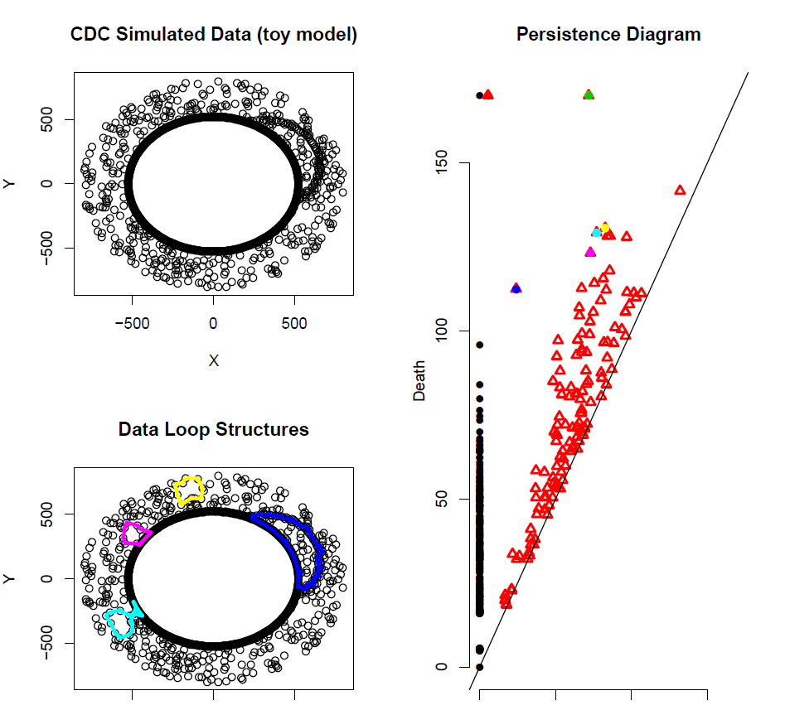
Toy model proof of concept – 10BG occupancy

Slide 10
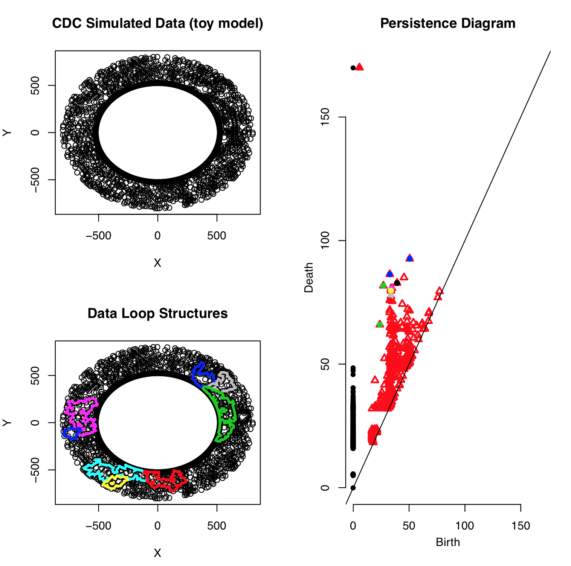
Track finding purity issues example (30% BG)

Slide 11
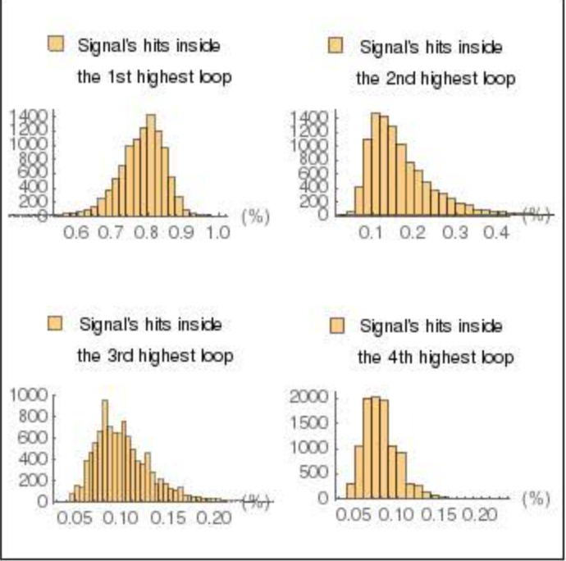
Signal hit efficiency in loop for 10% BG
$$Efficiency=$$
$$\frac{nb of signal hit in loop}{nb of signal hit in event}$$

Slide 12
Outlook
COMET Phase –I + Study motivation
Persistent homology
Result with toy model
Toy model vs real geometry
Resume and outline

Slide 13
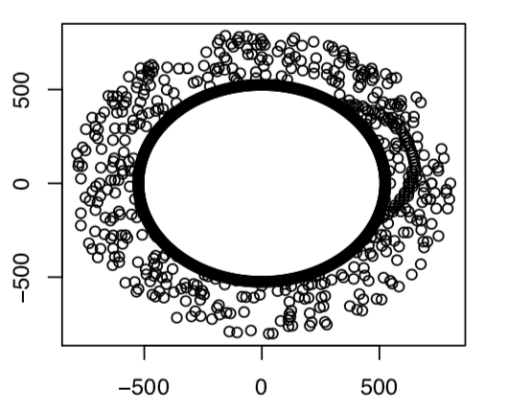
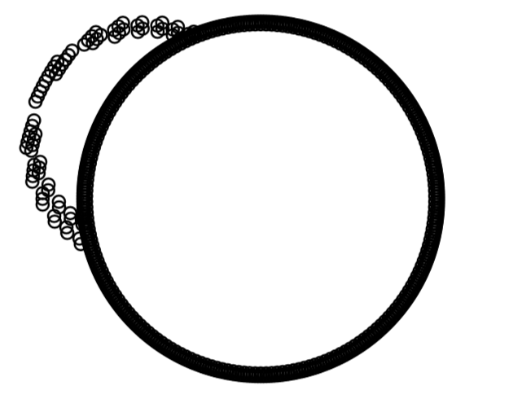
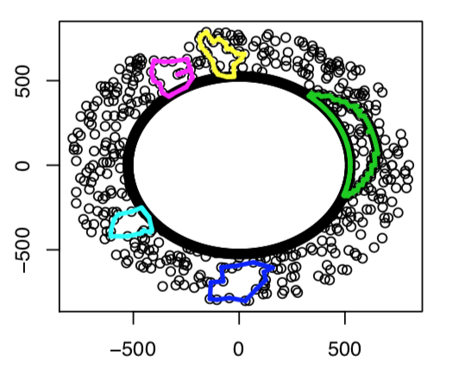
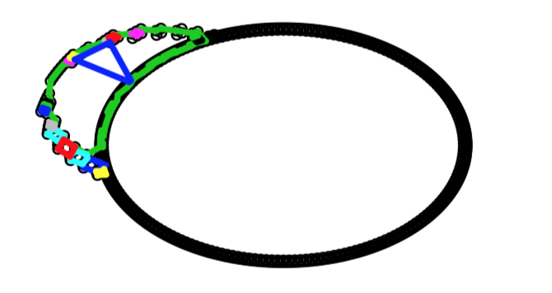
Toy model vs real geometry
Straight wire $vs$ stereo wire
Depending on z axis trajectory projection is not a demi-circle anymore
Even without noise we already lose a part of the signal

Slide 14
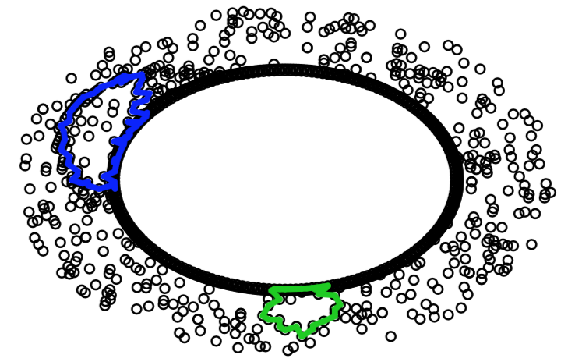
Toy model vs real geometry
Straight wire $vs$ stereo wire
Depending on z axis trajectory projection is not a demi-circle anymore
We lose even more information while adding noise

Slide 15
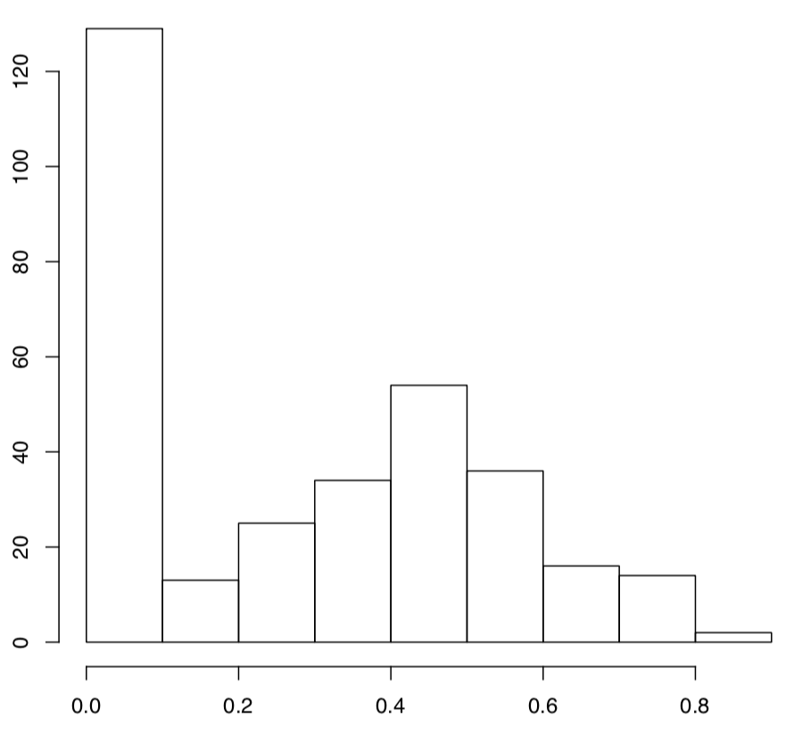
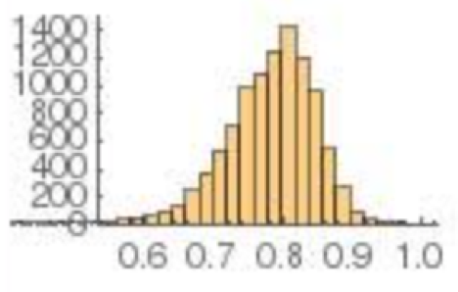
Toy model vs real geometry
Straight wire $vs$ stereo wire
Longest life time loop efficiency:
Toy model
Real geometry

Slide 16
Outlook
COMET Phase –I + Study motivation
Persistent homology
Result with toy model
Toy model vs real geometry
Resume and outline

Slide 17
Resume & Outline
In the toy model case (straight wire) :
Around 70 – 80 % efficiency for 10% BG
Efficiency become poor when increase BG over 25%
100 % efficiency can be recovered with simple circle fitting
In the real geometry case (stereo wire):
Even without noise we lose signal
With noise it’s even worse
There is a few way to solve those issues :
Filter background using energy deposit, drift time …
Separate layers by stereo angles (even and odd layers)
Combining with other track finding method (Hough transform ...)
Weighted persistence homology

Slide 18
Backup slide
Dorian Pieters

Slide 19
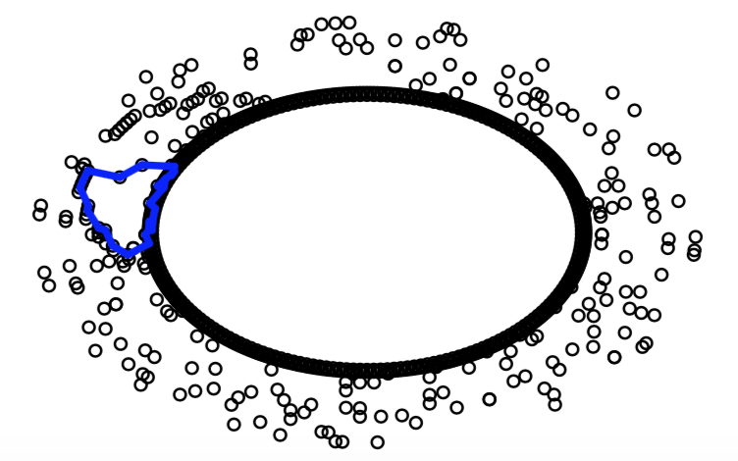
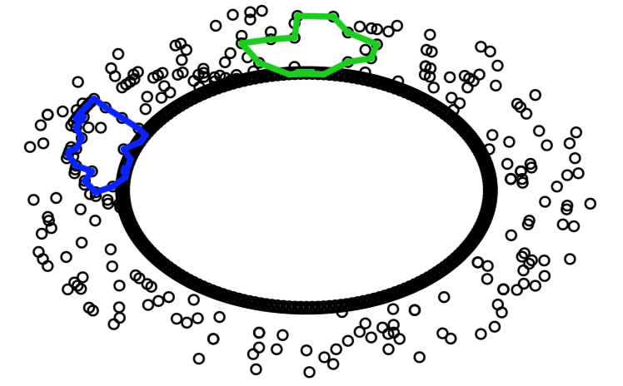
Layer separation by stereo angle
Layer separation doesn’t work at all in some event or is worst than both layers combined
All layers
Odd layers
Even layers

Slide 20
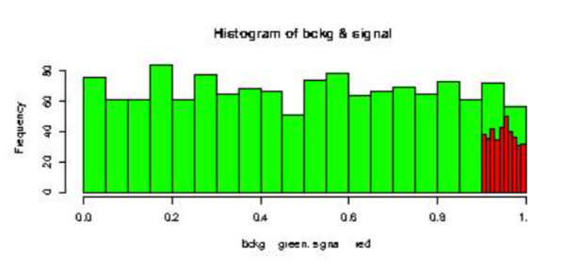
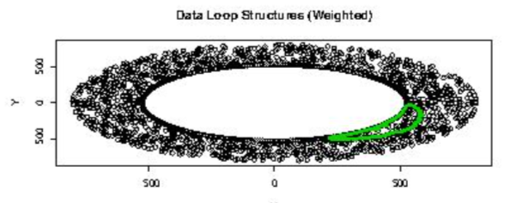
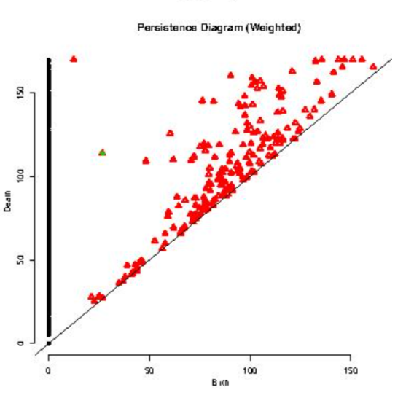
Weighted persistence homology
We can change the way we link point. We are currently using Euclidean distance to link point, and weight them with probability of being a hit of interest (use of dE/dx for example)
$$d\left(A,B\right)=W_{A}W_{B}d_{E}(A,B)$$
Where $W_{X}=1/P(X is a signal hit)$, $d_{E}(X,Y)$ the Euclidean distance between X and Y.
Wilfrid da Silva, Workshop 11-13/07/2018

