Slide 1
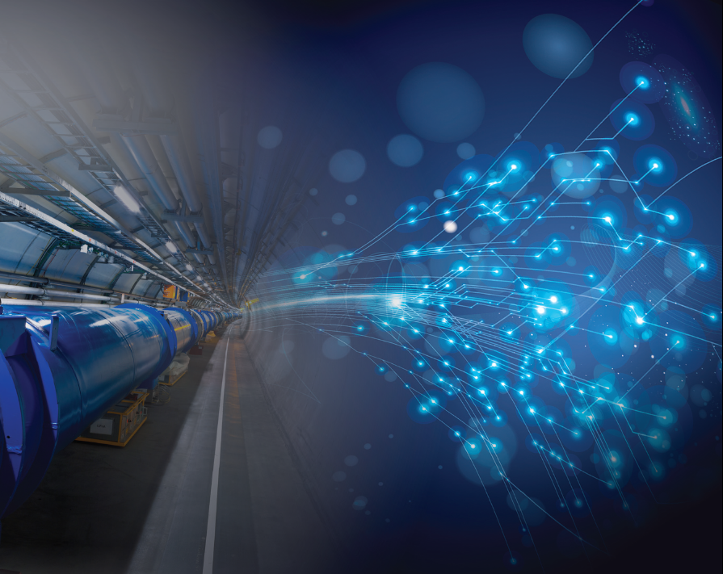
The FCC (ee-hh) project
Roy Aleksan
CEA
IHEP Seminar
22/10/2018
Introduction
Selected Physics reaches of FCCee and hh*
Main FCC Accelerator Technology Challenges
Conclusion
* Only a tiny part of physics program discussed here
Detector issues not discussed in this talk

Slide 2
The World (« Standard Model ») of Particle Physics in a slide
All particles (antiparticles)
&fields initially massless
Z⁰ , W±
ν_{e}
ν_{μ}
ν_{τ}
H
B, A³
A^{1,2}
leptons
B, A³
e
μ
SU(3)xSU(2)xU(1)
Higgs Mechanism does it all … at first look:
Brakes interaction symmetry
Generates masses
Enables particle/antiparticle symmetry breaking
τ
Mass (eV)
Everyday’s world
g
u
c
t
quarks
(+G)
d
s
b
But
Only Electroweak symmetry SU(2)xU(1) is broken (not a GUT)
Does not explain masses value nor the >15 order of magnitude
Enabled particle/antiparticle asymmetry but not enough to explain absence of antimatter
3 fermions
(antifermions) families
Interactions
γ
SU(3)xU(1)
… and does not say anything about 95% of Universe

Slide 3
Most of these issues call for BSM physics …
BUT !

Slide 4
Possible Strategy (… in my views)
Mesuring the electroweak sector with the HIGHEST possible precision with e⁺e⁻ collisions, i.e. in “clean environment” (Z, W, H, heavy flavors (b, top) …).
Search deviations from the SM providing indications on the scale of New Physics (ignoring Naturalness, so far BSM < ~10¹⁰ GeV from vacuum stability)
Complementing FCCee precision measurements and Exploring this New Physics directly with pp collisions
If needed, complement the studies with other types of collisions
  e^{+/-}p collisions
  γγ collisions
  μ⁺μ⁻ collisions
Could use FCC infrastructures, not discussed in this talk
We should develop a strategy toward Very High Energy … …possibly with the same complex.
A « >50-year » programme !

Slide 5
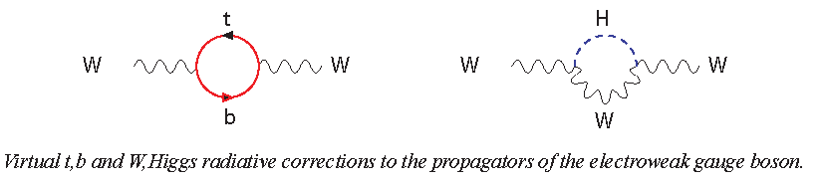
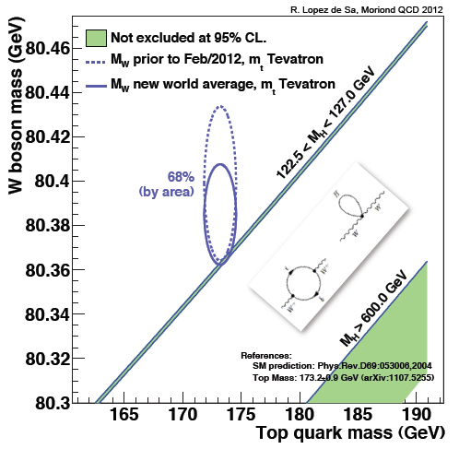
…What next
Continue to search for BSM physics
Verify further the consistency of the Standard Model
(Z)
(Z)
(Z)
(Z)
(t)
(Z)
∝ M_{t}²
∝ ln(M_{H}/M_{W(Z)})
M_{W}= 80.379 ± 0.012 GeV
M_{t}= 173.3 ± 0.4_{exp.} ± 0.5_{theo.} GeV
Need to improve
M_{w} and M_{t}
M_{H}

Slide 6
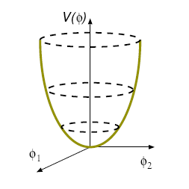
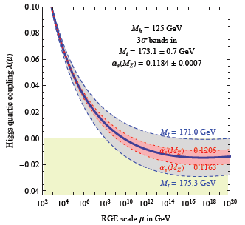
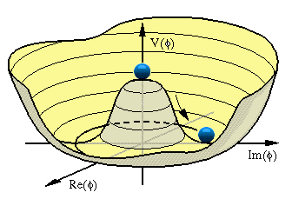




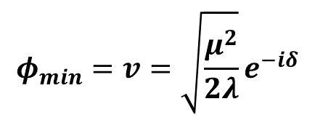
Study of the Higgs properties, its couplings and the potential
$V_{Higgs}={−μ}^{2}$ $φ^{†}φ+λ{φ^{†}φ}^{2}$
Interaction strength varies with energy scale, depends on quantum numbers and particle species
field self coupling
$$φ_{min}=v=0$$
H potential
λ runs too
H
H
∝ λ
H
$${φ_{min}=v=\sqrt{\frac{μ^{2}}{2λ}}e}^{−iδ}$$
H
H
∝ λ^{1/2}M_{H}
H
H
Consistency Check
$$υ=246 GeV$$
Vaccuum instability
Measure precisely λ, M_{t}, α_{s}
$$M_{H}=\sqrt{{2λv}^{2}}$$

Slide 7
BAU and Nature of EW phase transition
Strong 1st order phase transition is required to sustain the out of equilibrium generation of a baryon asymmetry during EW symmetry breaking
But because M_{H} =125 GeV, phase transition is smooth (2nd order) (M_{H}<80 GeV would be needed for 1st order transition)
does not allow to generate BAU
new physics, coupling to the Higgs and being effective at scales
O(TeV), must modify the Higgs potential to make this possible
Search for higher-order terms of the Higgs potential (self couplings)
Search for other particles coupled to the Higgs and/or measure very precisely the Yukawa couplings

Slide 8
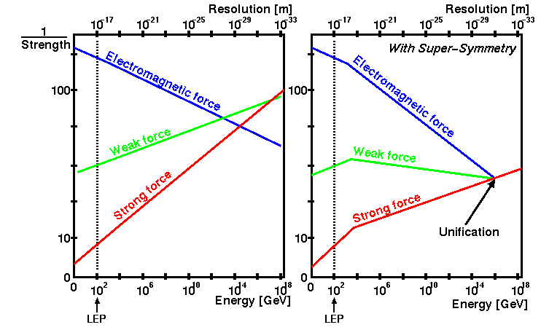



Grand unification of Interactions (Strong, Weak, Electromagnetic)
is still our goal
Additionnal particles (such as supersymmetric partners) with energy scales of TeVs affect the running of the coupling constants
$$\frac{1}{α_{1}}$$
$$\frac{1}{α_{2}}$$
$$\frac{1}{α_{3}}$$
Need to explore higher energy regions (up to ~10 TeV) for new particles

Slide 9

What do we need to Study Higgs properties
Upgrade LHC luminosity (by factor ~10)
  Improve beam currents and focusing
Build a dedicated « Ultimate Higgs & BSM Complex »
  e⁺e⁻/pp collider with highest possible luminosity
  enabling to explore the multi TeV scale (highest possible Energy)
What are the physics performance that can be achieved
Do we have the technology to build such a Complex?

Slide 10

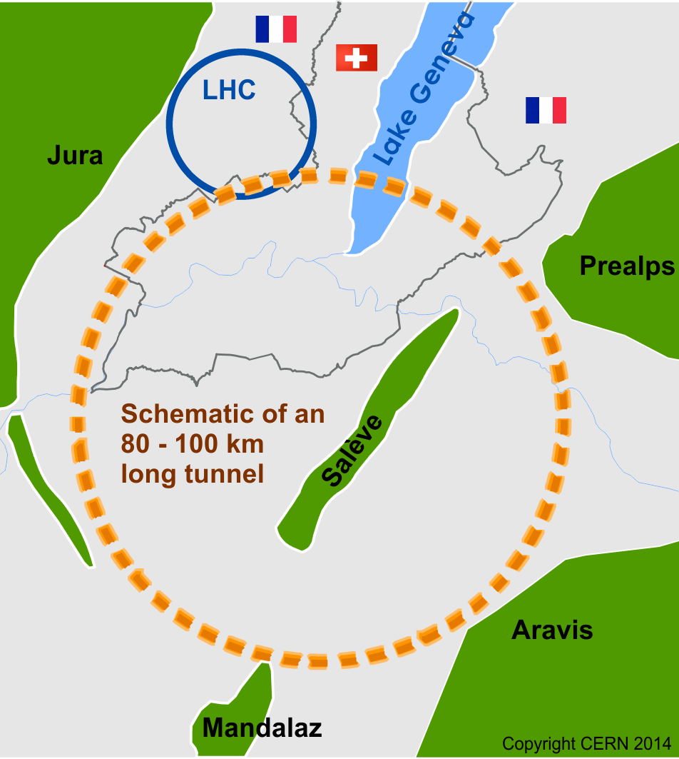

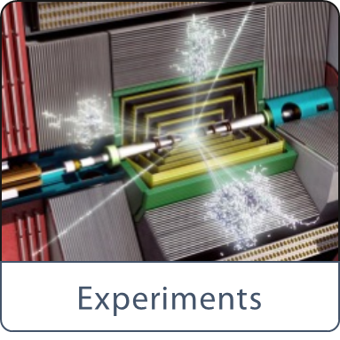
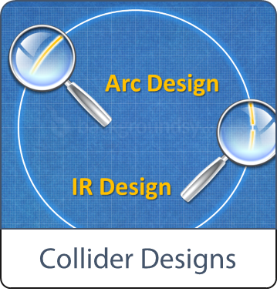
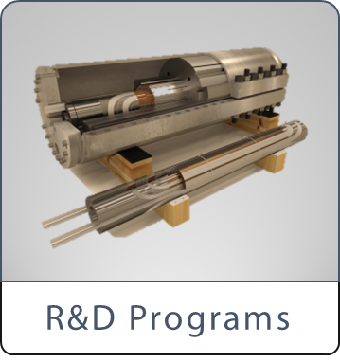

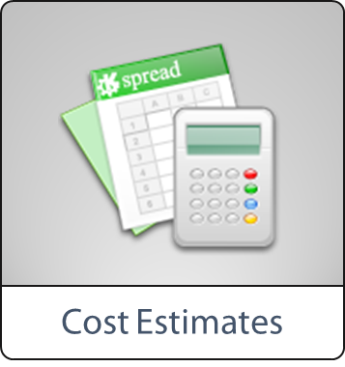
Future Circular Collider (FCC) Study
International FCC collaboration (CERN as host lab) to study:
pp-collider (FCC-hh) → main emphasis, defining infrastructure requirements
~100 km tunnel infrastructure in Geneva area, site specific
e⁺e⁻ collider (FCC-ee), as potential first step
HE-LHC with FCC-hh technology
p-e (FCC-he) option, IP integration, e⁻ from ERL
HE-LHC
~16 T ⇒ 100 TeV pp in 100 km
CDR in fall 2018

Slide 11
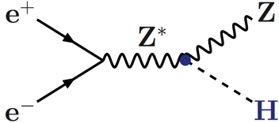
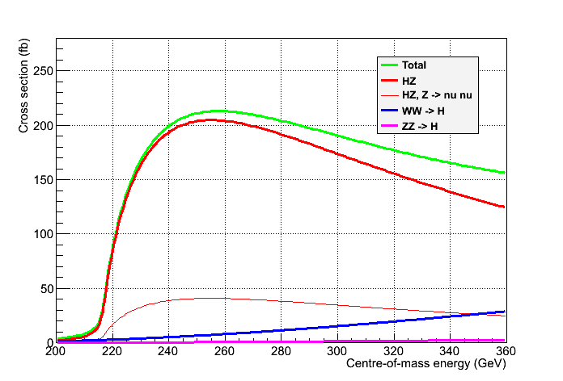

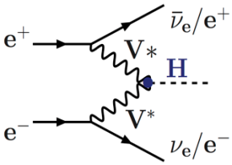
FCCee : High precisions Higgs couplings at 240 GeV and 350 GeV
Great e⁺e⁻ asset: Tagged Higgs sample
  Total Higgs decay width
  Individual branching ratios to sub %
  Invisible and exotic decays
Reconstruct Z
Determine recoil mass
(thanks to be beam-energy constraint , no beamstralhung)
But …
Cross section modest a very large luminosity
Unpolarized cross sections
P Janot and G. Ganis
σ_{Hνν,} BRs,
width
Spin,
mass
σ_{HZ,} BRs,
width
Z → All
Z → νν
δ(σ_{HZ}) = 0.5%

Slide 12
FCC-ee collider parameters
FCC-ee Luminosity for 50 MW power per beam and 2 IP
~2x10¹² Z/y (a EWK, flavor, lepton… physics)
~2x10⁷ W/y
~3x10⁵ H/y
~4x10⁵ t/y

Slide 13
FCCee sensitivities to Higgs couplings
5 Y
@
240GeV
+ 1.5 Y
@
365GeV
+ LHC

Slide 14
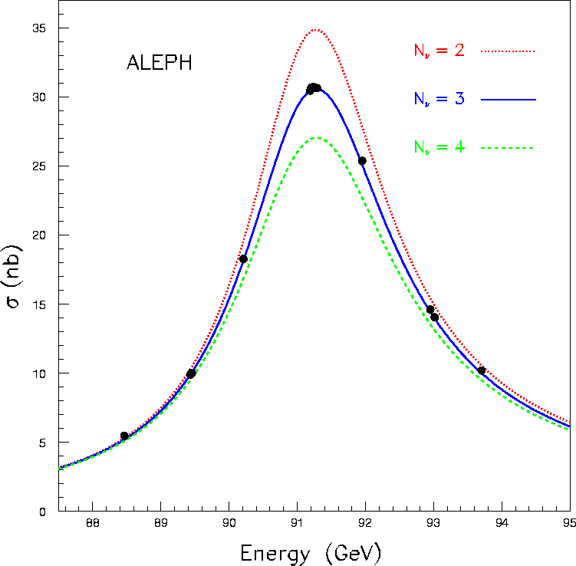
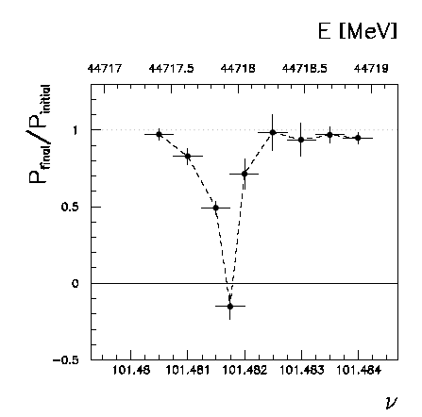
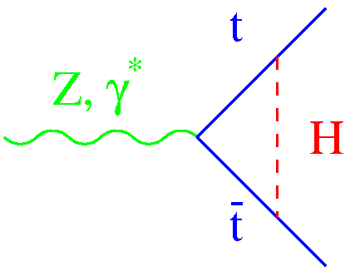
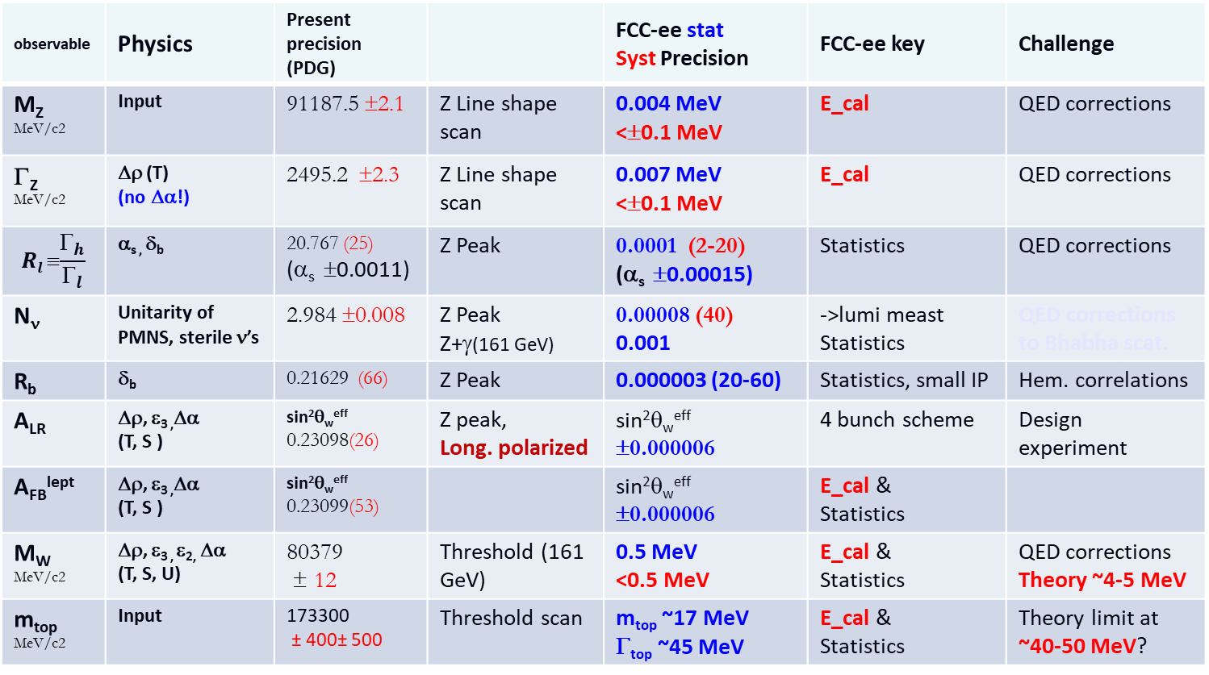
Higgs couplings only a part of FCCee program
observable | Physics | Present precision (PDG) |  | FCC-ee stat Syst Precision | FCC-ee key | Challenge
M_{Z} MeV/c2 | Input | 91187.5 ±2.1 | Z Line shape scan | 0.004 MeV <±0.1 MeV | E_cal | QED corrections
Γ_{Z} MeV/c2 | Δρ (T) (no Δα!) | 2495.2 ±2.3 | Z Line shape scan | 0.007 MeV <±0.1 MeV | E_cal | QED corrections
$$Rl ≡\frac{Γ_{h}}{Γ_{l}}$$ | α_{s ,} δ_{b} | 20.767 (25) (α_{s} ±0.0011) | Z Peak | 0.0001 (2-20) (α_{s} ±0.00015) | Statistics | QED corrections
N_{ν} | Unitarity of PMNS, sterile ν’s | 2.984 ±0.008 | Z Peak Z+γ(161 GeV) | 0.00008 (40) 0.001 | ->lumi meast Statistics | QED corrections to Bhabha scat.
R_{b} | δ_{b} | 0.21629 (66) | Z Peak | 0.000003 (20-60) | Statistics, small IP | Hem. correlations
A_{LR} | Δρ, ε_{3 ,}Δα (T, S ) | sin²θ_{w}^{eff} 0.23098(26) | Z peak, Long. polarized | sin²θ_{w}^{eff} ±0.000006 | 4 bunch scheme | Design experiment
A_{FB}^{lept} | Δρ, ε_{3 ,}Δα (T, S ) | sin²θ_{w}^{eff} 0.23099(53) |  | sin²θ_{w}^{eff} ±0.000006 | E_cal & Statistics
M_{W} MeV/c2 | Δρ, ε_{3 ,} ε_{2,} Δα (T, S, U) | 80379 ± 12 | Threshold (161 GeV) | 0.5 MeV <0.5 MeV | E_cal & Statistics | QED corrections Theory ~4-5 MeV
m_{top} MeV/c2 | Input | 173300 ± 400± 500 | Threshold scan | m_{top} ~17 MeV Γ_{top} ~45 MeV | E_cal & Statistics | Theory limit at ~40-50 MeV?
Beam E cal. with
reson. depolar.
Max sensit. to M
Max sensit. to Γ
As important is the precision on SM parameters :
FCCee will improve precision by > 1 order of magnitude
Running at Z pole mandatory, as is progress in theory

Slide 15
Precision measurements as of to date
Precision measurements as expected at FCCee
FCCee direct
FCCee Z pole

Slide 16
From EWK fit to search of NP scale
5D operator only relevant for majorana Neutrino
6D operators relevant for NP
examples
EW Precision measurements enable to set scale of New Physics in a model independent way if
NP scale >> EW scale
6D operators affect the EW Observables
FCCee is sensitive to scales up to 40 TeV !

Slide 17
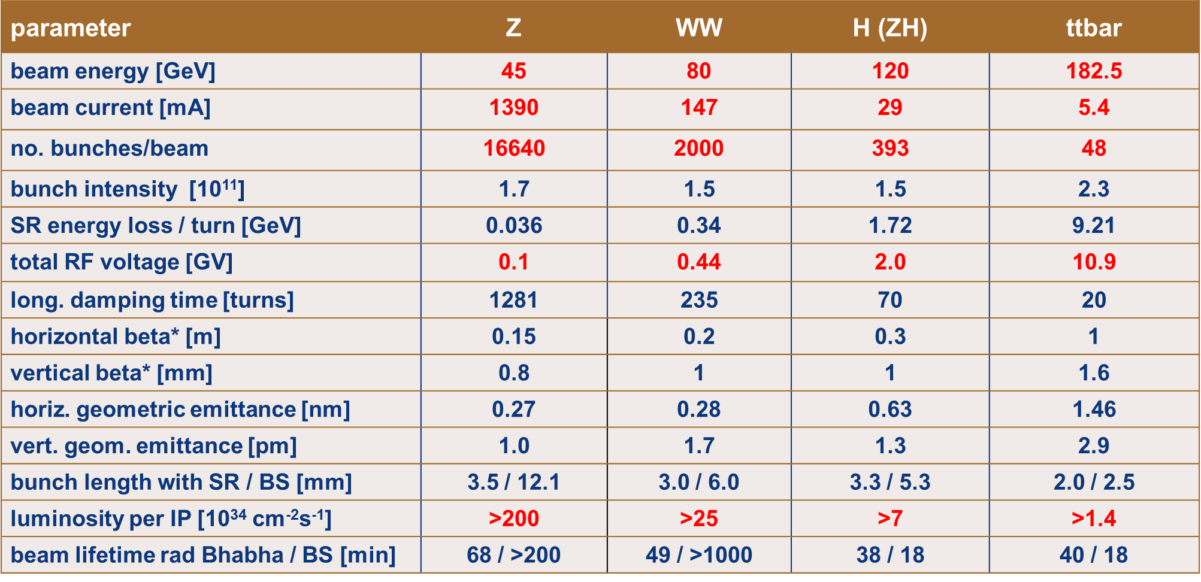
FCC-ee collider parameters

Slide 18
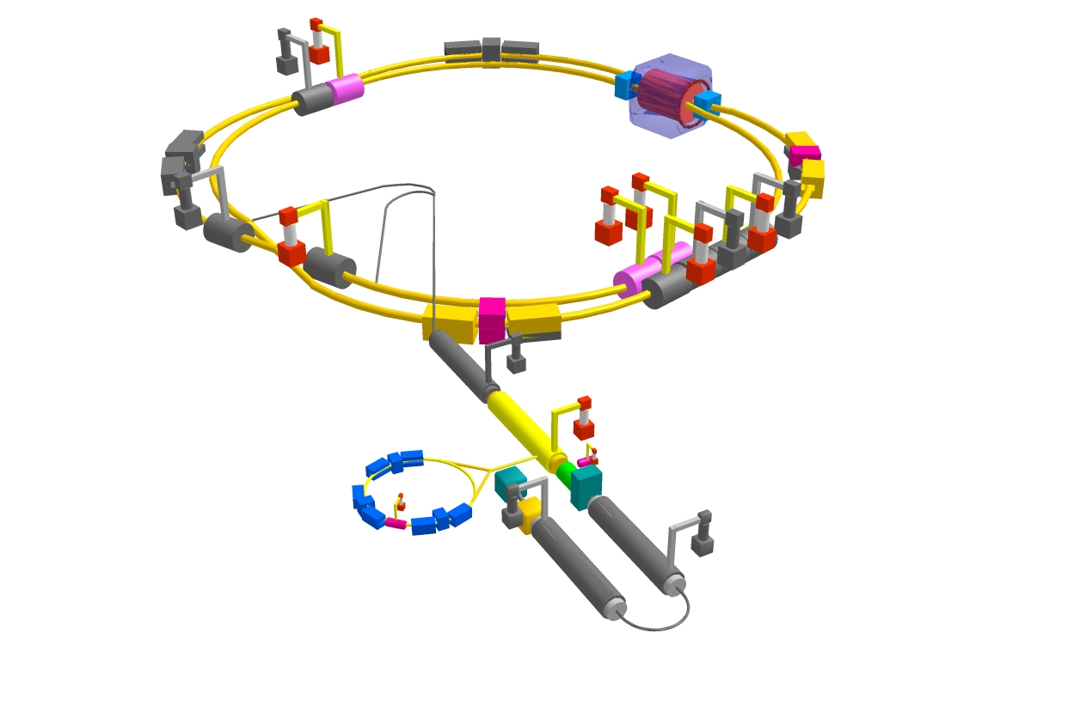
FCC-ee : selected mains challenges
top up injection at high current
β_{y}* =300 μm (FCC-ee: 1 mm)
lifetime 5 min (FCC-ee: ≥18 min)
ε_{y}/ε_{x} =0.25% (similar to FCC-ee)
off momentum acceptance (±1.5%, similar to FCC-ee)
e⁺ production rate (2.5x10¹²/s, FCC-ee: <1.5x10¹²/s (Z cr.waist)
Deal with small beam life time
a Top up scheme needed
I_{e+}=3.6 A, I_{e-}=2.6 A
SuperKEKB goes beyond FCC-ee, testing all concept
Develop high efficient gradiant RF system
three sets of RF cavities to cover all options for FCC-ee & booster:
high intensity (Z, FCC-hh): 400 MHz mono-cell cavities (4/cryom.)
higher energy (W, H, t): 400 MHz four-cell cavities (4/cryomodule)
ttbar machine complement: 800 MHz five-cell cavities (4/cryom.)
installation sequence comparable to LEP ( ≈ 30 CM/shutdown)
WP | V_{rf} [GV] | #bunches | I_{beam} [mA]
Z | 0.1 | 16640 | 1390
W | 0.44 | 2000 | 147
H | 2.0 | 393 | 29
ttbar | 10.9 | 48 | 5.4
“high-gradient” vs high-current machine
Including high efficiency RF generation (Klystrons…)

Slide 19
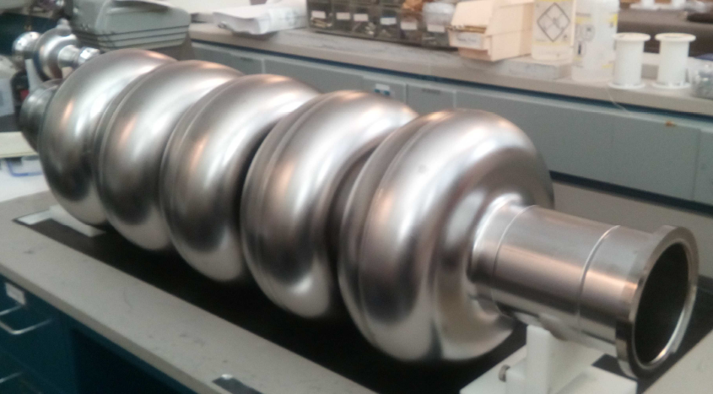
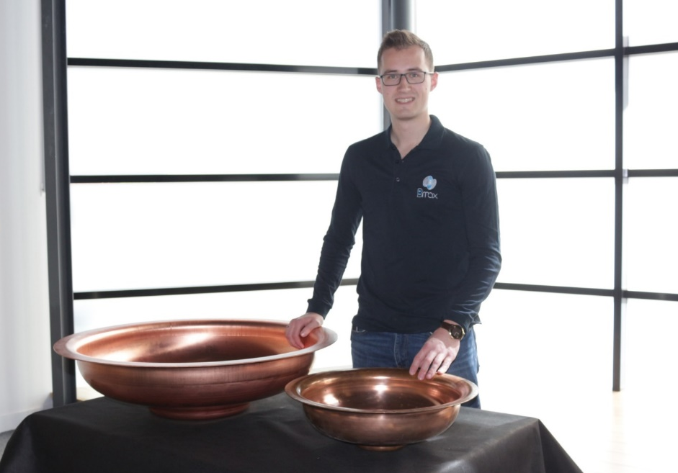
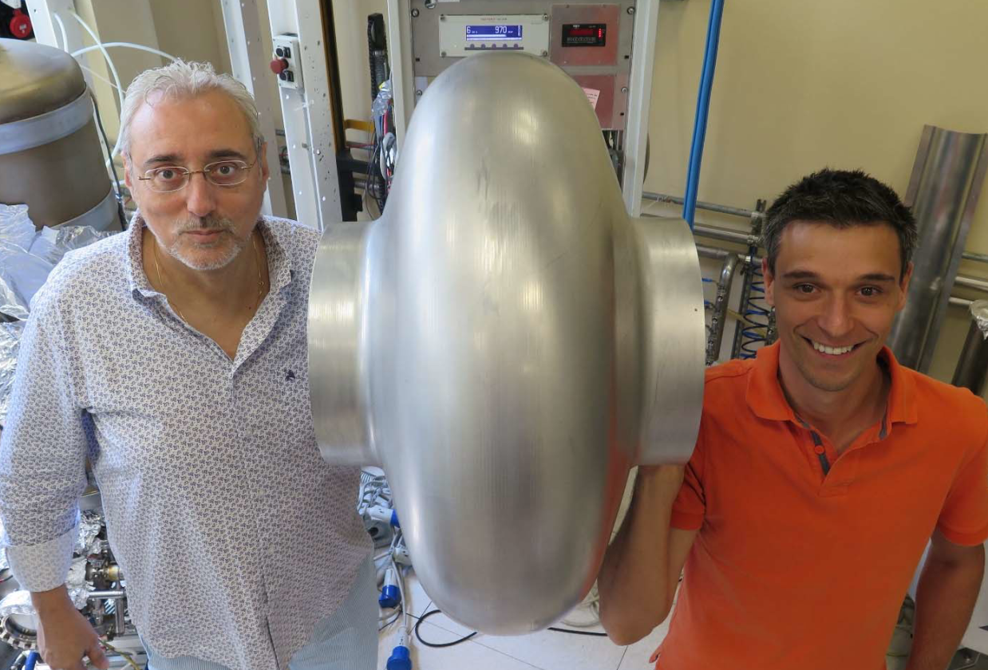
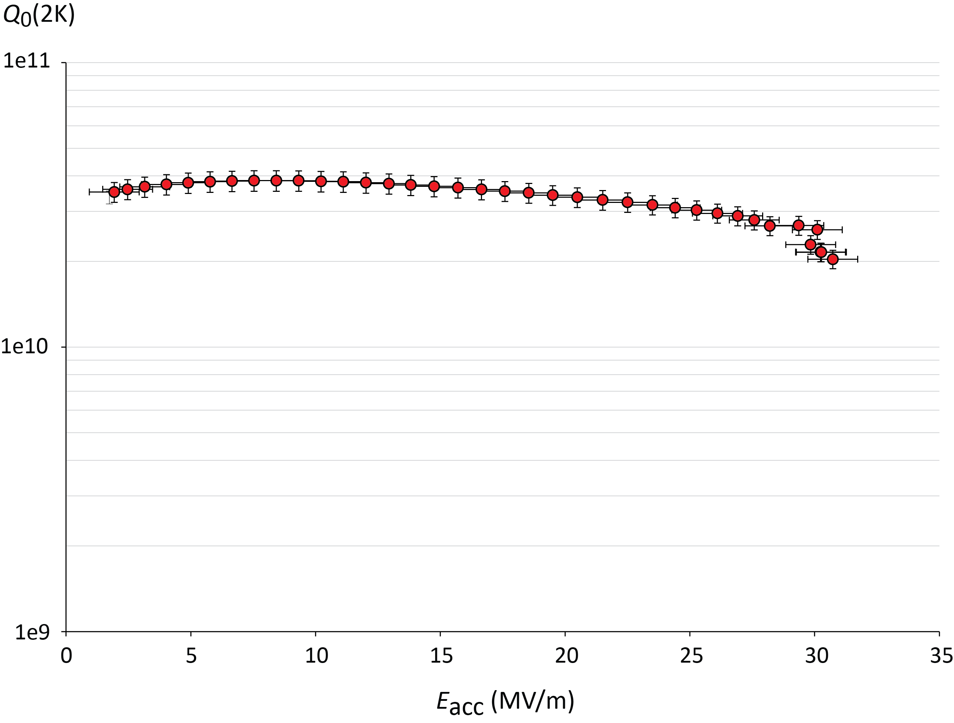

SRF cavity development (examples)
5-cell 800 MHz cavity, JLAB prototype for both FCC-ee (t-tbar) & FCC-eh ERL
Seamless 400 MHz single-cell cavity formed by spinning at INFN-LNL
CERN half-cells formed using Electro-Hydro-Forming (EHF) at Bmax.
Tooling fabricated and successfully tested with an Aluminium cavity.
Legnaro, Feb 2018
JLAB, Oct 25, 2017
F. Marhauser et al
5.5 x 24m²
$Q0 3∙{10}^{10}$ @ 2K
V. Palmieri † C. Pira
J.-F. Croteau, EASITrain PhD Student
31 MV/m
High strain rate technology using shockwaves in water from HV discharge.
EHF investigated for half-cells and seamless Nb and Cu cavities.
Regime of E_{acc}
requirements
in LHeC, PERLE,
FCC-ee
quench limit
Multi-pactor free, up to~20 MV/m

Slide 20
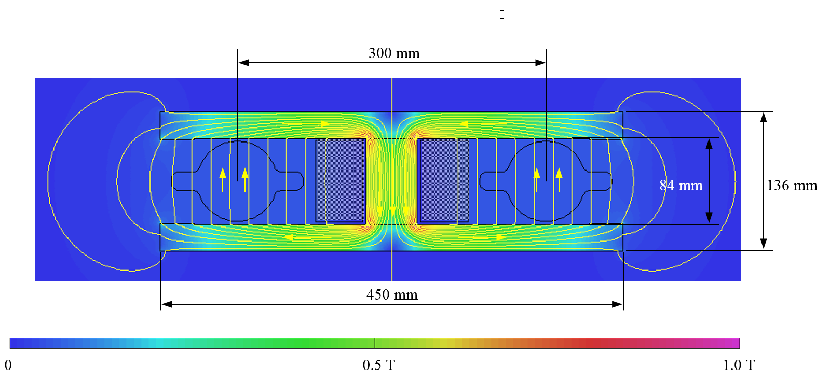
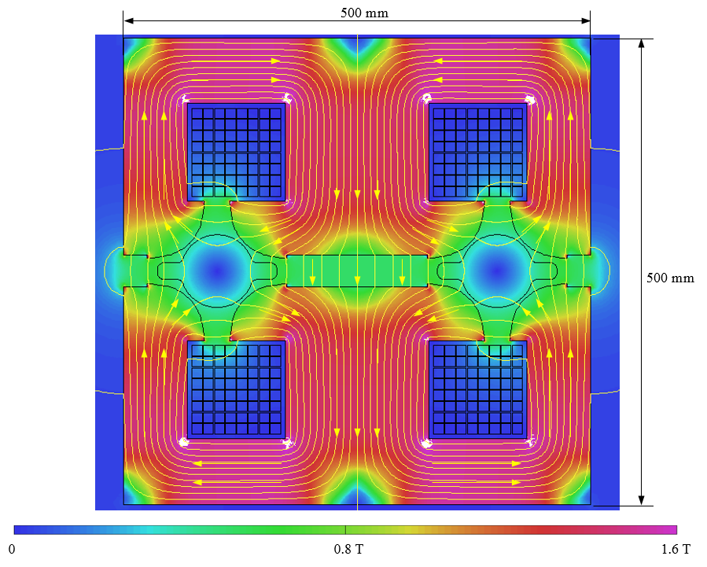
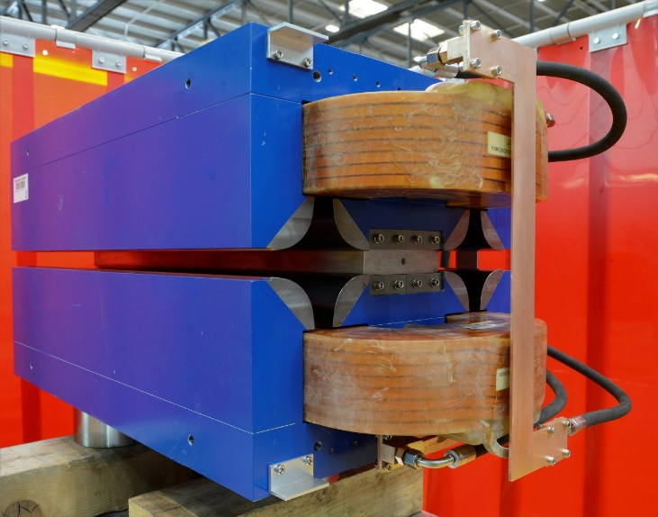
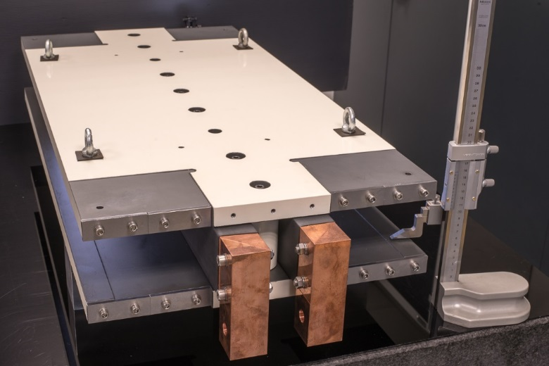
Low-power low-cost design for FCC-ee magnets
Twin-dipole design with 2× power saving
16 MW (at 175 GeV), with Al busbars
twin F/D quad design with 2× power saving
25 MW (at 175 GeV), with Cu conductor
first 1 m prototype
first 1 m long prototype
6 or 12 m dipoles needed for FCCee
2.5 m quadruploes needed
the twin behaviour is confirmed: more measurements are planned for the low field effects and the multipoles

Slide 21
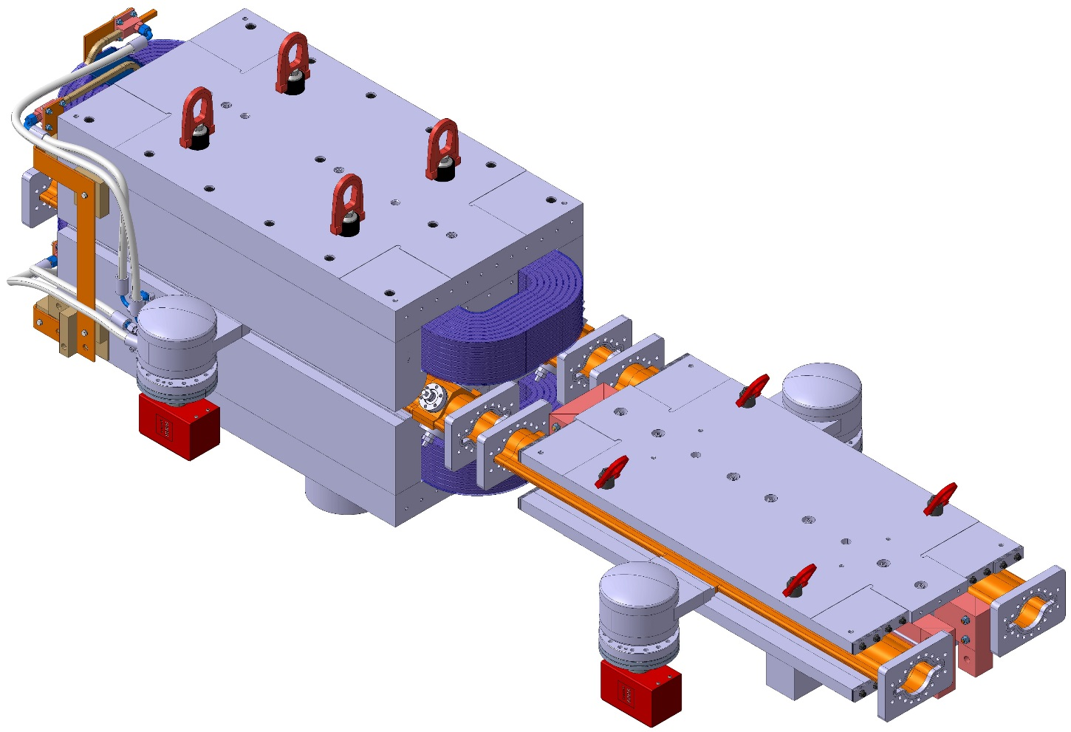
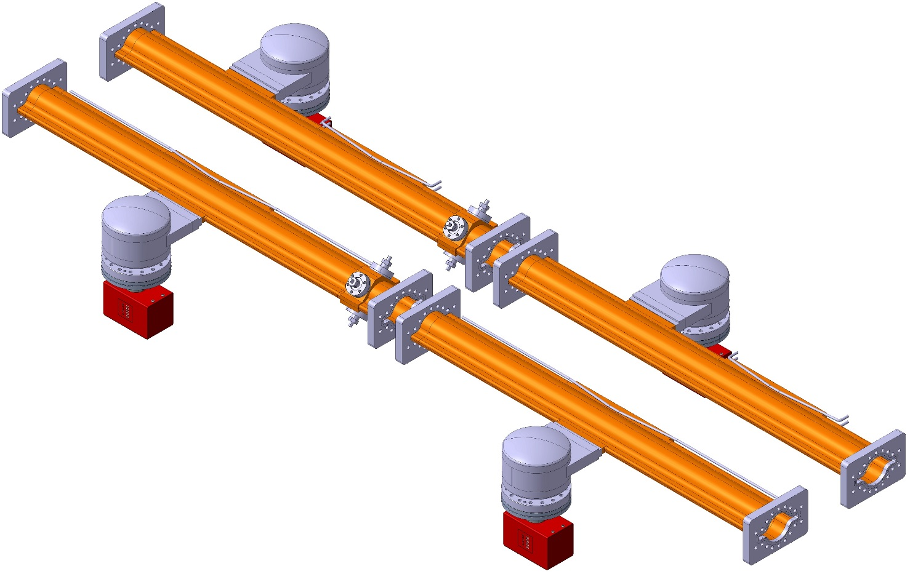
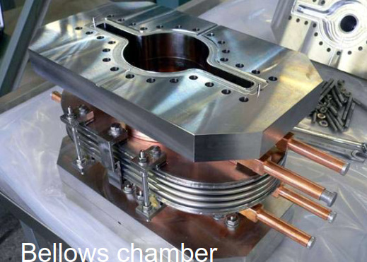
FCC-ee arc vacuum prototyping & integration
Vacuum chamber cross section: 70 mm ID with ”winglets” in the plane of the orbit (SuperKEKB-like);
The chambers feature lumped SR absorbers with NEG-pumps placed next to them.
Construction of chamber prototypes in coming months and integration with twin magnets

Slide 22
FCC-ee injector layout
SLC/SUPERKEKB-like linac accelerating 1 or 2 bunches with repetition rate of 100-200 Hz
Same linac used for positron production @ 4.46 GeV Positron beam emittances reduced in DR @ 1.54 GeV
Injection @ 6 GeV into of Pre-Booster Ring (SPS or new ring) and acceleration to 20 GeV
Injection to main Booster @ 20 GeV and interleaved filling of e+/e- (below 20 min for full filling) and continuous top-up

Slide 23

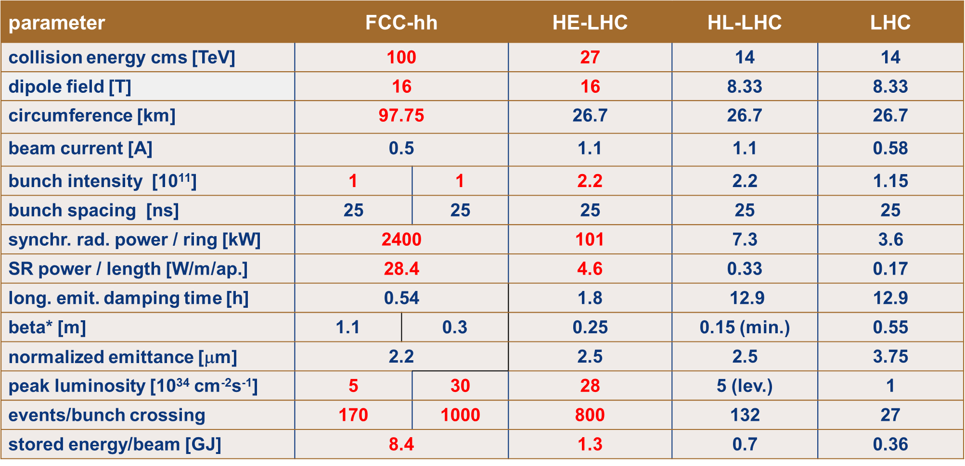
FCC-pp collider parameters

Slide 24
2 selected physics topics: Top Yukawa (ttH)
Besides search of new particles, the reachable mass scales as ${\sqrt{S}}/{\left(14 TeV\right)}$, i.e. factor 7.
σ(100 TeV)/σ(14 TeV) ≈60 x factor 10 for luminosity
Comparing ttZ to ttH
a suppression of most systematics
since similar graphs
δy_{t}/y_{t} <1%

Slide 25
Higgs self coupling @100 TeV
σ(100 TeV)/σ(14 TeV) ≈40 x factor 10 for luminosity
Negative interference between box and triangle
Sensitivity to λ from low M_{HH} region
Mode | Sensivity : δK_{λ}(Stat) with 30 ab⁻¹
HH g bbγγ | 3.5%
HHj g bbbbj + bbττj | 10-30%
HH g bb4l | 20-30%
HH g bbWWg bblνjj | 40%
FCChh is the machine for the H self coupling
δk_{λ}/k_{λ} <3.5%

Slide 26
Worldwide FCC Nb₃Sn program
5400 mm²
3150 mm²
Main development goal is wire performance increase:
J_{c} (16T, 4.2K) > 1500 A/mm² →50% increase wrt HL-LHC wire
Reduction of coil & magnet cross-section
~1.7 times less SC
~10% margin
HL-LHC
~10% margin
FCC ultimate
After only one year development, prototype Nb₃Sn wires from several new industrial FCC partners already achieve HL-LHC performance
Conductor activities for FCC started in 2017:
Bochvar Institute (production at TVEL), Russia
KEK (Jastec and Furukawa), Japan
KAT, Korea
Columbus, Italy
University of Geneva, Switzerland
Technical University of Vienna, Austria
SPIN, Italy
University of Freiberg, Germany
  In addition, agreements under preparation:
  Bruker, Germany
  Luvata Pori, Finland

Slide 27
FRESCA2 dipole: the first project as R&D for HL-LHC
(Project supported by several EC project, EuCARD, EuCARD2…)
Nb3Sn dipole for cable test facility.
Nominal design field 13 T (ultimate 15 T): reached 14.6 T, few quenches!

Slide 28
11T First Nb3Sn magnet
New Model (SP 107) model training
4 quenches to nominal
10 quenches to ultimate
2 quenches to ultimate after
thermal cycle
Nb3Sn magnet technology is being mastered

Slide 29
11T magnet production
Objective: installation of several magnets during LS2 (i.e. now)

Slide 30

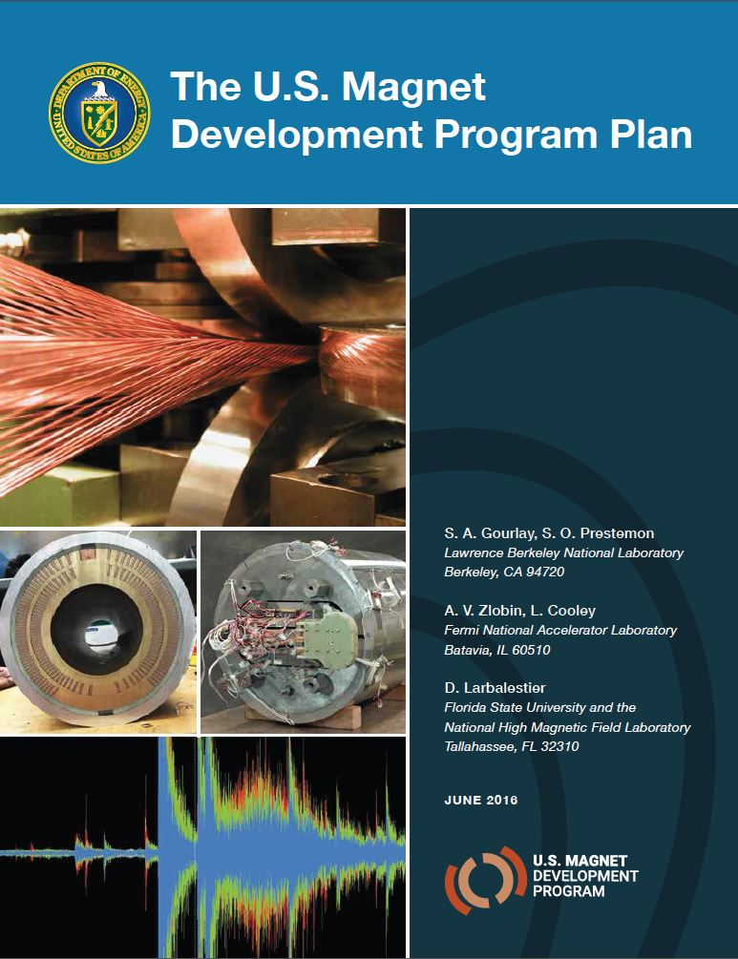
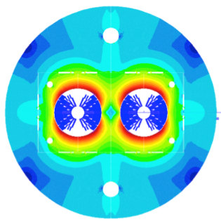
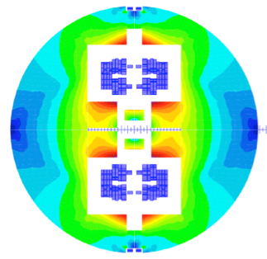

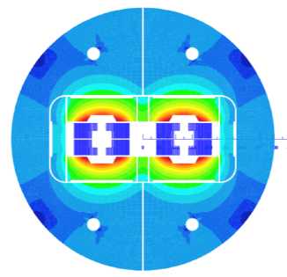
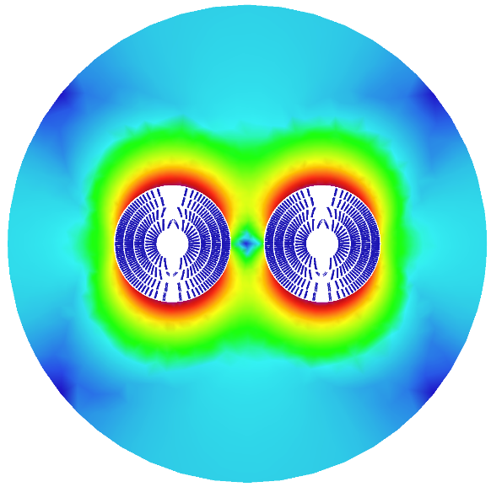
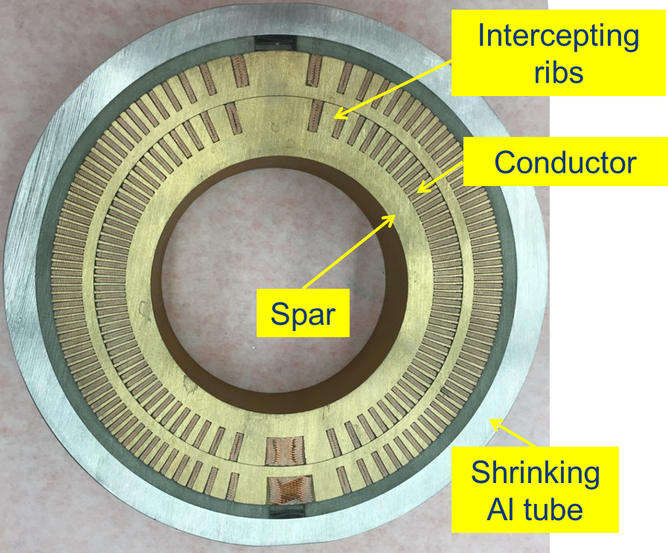
16 T dipole design activities and options
H2020
Swiss contribution
Cos-theta
Common coils
Canted
Cos-theta
Blocks
INFN
CIEMAT
LBNL
PSI
CEA
FNAL
Short model magnets (1.5 m lengths) will be built from 2018 – 2022
Russian 16 T magnet program launched by BINP recently.

Slide 31

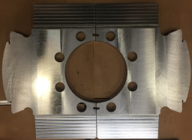
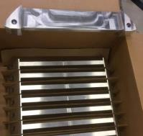
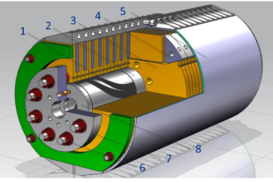
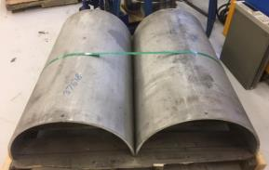
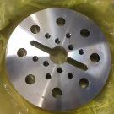
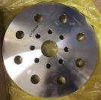
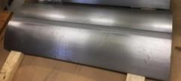
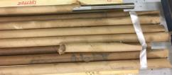
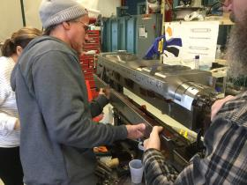
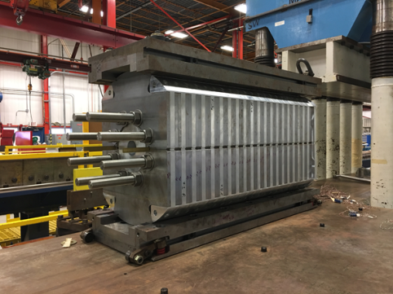
15 T dipole demonstrator (US-MDP)
Iron Laminations
AL I-Clamps
StSt Skin
End Plates
Fillers
Axial Rods
All coil parts, structural components and tooling are available at FNAL
Coil fabrication and the work with mechanical structure are in progress
Magnet first test in September 2018

Slide 32







16 T ERMC construction at CERN
Coil fabrication
  Winding of the first coil has been completed
  Preparation for reaction on-going
  All tooling for coil production ready
Aluminum shell
Magnet yoke
First ERMC coil winding
Magnet assembly
  components and tooling ready
  Dummy assembly to characterize the structure behavior on-going.
Coil Reaction Tool
Coil Impregnation Tool
Dummy coils
Axial rods

Slide 33




FCC-hh: beam screen evolution & tests
SR power @ 50 TeV/beam = 2.4 MW
Simplified BS design in view of:
Mass production
Impedance optimization
e- cloud mitigation
latest version to be tested summer ‘18
FCC
LHC
Cold Sprayed Isolated Electrode
(e-cloud mitigation option)
Design optimisation:
Ribs removed; Optimization of thickness of copper and steel
Connection absorber/cooling tube, and welding positions
Measurements at KARA/KIT (pressure evolution) confirm MC vacuum simulations
Confident to use simulations for all vacuum design

Slide 34



Implementation - new footprint baseline
Following geological review of the most challenging areas a new baseline position was established considering:
Lowest risk for construction
Fastest and cheapest construction
Feasible positions for large span caverns (the most challenging structures)
Next step: iteration with review on surface site locations and machine layout
> 90% of tunnel in « good rock »

Slide 35


FCC – tunnel integration in arcs
  FCC-ee FCC-hh
  new 5.5 m inner diameter

Slide 36
Technical Schedule for each of the 3 options
20
22
24
26
28
30
32
34
36
38
40
42
ESU
2020
Technical Design Phase
Strategy Update 2026 – assumed project decision
Dipole short models
Dipole long models
16 T magnets
SC Magnets
16 T dipole indust. prototypes
16 T dipoles preseries
16 T series production
Civil Engineering FCC-hh ring
FCC-hh
FCC-hh
CE TL to LHC
LHC Modification
Installation + test FCC-hh
CE FCC-ee ring + injector
FCC-ee
FCC-ee
Injector
Installation + test FCC-ee
LHC Removal
HE-LHC
HE-LHC
schedule constrained by 16 T magnets & CE
→ earliest possible physics starting dates
FCC-hh: 2043
FCC-ee: 2039
HE-LHC: 2040 (with HL-LHC stop LS5 / 2034)
Installation HE-LHC

Slide 37
Even higher energy pp collisions !
If one assumes the scenario FCCee first followed by FCChh:
More time available for R&D on HF magnets with HTS
Field up to 24 Tesla could be considered
a 150 TeV
We have checked that the tunnel designed for 100 TeV does not lead to show stoppers for 150 TeV
Strong R&D on HTS cable (in particular to reduce the cost is on-going

Slide 38
Conclusions
FCCee enables unequaled precision tests of the EW sector of the SM
Thanks to
Extremely high luminosities
Operation at the Z pole (mandatory) and WW threshold
Clean and well know initial condition (beam energy calibration, very small beamstralhung)
Well know accelerator technologies (being tested with KEKII)
FCChh enables unequaled reach for direct BSM physics as well as tests of the EW sector complementary to FCCee
Thanks to
Extremely high energy and luminosities
Excellent complementarity with FCCee (ttH and HHH couplings)
Accelerator technologies being tested at HL-LHC
As well as ANKA for vacuum system tests
FCC would enable a fantastic opportunity for HEP over the next 60 years or so …

Slide 39
Back up slides

Slide 40




Study further the Higgs properties and couplings
$V_{Higgs}={−μ}^{2}$ $φ^{†}φ+λ{φ^{†}φ}^{2}$
$$+\left[\overline{ψ_{Li}}Y_{ij}ψ_{Rj}φ+h.c.\right]$$
$${m_{ij}^{}≡ Y}_{ij}v$$
H coupling to fermions λ² ∝ m_{f}²
H
∝ Yν
f
f
High precisions H couplings needed

Slide 41




ElectroWeak Symmetry Breaking precision measurements
Example : Precision for Higgs couplings
SUSY modifies tree-level couplings
e.g. Pseudo-scalar A is difficult to find for moderate tanβ=5
H. Baer, M. Peskin et al.
Largest effet expected for bb, ττ
$$\frac{g_{hbb}}{g_{h_{SM}bb}}=\frac{g_{hττ}}{g_{h_{SM}ττ}}≈1+1.7\%{\left(\frac{1 TeV}{m_{A}}\right)}^{2}$$
e.g. light stop is an important search (hierarchy problem)
$$\frac{g_{hgg}}{g_{h_{SM}gg}}≈1+11.6\%{\left(\frac{0.5 TeV}{m_{T}}\right)}^{2}$$
$$\frac{g_{hγγ}}{g_{h_{SM}γγ}}≈1−3.2\%{\left(\frac{0.5 TeV}{m_{T}}\right)}^{2}$$
Compositness
All couplings reduced according to compositness scale
$$\frac{g_{hff}}{g_{h_{SM}ff}}≈\frac{g_{hVV}}{g_{h_{SM}VV}}≈1−3\%{\left(\frac{1 TeV}{mf}\right)}^{2}$$
Higgs couplings should be measured as precisely as possible (<%) !

Slide 42

High precisions H couplings
Sub % sensitivities on couplings to Higgs are highly desirable to probe new physics at and above the TeV scale

Slide 43

Polarization at circular colliders
e⁻(e⁺) spin naturally aligns opposite to dipole magnetic field (Sokolov-Ternov effect)
Transverse polarization builds up by synchrotron radiation emission (or if needed using wigglers) : Observed at LEP
Transverse to longitudinal polarization is achieved with Spin Rotators
RF-m
B⊥
10 % polarization in 90mn at the Z pole using wigglers
Resonant depolarization is achieved with small field (perpendicular to dipole field) RF-magnet with frequency in phase with precession frequency/turn. (Precession period is proportional to beam energy)
Depolarizing RF-magnet frequency measures beam energy with <0.1 MeV

Slide 44

Possible scenario for $\int{L }$vs running time
@ FCCee (88-365 GeV)

Slide 45
FCC-ee operation model
working point | luminosity/IP [10³⁴ cm⁻²s⁻¹] | total luminosity (2 IPs)/ yr | physics goal | run time [years]
Z first 2 years | 100 | 26 ab⁻¹/year | 150 ab⁻¹ | 4
Z later | 200 | 52 ab⁻¹/year
W | 25 | 7 ab⁻¹/year | 10 ab⁻¹ | 1
H | 7.0 | 1.8 ab⁻¹/year | 5 ab⁻¹ | 3
machine modification for RF installation & rearrangement: 1 year
top 1st year (350 GeV) | 0.8 | 0.2 ab⁻¹/year | 0.2 ab⁻¹ | 1
top later (365 GeV) | 1.4 | 0.36 ab⁻¹/year | 1.5 ab⁻¹ | 4
total program duration: 14 years - including machine modifications
phase 1 (Z, W, H): 8 years, phase 2 (top): 6 years

Slide 46
FCC-ee RF staging scenario
“Ampere-class” machine
three sets of RF cavities to cover all options for FCC-ee & booster:
high intensity (Z, FCC-hh): 400 MHz mono-cell cavities (4/cryom.)
higher energy (W, H, t): 400 MHz four-cell cavities (4/cryomodule)
ttbar machine complement: 800 MHz five-cell cavities (4/cryom.)
installation sequence comparable to LEP ( ≈ 30 CM/shutdown)
WP | V_{rf} [GV] | #bunches | I_{beam} [mA]
Z | 0.1 | 16640 | 1390
W | 0.44 | 2000 | 147
H | 2.0 | 393 | 29
ttbar | 10.9 | 48 | 5.4
“high-gradient” machine
RF system re-alignment
and modifications
26
machine
26
26
42
74
19
booster
time [operation years]
3
10
21
100
20

Slide 47




FCC-hh cryogenic beam vacuum system
synchrotron radiation (~ 30 W/m/beam (@16 T field) (cf. LHC <0.2W/m) ~ 5 MW total load in arcs
absorption of synchrotron radiation at higher temperature (> 1.8 K) for cryogenic efficiency
provision of beam vacuum, suppression of photo-electrons, electron cloud effect, impedance, etc.
FCC-hh beam-screen test set-up at ANKA/Germany:
beam tests since June 2017, for prototypes,
confirming vacuum design simulations
X-ray fan
ANKA e⁻ photon spectrum
= FCC –hh spectrum
2.5 GeV ANKA/KIT storage ring

Slide 48
Measuring sin²θ_{w}^{eff} from FB μμ asymmetry
Strong energy dependence in Z pole vicinity
Excellent knowledge of E beam
Possible with RD a < 0.1 MeV
a 6 10⁻⁶ on sin²θ_{w}^{eff} (now 1.6 10⁻⁴ direct and 7 10⁻⁵ EW fit see below)
Parametric uncertainties in EW fit
a Need to improbe α_{QED}
Possible by measuring the slope of A_{FB}^{μμ} near Z-pole (~-3 , ~+3 GeV)
δ(α_{QED}) = 3 10⁻⁵
a parametric contribution 9 10⁻⁶

Slide 49
Higgs self coupling @ FCCee (90-365 GeV)
Single Higgs Xsection is sensitive
to trilinear coupling
δk_{λ}/k_{λ} =25-40%

Slide 50

10/24/2018

Slide 52
FCC-ee “CLIC-Like” Detector (CLD) concept
Si pixel vertex det.
Si strip tracker
Si-W EM calorimeter
Scint.-Steel Had. Cal.
SC magnet
RPC muon traker

Slide 53





FCC-ee MDI & IDEA Detector concept
Beam pipe R ≤1.5 cm
VTX: 4-7 layers
Wire Drift Chamber:
4 m long, R 30-200 cm
He 90% - iC4H10 10%
1cm drift, <400ns
Outer Silicon Layer
thin SC Coil inside calos.:
2 T, R~2 m 0.79X₀
Preshower: ~ 1-2 X0
Dual Readout calorimeter
2 m/7λ_{I}
Yoke / muon chamber
combined test beam
VTX detector
drift chamber
luminosity
calorimeters
DR calorimeter with shifted fibers
compensating
solenoids

Slide 54
FCC-hh design – evolution since Berlin
L* 40 m
Experimental insertion adaption
Overall lenght 1.400 m
Optimisation work on betatron and momentum collimation systems
Optimisation of extraction/dump line design
Vertical extraction

Slide 55
HL-LHC Quadrupole Model tests
All MQXF magnets have exceptional memory
(no low current quench after thermal cycle)
MQXF4: Best HF magnet ever tested in terms of behaviour
Final conductor
final pre-stress procedure
MQXFS4
Ultimate with no quench after TC

Slide 56

Collaboration & Industry Relations
124
Institutes
30
Companies
32
Countries
EC
H2020

Slide 57

FCC-he Site and Integration to FCC-hh
Talks by O Brüning and J Osborne
ep with 1000 times
HERA luminosity
and
a new world
for eA!
L: FCC-he
ERL Design: CDR arXiv:1206.2913
60 GeV ERL tangential to FCC-hh. IP: L for geological reasons. L= 1.5 10³⁴ Higher s, Q², 1/x
57

Slide 58


FCC-hh reference detector
Detector concept unchanged since last year.
Central Solenoid, 4T, 10m free bore, unshielded
Forward Solenoids, 4T, 5m free bore, unshielded
  → Service cavern at 50m distance from detector cavern for magnetic shielding <0.5 mT and CE optimization.
Silicon Tracker 400m² total surface up to η=6
Precision momentum measurement up to η=4
ECAL & HCAL up to η=6
Granularity about 4x ATLAS/CMS
Muon system for trigger, identification, momentum resolut.
Challenges:
  Pileup of 1000 vs. 140 at HL-LHC
  Radiation levels up to 10¹⁸ cm⁻² 1MeV neutron equivalent vs. 10¹⁶ cm⁻² at HL-LHC
  Total data rate of 1-1.5 PByte/s
  Integration, opening and maintenance scenarios

