Slide 1
Minimal Yukawa Deflection of AMSB from the Kahler potential and axino DM
ZhengZhou University
Fei Wang
2019.4.20
2019年TeV工作组学术研讨会

Slide 3
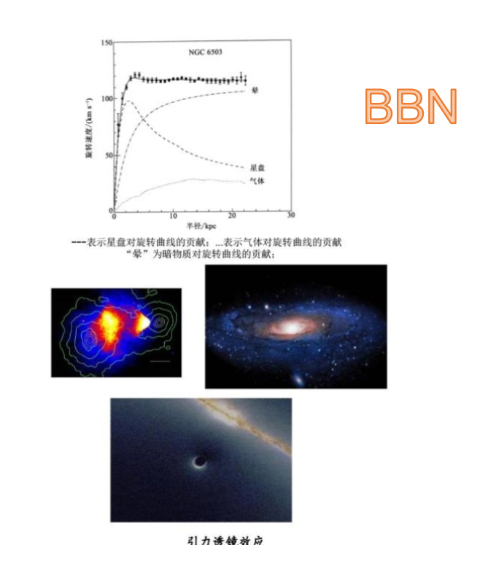
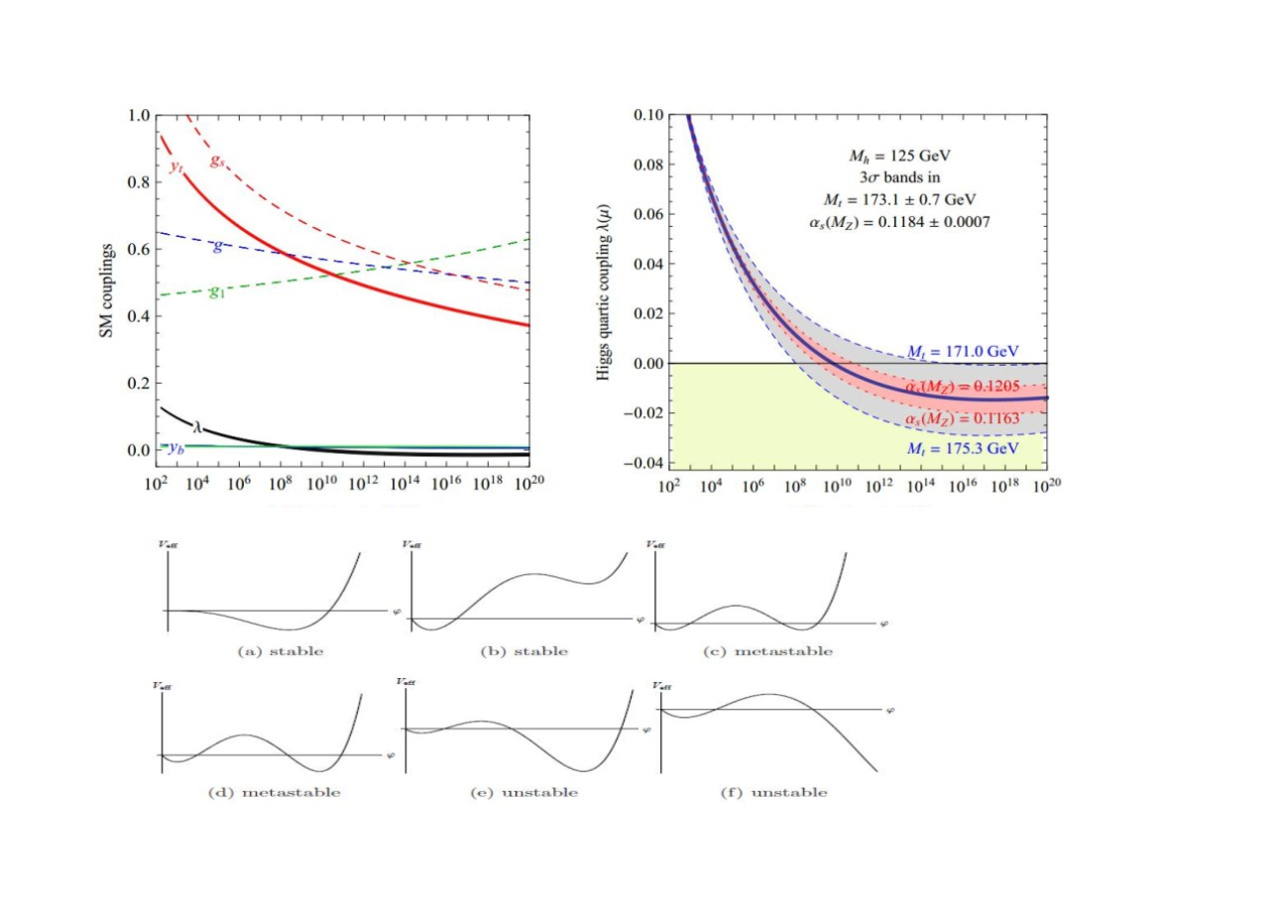
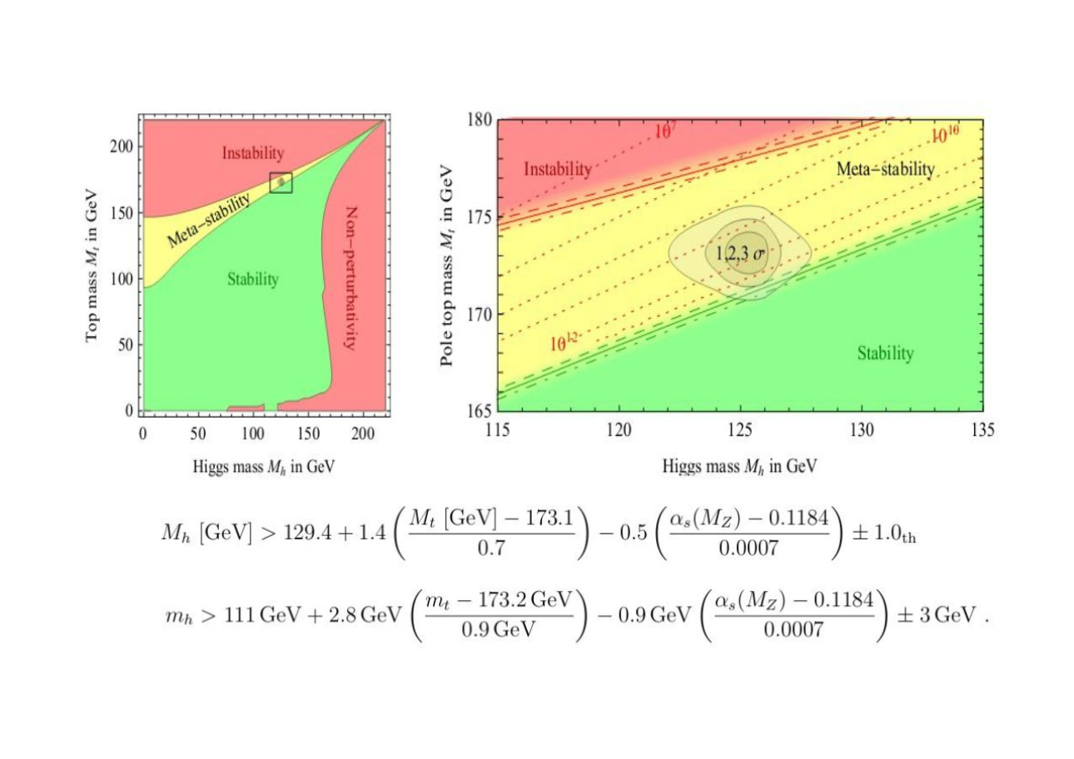
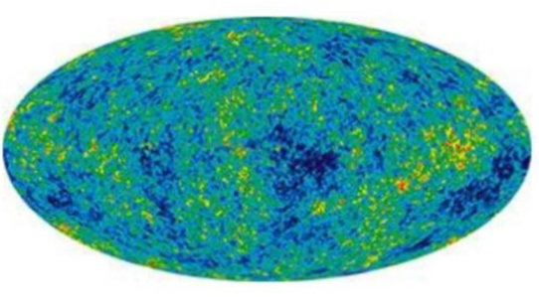

Slide 4
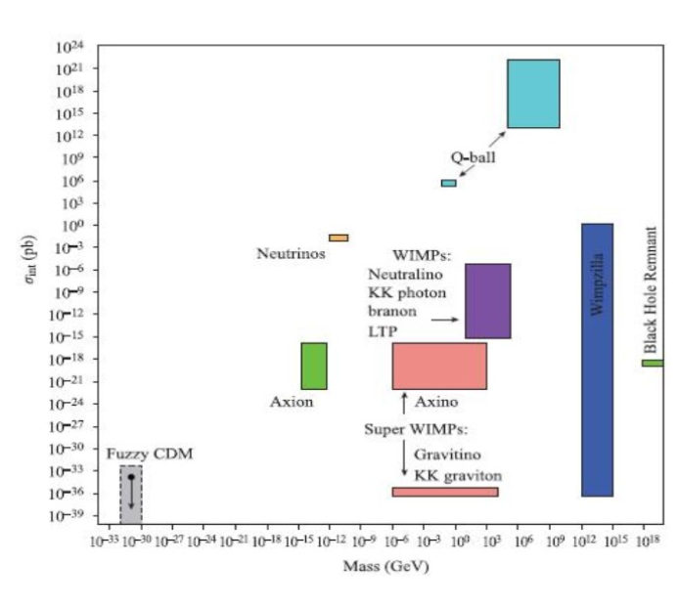
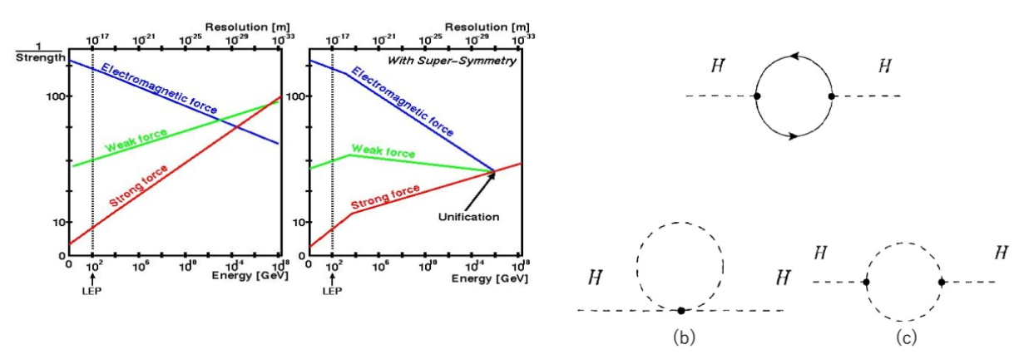
Why Supersymmetry

Slide 5
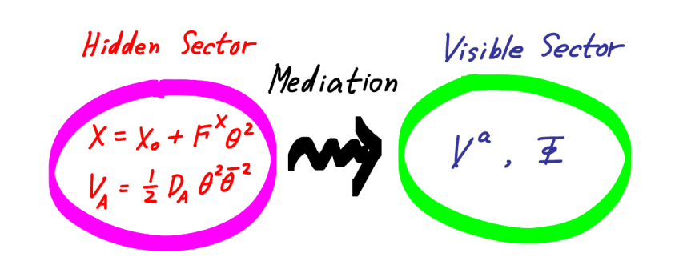
SUSY Breaking Mechanism
SSUGRA
SUGRA
GMSB
AMSB
Order parameter：
<F_X>≠0
Non-renormaliable contact term
Neutralino LSP
Flavor violation
Order parameter：
<F_phi~m_{3/2}>≠0
SuperWeyl anomaly
wino LSP
Flavor invariant
Order parameter：
<F_X>≠0
Gauge interactions
Gravitino LSP
Flavor invariant

Slide 7
偏转的反常传递超对称破缺机制
1.解决AMSB中的tachyonic slepton质量需要改变重整化群演化。
2. 最简单的就是引入重的threshold来偏转RGE的演化轨迹。
规避退耦定理？
超势中引入赝模场？
Kahler势中引入全纯项
第二项为零时，反规范传递贡献

Slide 8
复杂的NMSSM版本：
Du & Fei,
arXiv: 1710.06105
Eur. Phys. J. C (2018) 78:431
Based on 1903.05669 by
Fei Wang, Zhuang Li.

Slide 10
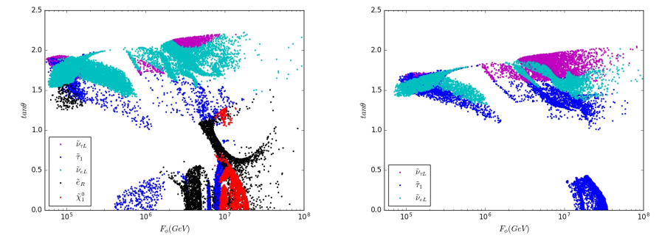
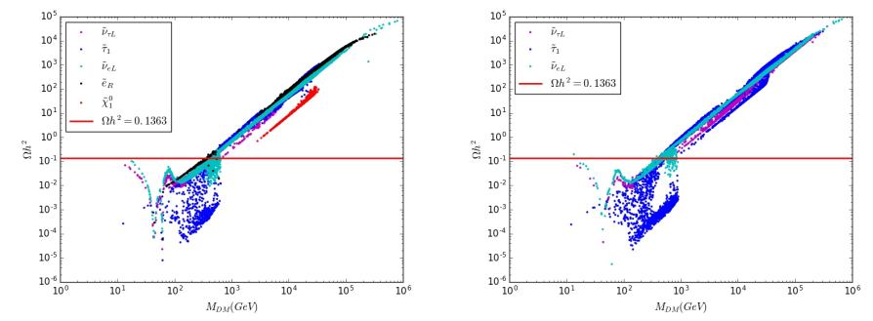
H_u messenger mixing
Need additional DM particles!
a=3 messengers
a=2 messengers

Slide 11
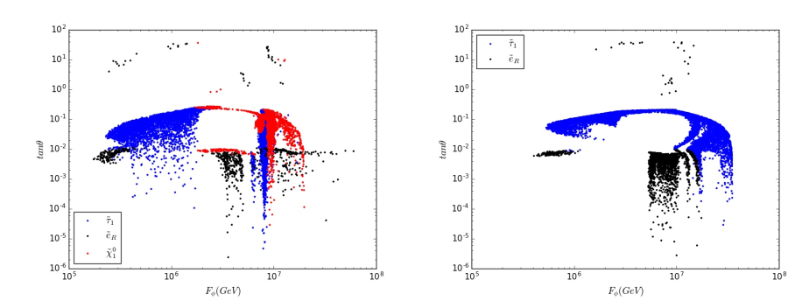
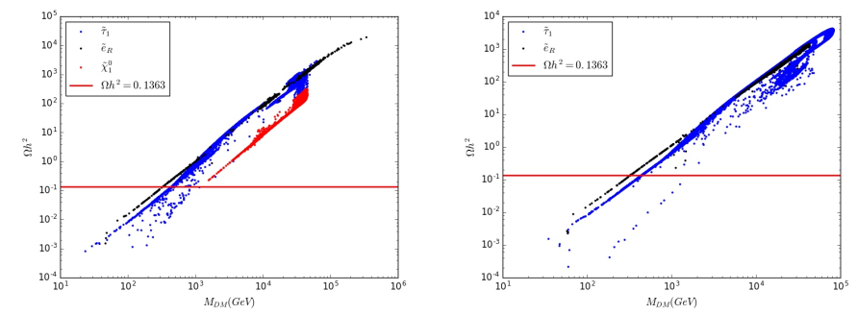
H_d messenger mixing
Need additional DM particles!
a=3 messengers
a=2 messengers

Slide 12
Axion and axino
Strong CP problem:
Massless up quark?
Peccei-Quinn symmetry: global U(1) symmetry with SU(3)_c anomaly
U(1)_{PQ} spontaneously broken pseudo-Goldstone axion

Slide 13
Axion and axino
Axion supermultiplet:
saxion
axino
SUSY limit: axino,axino,saxion essentiallty massless
Need to stablize the saxion field! Add SUSY effects

Slide 14
KSVZ axion
Including AMSB contributions:

Slide 15
Problems
Axino of order F_phi: heavier than MSSM sparticles
How to obtain light axino to act as DM?
Add contributions in the Kahler potential:
axino mass:
Possibly very light for c_S~-1.
So axino can be DMcandidate.

