Slide 1
de Sitter quantum loops as the origin of primordial non-gaussianities
In collaboration with Haipeng An and Mark Wise
arXiv:1806.05194 [hep-ph].
Apr 21, 2019
Zipei Zhang Tsinghua University

Slide 2
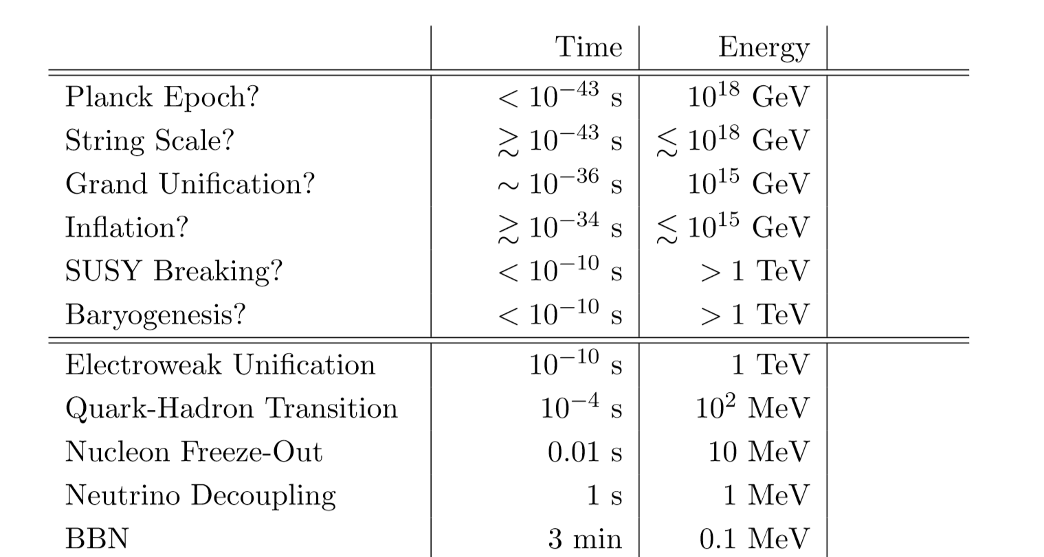
Notes:
The energy scale of inflation could be as high as 10^15 GeV.
This is much higher than the energy scale that we can expect to achieve with particle accelerators in the future.
So inflation might be the only chance for us to probe the laws of physics at such high energy scales.

Slide 3
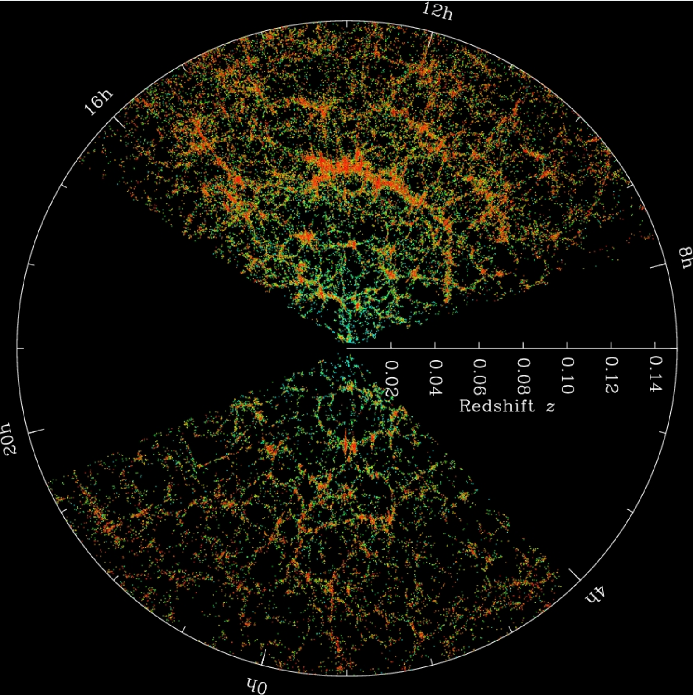
PLANCK
SDSS
Notes:
The high energy processes that took place in the early universe imprinted their signatures in the energy density fluctuations.
These fluctuations then became the seeds for the large scale structure that we observe today, such as the cmb and galaxy distributions.

Slide 4
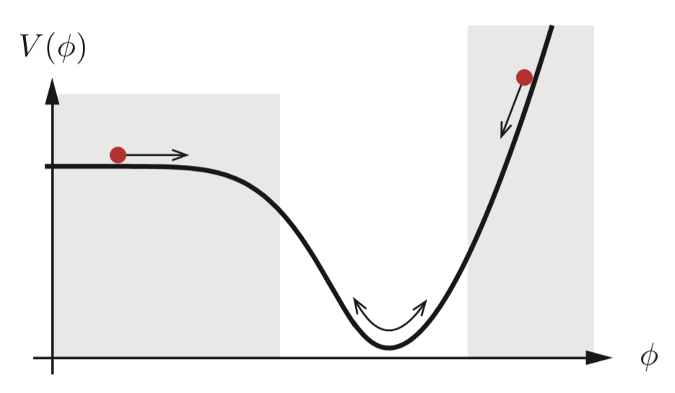
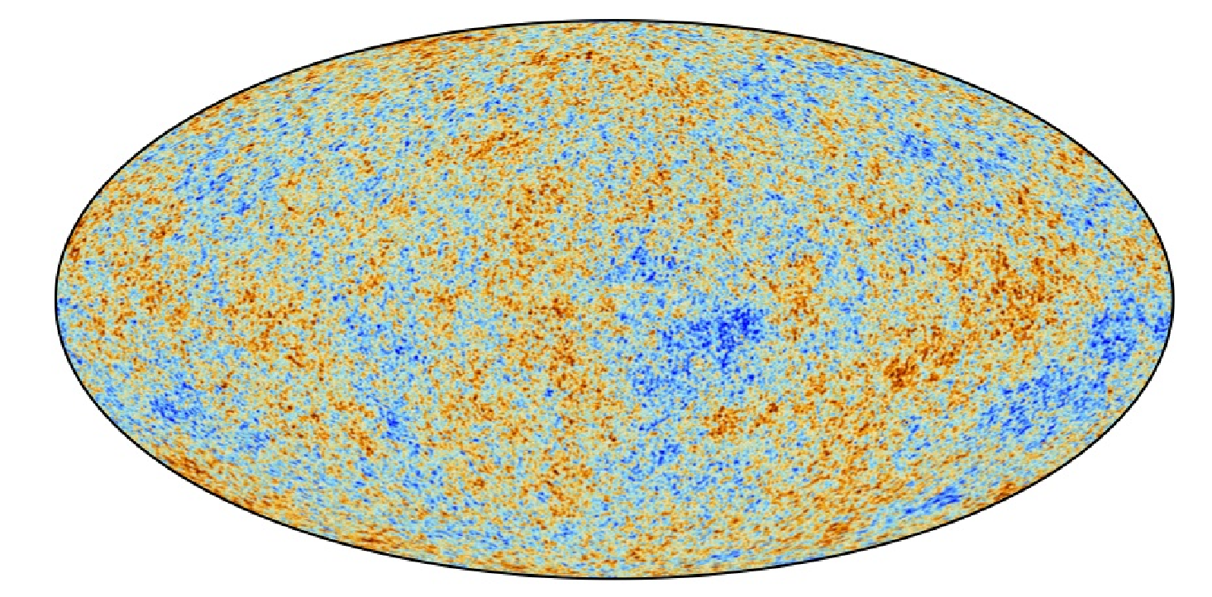
$δφ$ $ζ$ $Φ$ $δρ$
Inflaton curvature gravitational energy density
perturbation potential perturbation
$ds^{2}$=-$dt^{2}$+ $a^{2}e^{2ζ}δ_{ij}dx_{i}dx_{j}$
Notes:
In the simplest inflationary model, a scalar field called inflaton rolls down its potential and drives the expansion of the universe.
Fluctuations of the inflaton determines the curvature perturbation which stays constant when stretched to super-Hubble scale.
When inflation ends and the universe enters the radiation dominated era, the gravitational potential is proportional to the curvature perturbation.
The gravitational potential then determines the energy (matter) density perturbations in the simplest case.
As mentioned earlier, these fluctuations become the seeds for the temperature fluctuations in the cmb and fluctuations in the galaxy number densities

Slide 5
$$ζ$$
$$ζ$$
s
$$ζ$$
$$ζ$$
Heavy particles m$\sim H$ oscillatory behavior
Light particles m$≪H$
H
Heavy
Light
Arkani-Hamed, Nima et al. arXiv:1503.08043 [hep-th]
Notes:
It is natural for an inflationary model to contain many new fields other than the inflaton field.
Just like in particle physics, the information about the interactions between inflaton and these new fields is contained in higher order correlation functions, such as the four point correlation function.
It has been known that additional heavy particles will induce oscillatory behavior that contain information such as the mass of the new particle.
Here we would like to explore the consequences when an additional light particle is present.
But since the Hubble constant during inflation can be as high as 10^14GeV, light particles during inflation can still be very very heavy compared to SM particle.

Slide 6
Linear evolution
$δφ$ $ζ$ $Φ$ $δρ$
non-linear effect
$$ζ$$
$$ζ$$
$$δn_{g}$$
s
$$δn_{g}$$
$$δn_{g}≡\frac{n_{g}−\overline{n_{g}}}{\overline{n_{g}}}$$
$$ζ$$
$$ζ$$
galaxy density fluctuations
Notes:
It is in general difficult to measure three point or four point function both in cmb and galaxy surveys, while it is relatively easier to measure two point function or power spectrum.
In the early universe these fluctuations undergo linear evolutions and nonlinear effects take place later when gravity becomes strong enough and matter collapses to form galaxies.
In this way information about three point and four point function or the so-called non-gaussianities will be contained in the two point function of galaxy number fluctuations.

Slide 7
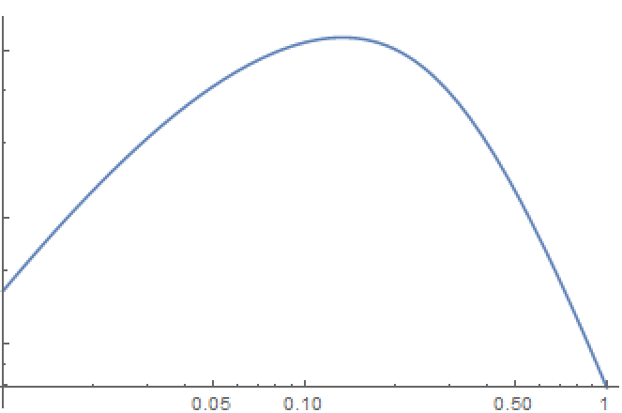
Threshold model: $n_{g}\left(x\right)=Θ_{H}(δρ\left(x\right)−δρ_{C})$
$δn_{g}\left(x\right)=b_{1}δρ+b_{2}\left(δρ^{2}− <δρ^{2}>\right)+$…
Poisson equation: $δρ\left(k\right)=\frac{2k^{2}}{5Ω_{m}H_{0}^{2}}T\left(k\right)ζ_{k}$
$<ζ_{k}ζ_{k}>\sim \frac{1}{k^{3}}$ gaussian $<δn_{g}δn_{g}>\sim b_{1}^{2}k$
$$δn_{g}$$
$$ζ$$
$$ζ$$
$$δn_{g}$$
Notes:
In the threshold model, we assume that galaxies form at those points in space where the matter overdensity exceeds a threshold.
The number density of galaxy fluctuations can be expressed as an expansion of the underlying matter density fluctuations.
And b1 and b2 are called bias coefficients.
The matter density fluctuations are related to the gravitational potential or the curvature perturbations by Poisson’s equation.
That’s the origin of the k^2.
T(k) is called transfer function.
When the fluctuations are gaussian, the galaxy number density fluctuation will be determined by the first term.
The power spectrum of zeta is proportional to k^(-3) so the two point function of galaxy number density fluctuations will be proportional k at small wavelength.
This is called the Harrison-Zeldovich spectrum.

Slide 8
Non-gaussian :
Compressed region : $k_{1}≅k_{2}≫\left|\vec{k_{1}}+\vec{k_{2}}\right|≡q,k_{3}≅k_{4}≫q$
$<ζ\left(k_{1}\right)ζ\left(k_{2}\right)ζ\left(k_{3}\right)ζ(k_{4})>\sim q^{−3+2ν}$
$<δn_{g}δn_{g}>\sim b_{2}^{2}q^{−3+2ν}$
$ν≡\frac{3}{2}−\sqrt{\frac{9}{4}−\frac{m^{2}}{H^{2}}}\sim \frac{m^{2}}{3H^{2}}$
$$k_{1}$$
$$k_{3}$$
$$δn_{g}$$
s
$$δn_{g}$$
$$k_{2}$$
$$k_{4}$$
An, Haipeng et al. Phys.Rev. D97 (2018) no.12, 123528
arXiv:1711.02667 [hep-ph]
Notes:
The situation is drastically different when non-gaussianities are present.
In the compressed region where the partial sum of the momenta is much smaller than the momentum itself, the four point function is proportional to q^(-3+2\nu).
However, in this case the enhancement at small wavelength is related to an internal line in the diagram and will not be affected by Poisson’s equation.

Slide 9
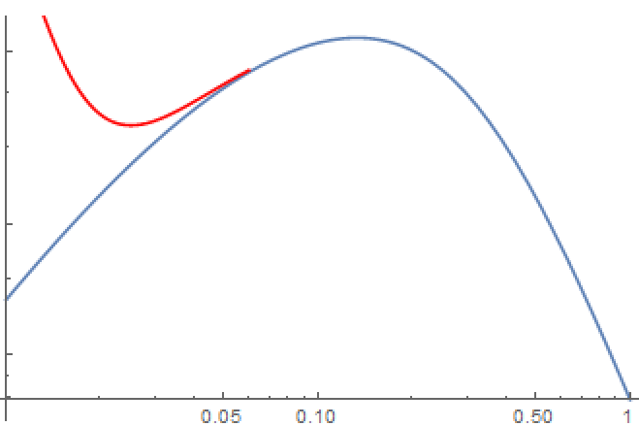
Non-gaussian :
Compressed region : $k_{1}≅k_{2}≫\left|\vec{k_{1}}+\vec{k_{2}}\right|≡q,k_{3}≅k_{4}≫q$
$<ζ\left(k_{1}\right)ζ\left(k_{2}\right)ζ\left(k_{3}\right)ζ(k_{4})>\sim q^{−3+2ν}$
$<δn_{g}δn_{g}>\sim b_{2}^{2}q^{−3+2ν}$
$ν≡\frac{3}{2}−\sqrt{\frac{9}{4}−\frac{m^{2}}{H^{2}}}\sim \frac{m^{2}}{3H^{2}}$
$$k_{1}$$
$$k_{3}$$
$$δn_{g}$$
s
$$δn_{g}$$
$$k_{2}$$
$$k_{4}$$
An, Haipeng et al. Phys.Rev. D97 (2018) no.12, 123528
arXiv:1711.02667 [hep-ph]
Notes:
This leads to an enhancement of the galaxy number density fluctuations at small wavelength and has been explored in this paper.
This is a tree level effect.
However, in some models tree level diagrams are forbidden by the symmetry of the theory, such as theories with Z2 symmetry.
So we would like to explore what happens at the loop level.

Slide 10
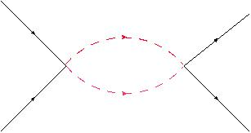
Minkowski spacetime
$$k_{1}$$
$$k_{3}$$
$$k_{1}$$
$$k_{3}$$
s
s
$$k_{2}$$
$$k_{4}$$
$$k_{2}$$
s
$$k_{4}$$
$$\sim \frac{1}{{\left(k_{1}+k_{2}\right)}^{2}−m^{2}}$$
$$\sim \int{\frac{d^{4}p}{{\left(2π\right)}^{4}}}\frac{1}{{\left(k_{1}+k_{2}+p \right)}^{2}−m^{2}}\frac{1}{p^{2}−m^{2}}$$
$\sim ln⁡[\frac{{\left(k_{1}+k_{2}\right)}^{2}}{m^{2}}]$
Notes:
In flat space, instead of a pole structure which leads to the enhancement at tree level, we would expect to find a branch cut at loop level.
And we no longer have this enhancement.

Slide 11
de Sitter spacetime
$ds^{2}=\frac{−dη^{2}+d{\vec{x}}^{2}}{H^{2}η^{2}}$ $η∈(−∞,0)$
$$η=0$$
$$φ$$
$$φ$$
$$φ$$
$$φ$$
Isometry: $\vec{x}→\frac{\vec{x}+\vec{b}{\left|x\right|}^{2}}{1+2\vec{b}∙\vec{x}+\left(−{\vec{x}}^{2}+η^{2}\right){\left|b\right|}^{2}}$
$$η→\frac{η}{1+2\vec{b}∙\vec{x}+\left(−{\vec{x}}^{2}+η^{2}\right){\left|b\right|}^{2}}$$
s
$φ\left(η,x_{i}\right)\sim η^{Δ_{±}}φ_{±}(x_{i})$
$Δ_{±}=\frac{3}{2}±\sqrt{\frac{9}{4}−{\left(\frac{m}{H}\right)}^{2}} \sim \frac{m^{2}}{3H^{2}}$ , 3- $\frac{m^{2}}{3H^{2}}$ for m$≪H$
$η=−∞$
Notes:
But the situation here is different since we are in the de Sitter space.
We are interested in the fluctuations at the boundary of this de Sitter space when \eta approaches 0.
In this limit, the isometry of de Sitter space approaches that of a 3d conformal field theory.
The conformal weight of the scalar field is related to its mass.

Slide 12
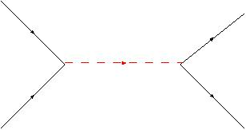
de Sitter spacetime
$$k_{1}$$
$$k_{3}$$
$$k_{1}$$
$$k_{3}$$
s
s
$$k_{2}$$
$$k_{4}$$
$$k_{2}$$
s
$$k_{4}$$
Compressed region : $k_{1}≅k_{2}≫\left|\vec{k_{1}}+\vec{k_{2}}\right|≡q,k_{3}≅k_{4}≫q$
OPE limit
$$\sim q^{−3+2ν}$$
$$\sim q^{−3+f(ν)}$$
$ν≡\frac{3}{2}−\sqrt{\frac{9}{4}−\frac{m^{2}}{H^{2}}}\sim \frac{m^{2}}{3H^{2}}$
Notes:
The compressed region will correspond to the operator product expansion limit of cft.
In this limit we expect that the four point function will reduce to the following form.
Since \nu is smaller than one, the loop diagram will also contain a pole structure.

Slide 13
Lowest dimension operator with $Z_{2}$symmetry
$L_{int}=\frac{1}{4Λ^{2}}g^{μν}\left(∂_{μ}φ∂_{ν}φ\right)s^{2}$
Effective theory approach
$$g^{μν}∂_{μ}φ∂_{ν}φ→g^{00}\dot{φ_{0}^{2}}→\dot{φ_{0}^{2}}g^{μν}∂_{μ}\left(t+{π/\dot{φ}}_{0}\right)∂_{ν}\left(t+{π/\dot{φ}}_{0}\right)$$
$$L_{int}=−\frac{1}{2H^{3}τ^{3}}\frac{{\dot{φ}}_{0}}{Λ^{2}} \frac{∂π}{∂τ}s^{2}+\frac{1}{4H^{2}τ^{2}Λ^{2}} η^{μν}∂_{μ}π∂_{ν}πs^{2}$$
$$ζ=−\frac{H}{\dot{φ_{0}}}π$$
Notes:
Now we can consider a specific model.
For example we can write down the lowest dimension operator with a Z2 symmetry which couples the inflaton field \phi to an additional light scalar field.
The inflaton field \phi has an approximate shift symmetry to insure inflation lasts long enough.
The Z_2 symmetry forbids any tree level diagrams.
We can take the effective theory approach which focuses on the goldstone mode \pi associated with the spontaneous breaking of time translation invariance.
\phi 0 stands for the classical background of the inflaton field
At this level the curvature perturbation is proportional to \pi

Slide 14
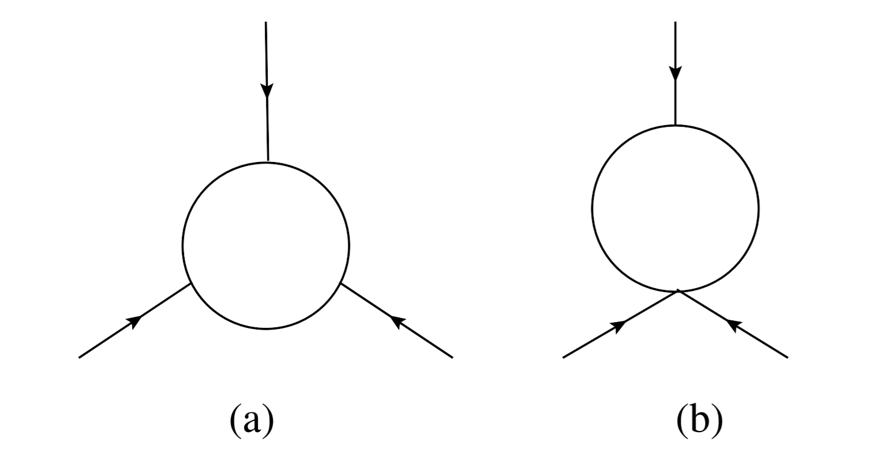
$$ζ$$
$$ζ$$
s
s
$$ζ$$
$$ζ$$
$$ζ$$
$$ζ$$
Bi-spectrum for general momentum
Notes:
We calculated the three point function or the bi-spectrum of curvature perturbations with the light field running in the loop.
The main contribution comes from the IR part of the diagram so we don’t have to do the explicit renormalization.

Slide 15
Local non-gaussianity
CMB constraint
|$f_{NL}^{local }$|$<10$
$$\frac{H}{Λ}{\left(\frac{1}{2ν}\right)}^{\frac{2}{3}}<0.012$$
P. A. R. Adeet al.[Planck Collaboration], Astron. Astrophys.594, A17 (2016)[arXiv:1502.01592 [astro-ph.CO]].
Notes:
When the ratio between different momenta is not too large, the shape of this three point function becomes that of the local form.
And we can use the 2σ constraint from planck to give a bound for the parameters in the model.

Slide 16
Trispectrum for general momentum
Notes:
Similarly we can calculate the four point function.
The general result looks complicated

Slide 17
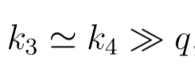
Trispectrum for general momentum
Compressed region
$B({\vec{k}}_{1},{\vec{k}}_{2},$ ${\vec{k}}_{3},$ ${\vec{k}}_{4})\sim \frac{π^{2}H^{2}{\left|a_{0}\right|}^{2}}{128Λ^{2}}{\left(\frac{1}{2ν}\right)}^{5}\frac{1}{k_{1}^{3+2ν}}\frac{1}{k_{3}^{3+2ν}}\frac{1}{q^{3−4ν}}$
$\sim \frac{1}{q^{3−4ν}}$
Notes:
But it simplifies in the compressed region and has a pole structure as we have expected.
So we can conclude that loop diagrams can also give raise to the enhancement that may be observable in galaxy surveys.

Slide 18
Local non-gaussianity
CMB constraint
$$τ_{NL}<2800$$
P. A. R. Adeet al.[Planck Collaboration], Astron. Astrophys.571, A24 (2014)[arXiv:1303.5084 [astro-ph.CO]].
$$\frac{H}{Λ}{\left(\frac{1}{2ν}\right)}^{5/8}<0.0095$$
Notes:
The four point function also reduces to the local form when the ratio between different momenta is not too large.
So again we can use the result from planck to give a bound for the parameters.
But this time the constraint is stronger compared to the constraint from the three point function(fnl).

Slide 19
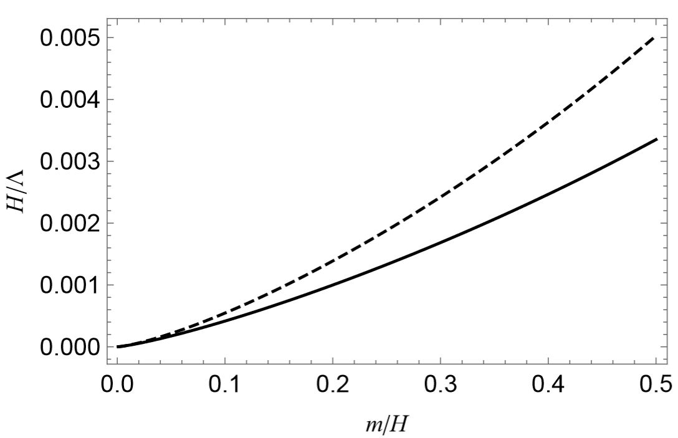
$f_{NL}$
$$τ_{NL}$$
Suyama-Yamaguchi bound: $τ_{NL}≥{\left(\frac{6}{5}f_{NL}\right)}^{2}$
$$τ_{NL}\sim f_{NL}^{\frac{4}{3}}ν^{\frac{1}{3}}$$
Notes:
The dashed and solid curves show the upper limits on H/Λ as a function of m/H from fNL and τNL constrsaint.
This result is in contrast to many other models, where the constraint from fNL is stronger.
This is of course because in our model the contribution is from loop diagrams.
This is also related to the fact that the consistency relation called Suyama-Yamaguchi Bound that hold for many inflationary models might be violated in this case.
This consistency relation can help us to distinguish between different inflationary models.

Slide 20
The red solid and dashed curves for $ν=0.05$ and $τ_{NL}$=2800,1400
Bule solid and dashed curves for $ν$=0.1
SDSS
Notes:
Finally this plot shows the long distance behavior of the power spectrum of the fluctuations in the galaxy number density.
One can see that if the current constraint from τNL is saturated the power spectrum of the galactic halo distribution can differ significantly from the Harrison-Zel’dovich spectrum (which is a constant line) at small wavelength.
Current observation from SDSS has not been able to see this effect but it might be observed in upcoming large-scale surveys

Slide 21
Conclusion:
(1) loops in de Sitter space can also induce non-gaussianities that might be observable in large-scale galaxy surveys
(2) loops may give us new consistency relations that can serve to distinguish different inflationary models

