Slide 1
Origin of the cosmic positron excess: an interesting story
Xiao-Jun Bi/IHEP
Apr. 22, 2019
14th workshop on TeV physics, Nanjing Normal University, Xianlin, Nanjing

Slide 2
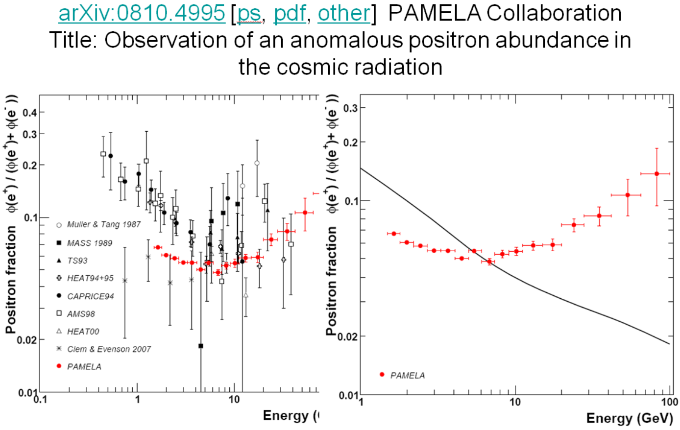
The story started 10 years ago
e+e- from DM annihilation;
e+e- from nearby pulsars;

Slide 3
Outline
A brief review of status before end of 2017
Development in the last 1 year
Summary

Slide 4
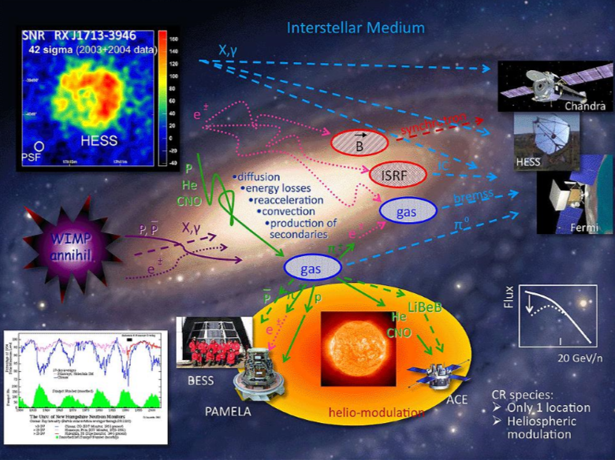
Cosmic rays propagation in the MW
B/C to determine the propagation parameter D
e+, pbar, diff γ are predicted
By Igor, Moskalenko

Slide 5
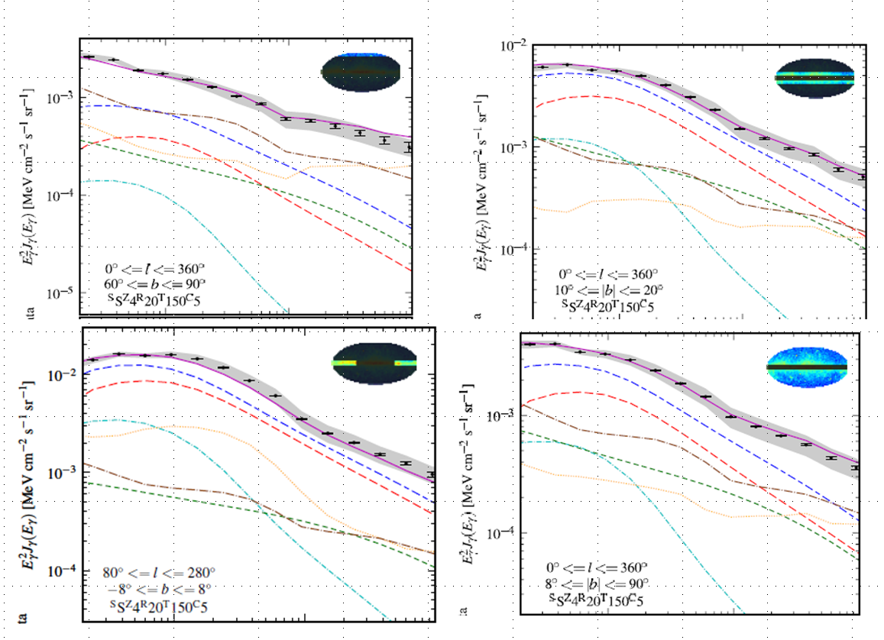
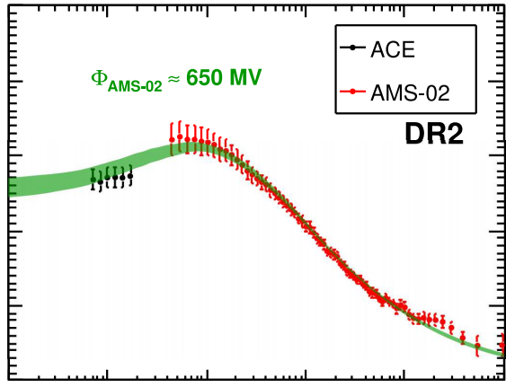
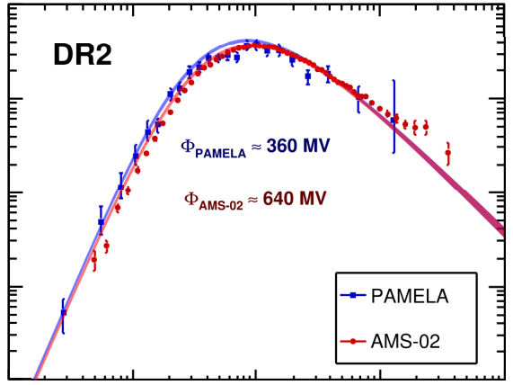
Success of the diffusive propagation model
B/C anti-proton diffuse gamma-ray
Yuan et al. 2017
Trotta et al. 2011

Slide 6
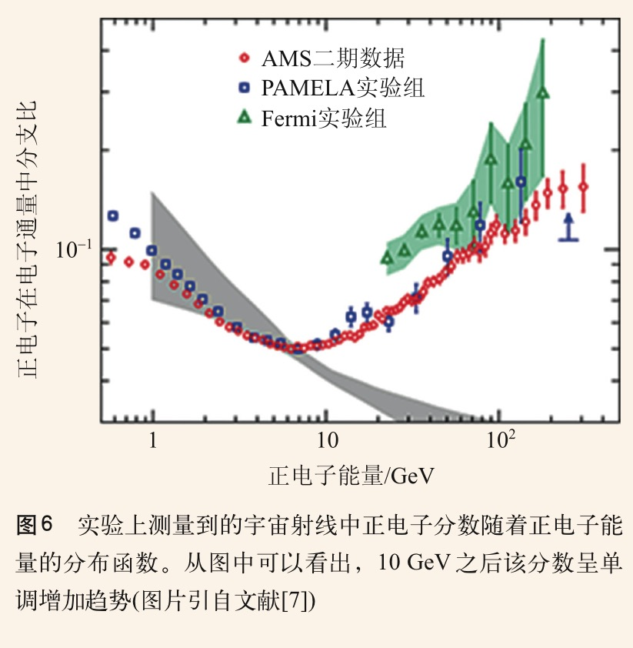
Positron excess and extra e+ sources
Positron excess detected by PAMLEA is confirmed by AMS-02 with higher precision.
Extra positron sources:
Astrophysical sources – pulsars e⁻e⁺
Dark matter Χ Χ 。。。 e⁻e⁺

Slide 7
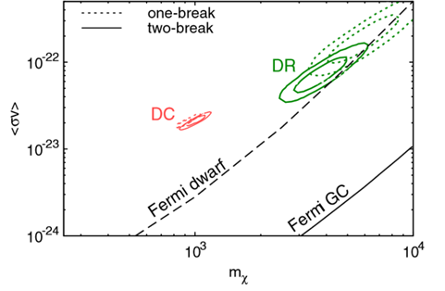
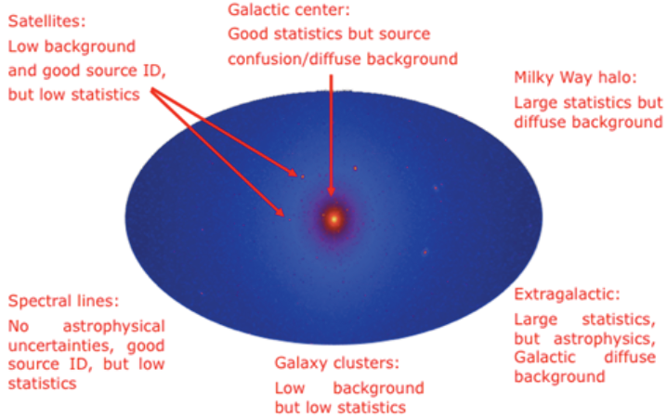
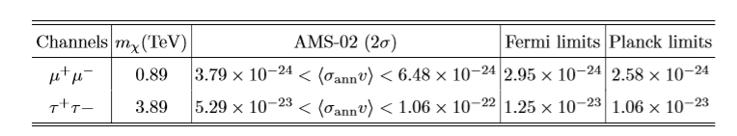
Constraints on the DM models
Excluded!?
Q. Xiang, X. Bi, S. Lin, P. Yin 2017
Fermi PRD2014
DM needs very large annihilation cross, but severely constrained by Fermi and Planck observations.

Slide 8
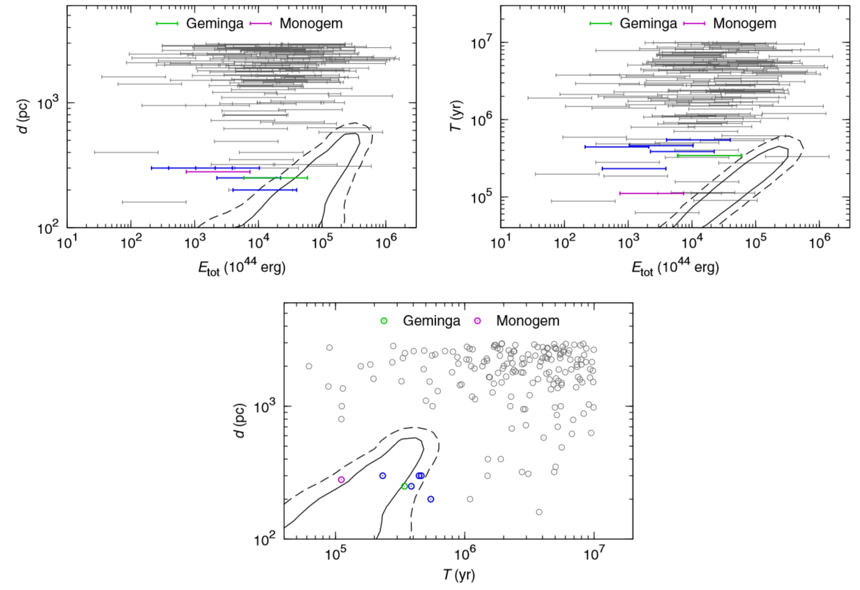
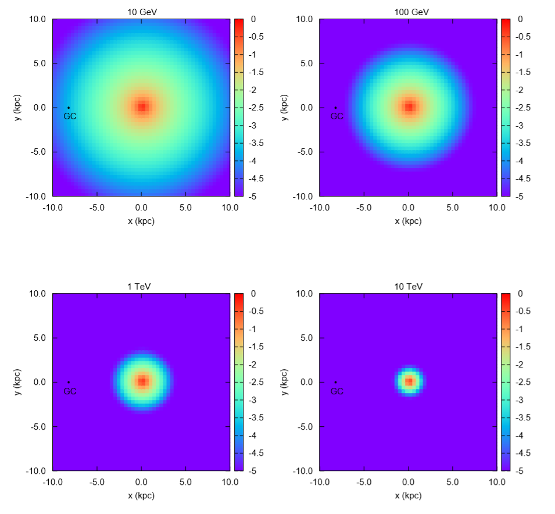
Can positrons come from nearby pulsars?
Yin, Yu, Yuan, Bi, PRD2013

Slide 9
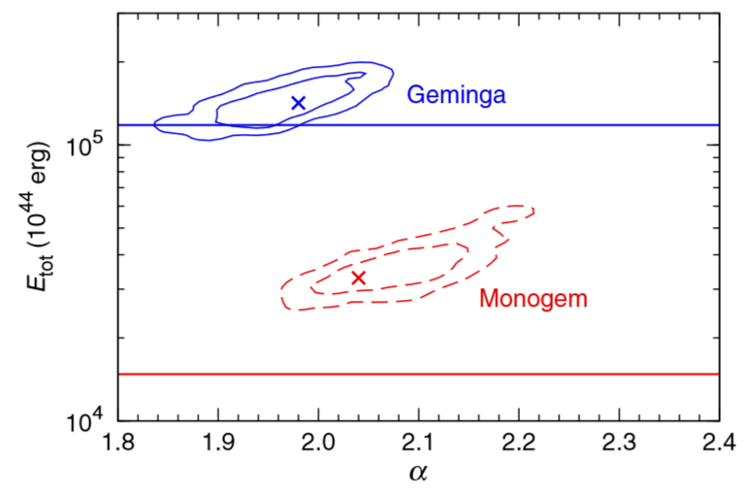
Geminga and Monogem are most possible candidates
Considering all possible uncertainties, pulsars can explain the positron excess marginally assuming 100% spin-down energy transferred to e+-.

Slide 10
New development --TeV gamma-ray halo of Geminga
A.U. Abeysekara et al. HAWC collaboration, Science 2017
The diffusion coefficient is hundreds times slower than that at the ISM derived by B/C !
If diffusion is slow in the whole MW, the pulsar contribution of e+ to AMS-02 data is negligible!
Excluded!?

Slide 11
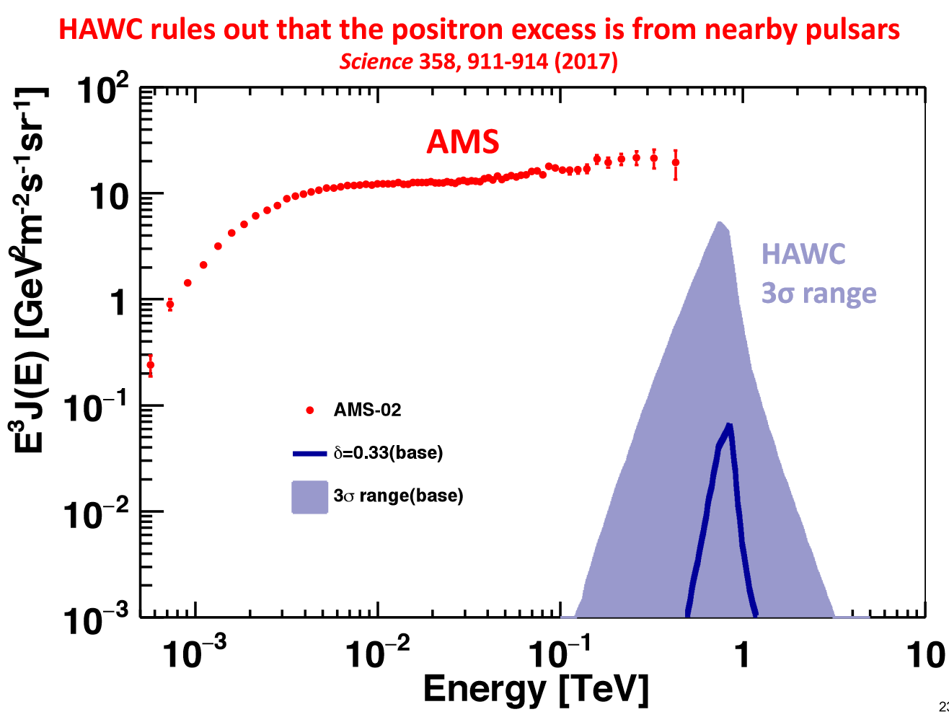
AMS-02 responds by Prof. Ting

Slide 12
Diffusion in ISM must be large!
Contradiction#1
B/C anti-proton diffuse gamma-ray
Trotta et al. 2011
Contradiction#2
Yuan et al. 2017
H.E.S.S has observed 20 TeV e-/e+ -> no source exist within few pc
The H.E.S.S Collaboration 2017

Slide 13
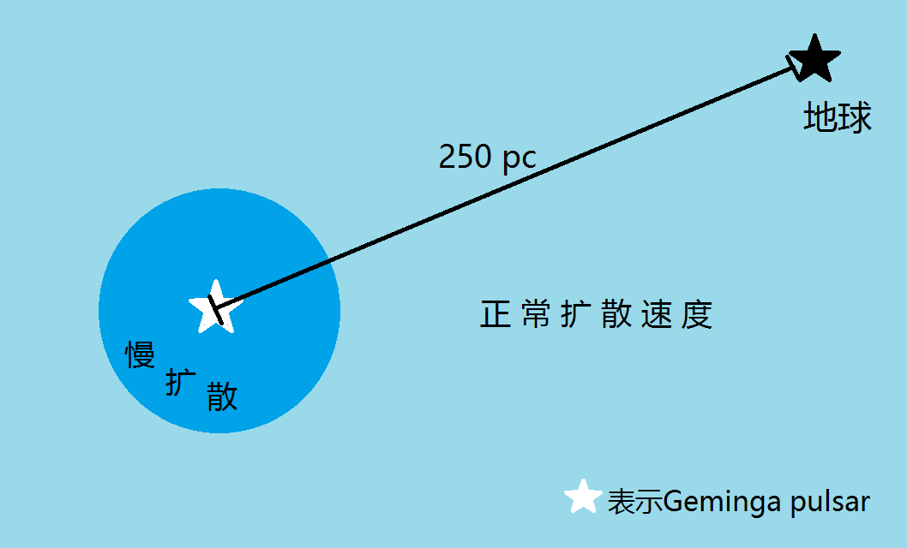
Two-zone diffusion for Geminga
r*
Fang et al. 1803.02640
The slow diffusion region is near the source; while the diffusion is still fast in most interstellar space.
All the previous predictions are not changed! We need to check the positron flux in this scenario.

Slide 14
Two-zone diffusion for Geminga
Propagation equation:
Diffusion coefficient:
D1 is derived by HAWC, D2 is the normal value
Numerical solution is required!
Operator splitting:
The finite volume method is adopted for the diffusion operator
GALPROP and DRAGON only apply to cases of smooth varying of D
We may expect the scenario be between the normal case (~1) and HAWC case (<1%)

Slide 15
Unexpected result of positron flux!
Spatial distribution of e-/e+
Spectrum at the earth
Earth
K. Fang, X. Bi, P. Yin, Q. Yuan 2018
Black line: fast diffusion with normal speed
Red line: slow diffusion given by HAWC
Other lines: two-zone diffusion with r*=40 pc, 70 pc, 100 pc

Slide 16
Geminga (considering the HAWC new observation) solves the positron excess
Compare with AMS-02 e+
γ=2.2
K. Fang, X. Bi, P. Yin, Q. Yuan 2018
The best-fit r_star is 50 pc
The conversion efficiency of Geminga is ~50-70%
Several papers followed and the idea is accepted

Slide 17
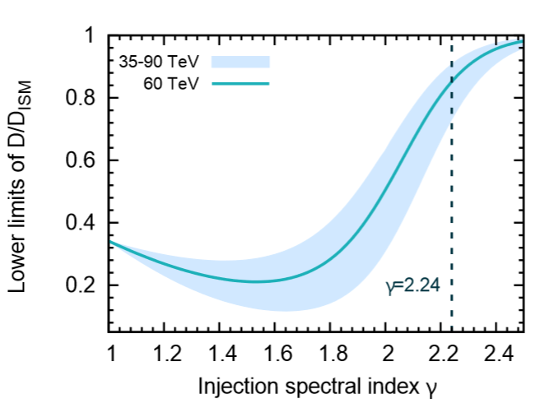
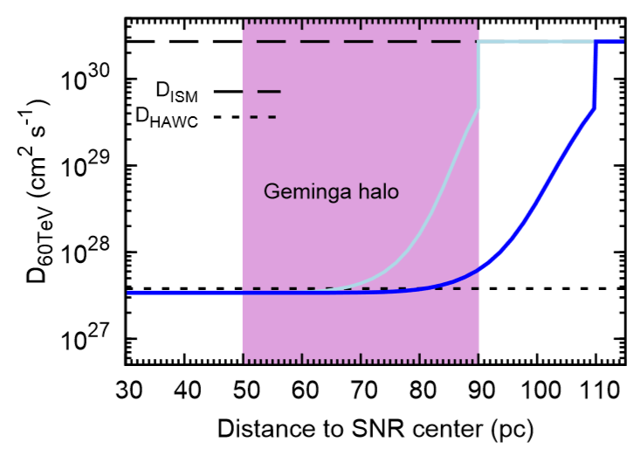
Interesting topics
general sources of TeV halos at LHAASO, Propagation include many slow regions, Fermi detection,
mechanism to slow diffusion
Fang et al. 1903.06421

Slide 18
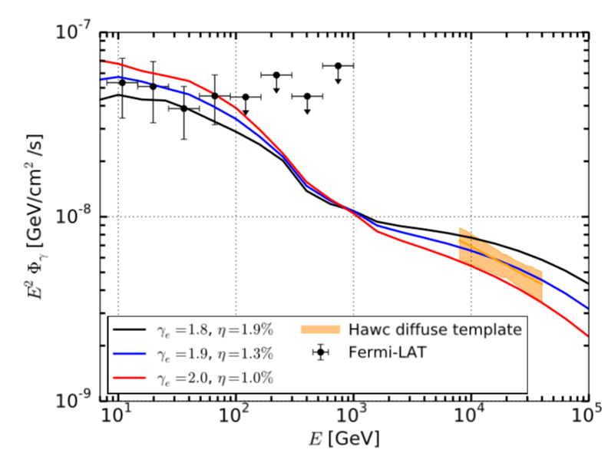
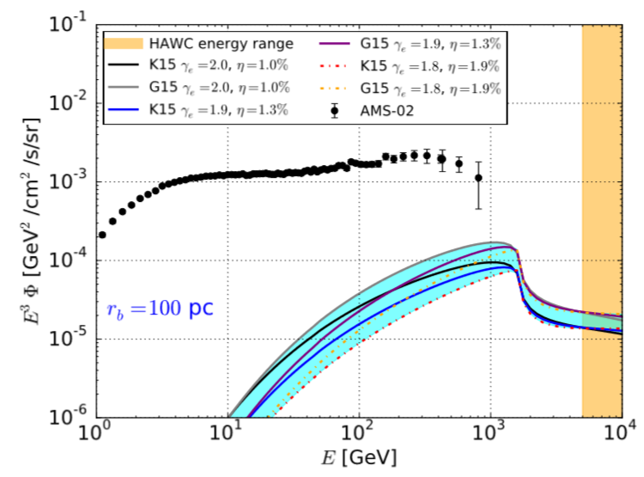
New Constraints from Fermi
Gamma rays from the halo at low energy constrain the electron spectrum harder and less electrons/positrons at low energy.
γ=2.2
γ=1.8
Pulsar can not!
SQ Xi et al. 1810.10928
Di Mauro et al. 1903.05647

Slide 19
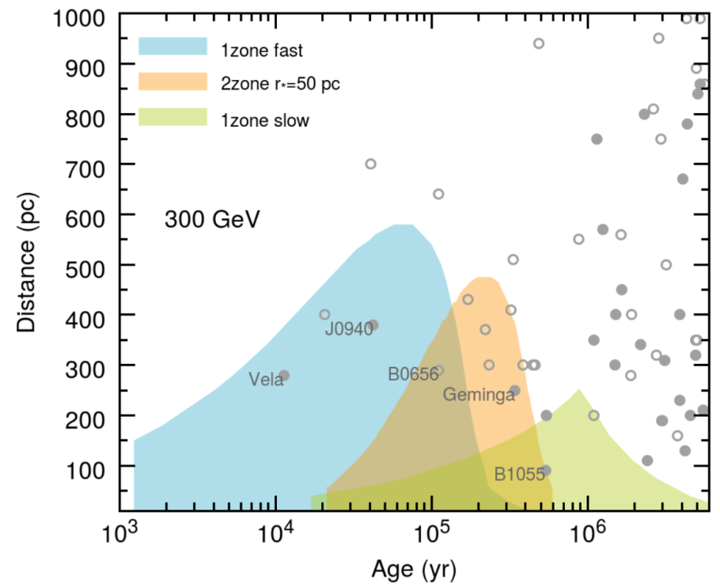
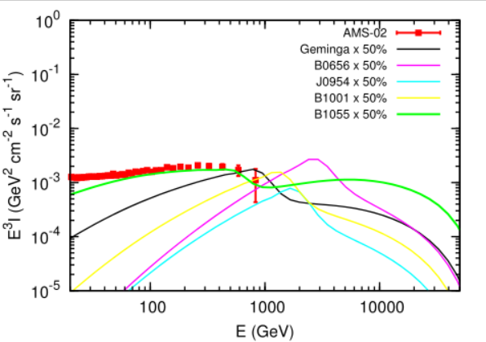
Our new preliminary results
γ=1.8
γ=1.8, not 2.2
Age =500/300kyr
Pulsar can!
Most pulsars are hard with indices smaller than 2.
Reanalyzed the pulsars contribution in a two-zone diffusion model.
A older and closer pulsar is an ideal source to account for AMS-02. B1055 is the best one.

Slide 20
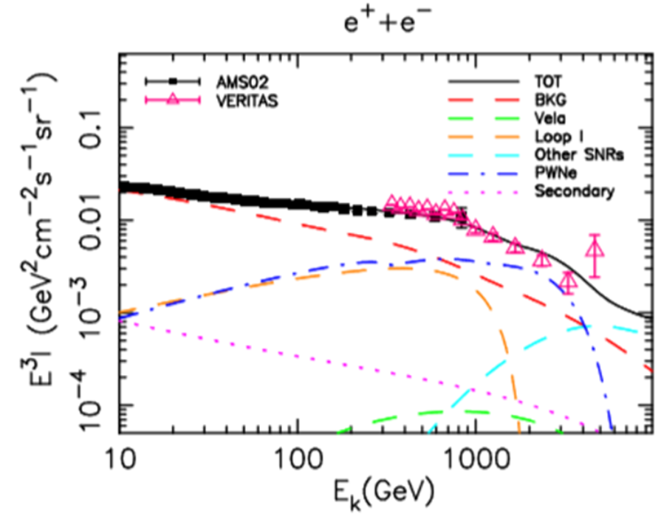
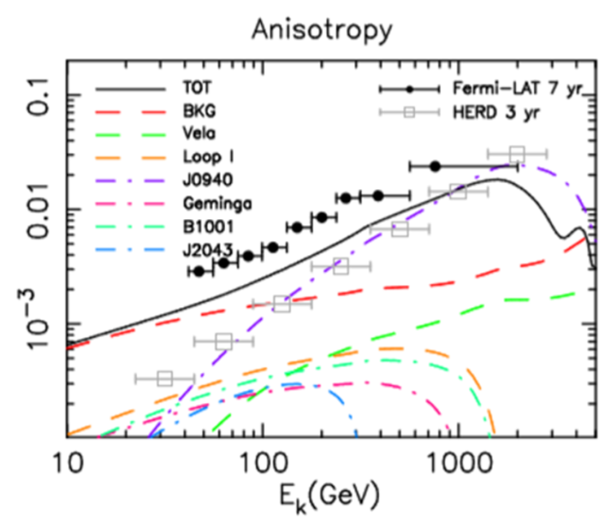
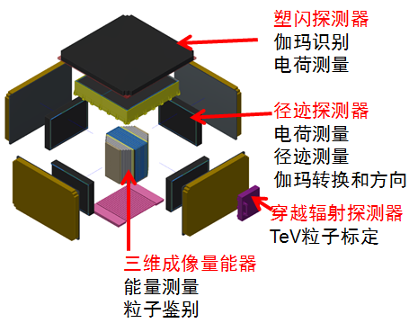
How to test the model
Electrons from pulsars has definite direction and lead to observable anisotropy;
The anisotropy may be observed by HERD – the next generation instrument installed in the China Space Station.
Need new calculation in two-zone

Slide 21
Summary
A 10yrs old story has rapid, exciting development in the last year driven by data!
After several rounds of oscillation of the ideas we still think pulsar is the most favorable source for positron excess. This scenario may be tested at future HERD.

Slide 22
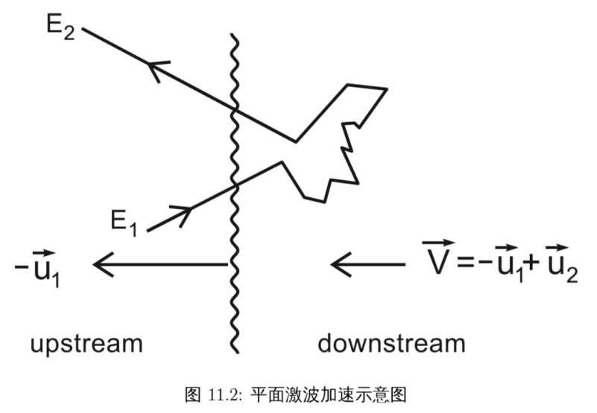
What is mechanism to produce a slow diffusion?
MHD waves can be amplifed by CRs streaming instabiltiy due to the large cosmic ray density gradient – a widely discussed mechanism necessary for DSA ( see Ptuskin et al 2003)

Slide 23
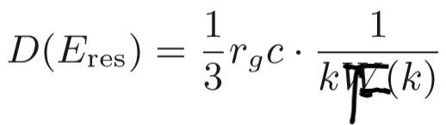
Self-confinement scenario
No evidence of anisotropic diffusion, such as elongated diffusion.
Abeysekara et al. 2017
It is reasonable to assume spherically symmetric diffusion.
Electron transport:
diffusion
energy lose
source function
Wave transport:
Wave growth:
Wave damping:
Skilling 1975
Farmer & Goldreich 2004

Slide 24
Self-confinement scenario
Growth and damping rate
Diffusion coefficient
So this mechanism does not work to generate such a small diffusion coefficient! Actually the reason is simple as the high energy electron (~100TeV) energy density is too small to amplify the MHD waves.
We suspect if this is an environment effect?
Moreover, Geminga should leave its birthplace for ~70 pc now.

Slide 25
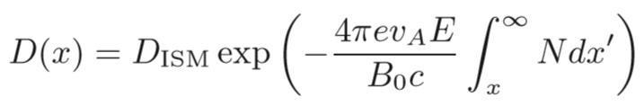
Lower limit
We derive a lower limit on the diffusion coefficient by assuming: no energy loss of electrons; no wave dissipation; we get an analytic solution
Considering the proper motion of Geminga at 200km/s, Geminga has left 70pc from its original place. We take electrons for the late 1/3 life time (230 – 340 kyr)
Lifetime of e (50TeV) < 10kyr
We then get the lower limit
Observed is 1/1000 D_{ISM}

Slide 26
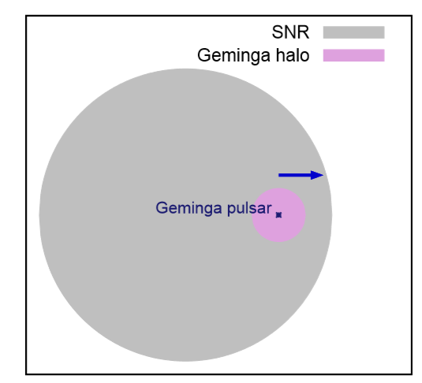
A possible mechanism
Just a guess: The slow diffusion may be an effect left by its prior SNR
The fast motion of the pulsar has been ignored.
Geminga has travelled ~70pc away from its original position.
According to a SNR evolution model SNR can expand to 90pc or larger after 340 kyr evolution if ISM density is low, in such case the pulsar is still within the SNR as shown;
The medium in the downstream of the shock may have strong turbulence and have a very small diffusion coefficient

Slide 27
Pre-existing scenario
If:
ISM density is 0.08 atom/cm^3
initial energy is 2 x 10^51 erg
the scale of SNR can reach ~90 pc at 342 kyr
low density
high energy
Leahy & Williams 2017
In the shock frame:
kinetic energy loss
avaiable for turbulence:
6 x 10^-12 erg/cm^3
magnetic energy:
4 x 10^-13 erg/cm^3
thermal energy + turbulent energy

Slide 28

Pre-existing scenario
Turbulence is generated just behind the shock (F0), and gradually dies out:
In the shock frame
Kolmogorov type damping:
We have assumed the initial value of F0
We CHOOSE??? the value to explain D by HAWC.

Slide 29
Pre-existing scenario
PSR B0656+14
Vela pulsar
Knies et al. 2018
H.E.S.S. Collaboration 2012
PSR B1957+20:
travel in ISM, can accelerate VHE electron, but no TeV structure around.

Slide 30
Summary
HAWC observation of the TeV gamma ray halos indicate a very slow diffusion around Geminga. Two zone diffusion model Geminga explains the positron excess on the Earth naturally.
Self-generated waves by CR e-+ is not enough to amplify the MHD waves to such slow diffusion. We propose such slow diffusion is possibly related with the surrounding SNR.
We can not give a quantitative calculation of the turbulence energy according to SNR dynamics.

Slide 31
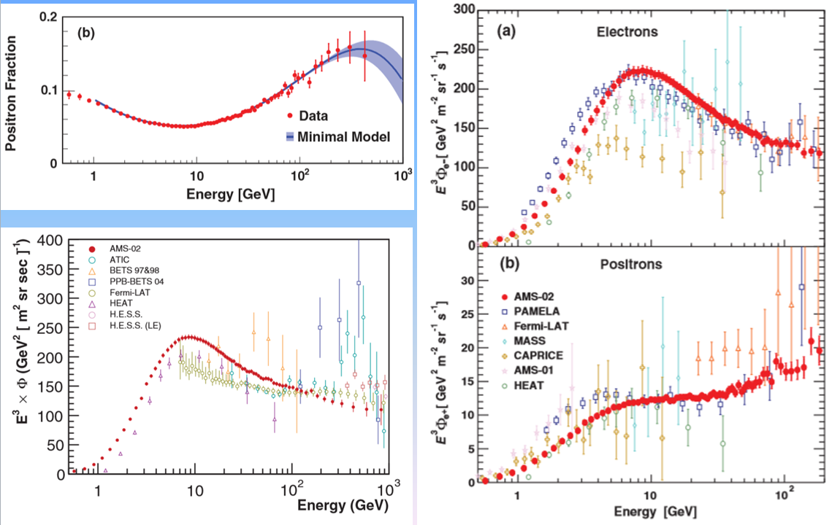
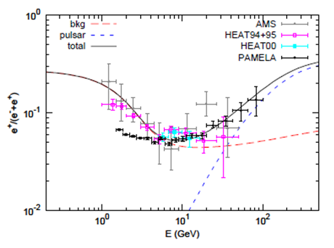
AMS-02的观测结果
AMS-02测量了正负电子比例，电子、正电子和正负电子和等能谱。测量到宇宙线中正电子超出！
正电子还没有明确的测量到截断

Slide 32
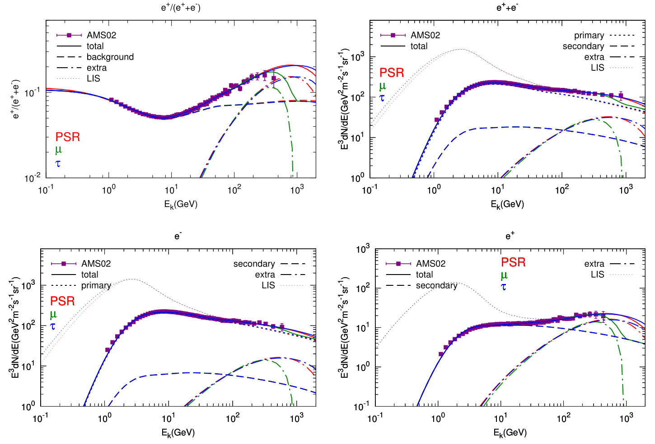
第一步：能谱上是否可以区分两者的贡献
Lin SJ et al. PRD91.063508, 2015
Notes:
Pulsar and DM are two typical benchmark model.

Slide 33
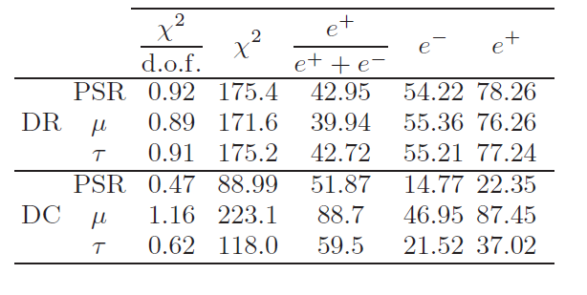
Conclusions of the quantitative study II
Both astrophysical sources, like pulsars, or dark matter can give good fit the AMS-02 data. AMS02 data can not distinguish the two scenarios.

Slide 34
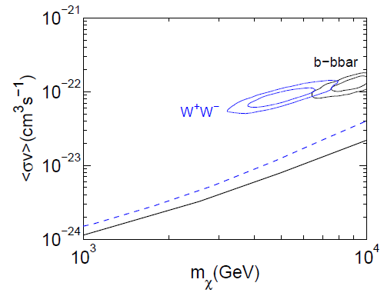

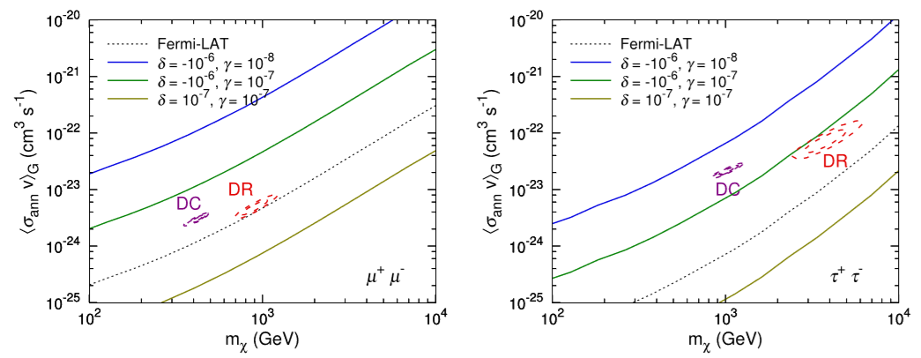
第二步：定量检验两个模型是否可以解释数据
Yuan, Bi, Chen, Guo, Lin, Zhang, 1304.1482, 1409.6248
伽玛射线和反质子的限制

Slide 35
1. B/C, (Sc+Ti+V)/Fe, ¹⁰Be/⁹Be, ²⁶Al/²⁷Al
通常宇宙线中H,He,C,N,O,Fe等为原初元素；Li,Be,Be,Sc,
Ti,V等为次级元素，由原初元素通过反应产生
通过次级元素和原初元素的比例研究宇宙线传播
Pato et al. 2010,
JCAP

Slide 36
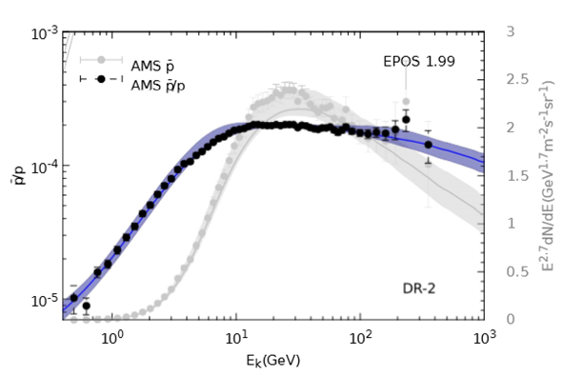
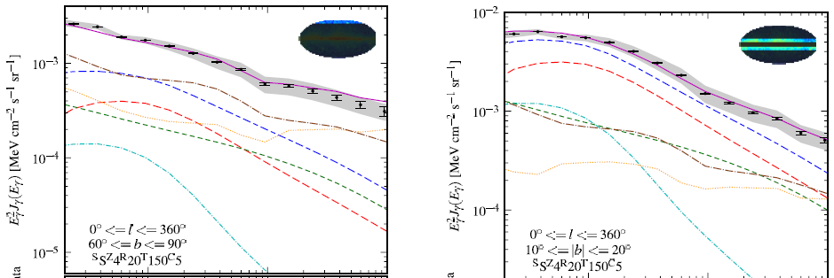
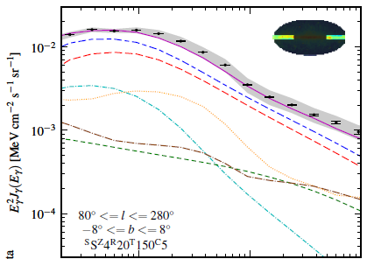
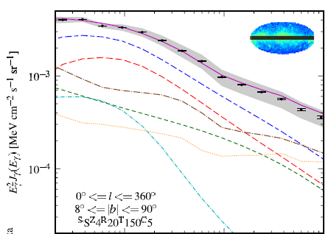
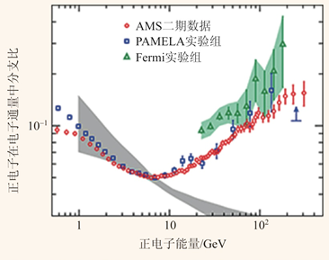
Galactic diffuse gamma-rays
Antiproton flux
Positron flux

Slide 37
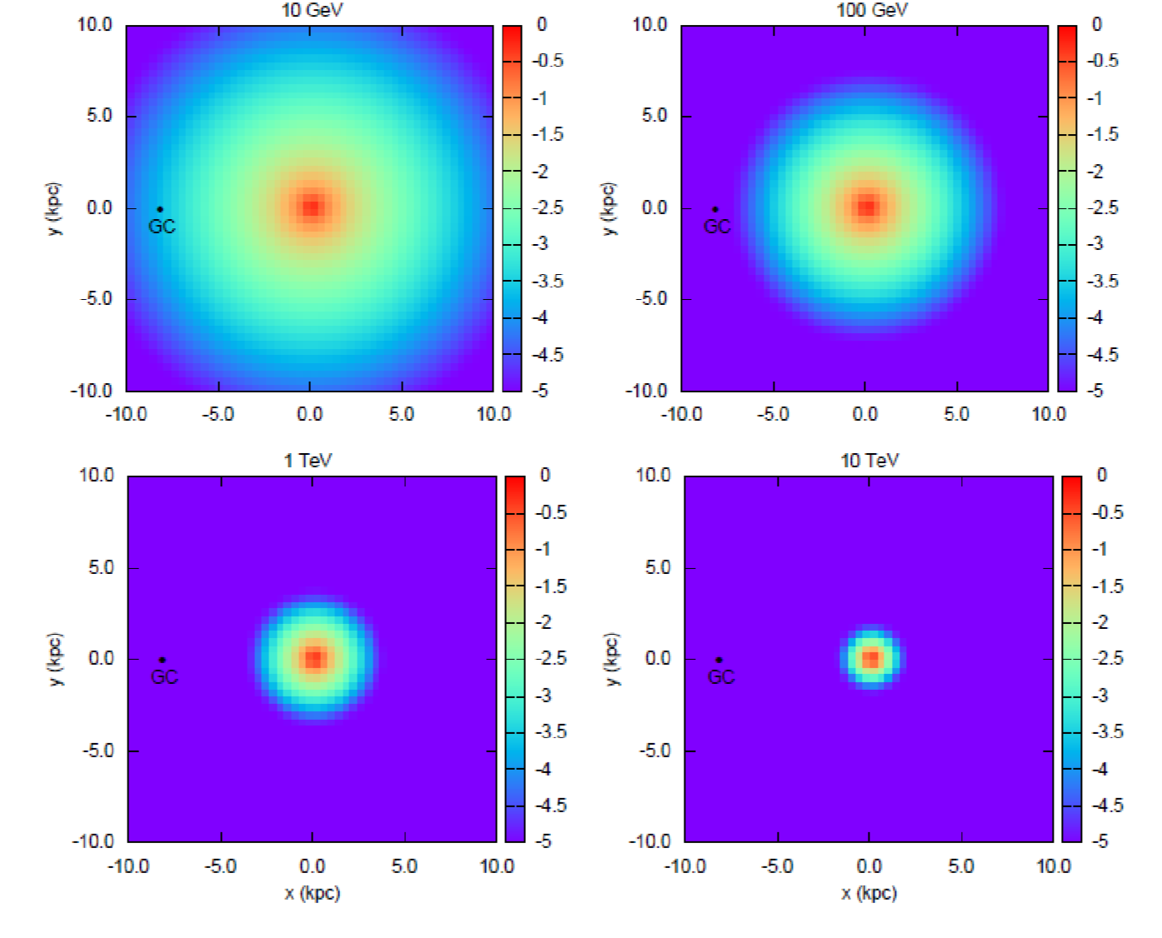
e⁺⁻ Propagation distance
If coming from nearby pulsar or SNR they may have possible features at higher energies, DM not
High energy e⁺⁻ can only come from nearby sources – the nearby SNR or pulsar induce large anisotropy, DM not

Slide 38
Two-zone diffusion for Geminga
Geminga: a plausible candidate of positron excess
r = 250 pc, t = 342 kyr, W = 1.23e49 erg
Observed multi-TeV halo (Milagro, HAWC)
0.3-5 keV, XMM-Newton
P.A.Caraveo et al. 2003
35 TeV, Milagro
A. A. Abdo et al. 2009

Slide 39
Two-zone diffusion for Geminga
A self-consistency check
The gamma-ray emission observed by HAWC is produced by ~100 TeV e-/e+, corresponding to a cooling time of 7000 yr.
K. Fang, X. Bi, P. Yin, Q. Yuan 2018
Explanation of the slow diffusion region?
Pre-existed: in the region influenced by its corresponding SNR
self-generated: the large gradient of CR near the source leads to the streaming instability

Slide 40
背景
Geminga是最有可能解释正电子超出的天体源之一
相比一般脉冲星的优势：
合适的距离和年龄：250 pc（是Crab的1/8，最近的脉冲星之一），342 kyr
足够大的转动减慢能量：1e49 erg
探测到了TeV伽马射线，是将正负电子加速到高能的直接证据
HAWC 2017
在8~40 TeV观测到尺度为25 pc的伽马射线晕
伽马射线应来自能量为~100 TeV的正负电子的逆康普顿散射

Slide 41
Self-generated turbulence
Obvious weakness of Evoli et al work：
They adopt a one-dimensional diffusion with 1pc tube fluix, which assumes a large scale regular magnetic field; however, the TeV halo is symmetric
They donot consider the walking of geminga 70pc. The slow diffusion is generated very late
我们的目标：
We have done the calculation in 3-dimension case
提出一种新的解释，即Geminga仍处于其对应SNR内部

Slide 42
检验自约束模型
Electron propagation
MHD wave evolution
Where
扩散系数与波的能量密度的关系
Wave growth by streaming instabiltyiy
束流不稳定导致的Alfven波增长率
Alfven波与背景MHD波碰撞导致的耗散率 dissapition
假设解为球对称形式，以数值方法对以上两方程同时求解

