Slide 1

Pion & Kaon Structure at the Electron Ion Collider
Craig Roberts
Notes:
25+5 … at most 45 transparencies

Slide 2
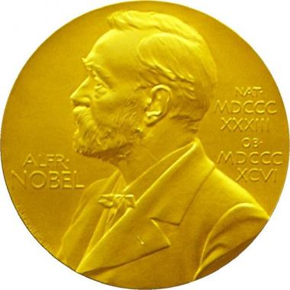

2013: Englert & Higgs
The 2013 Nobel Prize in Physics was awarded to Peter Higgs and Francois Englert following discovery of the Higgs boson at the Large Hadron Collider.
With this discovery the Standard Model of Particle Physics became complete.
Where to now?

Slide 3
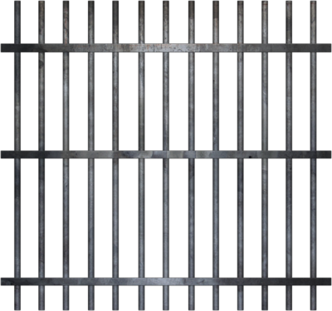


2013: Englert & Higgs
“The Higgs boson is often said to give mass to everything.”
“However, that is wrong. It only gives mass to some very simple particles, accounting for only
one or two percent of the mass
of more complex things …”
The vast majority of mass
comes from the energy needed
to hold quarks together inside hadrons
confinement

Slide 4
2013: Englert & Higgs
The most important chapter of the Standard Model is the least understood.
Quantum Chromodynamics (QCD) is that part of the Standard Model which is supposed to describe all of nuclear physics
  Matter = quarks
  Gauge bosons = gluons
Yet, fifty years after the discovery of quarks, we are only just beginning to understand how QCD moulds the basic bricks for nuclei: pions, neutrons, protons, etc.

Slide 5
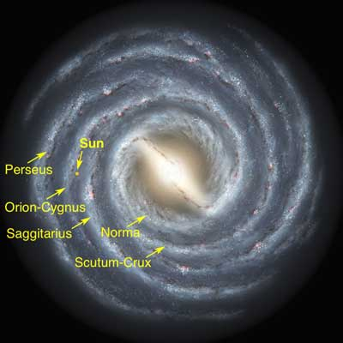
Emergent Phenomena in the Standard Model
Existence of our Universe depends critically on the following empirical facts:
Proton is massive
  i.e. the mass-scale for strong interactions is vastly different to that of electromagnetism
Proton is absolutely stable
  Despite being a composite object
  constituted from three valence quarks
Pion is unnaturally light (not massless, but lepton-like mass)
  Despite being a strongly interacting composite object built from a valence-quark and valence antiquark
Emergence: low-level rules producing high-level phenomena, with enormous apparent complexity

Slide 6
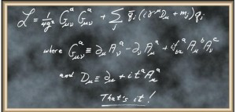
Quantum Chromodynamics
F. Wilczek, QCD Made Simple
Physics Today 53N8 22-28, (2000)
Quite possibly, the most remarkable theory we have ever invented
One line and two definitions are responsible for the
origin, mass and size of (almost) all visible matter!

Slide 7


Quantum Chromodynamics
F. Wilczek, QCD Made Simple
Physics Today 53N8 22-28, (2000)
Quite possibly, the most remarkable theory we have ever invented
One line and two definitions are responsible for the
origin, mass and size of (almost) all visible matter!

Slide 8

Strong Interactions in the Standard Model
Only apparent scale in chromodynamics is mass of the quark field
Quark mass is said to be generated by Higgs boson.
In connection with everyday matter, that mass is less-then 0.5% of the empirical scale for strong interactions,
viz. more-than two orders-of-magnitude smaller
Plainly, the Higgs-generated mass is very far removed from the natural scale for strongly-interacting matter
Nuclear physics mass-scale – 1 GeV – is an emergent feature of the Standard Model
  No amount of staring at L_{QCD} can reveal that scale
Contrast with quantum electrodynamics, e.g. spectrum of hydrogen levels measured in units of m_{e}, which appears in L_{QED}

Slide 9
Whence Mass?
Classical chromodynamics … non-Abelian local gauge theory
Remove the current mass … there’s no energy scale left
No dynamics in a scale-invariant theory; only kinematics … the theory looks the same at all length-scales … there can be no clumps of anything … hence bound-states are impossible.
Our Universe can’t exist
Higgs boson doesn’t solve this problem …
  normal matter is constituted from light-quarks
  the mass of protons and neutrons, the kernels of all visible matter, are 100-times larger than anything the Higgs can produce
Where did it all begin? … becomes … Where did it all come from?

Slide 10

Trace Anomaly
In a scale invariant theory Poincaré invariance entails
the energy-momentum tensor must be traceless: T_{μμ} ≡ 0
Regularisation and renormalisation of (ultraviolet) divergences in Quantum Chromodynamics introduces a mass-scale
  … dimensional transmutation:
  Lagrangian’s constants (couplings and masses) become dependent on a mass-scale, ζ
α → α(ζ) in QCD’s (massless) Lagrangian density, L(m=0)
  ⇒ ∂_{μ}D_{μ} = δL/δσ = αβ(α) dL/dα = β(α) ¼G_{μν} G_{μν} = T_{ρρ} =: Θ₀
    Quantisation of renormalisable four-dimensional theory forces nonzero value for trace of energy-momentum tensor
Trace anomaly
QCD β function … specifies how the coupling “runs”

Slide 11

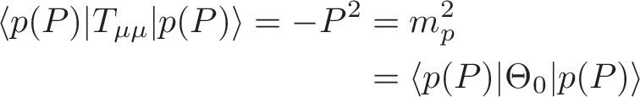
Trace Anomaly
Knowing that a trace anomaly exists does not deliver a great deal
… Indicates only that a mass-scale must exist
Key Question:
  Can one compute and/or understand the magnitude of that scale?
One can certainly measure the magnitude … consider proton:
In the chiral limit the entirety of the proton’s mass is produced by the trace anomaly, Θ₀
… In QCD, Θ₀ measures the strength of gluon self-interactions
… so, from one perspective, m_{p} is (somehow) completely generated by glue.

Slide 12
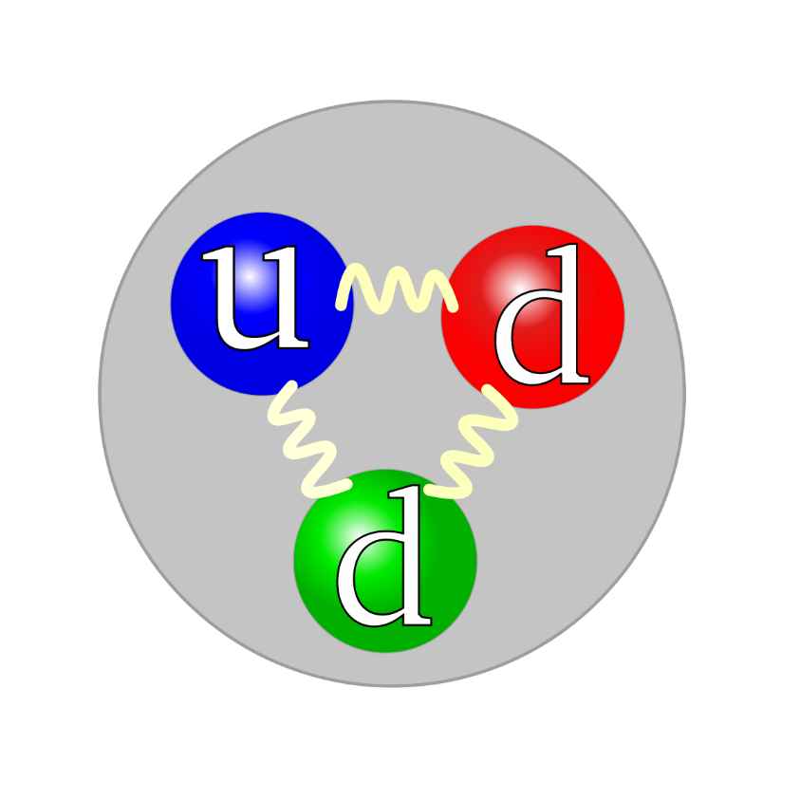

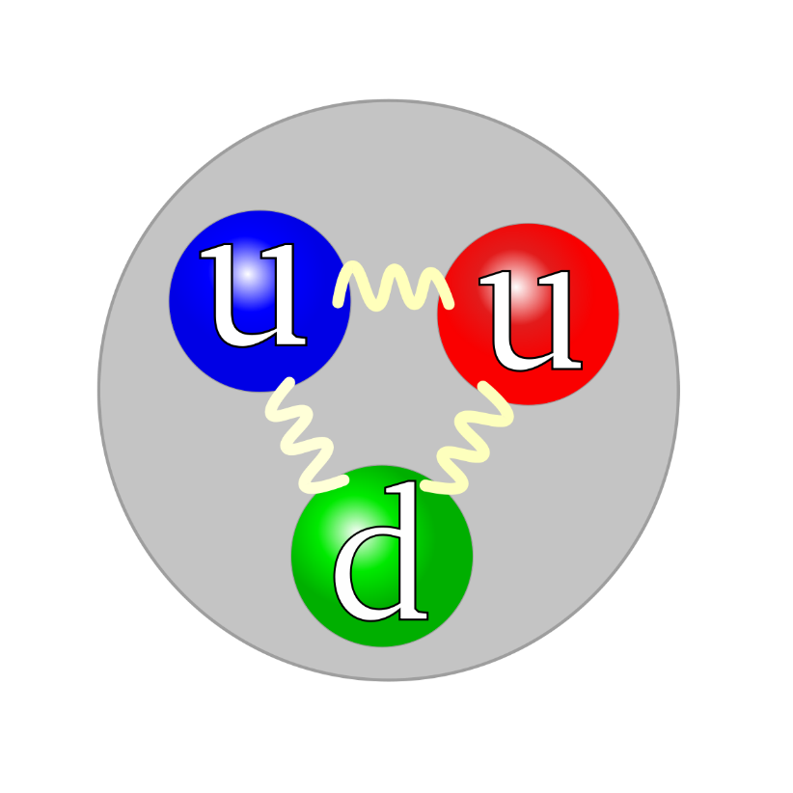
Confinement & Origin of Mass
The vast majority of mass comes from the energy needed to hold quarks together inside nuclei

Slide 13

On the other hand …

Slide 14
Trace Anomaly
In the chiral limit
⇒
Might mean that the scale anomaly vanishes trivially in the pion state, i.e. gluons contribute nothing to the pion mass.
But that is difficult way to obtain “zero”!
Easier to imagine that “zero” owes to cancellations between different operator contributions to the expectation value of Θ₀.
Of course, such precise cancellation should not be an accident.
    It could only arise naturally because
    of some symmetry and/or symmetry-breaking pattern.

Slide 15
Whence “1” and yet “0” ?
No statement of the question
“How does the mass of the proton arise?”
is complete without the additional clause
“How does the pion remain massless?”
Natural visible-matter mass-scale must emerge simultaneously with apparent preservation of scale invariance in related systems
  Expectation value of Θ₀ in chiral-limit pion is always zero,
  irrespective of the size of the natural mass-scale for strong interactions = m_{p}

Slide 16
Whence “1” and yet “0” ?
No statement of the question
“How does the mass of the proton arise?”
is complete without the additional clause
“How does the pion remain massless?”
Natural visible-matter mass-scale must emerge simultaneously with apparent preservation of scale invariance in related systems
  Expectation value of Θ₀ in pion is always zero,
  irrespective of the size of the natural mass-scale for strong interactions = m_{p}
Modern Physics must
Elucidate the Entire Array of Empirical Consequences
of the Mechanism responsible
so that the Standard Model can be Validated

Slide 17

Ideas: Old & New

Slide 18
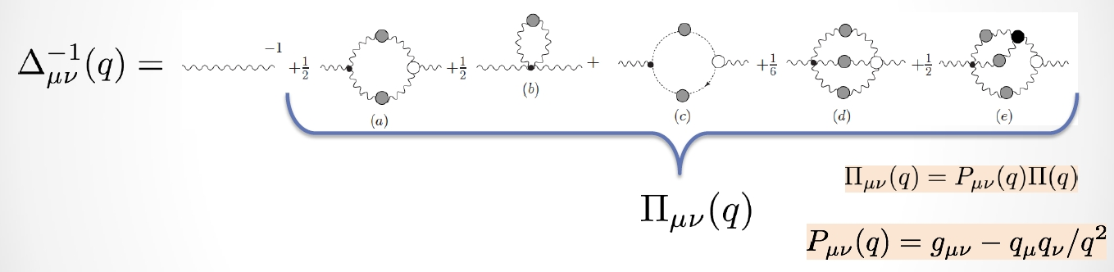
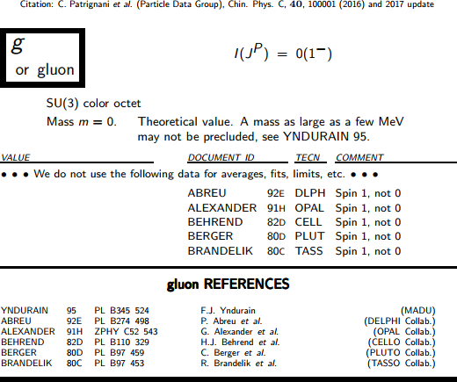
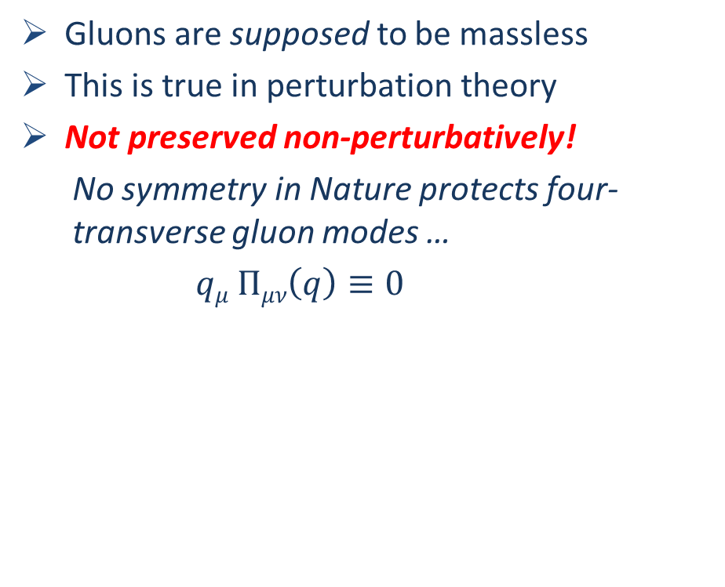
IR Behaviour of QCD
Gluons are supposed to be massless
This is true in perturbation theory
Not preserved non-perturbatively!
  No symmetry in Nature protects four-transverse gluon modes …
  $qμ Πμν\left(q\right)≡0$
≠

Slide 19


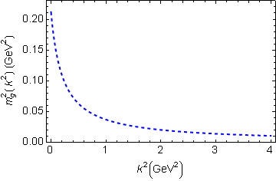
IR Behaviour of QCD
Running gluon mass
Gluons are cannibals – a particle species whose members become massive by eating each other!
μ_{g} ≈ ½ m_{p}
Expression of trace anomaly:
Massless glue becomes massive
Power-law suppressed in ultraviolet, so invisible in perturbation theory
Dynamical mass generation in continuum quantum chromodynamics
J.M. Cornwall, Phys. Rev. D 26 (1981) 1453
The Gluon Mass Generation Mechanism: A Concise Primer
A.C. Aguilar, D. Binosi, J. Papavassiliou, Front. Phys. 11 (2016) 111203
Combining DSE, lQCD and pQCD analyses of QCD’s gauge sector

Slide 20

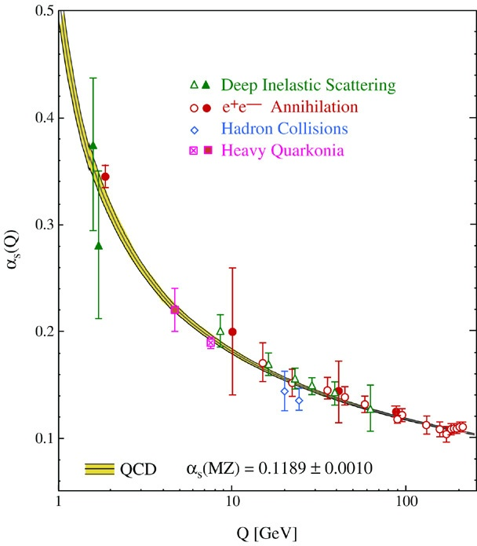
QCD’s Running Coupling
This is where we live
⇐
What’s happening
out here?!

Slide 21
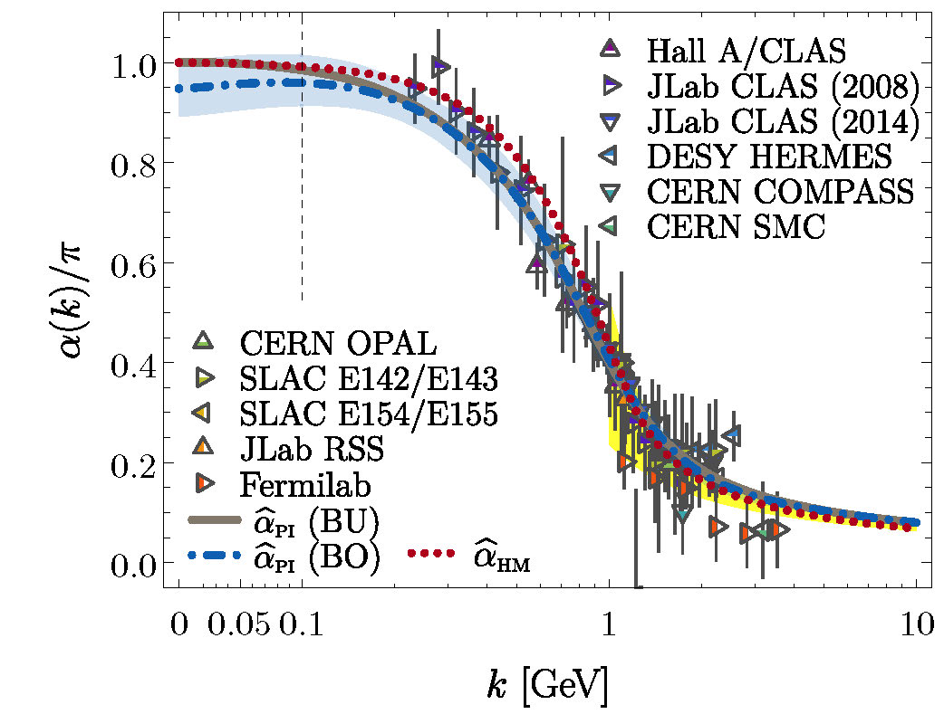
Process-independent effective-charge in QCD
The QCD Running Coupling,
A. Deur, S. J. Brodsky and G. F. de Teramond, Prog. Part. Nucl. Phys. 90 (2016) 1-74
Process independent strong running coupling
Daniele Binosi et al., arXiv:1612.04835 [nucl-th], Phys. Rev. D 96 (2017) 054026/1-7
Process-independent effective coupling. From QCD Green functions to phenomenology,
Jose Rodríguez-Quintero et al., arXiv:1801.10164 [nucl-th]. Few Body Syst. 59 (2018) 121/1-9
Modern continuum & lattice methods for analysing gauge sector enable
“Gell-Mann – Low”
  running charge to be defined in QCD
Combined continuum and lattice analysis of QCD’s gauge sector yields a parameter-free prediction
N.B. Qualitative change in α̂_{PI}(k) at k ≈ ½ m_{p}
Data = process dependent effective charge [Grunberg:1982fw]:
α_{g1}, defined via Bjorken Sum Rule

Slide 22
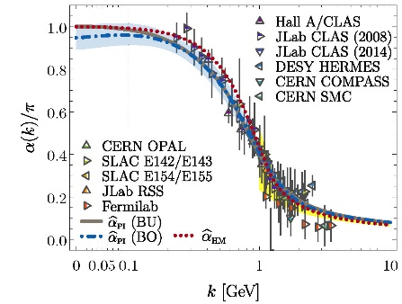
Process-independent effective-charge in QCD
Process independent strong running coupling
Binosi, Mezrag, Papavassiliou, Roberts, Rodriguez-Quintero
arXiv:1612.04835 [nucl-th], Phys. Rev. D 96 (2017) 054026/1-7
The QCD Running Coupling,
A. Deur, S. J. Brodsky and G. F. de Teramond,
Prog. Part. Nucl. Phys. 90 (2016) 1-74
Process-independent effective coupling. From QCD Green functions to phenomenology,
Jose Rodríguez-Quintero et al., arXiv:1801.10164 [nucl-th]. Few Body Syst. 59 (2018) 121/1-9
α̂_{PI} is a new & unique type of effective charge
  completely determined by the gauge-boson
  two-point function.
α̂_{PI} is
  process-independent
  unifies a vast array of observables
α̂_{PI} possesses an infrared saturation point
  Nonperturbative analysis demonstrating absence of a Landau pole in QCD
QCD is IR finite, owing to dynamical generation of gluon mass-scale
Asymptotic freedom ⇒ QCD is well-defined at UV momenta
QCD is therefore unique amongst known 4D quantum field theories
  Potentially, defined & internally consistent at all momenta

Slide 23
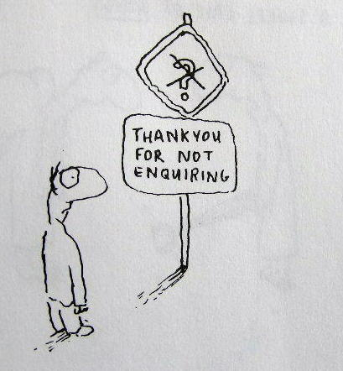
Enigma of Mass

Slide 24
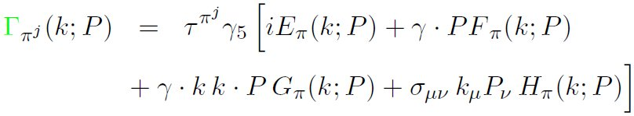

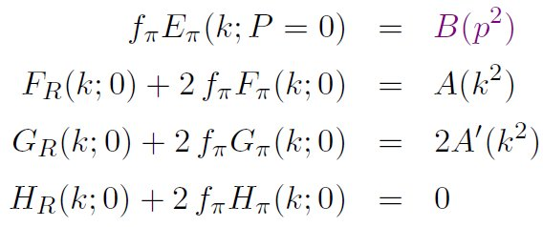
Pion’s Goldberger
-Treiman relation
Maris, Roberts and Tandy
nucl-th/9707003, Phys.Lett. B420 (1998) 267-273
Pion’s Bethe-Salpeter amplitude
Solution of the Bethe-Salpeter equation
Dressed-quark propagator
Axial-vector Ward-Takahashi identity entails
B(k²)
Owing to DCSB
& Exact in
Chiral QCD
Miracle: two body problem solved, almost completely, once solution of one body problem is known

Slide 25
The most fundamental expression of Goldstone’s Theorem and DCSB
Rudimentary version of this relation is apparent in Nambu’s Nobel Prize work
Model independent
Gauge independent
Scheme independent
f_{π} E_{π}(p²) = B(p²)

Slide 26
Pion exists if, and only if, mass emerges dynamically
Rudimentary version of this relation is apparent in Nambu’s Nobel Prize work
Model independent
Gauge independent
Scheme independent
f_{π} E_{π}(p²) = B(p²)

Slide 27
π-nucleon coupling is strong if, and only if, emergent mass is large
Rudimentary version of this relation is apparent in Nambu’s Nobel Prize work
Model independent
Gauge independent
Scheme independent
f_{π} E_{π}(p²) = B(p²)

Slide 28
Whence “0” ?

Slide 29
Whence “0” ?
The answer is algebraic

Slide 30
Pion masslessness
Munczek, H. J., Phys. Rev. D 52 (1995) pp. 4736-4740
Bender, A., Roberts, C.D. and von Smekal, L., Phys. Lett. B 380 (1996) pp. 7-12
Maris, P. , Roberts, C.D. and Tandy, P.C., Phys. Lett. B 420 (1998) pp. 267-273
Binosi, Chang, Papavassiliou, Qin, Roberts, Phys. Rev. D 93 (2016) 096010/1-7
Obtain a coupled set of gap- and Bethe-Salpeter equations
  Bethe-Salpeter Kernel:
    valence-quarks with a momentum-dependent running mass produced by self-interacting gluons, which have given themselves a running mass
    Interactions of arbitrary but enumerable complexity involving these “basis vectors”
  Chiral limit:
    Algebraic proof
      at any & each finite order in symmetry-preserving construction of kernels for
        the gap (quark dressing)
        and Bethe-Salpeter (bound-state) equations,
      there is a precise cancellation between
        mass-generating effect of dressing the valence-quarks
        and attraction introduced by the scattering events
    Cancellation guarantees that
      simple system, which began massless,
      becomes a complex system, with
        a nontrivial bound-state wave function
        attached to a pole in the scattering matrix, which remains at P²=0 …
    Interacting, bound system remains massless!

Slide 31
Pion masslessness
Munczek, H. J., Phys. Rev. D 52 (1995) pp. 4736-4740
Bender, A., Roberts, C.D. and von Smekal, L., Phys. Lett. B 380 (1996) pp. 7-12
Maris, P. , Roberts, C.D. and Tandy, P.C., Phys. Lett. B 420 (1998) pp. 267-273
Binosi, Chang, Papavassiliou, Qin, Roberts, Phys. Rev. D 93 (2016) 096010/1-7
Obtain a coupled set of gap- and Bethe-Salpeter equations
  Bethe-Salpeter Kernel:
    valence-quarks with a momentum-dependent running mass produced by self-interacting gluons, which have given themselves a running mass
    Interactions of arbitrary but enumerable complexity involving these “basis vectors”
  Chiral limit:
    Algebraic proof
      at any & each finite order in symmetry-preserving construction of kernels for
        the gap (quark dressing)
        and Bethe-Salpeter (bound-state) equations,
      there is a precise cancellation between
        mass-generating effect of dressing the valence-quarks
        and attraction introduced by the scattering events
    Cancellation guarantees that
      simple system, which began massless,
      becomes a complex system, with
        a nontrivial bound-state wave function
        attached to a pole in the scattering matrix, which remains at P²=0 …
    Interacting, bound system remains massless!
Quantum field theory statement:
In the pseudsocalar channel, the dynamically generated mass of the two fermions is precisely cancelled by the attractive interactions between them – iff –
f_{π} E_{π}(p²) = B(p²)
⇒ 2 M_{q} + U_{g} ≡ 0

Slide 32
Empirical Consequences of Emergent Mass
QCD's interactions are universal … same in all hadrons
Hence, similar cancellations must take place within the proton
However, in the proton, no symmetry requires cancellations to be complete
  Thus, value of proton's mass is typical of the magnitude of scale breaking in one body sectors = dressed-gluon and -quark mass scales
This “DCSB paradigm” provides basis for understanding why:
  mass-scale for strong interactions is vastly different to that of electromagnetism
  proton mass expresses that scale
  pion is nevertheless unnaturally light
No significant mass-scale is possible unless one of similar size is expressed in the dressed-propagators of gluons and quarks.
Follows that the mechanism(s) responsible for emergence of mass can be exposed by measurements sensitive to such dressing
This potential is offered by many observables … Three (particularly clean) Examples

Slide 33
Empirical Consequences of Emergent Mass
QCD's interactions are universal … same in all hadrons
Hence, similar cancellations must take place within the proton
However, in the proton, no symmetry requires cancellations to be complete
  Thus, value of proton's mass is typical of the magnitude of scale breaking in one body sectors = dressed-gluon and -quark mass scales
This “DCSB paradigm” provides basis for understanding why:
  mass-scale for strong interactions is vastly different to that of electromagnetism
  proton mass expresses that scale
  pion is nevertheless unnaturally light
No significant mass-scale is possible unless one of similar size is expressed in the dressed-propagators of gluons and quarks.
Follows that the mechanism(s) responsible for emergence of mass can be exposed by measurements sensitive to such dressing
This potential is offered by many observables … Three (particularly clean) Examples
Saturday 24 August 2019
(15:50-16:20) … Generalized Parton Distributions from light-front wave functions
- José RODRÍGUEZ QUINTERO
(16:20-16:50) … Nucleon-to-resonance electromagnetic form factors -
- Jorge SEGOVIA

Slide 34
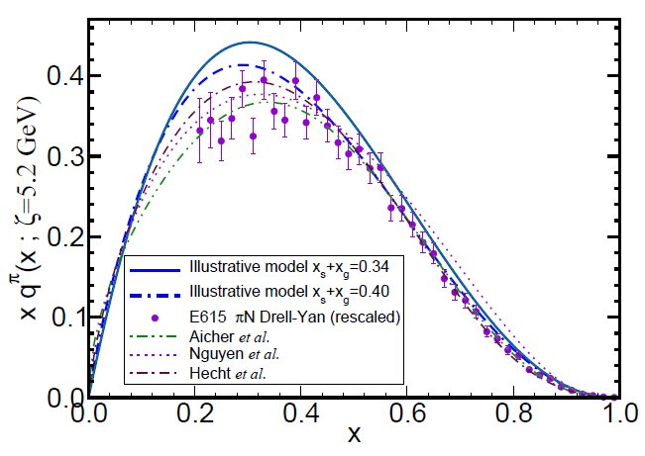
π & K Valence-quark Distribution Functions

Slide 35
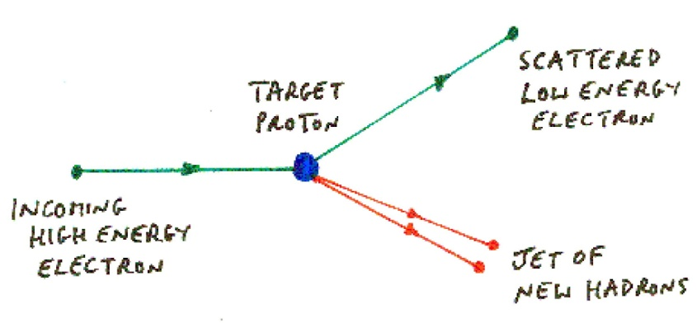

Deep inelastic processes
Quark discovery experiment at SLAC
(1966-1978, Nobel Prize in 1990)
Completely different to elastic scattering
  Blow the target to pieces instead of keeping only those events where it remains intact.
Cross-section serves as measurement of the momentum-fraction probability distribution for quarks and gluons within the target hadron: q(x), g(x)
Probability that a quark/gluon within the target will carry a fraction x of the bound-state’s light-front momentum
Distribution Functions of the Nucleon and Pion in the Valence Region,
Roy J. Holt and Craig D. Roberts,
arXiv:1002.4666 [nucl-th], Rev. Mod. Phys. 82 (2010) pp. 2991-3044
Parton momentum and helicity distributions in the nucleon
P. Jimenez-Delgado, W. Melnitchouk and J.F. Owens
arXiv:1306.6515, J.Phys. G 40 (2013) 093102

Slide 36
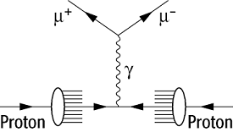
QCD prediction of π valence-quark distributions
Pion
Owing to absence of stable pion targets, the pion’s valence-quark distribution functions have hitherto been measured via the Drell-Yan process:
π p → μ⁺ μ⁻ X
Consider a theory in which quarks scatter via a vector-boson exchange interaction whose k²>>m_{G}² behaviour is (1/k²)^{β}
Then at a resolving scale ζ_{H} … u_{π}(x; ζ_{H}) ~ (1-x)^{2β}
namely, the large-x behaviour of the quark distribution function is a direct measure of the momentum-dependence of the underlying interaction.
In QCD, β=1 and hence
^{QCD} u_{π}(x; ζ_{H}) ~ (1-x)²
QCD: Q > ζ_{H} ⇒ 2 → 2+γ, γ > 0

Slide 37
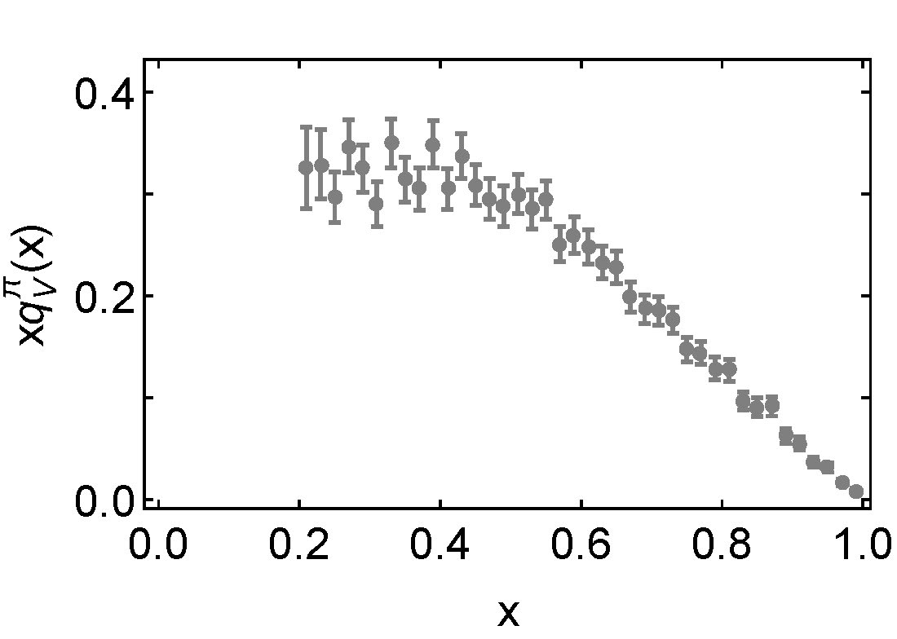
Empirical status of the Pion’s valence-quark distributions
Pion
Owing to absence of pion targets, the pion’s valence-quark distribution functions have hitherto been measured via the Drell-Yan process:
π p → μ⁺ μ⁻ X
Three experiments:
  CERN (1983 & 1985)
  FNAL (1989).
None more recent
Conway et al.
Phys. Rev. D 39, 92 (1989)
  Leading-order analysis of the Drell-Yan data
  ~ 400 citations

Slide 38
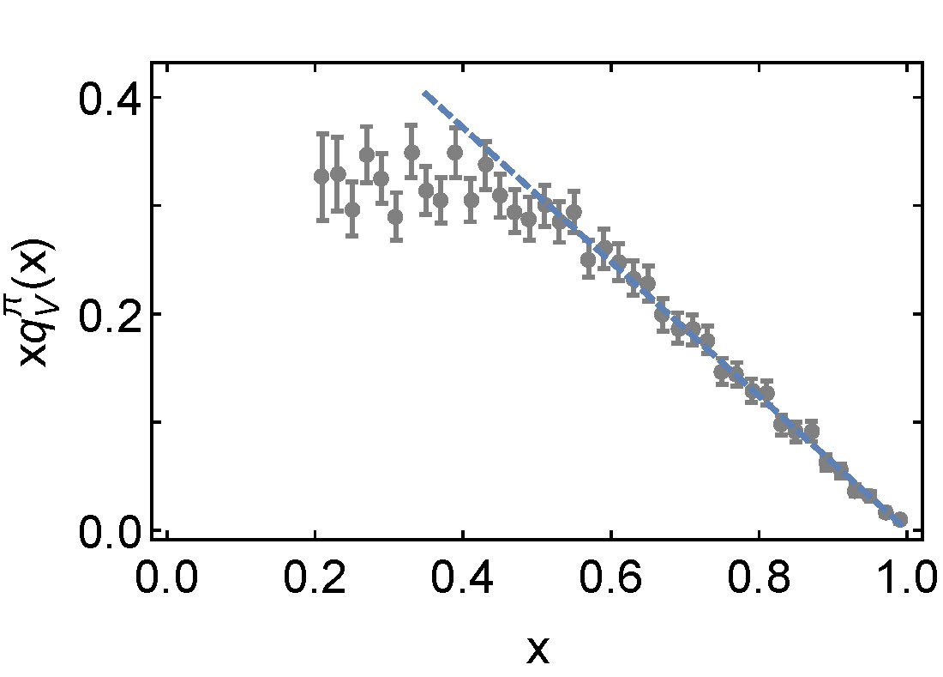
Empirical status of the Pion’s valence-quark distributions
Pion
Owing to absence of pion targets, the pion’s valence-quark distribution functions have hitherto been measured via the Drell-Yan process:
π p → μ⁺ μ⁻ X
Three experiments:
  CERN (1983 & 1985)
  FNAL (1989).
None more recent
Conway et al.
Phys. Rev. D 39, 92 (1989)
  Leading-order analysis of the Drell-Yan data
Factor of 2 discrepancy with QCD! Controversial!
∝ (1-x)¹

Slide 39
π valence-quark distributions
20 Years of Evolution
1989 … Conway et al. Phys. Rev. D 39, 92 (1989)
  Leading-order analysis of Drell-Yan data
Ensuing years, great deal of fog
Perceptions ebbed and flowed
  Is this data a fundamental challenge to Standard Model?
∝ (1-x)¹

Slide 40
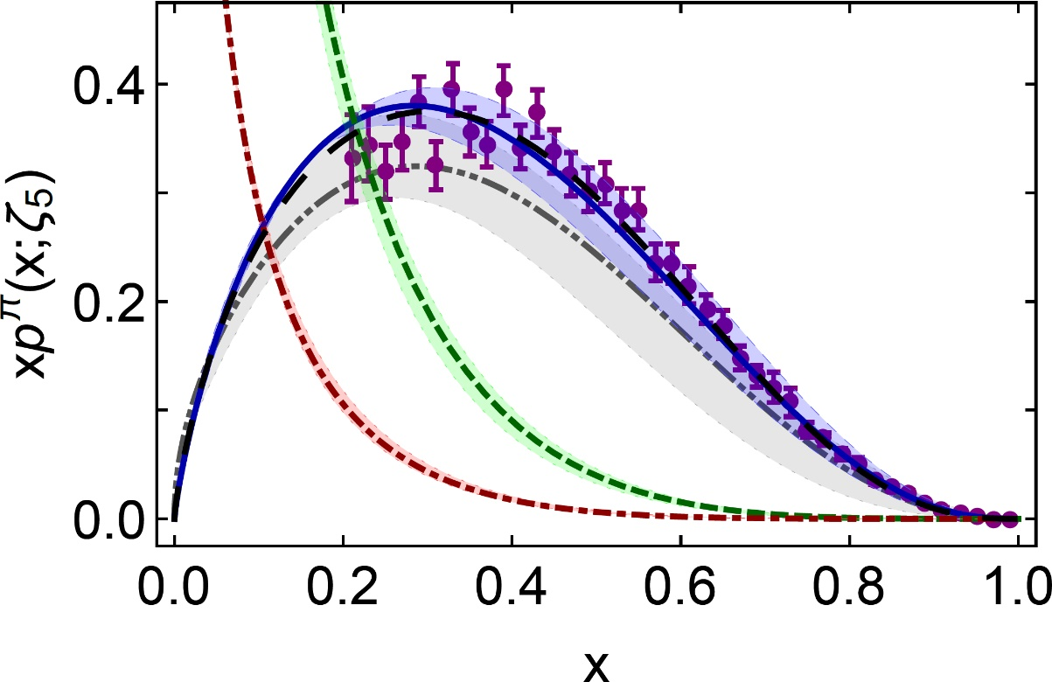
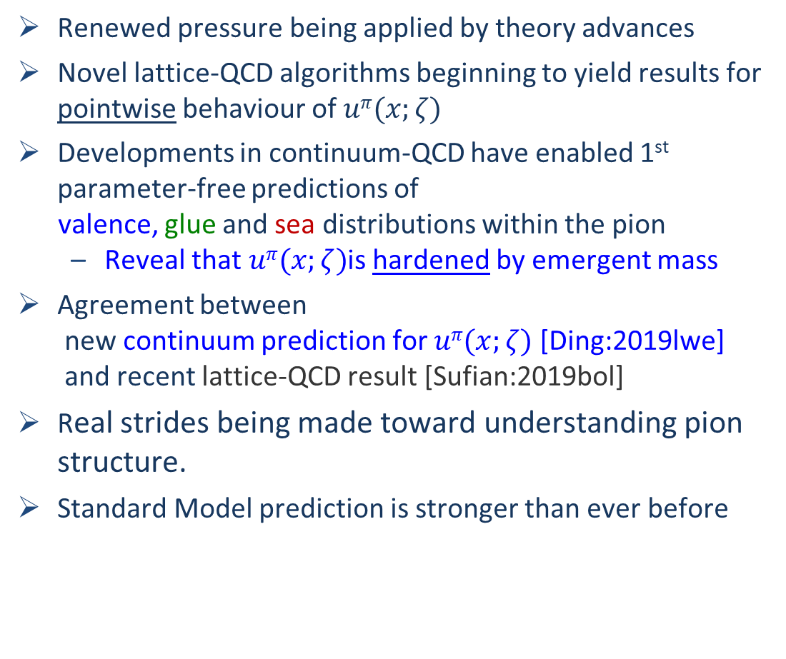
π valence-quark distributions
20 Years of Evolution → 2019
Renewed pressure being applied by theory advances
Novel lattice-QCD algorithms beginning to yield results for pointwise behaviour of $uπ(x;ζ)$
Developments in continuum-QCD have enabled 1st parameter-free predictions of
valence, glue and sea distributions within the pion
  Reveal that $uπ(x;ζ)$is hardened by emergent mass
Agreement between
  new continuum prediction for $uπ(x;ζ)$ [Ding:2019lwe] and recent lattice-QCD result [Sufian:2019bol]
Real strides being made toward understanding pion structure.
Standard Model prediction is stronger than ever before
β^{contm}(ζ₅) = 2.66(12)
β^{lattice}(ζ₅) = 2.45(58)
Now – after 30 years – new era dawning in which the ultimate experimental checks can be made

Slide 41
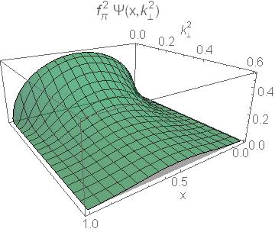
Meson Wave Functions

Slide 42
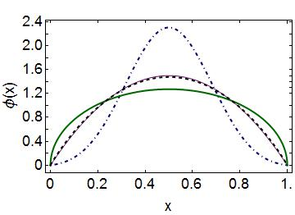
Emergent Mass vs. Higgs Mechanism
Parton distribution amplitudes of S-wave heavy-quarkonia
Minghui Ding, Fei Gao, Lei Chang, Yu-Xin Liu and Craig D. Roberts
arXiv:1511.04943 [nucl-th], Phys. Lett. B 753 (2016) pp. 330-335
When does Higgs mechanism begin to influence mass generation?
limit m_{quark}→ ∞
φ(x) → δ(x-½)
limit m_{quark} → 0
φ(x) ∼ (8/π) [x(1-x)]^{½}
Transition boundary lies just above m_{strange}
Hence … Comparisons between distributions of truly light quarks and those describing strange quarks are ideally suited to exposing measurable signals of emergent mass in counterpoint to Higgs-driven effects
asymptotic
c+c_{bar}: Higgs
(weak mass)
s+s_{bar}:
on the border
q+q_{bar}: Emergent
(strong mass)

Slide 43
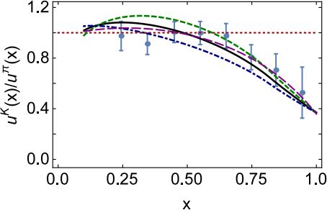
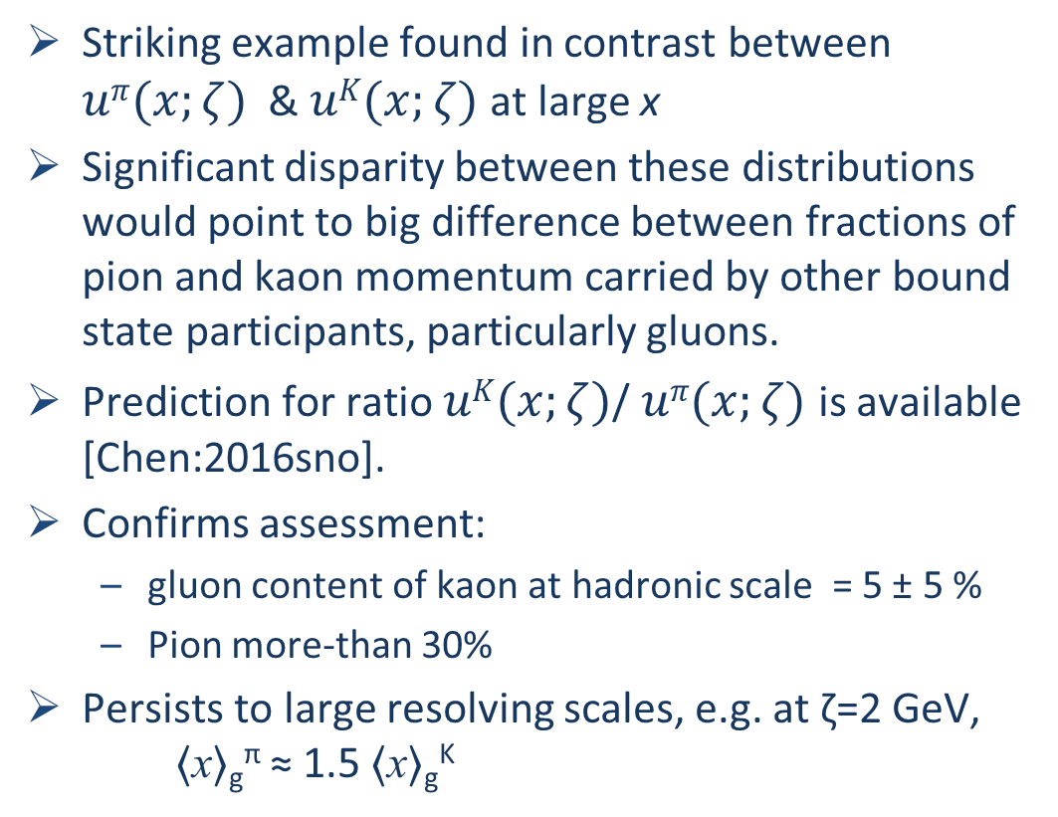

Emergent Mass vs. Higgs Mechanism
Striking example found in contrast between $uπ(x;ζ)$ & $uK(x;ζ)$at large x
Significant disparity between these distributions would point to big difference between fractions of pion and kaon momentum carried by other bound state participants, particularly gluons.
Prediction for ratio $uK(x;ζ)$/ $uπ(x;ζ)$ is available [Chen:2016sno].
Confirms assessment:
  gluon content of kaon at hadronic scale = 5 ± 5 %
  Pion more-than 30%
Persists to large resolving scales, e.g. at ζ=2 GeV, 〈x〉_{g}^{π} ≈ 1.5 〈x〉_{g}^{K}
0%
10%
glue in π ≫ glue in K
Difference in gluon content expressed clearly in large-x behaviour of
$uK(x;ζ)$/ $uπ(x;ζ)$

Slide 44

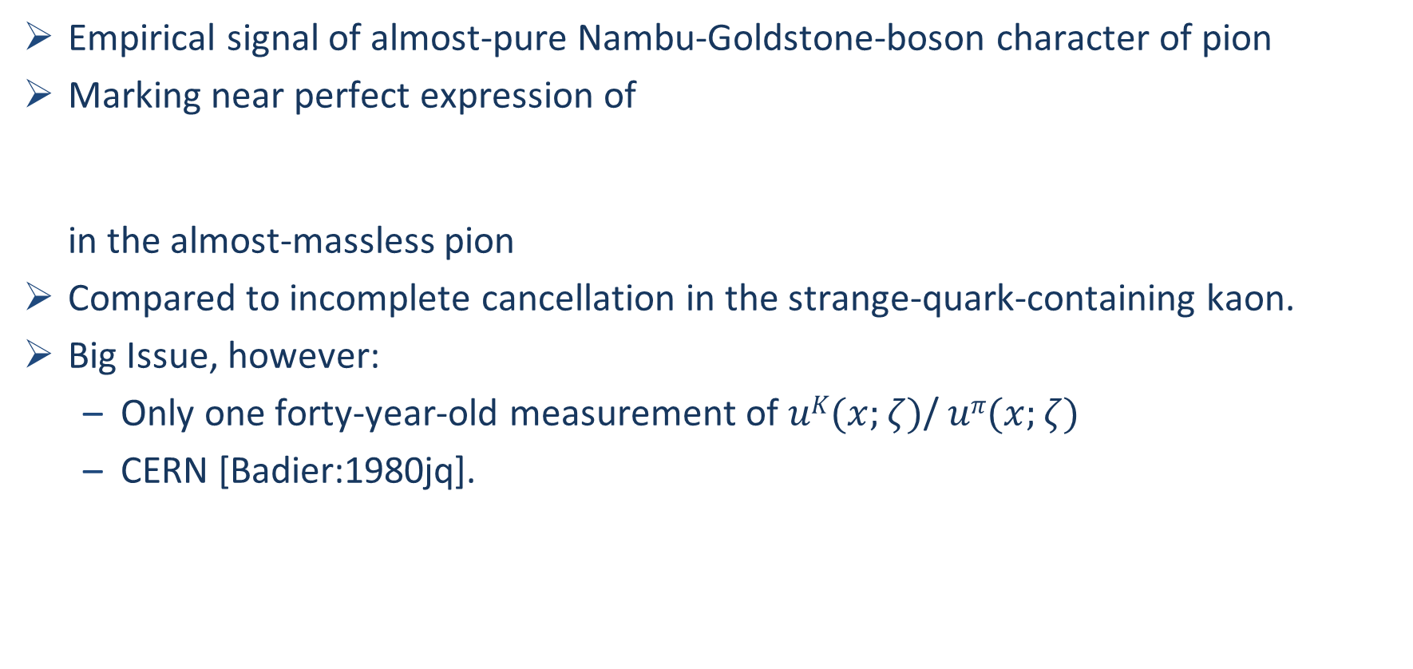
π & K PDFs
Valence-quark distribution functions in the kaon and pion,
Chen Chen, Lei Chang et al.
arXiv:1602.01502 [nucl-th], Phys. Rev. D93 (2016) 074021/1-11
Empirical signal of almost-pure Nambu-Goldstone-boson character of pion
Marking near perfect expression of
in the almost-massless pion
Compared to incomplete cancellation in the strange-quark-containing kaon.
Big Issue, however:
  Only one forty-year-old measurement of $uK(x;ζ)$/ $uπ(x;ζ)$
  CERN [Badier:1980jq].

Slide 45

π & K PDFs
Cannot claim understanding of Standard Model until explanation is provided for
emergence and structure of Nambu-Goldstone (NG) modes
NG modes are far more complex than is typically thought.
  Not pointlike;
  Intimately connected with the origin of mass;
  Probably play an essential part in any answer to the question of gluon and quark confinement in the physical Universe.
Internal structure of NG modes is very complicated; and that structure provides the clearest window onto the emergence of mass in the Standard Model.
Cleanest expression is found in following statement
  The gluon content of Nature's only near-pure Nambu-Goldstone mode, the pion, is far greater than that in any other hadron

Slide 46
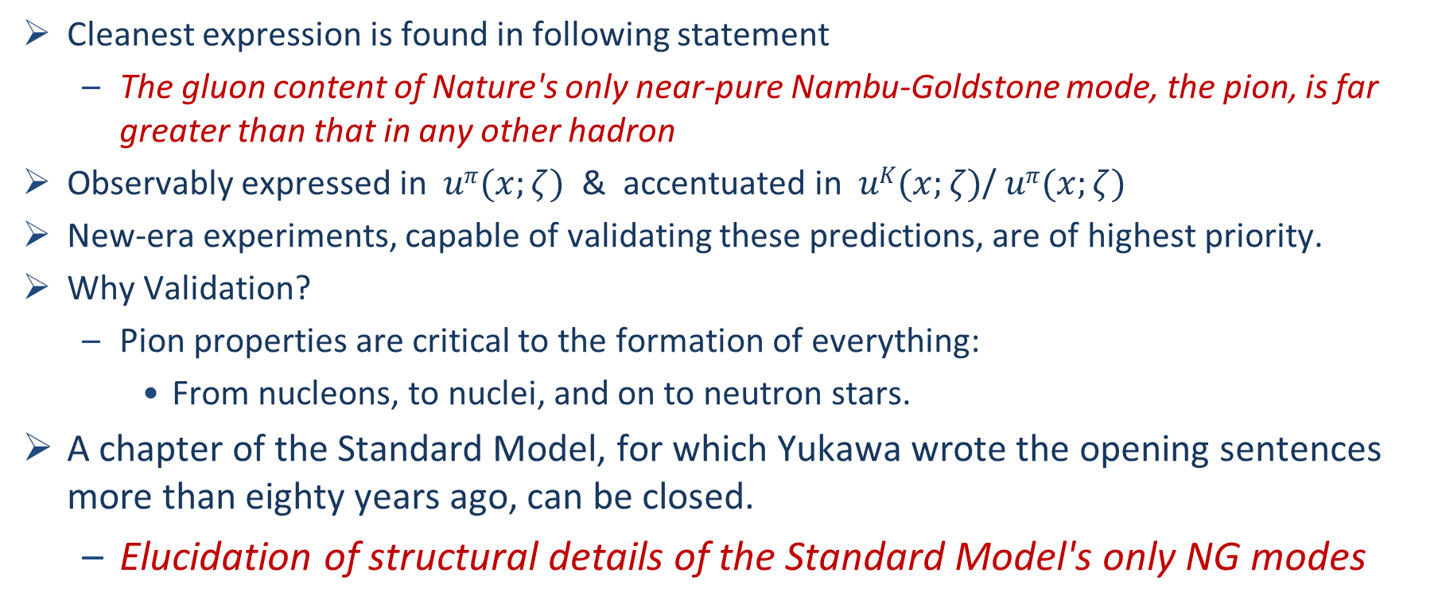
π & K PDFs
Cleanest expression is found in following statement
  The gluon content of Nature's only near-pure Nambu-Goldstone mode, the pion, is far greater than that in any other hadron
Observably expressed in $uπ(x;ζ)$ & accentuated in $uK(x;ζ)$/ $uπ(x;ζ)$
New-era experiments, capable of validating these predictions, are of highest priority.
Why Validation?
  Pion properties are critical to the formation of everything:
    From nucleons, to nuclei, and on to neutron stars.
A chapter of the Standard Model, for which Yukawa wrote the opening sentences more than eighty years ago, can be closed.
  Elucidation of structural details of the Standard Model's only NG modes

Slide 47
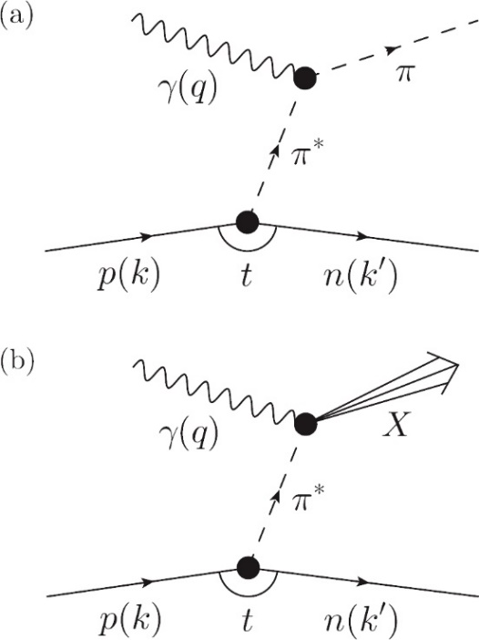
Approved & Planned Experiments
JLab 12 … Tagged Deep Inelastic Scattering
  Pion and Kaon PDFs at large x
  Sullivan Process …
    γ + p → n + X
    γ + p → Λ + X
  Approved … R. A. Montgomery et al., AIP Conf. Proc. 1819 (2017) 030004
Letter of Intent: A New QCD facility at the M2 beam line of the CERN SPS (COMPASS++/AMBER), B. Adams, arXiv:1808.00848 [hep-ex]
Pion and Kaon Structure at the EIC,
A. C. Aguilar et al., arXiv:1907.08218 [nucl-ex]
  5 key experiments:
    pion and kaon PDFs;
    pion and kaon GPDs;
    open charm production;
    pion form factor to 35 GeV²;
    pion and kaon fragmentation functions
Pion and kaon PDFs
via Drell-Yan reaction
Pion
& Kaon

Slide 48

Epilogue

Slide 49
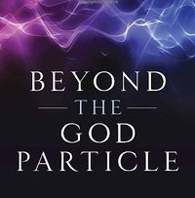
Epilogue
LHC has NOT found the “God Particle” … the Higgs boson is NOT the origin of mass
  Higgs-boson only produces a little bit of mass
  Higgs-generated light-quark mass-scales explain neither the proton’s mass
  nor the pion’s (near-) masslessness
Strong interaction sector of the Standard Model,
  i.e. QCD, is the key to understanding the
  origin, existence and properties
  of the vast bulk of all known matter

Slide 50
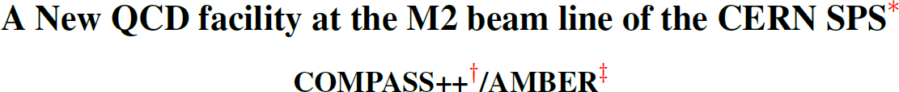
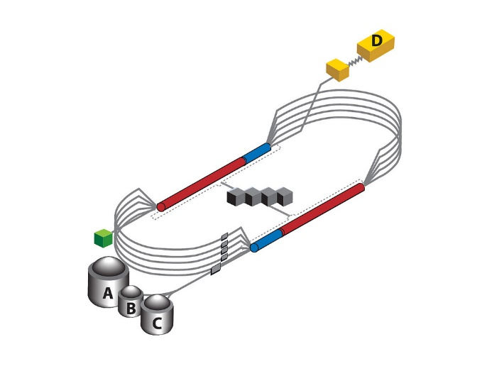

Epilogue
Challenge: Explain the Origin & Distribution of the Bulk of Visible Mass
Current Paradigm: Quantum Chromodynamics
QCD is plausibly a mathematically well-defined quantum field theory,
The only one we’ve ever produced
  Consequently, it potentially defines a new paradigm for developing Beyond-SM theories
Challenge is to reveal the content of strong-QCD
Progress and Insights
being delivered by amalgam of
  Experiment … Phenomenology …Theory
Continued exploitation of synergies essential
to capitalise on new opportunities provided
by existing & planned facilities

Slide 51
Selected Contributors: 2017 – Now
Students, Postdocs, Profs.
Thankyou!
Feliciano C. De Soto Borrero (UPO);
Tanja Horn (Catholic U. America)
Gastão Krein (UNESP – São Paulo)
Yu-Xin Liu (PKU);
Joannis Papavassiliou (U.Valencia)
Jia-Lun Ping (Nanjing Normal U.)
Si-xue Qin (Chongqing U.);
Jose Rodriguez Quintero (U. Huelva) ;
Elena Santopinto (Genova)
Jorge Segovia (U. Pablo de Olavide = UPO);
Sebastian Schmidt (IAS-FZJ & JARA);
Shaolong Wan (USTC) ;
Qing-Wu Wang (Sichuan U)
Shu-Sheng XU (NJUPT, Nanjing U.)
Pei-Lin Yin (NJUPT)
Hong-Shi Zong (Nanjing U)
… and many more …
Zhao-Qian YAO (Nanjing U.)
Yin-Zhen XU (Nanjing U.)
Marco BEDOLLA (Genova, U Michoácan)
Chen CHEN (Giessen, UNESP - São Paulo, USTC & IIT);
Muyang CHEN (NKU, PKU)
Zhu-Fang CUI (Nanjing U.) ;
Minghui DING (ECT*, ANL, Nankai U.) ;
Fei GAO (Heidelberg, Valencia, Peking U.) ;
Bo-Lin LI (Nanjing U.)
Ya LU (Nanjing U.)
Cédric MEZRAG (INFN-Roma, ANL, IRFU-Saclay) ;
Khépani RAYA (Nankai U., U Michoácan);
Adnan Bashir (U Michoácan);
Daniele Binosi (ECT*)
Volker Burkert (JLab)
Lei Chang (Nankai U. )
Xiao-Yun Chen (Jinling Inst. Tech., Nanjing)
Notes:
25+5 … Bonn Nstar 2019

Slide 52
Saturday 24 August 2019
(15:50-16:20) … Generalized Parton Distributions from light-front wave functions
- José RODRÍGUEZ QUINTERO
(16:20-16:50) … Nucleon-to-resonance electromagnetic form factors -
- Jorge SEGOVIA

