Slide 1

The 11th Workshop on Hadron Physics in China & Opportunities Worldwide
EicC parameters, design & status
Jiancheng Yang & Lijun Mao
on behalf of EicC general design group

Slide 2
Outline
HIAF introduction and status
EIC proposals in the world
Concept design of EicC-1 accelerator
Interaction region and luminosity concept
Cooling strategy and design
Summary
Notes:
In my talk, I will give a brief introduction of HIAF status, because the proposed EicC will be constructed in the same campus of HIAF, and some main accelerator components will be used for EicC. So the construction progress is very important for EicC.

Slide 3
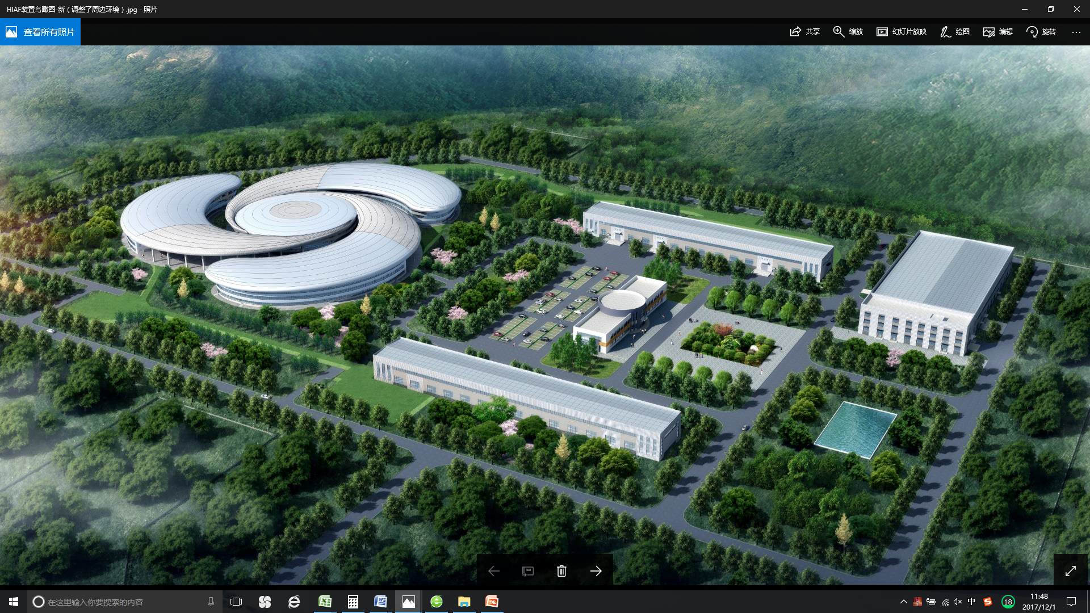
HIAF introduction and status
High-Intensity Heavy Ion Accelerator Facility-HIAF

Slide 4
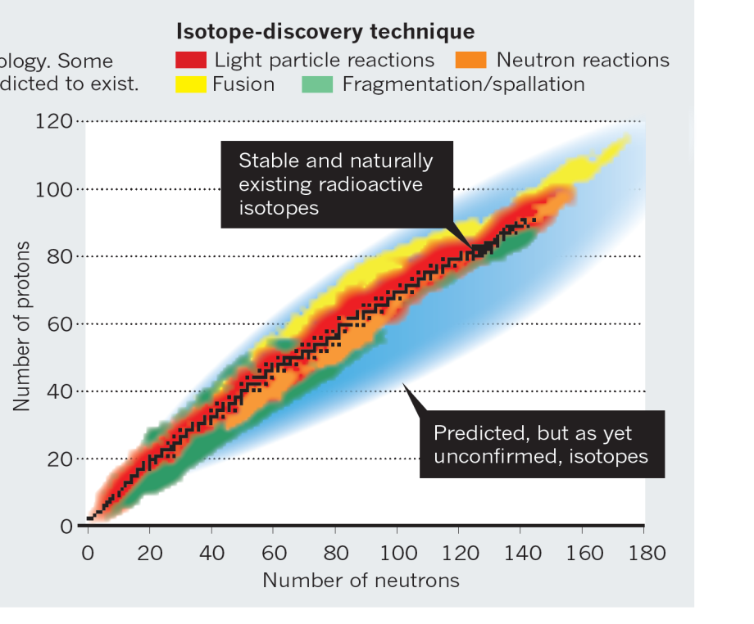
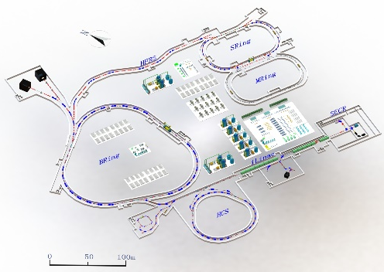
HIAF introduction and status
Next-generation high intensity facilities are required for advances in
nuclear physics and related research fields:
Fascinating and crucial questions
To explore the limit of nuclear existence
To study exotic nuclear structure
Understand the origin of the elements
To study the properties of High Energy
and Density Matter
……
Available today
Next-generation facilities are being constructed or proposed worldwide:
SPIRAL2 at GANIL in Caen, France
FAIR at GSI in Darmstadt, Germany
FRIB at MSU in the U.S.
NICA at JINR, Dubna, Russia
EURISOL in Europe
High Intensity Heavy-ion
Accelerator Facility
HIAF in China

Slide 5
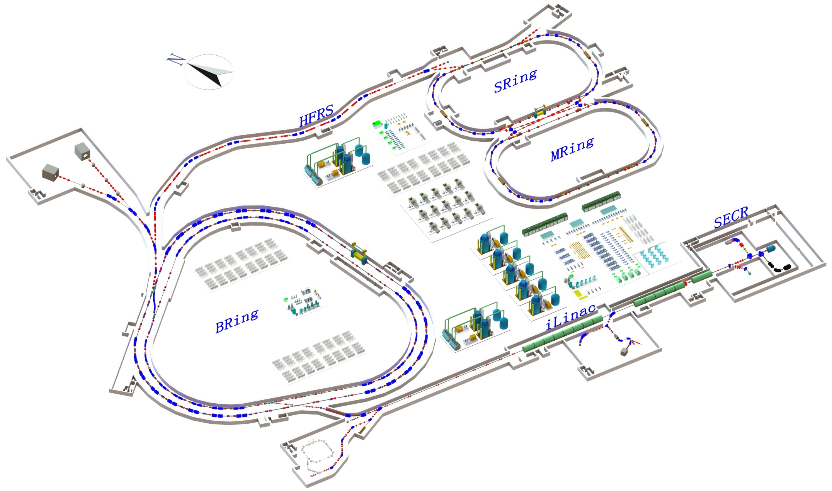
HIAF introduction and status
Main accelerator components
SRing: Spectrometer ring
Circumference: 273m
Rigidity: 13-15 Tm
Electron/Stochastic cooling
Two TOF detectors
Four operation modes
BRing-S: Booster ring
Circumference: 650 m
Rigidity: 86 Tm
Beam stacking
Beam acceleration
L: 180m, Bρ: 25 Tm
MRing: Figure “8” ring
Circumference: 273m
Rigidity: 15 Tm
Ion-ion merging
BRing-N: Fast cycle ring
Circumference: 570 m
Rigidity: 34 Tm
Large acceptance (250/120)
Two planes painting injection
Fast ramping rate（5-10Hz, 20Hz）
iLinac: Superconducting linac
Length:100 m
Energy: 17-22 MeV/u(U³⁵⁺⁻⁴⁵⁺)
These tunnels will be built in a cut and cover method and will be filled with 5 m overlay of soil. This conforms to the requirements of radiation safety.

Slide 6

HIAF introduction and status
Unprecedented parameters and unique features:
Highest beam Intensity （Comparison with HIRFL）:
Primary beam intensity increases by x 1000 - x 10000
Secondary beam intensity increases by up to x 10000
Highest heavy ion beam intensity in the world
Precisely-tailored beams - Precision frontiers
Beam cooling (Electron, Stochastic, laser; high quality, very small spot )
Beam compression (Ultra-short bunch length: 50-100ns)
Super long period slow extraction (Super long, high energy, quasi-continuous beam )
Versatile operation modes:
Parallel operation, beam splitting ( increase of target time, high integrated luminosity)
Parallel mode
Chopper
Switch
iLinac
Switch
BRing-N
SECR

Slide 7
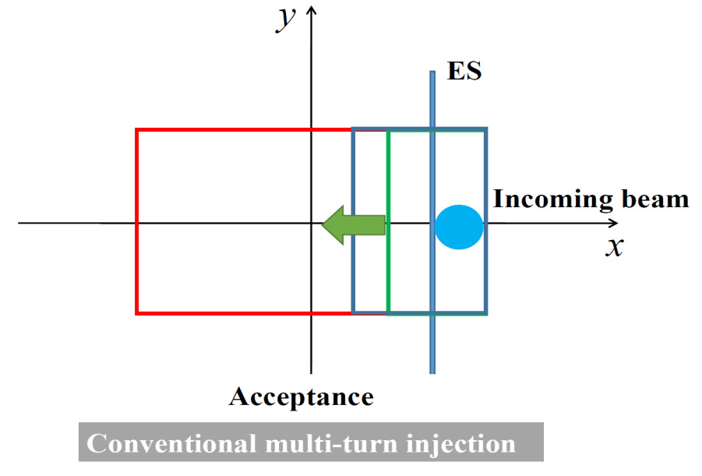
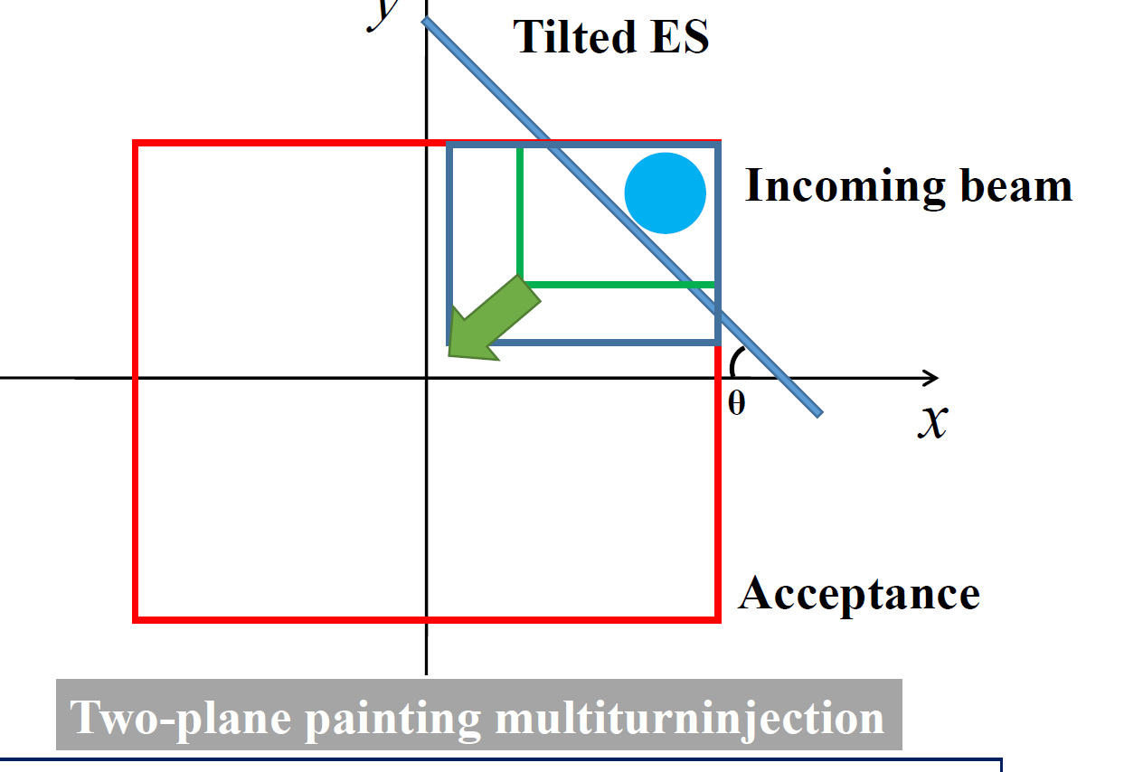
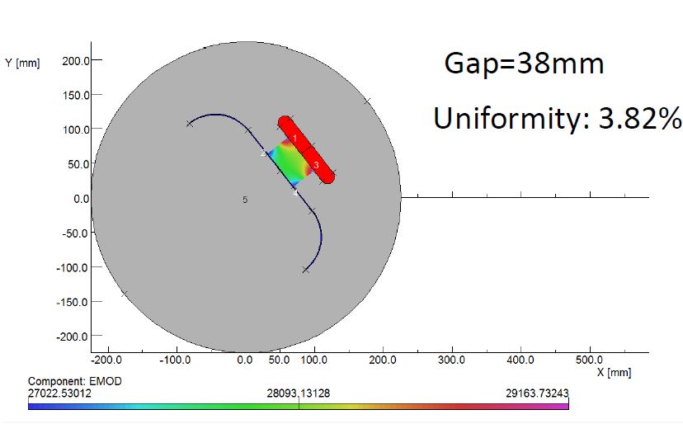
HIAF introduction and status
Two planes painting injection
Simultaneous injection in H and V planes using tilted septum

Slide 8
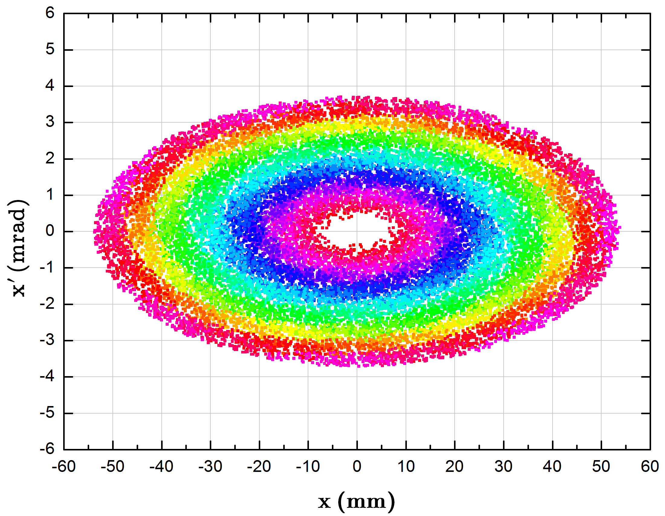
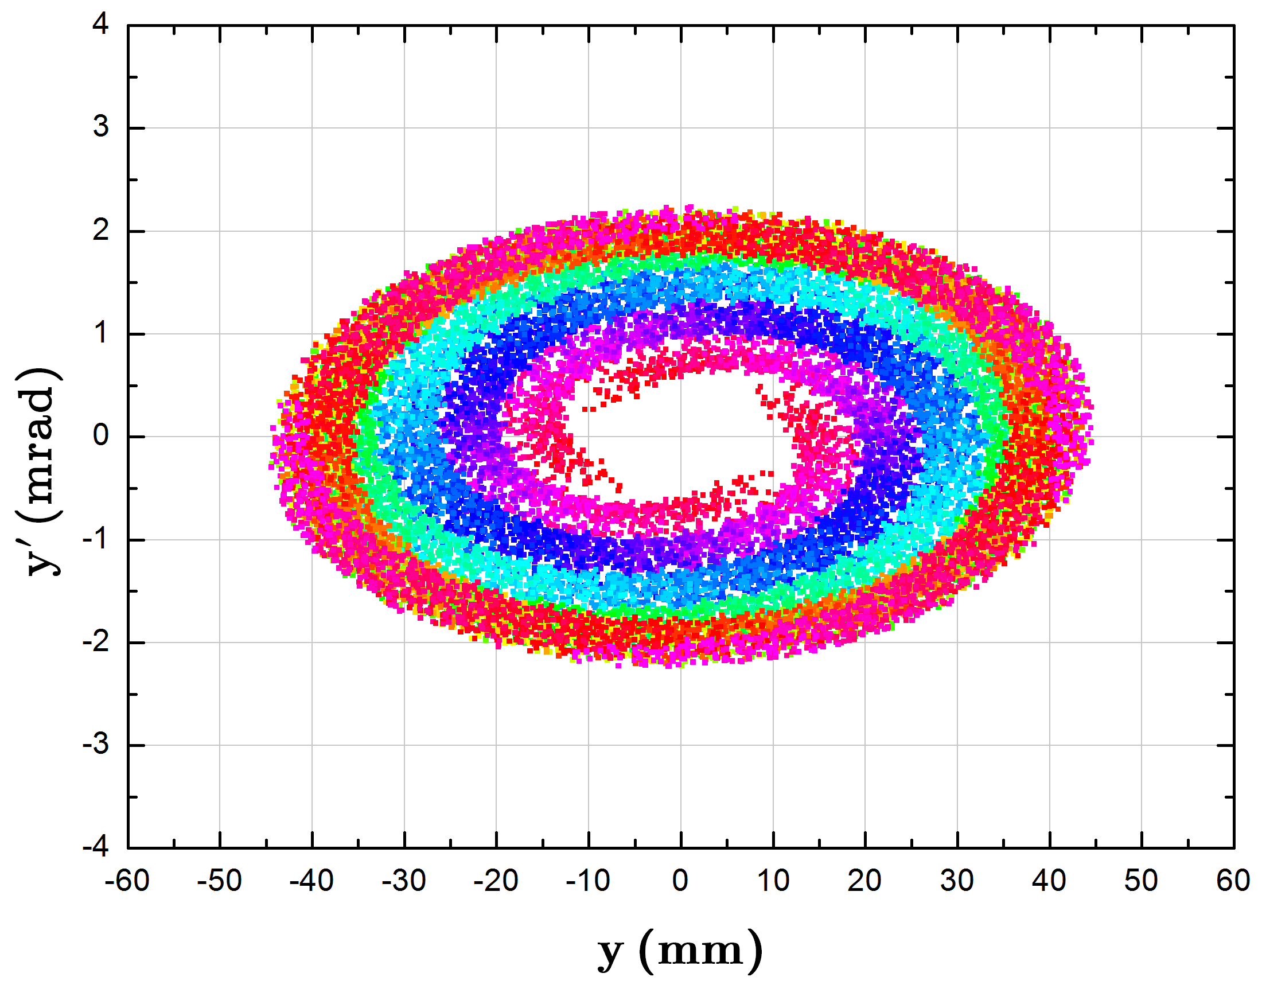
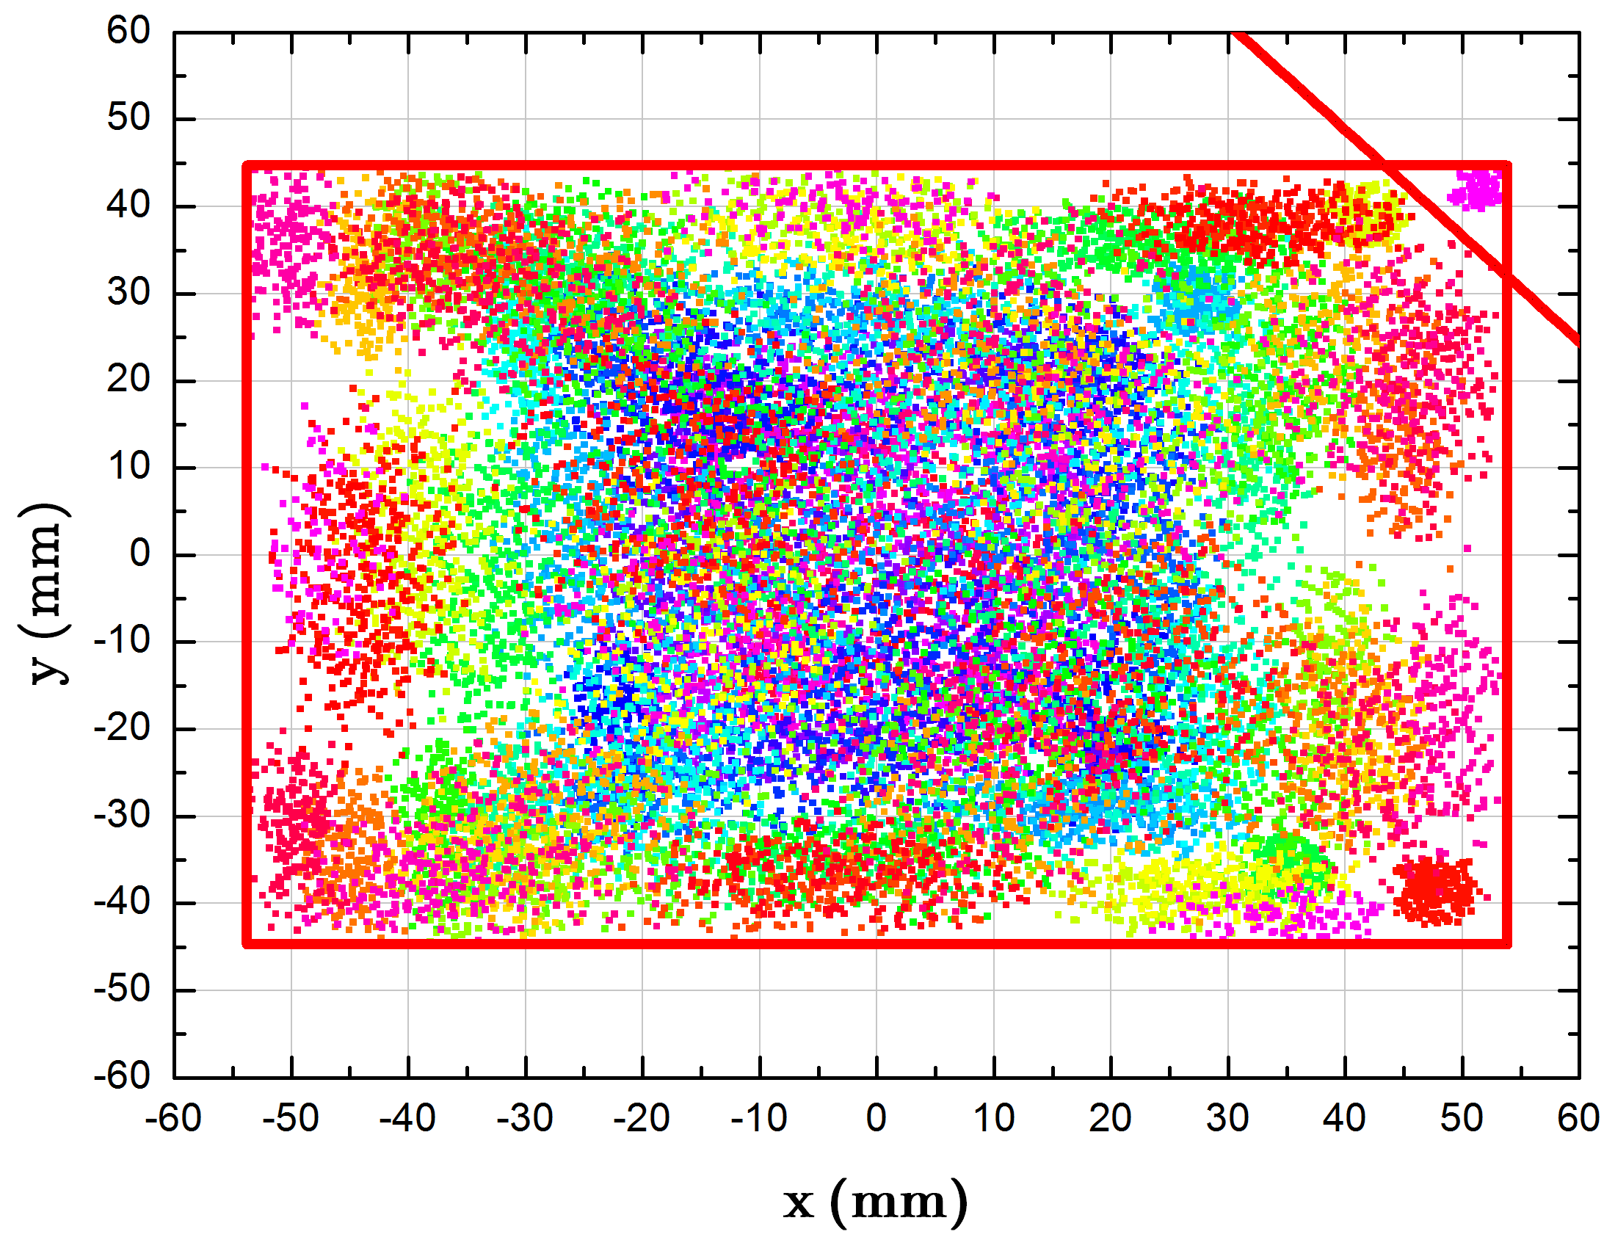
HIAF introduction and status
Two planes painting injection
Ions | Plane | Injection Turns | Single injection
²³⁸U³⁵⁺ | H | 33 | 3.3×10¹⁰
 | V | 16 | 1.6×10¹⁰
 | H+V | 150 | 2.0×10¹¹
The beam intensity could reach 2.0 ×10¹¹ with two planes painting, nearly 10 times over the conventional single-plane injection.

Slide 9
HIAF introduction and status
Heavy ion beam intensity
 | Ions | Energy | Intensity
SECR | ²³⁸U³⁵⁺ | 14 keV/u | 0.05-0.1 pmA
iLinac | ²³⁸U³⁵⁺ | 17 MeV/u | 0.028-0.05 pmA
BRing-N | ²³⁸U³⁵⁺ | 0.8 GeV/u | ~2.0×10¹¹ ppp
BRing-S | ²³⁸U³⁵⁺ | 2.3 GeV/u | ~1.0×10¹² ppp
 | ²³⁸U⁷⁶⁺ | 5.8 GeV/u | ~5.0×10¹¹ ppp
 | ²³⁸U⁹²⁺ | 7.3 GeV/u | ~5.0×10¹¹ ppp
SRing | RIBs: neutron-rich, proton-rich | 0.84 GeV/u(A/q=3) | ~10⁹⁻¹⁰ ppp
 | Fully stripped heavy ions H-like, He-like heavy ions | 0.8 GeV/u(²³⁸U⁹²⁺) | ~10¹¹⁻¹² ppp

Slide 10
HIAF introduction and status
Heavy ion beam intensity
The highest pulse heavy ion beam intensity in the world
Institute | Machine | Planned Intensity | Achieved Intensity | Ion species | Repetition rate
BNL | AGS Booster |  | 5×10⁹ | Au³²⁺
CERN | LEIR |  | 9×10⁸ | Pb⁵⁴⁺
JINR | NICA Booster | 4×10⁹ |  | Au³²⁺
GSI | SIS18 | 1.0×10¹¹ | 3×10¹⁰ | U²⁸⁺ | 2.7Hz
FAIR | SIS100 | 4.0×10¹¹ |  | U²⁸⁺
IMP | HIAF-BRing-N | 2.0×10¹¹ |  | U³⁵⁺ | 5-10Hz, 10-20Hz
IMP | HIAF-BRing-S | 1.0×10¹² 2.0×10¹² |  | U³⁵⁺

Slide 11
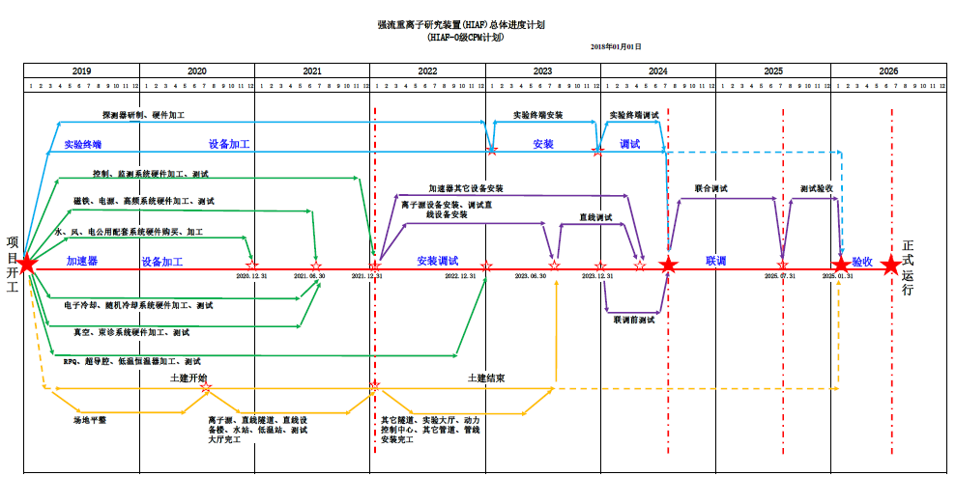
HIAF introduction and status
Schedule

Slide 12
Outline
HIAF introduction and status
EIC proposals in the world
Concept design of EicC-1 accelerator
Interaction region and luminosity concept
Cooling strategy and design
Summary
Notes:
Ab

Slide 13
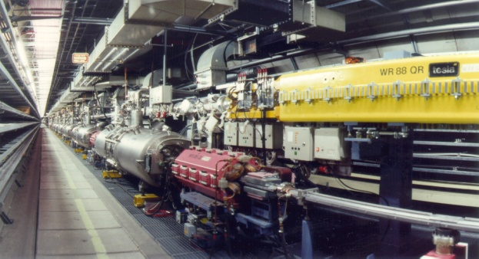
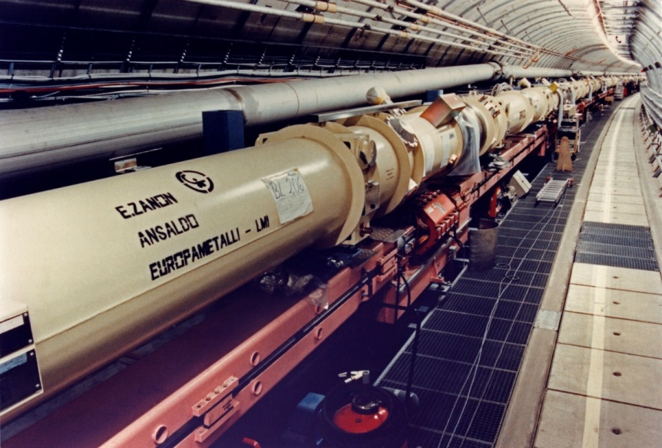
HERA: First EIC machine in the world
A Ring-Ring (polarized) Lepton-Proton collider with 320 GeV CM energy
1981 Proposal
1984 Start construction
1991 Commissioning, first Collisions
Start Operations for H1 and ZEUS,
➔1st exciting results with low luminosity
Install East Spin Rotators
➔ Longitudinal polarized leptons for HERMES
1996 Install 4th Interaction region for HERA-B
1999 High Luminosity Run with electrons
2000 High efficient luminosity production:100 /pb/y
Install luminosity upgrade,
Spin Rotators for H1 and ZEUS
Longitudinal polarization in high energy collisions
2007 End of a highly successful program
 |  | Lepton | Proton
Energy | GeV | 27.5 | 920
Intensities | mA | 60 | 180x10¹¹
Magnetic field | T | 0.15 | 1.5
Acc. voltage | MV | 130 | 2
e-polarization | % | 50 to 70 | --
Final luminosity
(1.5 to 5)x10³¹ cm⁻²s⁻¹
Tunnel: 5.2 m diameter
Notes:
Electron-ion collider is an ideal gluon microscope to explore new frontiers of nuclear science.
A series of fruitful research results have been got during its operation time. There were some update programs to get high luminosity and the final luminosity is about 5*10^31, this luminosity is not so high, and I think this is the important reason of shutdown.

Slide 14
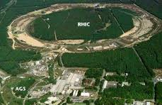
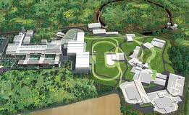
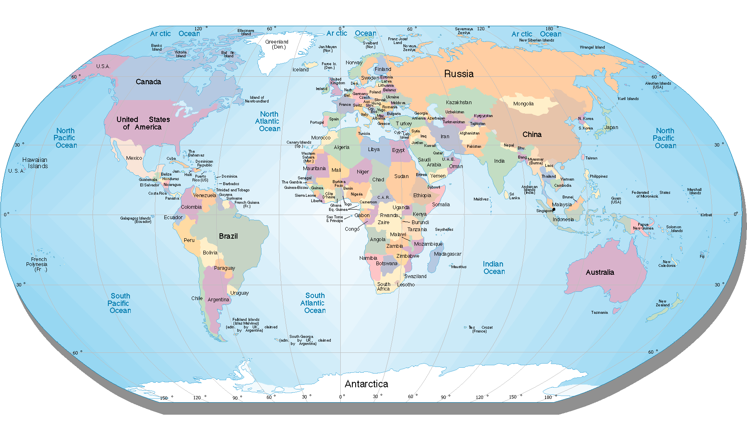
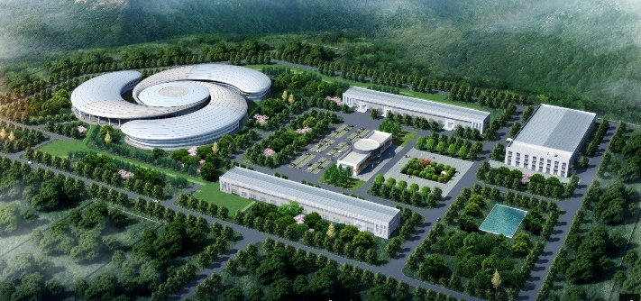
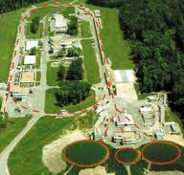
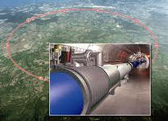
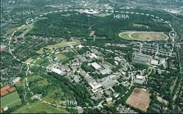
EIC proposals in the world
FAIR ➔ ENC
RHIC ➔ eRHIC
HIAF ➔ EicC
HIAF
CEBAF ➔ JLEIC
LHC ➔ LHeC
  能量 ~ 10倍， 流强 ~ 1000倍
  放射性束流强 1000 ~ 10000倍
  能量沉积率 1000 ~ 10000倍
HERA

Slide 15
Science Goals
LHeC
7TeV+60GeV
Unpolarized
E_{cm}: 1296 GeV
JLEIC
100(p)+5 (e)GeV
100(p)+10 (e)GeV
E_{cm}: 45/63 GeV
EicC
20(p)+3.5 (e) GeV
100(p)+10 (e) GeV
E_{cm}: 16.7/45 GeV
eRHIC
255(p)+15.9(e)GeV
E_{cm}: 126 GeV
The High-Energy/Nuclear Science of LHeC
Overarching Goal: lepton-proton at the TeV Scale
Hunt for quark substructure & high-density matter (saturation)
High precision QCD and EW studies and possible implications for GUT
The Nuclear Science of eRHIC/MEIC
Overarching Goal: Explore and Understand QCD:
Map the spin and spatial structure of quarks and gluons in nucleons
Discover the collective effects of gluons in atomic nuclei
(role of gluons in nuclei & onset of saturation)
The Nuclear Science of EicC
Overarching Goal: Explore Hadron Structure
Map the spin and spatial structure of valence & sea quarks in nucleons
Notes:
Here are basic beam parameters of these EIC facility proposal, the center mass energy of LHeC is about 1296GeV, and the center mass of energy of eRHIC is about 126GeV and the center mass of energy of JLEIC is about 40-60 GeV. With these parameters, the science goal of LHeC is
The center of mass energy of these machines are higher than 40GeV, actually if the center of mass is less than this point, there is still very good physics, such as, if the center of mass energy is around 15GeV, this energy range is a energy window for sea quarks study. This energy is not be covered by these machine, so this is good choice for EicC.
Electroweak-EW, Grand Unified Theory

Slide 16
Outline
HIAF introduction and status
EIC proposals in the world
Concept design of EicC-1 accelerator
Interaction region and luminosity concept
Cooling strategy and design
Summary
Notes:
Above is a very brief review of the EIC in the world. From these background, now let talk about the EicC accelerator design.

Slide 17
Machine Design Goal
Present baseline:
Energy: 3.5 GeV/electron, 20 GeV/proton First phase-EicC-1
5-10 GeV/electron, 60-100 GeV/proton Second phase-EicC-2
Ions: Polarized light ions (p, d, ³He), unpolarized heavy ions up to Uranium
High polarization for both beams, 70% for electron, and 70% for proton
Layout : Ring-Ring collision mode
New figure“8”shape ring for ion
Racetrack shape for electron
Electron injector based on SRF Linac-Ring
Cooling strategy :
Conventional DC cooling for pre-cooling
Bunched electron cooling for high energy stage based ERL
Luminosity :
(2-4)x10³³ cm-²s⁻¹ First phase-EicC-1
1x10³⁴ cm-²s⁻¹ Second phase-EicC-2
Notes:
The proposed EicC is divided into two phases.
The first phase is low energy phase, the electron energy is 3.5Gev and proton energy is 20GeV, the center of mass energy is 16.7GeV. Second phase is high energy phase, and electron is 5-10GeV and proton is 60-100GeV. For ion beams, both polarized light ions and unpolarized heavy ions will be provided. High polarization for both beams, at least 70% for electron and 70% for proton. Ring-Ring collision mode is proposed.

Slide 18
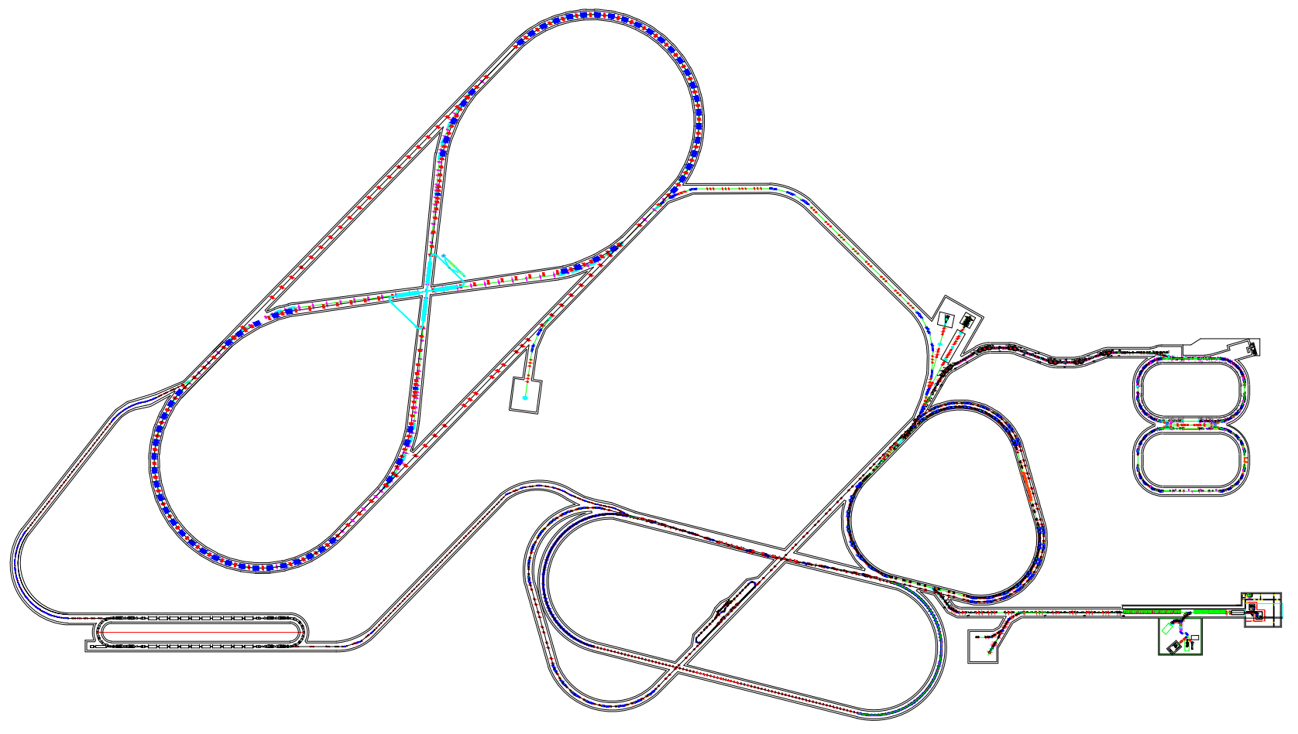
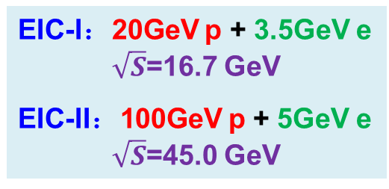
The preliminary concept design of EicC
The whole layout of EicC
EIC-I：20GeV p + 3.5GeV e
$\sqrt{S}$=16.7 GeV
EIC-II：100GeV p + 5GeV e
$\sqrt{S}$=45.0 GeV
EicC-II
高能电子对撞环
HeRing
5-10 GeV
C: 1.5-2.0 km
高功率重离子压缩环
高能量密度研究
7.6 GeV/u(U³⁴⁺)
5.0×10¹²ppp, 50-100ns
HIAF-I
HFRS
SRing
高能离子对撞环
HpRing
60-100 GeV
C: 1.5-2.0 km
MRing
EicC-I
BRing
电子对撞环-
eRing
电子注入器:
SRF Linac-ring, 3.5-10GeV
5.0 GeV
离子对撞环 - pRing
20 GeV，C: 1347 m Polarized proton
Notes:
Here is the whole layout of EicC based on these design goal. Here is HIAF and will be ion injector of EicC-1, BRing will be updated to Figure 8 ring for ion collider and a new electron injector and racetrack electron collider will be constructed in the future. For EicC-2 two figure 8 Rings will be developed for ions and electron, two rings stack vertically in the same tunnel. The electron injection will update to 10GeV and be the injector of EicC-2.

Slide 19
The beam preparation of EicC-1
Electron Collider
eRing
EIC IP
Ion Collider
pRing
3.5-5.0 GeV(e)
1.0 x10¹⁴
5.0 x10¹³
20 GeV(p)
1.0 x10¹⁴
1.3 x10¹³
Polarized ion source
EIC IP
Ion Linac
BRing
Barrier Bucket stacking
2-3 GeV(p)
1.0 x10¹³ ppp
Pre-cooling, DC
3.5 -5.0 GeV
Top-up
Electron injector:
SRF Linac-ring
17-22 MeV/u(U)
Two planes painting injection
50 MeV(p)
Notes:
For the beam preparation of EicC-1,
For ion beam preparation, the polarized proton or light ion beam is pre-accelerated by superconducting ion-linac to 50MeV for proton and 17-22MeV/u for ions, then accumulated with two planes painting injection and accelerated to 2-3GeV in BRing. A DC electron cooling device will adopted in BRing to get small emittance. After pre-cooling, beam will be stacked in ion collider for high intensity and accelerated to 20GeV, then collide with electron in these two interaction points. For electron, polarized electron beam is accelerated to 3.5-5.0GeV and injected to electron collider with top-up injection scheme.

Slide 20
Outline
HIAF introduction and status
EIC proposals in the world
Concept design of EicC-1 accelerator
Interaction region and luminosity concept
Cooling strategy and design
Summary

Slide 21
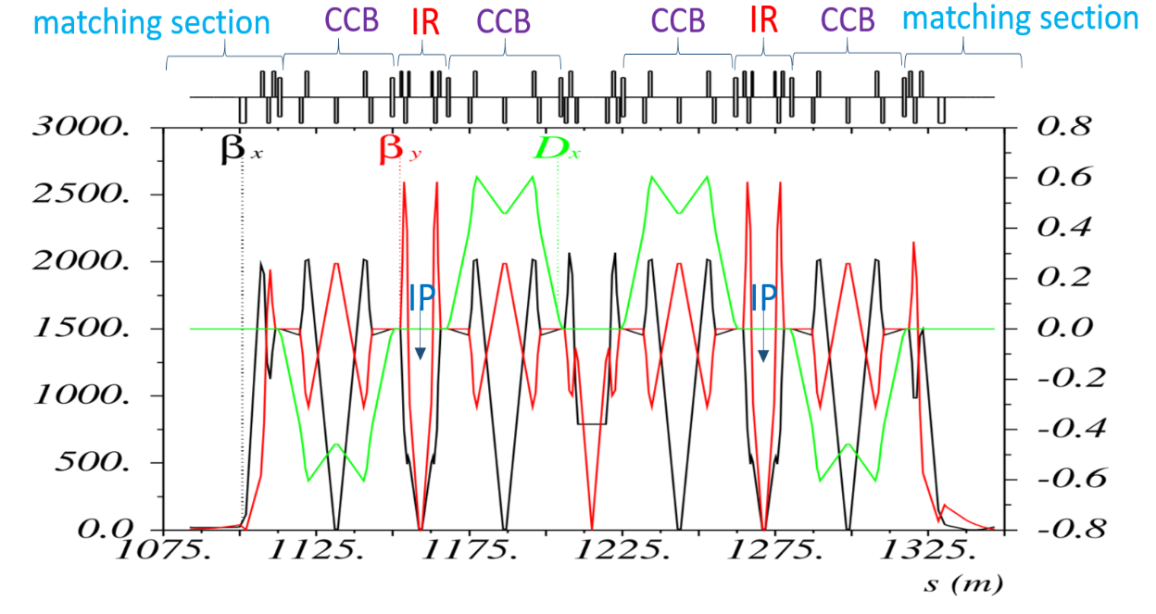
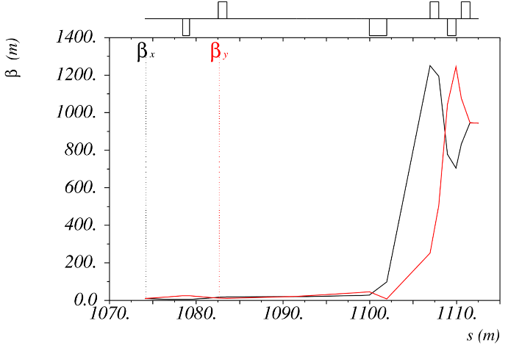
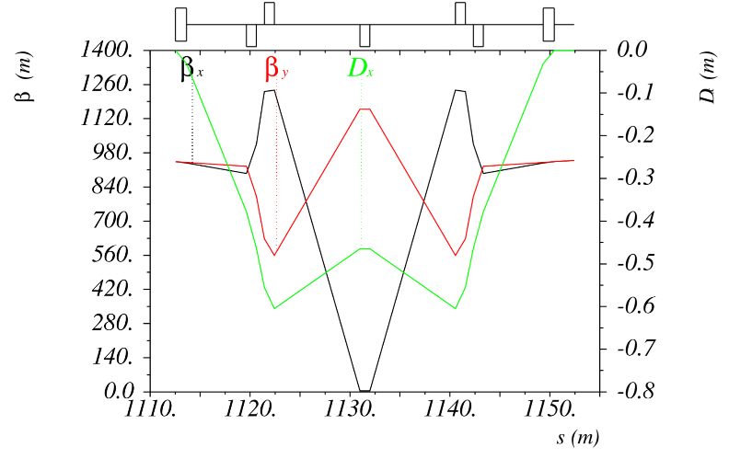
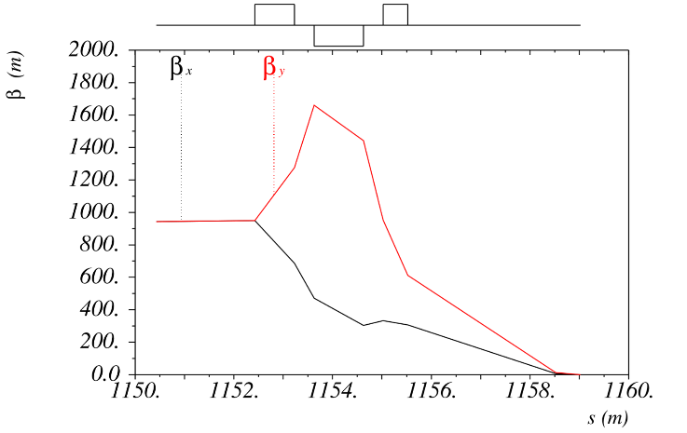
Interaction Region Optics - pRing
Interaction Region
  Symmetric optic design and no dispersion at IPS
  Two Interaction Regions based on Final Focusing Blocks(FFB)
  Three CCBs with dispersion suppression and chromaticity compensation
Matching section
CCB section
FFB section
Notes:
The key task in IR optics design is to satisfy the detector requirements, especially the full-acceptance detector concept. On the other hand, from the beam dynamics point of view, chromatic compensation is another key issue. In order to get a high luminosity, the large chromatic effect is caused by the strong final focus to get a ultra small Beta star.

Slide 22
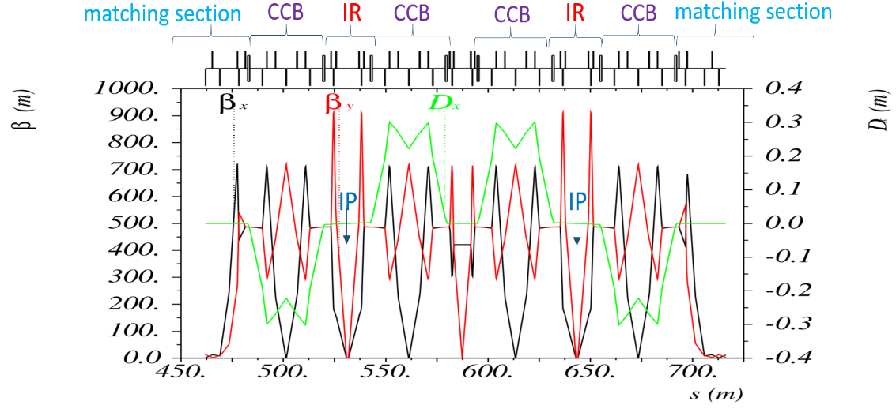
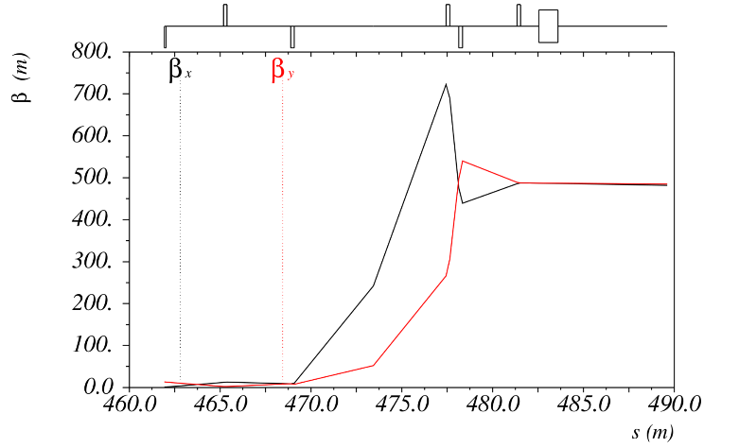
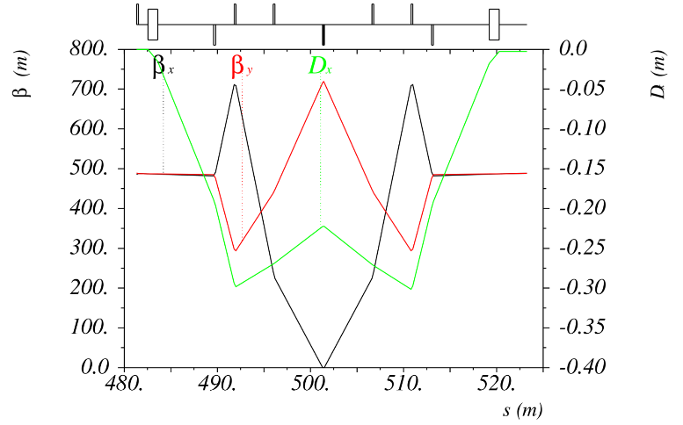
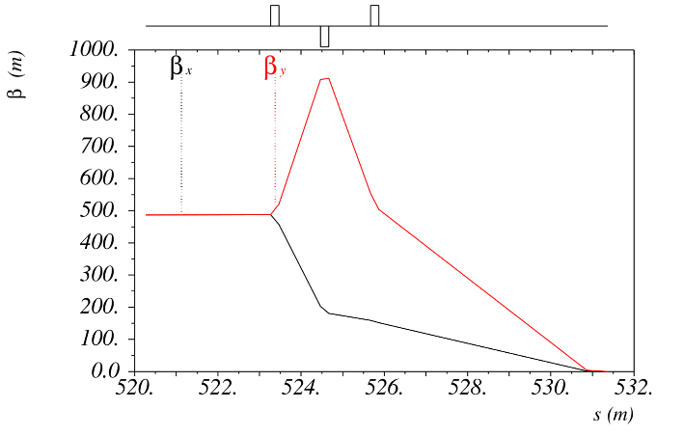
Interaction Region Optics - eRing
IR design feature similar to proton
  Symmetric optic design and no dispersion at IPS
  Two Interaction Regions based on Final Focusing Blocks(FFB)
  Three CCBs with dispersion suppression and chromaticity compensation
Matching section
CCB section
FFB section

Slide 23
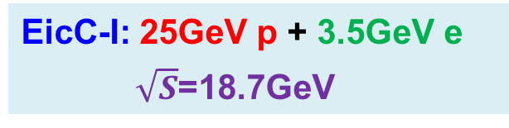
Luminosity concept
EicC-I: 25GeV p + 3.5GeV e
$\sqrt{S}$=18.7GeV
Luminosity: 2.0×10³³ cm⁻²s⁻¹
4.0×10³³ cm⁻²s⁻¹
Notes:
Second important issue of EicC design is luminosity, the design goal of EicC-1 is at least 1*10^33 for both polarized beam at center of mass energy of 16.7GeV. For this luminosity goal, a new luminosity concept is adopted for EicC-1, with this new design, the design

Slide 24
Basic strategy and design principles
 | Old |  | New
particle | p | e | p | e
circumference(m) | 1350 | 876 | 1350 | 820
energy(GeV) | 25 | 3.5 | 25 | 3.5
Bρ(T·m) | 87 | 11.7 | 87 | 11.7
f_{collision}(MHz) | 750 |  | 30
particles per bunch(×10¹⁰) | 0.5 | 2.6 | 10.4 | 62.5
ε_{x}, ε_{y}(nm·rad, rms) | 100/60 | 10 | 300/180 | 60
β*_{x}/β*_{y} (m) | 0.024/0.012 | 0.24/0.072 | 0.04/0.02 | 0.2/0.06
bunch length(m) | 0.02 | 0.01 | 0.035 | 0.02
dp/p | 5e-4 |  | 8.5e-4
Beam-Beam Parameter ξ_{y} | 0.002 | 0.007 | 0.011 | 0.04
Laslett tune shift | 0.01 | — | 0.05 | —
energy loss per turn(MeV) | — | 0.32 | — | 0.32
total SR power(MW) | — | 1.0 | — | 1.0
SR linear power density(kW/m) | — | 3.7 | — | 3.6
current(A) | 0.6 | 3.1 | 0.5 | 3.0
crossing angle(mrad) | 50 |  | 50
hourglass | 0.87 |  | 0.85
Luminosity(cm⁻²s⁻¹) | 0.5×10³³ |  | 2.0×10³³
Luminosity increases by 4 times

Slide 25
Outline
HIAF introduction and status
EIC proposals in the world
Concept design of EicC-1 accelerator
Interaction region and luminosity concept
Cooling strategy and design
Summary

Slide 26
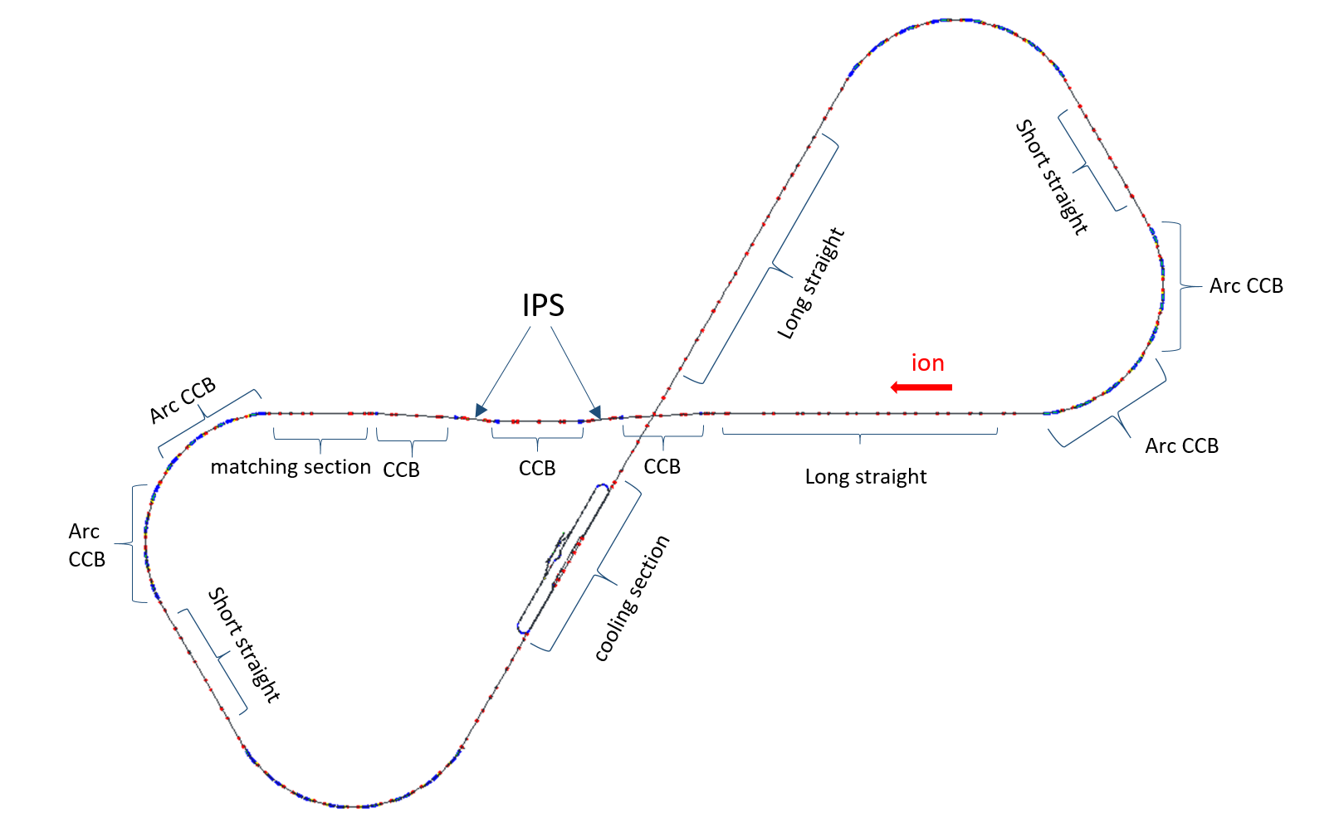
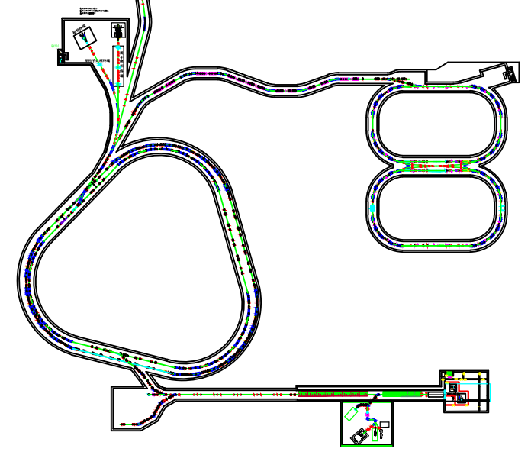
Cooling strategy
Cooling
Small emittance and short bunch (with strong SRF)
Enabling ultra strong final focusing and crab crossing
Suppressing IBS, expanding high luminosity lifetime
Two stages cooling scheme:
Pre-Cooling: Booster-BRing-N, 2GeV, Conventional DC cooler
Collision cooling: Proton collider-PRing, 25 GeV, ERL bunched cooler
Pre-Cooling
DC cooler
ERL bunched cooler
Notes:
For beam cooling, a staged cooling scheme was adopted. Two electron cooling facilities are needed for implementing the multi-step electron cooling scheme in EicC. The first one is a low energy electron cooler with a DC beam and is used in the BRing. The second one is a medium energy bunched beam cooling required in the ion collider ring, it is particularly important for preserving the collider luminosity and its lifetime by suppressing IBS induced heating

Slide 27
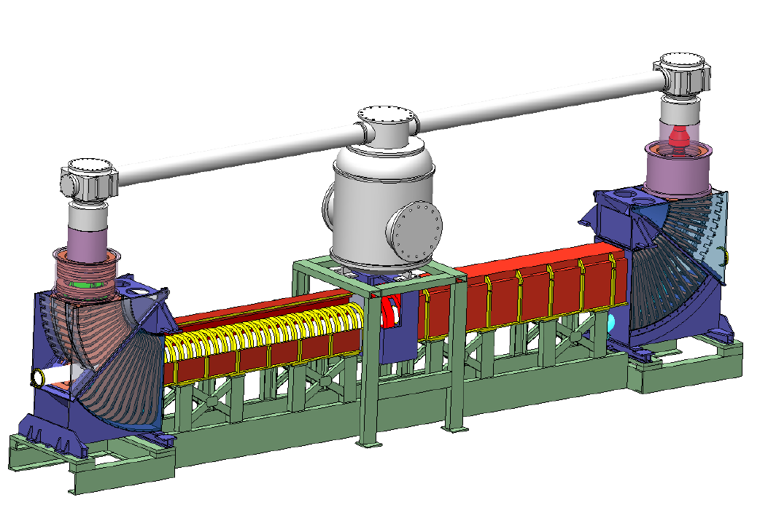
Cooling strategy
Pre-cooling design:
Pre-Cooling: Booster-BRing-N, 2GeV, Conventional DC cooler
Such a cooler is technically well developed and readily available

Slide 28
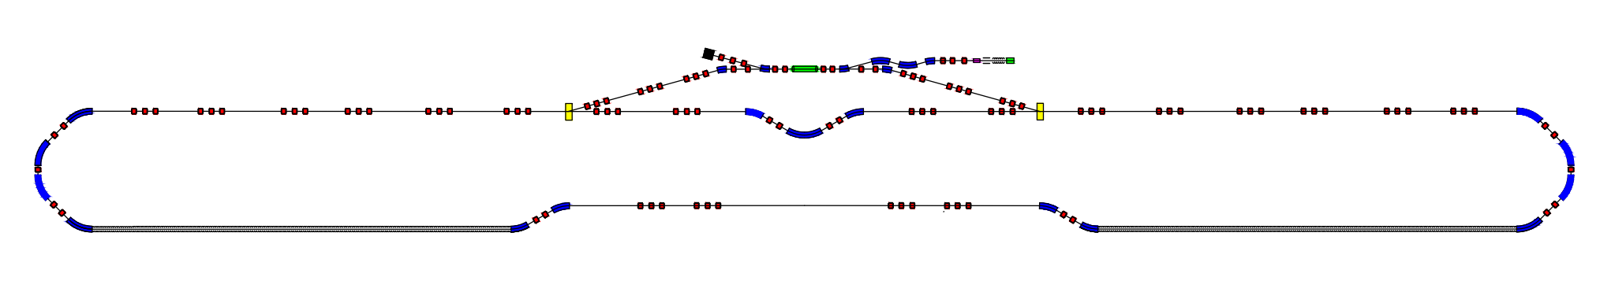
Cooling strategy
Collision cooler design:
Collision cooling: Proton collider-pRing, 25 GeV, ERL bunched cooler
SC cavity
Pre-acceleration cavity
Dump
Laser e-gun
Kicker
By-pass beam line
Kicker
Cooling section-1
Cooling section-2
Sketch of EicC collision cooling design
Gun type | NCRF | RMS energy spread | 5×10⁻⁴
RF frequency | 700 MHz | RMS bunch length | 200 ps
PRF | 2 MHz | Cooling section | 50m
Charge /bunch | 4 nC | Cryostat number | 1
Inject energy | 2 MeV | Cryostat length | 1.5m
Cooling energy | 14 MeV | Circumference of circulating ring | 160m
Transerse rms normalized emittance | 2.5𝜋mm mrad | Bunch frequency in circulating ring | 30 MHz
Notes:
For medium energy cooling, a scheme based on ERL linac technology has been design for EicC-1, this table shows the main parameters of this design. These parameters are very challenging. There are still many critical issues for medium energy bunched beam cooling from both the beam dynamics and technical aspects.

Slide 29
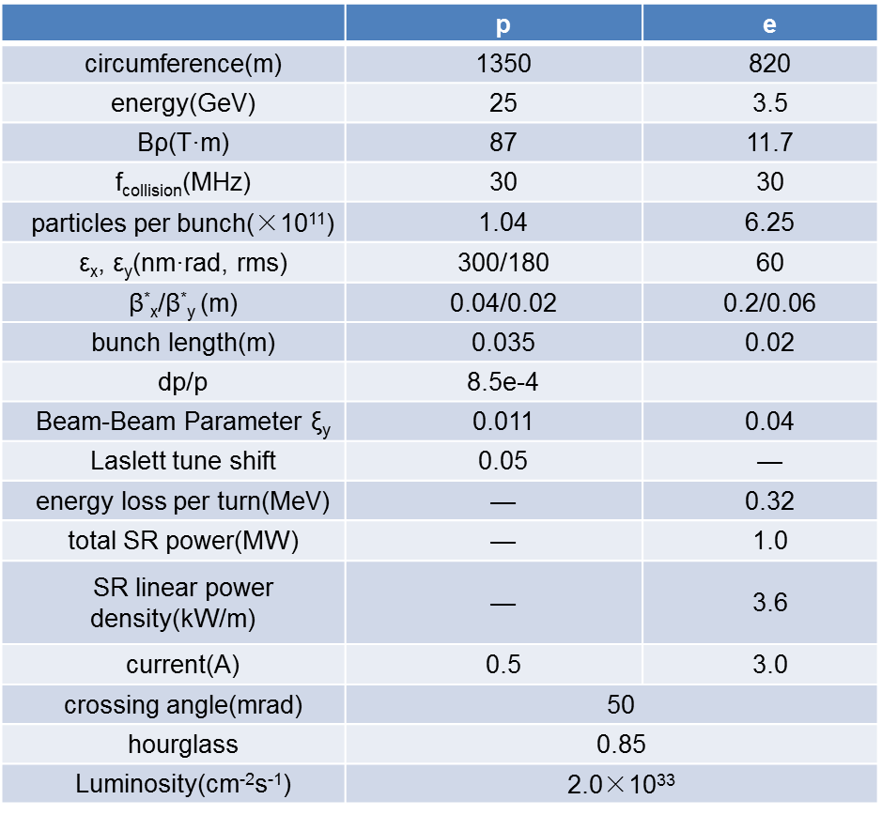
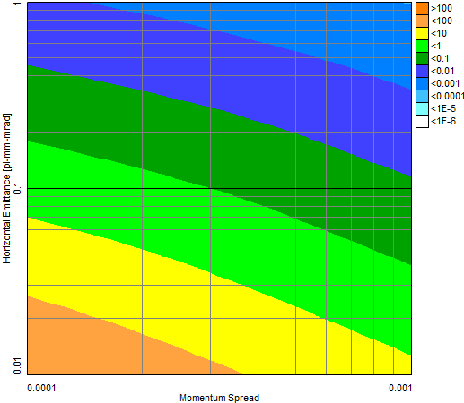
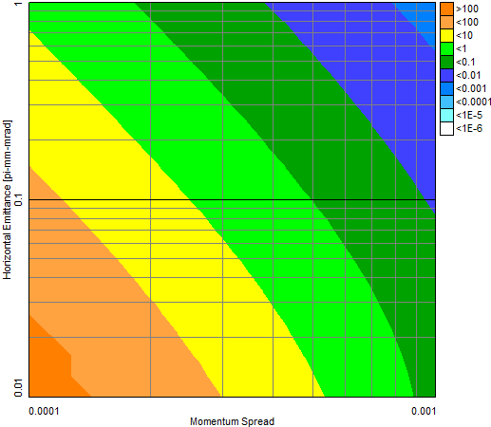
EicC luminosity parameters
Transverse IBS rate
The IBS growth rate is estimated around 1.2 h⁻¹
A beam cooling rate should be the same as IBS growth rate, to suppress the emittance growth in operation.
Longitudinal IBS rate

Slide 30
EicC proton beam cooling
heating
luminosity
cooling
Operation without cooling
heating
luminosity
cooling
Operation with cooling
Notes:
We have done some simulation for bunched beam cooling and initial estimates indicate that sufficient cooling rates can be obtained, much more detailed studies are necessary to ensure that unexpected effects will not reduce efficiency. We plan to carry out simulation studies next step.
We simulated the luminosity evolution in the cases without and with cooling. The upper is results without cooling. We can see from here, the luminosity decrease mainly caused by horizontal emittance and vertical emittance nearly keep constant.

Slide 31
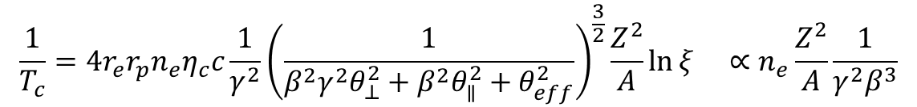
Cooling rates footprint (expt.)
EIC cooler
Recycler antiproton
CSRe Xe⁵⁴⁺
COSY proton
COSY proton
CSRe C⁶⁺
COSY proton
CSRe C⁶⁺
NAP_M proton
CSRm Ar¹⁸⁺
The cooling rates 1/T_{c} are normalized by Z²/A to an electron density n_{e} of 10⁸ cm⁻³
$$\frac{1}{T_{c}}=4r_{e}r_{p}n_{e}η_{c}c\frac{1}{γ^{2}}{\left(\frac{1}{β^{2}γ^{2}θ_{⊥}^{2}+β^{2}θ_{∥}^{2}+θ_{eff}^{2}}\right)}^{\frac{3}{2}}\frac{Z^{2}}{A}\ln{ξ ∝n_{e}\frac{Z^{2}}{A}\frac{1}{γ^{2}β^{3}}}$$
Notes:
Besides the simulation work, here we summarize cooling rate measurements of the low energy DC electron cooling in the world. The cooling rate is normalized by charge state, mass and electron beam density, the blue line is fitted by the formula. If we compare with these experimental results, we can say a strong cooling is needed for EIC-1, and the required parameters are an order of magnitude beyond state-of-the-art.

Slide 32
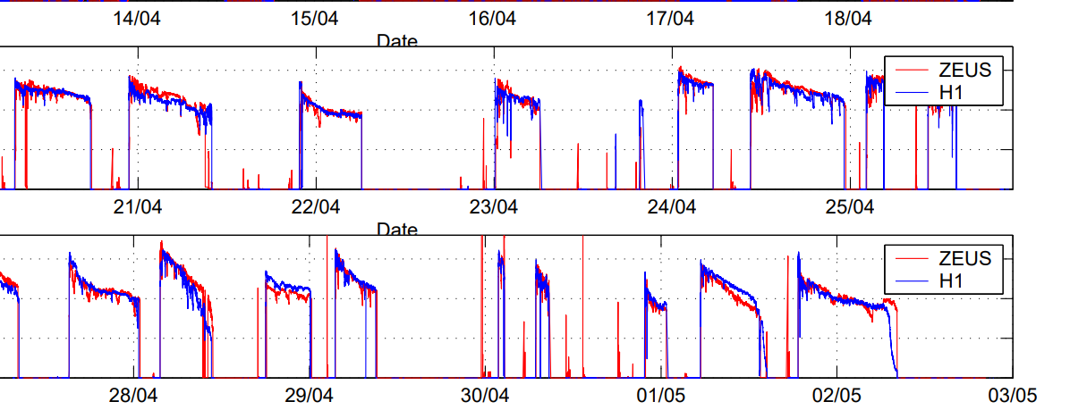
Operation mode and integrated luminosity
The normal integrated luminosity mode
 | LHC | RHIC | HERA | EicC-1
Injection | 20 min | 1 min | 20 min | 1-2s
Acceleration | 18 min | 130 s | 30 min | 4s
Collision | ~ 15 h | ~ 8 h （Max10 h） | ~ 10 h | ~ 2 h
Ions | p-p | Au-Au | p-e | p-e
Notes:
For normal collider, such as LHC, RHIC, and HERA, both the injection and acceleration time is about several tens minutes, that means the beam preparation time is about one hours and the collision time is about several hours. You can see the decrease of the luminosity during the collision. For this operation mode, the cooling is very important for the lifetime of luminosity.
But for EicC-1 fast ramping mode was adopted and beam preparation time is 5 seconds, life time is about 1-2 hours, so in this case, even without cooling, we still can keep high integrated luminosity through injection new fresh beam in very short time.

Slide 33
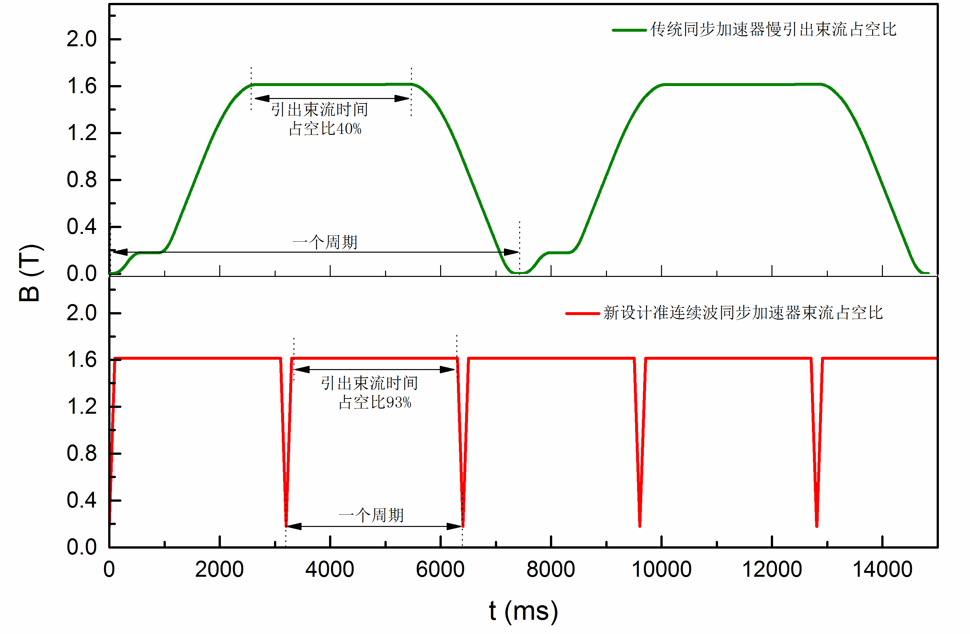
Operation mode and integrated luminosity
The new integrated luminosity scenario

Slide 34
Outline
HIAF introduction and status
EIC proposals in the world
Concept design of EicC-1 accelerator
Interaction region and luminosity concept
Cooling strategy and design
Summary

Slide 35
Summary
Based on the HIAF accelerator complex, a concept design of EicC-1 accelerator design was presented. The new design mainly focused on the scientific requirements, such as luminosity, interaction region and beam cooling.
This is a preliminary concept design and provides a basis for performance evaluation, technical risk assessment and cost estimation.
The design will be further optimized and improved. More details should be investigated, especially cooling scheme and stimulation studies.
The polarization issue is not covered by this presentation, for polarization in BRing, the Siberia Snakes will be used and figure 8 shape ring for ion collider ring-pRing.
A series of beam dynamics and technical challenges for EicC. Prototypes of key technologies or components will be developed step by step.

Slide 36
Thanks for your attention!

Slide 37
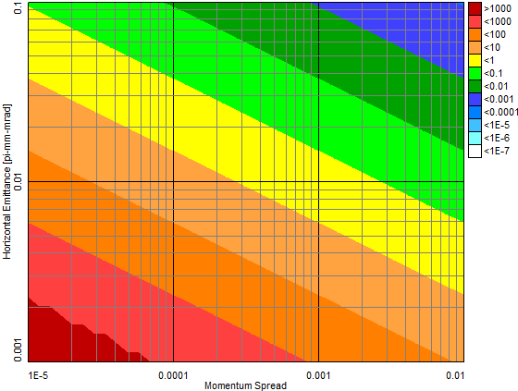
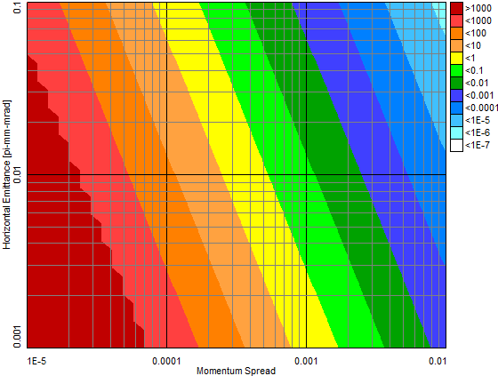
Cooling strategy
low luminosity
high luminosity
low luminosity
high luminosity
transverse
longitudinal
in principle, a fast cooling is necessary for low luminosity mode (t_{cooling} < 1000 sec)
and high luminosity (t_{cooling} < 100 sec)
the big challenge!
energy scaling from Recycler 8.9 GeV/c p cooling: t_{cooling} =3000 sec

Slide 38
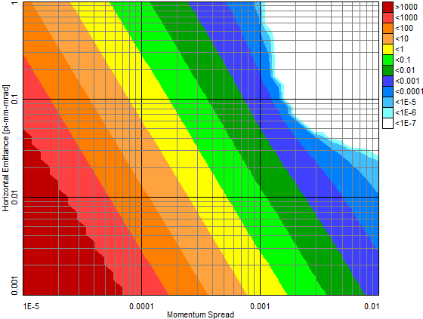
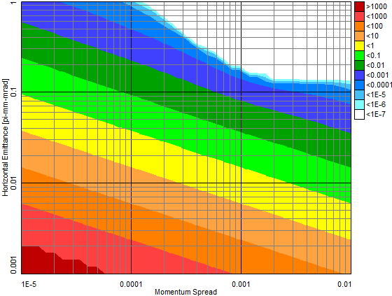
Cooling strategy
equilibrium point
电子束能量 | 10.89 MeV
电子束团长度 | 20 mm
电子束团动量分散 | 10⁻⁴
电子束团半径 | 2 mm
电子束团发射度 | 0.04 urad
电子束团峰值流强 | 4.7 A
电子束团密度 | 1.7×10¹⁴cm⁻³

Slide 39
 | p | e
circumference(m) | 1200 | 1200
energy(GeV) | 60 | 5
Bρ(T·m) | 203 | 16.7
f_{collision}(MHz) | 500 | 500
particles per bunch(×10¹⁰) | 1 | 3.2
ε_{x}, ε_{y}(nm·rad, rms) | 10/2 | 5/1
β*_{x}/β*_{y} (m) | 0.05/0.01 | 0.1/0.02
bunch length(m) | 0.012 | 0.01
Beam-Beam Parameter ξ_{y} | 0.01 | 0.076
Laslett tune shift | 0.06 | —
energy loss per turn(MeV) | — | 2.2
total SR power(MW) | — | 5.7
SR linear power density(kW/m) | — | 18
current(A) | 0.8 | 2.56
crossing angle(mrad) | 50
hourglass | 0.88
Luminosity(cm⁻²s⁻¹) | 1.1×10³⁴

Slide 40
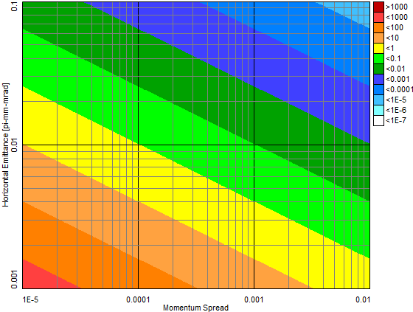
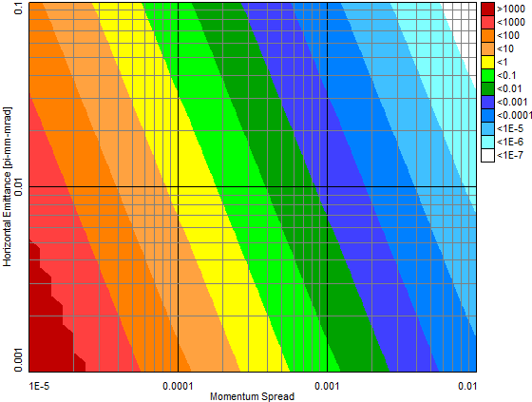
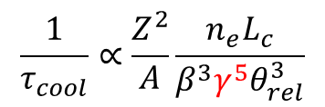
goal beam parameter
goal beam parameter
transverse
longitudinal
10 sec < t_{cooling} < 100 sec is needed for 60 GeV EIC!
$$\frac{1}{τ_{cool}}∝\frac{Z^{2}}{A}\frac{n_{e}L_{c}}{β^{3}γ^{5}θ_{rel}^{3}}$$

Slide 41
 | p | e
circumference(m) | 1200 | 1200
energy(GeV) | 60 | 5
Bρ(T·m) | 203 | 16.7
f_{collision}(MHz) | 750 | 750
particles per bunch(×10¹⁰) | 0.5 | 3.2
ε_{x}, ε_{y}(nm·rad, rms) | 100 | 10
β*_{x}/β*_{y} (m) | 0.02/0.01 | 0.2/0.1
IBS rate | 0.0003(H,V),0.0018(L) | —
bunch length(m) | 0.03 | 0.01
dp/p | 3e-4
Beam-Beam Parameter ξ_{y} | 0.0015 | 0.01
Laslett tune shift | 0.005 | —
energy loss per turn(MeV) | — | 0.33
total SR power(MW) | — | 1.3
SR linear power density(kW/m) | — | 5.2
current(A) | 0.6 | 3.9
crossing angle(mrad) | 50
hourglass | 0.75
Luminosity(cm⁻²s⁻¹) | 0.5×10³³

