Slide 1
Train model using GBBhabha data
Long Peixun
2018.11.15

Slide 2
GBBhabha Training and testing data
Signal
  Day = 171210, Run = 52962;
  Only reserve events with 2 tracks;
  Divide it into 6 parts to cross validation;
  ~10000 events per part, ~60000 events total.
Background
  Mix random trigger background with same run(52962).
  Trying reconstructing background, and discard events which have tracks.

Slide 3
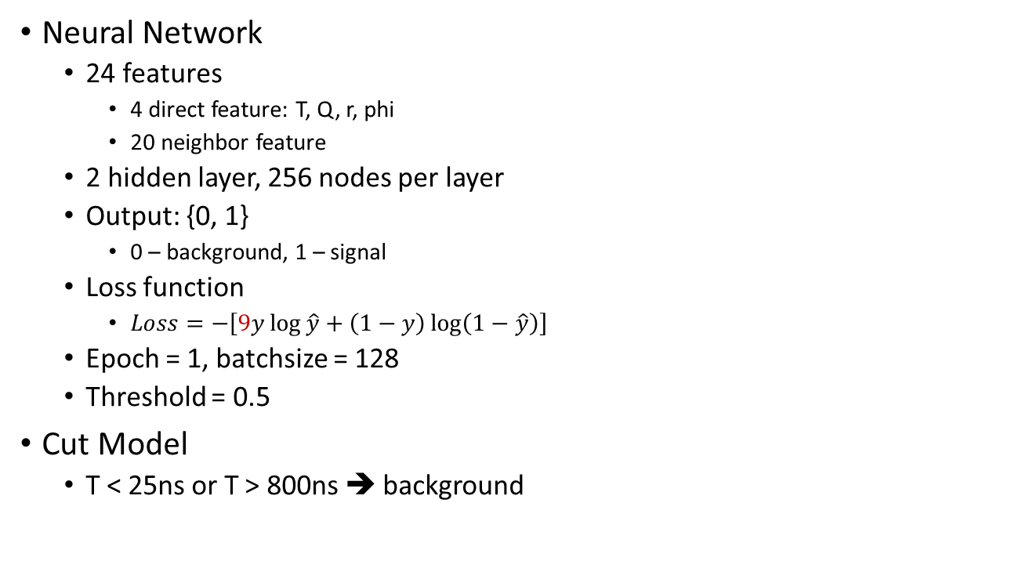
Model parameter
Neural Network
  24 features
    4 direct feature: T, Q, r, phi
    20 neighbor feature
  2 hidden layer, 256 nodes per layer
  Output: {0, 1}
    0 – background, 1 – signal
  Loss function
    $Loss=−\left[9y\log{\hat{y}}+\left(1−y\right)\log\left(1−\hat{y}\right)\right]$
  Epoch = 1, batchsize = 128
  Threshold = 0.5
Cut Model
  T < 25ns or T > 800ns ➔ background

Slide 4
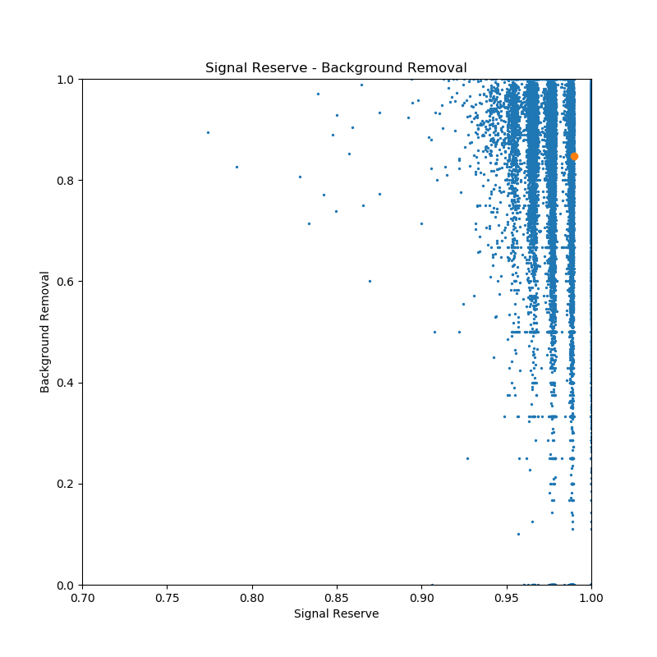
Cross validation result
Average
SR: 98.99%
BR: 84.75%
Compare with old data:
BBhabha, background not discard tracks
SR: 98.80%
BR: 78.56%

Slide 5
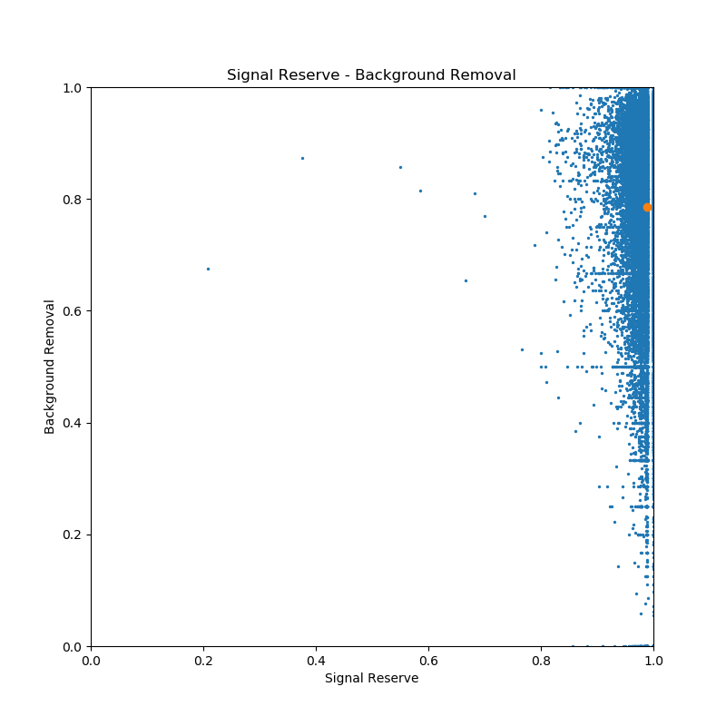
Average
SR: 98.80%
BR:78.56%
Old data:
BBhabha, background not discard tracks

Slide 6
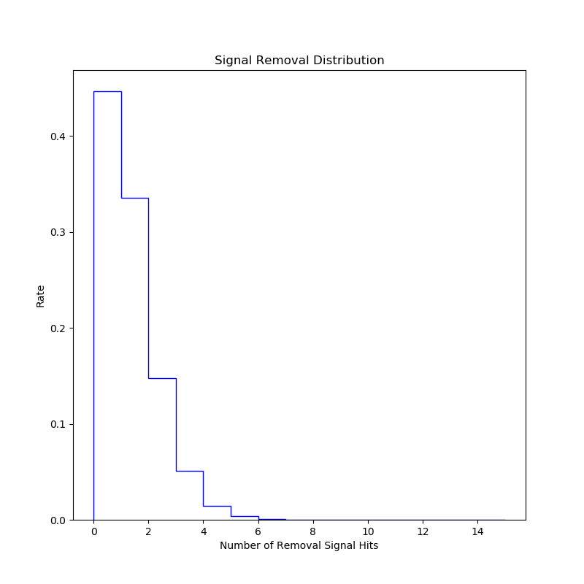
Cross validation result

Slide 7
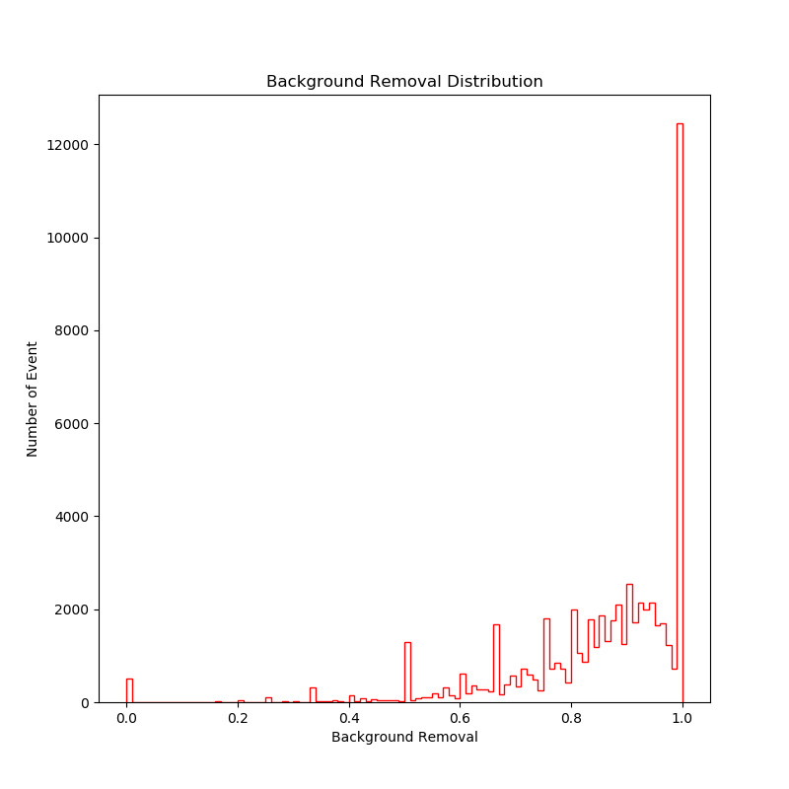
Cross validation result

Slide 8
Try using ML model for actual data
Test data
  Day = 180101, Run = 53335
  Get all hits without reconstruction.
  All hits have no label.
ML model
  Neural network with T-cut

Slide 9
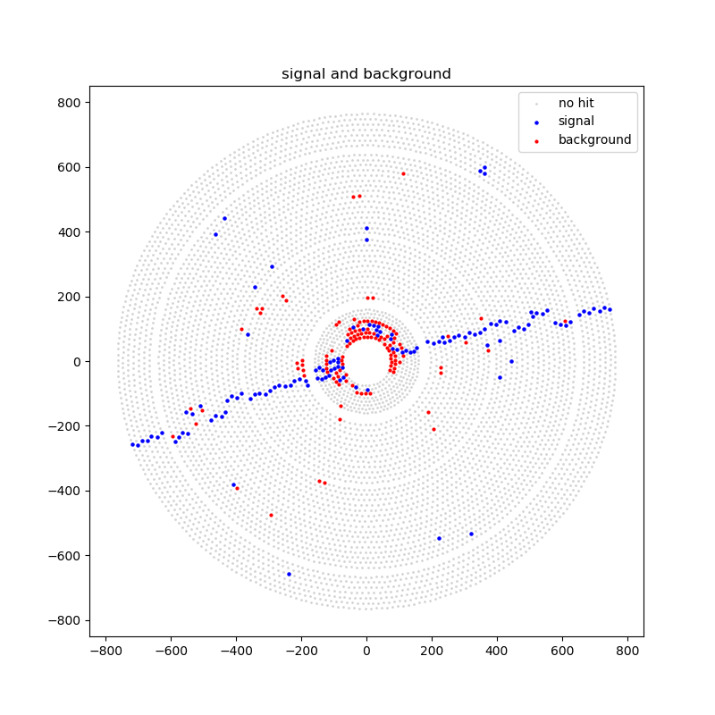
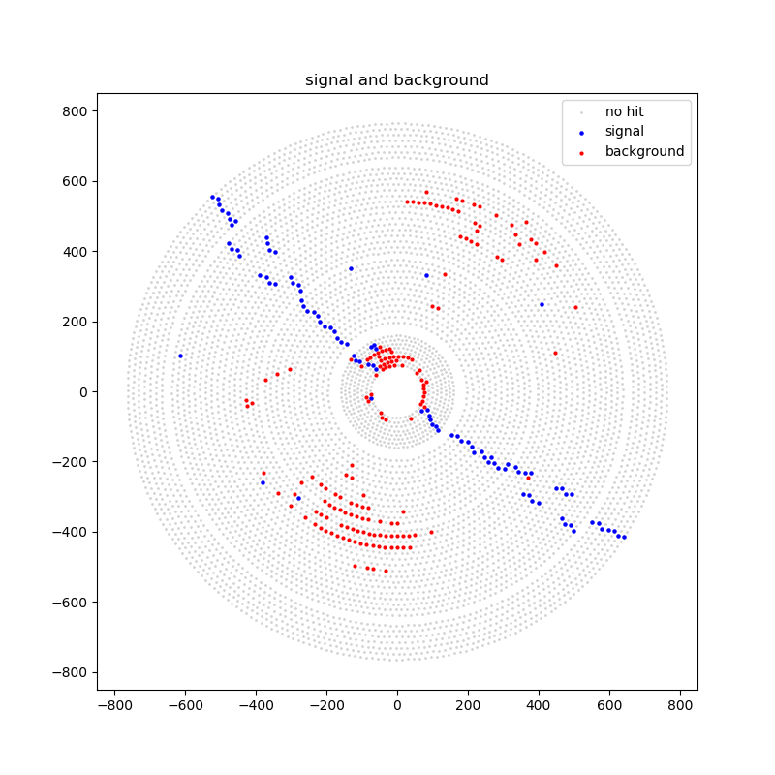
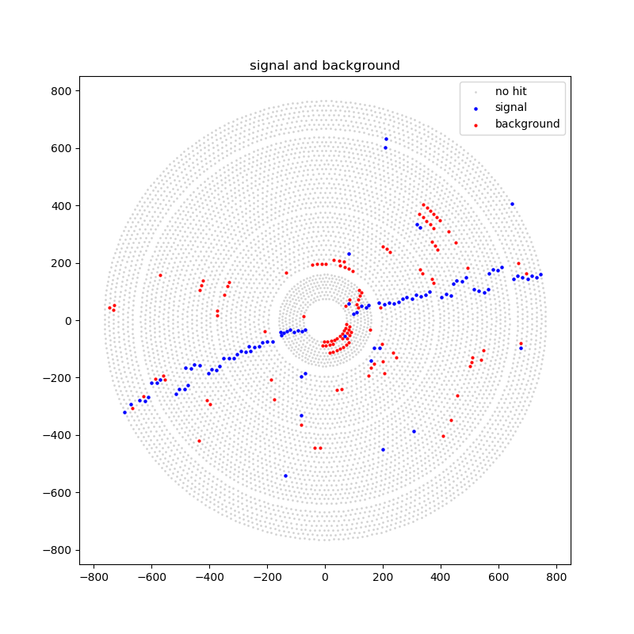
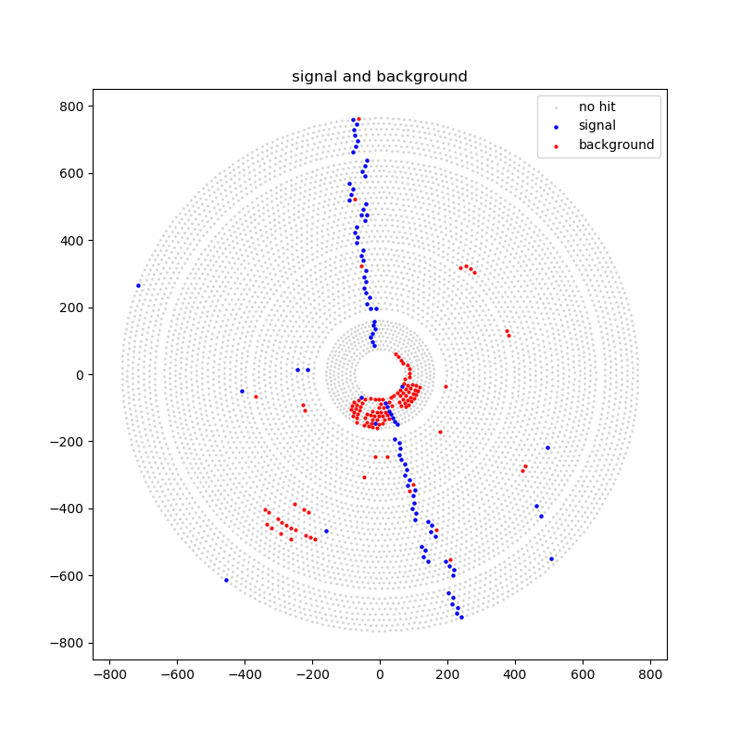

Slide 10
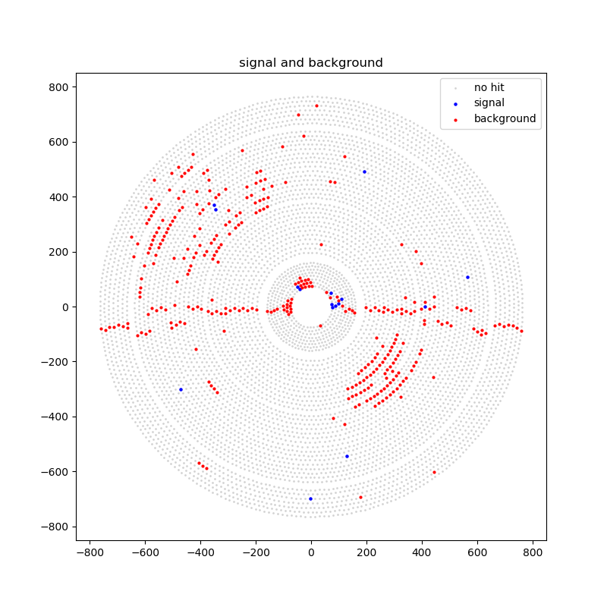
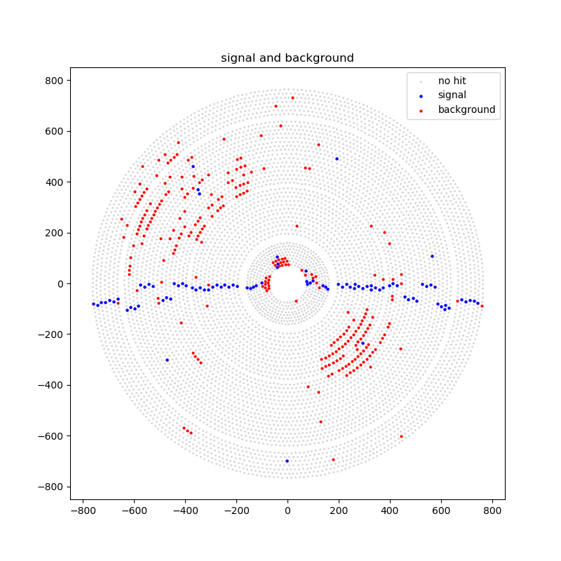
Try using ML model for actual data
Some events lost whole tracks, and the reason is T-cut.
  Raw data don’t have t0 (let t0=0 in program)
  T < 25ns or T > 800ns ➔ background
Including T-cut
Without T-cut

