Slide 1
Fix a bug in BesVis
Long Peixun
2018.11.1

Slide 2
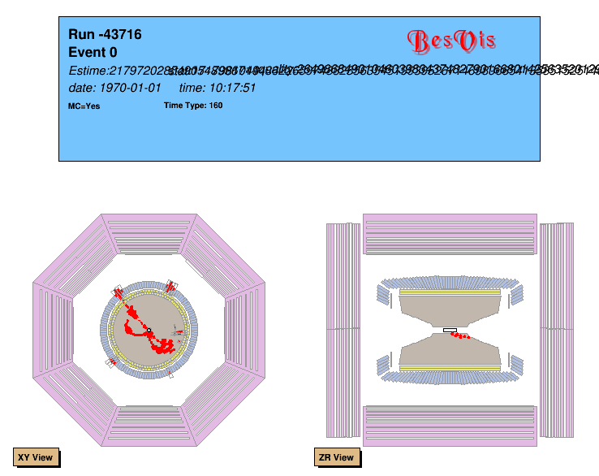
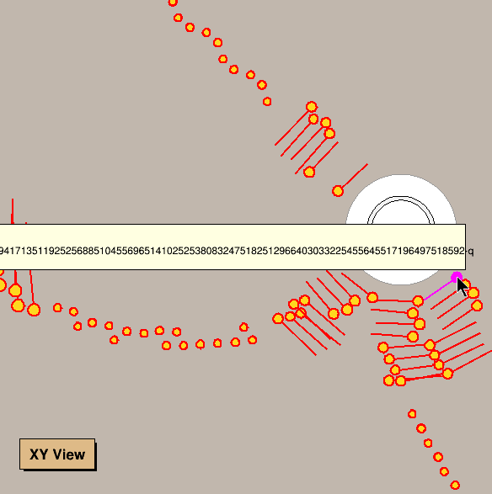
A bug in BesVis
When open rtraw or dst file, the information of estime, status and quality is wrong. The hit information of MDC and CGEM is also wrong.

Slide 3
Reason and solution
Reason
Rtraw and dst event files do not contain estime, status and quality.
If we try getting the value, we may get a random value.
In MDC and CGEM hit, hit’s time will be subtracted estime of event. If estime is wrong, hit’s information will also be wrong.
Solution
If open an rtraw or dst event file, do not get estime, status and quality.

Slide 4
Distinguish signal and background using neighbor features
Long Peixun
2018.11.1

Slide 5
Using better training data
Just reserve events with 2 tracks.
Round11 BBhabha
6 days
Signal: 171208, 171209, 171210, 171211, 171712, 171213
Background: Runno = 52944
52346 events, $\sim 6.6×{10}^{6}$hits
Cross Validation by DAY

Slide 6
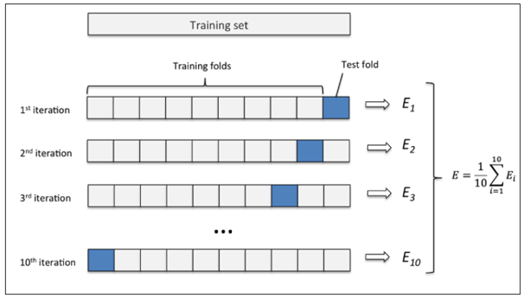
Cross Validation
A model evaluation method.
171208 | 171209 | 171210 | 171211 | 171212 | 171213

Slide 7
Goal and Loss function
Goal
Signal being recognized as background is unacceptable.
Constrain: (real=signal but predict=background) ~ 1%
Try to improve background removal rate.
Normal Cross Entropy Loss
$y:$ real label, $y∈\left\{0,1\right\}$; $\hat{y}:$ predict value, $\hat{y}∈\left[0,1\right]$
$L=−\left[y\log{\hat{y}}+\left(1−y\right)\log\left(1−\hat{y}\right)\right]$
Loss function in signal-background distinguishing
Signal being recognized as background generates more loss.
$L=−\left[ky\log{\hat{y}}+\left(1−y\right)\log\left(1−\hat{y}\right)\right]$
$\hat{y}>0.5$ signal, else background. ~99% signal reserve.

Slide 8
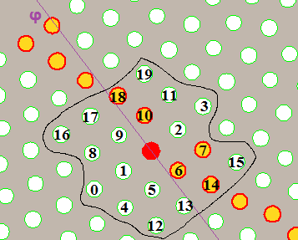
Neighbor features
Consider 20 neighbors around the hit.
Construct Neighbor Array:
Length = 20
0 – no hit, 1 – hit
Neighbor Array =
[0,0,0,0,0,0,1,1,0,0,1,0,0,0,1,0,0,0,1,0]

Slide 9
Model
Features will be used
Direct features: r, phi, rawtime, ADC
Neighbor Array (20 elements)
Model
Neural network
2 inner layers, 256 nodes per layer.
Input: 24 features (4 direct features + Neighbor Array)
Output: [0,1]
Epoch = 1, batchsize = 128
$Loss=−\left[11y\log{\hat{y}}+\left(1−y\right)\log\left(1−\hat{y}\right)\right]$
Threshold = 0.5

Slide 10
Prediction value distribution
Predict value

Slide 11
Test Result
Neighbor model:
Signal reserve: 99.24%
Background removal: 59.91%
Simple cut model:
qcut = 115
tcut1 = -50, tcut2 = 800
Signal reserve: 98.99%
Background removal: 68.00%
Simple Cut Model
if (ADC < qcut) return 0; else { if (rawtime > tcut1 && rawtime < tcut2) return 1; else return 0; }

Slide 12
Distribution of rawtime and ADC

Slide 13
Cut Model Display

Slide 14
Neighbor Model Display

Slide 15
Mix cut model and neighbor model
Test Item
Neighbor Model
Simple Cut Model
Parameters:
qcut = 100
tcut1 = -50, tcut2 = 1000
&
Result
Test Result:
Signal Reserve: 98.81%
Background Removal: 82.67%

Slide 16
Mix Model Display

