Slide 1
Distribution of Each Layer and Event
Long Peixun
2018.11.8

Slide 2
Distribution of each layer and event
Last week I have talked 3 types of Machine Learning Model in signal-background distinguishing:
Cut Model, Neural Network and Mix Model.
In order to analyze the performance of each model in each event and each layer in MDC. I’d like to show some distribution:
Signal Reserve-Background Removal distribution of each event;
Signal Reserve-Background Removal distribution of each MDC layer;
An event which has lowest signal reserve rate.

Slide 3
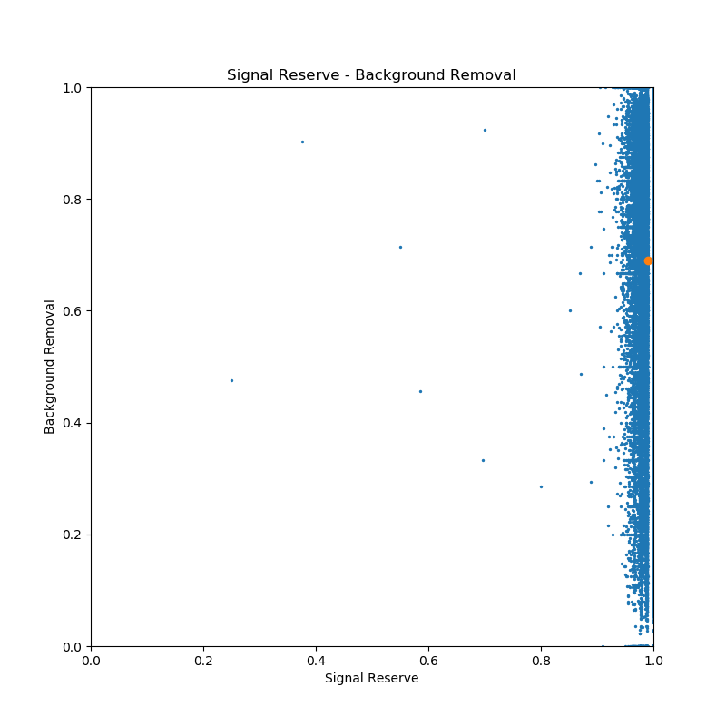
SR-BR distribution of each event
Cut Model
Average
SR: 99.00%
BR:69.04%

Slide 4
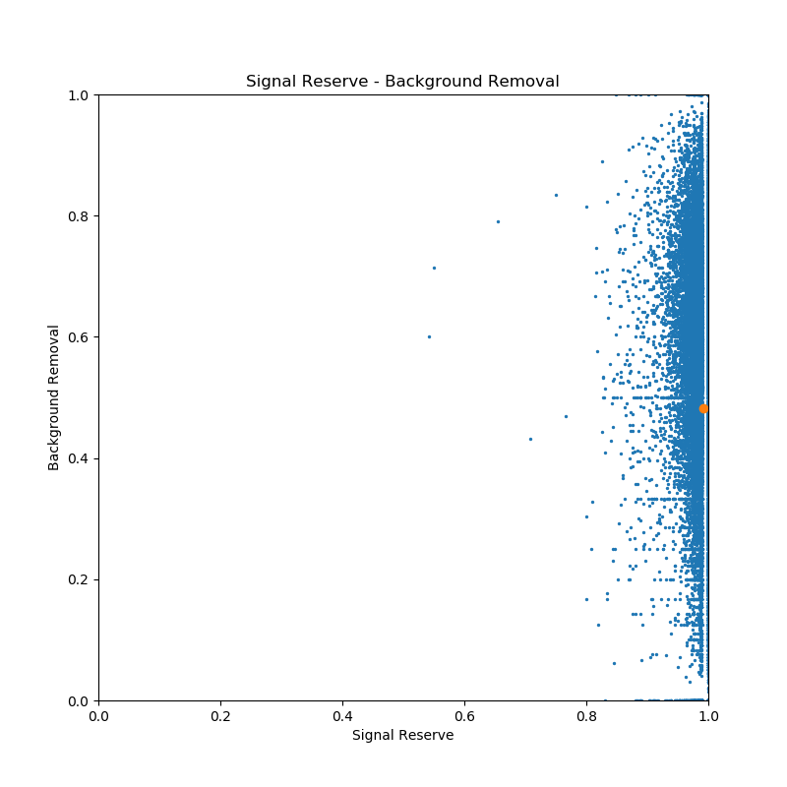
SR-BR distribution of each event
Neural Network
Average
SR: 99.22%
BR:48.16%

Slide 5
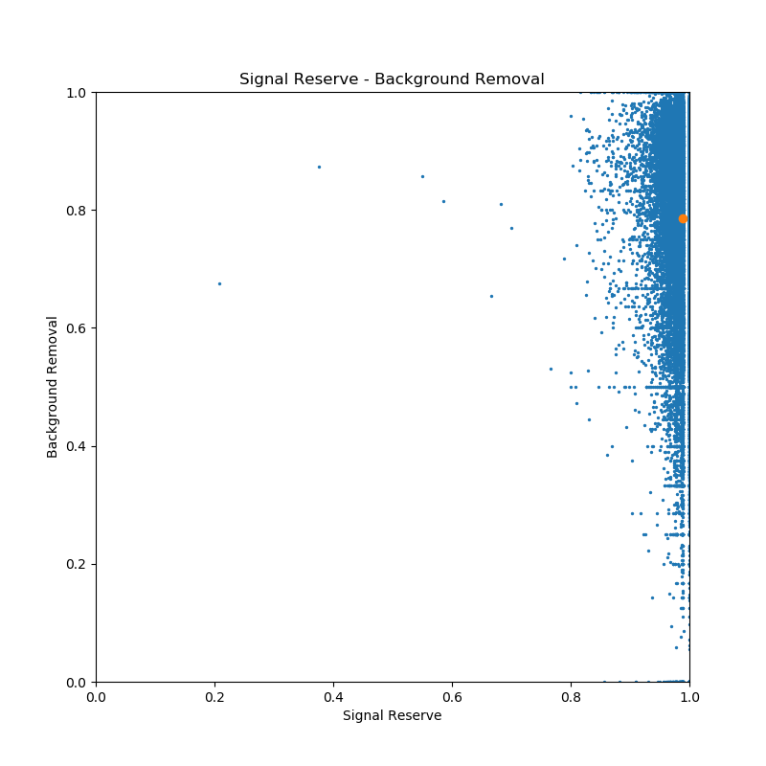
SR-BR distribution of each event
Average
SR: 98.80%
BR:78.56%
Mix Model

Slide 6
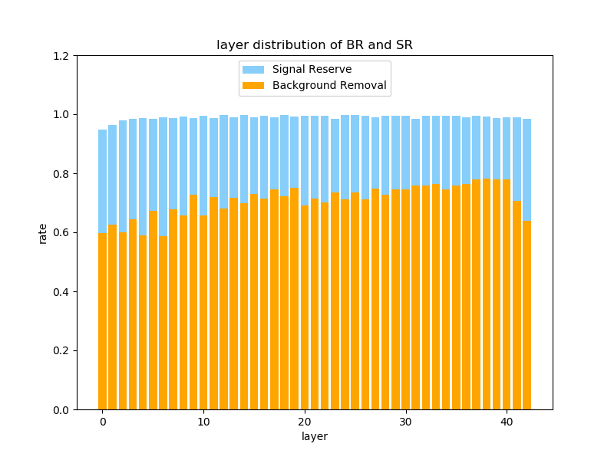
SR-BR distribution of each layer
Cut Model

Slide 7
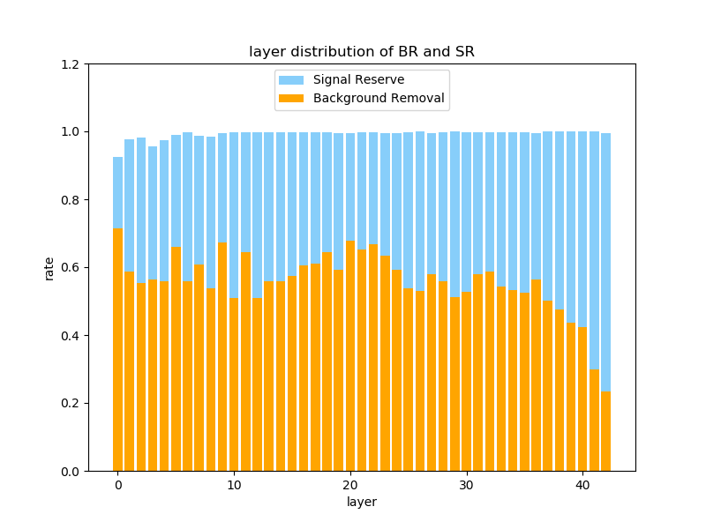
SR-BR distribution of each layer
Neural Network

Slide 8
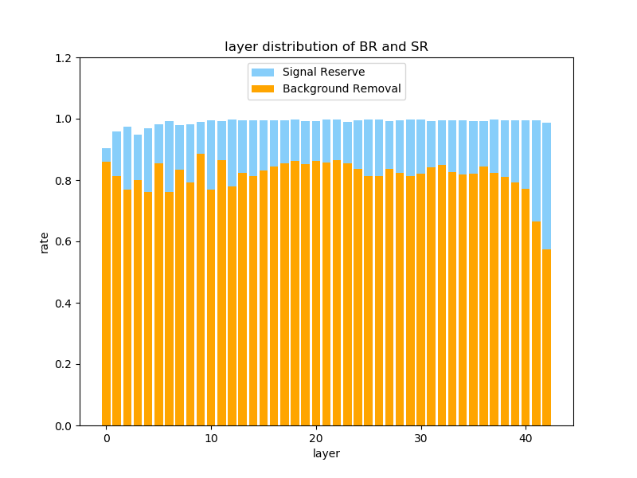
SR-BR distribution of each layer
Mix Model

Slide 9
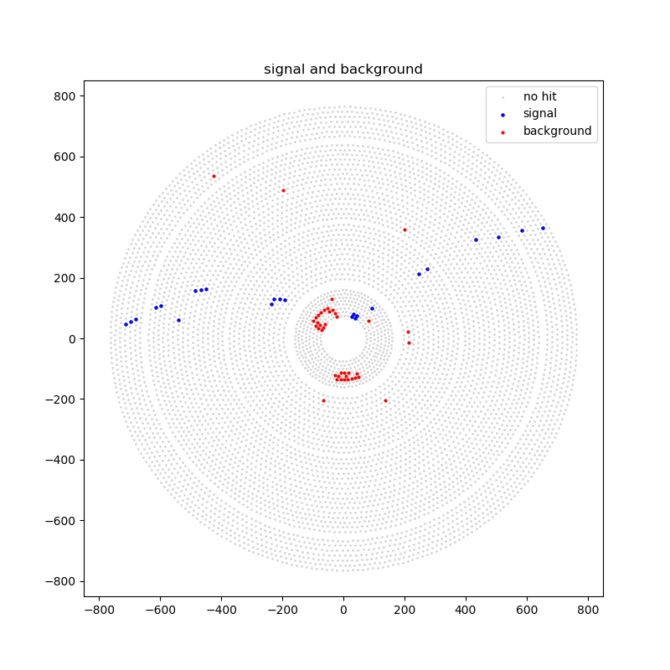
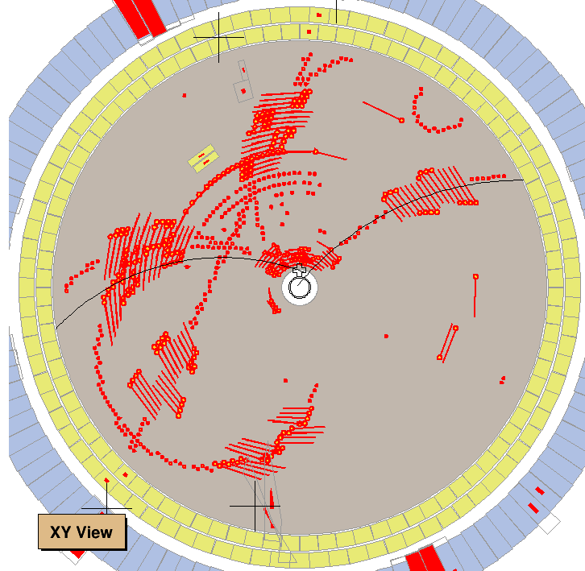
An event with lowest SR
Day == 171210, Run == 52961, EventID == 2251317

Slide 10
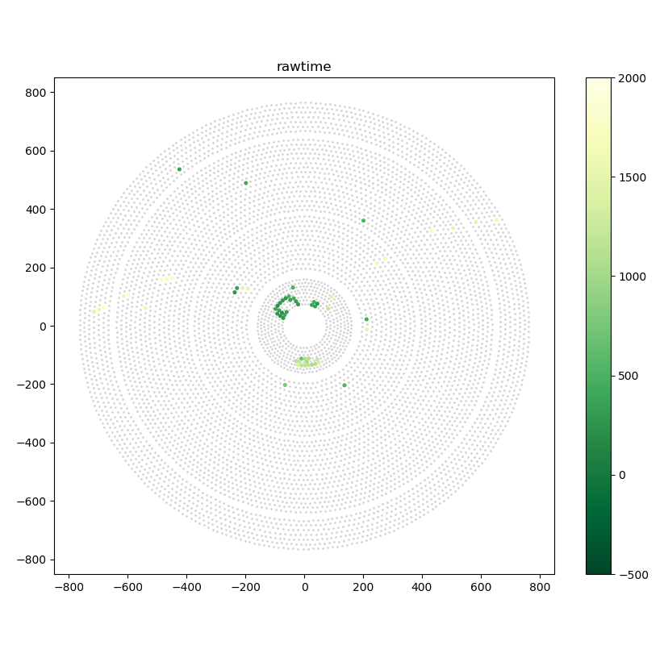
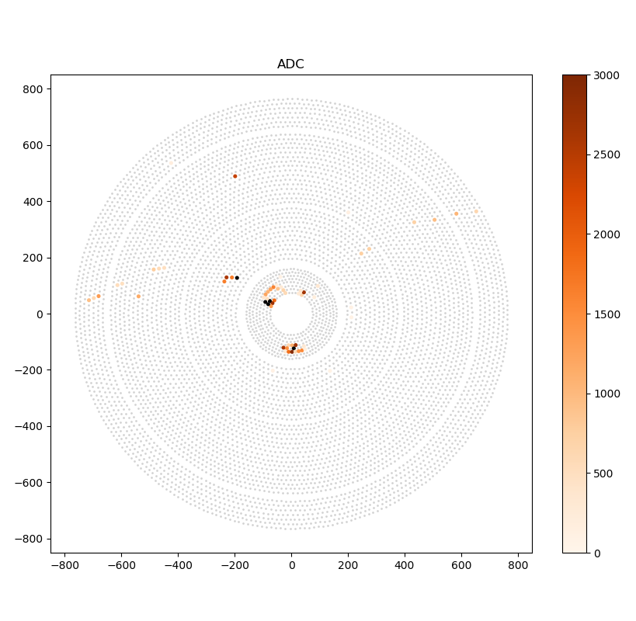
An event with lowest SR

Slide 11
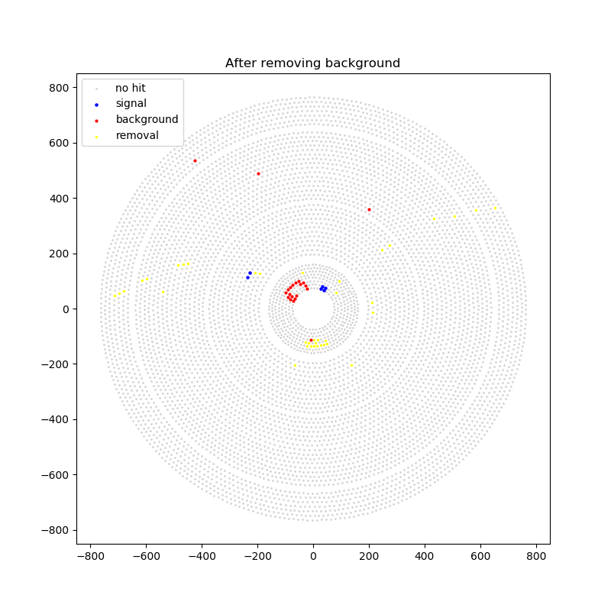
An event with lowest SR
Cut Model

Slide 12
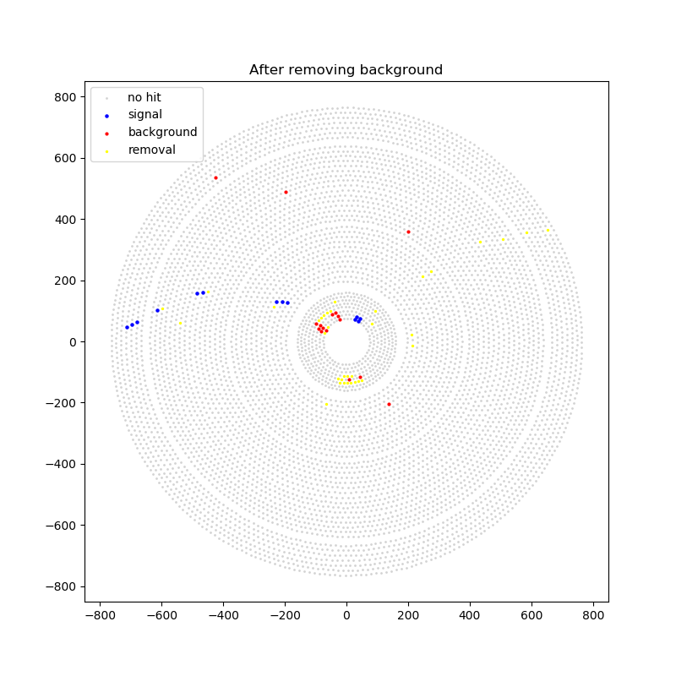
An event with lowest SR
Neural Network

Slide 13
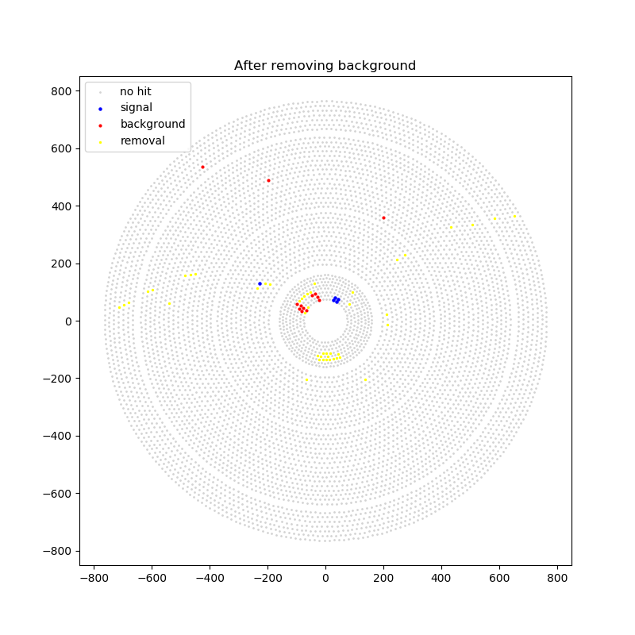
An event with lowest SR
Mix Model

