Slide 1
奇特态研究中的几个问题
李 刚
强子物理前沿会议，长沙，2018年11月5-9日

Slide 2
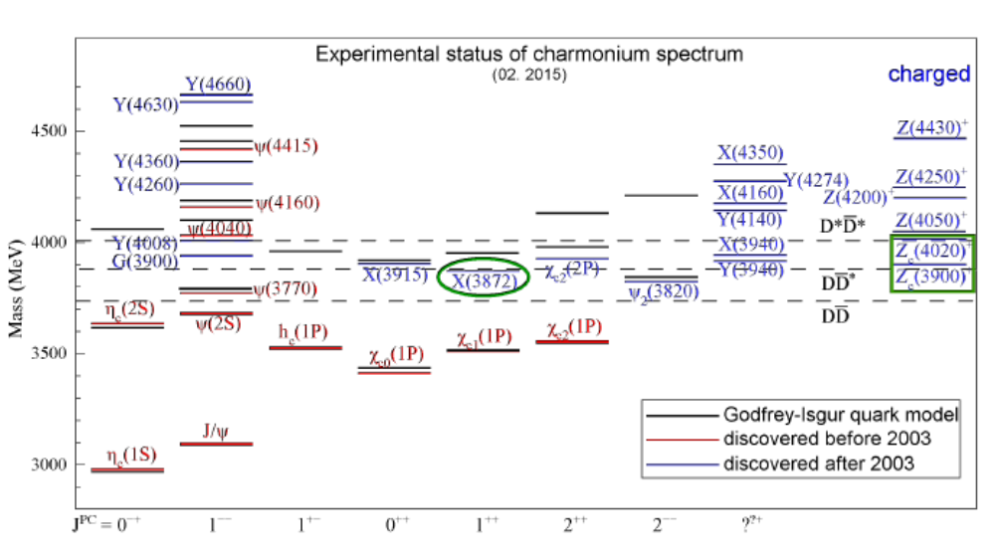
Notes:
2

Slide 3

















普通的强子：
介子
重子
QCD的多面性允许超出夸克模型的奇特强子态存在
混杂态 胶球 四夸克态 强子分子态
Notes:
3

Slide 4
综述文章
陈华星,陈伟,刘翔,朱世琳, "The hidden-charm pentaquark and tetraquark states",
Phys. Rept. 639 (2016) 1-121.
郭奉坤, Hanhart, Meißner, 王倩,赵强,邹冰松, "Hadronic molecules",
Rev. Mod. Phys. 90 (2018) 015004.
Esposito, Pilloni, Polosa, "Multiquark Resonances",
Phys. Rept. 668 (2016) 1-97.
Olsen, Skwarnicki, Zieminska, "Nonstandard heavy mesons and baryons: Experimental evidence", Rev. Mod. Phys. 90 (2018) 015003.
…
Notes:
4

Slide 5
实验上观测到新的XYZ态后，各种理论模型解释其可能的结构，如强子分子态、四夸克态、阈值效应等等，解释能力“强大” ！
实验上观测到新的XYZ态前，预言能力“欠缺” ！
如何从其中的解释中辨别真伪？
“猜测”，验证、抛弃或再改
Notes:
5

Slide 6
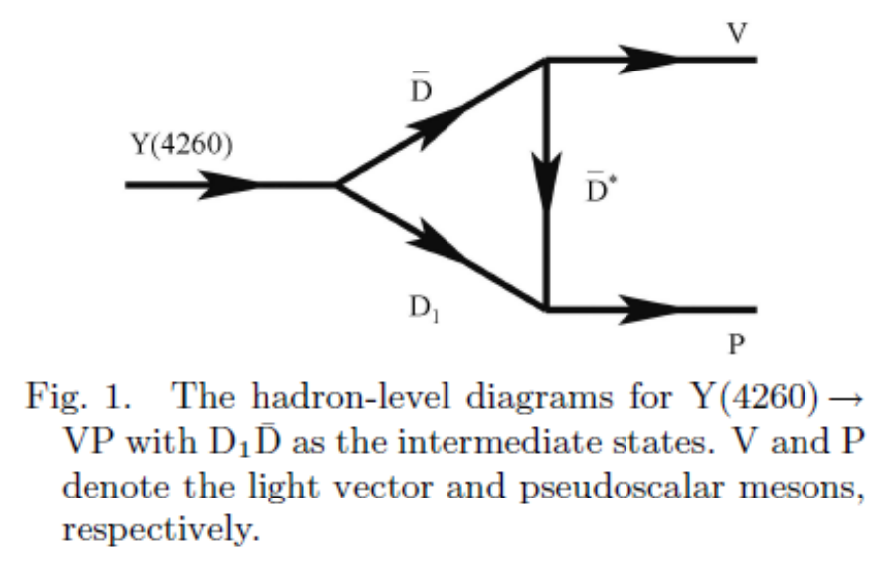
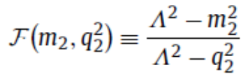

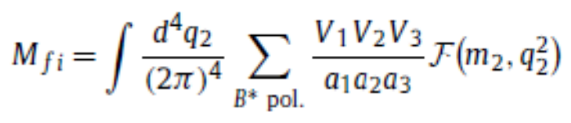

Y(4260) decays
G. Li et al., Chin. Phys. C39,063102.
S-wave
Introduce form factors to kill the divergence and also compensate the off-shell effects of intermediate mesons
Monopole:
Notes:
6

Slide 7
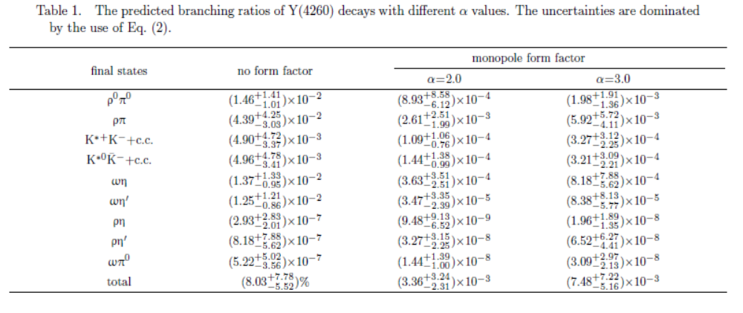
Notes:
7

Slide 8
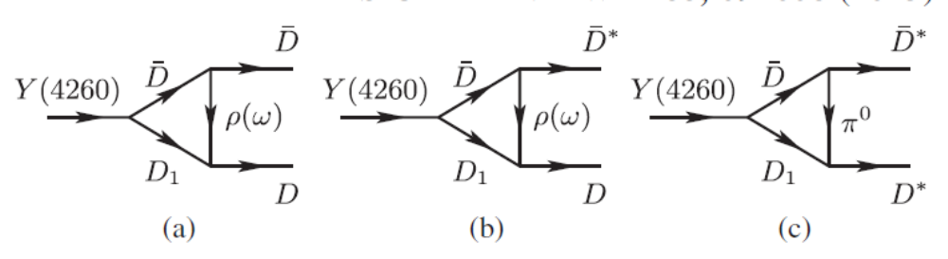
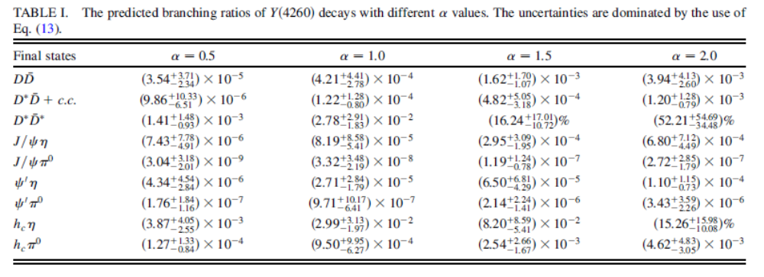
Notes:
8

Slide 9

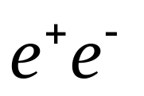
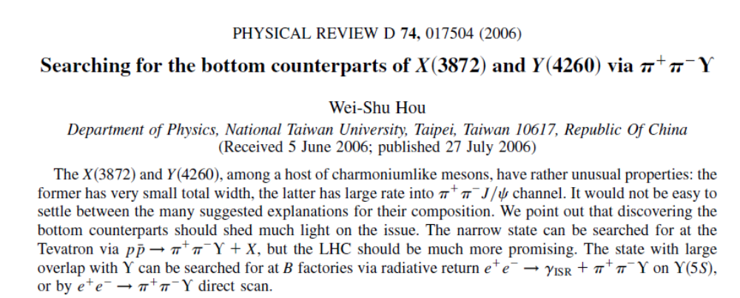
Conterpart of X(3872)—Xb states
Conterpart of X(3872): BB* molecule?
Very Heavy: difficult to directly produce at
Notes:
9

Slide 10

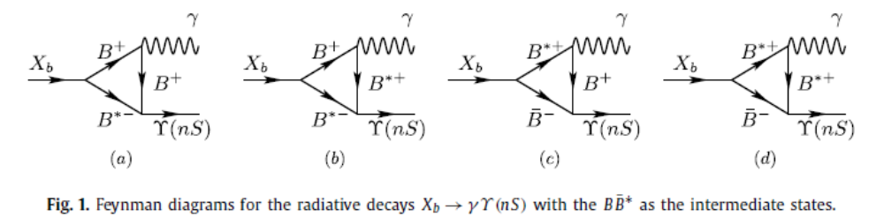
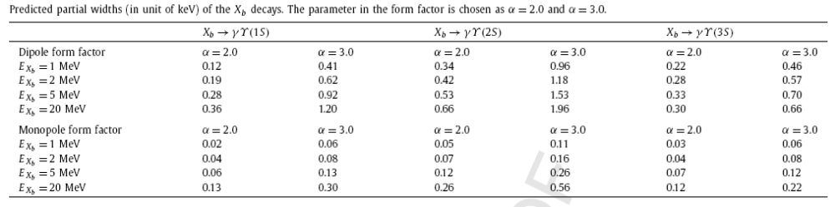
G.Li, W. Wang, Phys. Lett. B733, 100.
Notes:
10

Slide 11

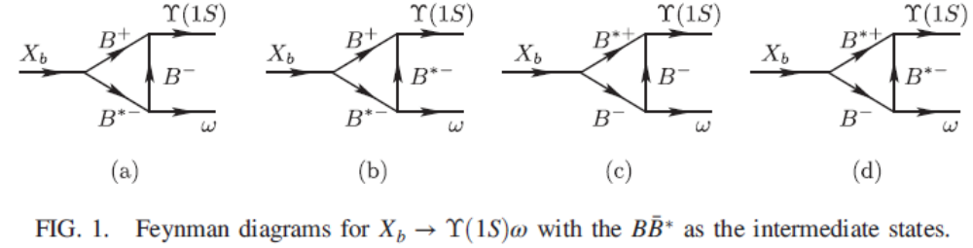
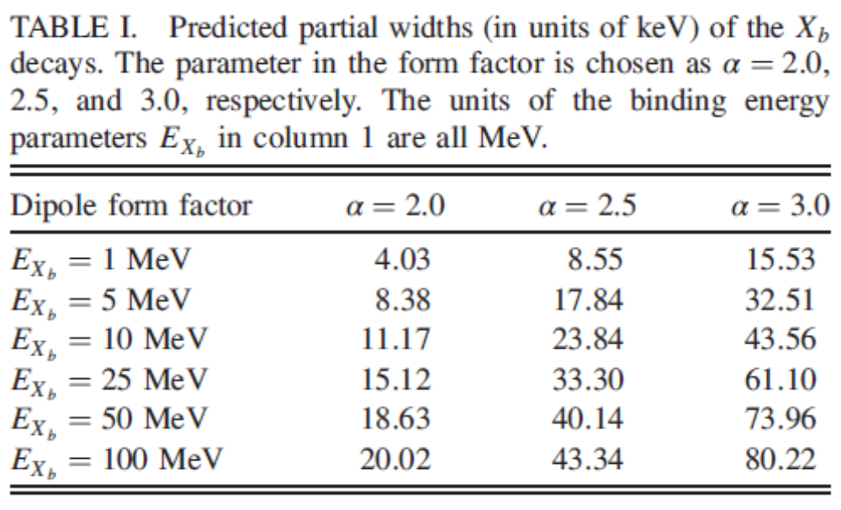
G. Li, Z. Zhou, Phys. Rev. D91, 034020.
No significant signal for has been seen by the Belle Collaboration.
X. H. He et al. [Belle Collaboration], Phys. Rev. Lett. 113,142001 (2014)
Notes:
11

Slide 12

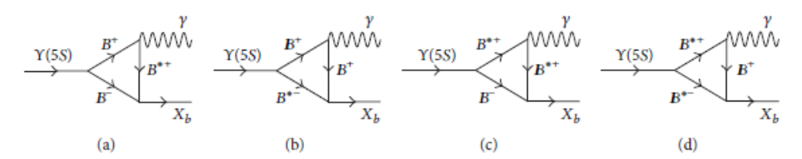
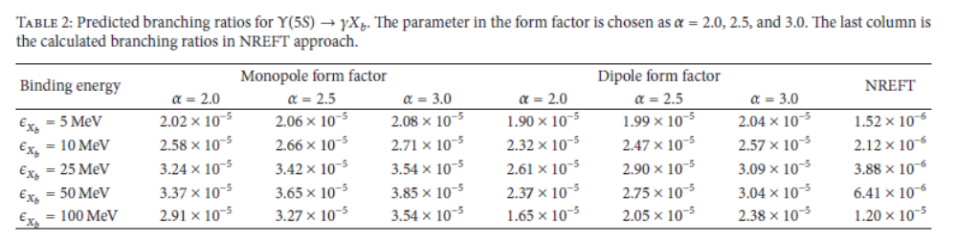
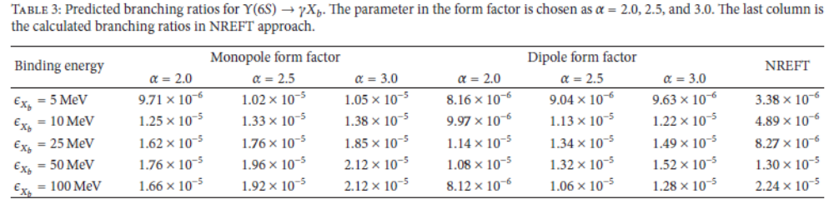
Notes:
12

Slide 13
Thanks for your attention !

