Slide 1




Institute of High Energy Physics
Key issues about the nature of Y(4260)
Qiang Zhao
Institute of High Energy Physics, Chinese Academy of Sciences
and Theoretical Physics Center for Science Facilities (TPCSF), CAS
zhaoq@ihep.ac.cn
2018-11-5, 长沙

Slide 2
Outline
Where are we?
Facts about Y(4260)
General comments and questions
Experimental reviews will be given by Yuanning and Chengping

Slide 3
1. Where are we?
-- Exp. status: A bottom line for any effort trying to understand candidates for exotic hadrons
Most of the ground states and states below open-flavor threshold are well established in the quark model.
A large number of excited states, i.e. XYZ states, cannot be accommodated by the conventional quark model, while a large fraction of these states appear to be correlated with the nearby S-wave open thresholds.
Lattice QCD are still unable to provide a full quantitative description of the hadron spectroscopy.

Slide 4
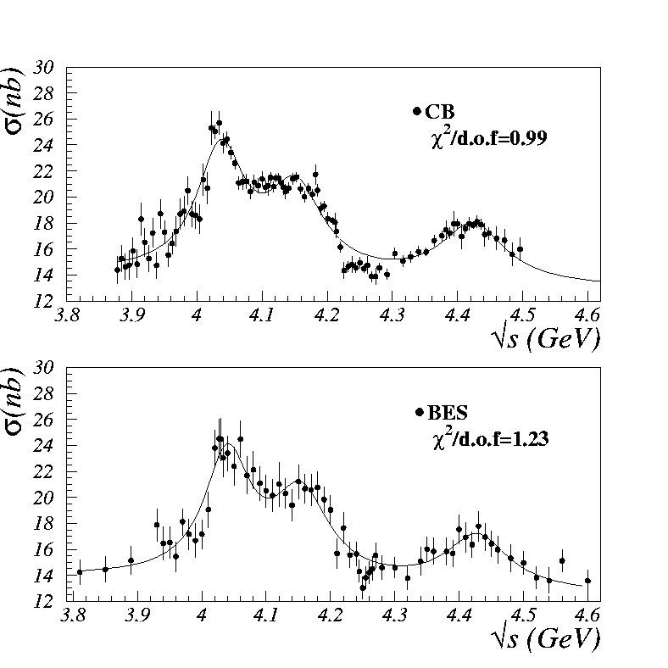
2. Facts about Y(4260)
σ(e⁺e⁻ → hadrons)
Y(4260) seems to be absent from the inclusive cross section of e+e- annihilations. But is this true?
Y(4260)
Y(4260)

Slide 5
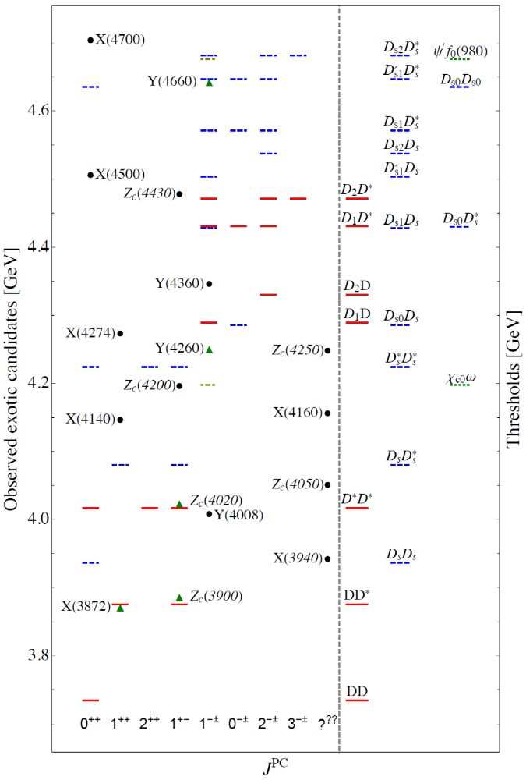
The signals of Y(4260) in open charm exclusive decay channels are very puzzling.
P-wave thresholds
S-wave thresholds

Slide 6
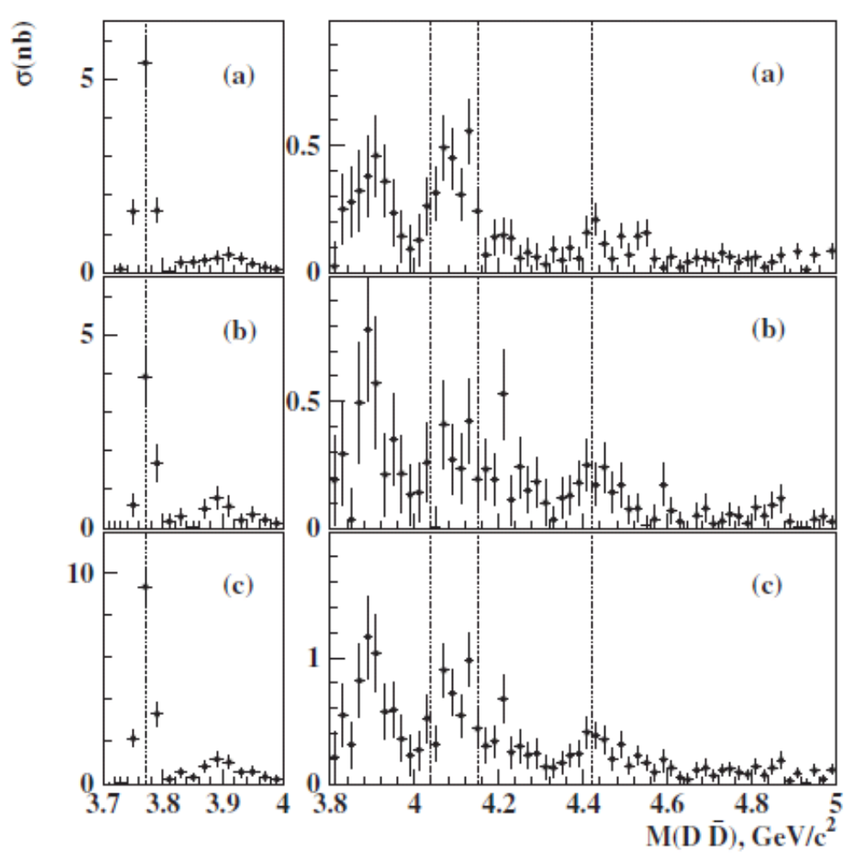
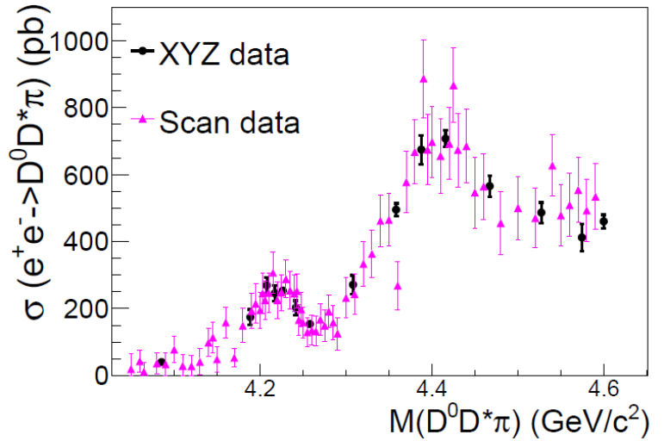
Y(4260) seems to be absent from the exclusive two-body open charm decays. But is this true?
ψ(3770), 1D
ψ(4040), 3S
X(3900) ?
ψ(4160), 2D
ψ(4415), 4S
Y(4260)
Signals in three-body open charm decay?
e+e- → D‾D* π +c.c.
Gao, et al., 1703.10351[hep-ex]
e+e- → D‾D
Belle PRD77, 011103(2008).

Slide 7
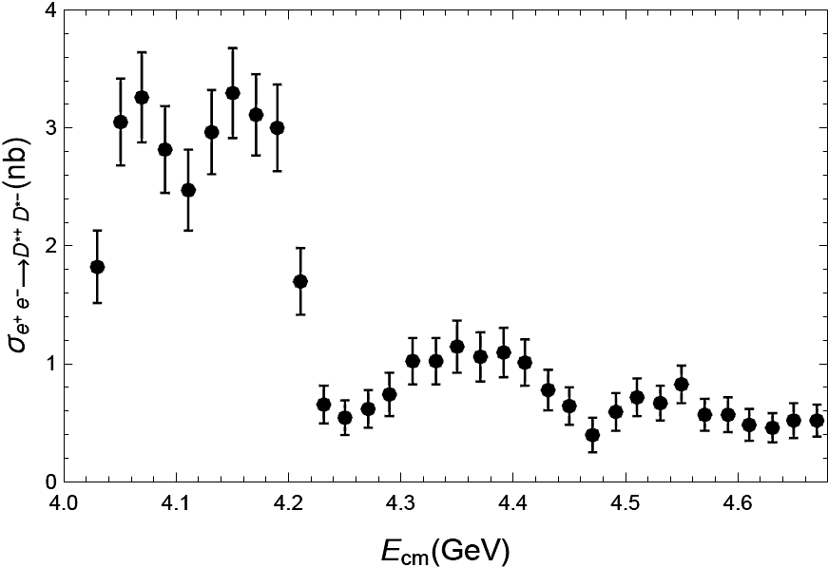
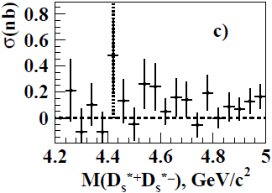


Peak or dip?
$e^{+}e^{−}→D^{∗}{\overline{D}}^{∗}$
$$e^{+}e^{−}→D_{s}^{∗}{\overline{D}}_{s}^{∗}$$
PRL 98 (2007) 092001
PRD 83, 011101 (2011)

Slide 8
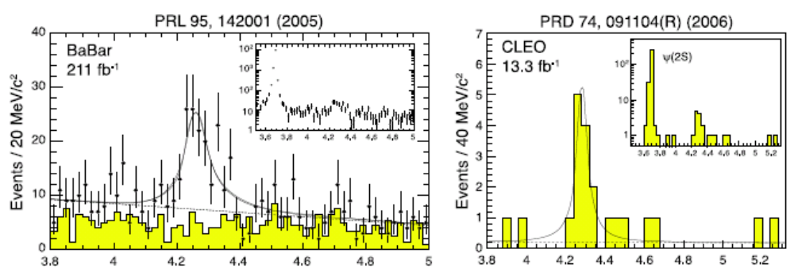
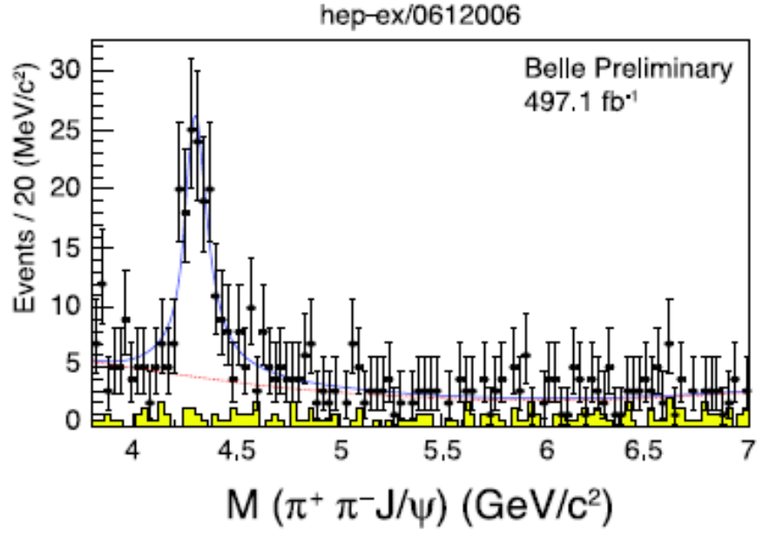
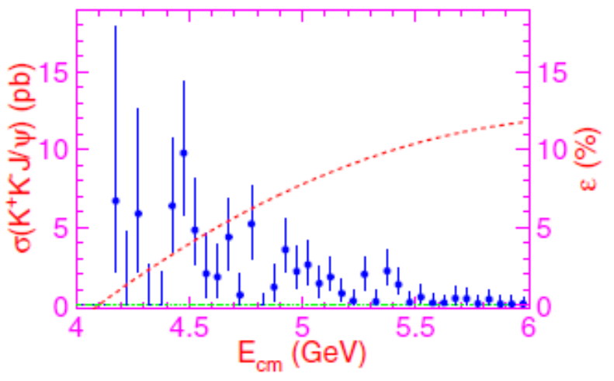
Signals from exclusive hidden charm decays are more apparent. But why?
Observation of Y(4260) in J/ψ ππ spectrum
PRD77, 011105 (2008)
Belle

Slide 9
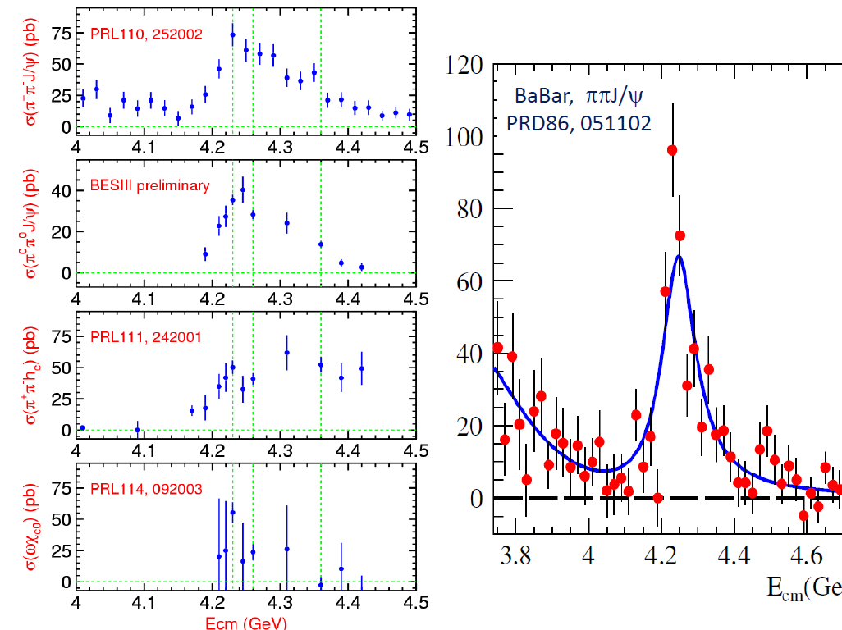
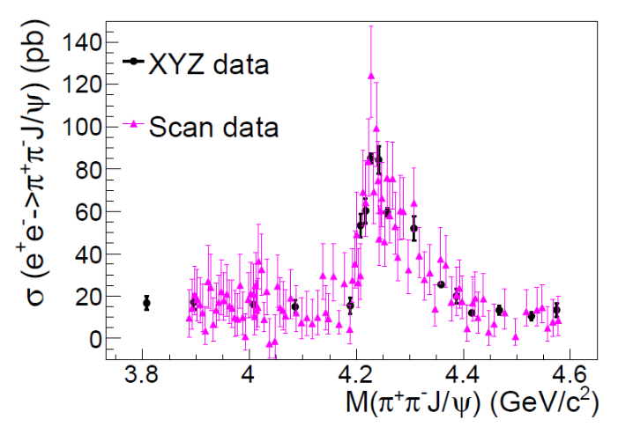
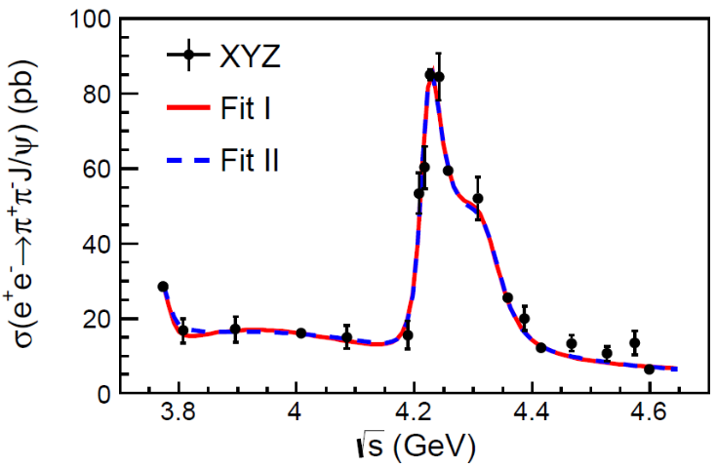
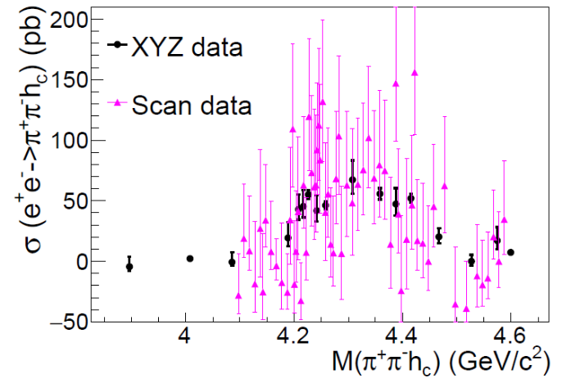
BESIII, arXiv:1611.01317 [hep-ex]
One state or two states?
BESIII, arXiv:1610.07044 [hep-ex]
Gao, et al., 1703.10351[hep-ex]

Slide 10
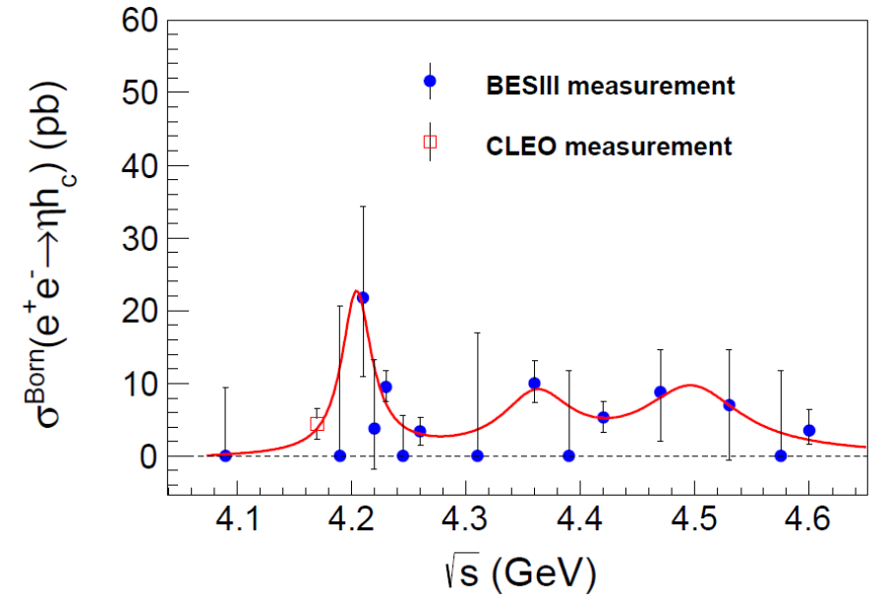
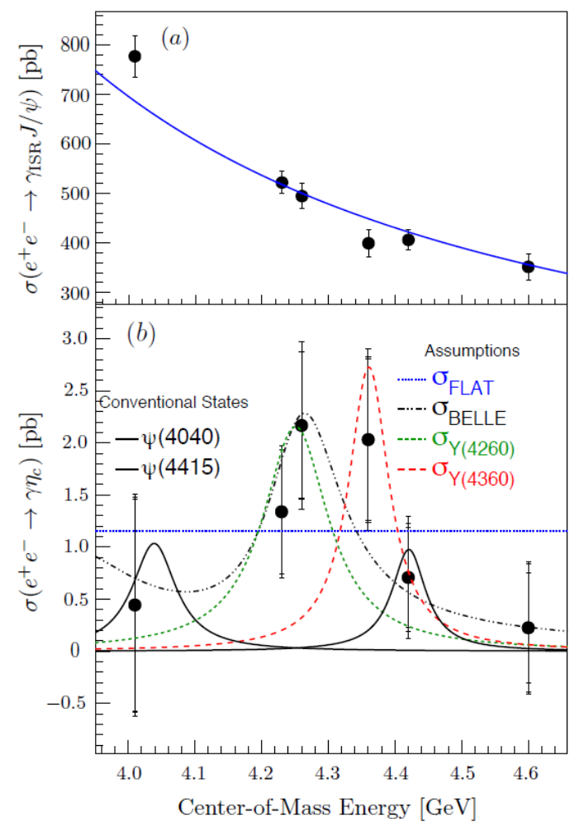
Signals from exclusive two-body hidden charm decays?
BESIII, 1705.06853[hep-ex]
BESIII, 1704.08033[hep-ex]

Slide 11
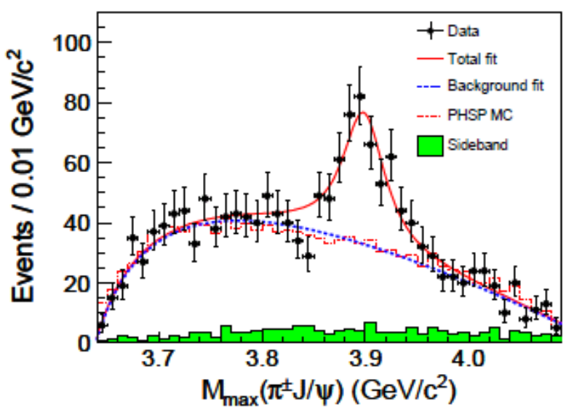
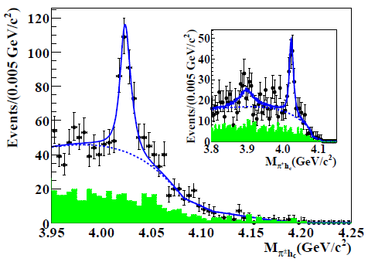
What’s the implication of Y(4260)’s correlation with the production of exotic candidates Zc(3900), Zc(4020) and X(3872)?
BESIII
At least, the production of Zc and X must be from more than three-body decays!

Slide 12
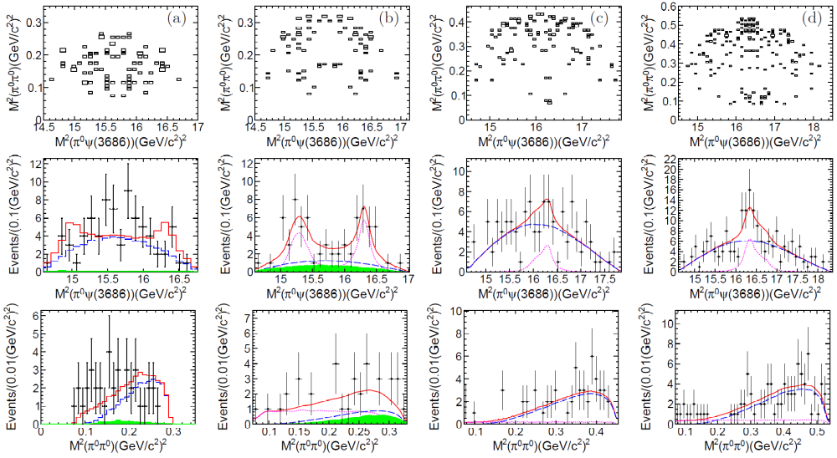

$$e^{+}e^{−}→ψ\left(3686\right)π^{0}{ π}^{0}$$
Phys.Rev. D97 (2018) no.5, 052001

Slide 13
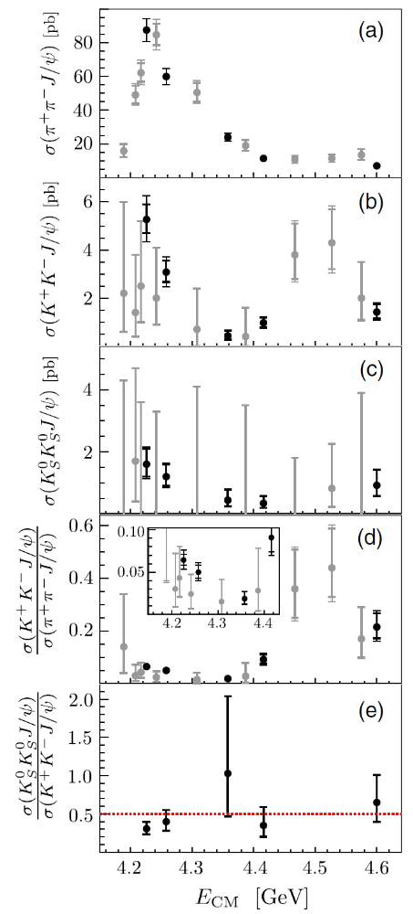

$$e^{+}e^{−}→K\overline{K} J/ψ$$
PRD 97, 071101(R) (2018)

Slide 14
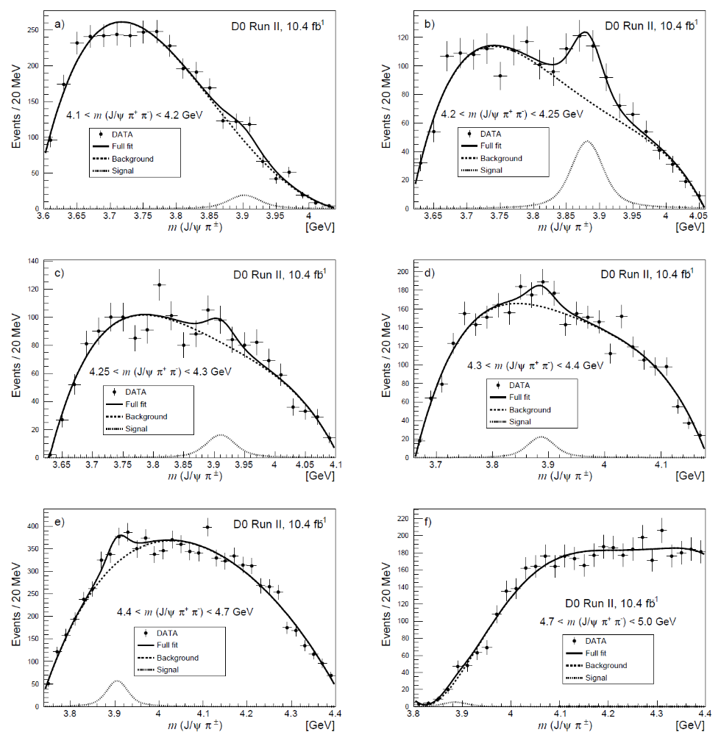

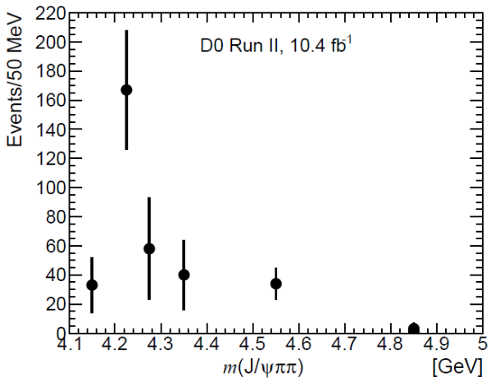
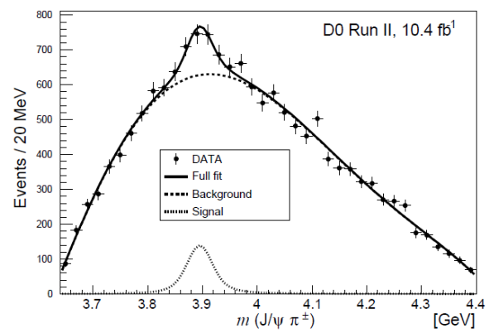

Slide 15
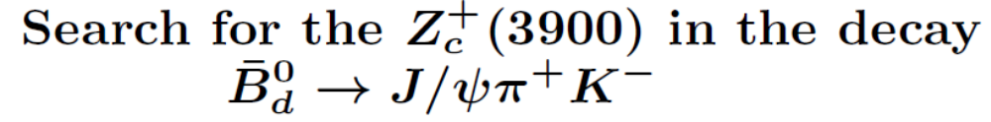
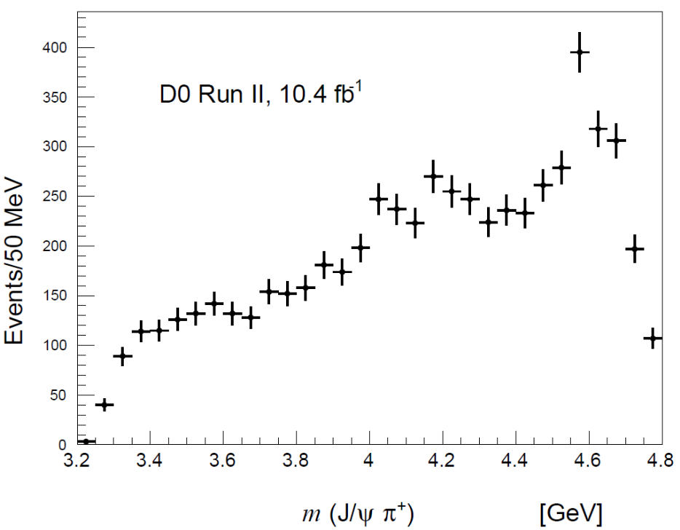
K* has been removed from the π K spectrum.
No Zc(3900) signals seem to be present.
Negative results from Belle and LHCb in similar processes.

Slide 16
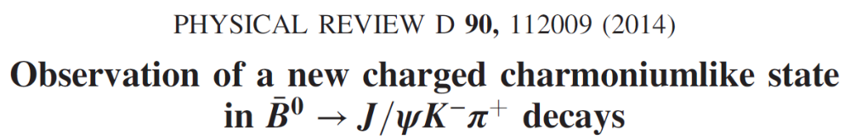
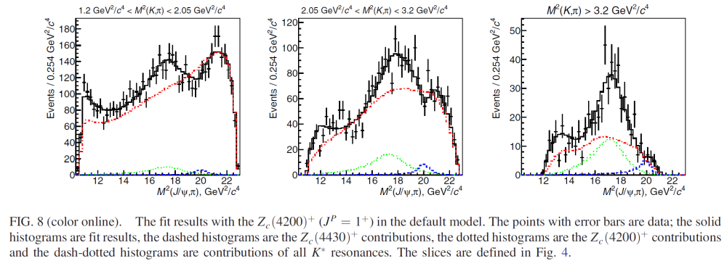
Belle Collaboration
Zc(4430) is confirmed? And Zc(4200) is observed?

Slide 17
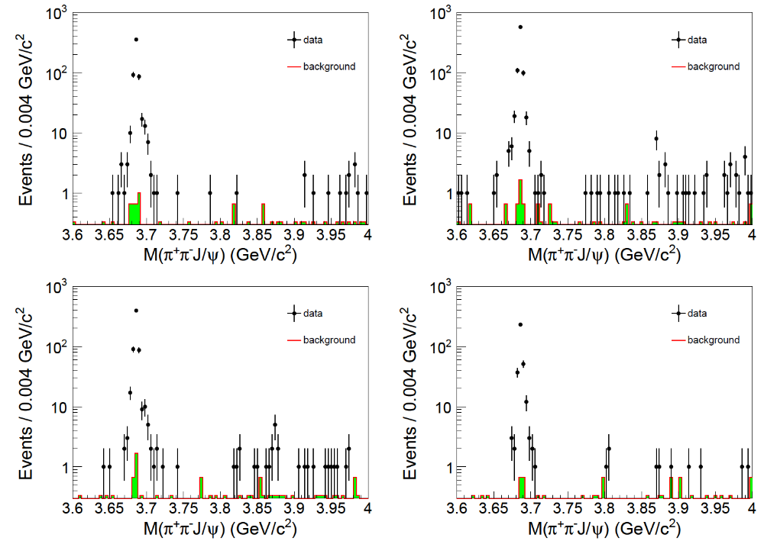

$$e^{+}e^{−}→{ X(3872)}^{}$$
Phys.Rev.Lett. 112 (2014) no.9, 092001

Slide 18
3. General comments and questions:
What can we learn from the production mechanisms for Y(4260)? (Seen in e+e- annihilations and b-flavored semi-inclusive decays.)
What can we learn from the decays of Y(4260)?
What can we learn from the correlations of Y(4260) with the exotic candidates Zc(3900), Zc(4020) and X(3872)?
What criteria/observables can we pin down in order to understand the nature of Y(4260)? (Lineshapes, strong decay branching ratios, leptonic width, radiative transitions, Dalitz plot analysis …)
What/How can we extend these results to the study of other exotic candidates? (Similar states in vector quarkonium spectrum? Similar phenomena in other channels?
… …

Slide 19
Institute of High Energy Physics
Thanks for your attention!

