Slide 1
International review meeting
Design of the Baseline-muSR (Super-muSR) and Baby-muSR spectrometers
Ziwen Pan, Xiaojie Ni, Qiuhe Zhao, Jingyu Dong,
Hao Liang, Bangjiao Ye
USTC Muon Group, Hefei, Anhui
21th Nov. 2018, Dongguan
Notes:
Good morning every experts in muon science or accelerator science! I am Ziwen Pan, from the Muon Group of University of Science and Technology of China. It’s my pleasure to present the progress of designing Baby-muSR and Baseline-muSR spectrometers on behalf of the China Spallation Neutron Source (CSNS) and the USTC Muon Group. I should mention you that the Super-MuSR is a dedicated name of a highly segmented MuSR spectrometer which will be built in ISIS Muon Source. So we use the baseline-muSR which is based on the design of the baseline muon beam currently. We will make a proper name later.

Slide 2
01
Physical basics of the muSR spectrometer
Designing and optimizing the Baby-muSR spectrometer
02
CONTENTS
03
Conceptual design of Baseline-muSR spectrometer
04
Conclusions
Notes:
In today’s presentation, I will tell you some basic physics of muSR techniques first. It can help us know the essence of the asymmetry. After that, I will show you how we update the 128-channel muSR prototype spectrometer to Baby-muSR spectrometer. It means that the later spectrometer inherits the advantage of the former spectrometer. But the later one is more advanced. Then I will show you the conceptual design of super-musr spectrometer for the high intensity muon beam. Finally I will conclude the work of designing muSR spectrometers.

Slide 3
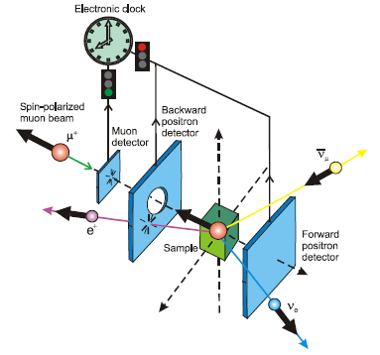
1 Physical basics of the muSR spectrometer
Typical experiment
Asymmetric positron distribution
Notes:
A bunch of nearly 100% polarized muons get though a muon detector giving the start time stamp to the electronics. For pulsed muon beam, the start signal can be given by the pulse monitor. After that muons get into the sample and interact with local or external magnetic field and decay into positrons with a lifetime of 2.2 microsecond. The decay positrons can be counted by detectors in the forward or backward direction along the muon spin. The positron counters will give the stop time stamp to the electronics. Then the electronic can provide us the time information of muons inside the sample as shown in the right side. The information of materials can be resolved by Mantid or other software analyzing the positron time spectrum.

Slide 4
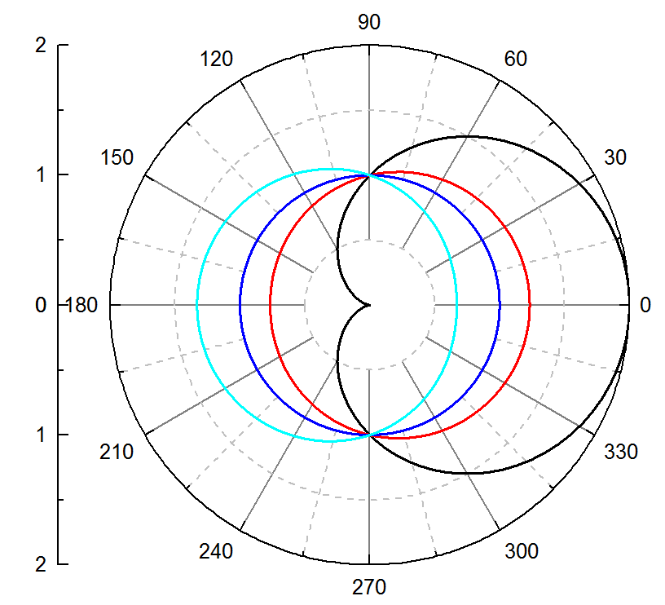
1 Physical basics of the muSR spectrometer
Asymmetry VS energy / emission angle
E (MeV) Asymmetry
52.3 1
36 0.232
26.2 0
0 -0.33
Michel distribution:
Spin
High energy positrons take high asymmetry;
Positrons emit along the spin preferentially.
Notes:
From the Michel distribution, we can also know the relation between asymmetry and kinetic energy. The formula indicates that the asymmetry is positively relative to the kinetic energy. High energy positrons take high asymmetry.
We can also dissolve the angular of positrons from the Michel distribution. From this formula, the angular distribution depends on the energy or asymmetry strongly. As the figure shown in the right, high energy positrons take up high asymmetry. And high asymmetric positrons emits along the spin preferentially. So we can get the conclusion that High energy positrons take high asymmetry; Positrons emit along the spin preferentially.
In order to get high asymmetry, we should block low energy positrons as much as possible.

Slide 5
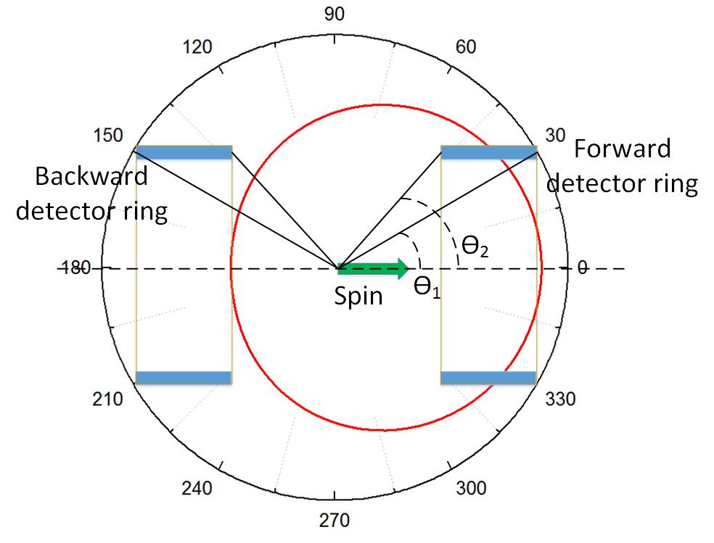
1 Physical basics of the muSR spectrometer
Asymmetry VS energy / emission angle
If we put two detectors along the beam polarization in two sides of the sample, we can get asymmetry = 1.
If ϴ₁ is confirmed, we can get the highest asymmetry using very small detector, meaning that ϴ₂≈ϴ₁.
To get high asymmetry, the radius of the detector ring should be small, or the distance should be large. We can also use degraders to block low energy positrons with low asymmetries.
Notes:
We can get important information from the formula below the graph.
If we put two detectors along the beam polarization in two sides of the sample, we can get asymmetry = 1.
If ϴ1 is confirmed, we can get the highest asymmetry using very small detector, meaning that ϴ2≈ϴ1.
To get high asymmetry, the radius of the detector ring should be small, or the distance should be large. We can also use degraders to block low energy positrons with low asymmetries.

Slide 6
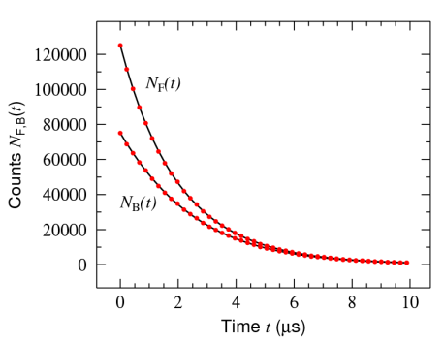
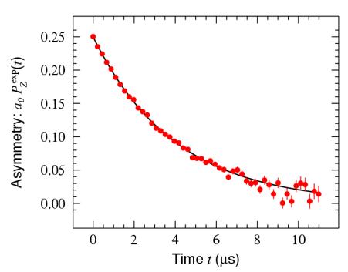
1 Physical basics of the muSR spectrometer
Positron time spectrum VS material properties
$$N\left(t\right)=N_{0}e^{−t/τ_{μ}}[1+a_{0}P^{exp}\left(t\right)]$$
$$P^{exp}\left(t\right)=G\left(t\right)cos⁡(γ_{μ}B_{⊥}t+φ_{0})$$
ZF (zero field) experiment:

Slide 7
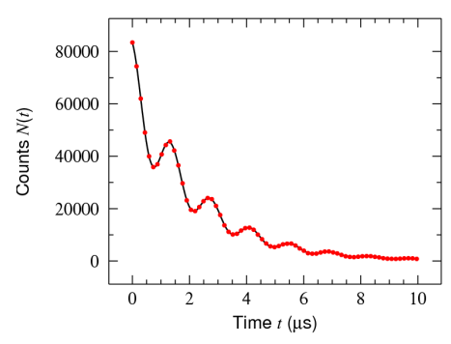
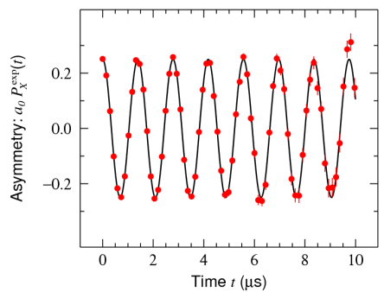
1 Physical basics of the muSR spectrometer
Positron time spectrum VS material properties
$$N\left(t\right)=N_{0}e^{−t/τ_{μ}}[1+a_{0}P^{exp}\left(t\right)]$$
$$P^{exp}\left(t\right)=G\left(t\right)cos⁡(γ_{μ}B_{⊥}t+φ_{0})$$
TF (transverse field) experiment:

Slide 8
2 Designing and optimizing the Baby-muSR spectrometer
 | ISIS | J-PARC | CSNS (Baby-scheme) | CSNS (Solenoid collection mode)
Beam Intensity (μ⁺/pulse) | ~ 3.3×10³ | ~ 4.0×10⁴ | ~ 4.8×10⁴ | ~ 4.0×10⁵
Repetition rate (Hz) | 40 | 25 | 2.5 | 2.5
Segments | 64/96/64 | 256/1280 | 256 | 2560
Covered solid angle (%) | > 40 | 8/23 | 33 | 45
The muon beam intensity per pulse is relatively high
The repetition rate is very low!
We can get high asymmetry by reducing the count rate of positrons in usage of degraders!
Notes:
As you can see in the table, the beam intensity per pulse of CSNS is relative high compared to the muon beam in ISIS or J-PARC. But the repetition rate of CSNS muon beam in very low, just 2.5 Hz. If we want to get the same event rate per hour, we need at least 10 times the detector segments. So in the future we will build the 2560-channel super-musr spectrometer to get enough data points in limited beam time. The purpose of getting around 100 million events per hour is to reduce the statistical fluctuation analyzing the data. But if the asymmetry of the musr spectrometer is high, I think we don’t need that much data. So We can get high asymmetry by reducing the count rate of positrons in usage of degraders when we design the baby-scheme and super-musr spectrometer.

Slide 9
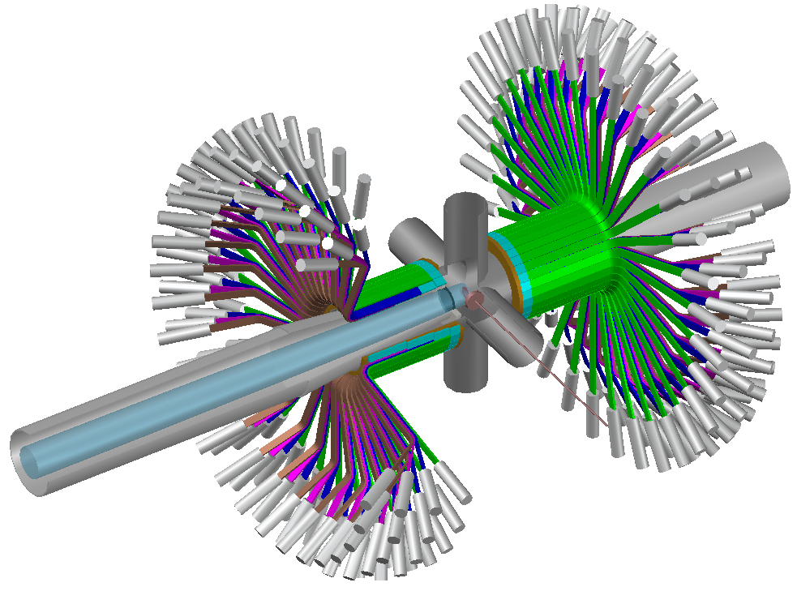
2 Designing and optimizing the Baby-muSR spectrometer
What we want to achieve?
Asymmetry: > 30%
Covered solid angle: > 30%
Beam intensity: 1.2x10⁵ muons/s
Count rate per detector per pulse: ~ 10
Sample environment: fly-past
Longitudinal field (LF): 3000 Gauss
Transverse field (TF): 300 Gauss
Million event rate: ~ 15 Mevents/hour

Slide 10
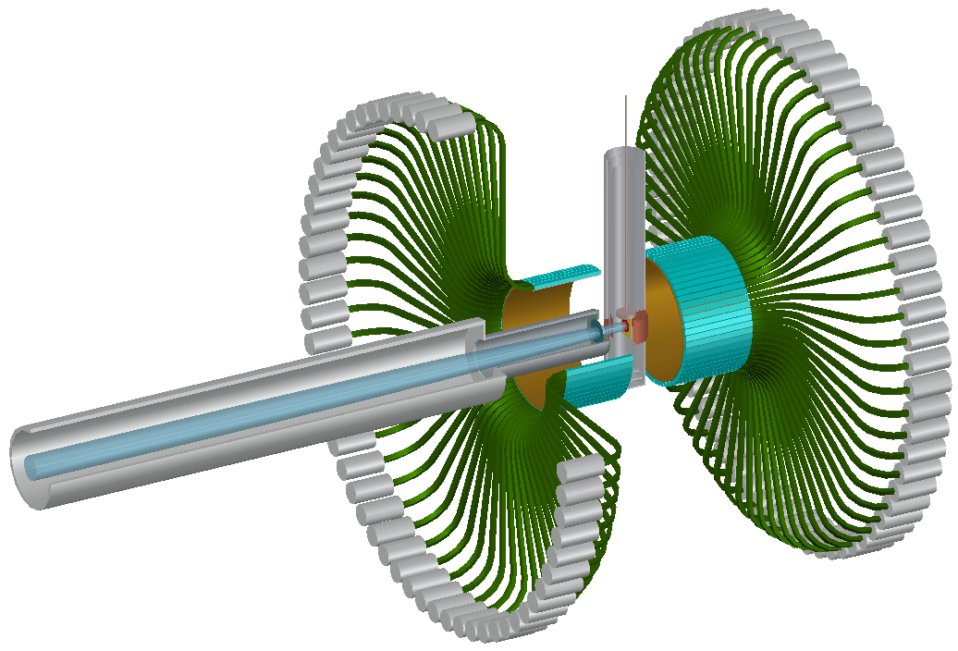
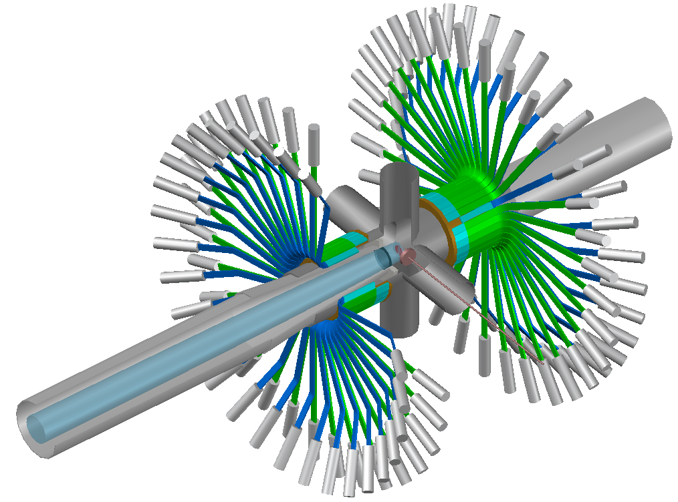
2 Designing and optimizing the Baby-muSR spectrometer
128-channel
Two rings
Radius: 150 mm
128-channel
Four rings
Radius: 90 mm
256-channel
Eight rings
Radius: 90 mm
Notes:
The current 128-channel muSR spectrometer has two rings in the forward and backward direction. In order to put 64 segments into one ring, the radius of the detector is very large, up to 150 mm. As mentioned before, if we want to get high asymmetry, the radius should be small. So we revised the two-ring structure to four-ring structure. The radius is only 90 mm which is just a little bit larger than the cruciform. As the repetition rate of the CSNS muon source is low (2.5 Hz) and the beam intensity is high, in order to accept such high beam intensity, we update the 128-channel muSR spectrometer to 256-channel Baby-muSR which will be mounted on the baby-scheme beam line.

Slide 11
2 Designing and optimizing the Baby-muSR spectrometer
Two ring structure:
Detector ring
Two rings: 64 channels / ring
Plastic scintillator: 13.5×5×175 mm³
Light guide： 150 mm (horizontal)
400 mm (vertical)
Degrader : ~11 mm (brass)
Beam: 1.2×10⁵ muons/s
Φ30 mm (FWHM)
Muon beam
Cryostat
Degrader
Notes:
As shown in the graph, the 128-channel muSR spectrometer consists of two detector rings, two degraders to block low energy positrons and the cryostat to cool the sample.
Each detector ring has 64 segments with the size of 13.5 by 5 by 175 mm. The scintillator is very long and narrow.
The light guide is very long. Because the PMT is sensitive to the magnetic field, we have to use long light guide to transfer light to the PMT.
The degrader is around 11 mm thick which can help us get the highest asymmetry.
The beam intensity is 1.2X10⁵ muons/s, so each pulse has 4.8X10⁴ muons.
The beam spot is 30 mm in diameter in full width half maximum. The sample is also 30 mm in diameter. We will face background problem.

Slide 12
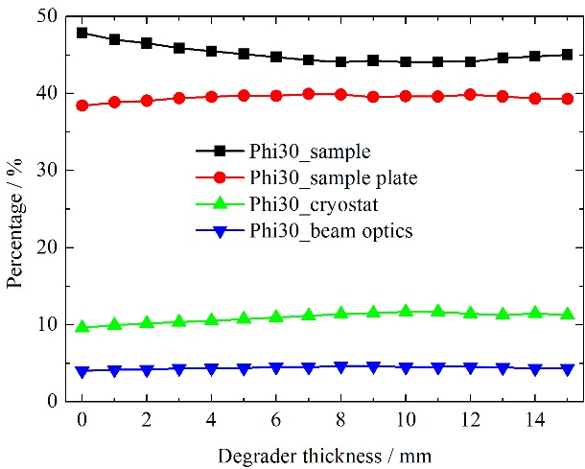
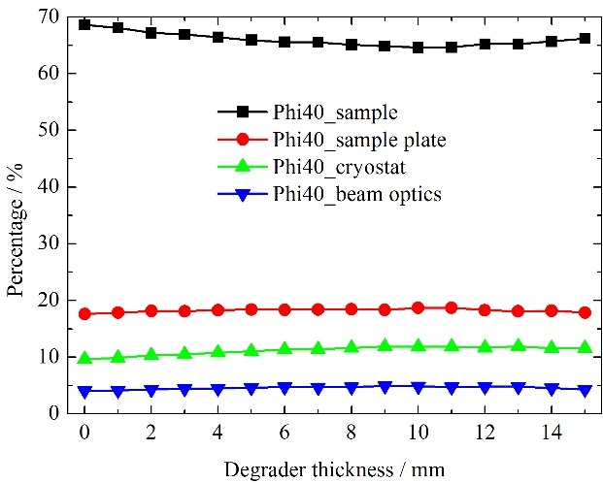
2 Designing and optimizing the Baby-muSR spectrometer
Two-ring structure:
Where the muons decay?
Φ30 mm
Φ40 mm
~65%
~45%
Fly-past sample vessel is needed!
Notes:
We should know where the muons decay first. I simulated the sample diameter by 30 mm and 40 mm. For the 30 mm sample , only 45% muons decay inside the sample. Most muons decay in the sample plate and cryostat. If we use 40 mm sample, 65% muons can decay inside the sample. It is a big improvement. But users should provide very large sample. We can also look at the percentage of muons decay in the beam pipe and cryostat. The percentage doesn’t change in two configurations. If we use cryostat in the future, we should do optimization on the setup of cryostat and the beam pipe and beam windows.
According to the simulation, changing the sample size is not a good option, we should use fly-past structure in substitution.

Slide 13
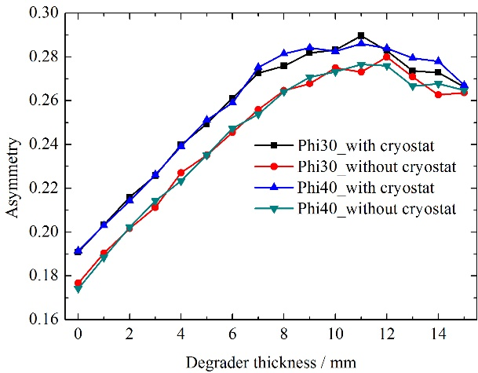
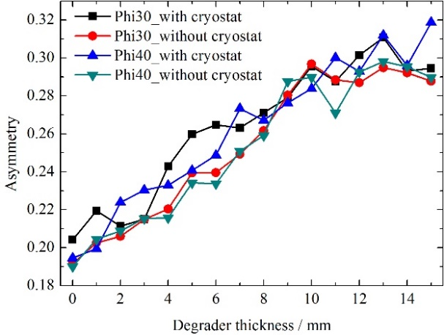
2 Designing and optimizing the Baby-muSR spectrometer
Two-ring structure:
ZF
TF
The asymmetry reaches its highest value (~0.28) with the degrader thickness = 11 mm.
Cryostat can also degrade low energy positrons.
Notes:
I also simulated the asymmetry with varying the thickness of the degrader in both zero-field and transverse field. We can look at the black and blue data, the sample size doesn’t affect the asymmetry.
If we look at the blue and red data, the existence of the cryostat make the asymmetry higher. This is because the cryostat is metal, it can block low energy positrons.
If we look at the black data, the asymmetry reaches it maximum (~0.28) with the thickness = 11 mm. Then it reduces.
So we get the conclusion that The asymmetry reaches its highest value (~0.28) with the degrader thickness = 11 mm. The cryostat can also degrade low energy positrons.

Slide 14
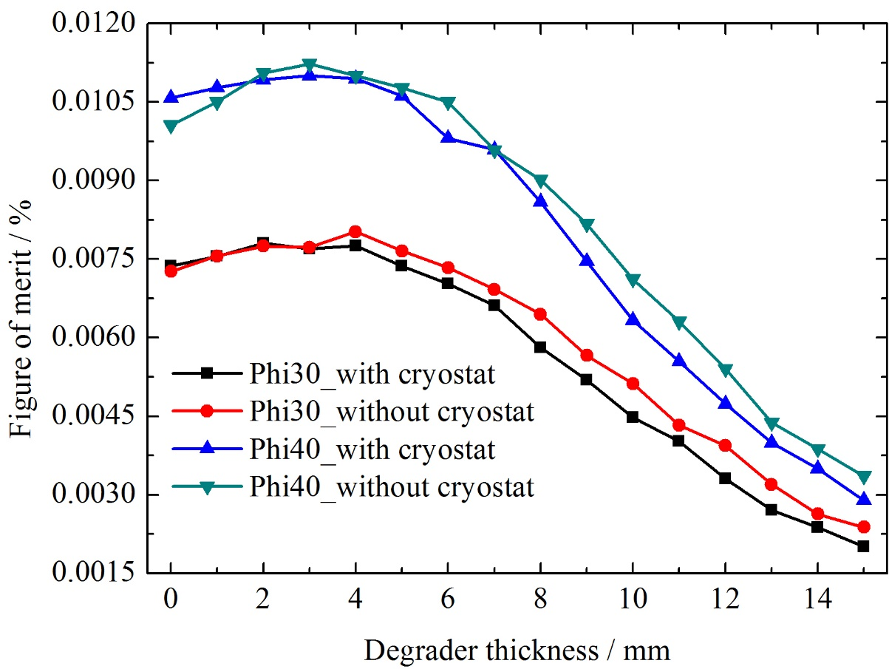
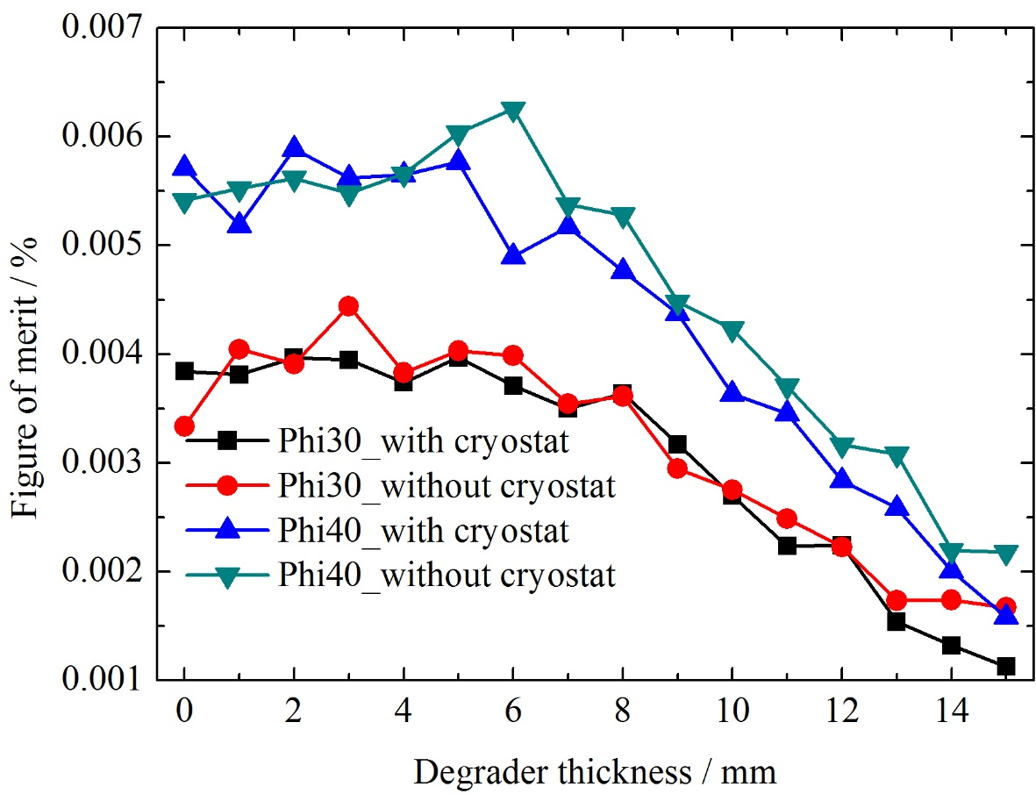
2 Designing and optimizing the Baby-muSR spectrometer
Two-ring structure:
Figure of merit = Asymmetry²×Detection rate
ZF
TF
The highest figure of merit is with ~ 3 mm brass degrader.
Notes:
The figure of merit is the asymmetry square multiply the detection rate. The asymmetry is more important than the detection rate. It can be used to quantify the usage of every muon when the muon intensity is relatively low.
We can look at the figure of merit in both ZF and TF conditions. All curves show the same trend. The figure of merit reaches the highest when the degrader is around 3 mm in thickness. If we only consider the figure of merit, we can use 3 mm brass as the degrader.

Slide 15
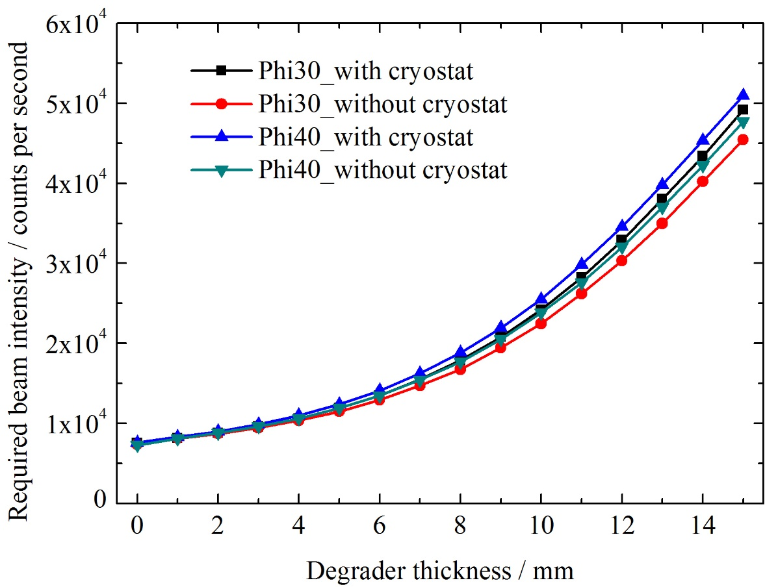
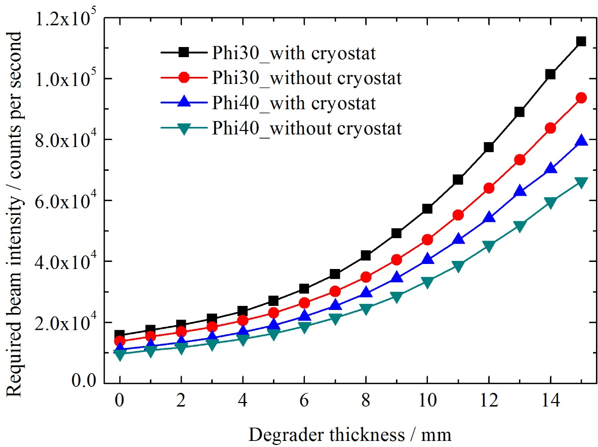
2 Designing and optimizing the Baby-muSR spectrometer
Two-ring structure:
Required beam intensity ≈ 10×128/Rate*2.5
TF
ZF
Only ~ 25% of the muon beam flux is needed!
We can change the arrangement of the detector rings to get higher asymmetry at the cost of losing beam flux.
Notes:
According to the using experience in ISIS muon source, when each detector gets around 10 events per frame, the distortion of the time spectrum of positrons can be ignored and corrected. If the count rate per frame is higher than 15, the distortion will be significant. So I use 10 counts per frame as the standard. So the required beam intensity is 10X128/Rate*2.5.
The required beam intensity in ZF and TF is slightly different. When we do ZF or TF experiment, we can change the slit to optimize the event rate.
For the ZF condition, 3X10⁴ muons/s is needed. It means the current prototype needs only 25% of the muon flux. So we can make use of the left 75% muons to get the asymmetry as high as possible.

Slide 16
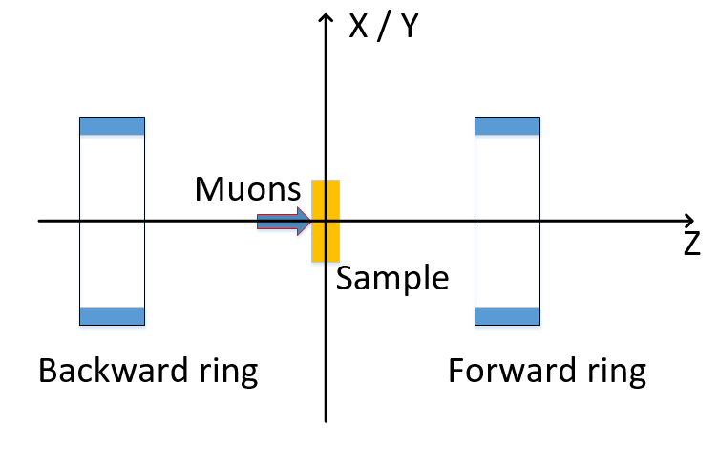
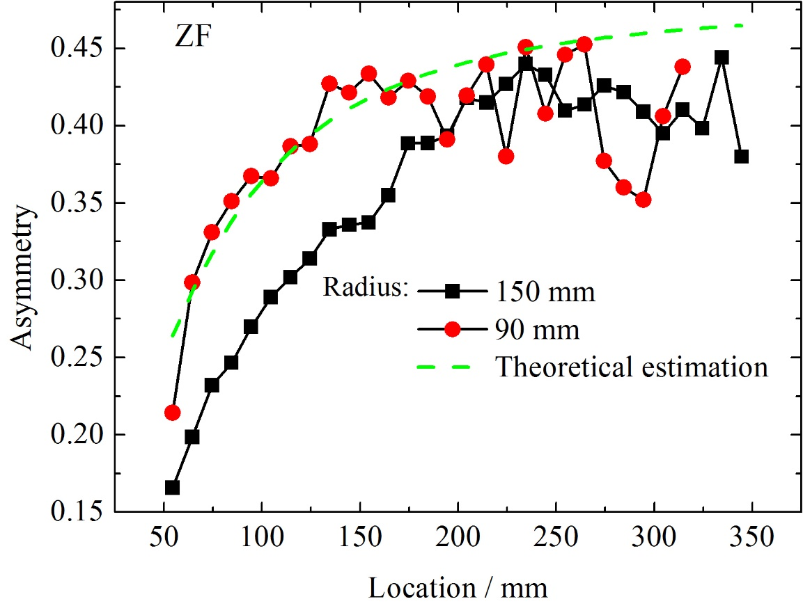
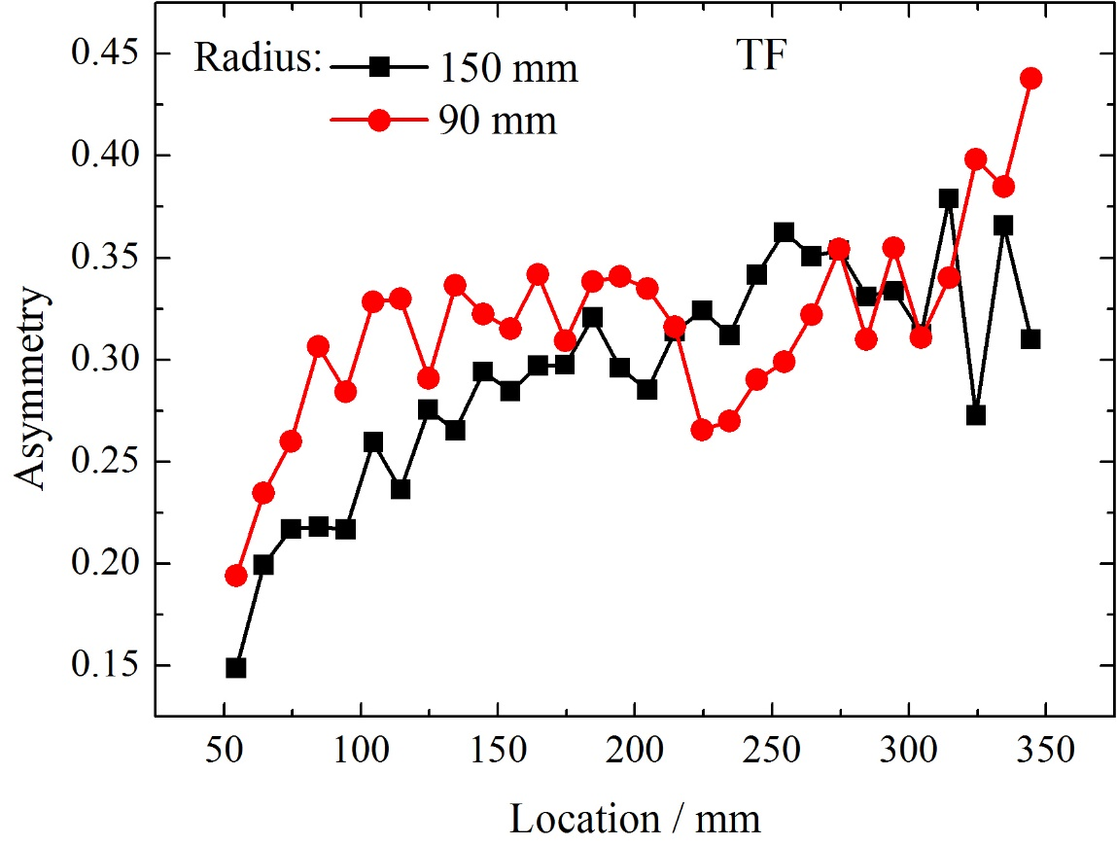
2 Designing and optimizing the Baby-muSR spectrometer
Two-ring structure
Four-ring structure
 | 1 | 2
Radius (mm) | 90 | 150
Scintillator length (mm) | 10 | 10
Number of segments | 32 / bank | 64 / bank
Both ZF and TF conditions have same tendency in asymmetry.
Detector ring with small radius reaches high asymmetry much quickly.
For the radius = 90 mm, when the location is over 150 mm, the asymmetry shows small change.
Notes:
According to the conclusion drawn in the last slide, we decided to change the two-ring structure to four-ring structure. I used two detector rings with the radius by 90 mm or 150 mm to search the highest asymmetry in the detection area. As shown in the figure, the location of changes from ~60 mm to ~350 mm.
Then I get the asymmetry in both ZF and TF condition. Both ZF and TF conditions have same tendency in asymmetry.
As you can see in the ZF condition, when the asymmetry reaches 0.42, it doesn’t change much. The fluctuation is due to the simulated number of muons. The difference between 90 mm and 150 mm is that the asymmetry reaches the highest more quickly in 90 mm.
For the radius = 90 mm, when the location is over 150 mm, the asymmetry shows small change. So we can put one detector ring after 150 mm along the spin to get the highest asymmetry. The length can be 100 mm. And we put another ring before 150 mm to get large covered solid angle.

Slide 17
2 Designing and optimizing the Baby-muSR spectrometer
Two-ring structure
Four-ring structure
Radius: 150 mm
Length: 175 mm
Radius: 95 mm (inner), 90 mm (outer)
Length: 40 mm (inner) 100 mm (outer)
Notes:
The current 128-channel muSR detector ring is 150 mm in radius and 175 mm in length.
As confirmed in the slide 14, one detector ring is located before 150 mm and the length is 100 mm. To keep the covered solid angle of both rings the same, the length of the other ring before 150 mm should be 40 mm. As the thickness of each detector is 5 mm, the radius of the inner ring in the right picture should be 5 mm larger which can avoid double-counting event. The double-counting event here means one positron gets into two scintillator along its path.

Slide 18
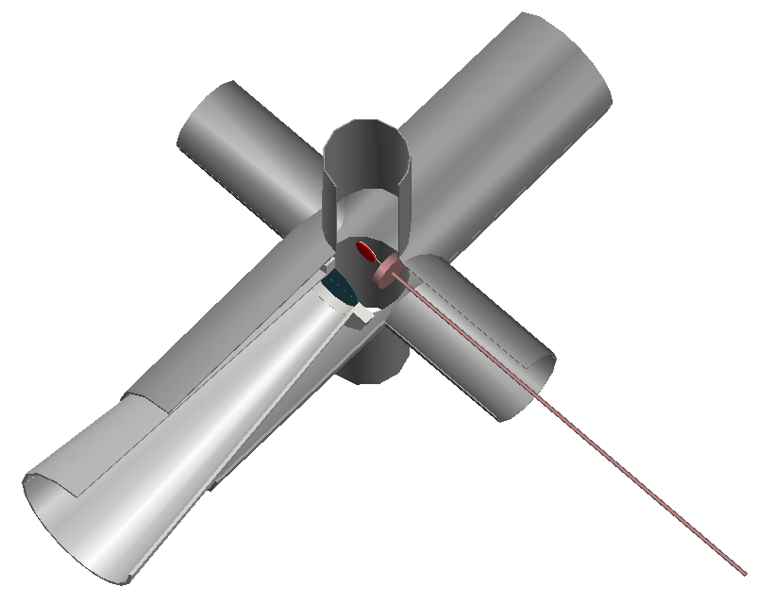
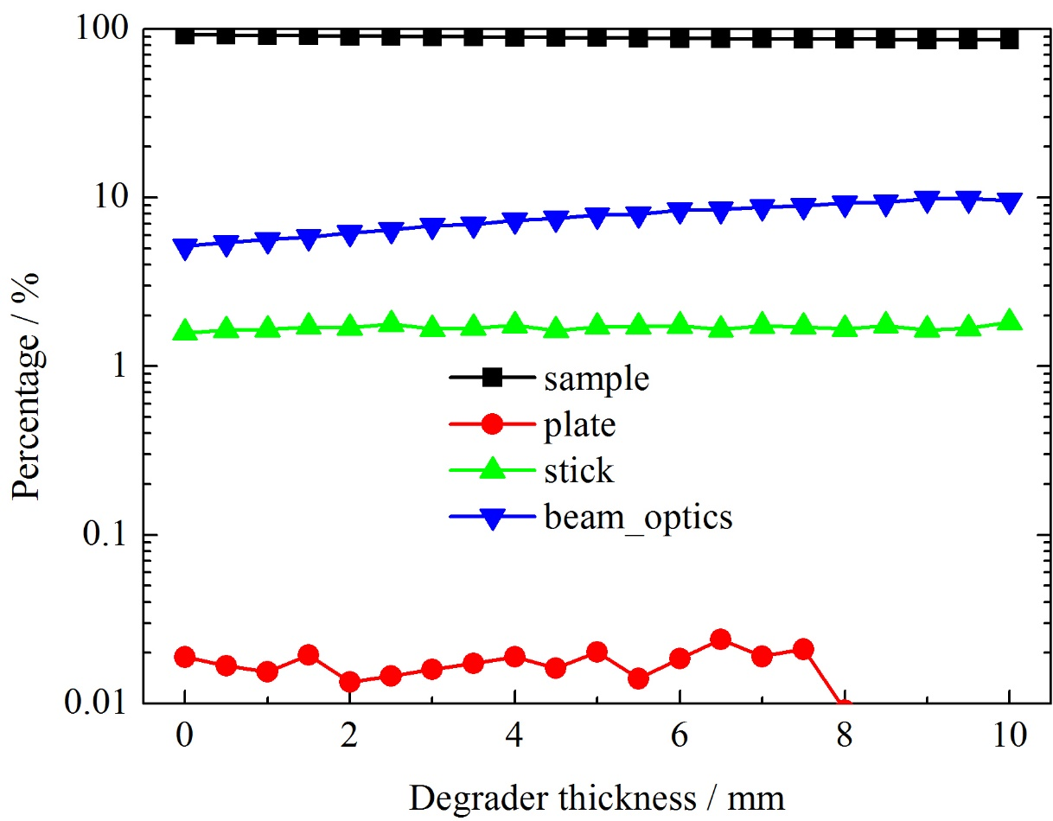
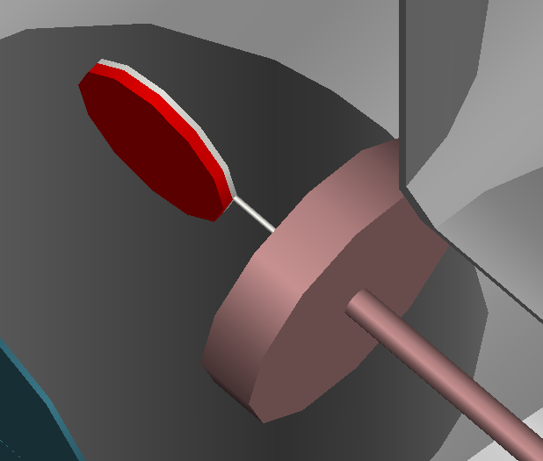
2 Designing and optimizing the Baby-muSR spectrometer
Four-ring structure:
Over 90% muons decay inside the sample.
Notes:
Let's look at the structure on the right. The graph On the right shows the structure of the sample environment. The sample will be cooled by CCR. on the path of the muons there is no block that most mouns can decay inside the sample. So we can see the fraction of muon decay site in the left that over 90 percent muons decay in the sample. We can do further optimization of the beam optics to let more muons decay in the sample.

Slide 19
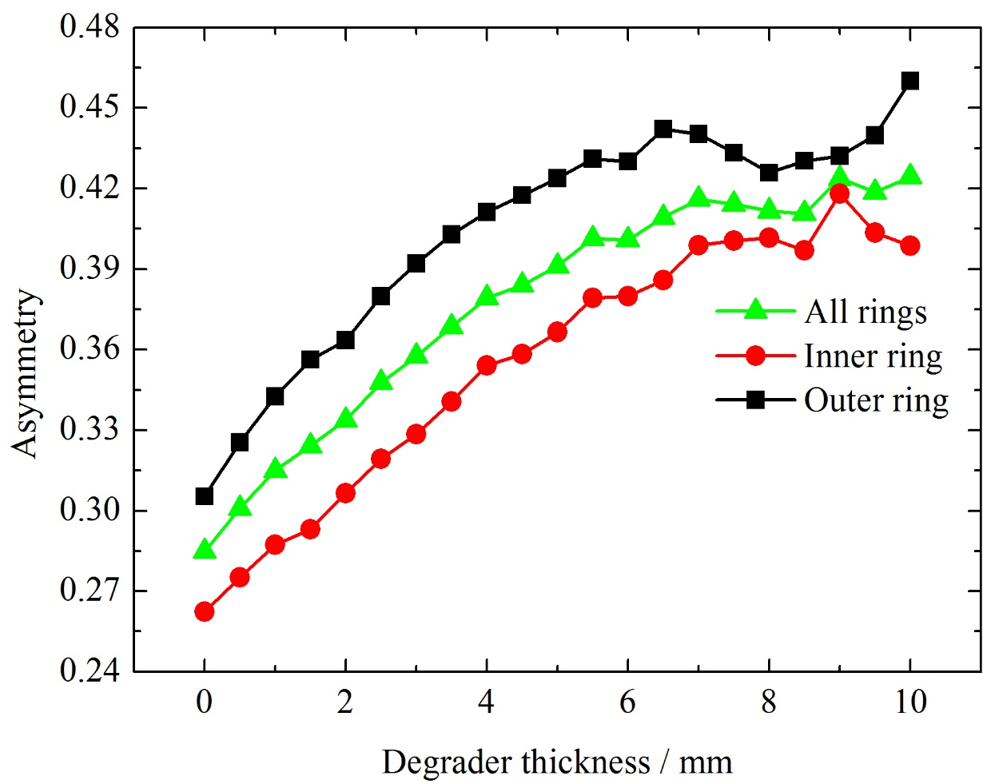
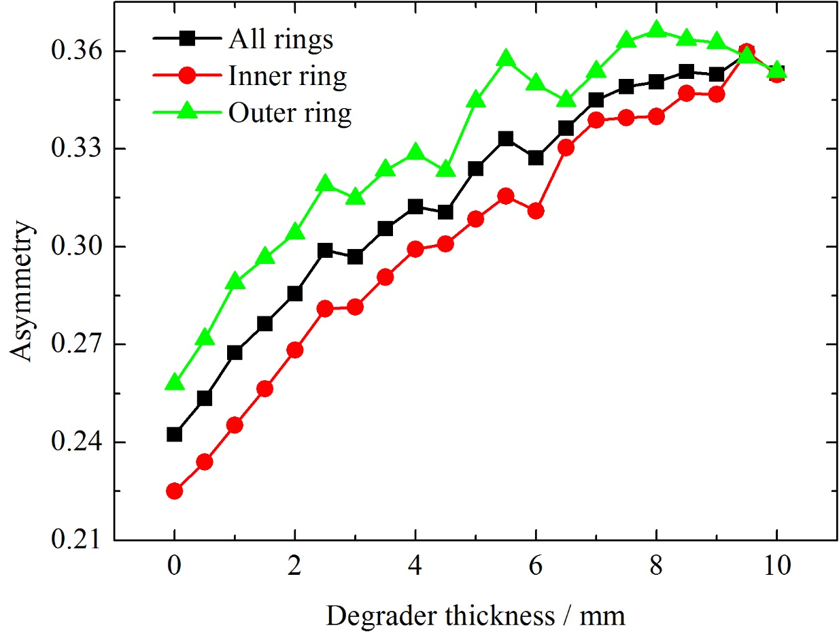
2 Designing and optimizing the Baby-muSR spectrometer
Four-ring structure:
ZF
TF
When the degrader thickness is over 7 mm, the asymmetry reaches the highest by ~ 0.44 (ZF).
The asymmetry of all rings is ~ 0.41.
Notes:
The asymmetries of two rings are shown here. The asymmetry in ZF is higher than that in TF. The asymmetry in the outer ring is higher. As I mentioned before, the asymmetry far from the sample is higher. We can see that when the degrader is over 7 mm, the asymmetry becomes stable and reaches the highest by 0.44. The overall asymmetry is also very high by around 0.41.

Slide 20
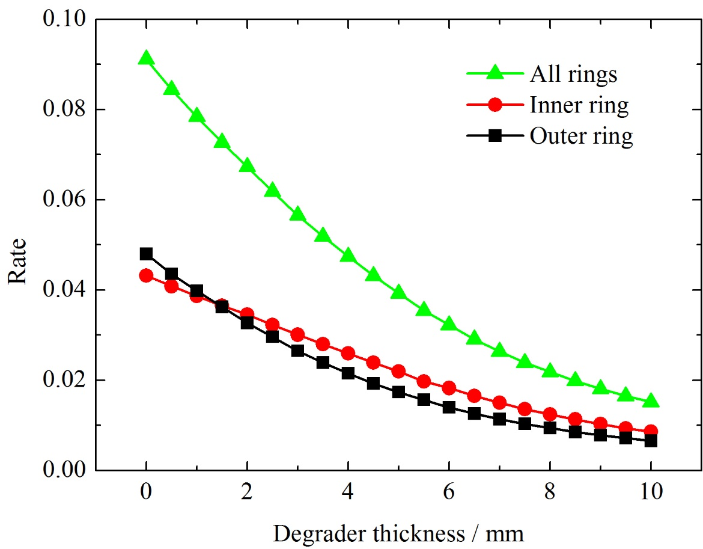
2 Designing and optimizing the Baby-muSR spectrometer
Four-ring structure:
 | Rate | Mean count rate (/frame/detector)
All rings | 0.0263 | 9.86
Inner ring | 0.0150 | 11.25
Outer ring | 0.010 | 8.25
Note: the degrader thickness = 7 mm;
the beam intensity = 1.2×10⁵ muons/s (2.5 Hz)
The detection rate of inner ring and outer ring are nearly the same!
The count rate of each ring is acceptable!
Notes:
Let's look at the rate of each ring. The count rate of each ring is very similar. This is because the covered solid angle is similar. The count rate of each ring is around 10 counts per detector per frame. I should say the count rate is acceptable.

Slide 21
2 Designing and optimizing the Baby-muSR spectrometer
Four-ring structure
Eight-ring structure
128-channel
256-channel
Radius: 95 mm (inner), 90 mm (outer)
Length: 40 mm (inner) 100 mm (outer)
Radius: 105 100 95 90 mm
Length: 25 40 70 100 mm
Notes:
The 128 channel is just a prototype. We can add more segments on it to get more positron event and inherit the high asymmetry. The sizes of four rings are optimized to cover the same solid angle as much as possible.

Slide 22
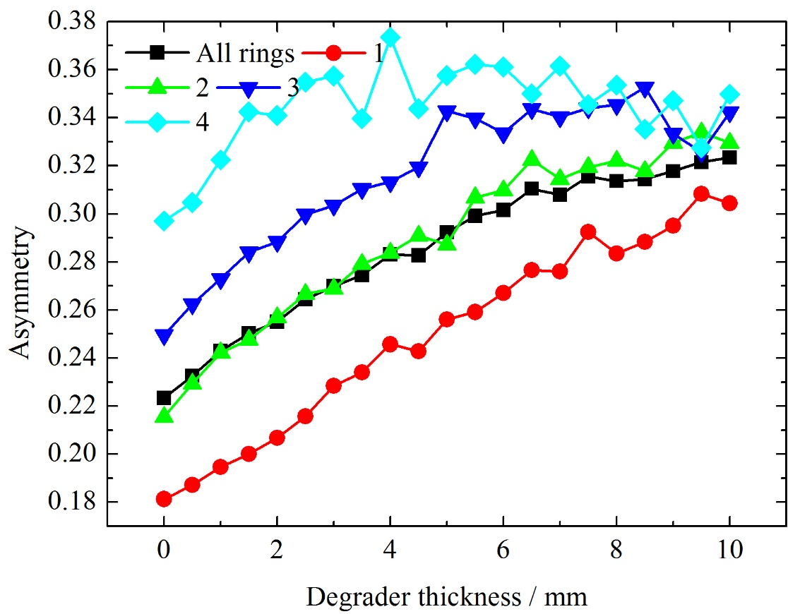
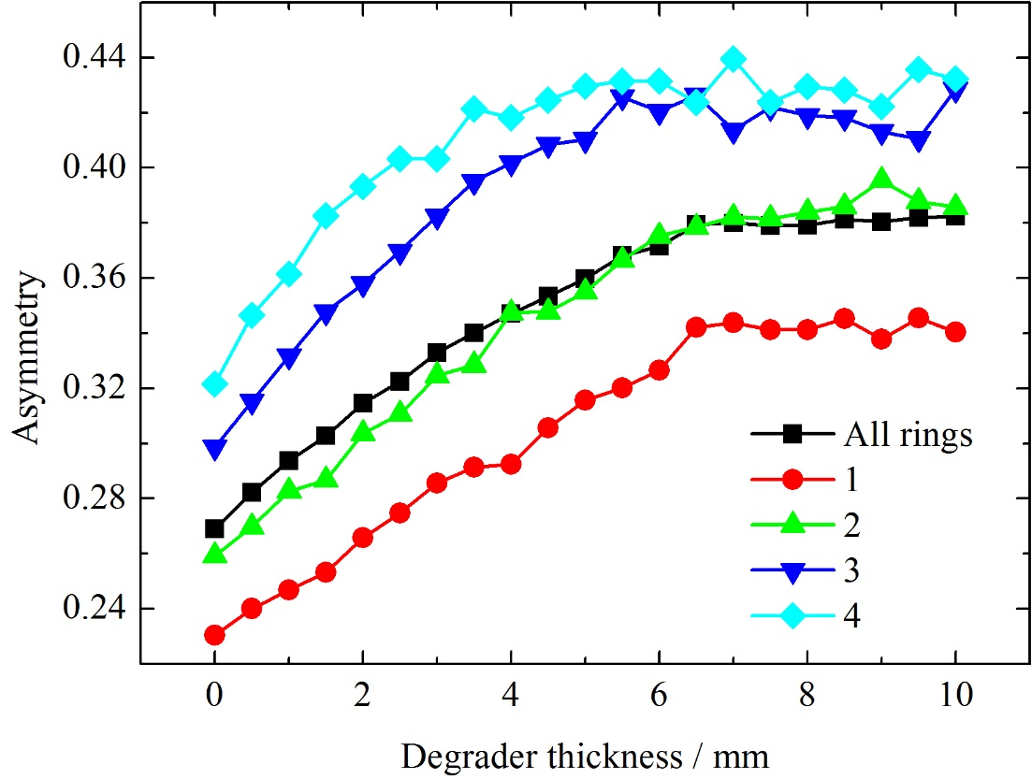
2 Designing and optimizing the Baby-muSR spectrometer
Eight-ring structure:
ZF
TF
When the degrader thickness is over 7 mm, the asymmetry reaches the highest by ~ 0.44 (ZF).
The third ring and fourth ting can be grouped together.
The asymmetry of all rings is ~ 0.38.
Notes:
Lets look at the asymmetry in each ring. The ring further away from the sample takes up high asymmetry.

Slide 23
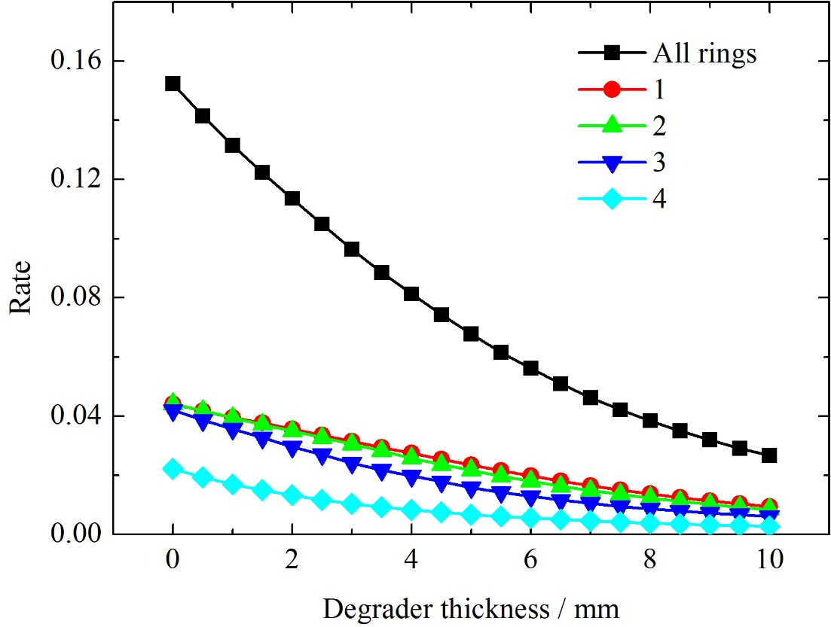
2 Designing and optimizing the Baby-muSR spectrometer
Eight-ring structure:
 | Rate | Mean count rate (/frame/detector)
All rings | 0.0462 | 6.77
First ring | 0.0164 | 9.61
Second ring | 0.0147 | 8.61
Third ring | 0.0106 | 6.21
Fourth ring | 0.0045 | 2.64
Note: the degrader thickness = 7 mm;
the beam intensity = 1.2×10⁵ muons/s (2.5 Hz)
The third and fourth ring have the highest asymmetry.
The detection rate of inner ring and outer ring are nearly the same!
The count rate of each ring is acceptable!

Slide 24
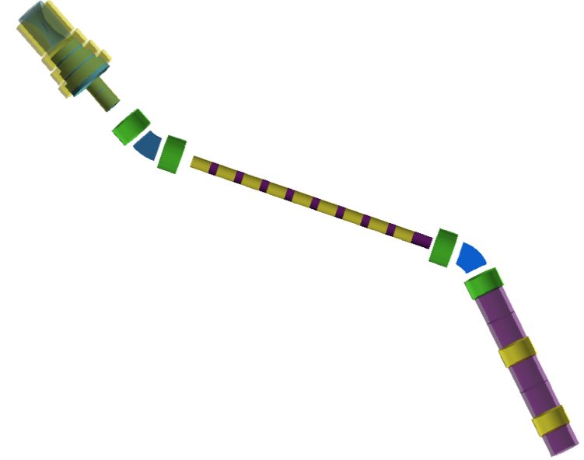
3 Conceptual design of Baseline-muSR spectrometer
Muon collection solenoid
Muon collection mode:
solenoid magnet collection
Beam intensity on sample:
~1.0×10⁶ muons/s (@2.5 Hz)
Beam size: Φ30 mm (FWHM)
Muon polarization: 75% (current simulation)
>80% (future optimization)
Asymmetry: ~ 0.3
Count rate per pulse per detector: ~10
Million event rate: > 100 Mevents/hour
Decay channel
Wien Filter
How can the spectrometer tolerate such high intensity?

Slide 25
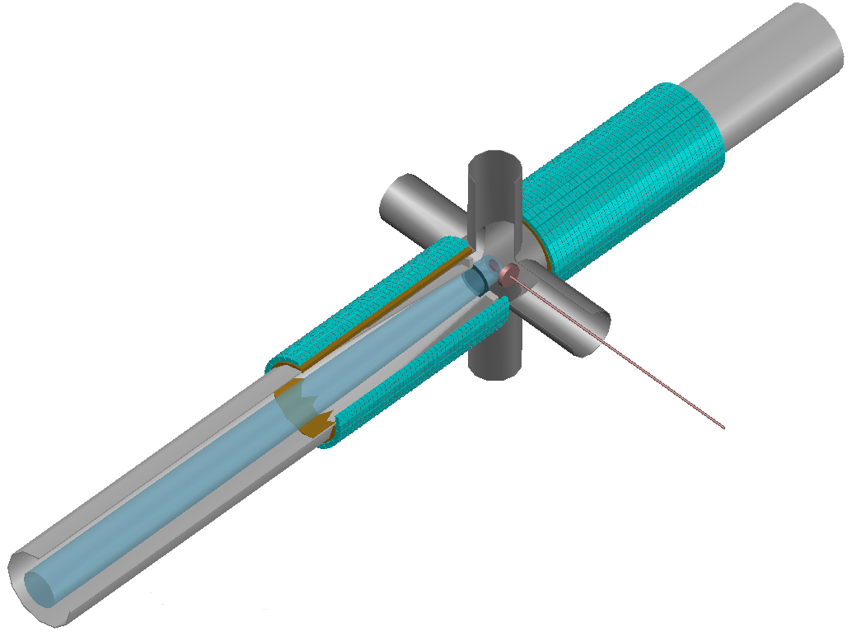
3 Conceptual design of Baseline-muSR spectrometer
X
x10 detector segments
x10 beam intensity
The 256-channel Baby-muSR spectrometer can accept 1.0×10⁵ muons/s.
The 2560-channel Baseline-muSR spectrometer

Slide 26
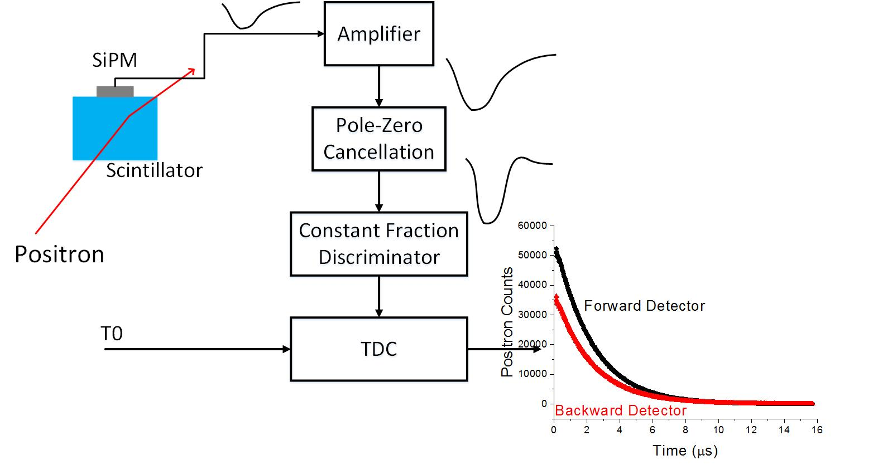
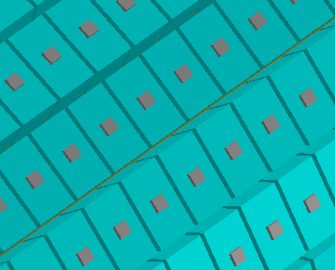
3 Conceptual design of Baseline-muSR spectrometer
Scintillator size: 10×10×18 mm
Arrangement: 32 / ring, 40 ring / bank
Cryogenics: CCR
Sample supporter: fly-past
Degrader: Brass
Signal processing:
Scintillator + SiPM
SiPM is just an option!

Slide 27
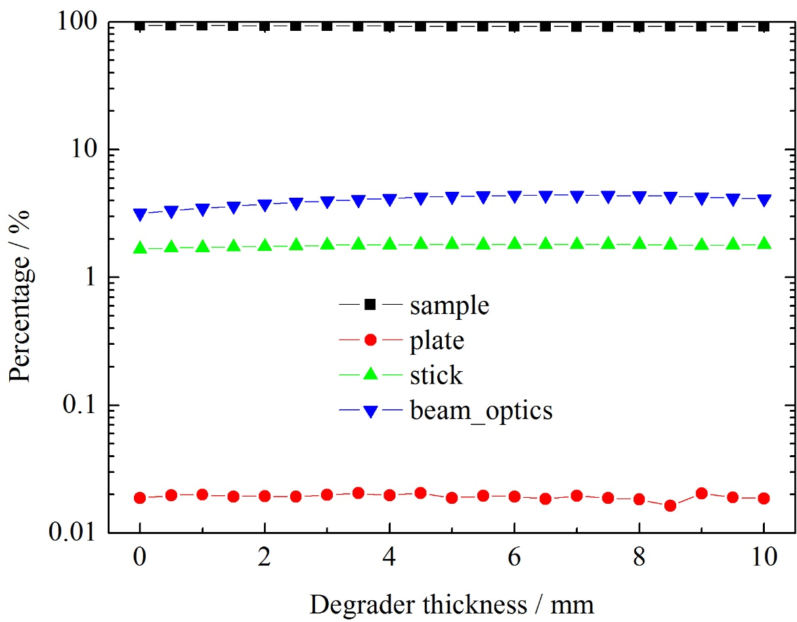
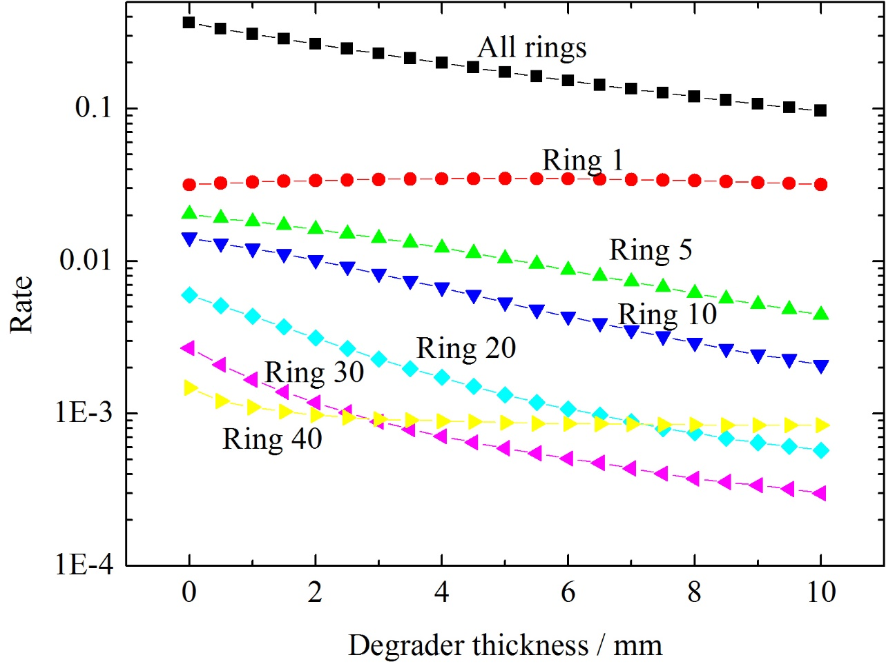
3 Conceptual design of Baseline-muSR spectrometer
Over 92% muons decay in sample! The degrader blocks positrons decaying from the beam pipe.
The overall rate is 0.135. The count rate per detector per frame is ~ 20. Further optimization is needed.
Notes:
The inner ring faces high count rate.

Slide 28
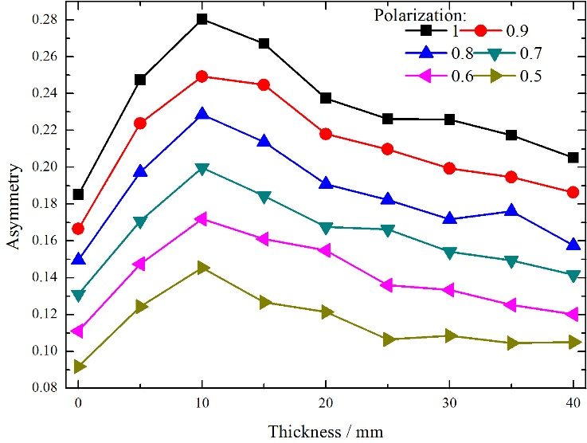
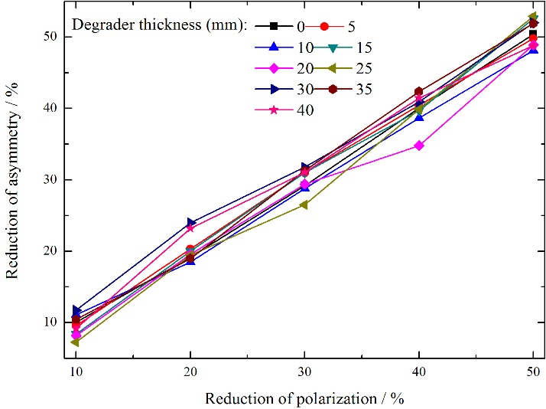
3 Conceptual design of Baseline-muSR spectrometer
Influence of polarization on asymmetry:
Note: the data are simulated by 128-channel muSR spectrometer.
Asymmetry ≈ A₀×Polarization

Slide 29
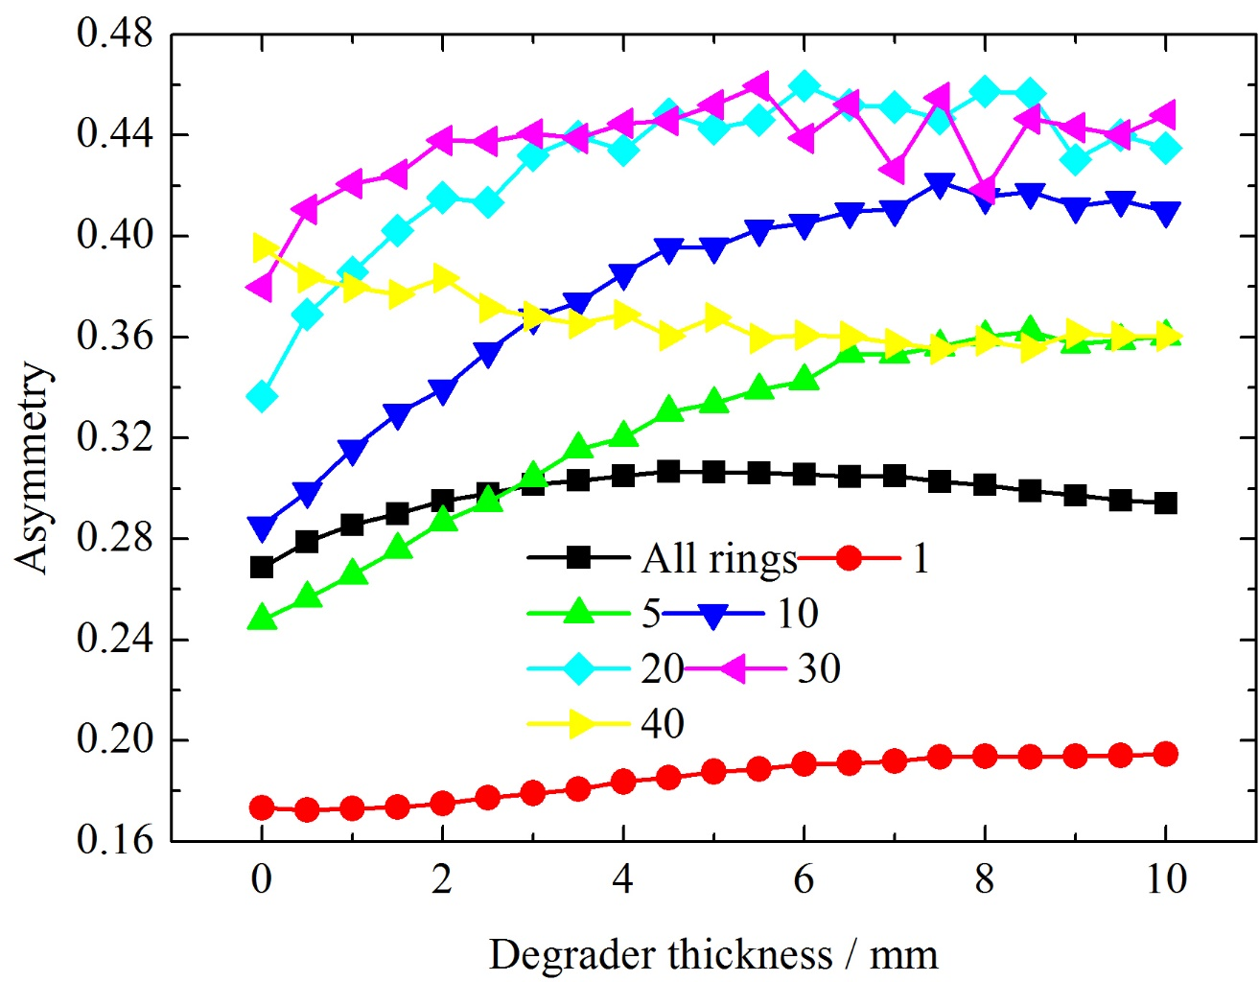
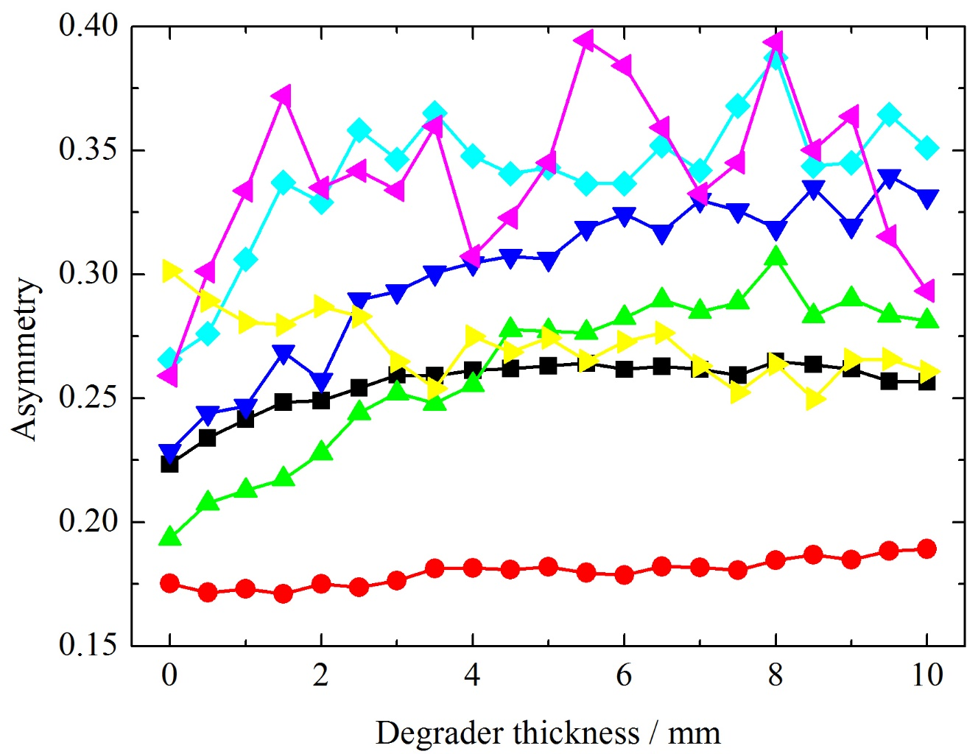
3 Conceptual design of Baseline-muSR spectrometer
ZF
TF
When the number of detector rings is over 10, the asymmetry becomes larger than 0.4.
We can group No. 10 – 40 together to get high asymmetry.
For the 80% polarization, we still have 0.44×0.8=0.35 asymmetry.

Slide 30
3 Conceptual design of Baseline-muSR spectrometer
Comparison between spectrometers:
 | 128-channel |  | 256-channel | 2560-channel
Number of rings | 2 | 4 | 8 | 80
LF (Gauss) | 300 |  | 3000 | 8000
Beam intensity (muons/s) | 1.2×10⁵ |  |  | ~1×10⁶
Beam spot (mm) | 30 (FWHM) |  |  | ?
Beam polarization | 92% |  |  | ~ 80%
Asymmetry | ~0.28 | ~0.44 | ~0.44 | ~0.35
Event rate (Mevents/hour) | 11.5 | 11.2 | 15.6 | > 100

Slide 31
4 Conclusions
The location of scintillators affects the asymmetry much.
Small radius of the detector ring takes large asymmetry.
Detectors far from the sample takes large asymmetry.
The beam spot is large (FWHM: Φ30 mm). Fly-past sample environment is needed.
The beam intensity of EMUS is very high. We can get high asymmetry (~0.44) by make full use of the beam intensity.
Although the event rate of 128- and 256-channel muSR spectrometer is low, the asymmetry is very high which can resolve the information of materials significantly.

Slide 32
4 Conclusions
The Baseline-muSR has 2560 segments. It can get high event rate (>100 MEv/h) and also high asymmetry in low beam repetition rate (2.5 Hz).
The SiPM with pole-zero cancellation circuit can cut the very slow signal (100 ~ 200 ns) to 10~20 ns. It is promising to be the detection sensor of the Baseline-muSR in the future.

Slide 33
THANKS

Slide 34
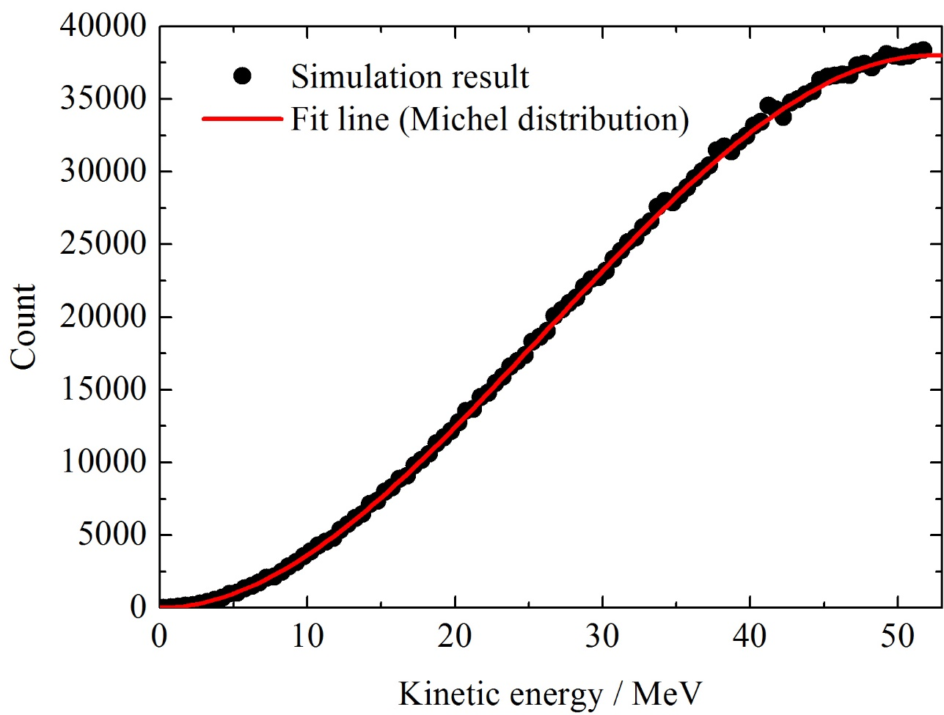
Appendix
Asymmetry VS energy / emission angle
Michel distribution:
99.99% positrons have the kinetic energy over 2 MeV! The mean energy is 36 MeV.

Slide 35
Appendix
Asymmetry VS energy / emission angle

Slide 36
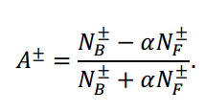
Appendix
Calculation of asymmetry
RAL Technician report: Monte Carlo simulations of the MuSR spectrometer at ISIS: current instrument and future designs

Slide 37
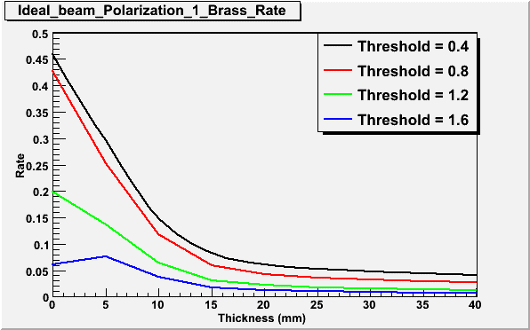
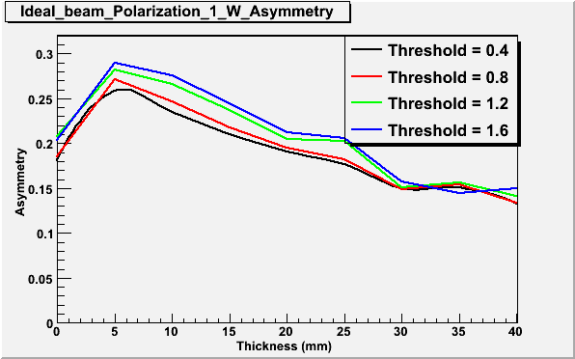
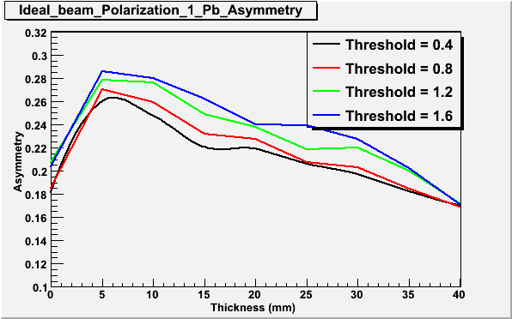
Appendix
Materials of degrader:
Tungsten
Brass
Lead

Slide 38
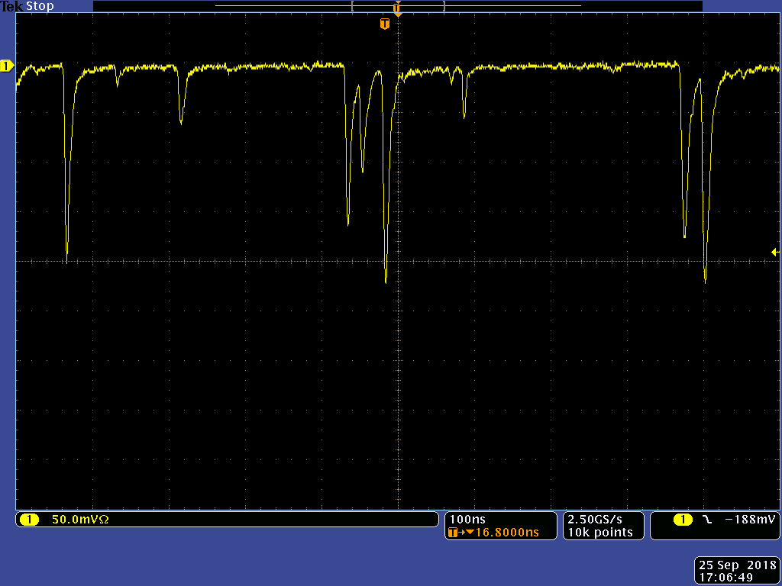
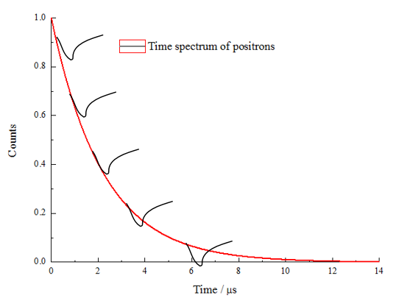
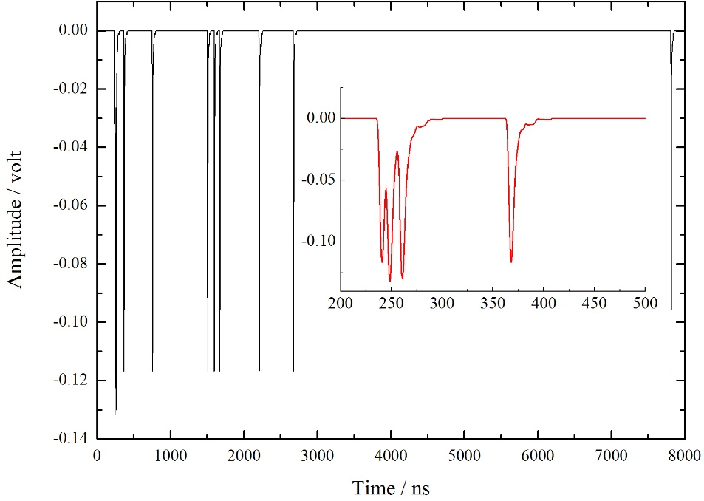
Appendix
Digitization method:
Hits on a detector per pulse frame
Experimental waveforms
Monte carlo simulation waveforms

Slide 39
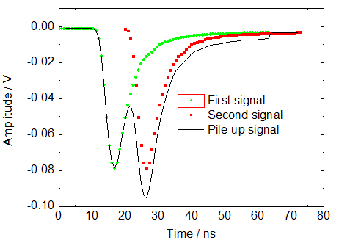
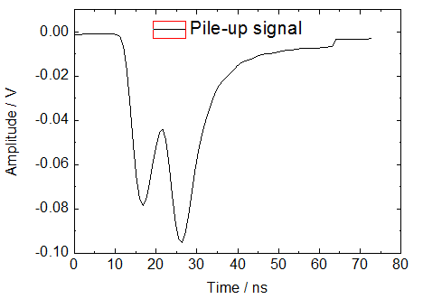
Appendix
Digitization method:
Off-line timing
Signal threshold
One positron is lost!
All positrons are recorded.

Slide 40
Appendix
SiPM signal shortening:
With Pole-Zero circuit
Fall time = 170 ns
Fall time = 15 ns

Slide 41
Appendix
Recovery of SiPM:
The recovery time depends on the model we use.
S10362-11-100U: 46 ns, S10352-11-050U: 11 ns, S10362-11-025U: 3.5 ns
Proceedings of the European Physical Society Conference on High Energy Physics (EPS-HEP2015). 22-29 July 2015
If(Photon number == Cell number)
All cells are fired;
The effective recovery time = Single cell recovery time;
If(Photon number < Cell number) // S13360-3050CS has 3600 cells
Few cells are fired;
Remained cells can be fired by sebquent events;
The effective recovery time < Single cell recovery time;

