Slide 1
Room Temperature Surface Muon Beam line at EMuS
China Spallation Neutron Source
Luping Zhou
2018/11/21

Slide 2
Outline
1. Overview
Current international muon beam line for μSR experiments
2. Design of baby-scheme muon beam line
  Optical design
  Multi-particle simulation without momentum spread
  Multi-particle simulation using the beam from the proton bombardment on target
3. Vertical muon beam line design(Baseline)
  Optical design
  Multi-particle simulation without momentum spread

Slide 3
Overview

Slide 4
Muon Beams Worldwide
Performance of different room temperature muon beam line:
 | Surface muon beamline | Magnitude of flux | Beam spot | Contamination | Momentum distribution
J-PARC, MUCE | D-line，S-line | 1.0E+07 | 30mm(H)*40mm(V) | -- | ~15%
ISIS muon facility | ISIS-Emu | 1E+06 | 10~30mm(H)*10mm(V) | e+/μ+<0.15 | 7%, centered at 27MeV/c
 | RIKEN-port2 | 1E+06 | Ø10~50,adjustable | --
PSI-SμS | πE3 | 1.0E+07 | 15mm(H)*30mm(V) | e+/μ+：1%~2% | 8%,centered at 28MeV/c
 | μE4 | 1.0E+08 | 25mm(H)*35mm(V) (WSX-off) | e+/μ+：1% | 1.8%~11%
TRIUMF-CMMS | M13 | 1.0E+05 | 30mm(H)*20mm(V) | -- | 20~30MeV/c
 | M15 | 1.0E+06 | 12mm(H)*16mm(V) | -- | 19~40MeV/c
Our Goal: Limited by cost, proton beam power and space, however we still expect to have at least 1.0E+05/s $μ^{+}$rate with a proper beam spot, low contamination and high polarization

Slide 5
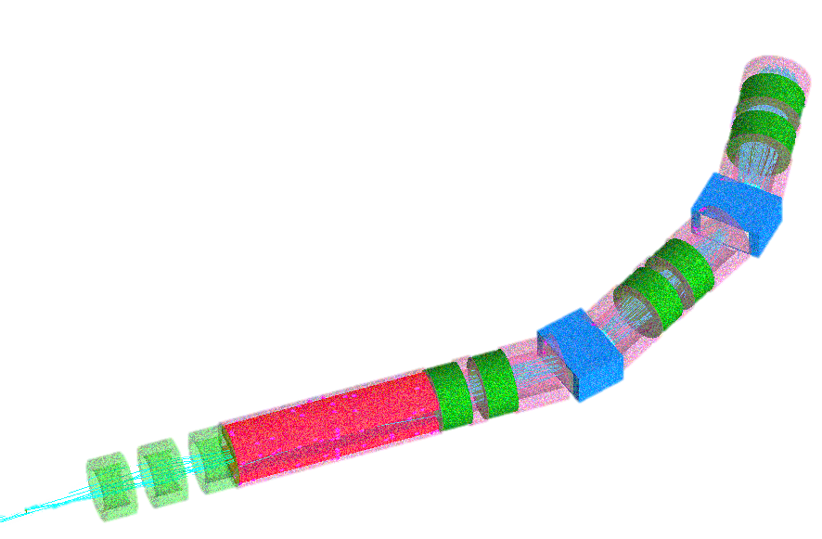
Design of Baby-Scheme
Muon Beam-line

Slide 6
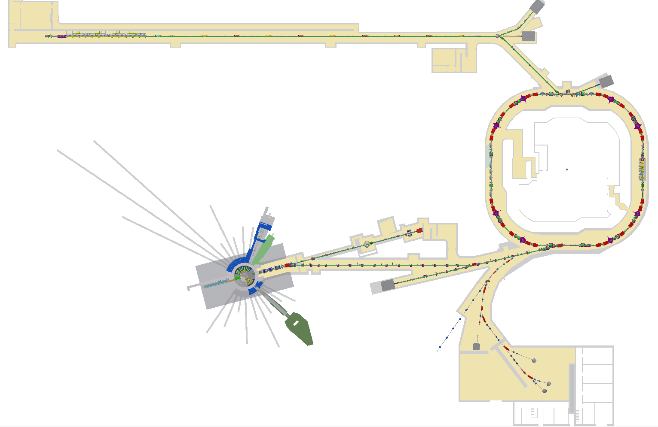
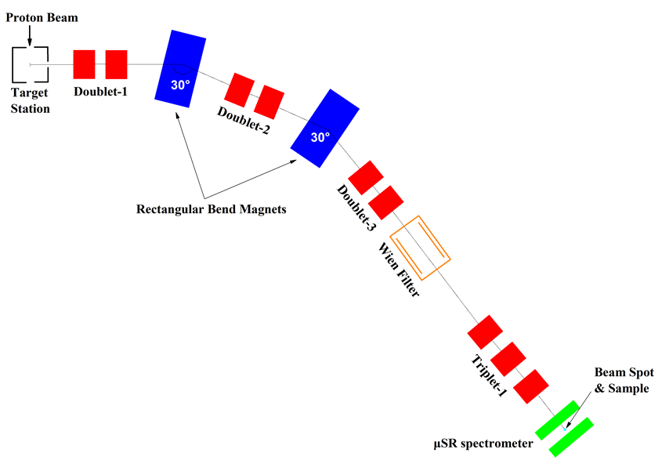
Beam Line Scheme
Baby-scheme muon beam line design
A simplified muon beam called ‘Baby-scheme muon’ will be located at High-energy Proton Experimental Area(HPEA)
Notes:
换图

Slide 7
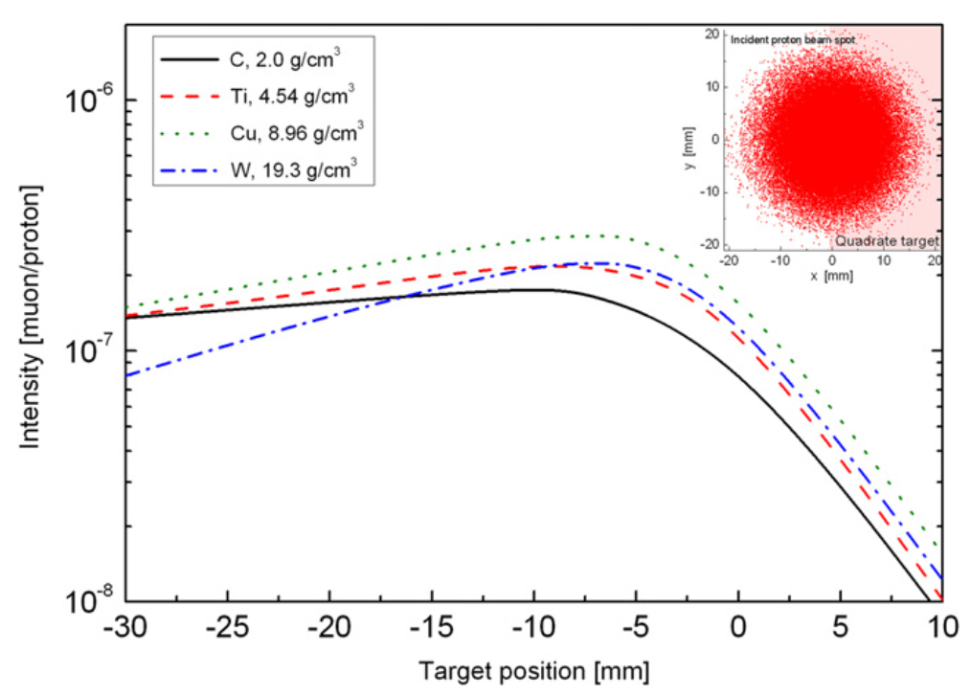
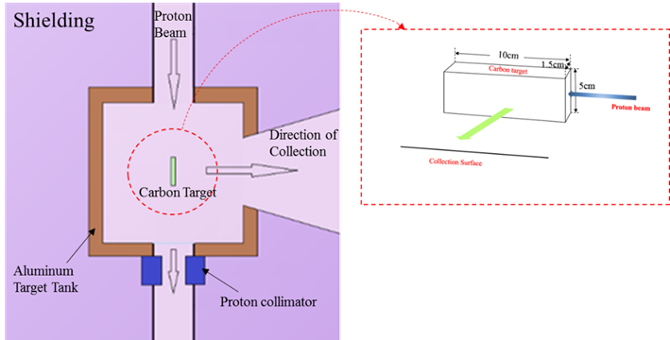
Target
According to previous research, a graphite target with a size of 10(L)*5(H)*1.5(W) was used to obtaining a higher production of surface muon
*Use a thick target to compensate for the low surface production due to low- power proton beam(5kW)
Surface muon yields for different target materials from a collector at 60 cm from the left lateral side of target vs. positions of the left edge of target relative to the beam axis.*
Baby-scheme target station
*Jing H T, Meng C, Tang J Y, et al. Production target and muon collection studies for an experimental muon source at CSNS[J]. Nuclear Inst & Methods in Physics Research A, 2012, 684(684):109-116.

Slide 8
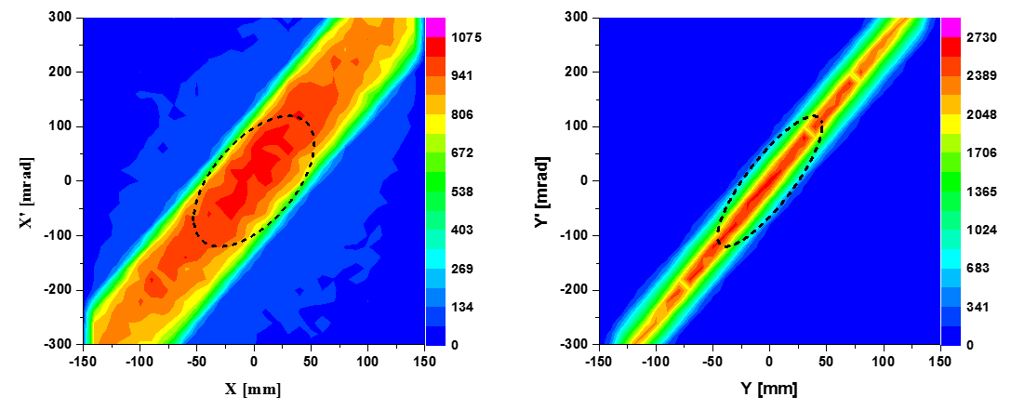
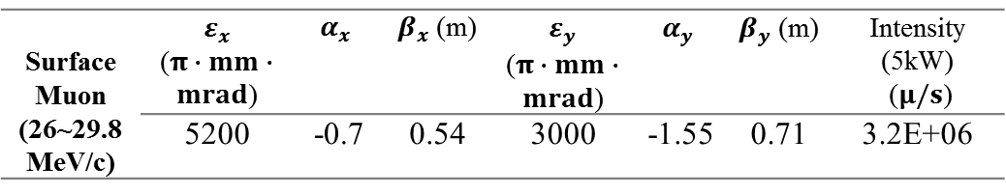
Primary Surface Muon Distribution
TWISS parameters of entrance are decided by the phase ellipses
Phase map at 0.4m from the surface of target
approximately uniform distribution
Emittance ellipse decided by:
Maximum envelop: the ‘band’ width
Maximum divergence: ~120mrad
Surface Muon (26~29.8MeV/c) | $ε_{x}$ ($π∙mm∙mrad$) | $$α_{x}$$ | $β_{x}$ (m) | $ε_{y}$ ($π∙mm∙mrad$) | $$α_{y}$$ | $β_{y}$ (m) | Intensity (5kW) ($μ/s$)
 | 5200 | -0.7 | 0.54 | 3000 | -1.55 | 0.71 | 3.2E+06
Notes:
表格标题栏调大

Slide 9
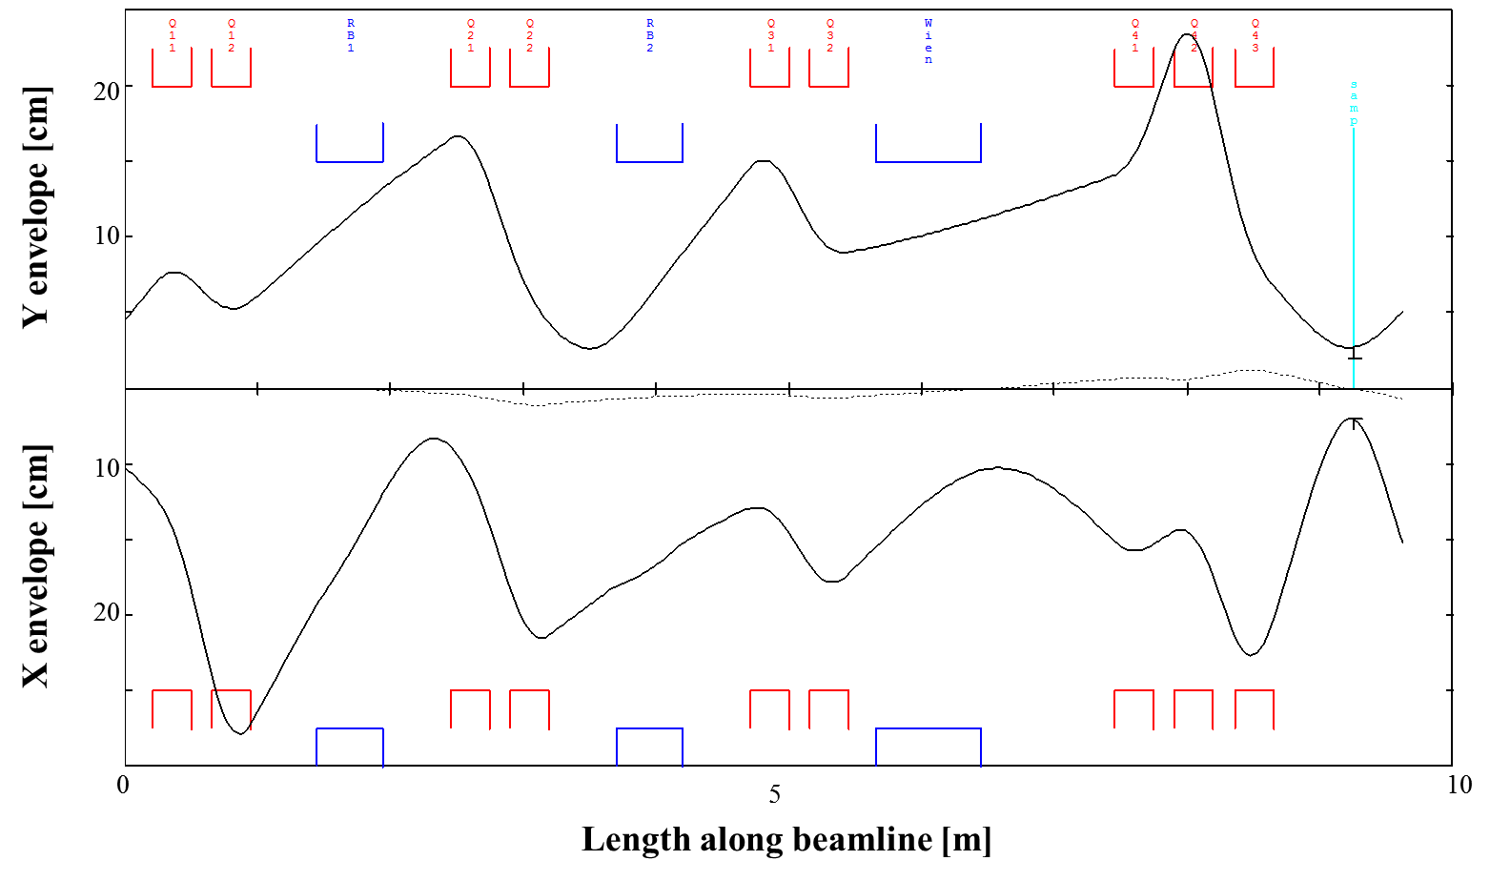
Optical Design
Using Graphic TRANSPORT to obtain approximate data of the lattice parameters of beam line

Slide 10
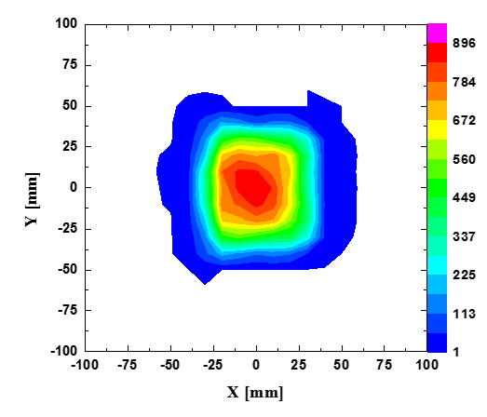
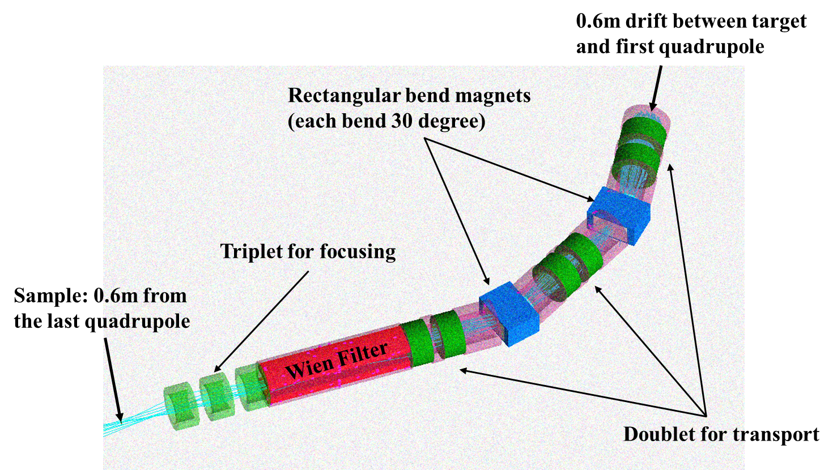
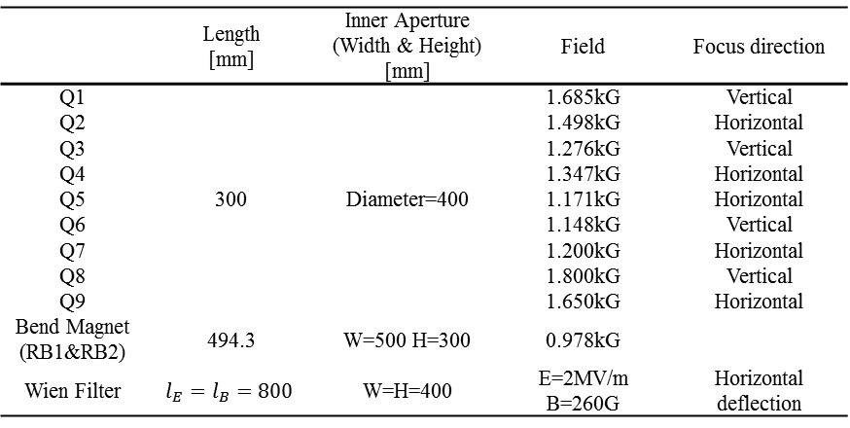
Parameter Optimization
Optimized partial magnet parameters in multi-particle simulation(G4beamline), even the fringe field is included.
Resultant lattice parameters of iterative optimization.
A K-V distribution similar to the surface muon from target is used as a primary test beam
 | Length [mm] | Inner Aperture (Width & Height) [mm] | Field | Focus direction
Q1 | 300 | Diameter=400 | 1.685kG | Vertical
Q2 |  |  | 1.498kG | Horizontal
Q3 |  |  | 1.276kG | Vertical
Q4 |  |  | 1.347kG | Horizontal
Q5 |  |  | 1.171kG | Horizontal
Q6 |  |  | 1.148kG | Vertical
Q7 |  |  | 1.200kG | Horizontal
Q8 |  |  | 1.800kG | Vertical
Q9 |  |  | 1.650kG | Horizontal
Bend Magnet (RB1&RB2) | 494.3 | W=500 H=300 | 0.978kG
Wien Filter | $$l_{E}=l_{B}=800$$ | W=H=400 | E=2MV/m B=260G | Horizontal deflection

Slide 11
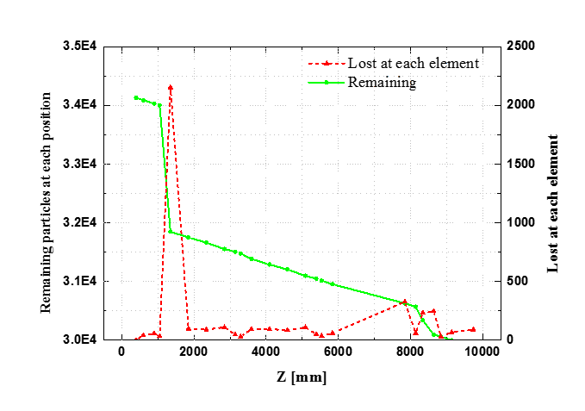

Beam Loss
Using K-V distribution particles without momentum spread, a 88% transmission efficiency is presented

Slide 12
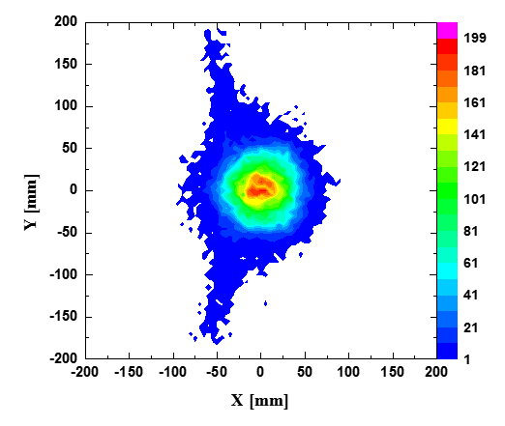
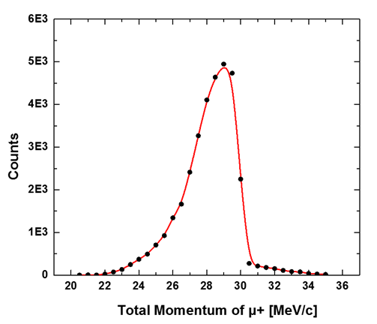
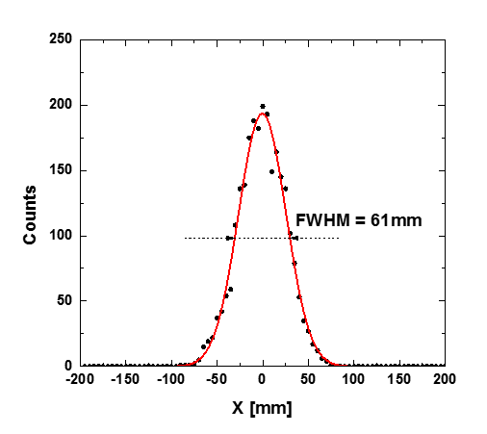
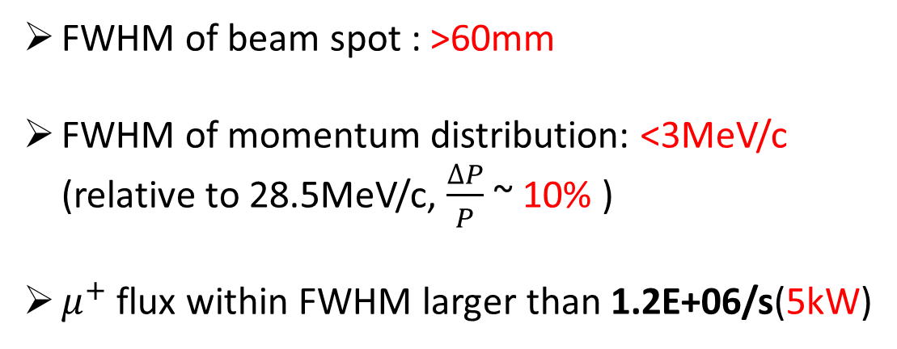
Simulation Using Beam from Target
FWHM of beam spot : >60mm
FWHM of momentum distribution: <3MeV/c (relative to 28.5MeV/c, $\frac{∆P}{P}$ ~ 10% )
$μ^{+}$ flux within FWHM larger than 1.2E+06/s(5kW)
Momentum spectrum
Profile of beam spot when Y=0 or X=0

Slide 13
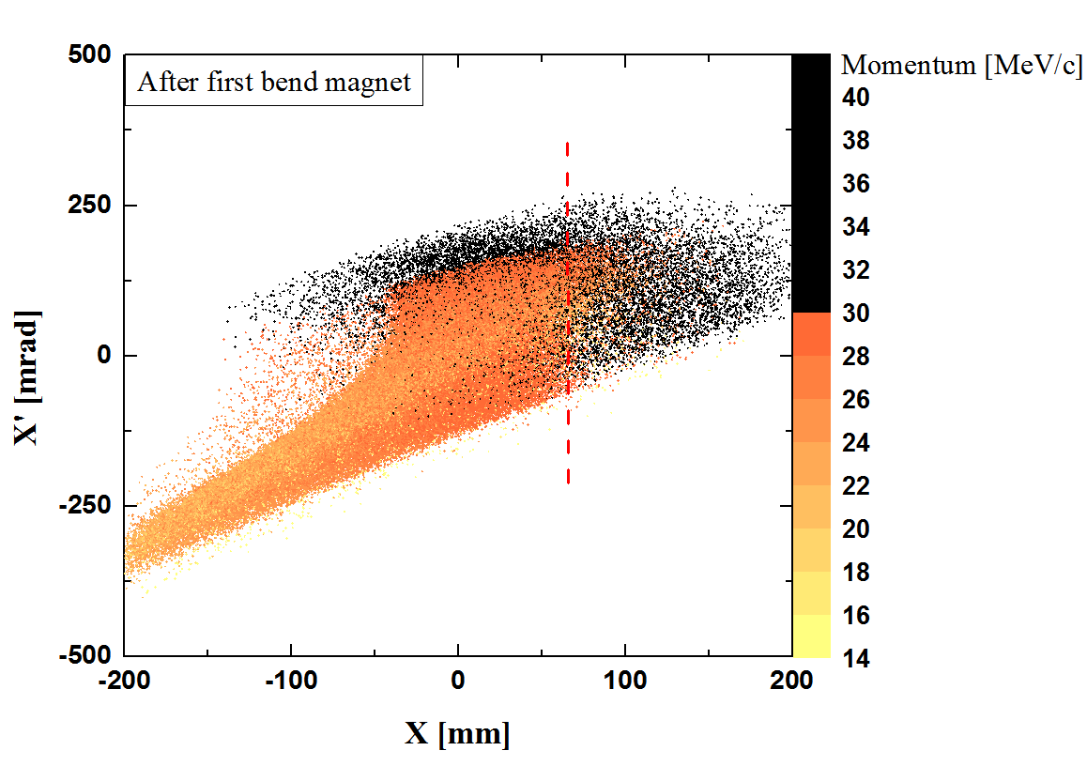
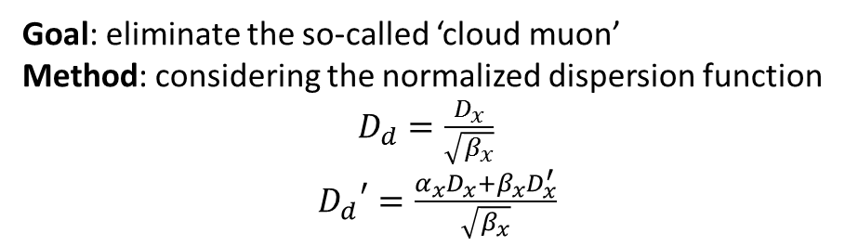
Collimation 1
Momentum Collimation
Goal: eliminate the so-called ‘cloud muon’
Method: considering the normalized dispersion function
$D_{d}=\frac{D_{x}}{\sqrt{β_{x}}}$
${D_{d}}^{′}=\frac{α_{x}D_{x}+β_{x}D_{x}^{′}}{\sqrt{β_{x}}}$
By collimation, a fraction of 10% cloud muon in beam spot reserved
Pol-Z about -0.92

Slide 14
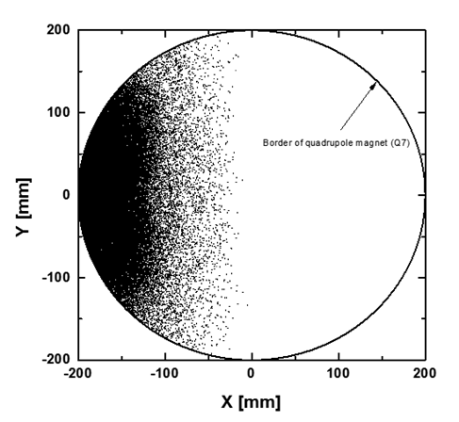
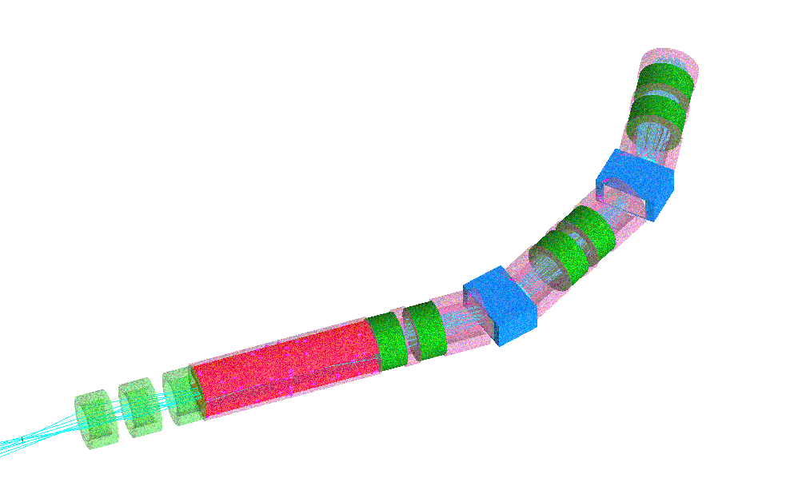


Collimation 2
Removal of positrons
Goal: eliminate the positrons contaminating in the muon beam
Method: ‘Wien Filter’+ a collimator
$φ_{E}(mrad)=l_{E}(m)∙\frac{E(kV/m)}{βp(MeV/c)}$
$φ_{B}(mrad)={30l}_{B}(m)∙\frac{B(G)}{p(MeV/c)}$ *
However, limited by the space after the wien filter, a collimator is placed before next quadrupole to eliminate the positrons
Location of wien filter
*Prokscha T, Morenzoni E, Deiters K, et al. The new μE4 beam at PSI: A hybrid-type large acceptance channel for the generation of a high intensity surface-muon beam[J]. Nuclear Inst & Methods in Physics Research A, 2008, 595(2):317-331.

Slide 15
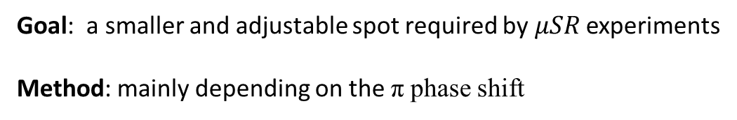
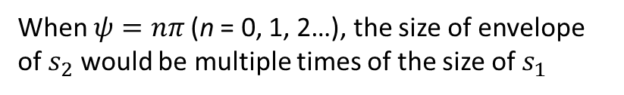
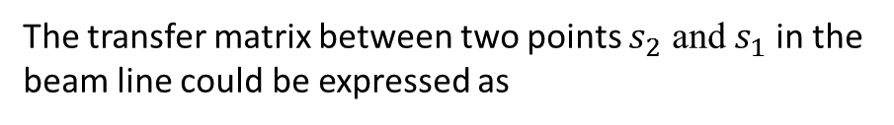
Collimation 3
Shrink beam spot by slits
Goal: a smaller and adjustable spot required by $μSR$ experiments
Method: mainly depending on the π phase shift
The transfer matrix between two points $s_{2}$ and $s_{1}$ in the beam line could be expressed as
When $ψ=nπ$ (n = 0, 1, 2…), the size of envelope of $s_{2}$ would be multiple times of the size of $s_{1}$
 | Z Position | Slit Width | Collimation Direction
Slit-1 | 3970mm | 50mm | vertical
Slit-2 | 6620mm | 80mm | horizontal
Slit-3 | 7839mm | 100mm(Horizontal) &60mm(Vertical) | horizontal &vertical
Non-effective for particles influenced by nonlinear effect

Slide 16
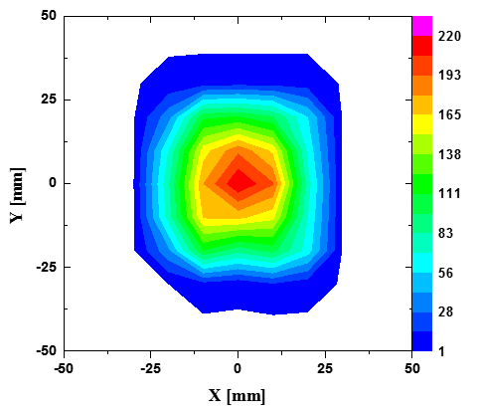
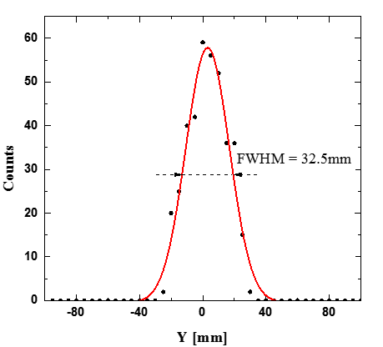
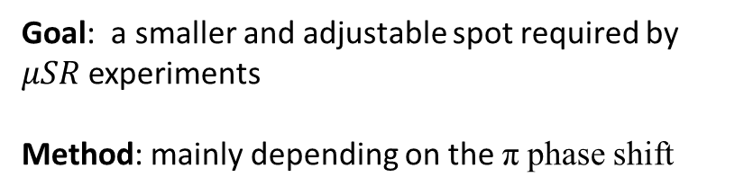
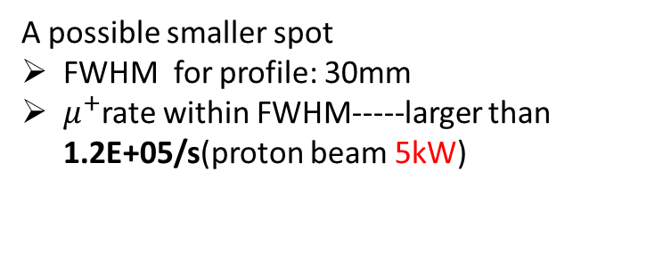
Collimation 3
Shrink beam spot by slits
Goal: a smaller and adjustable spot required by $μSR$ experiments
Method: mainly depending on the π phase shift
A possible smaller spot
FWHM for profile: 30mm
$μ^{+}$rate within FWHM-----larger than 1.2E+05/s(proton beam 5kW)
Notes:
按collimation1改

Slide 17
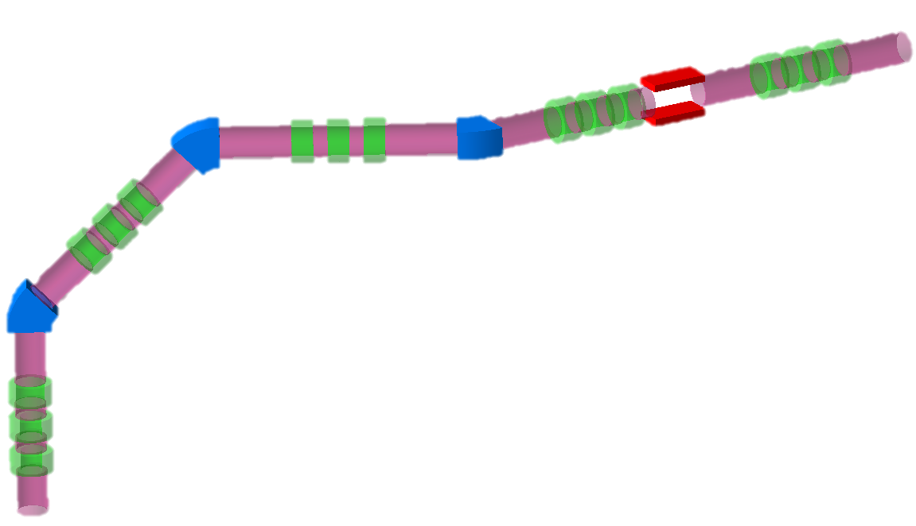
Vertical Muon Beam Line Design (Baseline)

Slide 18
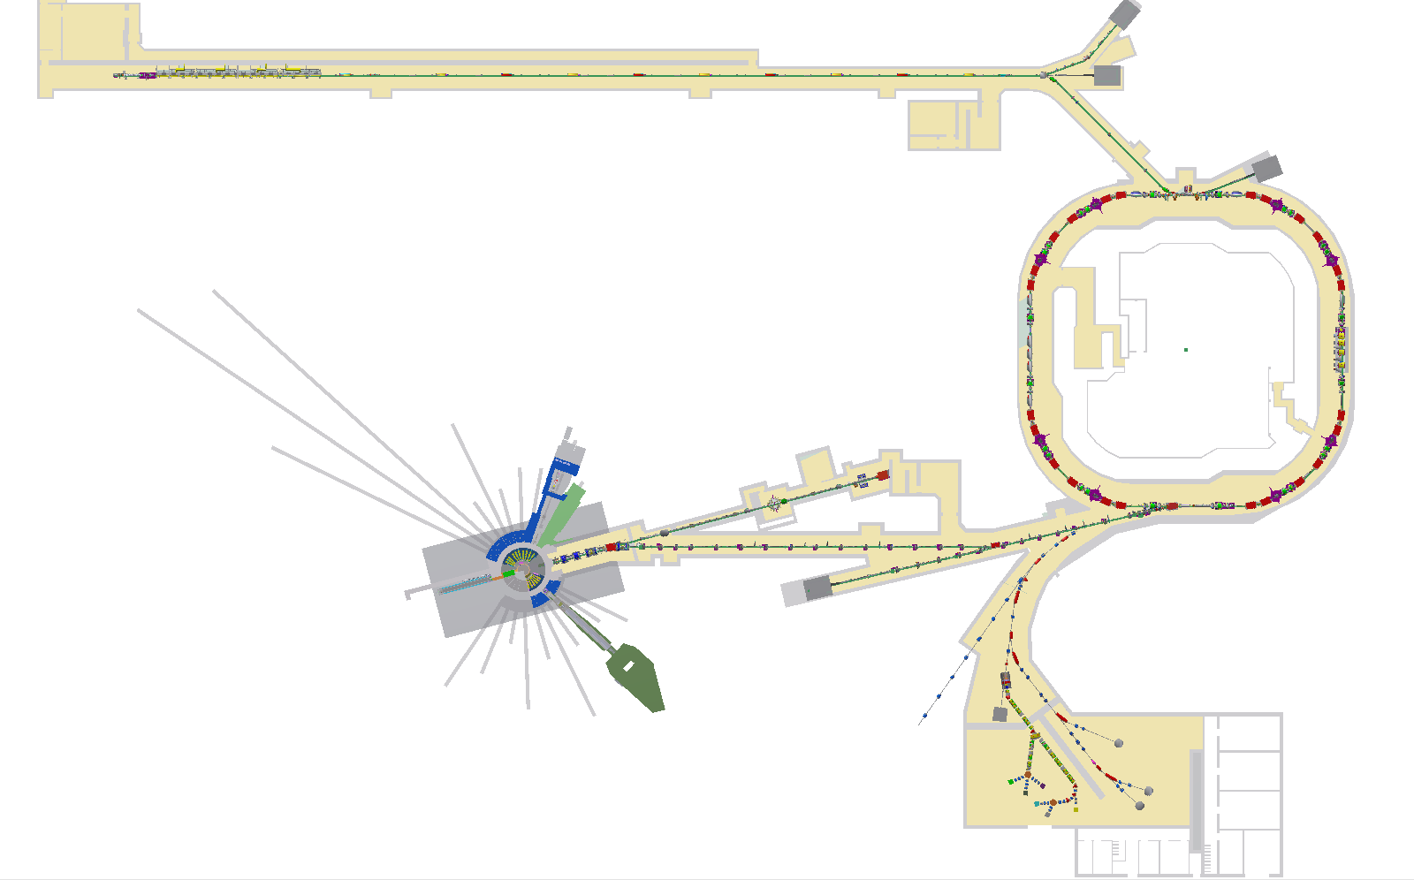
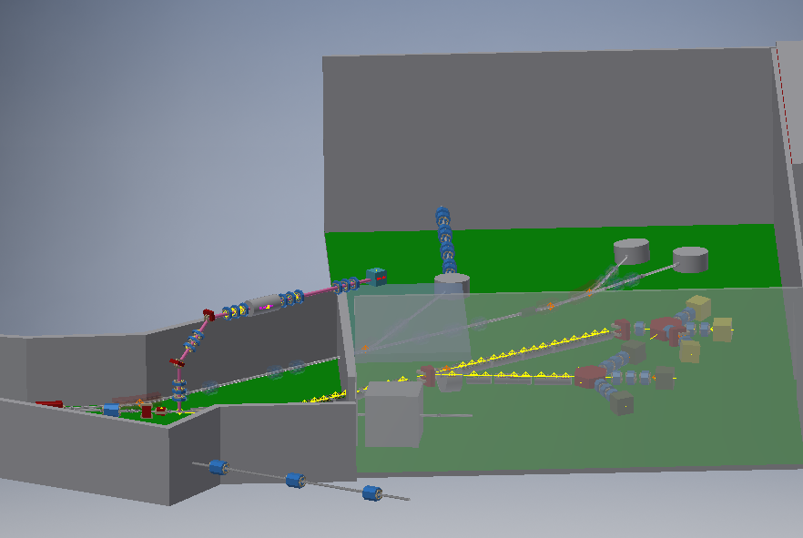
Scheme
Baseline-scheme design
Vertical conventional surface beam with a thin target
SC solenoidal muon beam line
Vertical Beam Line
Notes:
图墙删掉，看竖直的立体关系

Slide 19
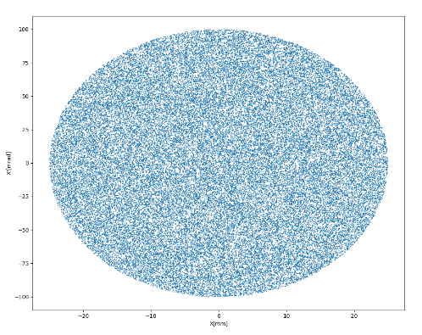
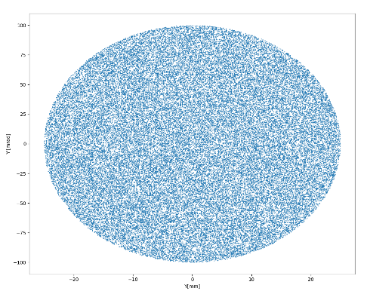
Primary Surface Muon Distribution
For a thin target with an equivalent thickness of 1 cm, the maximum envelop is 25mm according to the point A and B in the surface muon phase map
A K-V distributed particles with maximum envelop=25mm and maximum divergence=100mrad was used for test
Phase map at 30cm from the surface of target

Slide 20
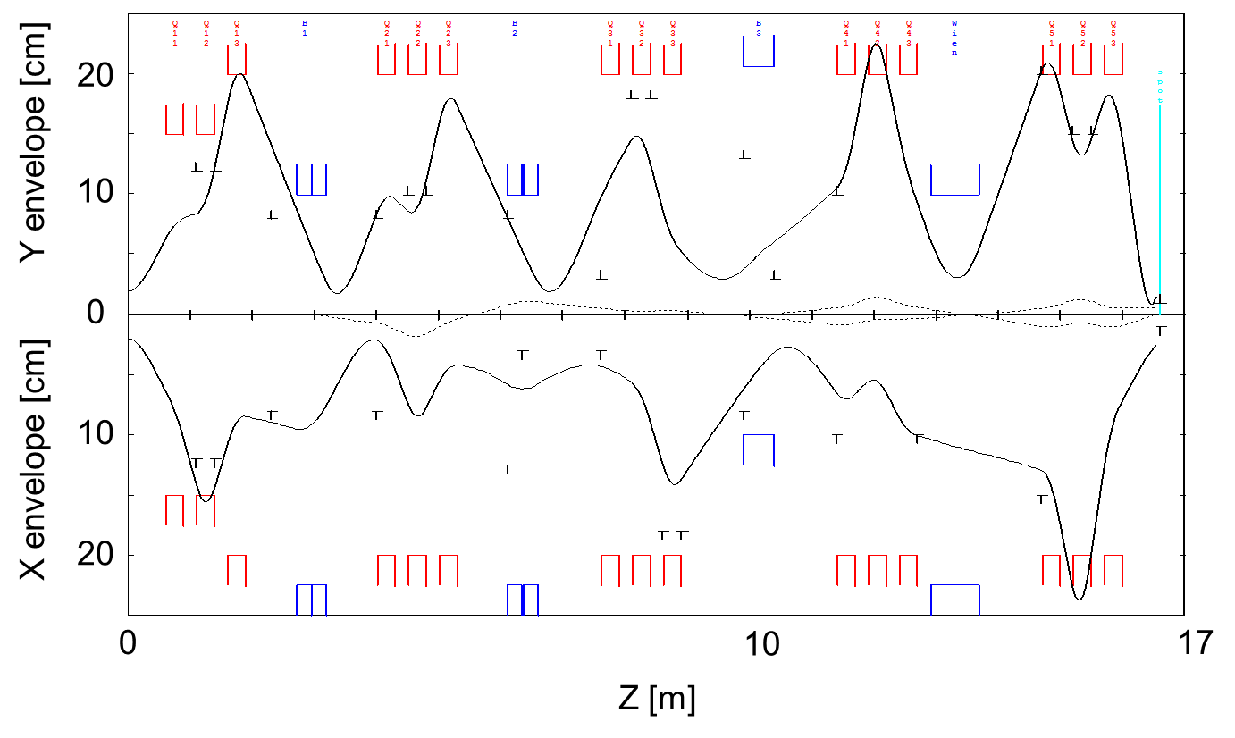
Optical Design
Linear optics was done by using GRAPHIC TRANSPORT
Limited by space, 300mm diameter of first two quadrupoles is used.
Horizontal and vertical dipoles are used to obtained a better momentum collimation

Slide 21
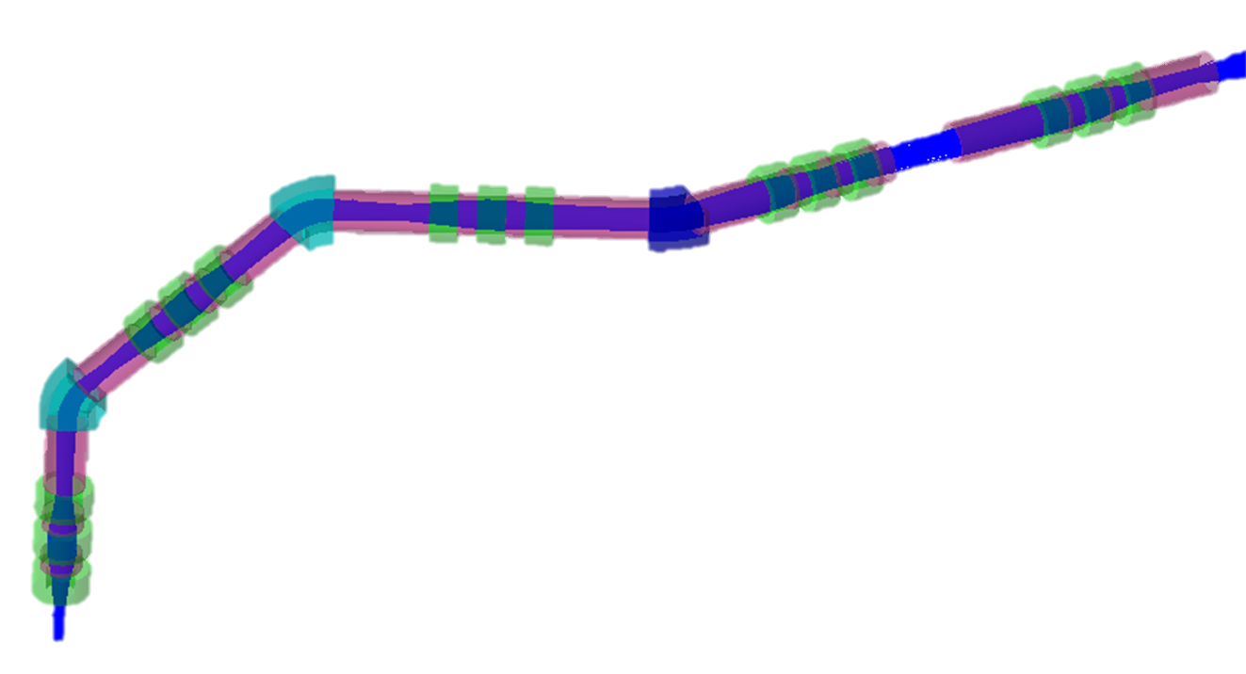
Multi-particle Transmission Using K-V Distribution
The multi-particle simulation was done by using G4beamline. All the magnets and tubs are slightly adjusted for a better performance
Transport efficiency:84%
Bending on both transverse direction for a better momentum collimation
Triplet, once used in baby-scheme muon beam

Slide 22
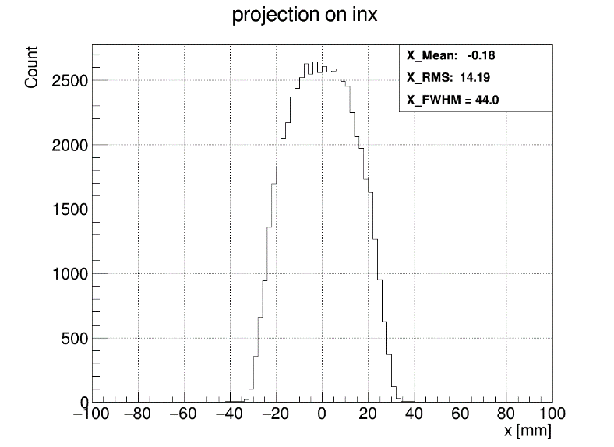
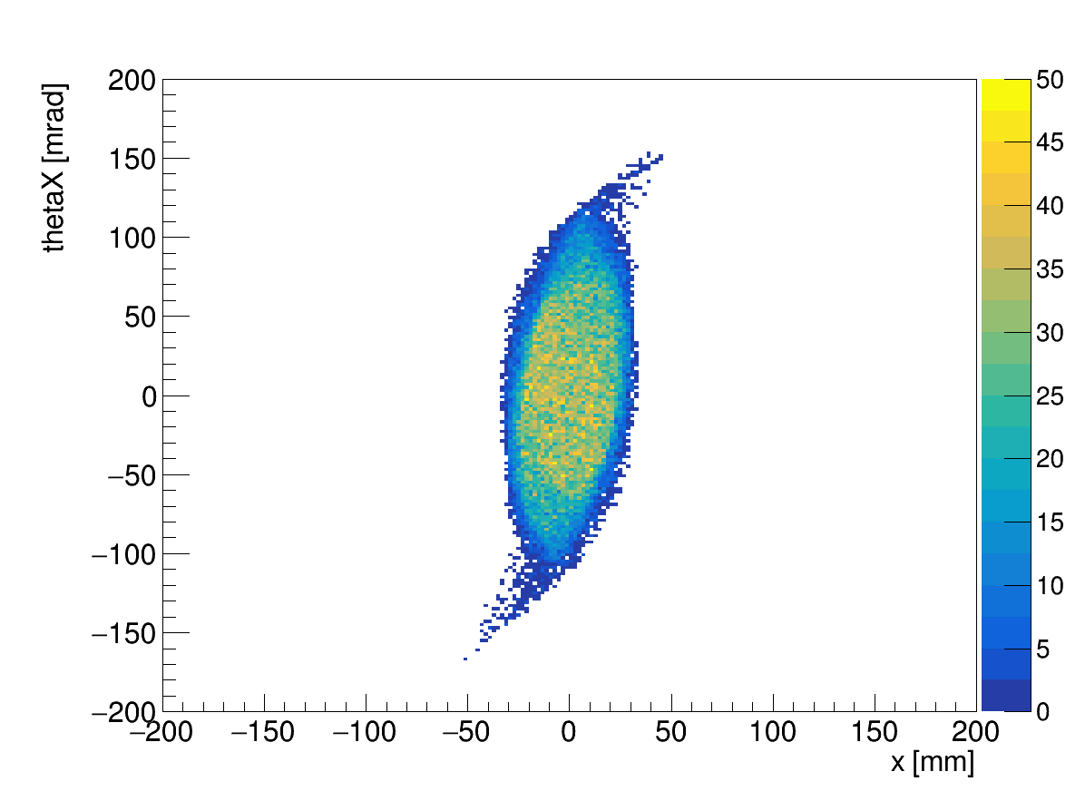
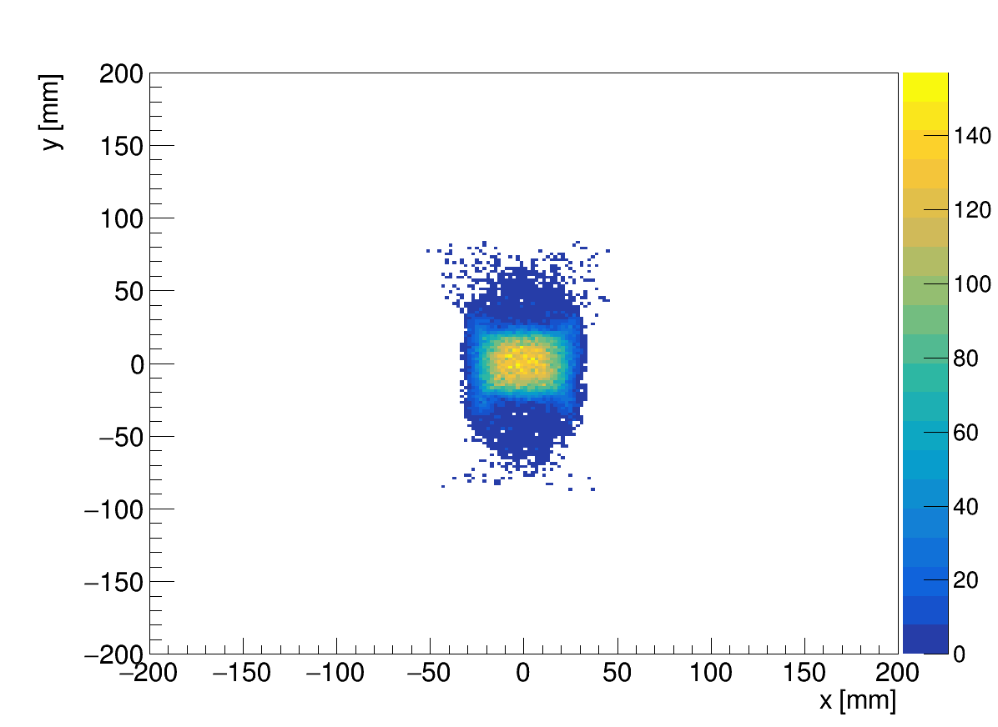
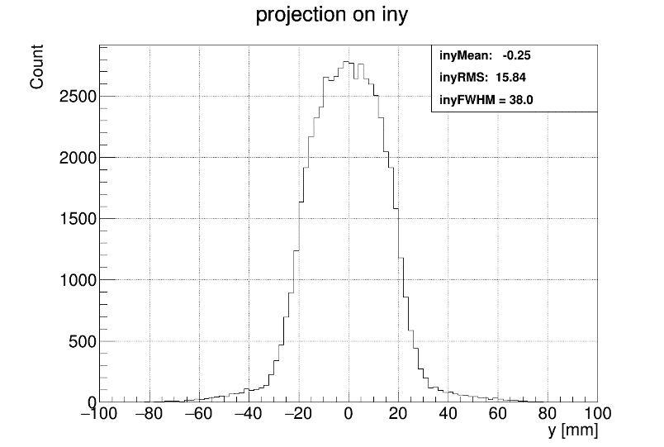
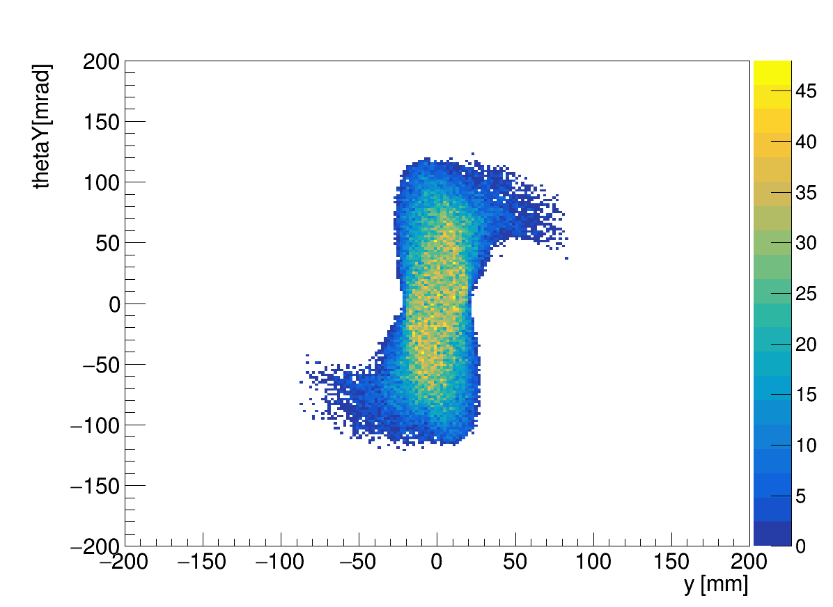

Results
Beam Spot
Projection of beam spot on X-axis & Y-axis
X-X’
X-Y
Y-Y’
Slightly larger beam spot
Transverse Direction | Sigma(mm) | FWHM(mm)
x | 13.6 | 46.0
y | 15.8 | 38.0

Slide 23
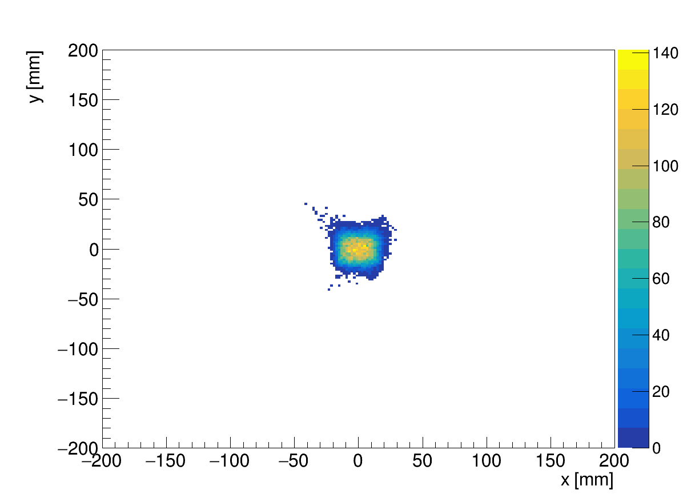
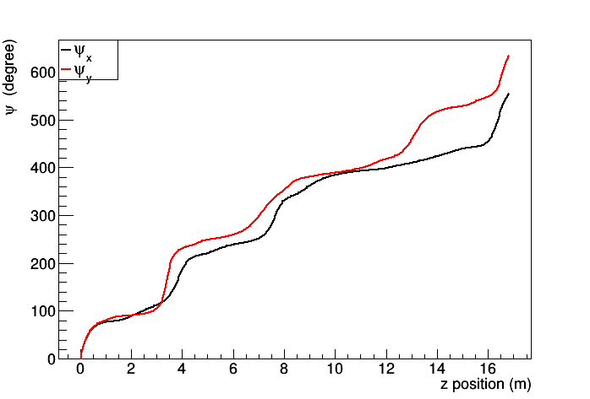
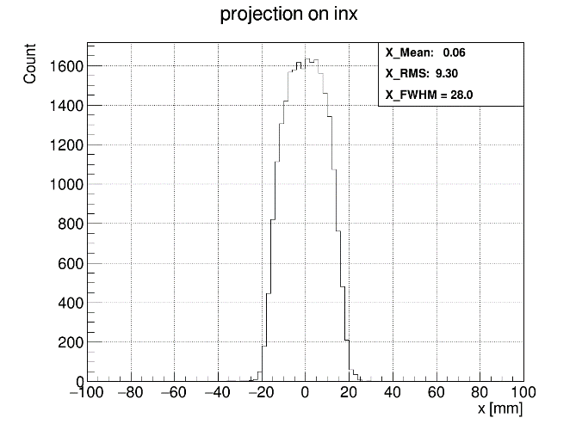
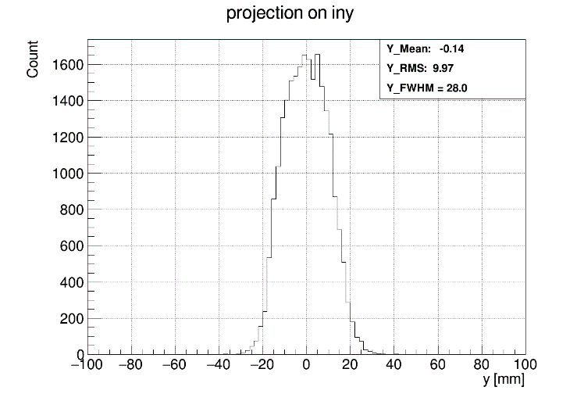
Collimation
Slits for smaller spot
 | Z Position | Slit Width | Collimation Direction
Slit-1 | 8900mm | 60mm | horizontal
Slit-2 | 12900mm | slit ≤ -25 | vertical
Slit-3 | 13050mm | slit ≥ 25 | vertical
FWHM=28mm
FWHM=28mm
Notes:
跟前面一样，说明下效率等

Slide 24
Summary
Beam Line | Reference momentum [MeV/c] | Momentum Spread | Polarization | Intensity [1E5/s] | Spot(FWHM) [mm] | Contamination
Muon Beam Line for Baby-Scheme Design | 28.5 | ~10% | -0.92 | 1.2 | 31.2(H)*32.5(V) | e+ < 1%
Vertical Beam Line for Baseline-Scheme Design | 28 | ＜8% | -0.94 | 0.6 | ~30(H)*30(V) | --

Slide 25
Summary
Two room temperature muon beam line is designed for EMuS. One is for baby scheme design and another is for baseline scheme design
For baby-scheme design , there is a simplified muon beam line. For this beam line now it has a suitable beam spot(FWHM=30mm) , 1E+05/s flux under 5kW proton beam and polarization is high enough(-0.92), while the contamination is rather low(<1%)
For vertical beam line of baseline design, the primary result shows that the finished design could deliver about 84% of particles in emittance ellipse to the final spot. After 3 groups slits, the spot could be further minified to 30mm(FWHM). However, more detailed simulation work is required in the next step
Notes:
不要括号

Slide 26
Thank you!

