Slide 1
International Review of EMuS
R&D Progress and Prototyping of μSR Spectrometer
Xiaojie NI, Ziwen PAN, Fanshui DENG, Hao LIANG, Bangjiao YE
State Key Laboratory of Particle Detection and Electronics
University of Science and Technology of China(USTC)
2018. 11. 21 Dongguan, China Spallation Neutron Source

Slide 2
01
μSR detector construction
and pre-tests
02
CONTENTS
Electronics
03
Beam tests
04
Summary

Slide 3
01
μSR detector construction and pre-tests
Integrated design, assembly of μSR detector, magnetic shield test, noise test, radiation test

Slide 4
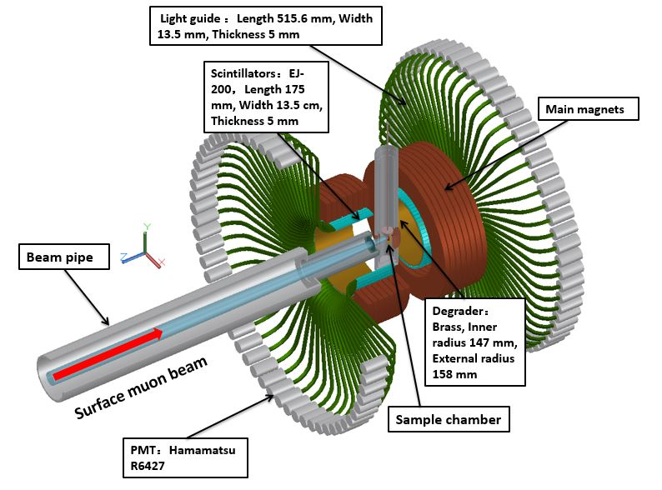
01 μSR detector construction and pre-tests
Target: To provide a basic prototype version of the μSR spectrometer
Channels: 128 channels (front and rear 64 channels)
Detector system: plastic scintillators + light guides + photomultiplier tubes (PMT)
Magnetic field system: ZF (zero field), LF (longitudinal field): 0~300 Gauss, TF (transverse field): 0~100 Gauss
Sample chamber: basic requirement, closed cycle cryostat: 10~400 K
Electronics: hardware, data acquisition (DAQ) software ,operation monitoring software
Integrated design of 128-channels μSR spectrometer prototype

Slide 5
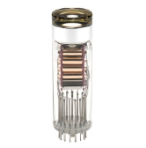
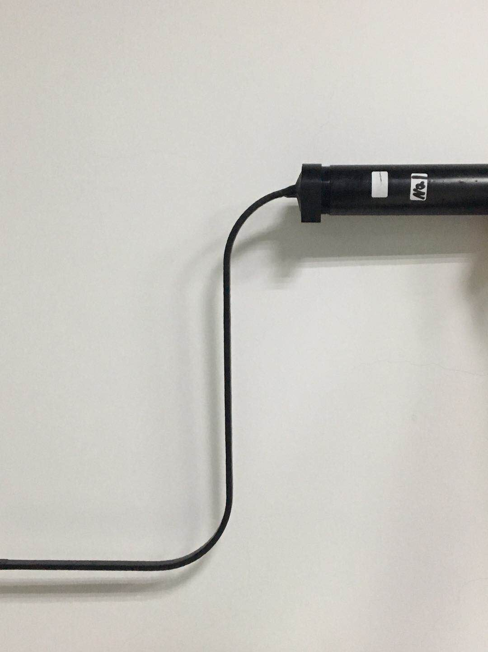
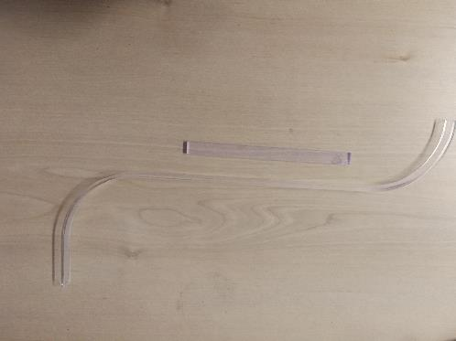
01 μSR detector construction and pre-tests
Assembly of μSR detector
PMT: Hamamatsu R6427
Diameter=1 inch
λ_{max}= 420 nm
Rise time = 1.7 ns
TTS = 500 ps
Gain = 5.0×10⁶
Max supply: 2000 V
Recommend supply: 1500 V
Linear acceleration
What are the most important to μSR detector?
Magnetic shield (20 Gauss)
Dead time (20 ns)
Signal to noise
Scintillator: EJ-200
λ_{max}= 425 nm
Rise time= 0.9 ns
Decay time = 2.1 ns
Size: 175×13.5×5 mm³
Scintillator sheet
One channel μSR detector
Light guide
Inside structure of detector

Slide 6
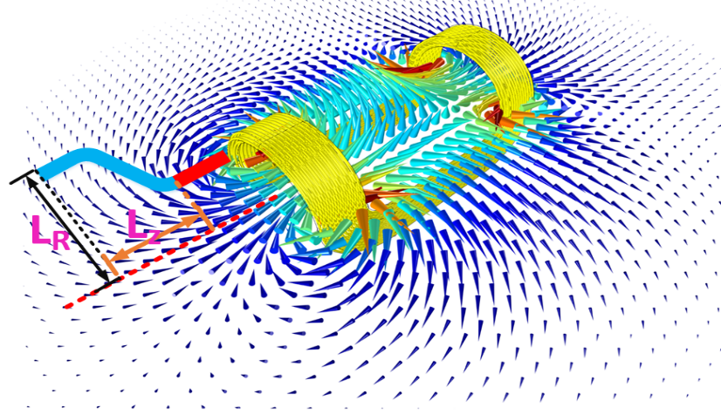
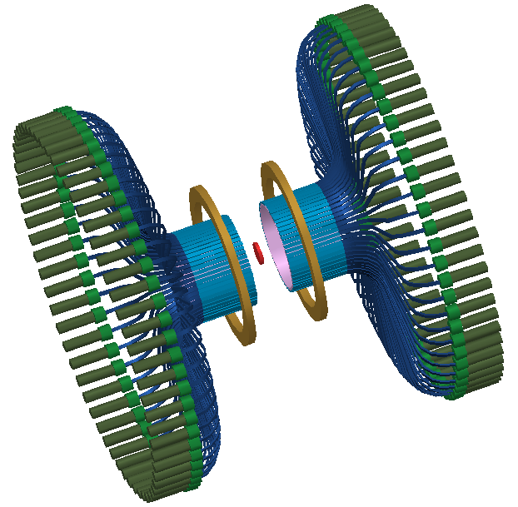
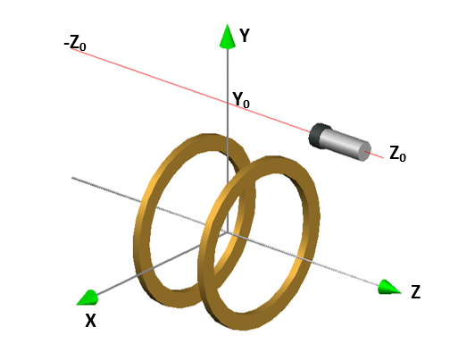
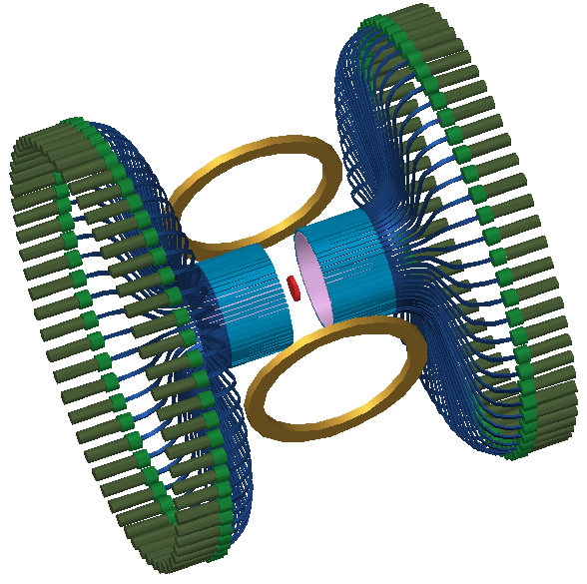
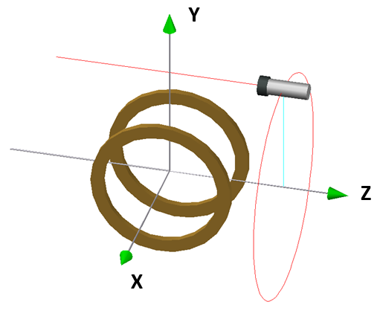
01 μSR detector construction and pre-tests
Magnetic shield test
Maximum magnetic flux density: 300 Gauss
ZF / LF
TF
According to the simulation results, the stray magnetic field is about 10 Gauss at the PMT position.

Slide 7
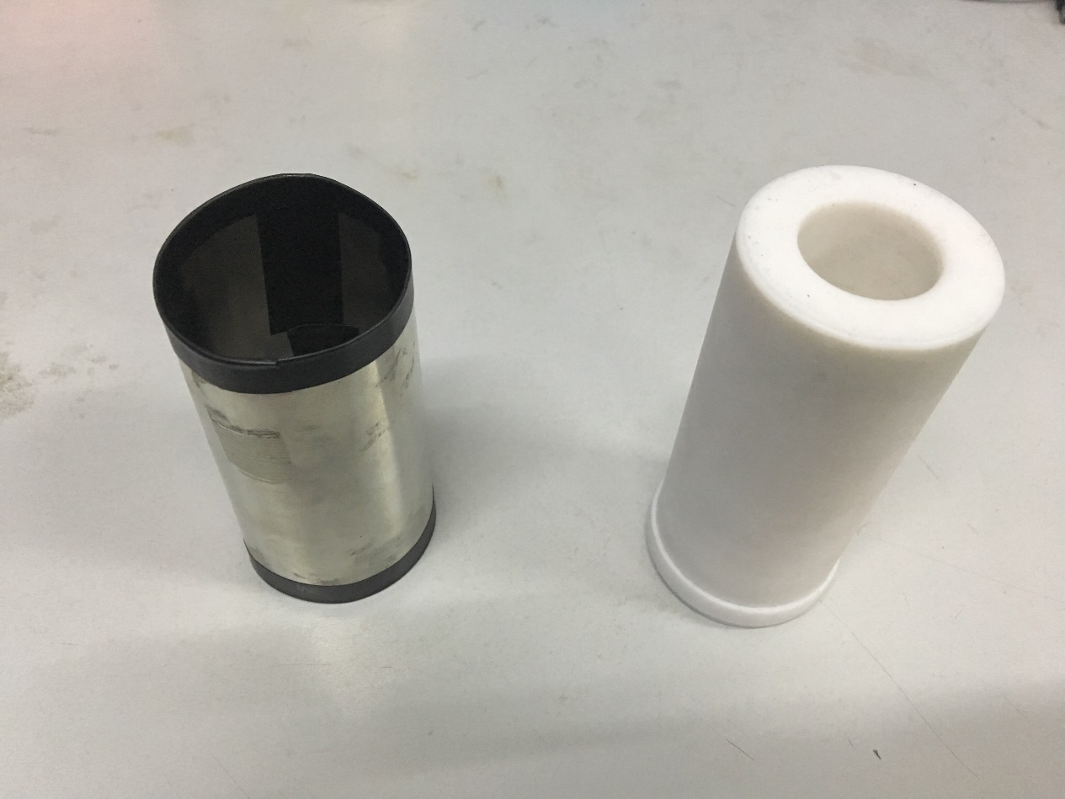
01 μSR detector construction and pre-tests
Magnetic shield test
Permalloy
Insulation
The magnetic field test results show that when the magnetic field in the X/Y direction is about 10 Gauss, the anode output is only about 0-20% left. Magnetic shield is necessary!
Because the R6427 is very sensitive to the magnetic field, we have designed a magnetic shielding case (four layers of 0.1 mm thick permalloy).

Slide 8
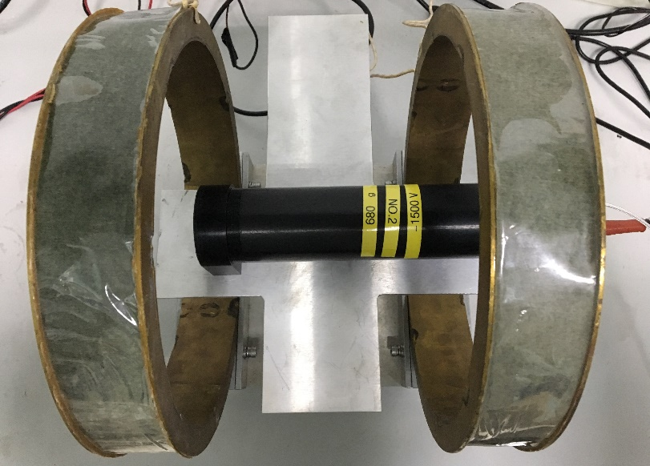
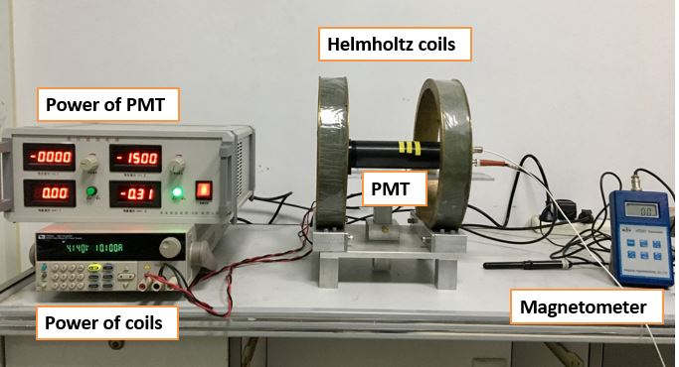
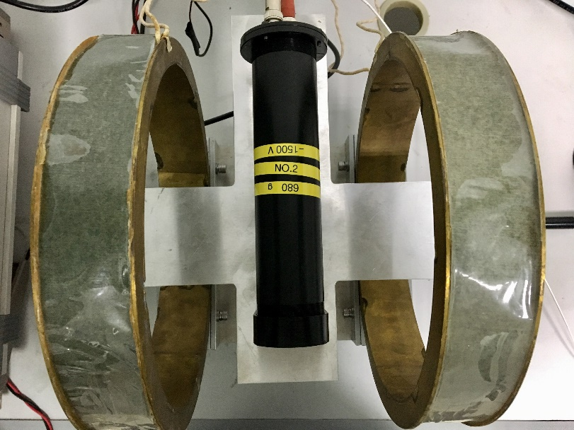
01 μSR detector construction and pre-tests
Magnetic shield test
The magnetic field parallel to PMT (LF)
The test system of magnetic shielding effect
We researched the magnetic shielding effect of the magnetic field parallel to PMT and perpendicular to PMT by the ²²Na energy spectra.
The magnetic field perpendicular to PMT (TF)

Slide 9
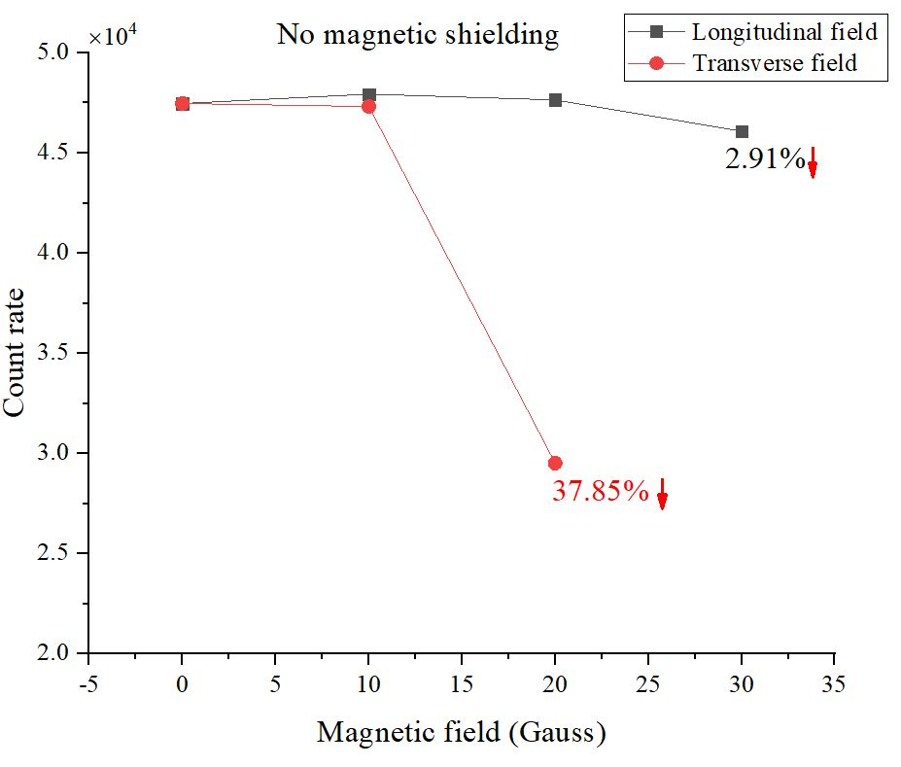
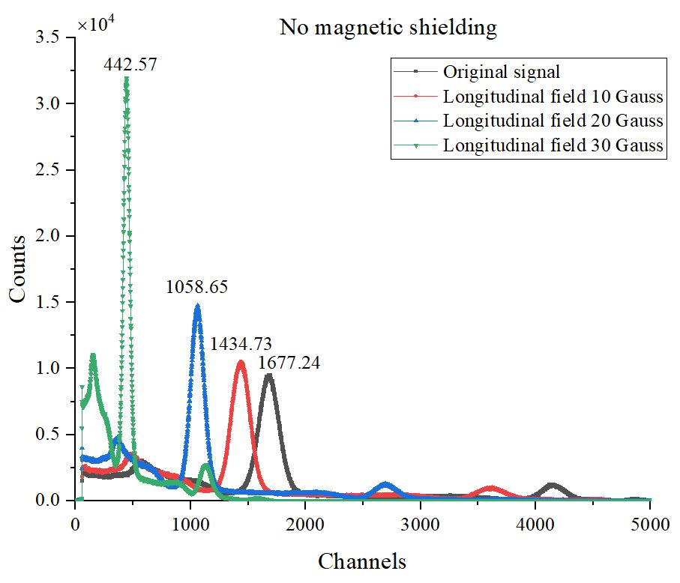
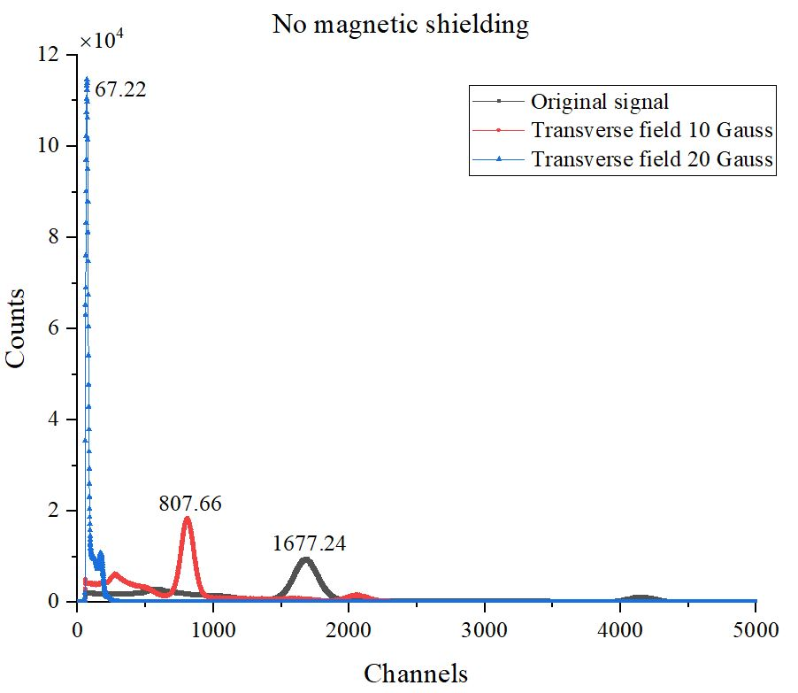
01 μSR detector construction and pre-tests
Magnetic shield test
Magnetic field test of R6427 with different fields by ²²Na energy spectra

Slide 10
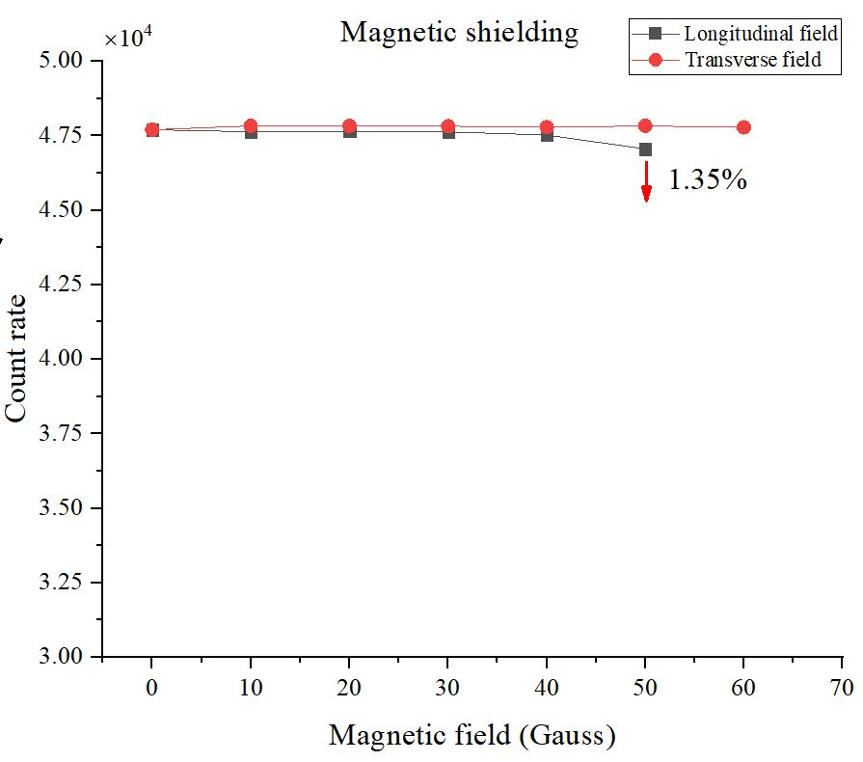
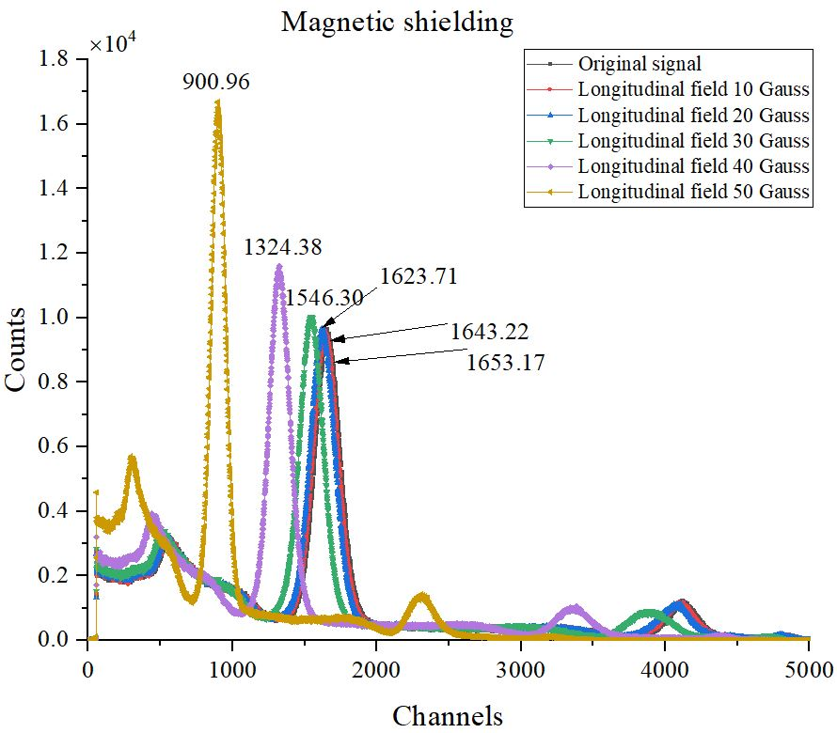
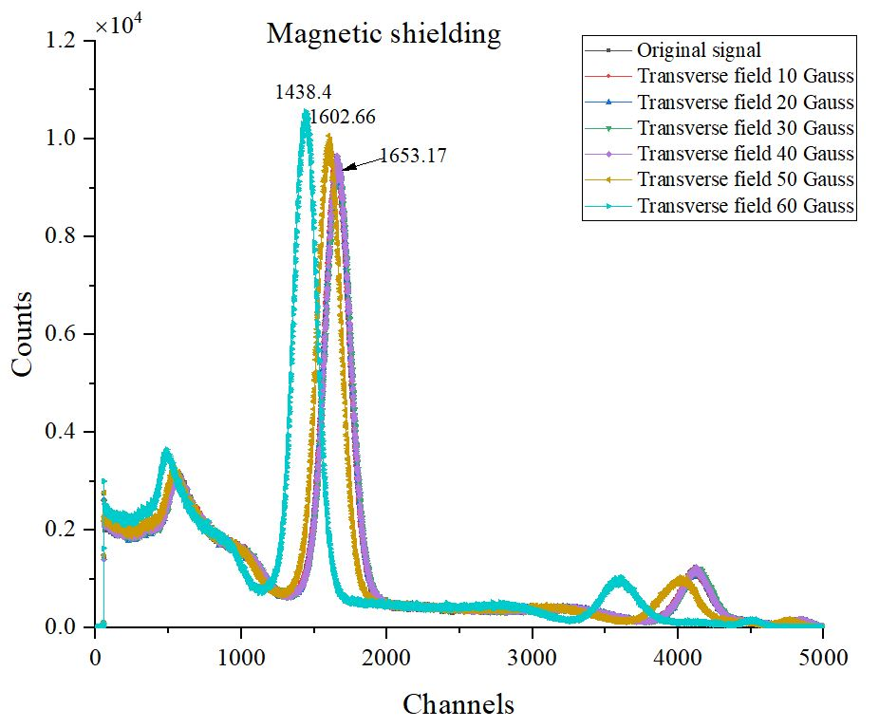
01 μSR detector construction and pre-tests
Magnetic shield test
Magnetic field test of R6427 with different fields by ²²Na energy spectra

Slide 11
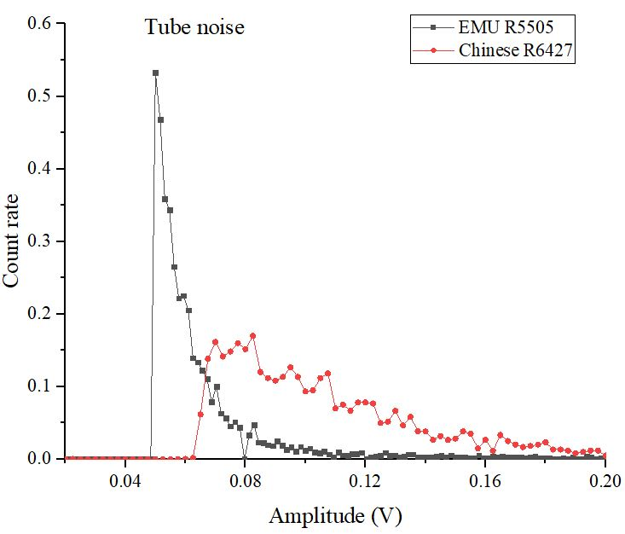
01 μSR detector construction and pre-tests
Noise test
Threshold=50 mV
Noise test of R5505 and R6427

Slide 12
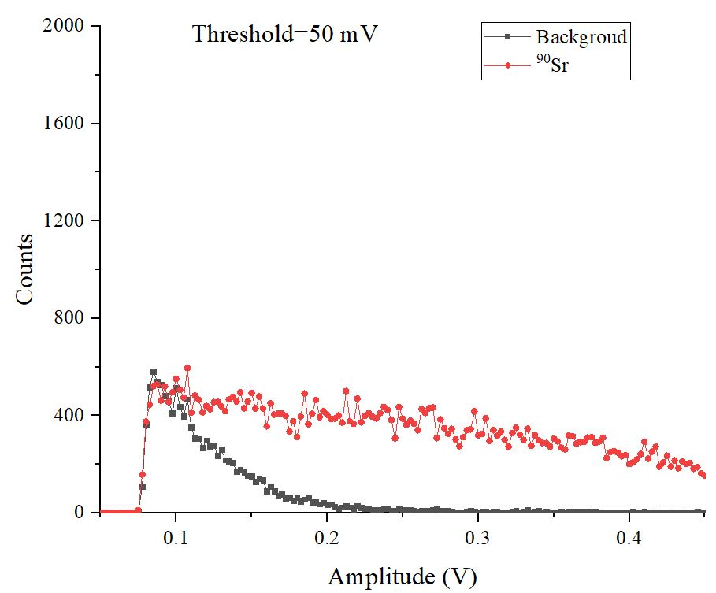
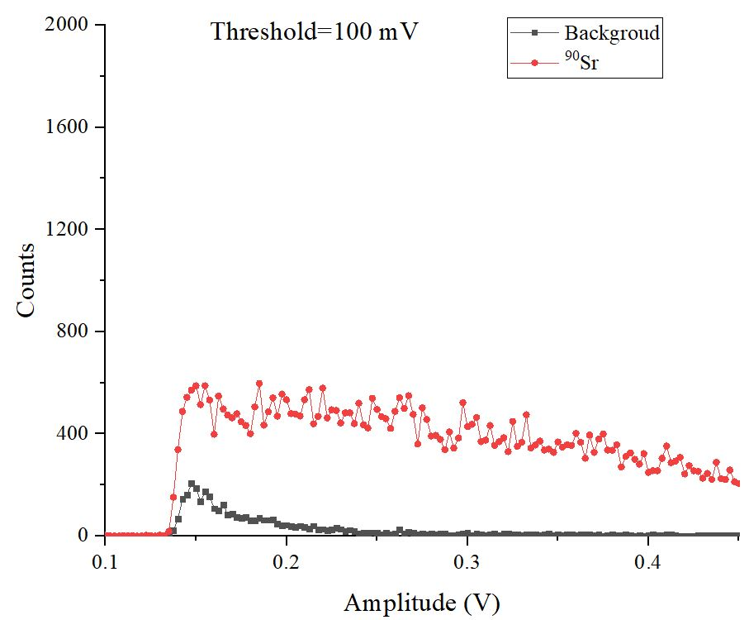
01 μSR detector construction and pre-tests
Radiation test
Radiation test of detector with EJ-200 scintillator and light guide by ⁹⁰Sr in 600 s

Slide 13
02
Electronics
Overall framework, design of FEE and TDC,
time resolution test, DAQ software, counting loss test

Slide 14
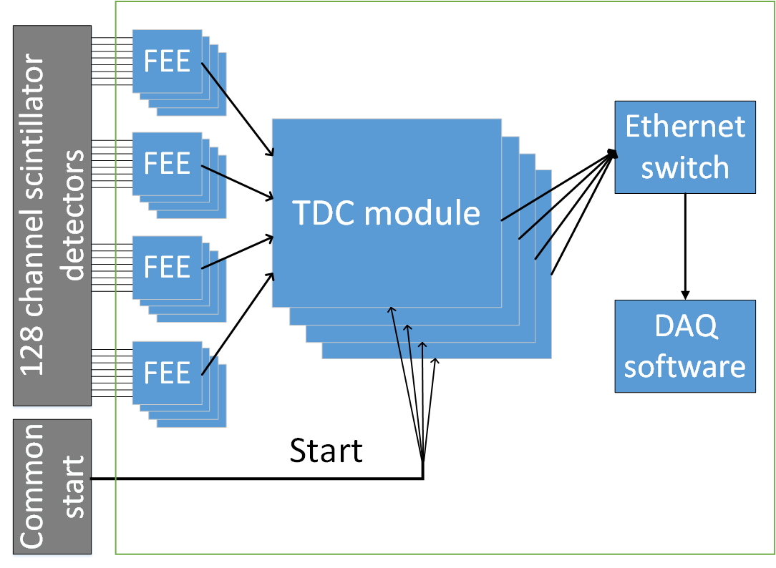
02 Electronics
Overall framework
Electronics prototype:
Totally 128 channels as stop signals and one as the start signal.
Two parts:
front-end electronics (FEE): 8 channels per FEE (16 needed) back-end TDC board (TDC Module). 32 channels each module(4 modules needed)
Data collected through network
The overall framework of electronics design of our μSR spectrometer prototype

Slide 15
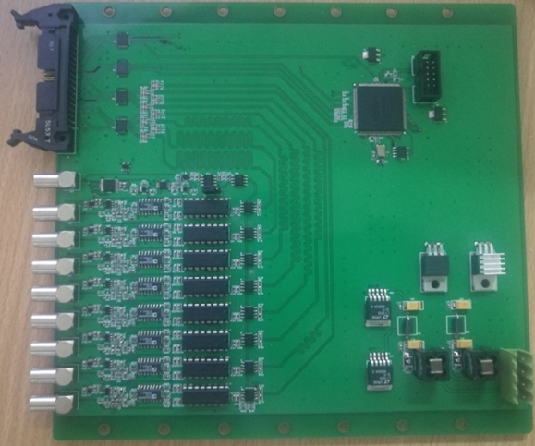
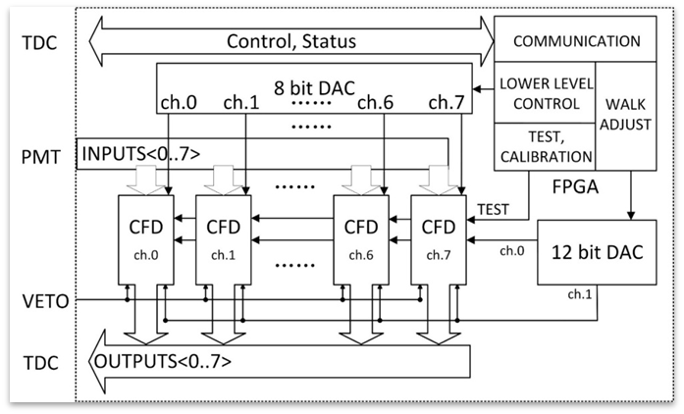
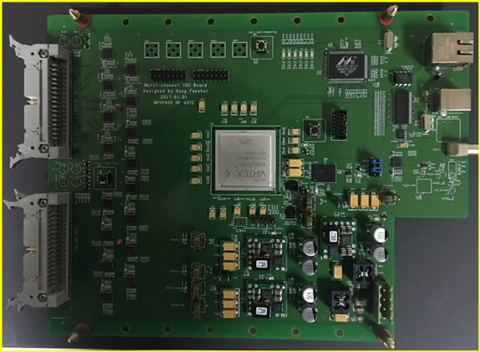
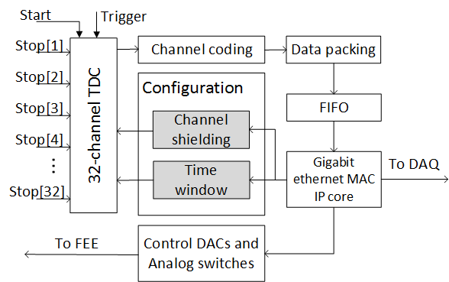
02 Electronics
Design of FEE and TDC
The FEE board
Logic diagram of FEE board
The back-end TDC board
Internal logic diagram of FPGA

Slide 16
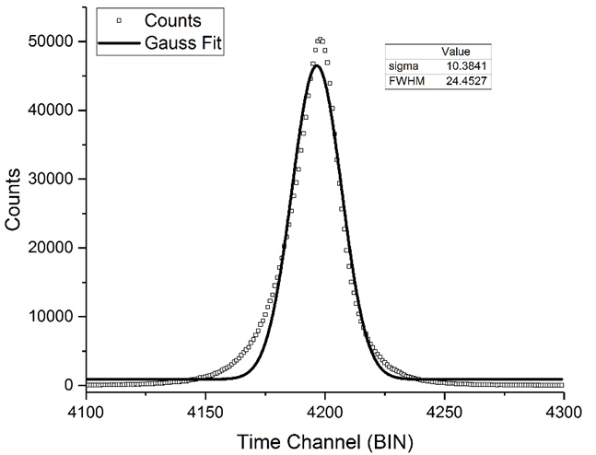
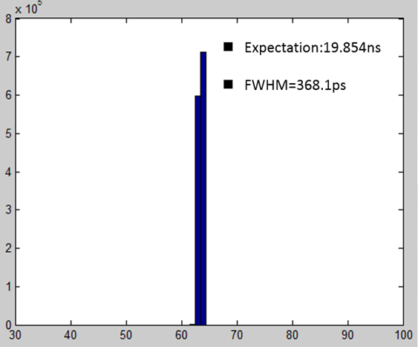
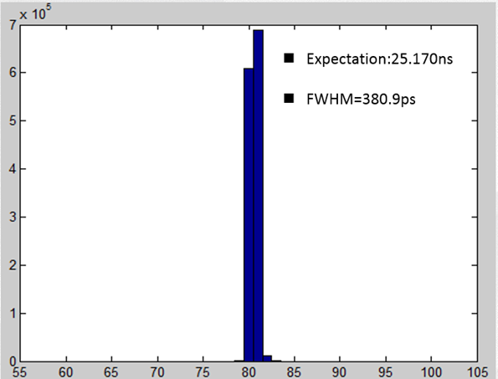
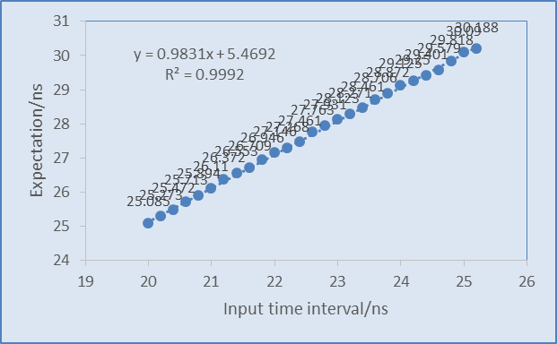
02 Electronics
Time resolution test
Time resolution (FWHM):
FEE: 55 ps;
TDC: 368 ps (channel to channel) FEE+TDC: 380 ps with good linearity
Test results of FEE
Test results of TDC
The FEE+TDC test
Linearity test

Slide 17
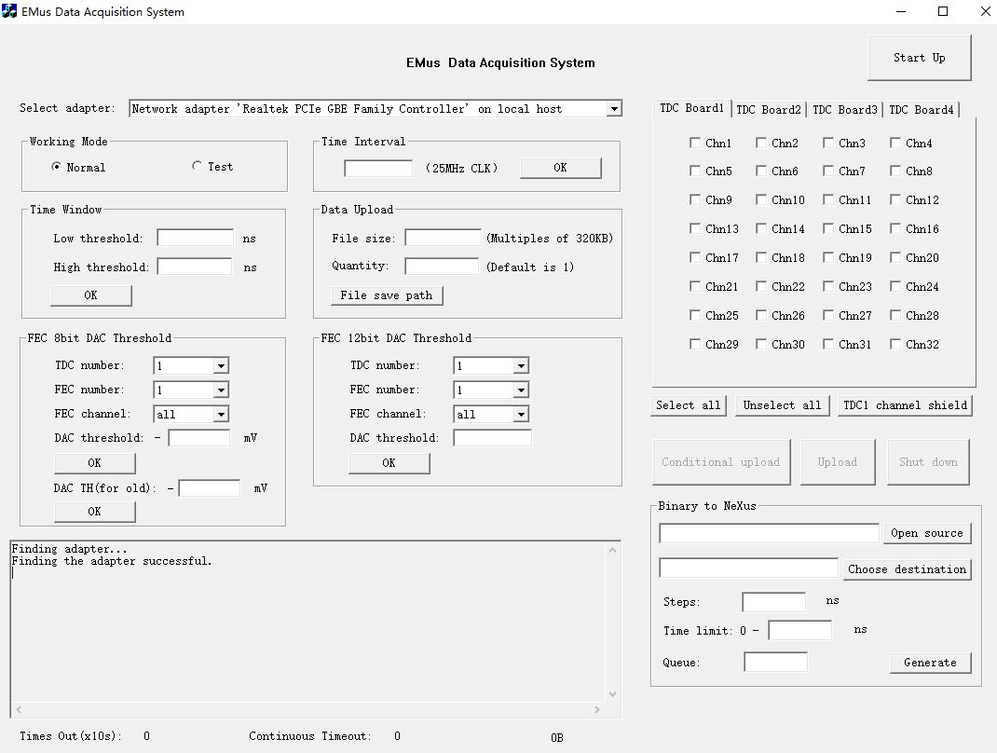
02 Electronics
DAQ software
Work normal or self-test
Set channel shield
Set time window
Set file size and path
Set threshold of FEE
Display panel
Data format conversion
Notes:
Progress of electronics includes compilation and testing of control logic for front-end electronics and TDC modules, and data acquisition software, the main features are as follows:
1、To achieve self-test function, without the connection of the detector, the electronics themselves produce a signal similar to the detector output to detect whether the electronics system works normal;
2、Set the time window(Low threshold and high threshold), You can choose to receive only the data for the time range of interest;
3、Set the channel shield, you can selectively mask some channel data (taking into account the actual work, some channels may be abnormal or necrosis);
4、Set the DACs’ threshold of front-end electronics , because the detector output signal is noisy, you can adjust the threshold to suppress noise;
5、Data format conversion, the analysis of the acquired data is meaningful, Muon data analysis software -Mantid provides a complete data analysis solutions, has been widely supported (including the European ISIS, ILL and the United States SNS, HFIR), To be able to use this software, we need to convert the data format to Mantid-supported format (NeXus).

Slide 18
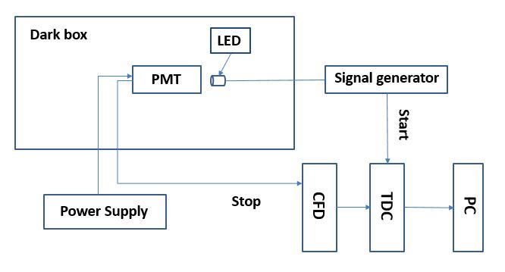
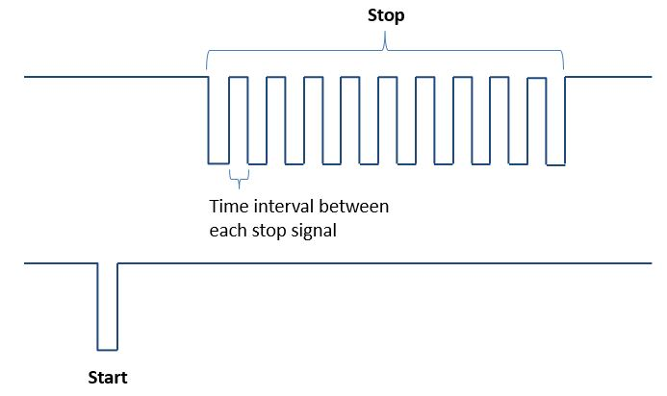
02 Electronics
Counting loss test
The block diagram of counting loss test
We have tested the counting loss of different situations (one start signal to 10, 30, 50, and 100 stop signals) and different time intervals (20, 25, 50, and 100 ns), respectively.

Slide 19
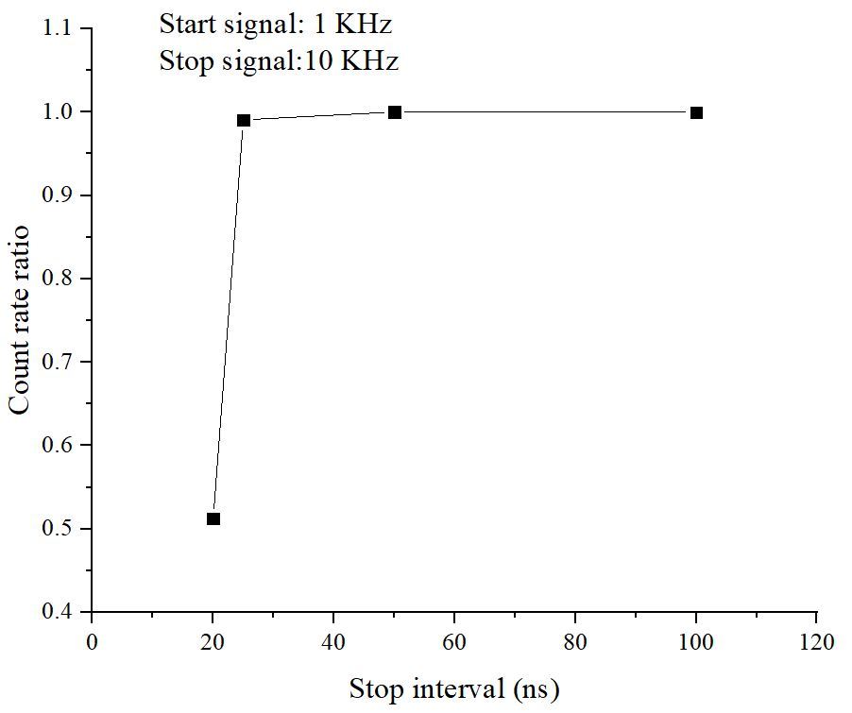
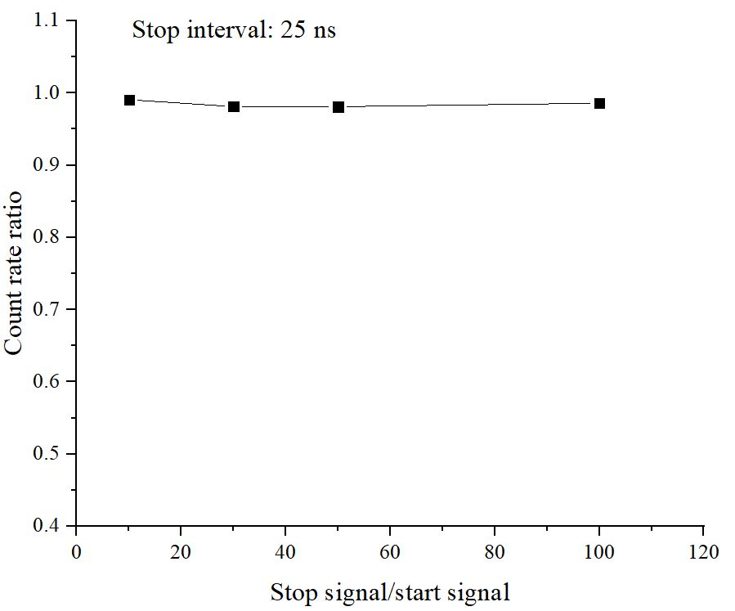
02 Electronics
Counting loss test
There is no counting loss when the time interval between each stop signal larger than 25 ns. It meets our requirement.

Slide 20
03
Beam tests
First beam test, second beam test, and data analysis

Slide 21
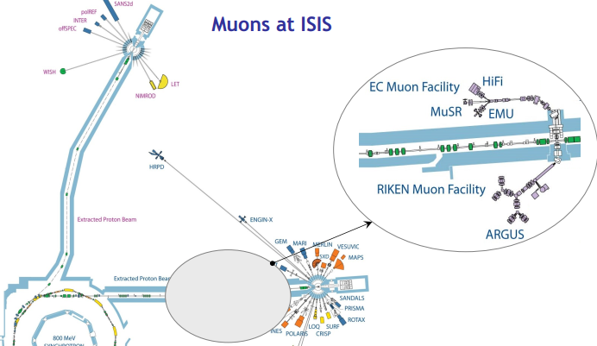
03 Beam tests
First beam test
Second beam test
Acknowledgement:
Thank you very much for ISIS Muon Group and Detector Group!
Many thanks to the technical support of Dr. Stephen Cottrell and Dr. Daniel Pooley and the helpful discussions of Dr. Adrian Hillier, Dr. Nigel Rhodes, Prof. Isao Watanabe, Dr. James Lord, and Dr. Peter Baker!

Slide 22
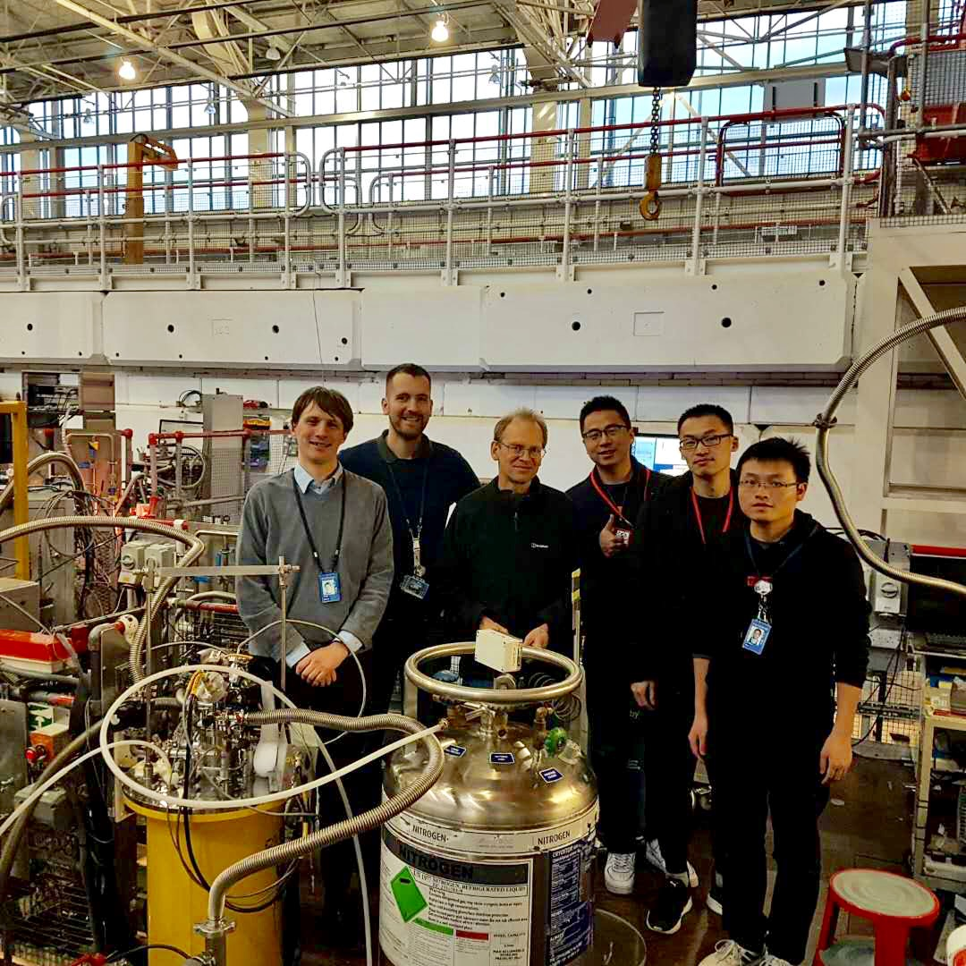
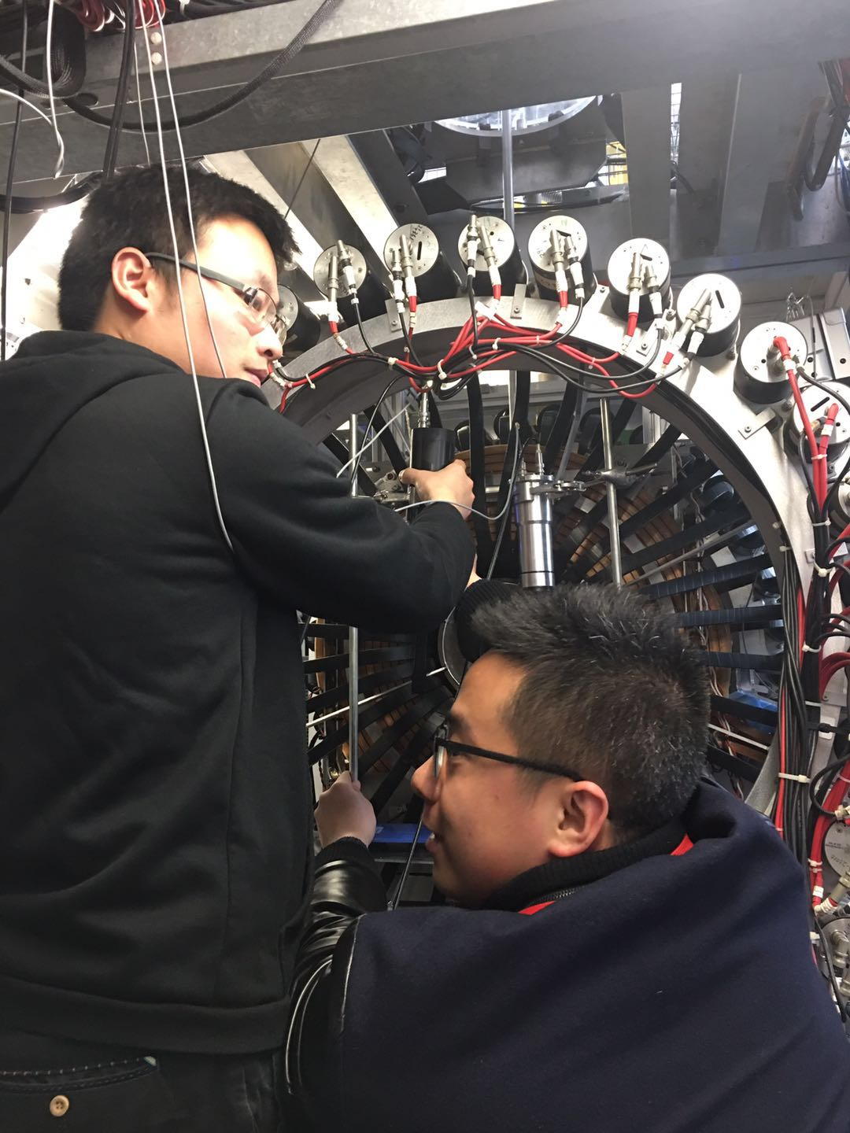
03 Beam tests
First beam test
The first test was successful but there were some problems in our detector and electronics. According to the first test results, we have improved our detector and electronics and completed the second test in ISIS.
Photo in ISIS Muon Group, from left to right: Dr. Peter Baker, Dr. Daniel Pooley, Dr. Stephen Cottrell, PhD student Xiaojie NI, Fanshui DENG, Ziwen PAN
To assemble Chinese detector and EMU R5505 detector on the muon beam

Slide 23
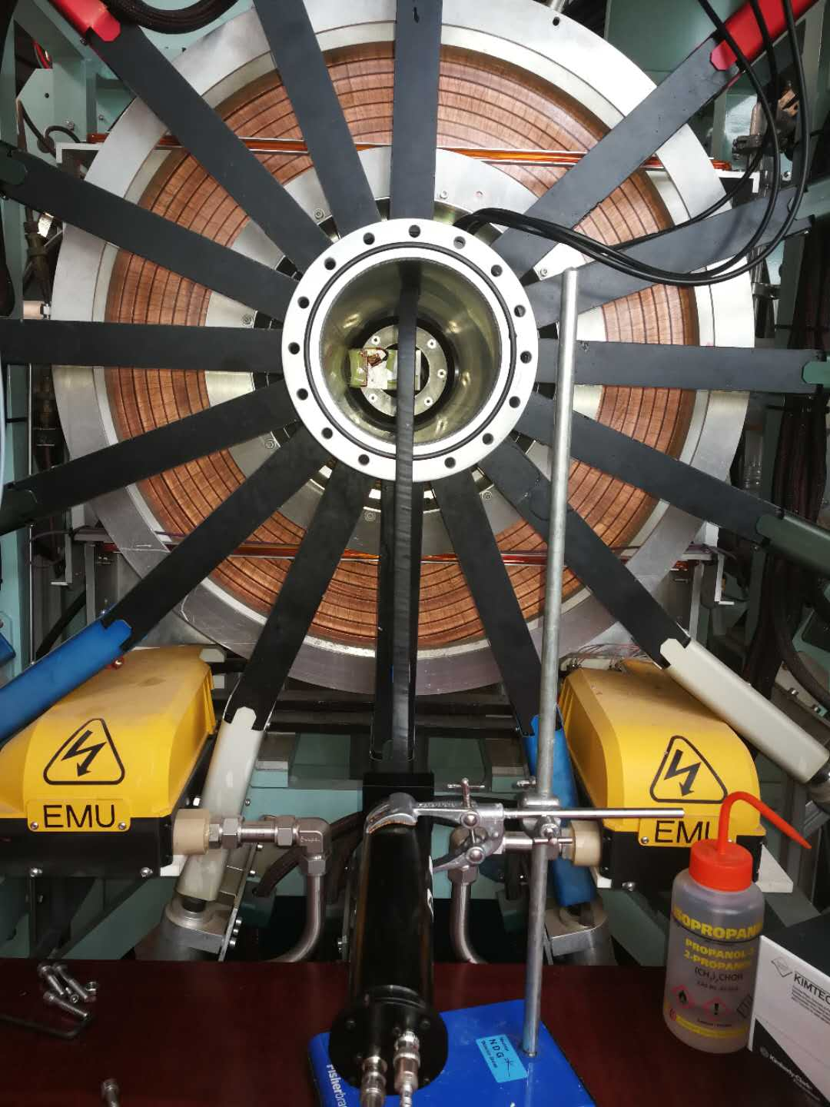
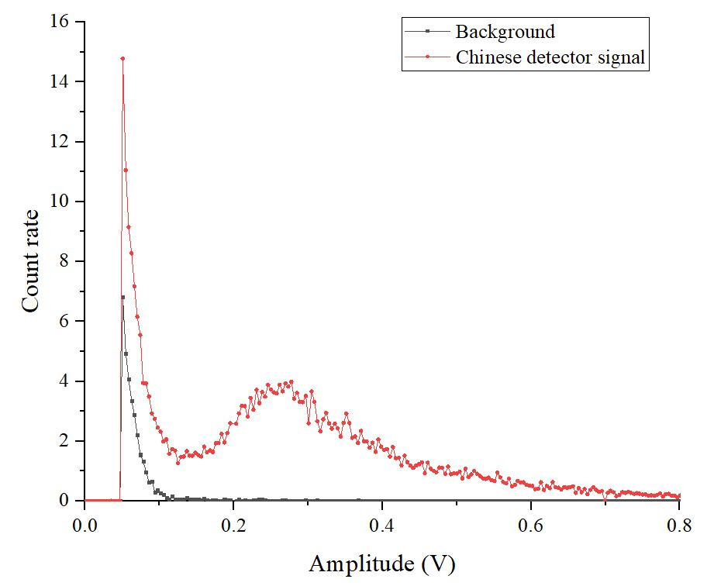
03 Beam tests
Second beam test
Threshold
Chinese detector
Chinese detector was put on EMU
Energy spectrum of Chinese detector on EMU

Slide 24
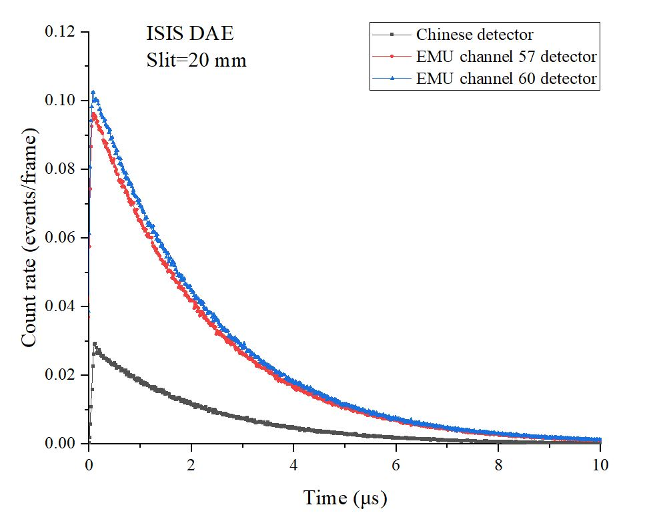
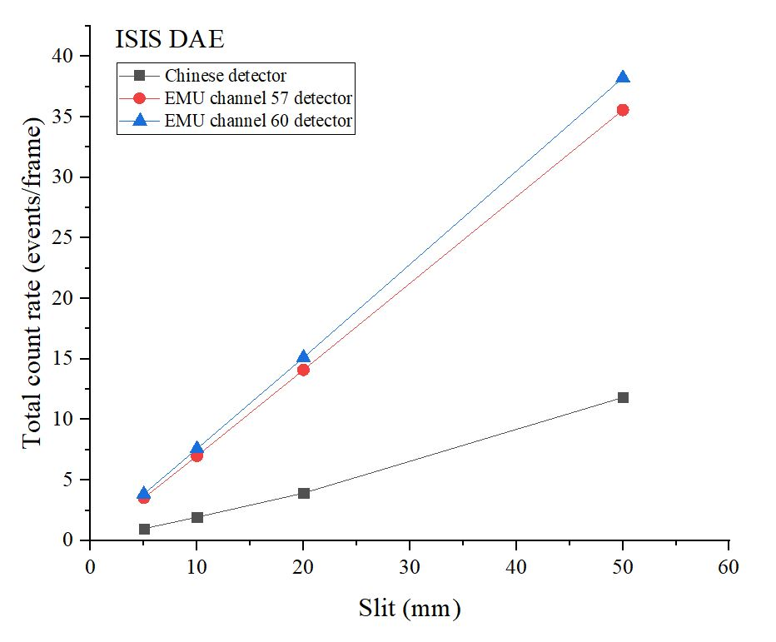
03 Beam tests
Data analysis
35.578
11.839
14.103
3.535
3.933
0.993
Time spectrum of different detectors with ISIS DAE
Total count rate of different detectors with ISIS DAE

Slide 25
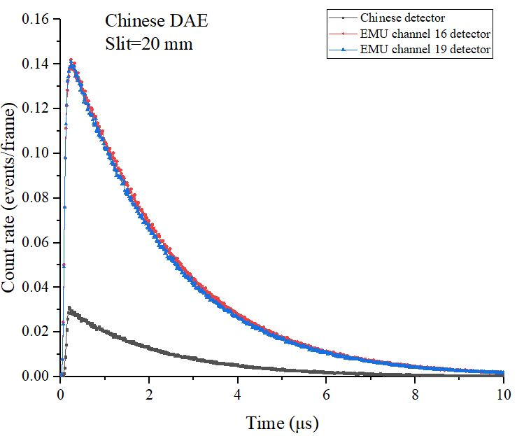
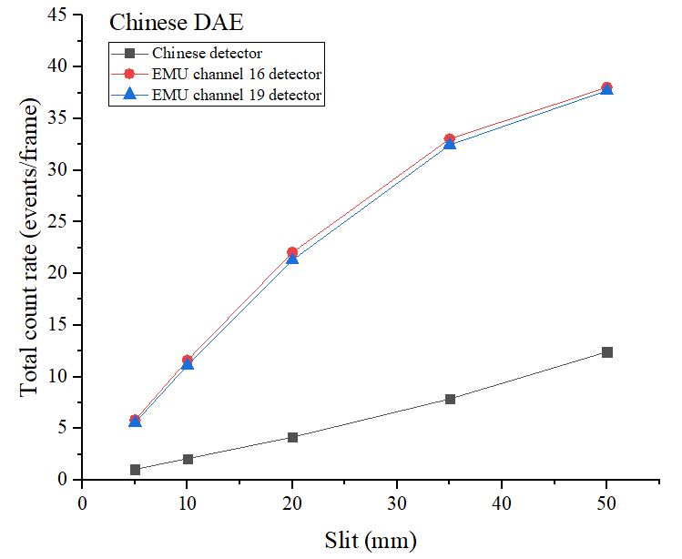
03 Beam tests
Data analysis
38.037
22.023
12.416
5.821
1.406
4.151
Time spectrum of different detectors with Chinese DAE
Total count rate of different detectors with Chinese DAE

Slide 26
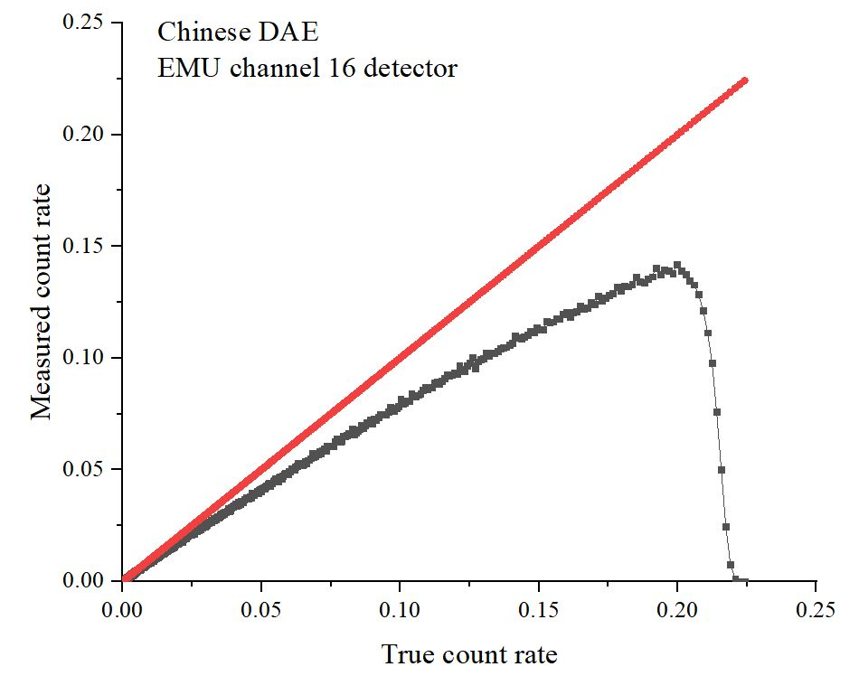
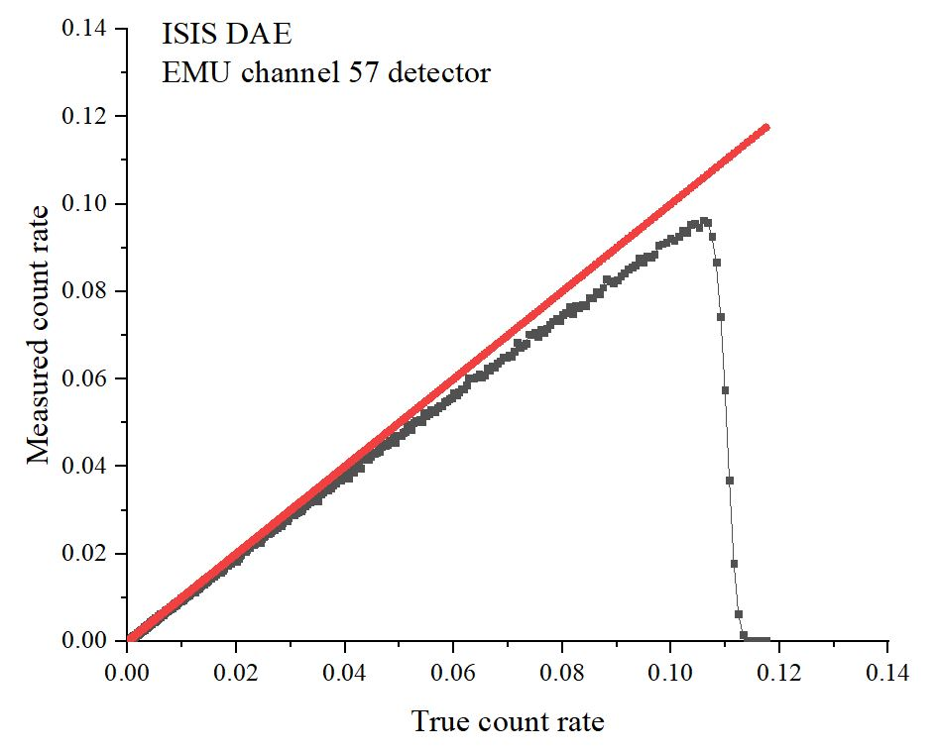
03 Beam tests
Data analysis
True count rate
True count rate
Measured count rate
Measured count rate
True count rate vs Measured count rate
There exists counting loss when using Chinese DAE, that is probably due to threshold setting. (EMU channel 16 and 57 detectors are the same detector)

Slide 27
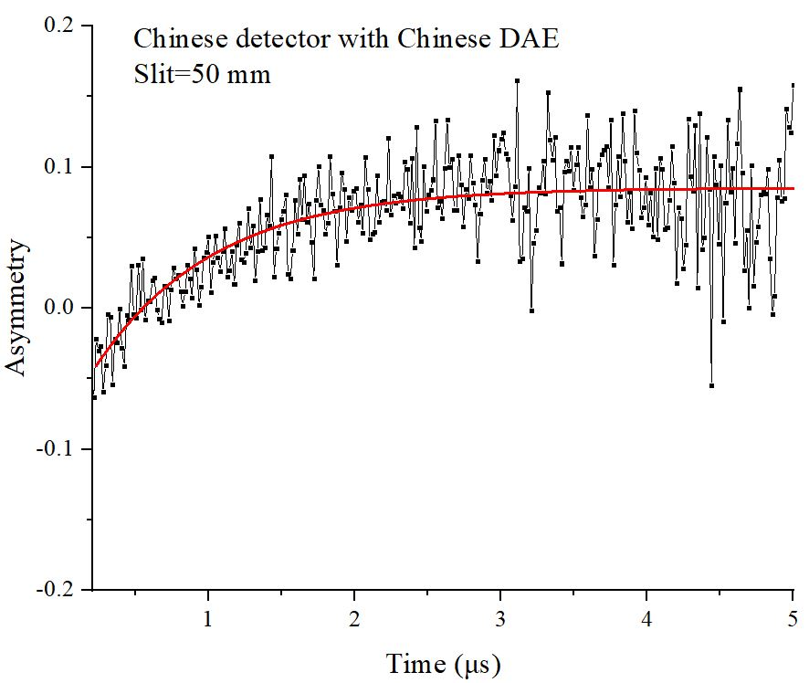
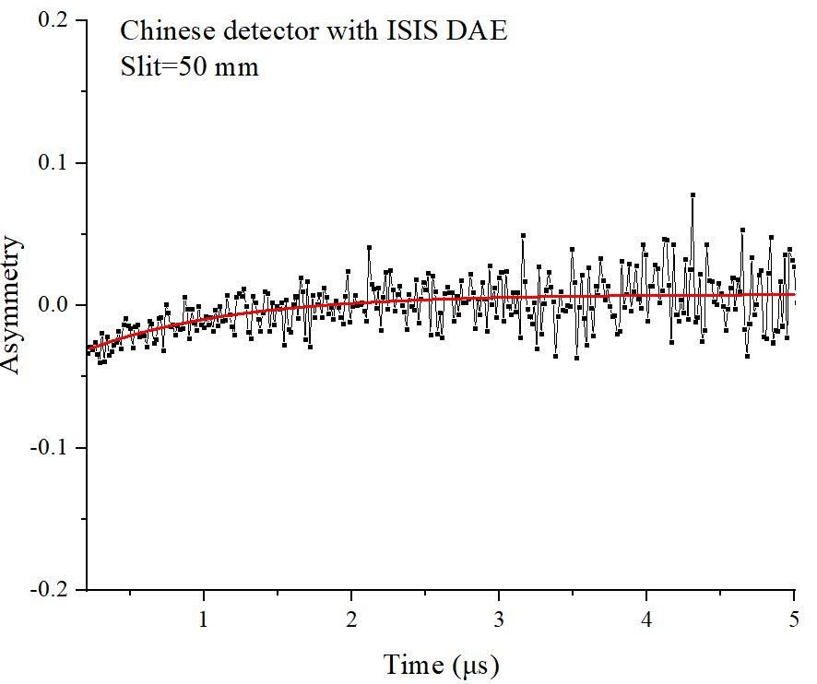
03 Beam tests
Data analysis
12.416 events/frame
11.839 events/frame
Asymmetry of Chinese detector with Chinese DAE and ISIS DAE

Slide 28
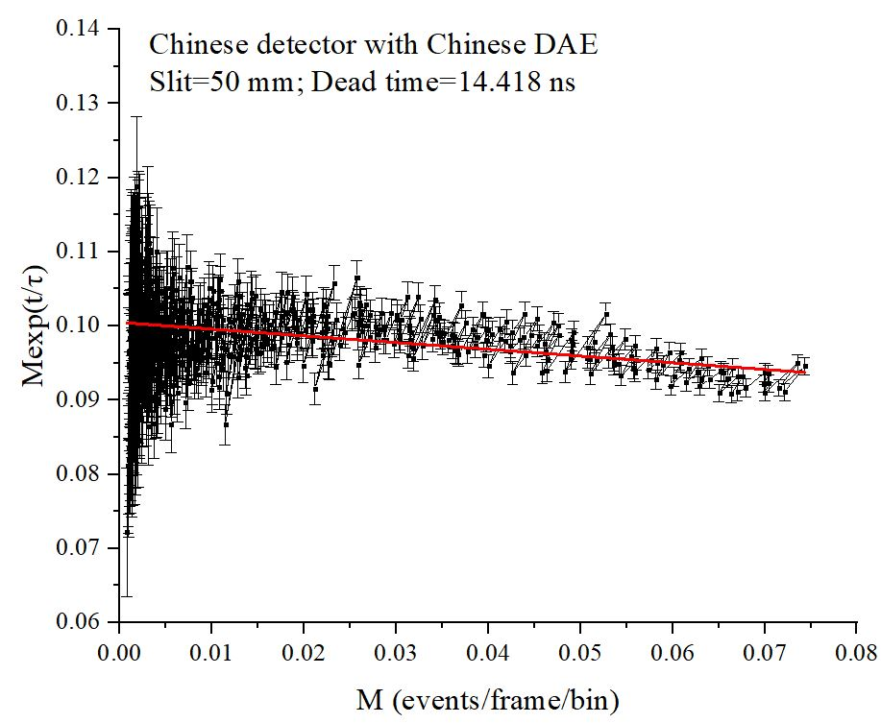
03 Beam tests
Data analysis
12.416 events/frame
11.839 events/frame
Dead time of Chinese detector with Chinese DAE and ISIS DAE

Slide 29
03 Beam tests
Data analysis
7.861 events/frame
7.604 events/frame
Dead time of Chinese detector with Chinese DAE
Dead time of EMU detector with ISIS DAE

Slide 30
03 Beam tests
Data analysis
Chinese DAE
A=0.239
ISIS DAE
A=0.249
Good frame:316757, Total counts=6138356
Good frame:342337, Total counts=8306252
Asymmetry of same EMU six detectors with different DAE

Slide 31
04
Summary

Slide 32
04 Summary
We have completed the integrated design of 128-channels μSR spectrometer prototype and the construction of one channel μSR and pre-tests of our μSR detector.
The front-end electronics and TDC modules, and data acquisition software of our electronics have been completed.
Two tests of our μSR spectrometer based on the muon beam of ISIS have been completed in March and September of 2018. The first test in ISIS was successful, but there is also some problems to solve. According the first test results, we have improved our detectors and electronics. They can work well. The best dead time we got is 1.384 ns in second test.
The sample chamber and the magnetic field system are also very important. In the next, we will complete these developments.
According to the funding, our μSR spectrometer may be extended to 256 channels. We need to carry out the overall design. The initial plan is one side of four rings, 32 channels for each ring.

Slide 33
THANK YOU

Slide 34
Dead time
$$m=n⋅ⅇ^{−nτ}$$
$$n=\frac{m}{1−m⋅τ}$$
Illustration of two assumed models of dead time behavior for radiation detectors
$n$=true interaction rate
$m$= recorded count rate
$τ$= system dead time
From the book《Radiation Detection and Measurement》

Slide 35
Methods of Dead Time Measurement
Two-source method: the method is based on observing the counting rate from two sources individually and in combination.
Decaying source method: the method is based on a short-lived radioisotope source.
For the decaying source method, in the limit of negligible background, the behavior of the true rate$:$
$$n≅n_{0}ⅇ^{−λt}$$
where $n_{0}$ is the true rate at the beginning of the measurement and $λ$is the decay constant of the
particular source used for the measurement.
For the nonparalyzable model:
$$n=\frac{m}{1−m⋅τ}$$
$$mⅇ^{λt}=n_{0}−n_{0}mτ$$
$$n≅n_{0}ⅇ^{−λt}$$
From the book《Radiation Detection and Measurement》

Slide 36
Methods of Dead Time Measurement
How to calculate muon dead time for each spectra?
$$N=\frac{M}{(1−M∗(\frac{t_{dead}}{t_{bin}∗F}))}$$
$$M\left(t\right)e^{\left(\frac{t}{T}\right)}=N_{0}−M\left(t\right)∗N_{0}∗(\frac{t_{dead}}{t_{bin}∗F})$$
$$N\left(t\right)=N_{0}e^{(−\frac{t}{T})}$$
$N\left(t\right) :$ true count as a function of time $t$
$N_{0}:$ true count at time zero
$M\left(t\right):$ measured count
$t_{dead}:$ dead time (fitted)
$t_{bin}:$ time bin width
$T:$ Muon lifetime
$F:$ Number of good frames
From the Mantid function ” CalMuonDeadTime”

Slide 37
Asymmetry of zero field
The formula for removing the exponential decay is given by:
NewData=(OldData×$e^{(\frac{t}{T})}$)/$B−1$
where $T$ is the muon lifetime (2.2 μs). $B$ is a fitted normalisation constant
$$N\left(t\right)=N_{0}e^{(−\frac{t}{T})}$$
Asymmetry should be a constant!
From the Mantid function ” RemoveExpDecay”

Slide 39
Due to early dead time distortion, there exits counting loss.
The time interval between two signals are large, so there is no counting loss. By fitting these data, we can get the true count rate

