Slide 1
General layout and conventional facilities
Speaker: Hantao Jing
Donghui Zhu, Changjun Ning, Yongji Yu, Gang Zhang, Kun He, Chongchao He
2018-11-21

Slide 2
Contents
Layout of High-energy Proton Experimental Area (HPEA)
Infrastructure and room allocation in HPEA
Radiation shielding and safety control
Conventional facilities
Electricity, cooling water and ventilation
Cryogenic system
Equipment transportation and hoisting

Slide 3
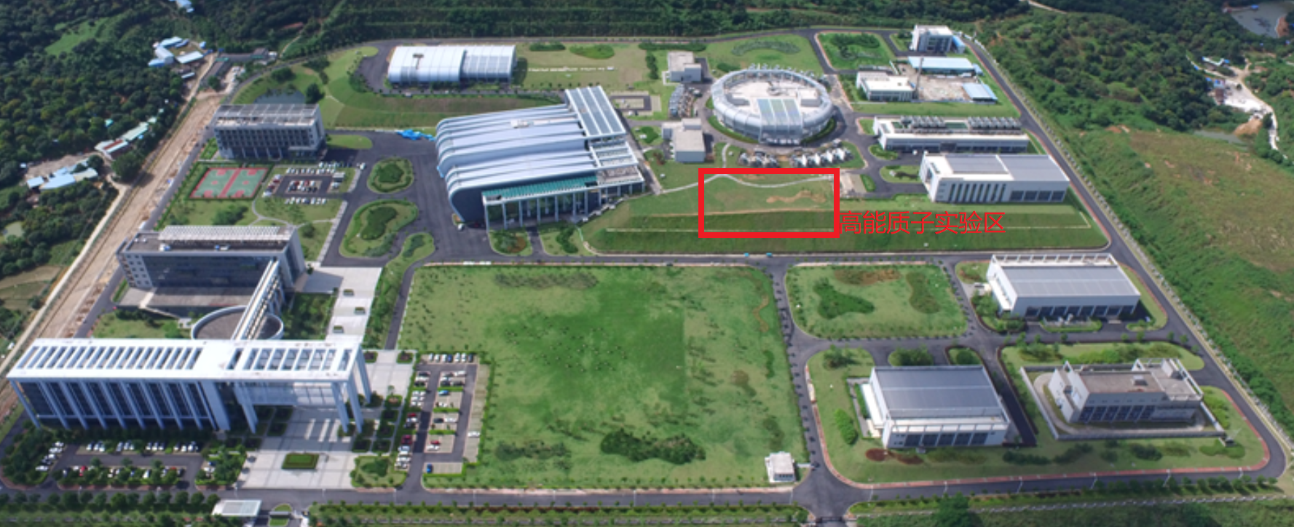
Bird’s view of CSNS
Office area
Facility area
Radiation protection building
Exhaust and air-condition centers
Support building
HPEA
Auxiliary area
2nd target station reserved
Test hall 1&2
Main substation

Slide 4
Layout of CSNS and High-energy Proton Experimental Area （HEPA）
Linac, 80 MeV@CSNS-I; 300 MeV@CSNS-II
RCS
1.6GeV, 25Hz
100 kW
1st target station
High-energy Proton
Experimental Area(HPEA)
Proton beam parameters for Experimental Muon Source (EMuS)
Proton energy：1.6 GeV
Beam power：5 kW
Bunch number per pulse: 1
Repetition：2.5 Hz
Proton number per bunch：7.8 E12 ppp (protons per pulse)
Notes:
Negative hydrogen ion

Slide 5
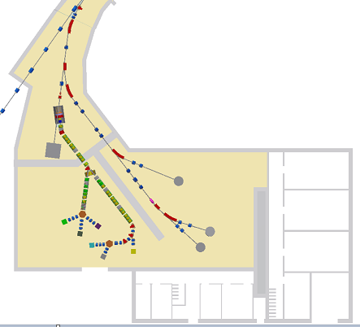
Infrastructure dimensions
Room allocation of Equipment building (3 floors)：
User offices
Laboratories
Sample preparation rooms
Electronic rooms
Control rooms
Conventional Hall
air condition
power supplement
water system
Extending tunnel：380 m²
Beamline height：1.605 m
Exp. hall： 48mX25m=1200 m²
Conventional hall: 715 m²
Equipment building：
3×25m×10.5m=788 m²

Slide 6
Radiation shielding and safety control

Slide 7
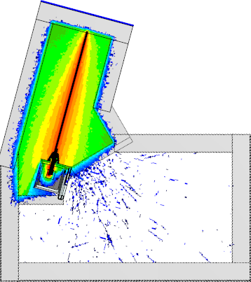
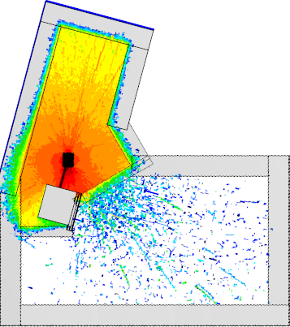
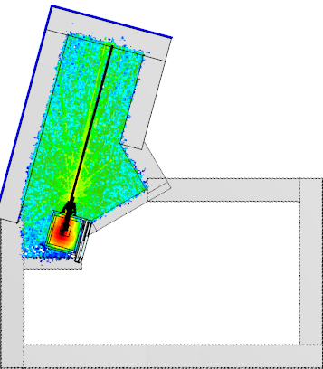
Prompt radiation
Proton beam loss @0.1W/m
Bombardment on target @5kW
Leakage from dump@5kW
Radiation from muon beamline will be calculated soon. Moveable shielding blocks are employed to control the overall radiation dose in experimental hall.

Slide 8
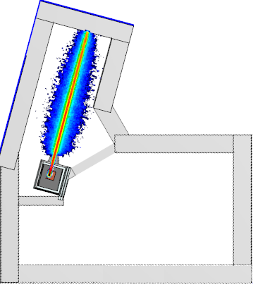
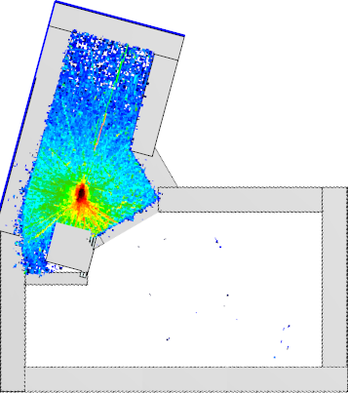
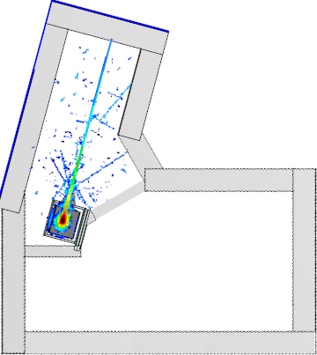
Induced radiation(operating 100 days & cooling 4h)
Proton beam loss @0.1W/m
Bombardment on target @5kW
Leakage from dump@5kW
Target region need some shielding for maintenance of other equipments!

Slide 9
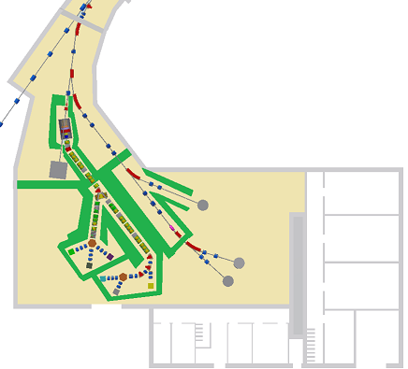
Safety control
Dose limitation
Forbidden region
Can’t enter the tunnel when the proton beam is on; Emergency repair is possible when CSNS accelerator is off.
Control region
Experimental personnel can enter experimental terminals to install or change samples when switching the beam off
Monitoring area
Authorized personnel can enter experimental hall
Public region
Office, control room et al.
Forbidden region >25 uSv/h
Control region >2.5 -25uSv/h
Monitoring area≤2.5uSv/h
Public region ≤0.3 uSv/h
Person protection system (PPS)
Interlock of forbidden region and CSNS accelerator;
Interlock of control region and extracted proton beam or muon beam;

Slide 10
Electricity and grounding
Common electricity （450 kW）
Lights, cranes, local air condition and exhaust equipment, water pump, et al.
Dynamic electricity （1500 kW）
For beamline equipments, such as vacuum pumps, magnets et al.
Clean electricity (Low interference) （100 kW）
Detectors, electronic equipments et al., a UPS will be needed to avoid the voltage fluctuation of power grid.
Grounding resistance：0.5-1.0 Ω

Slide 11
Cooling water
For magnets &Tungsten shielding
Conventional deionized water, High-activated closed loop water;
One water collecting reservoir for leakage of activated cooling water;
Total water volume: 80m³/h;
Living water for washing hands after handling in experimental hall;

Slide 12
Ventilation
Beam-line tunnel
Same way of handling with other tunnel of proton beam lines
Experimental hall
Non-activated air and direct emission to the atmosphere; update in-room air every two hours
Office and control room
Independent air condition system
Ventilation parameters：
Tunnel & experimental hall：
Environment temperature and humidity: 25±2 degree and 65±5%
Electronic and DAQ rooms:
Environment temperature and humidity: 23±2 degree and 65±5%

Slide 13
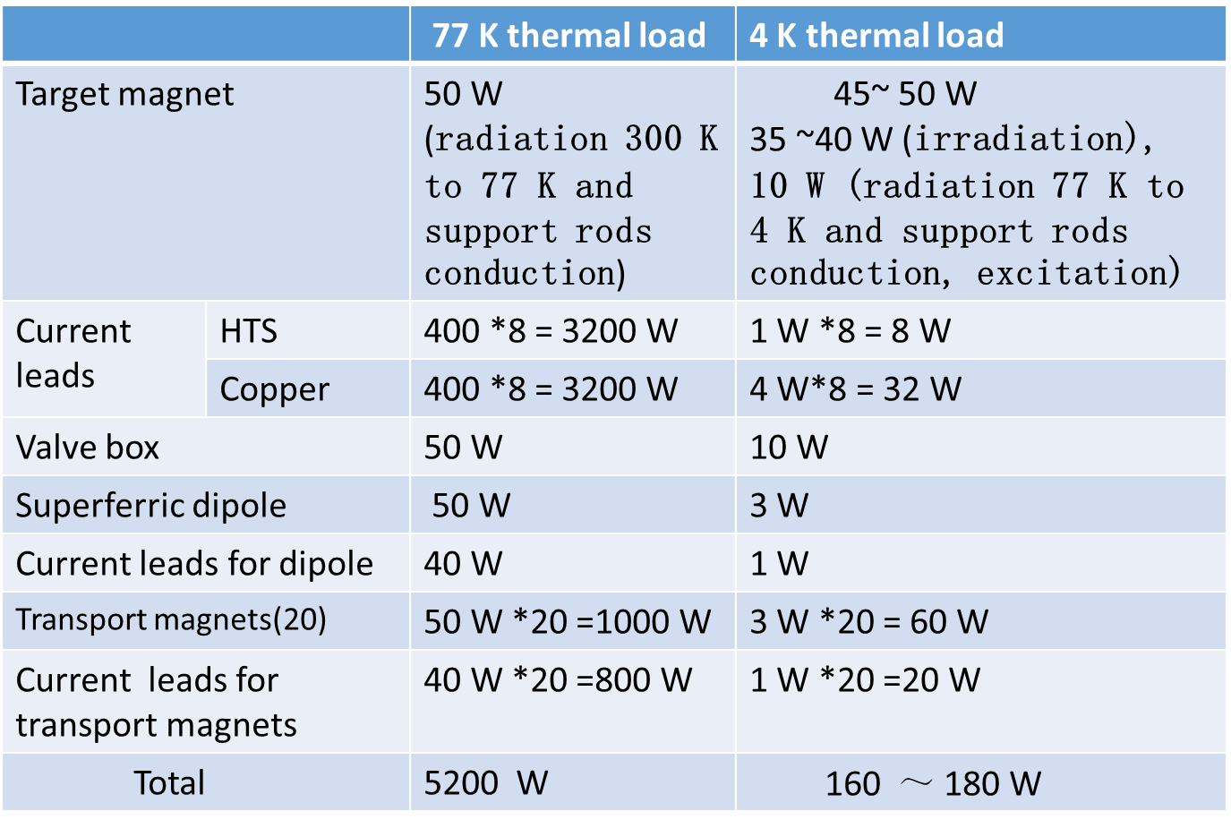
Cryogenic system
The design of EMuS cryogenic system is mainly to provide 4K cryogenic environment for superconducting solenoids
Heat loads：

Slide 14
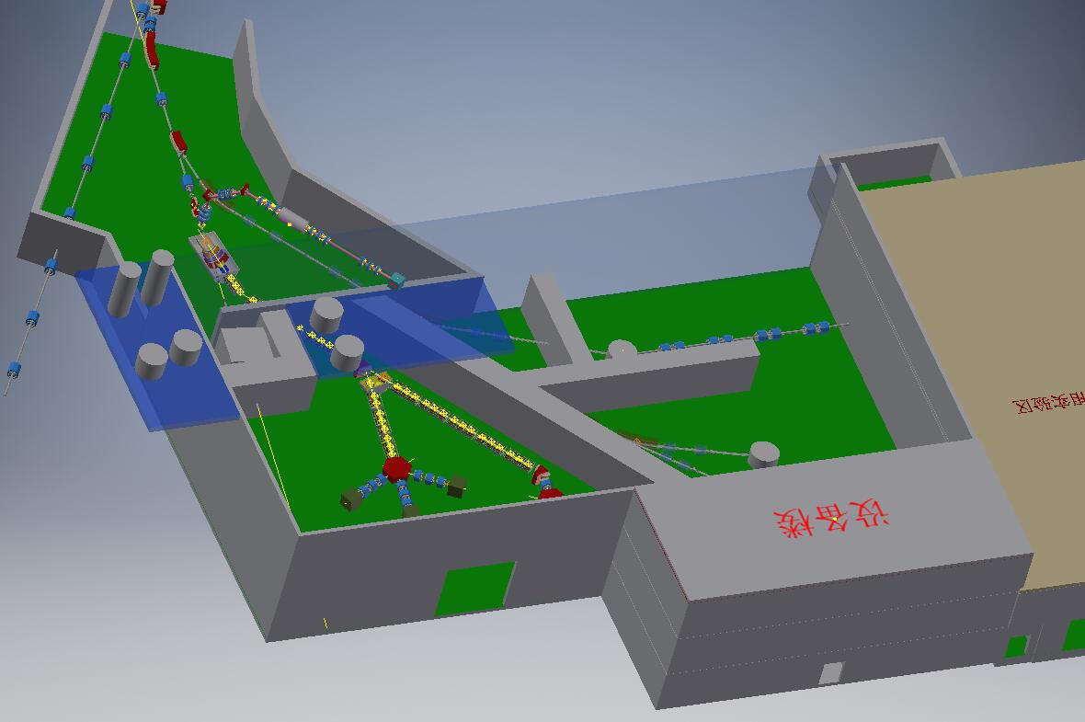
Layout considerations for cryogenic system
A new cryogenic hall with 60 m² for high-pressure He gas tank, compressor, Oil removing device
A platform with 40m² for Cold box & He Dewar
Liquid He surrounding by 80 k He gas is sent to SC cryogenic box
Cold box & He Dewar
Cryogenic platform
Cryogenic boxes
Target station
Straight section 1
Straight section 2
High-pressure He gas tank
Compressor & Oil removing device
Cryogenic hall

Slide 15
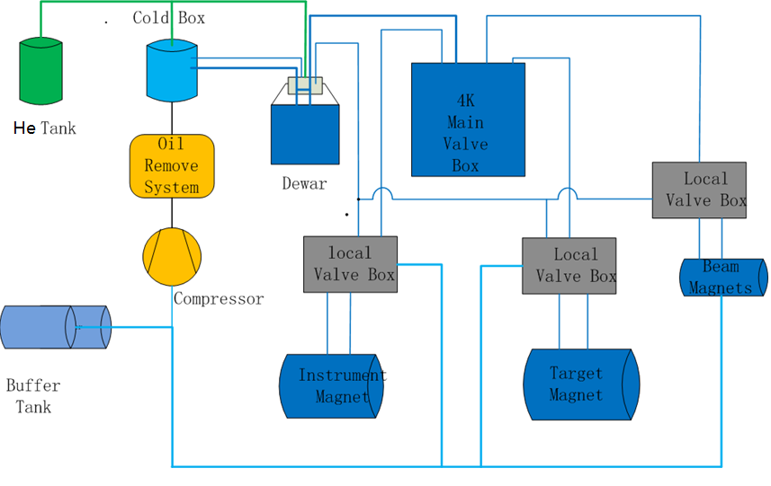
Flowchart of Cryogenic system

Slide 16
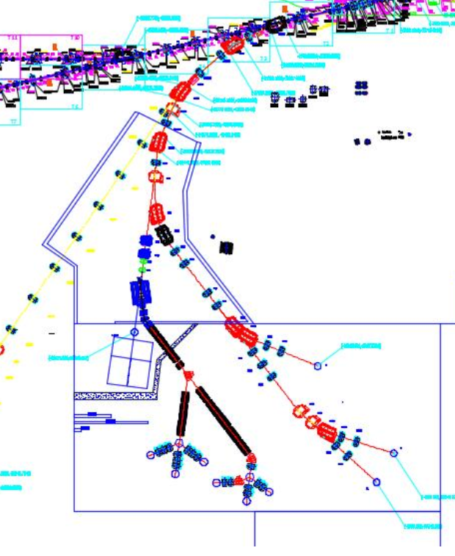
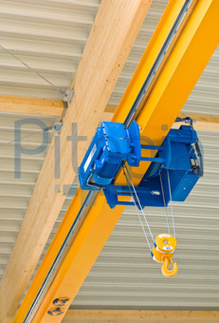
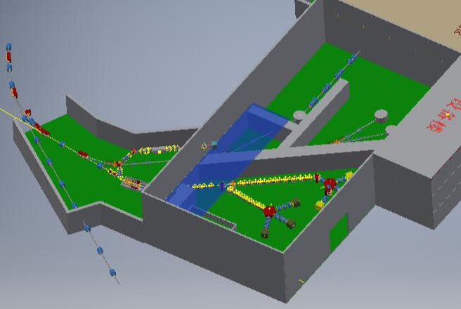
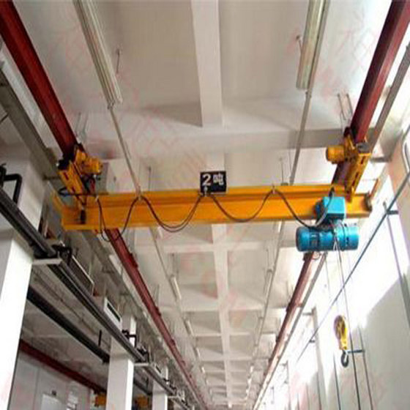
Equipment transport and hoisting
Overhead monorail crane @20t
Maintenance aisle
Additional monorail
~50t
platform
Hanging bridge crane @50t
Transport
Trenches or trays for cables and cooling-water tubes along beamlines

Slide 17
Summary
According the physics requirements, put all conventional parts, HPEA space allocation and maintenance together, the main interference issues are concerned.
The current results are preliminary and used as a reference for physics conceptual design.
After the beamline scheme and parameters are confirmed, the conventional facility will be designed in detail.

Slide 18
Thanks
Your comments are highly appreciated！

