Slide 1
Overall Design of EMuS
Yuan Ye
IHEP
20181120@CSNS
International Review on the Conceptual Design of EMuS

Slide 2
Outline
Question and solution
Keypoints of design
Summary

Slide 3
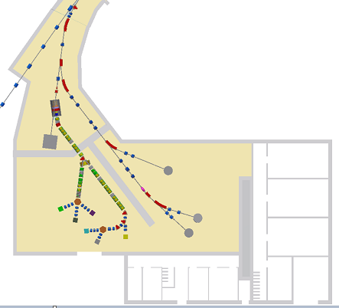
Question
Parameters | CSNS-I | CSNS-II
Linac Energy (MeV) | 80 | 250
RCS Energy (GeV) | 1.6 | 1.6
Power (kW) | 100 | 500
Power for EMuS (kW) | 5 | 25
How to make EMuS be an
attractive & cost effective
project based on 5KW proton beam?

Slide 4
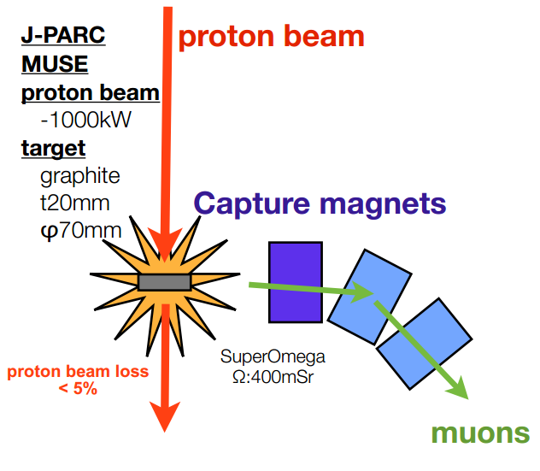
Conventional muon beam line
Thin target Different to spallation target
Side capture
Solution:
We can use thick target !
To improve secondary particle capture efficiency

Slide 5
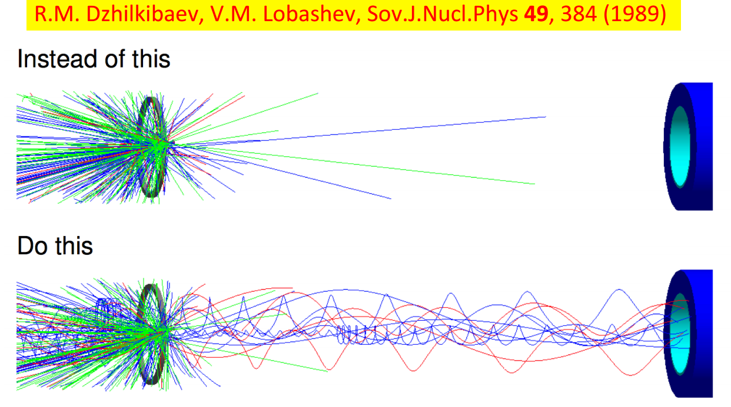
Improve capture efficiency
Put target inside solenoids

Slide 6
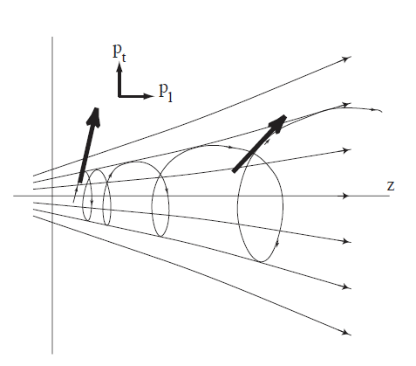
Adiabatic field capture
P²_{T} / B = C
conservation of
magnetic moment
P_{L}-> P_{T}

Slide 7
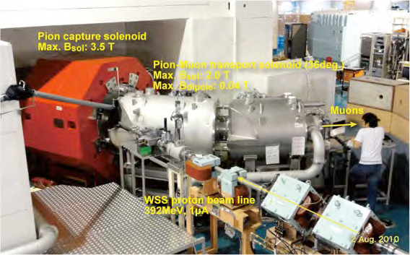
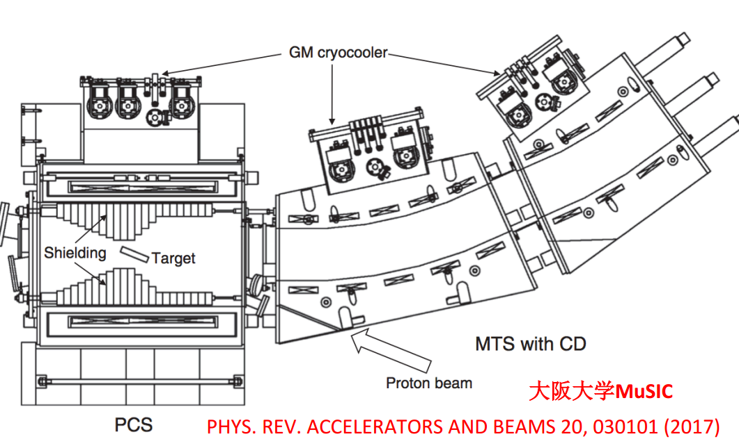
Demonstrated by MUSIC @2011
10⁸/s for 1MW @PSI
Large acceptance, wide momentum range
A factor of 1000 achieved than conventional method

Slide 8
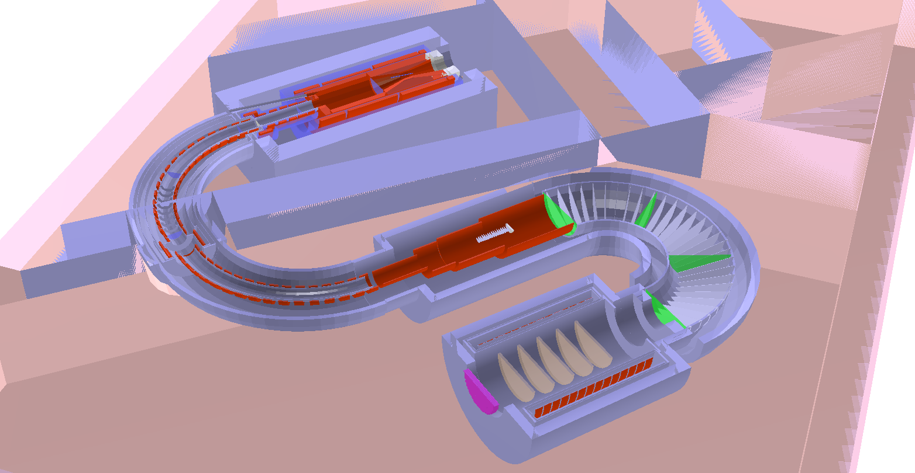
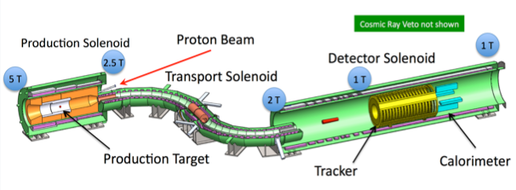
Projects for mu-e conversion
COMET @J-PARC:
Mu2e @ FNAL

Slide 9
EMuS
Competitive & Multi-purpose muon source
Surface muon mode: 29MeV/c
μSR, slow muon, muonium，…
Decay muon mode: 40-150MeV/c
μSR，
High momentum muon mode: 200-450MeV/c
μ imaging, neutrino physics…
Figure of Merit
μSR: IP²=Intensity * Polarization²
Others: Intensity
A difficult design， big challenge for us

Slide 10
Keypoints of design
Target station
Magnetic field, Geometry, Flexbility
Proton beamline
Combine with TS, Spent proton beam
Muon beamline
Large emittance, Wide momentum range,
Charge & momentum selection
Detector
Large spot, Relatively low polarization

Slide 11
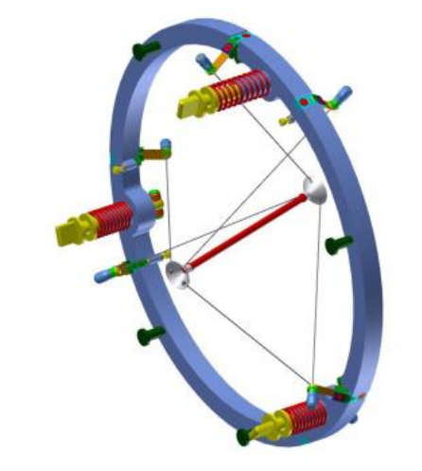
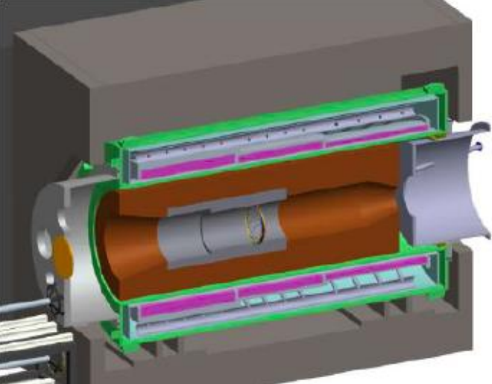
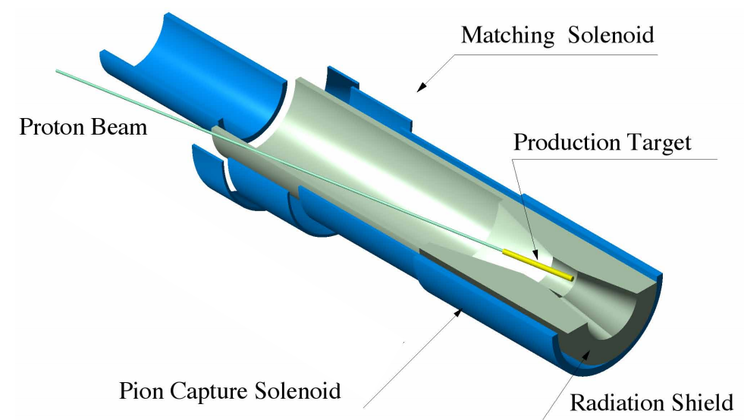
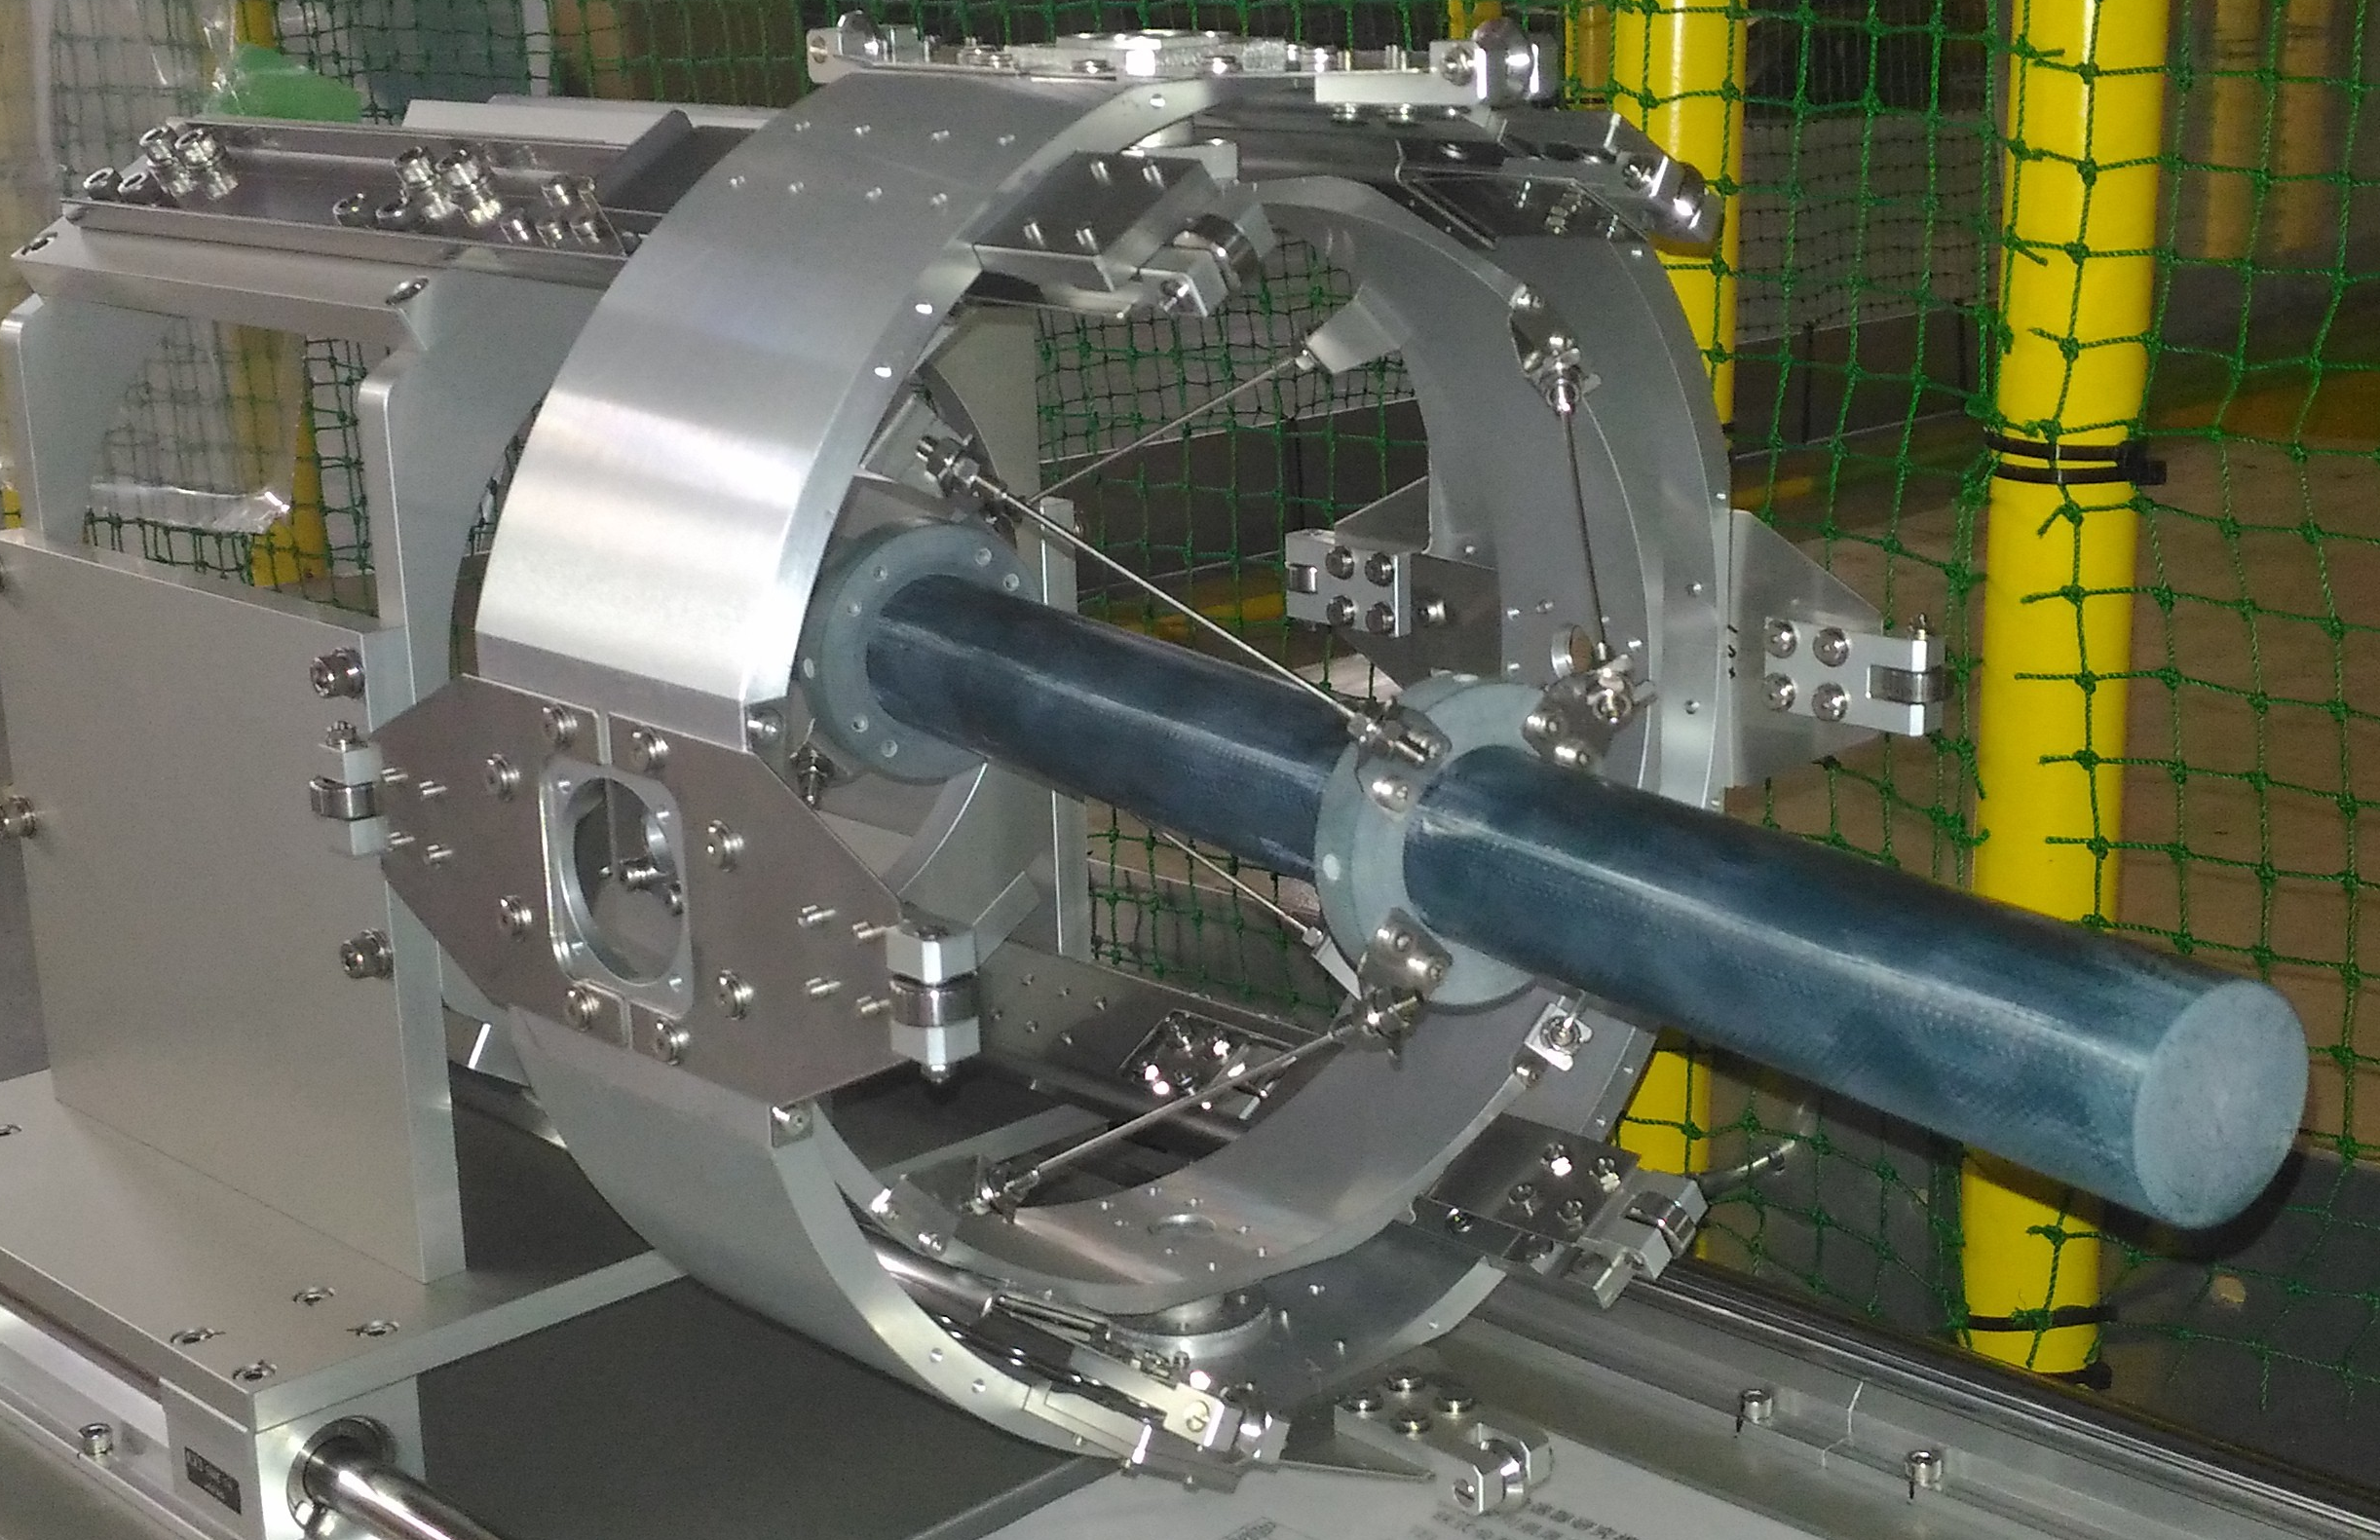
COMET & Mu2e
5T
Backward collection
Small size rod like target
Thick shield to protect Magnet

Slide 12
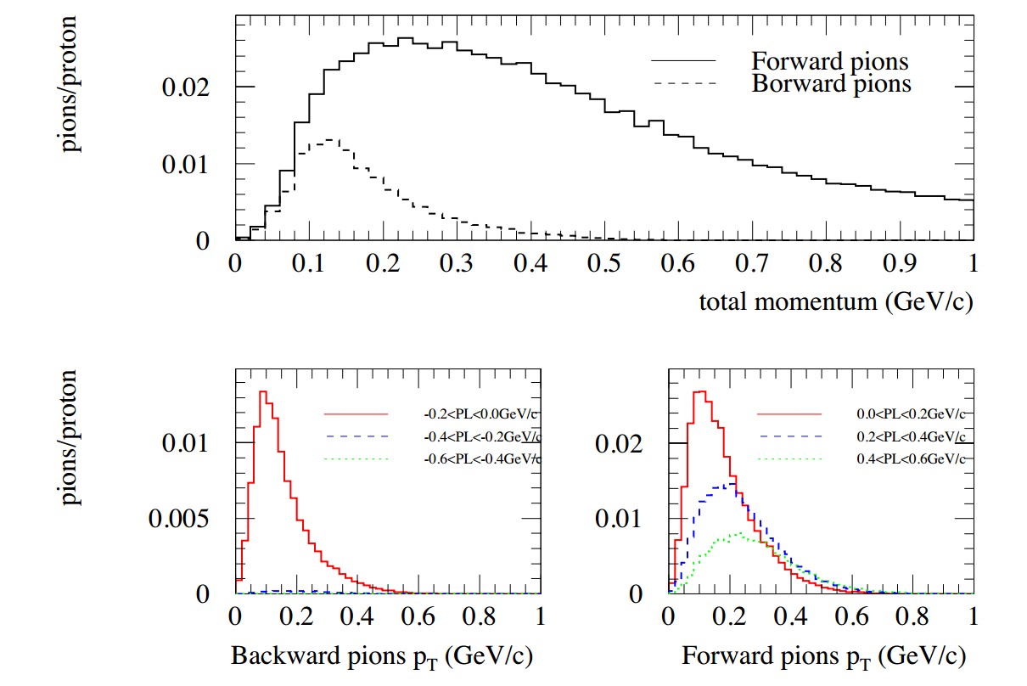
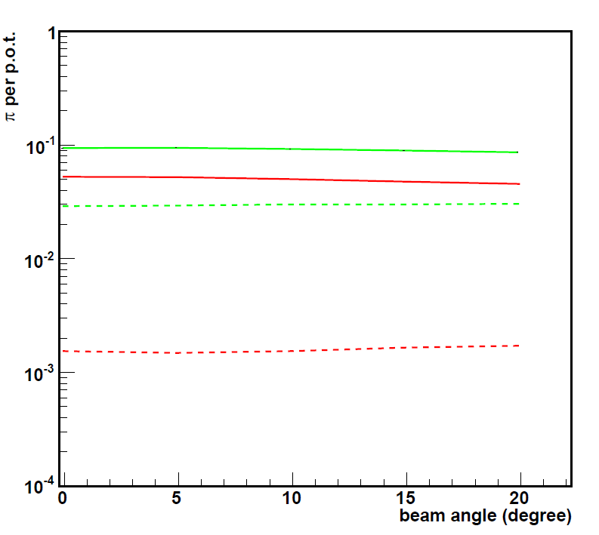
Backward or Forward?
pions per p.o.t.
frontward
backward
0.222 < p (GeV/c) < 0.776
High intensity and high momentum are essential to EMuS
Forward collection is chosen

Slide 13
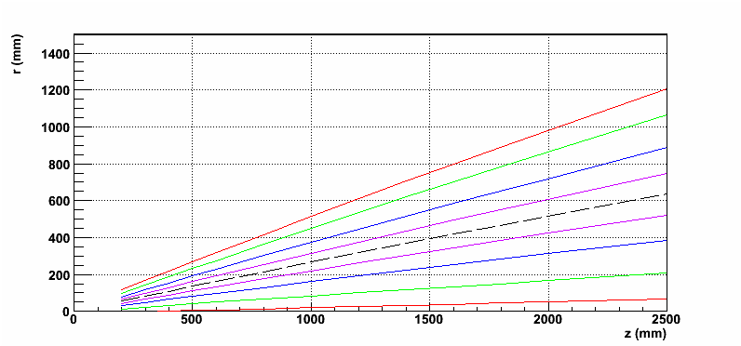
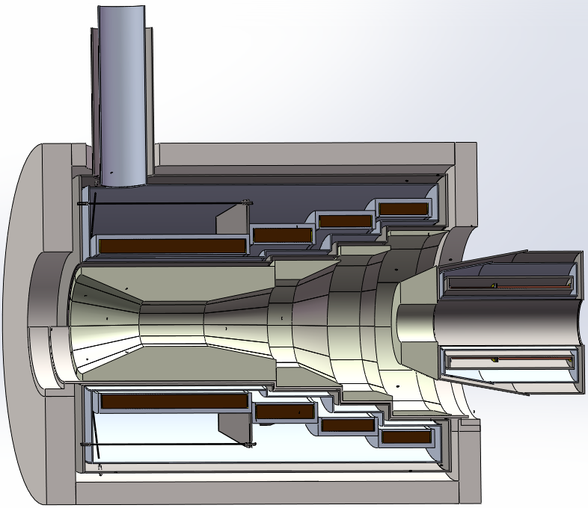
Spent proton beam extract
Proton beam distribution
SC4 + shielding
SC3 + shielding
SC2 + shielding
SC1 + shielding
MS + shielding
13
To make all the solenoids same radius is expensive, so a 4-coils/3-steps, 15º tilt angle geometry is chosen ( see details in Hou Zhilong’s report)
The detailed size of station depend on radiation and energy deposit ( see Zhao Guang’s report)

Slide 14
Flexible magnetic field
We found different magnetic field curve is needed for different run mode, especially for surface muon (see Nikos Vassilopoulos’s report)
This bring new requirements to Magnetic & proton beam design
 | μ⁺ with 27 < P < 29.8 MeV/c emittance = 10000 π mm mrad
B (T) | 1t0.5 | 2t1 | 3t1.5 | 5t3
i (x10⁶) μ/sec | 3 | 4 | 4.8 | 8.2
<Polz> % | .75 | .45 | .25 | .22

Slide 15
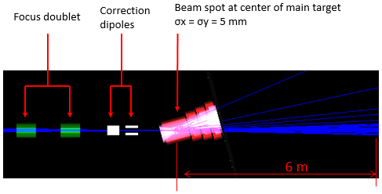
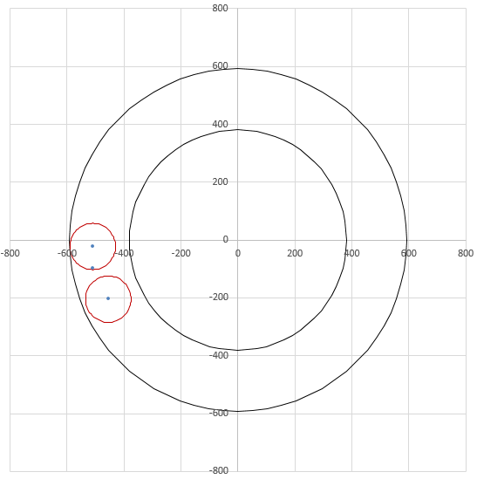
Adjustable proton beamline
Extraction hole for surface muon mode（ 2 T ）
Extraction hole for decay muon mode（ 5 T ）
Correction dipoles are needed
to make proton beam hit target correctly and extracted to beam dump safety ( see Chen Yukai’s report)

Slide 16
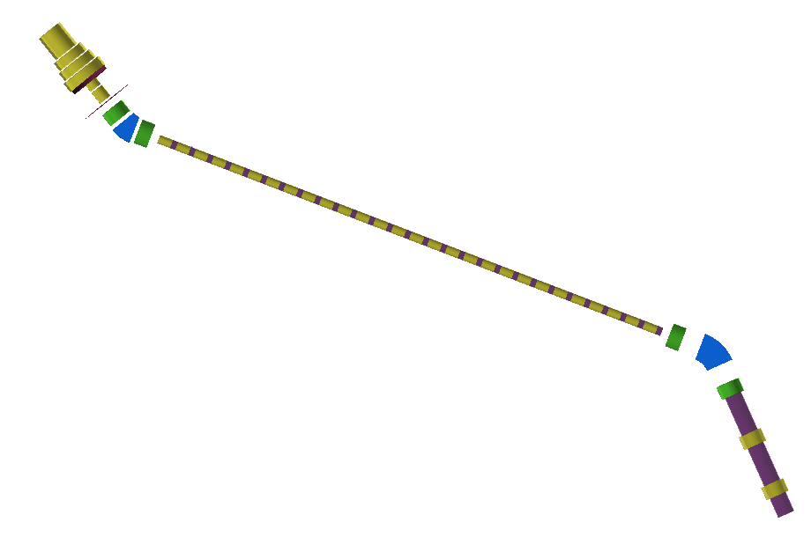
Multi-mode muon beamline
Large aperture, SC solenoids for large emittance (see Bao Yu’s report)
Charge/momentum selection for pion/decay muons
pion decay section
μSR muon section
2nd selection,
decay muons
Decay muon section

Slide 17
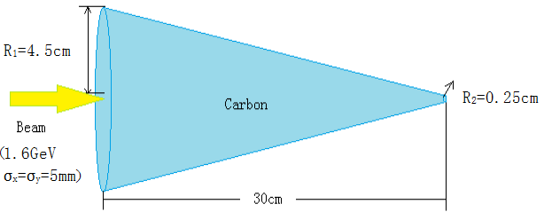
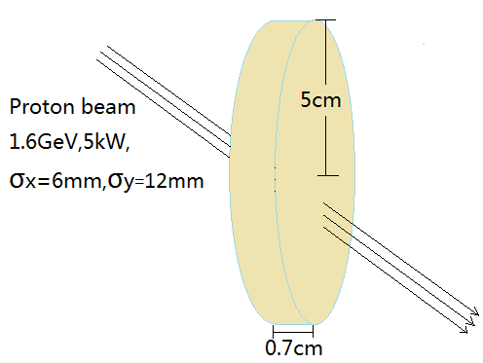
More consideration
Larger conical target for better μSR rate than cylindrical ones
An extra high-polarization thin target

Slide 18
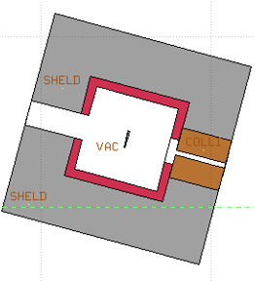
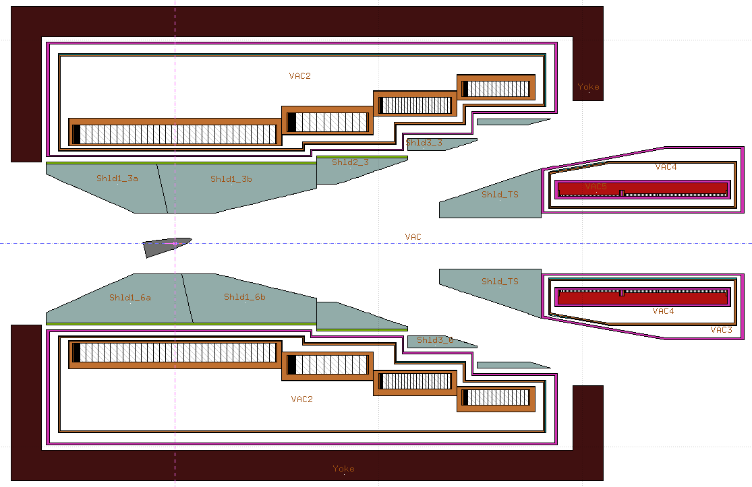
Baseline scheme: Target station
Thin target
Main target
SC3
SC4
SC1
SC2
π+
MS1
protons
π+
μ+
protons

Slide 19
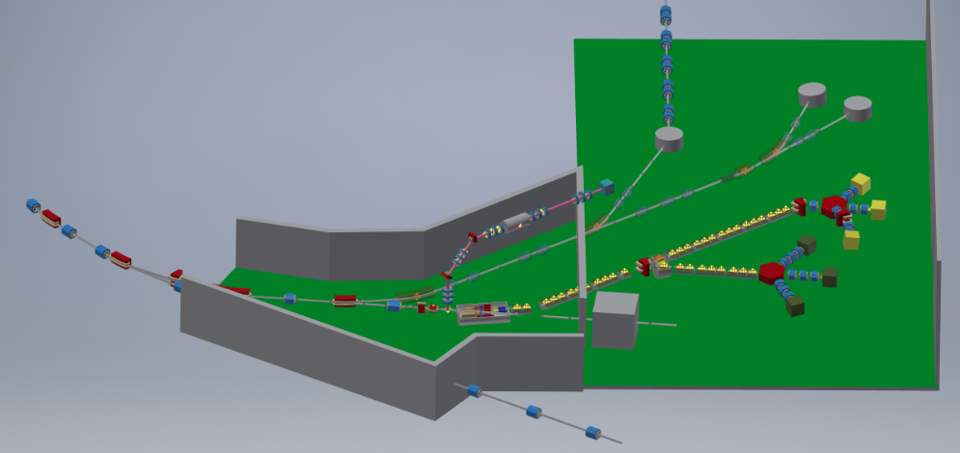
Baseline scheme: layout
Vertical beamline for thin target
Main muon beamline
Proton beamline
Main target station
Beam dump

Slide 20
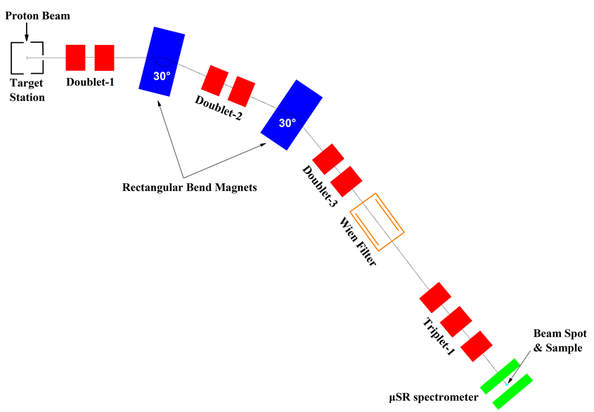
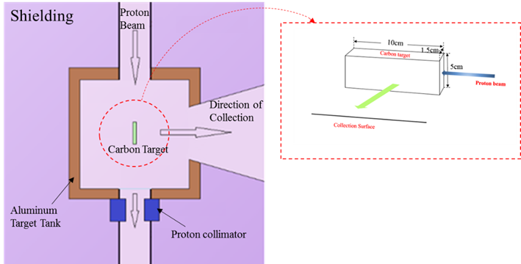
Baby scheme
Message from funding agency: EMuS may not be done in one step, a modest goal μSR project as first step
Conventional side collection solution
Reusable

Slide 21
Parameters
 |  | Ref. momentum | High-intensity |  |  | High-polarization
 |  |  | Intensity(1E6/s) | PolZ | Spot_{FWHM} (mm) | Intensity (1E6/s) | PolZ | Spot_{FWHM} (mm)
Surface muon | Baseline- scheme SC surface muon | 29 | 74 | -0.51 | 96×96 | 24 | -0.74 | 72×80
 | Baby-scheme muon | 28.5 |  |  |  | 0.12 | -0.92 | 31.2*32.5
 | Baseline-scheme vertical muon |  |  |  |  | ~0.06 | -0.94 | ~30*30
Decay muon |  | 45 |  |  |  | 25 | 0.68 | 88×88
 |  | 150 | 400 | 0.53 | 60×60 | 50 | 0.73 | 60×60
High-momentum muon |  | 450 | 130 |  | 72×76
Momentum spread for decay muon and high-momentum muon is ±6.7%

Slide 22
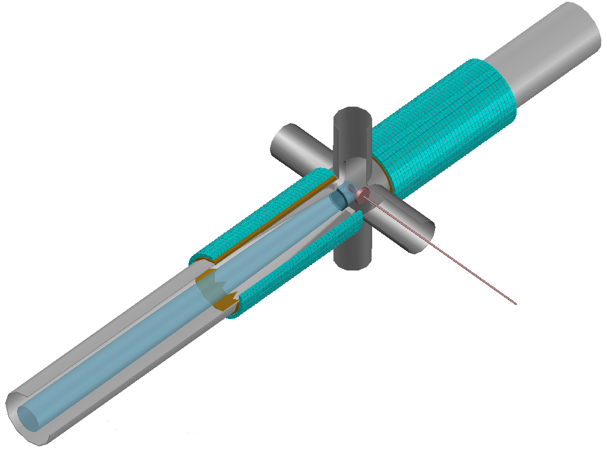
Detector
The beam spot is large
The muon beam intensity per pulse is relatively high，
polarization is relatively low
The repetition rate is low-2.5Hz
To get good performance
Fly-past sample environment
Reducing the count rate of
positrons in usage of degrader
Small radius ring, small size scintillator,
SiPM
(see Pan Ziwen’s report)
2560Scintillator + SiPM

Slide 23
Summary
A competitive muon source project is designed
Looking forward comments and ideas to improve
our design and finally lead to a success project
Thanks!

