Slide 1
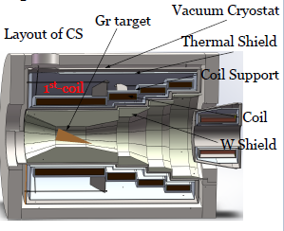
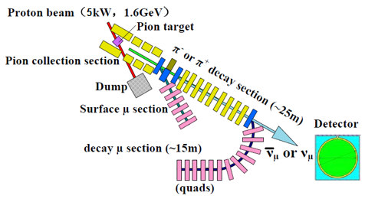
Target System Studies Experimental Muon Source
Nikos, IHEP, CAS

Slide 2
layout
Talk about the optimization of the 3 different targets for the Experimental Muon Source:
Baseline scheme targets:
muon and pion collection with 4-coils/3-steps Superconducting Adiabatic Solenoid
Graphite conical target
15⁰ tilt angle
capture for surface muons and pions/decay muons
comparison between FLUKA (used as default MC) and G4
highly polarized surface muons with thin target
Baby scheme target
typical Graphite slab used in singlet, doublet or triplet configurations
Aim
produce a competitive number of muons for μSR applications
a rate of 10⁶ – 10⁷ for surface muons / second and higher for decay muons under certain emittance selection criteria

Slide 3
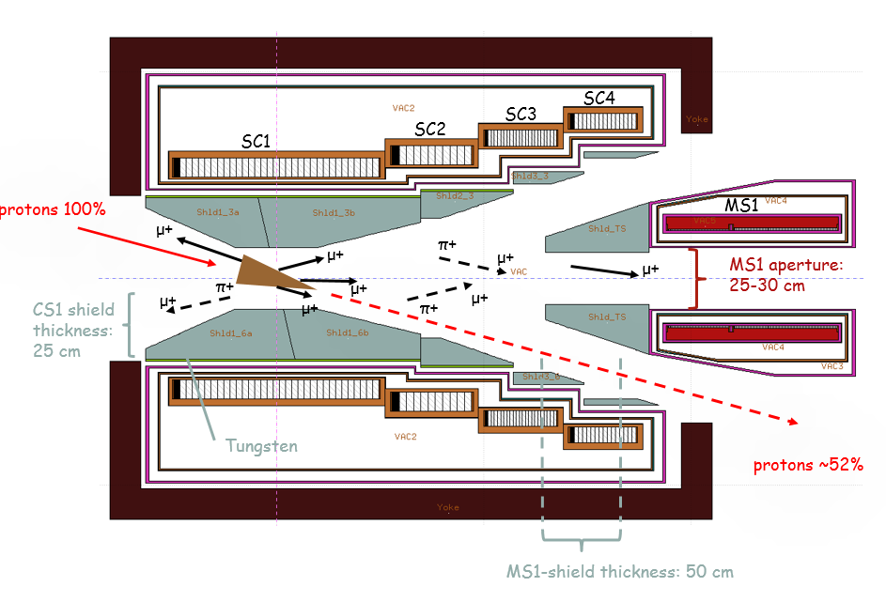
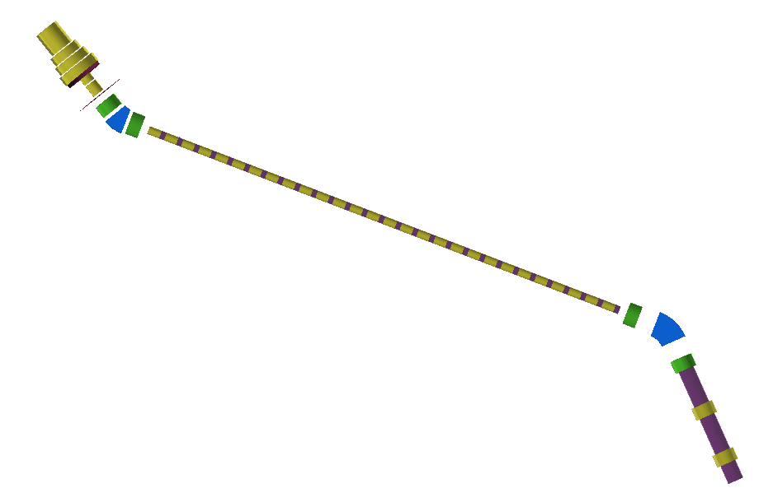
baseline scheme: Superconducting Capture solenoid for surface and decay muons
Superconducting Capture Solenoid
Charge/momentum selection for pion/decay muons
25 m superconducting transport solenoid
pion decay section
“surface” muon section
2nd selection,
decay muons
Decay muon section
secondary beam operation modes (independent):
surface muon mode for μSR physics @ 1 T
Ref. Pμ=25-29.8 MeV/c
decay muon mode @ 5 T
Ref. Pμ = 40, 150 MeV/c for higher energy μSR physics, and muon imaging
Captured pions ref. Pπ = 100, 260, 450 MeV/c Momentum spread: <± 10%
neutrino mode (optional) @ 5 T
Wide energy spectra
Ref. Pπ=260-500 MeV/c

Slide 4
proton and target parameters
proton beam parameters
E_{kin} (GeV) | σ (cm) | Power (kW)
1.6 | ~ 0.5 at target, double Gaussian | 5
target parameters for the cylindrical shape
material | radius r1 large / r2 small (cm2) | length (cm) | Z | λ_{I} (cm)
C (1.82 gr/cm³) | 4.5 / 0.25 | 30 / 0.65 λ_{I} | 6 | 47
r1
r2
Graphite is a common material used in neutrino and muon beams
lower neutron radiation due to low Z
30 cm length is optimized for coil radiation protection, power deposition in the Superconducting Solenoid
other material as Be or SiC have been considered and studied
Graphite

Slide 5
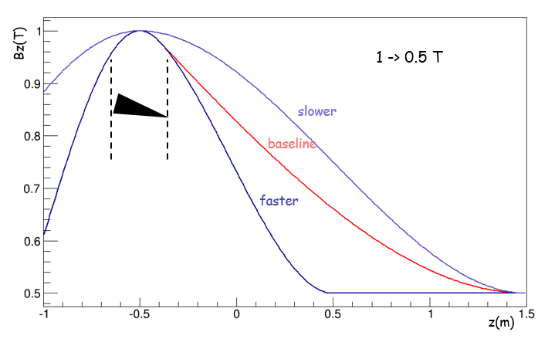
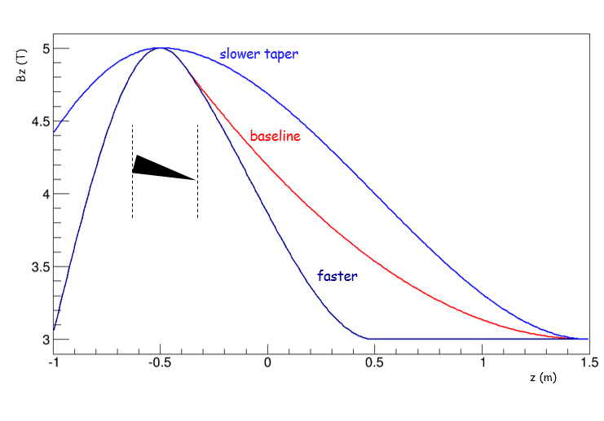
several adiabatic tapers are suggested for the surface and decay muon capture
1 or 2.5 -> 0.5 T for surface muon mode
5 -> 3 T for decay muon mode
surface muons collection
best π+ (decay muon) collection
Bz(r=0) T
Bz(r=0) T
1 -> 0.5 T
5 -> 3 T
z(m)
z(m)

Slide 6
Superconducting Capture Adiabatic Solenoid Target System
Forward spent-proton extraction, proton beam & target tilted in respect to magnetic axis, θp = 15º
4-coils/3-steps design, NbTi-Al coils, adiabatic taper
15⁰ tilt of protons/target with respect to magnetic field lines:
facilitate the extraction of spent-protons with a moderate length of 2.5 m of the CS through the Matching Solenoid and capture coils
lower tilts as 10⁰ make the length of CS excessive due to MS shielding

Slide 7
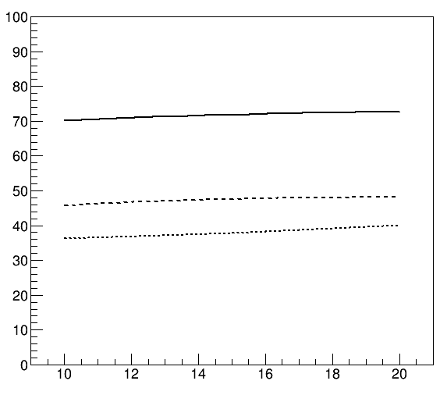
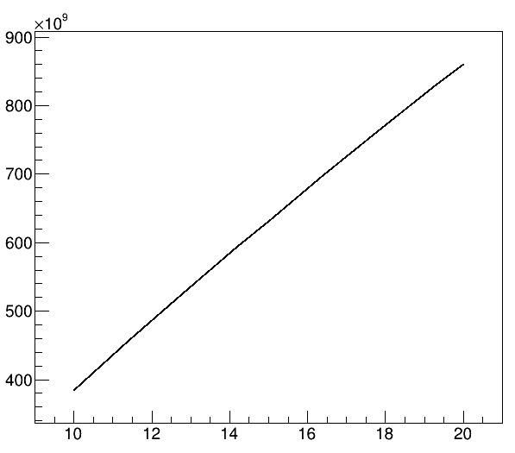
best surface muons polarization at 1 T
tilt aids π+ capture (also for surface muons)
r1 = 4.5 cm
r2 = 0.25 cm
Graphite
polarization of surface muons
as function of tilt angle/fields
π+ rate as function of tilt angle
π+ / s
5 -> 3 T
polarization (%)
1 -> 0.5 T
2.5 -> 0.5 T
5 -> 3 T
baseline tilt 15⁰
baseline tilt 15⁰
1st coil study – no shielding
no emittance selection
tilt angle
tilt angle

Slide 8
μSR: surface muon collection at entrance of MS1 at 1 and 2.5 T
surface muon sources
target
shielding
shielding of MS1 act as collimator

Slide 9
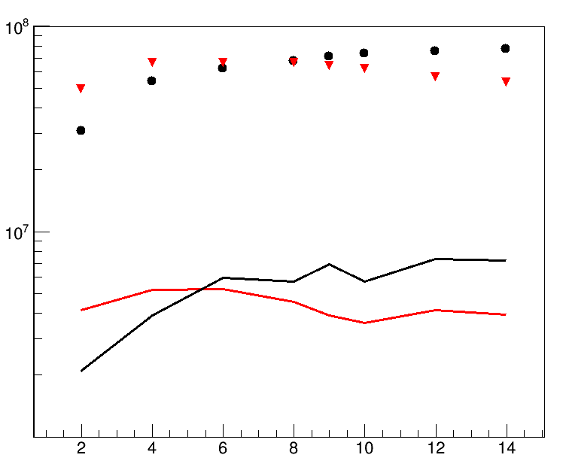
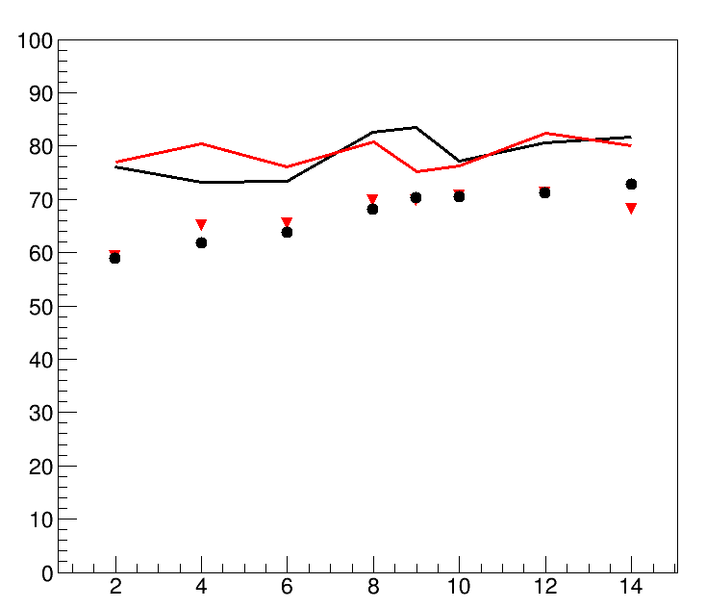
conical target
better surface muon collection
lower power deposition on the SC than the cylindrical one
μ+ with 25 ≤ P (MeV/c) ≤ 29.8
similar polarization
r1 = 4.5 cm
r1
r2 = 0.25 cm
rate and polarization as function of radius r1 (in σ_{b} = 0.5 cm)
10000 π mm mrad selection
μ+ / s
no emittance selection
stat. error ~ 1%
Polarization (%)
cone
cylinder
10000 π mm mrad
stat. error ~ 5%
no selection
baseline
r1 (σ_{b} )
r1 (σ_{b} )

Slide 10
μSR: μ+ collection at MS1
1 or 2.5 -> 0.5 T
r1 = 4.5 cm
r2 = 0.25 cm
emittance (π mm mrad) | 10000
momentum (MeV/c) | μSR - μ⁺ 25 < P < 29.8
field | 1 -> 0.5 T |  | 2.5 -> 0.5 T
target material | Gr | SiC | Gr | SiC
intensity (x10⁶) μ/sec | 7 | 7 | 18 | 22
polarization | -0.83 | -0.85 | -0.62 | -0.60
surface muon purity (%) | 86 | 85 | 68 | 65
stat. errors for both intensity and polarization < 5%
1T has the better polarization 83% @ 10000 π mm mrad
2.5 T has the better rates

Slide 11
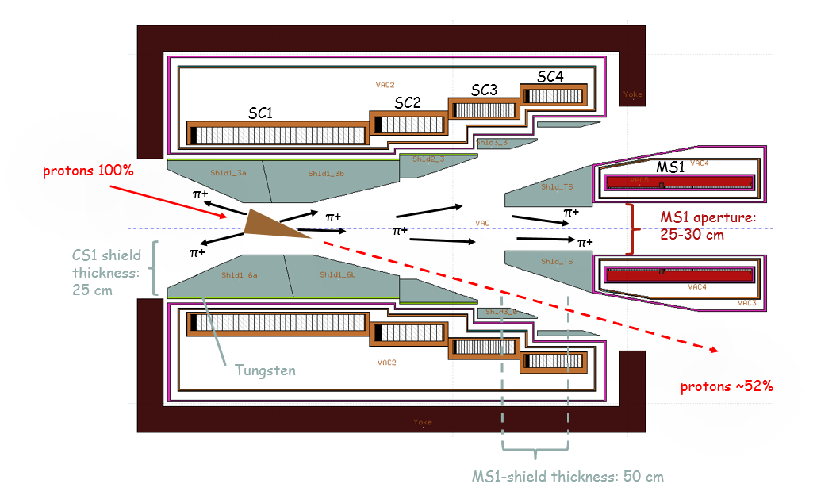
μSR: π+ collection for decay muons at entrance of MS1 and 5 T

Slide 12
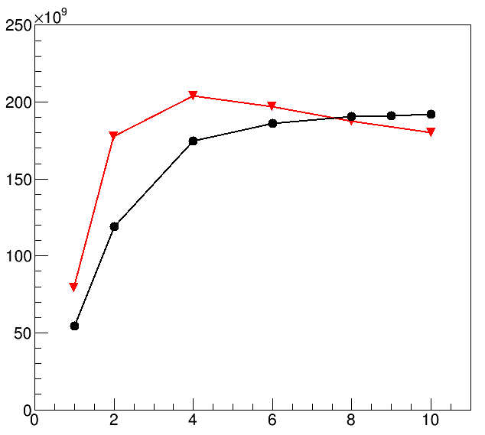
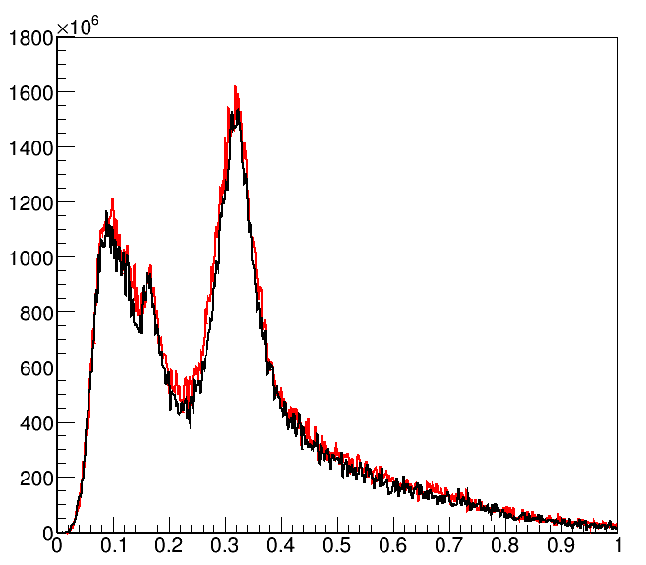
conical target π+ collection at MS1
slightly less (-10%) collection than cylindrical best
r1 = 4.5 cm
r2 = 0.25 cm
r1
rate as function of radius r1 (in σ_{b} = 0.5 cm) and momentum distributions
π+ / s
π⁺ / 2 MeV / s
conical baseline
cylinder best
baseline for conical
r1 (σ_{b} )
P GeV/c

Slide 13
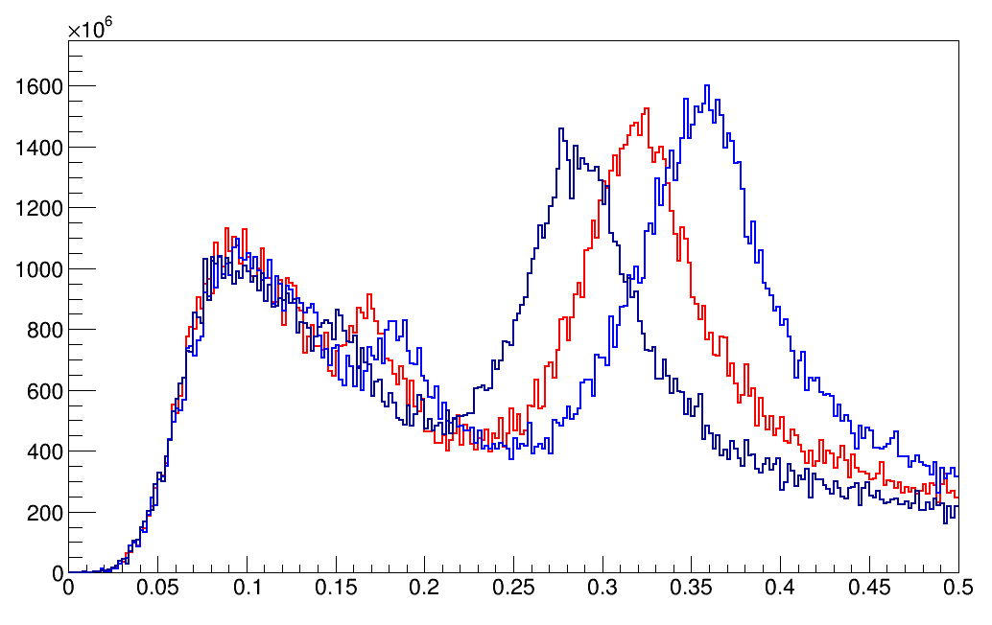
different adiabatic tapers <-> different momentum selection
5T case
π+ entering MS1 as function
of different taper shapes at 5T
5T taper variations
100 MeV/c
~100 MeV/c
450 MeV/c
Bz(r=0) T
π⁺ / 2 MeV / s
Slower taper
Baseline
Faster
5 ->3 T
z(m)
P GeV/c

Slide 14
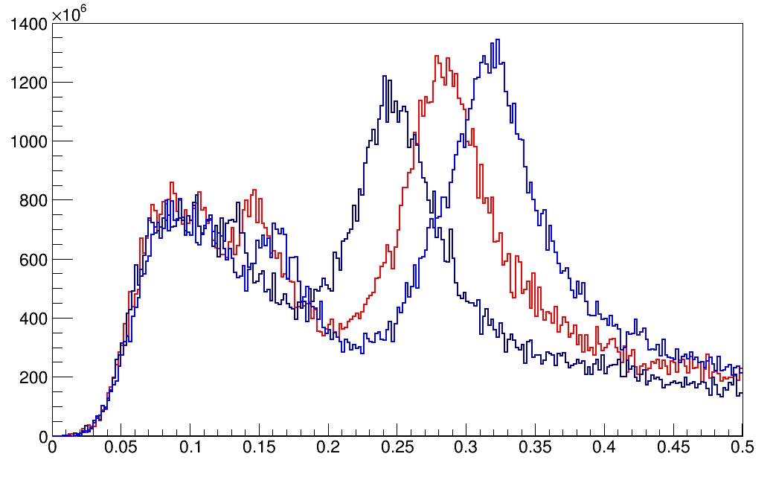
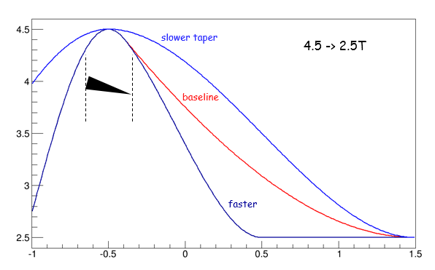
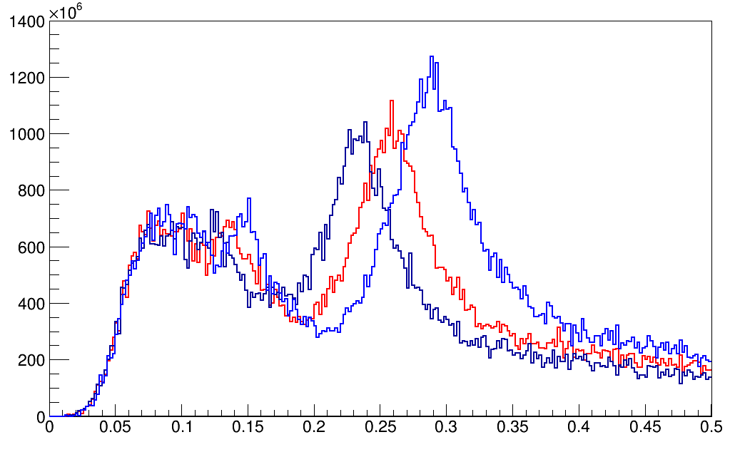
different momentum selection
4.5, 4 T cases
260 MeV/c
4.5 -> 2.5 T
π⁺ / 2 MeV / s
4.5T taper variations
Bz(r=0) T
P GeV/c
260 MeV/c
4 -> 2.5 T
π⁺ / 2 MeV / s
z(m)
P GeV/c

Slide 15
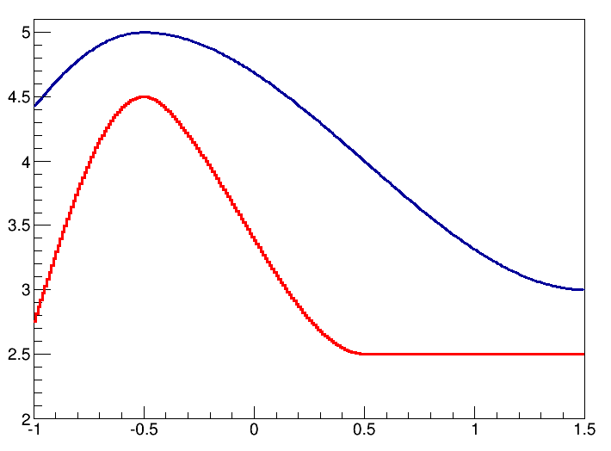
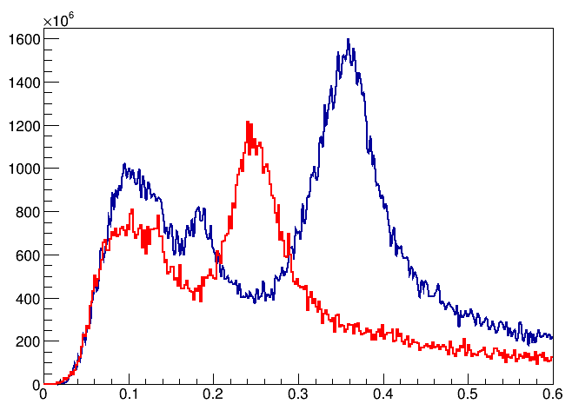
π+ collection for decay muons
final 5, 4.5 T tapers used for π+ collection
5 , 4.5 T taper variations
π+ entering MS1 as function for different taper
100 MeV/c
260 MeV/c
450 MeV/c
Bz(r=0) T
π⁺ / 2 MeV / s
100000 π mm mrad
Z in m
P GeV/c
emittance (π mm mrad) | 100000
P (MeV/c) ± 10% | 100 | 260 | 450
intensity π+ (x10¹⁰) μ/sec | 1 | 2.8 | 2.4
stat. error ~ 1%

Slide 16
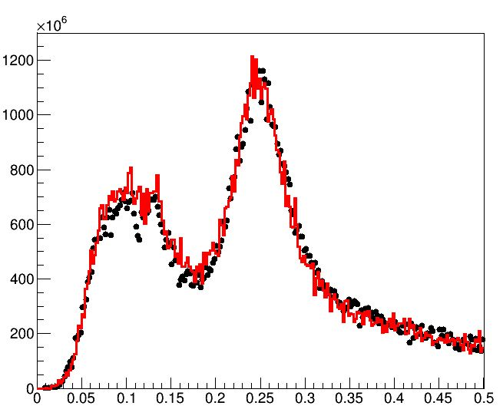
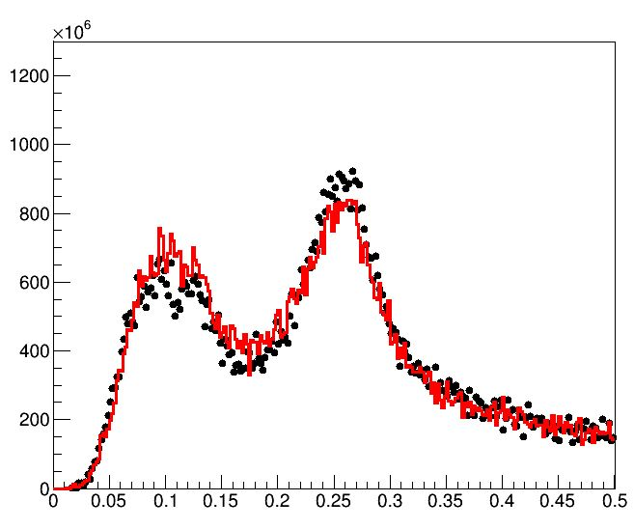
the polynomial best field used for optimization can be reproduced with realistic coil design
π+ collection at 260 MeV/c at MS1 entrance/exit
Entrance of MS1
Exit of MS1
260 MeV/c
π⁺ / 2 MeV / s
260 MeV/c
π⁺ / 2 MeV / s
100000 π mm mrad
Best 4.5->2.5 T fast
100000 π mm mrad
Best 4.5->2.5 T fast
coil design
4.4->2.4 T
coil design
4.4->2.4 T
P GeV/c
P GeV/c

Slide 17
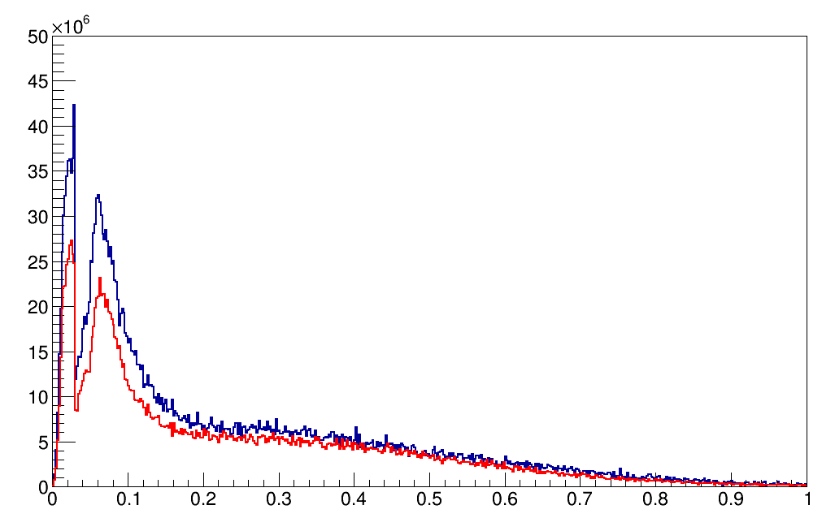
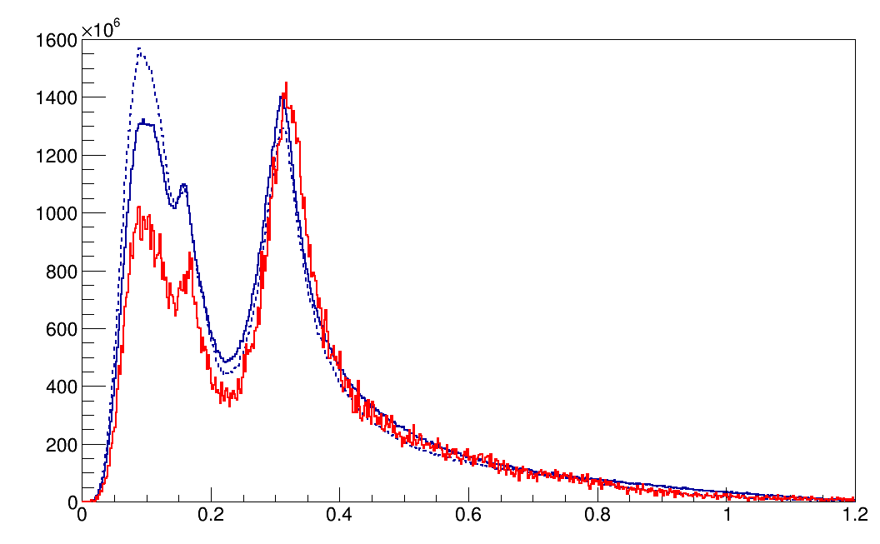
Systematics between FLUKA and G4
μ+, 1 T
π+, 5 T
μ⁺ / 2 MeV / s
FLUKA = 2.2x10⁹
G4 (incl) = 2.9x10⁹
π⁺ / 2 MeV / s
FLUKA = 1.7x10¹¹
G4 (bert) = 2x10¹¹
G4 (incl) = 2x10¹¹
Ratio μ+/μ-
FL = 2
G4 = 3.6
Ratio π+/π-:
FL = 1.9
G4 (bert) = 2.9
G4 (incl) = 2.2
G4: Song Yingpeng
P GeV/c
P GeV/c
For μSR μ+:
FLUKA ~ -30%
Both MCs could be used keeping in mind the difference
For π+:
Total pions are similar with FLUKA and G4 (BERTINI)
FLUKA predicts a ratio π+/π- = 2

Slide 18
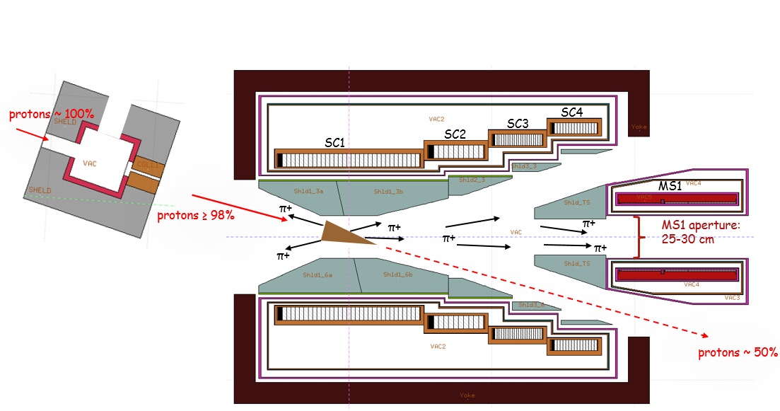
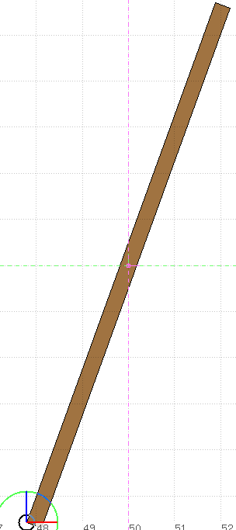
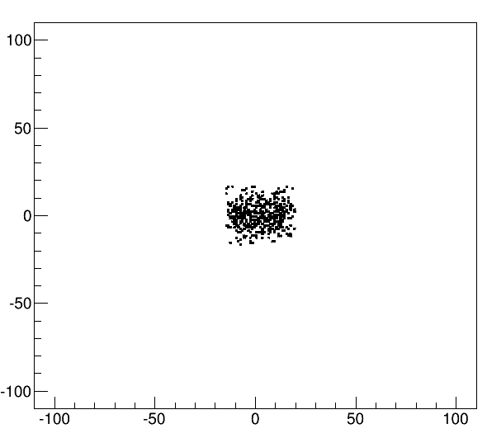
thin tilted target for baseline scheme
target-proton interaction ≤ 1 cm
create highly polarized μSR beam parallel to decay muons mode
quadrupole collection
μ+
Length = 12 cm
protons @ z-axis
μ+
π+
μ+
collection surface
r= 16cm
collected surface muon vertices at target
4500 π mm mrad selection
Height = 12 cm
tilt = 20⁰
μ+
y (mm)
Width = 0.34 cm
Turn = 45⁰
x-axis, 60 cm
Graphite slab | 1 cm p -> Gr interaction
emittance (π mm mrad) | 4500
momentum | μSR - μ⁺ 25 < P < 29.8 MeV/c
Target Length x Height (cm2) | 12x12
Tilt (degree) | 20 | 30 | 45
intensity (x10⁶) μ/sec | 1 | 0.95 | 0.8
polarization | -0.97 | -0.97 | -0.97
surface muon purity (%) | 98 | 98 | 97
statistical error | ~ 2% / 1% on intensity / polarization
proton beam @ z-axis
only a part of the target is playing a role
we can reduce the target to
Length x Height = 5 x 4 cm2
z (mm)

Slide 19
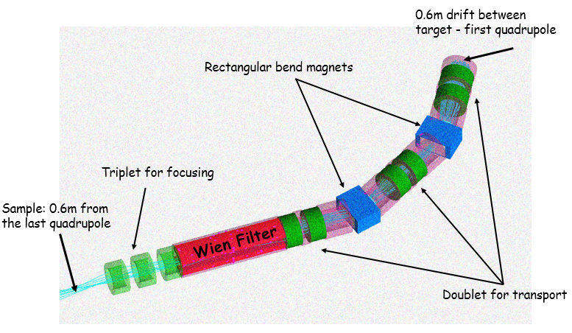
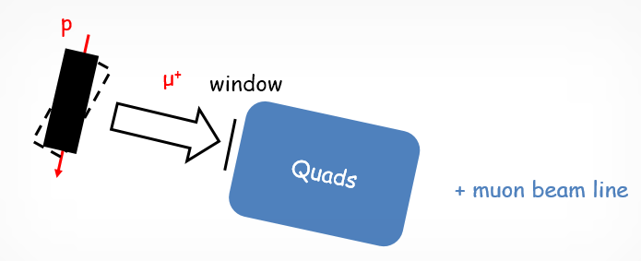
“Baby” scheme, target outside collector only for surface muons
Sideway μSR collection at 90⁰ with respect to the primary proton beam direction
Quadrupole system, low acceptance collector
Aim to maximize the μSR rate at the entrance of quadrupole using FLUKA MC for:
singlet, singlet-tilt
doublet (triplet)

Slide 20
singlet slab
surface muons rates and polarizations as function of target face width
proton beam peak is centered
rectangular target
Best Width = 1 or 2 cm
Length = 12 cm
length
protons
μ+
μ+
height
Height = 12 cm
π+
protons
μ+
collection surface
(z,y), r= 16cm
x-axis 60 cm
Target | Gr slab – sides : 12x12 cm2
emittance (π mm mrad) | 4500
momentum | μSR - μ⁺ 25 < P < 29.8 MeV/c
Target’s width (cm) | 4 | 3 | 2 | 1
intensity (x10⁶) μ/sec | 2 | 2.4 | 2.8 | 2.9
polarization | -0.88 | -0.91 | -0.94 | -0.96
surface muon purity (%) | 92 | 94 | 96 | 97
stat. error ~ 1.5% for intensity / polarization

Slide 21
singlet slab best case
proton’s Gaussian peak is displaced by 0.5 cm = 1 σ_{p} from side (collection) surface
collection surface
(z,y), r= 16cm
Target | Gr slab – sides : 12x12 cm2, width = 4 cm , σ_{p} = 0.5 cm
emittance (π mm mrad) | 4500
momentum | μSR - μ⁺ 25 < P < 29.8 MeV/c
Gaussian peak from side surface (cm) | 0 | 0.5 | 1 | 1.5 | 2
intensity (x10⁶) μ/sec | 2.4 | 3.3 | 3.1 | 2.3 | 2
polarization | -0,96 | -0.96 | -0.93 | -0.92 | -0.89
surface muon purity (%) | 97 | 97 | 95 | 94 | 92
stat. error ~ 1.5% for intensity / polarization
Length = 12 cm
Width = 3 or 4 cm
protons
protons
μ+
μ+
Height = 12 cm
π+
μ+
x-axis, 60 cm
This is the best case compared to singlet-turn, also to doublet and triplet and selection of 4500 π mm mrad, see next pages

Slide 22
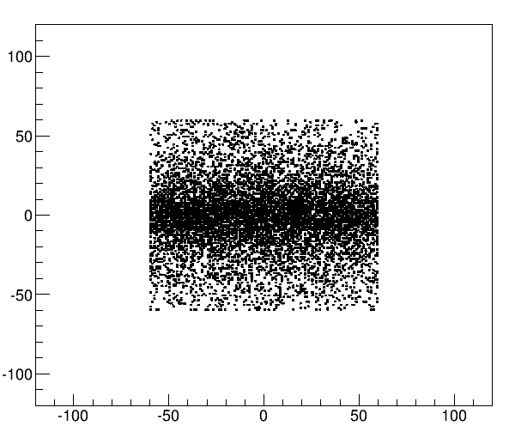
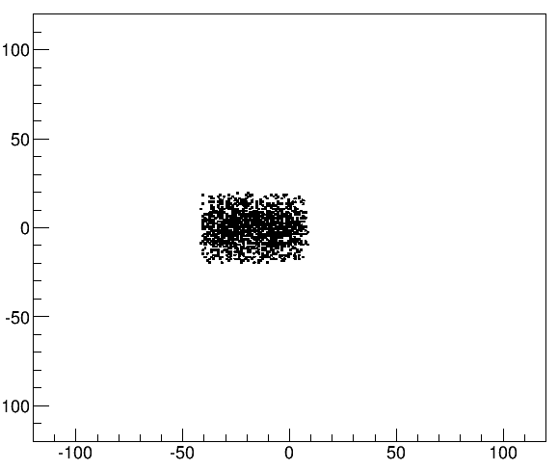
vertices of all and selected surface muons passing through the collection surface
y (mm)
all surface muons
surface muon
4500 π mm mrad selection
y (mm)
proton beam @ z-axis
proton beam @ z-axis
whole target side surface is displayed, 12x12 cm2
only the first part of the target is playing a role due to emittance selection
z (mm)
z (mm)
Length (z) = 12 cm
for the given emittance selection target side surface could be reduced from 12x12 cm2
the target of Length x Height = 10x5 cm2 used is probably ok
protons
Height (y) = 12 cm

Slide 23
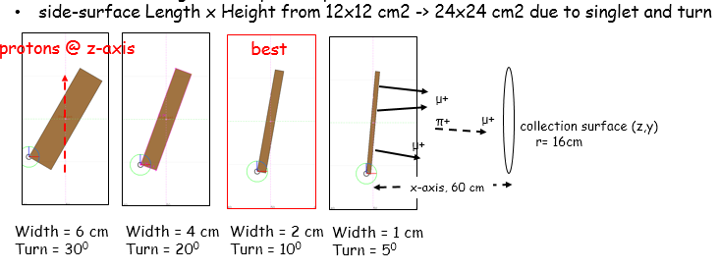
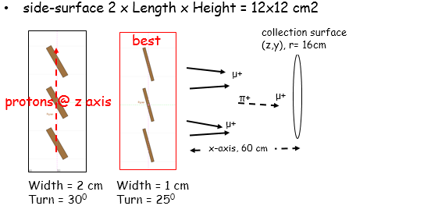
singlet-tilt case and doublets triplets
total proton – target interaction always at 12 cm
best cases for doublets or triplets
multiplets not shadowing the collection surface
Target | Gr slab
Selection | μSR - μ⁺ 25 < P < 29.8 MeV/c
target | BEST singlet with Gaussian peak 0.5 cm from side collection surface | singlet-tilt | doublet | triplet
total intensity (x10⁶) μ/sec | 24 | 31 | 28 | 31
emittance (π mm mrad) | 4500
intensity (x10⁶) μ/sec | 3.3 | 3.2 | 2.6 | 3.2
polarization | -0,96 | -0.96 | -0.95 | -0.95
surface muon purity (%) | 97 | 96 | 97 | 96
stat. error ~ 1.5% for intensity / polarization

Slide 24
Conclusions on muon/pion collection
full scheme with 4-coils/3-steps SC solenoid / collection at MS1:
μSR physics with surface muons
1 -> 0.5 T, best for polarization
7x10⁶ μ+ / s, 83% polarization, 86% surface muon purity @ 10000 π mm mrad
2.5 -> 0.5 T
1.8x10⁷ μ+ / s, 62% polarization, 68% surface muon purity @ 10000 π mm mrad
one order more for total muon rates
decay muons, π+ collection
5 T for 100 and 450 MeV/c, and 4.5 T for 260 MeV/c
π+ / s ~ ≥ 10¹⁰ π+/s @ 100000 π mm mrad
thin target / collection at quadrupole
~ 10⁶ μ+ / s, 97% polarization, 98% surface muon purity @ 4500 π mm mrad
baby scheme / collection at quadrupole:
3.3x10⁶ μ+/s with 96% polarization and 97% surface muon purity @ 4500 π mm mrad
Thanks

Slide 25
questions
concerning the capture systems
what is the minimum limit of polarization for μSR physics
what is the decay muon best momentum range ?

Slide 26
extra

Slide 27
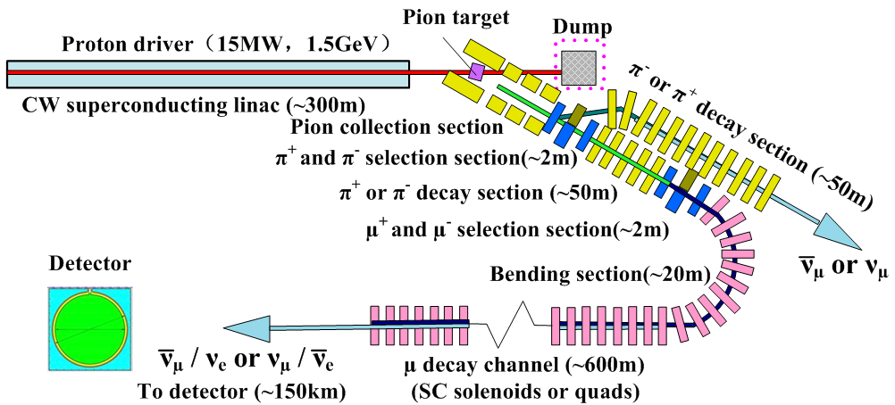
thanks
EMuS innovation:
Unique SC capture solenoid (5T max.)
Forward capture & spent proton extraction
Coils will be made by Chinese industry
MOMENT at future:
15 MW cw-proton beam
Leptonic CP-violation
DAR
CC-NSI
EMuS as R&D for MOMENT:
MW Capture system
Pion transport/decay
Charge separation
Muon transport/decay channels

Slide 28
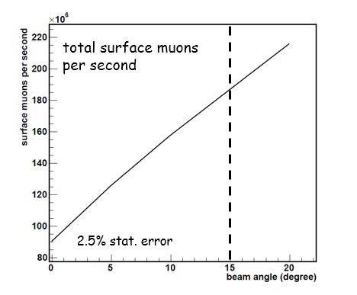
muon yields as function of target tilt and length (exit of 1st coil, no-shield)
For baseline target
15º
Total surface muons 10⁸ / second
Polarization along beam axis ~ 80-82%

Slide 29
Field Study, 1 T to 5 T
μ⁺ with 27 < P < 29.8 MeV/c
 | μ⁺ with 27 < P < 29.8 MeV/c – ε_{x} and ε_{y} = 10000 π mm mrad
 | cone, r1 = 8 cm, r2 = 4σ_{b}, σ_{b} = 10 mm (max ~ 12% / 8% / 8% error on ip2 / i / Polz)
B (T) | 1t0.5 |  |  | 2t1 |  |  | 3t1.5 |  |  | 5t3
type | cub. | 1st coil | fast | cub. | 1st coil | fast | cub. | 1st coil | fast | cub. | 1st coil | fast
ip2(x10⁶) | 1.7 | 1.8 | 1.7 | .8 | 1.8 | .9 | .3 | 1.4 | .2 | .4 | 1.4 | -
i (x10⁶) μ/sec | 2.9 | 2.7 | 3 | 4 | 3.6 | 3.5 | 4.8 | 4.3 | 3.8 | 8.2 | 4.8
<Polz> % | .76 | .81 | .75 | .45 | .71 | .51 | .25 | .57 | .23 | .22 | .54 | -
1 T field is the best case
1st – coils are also good

Slide 30
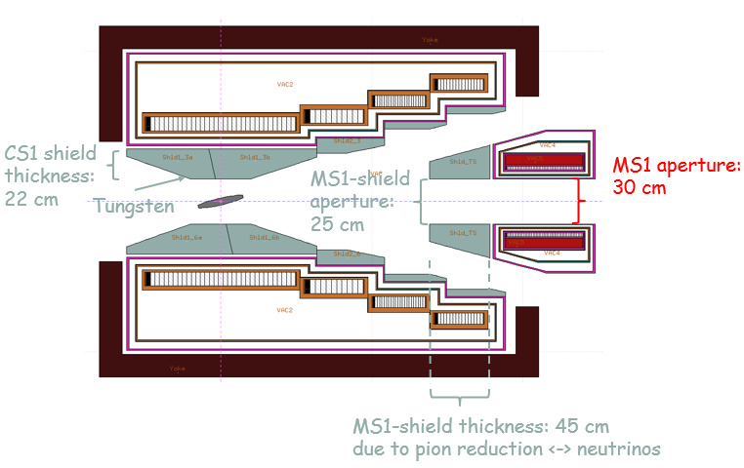
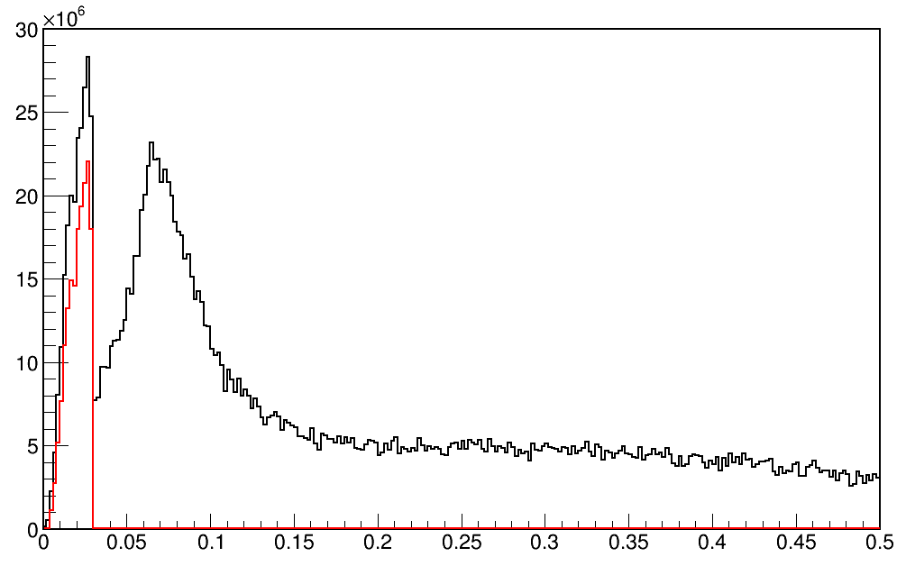
μSR and decay muons at matching solenoid entrance
1->0.5T
μ⁺/s/2MeV
Total muons
Only surface muons
from DAR at target
Beam operation modes (independent):
Surface muon mode (baseline)
Ref. Pμ=29 MeV/c
Momentum spread: <±5%
P(MeV/c)

Slide 31
15⁰ tilt of protons/target with respect to magnetic field lines
not influence the collection of the pion due to the short length of the target
facilitate the extraction of spent-protons with a moderate length of 2.5 m of the Superconducting Solenoid though the Matching Solenoid and capture coils

Slide 32
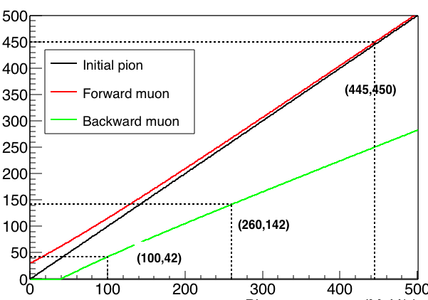
π+ momentum selection for decay muons
Charge/momentum selection for pion/decay muons
muon momentum MeV/c
pion decay section
2nd selection,
decay muons
μSR muon section
decay muons require pion capture momentum at 100, 260 and 450 MeV/c
Decay muon section
pion momentum MeV/c
+ or – reflects spin direction of “forward” and “backward” muon

Slide 33
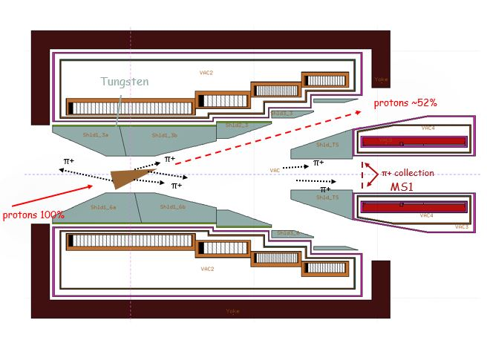
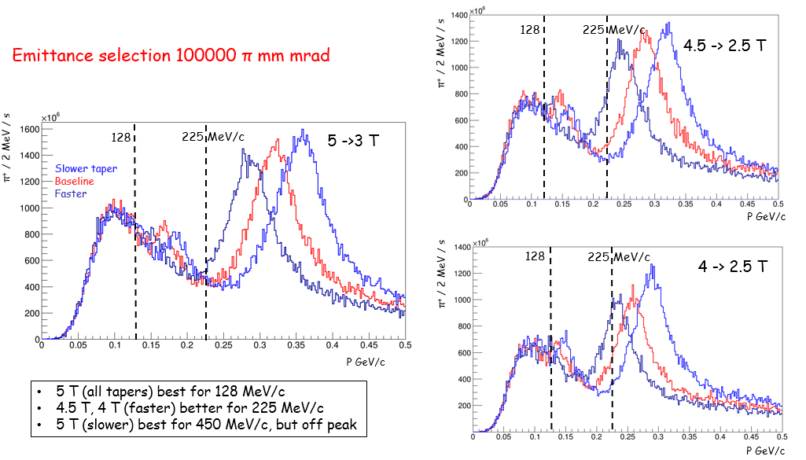
π+ capture for decay muons μ+ : change the field intensity and shape in order to collect required pions
5 T taper variations
Bz(r=0) T
5 -> 3 T
Z in m
P ± 10% (MeV/c) | 128 |  |  | 225
Taper (T) | 4f | 4.5f | 5f | 4f | 4.5f | 5f
i x 10⁹ (π+ /sec) | 8.6 | 9.7 | 12 | 19 | 20 | 13

Slide 34
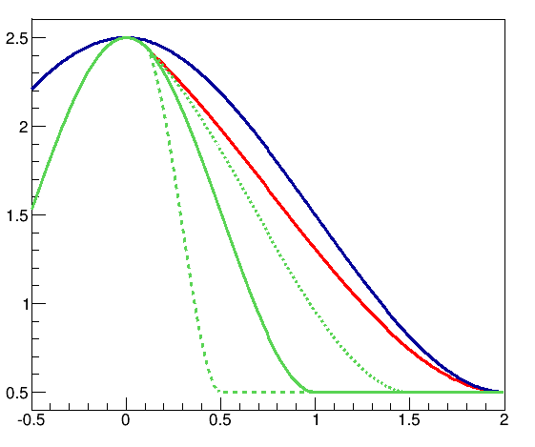
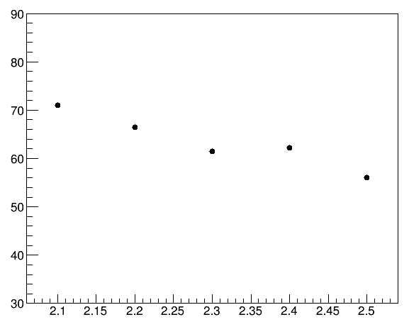
Faster adiabatic tapers can increase the polarization, 25 ≤ P (MeV/c) ≤ 29.8 example at 2.5 T
field variations 2.5 -> 0.5 T
polarization (%)
MS1 entrance
10000 π mm mrad
baseline
slow
baseline
fast
1
2
3
4
5
3% statistical error
Field case

Slide 35
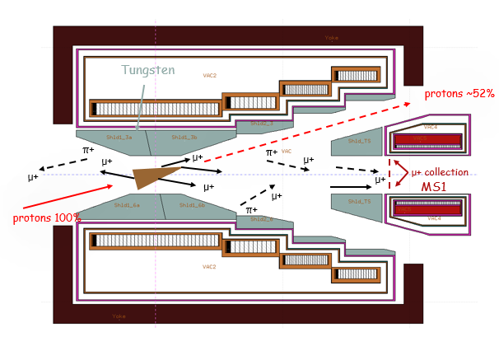
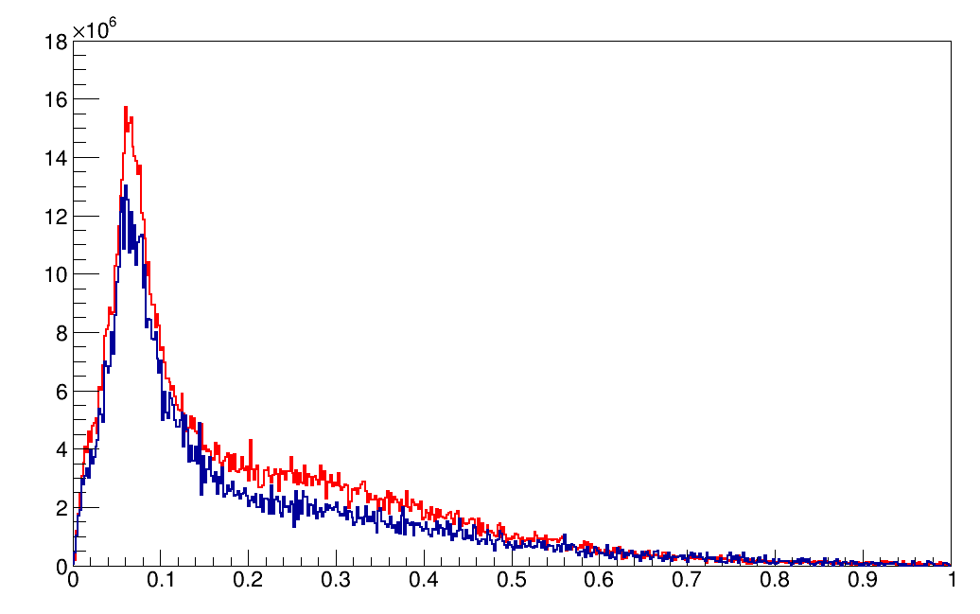
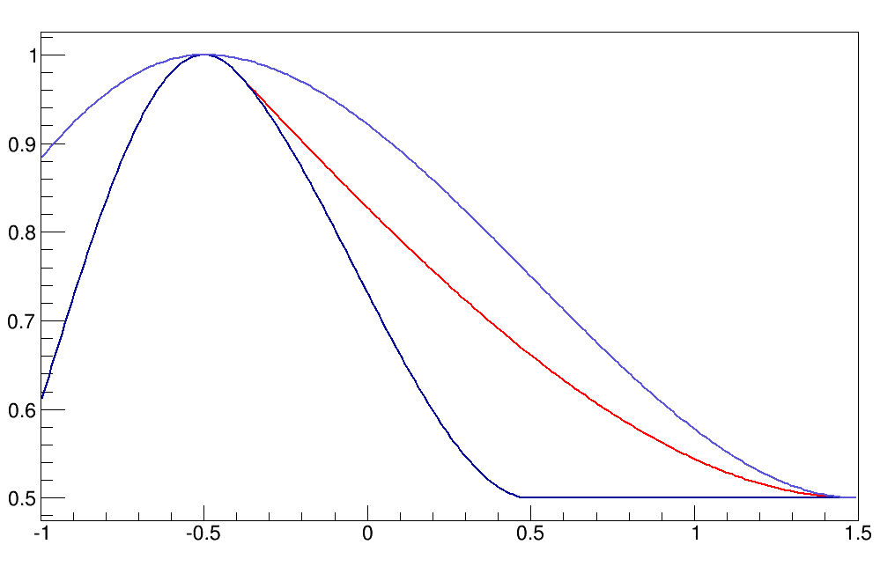
Systematics from monte-carlos: μ+ and μ- with FLUKA and G4 (BERTINI) at MS1, 1 Τ
μ+, 1 T
μ⁺ / 2 MeV / s
FLUKA = 2.2x10⁹
G4 = 2.9x10⁹
P GeV/c
Ratio μ+/μ-
FL = 2
G4 = 3.6
Same baseline 1T taper used on both
μ-, 1 Τ
μ⁻ / 2 MeV / s
FLUKA = 1.1x10⁹
G4 = 0.8x10⁹
For surface muons
FLUKA -25%
FLUKA predicts again a ratio μ+/μ- = 2
Momenta distribution similar
Both codex could be used keeping in mind the difference
G4: Song Yingpeng
P GeV/c

Slide 36
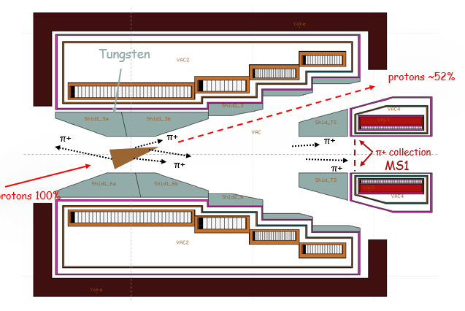
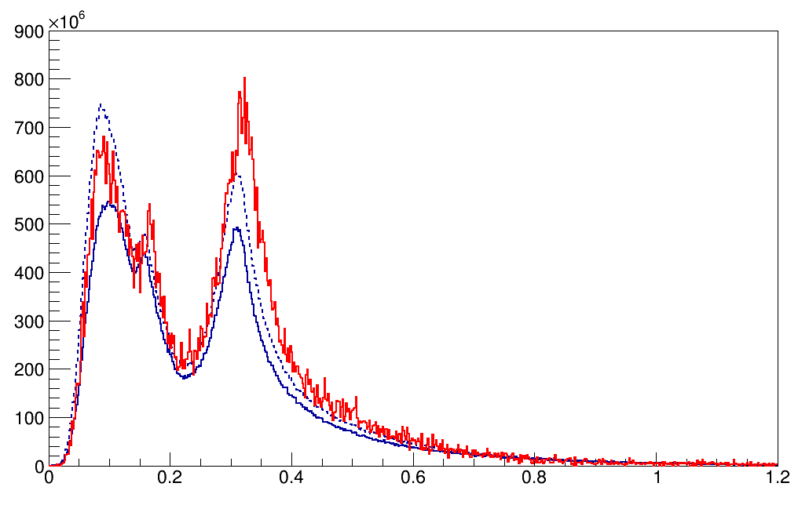
Systematics from monte-carlos: π+ and π- with FLUKA and G4 (BERTINI, INCL) at MS1, 5 Τ
π+, 5 T
π⁺ / 2 MeV / s
G4 bert
FLUKA = 1.7x10¹¹
G4 (bert) = 2x10¹¹
G4 (incl) = 2x10¹¹
G4incl
Ratio π+/π-:
FL = 1.9
G4 (bert) = 2.9
G4 (incl) = 2.2
Same baseline 5T taper used on both
P GeV/c
π-, 5 T
π⁻ / 2 MeV / s
FLUKA = 0.9x10¹¹
G4 (bert) = 0.7x10¹¹
G4 (incl) = 0.9x10¹¹
Total pions are similar with FLUKA and G4 (BERTINI)
G4(INCL) produces more pions
The distribution at the high momentum peak is similar
FLUKA predicts a ratio π+/π- = 2
G4: Song Yingpeng
P GeV/c

Slide 37
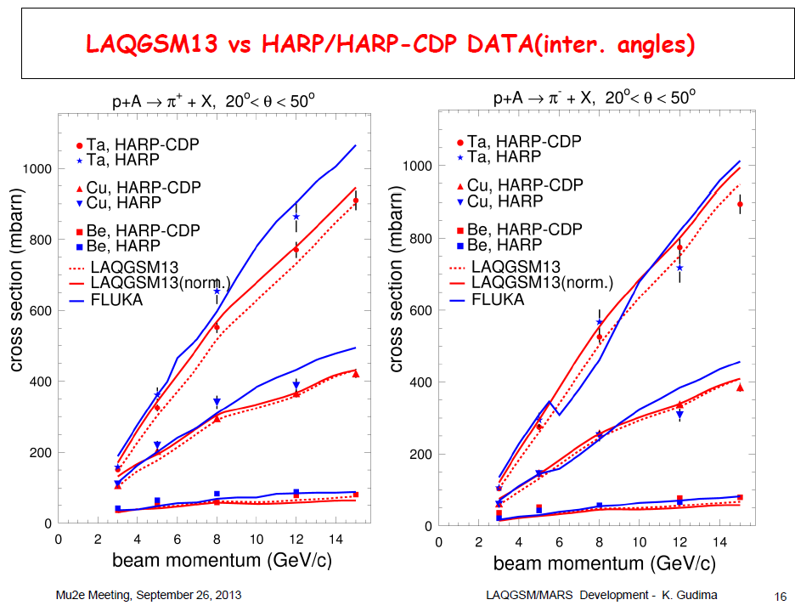
FLUKA vs MARS vs HARP
FLUKA is in agreement with MARS and HARP data @ E_{k} = 2.2 GeV

Slide 38
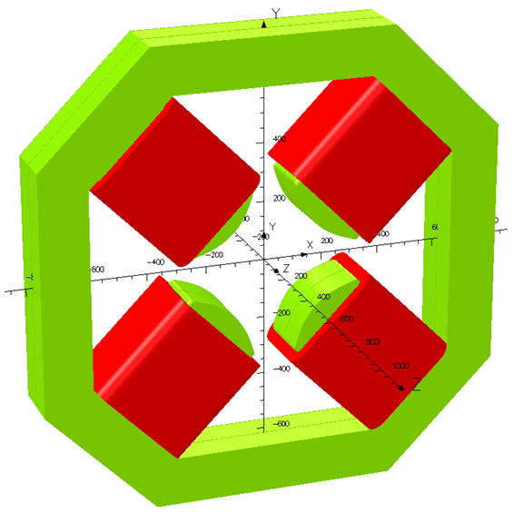
“Baby” scheme, μSR - μ⁺ 25 < P (MeV/c) < 29.8
rectangular target
μSR beamline, Zhou Luping/IHEP
length
width
p
μ+
height
p
π+
μ+
μ+
60 cm
Available “good” magnetic field radius = 16 cm
μSR @ 4500 π mm mrad
μ⁺/s: max for Cu ~ 10⁷
polarization: 94%
different Graphite target sizes performances
Target material | Slab Gr, Width = 8 σ_{p}
ε (π mm mrad) | 4500
Target, (Height x Length) | 6x6 | 12x12 | 24x24
intensity (x10⁶) μ/sec | 2.9 | 3.3 | 3.4
polarization | -0.96 | -0.96 | -0.94
surface muon purity (%) | 98 | 97 | 96
statistical error | < 2% on intensity, < 1% on polarization
different target materiel performances
Target | Slab, Height x Length = 24x24 cm2, Width = 8 σ_{p}
ε (π mm mrad) | 4500
material | Gr | SiC | Be | Ti | Cu | W
L_{t} / λ_{Ι} | 0.5 | - | 0.57 | 0.86 | 1.6 | 2.4
intensity (x10⁶) μ/sec | 3.4 | 5.4 | 4.5 | 5.5 | 9.4 | 8.5
polarization | -0.94 | -0.94 | -0.94 | -0.94 | -0.94 | -0.92
surface muon purity (%) | 96 | 96 | 96 | 96 | 97 | 96
statistical error | < 2% on intensity, < 1% on polarization
12x12cm2 is similar to 24x24cm2 due to small emittance selection/ quadrupole acceptance

Slide 39
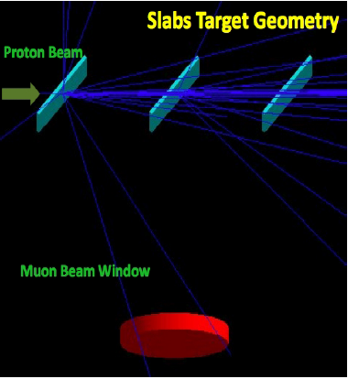
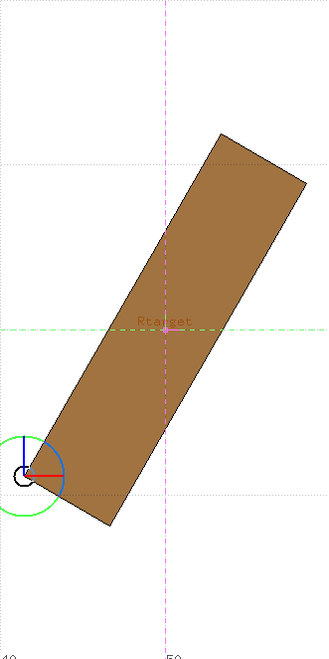
turned-singlet, proton – target interaction 12 cm
different turn angles in respect to proton beam and widths
side-surface Length x Height from 12x12 cm2 -> 24x24 cm2 due to singlet and turn
protons @ z-axis
best
μ+
protons @ z axis
π+
μ+
collection surface (z,y)
r= 16cm
μ+
Schematics only
x-axis, 60 cm
Width = 6 cm
Turn = 30⁰
Width = 4 cm
Turn = 20⁰
Width = 2 cm
Turn = 10⁰
Width = 1 cm
Turn = 5⁰
Best, Length x Height x Width = 24x24x2 cm3, turn = 10⁰
μSR (25 MeV/c – 29.8 MeV/c)
3.1 x10⁷ μ⁺/s, +30%
μSR (25 MeV/c – 29.8 MeV/c), 4500 π mm mrad
3.2 x10⁶ μ⁺/s, -9%
<p> 96%, purity 97%

Slide 40
zz‘ phase space on the /target beam axis z is split into two with doublet (three with triplet)
zz’ at the collection surface
yy’ at the collection surface
zy vertex at of selected surface muons
z‘ (mrad)
y‘ (mrad)
y (mm)
proton beam @ z-axis
only surface muons from
the first target due to
the emittance selection
z (mm)
y (mm)
z (mm)
doublet underperformance:
selected μSR μ⁺ from only one ellipse at zz’ e_{z} .and. e_{y} @ 4500 π mm mrad

Slide 41
Doublet, selected μSR μ⁺ from two ellipses at zz’ (e_{z1} .or. e_{z2}) .and. e_{y} @ 4500 π mm mrad
zz’ at the collection surface
zy vertex at targets of selected surface muons
z‘ (mrad)
y (mm)
both targets are contributing
by selecting both ellipses
proton beam @ z-axis
z (mm)
z (mm)
Best, Length x Height x Width = 2 x 12x12x2 cm3, turn = 40⁰
μSR (25 MeV/c – 29.8 MeV/c), 4500 π mm mrad
4.8 x10⁶ μ⁺/s , +37%
<p> 95%, purity 96%

Slide 42
Doublet, phase spaces zz’, yy’ at collection surface (e_{z1} .or. e_{z2}) .and. e_{y} @ 4500 π mm mrad
zz’ at the collection surface
yy’ at the collection surface
z‘ (mrad)
y‘ (mrad)
z (mm)
y (mm)

Slide 43
SC4
SC2
SC3
SC1
protons 100%
MS1
π+
π+
π+
MS1 aperture:
25-30 cm
π+
π+
CS1 shield
thickness:
25 cm
π+
Tungsten
protons ~52%
MS1-shield thickness: 50 cm

Slide 44
SC4
SC2
SC3
SC1
protons 100%
MS1
μ+
μ+
π+
μ+
μ+
MS1 aperture:
25-30 cm
μ+
π+
μ+
μ+
CS1 shield
thickness:
25 cm
μ+
π+
Tungsten
protons ~52%
MS1-shield thickness: 50 cm

Slide 45
additionally highly polarized μSR beam concept short interacting ( ≤ 1 cm ) thin target upstream of capture solenoid
protons ~ 100%
SC4
SC2
SC3
SC1
MS1
protons ≥ 98%
π+
π+
π+
π+
π+
π+
MS1 aperture:
25-30 cm
protons ~ 50%

