Slide 1
Proton beam line design for EMuS
Chen Yukai, Jing Hantao, Zhao Guang, Mu Qili
IHEP Dongguan, November 20 - 21, 2018
International Review on the Conceptual Design of EMuS

Slide 2
Contents
1. Background and general layout of HEPEA
2. Proton transport line and beam optics
3. Proton beam extraction from RTBT
4. Beam loss and preliminary collimation consideration
5. Correction of proton beam deflected by the solenoid
6. Summary

Slide 3
1. Background and general layout of HEPEA

Slide 4
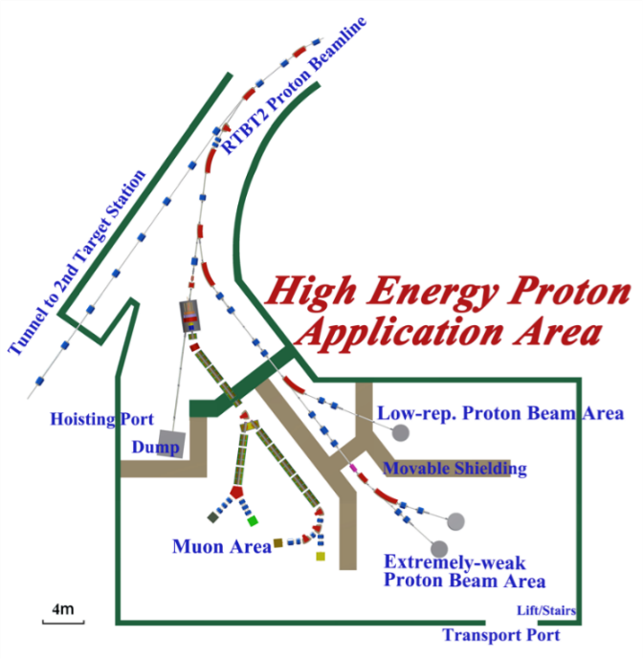
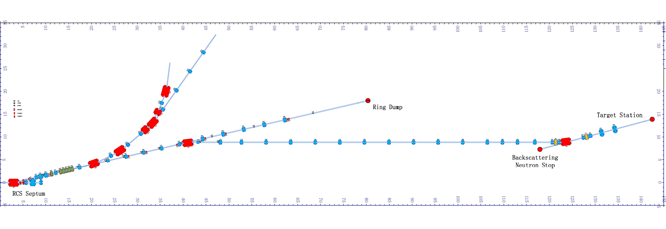
Transport beam line to proton beam application area
Transport beam line to Target Station 2
HEPEA: plan to build
Transport beam line to Target Station 1
Proton extraction
RTBT：running at present
General layout of transport beam line in CSNS
Main parameters of proton beam
Parameters | CSNS-I | CSNS-II | EMuS
Linac Energy (MeV) | 80 | 250 | 80
RCS Energy (GeV) | 1.6 | 1.6 | 1.6
Power (kW) | 100 | 500 | 5
Beam current (μA) | 62.5 | 312.5 | 3.125
Protons per second | 3.91×10¹⁴ | 1.95×10¹⁵ | 1.95×10¹³
Length of one bunch (ns) | 70 | 70 | 70
Keypoints of proton beamline design
Transport line Lattice design
Protons extraction from RTBT
Beam halo collimation
Make proton beam through solenoid correctly
Spent protons collimation

Slide 5
2. Proton transport line and beam optics

Slide 6
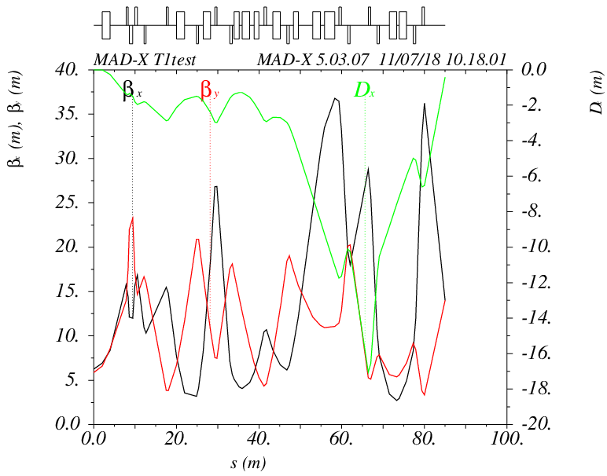
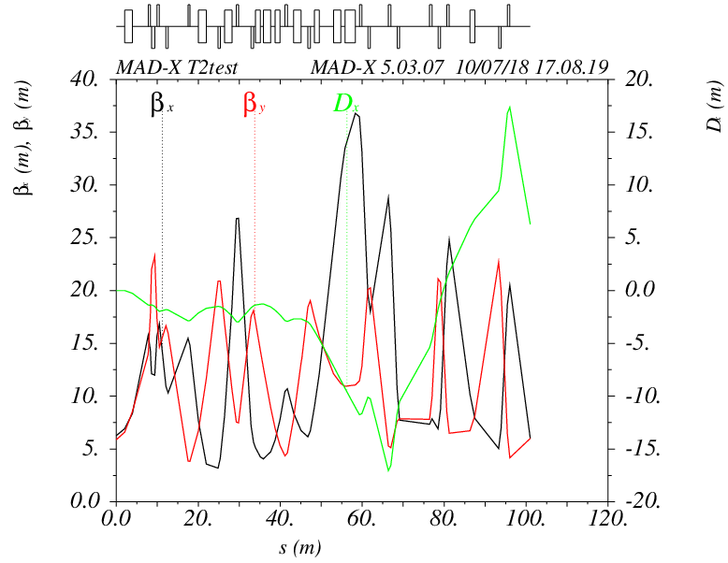
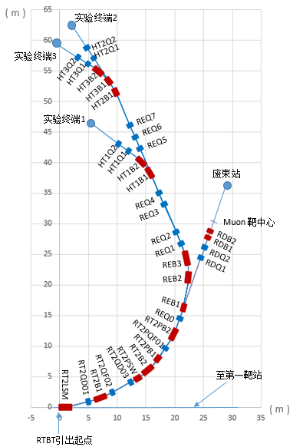
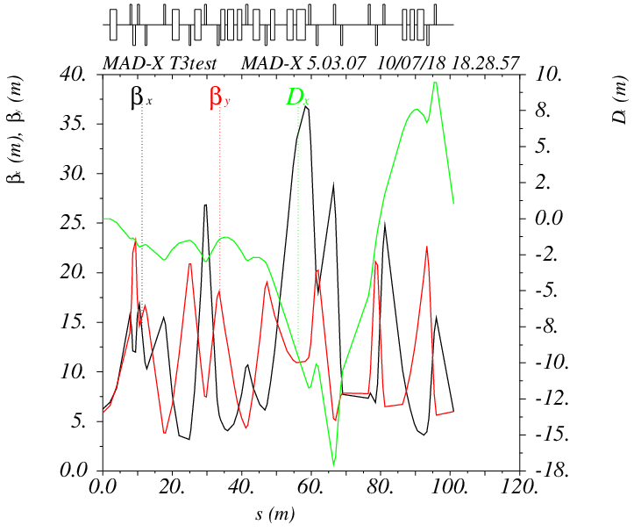
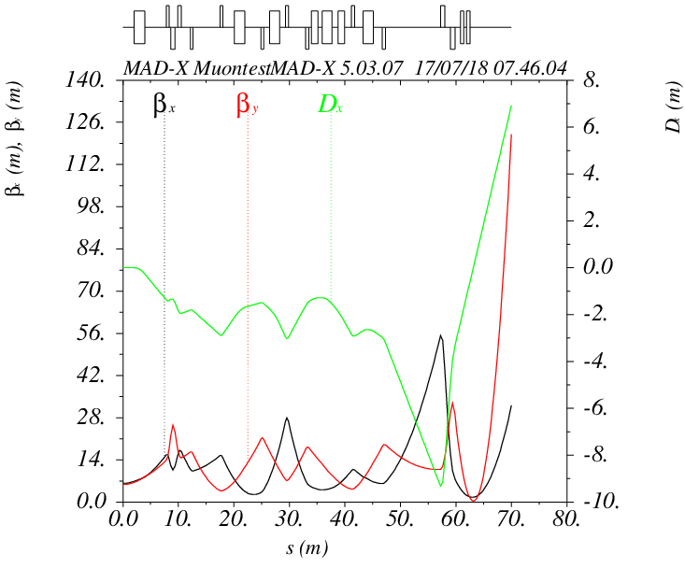
Transport line lattice and beam envelope
To experiment terminal 1
To experiment terminal 2
Transport line lattice of HEPEA
To experiment terminal 3
To EMuS
Total 16 bending magnets, 20 quadrupole magnets
Beam optics of different transport line

Slide 7
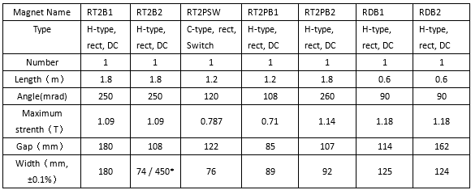
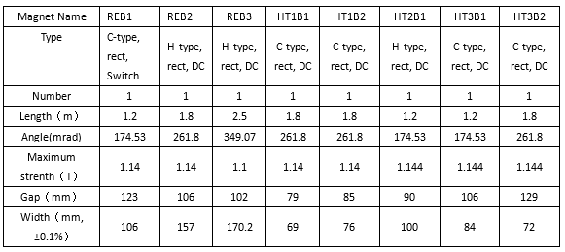
Table 2. parameters of dipoles
Preliminary magnets parameters of HEPEA
Table 1. parameters of dipoles
Transport line lattice of HEPEA
Emittance acceptance(before RT2PSW): 350 π mm·mrad
Emittance acceptance(after RT2PSW): 150 π mm·mrad

Slide 8
Preliminary magnets parameters of HEPEA
Table 2. Parameters of quadrupoles
RP-220QA including：RT2QD01 , RT2QF02;
RP-205QA including ：RDQ1 , RDQ2;
RP-180QA including：REQ1 , REQ3 , REQ7 , HT1Q2;
RP-140QA including：RT2QD03, RT2PQF01 , REQ0 , REQ2 , REQ4 , REQ5 ,
REQ6 , HT1Q1 , HT2Q1 , HT2Q2 , HT3Q1 , HT3Q2.
Transport line lattice of HEPEA
Emittance acceptance(before RT2PSW): 350 π mm·mrad
Emittance acceptance(after RT2PSW): 150 π mm·mrad

Slide 9
3. Proton beam extraction from RTBT

Slide 10
Proton beam extraction to EMuS
Transport beam line to proton beam application area
Transport beam line to Target Station 2
Transport beam line to Target Station 1
HEPEA: plan to build
Proton extraction
RTBT：running at present
General layout of transport beam line in CSNS
40 ms
……
410 ns
~ 70 ns
Proton beam structure in RTBT
(25 Hz, two bunches in one pulse)
Kicker and Lambertson magnet (5%)
400 ms
……
~ 70 ns
Proton beam structure transported to EMuS target
(2.5 Hz, one bunch in one pulse)

Slide 11
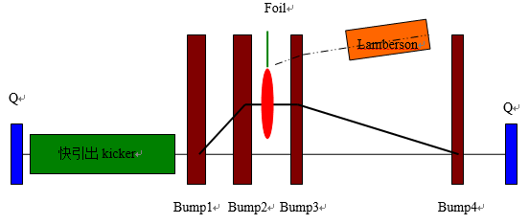
Proton beam extraction to Extremely Weak Proton Beam area
40 ms
~ 1.6 ms
…
…
……
…
…
~ 70 ns ( 1-1000 protons per pulse)
410 ns
Proton beam structure in RTBT
(25 Hz, two bunches in one pulse
& ~4000 extremely weak bunches)
Switcher and Lambertson magnet
40 ms
~ 1.6 ms
…
…
……
…
…
410 ns
~ 70 ns ( 1-1000 protons per pulse)
Proton beam structure transported to Extremely Weak Proton Beam Area
Foil scattering extraction for Extremely Weak Beam (Future plan)

Slide 12
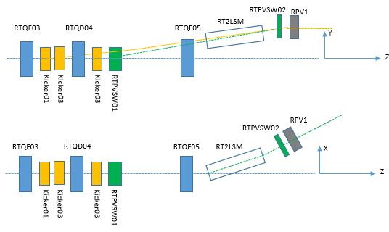
Magnet design of proton beam extraction from RTBT
Beam orbit will be lifted by vertical kickers and quadrupoles.
Beam orbit of kickers extraction and switcher extraction should be the same when the extraction is completed.
Orbit lifting at RTQF05 should be less than 66 mm*.
Orbit lifting at the entrance of Lambertson should be larger than 116.5 mm*.
* when emittance acceptance of extraction tunnel is 250 π mm.mrad
Kickers and switchers layout for proton beam extraction
Kickers and switchers parameters
Orbit lifting of kickers extraction
 | Kicker01 | Kicker02 | Kicker03 | Switcher01 | Switcher02 | RPV1
Strength(Gauss) | 629 | 671 | 735 | 2224.94 | -693.95 | -3633.42
Theta(mrad) | 3.80 | 4.053 | 4.204 | 14.14 | -1.76 | -23.09
Length(m) | 0.485 | 0.485 | 0.459 | 0.5 | 0.2 | 0.5
Width(mm) | 154.0 | 154.0 | 150.0 | 155 | 150 | 155
Gap(mm) | 160.0 | 150.0 | 137.0 | 142 | 155 | 160
Inductance(uH) | 0.66 | 0.70 | 0.71
Field rise time(ns) | 250 | 260 | 262
Characteristic impedance (Ohm) | 12.5 | 12.5 | 12.5
Effective current(A) | 7848.2 | 7848.2 | 7848.2
PFN Voltage(KV) | 49.1 | 49.1 | 49.1
 | Orbit lifting(mm) | Meet requirment?
RTQD05 exit | 68.12 | Almost
Lambertson entrance | 115.46 | Almost
RPV1 exit | 188.2
Orbit lifting of switcher extraction
 | Orbit lifting(mm) | Meet requirment?
RTQD05 exit | 60.09 | Yes
Lambertson entrance | 111.05 | No
RPV1 exit | 188.2

Slide 13
4. Beam loss and beam halo collimation

Slide 14
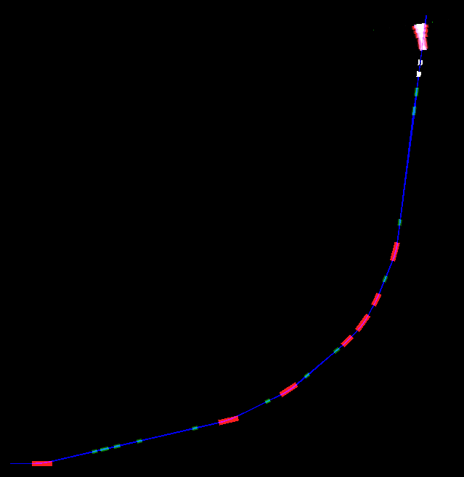
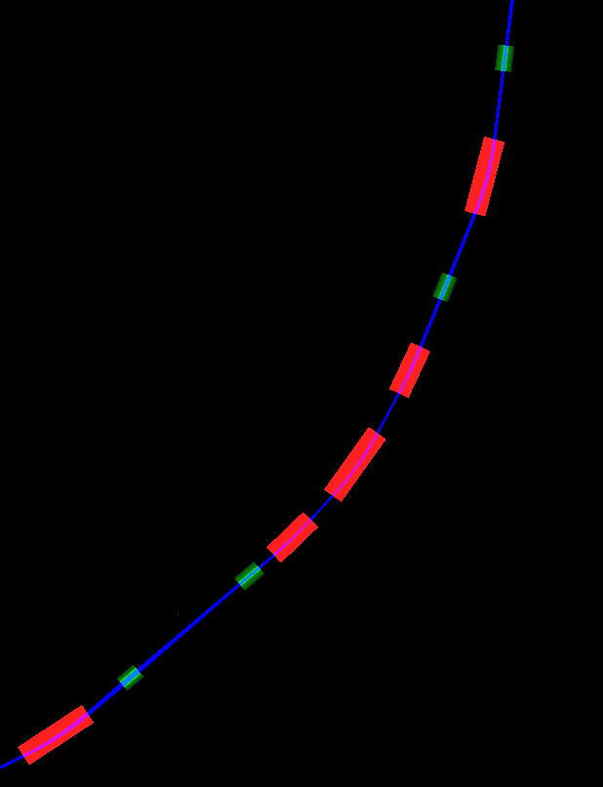
Position for beam halo collimation
Position B
1.55 m
Simulation of beam halo collimation
Extraction point from RTBT
Position A
3.1 m
Phase advance:
μ_{x A->B}=117 deg
μ_{y A->B}=85.2 deg
Proton beam line to EMuS
Quadrupoles Name | RT2QD03 | RT2PQF01 | REQ0 | RDQ1 | RDQ2
Aperture φ（mm） | 120 | 120 | 120 | 185 | 185
Beam source in simulation is combined by two Gaussian distribution:
* Beam core: include 97% particles, 3sigma=80 π mm·mrad
* Beam halo: include 3% particles, 3sigma=350 π mm·mrad
Dipoles Name | RT2PSW | RT2B2 | RT2PB1 | RT2PB2 | RDB1 | RDB2
Gap（mm） | 102 | 88 | 70 | 89 | 94 | 142
* Emittance acceptance in RTBT: 350 mm·mrad
* Emittance acceptance after halo collimation:150 π mm·mrad

Slide 15
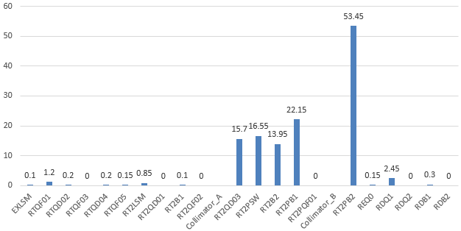
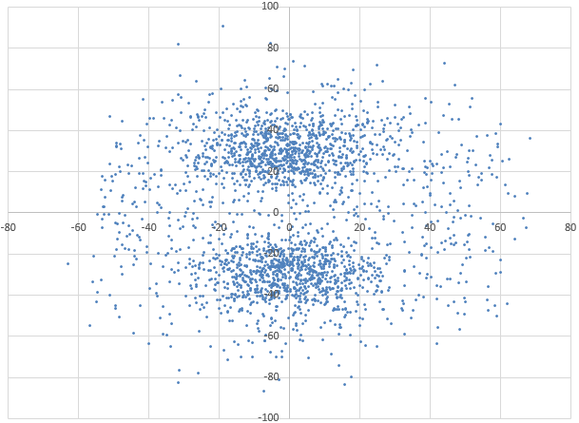
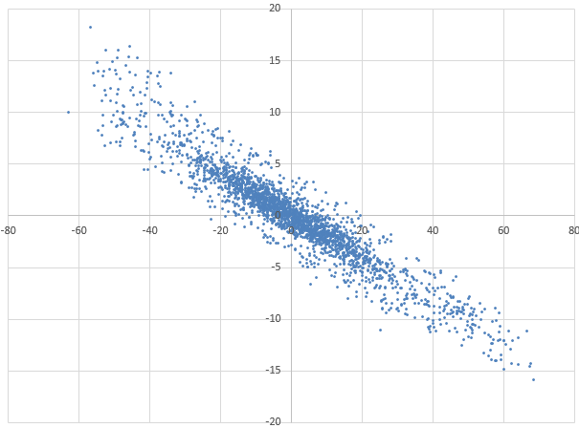
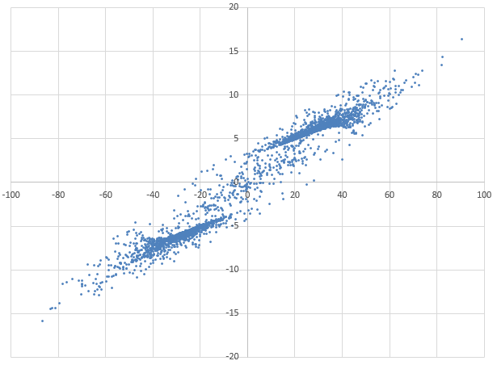
Beam power losses at magnets
(W)
Position B
1.55 m
Total power: 128 W ( 2.6%)
Position A
3.1 m
Beam power losses at different magnets without collimator
Y (mm)
X’ (mrad)
Y’ (mrad)
X (mm)
X (mm)
Y (mm)
Lost particles distribution at collimation position A

Slide 16
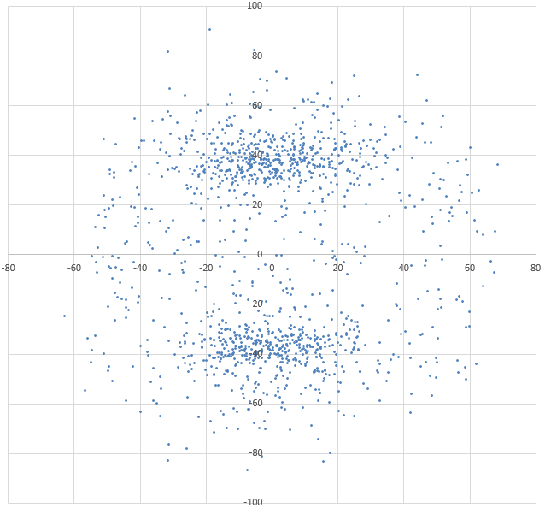
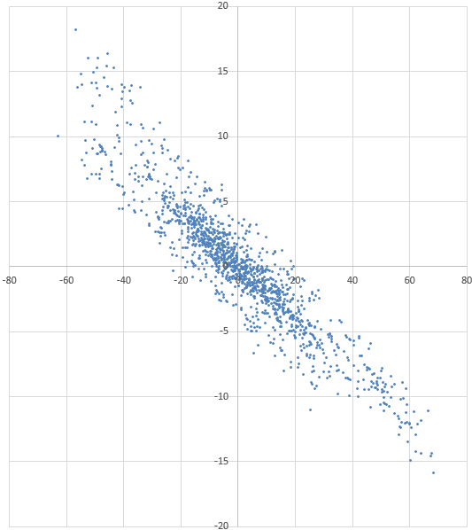
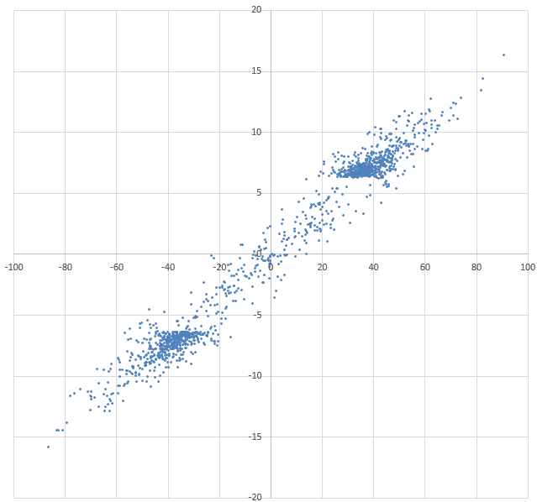
(W)
Position B
1.55 m
Total power: 128 W ( 2.6%)
Position A
3.1 m
Beam power losses at different magnets without collimator
Y (mm)
X’ (mrad)
Y’ (mrad)
X (mm)
X (mm)
Y (mm)
60 mm
56 mm
Lost particles distribution at collimation position A

Slide 17
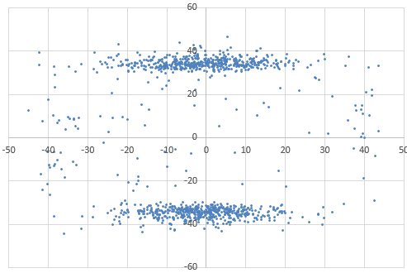
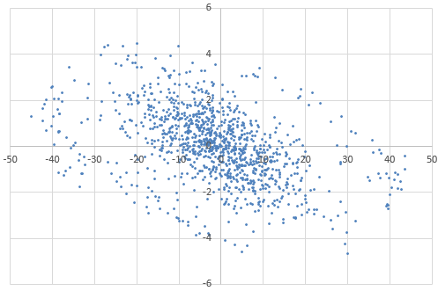
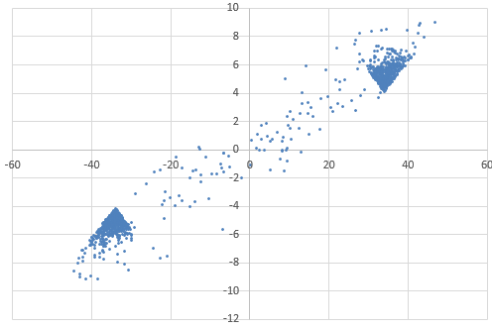
(W)
Position B
1.55 m
Total power: 128 W ( 2.6%)
Position A
3.1 m
Beam power losses at different magnets without collimator
Y’ (mrad)
Y (mm)
X’ (mrad)
X (mm)
X (mm)
Y (mm)
60 mm
60 mm
Lost particles distribution at collimation position B

Slide 18
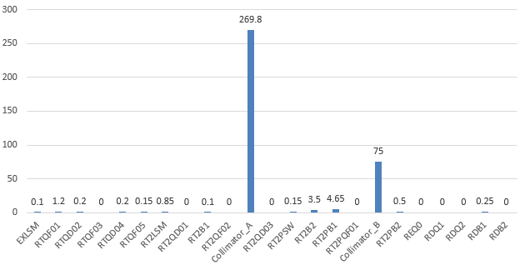
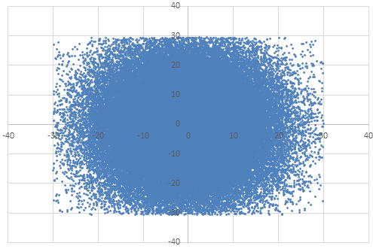
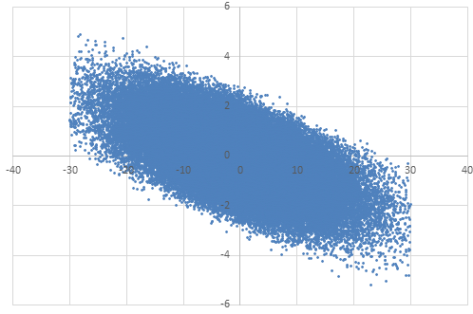
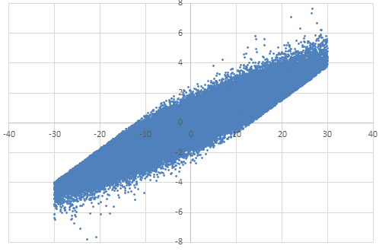
Result of halo collimation
Position B
1.55 m
Total power: 355 W (7.1%)
Beam power loss at each magnet: < 5 W
Position A
3.1 m
Beam power losses at different magnets with collimator
Y (mm)
X’ (mrad)
Y’ (mrad)
X (mm)
X (mm)
Y (mm)
Particles distribution after two collimators

Slide 19
5. Correction of proton beam deflected by the solenoid

Slide 20
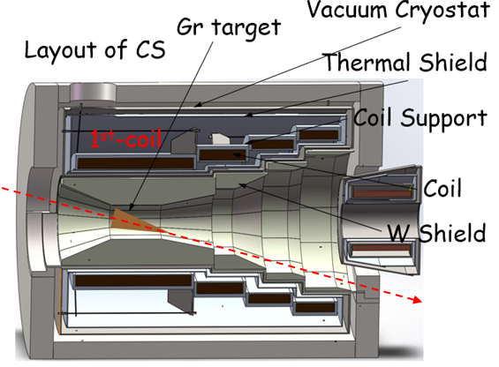
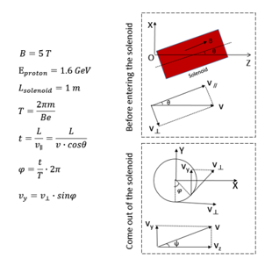
Proton beam deflected by the tilted solenoid
Proton direction
Shape of target station
Schematic of the deflection
Proton deflected by solenoid
Peak field of solenoid | Beam spot at center of 1st-coil |  | Beam spot at beam dump ( 6 m after the target )
 | X (mm) | Y (mm) | X (mm) | Y (mm)
0 T | 0 | 0 | 0 | 0
1 T | 0.03 | -0.72 | 17.1 | -212.7
2 T | 0.12 | -1.44 | 69.3 | -419.5
5 T | 0.68 | -3.74 | 410.2 | -949.6
Problem due to the deflected:
Beam spot will be deviation at target center
Beam spot will be deviation at beam dump, larger beam dump is needed.
Beam spot positions will be different for different magnet field

Slide 21
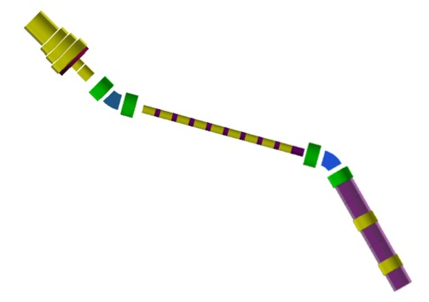
Minimum distance between beam dump and the target center
Angles between main solenoid axis and original direction of proton beam: 15 degree
Distance between entrance of first dipole for muon transport line and target center: 3.77 m
Bending angle of first dipole for muon transport line: 30 degrees
Length of first dipole for muon transport line: 0.524 m
3.77 m
0.5 m
5.6 m
0.524 m
2 m
Muon transport line
Half width of beam dump set to be: 2 m
Half width of muon transport line and reserved space: 0.5 m
So shortest distance between beam dump and the target center is 5.6 m
Original direction of proton beam
Reducing this distance can help to reduce the difficulty of beam dump and collimator design

Slide 22
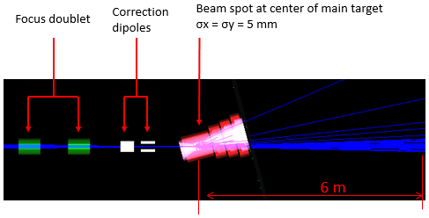
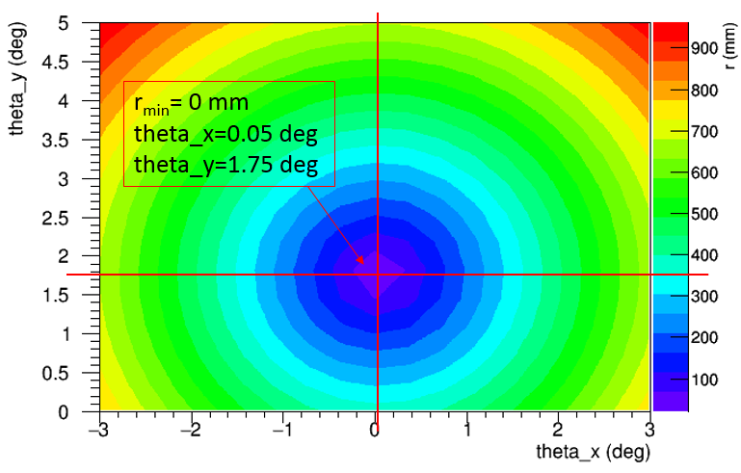
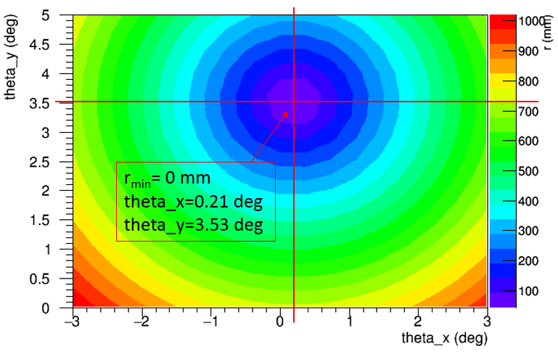
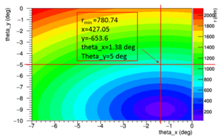
Correction scheme of beam deflected
Requirement of the dipole:
Maximum bending angle: less than 5 deg
Magnet field: < 1.2 T
Length: ~ 0.6 m
Magnet Name | RDB1 | RDB2
Length（m） | 0.6 | 0.6
Maximum angle(mrad) | 90 | 90
Maximum strength（T） | 1.18 | 1.18
Gap（mm） | 114 | 162
Width of good field(mm, ±0.1%) | 125 | 124
1.2 m
(When solenoid magnet field is 1 T)
(When solenoid magnet field is 2 T)
(When solenoid magnet field is 5 T)
Minimum proton center deviation at beam dump with correction angles less than 5 deg

Slide 23
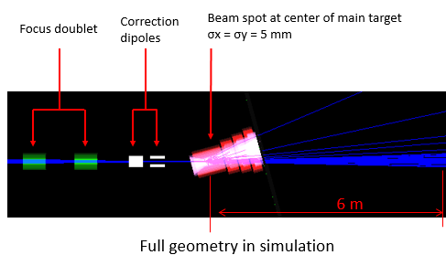
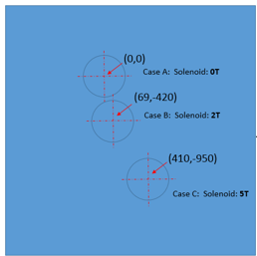
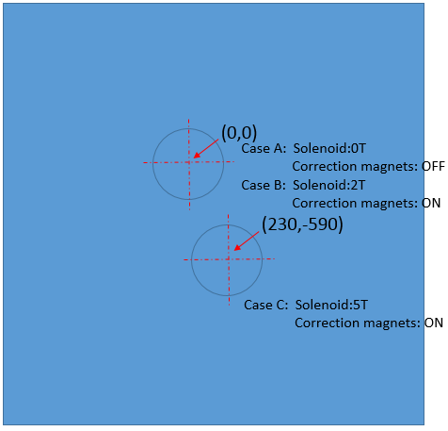
Beam spots correction at beam dump (1)
Distance between beam dump and target center: 6 m
Peak field of solenoid for surface muon mode: 2 T
Peak field of solenoid for decay muon mode: 5 T
Position: x =4.9 mm y=97.98 mm
Correction angles
Correction angles | theta_x (deg) | theta_y (deg)
surface muon | 0.110 | 3.163
Decay muon | 0.110 | 3.163
After correction
Beam spot at center of target
Beam position | X (mm) | Y (mm)
surface muon | 4.9 | 97.98
Decay muon | 4.59 | 95.89
Dump holes distribution without correction
Dump holes distribution with correction

Slide 24
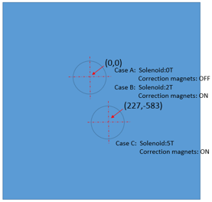
Beam spots correction at beam dump (1)
Distance between beam dump and target center: 6 m
Peak field of solenoid for surface muon mode: 2 T
Peak field of solenoid for decay muon mode: 5 T
Position: x =4.9 mm y=97.98 mm
Correction angles
Correction angles | theta_x (deg) | theta_y (deg)
surface muon | 0.110 | 3.163
Decay muon | 0.126 | 3.227
After correction
Beam spot at center of target
Beam position | X (mm) | Y (mm)
surface muon | 4.9 | 97.98
Decay muon | 4.89 | 97.98
Dump holes distribution without correction
Dump holes distribution with correction

Slide 25
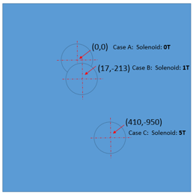
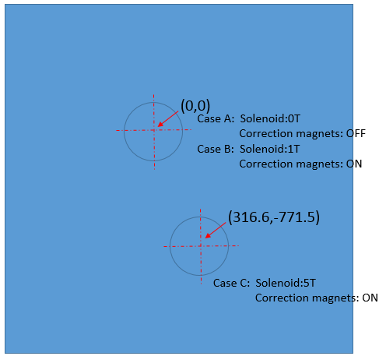
Beam spots correction at beam dump (2)
Distance between beam dump and target center: 6 m
Peak field of solenoid for surface muon mode: 1 T
Peak field of solenoid for decay muon mode: 5 T
Position: x =1.22 mm y=48.74 mm
Correction angles
Correction angles | theta_x (deg) | theta_y (deg)
surface muon | 0.027 | 1.575
Decay muon | 0.027 | 1.575
After correction
Beam spot at center of target
Beam position | X (mm) | Y (mm)
surface muon | 1.22 | 48.74
Decay muon | 0.75 | 45.74
Dump holes distribution without correction
Dump holes distribution with correction

Slide 26
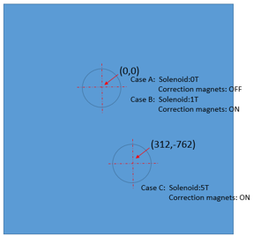
Beam spots correction at beam dump (2)
Distance between beam dump and target center: 6 m
Peak field of solenoid for surface muon mode: 1 T
Peak field of solenoid for decay muon mode: 5 T
Position: x =1.22 mm y=48.74 mm
Correction angles
Correction angles | theta_x (deg) | theta_y (deg)
surface muon | 0.027 | 1.575
Decay muon | 0.051 | 1.667
After correction
Beam spot at center of target
Beam position | X (mm) | Y (mm)
surface muon | 1.22 | 48.74
Decay muon | 1.21 | 48.75
Dump holes distribution without correction
Dump holes distribution with correction

Slide 27
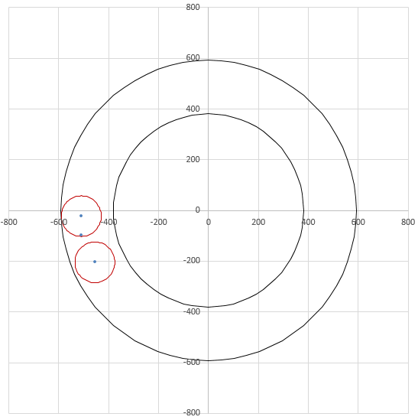
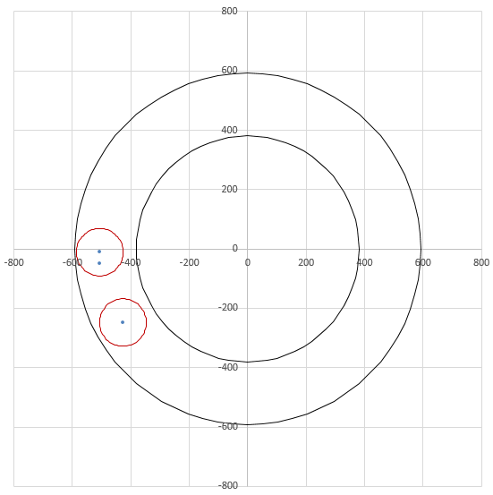
Extraction holes distribution at the Exit of solenoid
Extraction plane
Extraction hole for surface muon mode（ 2 T ）
Extraction hole for surface muon mode（ 1 T ）
Extraction hole for decay muon mode（ 5 T ）
Extraction hole for decay muon mode（ 5 T ）
Distance between beam dump and target center: 6 m
Peak field of solenoid for surface muon mode: 2 T
Peak field of solenoid for decade muon mode: 5 T
Size of Extraction holes: Φ160
Distance between beam dump and target center: 6 m
Peak field of solenoid for surface muon mode: 1 T
Peak field of solenoid for decade muon mode: 5 T
Size of Extraction holes: Φ160

Slide 28
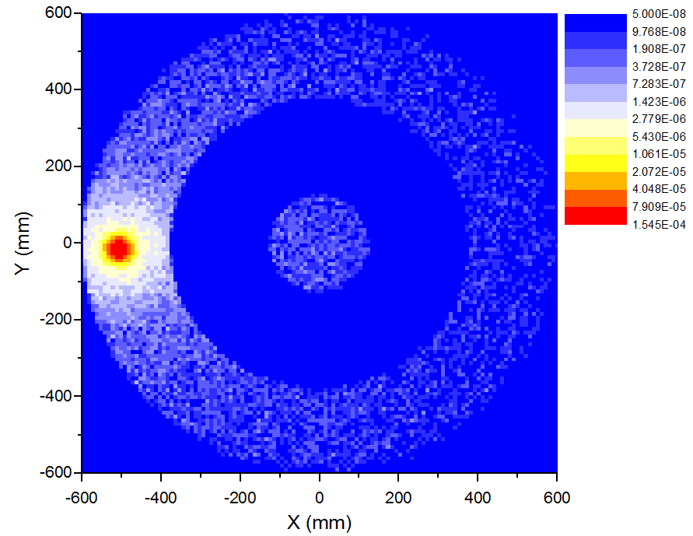
Spent protons collimation consideration
Extraction hole
Protons/mm²
Insert target
1.2 m
Protons distribution at the exit of solenoid
Influence of insert target:
Effective length is 7 mm
Enlarge beam spot at main target a little
σx: 5.0 mm -> 6.2 mm， σy: 5.0 mm -> 5.9 mm
About 0.5% particles (25 W) can’t hit the main target
Influence of main target:
Efficiency length is 300 mm
Proton will be scattered by the main target obviously
About half of the beam power is deposited in the target station
About 300 W beam power need to be collimated at the exit of solenoid
Relevant collimators design see Mu Qili’s talk

Slide 29
6. Summary
Magnets parameters have been available according to lattice design
Kickers and Lambertson magnets will be used to extract proton beam from RTBT
Use two collimators to scrape the beam halo to reduce the aperture of magnets
Correction scheme of adding two dipoles before the main solenoid has been presented
Two dump holes and two extraction holes scheme is needed to deal with different modes of the target station
Thank you for your attention！

