Slide 1
Magnet design for EMuS experiment
Hou Zhilong （houzl@ihep.ac.cn)
Xie Zongtai, Zhao Guang, Yuan Ye, Nikos Vassilopoulos, Chen Yuan
2018.11.20
Notes:
Goof afternoon, I’m Hou Zhilong. I will give a report on the magnet design for EMuS experiment.

Slide 2
Contents
Magnet design for the target station
Magnetic Field design
Mechanical design and analysis
Manufacture and test of coil
Magnet design for the superferric dipole
Magnetic Field design
Mechanical analysis
Conceptual design for the transport line magnet
Summary
Notes:
There are three parts in my report.
First I will introduce the magnet design for the target station
Then I will introduce the superferric dipole magnet design
Following that, I will introduce the conceptual design for the transport line magnet.
I will give a brief summary at last.

Slide 3
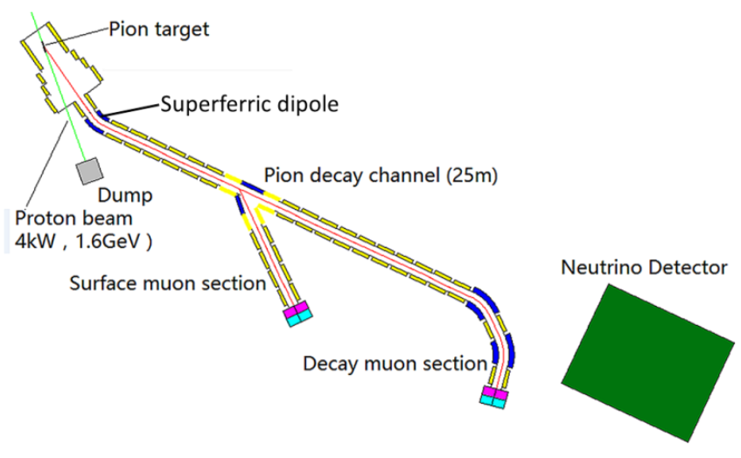
EMuS layout
Target station magnet-
4-coils/3-steps
Superferric dipole
Transport magnet
Target station magnet
Transport magnet
Notes:
This picture shows the EMuS layout.
There are three kinds of magnet, target station magnet for capturing and collecting particles , superferric dipole for bending particles , and transport magnet for transfering particles.

Slide 4
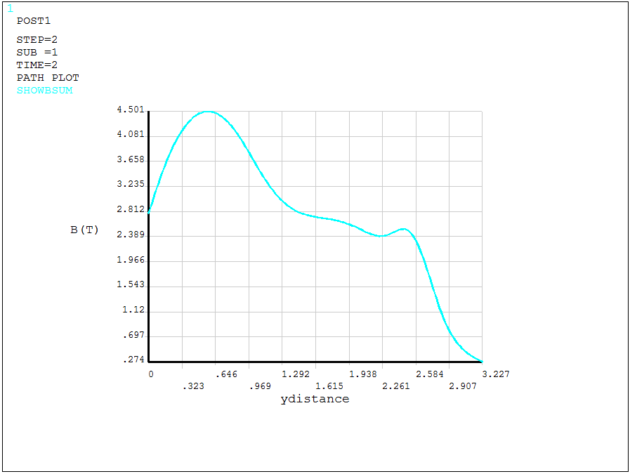
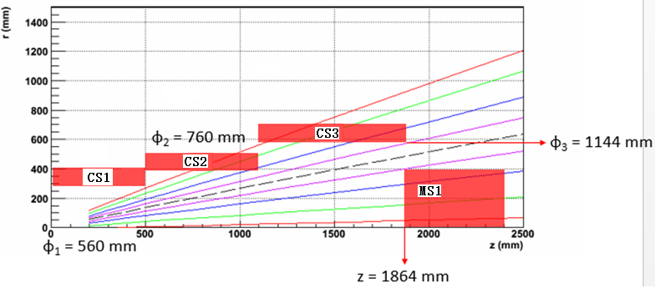
Magnet design for the target station
Physics Requirements
Peak field – 5T
Peak field – 4.5T
Peak field - 1T
Center of CS1
Notes:
The EMuS will be run at different mode, high momentum, decay muon, and surface muon. Each mode require different magnet field at the target station. The coils should be apart from the used beam line for the radiation effect.

Slide 5
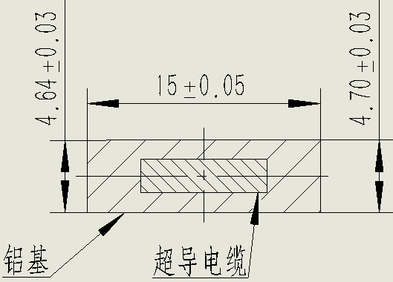
Magnetic Field design
Conductor ——Aluminum stabilized Rutherford cable
Parameters of cable and strand
Aluminum
Rutherford cable
Item | Value
Cable Dimension (without insulation) | 15×4.7 mm²
Cable Dimension (with insulation) | 15.3×5 mm²
Strand Diameter | 1.20 mm
Strand Number | 16
Cu/NbTi | 1.0/1.0
Aluminum RRR | 500
Copper RRR | 70
Ic @ 5.5 T 4.2 K | > 1350 A
Al yield strength | 55 Mpa
Overall yield strength | 150 Mpa
Cable Ic @ 4.2K ,5.5 T | >17280 A
Nominal Current | 3944.5 A
Operate temperature | 5.0 ~5.9 K
Cross section of the conductor
One side be compressed, the other side be tensioned
Notes:
Aluminum stabilized Rutherford cable and copper / Niobium Titanium strand will be adopted to manufacture the target station magnet. This table list the parameters of the cable and strand. The dimension of the cable without insulation is fifteen multiply four point seven square millimeter. The diameter of the strand is one point two millimeter. The critical current of the cable at four point two kelvin is about eighteen thousand ampere. The nominal current of the target station magnet is about four thousand ampere. The target station magnet will be operated between 5 K to 5.9 kelvin.
This picture shows the cross section of the aluminum stabilized cable.

Slide 6
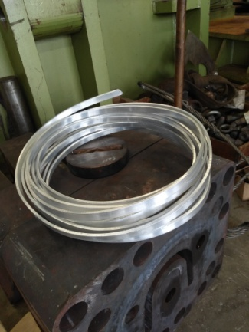
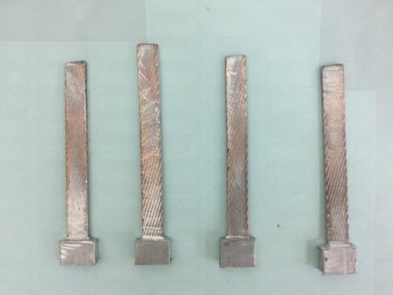
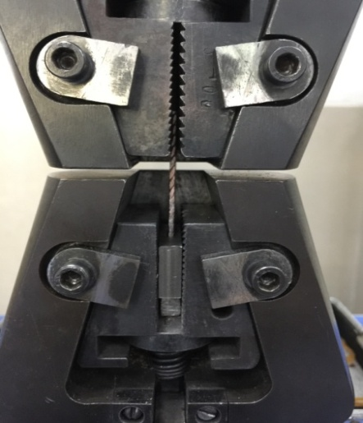
Status of the developing of aluminum stabilized cable
10 mm
Sample for testing shear strength
Test of shear strength
Result of shear strength
No | Length of Tested sample (mm) | load(kN) | Shear strength(MPa) | Length of cable （m）
1 | 10 | 5.60 | 25.07 | 10
2 | 10 | 2.50 | 11.19 | 10
3 | 10 | 4.26 | 19.07 | 10
4 | 10 | 5.18 | 23.19 | 10
5 | 10 | 6.31 | 28.25 | 10
6 | 10 | 3.28 | 14.68 | 10
Sample of 10 m cable
Electrical property will be test ——Critical current
Notes:
We are now developing the aluminum stabilized cable with a domestic company.
A sample cable with a length of ten meter have been produced. Some mechanical tests have been carried out. Next step, the electrical property test will be done.

Slide 7
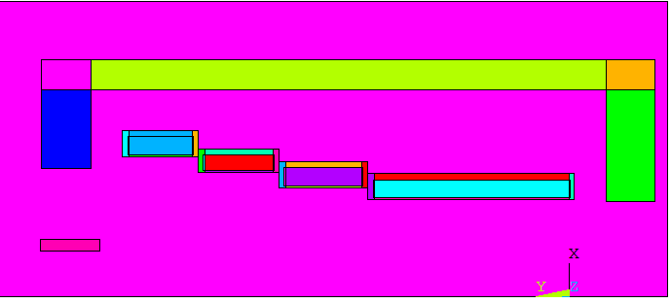
Magnetic Field design
Layout of coils and yoke
Parameter of coils
coil | Rmin (m) | Rmax (m) | Zmin(m) | Zmax (m)
CS1 | 0.50 | 0.5918 | -0.986 | 0
CS2 | 0.56 | 0.6518 | -1.05 | -1.436
CS3 | 0.64 | 0.7165 | -1.5 | -1.846
CS4 | 0.72 | 0.8118 | -1.91 | -2.23
MS1 | 0.23 | 0.2912 | -2.38 | -2.68
MS1
CS1
Coils density of current for different run mode
CS1~CS4 be put in one cryostat
Four pairs of current leads will be used
coil | 5 T ~ 2.7 T | 4.87 T ~ 2.4 T | 4.5 T ~ 2.5 T | 1 T ~ 0.5 T | 1 T ~ 0.5 T | 1 T ~ 0.5 T
01 | 50.35 | 50.55 | 50.55 | 9.95 | 10.3 | 11.3
02 | 50.35 | 40 | 15 | 9.95 | 8.5 | 2.5
03 | 50.35 | 30 | 35 | 9.95 | 6 | 3.3
04 | 50.35 | 50.55 | 50.55 | 9.95 | 10 | 11.8
05 | 32 | 28 | 33 | 6.4 | 6 | 6.3
Notes:
This picture shows the layout of the coils for the target station magnet. The parameter of the coils are list in this table. The inner diameter of CS1 is 1 meter, the inner diameter of CS4 is 1.44 meter. For the target station magnet need to produce different magnet field, the current of each coil should be adjusted individually, four pairs of current leads will be used. The following table lists the density of current of the coils for different run mode respectively.

Slide 8
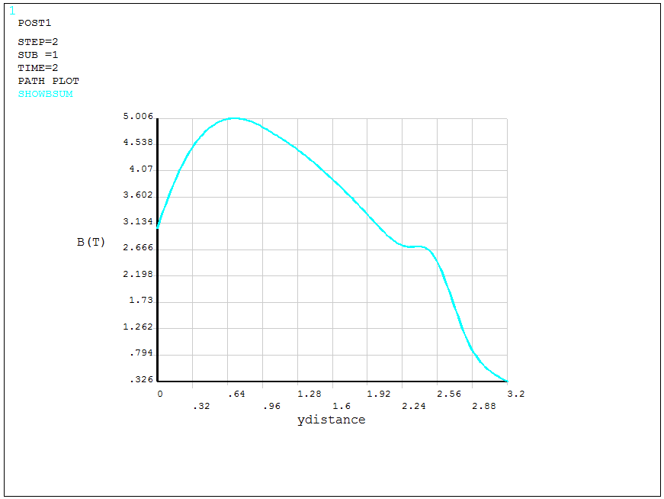
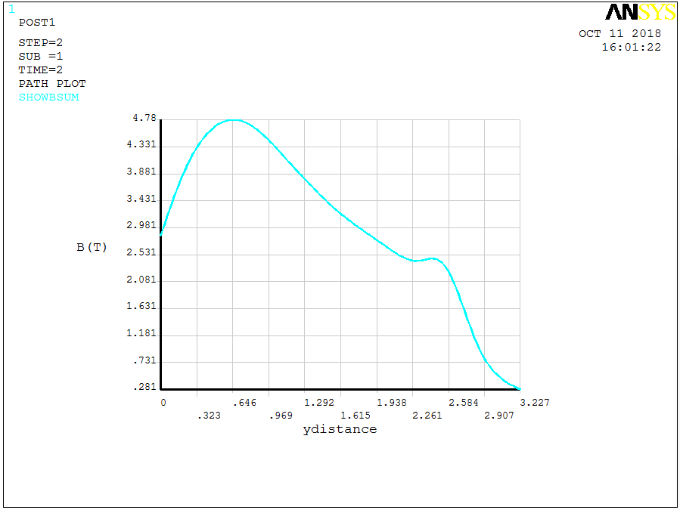
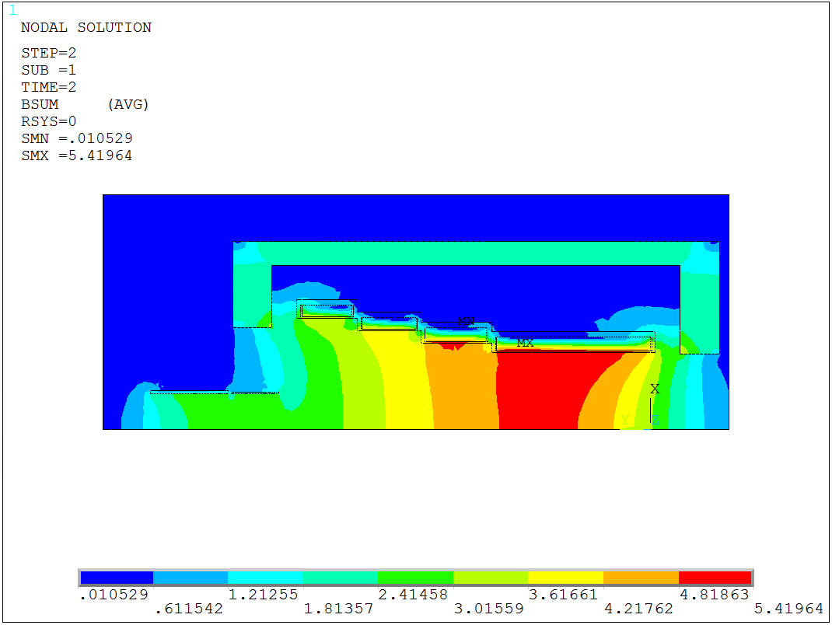
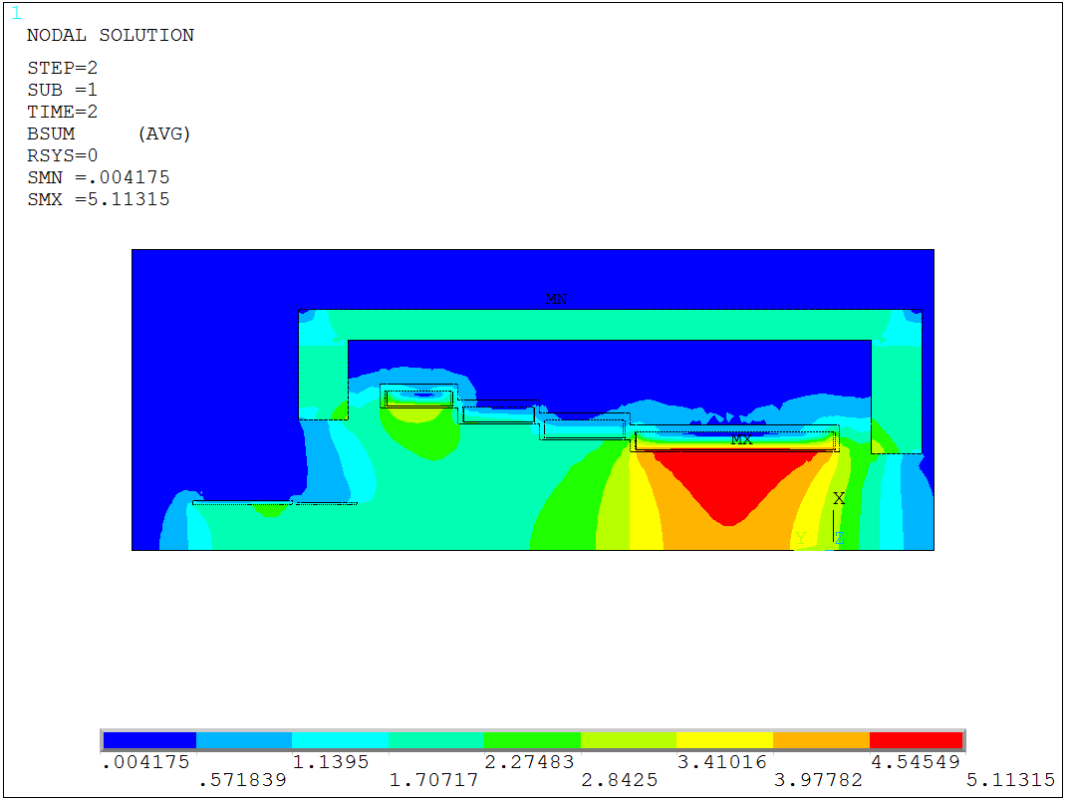
Magnetic Field design –for different mode
Peak Field 5 ~2.7 T(Slower taper)
Peak Field 4.87 ~ 2.4 T(baseline)
Peak Field 4.5 ~2.5 T(faster)
Bsum_{max}= 5.42 T
Bsum_{max}= 5.36 T
Bsum_{max}= 5.11 T
Notes:
These pictures show the field curve along the magnet axis for different run mode. The peak field along the axis is 5 T, 4.8 T and 4.5 T respectively.
The following pictures show the field distribution at the target station.
The maximum field at the coil is 5.42T , 5.36 T and 5.11 T accordingly.

Slide 9
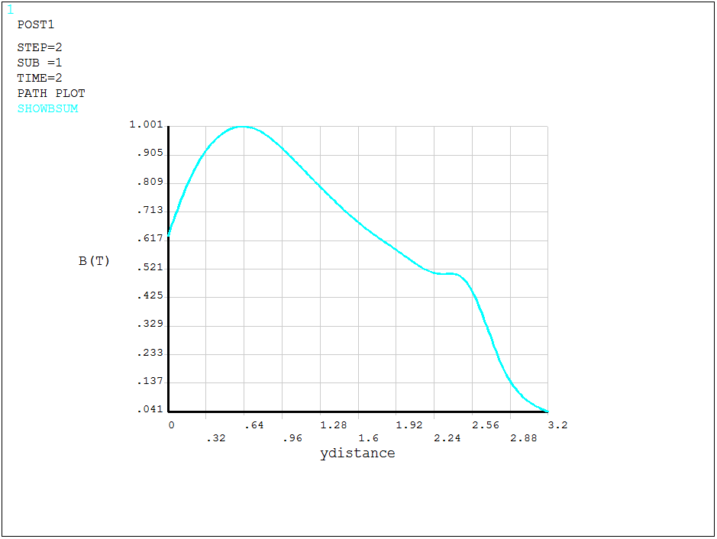
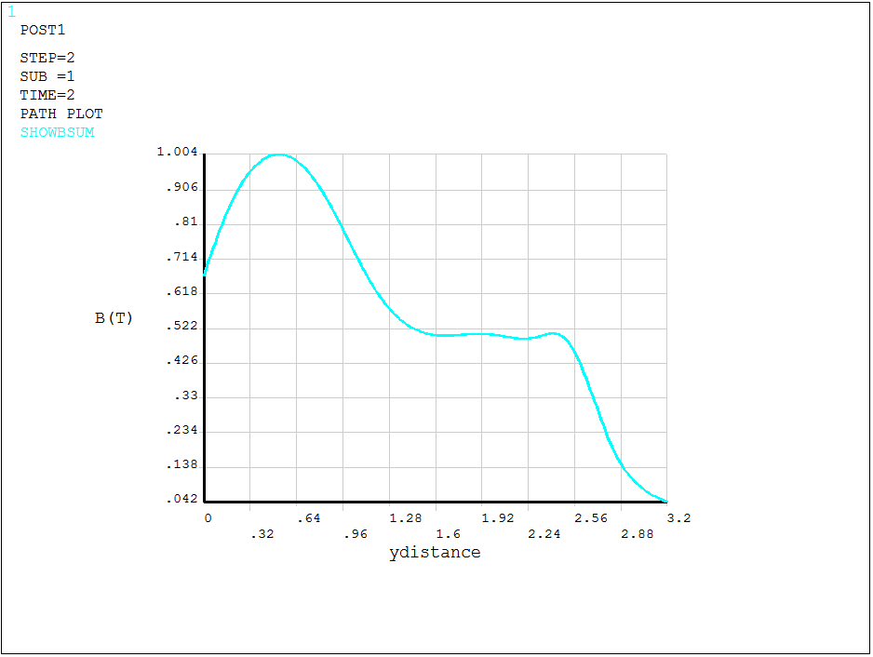
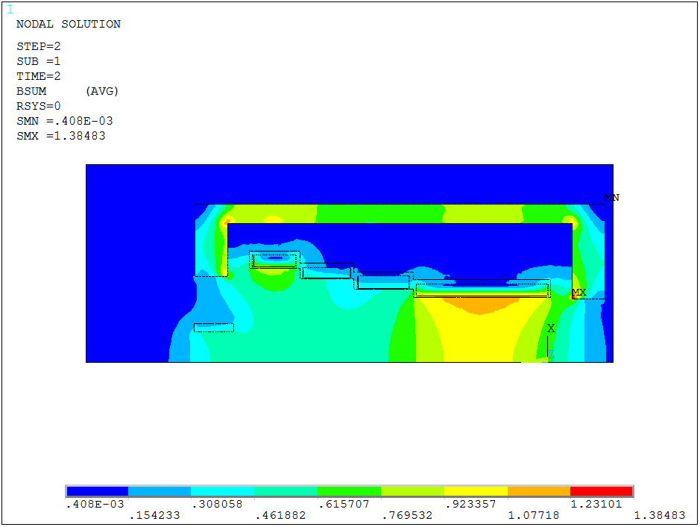
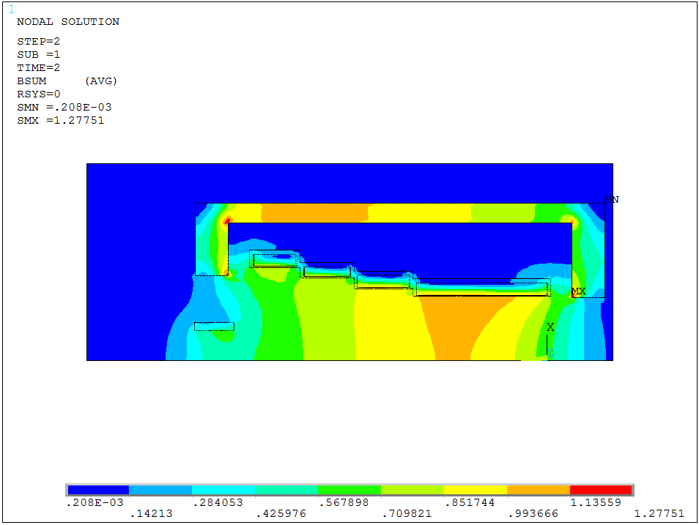
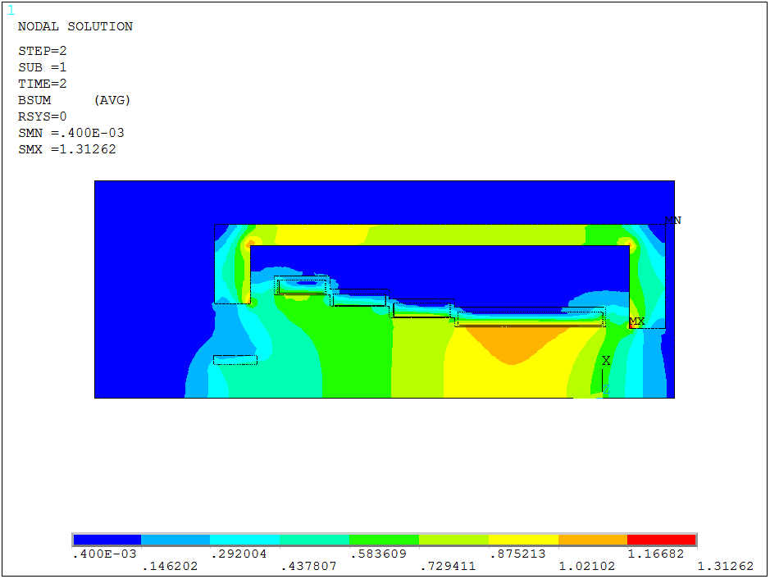
Magnetic Field design-for surface muon
Peak Field 1 ~0.5 T(Slower taper)
Peak Field 1 ~ 0.5 T(baseline)
Peak Field 1 ~0.5 T(faster)
Bsum_{max}= 1.27 T
Bsum_{max}= 1.313 T
Bsum_{max}= 1.385T
Notes:
These pictures show the field curve along the axis decreasing from 1 T .
The following pictures show the field distribution at the target station.
The maximum field at the coil is 1.27 T , 1.31 T and 1.38 T accordingly.

Slide 10
Cable load analysis
N=6*986/5.1=1160（gap between turns：0.1mm）
Iop = Jcoil*2l*（a2-a1）/N = 3944.5A
Operating @ 5.0 K
Ic of strand@5.0 K ,5.5 T = 870 A
Ic of cable @5.0 K ,5.5 T = 870 *16* 85% = 11832 A
Iop/Ic = 3944.5 A/ 11832 = 33.33% （5 K, 5.5 T）
Operating @ 5.5 K
Ic of strand@5.5 K ,5.5 T = 570 A
Ic of cable @5.5 K ,5.5 T = 570 *16* 85% = 7752 A
Iop/Ic = 3944.5 A/ 7752 = 50.88%（ 5.5 K , 5.5 T ）
Notes:
The target station magnet will be operated between 5.0 ~5.5 K at 5.5 T. When it run at 5.0 K and 5.5 T , the ratio of operation current to critical current is 0.33.
When it run at 5.5 K and 5.5 T , the ratio of operation current to critical current is 0.5.

Slide 11
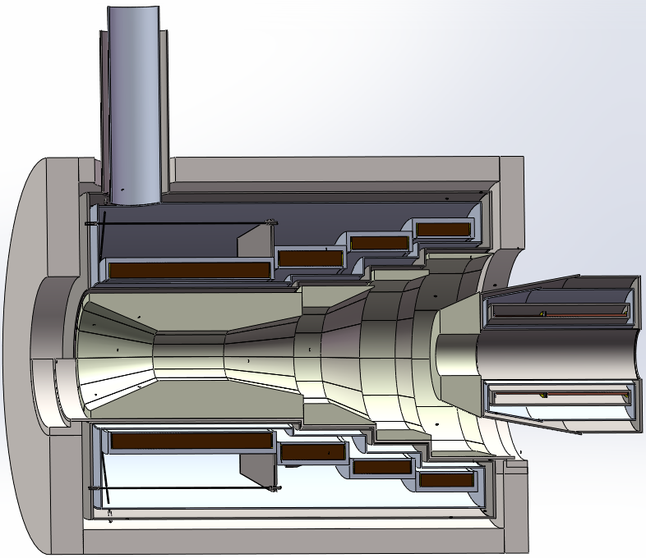
Mechanical design and analysis
Mechanical design
Cryostat
150
200
Thermal Shield
Coil Support
Coil
Cold mass suspend：Ti alloy rod, 4 axial and radial rods for each end respectively.
Matching Solenoid
Yoke
Notes:
This picture show the mechanical structure of the target station magnet. The thickness of the end yoke is 200 millimeter, the thickness of the barrel yoke is 150 millimeter. The cold mass will be suspended by four axial and four radial Titanium alloy rods for each end respectively.

Slide 12
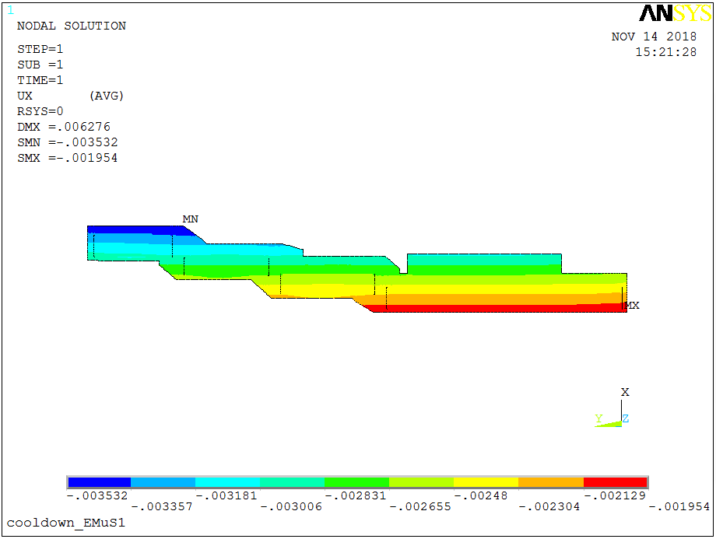
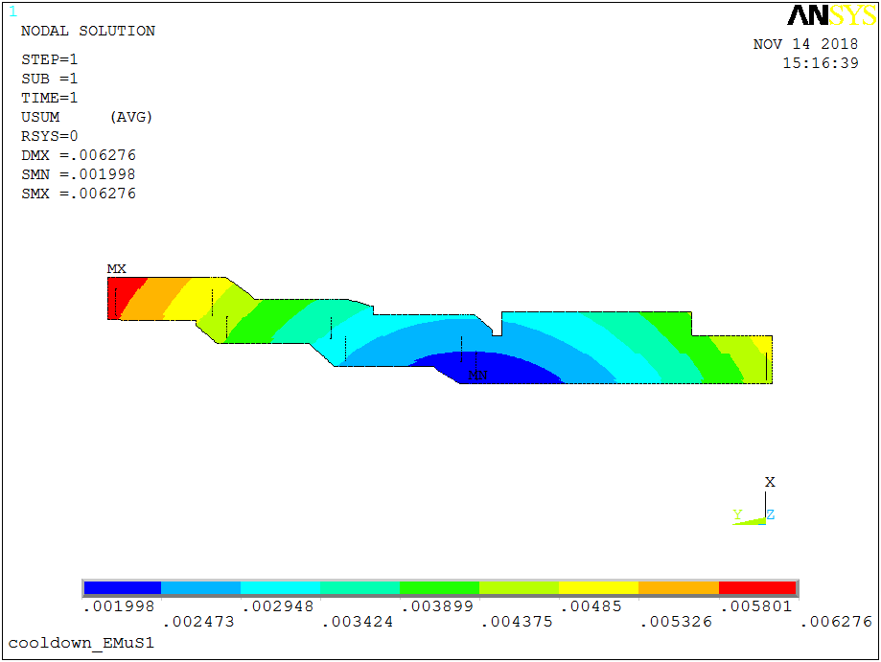
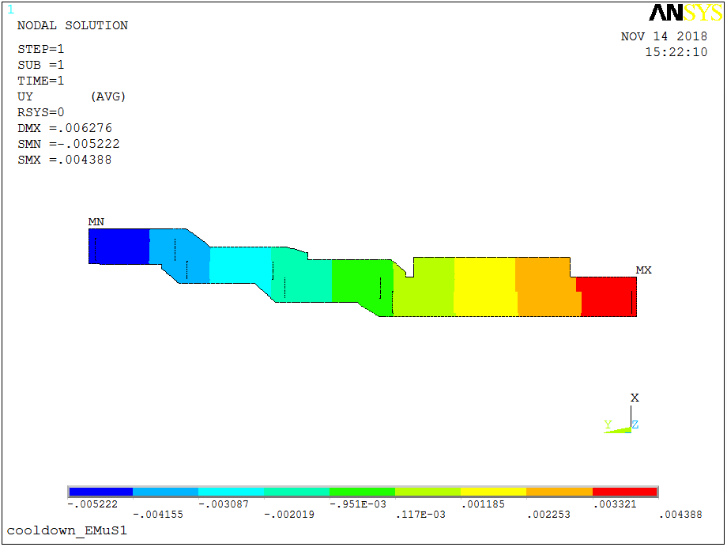
Mechanical Analysis（Contact）
Displacement after cooling down
U_{x} -3.53 ~ -1.95mm
Usum_{max} = 6.27 mm
U_{y} -5.2~4.38 mm
Fixing the first and second coil interface
Notes:
Mechanical analysis was carried out by using Finite Element Method soft ANSYS
Two kinds of method were used: Coil contact with support shell, coil glue with support shell. First I will introduce the result of using contact method.
These pictures show the displacement of the coils after cooling down. The maximum displacement of the coils is 6.27 millimeter.

Slide 13
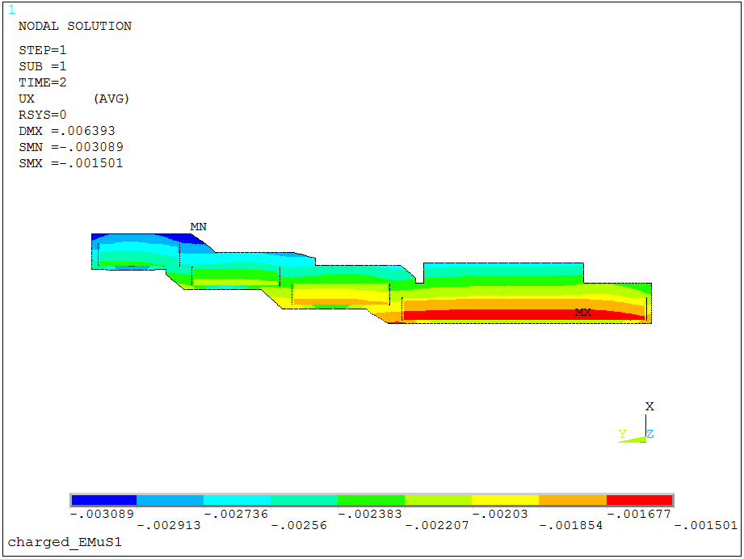
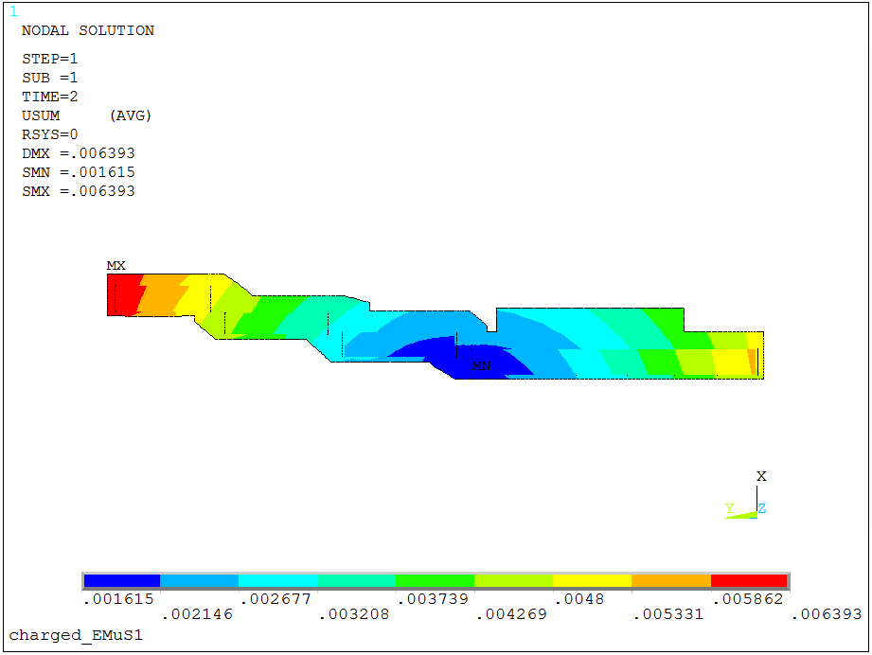
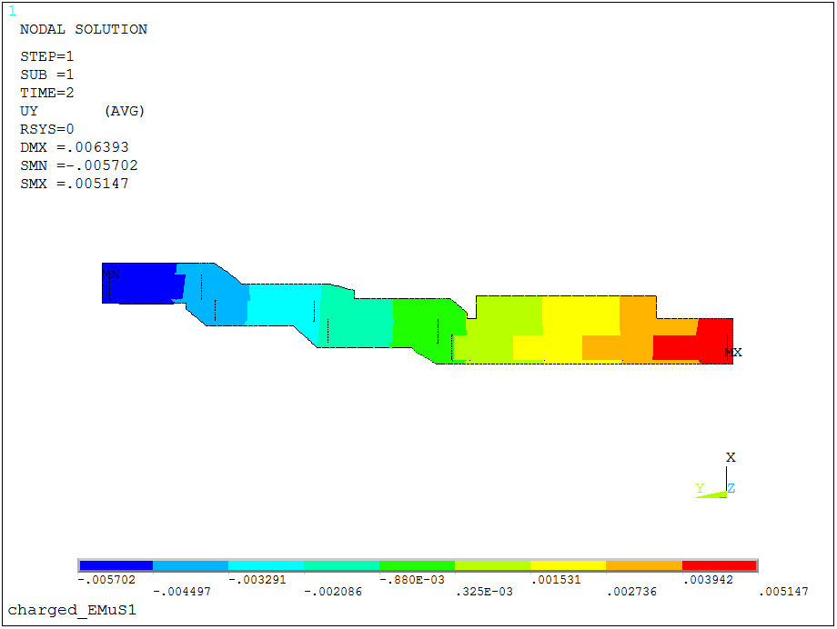
Mechanical Analysis （Contact)
Displacement after excited @ 5 T
U_{x} -3.089 ~ -1.5 mm
U_{y} -5.7 ~5.15 mm
Fixing the first and second coil interface
Usum_{max} = 6.39 mm
Notes:
These pictures show the displacement after the magnet excited to 5 T. The maximum displacement of the coils is 6.39 millimeter.

Slide 14
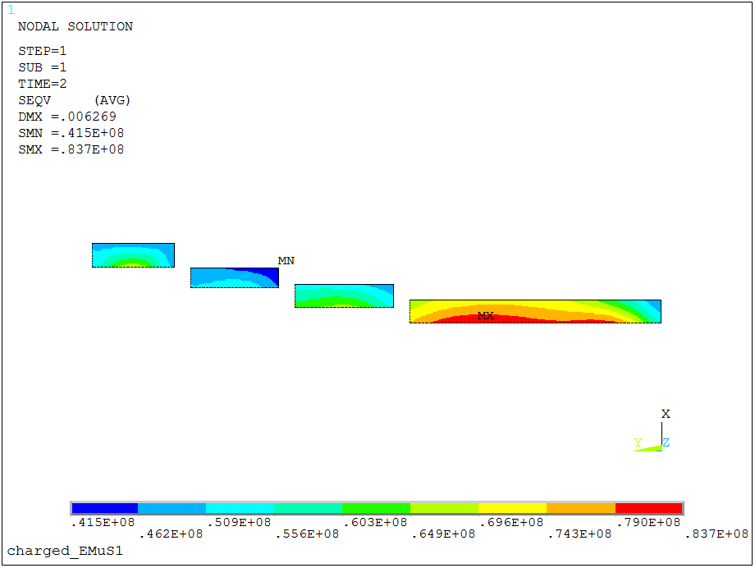
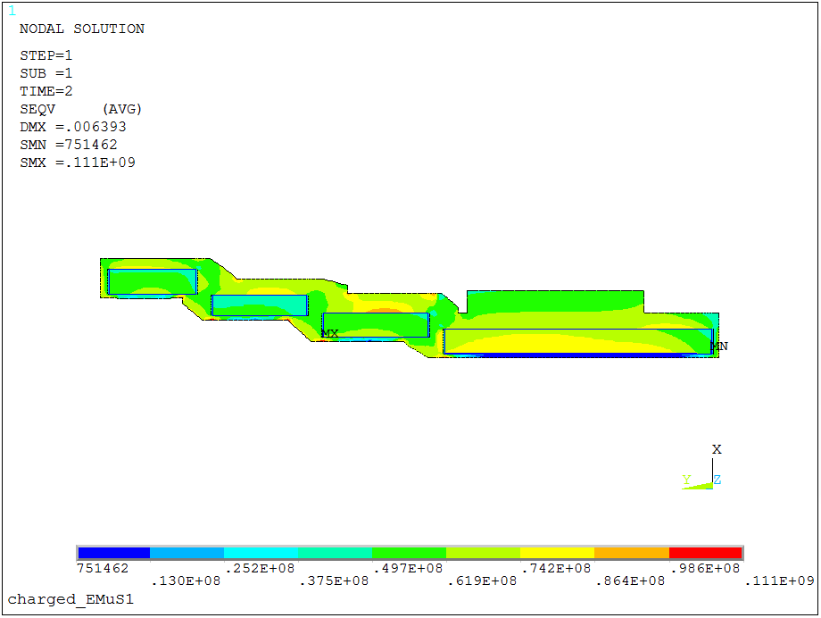
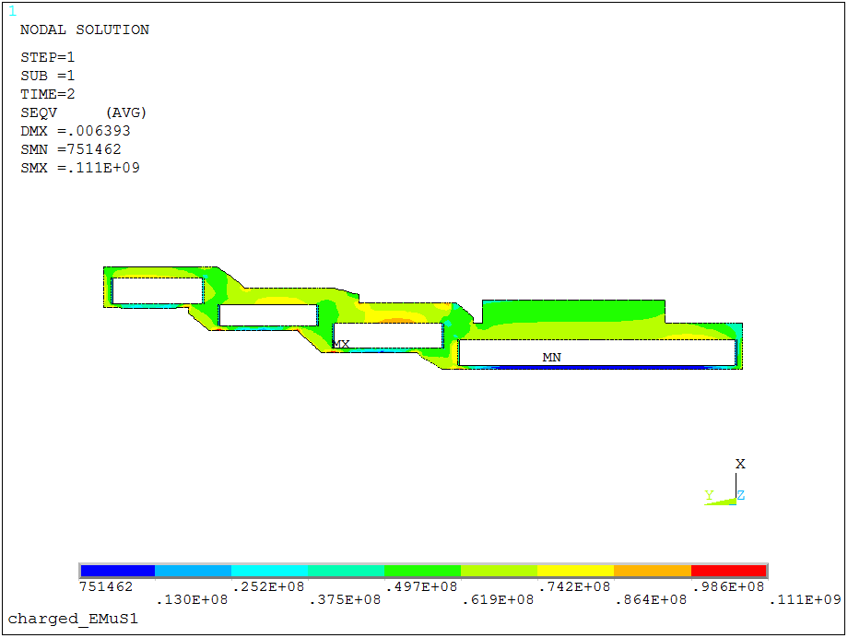
Mechanical Analysis（contact ）
Stress after excited@ 5 T
Seqv_{max} =83.7 MPa
Seqv_{max} =111 MPa
Seqv_{max} =111 MPa
Notes:
These pictures show the stress after the magnet excited to 5 T. The maximum stress of the coils is 83.7 MPa. The maximum stress of the support shell is 111 Mpa.

Slide 15
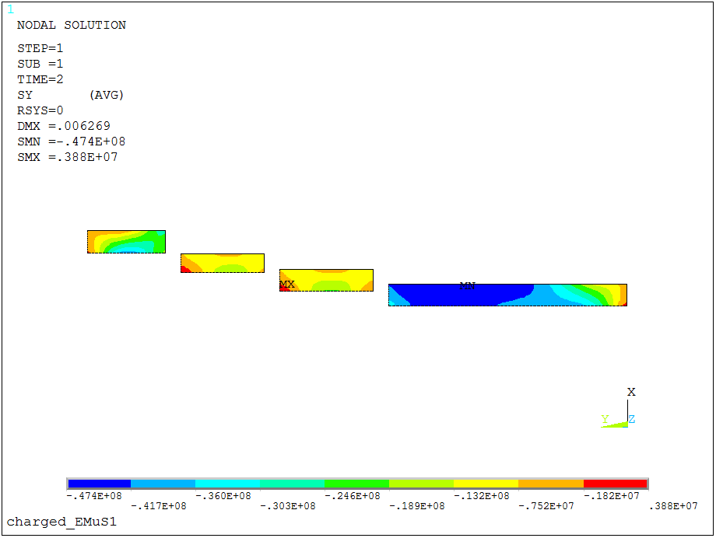
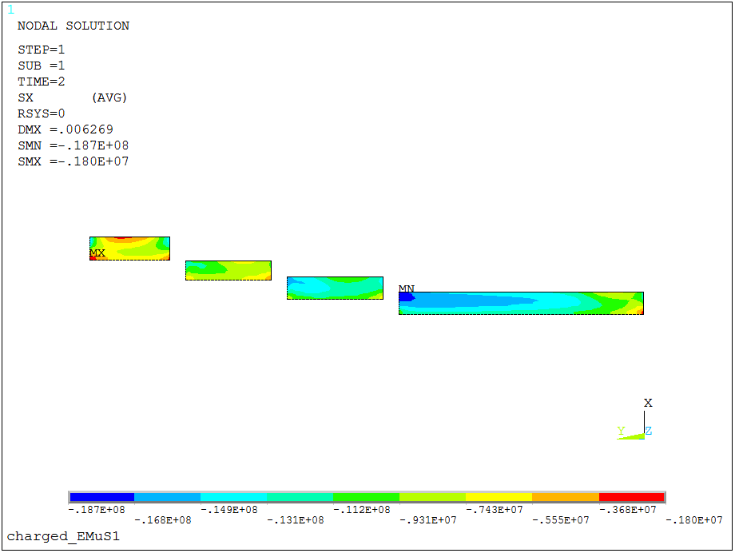
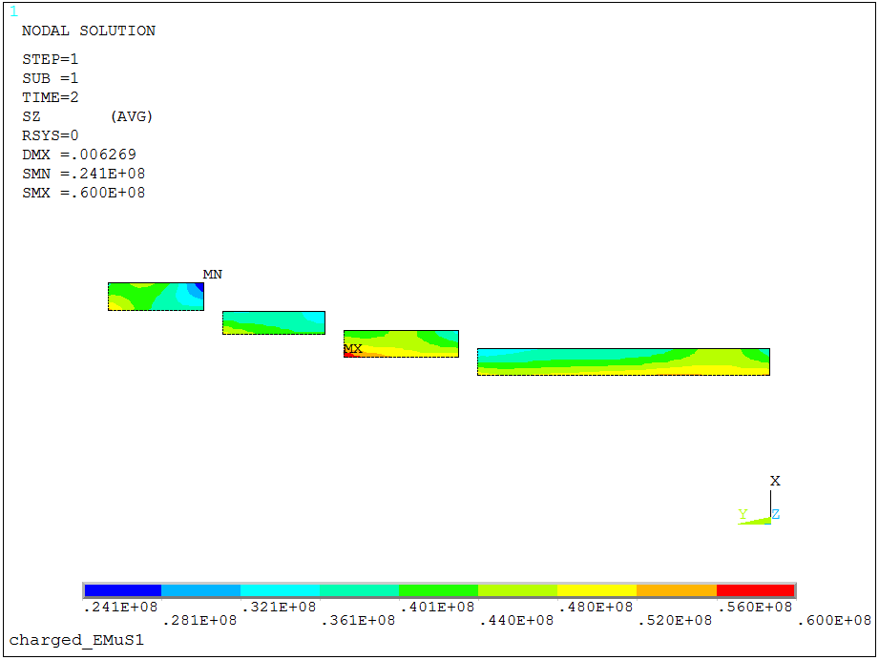
Mechanical Analysis（contact ）
Stress after excited@ 5 T
S_{Ymax} =47.7 MPa (press)
Sx_{max} = 18.7 MPa (press)
Sz_{max} =60 MPa
Notes:
These pictures show the X, Y, Z components stress. The z direction is along the longitudinal of the conductor. The maximum stress of Z component is 60 Mpa.

Slide 16
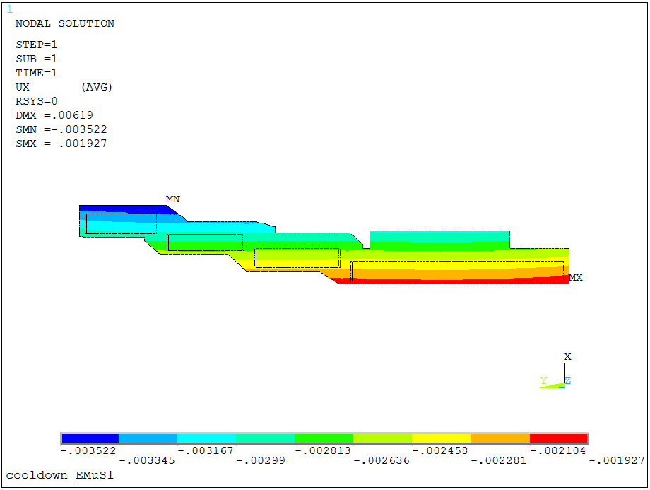
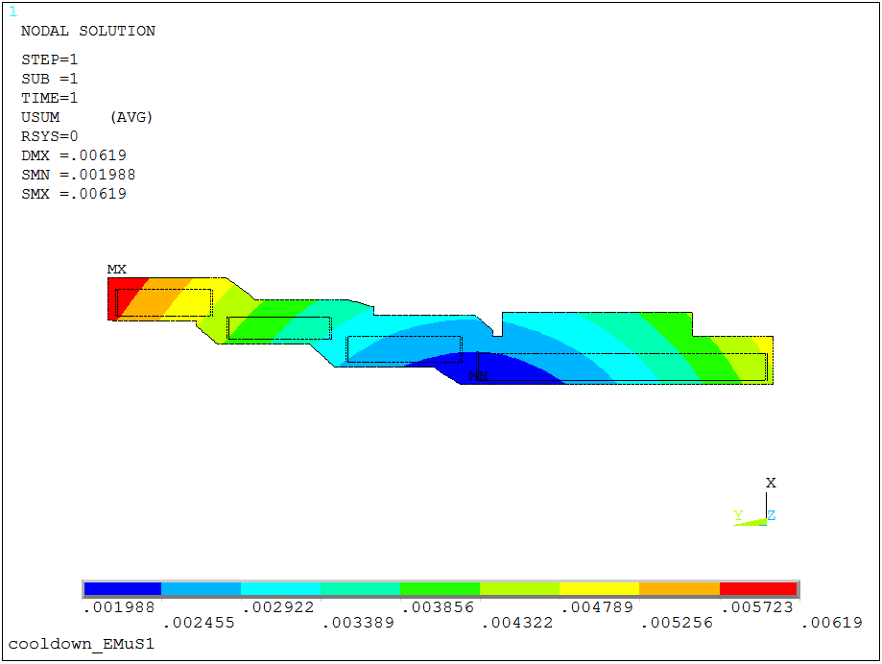
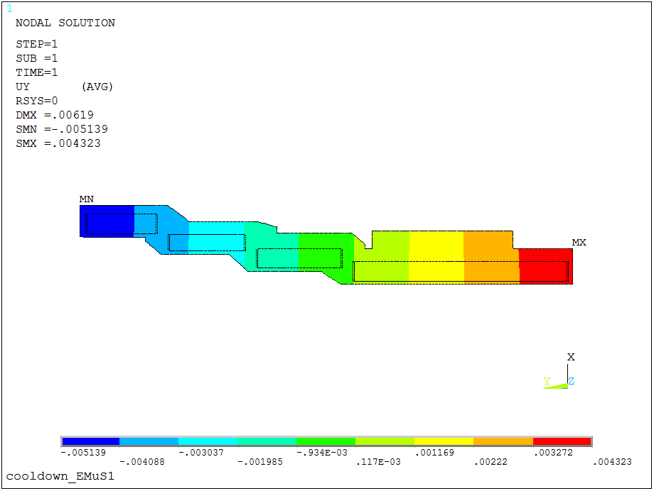
Mechanical Analysis（Glue）
Displacement after cooling down
U_{x} -3.52 ~ -1.93mm
Usum_{max} = 6.19 mm
U_{y} -5.14~4.32 mm
Fixing the first and second coil interface
Notes:
When using glue method to analyze,. The maximum displacement of the coils is 6.19 millimeter after cooling down.

Slide 17
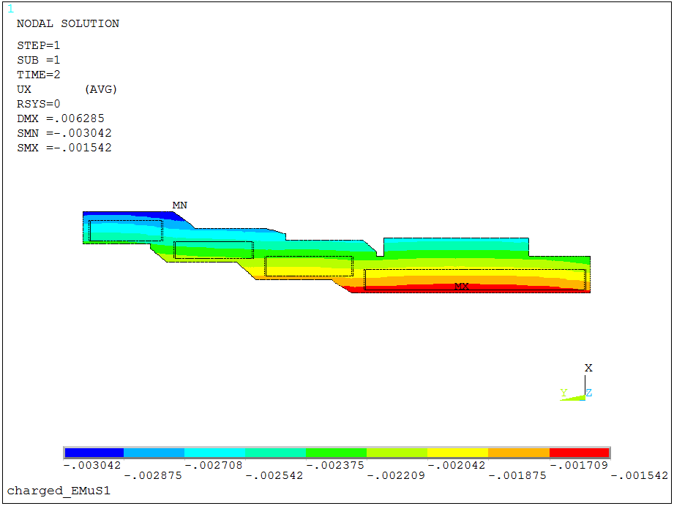
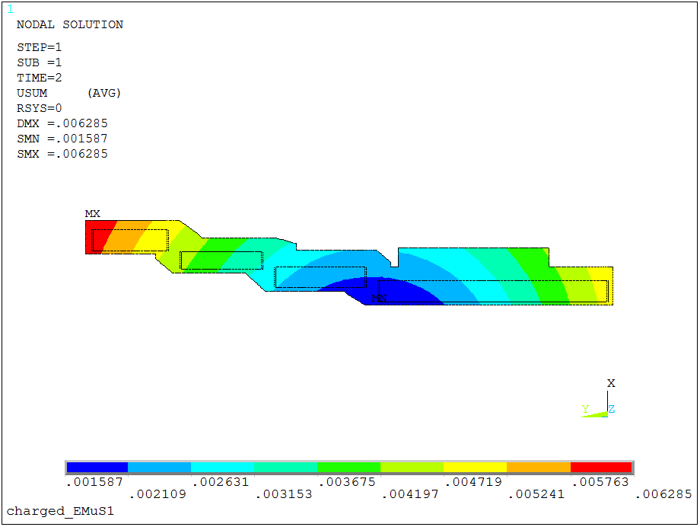
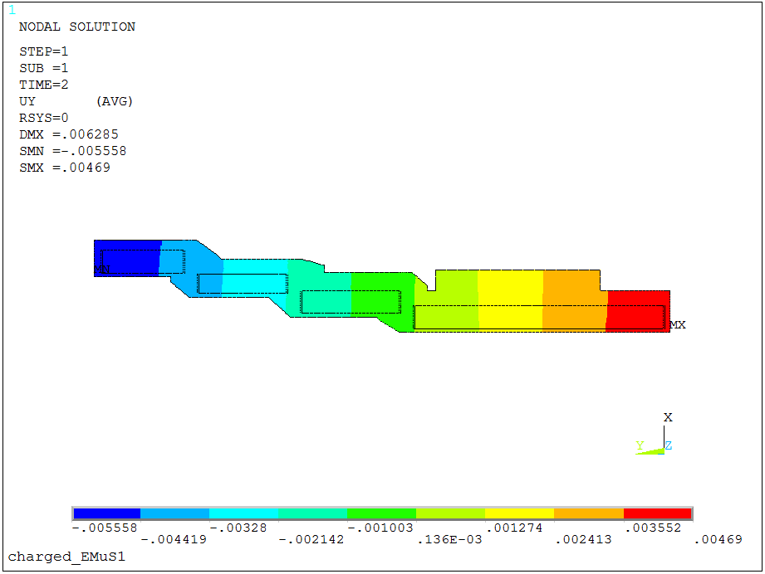
Mechanical Analysis （Glue)
Displacement after excited @ 5 T
U_{x} -3.04 ~ -1.54 mm
Usum_{max} = 6.28 mm
U_{y} -5.56 ~4.69 mm
Fixing the first and second coil interface
Notes:
These pictures show the displacement after the magnet excited to 5 T. The maximum displacement of the coils is 6.28 millimeter.

Slide 18
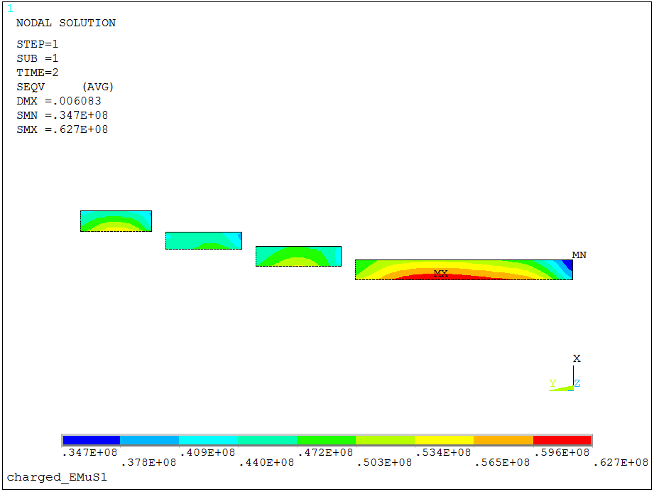
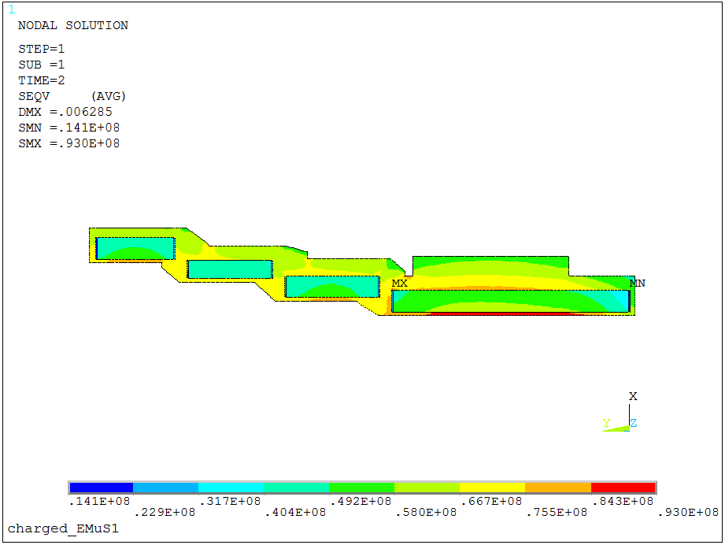
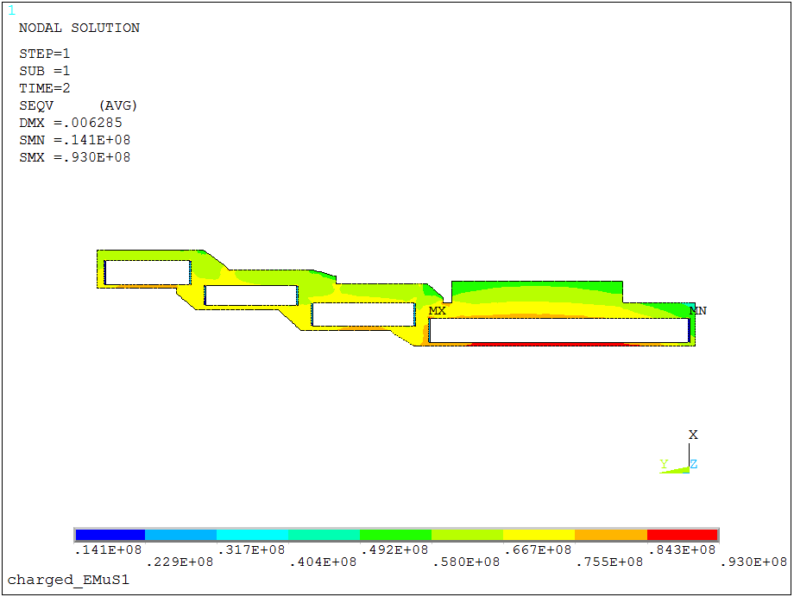
Mechanical Analysis（ Glue ）
Stress after excited@ 5 T
Seqv_{max} =62.7 MPa
Seqv_{max} = 93 MPa
Seqv_{max} =93 MPa
Notes:
These pictures show the stress after the magnet excited to 5 T. The maximum stress of the coils is 62.7 MPa. The maximum stress of the support shell is 93 MPa.

Slide 19
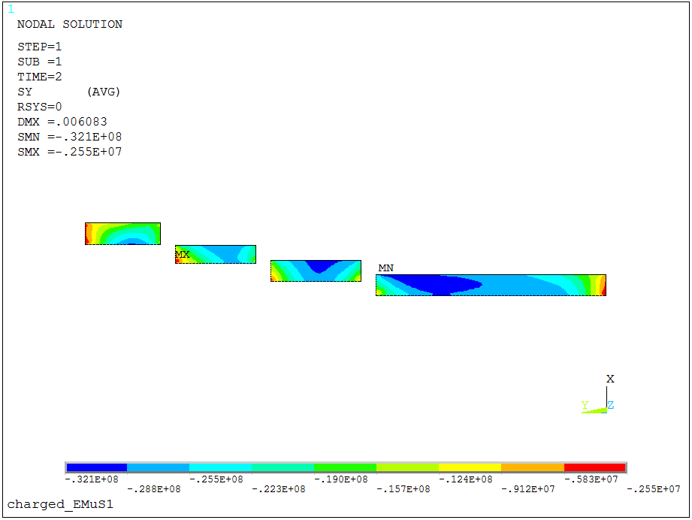
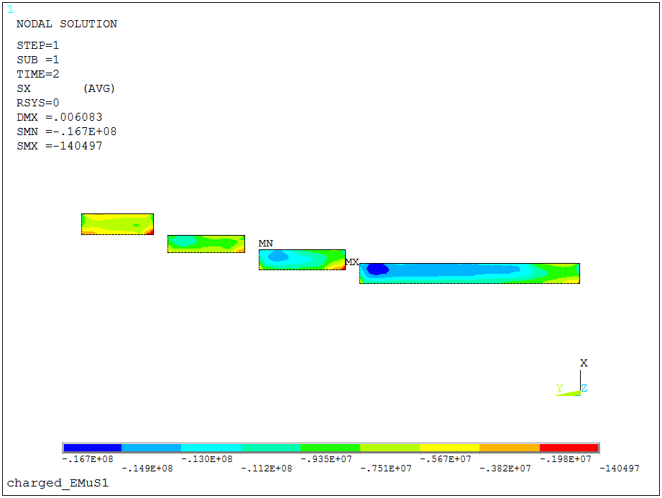
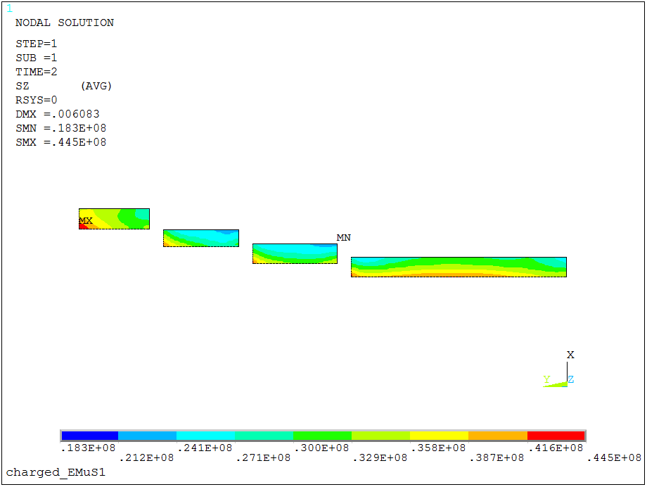
Mechanical Analysis（ Glue ）
Stress after excited@ 5 T
S_{Ymax} =32 MPa (press)
Sx_{max} = 16.7 MPa (press)
Sz_{max} =44.5 MPa
Notes:
These pictures show the X, Y, Z components stress. The z direction is along the longitudinal of the conductor. The maximum stress of Z component is 44.5 Mpa.

Slide 20
Mechanical Analysis result
Item | Contact element | Glue | Comparison
Displacement (cooled down) mm | 6.27 | 6.19 | 0.08
Displacement(excited) mm | 6.39 | 6.28 | 0.11
Von Mises Stress (excited) MPa | 111 | 93 | 18
Von Mises Stress on coil (excited) MPa | 83.7 | 62.7 | 21
X-Component of stress MPa | -18.7 | -16.7 | 2
Y-Component of stress MPa | -47.4 | -32.1 | 15.3
Z-Component of stress(Along the conductor)MPa | 60 | 44.5 | 15.5
Proof stress of Al stabilizer：85 MPa @4.2 K
Yield strength of A5083-O@ 4.2 K : 179 MPa
Stress distribution is acceptable.
Notes:
This table list the results. For the coil will be solidified with the support shell by BT resin, the result of glue method will be more close to the reality.
The stress distribution is acceptable.

Slide 21
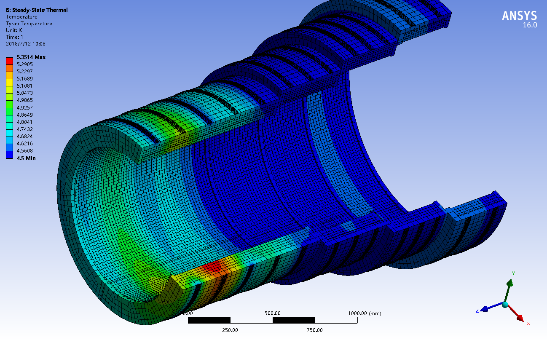
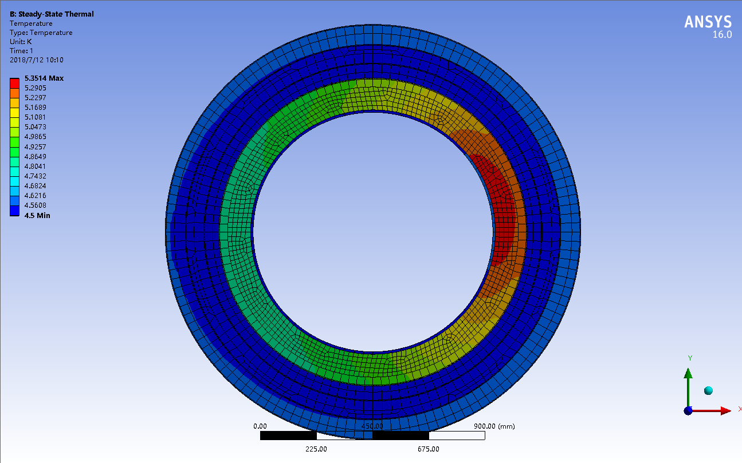
Thermal Analysis
Temperature nephogram
Thermal load：irradiation heat（except conduction，radiation and convection heat）Cs1：11.11 w，Cs2：9.04 w，Cs3：7.12 w，Cs4：6.61 w
Cold source: 4.5 k two-phase helium forced-flow
Maximum temperature: 4.95 K
The irradiation heat is not uniform along the circumference
Notes:
The left picture is the temperature distribution of the coils. The thermal load is the irradiation heat, the conduction, radiation and convection heat have not been included here. The irradiation heat is close to 35 watt. The cold source is 4.5 K two-phase helium forced-flow. The maximum temperature is 4.95 K. We want the temperature of the coil low 5 K at the beginning of the operation. Adding pure aluminum strip and other method will be needed.

Slide 22
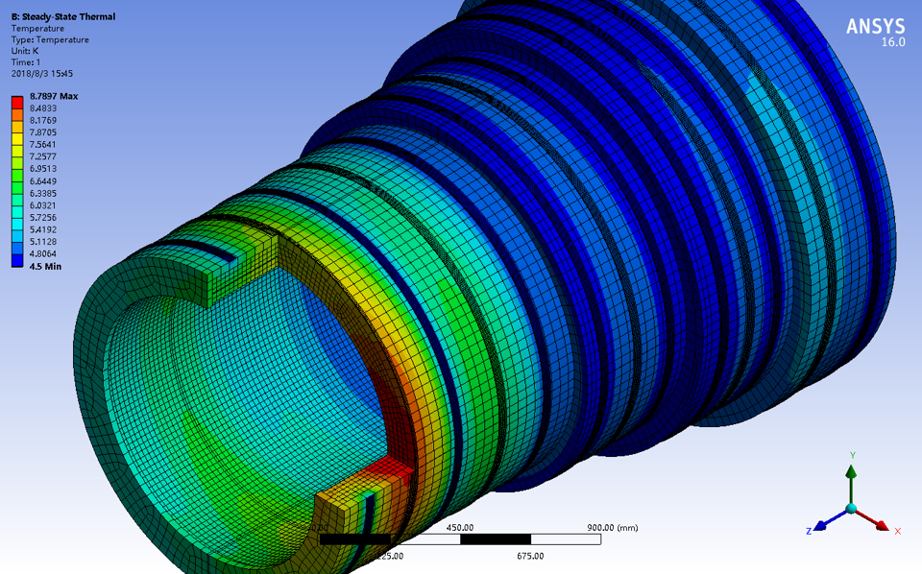
Thermal Analysis
Degradation of Al stabilizer(RRR) for the irradiation
maximum temperature during continuous operation
12 months continuous operation, maximum temperature: 7.08 K (with axial pure Al strip),
7.3 K (None Al pure strip)
Continuous operation time: about 5 months ( 2 month ,5.0 T , 3 month , 1.0 T)
Notes:
Triple R of the aluminum stabilizer will degrade for the irradiation. The maximum temperature will rise during continuous operation. After 12 months continuous operation the maximum temperature will beyond 7 K. The EMuS is probably operated 5 months continuous.

Slide 23
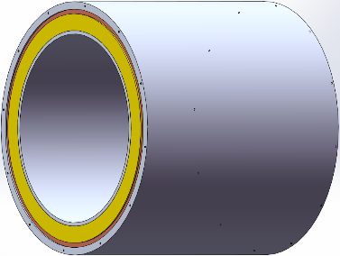
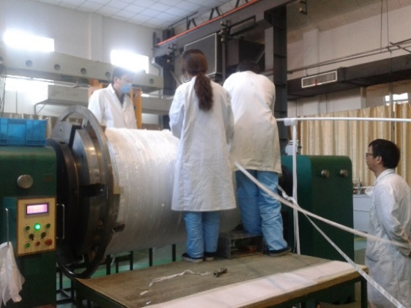
Manufacture of coil
Outer winding——mechanical assembly
temperature difference assembly method
outer supporter 100°
ΔD= α *D* ΔT = 2.46 mm
Coil cooling down -200°
ΔD= α *D* ΔT =4.06 mm
Vacuum pressure impregnation
BT resin
23
Notes:
Outer winding method will be adopted to manufacture the coils. Temperature difference assembly method will be used to assemble the coil and the outer support shell. To solidify the coil and the support shell, vacuum pressure impregnation with BT resin will be carried out after the assembly.

Slide 24
Design of insulation
Insulation of conductor— One layer of UG (Upilex —Kapton with B stage fiber glass epoxy，0.075 mm) with 100% coverage. The insulation strength is required exceeding 500 V DC.
or replaced by one layer of Kapton, one layer of fiber glass
Ground insulation
Inner support—2 layers of GUG ,
The side wall —7 mm thick G-10.
Outer support—2 layers of GUG
The insulation strength is required exceeding 2000V DC.
Notes:
The insulation of conductor will adopt one layer of UG with 100% coverage, or replaced by one layer of Kapton ,one layer of fiber glass. The insulation strength is required exceeding 500 Volt.
The ground insulation of the inner and outer support will use two layers of GUG, and its side wall will use 7 mm thick G-10.
The insulation strength is required exceeding 2000 Volt.

Slide 25
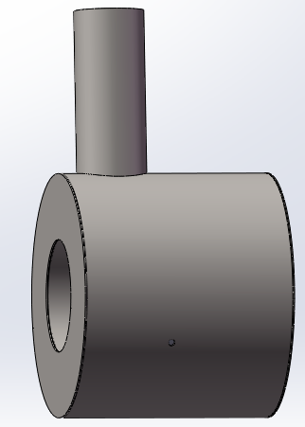
Test of coil
First step– coil CS1
Cold mass ：1.6 t
Inductance：0.98 H
Store energy：7.6 MJ
Conduction cooling (two-phase helium )
Test time：3 hours for excitation, 1 hour for measuring the field, 2 hours for demagnetization
Liquid helium supply system is required;
coil temperature distribution can be measured;
25
Notes:
We will manufacture and test the CS1 at the first step. Two phase helium forced flow will be used as cooling source. One test will cost 6 hours.

Slide 26
Cryogenic flow sheet
Liquid nitrogen to thermal shield
Liquid helium return
Liquid helium to coil
Liquid nitrogen return
Notes:
This is the cryogenic flow sheet. Liquid helium is used to cool the coil and liquid nitrogen is used to cool the thermal shield.

Slide 27
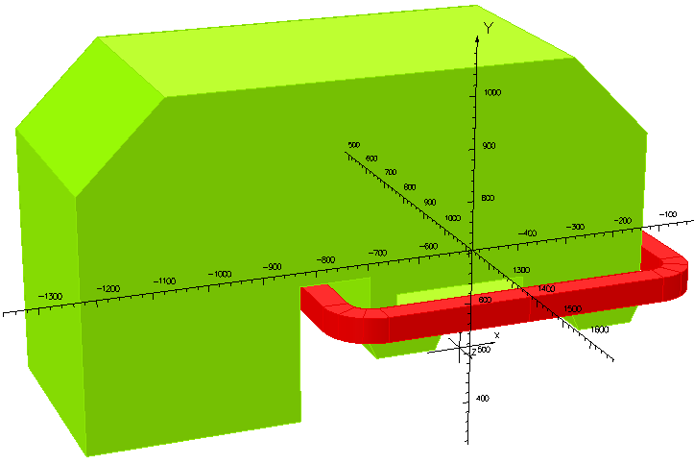
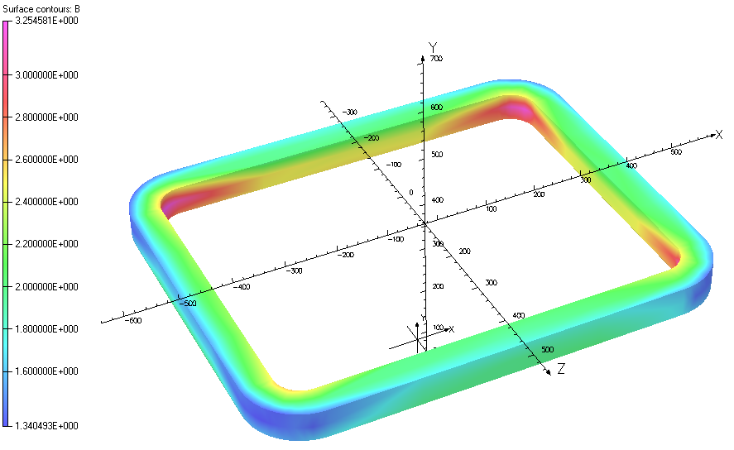
Magnet design for the Superferric dipole
Name of the magnet | EMuS-Dipole
Design | superferric C-type, straight
Max. dipole field(T) | 1.667
Bending angle(degree) | 30
Curvature radius(mm) | 1000.68
Pole width(mm) | 700
Effective path length(mm) | 262
Useable horizontal aperture(mm) | 300
Useable vertical gap(mm) | 300
Vertical pole gap height(mm) | 320
Integral field quality | ±5.0×10⁻⁴
Notes:
The supperferric dipole will manufacture by NbTi superconductor.The table lists the parameter of the superferric dipole. The maximum field of the dipole is 1.66 T .The bending angle is 30 degree. The integral field quality is plus minus 5.0 multiply minus four times of ten along the x direction.

Slide 28
Displacement & stress analysis
Uz_{max}= 0.339 mm
Seqv_{max}= 96 MPa
Put coils in coil cases to reduce the stress and displacement. Stainless steel 316LN is chosen for the coil case.
Notes:
The coil will be put in a stainless steel case.
The maximum displacement of z direction is 0.34 mm. The stress of the coil is 96 MPa.

Slide 29
Conceptual design for the transport line magnet
Conductor —Nb-Ti / Copper Matrix Monolith Wire
Parameters of strand
Item | Value
Strand Diameter | 1.56 mm
Cu/NbTi | 6.0/1.0
Ic @ 5.0 T 4.2 K | > 700 A
Nominal Current | 200 A
Operate temperature | 4.2 K
500
200
Notes:
There will be 20 transport line magnets. Each coil will be 500 mm long. There is at least 200 mm gap between every two coils. Nb-Ti / Copper Matrix Monolith wire will be used to manufacture the transport line magnets. The designed nominal current will be 200 ampere. Helium bath will be used to cool the coil.

Slide 30
Conceptual design for the transport line magnet
Field along the axis: 2.1 ~3.3 T
Peak field : 3.56 T
Notes:
The left picture shows the field changing along the axis. The field change between 2.1 to 3.3 T. The right picture shows the field distribution. The peak field on the coil is 3.56 T.

Slide 31
Thermal loads
 |  | 77 K thermal load | 4 K thermal load
Target magnet |  | 50 W (radiation 300 K to 77 K and support rods conduction) | 45~ 50 W 35 ~40 W (irradiation), 10 W (radiation 77 K to 4 K and support rods conduction, excitation)
Current leads | HTS | 400 *8 = 3200 W | 1 W *8 = 8 W
 | Copper | 400 *8 = 3200 W | 4 W*8 = 32 W
Valve box |  | 50 W | 10 W
Superferric dipole |  | 50 W | 3 W
Current leads for dipole |  | 40 W | 1 W
Transport magnets(20) |  | 50 W *20 =1000 W | 3 W *20 = 60 W
Current leads for transport magnets |  | 40 W *20 =800 W | 1 W *20 =20 W
Total |  | 5200 W | 160 ～ 180 W
Notes:
This table lists the thermal loads of EMuS magnets. The 77 K thermal load will be 5200 watt. The 4 K thermal load will be 160 ~180 watt.

Slide 32
Summary
Magnet design for the target
4-coils/3-steps is designed.
There will be different operation modes, current of each coil need to be adjusted. Four pairs of current leads will be used.
The stress distribution is acceptable.
Next step, the quench analysis and quench protect design will be done.
Magnet design for the superferric dipole
The maximum field of the dipole is 1.66 T .The bending angle is 30 degree.
Field uniformity is better than 5.0×10⁻⁴
Magnet design for the transport line.
Peak field along the axis is 3.3 T.
The gap between coils is 200 mm.
Optimization of coil layout will be carried out later.
Thanks
Notes:
Here I will give a brief summary about the magnets design.
The magnet for the target station will be a 4- coils / 3 steps structure.
There will be different operation modes, current of each coil need to be adjusted. Four pairs of current leads will be used.
The stress distribution is acceptable.
Next step, the quench analysis and quench protect design will be done.
The maximum field of the dipole is 1.66 T .The bending angle is 30 degree.
The field quality is better than 5.0 times ten to the minus four.
The Peak field of the transport magnets along the axis is 3.3 T.
The gap between coils is 200 mm.
Optimization of coil layout will be carried out later.

