Slide 1
Proton beam collimation and beam dump
Qili Mu, Yukai Chen, Gang Zhang, Hantao Jing
2018.11.21
Notes:
Good afternoon everyone, my report is about proton beam collimation and proton beam dump.

Slide 2
Outline
Motivation and collimation positions
Choice of collimator’s material, shape, and shielding
Collimation analysis
  Collimation of primary proton beam
  Collimation after thin target
  Collimation after main target
Design of proton beam dump
Notes:
It’s the outline. First content is..

Slide 3
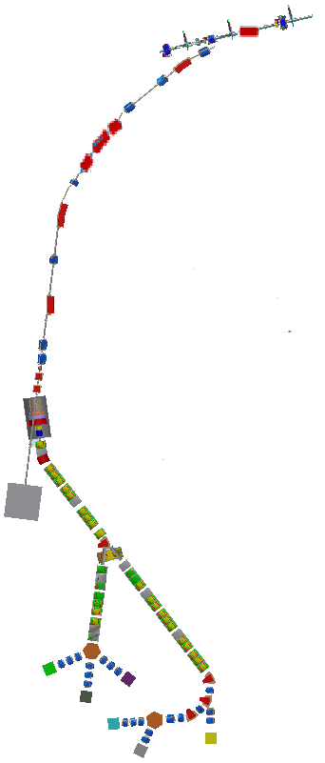
Motivation and collimation positions
Motivation
Reduce primary proton beam line acceptance from 350 π mm·mrad to 150 π mm·mrad.
Control beam loss position and region.
Baseline scheme
Beam halo collimation
position A
Positions
Beam halo collimation position A
Beam halo collimation position B
After the thin target
After the main target
Beam halo collimation
position B
After the thin target
After the main target
Notes:
There are two motivations, one is to …,that need 2 collimators at …;
the other one is to…, like collimation after …..

Slide 4
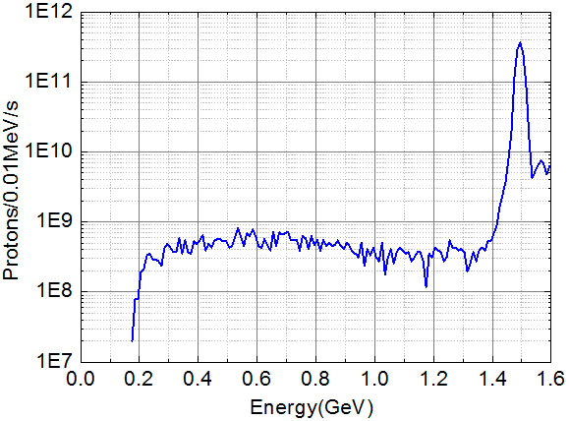
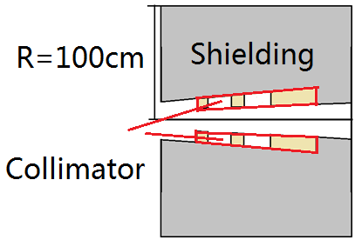
Choice of collimator’s shielding
The design difficulty of collimators mainly is the shielding of induced radiation.
Collimated proton beam with energy close to 1.6 GeV.
Shielding goal:
When the equipment is continuously operated for 100 days, and the dose rate outside the shielding can be reduced to 1 mSv/h after cooling 4 hours.
Shielding schematic
Proton beam energy spectrum
to be collimated
Notes:
…So I’d like to introduce the …. firstly.
The proton beam power to be collimated by the four collimators is all close to 1.6 GeV, like this energy spectrum, so there are many things in common in the collimator design.

Slide 5
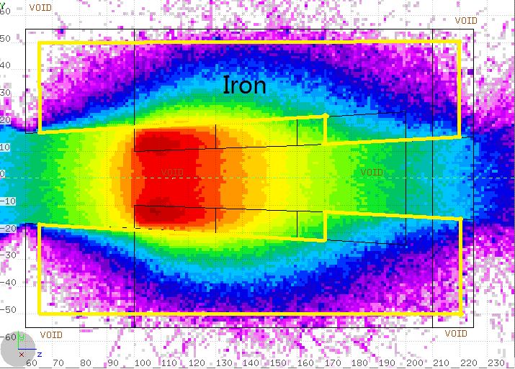
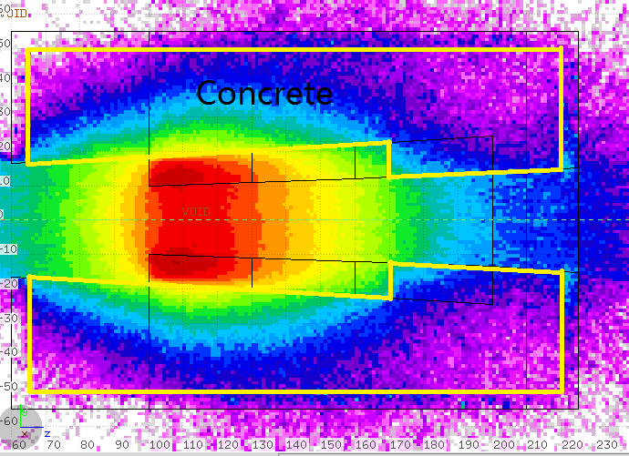
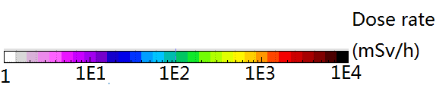
Comparison of shielding effects
Conclusion
The shielding effect of iron is
obviously better than that of
concrete and copper.
Iron shielding
Copper shielding
Residual radiation
dose rate
Iron shielding
Concrete shielding
Notes:
White colour part

Slide 6
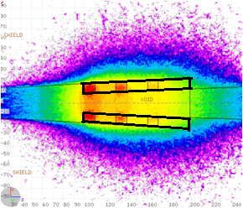
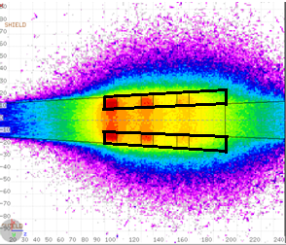
Choice of collimator’s materials
Iron collimator Copper collimator
Conclusion
Induced radiation shielding for Iron and copper collimators have almost the same thickness requirement.
Iron material is chosen to cut cost.
Notes:
1. 能谱

Slide 7
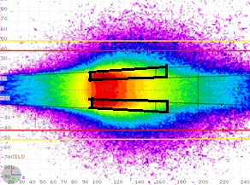
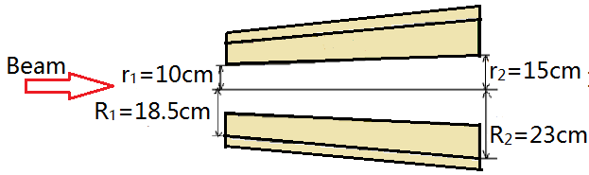
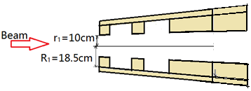
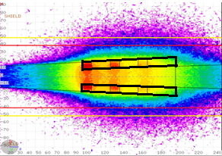
Choice of collimator’s shape
Collimator schematics
Iron
Block structure
Conclusion
Tooth structure does not have a significant advantage in reducing the radial thickness of the shielding.
Tooth structure
Notes:
改图片

Slide 8
Collimation analysis

Slide 9
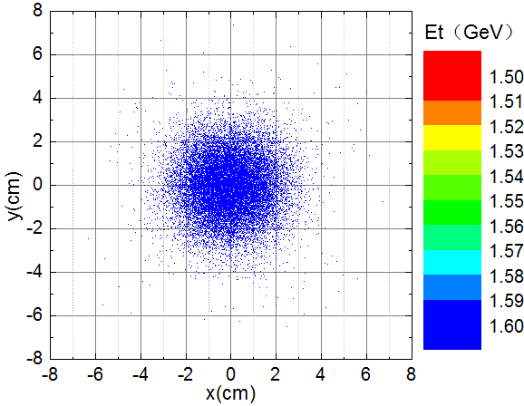
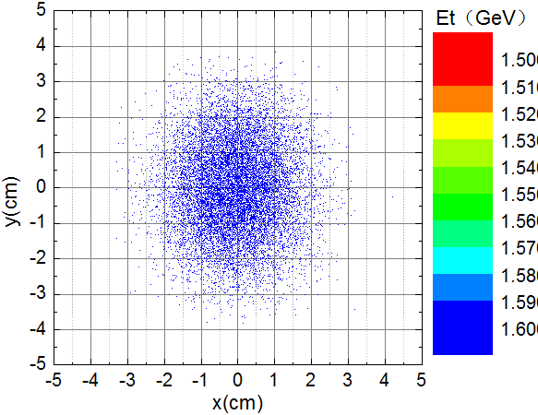
1.Collimation of primary proton beam
Purpose of collimation
Reduce the beam acceptance from
350 π mm·mrad to 150 π mm·mrad
by two collimators(A and B).
Collimation hole at position A: |x|>3cm, |y|>2.8cm
Collimation hole at position B: |x|>3cm, |y|>3cm
Beam halo collimation
position A
Beam halo collimation
Position B
After the thin target
After the main target
260W
70W
Beam spot distribution at position A
Beam spot distribution at position B
Notes:
改图，frame

Slide 10
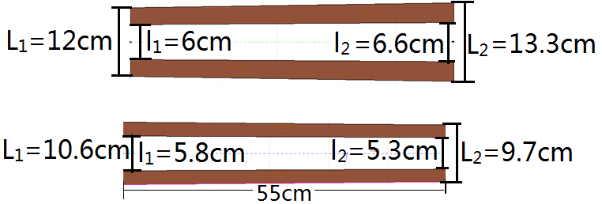
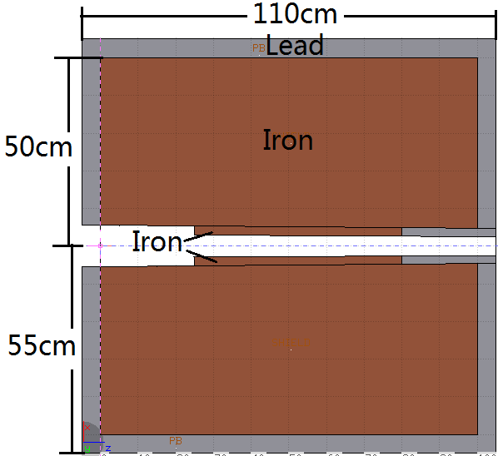
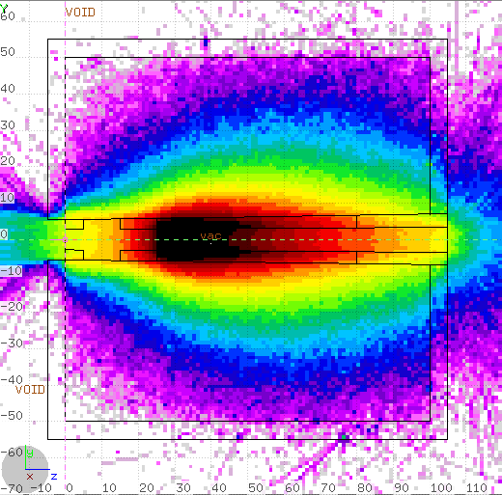
Collimator A
Shape of collimator A:
Vertical
Horizontal
Shielding shape of collimator A:
Lead layer enhances
shielding effect
Notes:
改图

Slide 11
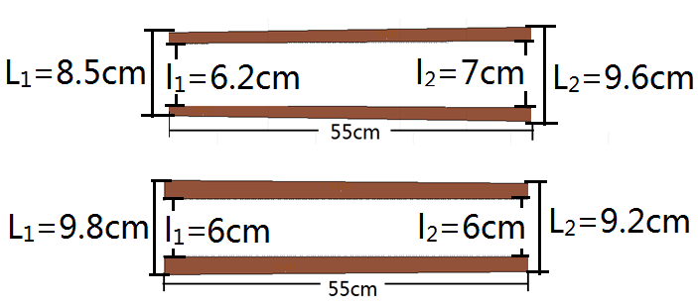
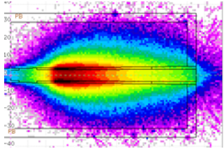
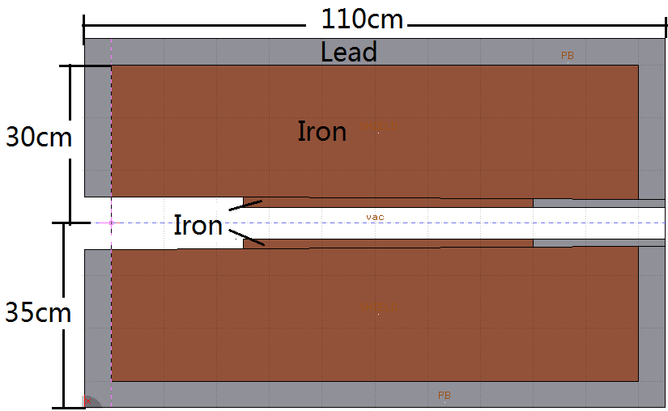
Collimator B
Shape of collimator B:
Vertical
Horizontal
Shielding shape of collimator B:

Slide 12
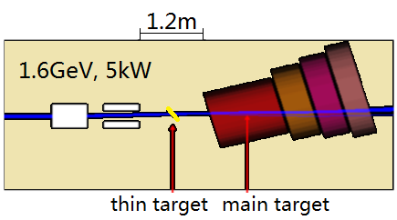
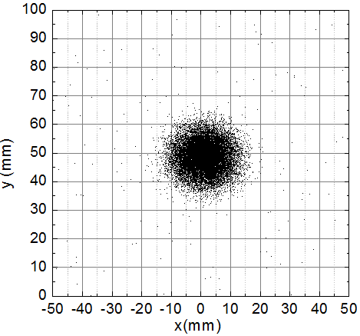
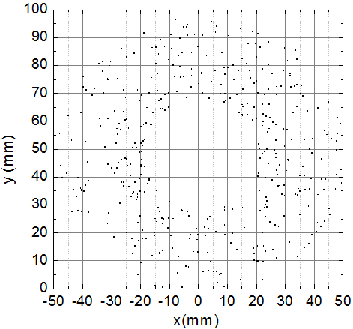
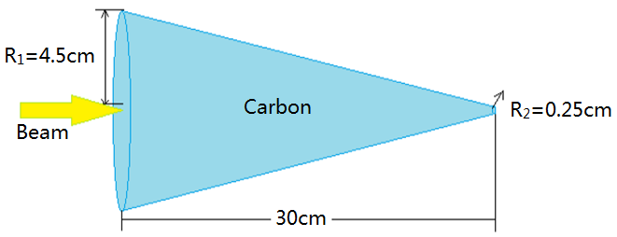
2.Collimation after thin target
30W
Proton at the center of main target
Protons outside of target profile
Collimation goal
Scrape off protons that can not hit the main target.
Conclusion
This power is not big and space is not enough;
Not suitable space for a collimator.
main target schematic
Notes:
换顺序

Slide 13
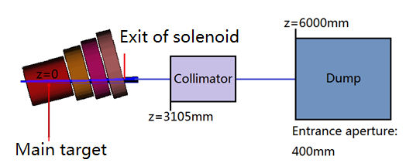
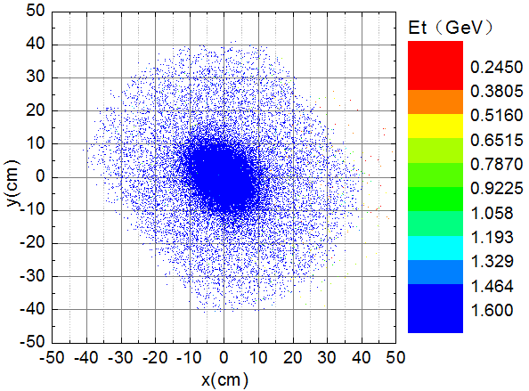
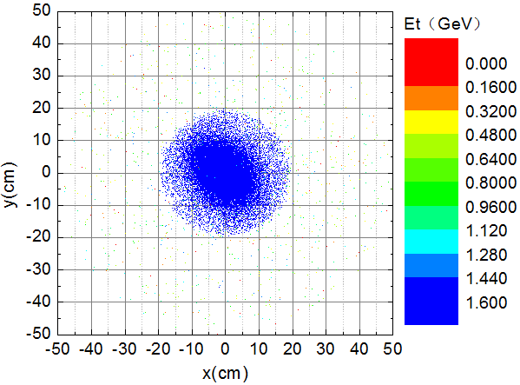
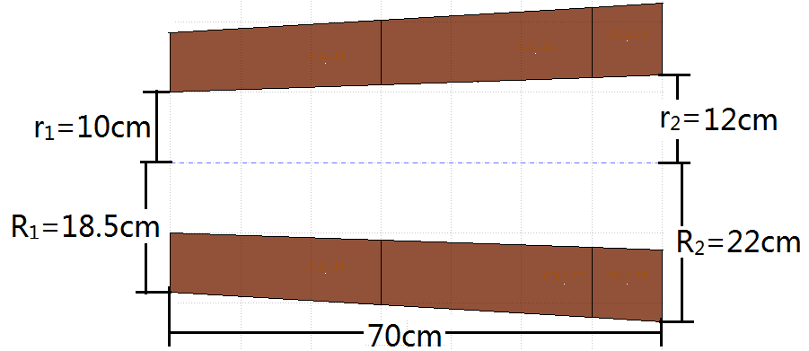
3.Collimator after the main target
Collimation result:
Aperture at the exit of the solenoid: 250mm
Beam spot distribution at
dump without collimator(1918W)
Collimation goal
Scrape off protons that can not enter
the dump hole.
Collimator shape and size:
Beam spot distribution at
dump with collimator(1650W)
Power of protons out of
dump hole is 5W
Notes:
改图

Slide 14
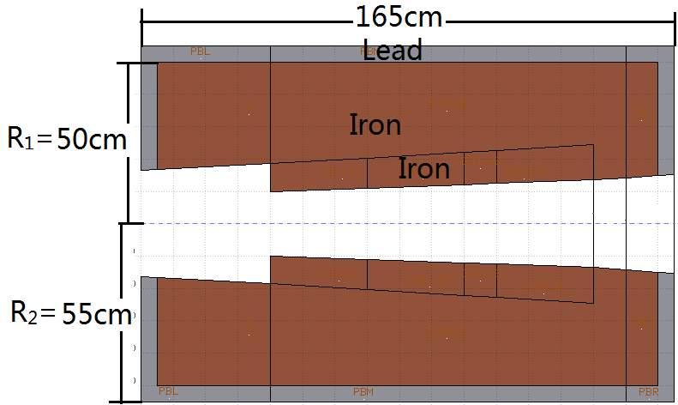
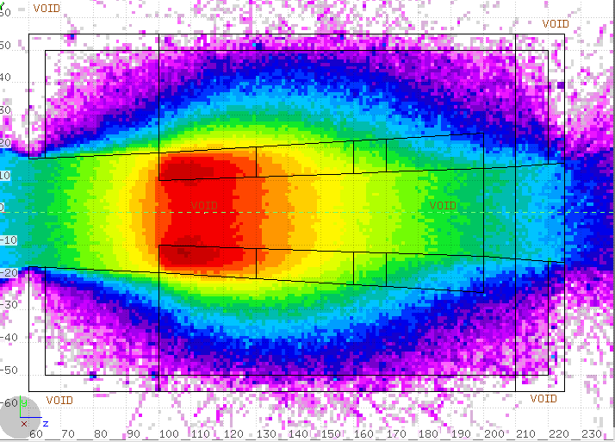
Overall results
Shielding shape and size:
Shielding result:
Notes:
Note:
The radiation dose here is mostly caused by gamma rays. Therefore, 5cm thick lead is added out of the iron shield to enhance the shielding effect.
After operating long time , the front part of the collimator is activated most seriously, making shielding more difficult. Putting two collimated blocks instead of a whole collimator can effectively reduce the dose rate of that part.

Slide 15
Design of proton beam dump

Slide 16
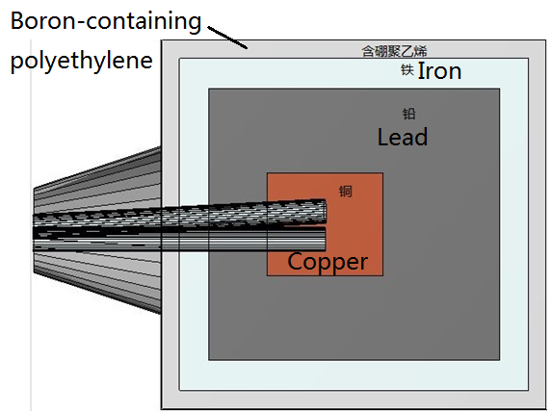
Position and Structure
Beam dump design requirements
Incident beam power：5kW
Prompt radiation shielding:
The prompt dose rate in the experimental hall is less than 2.5μSv/h;
Residual radiation shielding :
After 100 days operation and 4h cooling, the residual radiation dose rate at 30cm from the surface of the dump is less than 1mSv/h.
Dump structure
Copper：1.7m×2.4m×2.0m
Lead：4.5m×5.2m×5.0m
Iron：5.5m×6.2m×6.0m
Boron-containing polyethylene： 6.1m×6.8m×6.6m+2.0m(cone)

Slide 17
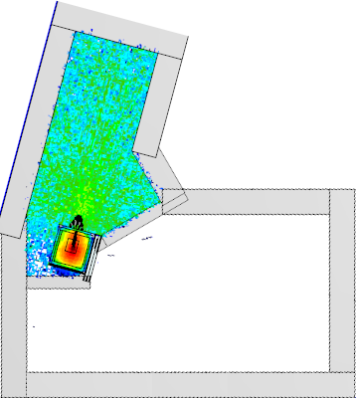
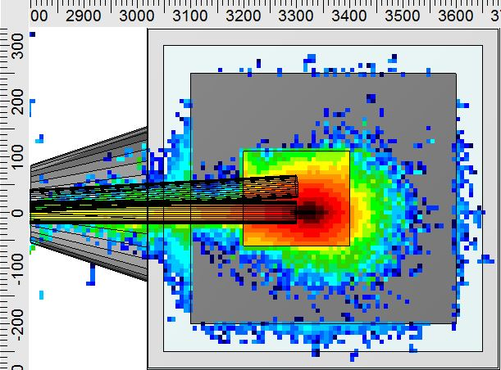


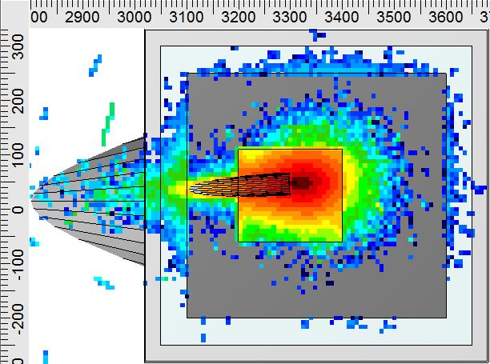

Residual radiation dose rate for
1T mode (mSv/h)
Prompt dose rate in experimental hall
on 1T mode(mSv/h)
(5T mode has a similar result )
Result:
The prompt dose rate in the experimental hall is less than 2.5μSv/h(except for experimental end-stations).
The residual radiation dose at 30cm from the surface of the dump is 1μSv/h less than 1mSv/h.
Residual radiation dose rate for 5T
mode (mSv/h)

Slide 18
Thank you

