Slide 1

Muon beam transport based on SC solenoids
International review of EMuS
Nov. 20-21, 2018, CSNS, Dongguan
Yingpeng Song, Yu Bao

Slide 2
Outline
Beamline introduction
Beamline design
  Surface muon beamline design
  Decay muon & high-momentum muon beamline deisgn
Conclusions

Slide 3
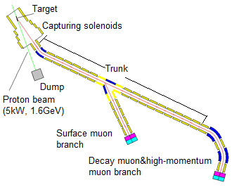
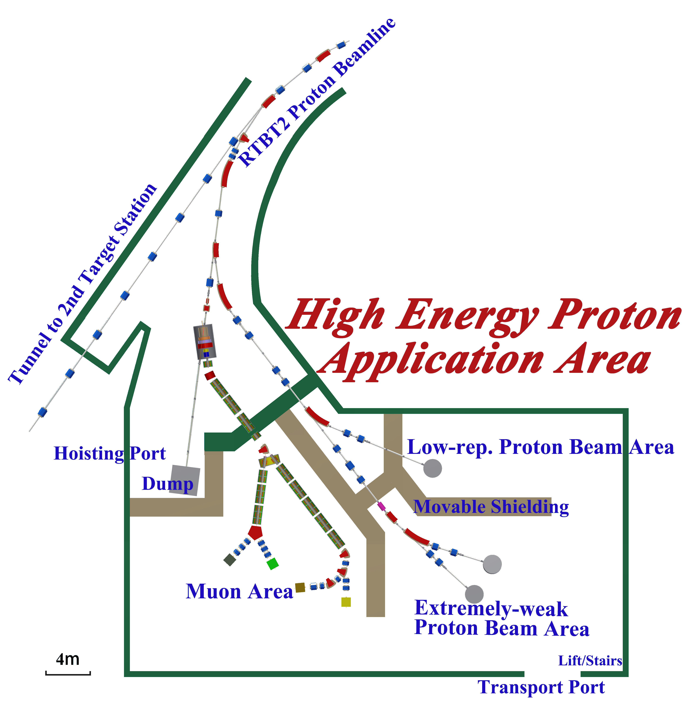
Beamline introduction
CSNS/RCS
Operation modes :
Surface muon
  Ref. Pμ=29MeV/c
Decay muon
  Pμ =40-150MeV/c
High-P muon
  Pμ=200-450MeV/c

Slide 4
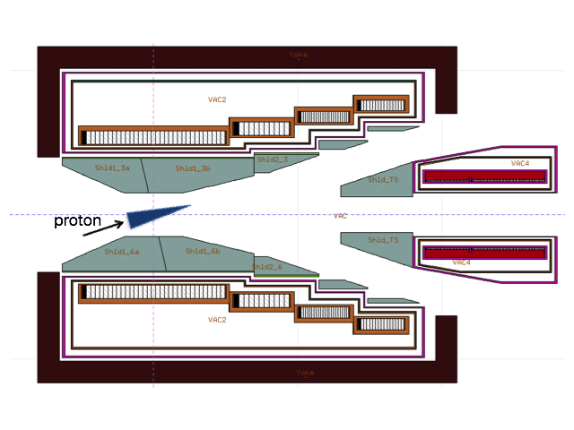
Challenges and possibilities
For μSR applications, users want
  High polarization
  High muon intensity
  Small beam spot
  Proton beam
    stand-alone
  Target thickness and geometry
    30cm,conical
  Collection method
    inner target
  Beamline
    solenoid
Possible ways to
improve intensity
5kW
Challenges for beamline design
Cloud muon contamination
Momentum selection
Spin procession
Beam spot focusing
Detailed design in Nikos’s talk

Slide 5
Trunk design
Objective
Compatible for three different running modes
--- realized by adjusting currents in solenoids
 | particles | Ref. momentum | dp/p
Surface muon | μ⁺ | 29 MeV/c | ±7.1%
Decay muon | π⁺/μ⁺或π⁻/μ⁻ | 40-260 MeV/c | ±10%
High-P muon | π⁺/μ⁺或π⁻/μ⁻ | 200-450 MeV/c | ±30%
Pπ =230 MeV/c case

Slide 6
Surface muon beamline design
  Intensity >1E6/s
  Polarization >80%
  Positron <10%
  dp/p <15% (FWHM)
  Beam spot FWHM ~30mm
Objectives:
Ref.=29 MeV/c; dp/p=±3.5%; acceptance=30 πmm⋅rad

Slide 7
Multi-particle simulation
High-order effects make the beamline design much more complicated
we need
Equivalent field
Transmission optimizing
Optimization works for specified issues (e.g. momentum selection, positron elimination)
 | TURTLE | G4BL (ideal beam distribution) |  |  |  | G4BL (target)
 |  | w/o | w | w/o | w | w/o | w
distribution | Gaussian | Gaussian | Gaussian | K-V | K-V | target | target
order | 3 | full | full | full | full | full | full
transmission | 97% | 81% | 93% | 57% | 73% | 38% | 60%
Particles in R=50 mm | 73% | 57% | 71% | 22% | 31% | 20% | 26%
w and w/o means with or without fieldmap optimization

Slide 8
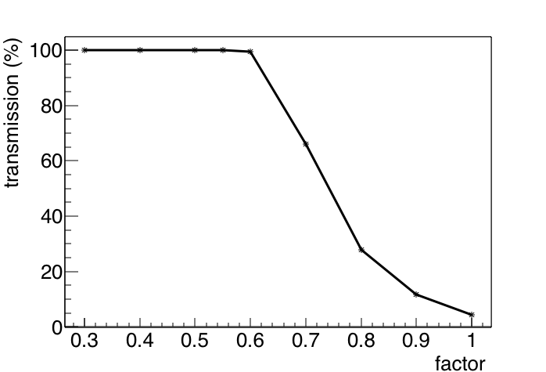
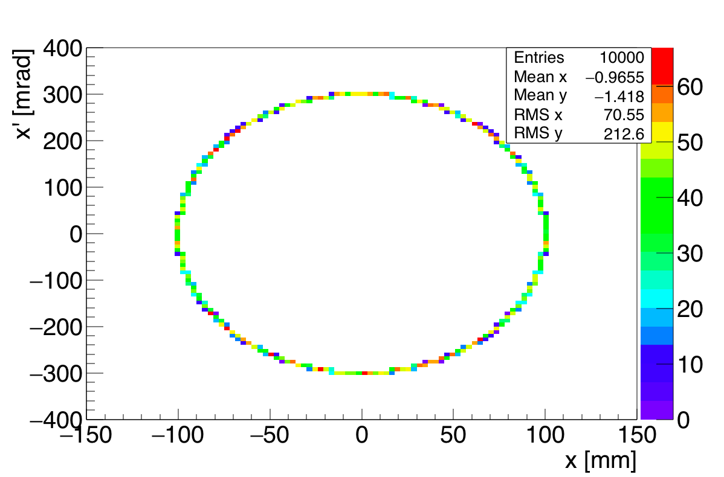
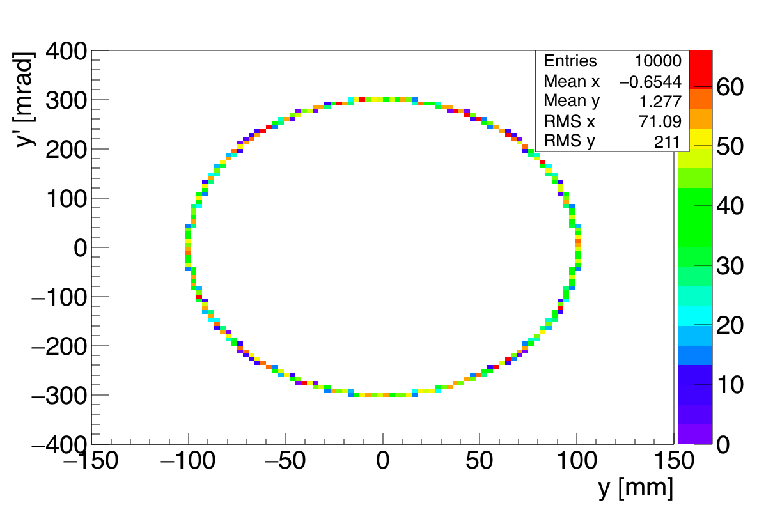
Acceptance test
High-order effects reduce the acceptance
  Hollow-distributed beam adopted

Slide 9
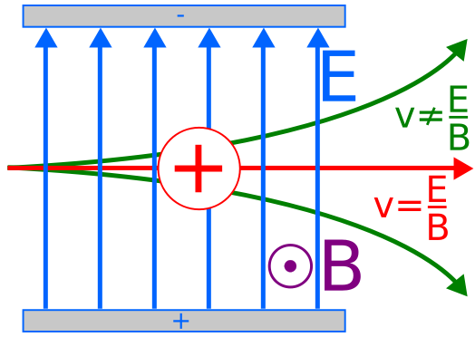
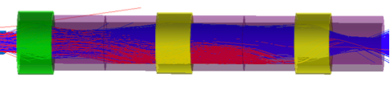
Positron elimination
Wien Filter is adopted for positron elimination -- Separator
The spin will precess in the magnetic field -- Spin Rotator
collimators
The procession angle is ~20°

Slide 10
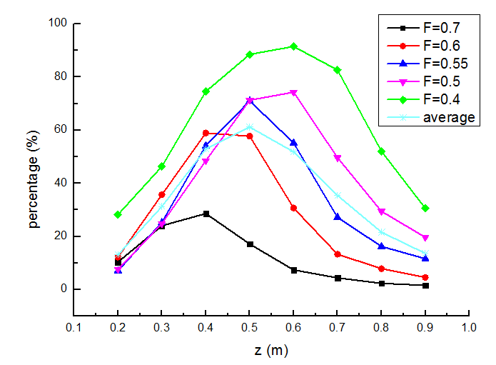
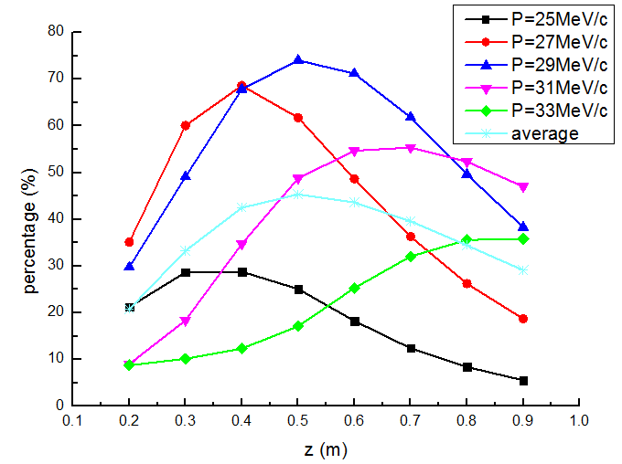
Beam spot
The focal plan is tilted for different emittance particles (Fig.1) and off-momentum particles (Fig.2).
Fig.1
Fig.2
Beam percentage in Φ100mm VS distance away from last solenoid

Slide 11
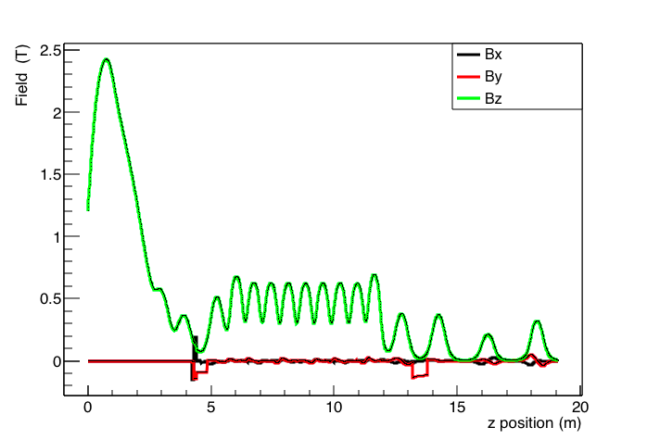
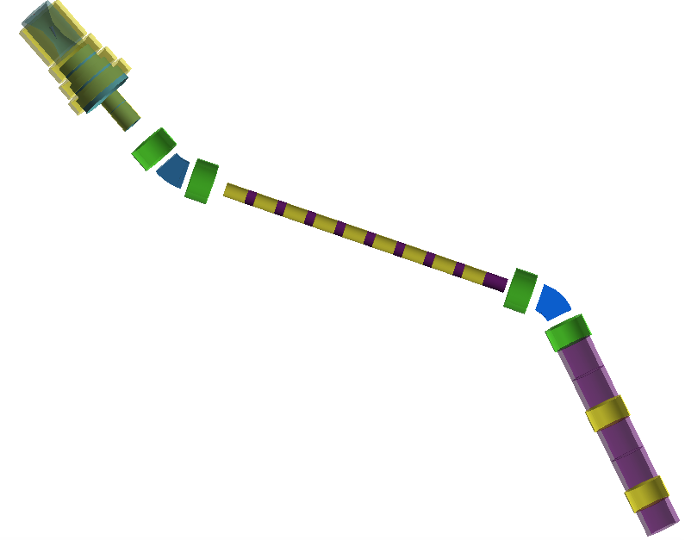
Beamline layout and fieldmap
Layout adjustments compared with optics design:
1. B2 30°--45°
  --for momentum selection
2. Drifts 1.0 – 1.5m
  -- for positron elimination
Collimators for momentum selection and
positron elimination
 | placement | gepmetry
CM1 | z=15086 mm x=200 mm y=-200 mm rotation=Z45° | square a=283 mm
CM2 | z=17236 mm x=y=0 | ring R1=250 mm，R2=300 mm
CM3 | z=18486 mm x=y=0 | ring R1=160 mm，R2=300 mm
CM4 | z=18786 mm x=y=0 | ring R1=100 mm，R2=300 mm

Slide 12
Surface muon parameters on different facilities
 | EMuS （1T） | μE4@PSI WSX-on | μE4@PSI WSX-off | ISIS | D-Line@J-PARC | H-Line@J-PARC
Proton beam power (MW) | 0.005 | 1.3 | 1.3 | 0.2 | 1.0 | 1.0
μ momentum (MeV/c) | 29.8 | 29.8 | 29.8 | 29.8 | 29.8 | 29.8
Intensity (1E6/s) | 23.7 | 420 | 21 | 1 | 10 | 100
Polarization | ~0.75 | ~0.9 | ≥0.95 | ≥0.95 | ≥0.95 | ~0.9
I⋅P2 (1E6/s) | 13 | 340 | 20 | 0.8 | 8 | 81
dp/p (FWHM) | 15.2% | 5~9.5% | 1.8~11% | 10% | 15%
x (FWHM) | 72 mm | 65 mm | 24 mm | ~30 mm | ~30 mm
y (FWHM) | 80 mm | 26 mm | 30 mm | ~30 mm | ~40 mm

Slide 13
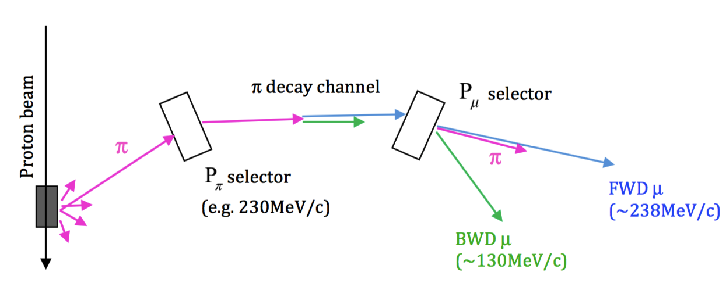
Decay muon beamline design
Ways to obtain high polarized decay muon beam
Pion momentum selection ---> make decay muon IP2 maximized
Decay solenoid for pion decay ---> wide momentum acceptance
Muon momentum selection ---> make IP2 maximized
1
2
3

Slide 14
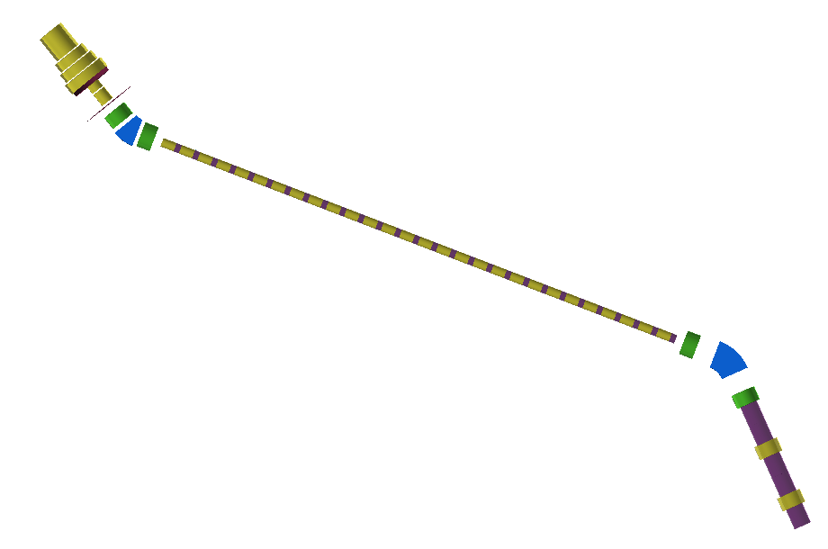
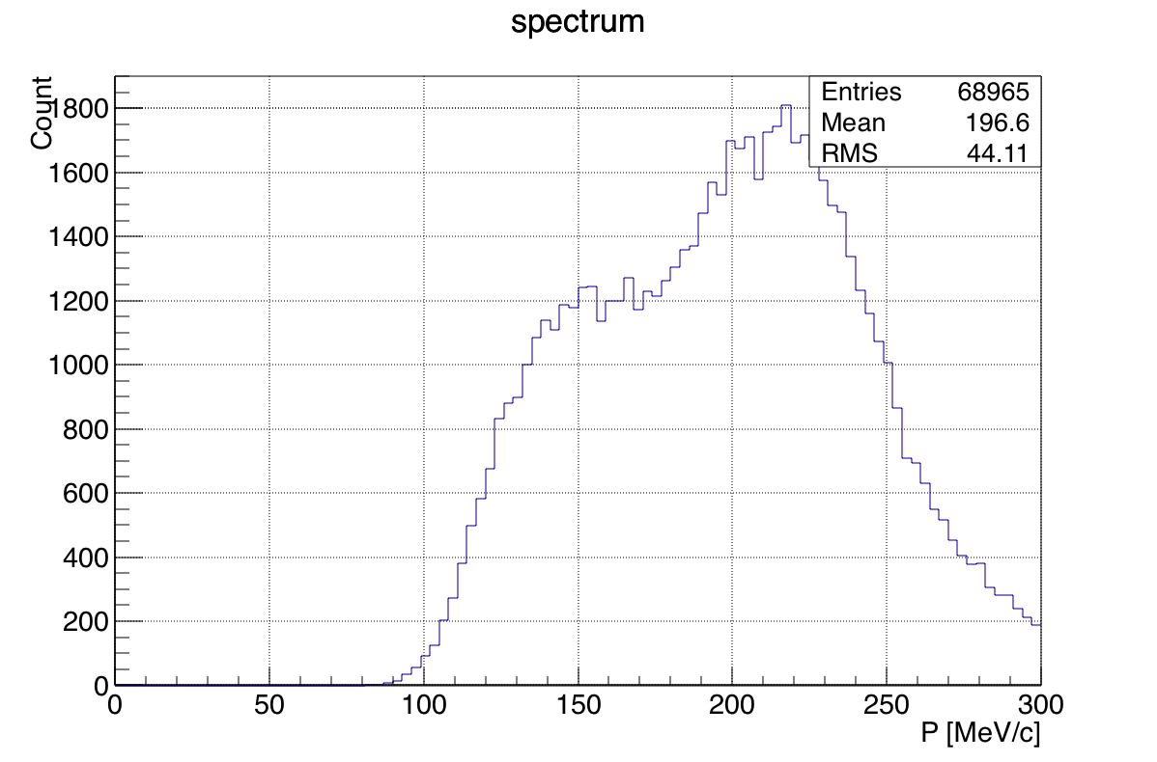
Layout of decay muon beamline
Ways to improve momentum selection ability
Increase the drift length between B2 and adjacent solenoids
Set By of B2 away from the reference momentum
New issue：wideμspectrum

Slide 15
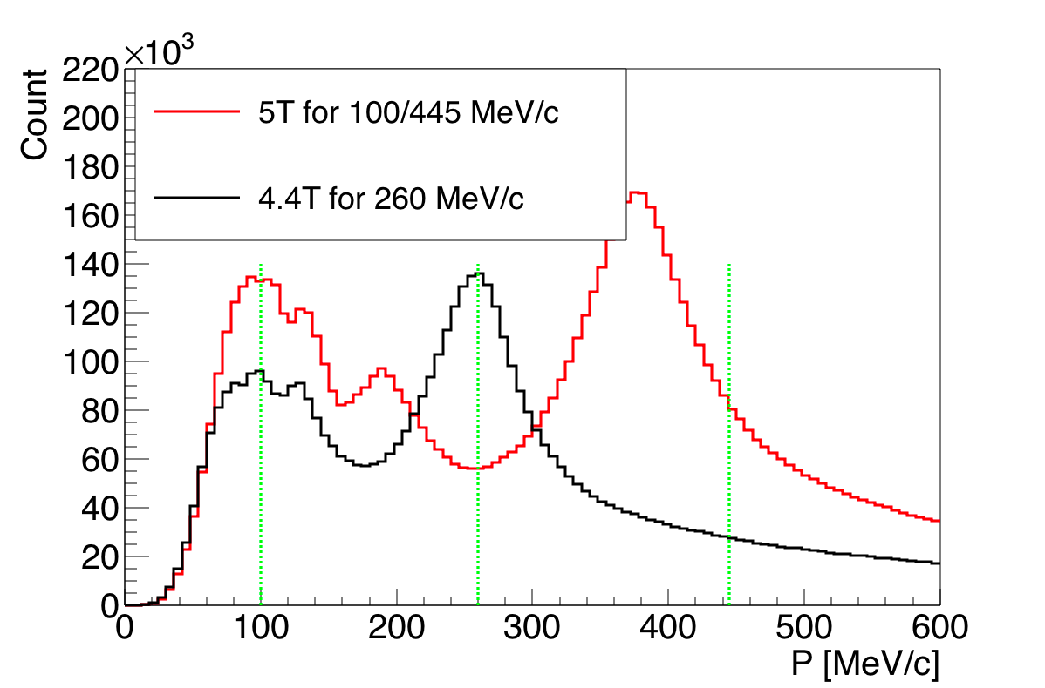
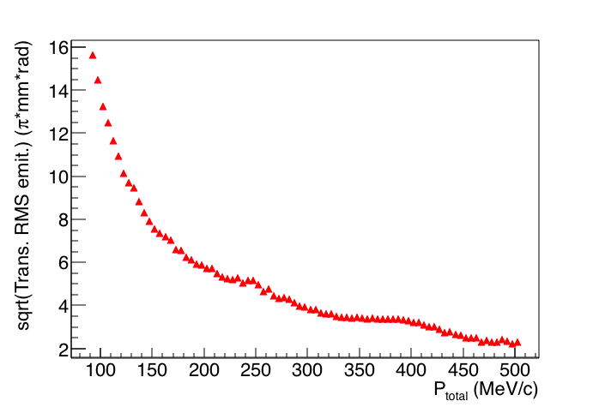
The beamlines are optimized based three pion momentum points, 100,
260 and 445 MeV/c, the corresponding muon momentum is 45, 150, 450 MeV/c.
Objectives:
  Intensity >1E6/s
  Polarization >70%
  Positron <10%
  dp/p <15% (FWHM)
  Beam spot FWHM ~30mm
For high-momentum muon, we only need intensity requirement.

Slide 16
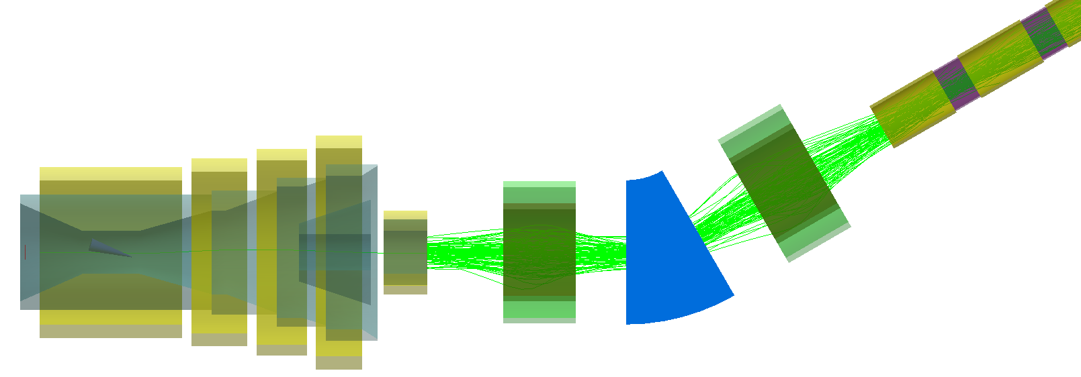
Matching strategies in G4BL
Adjust S1 and S2 to match the beam to the straight
S1
S2
Matching strategies:
Initial beam distribution analyses
Choose (x, x’, y, y’) parameters that can present initial beam well
Adjust S1 and S2 to make the ideal beam get a good transmission (>85% depend on the parameters we chose)

Slide 17
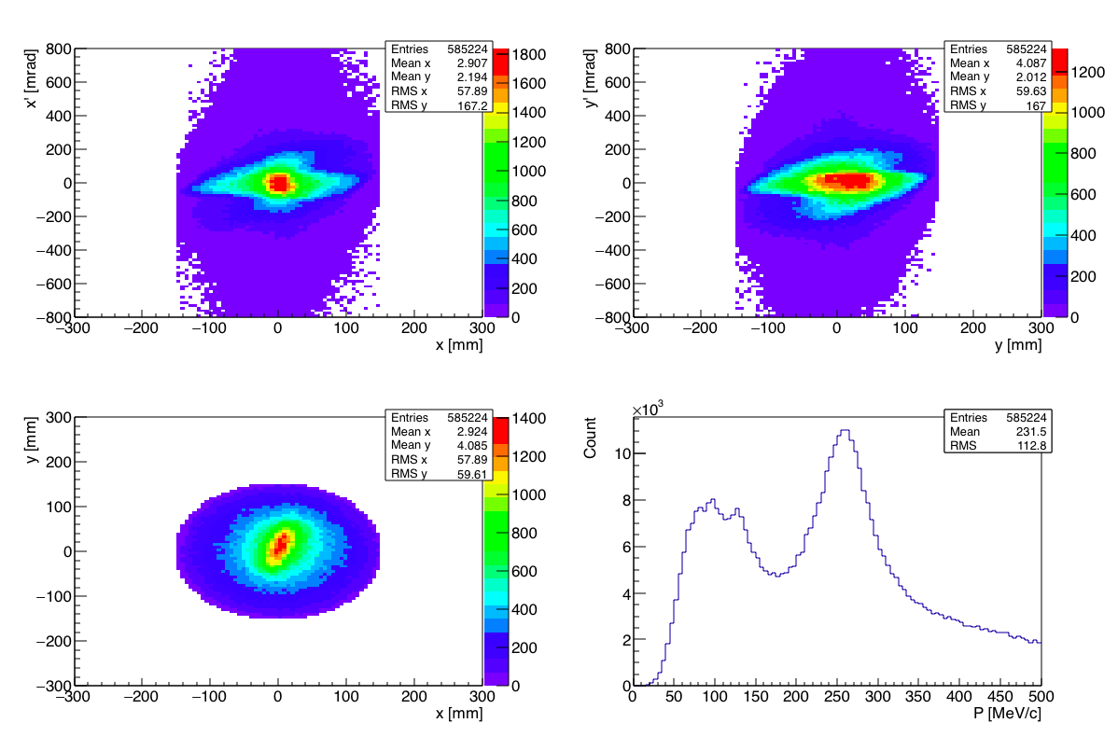
Initial pion distribution analyses
From target station (Pπ =260 MeV/c case)
260 MeV/c

Slide 18
Acceptance of straight decay channel
Original:
  InnerRadius=150 mm
  OuterRadius=160 mm
  Current=150A/mm2
  Max field = 1.6 T
New:
  InnerRadius=150 mm
  OuterRadius=170 mm
  Current=150A/mm2
  Max field = 3.3 T
The ideal Gaussian distribution beam are chosen
Transmission：48%
Transmission：88%

Slide 19
High polarization
Collimators are used for momentum selection
S2
S1
momentum
R
Selection performance

Slide 20
Decay muon parameters on different facilities
 | EMuS | μE1@PSI | RIKEN-RAL | D-Line@J-PARC
Proton beam power (MW) | 0.005 | 1.3 | 0.16 | 1.0
μ momentum range (MeV/c) | 40-160 | 85-125 | 65-120 | 33-250
Intensity (1E6/s) | 50 | 240 | 1 | 10
Polarization | 0.73 | ~0.75 | ≥0.8 | ~0.8
I⋅P² (1E6/s) | 27 | 180 | 0.8 | 8
dp/p (FWHM) | 14% | 3% | 10% | 15%
x (FWHM) | 70 mm | 39 mm | ~30 mm | ~35 mm
y (FWHM) | 70 mm | 25 mm | ~30 mm | ~35 mm

Slide 21
Muon beam parameter table for baseline
 | Ref. momentum | High-intensity |  |  | High-polarization
 |  | Intensity(1E6/s) | PolZ | Spot_{FWHM} (mm) | Intensity(1E6/s) | PolZ | Spot_{FWHM} (mm)
Surface muon | 29 | 74 | -0.51 | 96×96 | 24 | -0.74 | 72×80
Decay muon | 45 | 25 | 0.68 | 88×88 | 25 (2) | 0.68 (0.73) | 88×88
 | 150 | 400 | 0.53 | 60×60 | 50 (7) | 0.73 (0.75) | 60×60
High-P muon | 450 | 130 | - | 72×76 | - | - | -
Momentum spread for decay muon and high-momentum muon is 10~20%(FWHM)
Numbers in () are muons within beam size of Φ30mm

Slide 22
Conclusions
With inner target nested in superconducting solenoid, we can improve muon beam intensity hugely, with about 15% polarization decrease.
Trunk can operate compatibly by tuning solenoid currents.
For decay muon mode, the high polarization can be reached by sacrificing some intensity.
Beam splitting studies is underway, a promising way to mitigate spin procession and large beam spot.

Slide 23
BACK UP

Slide 24
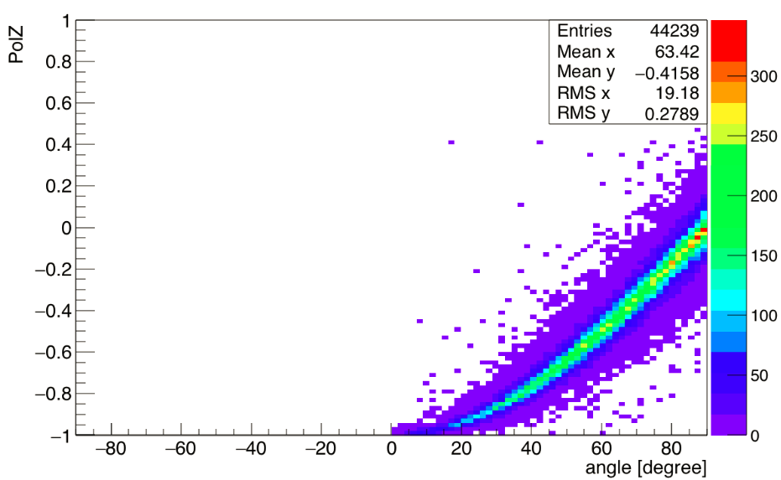
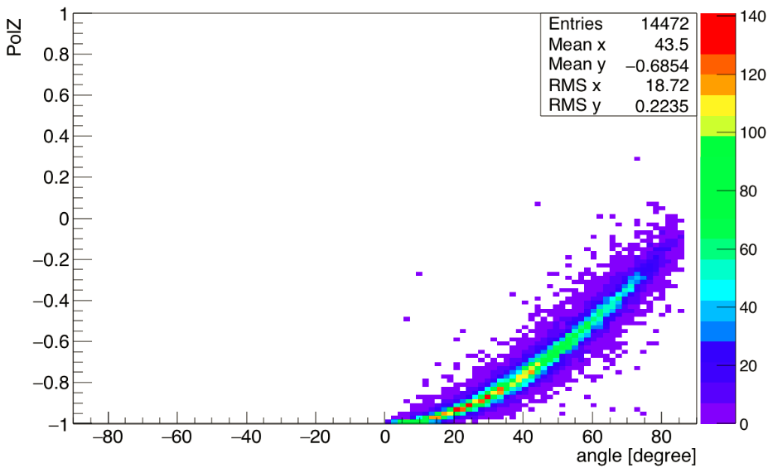
Surface mu yield from target surface
Cylinder VS slab (5*10^8 pronton)
  Cylinder (left): radius=10mm length=300mm, 1.6GeV
  Slab (right): geometry X=6mm Y=40mm Z=40mm, 585MeV

Slide 25
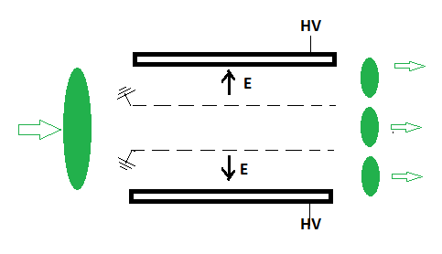
Beam size
  Scraping with collimators
  Beam split
collimators

Slide 26
Field check

Slide 27
High-intensity
Intensity about 4E8/s, polarization about 53%

Slide 28
High polarization
S1 and S2 can be adjusted for momentum selection
S2
S1
1
2
S1
B1
S2

Slide 29
High polarization
Polarization can reach 75% with intensity of 5E7, muons from 140 to 160 MeV/c.

Slide 30
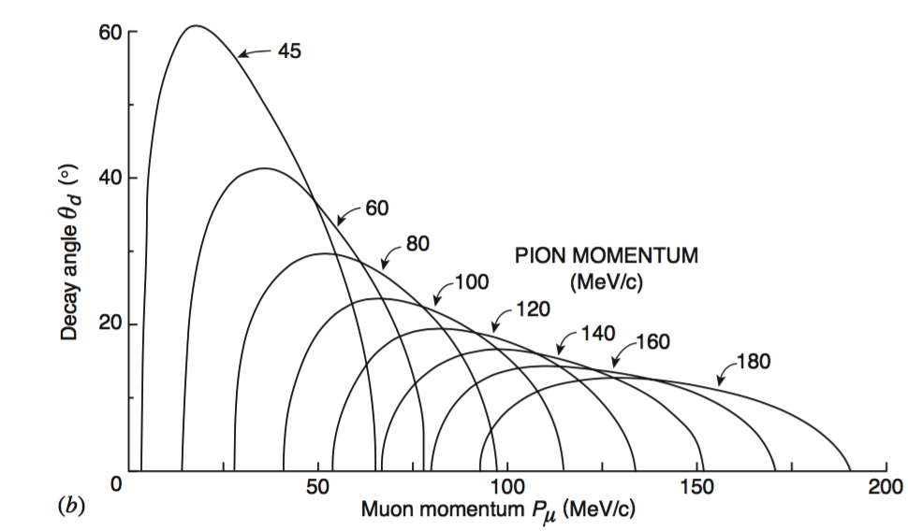
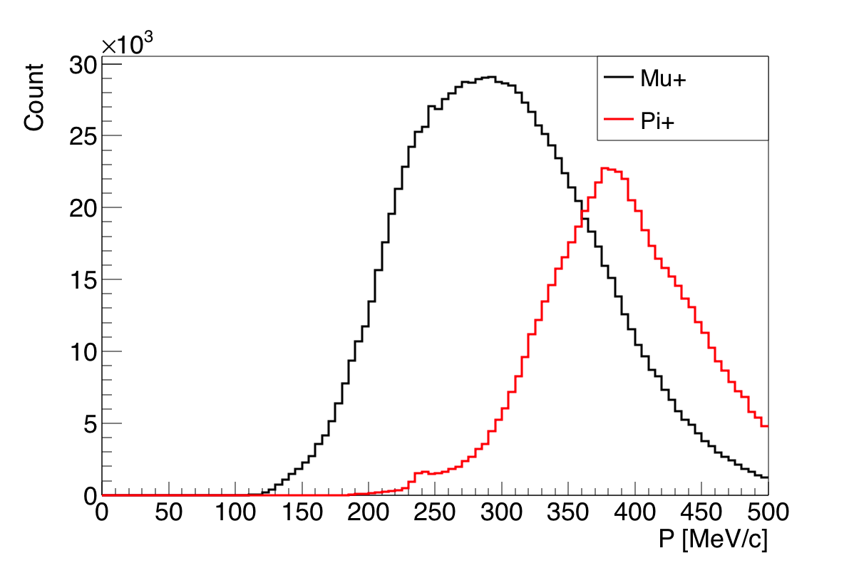
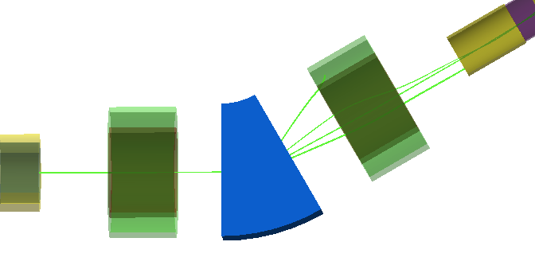
High-intensity mode
Prefer broad momentum spread beam in the decay channel
High-momentum pion elimination
  Collimators
  Reduce
  Intensity >1E6/s
  Polarization >80%
  Positron <10%
  dp/p <15% (FWHM)
  Beam spot FWHM ~30mm

