Slide 1
Overview of
EMuS beamline design
Yu Bao
International Review Meeting 2018
@CSNS
2018.11.21

Slide 2
Outlines
Layout and strategy of EMuS beamlines
Introduction of the beamlines:
  Design goals and challenges
R&D on muon moderation

Slide 3
Staging Strategy of EMuS
First funding
Second funding
CDR
Baby Scheme
Baseline Scheme
Verticle beamline
First beam for muSR
High Intensity Surface & Decay muon beam
High polarization surface muon

Slide 4
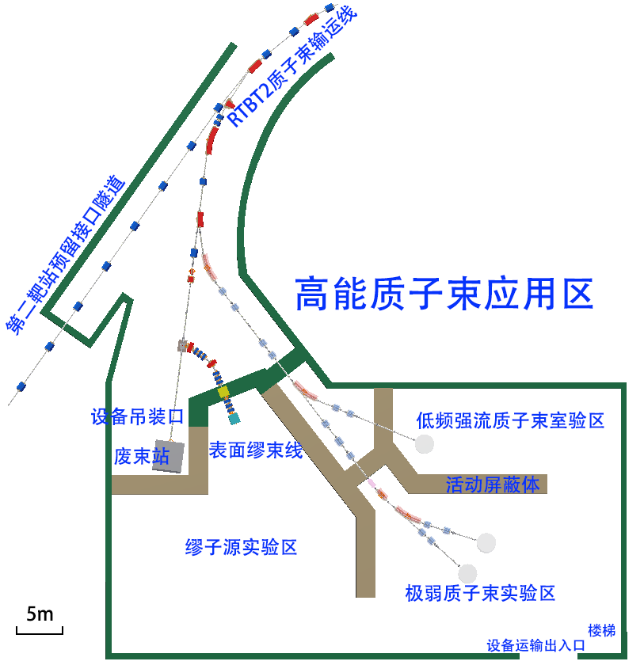
Baby scheme
Requirement:
  High polarization surface muon.
  Intensity reaches requirement of the 256-channel spectrometer (~10⁵/s).
  Beam spot < 30mm
Challenge:
  Low proton power
Solution:
  Thick target 10cm

Slide 5
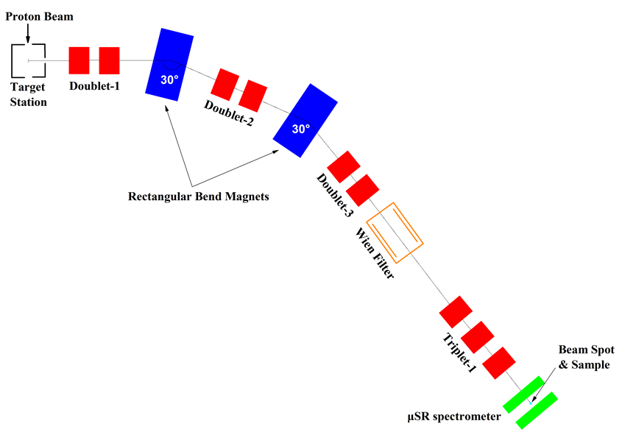
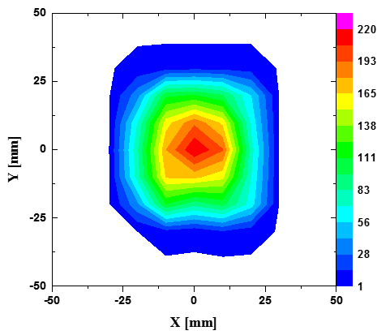
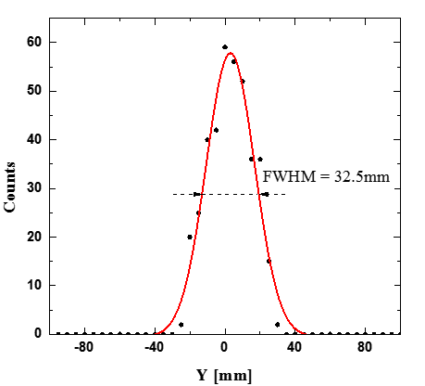
What we have achieved for Baby Scheme
Talk from Luping Zhou
Intensity: 1.2E5/s
Polarization: >90%
Energy spread: <10%
Beam spot(FWHM):<30mm
e+: <1%

Slide 6
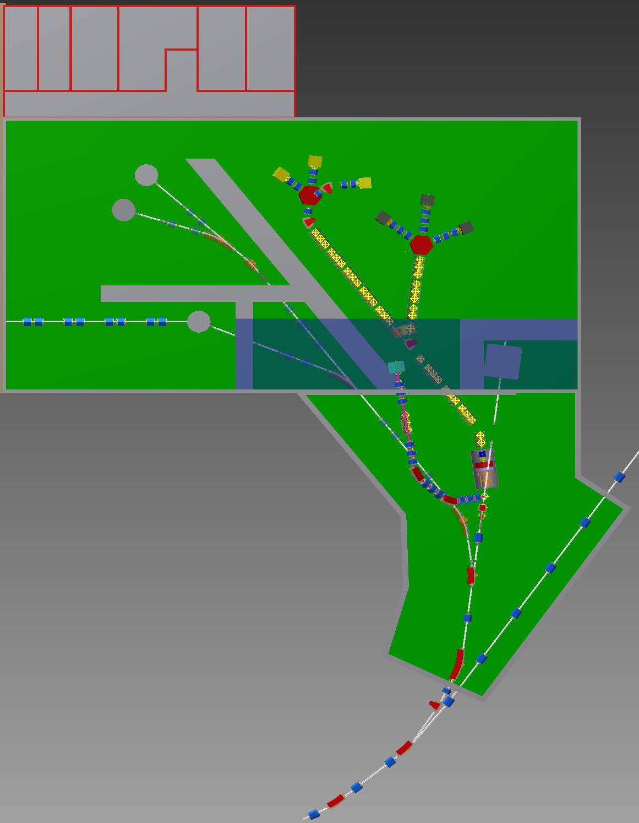
Vertical beamline design
Requirement:
  “Useable” beam for μSR study
  NOT affect the main target station too much!
Challenge:
  Low proton power
  Thin target!
Achieved:
  Intensity: 6E4 μ+/s
  Polarization: >90%
  Beam spot: <30mm

Slide 7
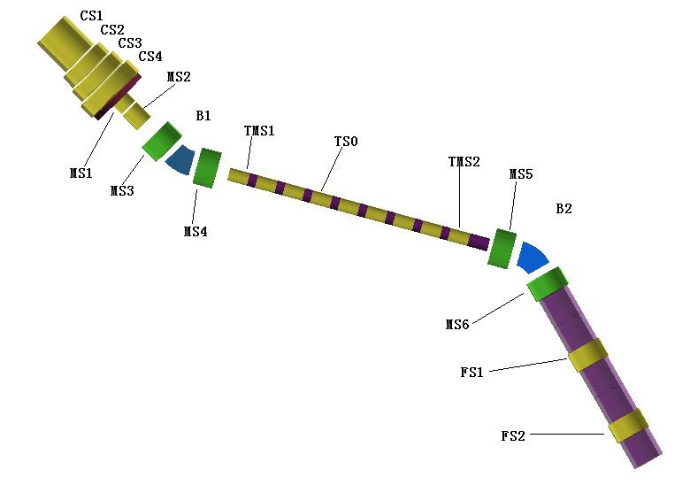
Superconducting Surface Muon Beamline
Matching solenoids
Goal: high intensity surface muon for future super muSR spectrometer
Challenge:
  Large momentum spread and emittance
  High positron containment
Approach:
  Beam matching
  Wein filter

Slide 8
Beam matching design （1）

Slide 9
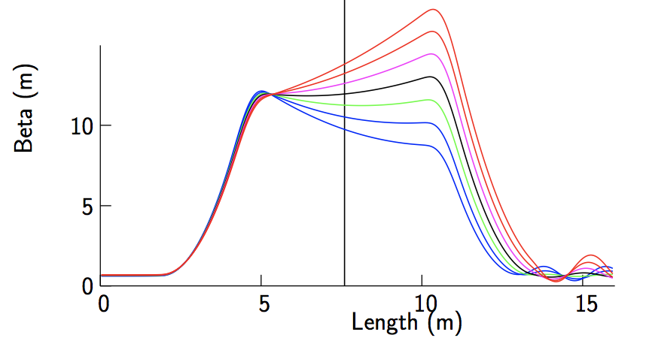
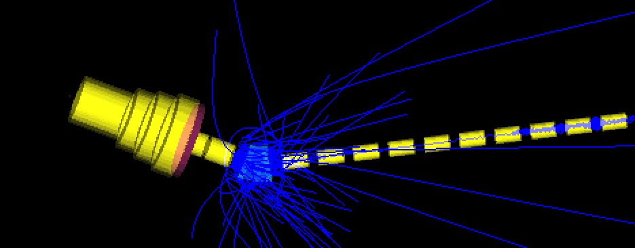
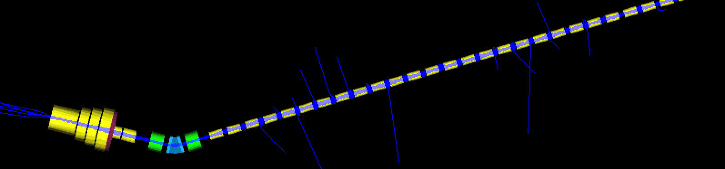
Beam matching (2)
Without matching
With matching
Beam matching increases the beam intensity and reduces the momentum spread.

Slide 10
Surface muon beam parameters
 | High Intensity Mode | High Polarization Mode
Intensity(1E6/s) | 74 | 24
Polarization | 50% | 75%
Beam spot (FWHM) | 96*96 mm | 72*80 mm
Momentum spread (FWHM) | <15% | <10%
e+ | <8% | <5%

Slide 11
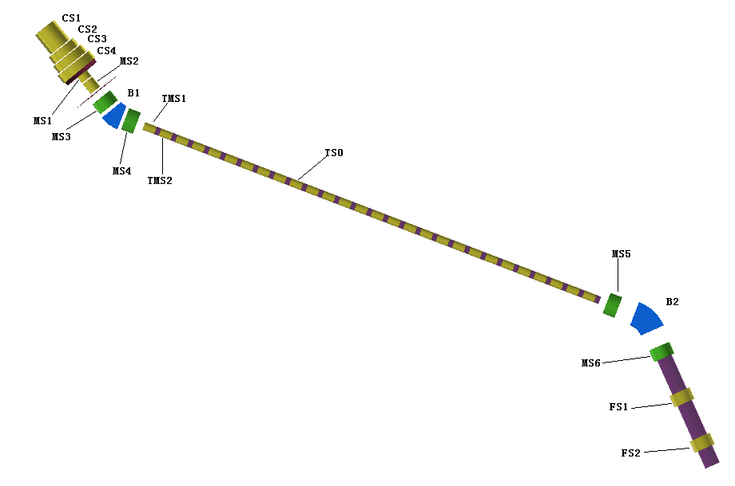
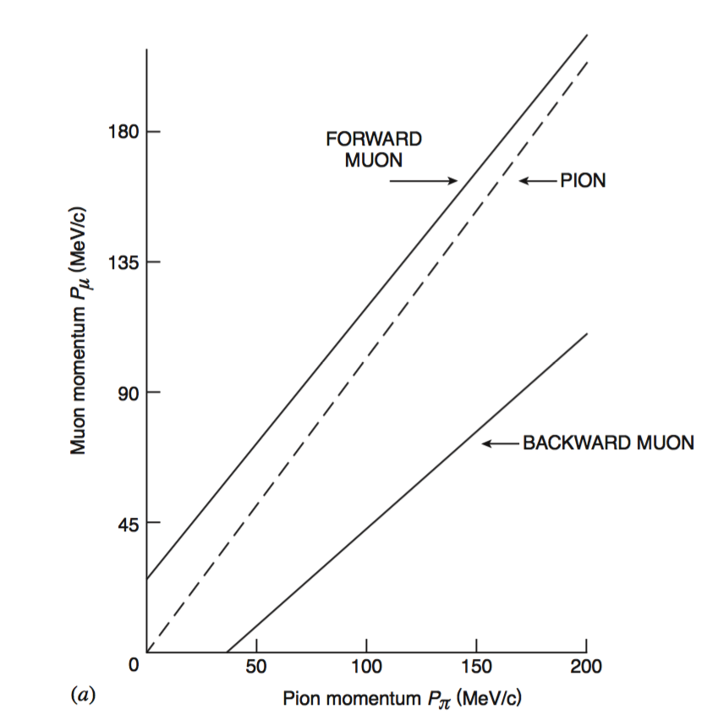
Decay muon beamline
Design goal:
  Flexible muon beam: tunable energy, tunable polarization and intensity
Challenges:
  Large momentum spread
  Large emittance
Solutions
  Matching and collimation

Slide 12
Decay muon beamline parameters
Talk from Yingpeng Song
 | Ref. momentum | High-intensity |  |  | High-polarization
 |  | Intensity(1E6/s) | PolZ | Spot_{FWHM} (mm) | Intensity(1E6/s) | PolZ | Spot_{FWHM} (mm)
Decay muon | 45 | 25 | 0.68 | 88×88 | 25(2) | 0.68(0.73) | 88×88
 | 150 | 400 | 0.53 | 60×60 | 50(7) | 0.73(0.75) | 60×60
High-momentum muon | 450 | 130 |  | 72×76
*The numbers in () are muons within a spot size of 30mm, in case we have fly pass setting in the spectrometer.

Slide 13
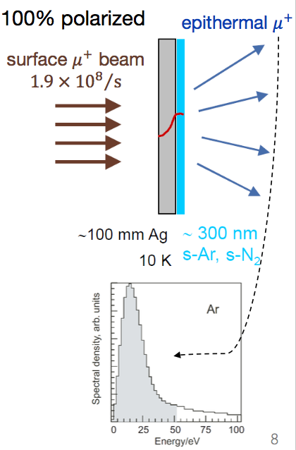
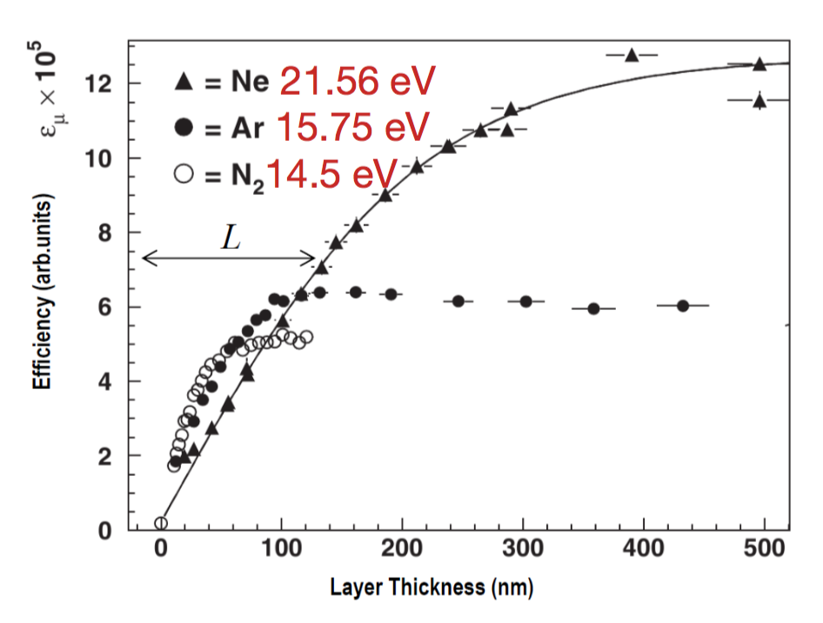
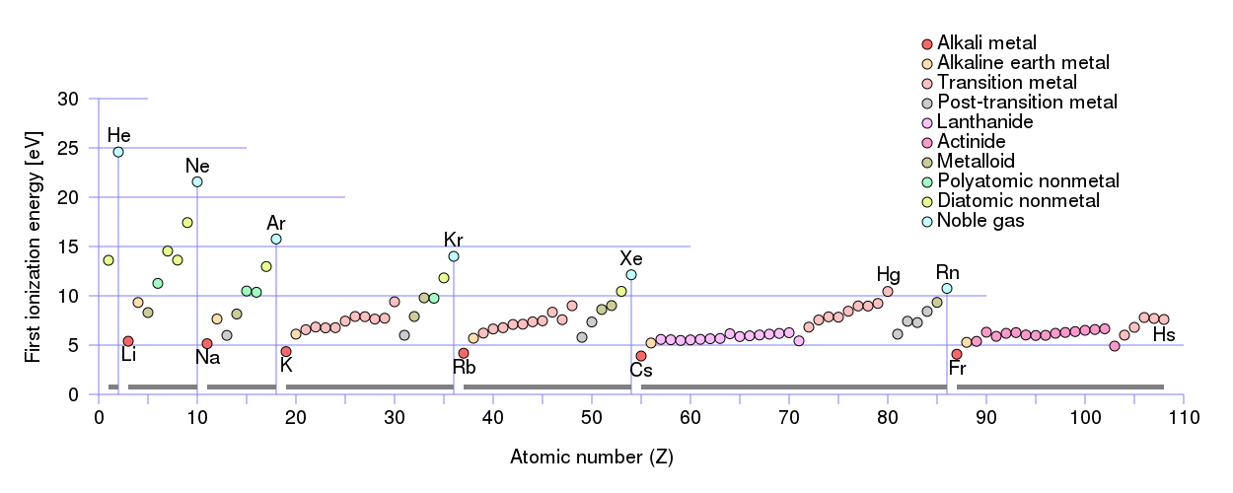
Muon moderation – conventional method
Low Energy Muon (LEM) at PSI uses solid rare gas to moderate muons with an efficiency around 10⁻⁵
The large band gap means muons can not loss energy when their energy is less than tens of eV
This results in large escape length of muons in these materials

Slide 14
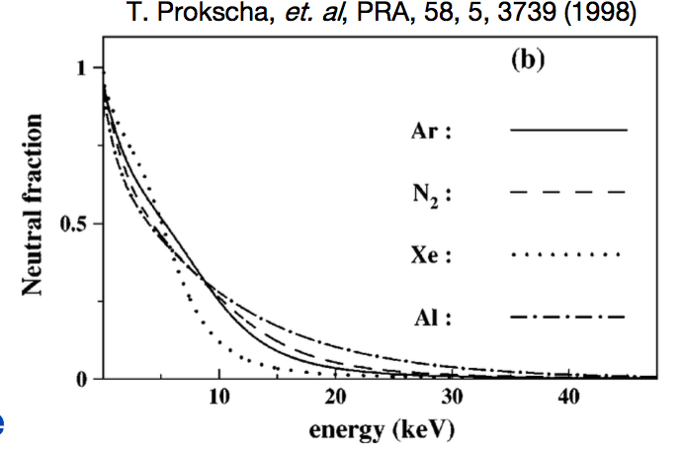
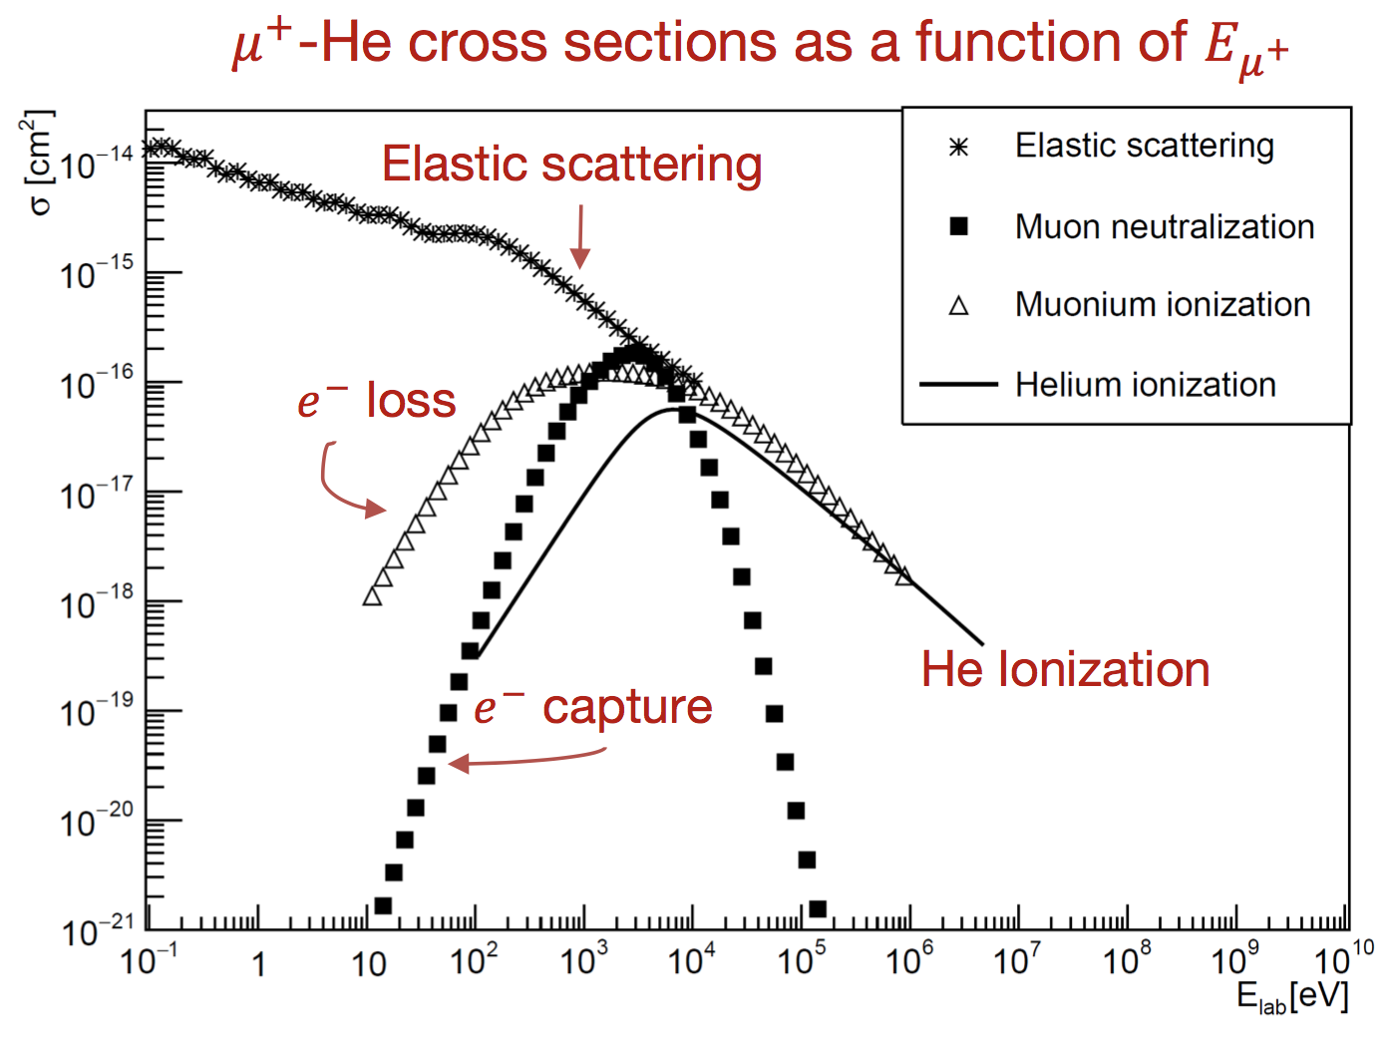
Muon moderation with helium
– slow muons for the future
Helium advantage:
  Largest band gap
  Low density (liquid/gas)
  No muonium formation!
Technical Challenges:
  Liquid helium hard to control in vacuum
  Electrical discharge in helium gas
    Need Demonstration !

Slide 15
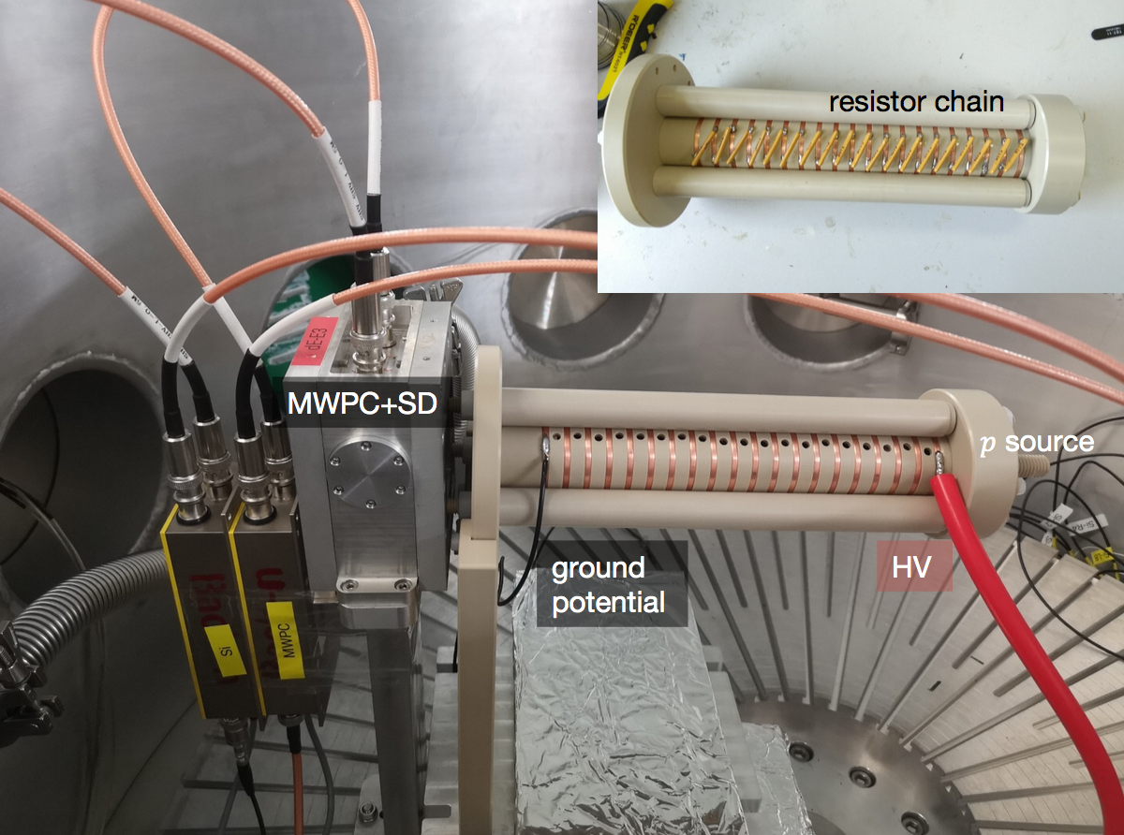
Muon Moderation Demonstration
Since we have no muons in China yet, we are going to use protons/positrons to demonstrate the methods – the low energy processes in materials are similar with muons

Slide 16
Summary
A staging strategy has been outlined for EMuS, starting from a “baby beamline” to a superconducting scheme
We have designed flexible muon beams covering a wide range of energy for various μSR studies and high-energy applications.
We are investigating the possibility of improving the muon moderation efficiency. R&D work has been started.

Slide 17
backups

