Slide 1
Exotics in QCD sum rules
Hua-Xing Chen
Beihang University
Collaborators: Wei Chen, Xiang Liu, Shi-Lin Zhu
Guilin 2019/08/17

Slide 2

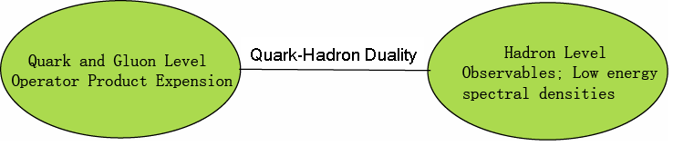
QCD Sum Rules
In sum rule analyses, we consider two-point correlation functions:
where η is the current which can couple to hadronic states.
In QCD sum rules, we can calculate these matrix elements from QCD (OPE) and relate them to observables by using dispersion relation.

Slide 3


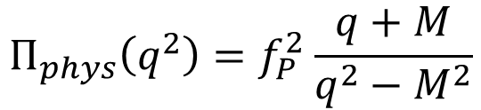
SVZ sum rule (Shifman et al 1979)
Quark and Gluon Level
(Convergence of OPE)
dispersion relation
s = -q²
Quark-Hadron Duality
Hadron Level
$$Π_{phys}\left(q^{2}\right)=f_{P}^{2}\frac{q+M}{q^{2}−M^{2}}$$
(Positivity)
(for baryon case)
ρ
(Sufficient amount of Pole contribution)
0
M
s₀
s

Slide 4

QCD Sum Rules
Borel transformation to suppress the higher order terms:
Two parameters
M_{B} , s₀
We need to choose certain region of (M_{B}, s₀).
Criteria
1. Stability
2. Convergence of OPE
3. Positivity of spectral density
4. Sufficient amount of pole contribution

Slide 5
Internal structure of exotic hadrons
The internal structure of exotic hadrons is complicated.
We can construct various interpolating currents/fields to reflect this using the method of
QCD sum rules

Slide 6
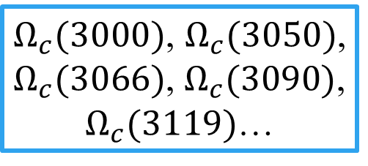
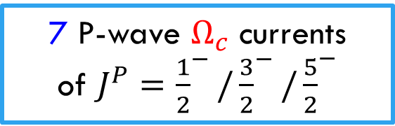
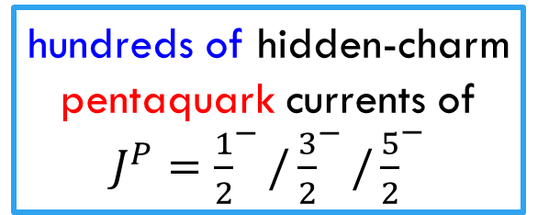
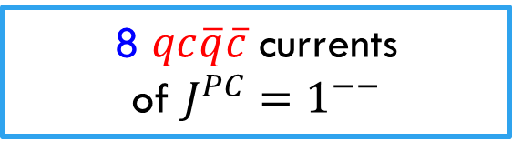
Question: Relations between currents and hadrons
7 P-wave $Ω_{c}$ currents
of $J^{P}={\frac{1}{2}}^{−}/{\frac{3}{2}}^{−}/{\frac{5}{2}}^{−}$
$Ω_{c}(3000)$, $Ω_{c}(3050)$, $Ω_{c}(3066)$, $Ω_{c}(3090)$, $Ω_{c}(3119)$…
Y(4008), Y(4220), Y(4320), Y(4360), Y(4390), Y(4660)…
8 $qc\overline{q}\overline{c}$ currents
of $J^{PC}=1^{−−}$
hundreds of hidden-charm pentaquark currents of $J^{P}={\frac{1}{2}}^{−}/{\frac{3}{2}}^{−}/{\frac{5}{2}}^{−}$
Pc(4312), Pc(4380), Pc(4440), Pc(4457)…

Slide 7
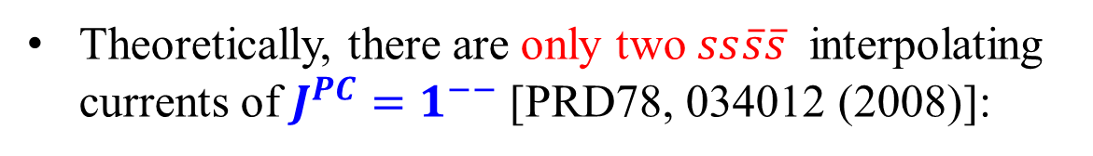
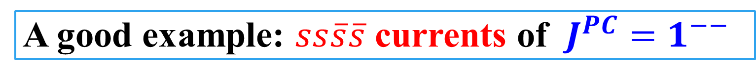
A good example: $ss\overline{s}\overline{s}$ currents of $J^{PC}=1^{−−}$
Theoretically, there are only two $ss\overline{s}\overline{s}$ interpolating currents of $J^{PC}=1^{−−}$ [PRD78, 034012 (2008)]:

Slide 8
A good example: $ss\overline{s}\overline{s}$ currents of $J^{PC}=1^{−−}$
Theoretically, there are only two $ss\overline{s}\overline{s}$ interpolating currents of $J^{PC}=1^{−−}$ [PRD78, 034012 (2008)]:
Y(2175)
Y(24??)

Slide 9
BaBar, PRD74, 091103 (2006)
2175 MeV

Slide 10
BaBar, PRD76, 012008 (2007)
2187 MeV
2470 MeV
Diff: 283 MeV

Slide 11
Belle, PRD80, 031101 (2009)
2079 MeV
~2400 MeV
Diff: ~320 MeV

Slide 12
C. P. Shen and C. Z. Yuan, CPC34, 1045 (2010)
2171 MeV
2436 MeV
Diff: 265 MeV

Slide 13
C. P. Shen and C. Z. Yuan, CPC34, 1045 (2010)
2171 MeV
2436 MeV
Diff: 265 MeV
<3.0σ

Slide 14
BES, PRL100, 102003 (2008)
2186 MeV
~2460 MeV
Diff: ~270 MeV

Slide 15
BESIII, PRD91, 052017 (2015)
2200 MeV
~2350 MeV
Diff: ~150 MeV

Slide 16
A good example: $ss\overline{s}\overline{s}$ currents of $J^{PC}=1^{−−}$
Theoretically, there are only two $ss\overline{s}\overline{s}$ interpolating currents of $J^{PC}=1^{−−}$ [PRD78, 034012 (2008)]:
Y(2175)
Y(24??)

Slide 17


Case 1: Y(2175) only
PRD78 (2008) 034012
$$<0\left| η_{1μ} \right|Y> =f_{η1} ε_{μ} ≠0$$
$$<0\left| η_{2μ} \right|Y> =f_{η2} ε_{μ} ≠0$$

Slide 18




Case 1: Y(2175) only
PRD78 (2008) 034012
$$<0\left| η_{1μ} \right|Y> =f_{η1} ε_{μ} ≠0$$
$$<0\left|T[η_{1μ}{η_{1ν}}^{+}] \right|0> ≠0$$
$$M\sim 2.3 GeV$$
$$<0\left| η_{2μ} \right|Y> =f_{η2} ε_{μ} ≠0$$
$$<0\left|T[η_{2μ}{η_{2ν}}^{+}] \right|0> ≠0$$
$$M\sim 2.3 GeV$$

Slide 19


Case 1: Y(2175) only
PRD78 (2008) 034012
$$<0\left| η_{1μ} \right|Y> =f_{η1} ε_{μ} ≠0$$
$$<0\left|T[η_{1μ}{η_{1ν}}^{+}] \right|0> ≠0$$
$$M\sim 2.3 GeV$$
$$<0\left| η_{2μ} \right|Y> =f_{η2} ε_{μ} ≠0$$
$$<0\left|T[η_{2μ}{η_{2ν}}^{+}] \right|0> ≠0$$
$$M\sim 2.3 GeV$$
$$<0\left|T[η_{1μ}{η_{2ν}}^{+}] \right|0>\sim <0\left|η_{1μ}\right|Y><Y\left|{η_{2ν}}^{+}\right|0>≠0$$

Slide 20
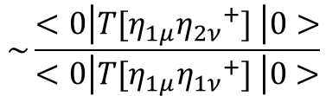
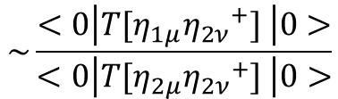
$$\sim \frac{<0\left|T[η_{1μ}{η_{2ν}}^{+}] \right|0>}{<0\left|T[η_{1μ}{η_{1ν}}^{+}] \right|0>}$$
$$\sim \frac{<0\left|T[η_{1μ}{η_{2ν}}^{+}] \right|0>}{<0\left|T[η_{2μ}{η_{2ν}}^{+}] \right|0>}$$

Slide 21
Case 2: not only Y(2175)
PRD98 (2018) 014011

Slide 22

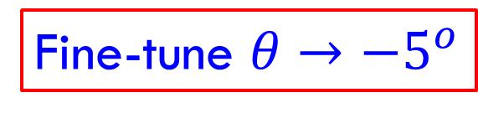
Case 2: not only Y(2175)
PRD98 (2018) 014011
$$<0\left|T[J_{1μ}{J_{2ν}}^{+}] \right|0>≈0$$
Fine-tune $θ→−5^{o}$

Slide 23
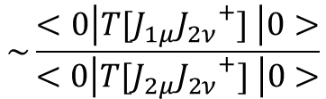
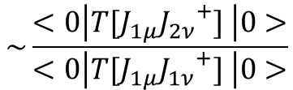
$$\sim \frac{<0\left|T[η_{1μ}{η_{2ν}}^{+}] \right|0>}{<0\left|T[η_{1μ}{η_{1ν}}^{+}] \right|0>}$$
$$\sim \frac{<0\left|T[J_{1μ}{J_{2ν}}^{+}] \right|0>}{<0\left|T[J_{1μ}{J_{1ν}}^{+}] \right|0>}$$
$$\sim \frac{<0\left|T[η_{1μ}{η_{2ν}}^{+}] \right|0>}{<0\left|T[η_{2μ}{η_{2ν}}^{+}] \right|0>}$$
$$\sim \frac{<0\left|T[J_{1μ}{J_{2ν}}^{+}] \right|0>}{<0\left|T[J_{2μ}{J_{2ν}}^{+}] \right|0>}$$

Slide 24


Case 2: not only Y(2175)
PRD98 (2018) 014011
$$<0\left|T[J_{1μ}{J_{2ν}}^{+}] \right|0>≈0$$
$$<0\left| J_{1μ} \right|Y> =f_{J1} ε_{μ} ≠0$$
if Y(2175) only
$$<0\left| J_{2μ} \right|Y> =f_{J2} ε_{μ} ≠0$$

Slide 25
Case 2: not only Y(2175)
PRD98 (2018) 014011
$$<0\left|T[J_{1μ}{J_{2ν}}^{+}] \right|0>≈0$$
$$<0\left| J_{1μ} \right|Y> =f_{J1} ε_{μ} ≠0$$
if Y(2175) only
$$<0\left| J_{2μ} \right|Y> =f_{J2} ε_{μ} ≠0$$

Slide 26




Case 2: Y(2175) & Y(24??)
PRD98 (2018) 014011
$$<0\left|T[J_{1μ}{J_{2ν}}^{+}] \right|0>≈0$$
$$<0\left| J_{1μ} \right|Y_{1}> =f_{J1} ε_{μ} ≠0$$
$$<0\left|T[J_{1μ}{J_{1ν}}^{+}] \right|0> ≠0$$
$$<0\left| J_{2μ} \right|Y_{2}> =f_{J2} ε_{μ} ≠0$$
$$<0\left|T[J_{2μ}{J_{2ν}}^{+}] \right|0> ≠0$$

Slide 27


Case 2: Y(2175) & Y(24??)
PRD98 (2018) 014011
$$<0\left|T[J_{1μ}{J_{2ν}}^{+}] \right|0>≈0$$
$$<0\left| J_{1μ} \right|Y_{1}> =f_{J1} ε_{μ} ≠0$$
$$M_{Y1}=2.41±0.25 GeV$$
$$<0\left| J_{2μ} \right|Y_{2}> =f_{J2} ε_{μ} ≠0$$
$$M_{Y2}=2.34±0.17 GeV$$

Slide 28


Case 2: Y(2175) & Y(24??)
PRD98 (2018) 014011
$$<0\left|T[J_{1μ}{J_{2ν}}^{+}] \right|0>≈0$$
$$<0\left| J_{1μ} \right|Y_{1}> =f_{J1} ε_{μ} ≠0$$
$$M_{Y1}=2.41±0.25 GeV$$
$$Y(24??)$$
$$<0\left| J_{2μ} \right|Y_{2}> =f_{J2} ε_{μ} ≠0$$
$$M_{Y2}=2.34±0.17 GeV$$
$$Y(2175)$$

Slide 29
independent currents
non-correlated currents
physical states

Slide 30
Zc(3900) & Zc(4020) & Zc(4430) & Zc(4600)
Maiani et al
PRD89 (2014) 114010

Slide 31
Zc(3900) & Zc(4020) & Zc(4430) & Zc(4600)
Maiani et al
PRD89 (2014) 114010

Slide 32
Zc(3900) & Zc(4020) & Zc(4430) & Zc(4600)
Maiani et al
PRD89 (2014) 114010

Slide 33
Zc(3900) & Zc(4020) & Zc(4430) & Zc(4600)
Two corresponding $qc\overline{q}\overline{c}$ currents of $J^{PC}=1^{+−}$:
They weakly correlate to each other:

Slide 34
Zc(3900) & Zc(4020) & Zc(4430) & Zc(4600)
Two corresponding $qc\overline{q}\overline{c}$ currents of $J^{PC}=1^{+−}$:

Slide 35




Zc(3900) & Zc(4020) & Zc(4430) & Zc(4600)
Two corresponding $qc\overline{q}\overline{c}$ currents of $J^{PC}=1^{+−}$:
$$Z_{c}(3900)$$
$$Z_{c}(4020)$$
$$Z_{c}(4430)$$
$$Z_{c}(4600)$$

Slide 36
Summary
The internal structure of exotic hadrons is complicated.
To understand this, we need to study the relations between currents and hadrons when using QCD sum rules.
The non-correlated currents are useful, and may help us better understand their internal structure.

Slide 37
Thank you very much!
谢谢

Slide 38
Pc(4312) & Pc(4380) & Pc(4440) & Pc(4457)
LHCb, PRL 115 (2015) 072001
LHCb, PRL 122 (2019) 222001

Slide 39
Pc(4312) & Pc(4380) & Pc(4440) & Pc(4457)
There are hundreds of hidden-charm pentaquark interpolating currents.
We selected some of them to perform the QCD sum rule analyses.
We collect here all the mass predictions that are less than 4.5 GeV.
EPJC 76 (2016) 572

Slide 40


Pc(4312) & Pc(4380) & Pc(4440) & Pc(4457)
There are hundreds of hidden-charm pentaquark interpolating currents.
We selected some of them to perform the QCD sum rule analyses.
We collect here all the mass predictions that are less than 4.5 GeV.
EPJC 76 (2016) 572
$$P_{c}(4312)$$
$$P_{c}(4457)$$

Slide 41
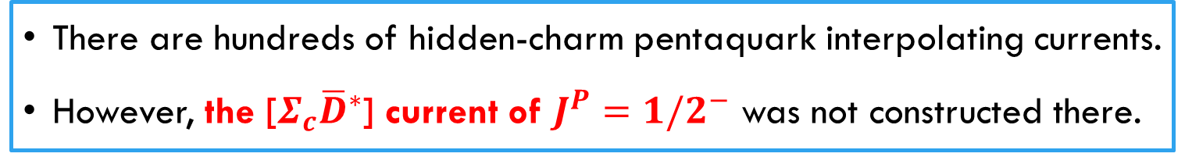
Pc(4312) & Pc(4380) & Pc(4440) & Pc(4457)
There are hundreds of hidden-charm pentaquark interpolating currents.
However, the [$Σ_{c}{\overline{D}}^{∗}$] current of $J^{P}={1/2}^{−}$ was not constructed there.
EPJC 76 (2016) 572

Slide 42
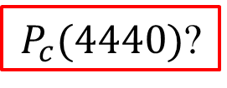


Pc(4312) & Pc(4380) & Pc(4440) & Pc(4457)
There are hundreds of hidden-charm pentaquark interpolating currents.
However, the [$Σ_{c}{\overline{D}}^{∗}$] current of $J^{P}={1/2}^{−}$ was not constructed there.
EPJC 76 (2016) 572
$P_{c}(4440)$?
$P_{c}(4440)$?
$P_{c}(4440)$?

Slide 43
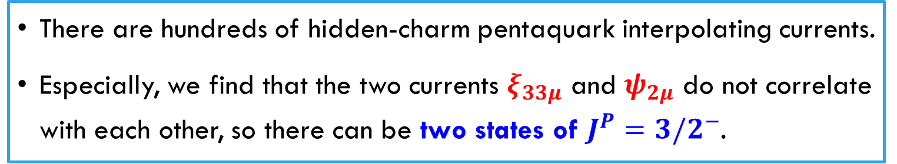
Pc(4312) & Pc(4380) & Pc(4440) & Pc(4457)
There are hundreds of hidden-charm pentaquark interpolating currents.
Especially, we find that the two currents $ξ_{33μ}$ and $ψ_{2μ}$ do not correlate with each other, so there can be two states of $J^{P}={3/2}^{−}$.
arXiv:1903.11001

Slide 44

Pc(4312) & Pc(4380) & Pc(4440) & Pc(4457)
There are hundreds of hidden-charm pentaquark interpolating currents.
Especially, we find that the two currents $ξ_{33μ}$ and $ψ_{2μ}$ do not correlate with each other, so there can be two states of $J^{P}={3/2}^{−}$.
arXiv:1903.11001
$$P_{c}(4457)$$
$P_{c}(4440)$?

